Slide 1
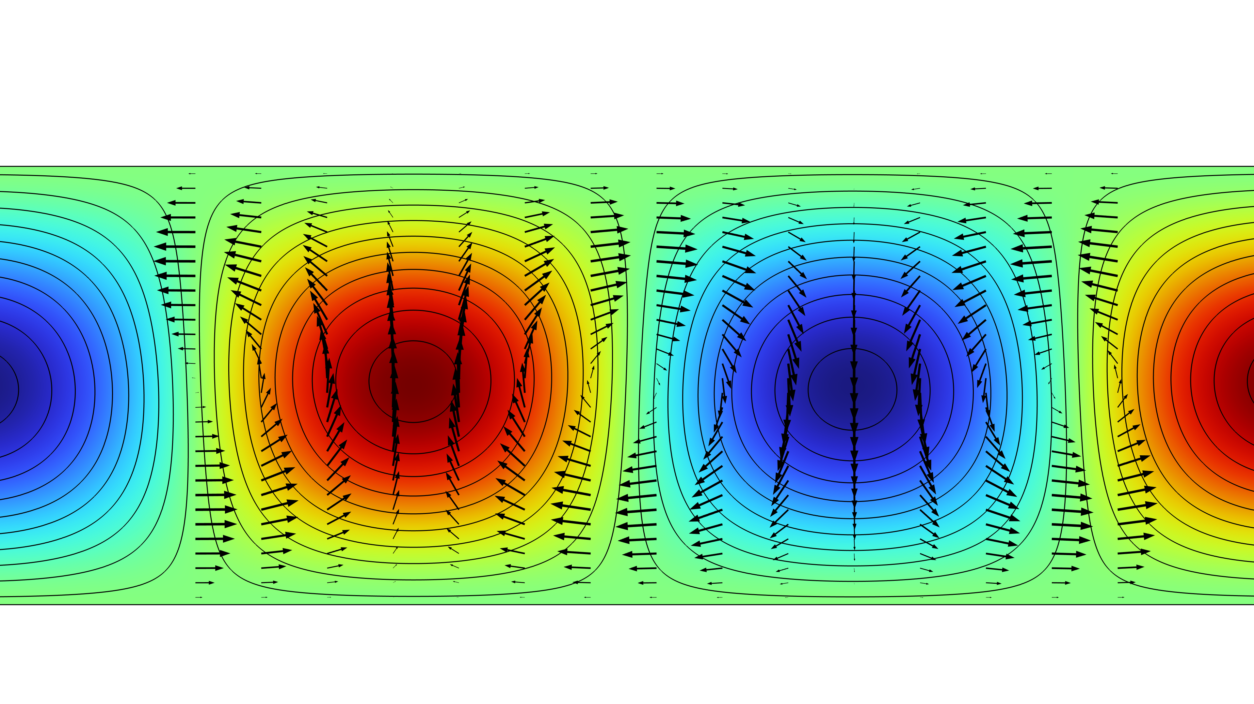
Rayleigh–Bénard Convection

Slide 2
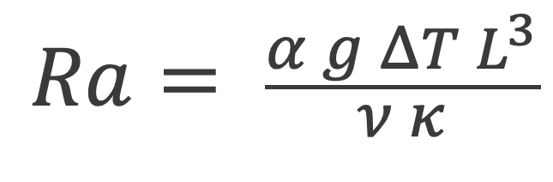
Background and Motivation
Cold
$$Ra= \frac{α g ΔT L^{3}}{ν κ}$$
Hot
Rayleigh–Bénard convection represents an idealized model for the atmospheric circulation where the sun radiation reaches and heats the ground, while the top layer of the atmosphere is kept cold.
The modeled phenomenon exhibits a stationary, purely conductive profile up to a critical value of the Rayleigh number, Ra_{c}.
The 2D model equations, which can be solved analytically, give a critical value of Ra_{c} = 1708 for no-slip horizontal walls. At higher Ra numbers, circulating convection cells are formed.
Rayleigh–Bénard convection has been extensively studied: experimentally since Bénard in 1900 and theoretically since Rayleigh in 1916. The analytical solution used for reference was obtained with linear stability theory (see, for instance, Ref. 1).
This example shows how to find the critical Ra_{c} number through two different implementations of a parametric study over the Ra_{c} number:
  A parametric stationary study (Part 1).
  A linear perturbation analysis performed using a parametric eigenvalue study (Part 2).
1. P.G. Drazin and W.H. Reid, “Hydrodynamic Stability”, Cambridge University Press, 2004.

Slide 3





Simulation Approach, Part 1:
Stationary Parametric Study
Variable | Scaling
Length
Time
Velocity
Temperature
Pressure
$$L$$
Nonisothermal flow is used, i.e., Navier–Stokes equations coupled to heat transfer.
Flow equations use the Boussinesq approximation.
The equations are then dependent on the Rayleigh number only.
$$\frac{L^{2}}{κ}$$
$$\frac{κ}{ L}$$
$$ΔT$$
$$\frac{ρ k^{2}}{ L^{2}}$$

Slide 4

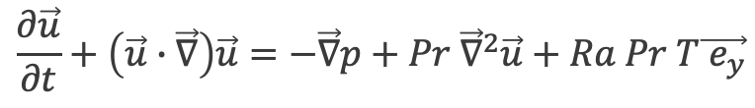




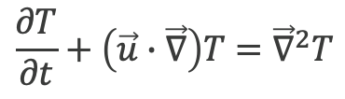
Equations System and Boundary Conditions
Stationary solution cancels the time derivative.
Boundary conditions:
  Vertical walls:
    Periodic boundary conditions for u, p, and T.
  Horizontal walls:
    No-slip boundary condition.
    T = 1 K at the bottom boundary.
    T = 0 K at the top boundary.
A reference pressure, p = 0, is set at one of the points.
$$div(\vec{u})=0$$
$$\frac{∂\vec{u}}{∂t}+\left(\vec{u}∙\vec{∇}\right)\vec{u}=−\vec{∇}p+Pr {\vec{∇}}^{2}\vec{u}+Ra Pr T\vec{{ e}_{y}}$$
$$\frac{∂T}{∂t}+\left(\vec{u}∙\vec{∇}\right)T={\vec{∇}}^{2}T$$
$$Ra= \frac{α g ΔT L^{3}}{ν κ}$$
$$Pr= \frac{ν}{ κ}$$
$$ΔT=1[K]$$
$$L=1[m]$$

Slide 5
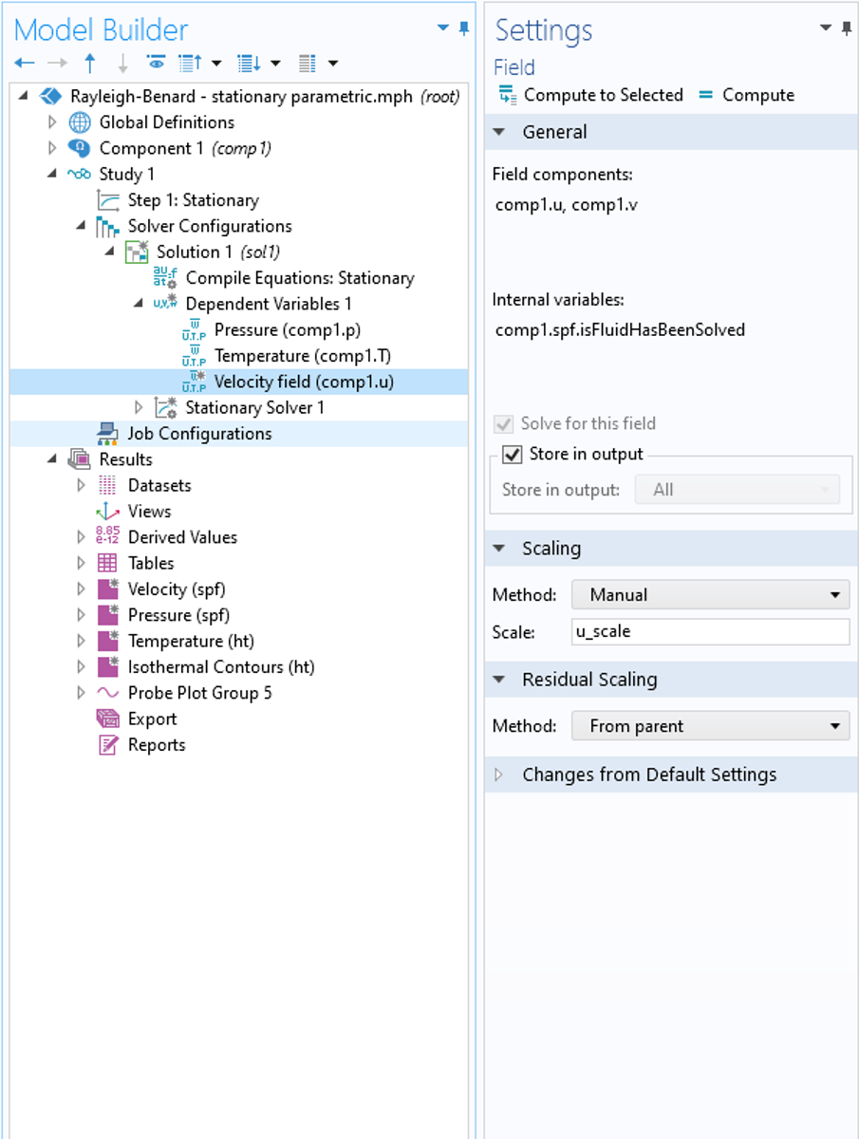
Solver Settings
Since the first solutions for the velocity field are zero, the solver may have difficulties in adjusting the scaling of variables:
  A manual, nonzero value for the scaling of the velocity solves this issue.
Nonlinear solver settings:
  Fully coupled.
  Nonlinear method: constant (Newton).
  Stabilization and acceleration option: pseudo time stepping.
Manual scaling for the velocity. u_scale is defined as the parameter.

Slide 6
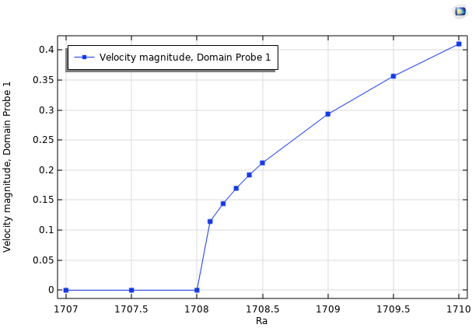
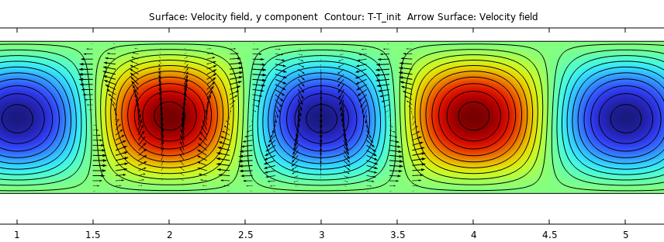
Results
Maximum Velocity
Wavenumber
Convection rolls for Ra = 1710. Isotherms of the temperature difference between the conductive profile (black). Colors show the vertical velocity magnitude.
Maximum velocity in the domain versus Ra shows the critical Ra number
1708 < Ra_{c} < 1708.1,
which shows good accuracy compared to the analytical solution Ra_{c} = 1707.8.
The wavenumber is found to be 3.14 (π), whereas it is reported to be 3.12 in the literature.
Max velocity versus Rayleigh number showing the onset of the convective regime.

Slide 7
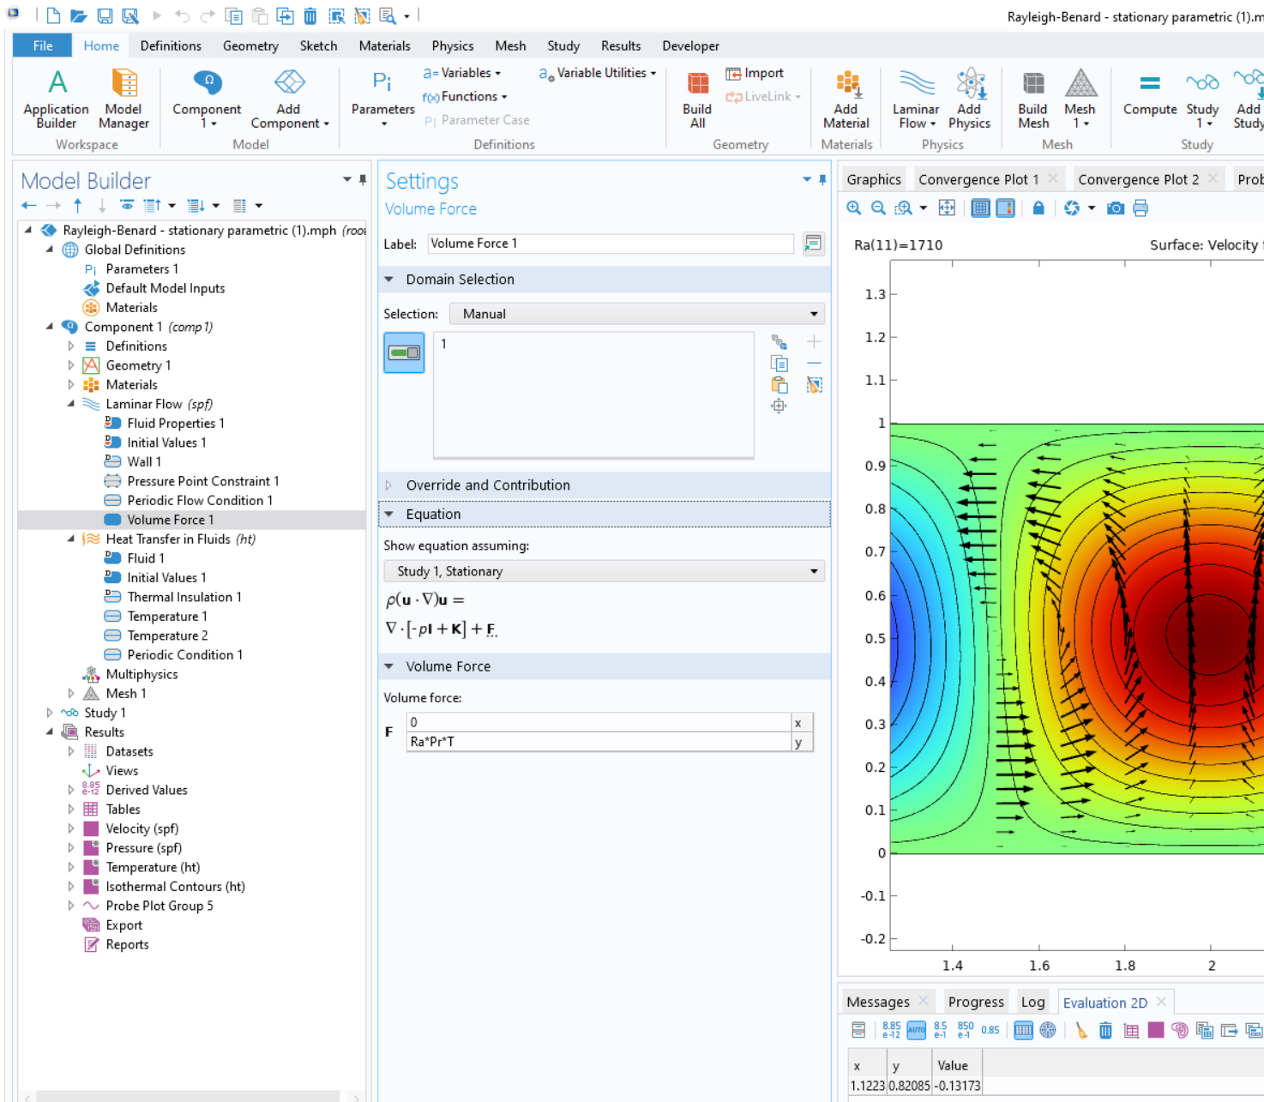
Implementation Details
Nonisothermal, Laminar Flow multiphysics interface:
Add a material with constant values, according to the nondimensional form of the equations.
In the Laminar Flow node’s settings, select Incompressible flow in the Physical Model section.
Delete the Nonisothermal flow subnode in the Multiphysics branch.
Add the buoyancy force as a Volume Force in the Laminar Flow interface.
Enter Ra*Pr*T in the second component of the volume force (y-component), see the nondimensional form of the equation.
In the Heat Transfer in Fluids interface, in the Heat convection section of the Fluid node’s Settings window, select Velocity field (spf) in the u combo box.
Define a mapped mesh with a maximum element size controlled by the parameter ms_max.
Define a parametric study over the Ra number using the study extension, using range(1700,1,1720).
Define a probe that displays the maximum velocity magnitude in the domain while solving.

Slide 8



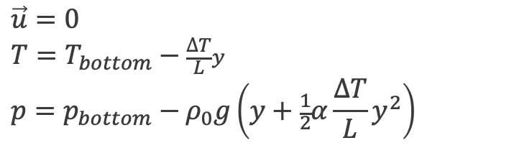

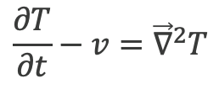
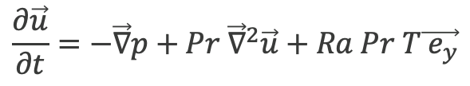
Simulation Approach, Part 2: Parametric Eigenvalue Study
The Navier–Stokes and heat transfer equations are linearized around the state at rest,
with a linear temperature profile. The state at rest is described as follows¹:
Using this as the linearization point in the initial nonlinear problem leads
to the following linearized equations:
$$\vec{u}=0$$
$$T=T_{bottom}−\frac{∆T}{L}y$$
$$p=p_{bottom}−ρ_{0}g\left(y+\frac{1}{2}α\frac{∆T}{L}y^{2}\right)$$
$$div(\vec{u})=0$$
$$\frac{∂\vec{u}}{∂t}=−\vec{∇}p+Pr {\vec{∇}}^{2}\vec{u}+Ra Pr T\vec{{ e}_{y}}$$
$$\vec{u}=\left(\begin{aligned}u \\ v\end{aligned}\right)$$
$$Ra= \frac{α g ΔT L^{3}}{ν κ}$$
$$Pr= \frac{ν}{ κ}$$
$$\frac{∂T}{∂t}−v={\vec{∇}}^{2}T$$
1. P.G. Drazin and W.H. Reid, “Hydrodynamic Stability”, pp. 37, Cambridge University Press, 2004.

Slide 9
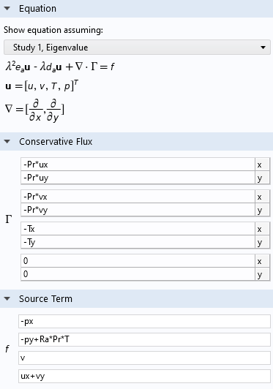
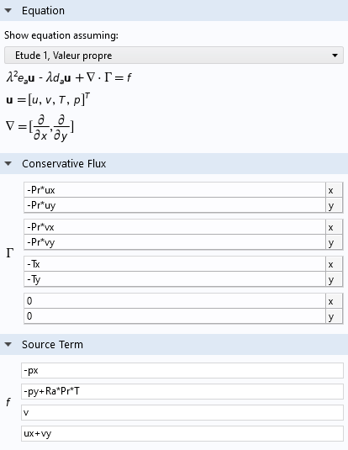
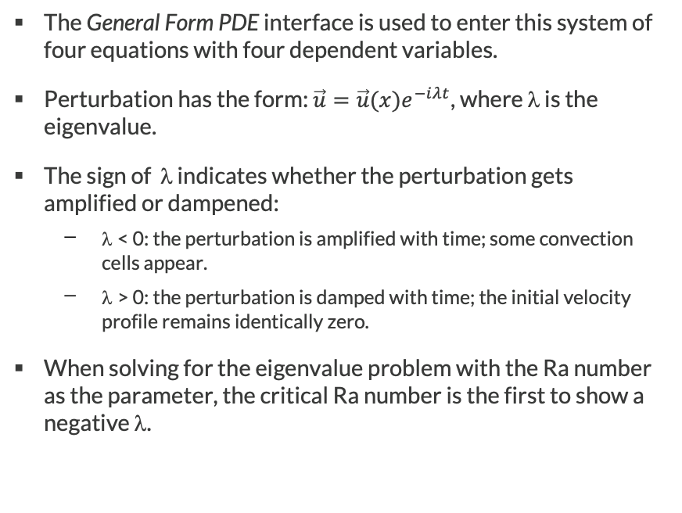
General Form PDE
The General Form PDE interface is used to enter this system of four equations with four dependent variables.
Perturbation has the form: $\vec{u}={\vec{u}(x)e}^{−iλt}$, where λ is the eigenvalue.
The sign of λ indicates whether the perturbation gets amplified or dampened:
  λ < 0: the perturbation is amplified with time; some convection cells appear.
  λ > 0: the perturbation is damped with time; the initial velocity profile remains identically zero.
When solving for the eigenvalue problem with the Ra number as the parameter, the critical Ra number is the first to show a negative λ.

Slide 10
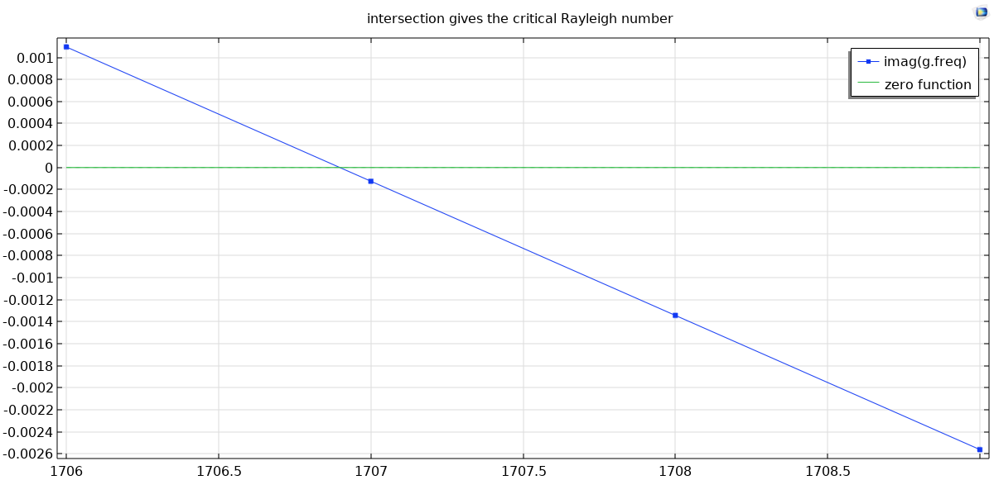
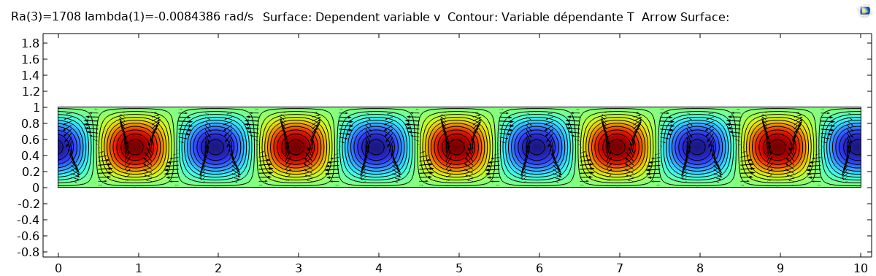
Results
Rayleigh Number
Ra_{c} = 1706.9 is the result, to be compared with the analytical value 1707.76.
The intersection of the two curves gives the critical Rayleigh number.
Solution
Note that the solution gets closer to the analytical value as the mesh is refined.
The shape of the first amplified mode. This shows the vertical velocity perturbation (colors), isotherms of temperature perturbation (black), and velocity field (arrows).

Slide 11
Concluding Remarks
Two methods are used to analyze the transition from conductive to convective state, known as Rayleigh–Bénard’s cells.
The first method uses a parametric stationary study based on the full nonlinear system of heat transfer equations coupled with the Navier–Stokes equations with the Boussinesq approximation. It detects the onset of the convective state and computes the intensity of the fluid flow.
The second method uses a linear eigenvalue study around the linearization point, which is the purely conductive solution. This method only detects the onset of the convection cells.
Both analyses show good agreement with the analytic solution of the problem¹.
1. P.G. Drazin and W.H. Reid, “Hydrodynamic Stability”, Cambridge University Press, 2004.

