Slide 1
Edge Effects in a Spirally Wound Lithium-Ion Battery
COMSOL

Slide 2
Introduction
With the thickness of the different layers typically being several orders of magnitude smaller than the extension in the sheet direction, a lithium-ion battery is often well represented by a one-dimensional model
However, the packing and stacking of the battery may cause edge effects which motivate modeling in higher dimensions
This example investigates the geometrical effects that occur when a constructing a lithium-ion battery by spirally winding the active battery components to construct a cylindrical “jelly-roll” battery

Slide 3
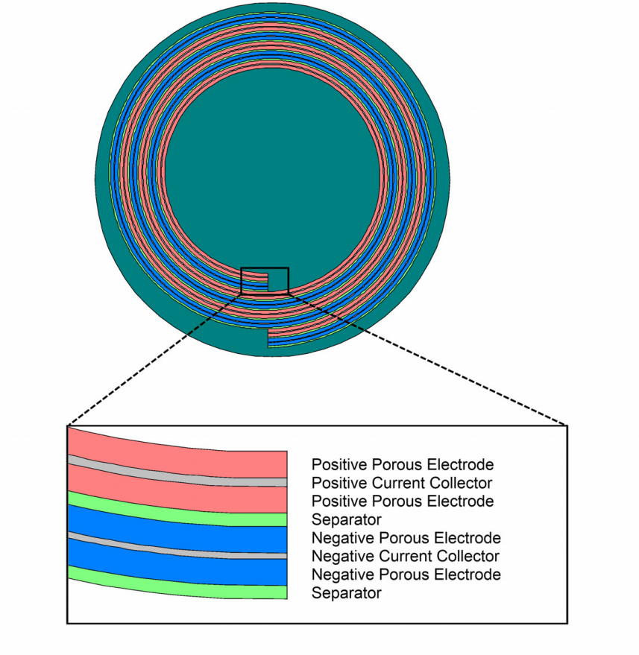
Model Definition
Geometry
The battery is constructed by winding a laminated bi-battery sheet into a spiral, which is placed in a cylinder and filled with liquid electrolyte
The battery model consists of the following parts:
  Two negative porous electrodes (60 μm thick)
  Two positive porous electrodes (60 μm thick)
  One negative current collector (14 μm thick)
Modeled geometry. Spirally wound bi-battery in circular casing filled with liquid electrolyte

Slide 4
Model Definition
  One positive current collector (20 μm thick)
  Two separator regions (30 μm thick)
  One inner and one outer liquid electrolyte region, filling up the hollow space between the active components and the circular battery casing
The spiral revolves three full laps
Modeled geometry. Spirally wound bi-battery in circular casing filled with liquid electrolyte

Slide 5
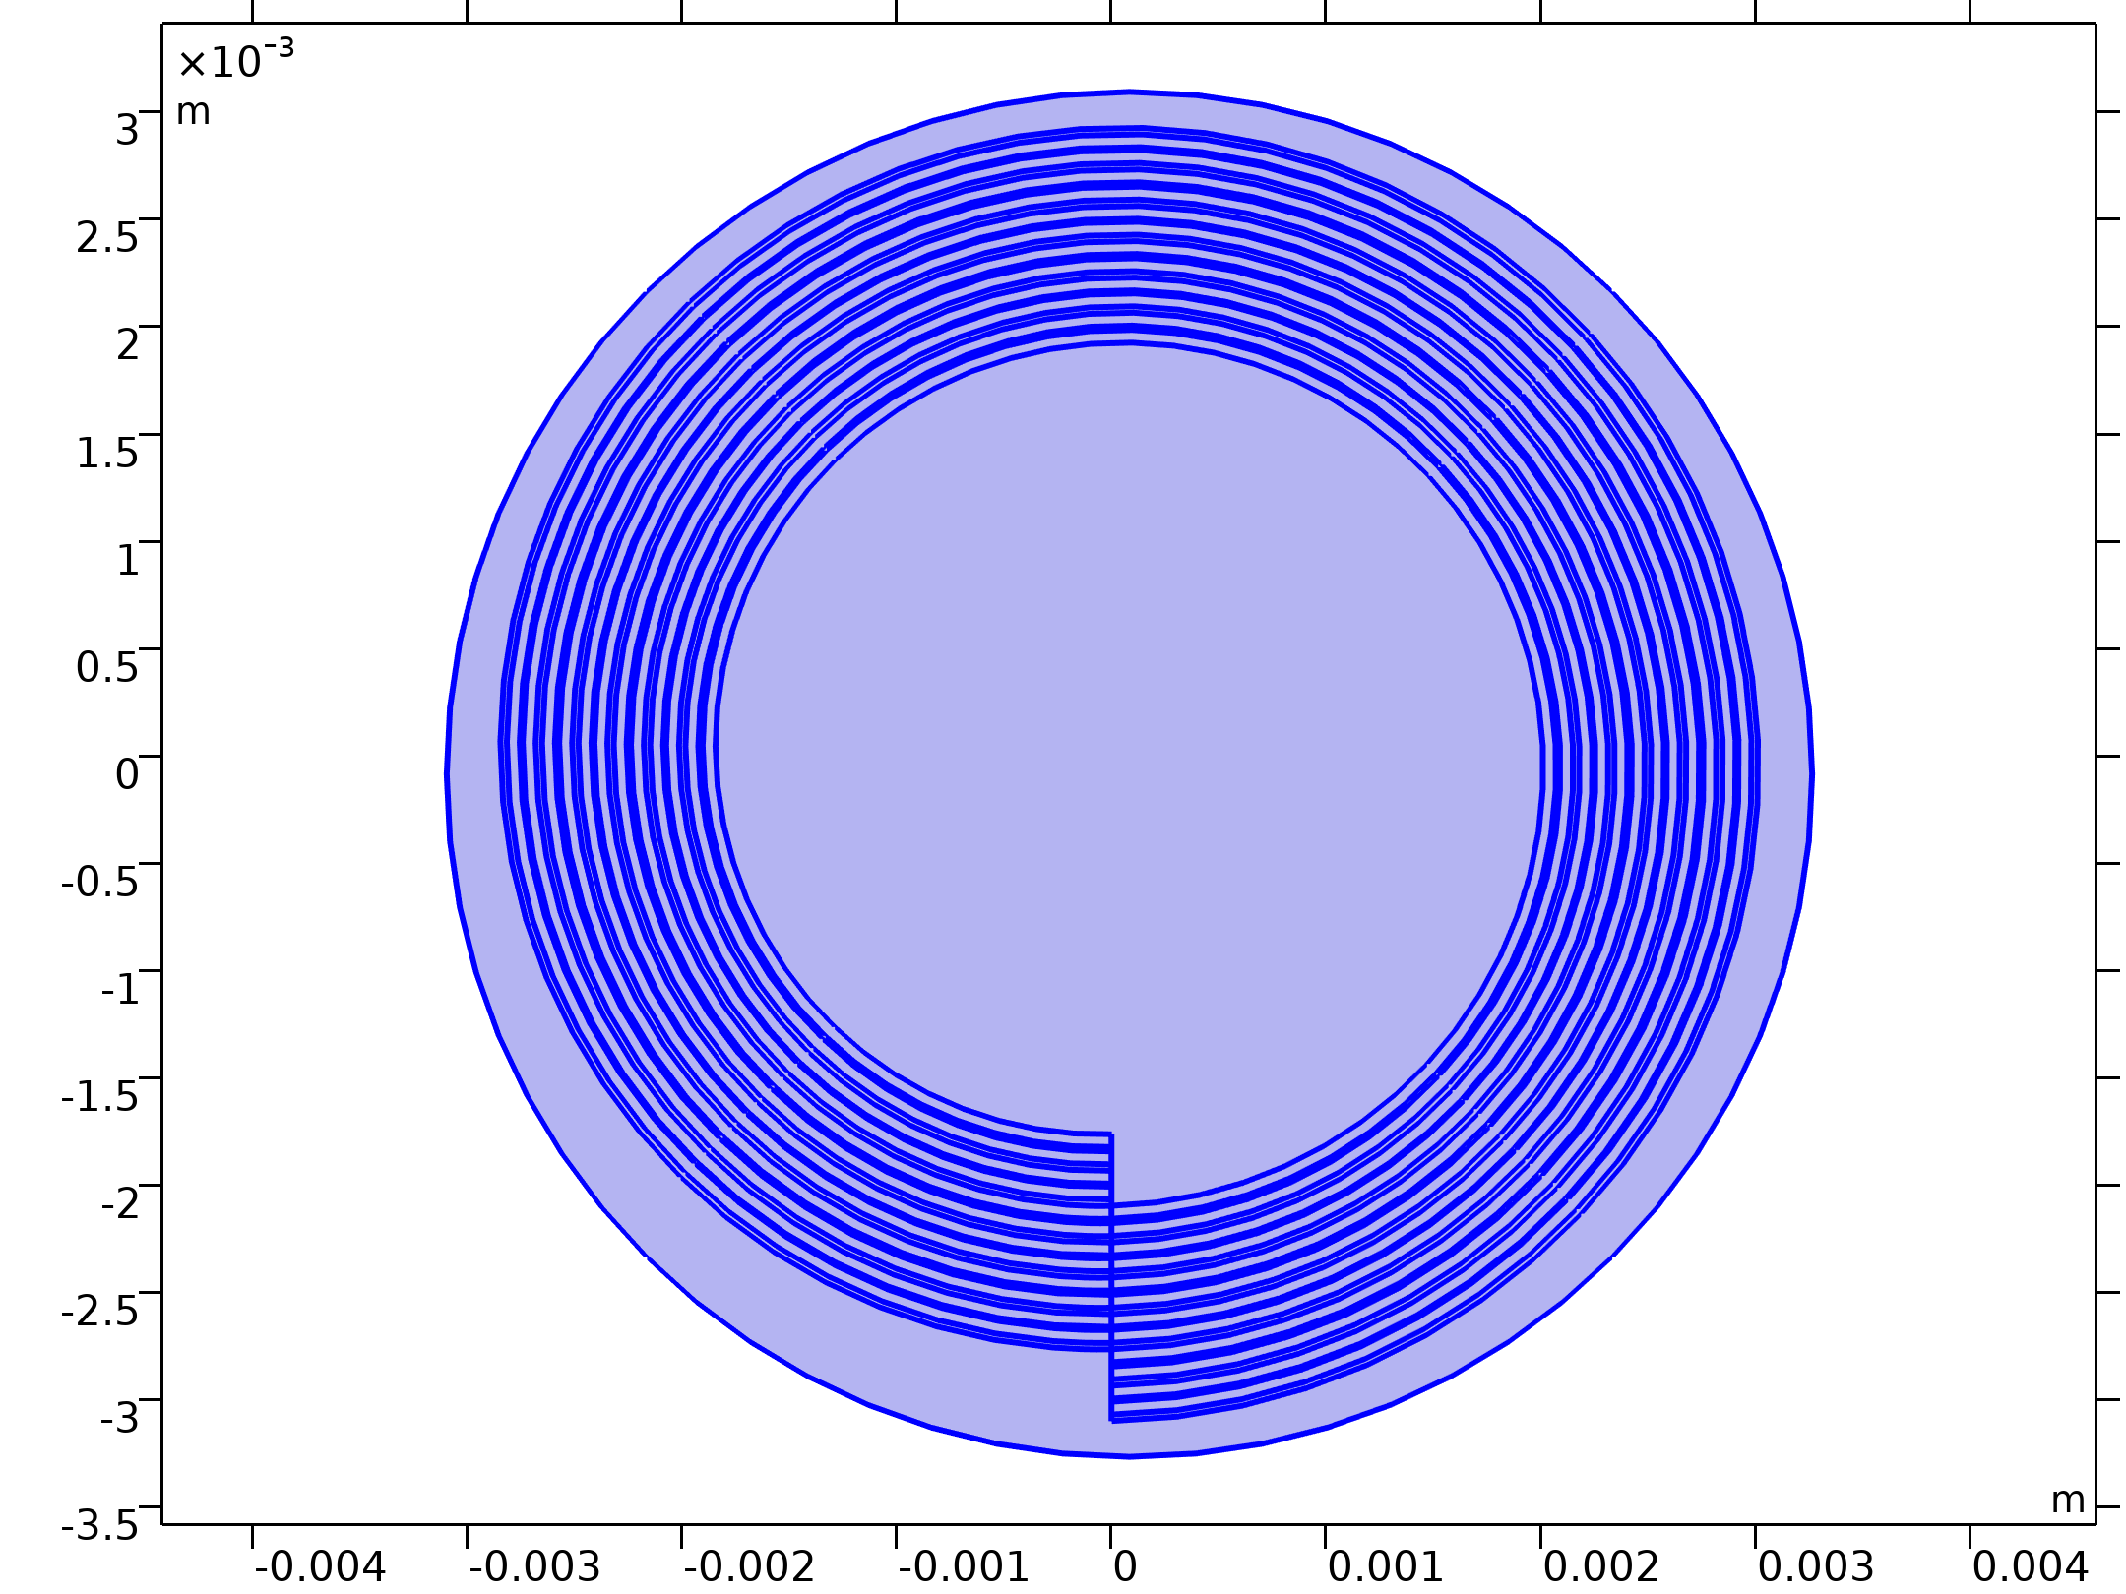




Model Definition
Equations
Lithium-Ion Battery

Slide 6
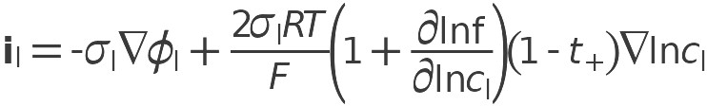

Model Definition
Equations
Lithium-Ion Battery

Slide 7
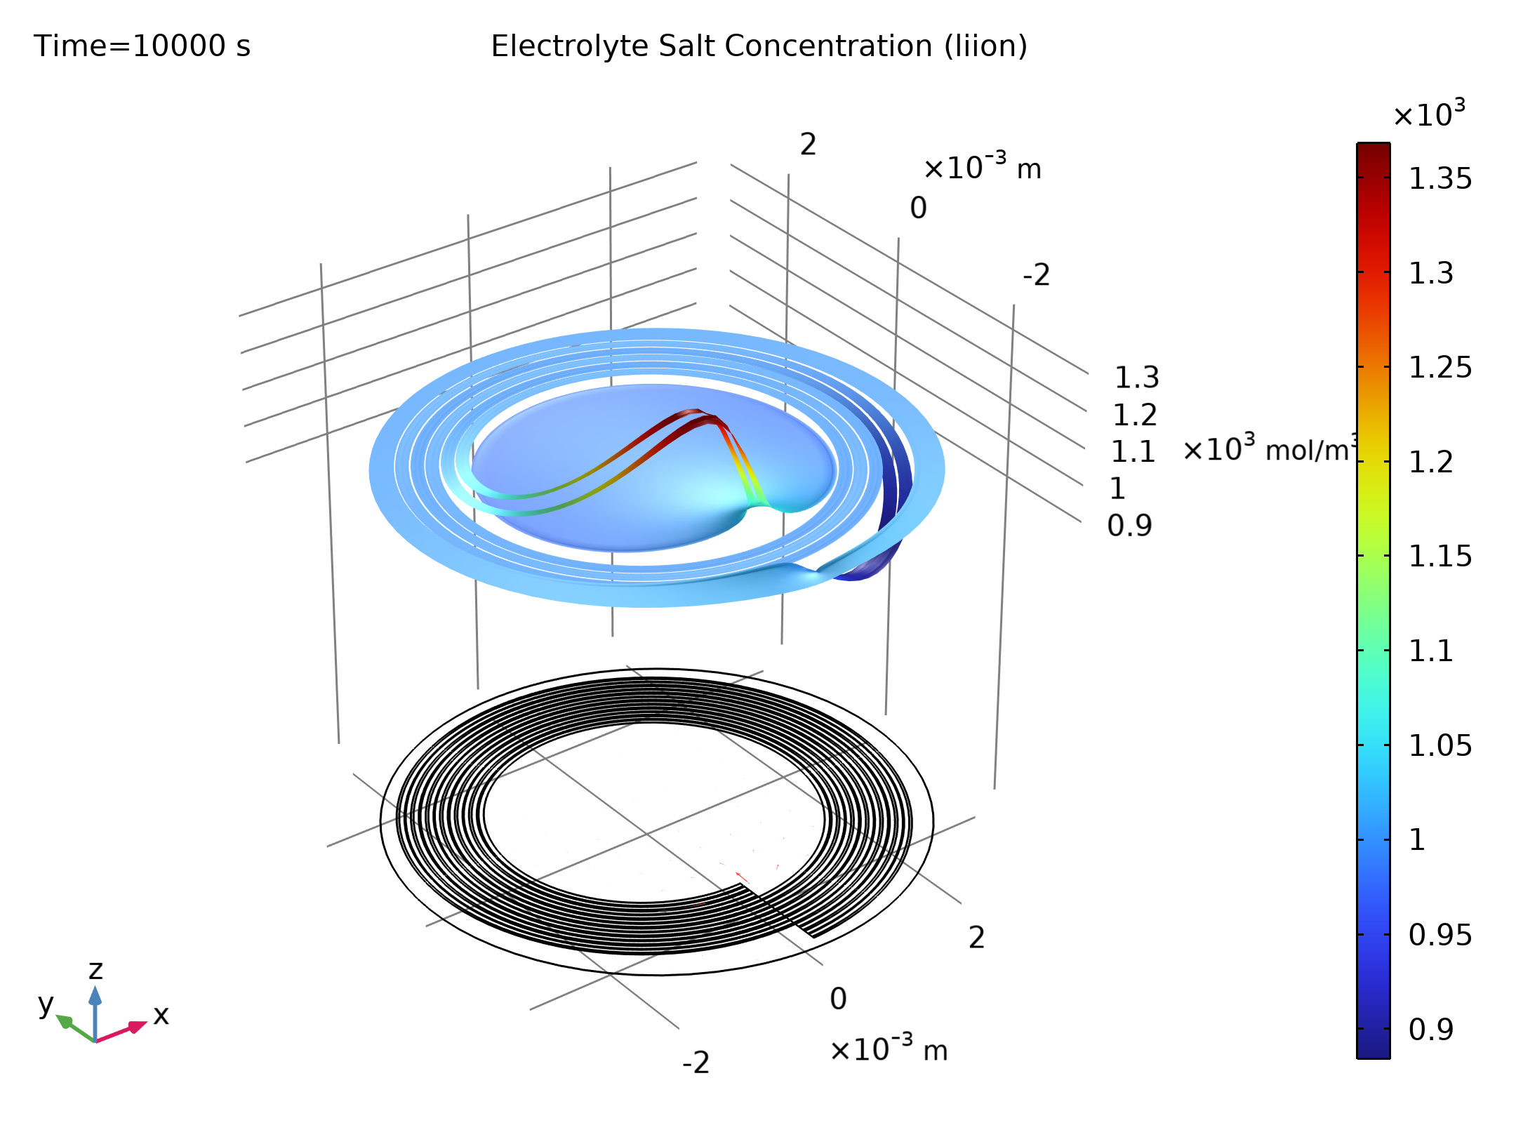
Results
The graph shows the cell potential versus time during the 1C discharge
Cell potential versus time during the 1C discharge

Slide 8
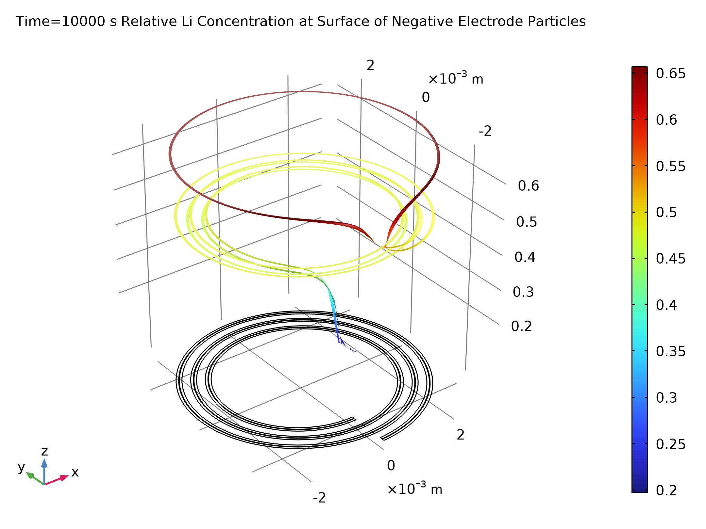
Results
The figure shows the relative lithium concentration at the surface of the electrode particles for the negative porous electrode regions at the end of the 1C discharge (t = 1800 s)
Due to the resulting large electrolyte resistivity for lithium transport from and to the innermost and outermost parts of the spiral, these areas of the porous electrodes are hardly discharged at all
The discharge rate is higher for the negative electrode at the inner end of the spiral
Relative lithium concentration at the surface of the negative electrode particles during at t = 1800 s for the 1C discharge

Slide 9
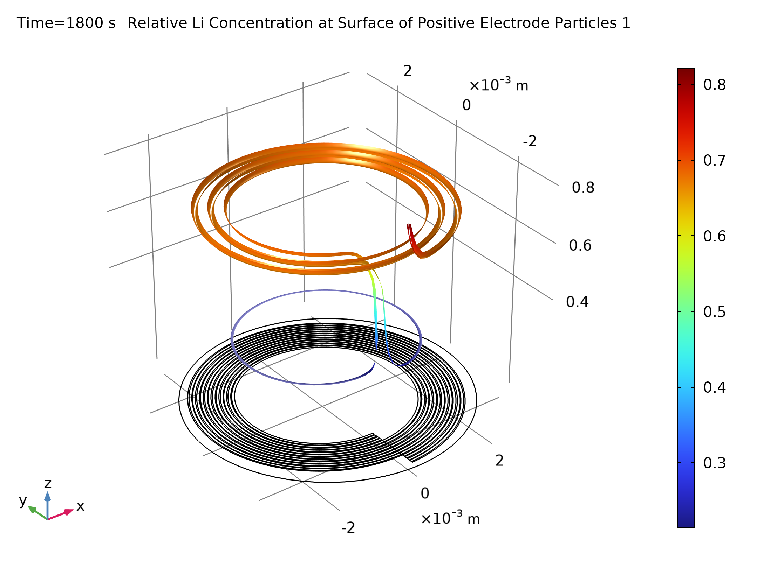
Results
The figure shows the relative lithium concentration at the surface of the electrode particles for the positive porous electrode regions at the end of the 1C discharge (t = 1800 s)
The discharge rate is higher at the outer end for the positive electrodes
This is an effect of the outermost or innermost porous electrode regions contributing to the electrochemical current close to the spiral ends
Relative lithium concentration at the surface of the positive electrode particles

Slide 10
Results
These locally higher discharge rates at the ends typically results in a shorter lifetime for these regions than for the inner parts of the spiral, which are discharged more uniformly
However, for a battery with more windings, the relative area of these end regions is small compared to the inner part of the spiral
For this system, there is an excess of negative porous electrode material, and therefore the negative electrode does not get fully depleted in areas where the positive electrode reaches lithium saturation (a relative lithium concentration close to unity in relation to the maximum possible concentration)

Slide 11
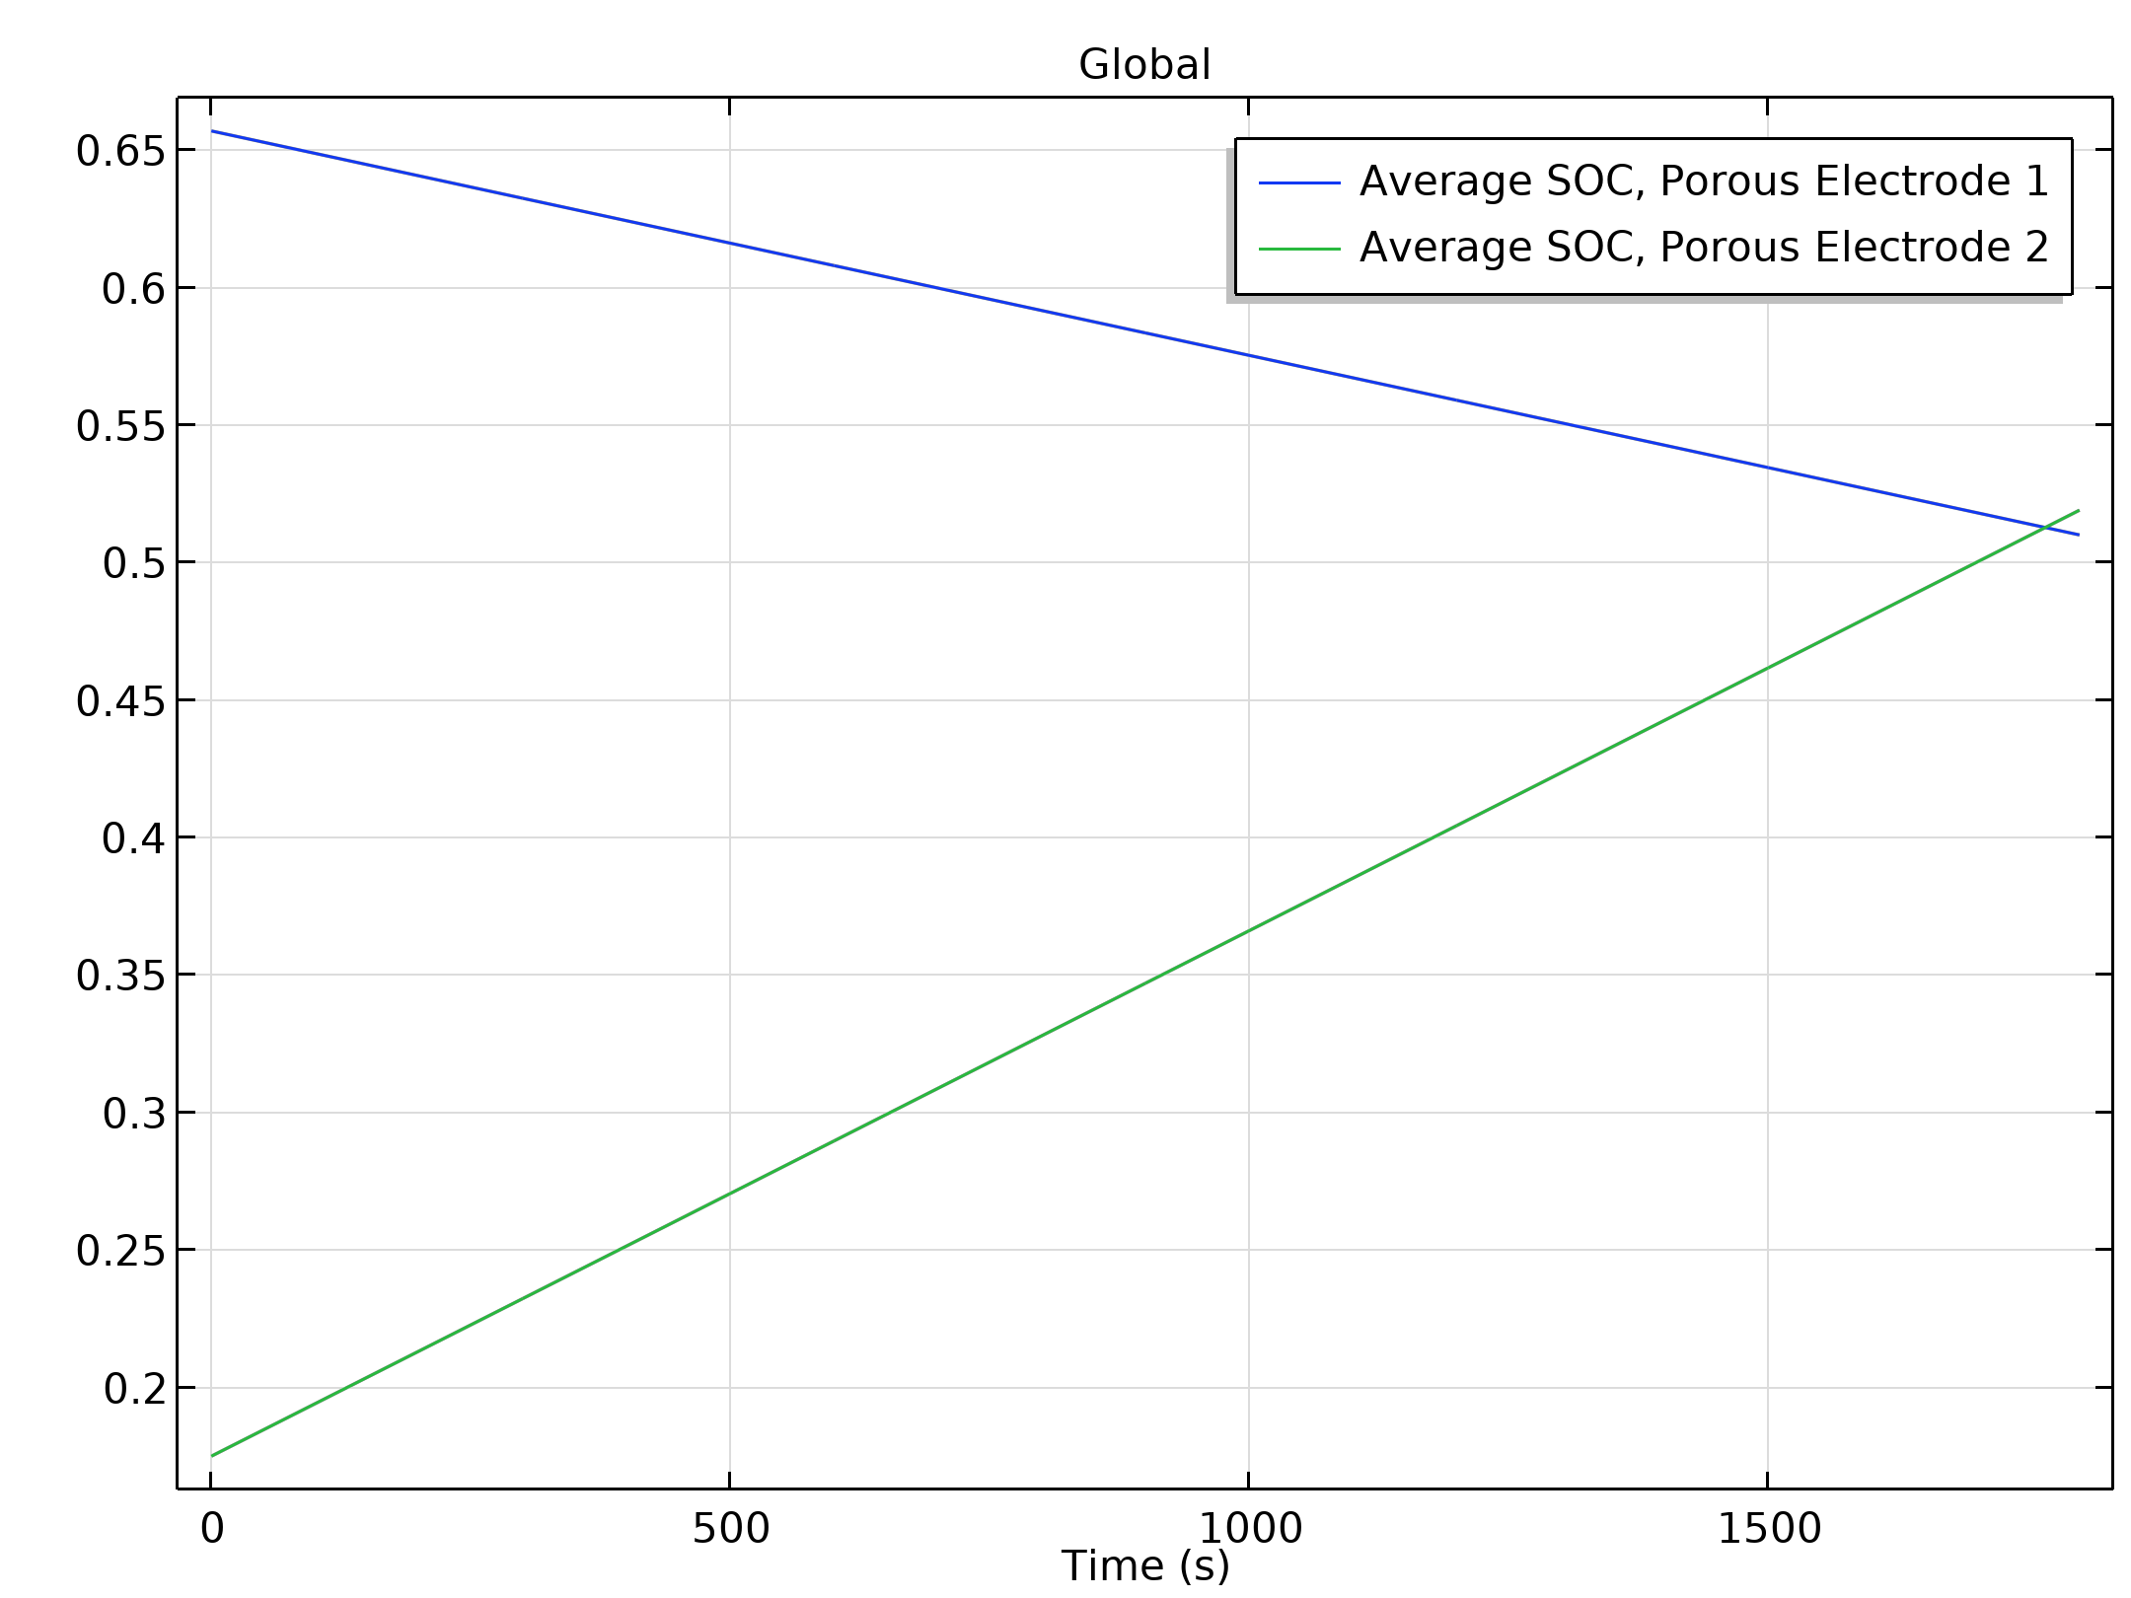
Results
The figure shows the electrolyte potential at the end of the 1C discharge cycle (t = 1800 s)
There is a significant drop in potential from the outer liquid electrolyte region through the spiral into the inner electrolyte region
This is an effect of the outermost and innermost porous electrode regions being discharged at a much lower rate than the rest of the system due to large ohmic drops in the electrolyte, and thereby in effect having almost constant equilibrium potentials throughout the discharge
Electrolyte potential at t = 1800 s for the 1C discharge

Slide 12
Results
The potential gradients indicate that there is a current flowing also in the spiral direction close to the spiral ends
Electrolyte potential at t = 1800 s for the 1C discharge

Slide 13
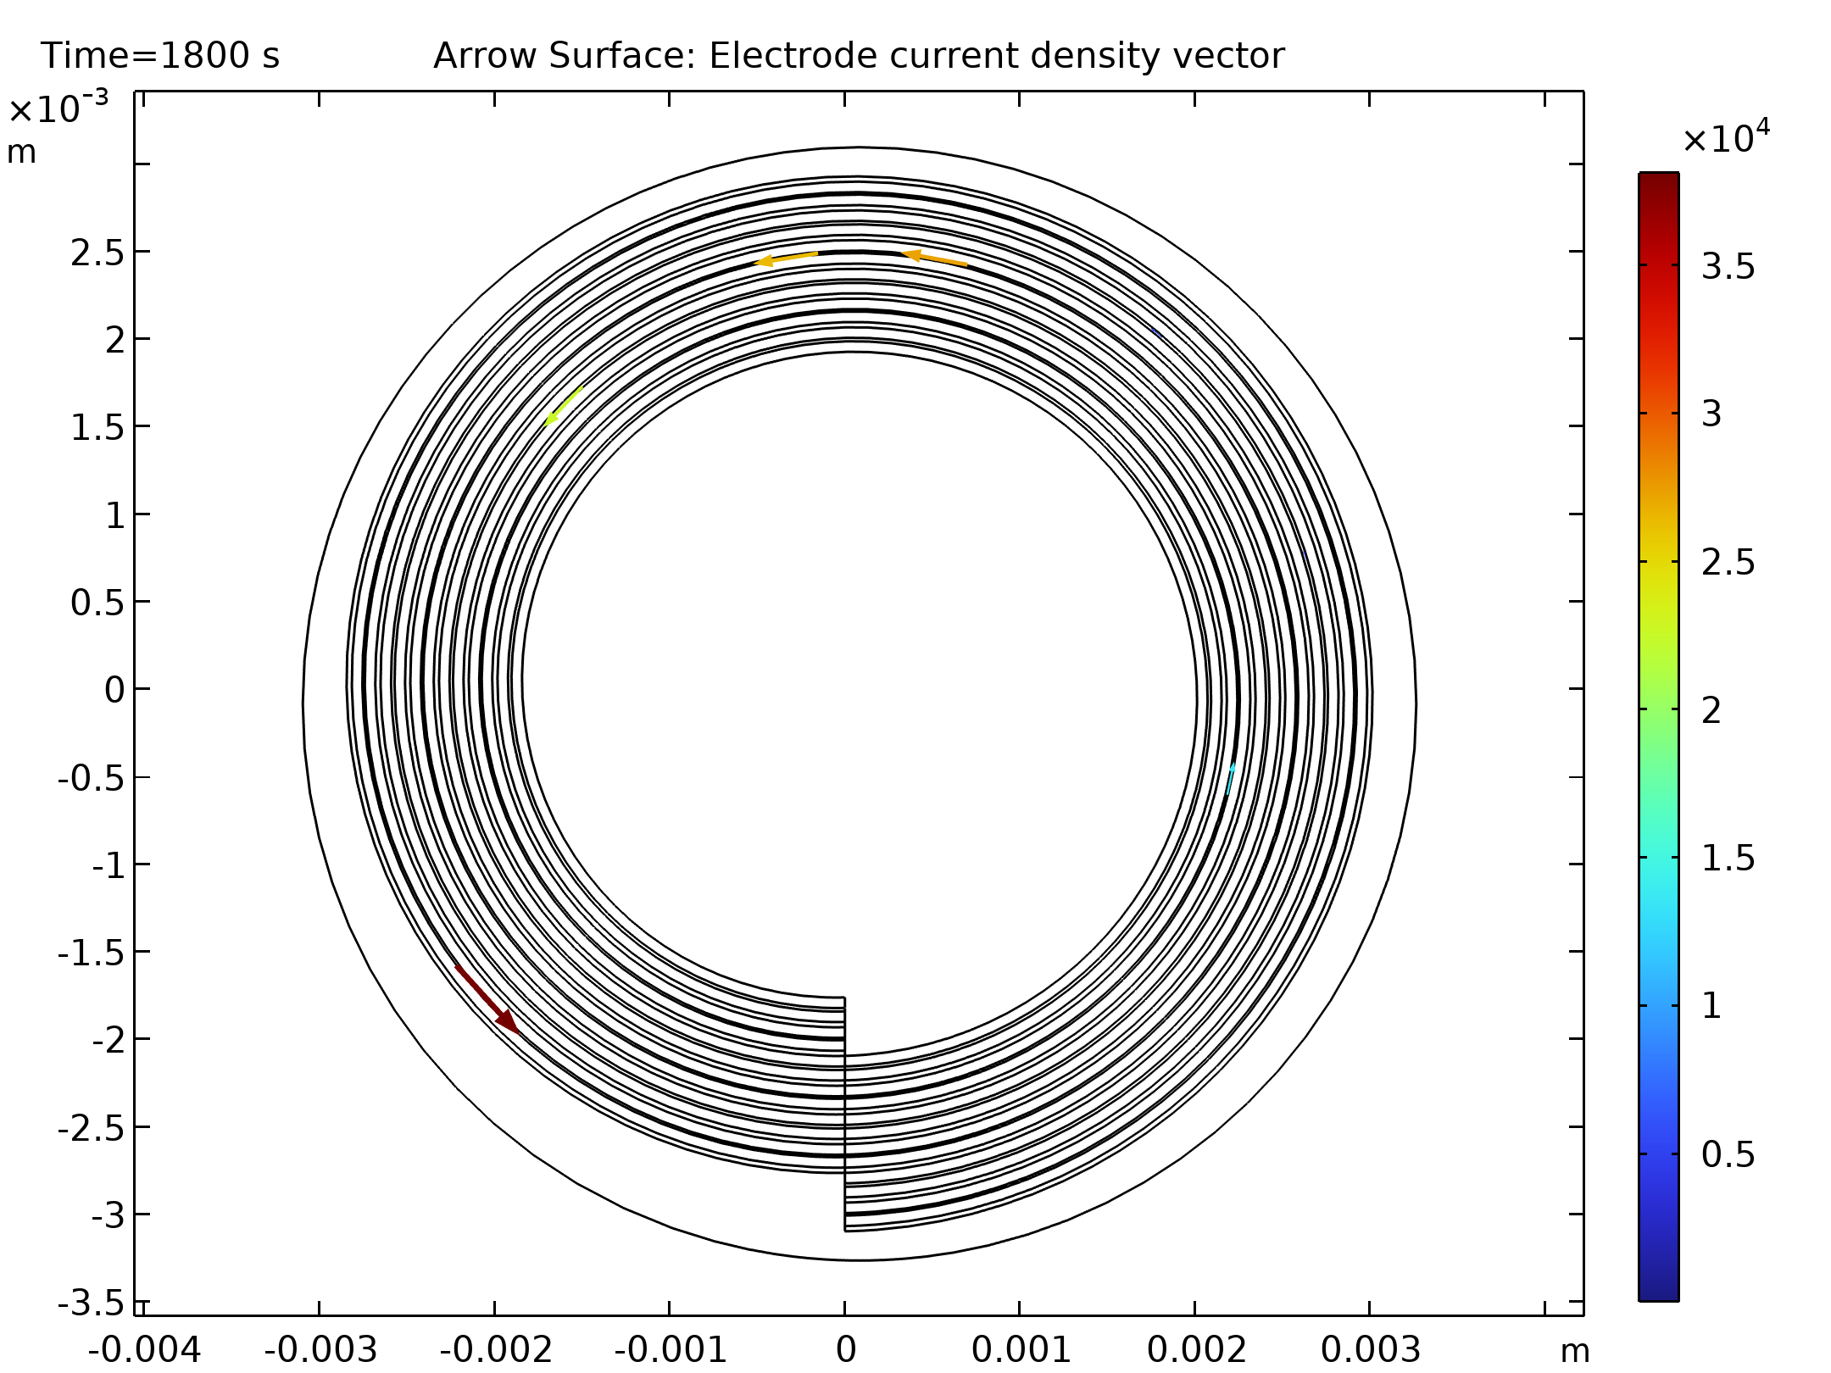
Results
The figure shows the electrolyte salt concentration at the end of the 1C discharge (t = 1800 s)
The concentration gradients close to the spiral ends are due to the current flowing in the spiral direction
Electrolyte salt concentration at t = 1800 s for the 1C discharge

Slide 14
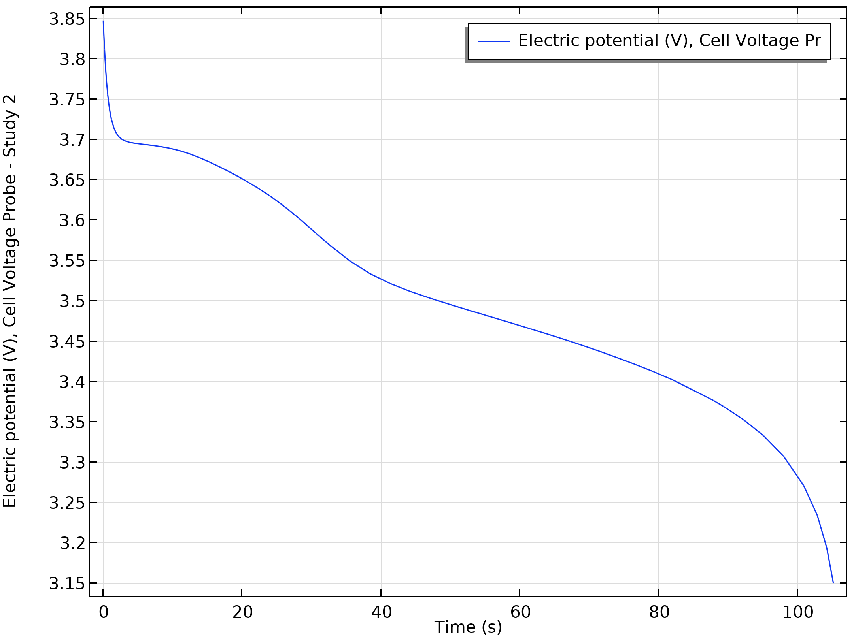
Results
The plot for the 10C discharge of cell voltage versus time
Cell potential versus time during the 10C discharge

Slide 15
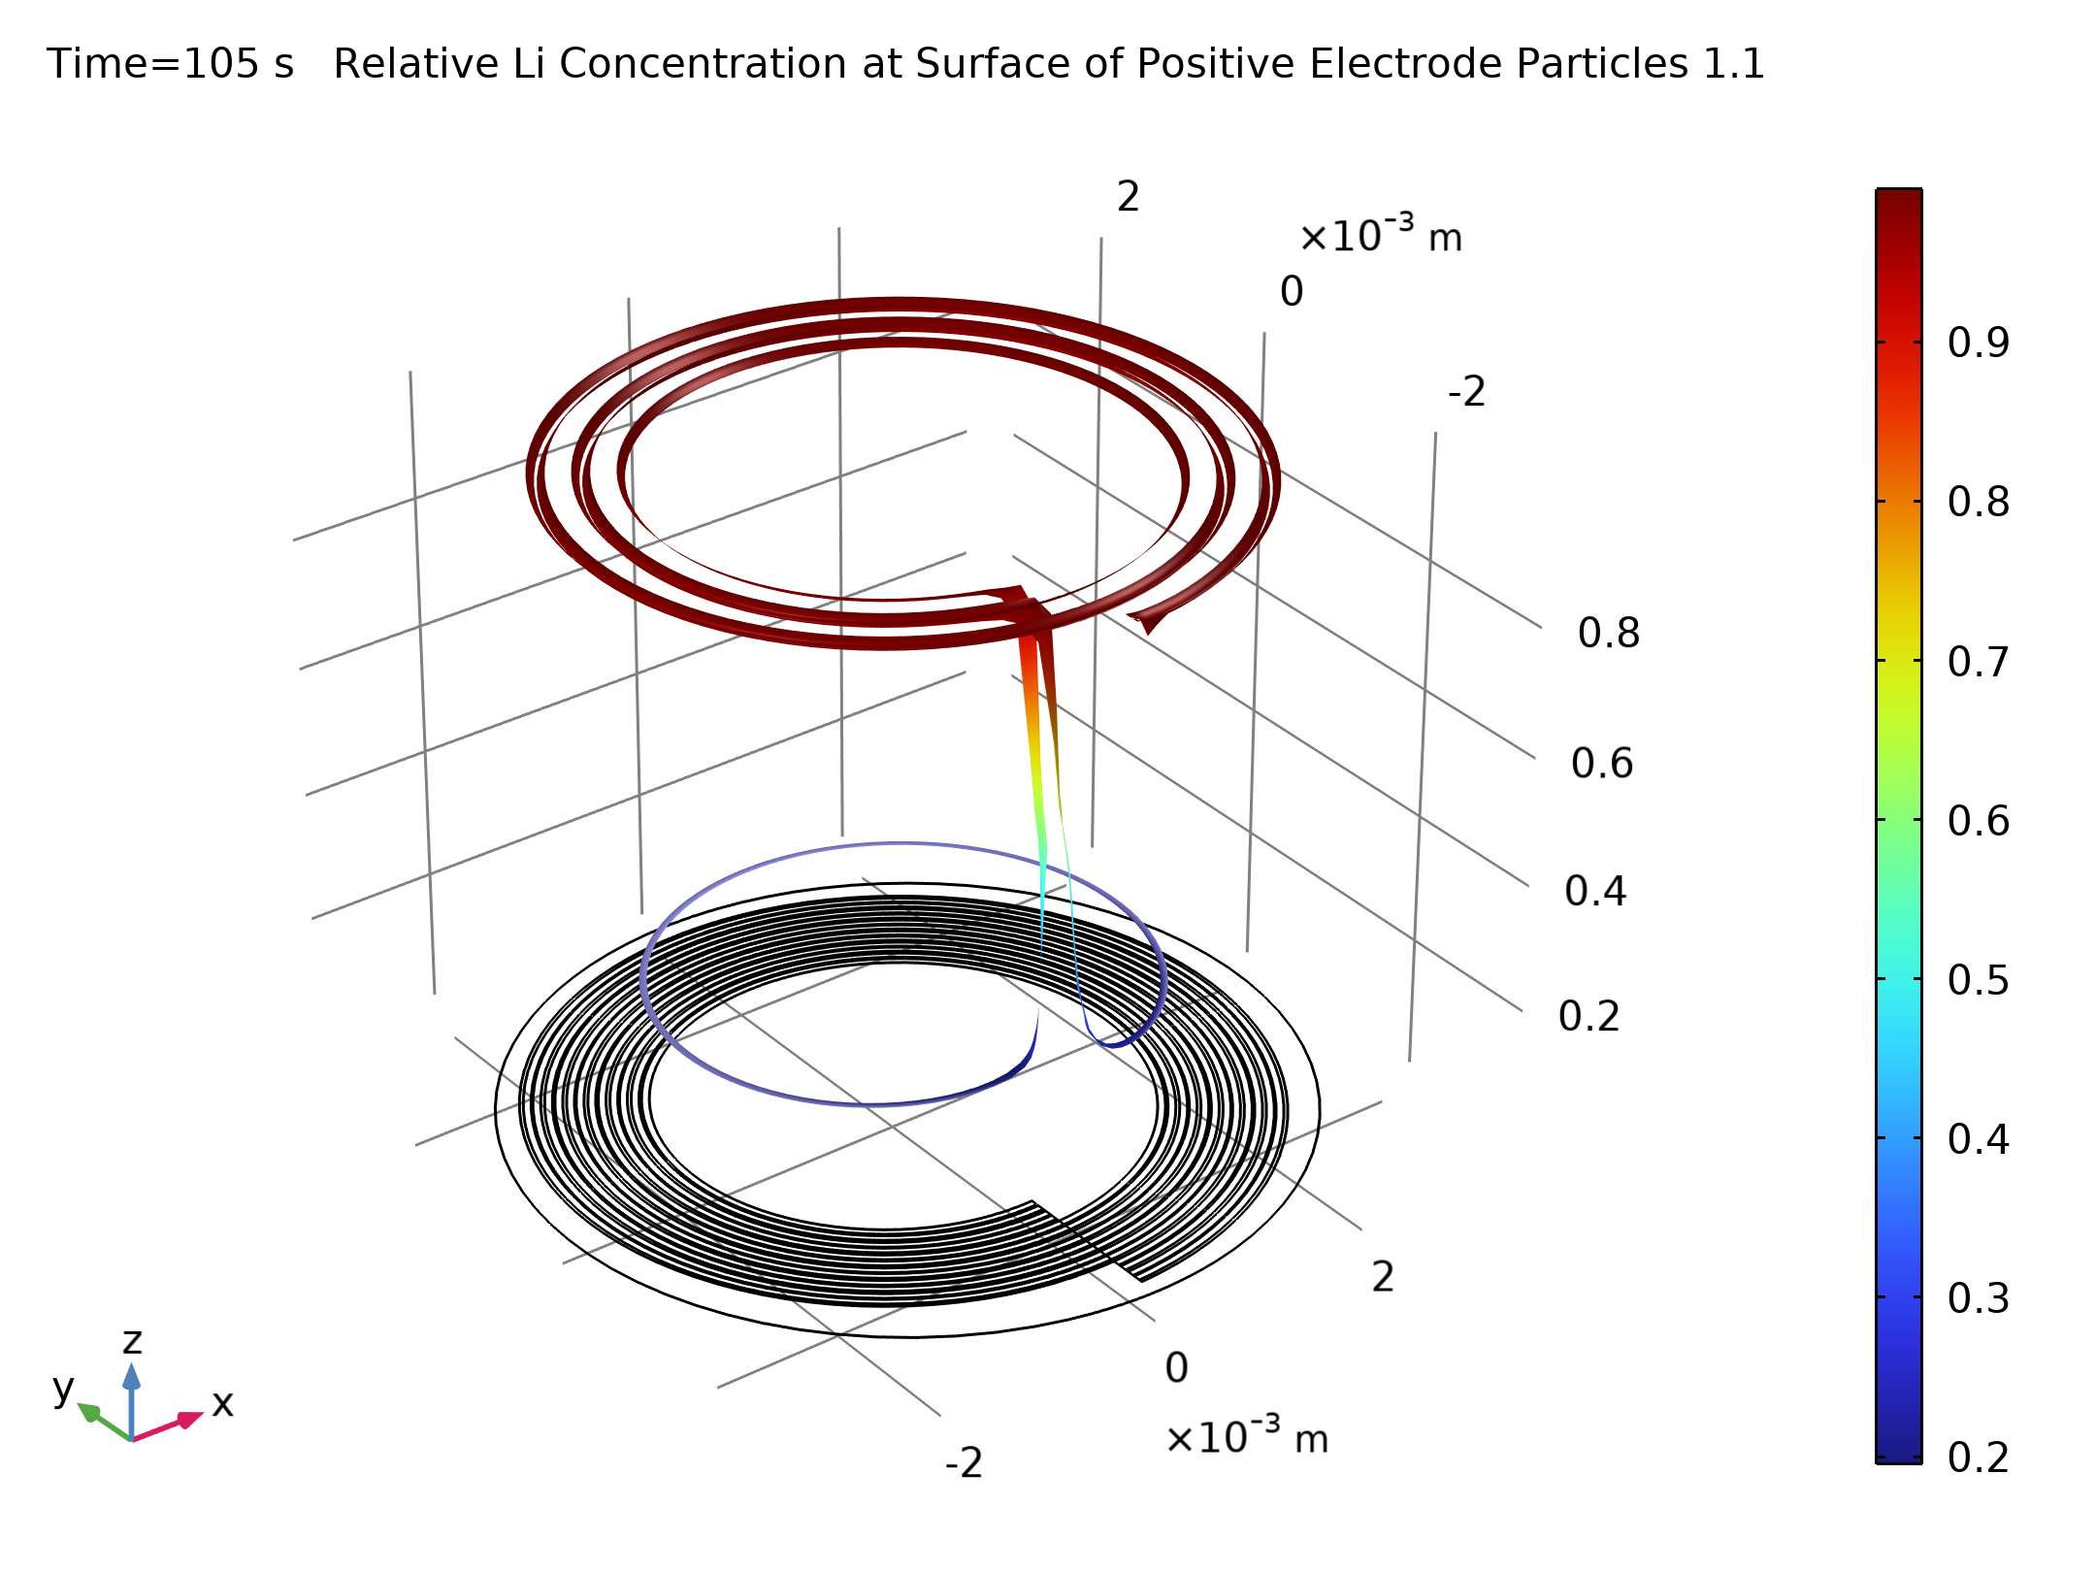
Results
Relative lithium concentration at the surface of the negative electrode particles during at t = 180 s for the 10C discharge

Slide 16
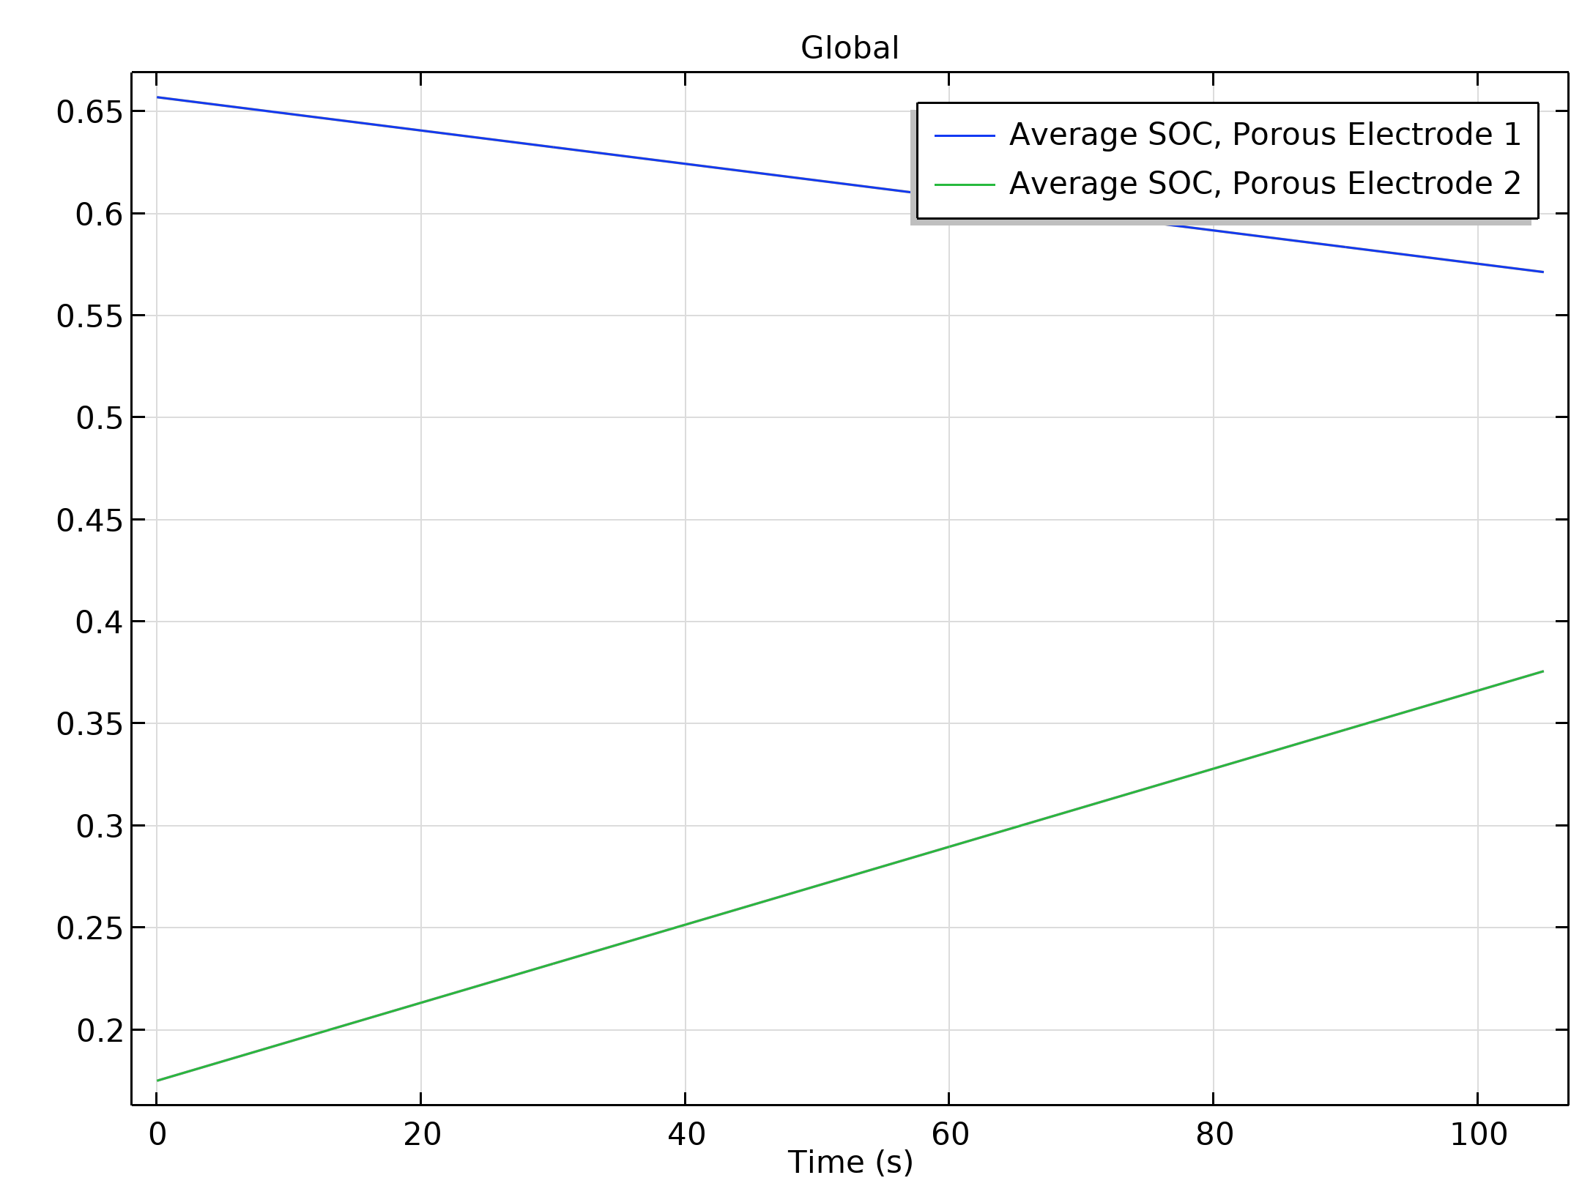
Results
Relative lithium concentration at the surface of the positive electrode particles during at t = 180 s for the 10C discharge

Slide 17
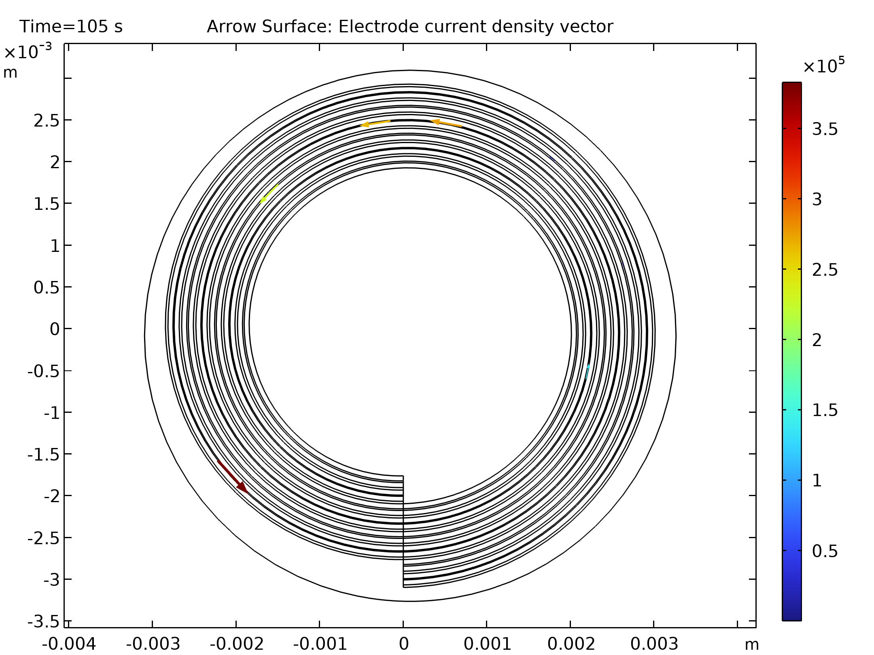
Results
The higher discharge rates result in higher gradients in the battery direction compared to the spiral direction, giving less pronounced edge effects and a more uniform discharge
Electrolyte potential at t = 180 s for the 10C discharge

Slide 18
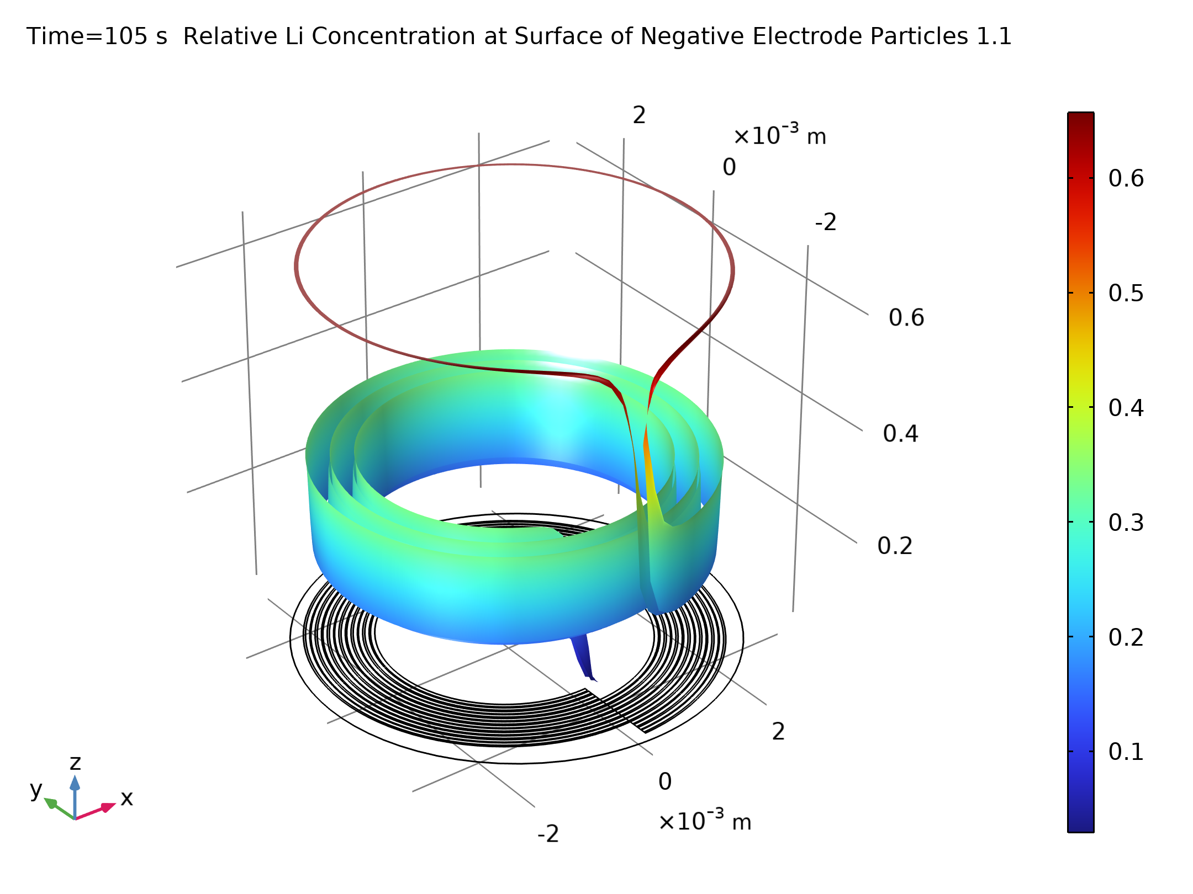
Results
Electrolyte salt concentration at t = 180 s for the 10C discharge

Slide 19
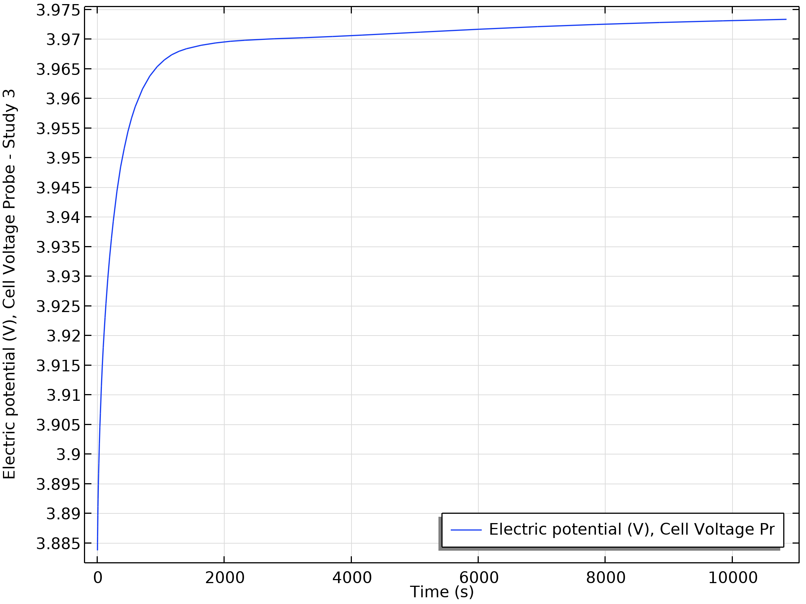
Results
The first steep rise in cell voltage is closely related to the same relaxation phenomenon seen in the 1D Isothermal Lithium-Ion Battery model, whereas the slower rise after the first minutes is attributed to moving lithium to and from the outermost and innermost part of the spiral, a process that is very slow due to the long traveling distance in the spiral direction
Cell potential versus time during the relaxation simulation

Slide 20
Results
Relative lithium concentration at the surface of the negative electrode particles during at t = 10,000 s for the relaxation simulation

Slide 21
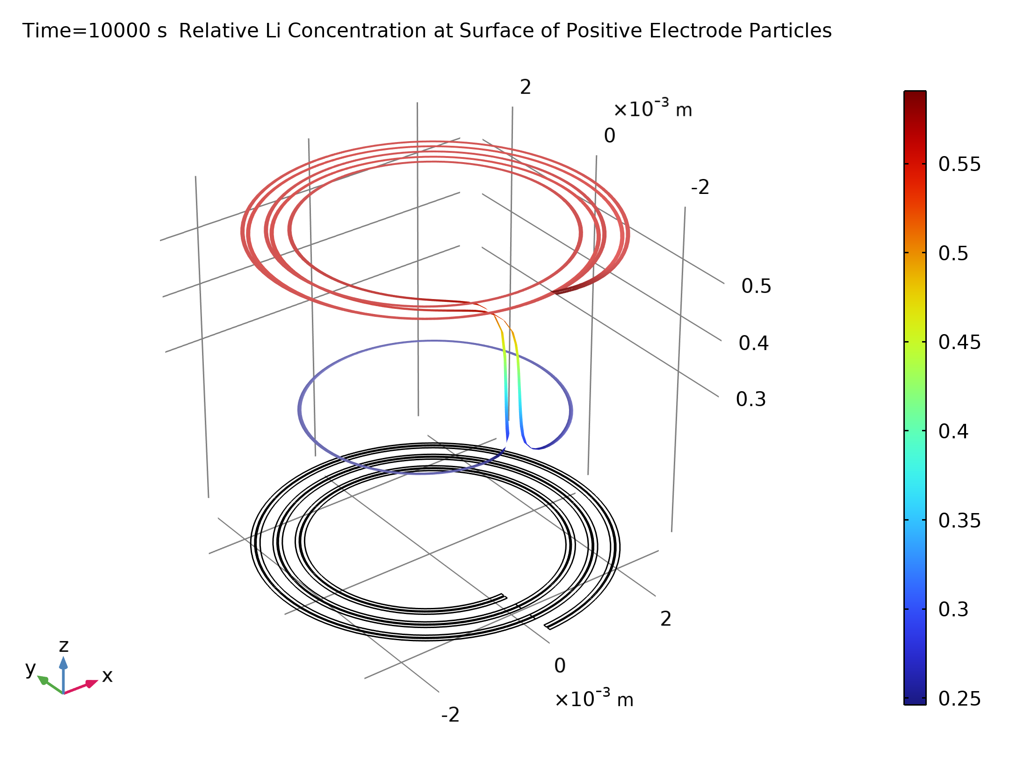
Results
Relative lithium concentration at the surface of the positive electrode particles during at t = 10,000 s for the relaxation simulation

Slide 22
Results
Electrolyte potential at t = 10,000 s for the relaxation simulation

Slide 23
Results
Electrolyte salt concentration at t = 10,000 s for the relaxation simulation

Slide 24
Results
All the figures from the last study depict the cell potential, lithium concentrations, electrolyte potential, and electrolyte salt concentration at the end of a 10,000 s relaxation simulation after the 50% discharge at 1C
After approx 3 h of relaxation the battery has not yet reached complete equilibrium

