Slide 1
Star-Shaped Microchannel
COMSOL

Slide 2
Introduction
Lab-on-a-chip devices have become quite popular for analyses in fields such as biochemistry and bioengineering
Through various techniques they incorporate all the equipment involved in a chemical process such as chemical reactors, heat exchangers, separators, and mixers
This example involves the design of an infuser, a device that feeds a reactor or analysis equipment with a specific amount of fluid
Controlling pressure is an accurate way to introduce a set quantity of fluid at a certain velocity to some piece of equipment
Flushing the equipment can also be important
Optimizing such an infuser to maximize its use would involve spending the least amount of time (and fluid) flushing the equipment
Modeling this process in the time domain can lead to an optimization of the infusing pressure, microchannel design, and time control

Slide 3
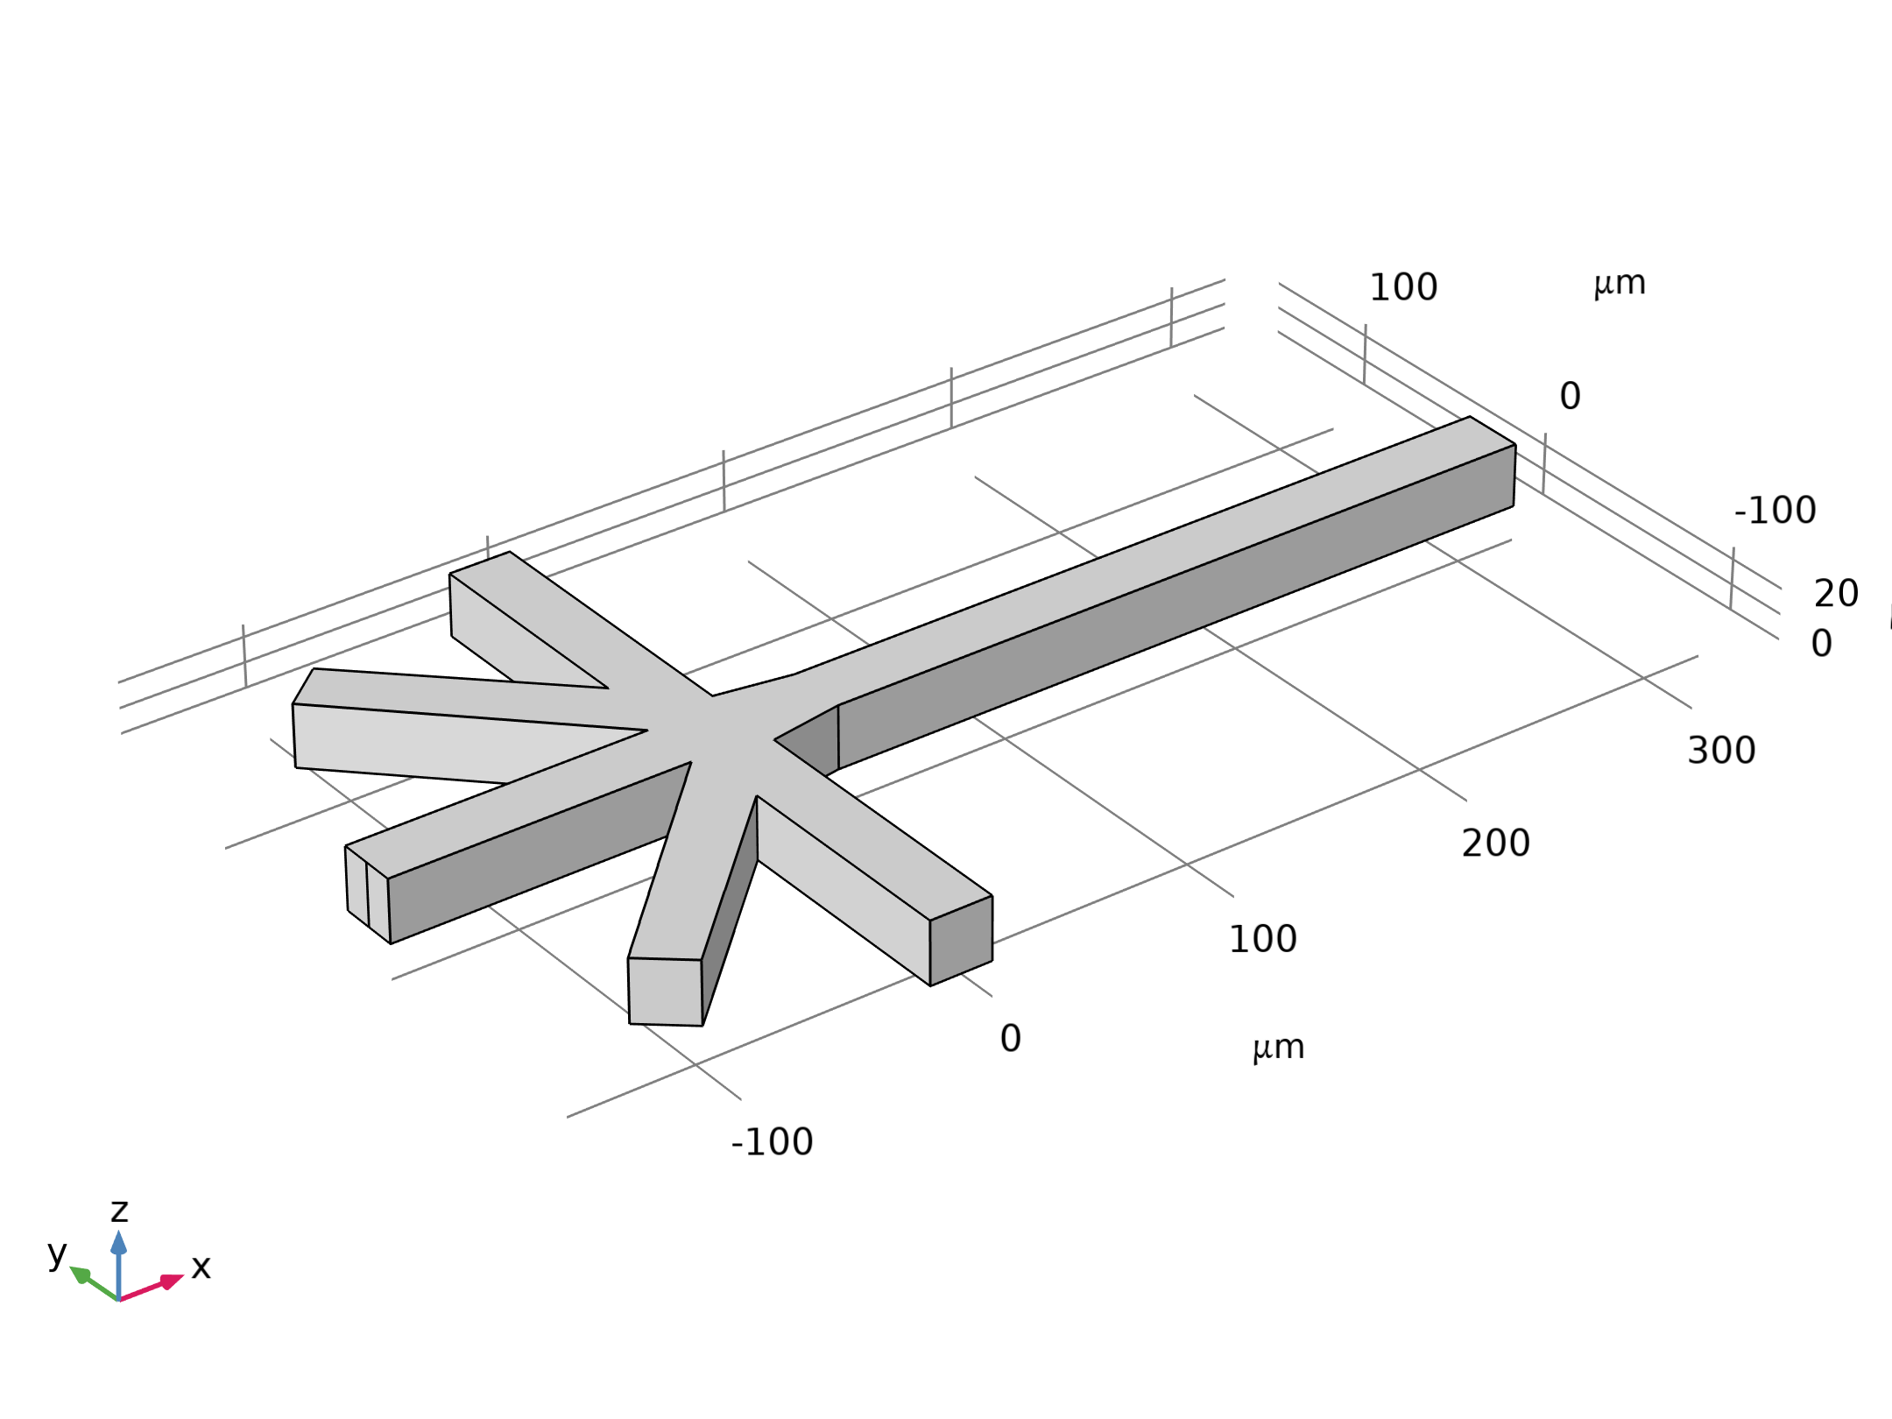
Model Definition
This exercise arbitrarily sets the geometry and conditions of the microchannel lab-on-achip
The differential pressure at the five inlets relative to the outlet pressure is time-controlled so that the inlet flow passes from one to the next in a smooth way
At any particular instant, one of the inlet flows dominates, although flow could be significant from more than one inlet
The pressure at the outlet is set to zero
Geometry 1

Slide 4
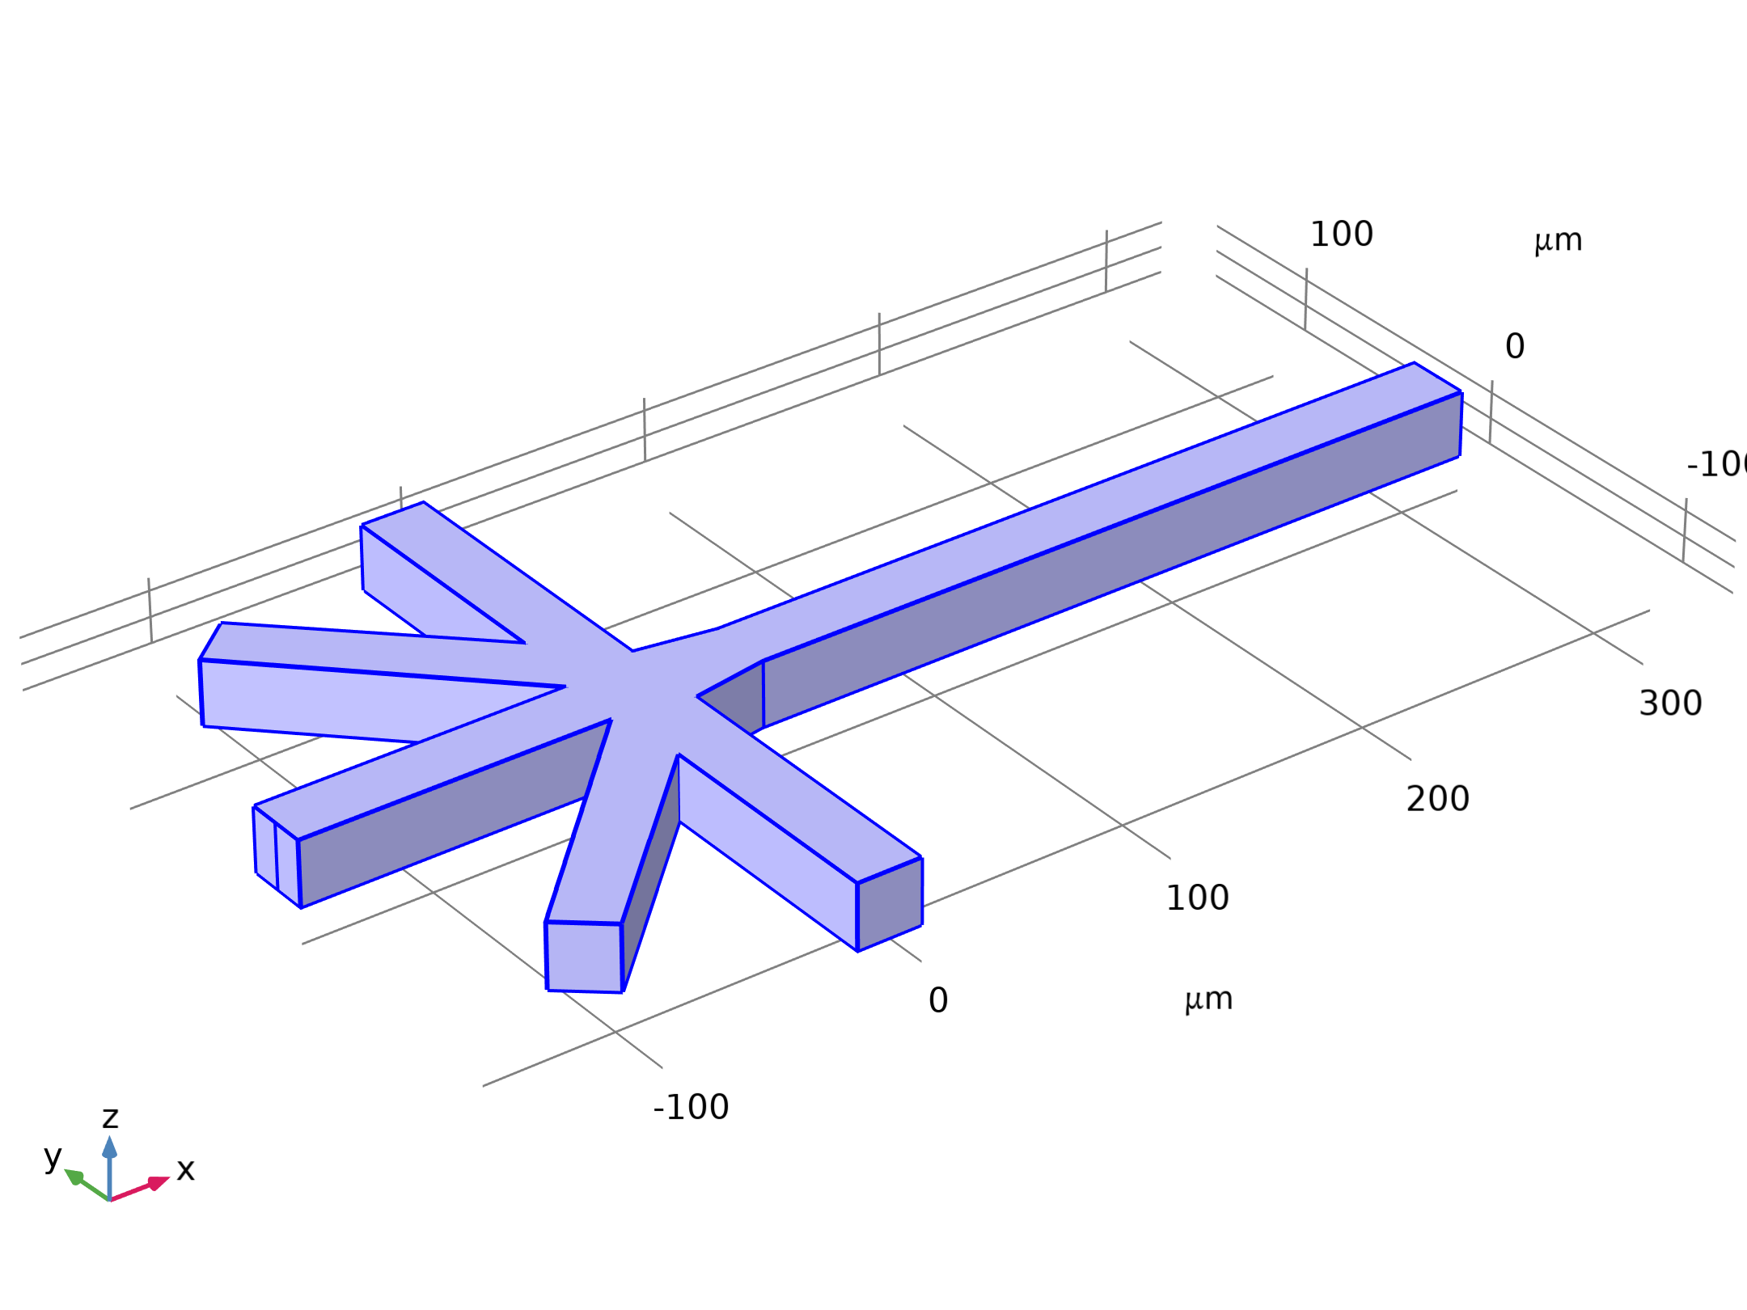


Model Definition
Laminar Flow

Slide 5
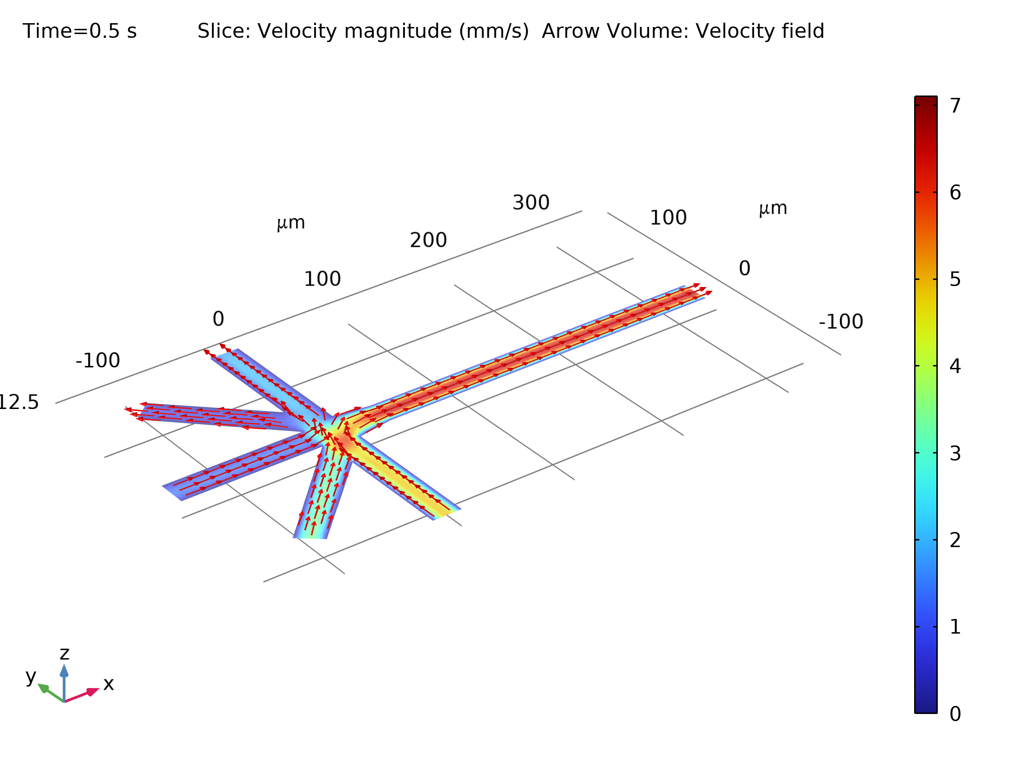
Results
The figure shows the velocity field as a combined slice and arrow plot through the middle of the geometry at t = 0.5 s
Setting up and observing this plot as an animation gives an informative qualitative description of the process
The velocity field in a microchannel infuser through the middle of the geometry

Slide 6
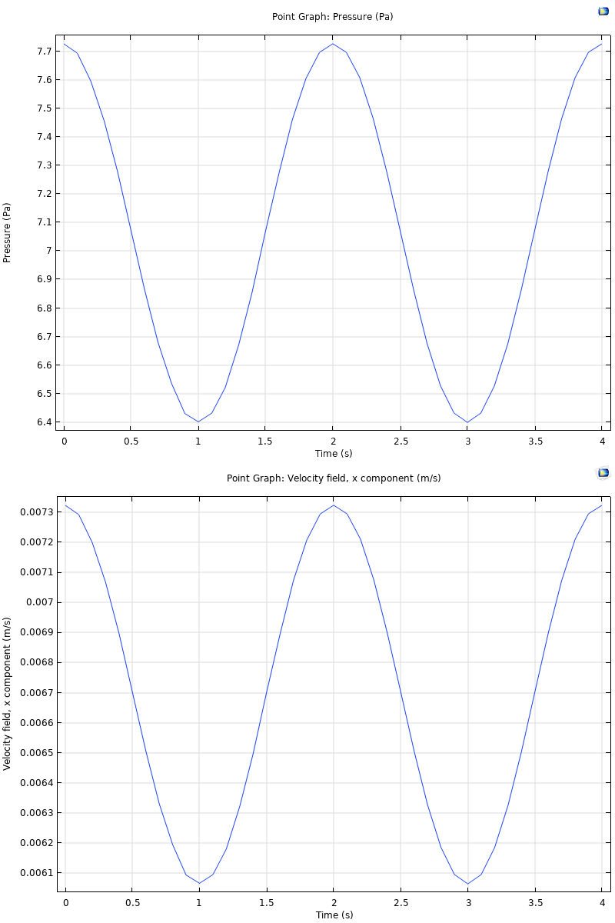
Results
The figure shows the velocity in the x direction and the pressure in a point near the outlets functions of time
Velocity in the x direction (bottom) and pressure (top) at a point near the outlet

