Slide 1
Evaporator
COMSOL

Slide 2
Introduction
This model shows how to compute the film thickness deposited on a wafer from an evaporative source

Slide 3
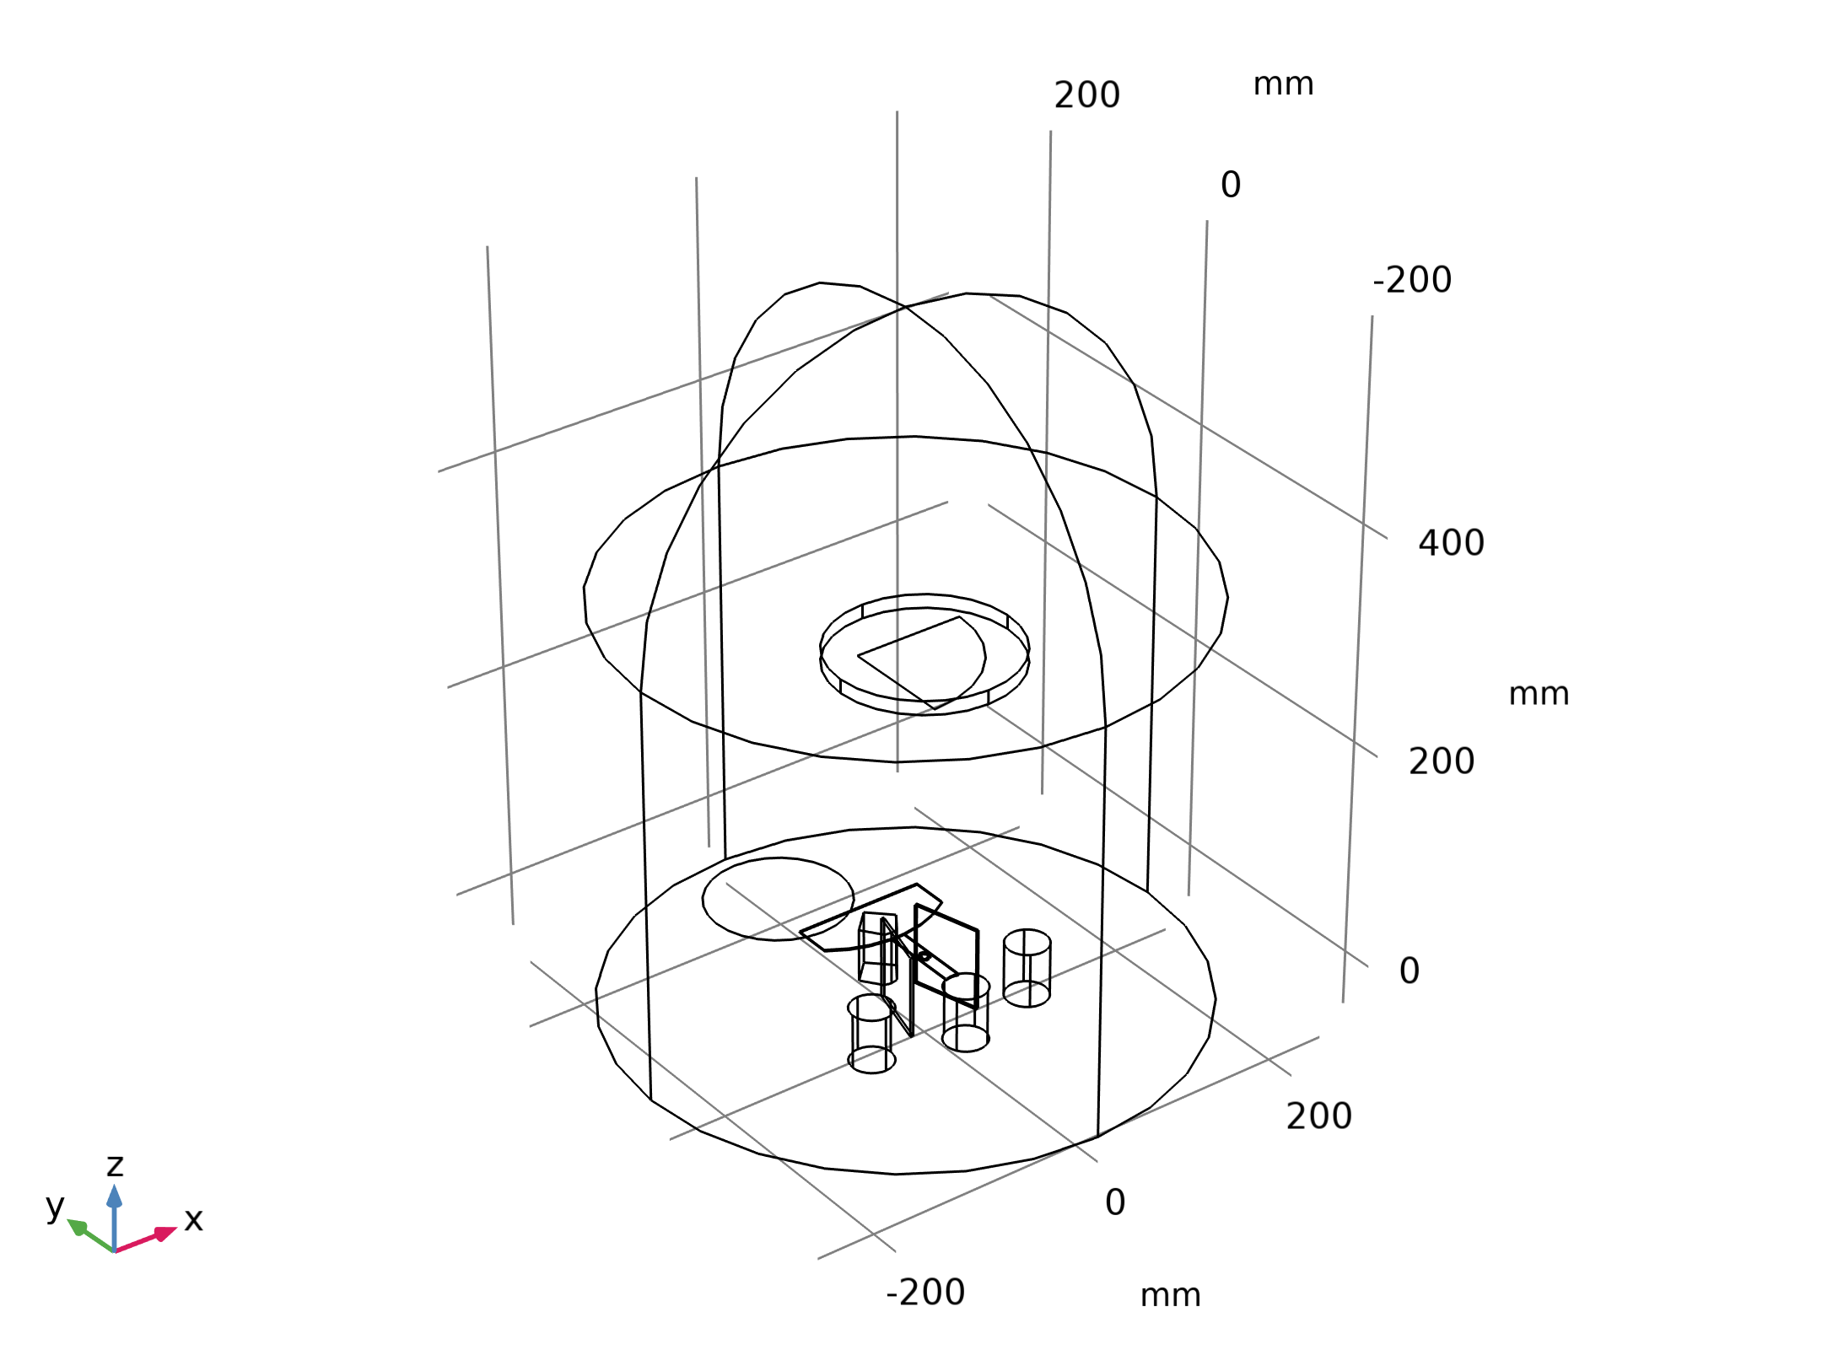
Model Definition
Gold is evaporated from a thermal source at a temperature of 2000 K onto a substrate held on a fixed surface
The deposited film thickness on the substrate and the chamber walls is computed
The figure shows the model geometry
Geometry 1

Slide 4
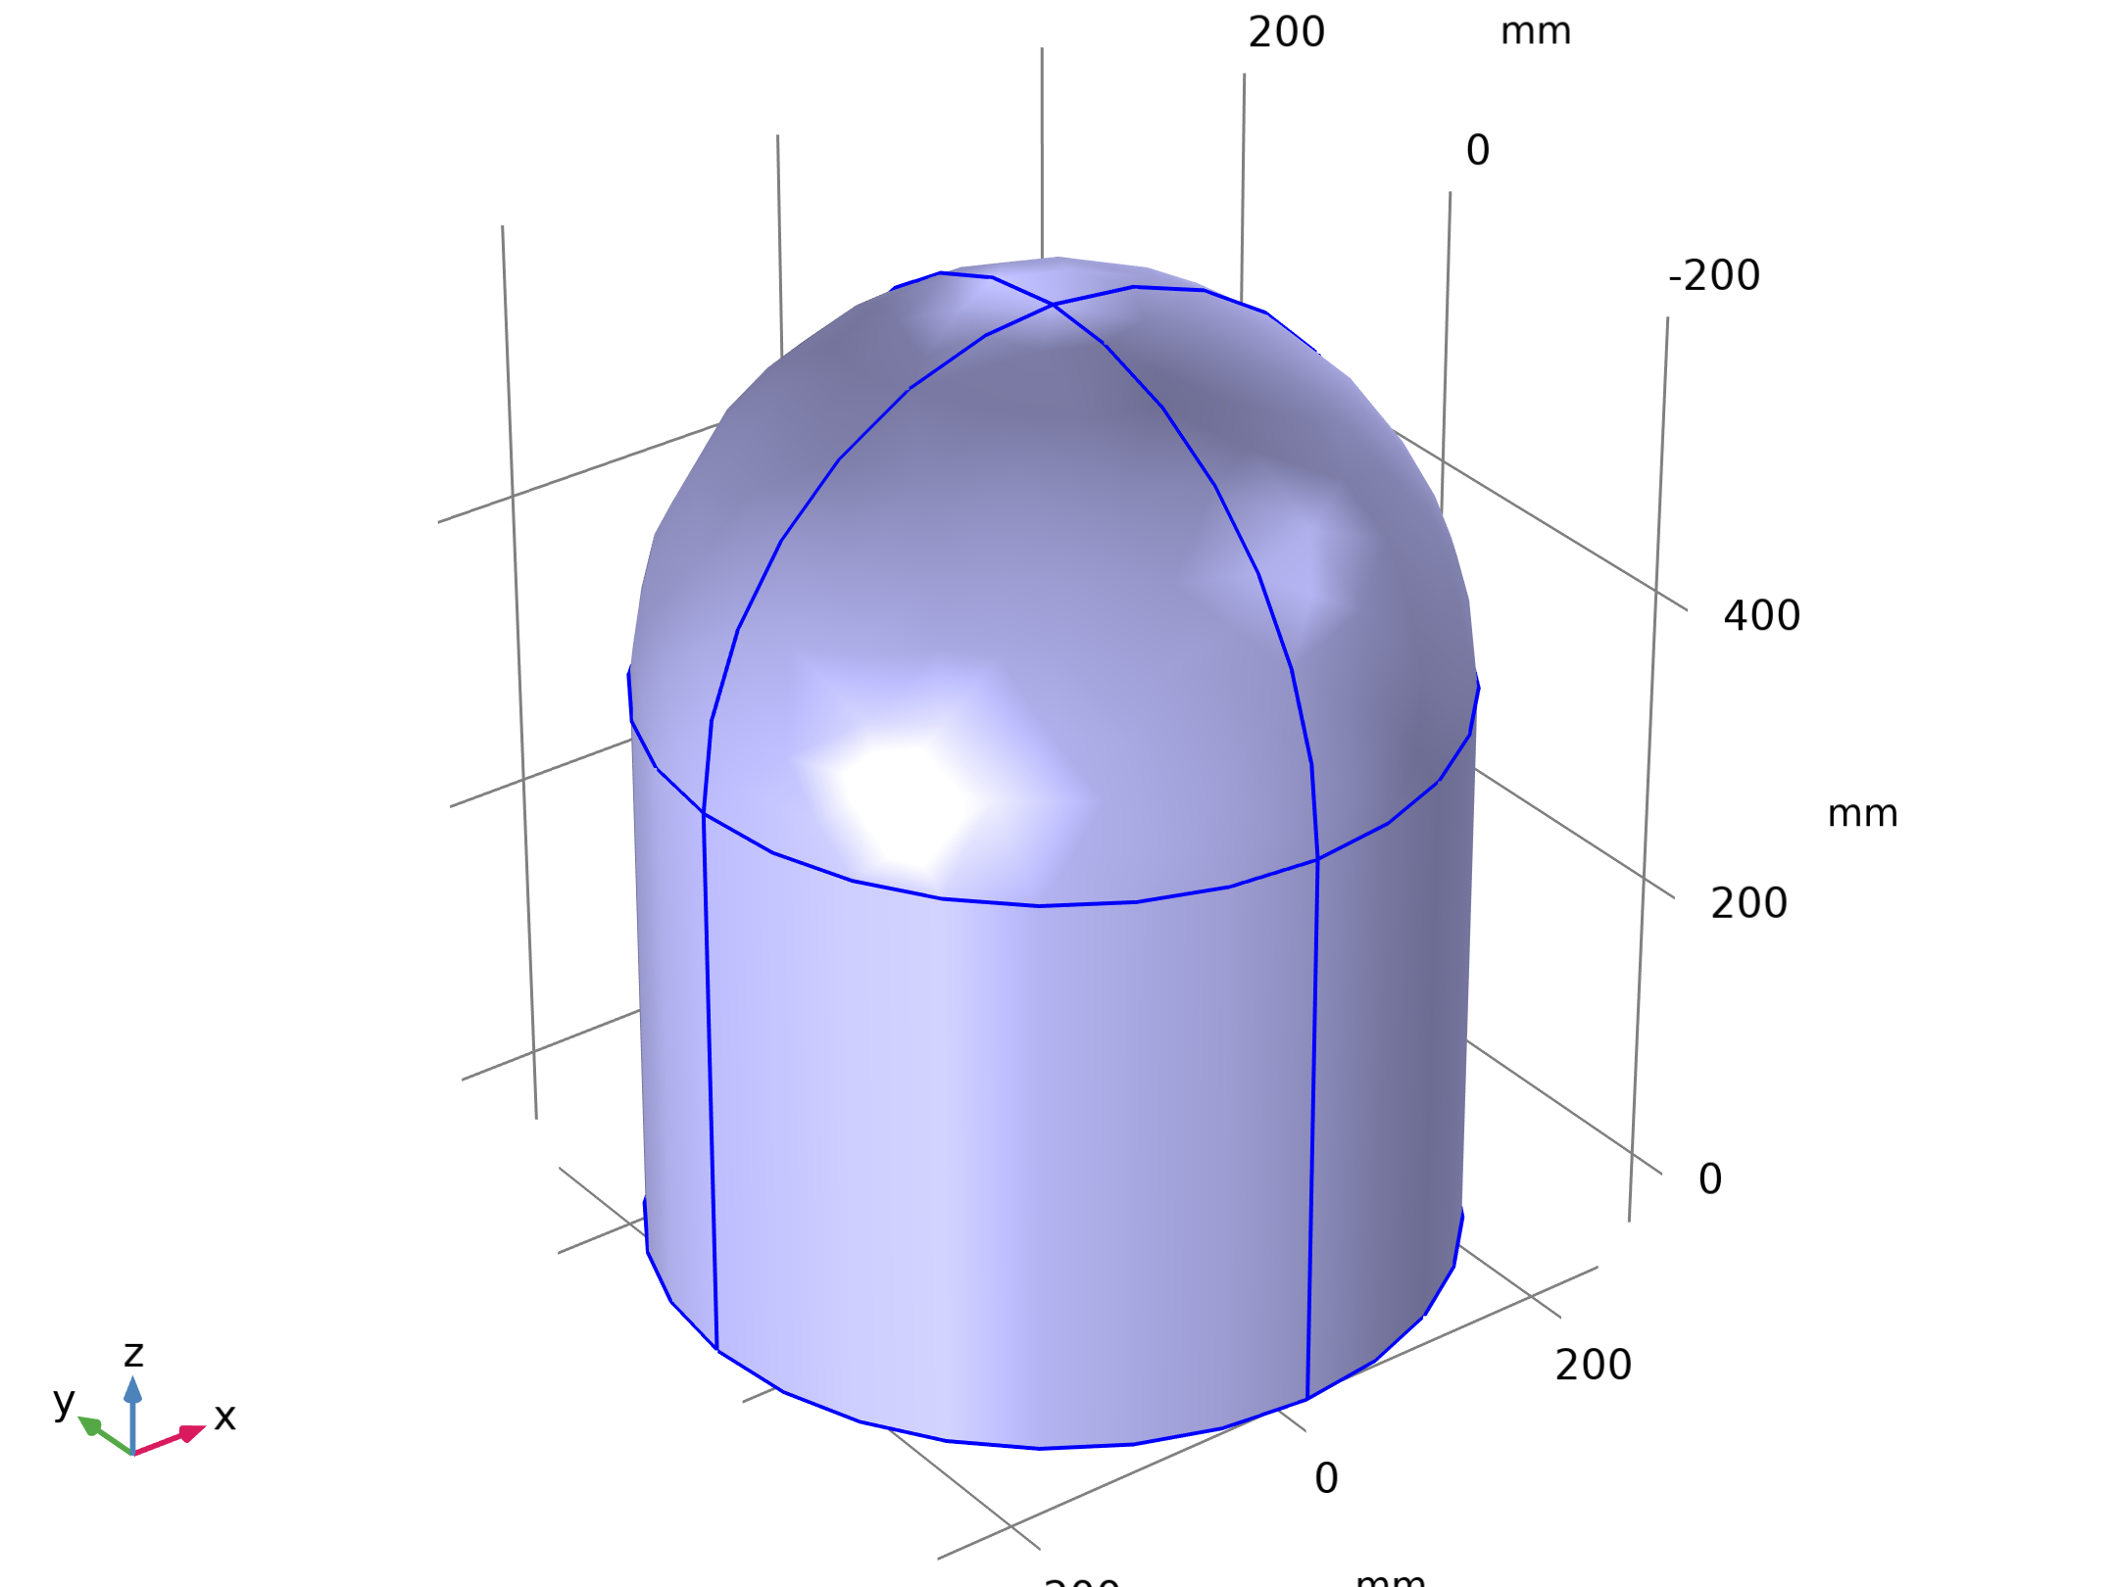
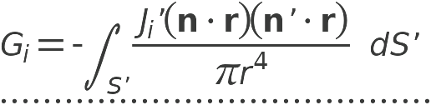
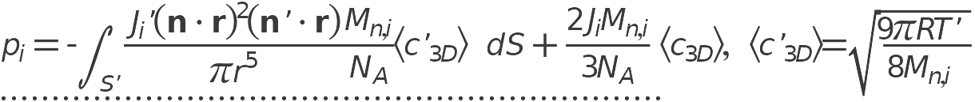
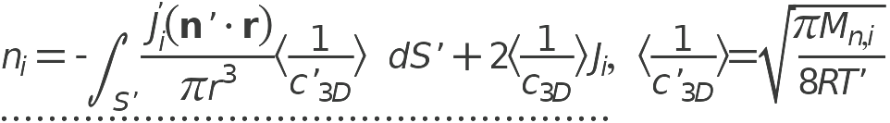
Model Definition
Free Molecular Flow

Slide 5
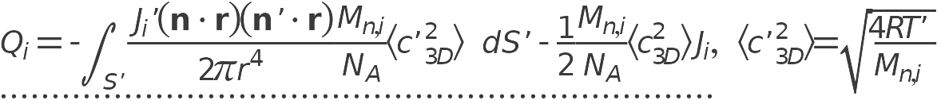
Model Definition
Free Molecular Flow

Slide 6
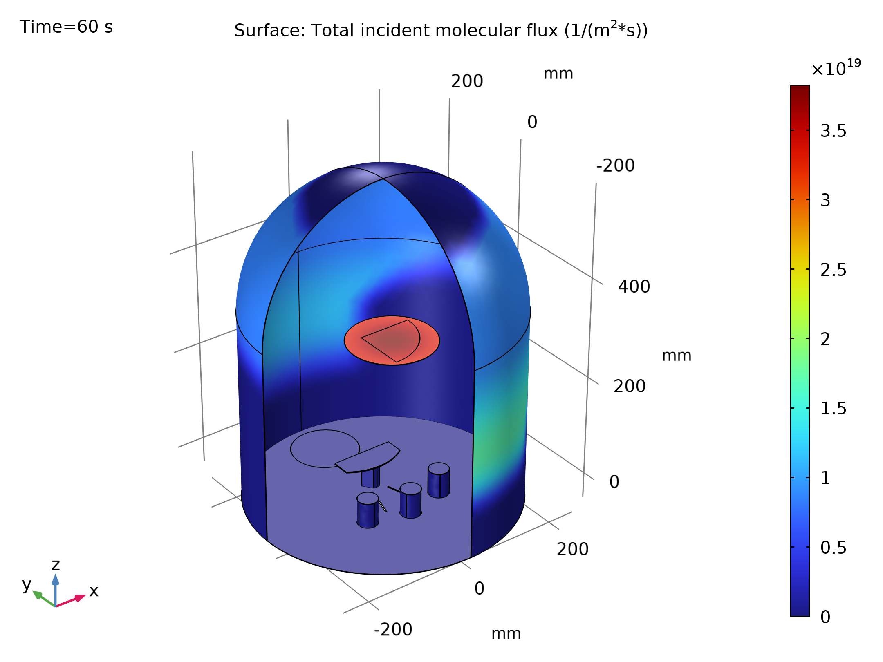
Results
The figure shows the flux of gold molecules on the surfaces of the model
This constant flux determines the thickness of gold deposited
Only the flux is required to compute the deposition rate, but in this instance, since most of the computational time is used to compute the view factors, solving the time-dependent problem adds little additional time to the solution process
Molecular flux on the surfaces of the system, during deposition

Slide 7
Results
Using a time-dependent model also allows for more advanced extensions of the model, for example, reevaporation of gold from hot surfaces close to the evaporative source could be included
Molecular flux on the surfaces of the system, during deposition

Slide 8
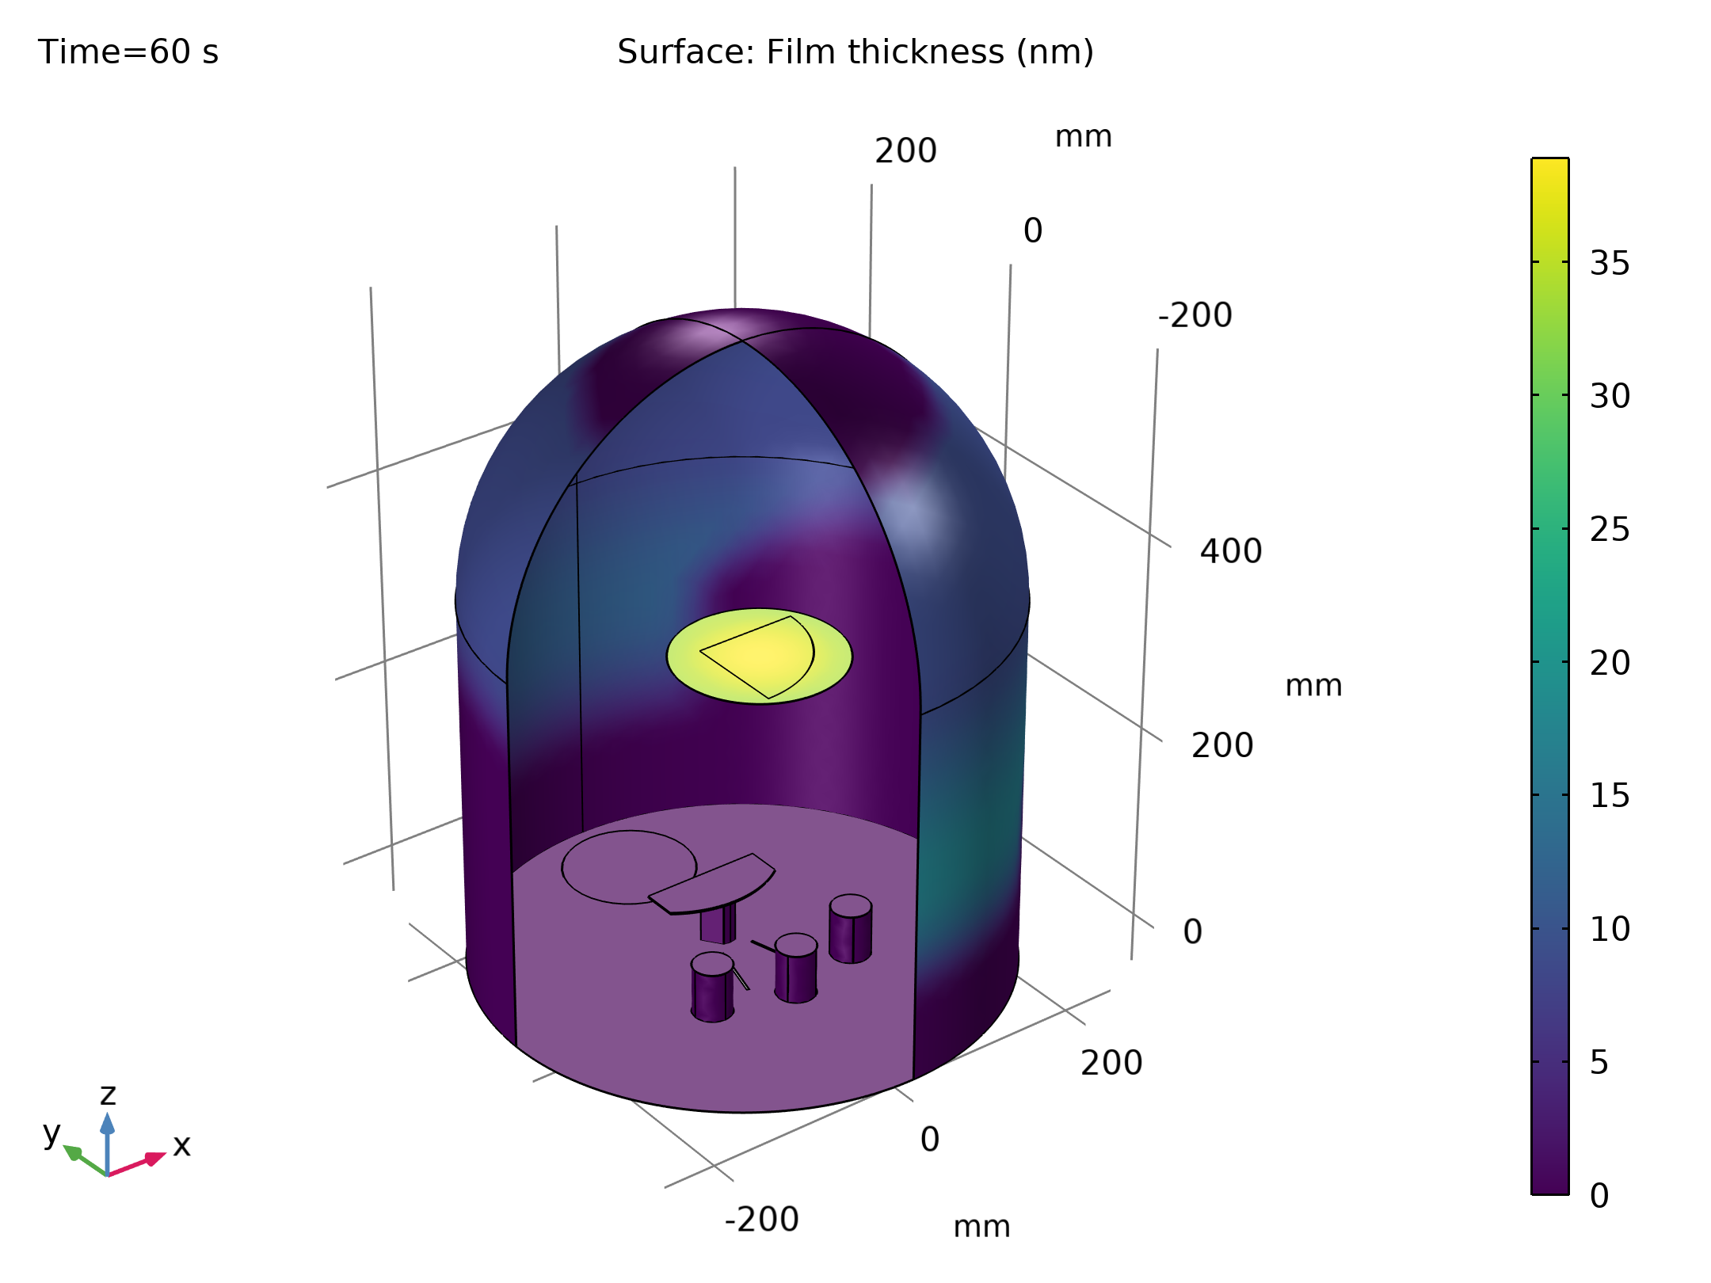
Results
The constant flux determines the thickness of gold deposited shown in the figure
Film thickness on the surfaces of the system, after 60 s of deposition

Slide 9
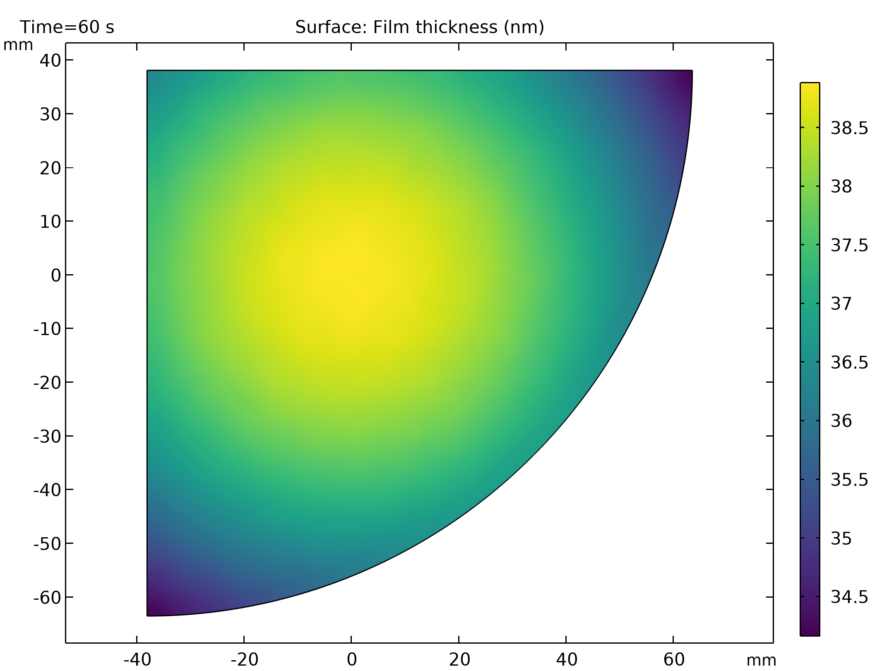
Results
The figure shows the film thickness on the sample after 60 s of deposition
The thickness varies between 34 nm and 39 nm across the sample, with radial symmetry about the midpoint of the source
Film thickness on the sample, after 60 s of deposition

Slide 10
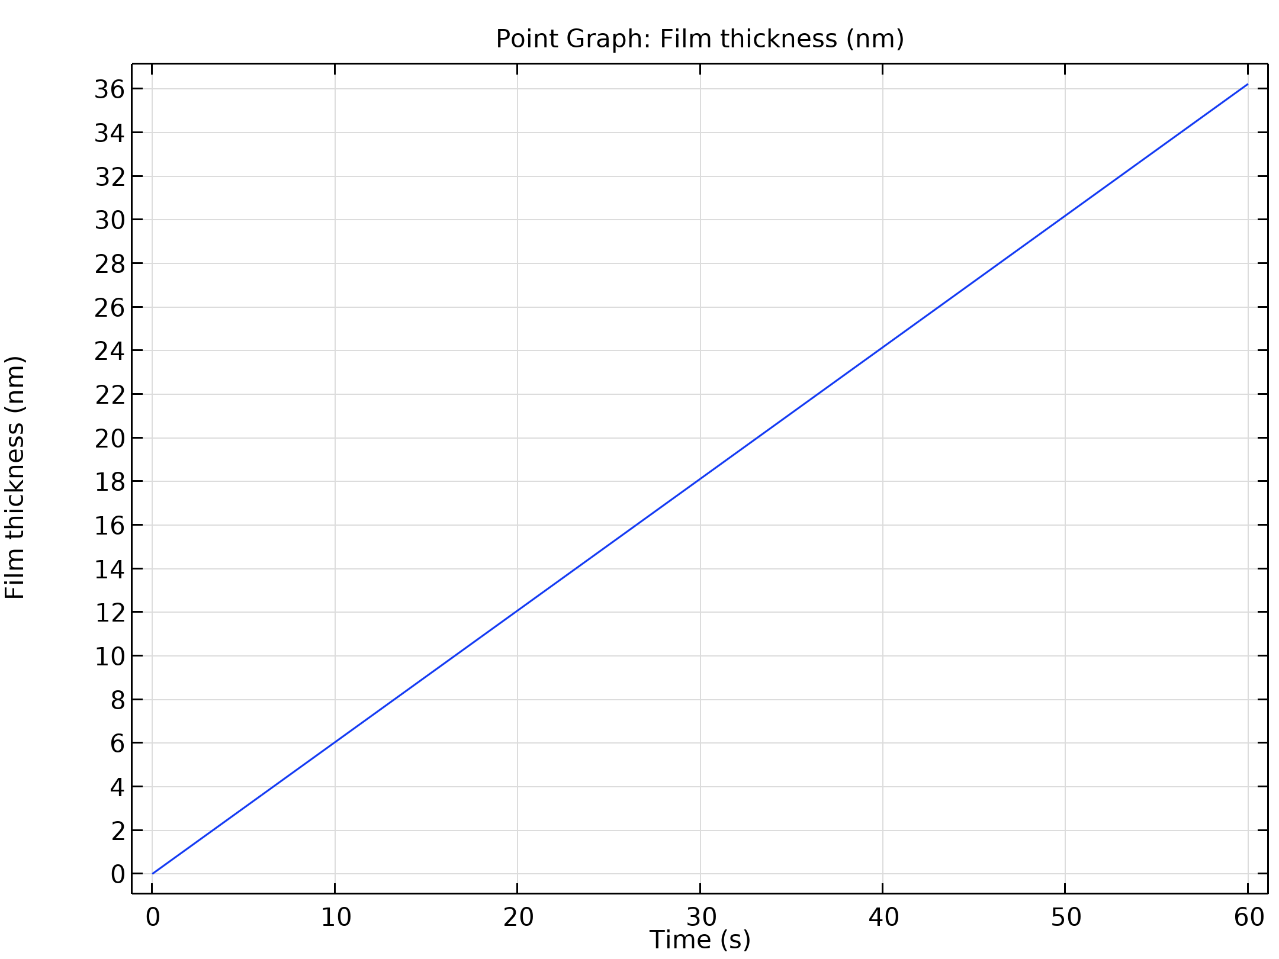
Results
As expected the film thickness at a point increases linearly with time, as shown in the figure
Film thickness versus time at a point on the corner of the sample

