Slide 1
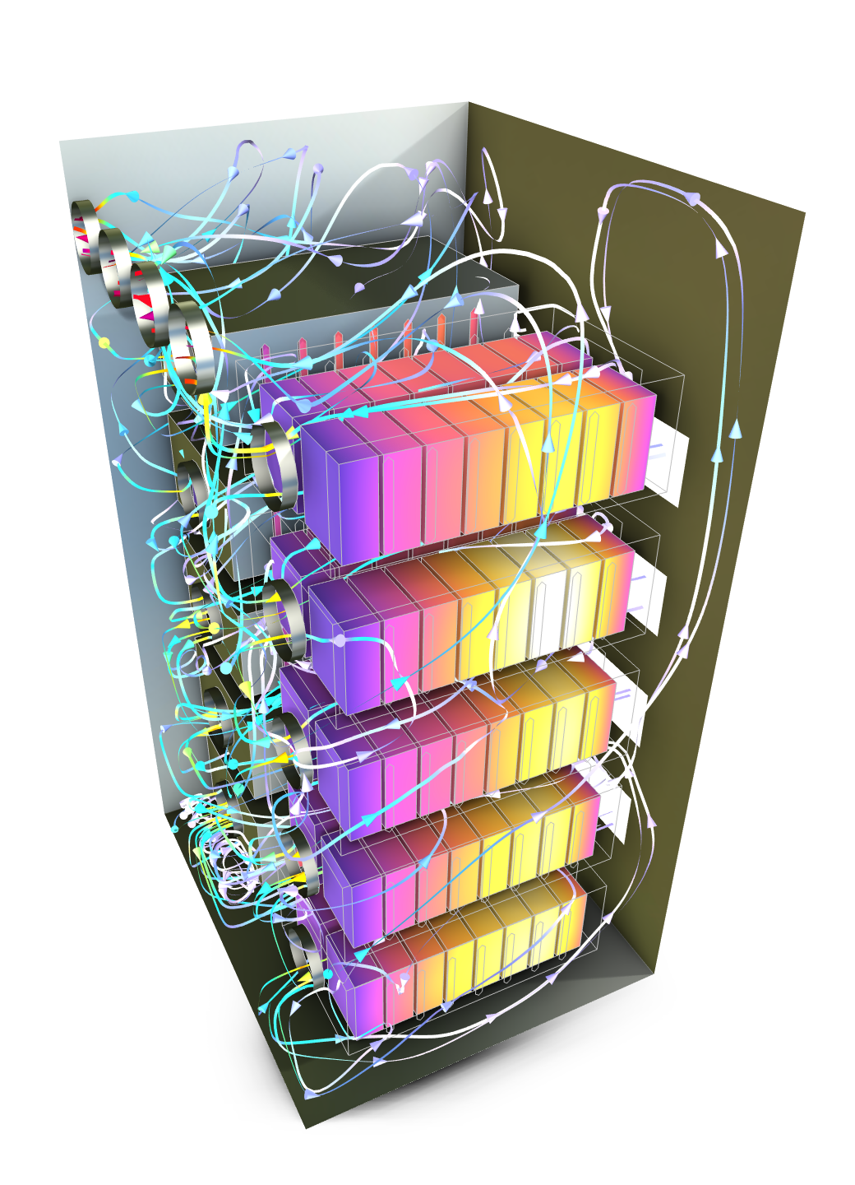
Model of an Air-Cooled
Battery Energy System
COMSOL

Slide 2
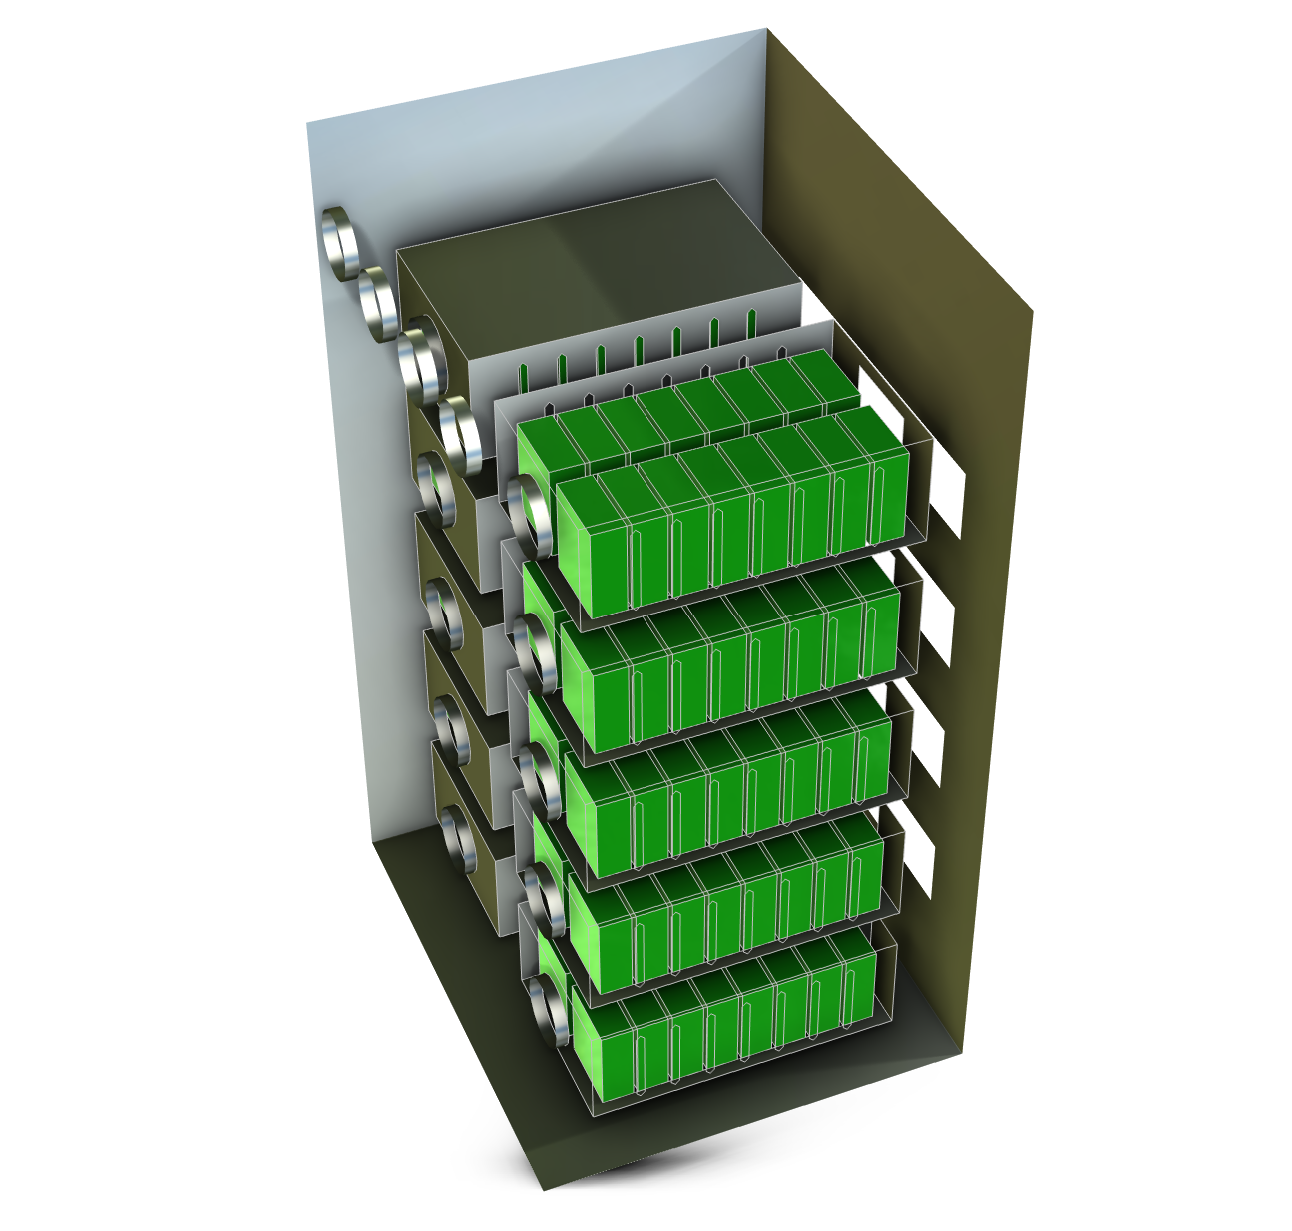
Background
A conjugate heat transfer model with turbulent flow is used to investigate the forced convection air cooling of a battery energy storage system (BESS).
The model can be used to verify and improve the design of the thermal management of the BESS.

Slide 3
Model Definition
Cabinet fan
Side openings
Battery energy storage system:
  Battery cabinet, 1mx1mx2m
  10 battery modules, 8s2p
  Fans and grilles:
    Cabinet: 4 inlet grilles, 4 outlet fans
    Module: 1 fan, 1 perforated plate, side openings for air
Battery heat source:
  Volume heat source in each cell
Module fan
Cabinet grille
Module screen
Cabinet
Battery module
Battery cells

Slide 4
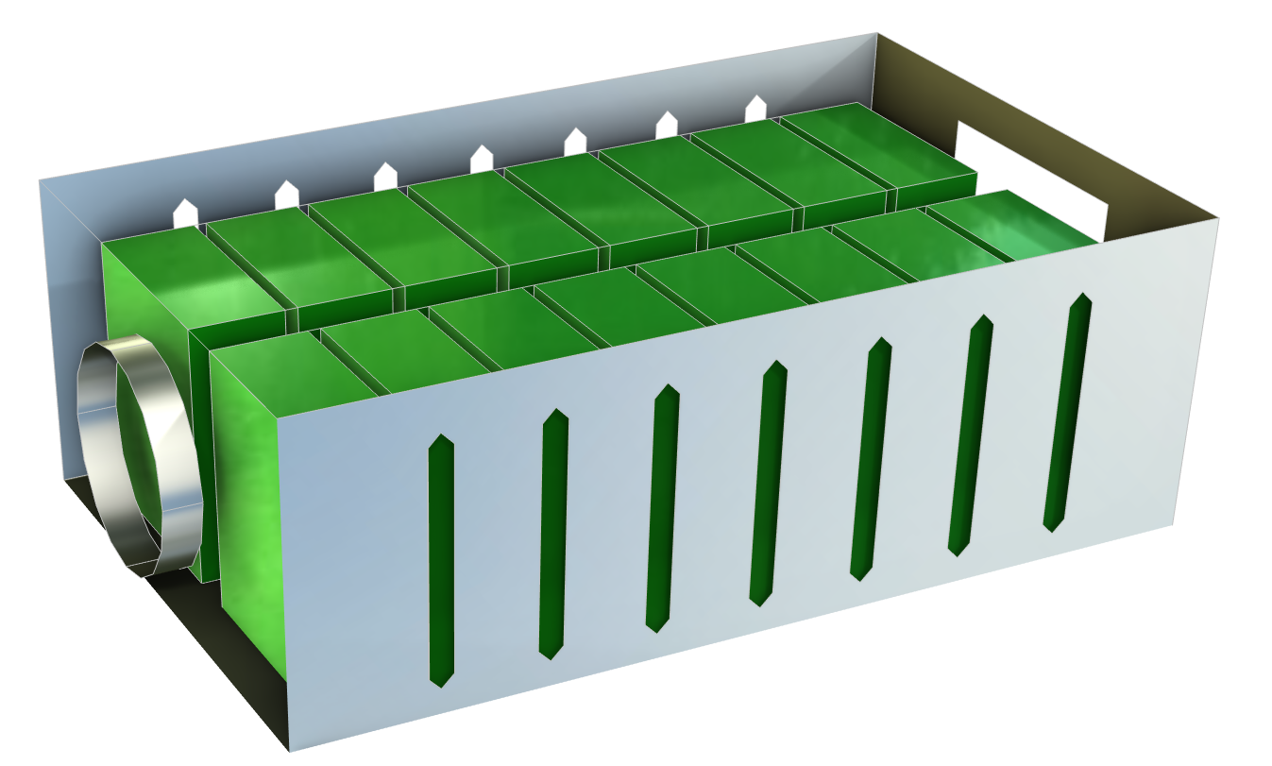
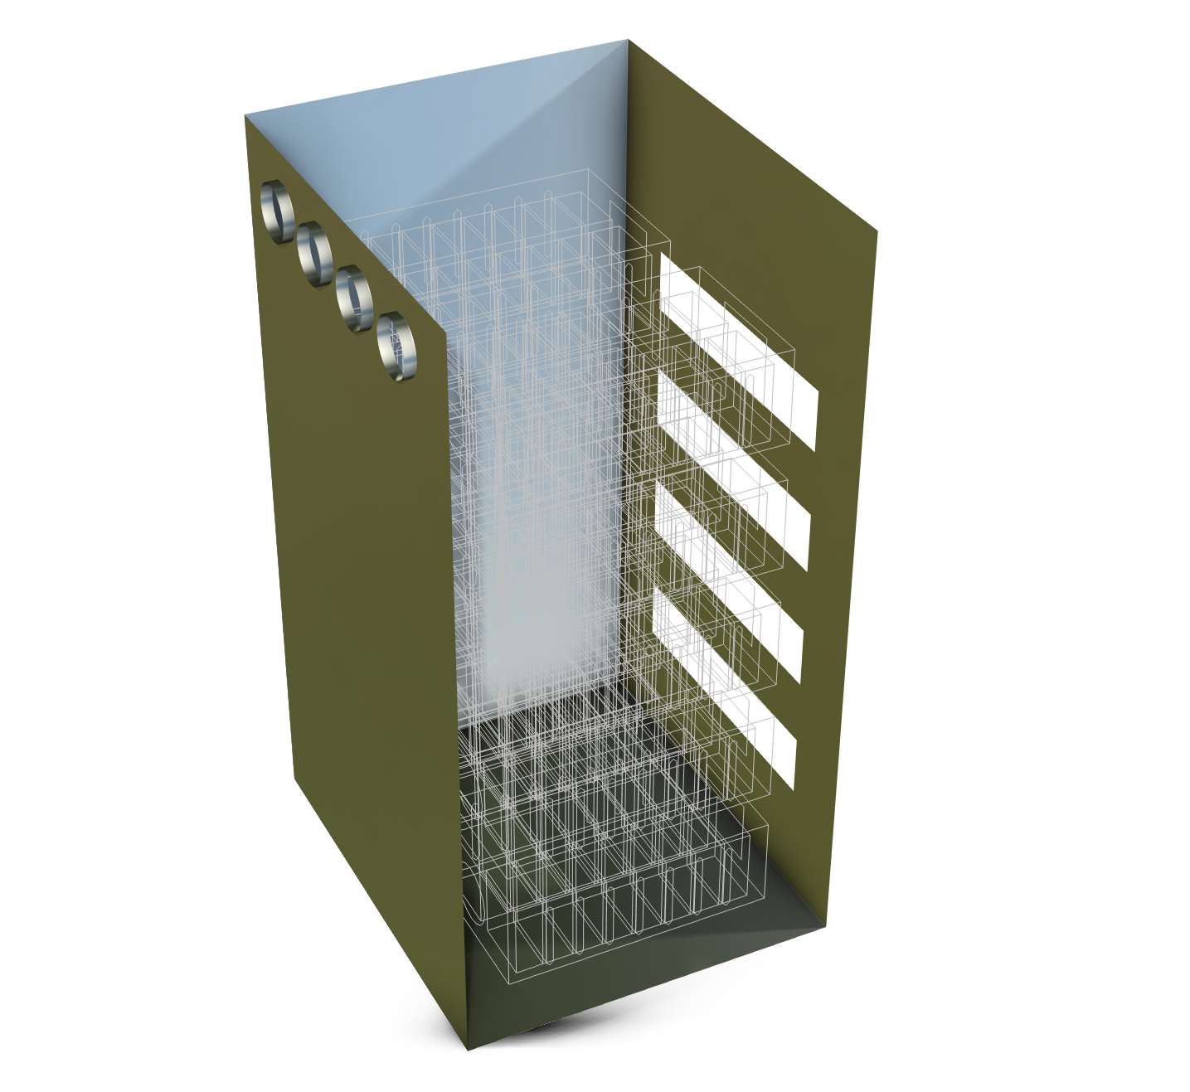
Model Definition: Fans and Grilles
Inlets:
Module screens
Outlets:
Cabinet fans
Inlets:
Cabinet grilles
Outlets:
Module fans
Inlets:
Side openings
Each module has an outlet fan on the front side, a perforated inlet screen on the rear side, and side wall openings.
Four outlet fans are placed at the front side of the cabinet, and grilles are evenly arranged on the rear side of the cabinet.

Slide 5
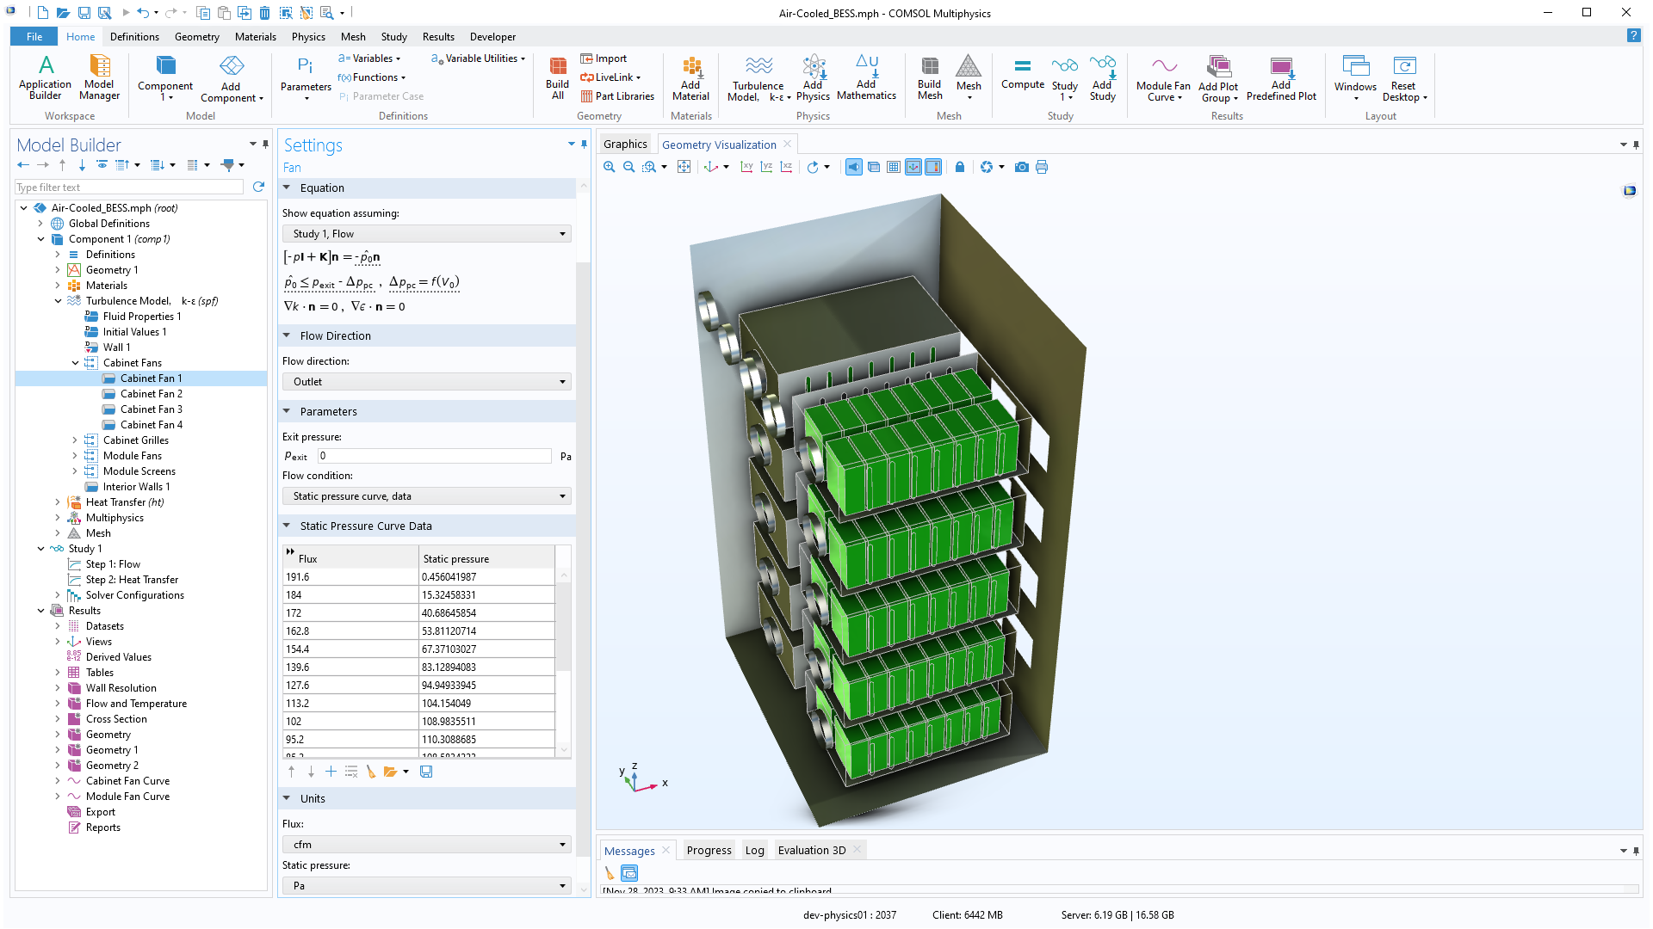
Turbulent Flow
Turbulence Model, k-ε interface
Fan boundary condition for the cabinet outlets
Interior fan boundary condition for the module fan outlets
Grille inlets for the cabinet grilles
Interior screens at the module inlet

Slide 6
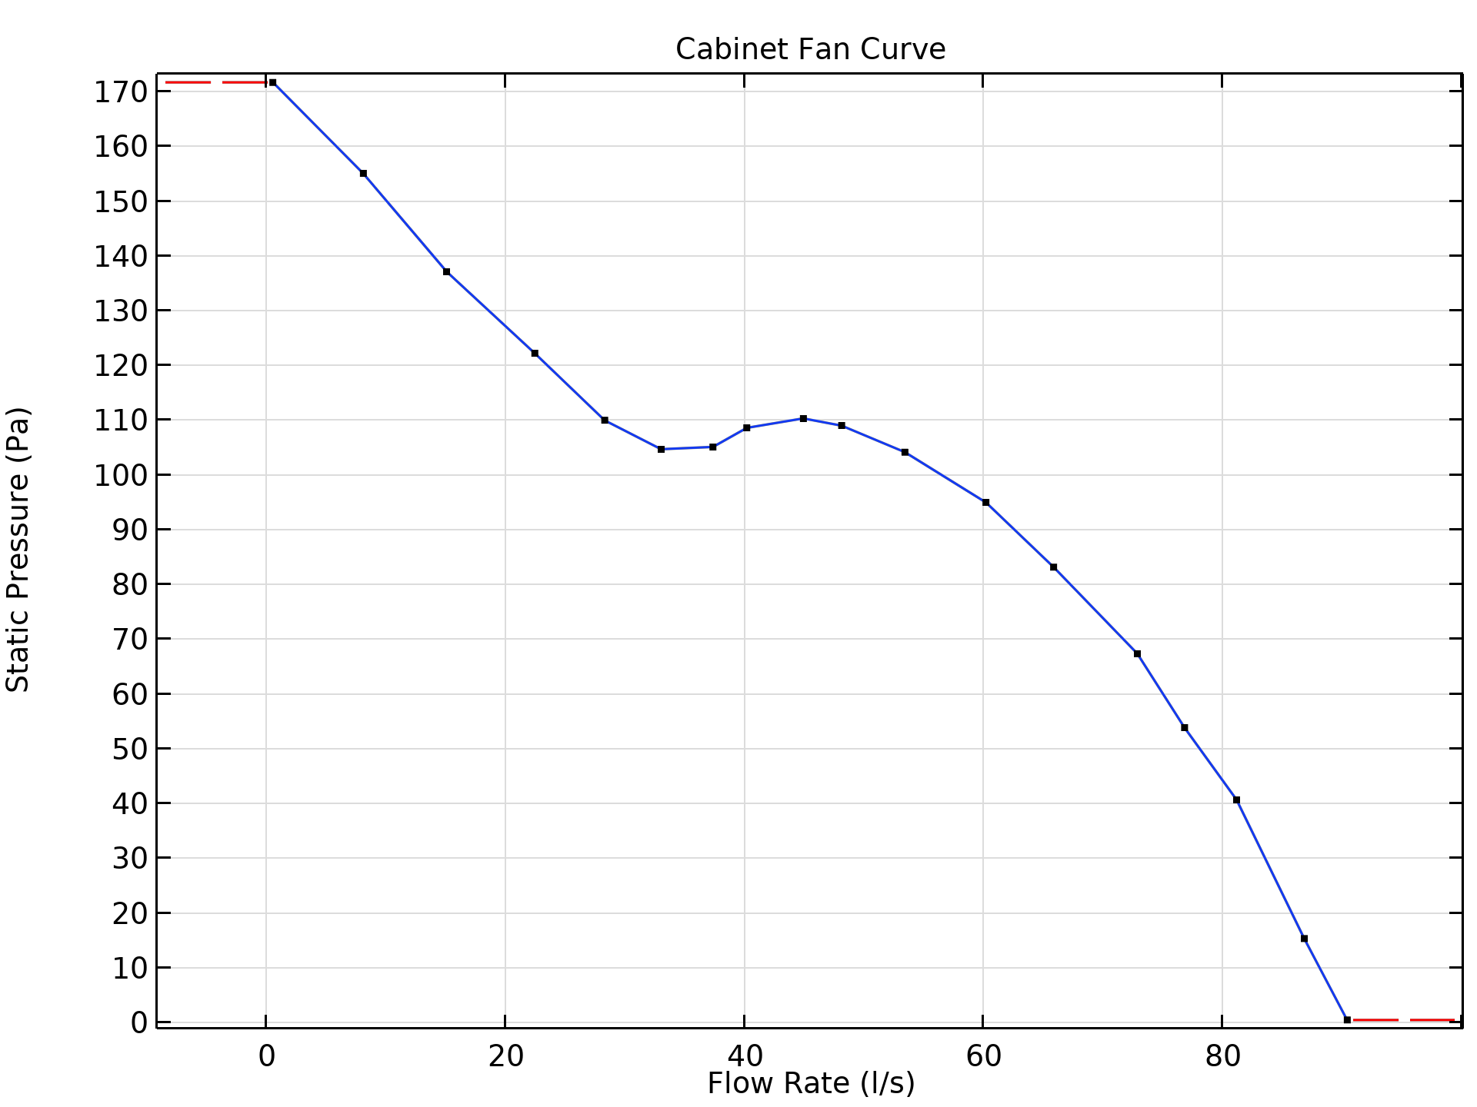
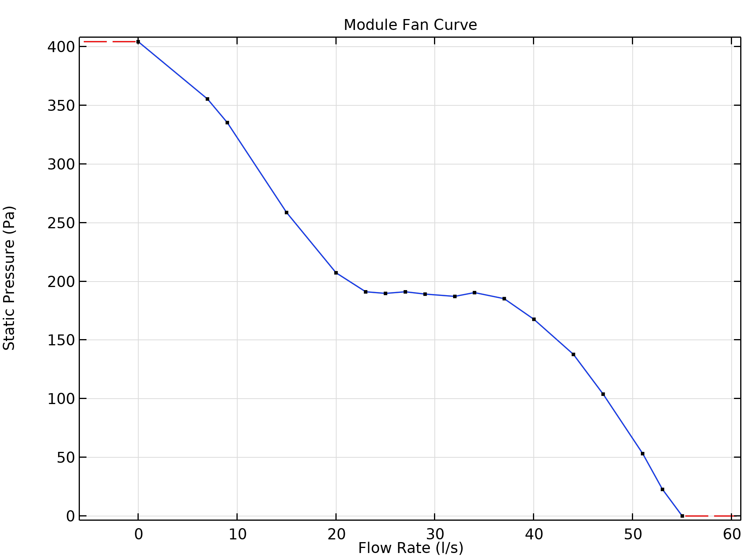
Fan Curves at External and Internal Boundaries
Cabinet Fan Curve
Module Fan Curve

Slide 7

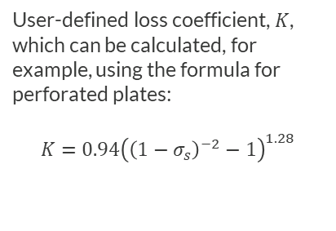
Turbulent Flow
Grille
User-defined loss coefficient, $K$, which can be calculated, for example, using the formula for perforated plates:
$$K=0.94{\left({\left(1−σ_{s}\right)}^{−2}−1\right)}^{1.28}$$

Slide 8

Turbulent Flow
Internal Screen
Screen condition allows for different screen types with predefined loss coefficient expressions, such as perforated plate, wire gauze, and square mesh

Slide 9

Heat Transfer in Fluids and Solids
Inflow conditions for the cabinet grilles using Ambient temperature as the upstream temperature

Slide 10
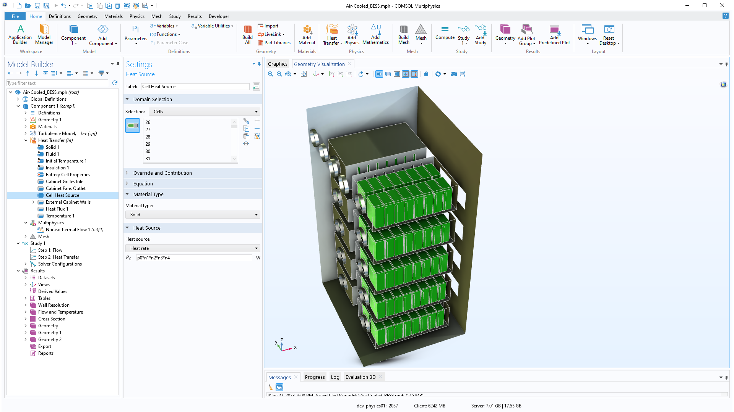
Heat Transfer in Fluids and Solids
The losses in the battery cells and current collectors are introduced as heat sources in the solid cell domains

Slide 11

Nonisothermal Flow Coupling
The Nonisothermal Flow feature automatically couples the fluid flow and the heat transfer interfaces in the fluid domains

Slide 12

Study
A first study step solves for the flow field
A second study solves the heat transfer equations

Slide 13
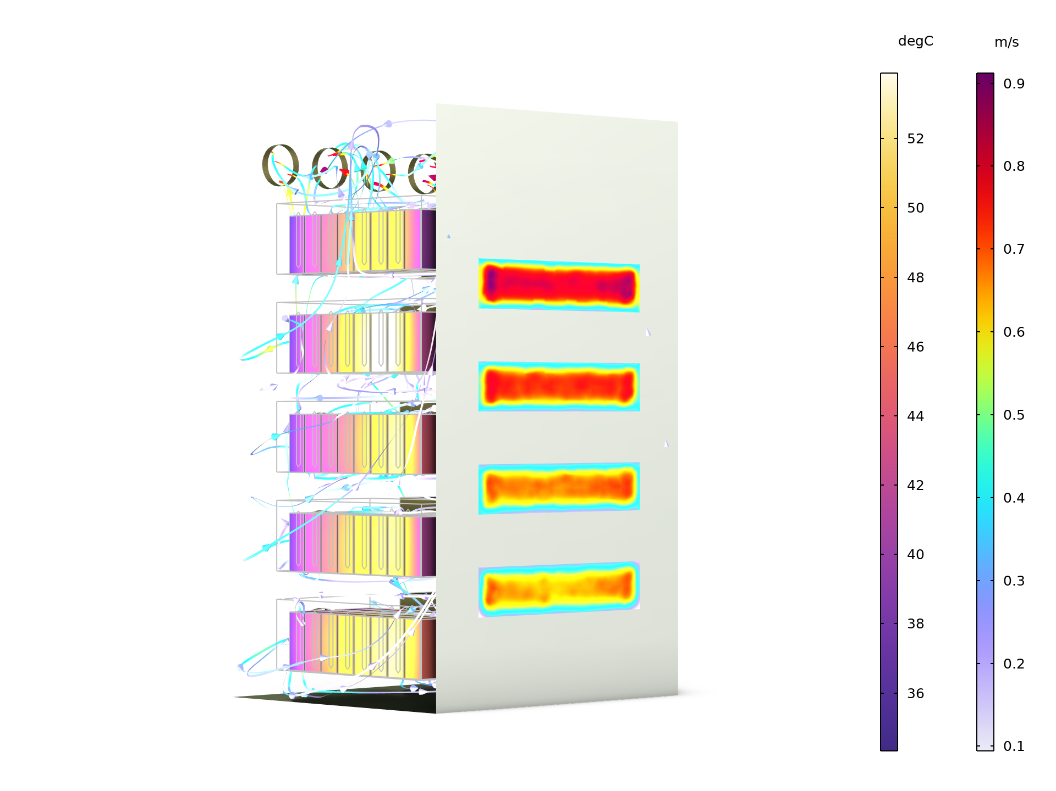
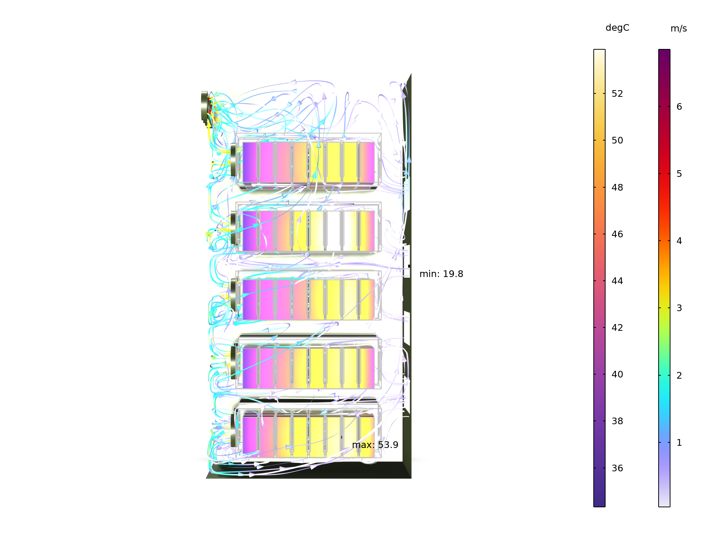
Temperature and Flow
The inlet flow to the cabinet is not uniformly distributed, see figure. We can see that the top cabinet grille receives more air and the flow rate decreases further down. The top inlet is closest to the outlet fans and the flow resistance is smallest for the flow over this inlet and through the cabinet.
The uneven flow distribution also results in the battery modules at the bottom receiving the least cooling and it is here we find the highest temperature, see bottom figure.
Velocity magnitude in the cabinet
grilles and temperature in the cells
Velocity streamlines and
temperature in the cells

Slide 14
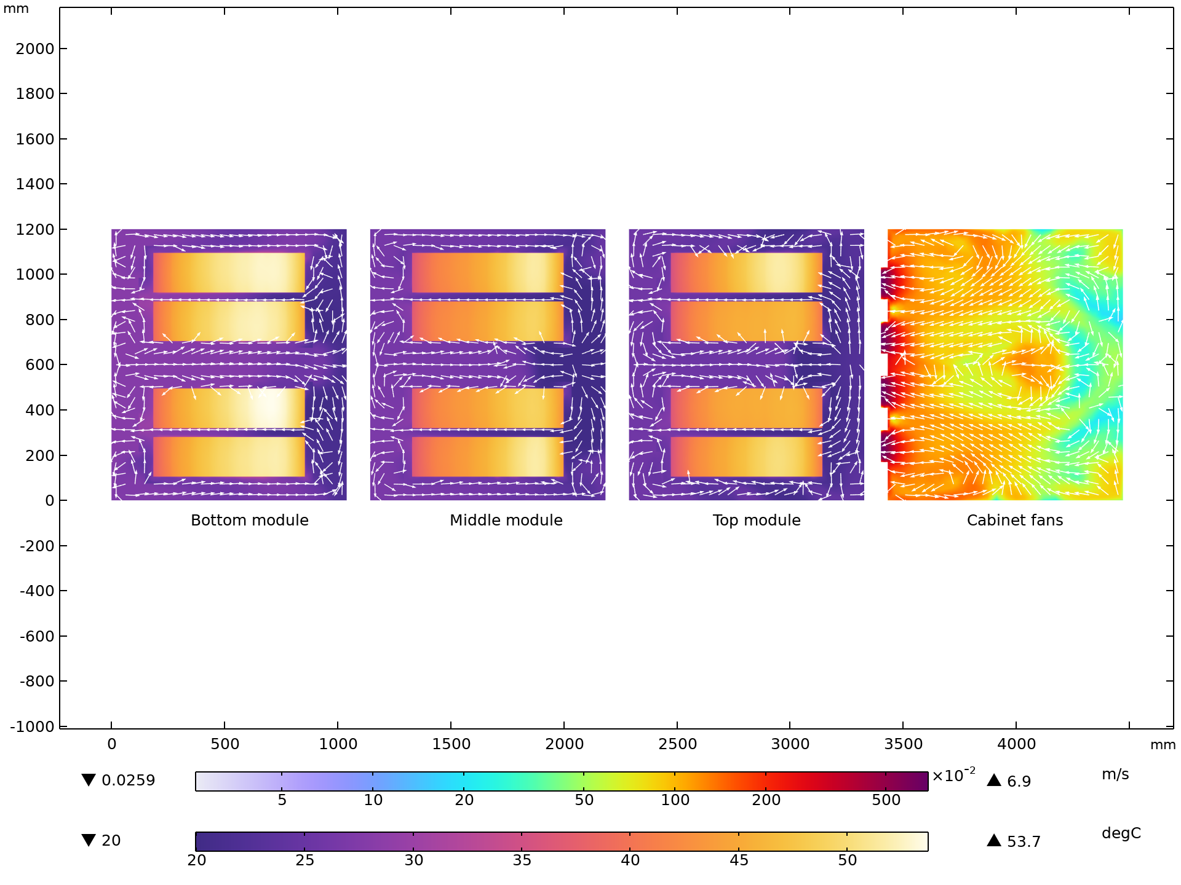
Temperature and Flow
The impact of the flow distribution is also seen in cross-section plot of the temperature
As already concluded, the modules at the bottom are subjected to the highest temperature
We can also see that the flow is forced from the back to the front of the modules by the internal fans, while it is recirculated from the front to the back of the cabinet outside the module walls
Note also that the hottest cells in each module seem to be placed closer to the air inlet, which is somewhat unexpected

Slide 15
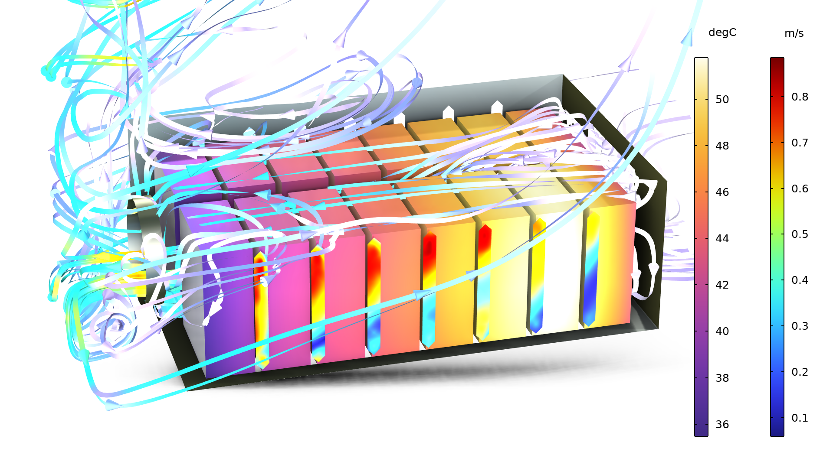
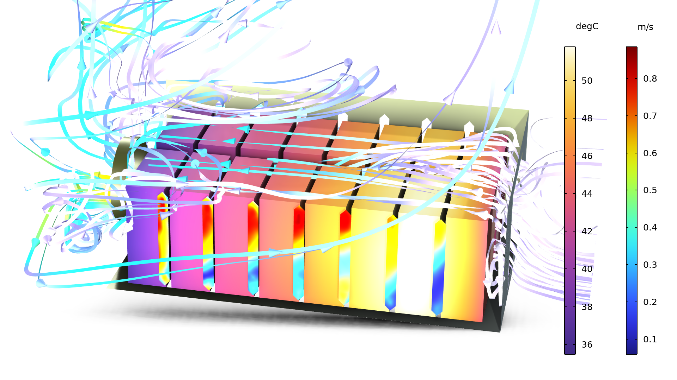
Temperature and Flow
Here we can clearly see that the second cell from the back has the highest temperature
The flow at the inlet tends to go upwards to the space between the top of the box and the cells
After 2-3 cells from the back, the flow is channeled downwards to the space between the cells, giving a better cooling
The flow through the side opening is also larger closer to the fan, resulting in a better cooling of the cells closer to the outlet
The cells facing the middle of the cabinet, i.e. furthest away from the viewing plane, also tend to get a slightly better cooling, due to funneling in the middle of the cabinet
Side openings
Side openings

Slide 16
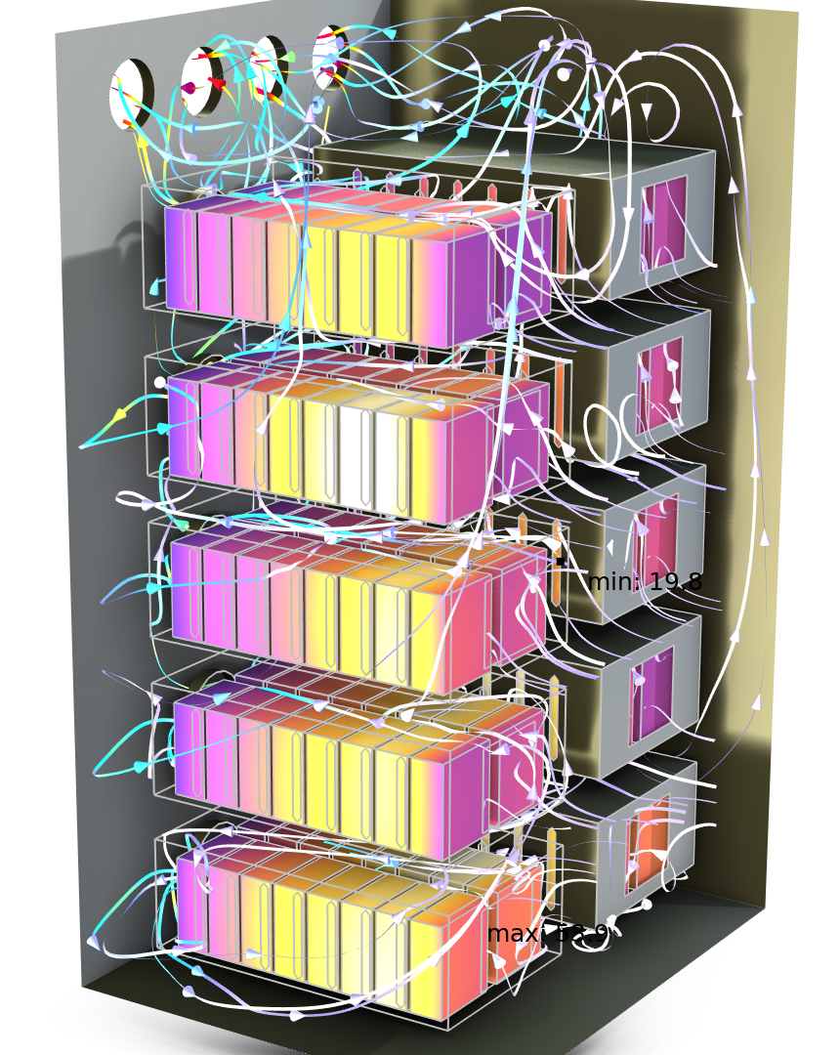
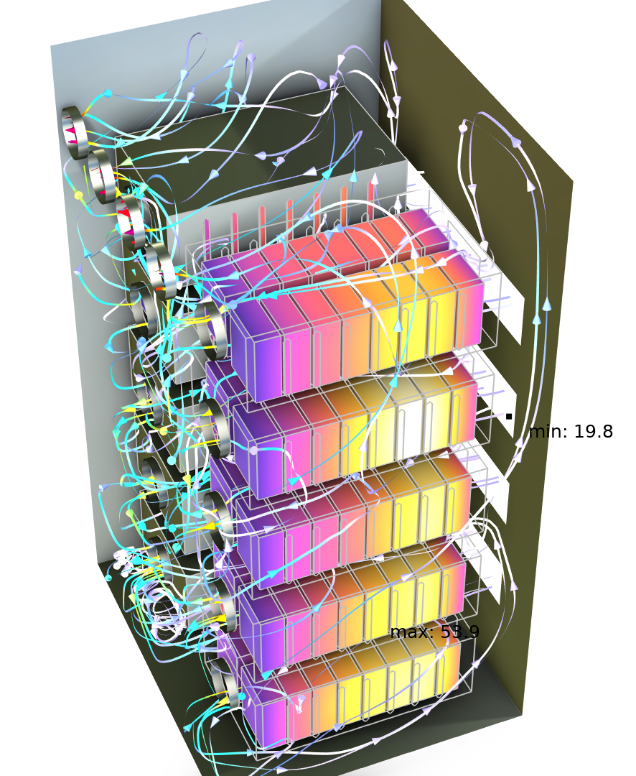
CONCLUDING REMARKS
Air-Cooled BESS
It is straightforward to define and solve the conjugate heat transfer problem for the BESS including turbulent flow, fans, grilles, and screens. Possible expansions of the model would be to include the battery electrochemistry and the buoyancy due to temperature variations.

