Slide 1
Reduction of Iron Ore Pellets in a Packed Bed Reactor

Slide 2
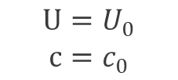
Shrinking Core Model
$$U=U_{0}$$
$$c=c_{0}$$
Packed bed with solid particles
Consumption of reactant particles:
  Solid reactant or solid mixture
  Heterogeneous reactions consume the reactant
  Porous layer forms
Bed inlet
x
Unreacted core
Porous layer
Diffusion layer
Core and layers of a shrinking core particle.

Slide 3
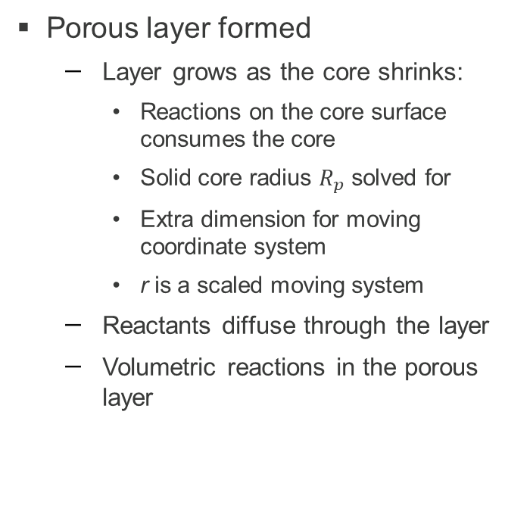
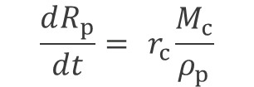



Shrinking Core Model
Core surface position:
Reacted layer coordinate:
$$\frac{dR_{p}}{dt}={ r}_{c}\frac{M_{c}}{ρ_{p}}$$
$$r=R_{p}+s(R_{o}−R_{p})$$
Porous layer formed
  Layer grows as the core shrinks:
    Reactions on the core surface consumes the core
    Solid core radius $R_{p}$ solved for
    Extra dimension for moving coordinate system
    r is a scaled moving system
  Reactants diffuse through the layer
  Volumetric reactions in the porous layer
R_{p}
$$c$$
r
Unreacted core
Porous layer
0
$$s$$
1
Diffusion layer
R_{o}
Core and layers of a shrinking core particle.
Diffusive transport in the reacted layer (extra dimension).

Slide 4

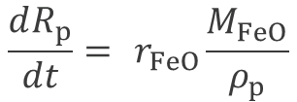
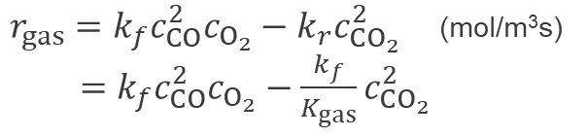
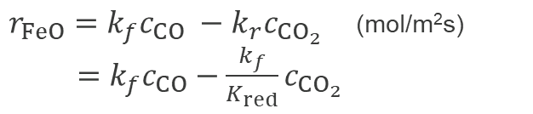

Iron Ore Pellet Reduction
Reduction reaction
Surface sites s(ads) indicates a surface reaction. Not used here in the reaction rate.
FeO(s) + CO + s(ads) ⇄ Fe(s) + ${CO}_{2}$
$r_{FeO}=k_{f}c_{CO} −k_{r}c_{{CO}_{2}}$ (mol/m²s) ${}_{} =k_{f}c_{CO}−\frac{k_{f}}{K_{red}}c_{{CO}_{2}}$
Ore pellet processes
  Diffusion through porous layer
    CO required for reduction
  Reduction at the FeO surface produces a flux of gas reactants
  FeO core reduced
  Volumetric gas phase reaction in the formed Fe layer
  Reactions rates defined in a Chemistry interface
$$\frac{dR_{p}}{dt}={ r}_{FeO}\frac{M_{FeO}}{ρ_{p}}$$
Unreacted FeO
Porous reacted Fe
Gas phase reaction
Diffusion layer
2 CO + $O_{2}$ ⇄ 2 ${CO}_{2}$
$r_{gas}=k_{f}c_{CO}^{2}c_{O_{2}}−k_{r}c_{{CO}_{2}}^{2}$ (mol/m³s) ${}_{}=k_{f}c_{CO}^{2}c_{O_{2}}−\frac{k_{f}}{K_{gas}}c_{{CO}_{2}}^{2}$

Slide 5
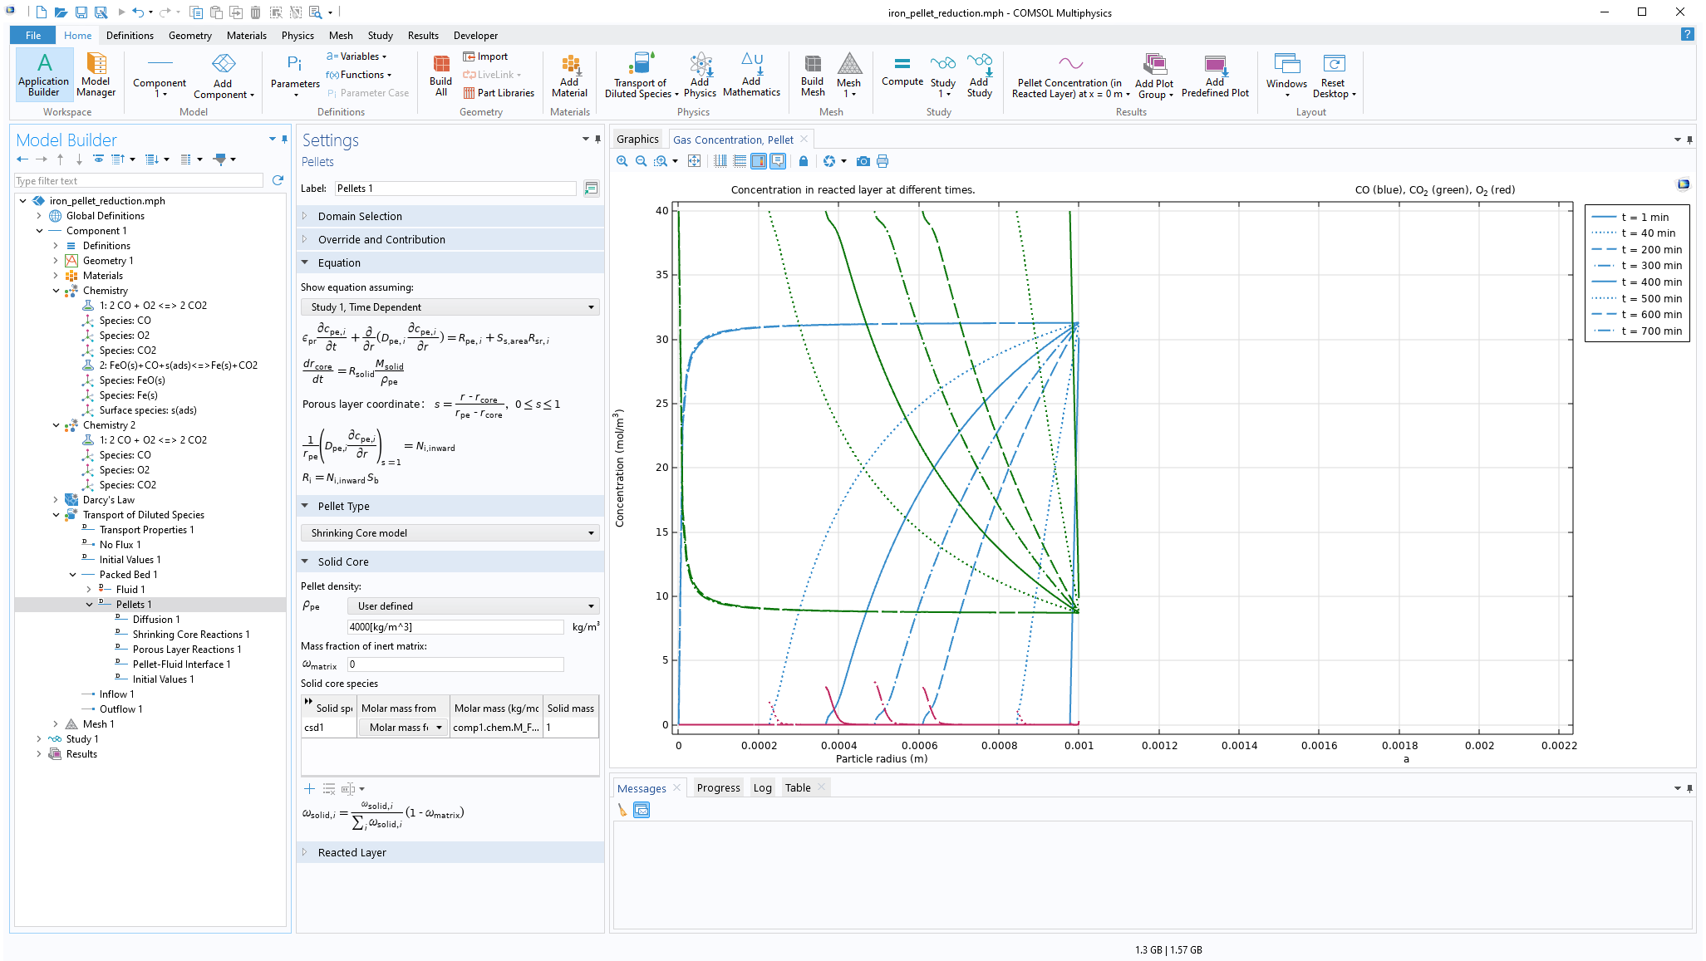
Iron Ore Pellet Reduction
Core development
1
Define reaction kinetics
Add a Packed Bed feature
Enable the Shrinking Core model
Specify core density and composition
Apply the core consuming reaction
Apply the porous layer reaction
3
2
4
5
6

Slide 6
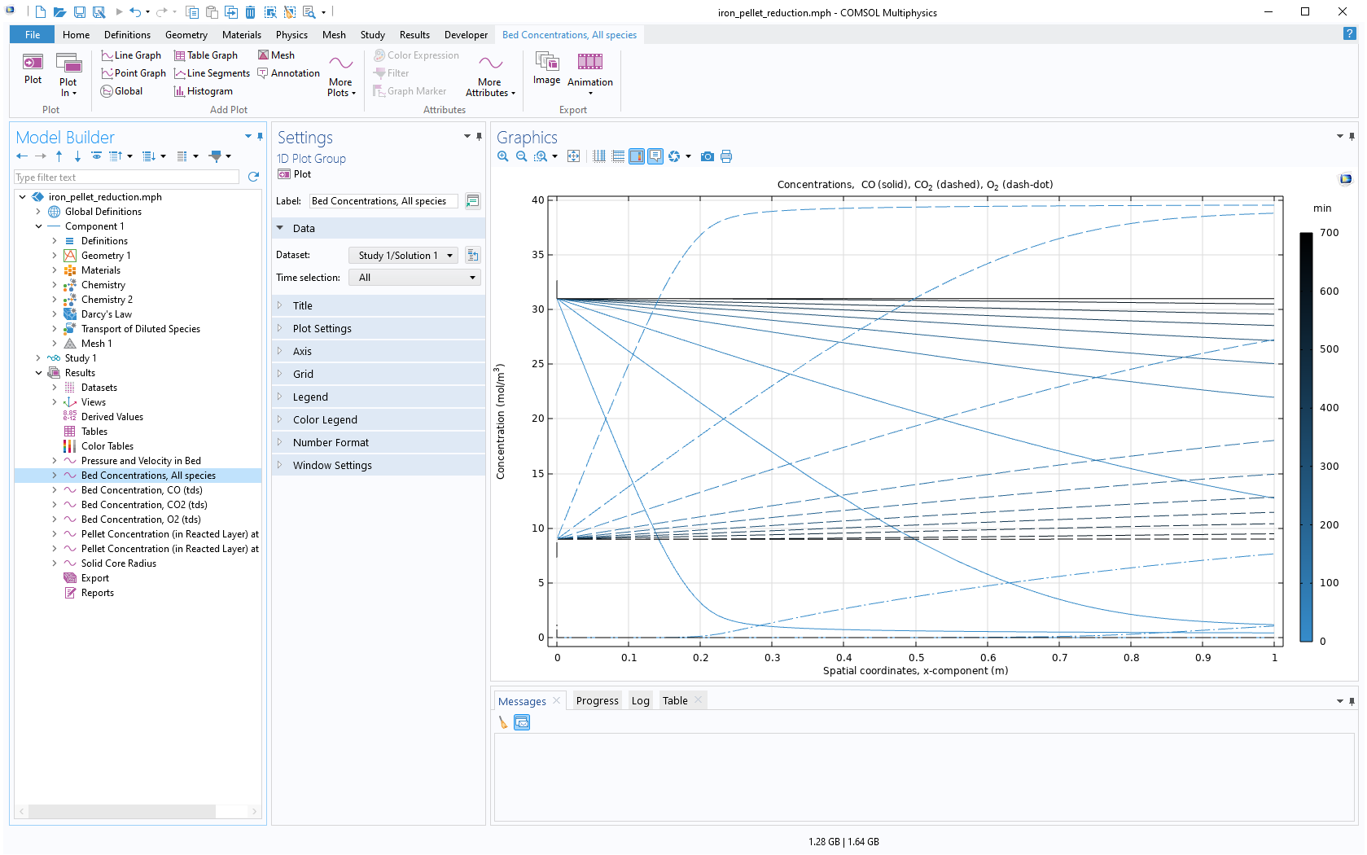
BED GAS PHASE CONCENTRATION DEVELOPMENT

Slide 7
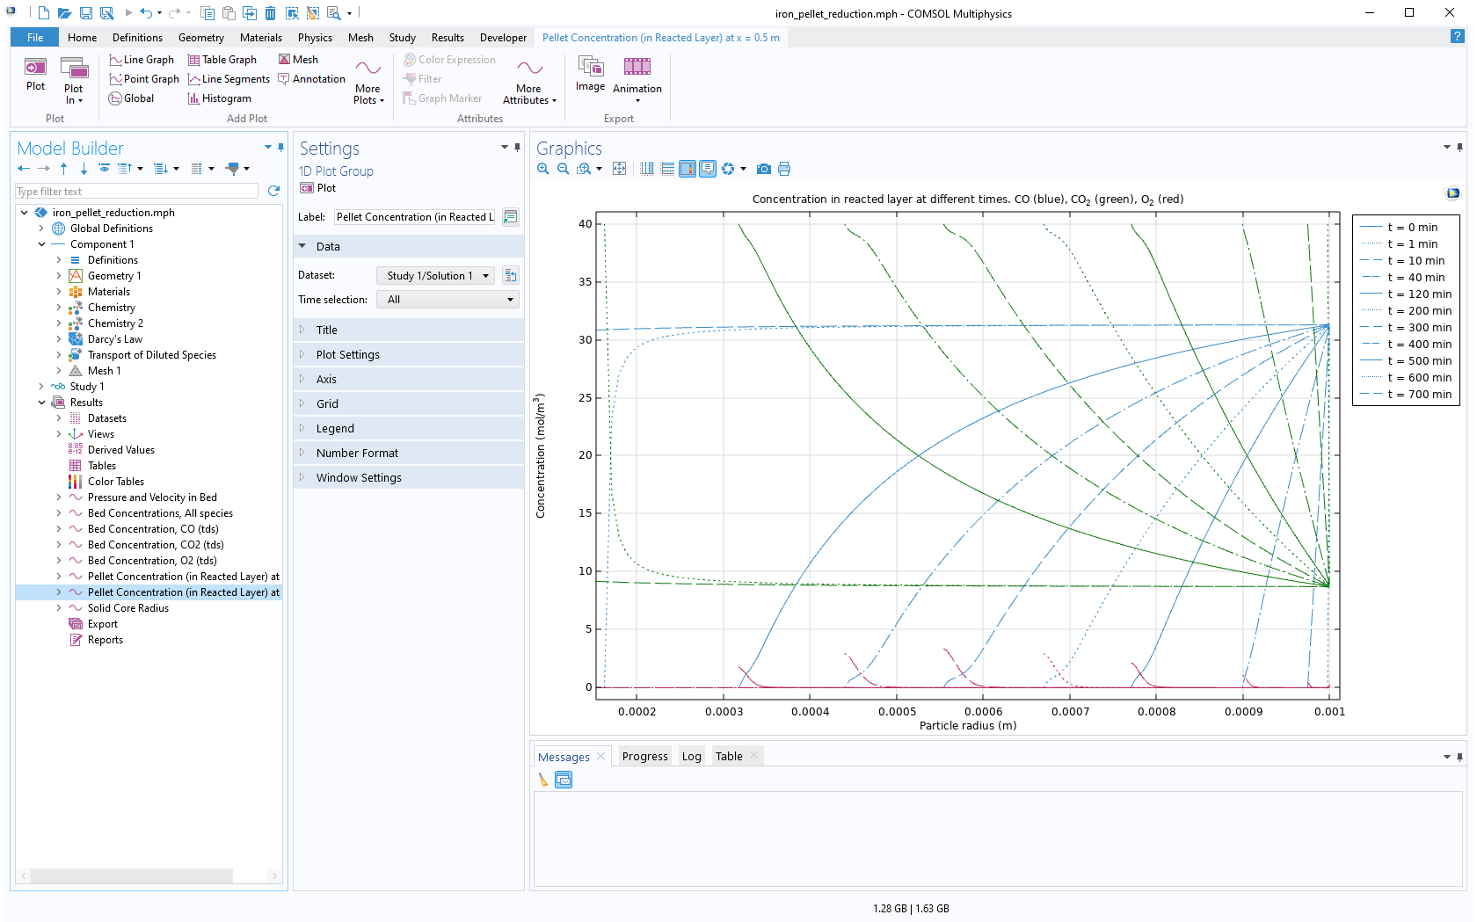
PELLET CONCENTRATIONS IN THE MIDDLE OF THE BED

Slide 8
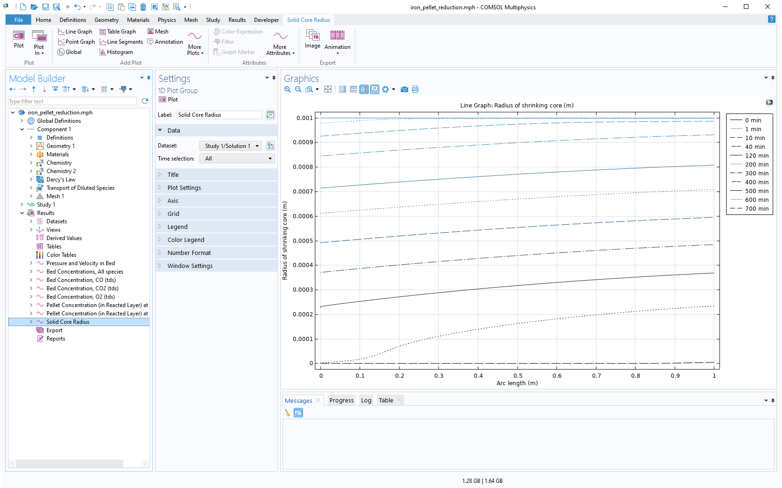
PELLET CORE RADIUS DEVELOPMENT

