Slide 1
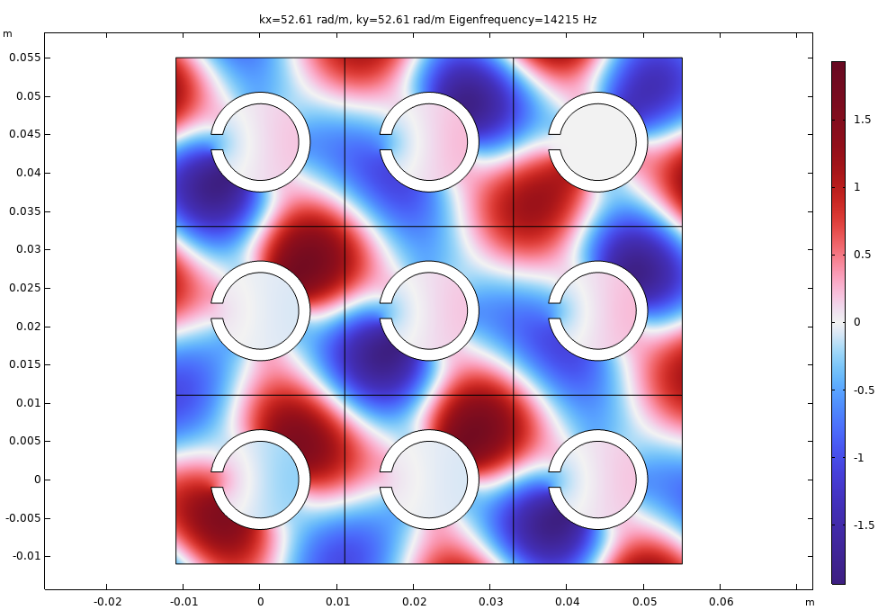
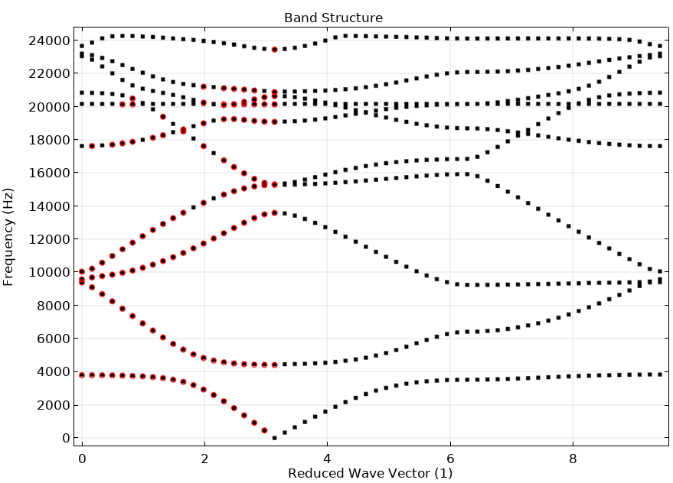
Sonic Crystal

Slide 2
Background and Motivation
Phononic and sonic crystals have generated rising scientific interest for very diverse technological applications. These crystals are made of periodic distributions of scatters embedded in a matrix. Under certain conditions, acoustic band gaps can form. These are spectral bands where propagation of waves is forbidden through the structure. These periodic structures are also often referred to as metamaterials.
This model first calculates the band structure of an infinite array of scatters. This is done by analyzing a single unit cell, applying periodic Floquet conditions (aka Bloch conditions) together with an eigenfrequency study.
Secondly, a finite array of scatters is analyzed and the transmission the loss calculated. A large transmission loss (band stop behavior) is seen to agree well with the band structure calculation for the given k-space direction analyzed.
The effects of thermoviscous boundary-layer losses are also studied here. Both the analysis of the unit cell as well as the finite array analysis include these effects. The results are compared to the classical lossless results.
The present model is based on the paper: D. P. Elford, L. Chalmers, F. V. Kusmartsev, and G. M. Swallowen, “Matryoshka locally resonant sonic crystal,” J. Acoust. Soc. Am. 130, pp. 2746 (2011).

Slide 3
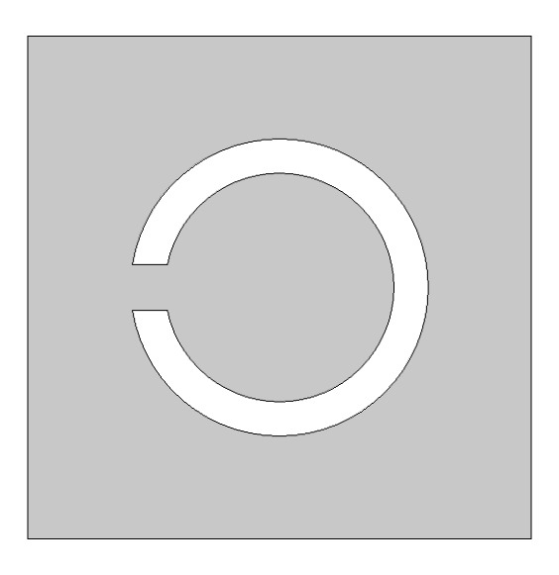
Geometry and Setup
p₄ = p₃ exp(-i k_{y} a₂)
Floquet periodic condition
a₁
a₂
p₁ = p₂ exp(-i k_{x} a₁)
R₁
p₂
R₂
Unit cell comprising a scatter
p₃

Slide 4
Analysis for Band Structure
Sweep k-vector k = (kx, ky) over the Brillouin zone
kx ∈ [0; π/a1] and ky ∈ [0; π/a2] (this sweeps the periodicity of the solution)
For each k vector value perform an eigenfrequency analysis to determine existing eigenmodes (first 10 eigenmodes are found here) for the given solution k-vector and periodicity
Plot the eigenmodes as function of the k-vector to depict the band structure of the material
Propagating modes exist at a frequency if there are eigenmodes for a given k-vector direction. Meaning that, if there are no eigenmodes for a given frequency then there is a bandgap and there will be no transmission in an infinite array. In finite array this will correspond to a high transmission.

Slide 5
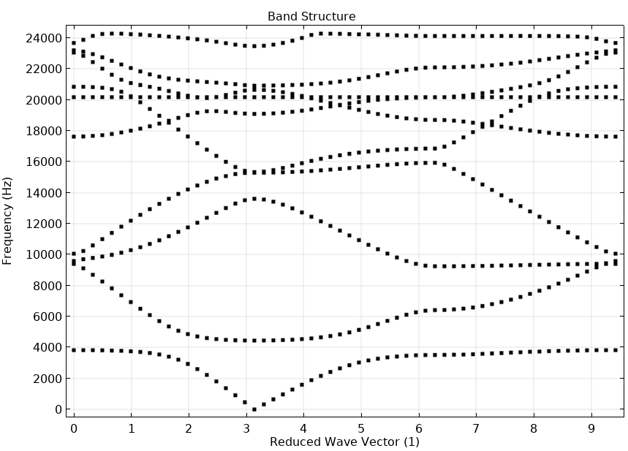
Results: Band Structure
Reduced k-vector directions
[1,1]
[0,0]
[1,0]
[1,1]

Slide 6
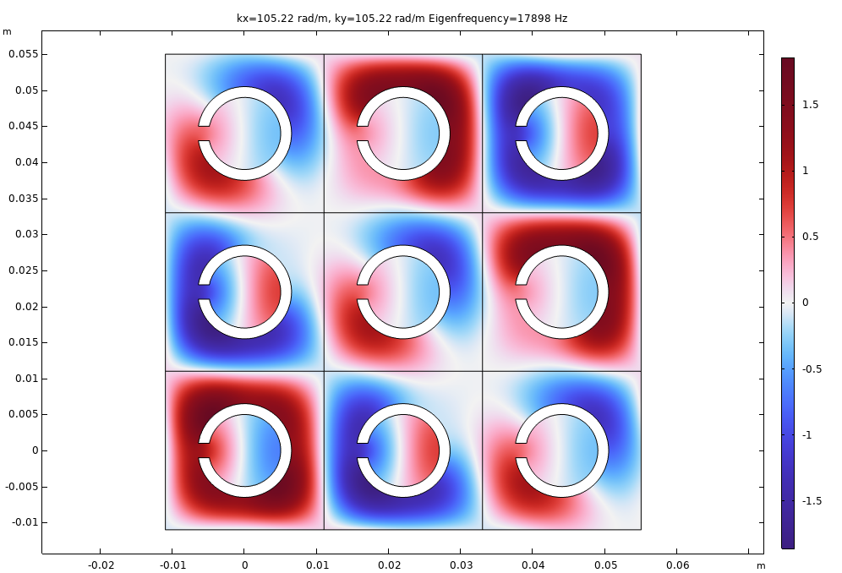
Results: Some modes for the [1,1] direction

Slide 7
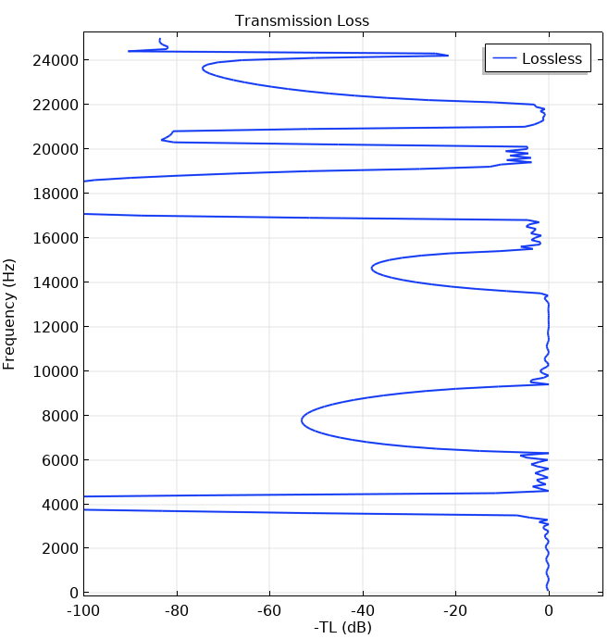
Results: Finite Array
Analyzing modes that can propagate in the [1,0] direction.
No propagation (low TL values) is expected where there is a bandgap between the [0,0] and [1,0] lines in the Band Structure plot.
bandgap
[1,1]
[0,0]
[1,0]
[1,1]

Slide 8
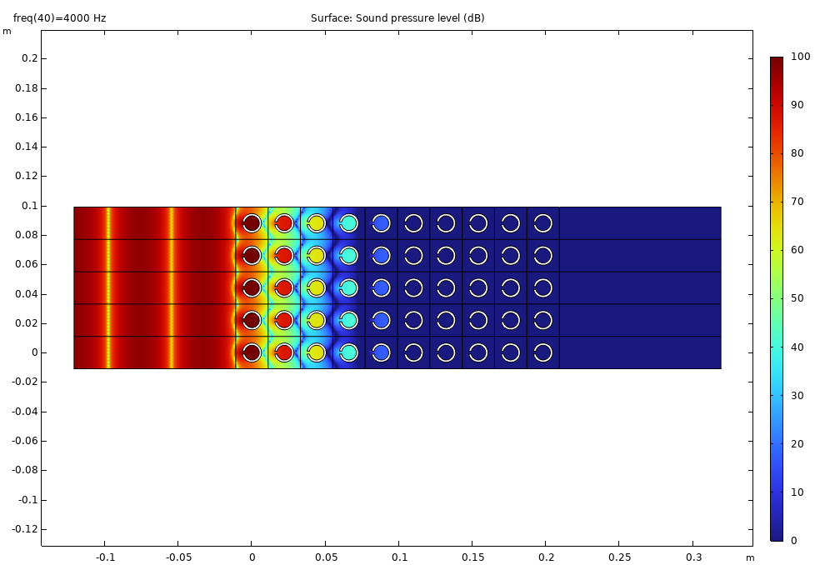
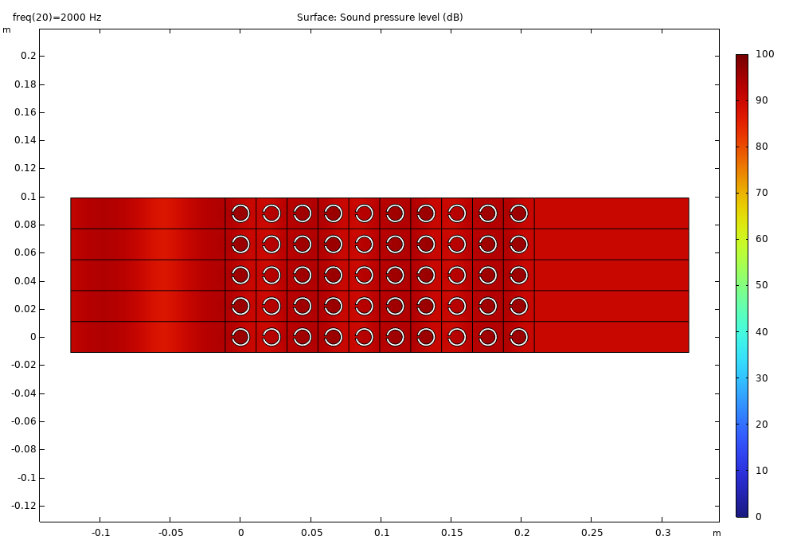
Results: Finite Array (with 10 layers)
No transmission at 4000 Hz in the bandgap (see previous slide)
Nearly full transmission at 2000 Hz (see previous slide)

Slide 9
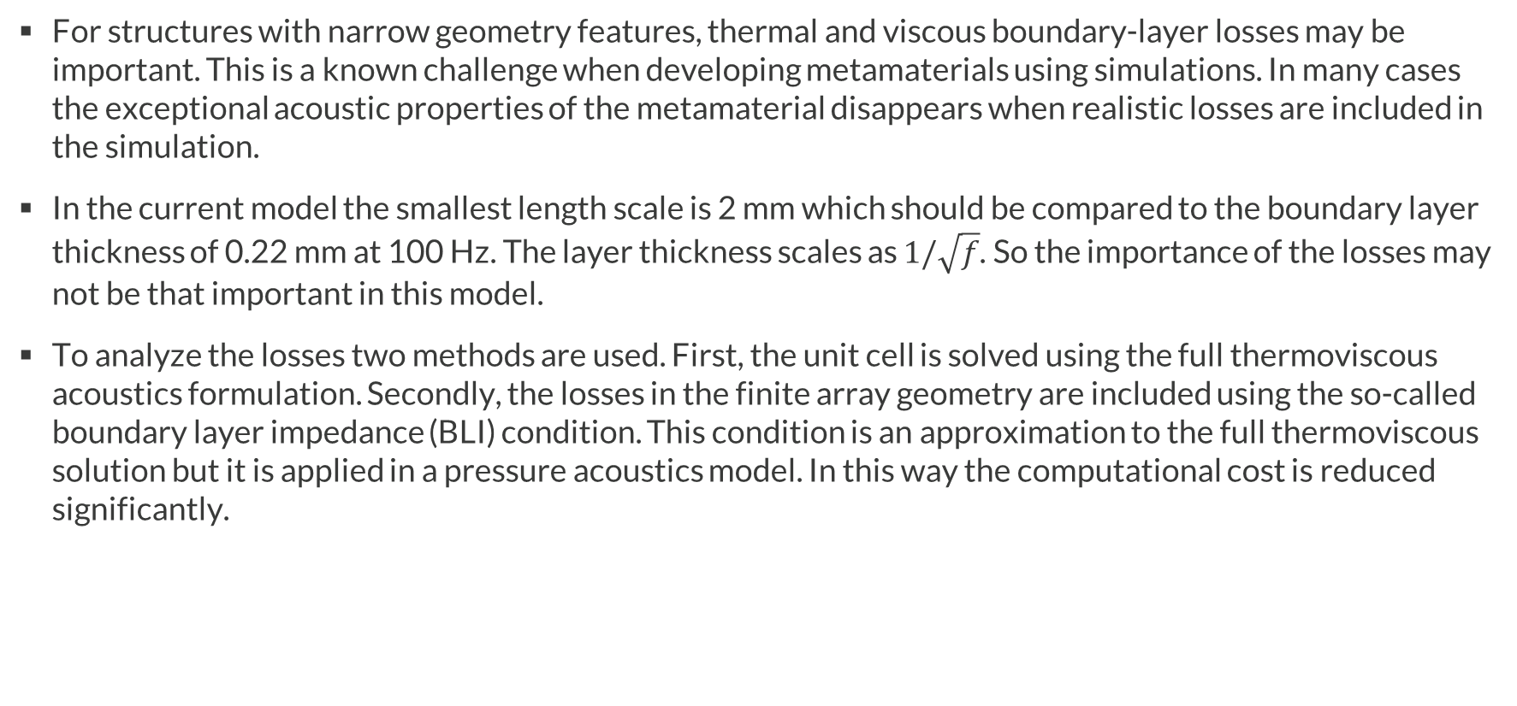
Thermoviscous Boundary Layer Losses
For structures with narrow geometry features, thermal and viscous boundary-layer losses may be important. This is a known challenge when developing metamaterials using simulations. In many cases the exceptional acoustic properties of the metamaterial disappears when realistic losses are included in the simulation.
In the current model the smallest length scale is 2 mm which should be compared to the boundary layer thickness of 0.22 mm at 100 Hz. The layer thickness scales as $1/\sqrt{f}$. So the importance of the losses may not be that important in this model.
To analyze the losses two methods are used. First, the unit cell is solved using the full thermoviscous acoustics formulation. Secondly, the losses in the finite array geometry are included using the so-called boundary layer impedance (BLI) condition. This condition is an approximation to the full thermoviscous solution but it is applied in a pressure acoustics model. In this way the computational cost is reduced significantly.

Slide 10
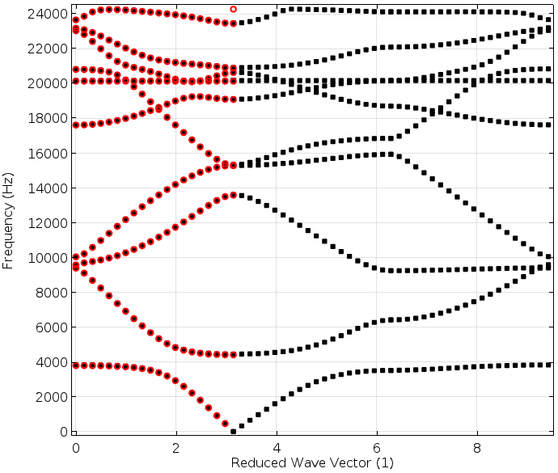
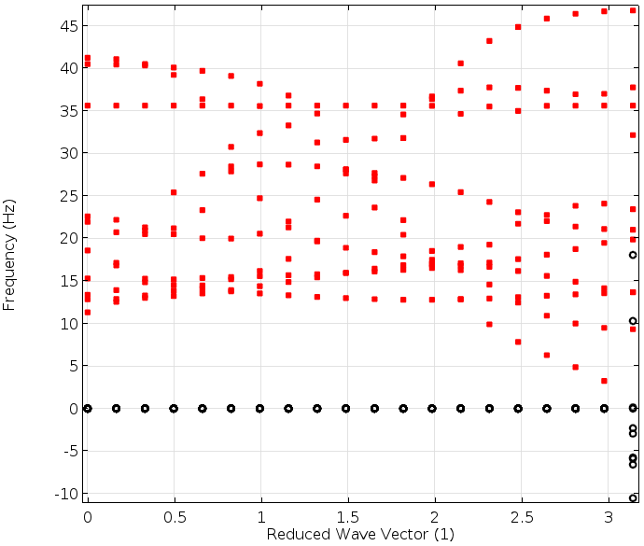
Thermoviscous Acoustics:
Band Structure
Part of the band structure of the unit cell is solved using the Thermoviscous Acoustic, Frequency Domain physics interface. This is done in Study 4.
The results are depicted to the right. The thermoviscous results are plotted as red markers.
The Eigenfrequency analysis tells you what would happen if you at time t = 0 have an infinite periodic field distribution that can be expanded by your spectral and spatial field distributions, as computed by the Floquet periodic Eigenfrequency problem. As time evolves, the different fields will decay with the time constants that your Eigenfrequency analysis has computed (complex part of the eigenfrequency) and, thus, the total field will vary with time accordingly. The initial energy contained by the field will be transformed to heat.
Re(f)
Im(f)

Slide 11
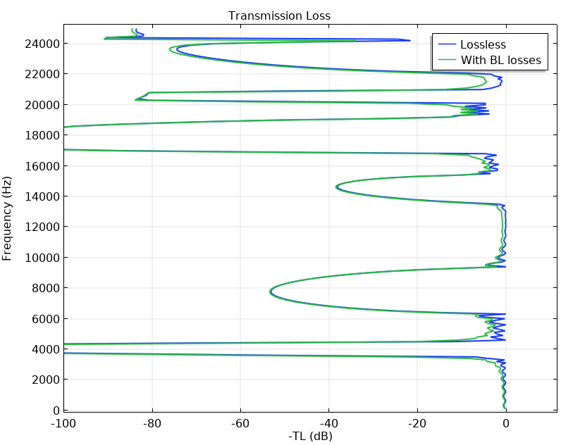
Thermoviscous Boundary Layer Impedance (BLI) Condition
The Thermoviscous Boundary Layer Impedance (BLI) condition, available in Pressure Acoustics, Frequency Domain, is used to model the losses with this homogenized approach.
The condition is only valid for gaps larger than the boundary layers δ_{v} << h, where δ_{v} and δ_{th} are the viscous and thermal boundary layer thickness, respectively.
The condition is not valid for highly curved geometries: δ_{v} << R
The condition is not for “complex geometries” that include corners and sudden expansions.
h
R

