Slide 1
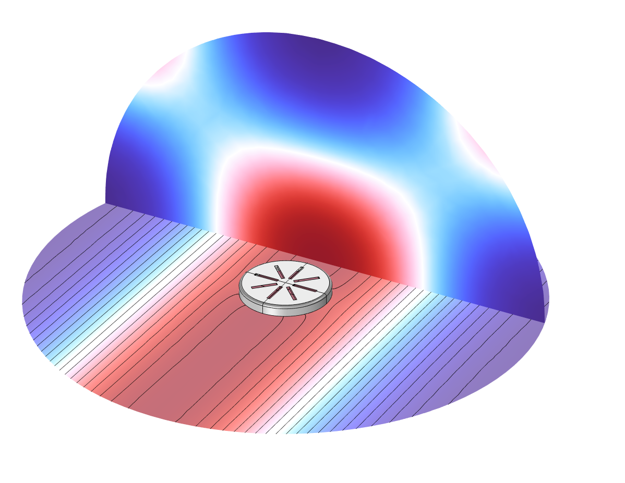
Microphone Grid:
Spatial Free-Field Correction Curves

Slide 2
Abstract
This is a conceptual model of a microphone placed in an infinite baffle (flush mounted). The purpose is to determine the free-field level correction curve of the setup, which includes the exterior domain, microphone grid, and volume between the grid and the diaphragm. The microphone diaphragm is characterized with a simple RCL impedance and the open radiation condition is modeled with a Perfectly Matched Layers (PMLs).
This model uses the Acoustic-Thermoviscous Acoustic Boundary multiphysics coupling to couple Thermoviscous Acoustics to the exterior Pressure Acoustics. Thermoviscous acoustics is used to model the acoustics in the small domain between the diaphragm and the grid, calculating the pressure distribution, temperature fluctuation distribution, and velocity magnitude. Pressure Acoustics is used to calculate the incident and scattered pressure fields in the exterior domain.

Slide 3
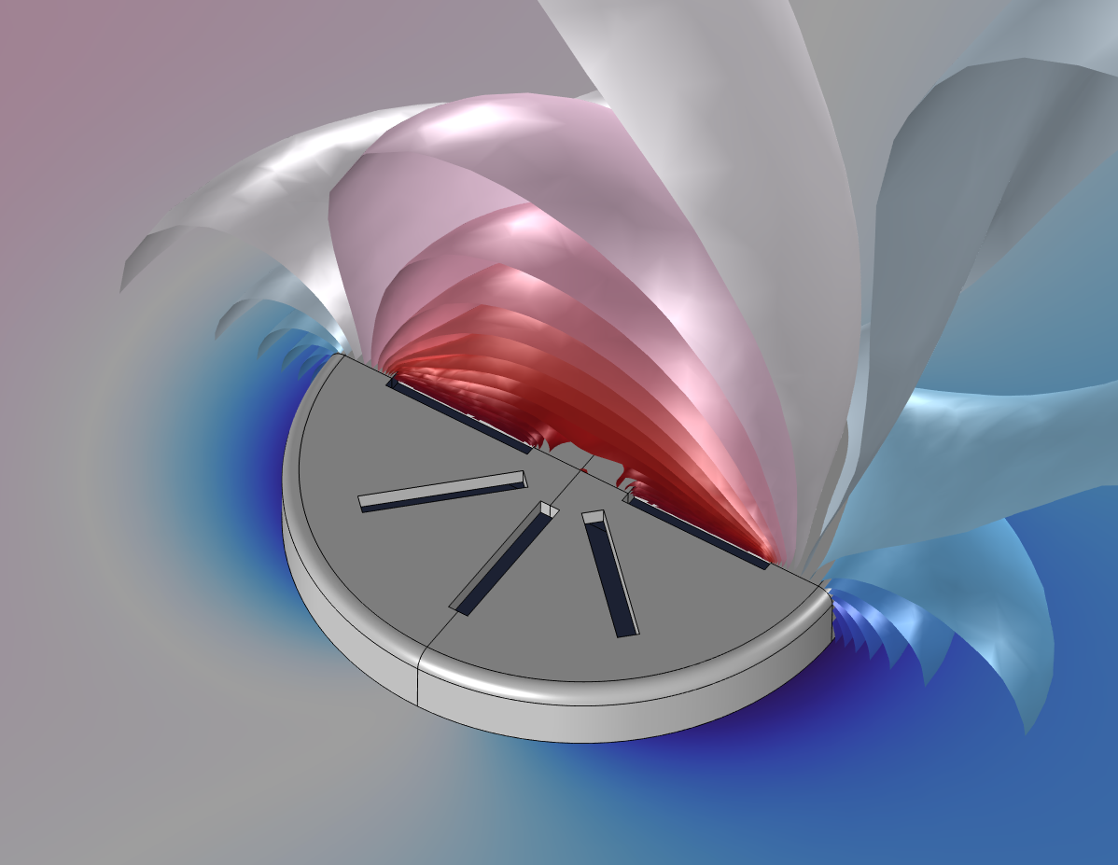
Model Geometry
incident plane wave
k
microphone grid
infinite baffle
microphone
microphone protective grid

Slide 4

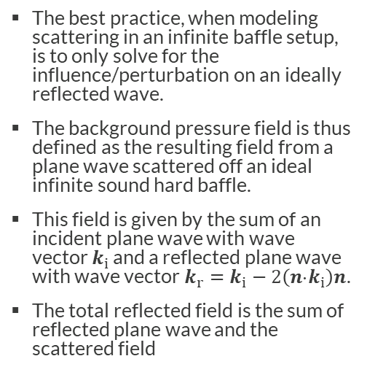



Modeling Scattering in an Infinite Baffle Setup
The best practice, when modeling scattering in an infinite baffle setup, is to only solve for the influence/perturbation on an ideally reflected wave.
The background pressure field is thus defined as the resulting field from a plane wave scattered off an ideal infinite sound hard baffle.
This field is given by the sum of an incident plane wave with wave vector $k_{i}$ and a reflected plane wave with wave vector$k_{r}=k_{i}−2\left(n⋅k_{i}\right)n$.
The total reflected field is the sum of reflected plane wave and the scattered field
$$k_{r}$$
$$k_{i}$$
$$n$$
Wave vector $k_{i}$ for the incident plane wave p_{i} and wave vector $k_{r}$for the reflected plane wave p_{r.}

Slide 5
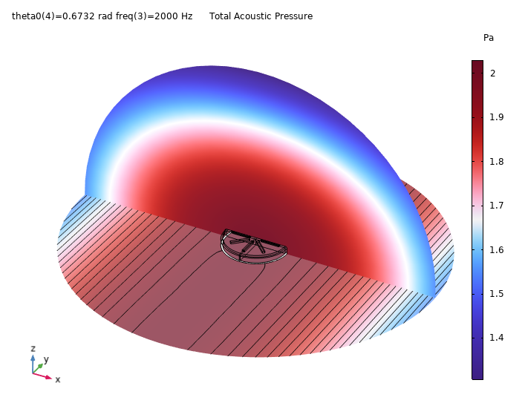
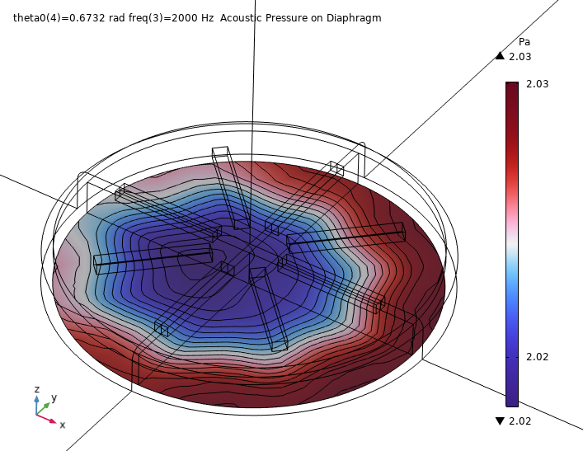
Results
Pressure distribution at 2000 Hz and an angle of incidence around 38.6º

Slide 6
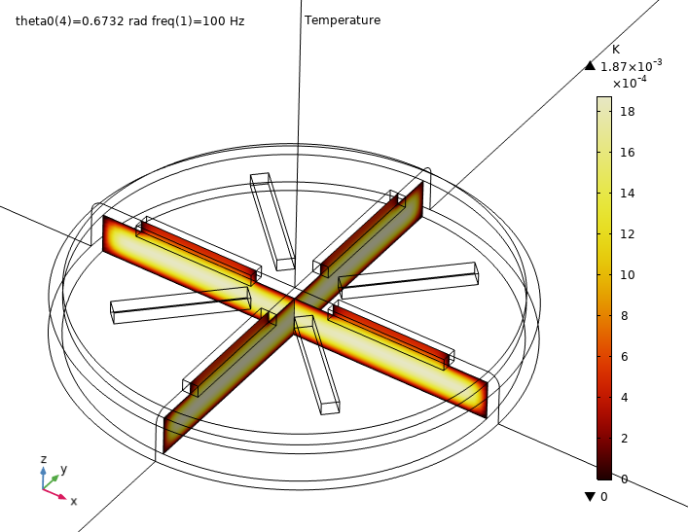
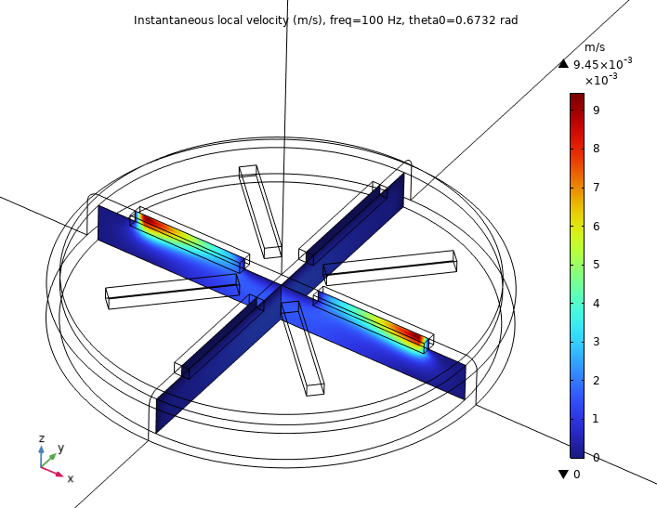
Results
Below: Velocity magnitude at 100 Hz and an angle of incidence around 38.6º. The viscous boundary layer is visible.
Above: Temperature distribution at 100 Hz and an angle of incidence around 38.6º. The thermal boundary layer is visible.

Slide 7
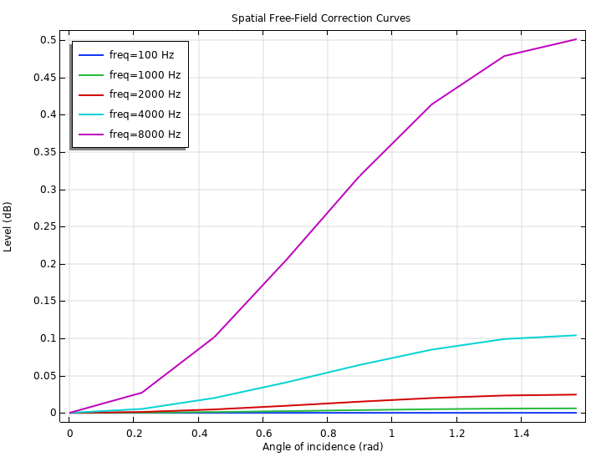
Results
Spatial free-field correction curves gives the SPL at the surface of the microphone for different angles of incidence and frequencies.
The effect scales with wavelength and in particular the wavelength compared to the characteristic length scales of the microphone. The correction increases for increasing frequencies.

