Slide 1
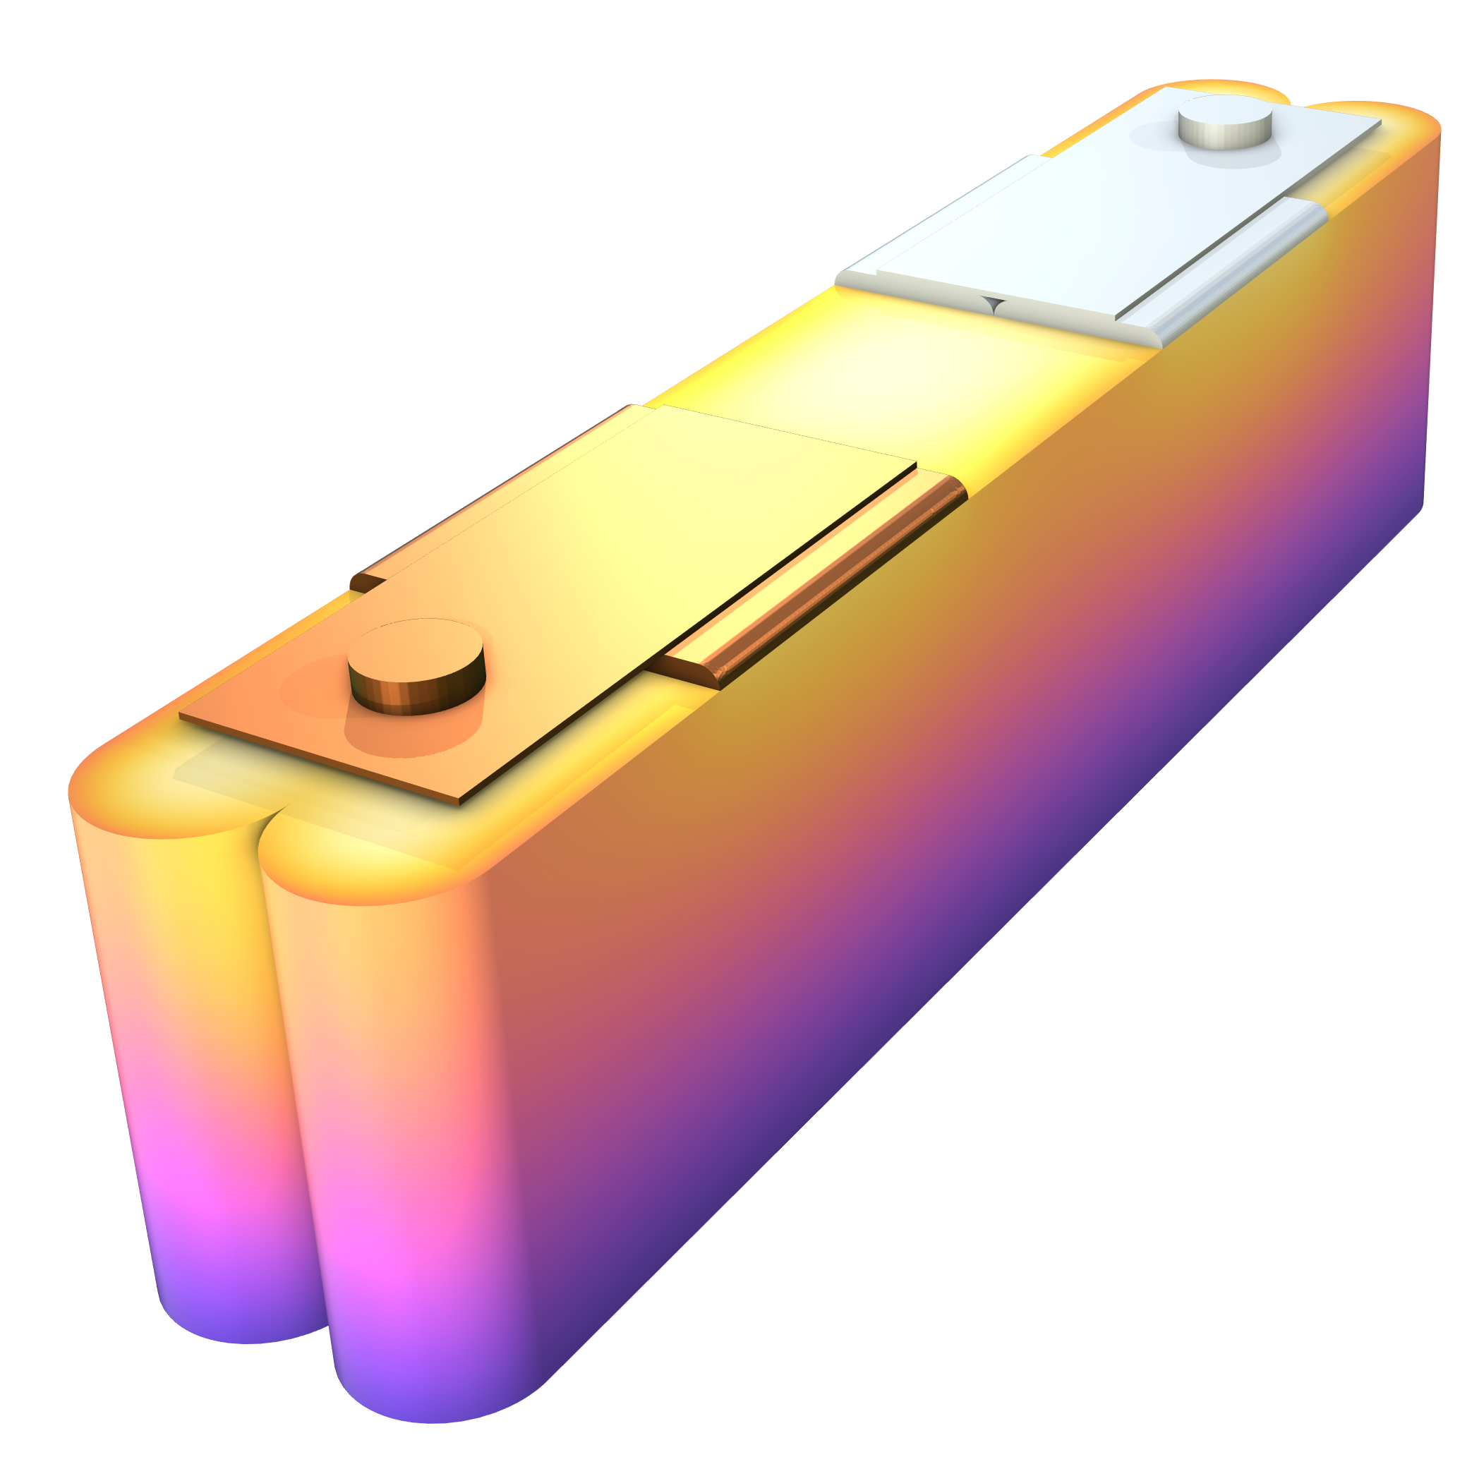
Cooling of a
Prismatic Battery

Slide 2
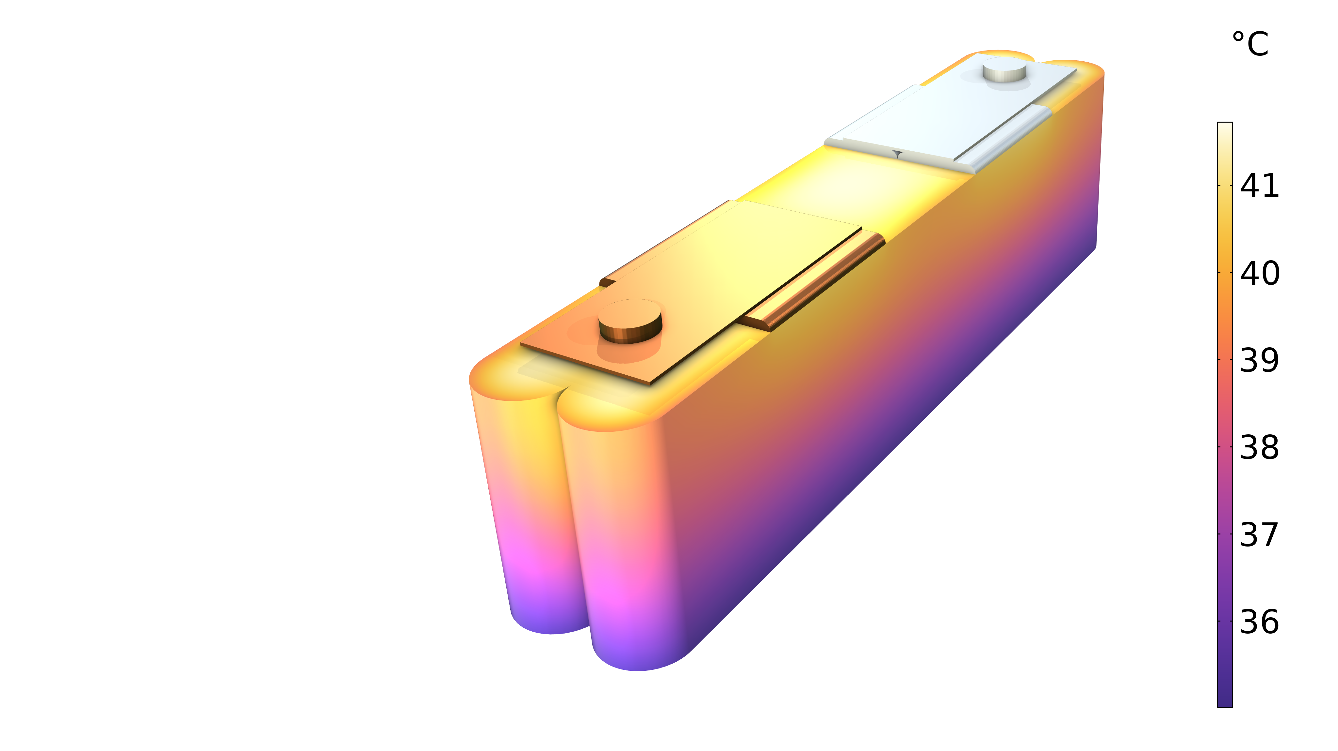
Introduction
This tutorial models the internal temperature distribution in a prismatic battery during a high-rate charge.
The electrochemical model deploys a lumped two-electrode model to define the active layers of the battery cell (the “jelly roll”), in combination with a space-dependent model for the electronic current conduction in the current collectors plates (arrester tabs), the current collector foils, and the terminals.
The heat sources from the electrochemical model are coupled to a heat transfer model, where anisotropic thermal conductivities are used to define the layer orientation within the homogenized jelly roll domains.

Slide 3
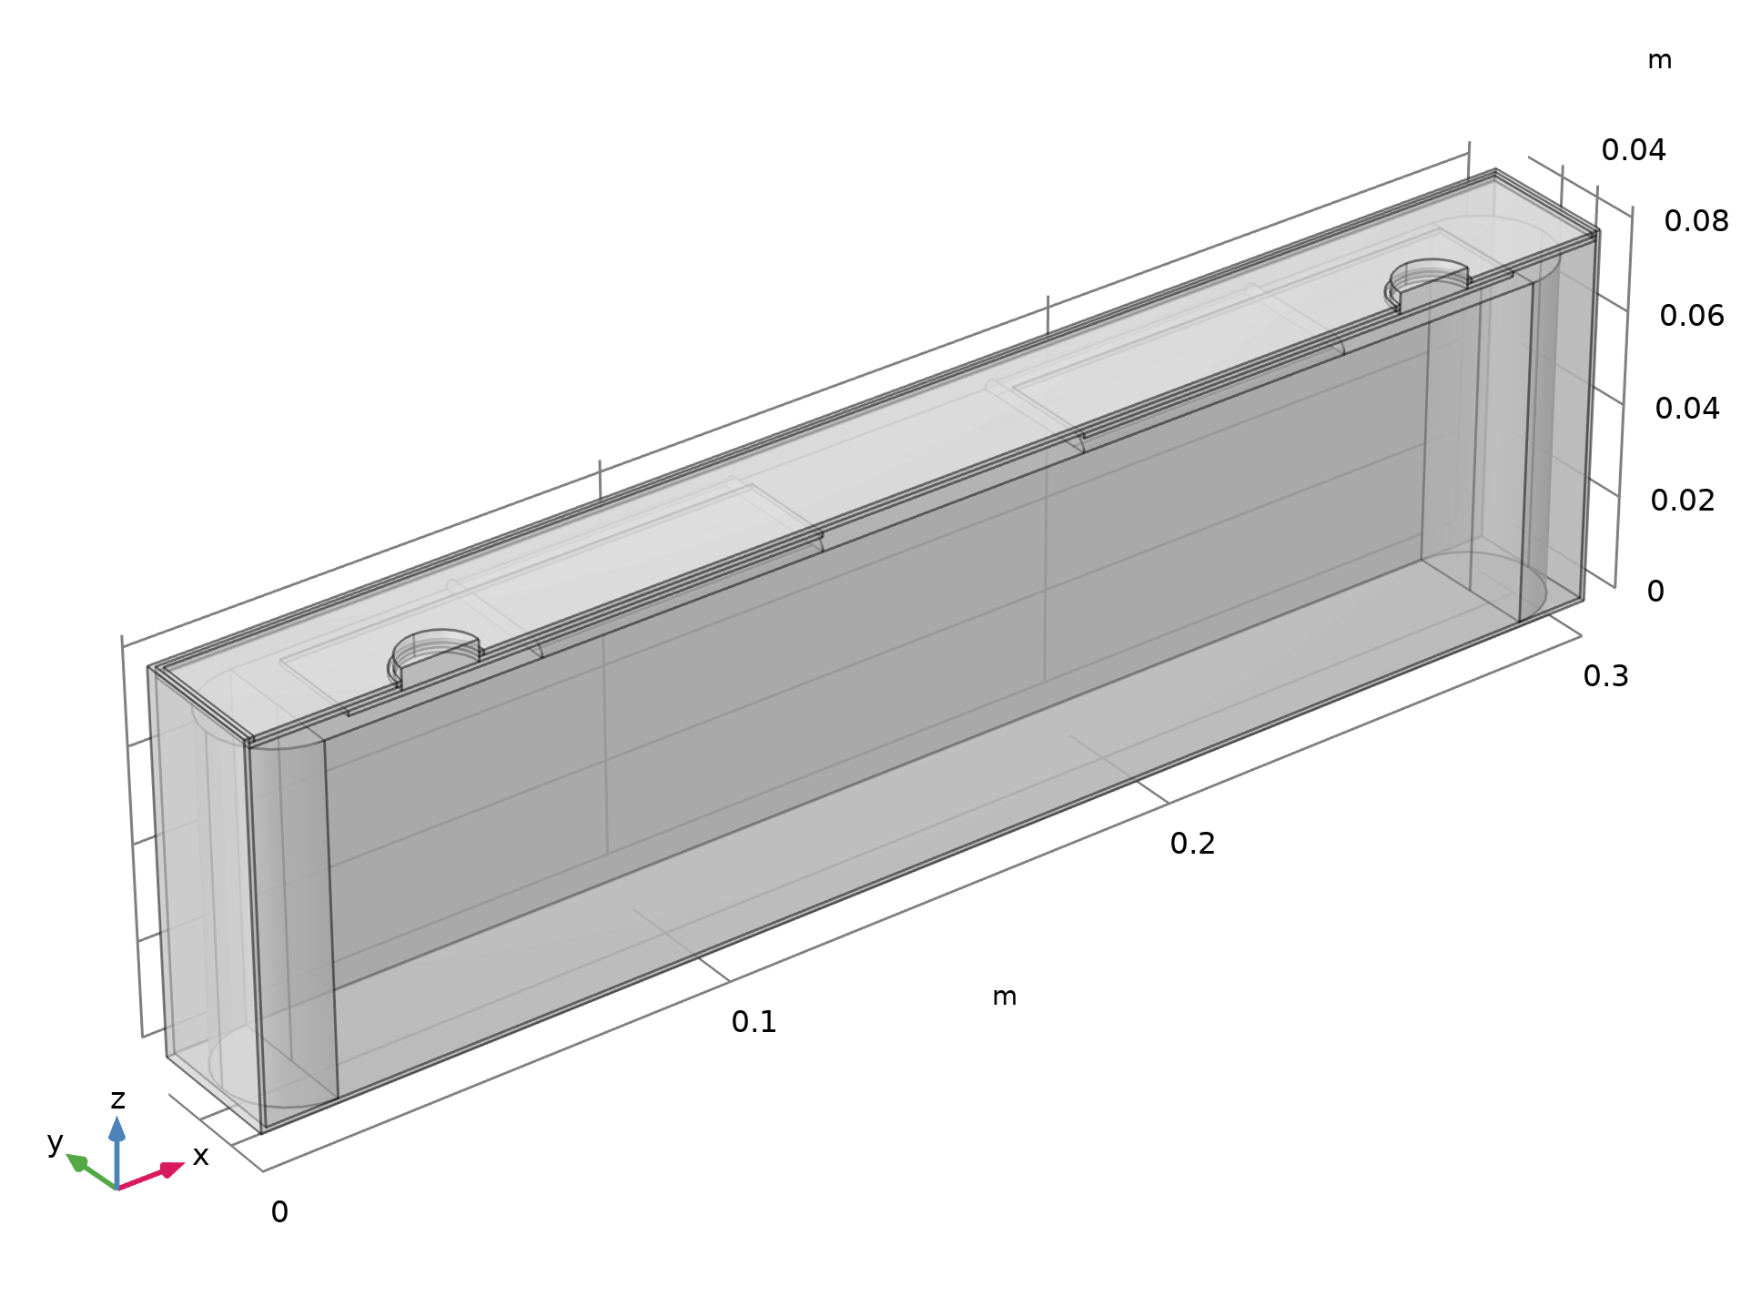
Geometry
Positive Terminal
Cap
The full prismatic battery contains two jelly rolls
Due to symmetry, only half of the geometry has to be treated
Negative Terminal
Free Electrolyte
Jelly Roll
Cell Can

Slide 4
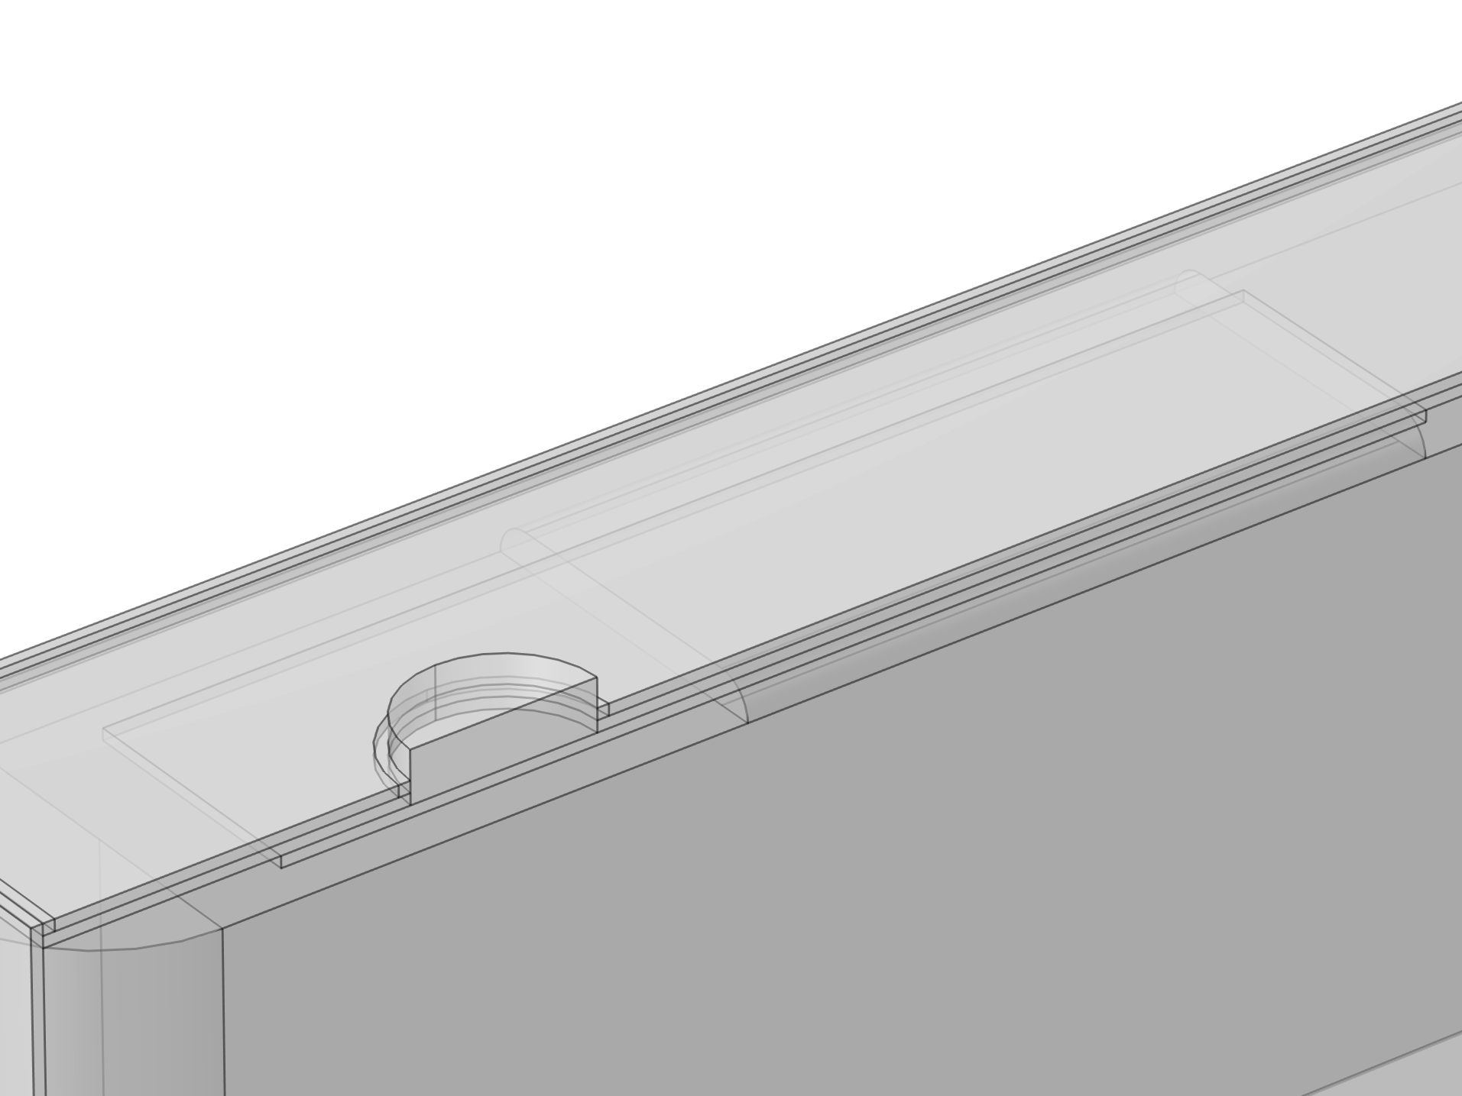
Geometry – Closeup of Negative Terminal
Foils Bundle
Seal
Current Conductor Plate
Insulating Spacer

Slide 5

Implementation in COMSOL Multiphysics®
The electrochemistry, current conduction from the jelly roll to the terminals, and heat transfer problems are defined in the following ready-made interfaces:
  Lumped Battery interface
  Primary Current Distribution interface
  Heat Transfer in Solids interface
The Electrochemical Heating feature couples
the electrochemistry and heat transfer equations
1
1
2
2
3
3
4
4

Slide 6

Implementation in COMSOL Multiphysics®
2
1
The Lumped Battery interface defines the cell chemistry for a Graphite/LFP Lithium-Ion Battery
Half-cell equilibrium potentials data are from the Battery material library
1
2

Slide 7
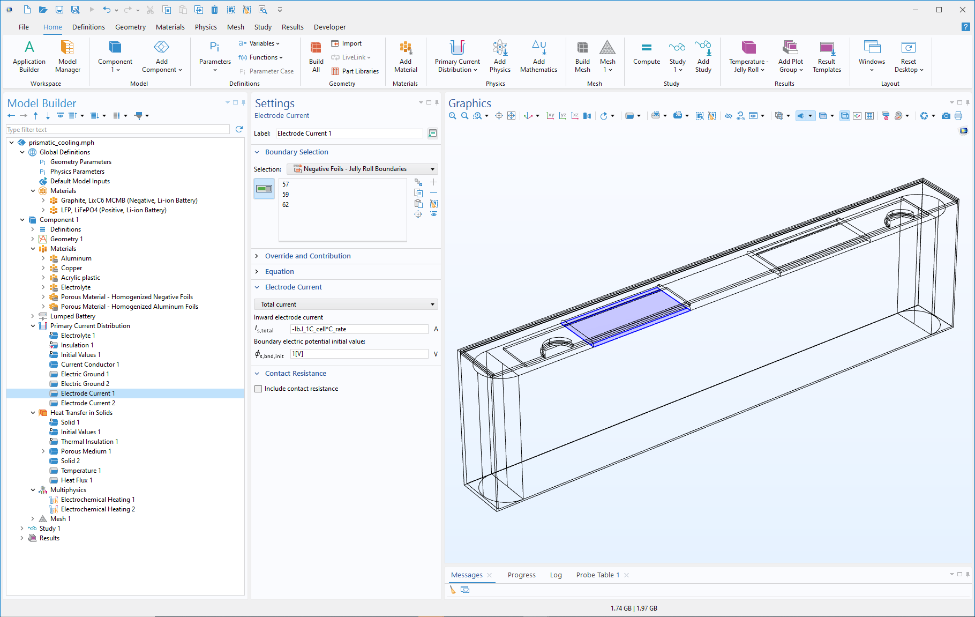
Implementation in COMSOL Multiphysics®
The Primary Current Distribution defines the electric potential distribution in the terminals, current conductor plates and foils

Slide 8

Implementation in COMSOL Multiphysics®
The Heat Transfer interface defines the temperature distribution
Properties are from materials for all domains except the jelly roll

Slide 9

Implementation in COMSOL Multiphysics®
1
2
The layer orientation of the jelly roll is defined by
A cartesian coordinate system for the rectangular part
Cylindrical coordinate systems for the half cylinders
Separate through-layer and in-layer thermal conductivities
1
3
2
3

Slide 10

Implementation in COMSOL Multiphysics®
The battery is cooled from below by setting the temperature to 35°C
Convective cooling heat flux is applied on top and side boundaries

Slide 11
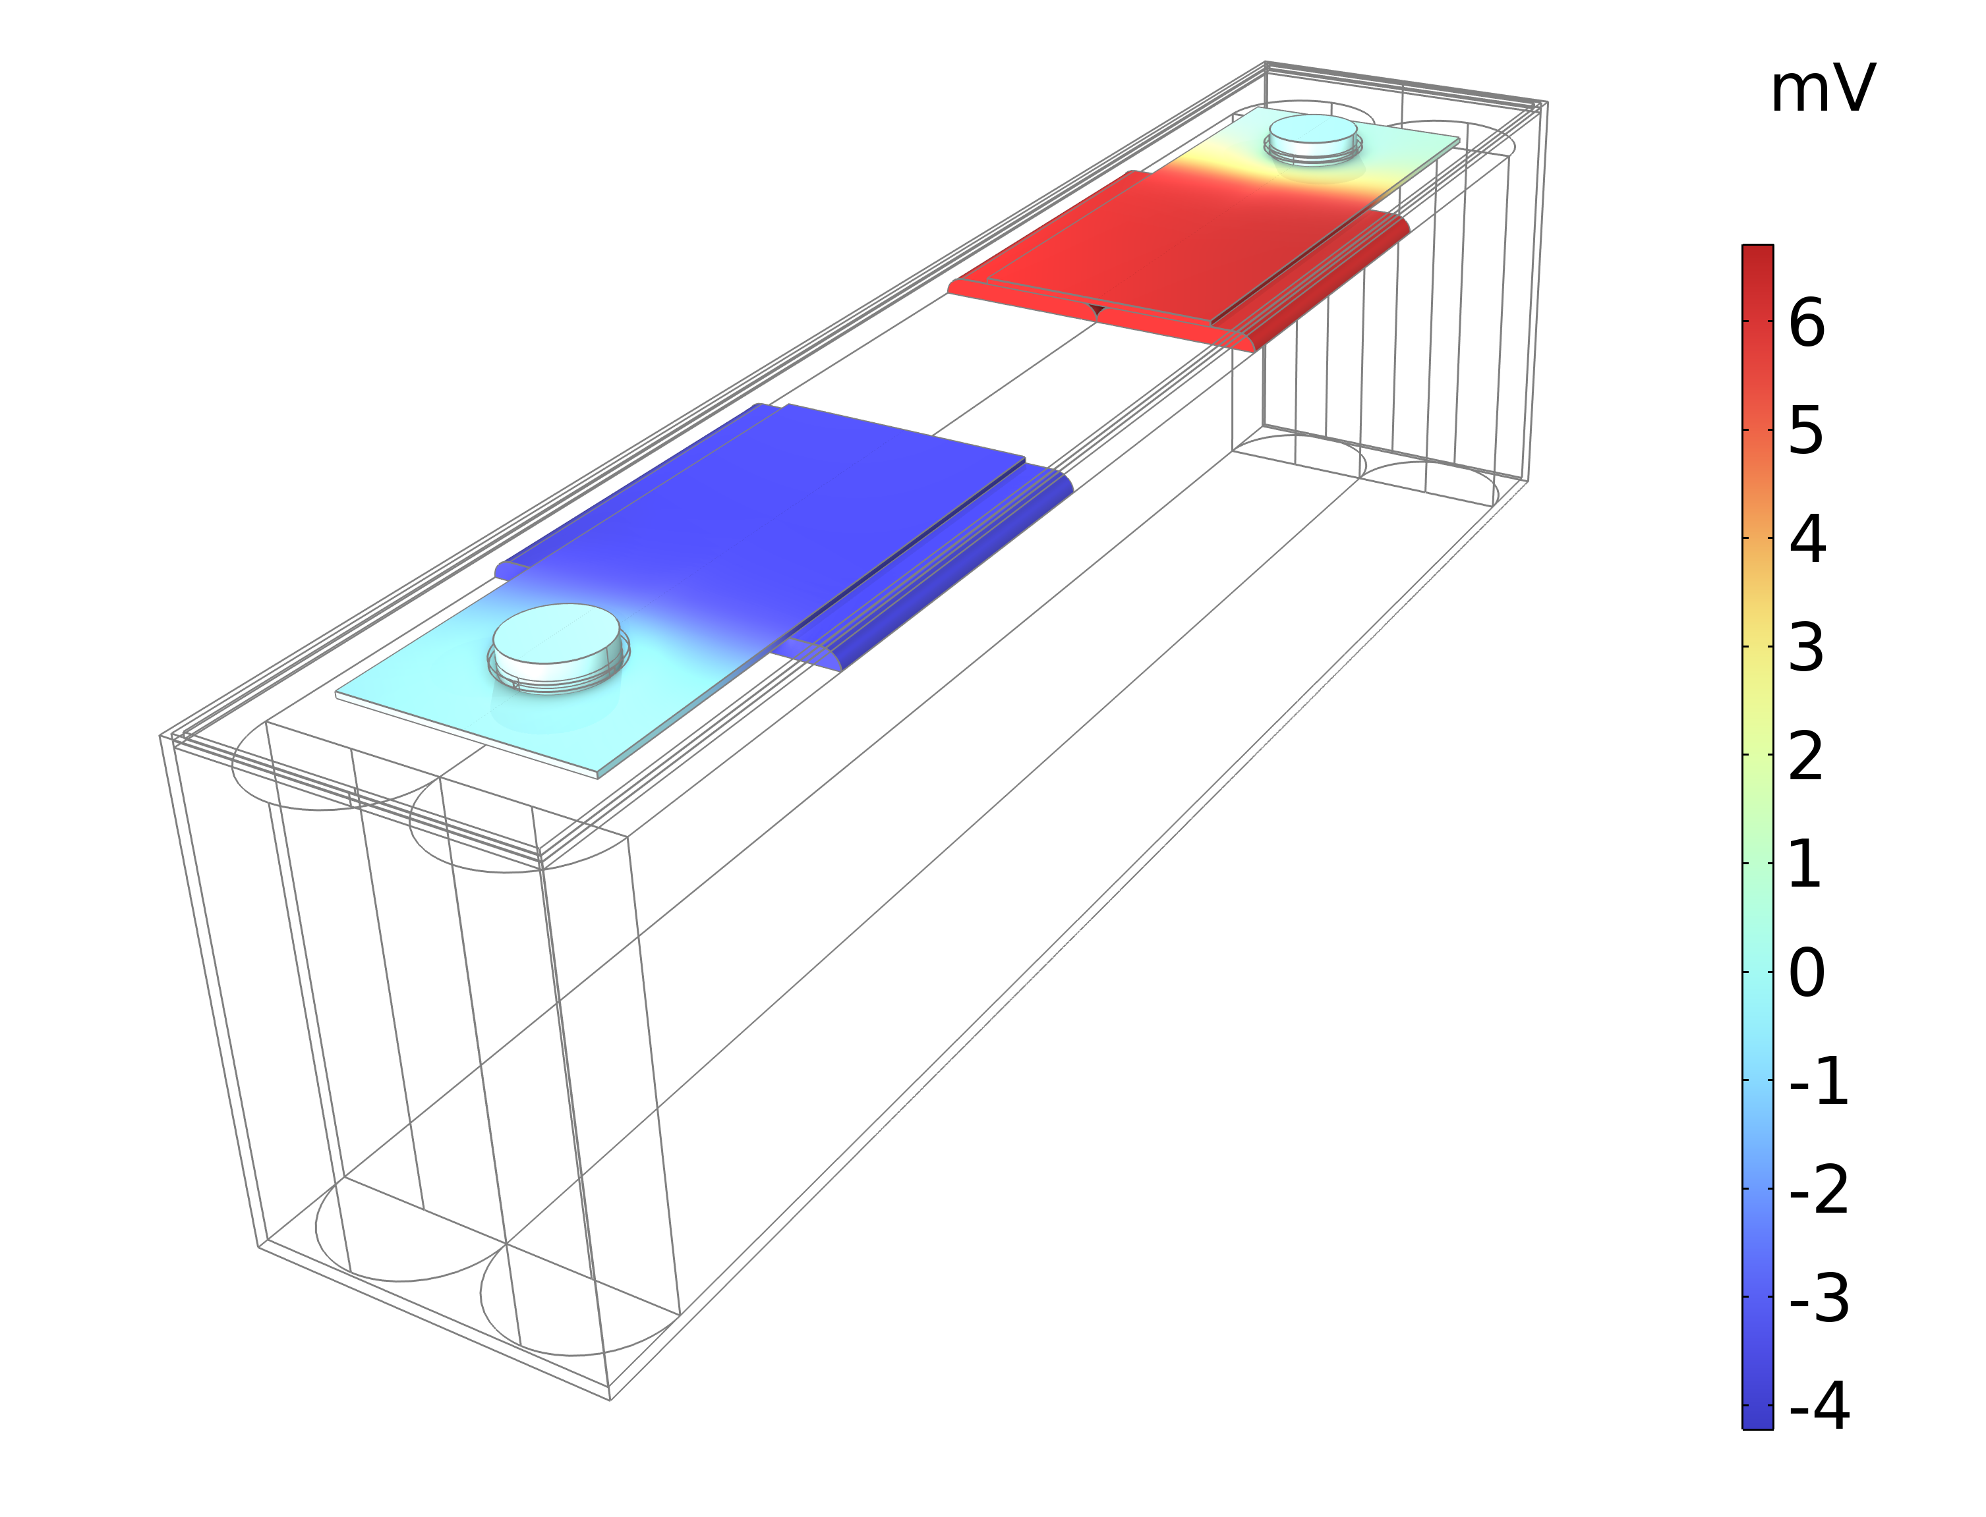
Current Conductor Potentials
Higher voltage losses at the positive side (right) than the negative side (left)
Aluminum, used for the positive conductors, has slightly lower electric conductivity

Slide 12
Jelly Roll Temperature
The jelly roll temperature is generally higher in the regions closer to the positive terminal. This is an effect of the lower electric conductivity of the aluminum current conductors, giving rise to a larger contribution from Joule heating.
It can also be seen that the temperature in the regions facing the short sides are slightly lower than for the central parts of the long sides. This is a result of a convective cooling condition applied on the short side external boundaries.

Slide 13

Try the COMSOL Multiphysics® software
Check your email for your free two-week trial, which includes:
  A guided tutorial
  Full technical support
  Access to examples
Photo will go here
CONTACT
Get in touch with your CSR if you have any questions
CSR name
CSR direct #
name@comsol.com

