Slide 1
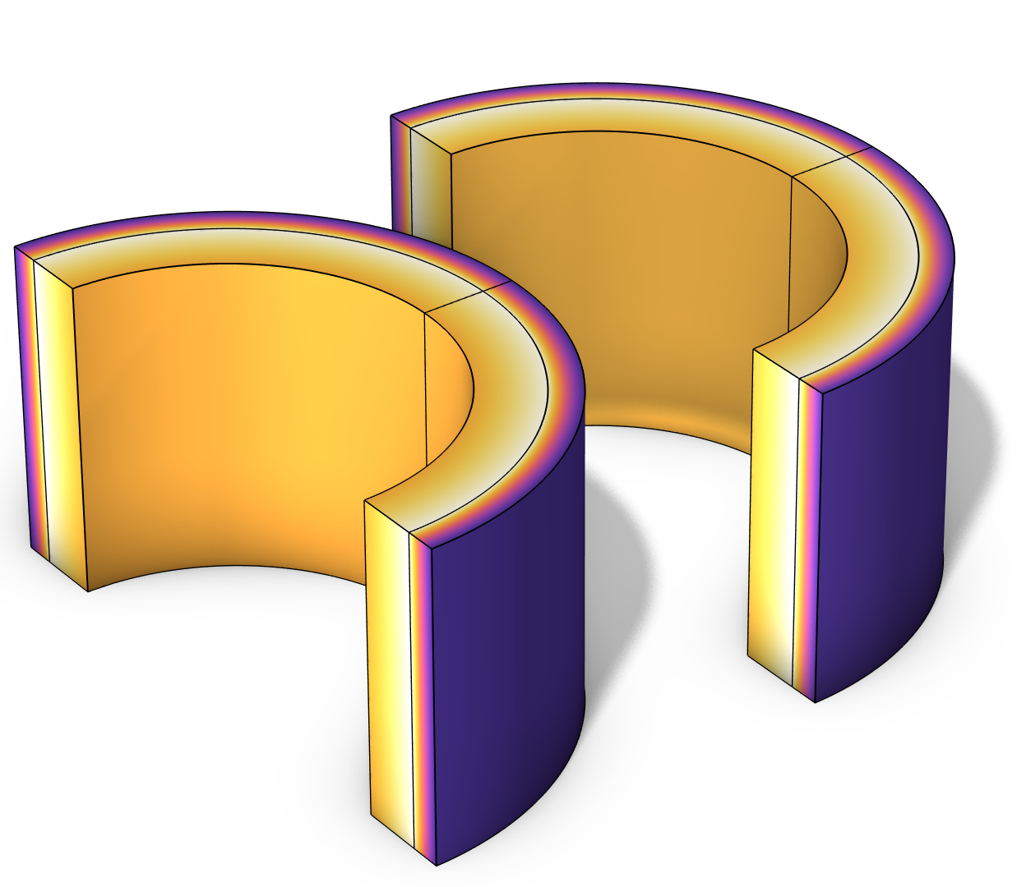
Area Scaling Factor in Heat Transfer in Shells

Slide 2
Motivation
This tutorial model demonstrates the use of the Area Scaling Factor (ASF) in the Heat Transfer in Shells interface, to account for the curvature of the layers when applying heat fluxes and heat sources.
The results obtained with the Heat Transfer in Shells interface applied to a boundary (with extra dimension) are compared with those obtained with the Heat Transfer in Solids interface on the equivalent solid geometry.

Slide 3
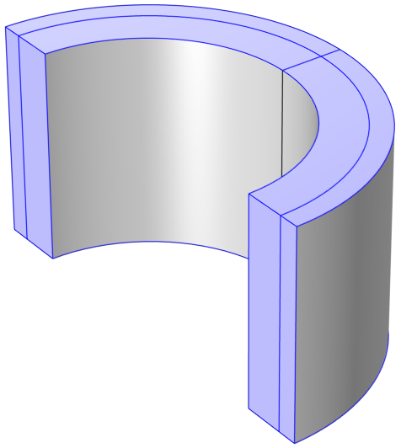
Model Definition
A cylinder of copper is coated with a layer of iron.
All highlighted boundaries are thermally insulated.
On the outside the temperature is fixed to 20°C.
At the interface between iron and copper, a boundary heat source is applied.
On the interior, a heat flux is considered.
The same configuration is created with the Heat Transfer in Shells interface.
Iron
Copper
Thermal insulation
T=20°C
Q=5e5 W/m²
P=-5e3 W
Model geometry and boundary conditions for the 3D configuration

Slide 4
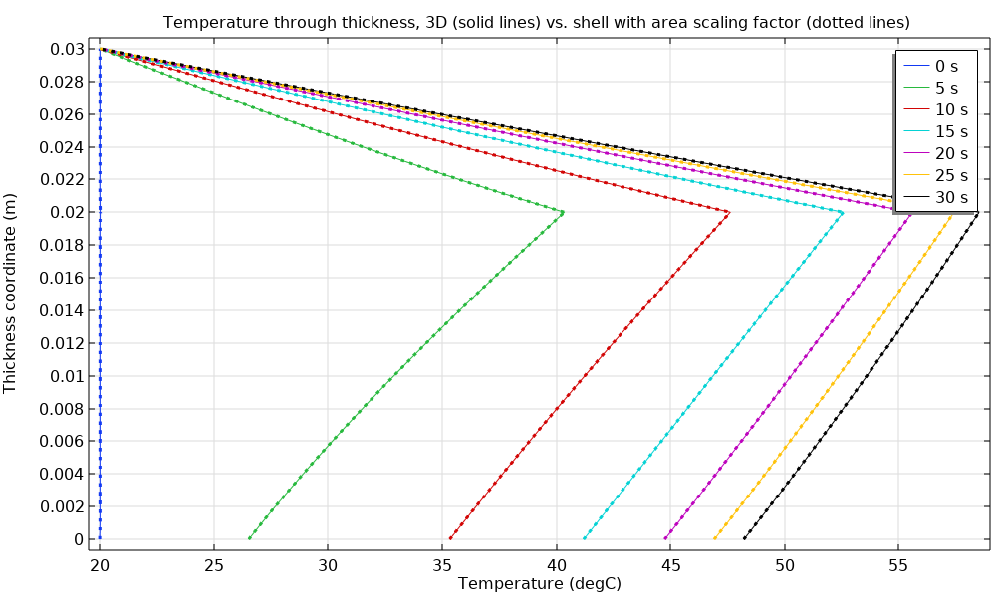
Results
A transient computation is performed for the 3D (solid lines) and shell models (dotted lines).
Results are compared at different times, and show a very good agreement.
Comparison of temperature through thickness for 3D and shell models

Slide 5
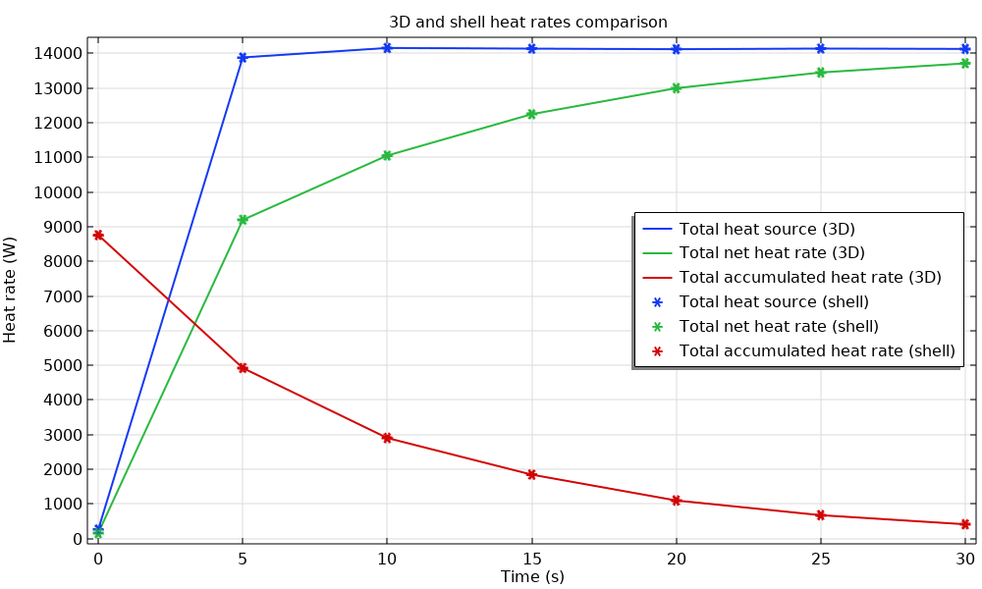
Results
Heat rates are compared for both approaches. Very good agreement is obtained.
The Heat Transfer in Shells interface with area scaling factor can be used to model curved layers in place of a solid 3D model.
Comparison of heat rates for 3D and shell models

