Slide 1
Induction Motor in 2D
COMSOL

Slide 2
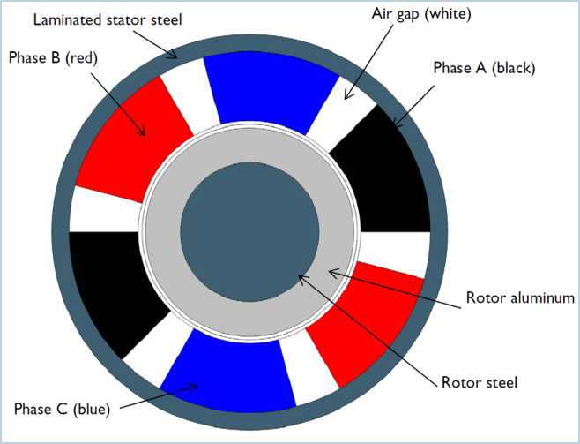
Induction Motor in 2D
Model the induction motor with a conducting rotor cylinder and three phase stator windings
The rotational torque and angular speed is evaluated as a function of time
The effect of step change in load torque is included
Illustration of the induction motor showing the different coil phases.

Slide 3
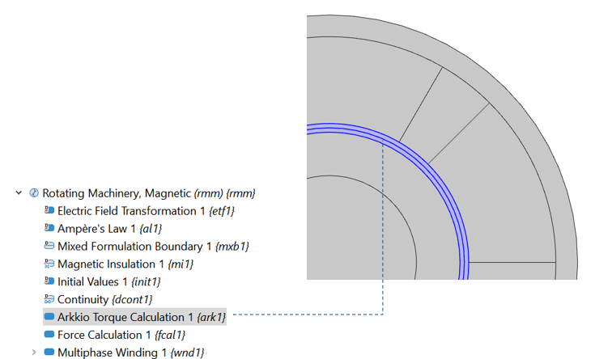
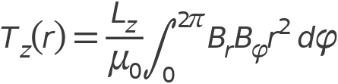
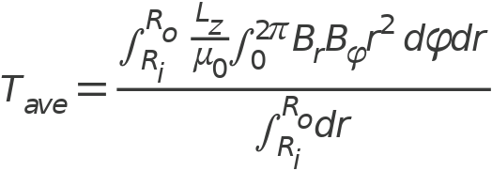
Arkkio‘s Method - Theory
Torque from Maxwell‘s stress tensor:
Average torque for all rings of rotor air gap:

Slide 4
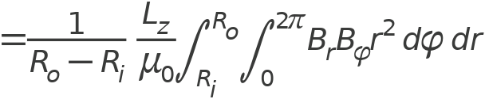
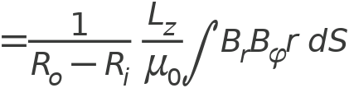
Arkkio‘s Method - Theory

Slide 5

Motion of Rotor
The motion of the rotor can be described by
This relation is solved automatically when the Rotating Domain node is set to Rigid domain
The rotor’s moment of inertia is taken from Mass Properties nodes, the applied moment is taken from the Force Calculation

Slide 6
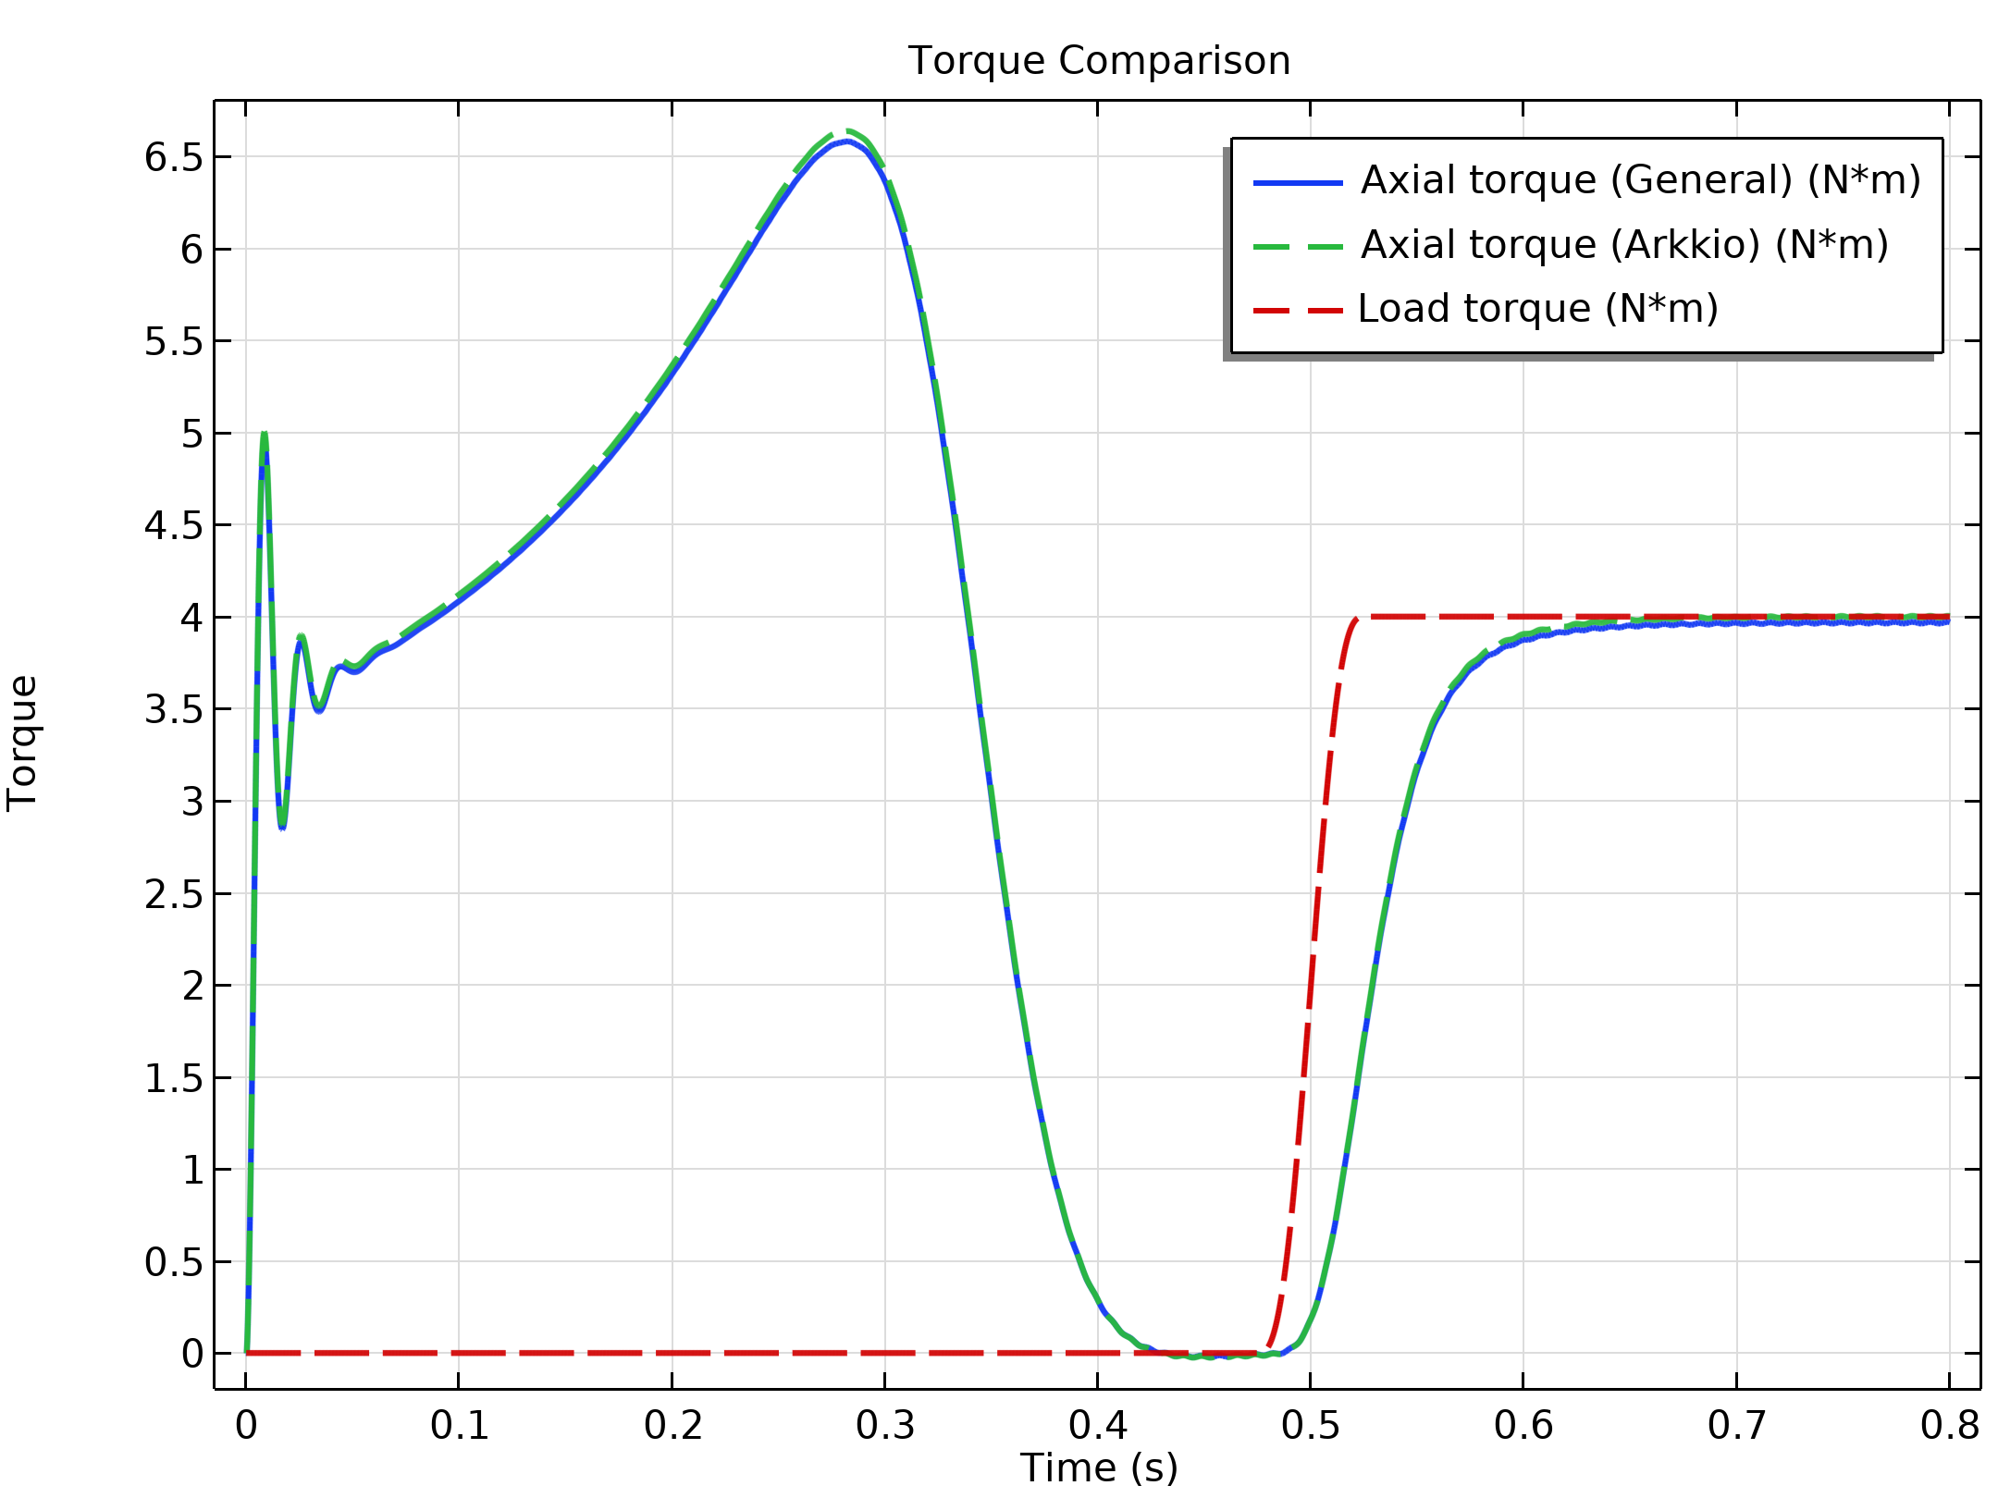
Torque Comparison
Torque values from COMSOL‘s Force Calculation and Arkkio‘s method are in good agreement
The torque goes to zero as soon as the motor is fully accelerated. After that, the load torque is applied.

Slide 7
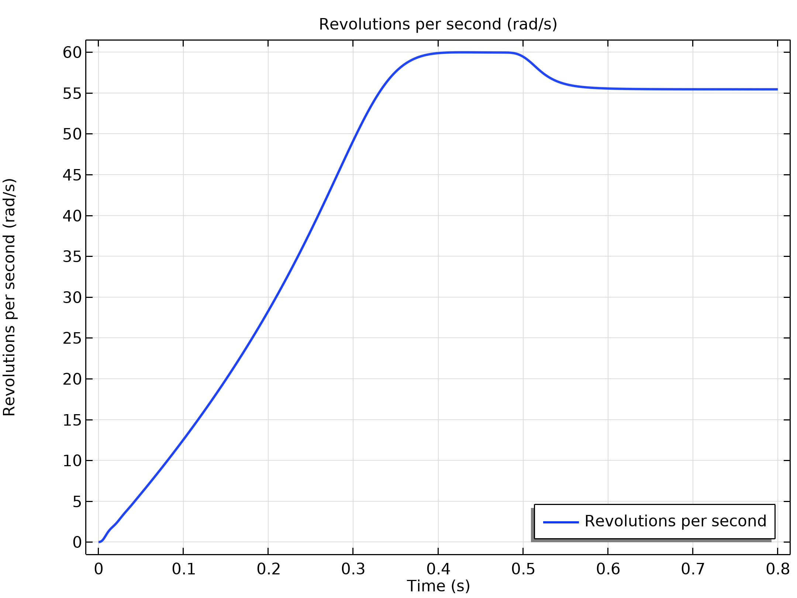
Angular speed
The revolutions per second (RPS) of an induction motor must be slightly different from the AC frequency of the coils in order to generate torque
The motor accelerates to 60 RPS which is equal to the AC frequency. No more torque is generated; the motor neither brakes nor accelerates
Due to the frequency drop after applying the load torque, there is a mismatch between AC frequency and RPS and the motor generates torque again

Slide 8
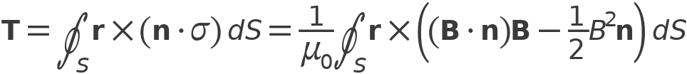

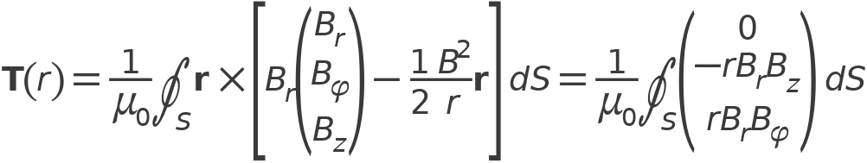
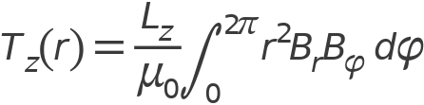
Appendix: Arkkio‘s Method (Theory)

Slide 9

Appendix: Arkkio‘s Method (Theory)

