Slide 1
Using Artificial Intelligence (AI) within COMSOL Multiphysics® to Create Machine Learning Tools
COMSOL European Conference:
Florence, 22-24 October 2024
F. Viry¹, M. Sturma², P. Namy¹, B. Barbet²
¹ : SIMTEC, 5 rue Felix Poulat 38000 Grenoble France
² : MARKEM-IMAJE, Bourg-lès-Valence, France
Property of SIMTEC - All rights reserved
Notes:
Hello everybody, my name is XXX, and I’m going to talk to you today about modeling of the YYYusing Comsol Multiphysics.
This work has been performed in collaboration between XXX (an international leader in XXX) and Simtec, the leader of the French Comsol Certified Consultant and a key partner of the COMSOL Certified Consultant Worldwide.

Slide 2
Outline
  Background – Motivations – Objectives
  Modelling and Numerical Model
  Main Results
  Conclusions – Perspectives

Slide 3





























Before starting, who we are… www.simtecsolution.fr
SIMTEC : Fundamentals
French Numerical modelling consultancy
Leader in France of the COMSOL Certified Consultants, key partner worldwide
9 members Eng.D. + Ph.D.
Main partners:
  big international companies
  laboratories
Involved in the Research projects like EU FP (SHARK, SisAl)/ PhD supervision
Notes:
FP= framework program
Two words about SIMTEC and our clients.
Simtec is the leader of the French COMSOL certified consultant company.
There are 7 members and we all have an engineering degree and a PhD. That means we have an extensive research background and we can handle very complex problems in a range of physics area and industry sectors.
Our main clients are big groups and government laboratories. You can see here some of them
We are also involved in research, for instance we are part of European Research Projects like SisAl Pilot.
So can go to our website to discover more user cases!

Slide 4




I. Background – Motivations – Objectives
?
At SIMTEC,
Creation of dozen of COMSOL model every year
Worldwide,
A big boom in AI assisted processes
(chatgpt, deepl…)

Slide 5
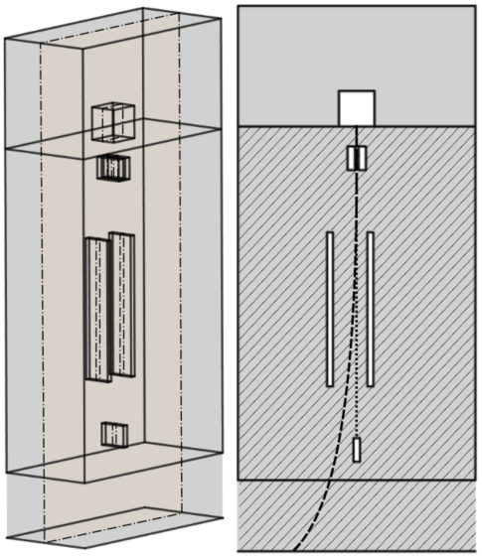
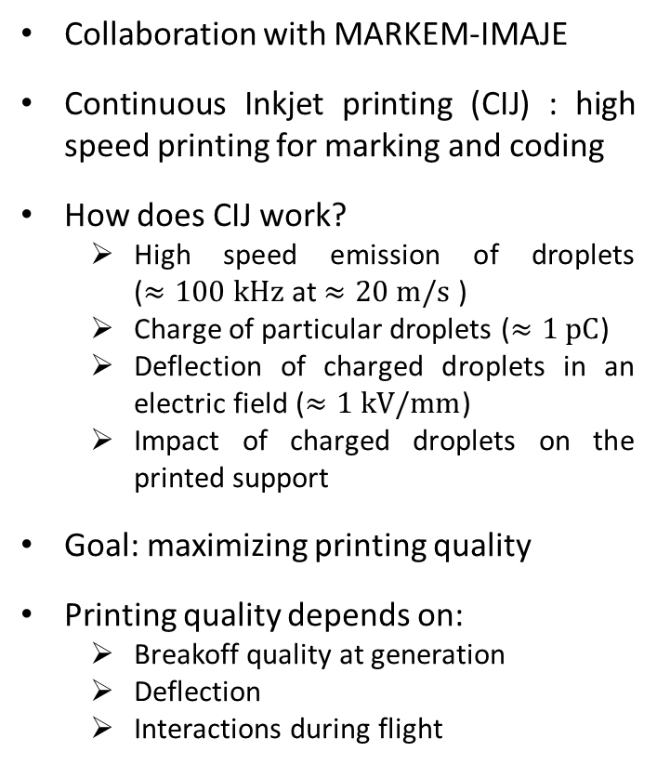
I. Background – Motivations – Objectives
Collaboration with MARKEM-IMAJE
Continuous Inkjet printing (CIJ) : high speed printing for marking and coding
How does CIJ work?
  High speed emission of droplets
  ($≈100 kHz$ at $≈20 m/s$ )
  Charge of particular droplets ($≈1 pC$)
  Deflection of charged droplets in an electric field ($≈1 kV/mm$)
  Impact of charged droplets on the printed support
Goal: maximizing printing quality
Printing quality depends on:
  Breakoff quality at generation
  Deflection
  Interactions during flight
Droplet generator
Nozzle
Charge electrodes
Deflection electrode 1
Deflection electrode 2
Gutter
$$y$$
$$x$$
$$z$$
Printed support
Trajectory of a non-charged droplet
Trajectory of a charged droplet
Schematic representation of a print head

Slide 6



II. Modelling and Numerical Model
Tools
Data treatments
Training models
→ Data generation/collection

Slide 7














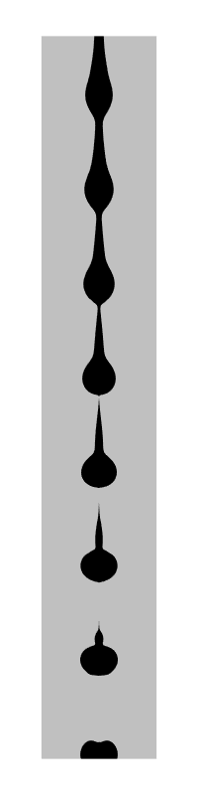


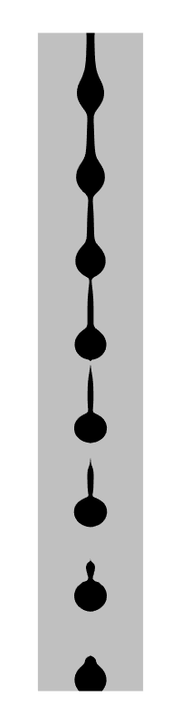
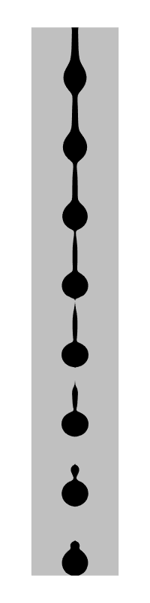
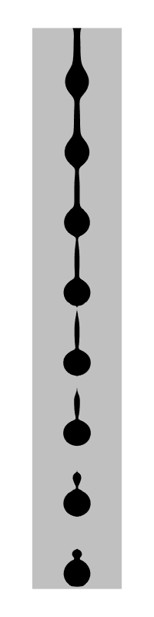
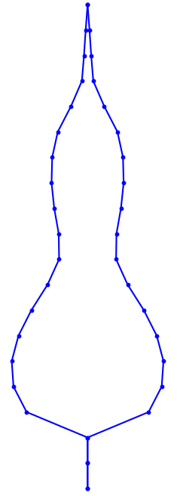
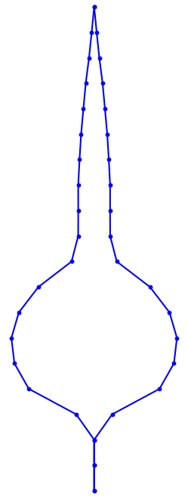
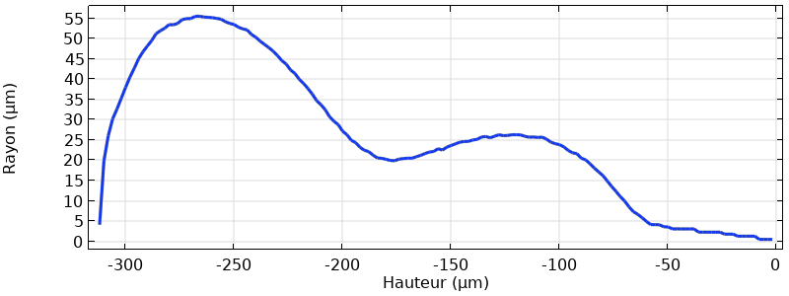
II. Modelling and Numerical Model
Collecting Data
Use-case
Droplet shapes
Choose a set input values (design of experiment)
Build the “input matrix” in the Python code
Perform one simulation per input value (COMSOL)
For each simulation: export the output as a TXT file (COMSOL)
Project outputs into a common subspace (COMSOL or Python)
Build the “output matrix” in the Python code
Ink viscosity
1D point cloud of the border (COMSOL)
Projection on a common grid (Python)
2D phase function
(COMSOL)

Slide 8
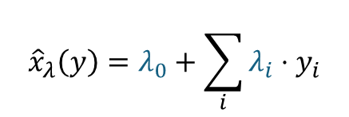
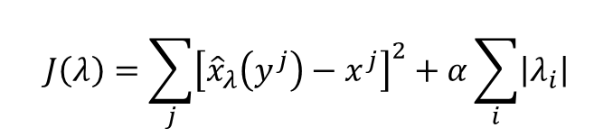
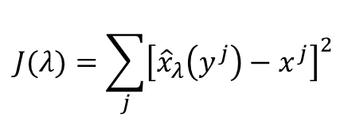
II. Modelling and Numerical Model
Training a Model (Python)
Use-case
$${\hat{x}}_{λ}\left(y\right)=λ_{0}+\sum_{i}{λ_{i}⋅y_{i}}$$
Choose a mathematical model to express the viscosity according the radius of the droplet
Choose an optimization criterion to train the model
Regularization to avoid overfitting
Linear model:
Input prediction
Output
Parameters of the mathematical model to optimize
Optimization criterion: minimization of the MSE
$$J(λ)=\sum_{j}{{\left[{\hat{x}}_{λ}\left(y^{j}\right)−x^{j}\right]}^{2}}$$
To minimize
Regularization: LASSO
$$J\left(λ\right)=\sum_{j}{{\left[{\hat{x}}_{λ}\left(y^{j}\right)−x^{j}\right]}^{2}}+α\sum_{i}{\left|λ_{i}\right|}$$
To choose appropriately to prevent overfitting
Notes:
The model is often “too complex”, and the optimization criterion may include regularization to prevent overfitting

Slide 9
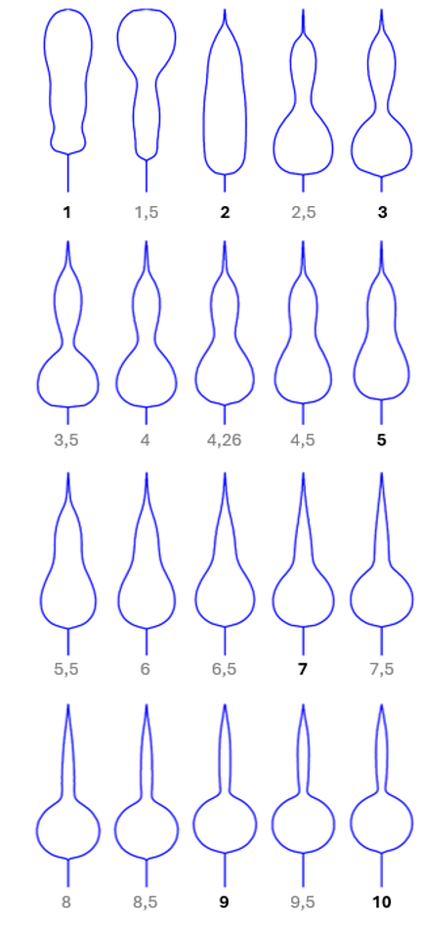
III. Main Results
Dataset: droplets shapes at break simulated for multiple values of viscosities (in cP)

Slide 10
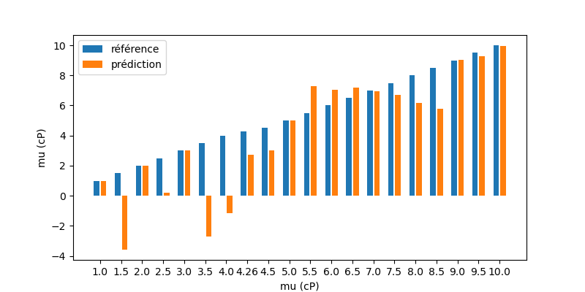
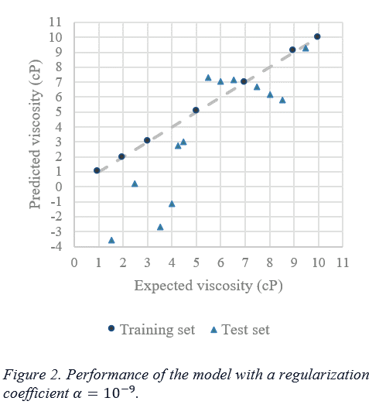
III. Main Results
Expected
Predicted
Train set
Good fit on train set
Bad predictions on test set
→ Overfitting X

Slide 11
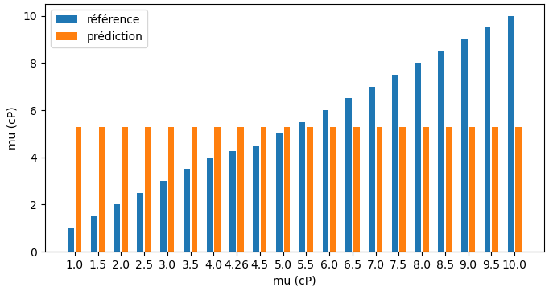
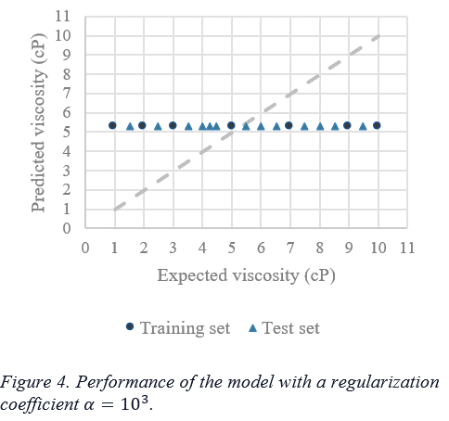
III. Main Results
Expected
Predicted
Train set
Bad fit on train set
Bad predictions on test set
→ Underfitting X

Slide 12
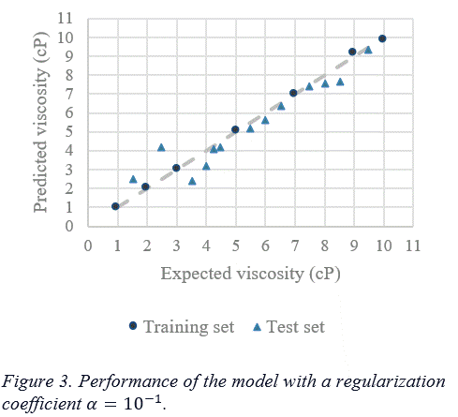
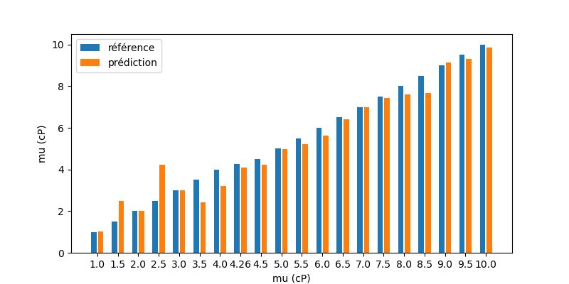
III. Main Results
Expected
Predicted
Train set
Good fit on train set
Good predictions on test set
→ Good model ✓

Slide 13
IV. Conclusions - Perspectives
Interest of Machine Learning methods:
  Minimize the simulation computational cost → Building Surrogate Models
  Retrieve simulation inputs providing a given output → Solving Inverse Problems
What we have done:
  Extract inputs/outputs data from COMSOL
  Solve an inverse problem using Supervised Machine Learning tools in Python
Flexibility of COMSOL is of great help to do so ☺
Coupling COMSOL with Machine Learning tools is feasible!

Slide 14
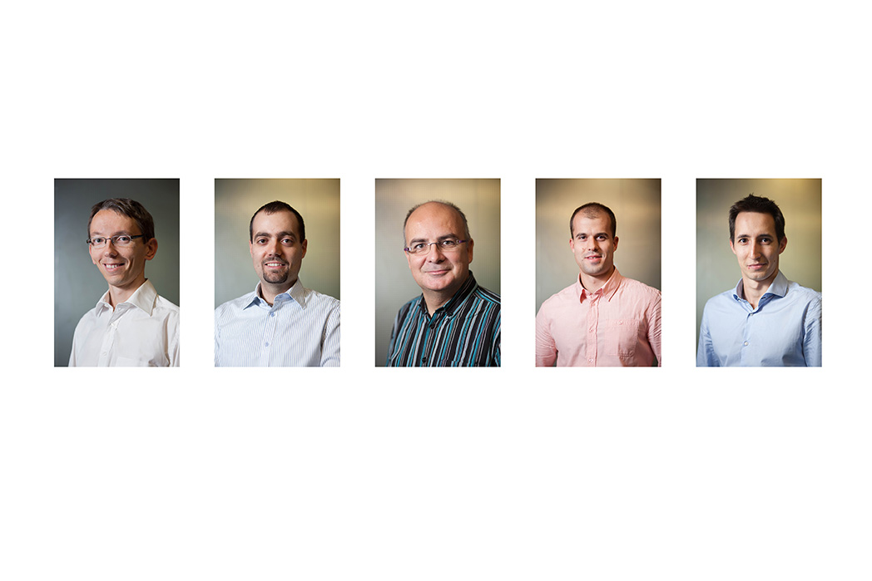
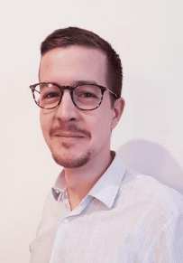
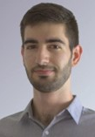
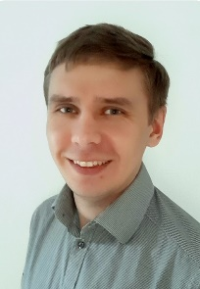
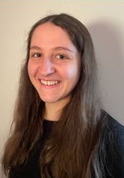
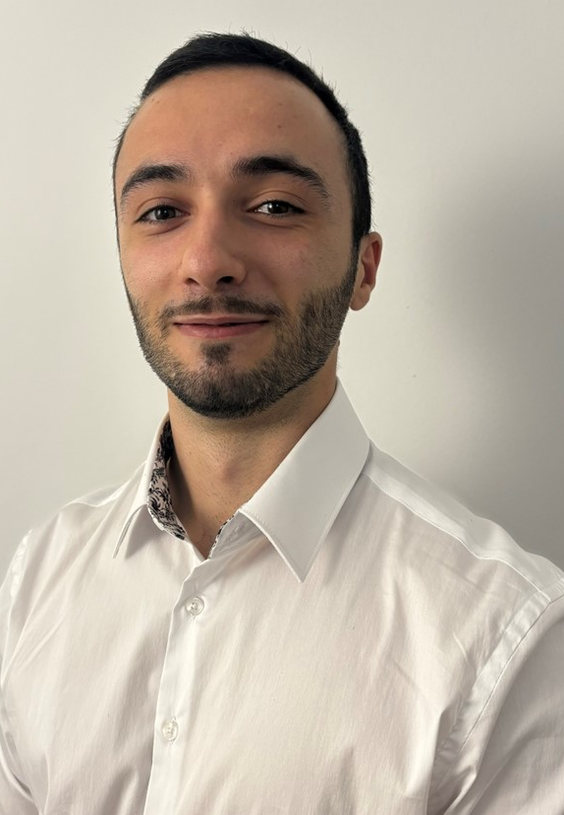
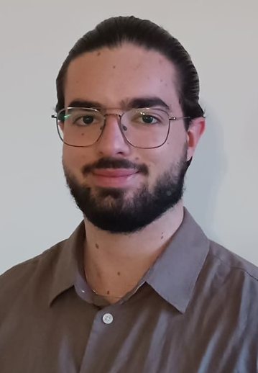

To finish…
Thank you!
Q&A?
Our question: Who would like to try on your models? ☺
Patrick NAMY
SIMTEC (+33) (0)9 53 51 45 60
patrick.namy@simtecsolution.fr

