Slide 1
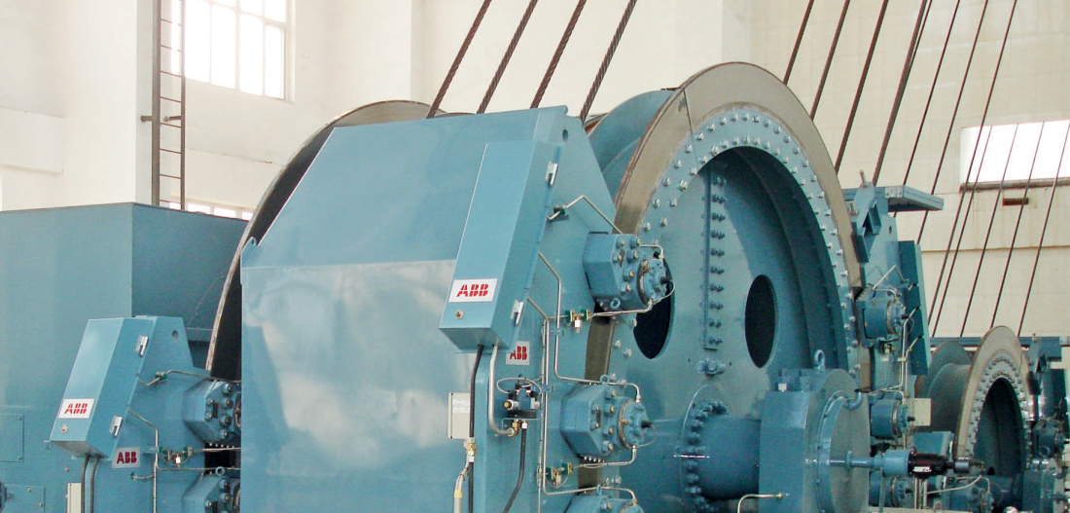
Towards Mechanical Digitalization of Mine Hoist with COMSOL
confidential
22-24 October 2024
COMSOL Conference 2024, Florence
Krystof Kryniski, Sean Martin, Jacob Van Wyk, Mike Davis, Tim Gartner

Slide 2
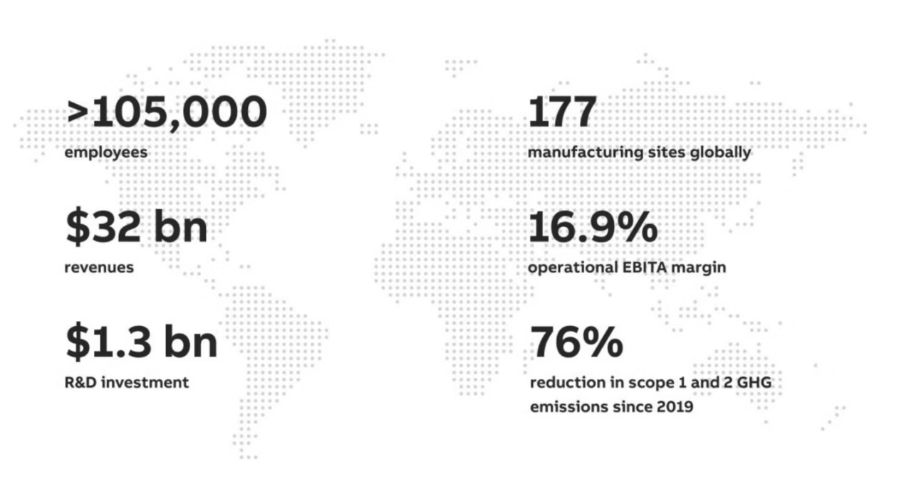
About ABB
ABB in numbers 2023
ABB solutions connect engineering know-how and software to optimize how things are manufactured, moved, powered and operated.
In collaboration with the customers, partners and suppliers, ABB address the world’s energy challenges, transform industries and embed sustainability in everything.

Slide 3
ABB MINING HOISTS
So, Let’s focus on it
Mine hoist is significant capital investments. Its efficient, safe, and reliable operation are of vital importance to mining companies. ABB delivers one of the largest units covering hoisting system , motors, control systems e.g., the ACS 6000 MV drives, break control system and related technical support.
Drums of diameter up to 5.7 m
ACS 600 for 3-36 MW motors
Payload up to 45 t with average payload up to 1530 tph
NO UNPLANNED DOWNTIMES !

Slide 4
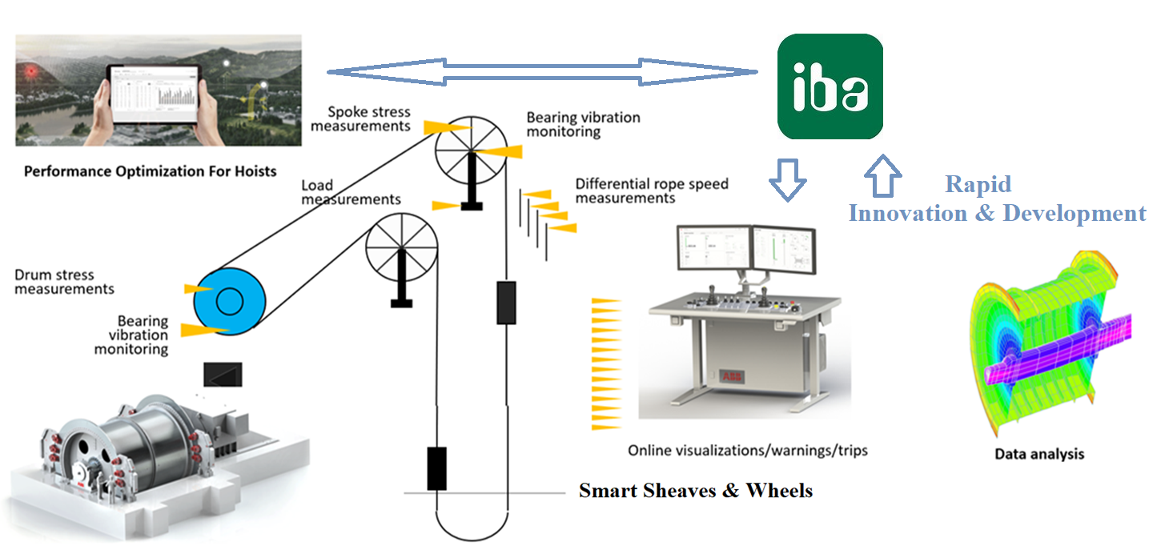
MECHANICAL DIGITALIZATION
ABB Vision on Mine Hoist Monitoring
Conventional process of mechanical design assumes predetermined, limited numbers of hoist load cycles.
After the initial design and commissioning of the mine hoist, the mechanical strain within the hoist components is usually no longer monitored.
It is generally assumed that the safety factors incorporated into the design are sufficient to ensure the safe operation of the mine hoist throughout its lifecycle.
New generation of hoists is going to be equipped with stress/vibration monitoring systems that continuously feed data into advanced models.

Slide 5
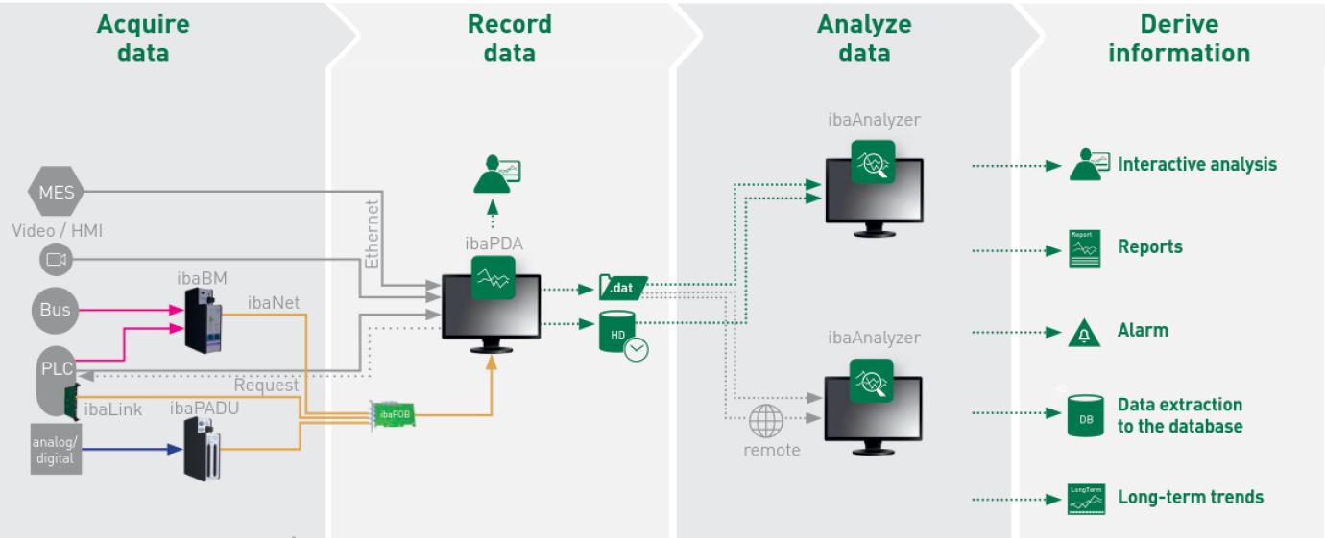
IBA BASED MONITORING SYSTEM
Rapid Innovation & Development
PLUG & PLAY
To stay ahead, research must have access to a dedicated, flexible, and powerful platform that can seamlessly integrate with existing industrial systems.
This would enable rapid testing and validation of new algorithms in real-world environments.
We must ensure technological advancements are not only theoretical but also practically applicable.
IBA SYSTEM

Slide 6
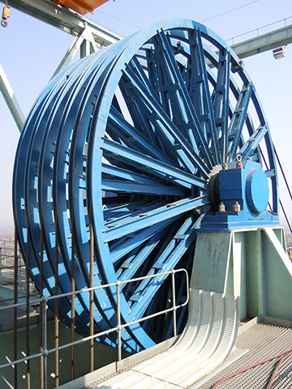
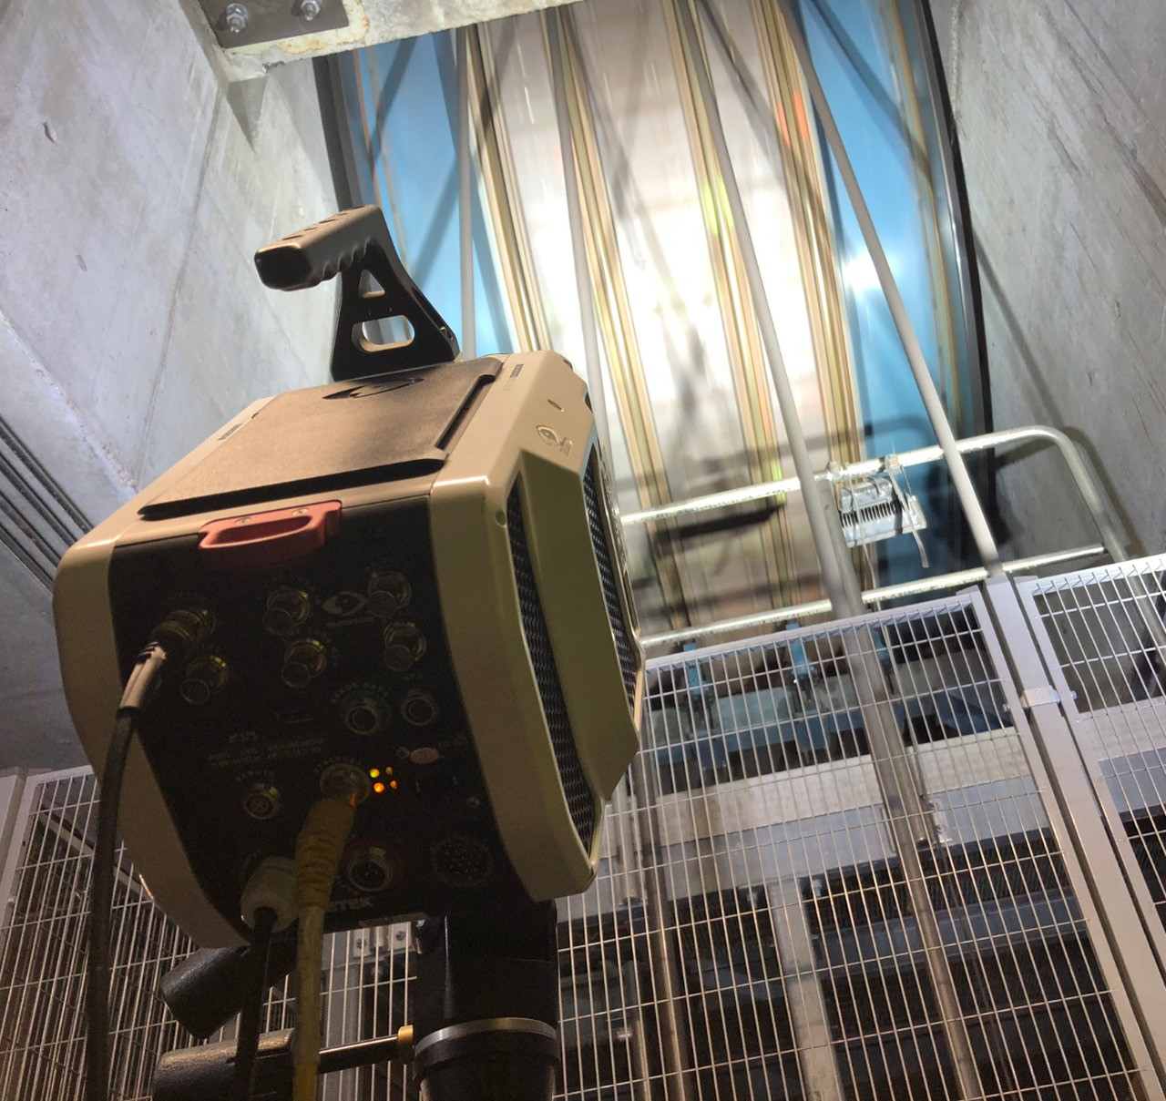
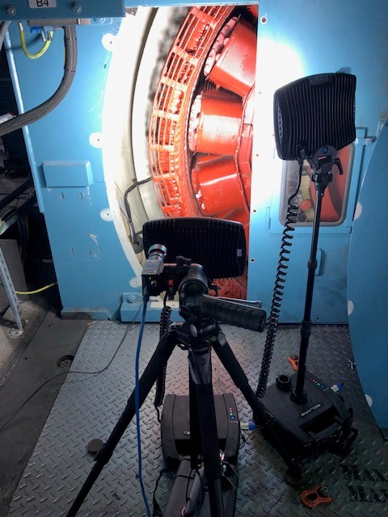
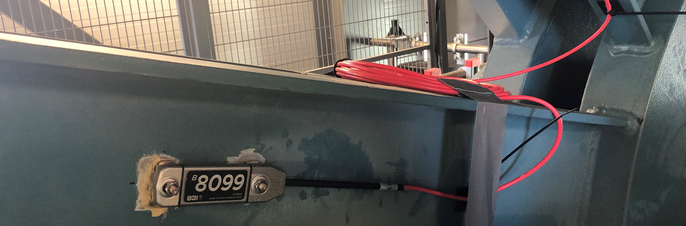
ADVANCED SENSING TECHNOLOGY
State-of-Art Sensors & Advanced Processing
IRIS-M Camera & KALMAN Order Tracking
Wireless, Multi-Channel Stress/Motion Sensors
Vision & Advanced Image Processing

Slide 7
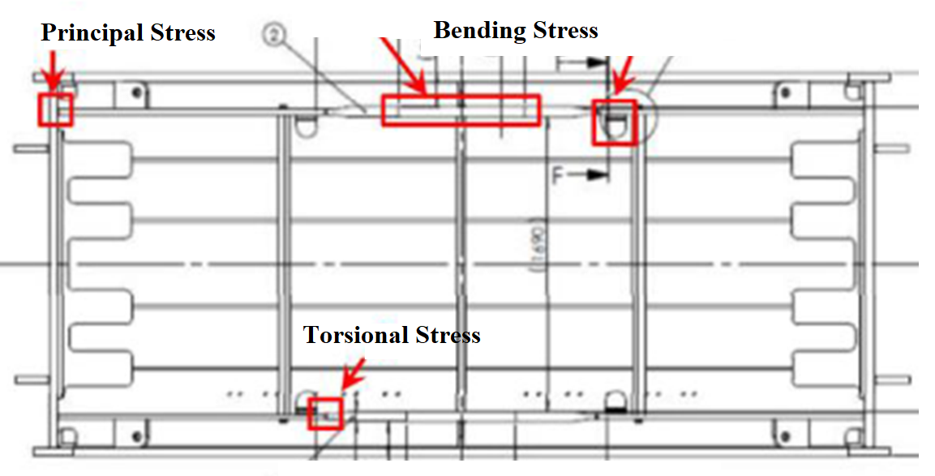
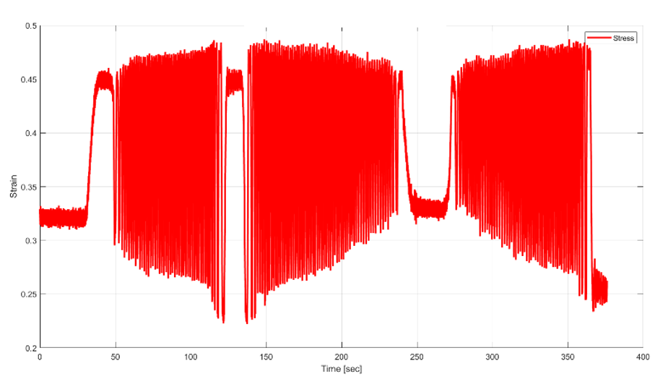
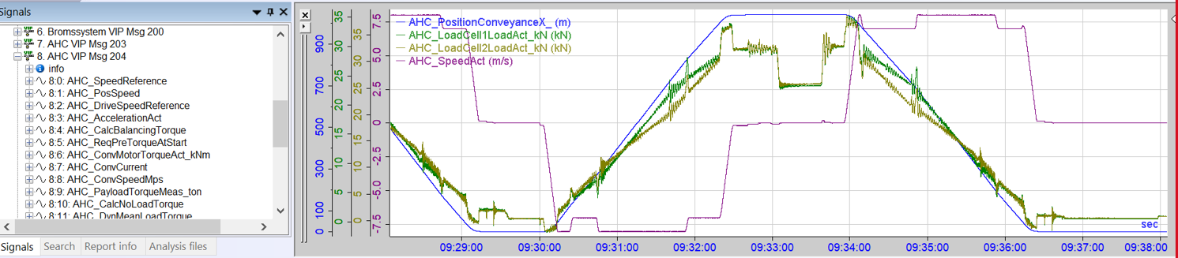
COMSOL PROTOTYPING
Stress Distribution & Life Assessment
Stress Distribution & Life Assessment
Virtual Sensors & Cross-Relations
Mechanical Digital Twin
    OPC data available as the INPUT
    Synchronized field data as OUTPUT
    Data simulated via validated models
    Surrogate Model Training
    Optimization of the hoist performance.
    Bending stresses in the drum
    Torsional stresses on a driving shaft
    Combined stress on the drum cheek
    Stress & vibration signals well-synchronized with OPC parameters-

Slide 8

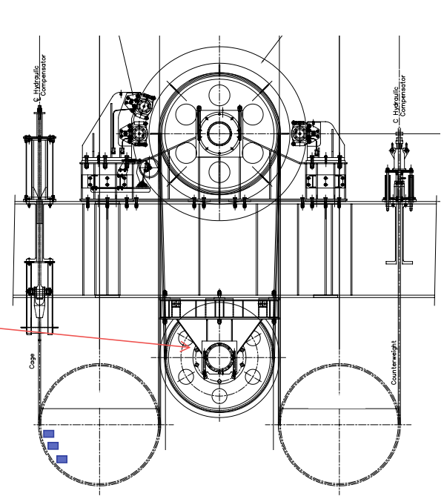
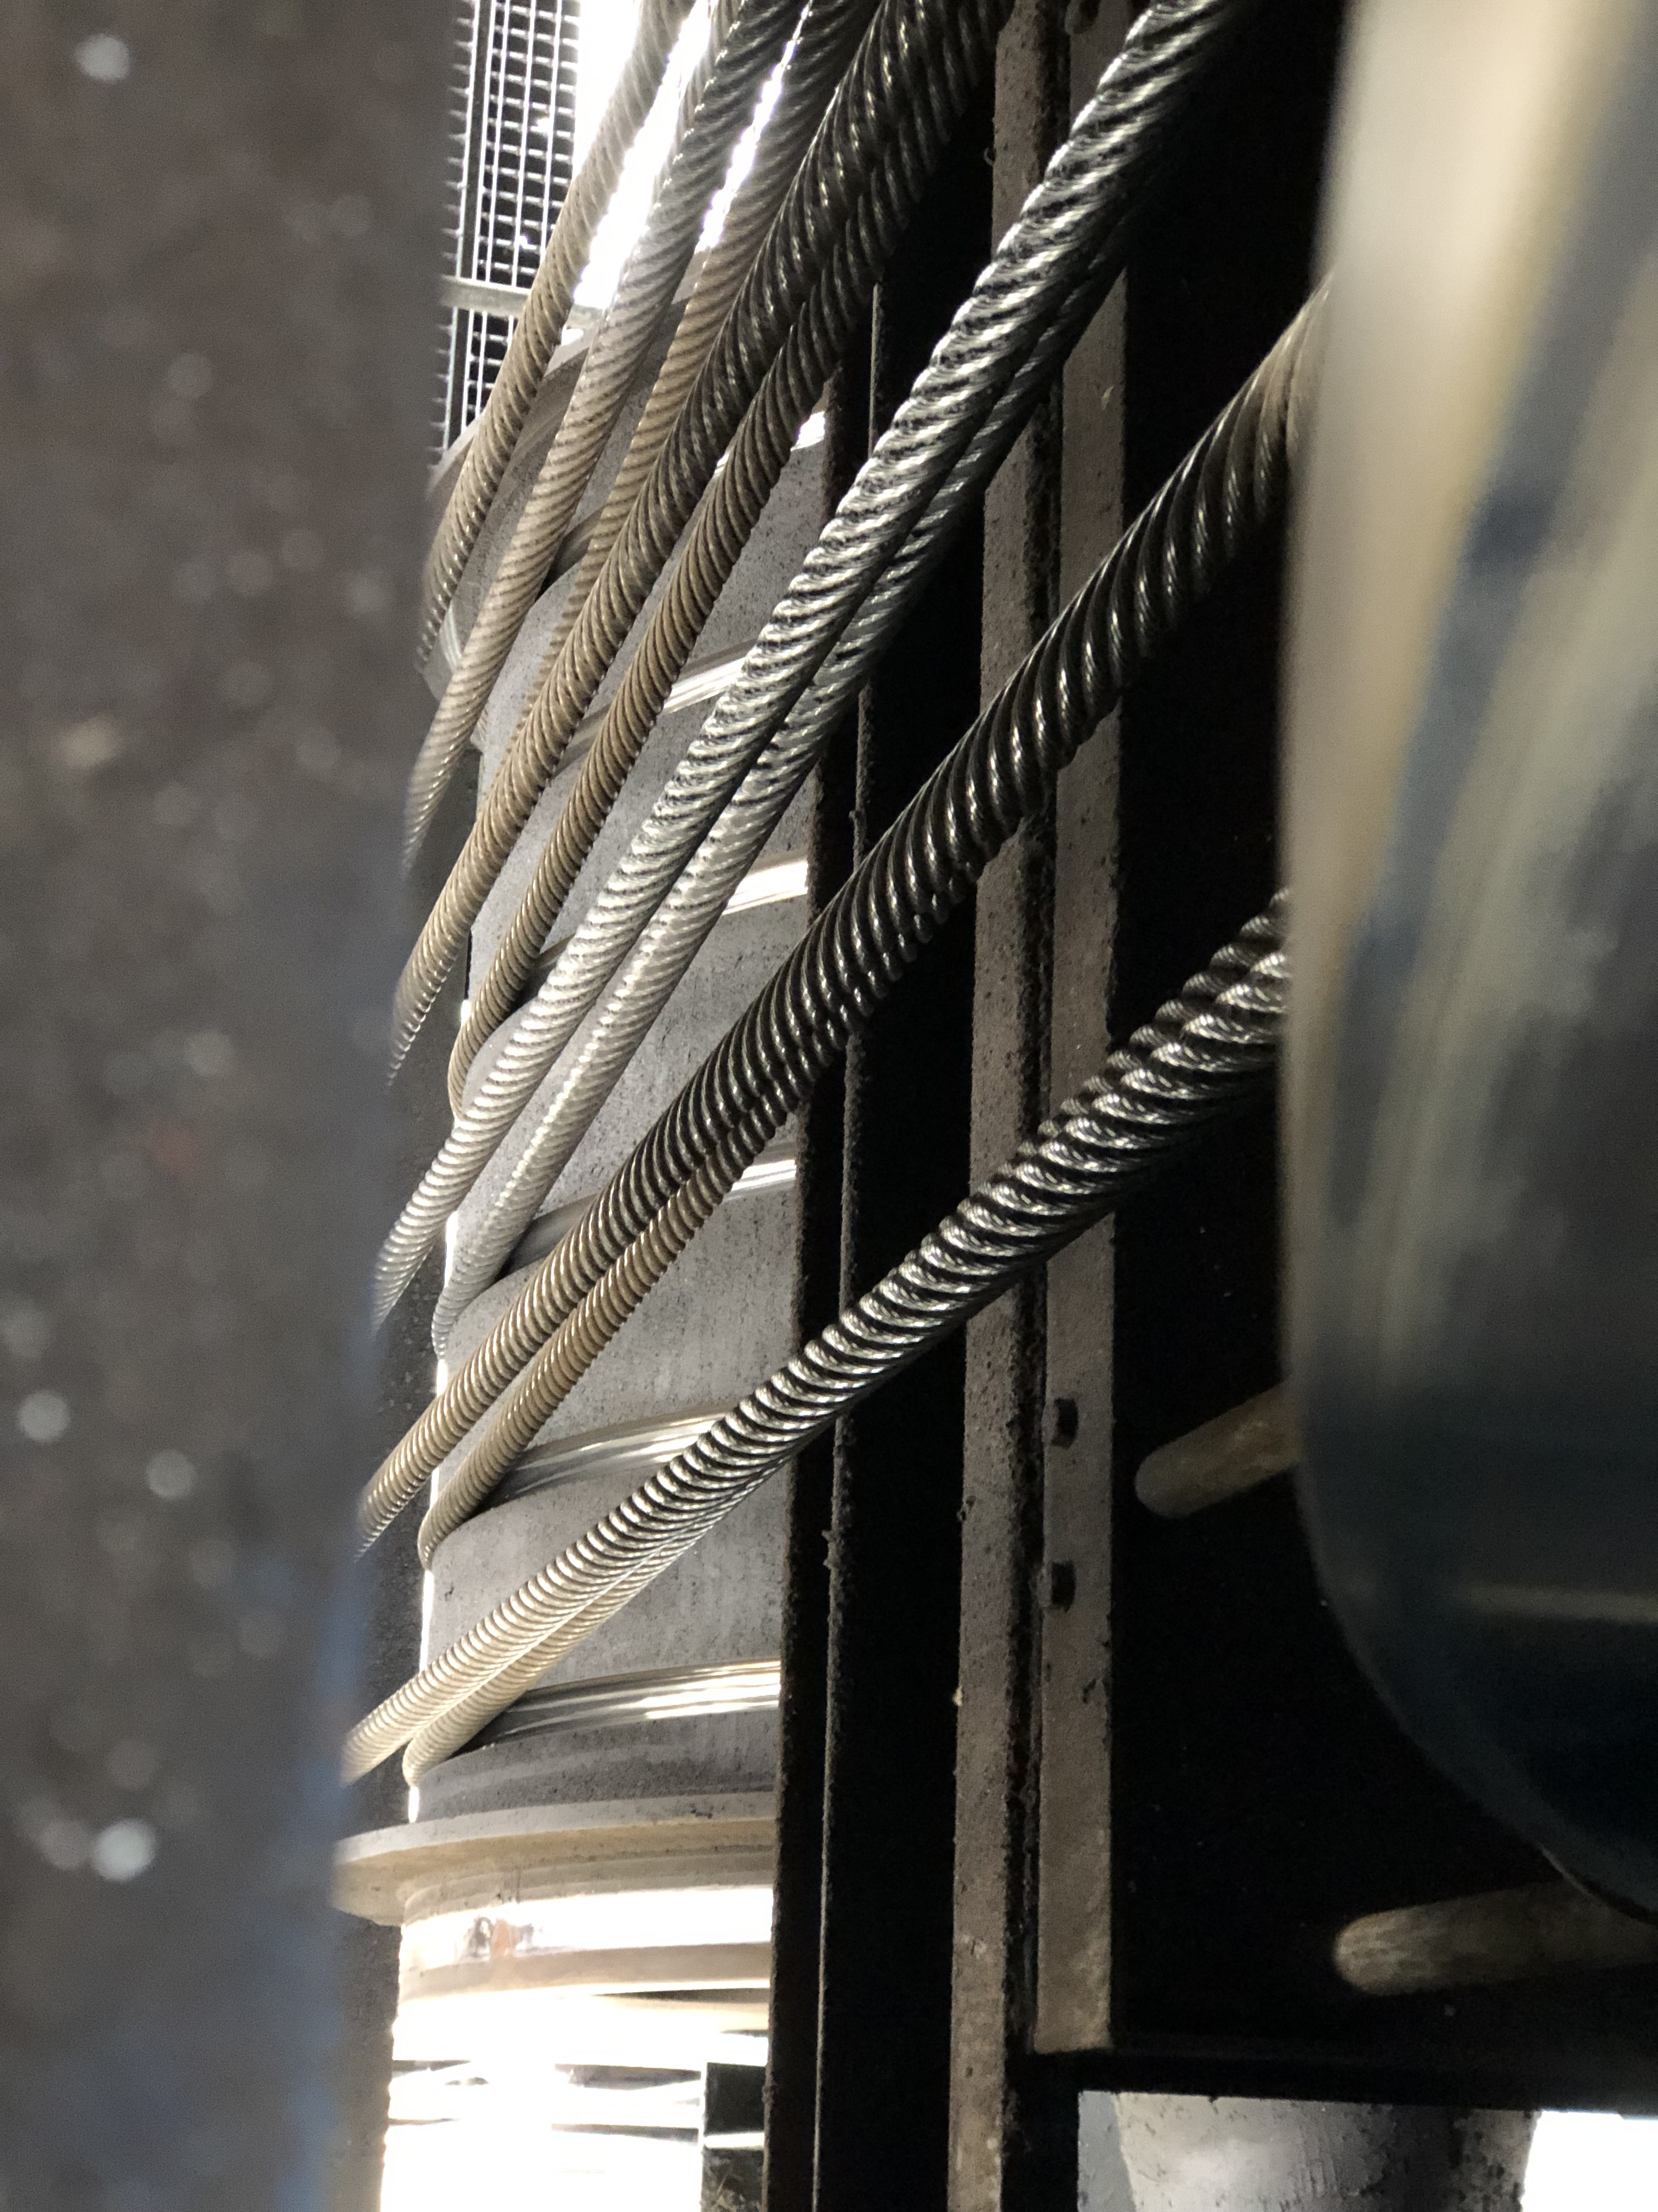
COMSOL PROTOTYPING
Structural Modelling & Life Assessment
Structural modelling in COMSOL is highly effective for simulating mechanical structures, analysing their behaviour under various loads, constraints, and environmental conditions, and assessing their long-term durability and reliability. The software enables rapid insights into hoist components or similar systems with relatively low computational power, making it efficient for both detailed analysis and operational life assessment.
Koepe Winder

Slide 9
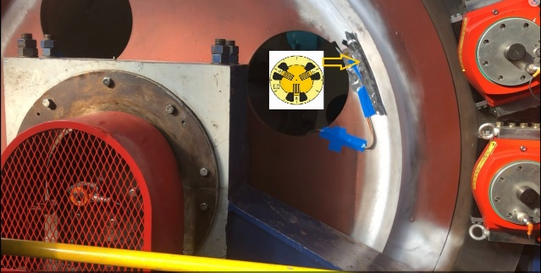
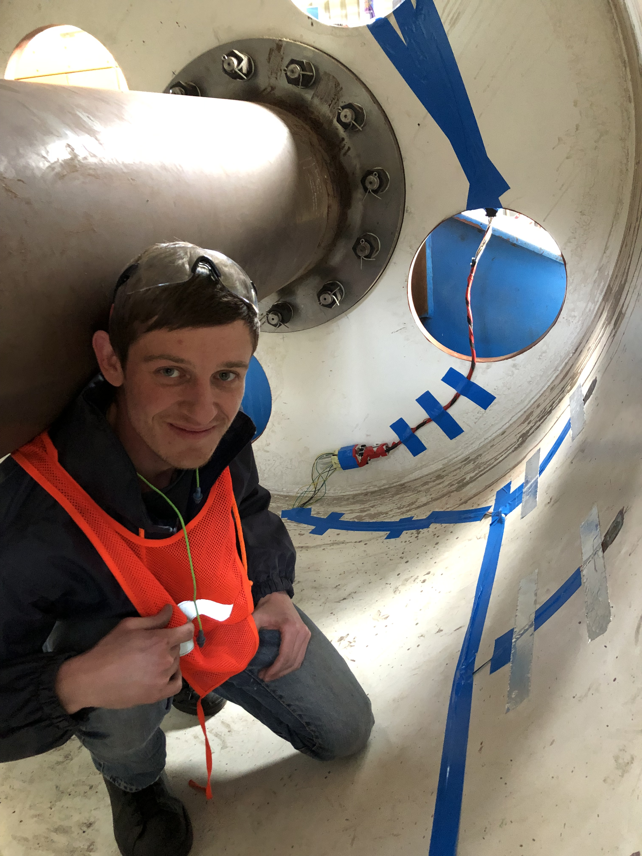
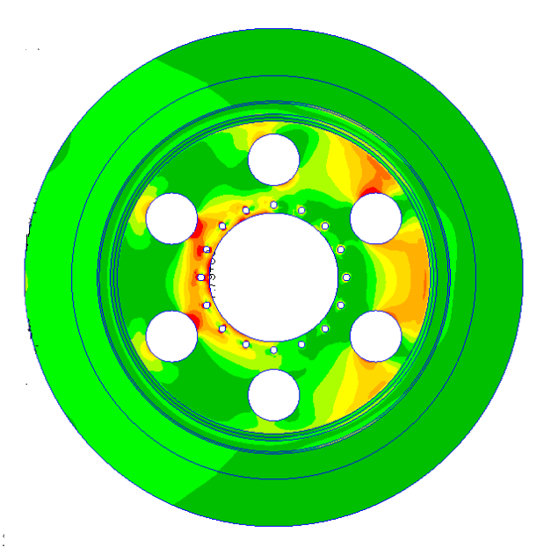
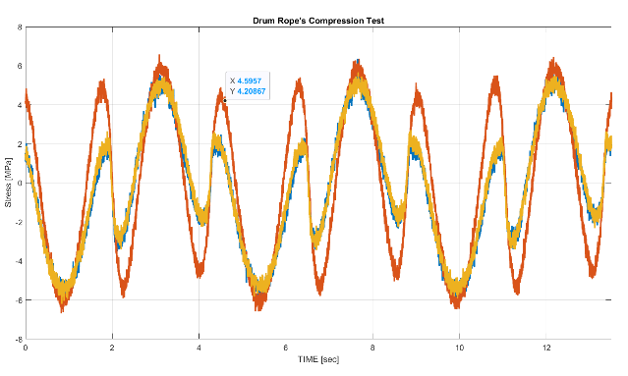
COMSOL PROTOTYPING
Structural Mechanics & Life Assessment
Structural modelling in COMSOL is highly effective for simulating mechanical structures, analysing their behaviour under various loads, constraints, and environmental conditions, and assessing their long-term durability and reliability. The software enables rapid insights into hoist components or similar systems with relatively low computational power, making it efficient for both detailed analysis and operational life assessment.

Slide 10
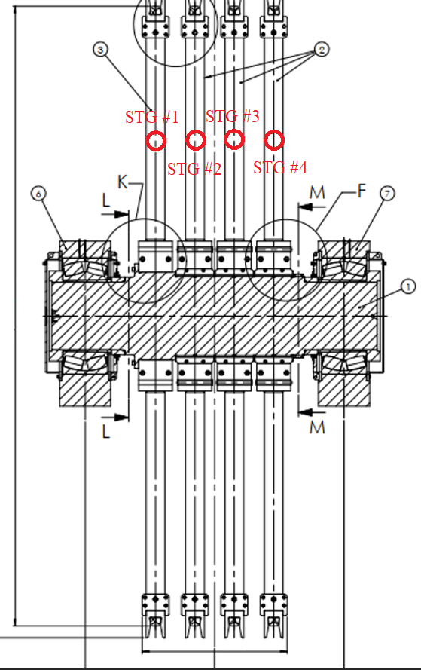

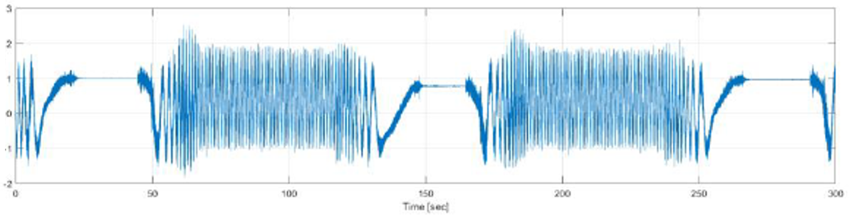
COMSOL PROTOTYPING
Virtual Sensors & Cross-Relations
Virtual sensors use models or algorithms to estimate physical quantities that are difficult or costly to measure directly. COMSOL enables the streaming of data such as stress, temperature, and displacement at specific locations, allowing for efficient monitoring and performance optimization without physical sensors. Additionally, COMSOL reveals mutual relationships between variables, enabling the creation of sensitivity and cross-correlation matrices for deeper analysis.
Improper Tension/Rope Slippage

Slide 11
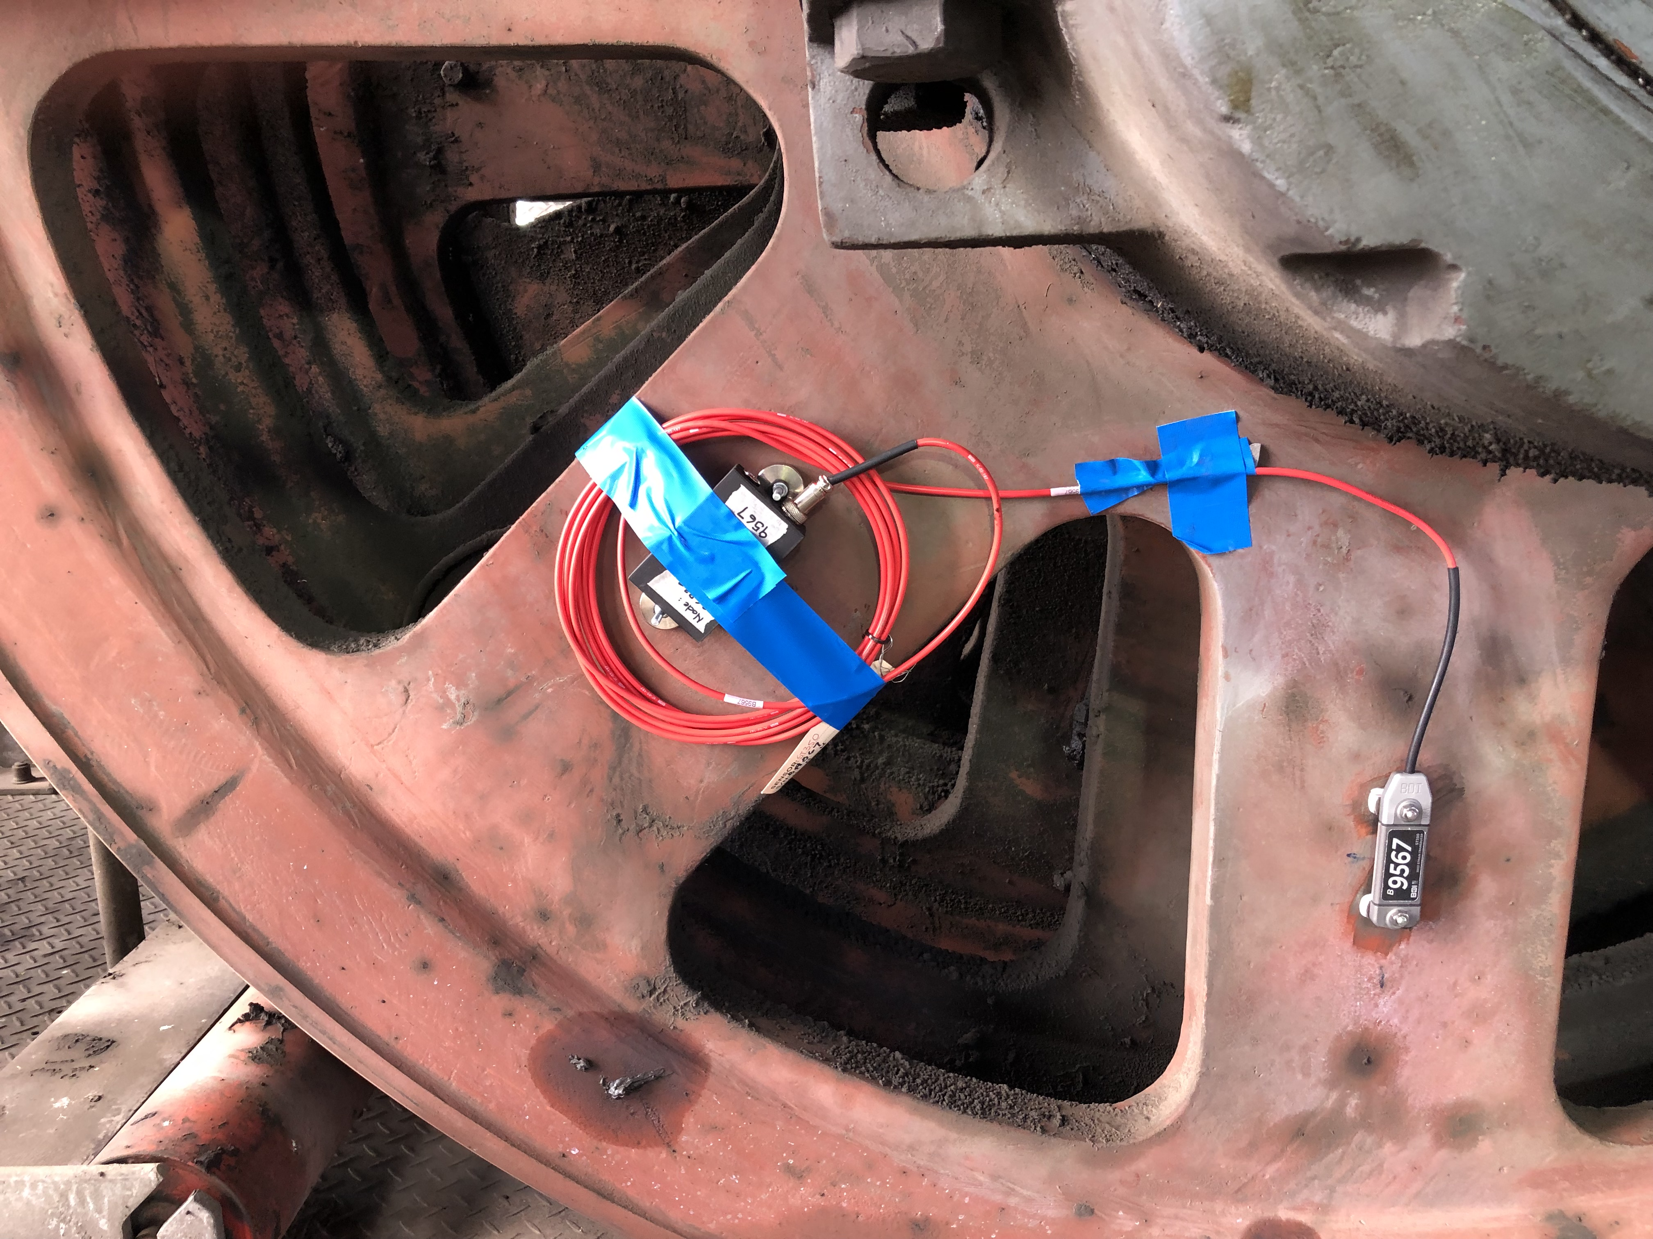
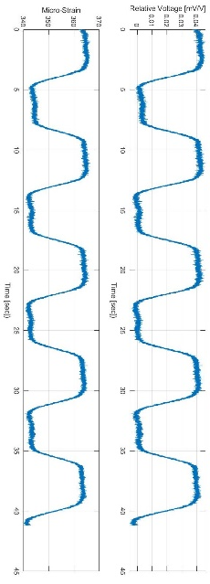
COMSOL PROTOTYPING
Virtual Sensors & Cross-Relations
Virtual sensors use models or algorithms to estimate physical quantities that are difficult or costly to measure directly. COMSOL enables the streaming of data such as stress, temperature, and displacement at specific locations, allowing for efficient monitoring and performance optimization without physical sensors. Additionally, COMSOL reveals mutual relationships between variables, enabling the creation of sensitivity and cross-correlation matrices for deeper analysis.

Slide 12

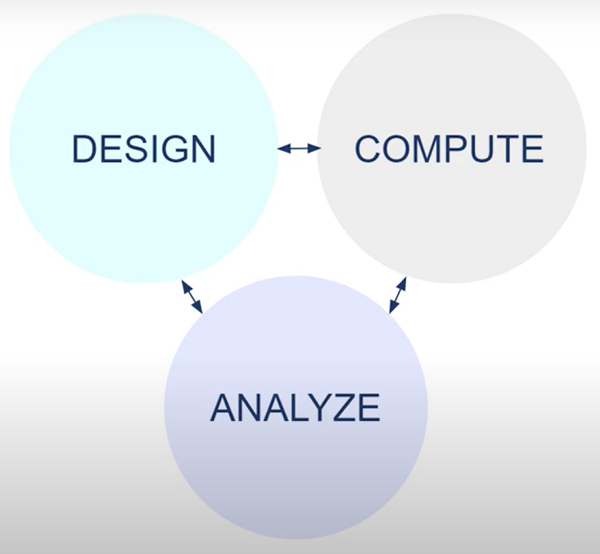
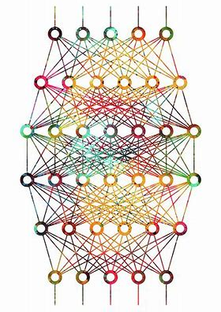
COMSOL PROTOTYPING
Industrial Modelling
Computationally expensive models can be approximated using surrogate models, also known as reduced-order models. These surrogates provide an efficient alternative to the full model by using machine learning algorithms, such as regression and neural networks, to fit the model based on data set. Once trained and validated, the surrogate model can be employed for rapid predictions, design optimization, and sensitivity analysis, significantly reducing computational costs and time.
PERFORMANCE OPTINIZATION OF HOISTS
OUTPUT
INPUT

Slide 13
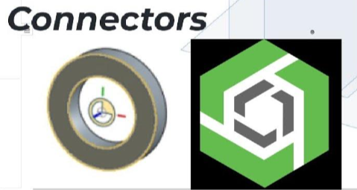
RINDÖ 2025
Extended Mate Connector
ONSHAPE
Concept of MATE CONNECTORS
COMSOL
ONSHAPE is CAD software, delivered over the Internet via SaaS model. It makes extensive use of cloud computing, with compute-intensive processing and rendering performed on Internet-based servers, and users are interacting with the system via a web browser.
ONSHAPE is NOT a Multiphysics Solution
Importing geometry objects from a 3D CAD file into COMSOL is seamless. However, setting boundary conditions and loads can be more complex and less intuitive
Mate connectors are local coordinate system entities located on or between entities. They are used within a mate to locate and orient instances with respect to each other. You can also use mate connectors to create planes.
COMSOL is NOT a CAD Solution
One of the key objectives of the RINDÖ project is to develop an extension for the mate connector automatically handling the loads and reactions between adjacent entities. Experimental validation is a MUST.

Slide 14
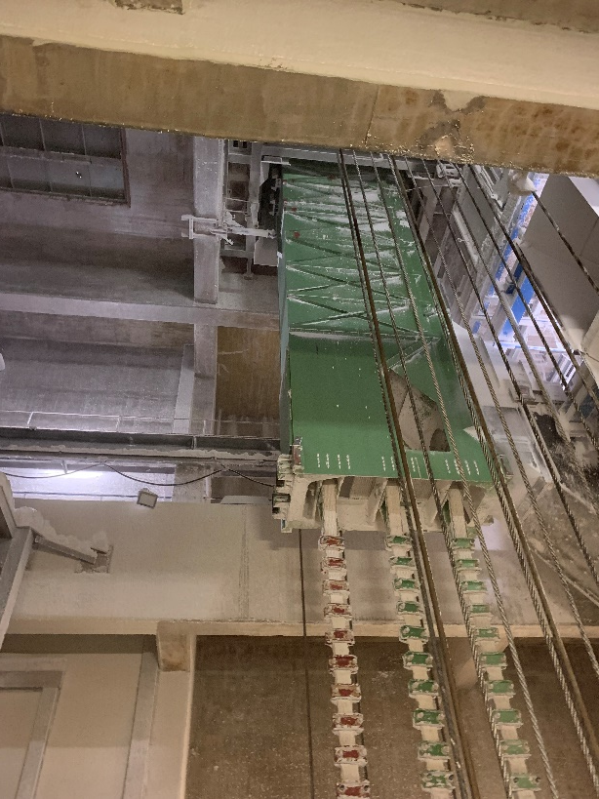
RINDÖ 2025
Potential Industrial Case
ABB is engaged in designing new skips for German potash mines, ensuring compliance with EUROCODE 3 standards.
The customer’s current skips have shown signs of minor cracking in their structure.
In response, the customer has requested a series of stress and vibration measurements to serve as the foundation for the calculations needed to develop new skips that are more resistant to cracking.
VIBRATION: 3-directional accelerometers
PRINCIPAL STRESSES: Rosette Strain-gauges
High-speed DAQ, remotely controlled
DATA: Several operational cycles for loaded and unloaded conditions.

Slide 15
