Slide 1
Towards Machine Learning for Acoustic Resonance Technology
23/10/2024
Elisabetta Merico^{1*} and Antonio Jimenez-Garcia²
¹Graduate Multiphysics Engineer, FT Technologies Ltd, Sunbury House, London, UK
²Principal Research Engineer, FT Technologies Ltd, Sunbury House, London, UK
*elisabetta.merico@fttechnologes.com

Slide 2
Agenda
  Introduction to FT Technologies
  Objectives of this Study
  Results of the Study
    Validation of COMSOL Model
    Hyperparameter Optimisation
  Conclusions
FT742 Flat Front [1]

Slide 3
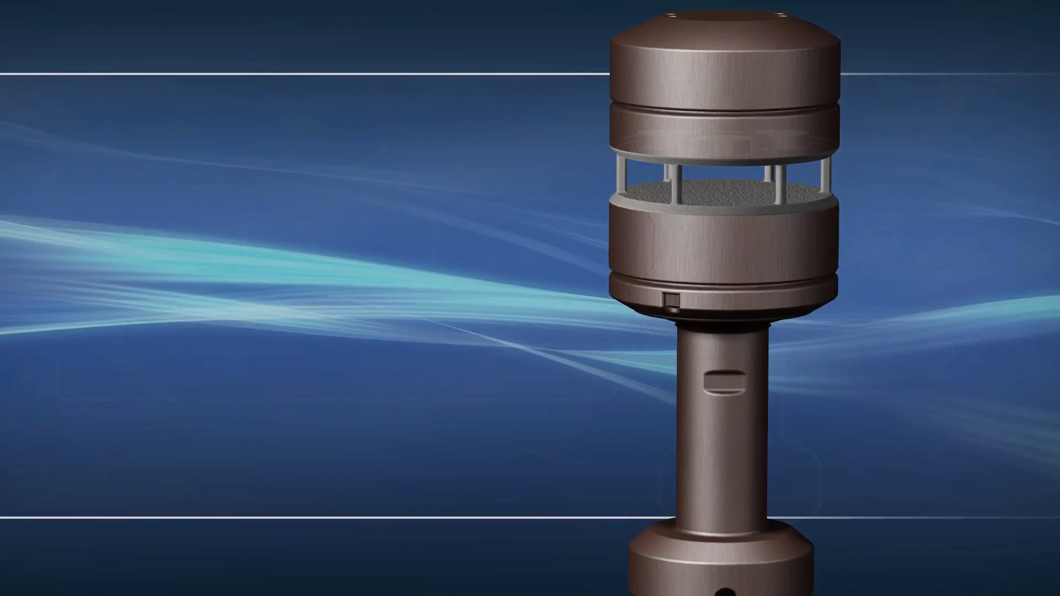
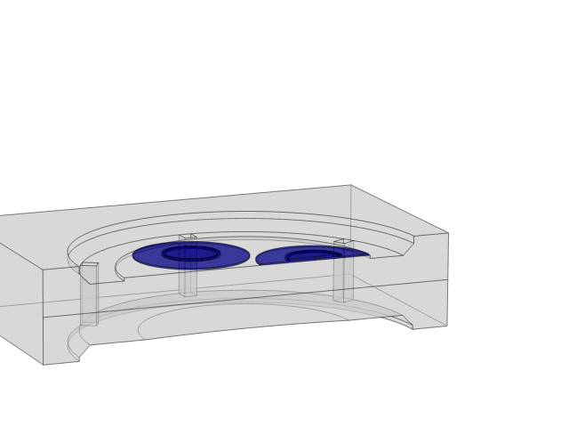
Introduction to FT Technologies
  Ultrasonic wind sensor that measures speed, direction, and temperature using acoustic resonance technology (Acu-Res® [2])
  Operating range from 0 to 90 m/s and -40°C to 85°C

Slide 4
Objectives and Steps of the Study
AIM: Comparison of Finite Elements (FE) simulations in COMSOL Multiphysics® and the new Surrogate Modelling functionality introduced in v6.2, with hyperparameter optimisation of a DNN to represent acoustic resonance technology
STEPS:
  Create and validate against experimental data an FE model in COMSOL Multiphysics® of the sensor resonator in the frequency domain, exploiting the Acoustic module and the LiveLink for SolidWorks®
  Generate a Design of Experiment (DoE), varying 10 geometrical parameters
  Use the DoE to train a DNN, optimising its hyperparameters through the comparison with the Finite Elements simulations

Slide 5
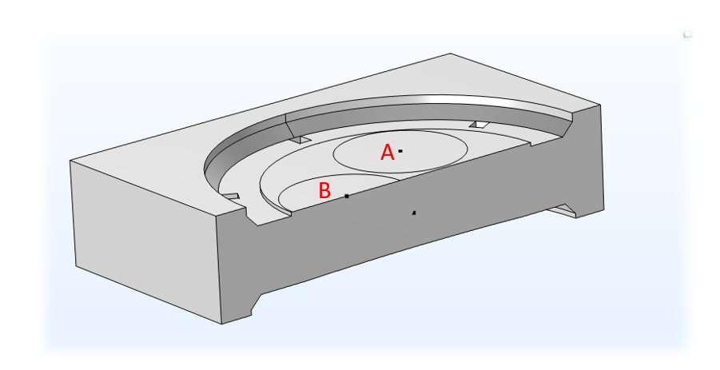
Step 1.a: FE Model Definition
Import a simplified geometry through the LiveLink for SolidWorks® (it will be needed later for the DoE)
Define computational domain encompassing half the resonator area and extending half the maximum[3] wavelength outside of it
Impose appropriate boundary conditions:
  Impedance matching at the extremes of the domain to avoid reflections
  Sound hard boundary in the middle plane to simulate a symmetry plane
  Wall with optimised absorption coefficient on the edges of the resonator cavity
  Constant amplitude of the normal velocity on transducer B to simulate its behaviour
Computational Domain encompassing half the resonator area, with transmitting transducer B and receiving transducer A

Slide 6
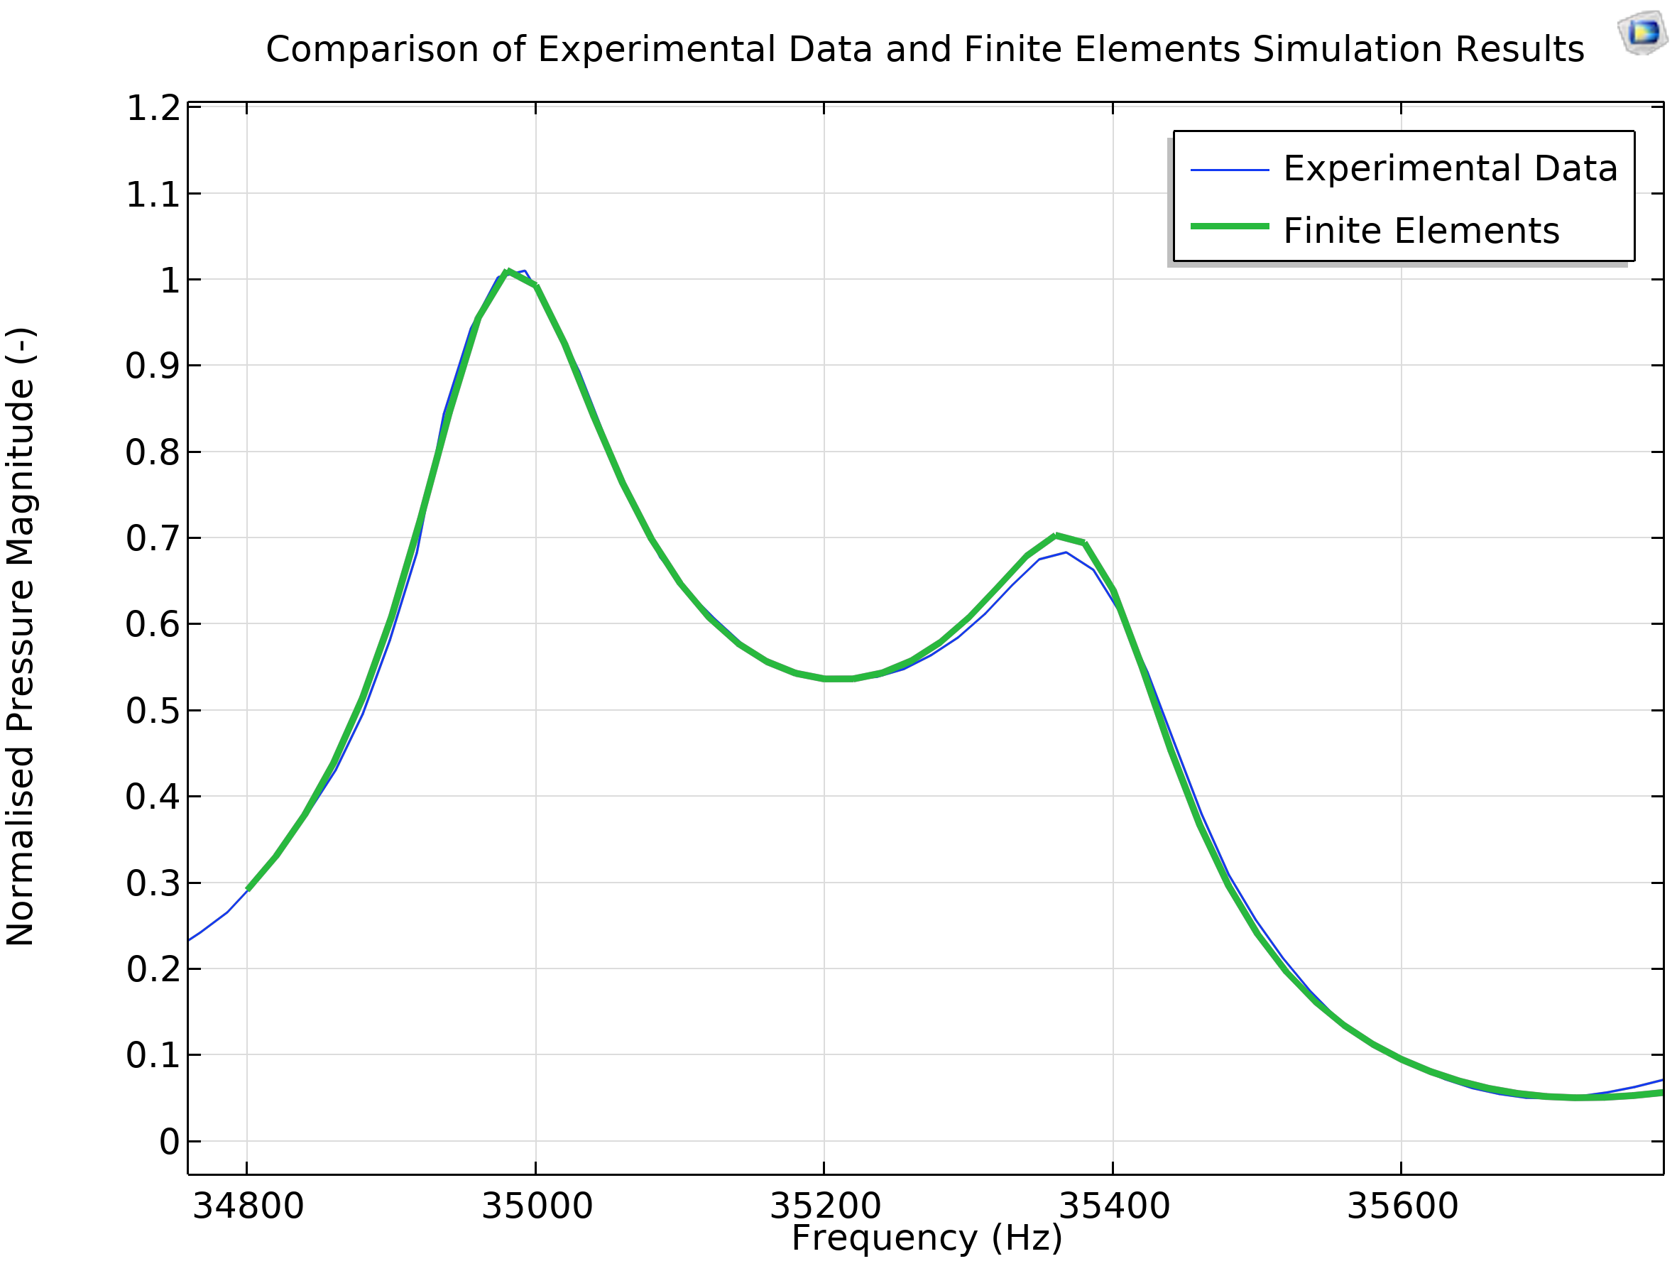
Step 1.b: FE Model Validation
Measure the dimensions of a real sensor on a coordinate measuring machine (CMM) and recreate an exact model in COMSOL
Compare the signal received by transducer A in the real sensor with the average pressure on the surface of transducer A in the simulation across the frequency range of interest
FE simulation validation against experimental data

Slide 7
Traditional Software vs AI
Traditional Software
AI Algorithm
PROs
It can adapt easily
It can handle complex problem
We don’t need to fully know the physics
user provides
user provides
input
input
rules
output
CONs
Often obscure
It can produce unexpected results
produced
produced
output
rules

Slide 8
Step 3: Build DNN and Compare Results with FE
Number of points in DoE needed
Optimal Learning Rate
Number of Epochs (duration of the training):
Layer Structure

Slide 9
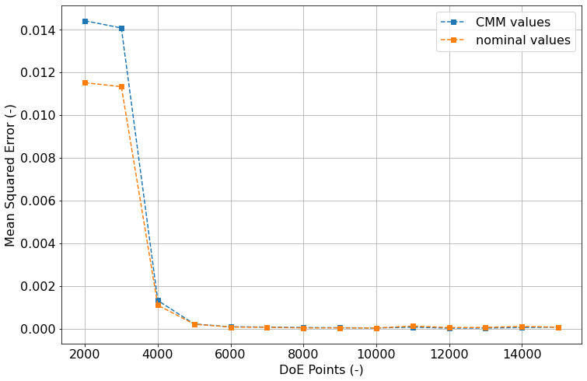
Step 3.a: Effects of the Number of DoE points
Increasing the number of points used to build the DoE greatly improves the accuracy of the DNN predictions, plateauing if more than 6000 points are used, both when compared with the nominal values and with the CMM scanned values
MSE between DNN predictions and FE simulation results for nominal and CMM values, increasing the number of points in the DoE

Slide 10
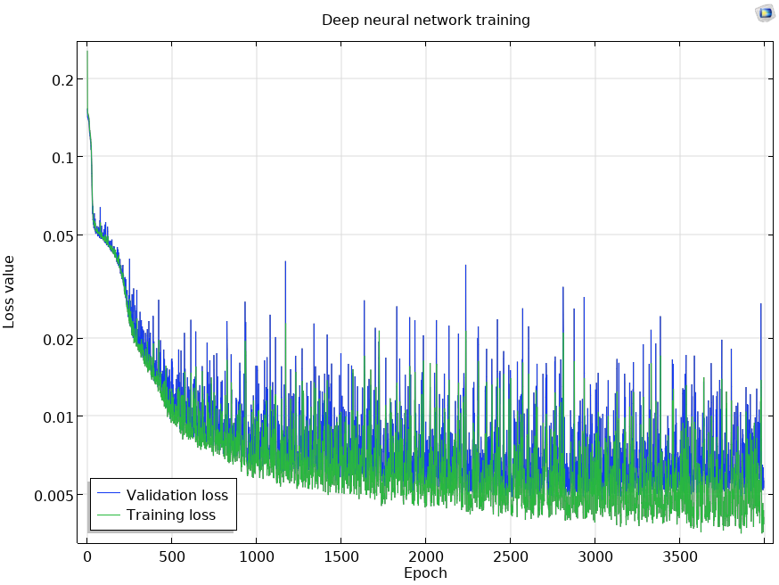
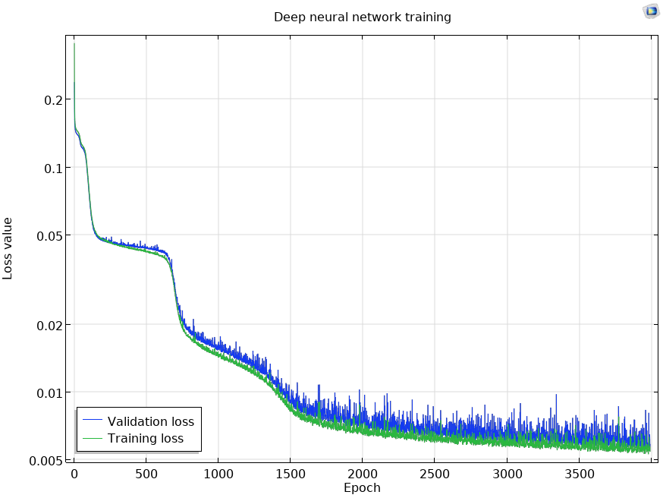
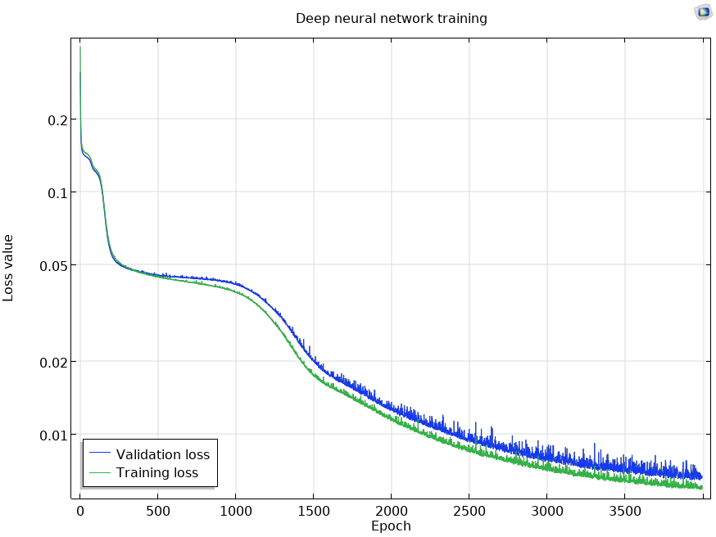
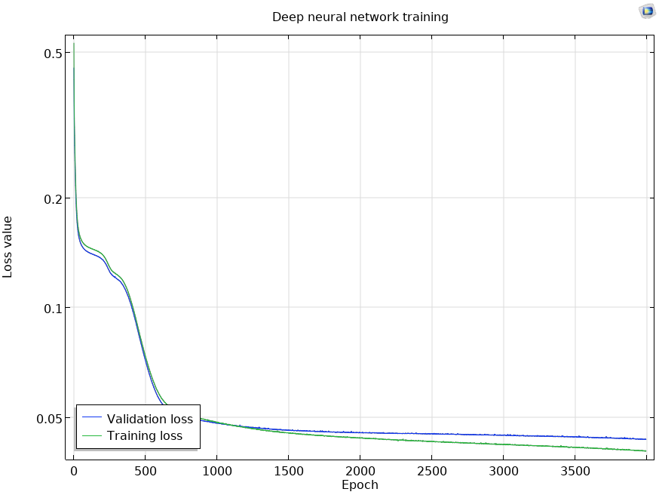
Step 3.b: Influence of Learning Rate (α)
α = 5e-3
α = 1e-3
Overfitting
α = 5e-4
α = 1e-4
Loss function decrease with epochs when different learning rates are employed
Training Not Finished
Stuck in a local minimum

Slide 11
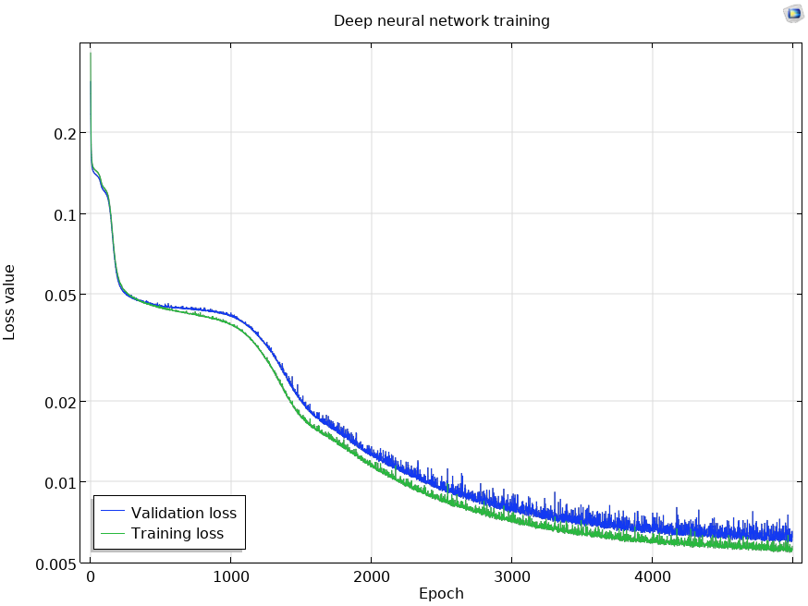
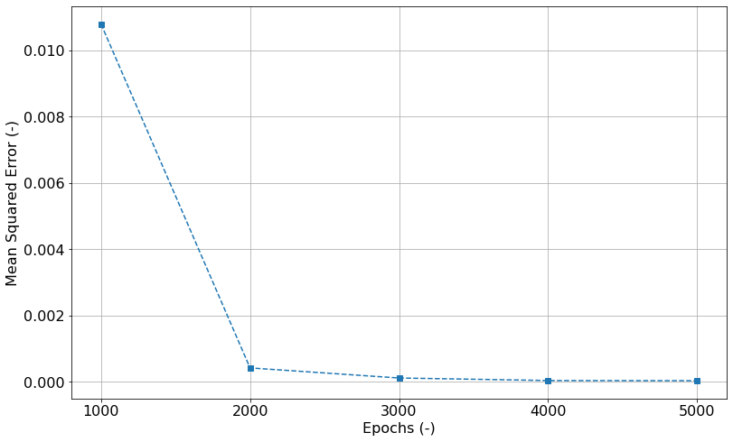
Step 3.c: Effects of the Duration of the Training
The longer the training, the smaller the loss function is allowed to get; however, comparing the DNN predictions with FE simulation results shows that the improvement after 4000 epochs is negligible
a
b
c
d
e

Slide 12
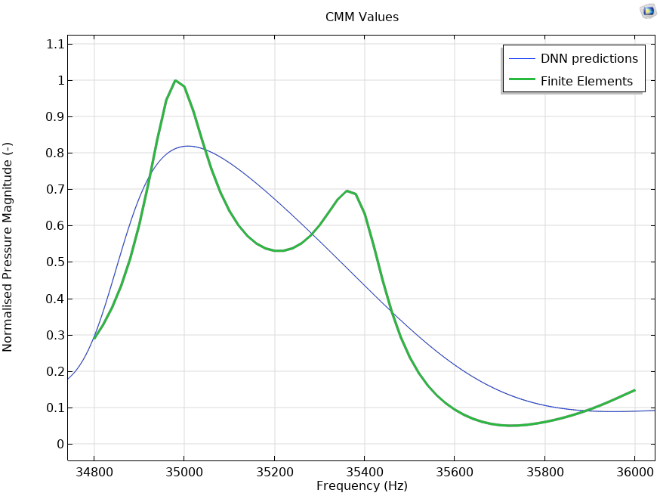
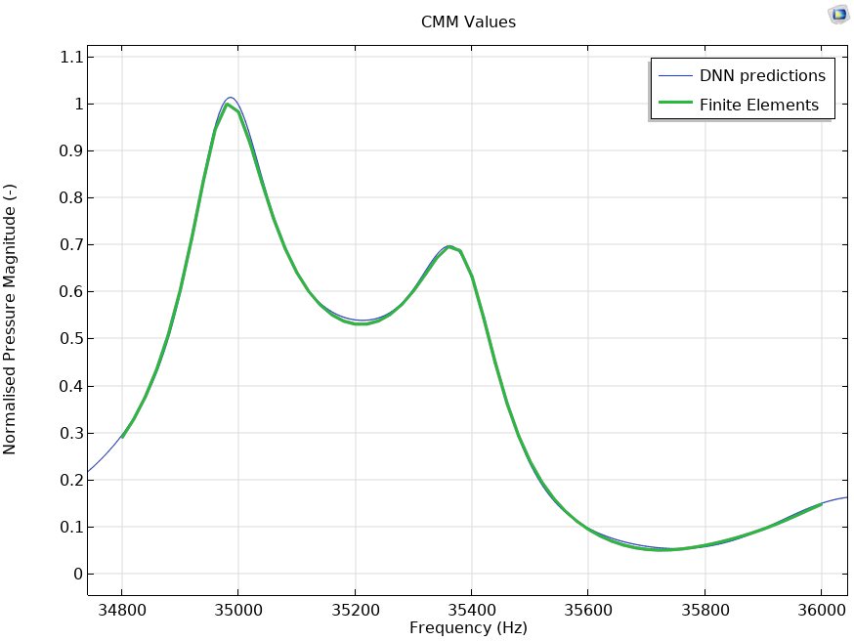
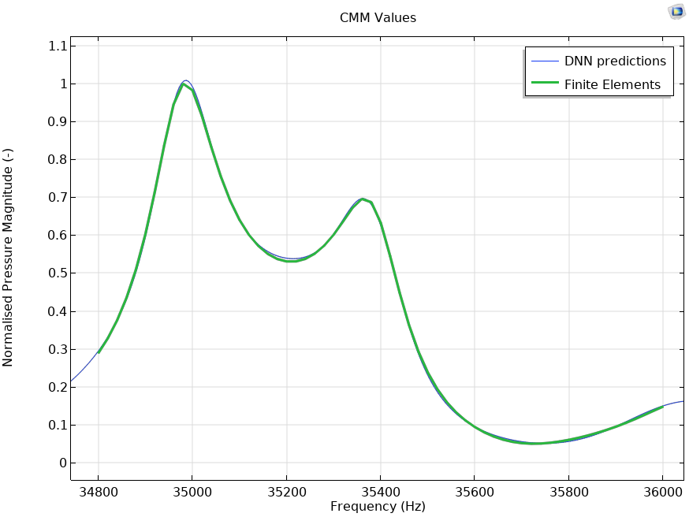
Step 3.c: Effects of the Duration of the Training
1000 epochs
4000 epochs
5000 epochs
Comparison of the DNN predictions with FE simulations when CMM values are considered for an increasing number of epochs for the training
When the Deep Neural Network is allowed more epochs for the training the loss error decreases, leading to a higher accuracy of the predictions

Slide 13
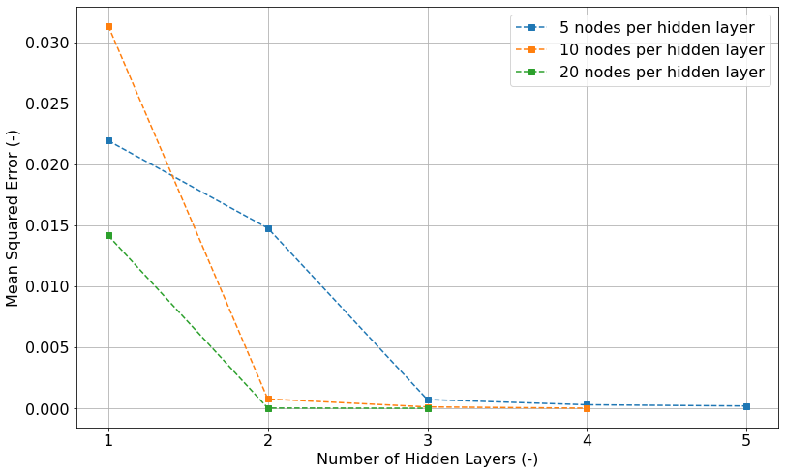
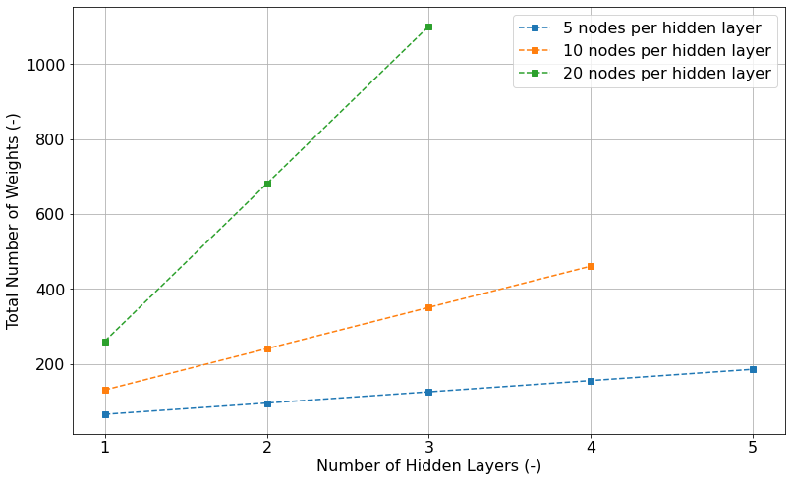
Step 3.d: Influence of the Layer Structure
Increasing the number of layers more complex features and non-linearities of the function can captured by the DNN
A wide network greatly increases the number of weights needed, causing a longer and more computationally expensive training of the DNN

Slide 14
Conclusions
Optimised DNN hyperparameters:
  DoE points: 6000
  Learning Rate (α): 5e-4
  Epochs to train for: 4000
  Wider shallow layer structure
Computational Time Comparison:
  With FE simulations:
    4 mins/simulation
    3¹⁰ simulations needed
    236,196 mins ≈ half a year
  With ML:
    14.5s per point in DoE
    6000 points needed
    24 hrs 10 mins

Slide 15
References
[1] FT Technologies website, https://fttechnologies.com/ , last accessed 19/09/2024
[2] S. Kapartis "Anemometer employing standing wave normal to fluid flow and travelling wave normal to standing wave." U.S. Patent No. 5,877,416. 2 Mar. 1999
[3] A. Jimenez-Garcia and G. C. Diwan, "A comparison of acoustic solvers for FT ultrasonic wind," in 54th Spanish Congress on Acoustics, Cuenca, 2023.

