Slide 1

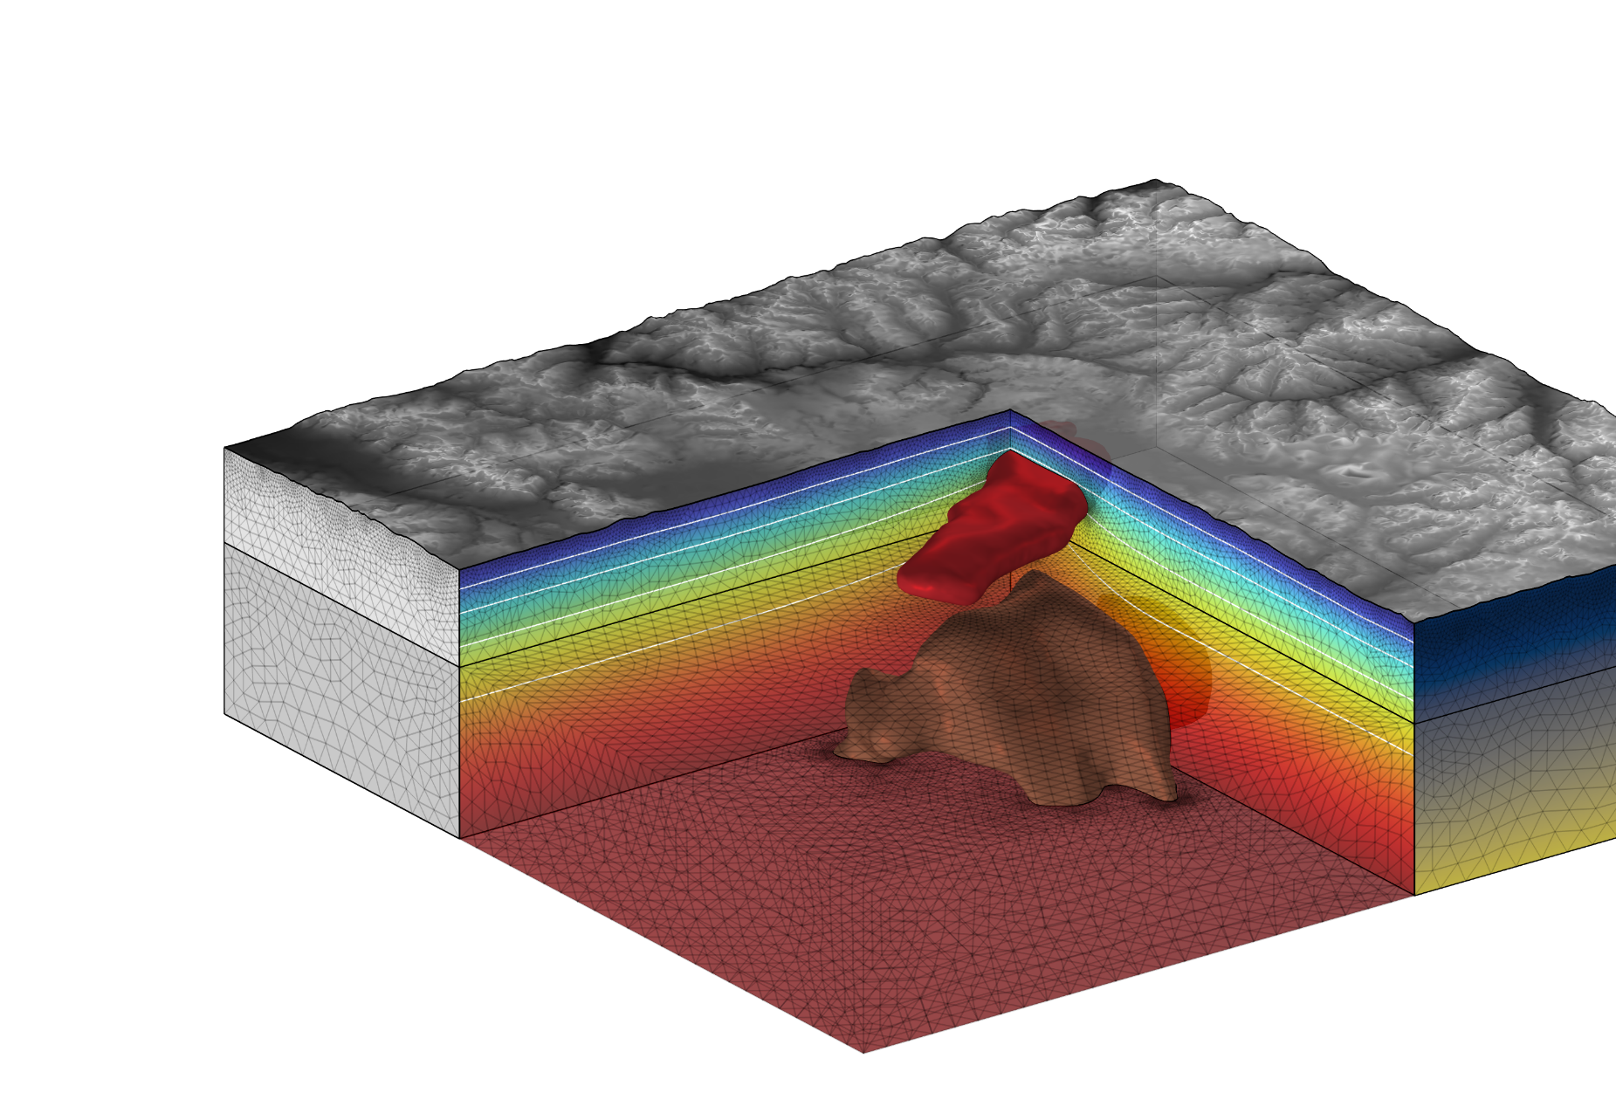




This work is carried out as part of the Italian project TRHAM (project code: p2022p37sn)
funded under the PRIN 2022 PNRR call
Thermo-Rheological Modelling of the Yellowstone Caldera:
Insights into Volcanic Processes
Perrini M.¹, Gola G.², Tizzani P.¹, Fedi F.³, Brahmi M.^{1,3}, Castaldo R.¹
1) 2) 3)
1. Istituto per il Rilevamento Elettromagnetico dell’Ambiente (IREA), Consiglio Nazionale delle Ricerche (CNR), Via Diocleziano, 328, 80124 Napoli, Italia.
2. Istituto di Geoscienze e Georisorse (IGG), Consiglio Nazionale delle Ricerche (CNR), Via Valperga Caluso, 35, 10125 Torino, Italia.
3. Dipartimento di Scienze della Terra, dell’Ambiente e delle Risorse (DiSTAR), Università degli Studi di Napoli Federico II, Via Vicinale Cupa Cintia, 21, 80126 Napoli, Italia.

Slide 2
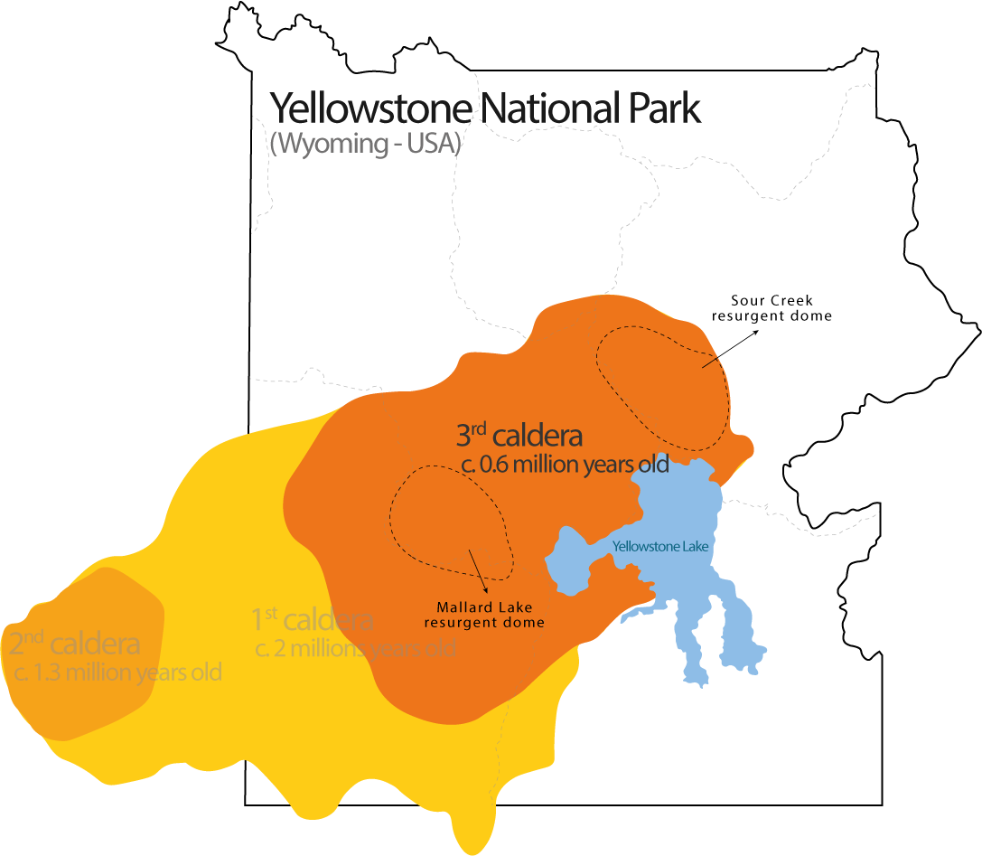
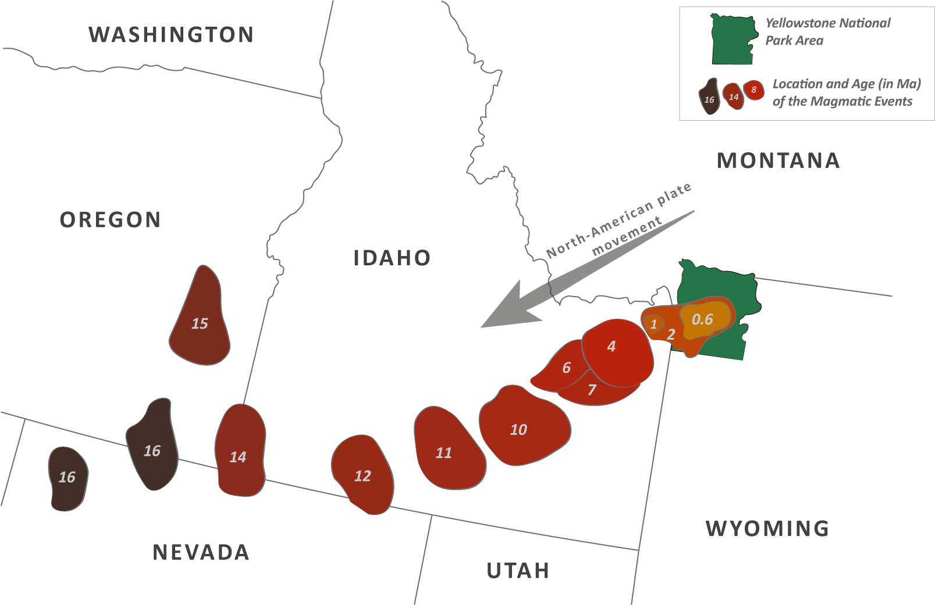
The Yellowstone Volcanic Field is one of
the largest centers of silicic magmatism on Earth
The Yellowstone hotspot is responsible for a series of volcanic eruptions over millions of years, creating the Yellowstone Caldera and other volcanic features
(Christiansen, 1982, 1989; M. A. Lanphere et al.,2001)

Slide 3
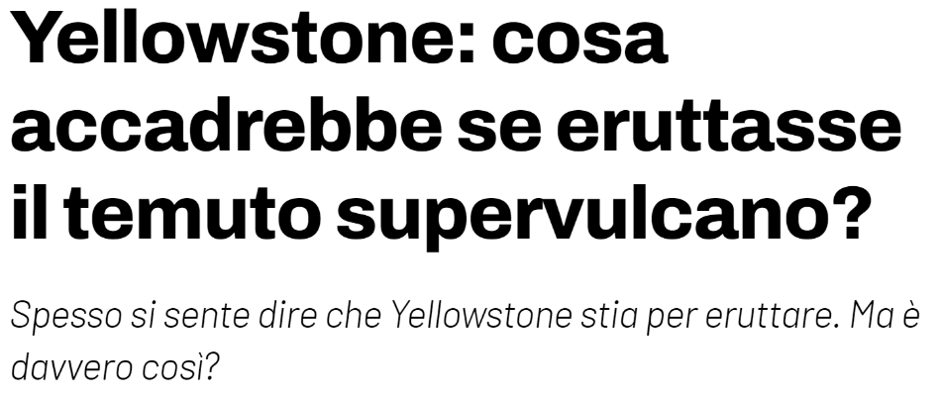
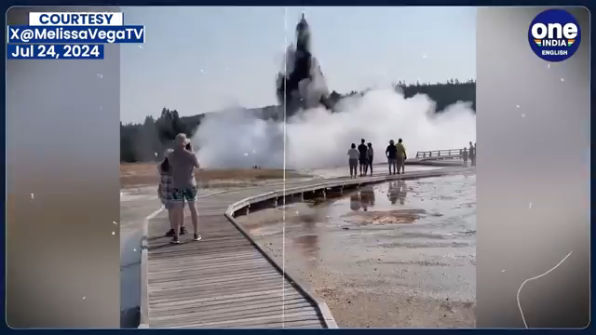
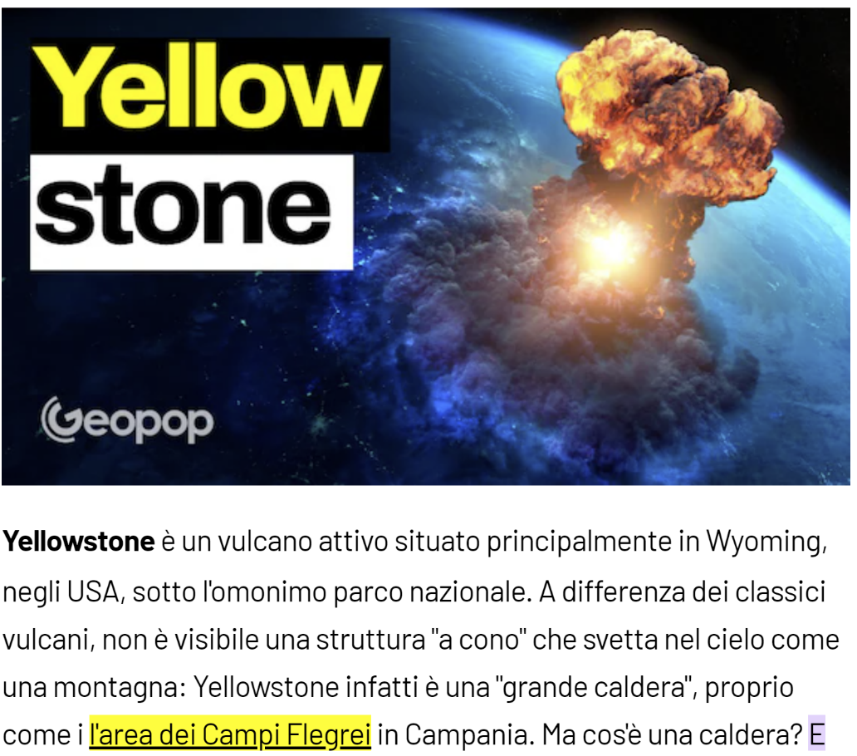
Yellowstone draws significant scientific attention due to its massive eruption potential and active geothermal system
July 23, 2024
a hydrothermal explosion occurred at Biscuit Basin serving as a stark reminder of the volcanic-geothermal hazards in the park
Studying the thermal state of the Crust beneath the Yellowstone National Park is crucial as it provides insights into the dynamics of one of the world's most active volcanic systems

Slide 4

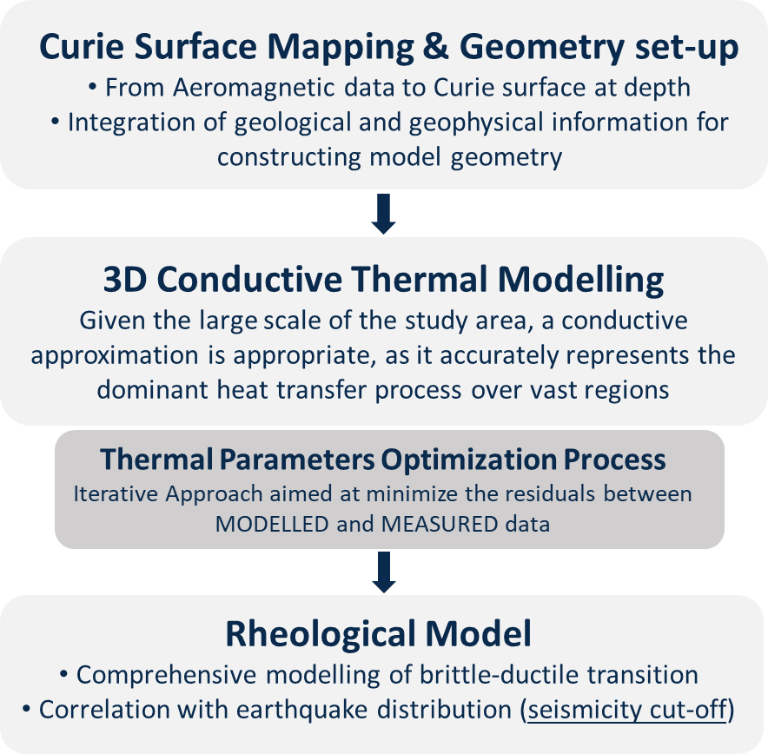

GOAL AND APPROACH
MODELLING WORKFLOW
GOAL AND APPROACH
Investigate the thermo-rheological state of Yellowstone crust, focusing on the interactions between thermal dynamics and crustal mechanics, which are essential for evaluating volcanic activity, geothermal potential, and the region's long-term stability

Slide 5
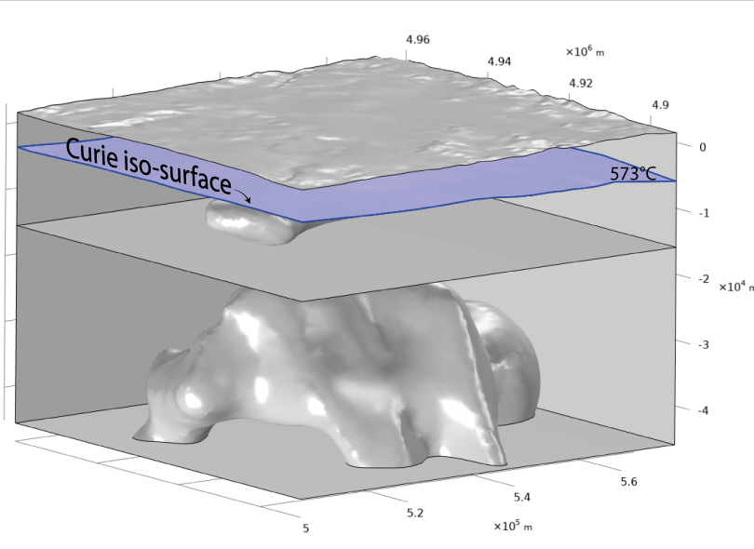
MODELLING WORKFLOW
The Curie iso-surface* was obtained using a high-resolution aeromagnetic dataset, with techniques based on spectral analysis of magnetic anomalies
The Curie surface is the depth in the crust where temperatures reach the Curie point, causing magnetic minerals to lose their magnetization
The depth of the Curie surface is important in geophysics because it gives insight into the thermal structure of the Earth's crust and helps identify areas with potential geothermal resources
Model parameters optimization is controlled by the Curie isotherm at 573°C
*The Curie isosurface mapping originates from Dr. Brahmi Mouna PhD thesis (2017)

Slide 6
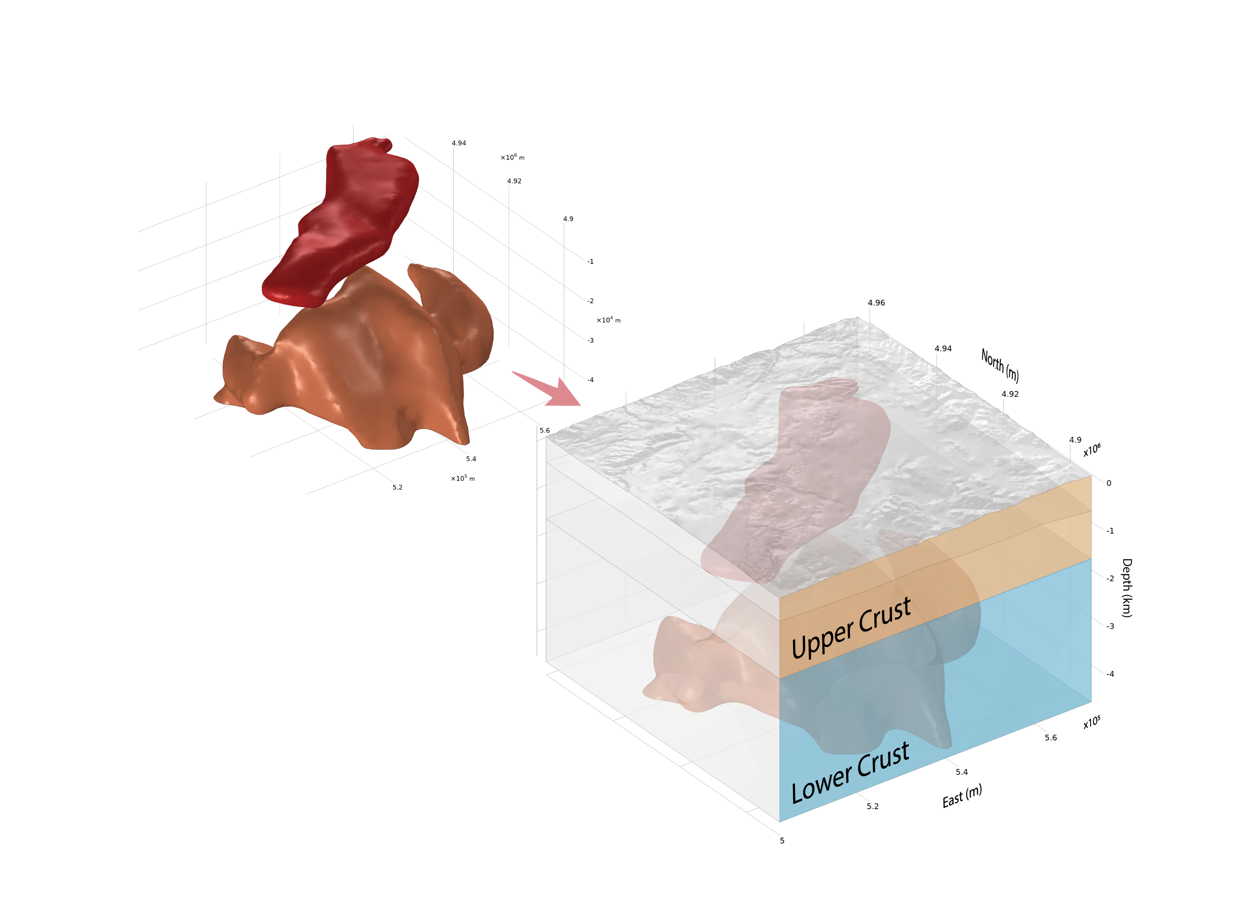
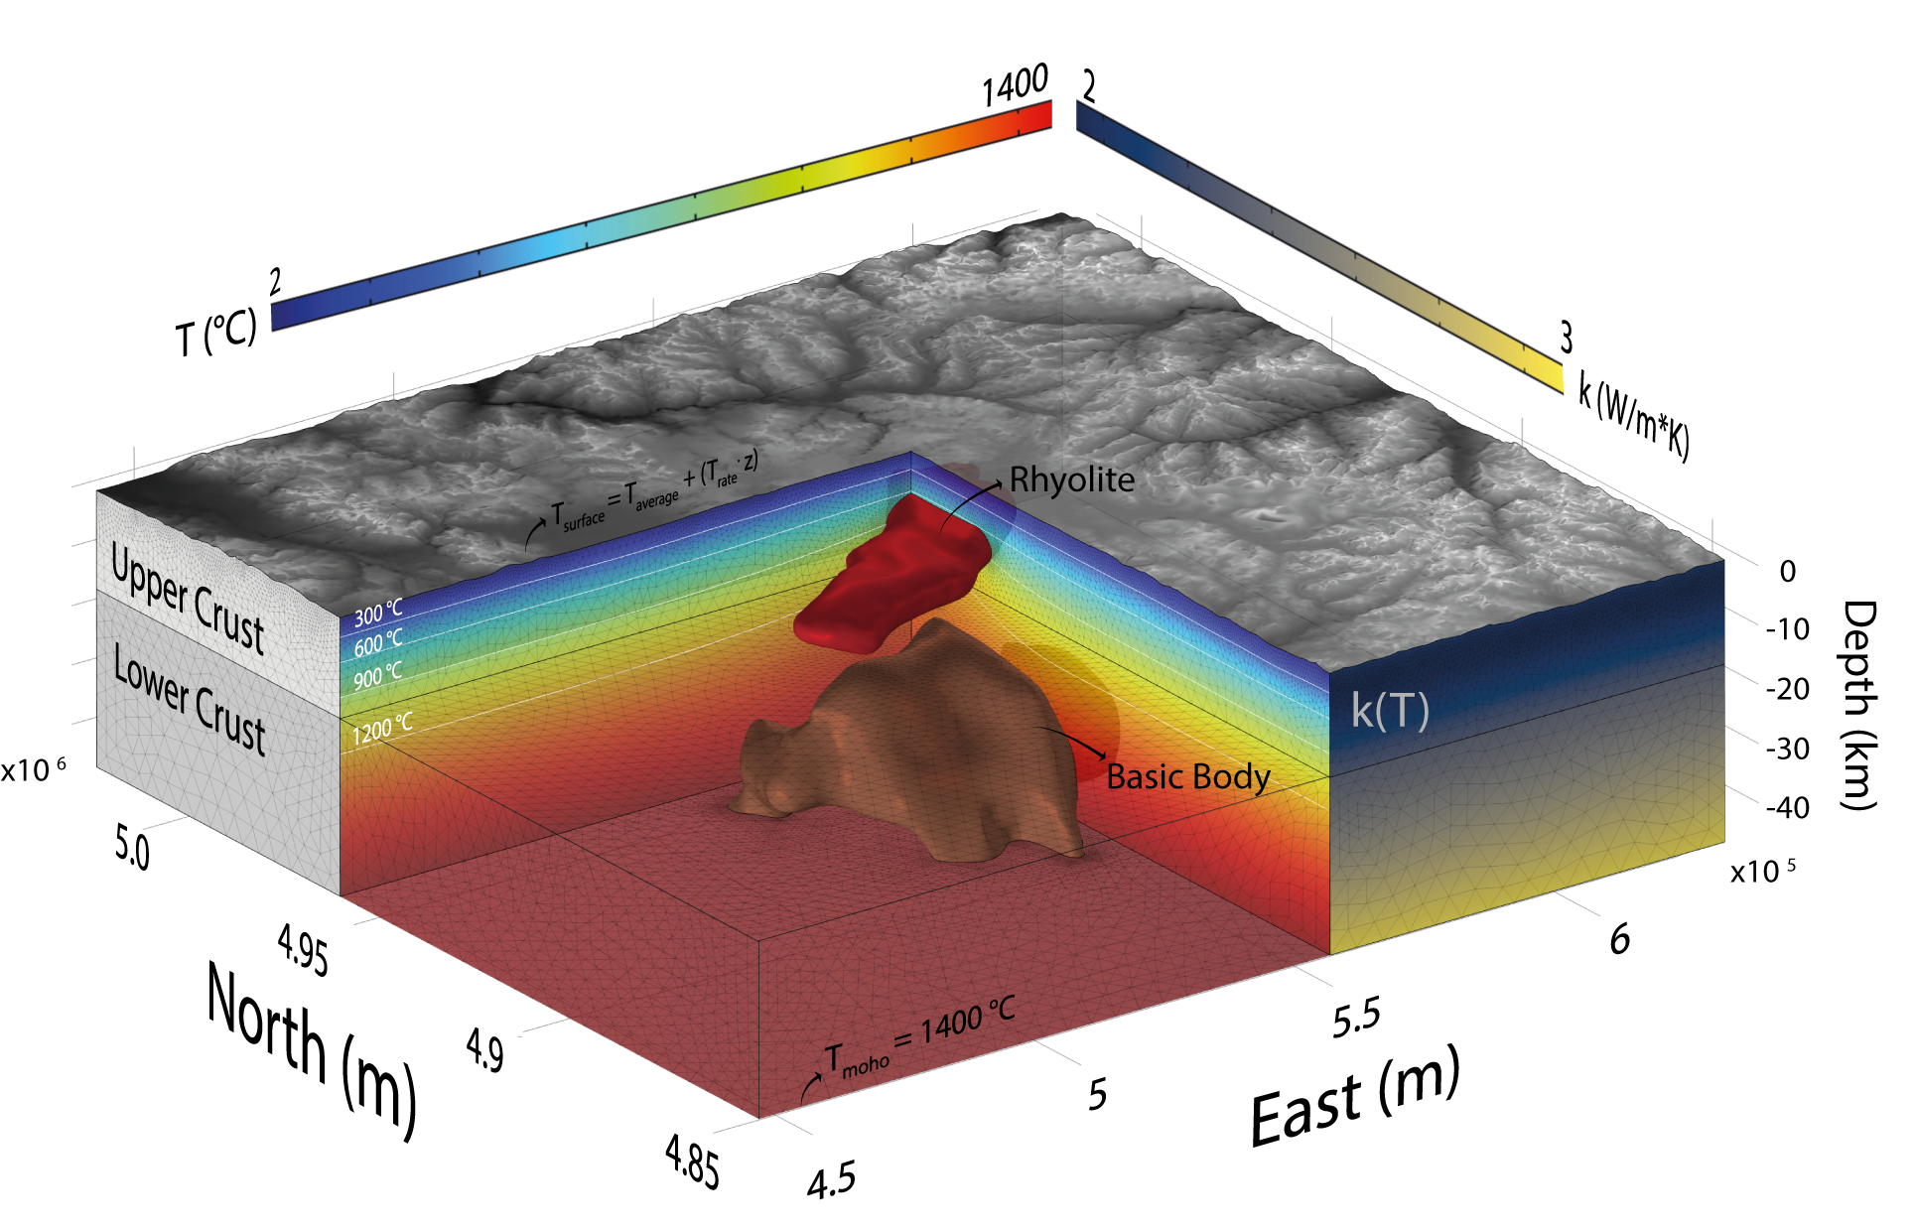
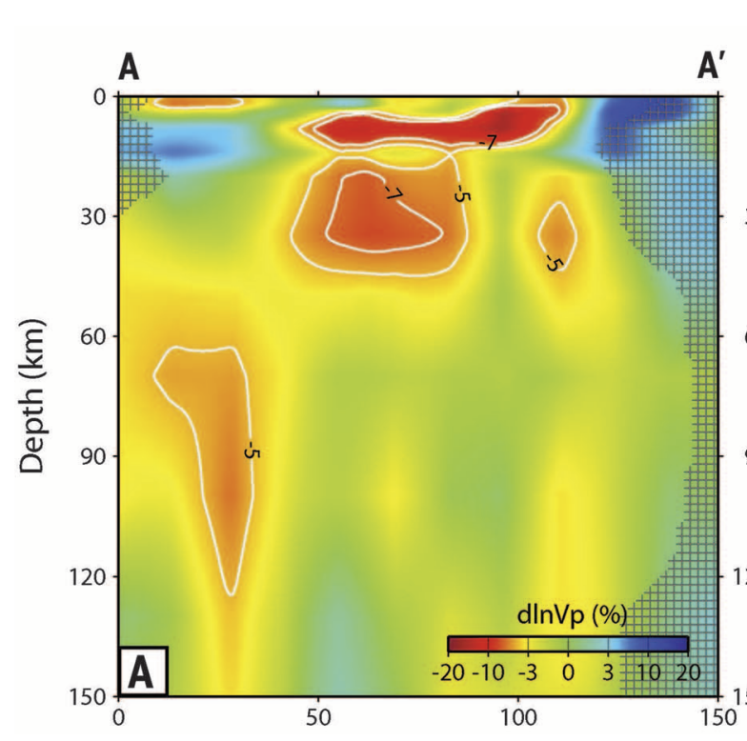
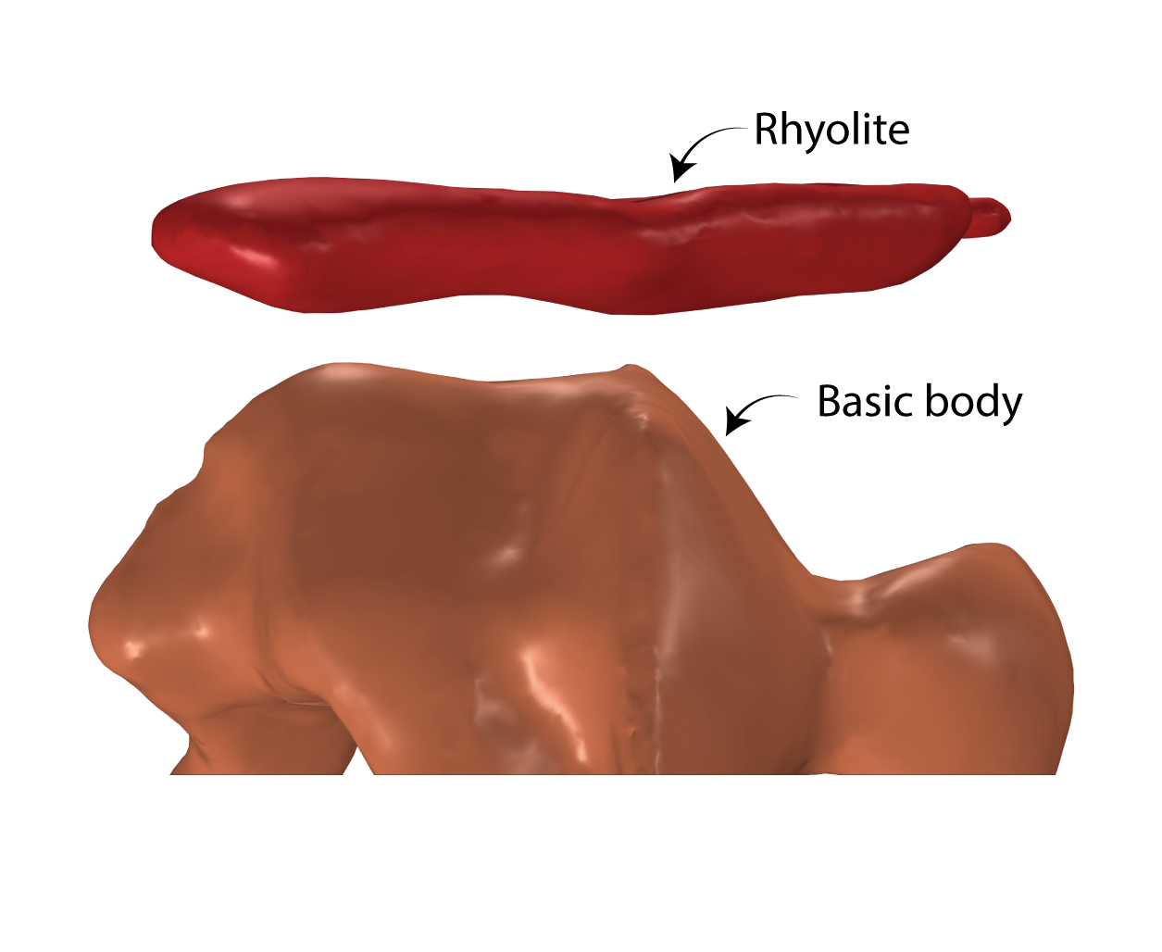
MODELLING WORKFLOW
From literature conceptual model to 3D THERMAL MODEL of the Yellowstone magmatic system
Tomographic view of crustal magmatic structures, incorporating rhyolite and deep-seated mafic bodies, according to Huang et al., 2015.

Slide 7
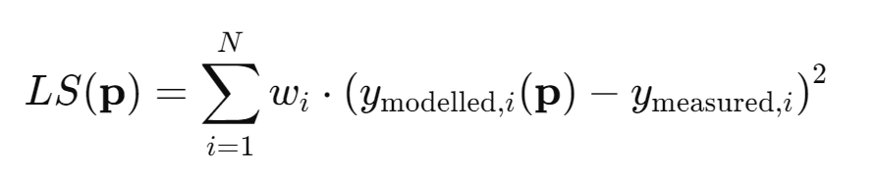
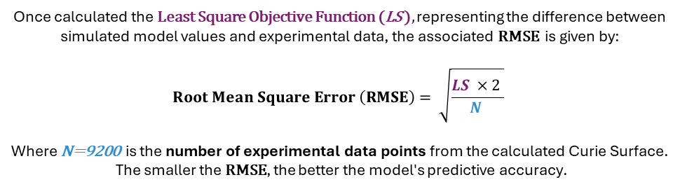
PARAMETER OPTIMIZATION
MODELLING WORKFLOW
Method: COORDINATE SEARCH
Once calculated the Least Square Objective Function (LS ), representing the difference between simulated model values and experimental data, the associated RMSE is given by:
$$Root Mean Square Error \left(RMSE\right)= \sqrt{\frac{LS ×2 }{N }}$$
​​Where N=9200 is the number of experimental data points from the calculated Curie Surface.
The smaller the RMSE, the better the model's predictive accuracy.
*optimized parameters

Slide 8
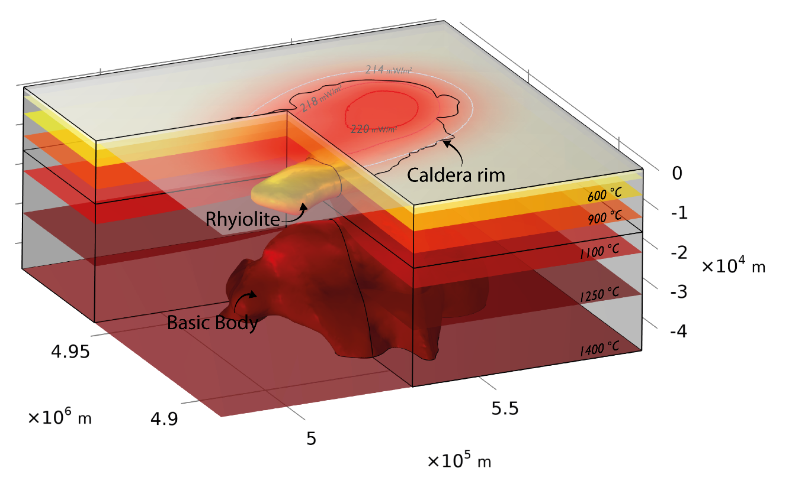
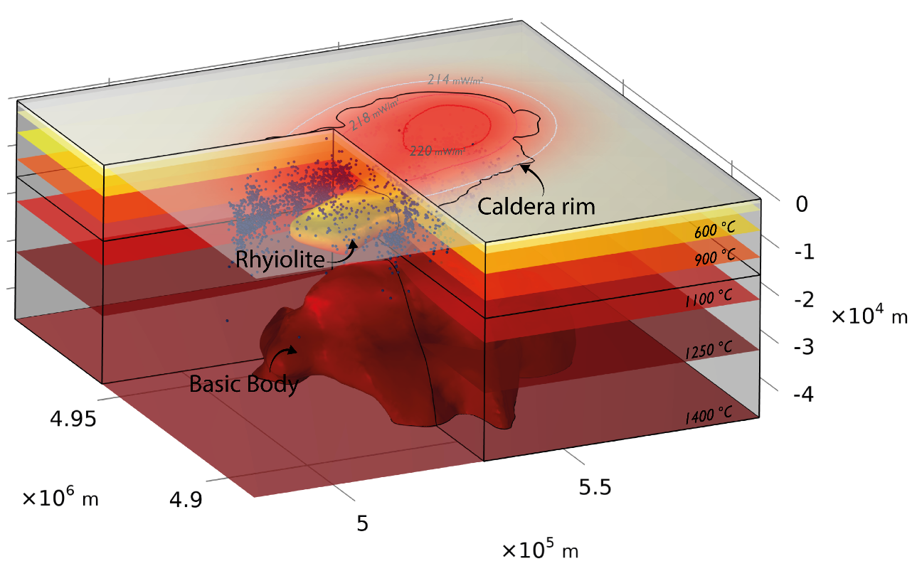
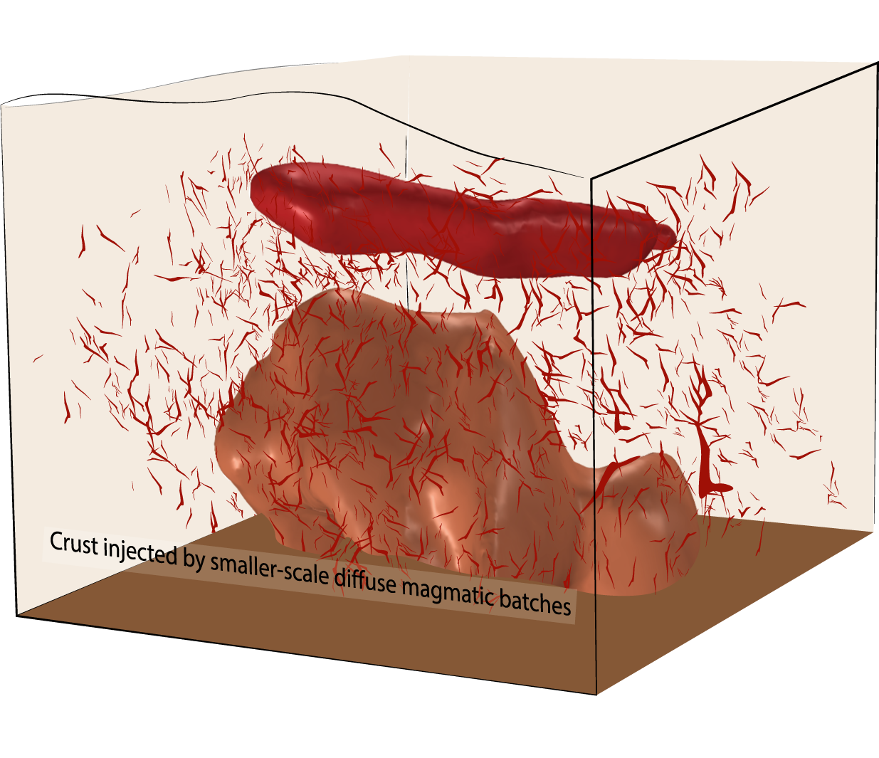

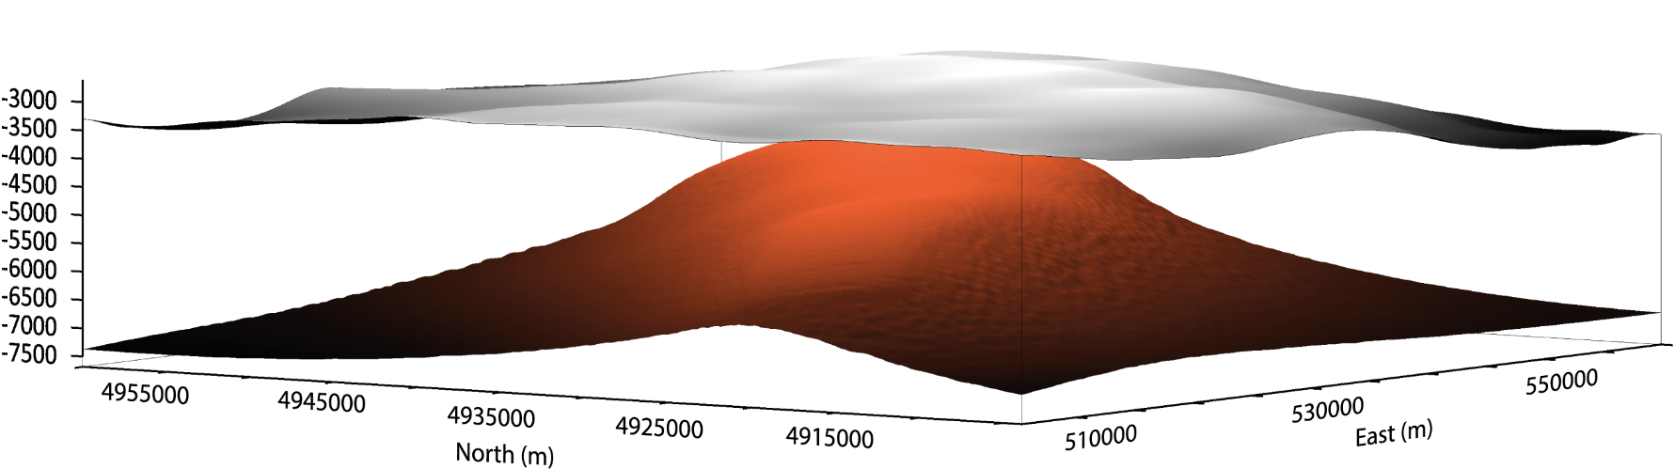
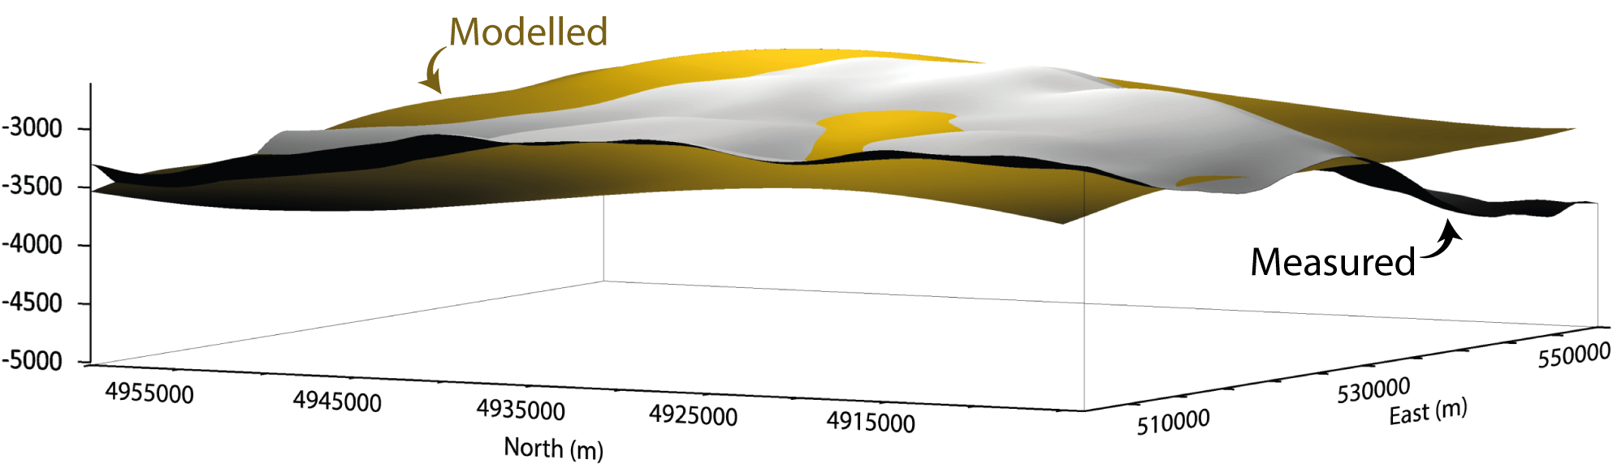

$$∇⋅\left(−k∇T\right)=HSrhyolite+HSbasicbody​+Aradiogenic​$$
Over 1200 iterations were conducted, stabilizing RMSE within a temperature range of 165°C
This indicates that the process achieved a consistent objective function plateau
However, the lateral sides of the surface remain significantly divergent from the expected Curie surface profile, which exhibits a more uniform regional behavior
Additional «generic» Heat Source
$$∇⋅\left(−k∇T\right)=HSrhyolite+HSbasicbody​+HSgeneric​+Aradiogenic​$$
HS_{basicbody}: 18.49 μW/m³
HS_{rhyolite} : 1.51 μW/m³
k_{0 UpperCrust} : 2.1 W/(m*K)
k_{0 LowerCrust} : 3.99 W/(m*K)
A0 : 3.98 μW/m³
A1 : 7.98 μW/m³
Da : 17451.8 m
minRMSE: 28.5 °C
This discrepancy suggests that adjustments to the modelling approach may be needed to achieve closer alignment with the measured Curie surface
Measured Curie
Modelled Curie

Slide 9
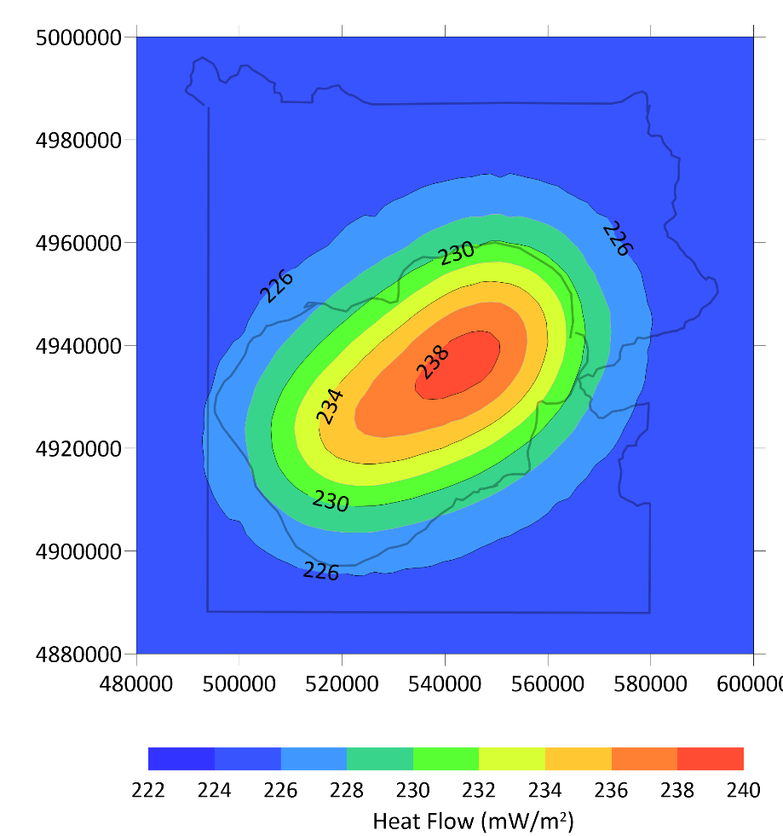
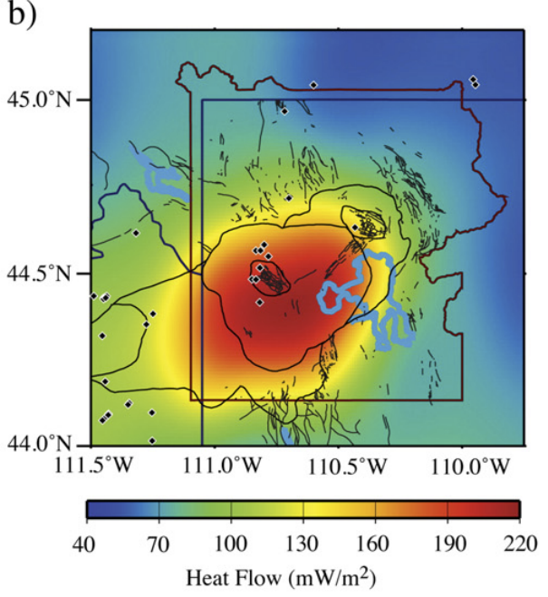
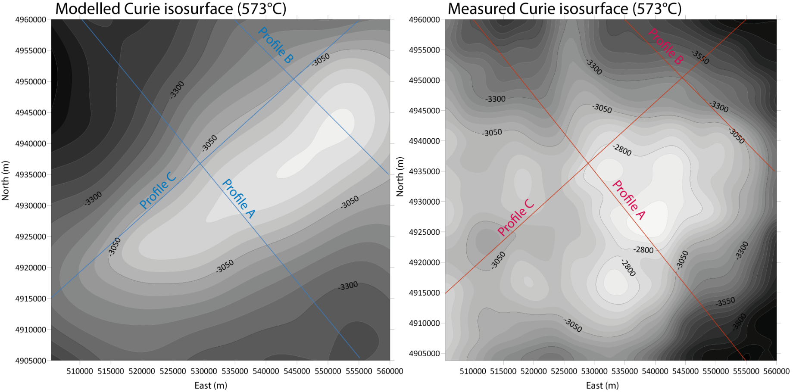
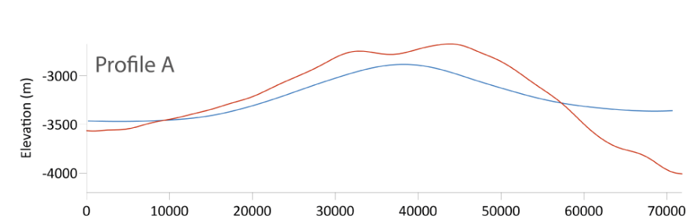
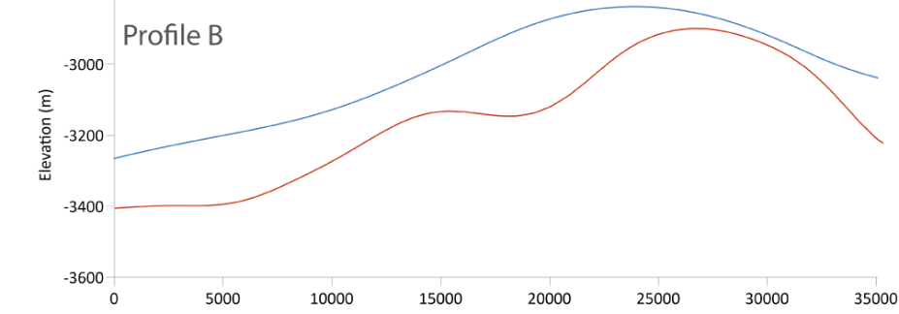
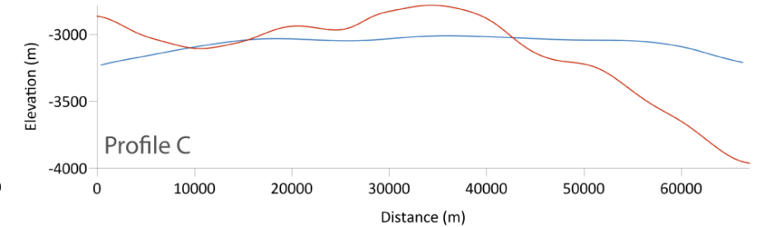
MODEL VALIDATION
Surfac Heat Flux anomaly (SHF)
Curie iso-surface ($\sim$573°C)
Smith et al., 2009
Average Heat Flow:
100 (outside caldera) -220 (inside caldera) mW/m²
Localized Heat Flow (e.g. Geyser Basins):
Up to 500 mW/m², with extreme cases reaching 2,000 mW/m²
Model
Data

Slide 10
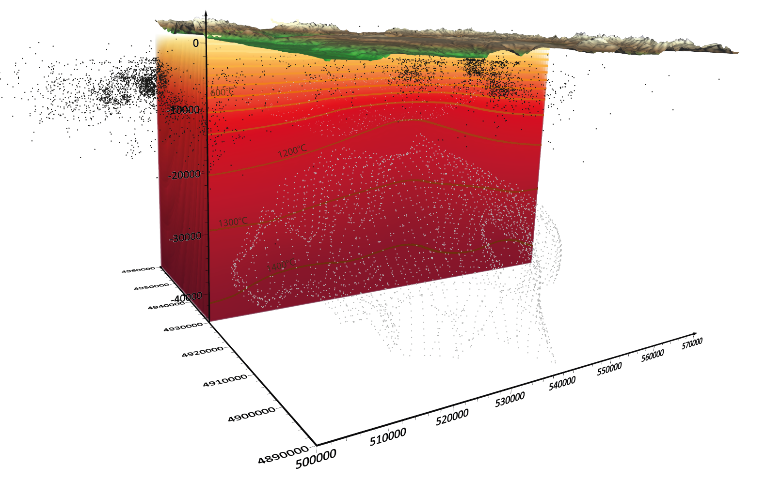
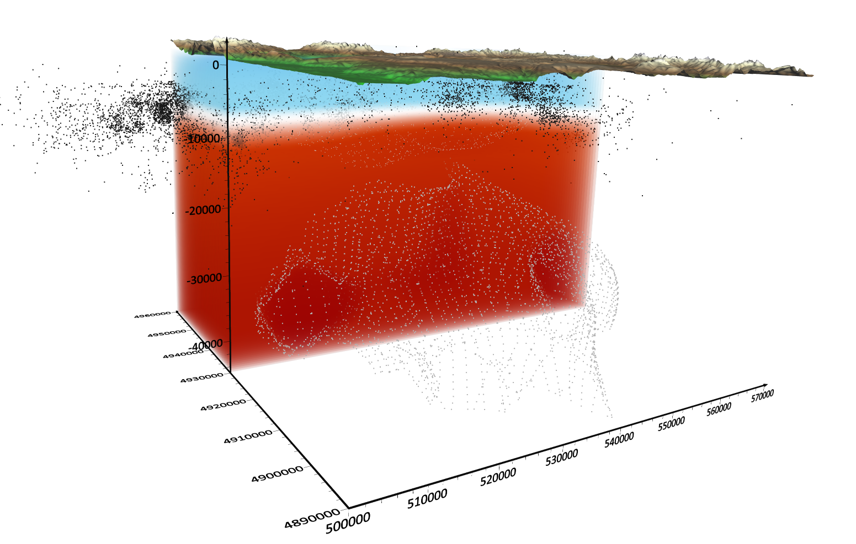
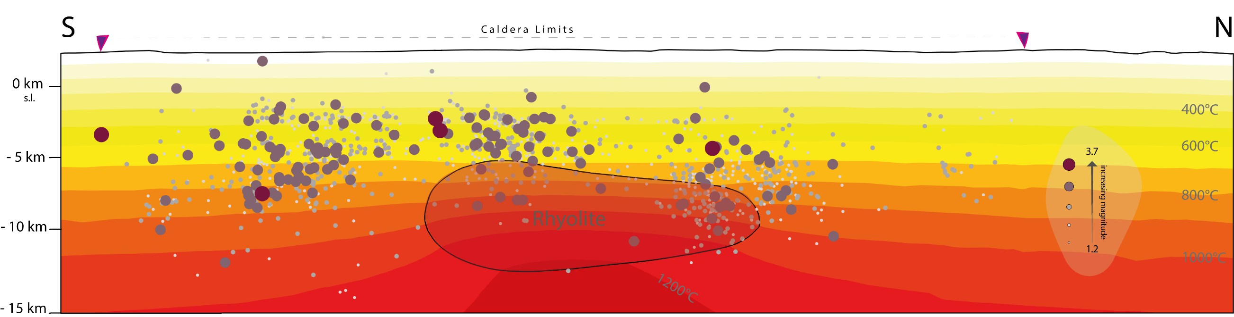


FROM THERMAL TO RHEOLOGICAL MODELLING
RHEOLOGY VALIDATION THROUGH SEISMIC EVENTS DISTRIBUTION
Brittle behaviour is expressed by the linear friction failure law proposed by Sibson (1974):
$${\left(σ_{1}−σ_{3}\right)}_{Brittle}=β∙ρ∙g∙\left(1−λ\right)$$
At sufficiently high temperatures, the creep strength strongly depends on temperature, and ductile behaviour can be empirically described by a power law creep (Kirby, 1983):
$${\left(σ_{1}−σ_{3}\right)}_{Ductile}={\left(\frac{\dot{ε}}{A}\right)}^{1/n}e^{\left(Q/{nRT}\right)}$$
Brittle/Ductile transition

Slide 11
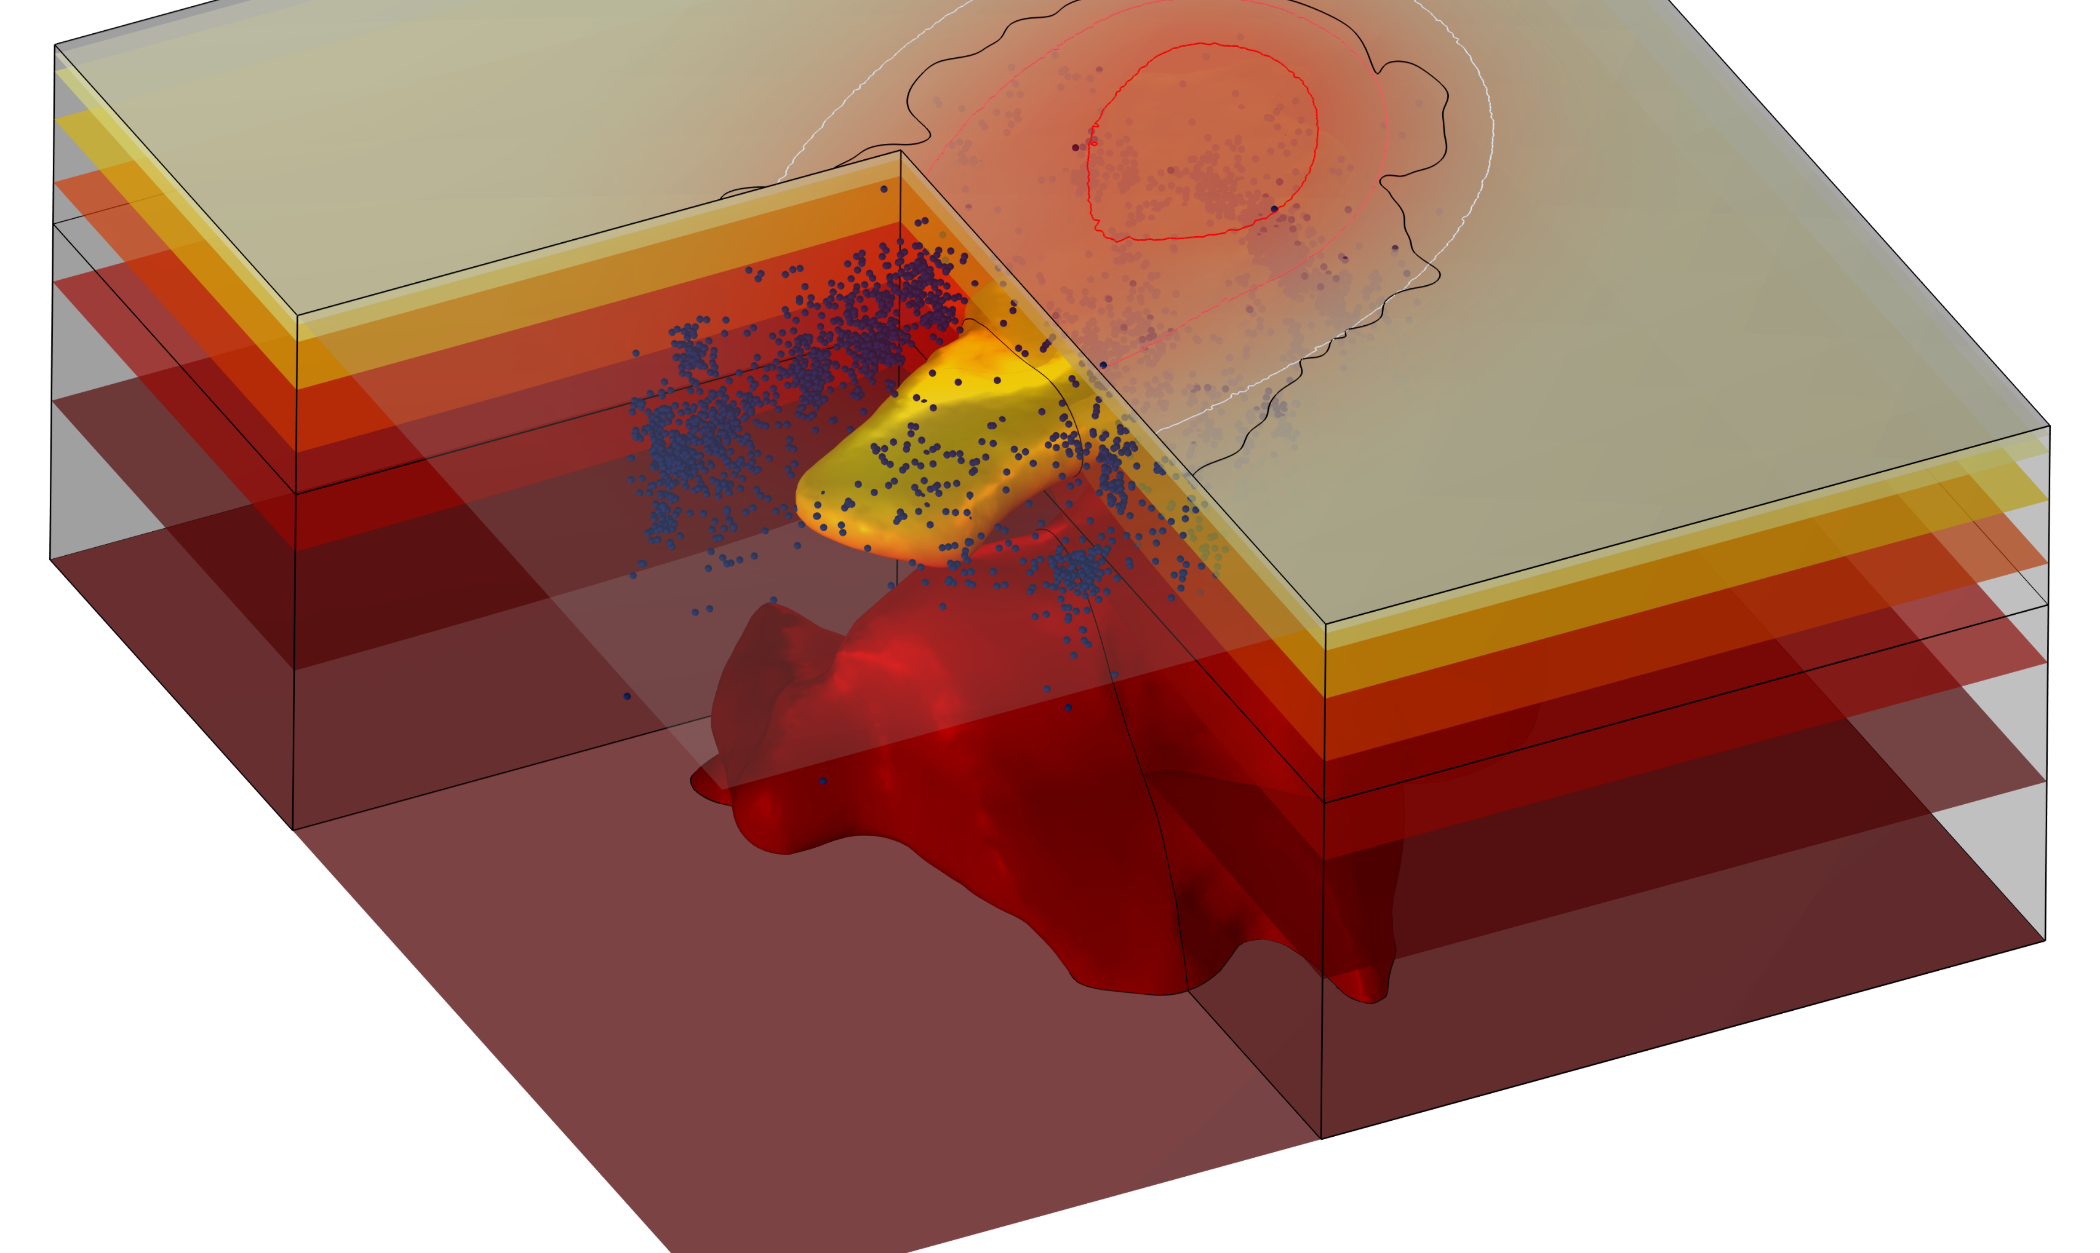
CONCLUDING REMARKS
Development of a Realistic Model
  Integration of geophysical data from imaging techniques, focusing on an iconic caldera and associated magmatic systems.
Analysis of Alternative Scenarios
  Combined exploration of internal heat sources, adjusting thermal properties for more accurate simulations.
Optimization of Solutions:
  Implementation of algorithms to minimize the error between modeled and calculated results, achieving precision within a reasonable number of iterations.
Overall impact
  A multidisciplinary approach has improved the accuracy and reliability of the simulations.

Slide 12
Acknowledgments:
This work is supported by the Italian project funded by the call Prin2022PNRR, code p2022p37sn project "Relation Between 3d Thermo-Rheological Model And Seismic Hazard For The Risk Mitigation in the Urban Areas Of Southern Italy (TRHAM)", decree of admission to funding - director's decree no. 1409 of 14/09/2023, ERC sector pe10 "earth system science, funded by the European union - NextGenerationEU.
Thanks for your attention!
Perrini M.¹, Gola G.², Tizzani P.¹, Fedi F.³, Brahmi M.^{1,3}, Castaldo R.¹
1) 2) 3)
1. Istituto per il Rilevamento Elettromagnetico dell’Ambiente (IREA), Consiglio Nazionale delle Ricerche (CNR), Via Diocleziano, 328, 80124 Napoli, Italia.
2. Istituto di Geoscienze e Georisorse (IGG), Consiglio Nazionale delle Ricerche (CNR), Via Valperga Caluso, 35, 10125 Torino, Italia.
3. Dipartimento di Scienze della Terra, dell’Ambiente e delle Risorse (DiSTAR), Università degli Studi di Napoli Federico II, Via Vicinale Cupa Cintia, 21, 80126 Napoli, Italia.

