Slide 1

Simulating the Coupled Mass and Heat Transport in Package Material during Induction Sealing
Henrik Makungu Askfelt, Giovanni Betti Beneventi
COMSOL Conference - Florence, Italy, 22 October 2024

Slide 2
Outline
Introduction
  Tetra Pak, Tetra Pak® Package Material, Induction Sealing
Package material model: heat and mass transport
Induction heating device model
Results & discussion

Slide 3
Outline
Introduction
  Tetra Pak, Tetra Pak® Package Material, Induction Sealing
Package material model: heat and mass transport
Induction heating device model
Results & discussion

Slide 4
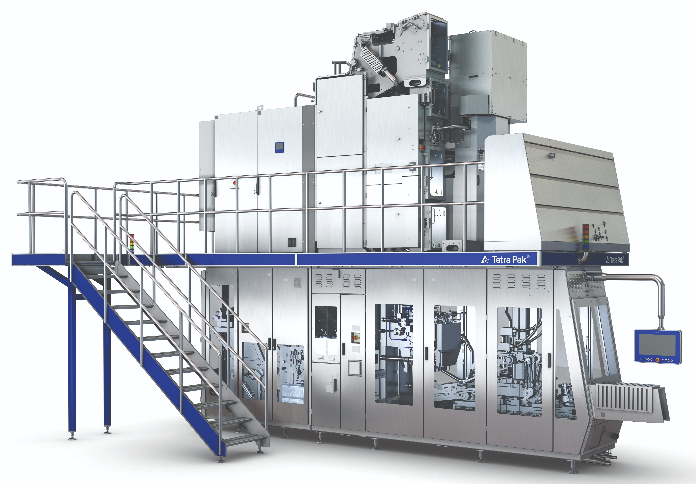
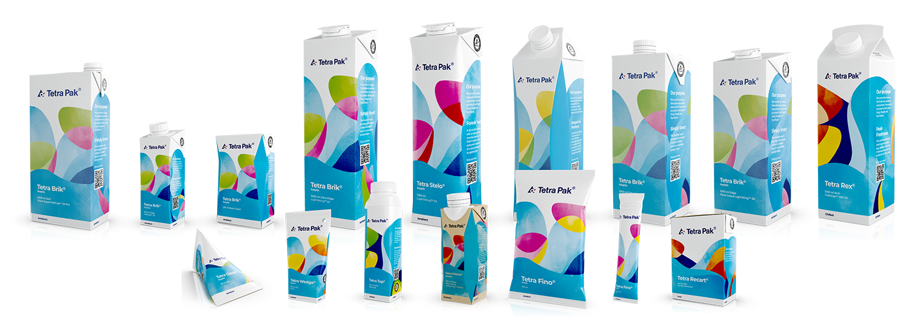

Tetra Pak
A world leading food processing and packaging company
Packaging technology: design and engineering of Filling Machines
Automated machines; from package material reels to liquid food containers in the order of thousands-per-hour
Stored food must stay fresh and safe for consumption for 1 year without the need for preservatives or refrigeration
> 8k Filling Machines in operation
$≈200⋅10^{9}$ Tetra Pak® packages produced 2023

Slide 5
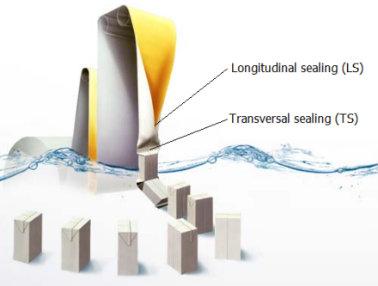
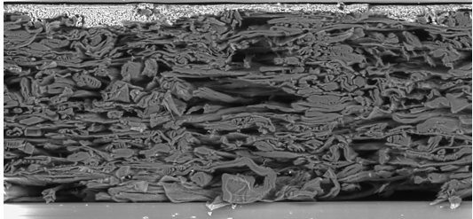
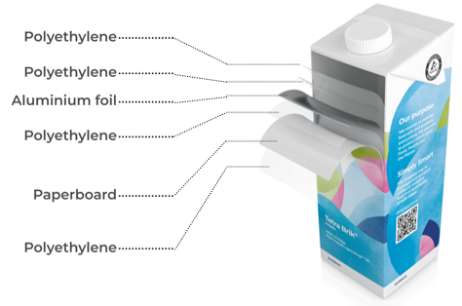
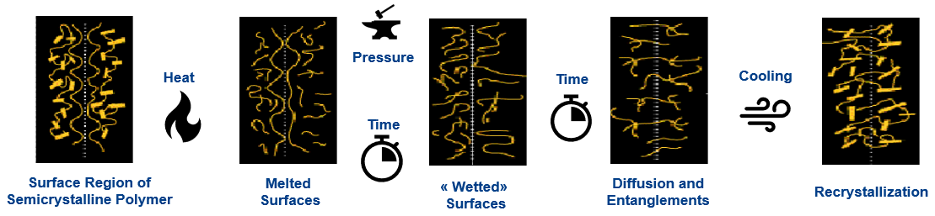
Filling machines, package material, induction sealing
Sterilization, Forming, Filling, Sealing, Cutting
Package Material: multi-layered
Paperboard: Porous, Hygroscopic
Induction sealing is deeply impacted by paperboard physics
Heating → Drying → Energy
Heating → Vapour → Pressure
Induction sealing process
Exploit high electrical conductivity of Al-foil
(eddy current) to heat-up the polyethylene
for polymer welding.
Typically: up to 150 ℃ in < 1 s.
Next
How is induction heating of package material affected by board properties?

Slide 6
Outline
Introduction
  Tetra Pak, Tetra Pak® Package Material, Induction Sealing
Package material model: heat and mass transport
Induction heating device model
Results & discussion

Slide 7

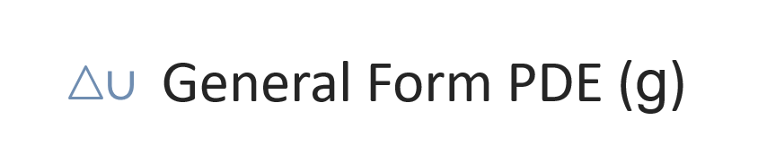
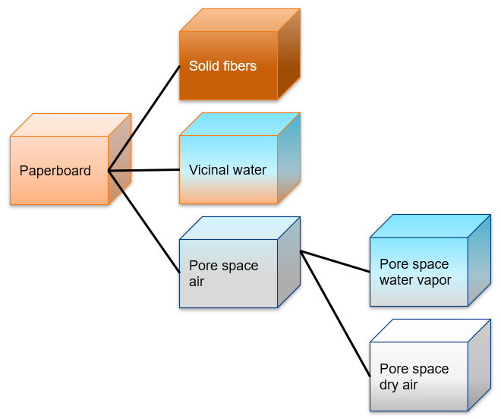









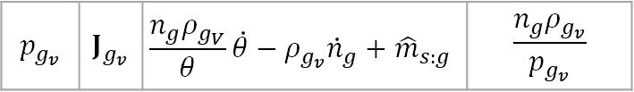
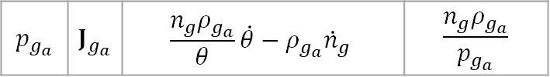
Package material model: heat and mass transport
Paperboard heat & mass transport – Mixture theory [2]
$$a$$ | $$Γ$$ | $$F$$ | $$d_{a}$$
Mass Balance
$$ω$$ | $$0$$ | $$−{\hat{m}}_{s:g}$$ | $$ρ_{s}n_{s}$$
Mass Balance
$$p_{g_{v}}$$ | $$J_{g_{v}}$$ | $$\frac{n_{g}ρ_{g_{V}}}{θ}\dot{θ}−ρ_{g_{v}}{\dot{n}}_{g}+{\hat{m}}_{s:g}$$ | $$\frac{n_{g}ρ_{g_{v}}}{p_{g_{v}}}$$
Mass Balance
$$p_{g_{a}}$$ | $$J_{g_{a}}$$ | $$\frac{n_{g}ρ_{g_{a}}}{θ}\dot{θ}−ρ_{g_{a}}{\dot{n}}_{g}$$ | $$\frac{n_{g}ρ_{g_{a}}}{p_{g_{a}}}$$
Energy Balance
$$θ$$ | $$q_{θ}^{MT}$$ | $$−{\hat{m}}_{s:g}ΔH_{s:g}$$ | $$ρ_{PB}c_{PB}^{p}$$
Energy Balance
Polymers heat transport
$$θ$$ | $$q_{θ}^{PE}$$ | 0 | $ρ_{PE}c_{PE}^{p}$
from
Energy Balance
Al-foil heat transport
$$ρ_{Al}c_{Al}^{p} \dot{θ}−∇ ⋅ (λ_{Al}∇(θ)) − Q_{IH} =0$$
[2] H. Askfelt and M. Ristinmaa, "Experimental and numerical analysis of adhesion failure in moist packaging material during excessive heating," International Journal of Heat and Mass Transfer, vol. 108, pp. 2566 - 2580, 2017

Slide 8
Outline
Introduction
  Tetra Pak, Tetra Pak® Package Material, Induction Sealing
Package material model: heat and mass transport
Induction heating device model
Results & discussion

Slide 9


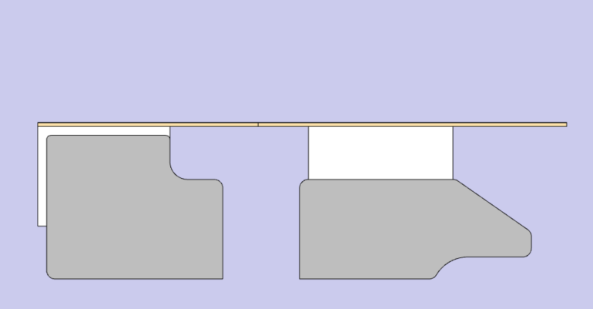
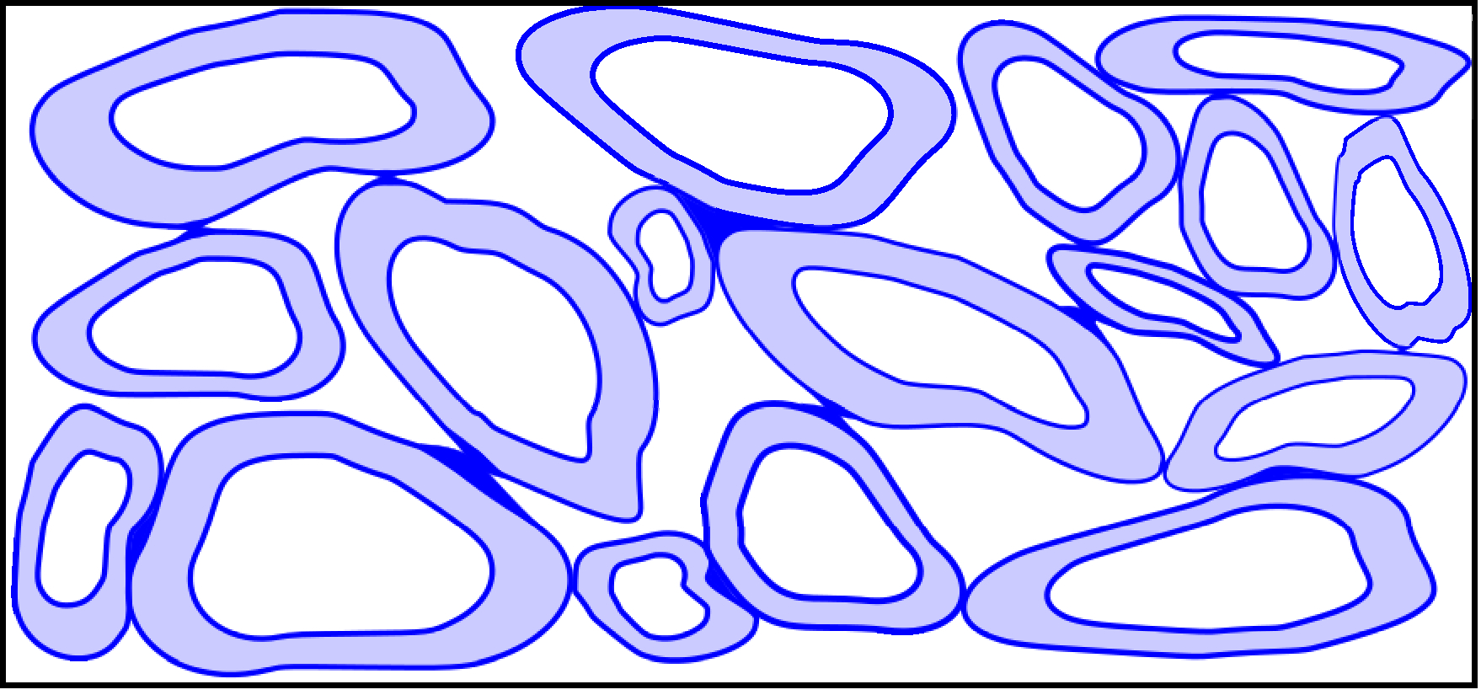

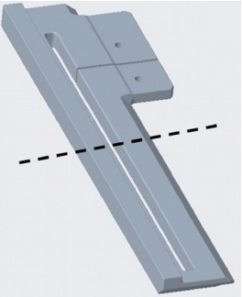






Induction heating device model (2-D)
Al-foil
Test setup [1]
Inside
Cross - section
Laminate
Package Material
Paperboard
Tape
Outside
Active area
Return area
Coil excitation – Current $I≡0$
aluminum coil
ac current (f ~ 500 kHz)
Coil excitation – Current $I_{rms}$
$I_{rms}$→ Total load power fixed
[1] M. Giangolini, G. Betti Beneventi and A. Babini, "Assessment of thermographic tools for the validation of physics-based models of an induction sealing process," International Journal of Applied Electromagnetics and Mechanics, vol. 75, no. 2, pp. 179-191, 2024.

Slide 10
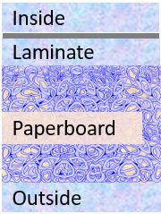
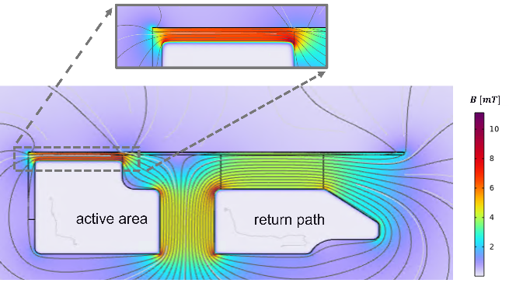
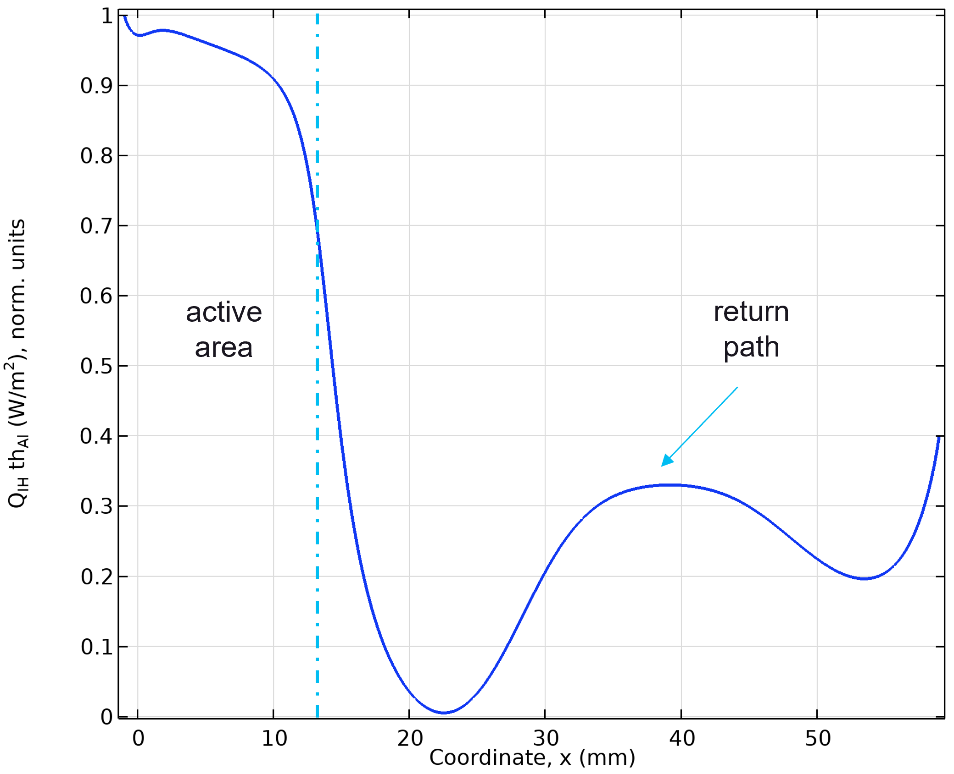
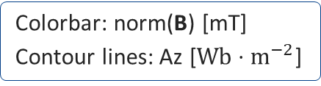
Induction heating device model (2-D)
Colorbar: norm(B) [mT]
Contour lines: Az [$Wb⋅m^{−2}$]
Normalized electromagnetic surface loss. density vs. coordinate
  Excitation: load power (~650 W) ; 600 ms of on-time (Frequency –Transient)
Next: sensitivity analysis vs. board initial moisture ratio and density

Slide 11
Outline
Introduction
  Tetra Pak, Tetra Pak® Package Material, Induction Sealing
Package material model: heat and mass transport
Induction heating device model
Results & discussion

Slide 12
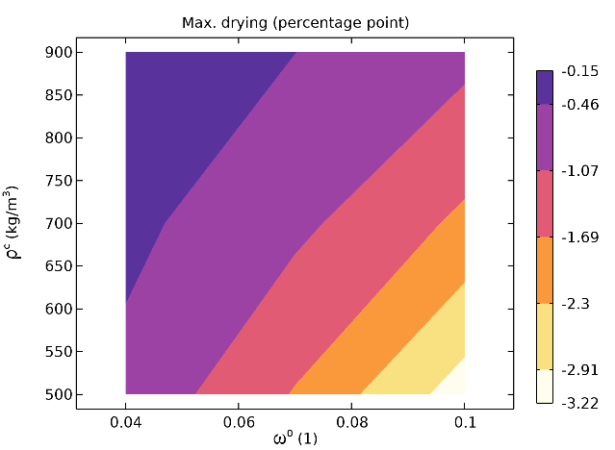
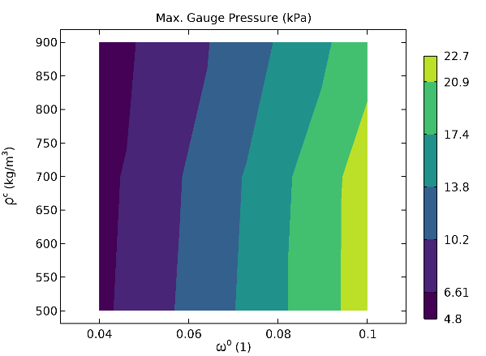
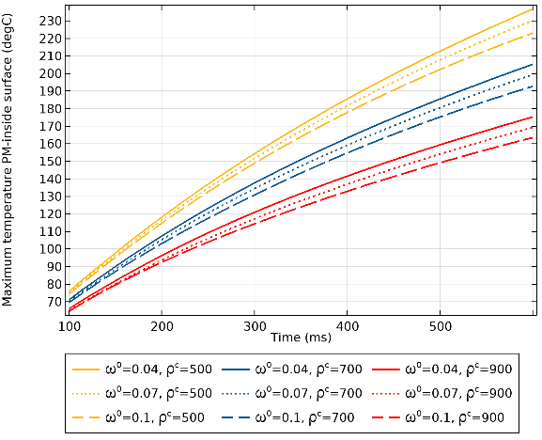
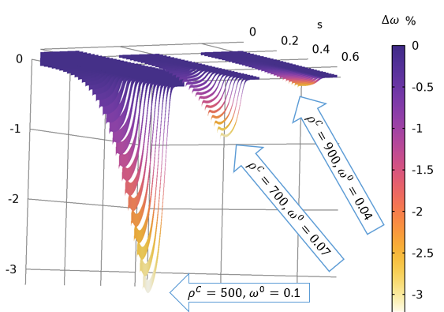
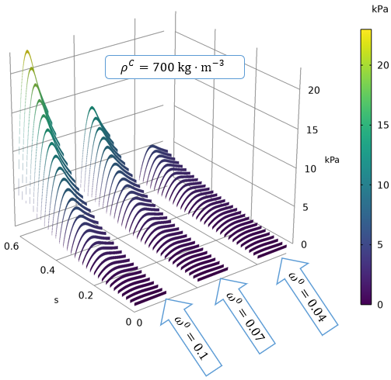
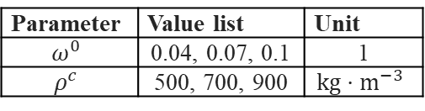
Model results
- Sensitivity analysis
Maximum of drying and internal pressure over paperboard domain
Parametric sweep
initial moisture ratio
Parameter | Value list | Unit
$$ω^{0}$$ | 0.04, 0.07, 0.1 | 1
$$ρ^{c}$$ | 500, 700, 900 | $$kg⋅m^{−3}$$
initial
board density
Time-evolution at the board/laminate interface, above the coil active area
Evolution of the maximum temperature of the package material inside top surface

Slide 13
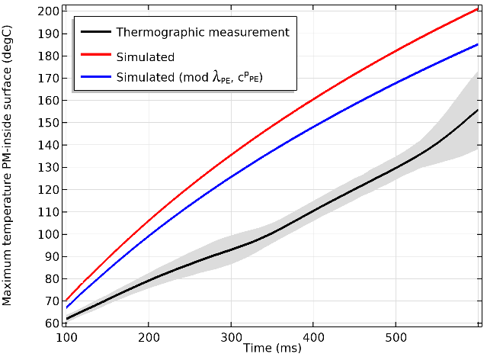


Discussion
- Model vs. experimental data carried out on a given board grade
FLIR cooled camera
Max. temperature on inside top surface vs. time
Matching between model and data [1] currently is not satisfactory
Prediction improved with temperature-dependent heat transport parameters of PE
The model can be used in its present state for relative comparisons and to study interplay of physical parameters
COMSOL Multiphysics® as enabling technology to allow the collaboration of modeling engineers having different expertise (e.g., paperboard physics / electromagnetic modeling)
[1] M. Giangolini, G. Betti Beneventi and A. Babini, "Assessment of thermographic tools for the validation of physics-based models of an induction sealing process," International Journal of Applied Electromagnetics and Mechanics, vol. 75, no. 2, pp. 179-191, 2024.

Slide 14
Recap
Key takeaways
With COMSOL we are able to simulate the package material response during induction heating.
The model is able to capture complex multiphysical couplings such as gauge pressure build up and drying
The model may be used to understand how different attributes of the board will affect the package material behavior
Next step
Improve polymer model
- Heat transport & phase transformation

Slide 15
Backup Slides

Slide 16


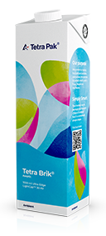
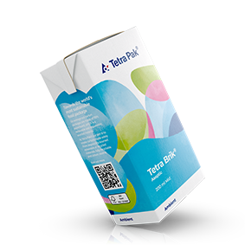
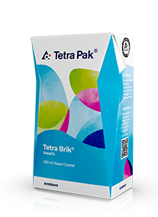
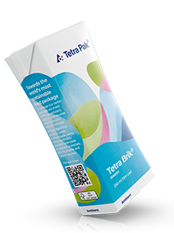
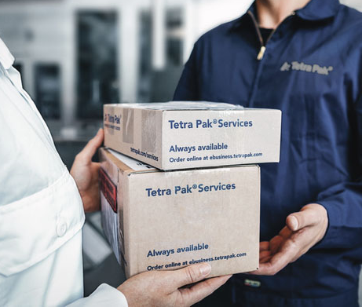
Tetra Pak
- World leading food processing and packaging solutions company
Processing
Solutions and equipment for dairy, plant-based, cheese, powder, ice cream, beverages and prepared food.
Packaging
A complete carton packaging range for consuming food products offering convenience, easy opening, optimal shelf life and the ability to give maximum brand exposure.
Services
Helps improve performance, optimise costs and ensure food safety throughout the lifecycle of operations.

Slide 17


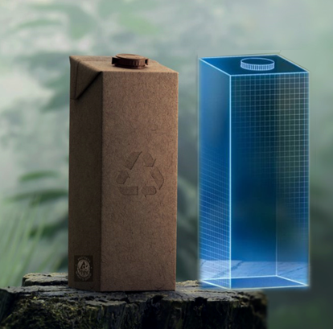

Introduction
- Tetra Pak Packaging
Our Ambition
To deliver the world's most sustainable food package.
$≈2×10^{11}$ Tetra Pak® packages sold 2023
8.5 k Filling machines in operation
Simulation driven design
Necessary tool when approaching our Ambition
https://www.tetrapak.com/sv-se/about-tetra-pak/who-we-are/facts-figures

Slide 18
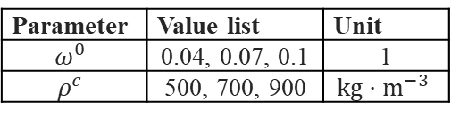
Model Results
- Sensitivity analysis
Parametric sweep
Parameter | Value list | Unit
$$ω^{0}$$ | 0.04, 0.07, 0.1 | 1
$$ρ^{c}$$ | 500, 700, 900 | $$kg⋅m^{−3}$$
initial moisture ratio
initial density
Max. temperature on inside top surface vs. time
  Lower PE temperature for higher density board
    higher specific heat
    higher thermal conductivity
  Lower PE temperature the higher the moisture content
    higher specific heat
    higher thermal conductivity
    more energy required to dry
PE = polyethylene

Slide 19
Model Results
- Sensitivity analysis
Parametric sweep
Parameter | Value list | Unit
$$ω^{0}$$ | 0.04, 0.07, 0.1 | 1
$$ρ^{c}$$ | 500, 700, 900 | $$kg⋅m^{−3}$$
initial moisture ratio
initial density
  located on top left corner of board below Al-foil nearby active area
  higher for higher initial moisture ratio → more desorption
    increased driving force for drying
  higher for decreased density → increased gas volume
    gas accumulates more water
    ease for vapor to flow within the board
  higher initial moisture → more desorption
  increased density → less desorption
    increase resistance for gas to flow→ higher pressure → higher desorption
    BUT
    increased density → lower temperature → lower pressure → lower desorption
  decreased temperature dominates over higher mass flux resistivity
Max drying over paperboard domain (end of heating phase)
Max internal pressure build-up over paperboard domain (end of heating phase)

Slide 20
Model Results
- Sensitivity analysis
Parametric sweep
Parameter | Value list | Unit
$$ω^{0}$$ | 0.04, 0.07, 0.1 | 1
$$ρ^{c}$$ | 500, 700, 900 | $$kg⋅m^{−3}$$
initial moisture ratio
initial density
Drying and internal pressure time evolution at the board/laminate interface, above the active area coil

Slide 21
