Slide 1


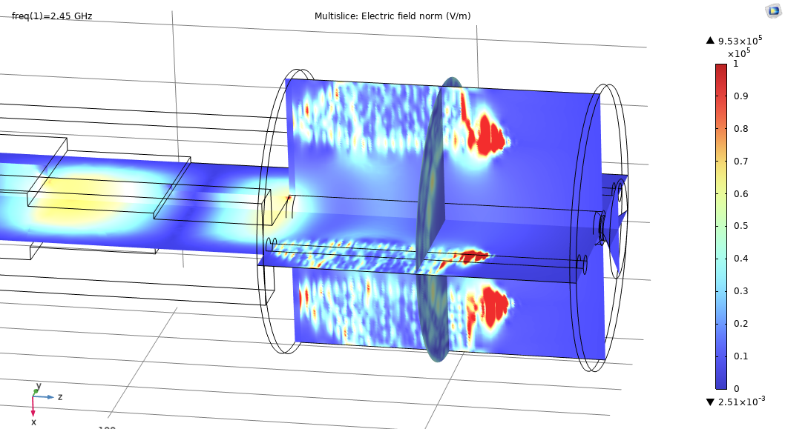
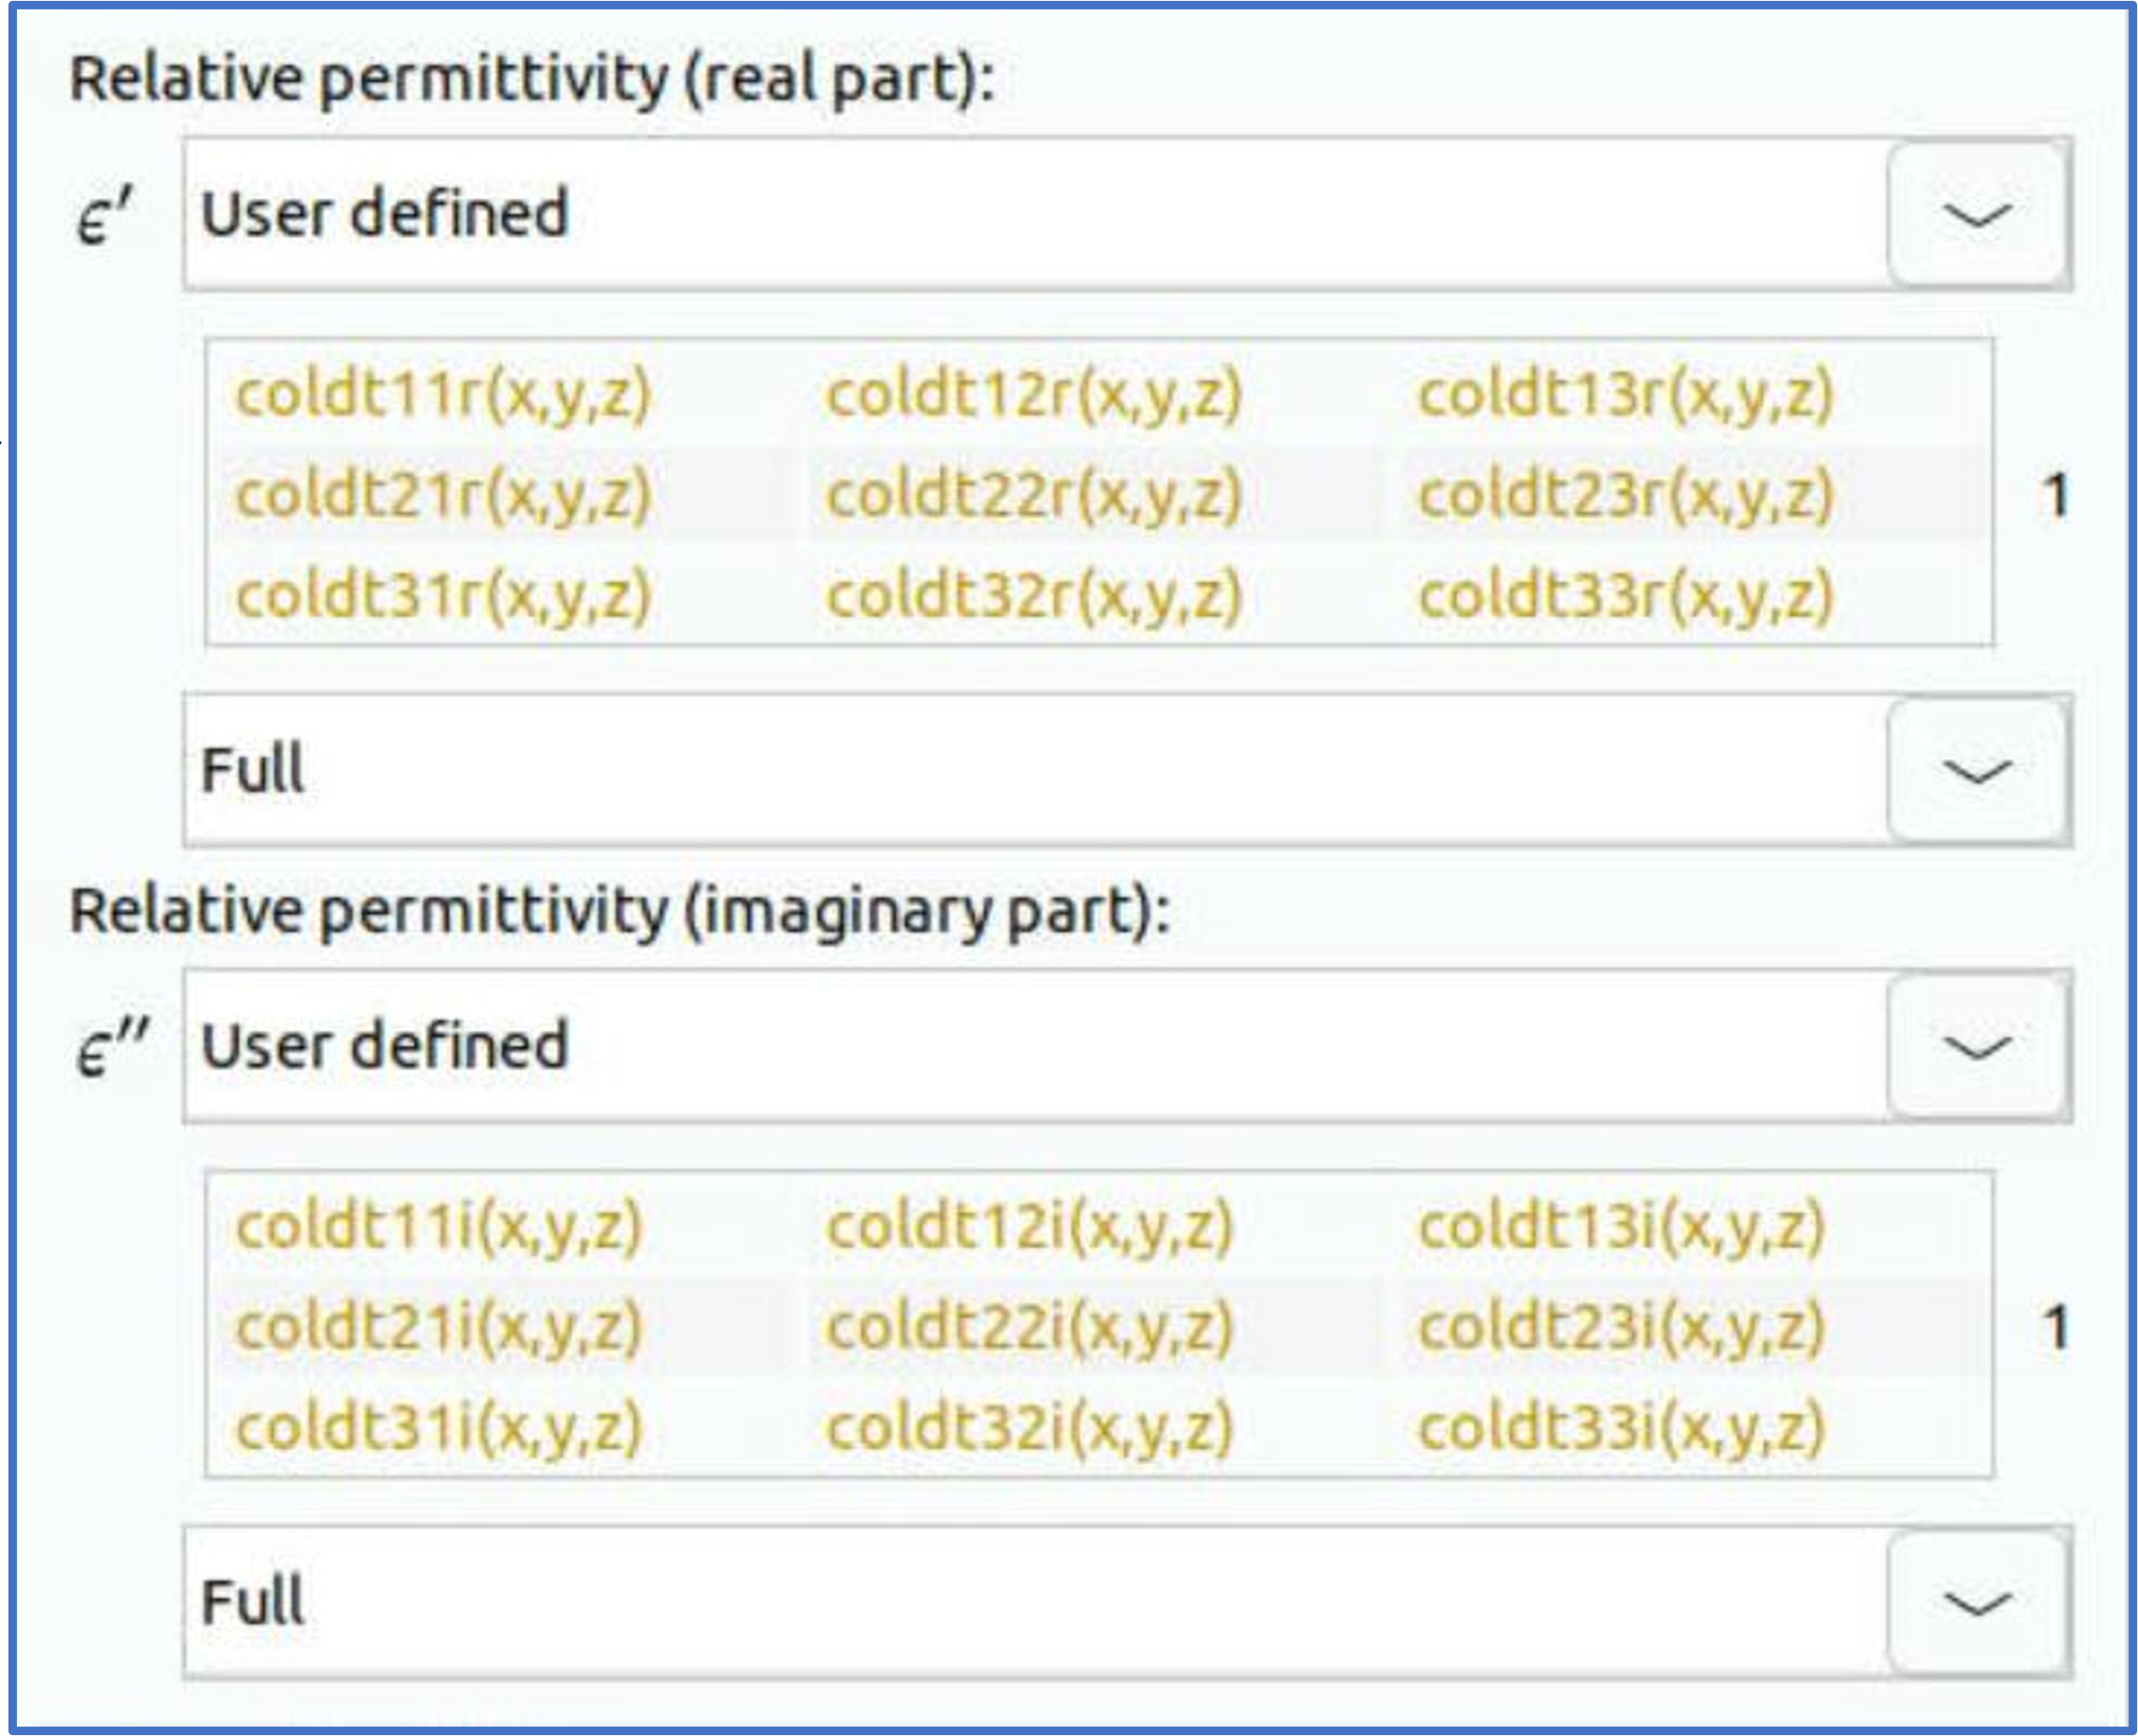
PIC simulation of a 2.45 GHz ECR ion source using COMSOL tensorial permittivity RF capability
Lorenzo Neri
INFN-LNS

Slide 2
Outline
Standard Outline
How
Results
Perspectives
Outline for COMSOL users
Results (brief scientific report)
How COMSOL was used
Perspectives about COMSOL use
1

Slide 3
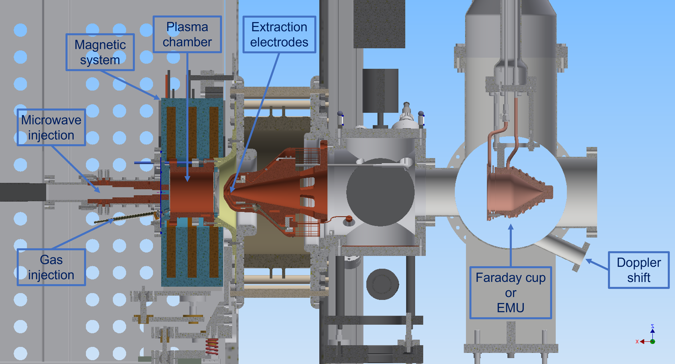

2.45 GHz ECR ion sources
ECR resonance: $ω_{RF}=\frac{q_{e}B}{m_{e}}$
+
High voltage (75 kV)
=
Beam (100 mA)
Gas (4 SCCM H₂)
+
Magnetic field (≈875 Gauss)
+
Microwave power (2.45 GHz)
=
Plasma (1E17 m⁻³)
Proton Source for the European Spallation Source (PS-ESS), developed and commissioned at INFN-LNS and sent to ESS in Sweden 01/02/2018
2

Slide 4
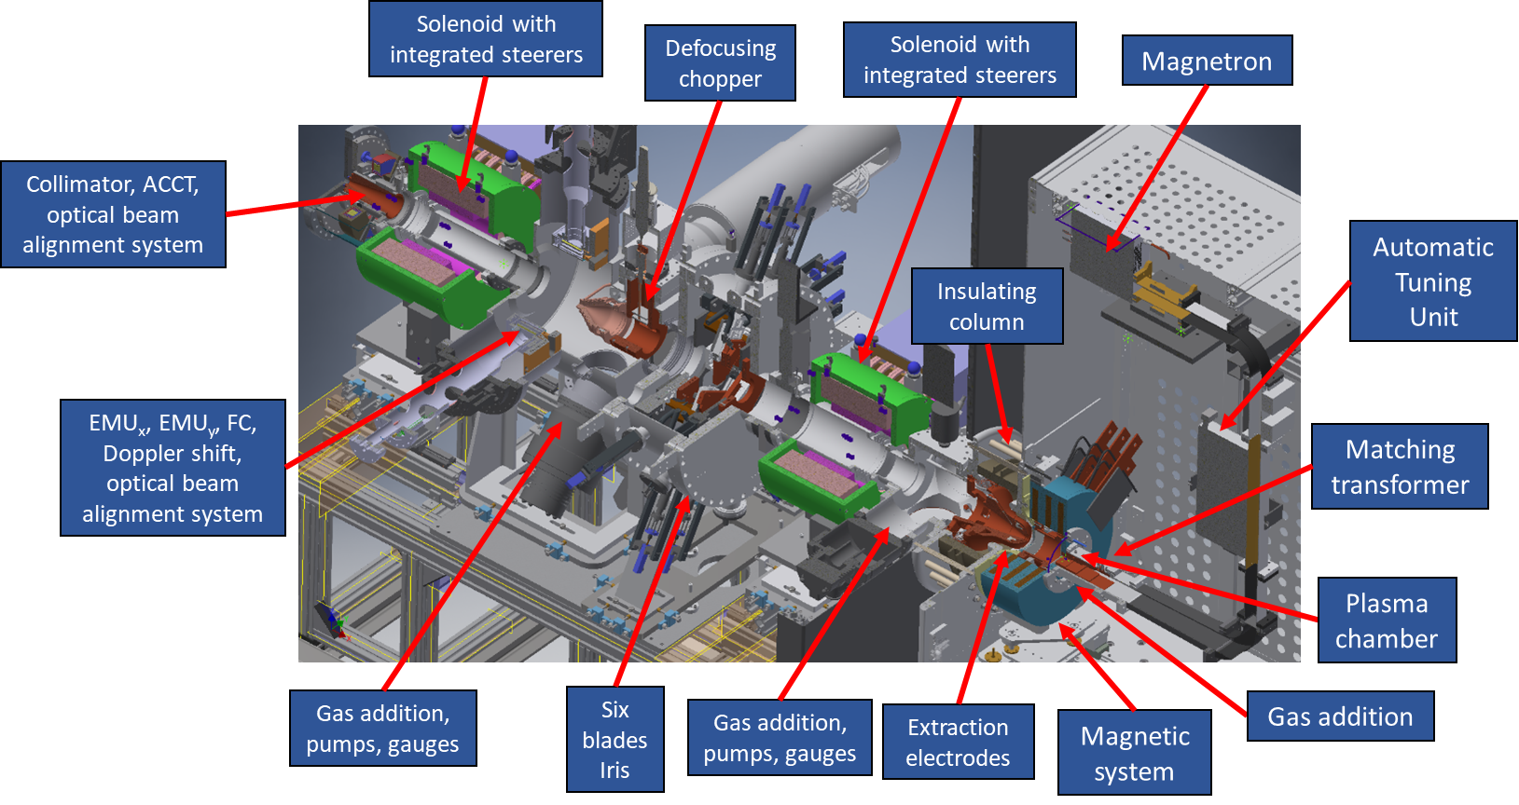

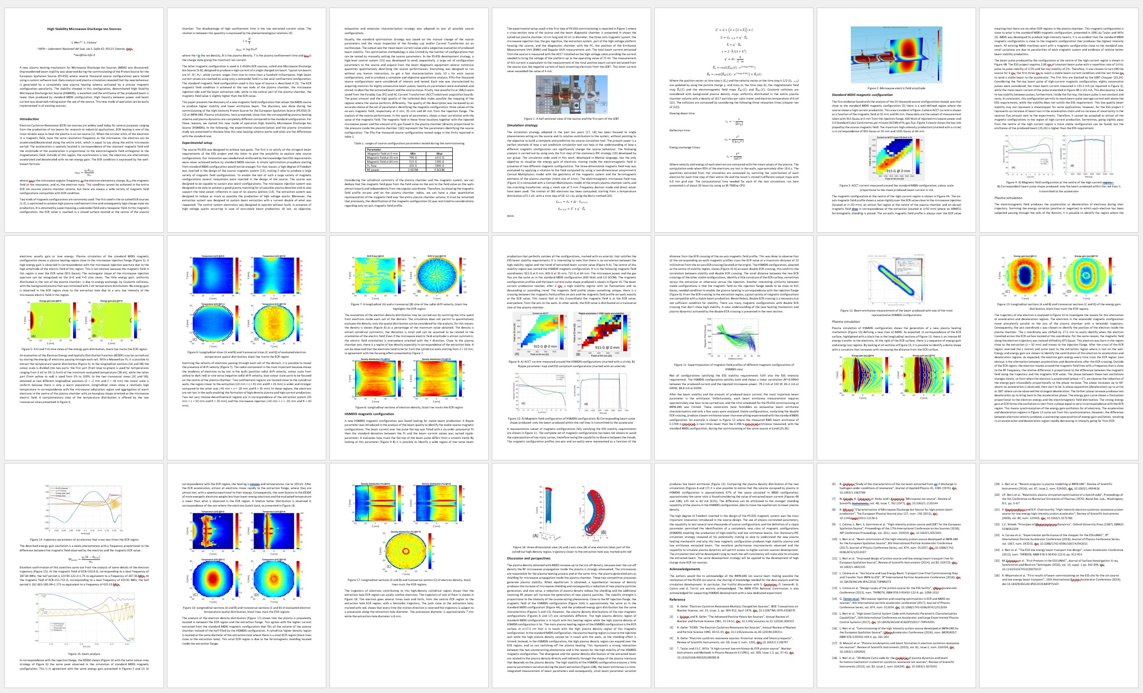
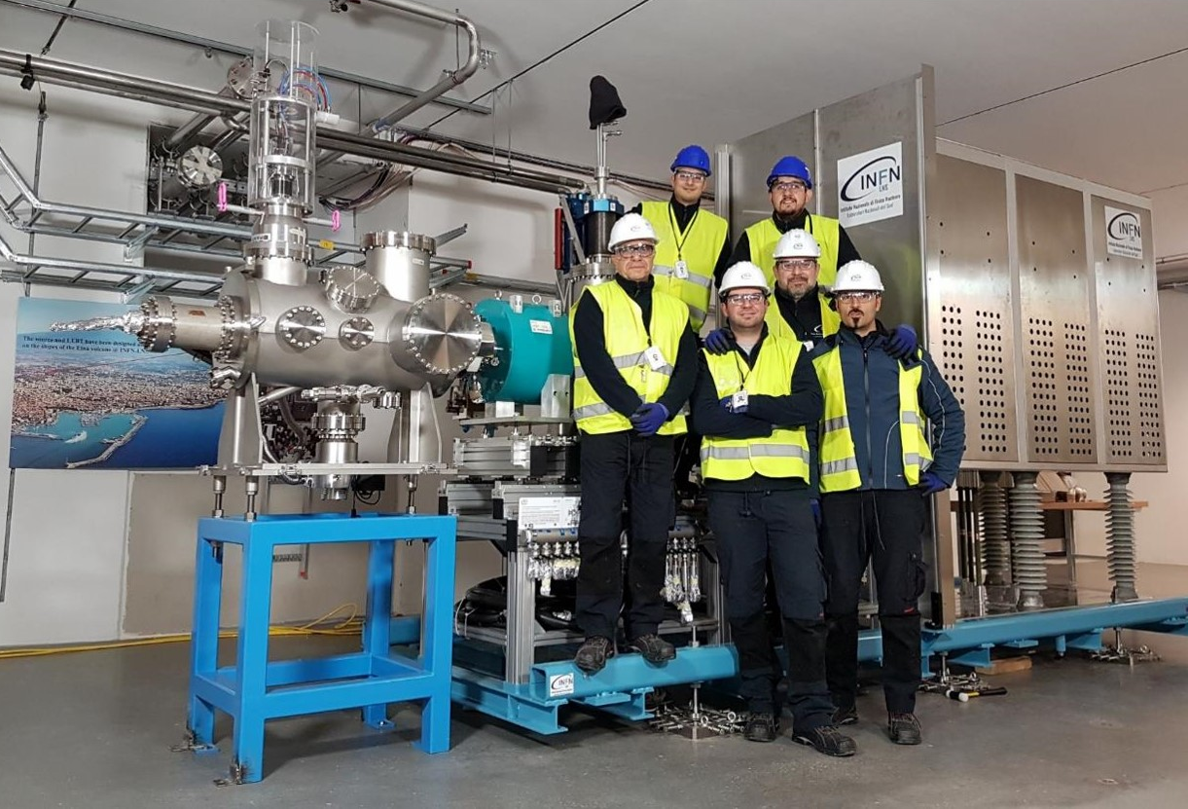
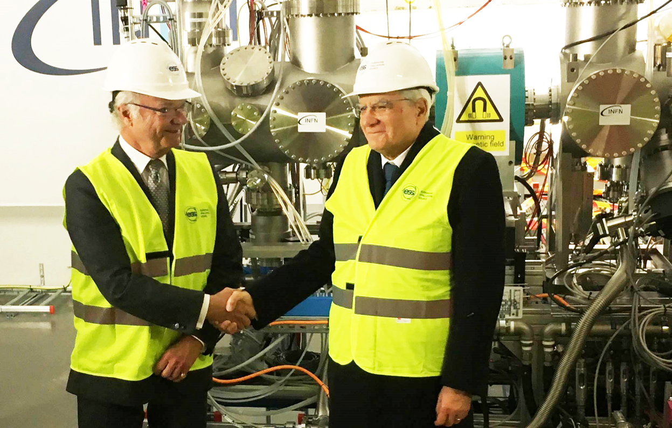

Proton Source for European Spallation Source (PS-ESS)
and the new optimum ion source magnetic configuration
Title: High Stability Microwave Discharge Ion Sources
Authors: L. Neri, L. Celona
Journal: Nature Scientific Reports
12, 3064 (2022) https://doi.org/10.1038/s41598-022-06937-7
01/02/2018
3

Slide 5





The team of the HSMDIS project (INFN-CSN5)
INFN-LNS in Catania:
Lorenzo Neri (developper), Giuseppe Castro, Ornella Leonardi, Andrea Miraglia, Lugi Celona, Santo Gammino
INFN-LNL in Legnaro:
Francesco Grespan, Michele Comunian
UNICT-DMI in Catania:
Giovanni Russo, Sebastiano Boscarino, Armando Coco
(mathematicians working on custom Poisson solver)
INGV in Catania:
Giuseppe Bilotta
(mathematician working on code optimization)
CNR-ISTP in Bari:
Gianpiero Colonna, Annarita Laricchiuta, Francesco Taccogna
(working on plasma chemistry)
4

Slide 6
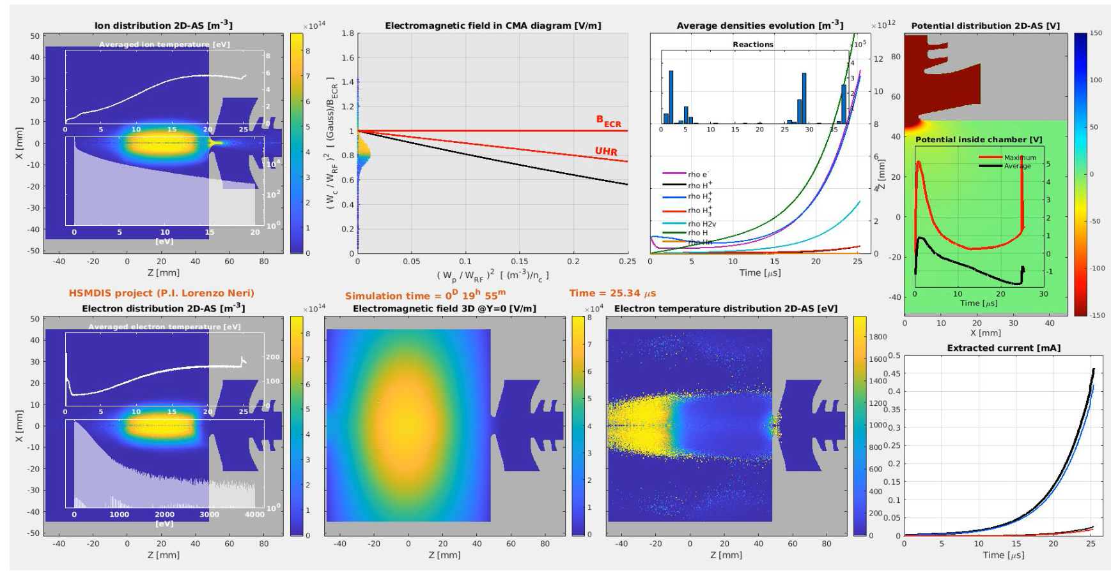
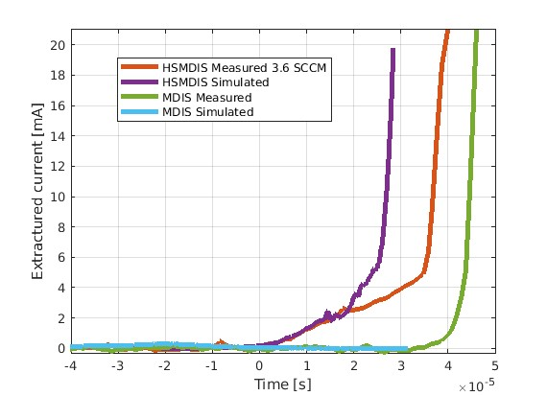
PIC simulation of the
HSMDIS magnetic configuration
The code development is in a validation stage where we are trying to reproduce experimental behaviour.
5

Slide 7
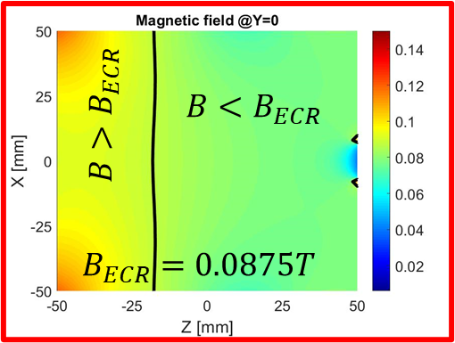
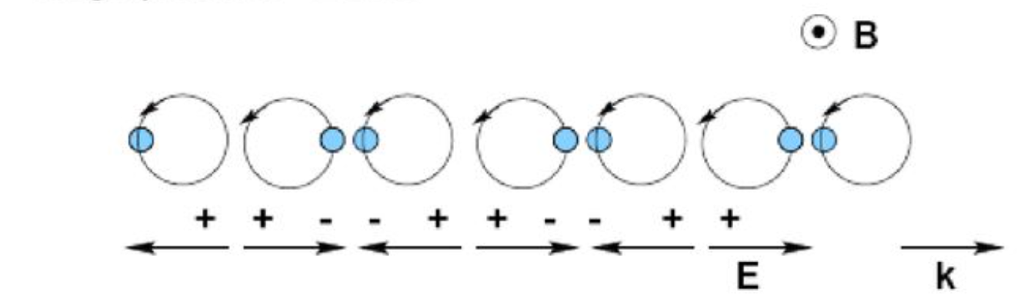
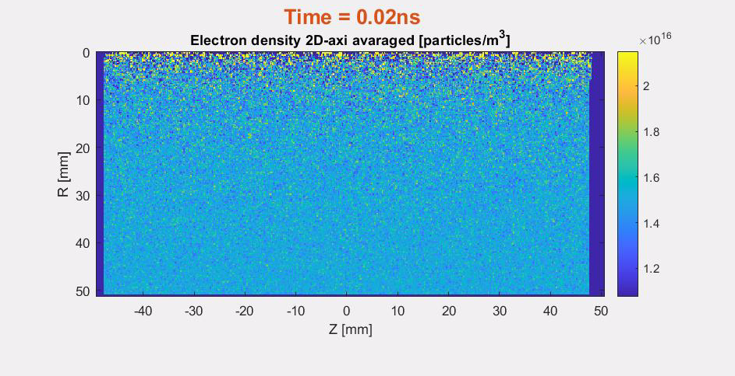
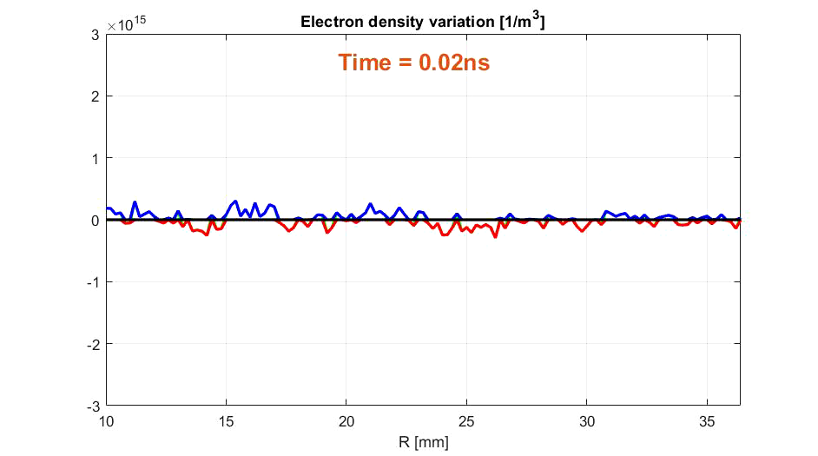
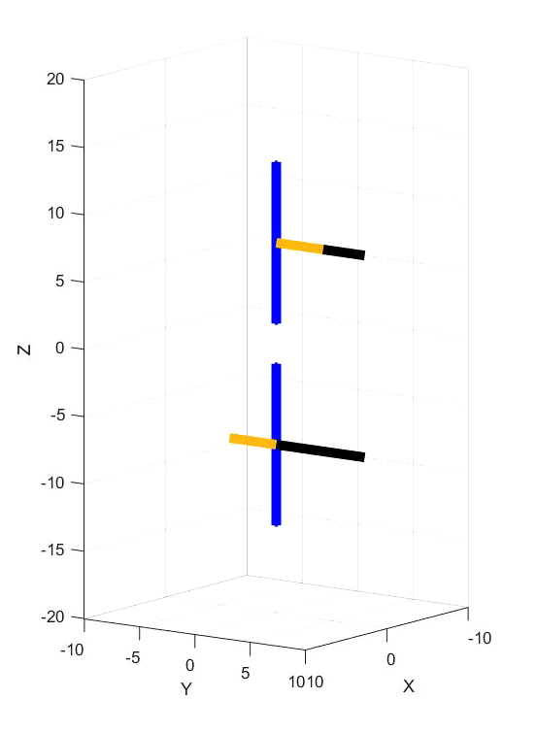
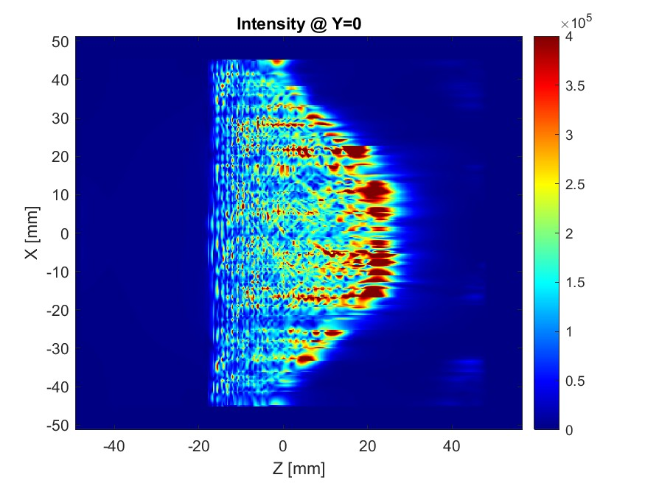
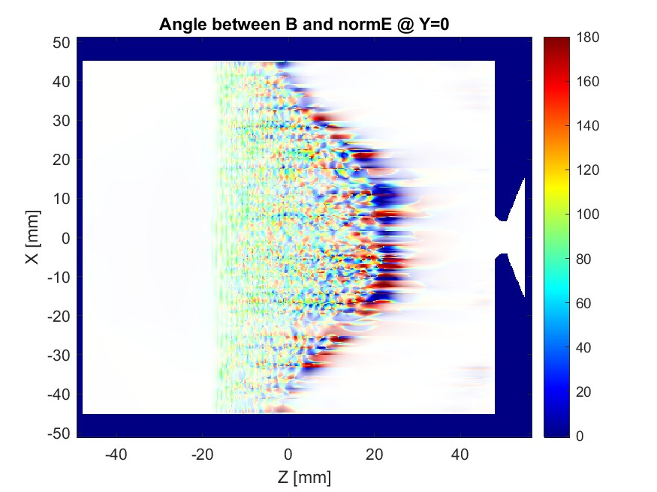
HSMDIS
Generation of Electron Bernstein waves
TPw₁
EBw
UHR
Θ = 180°
E_{RF}
Θ = 0°
UHR
normE
E_{RF}
normE
B_{S}
6

Slide 8



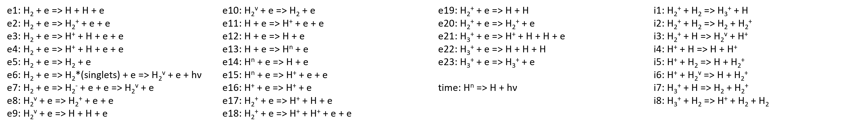
PIC simulation tool
From plasma formation to beam extraction
I
MS
3D Initialization of 1E7 particles
3D MagnetoStatic simulation
3D (2.45GHz) ElectroMagnetic simulation with tensorial complex permittivity (0.1 µs time step for resonances)
2D Axial Symmetric ElectroStatic simulation with adaptive time step up to 4E-12 s
3D Motion of Electrons (Boris mover)
3D Motion of Ions (Boris mover)
Different Adaptive techniques to speed up the computation
3D 32 Plasma reactions (e⁻, H⁺, H₂⁺, H₃⁺, H₂, H, H₂^{v}, H^{n})
3D Interaction with Walls: particle loss, secondary electrons, reflection
The End
E-5 s
Adaptive
+
EM
W
ES
Adaptive
First electrostatic computations in COMSOL last 10 seconds
➔
Now custom Poisson solver needs only 0.064 seconds
E-12 s
Adaptive
ME
E-10 s
MI
E-9 s
32
2E-4 s
TE
7

Slide 9
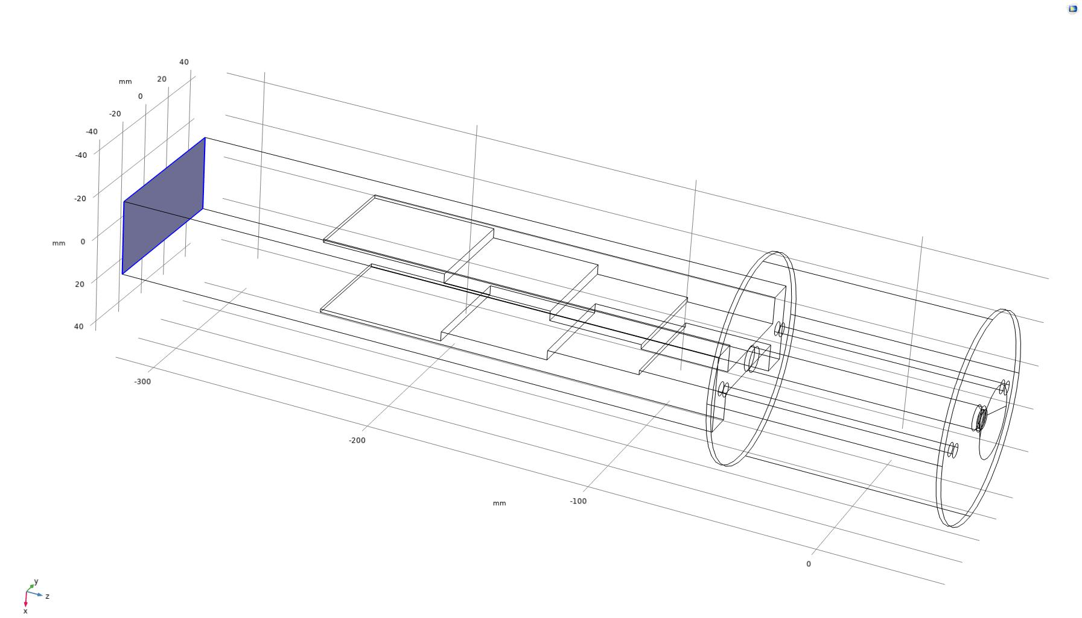
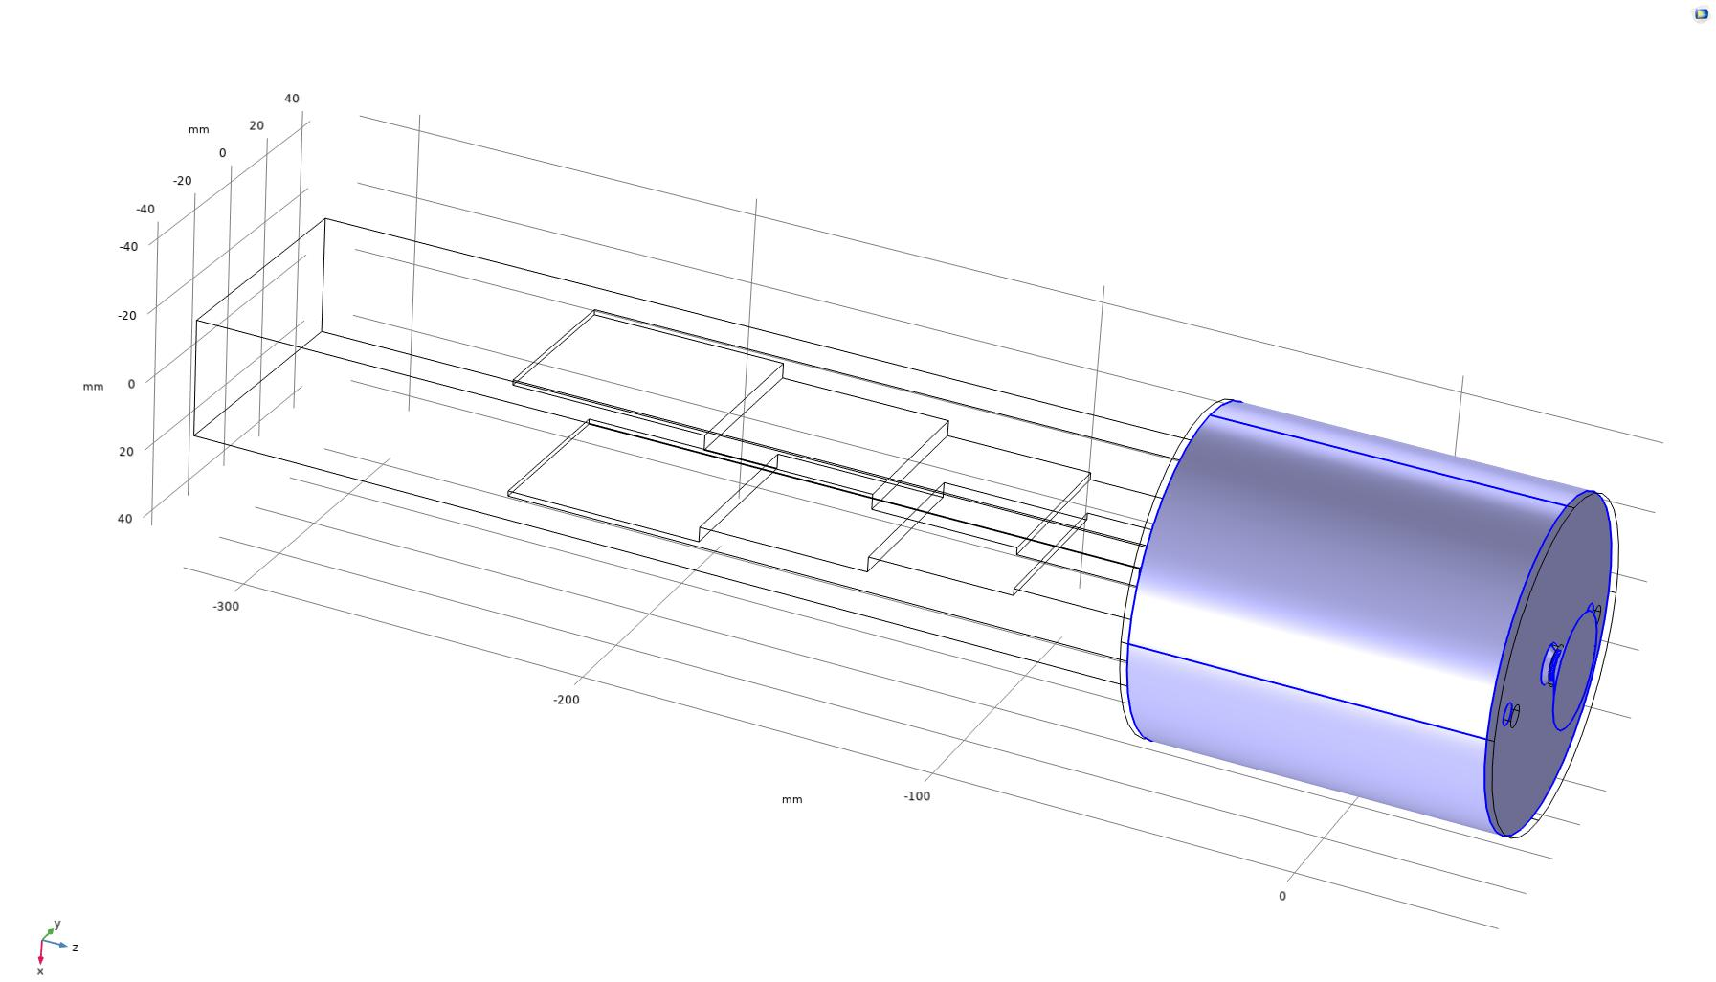
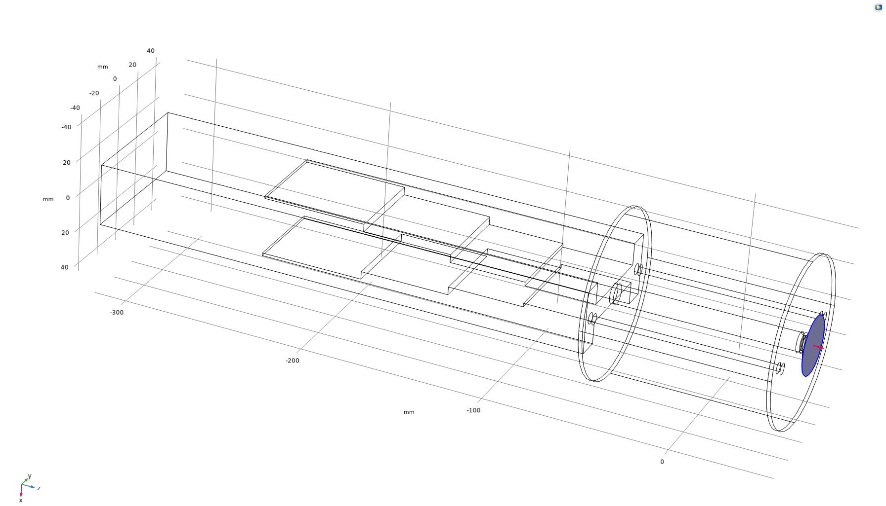
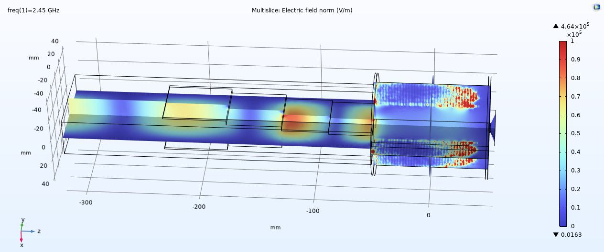
Electromagnetic simulation
Plasma chamber (tensorial permittivity)
Output port
Input port 500 Watt
@ 2.45GHz
Stepped impedance transformer
Cold tensor approximation
$$\overset{̿}{ε_{r}}=\overset{̿}{I}−\frac{n_{e}q_{e}}{iwε_{0}\left(A^{3}+AB^{2}\right)}\left[\begin{matrix}A^{2}+B_{x}^{2} & B_{x}B_{y}+AB_{z} & B_{x}B_{z}−AB_{y} \\ B_{x}B_{y}−AB_{z} & A^{2}+B_{y}^{2} & B_{y}B_{z}+AB_{x} \\ B_{x}B_{z}+AB_{y} & B_{y}B_{z}−AB_{x} & A^{2}+B_{z}^{2}\end{matrix}\right]=\overset{̿}{ε_{r}}\left(n_{e}\left(\vec{r}\right),T_{e}\left(\vec{r}\right),\vec{B}\left(\vec{r}\right)\right)$$
where:
$$A=\frac{−iw−w_{eff}(T_{e})}{e/{m_{e}}}$$
Tensorial permittivity is needed because the plasma is not uniformly magnetized
Matlab and COMSOL meshes are different, and two interpolation steps are needed
8

Slide 10
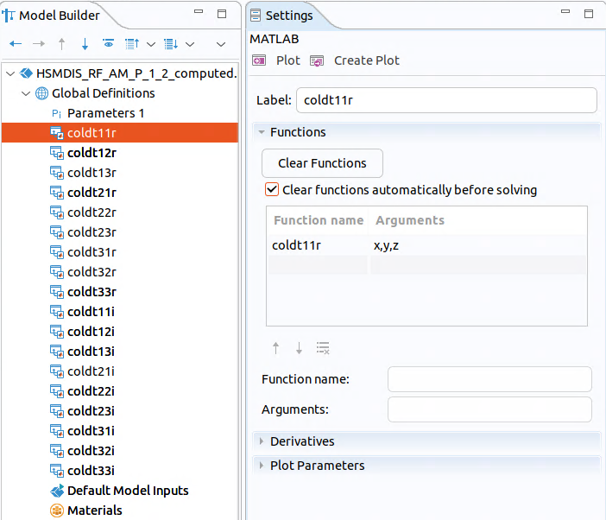
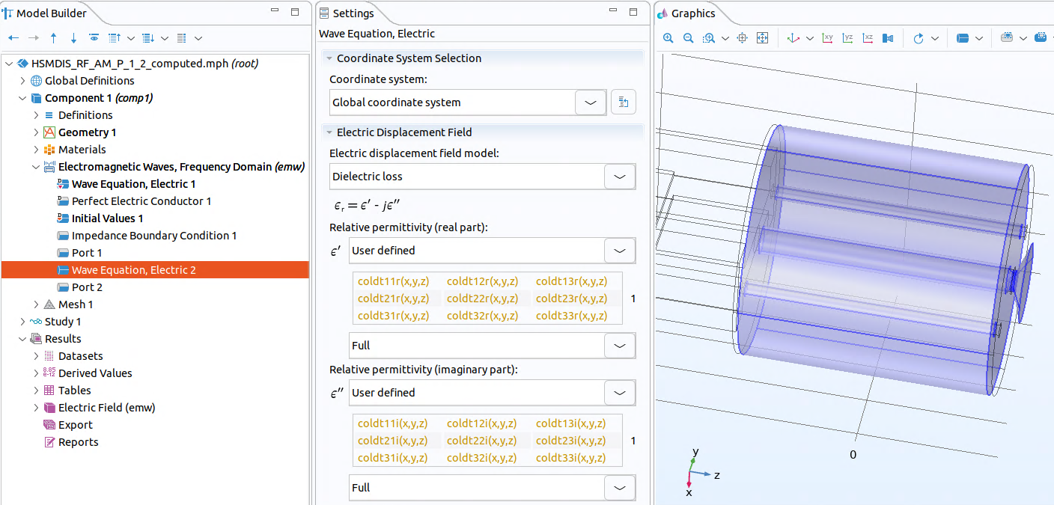
Electromagnetic simulation
9

Slide 11

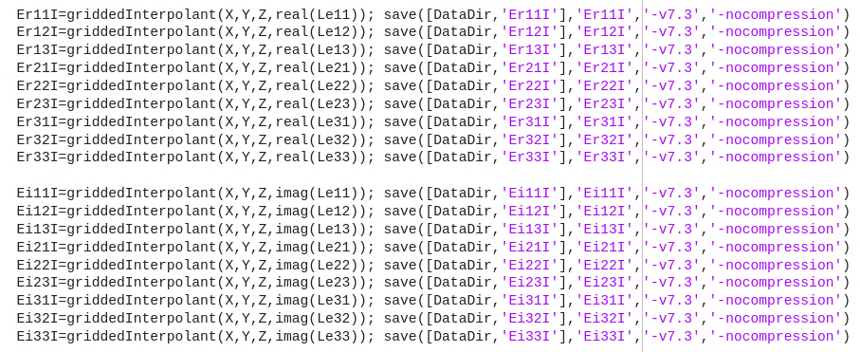

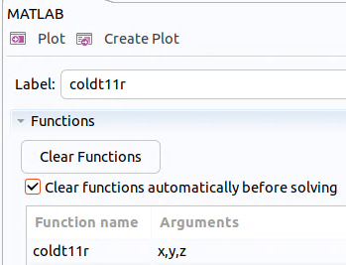
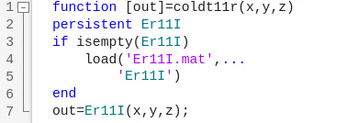
Electromagnetic simulation
1) Compute the complex permittivity and save 18 griddedInterpolant functions
2) Compute model using tensorial permittivity provided by Matlab functions
3) Retrieve solution from COMSOL
10

Slide 12
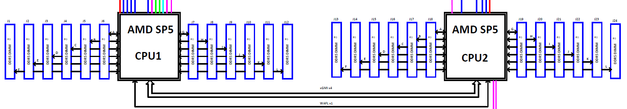
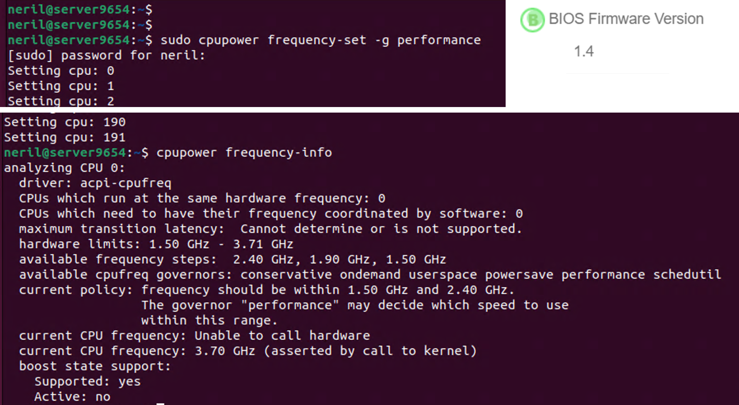

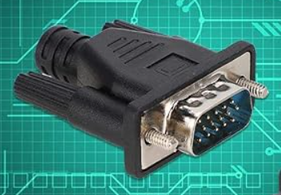
Hardware
9654
9654
30 k€
Supermicro AS-2025HS-TNR
2x AMD 9654, 96 cores each, 2.4GHz / 3.7GHz
1.6TB RAM DDR5 4800MT/s
6.4TB SSD NVME
16TB Hard Disk SATA3
Dummy VGA plug ➔ Enable
1920x1080 remote desktop instead of 800x600
12

Slide 13
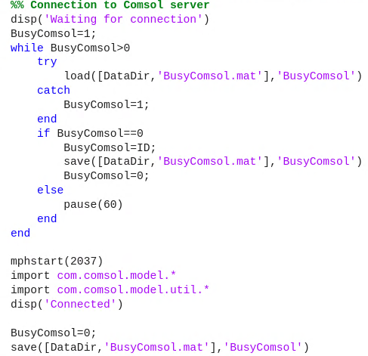
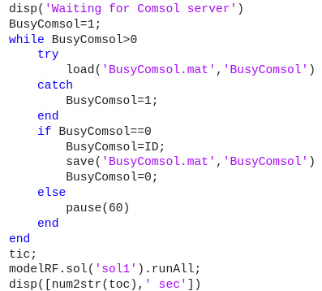
One COMSOL server for two Matlab instances
9654
9654
PIC execution optimized for single CPU
PIC execution optimized for single CPU
COMSOL model solver works better on all CPUs
To wait until the COMSOL server is free

Slide 14
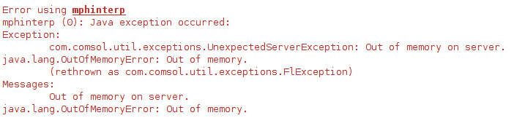
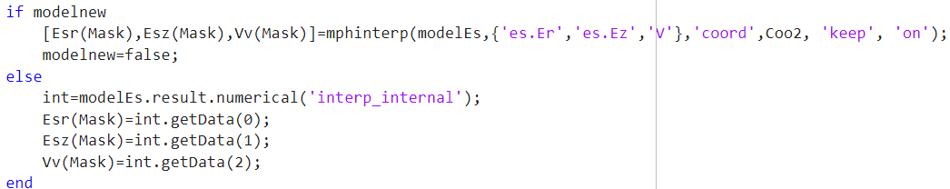
Perspectives about COMSOL use (1/2)
If you request too many values with ‘’mphinterp’’
Solution 1: increase swap memory
Solution 2: split into groups the values to be requested
With grouped data we lose the capability to store points of interest that are requested many times,
‘keep’ ‘on’ and ‘’getData’’ don’t work
Is it possible to use ‘’getData’’ with grouped data?
13

Slide 15
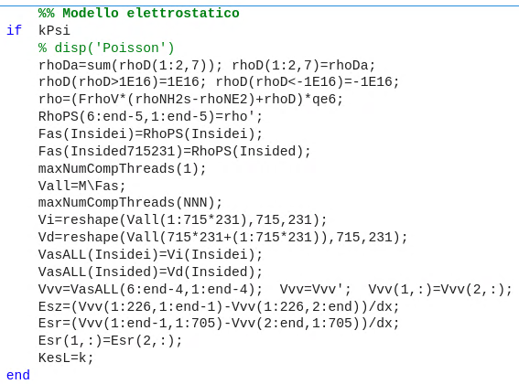

Perspectives about COMSOL use (2/2)
Custom Poisson solver was reduced to the solution of a linear system using Matlab “mldivide, \”
Decomposition is 9/10 of the computational cost.
In Matlab, it is possible to do it once and use it every time.
Is it possible to save decomposition in COMSOL?
Is it possible to use parts of the previous solver iteration?
14

Slide 16
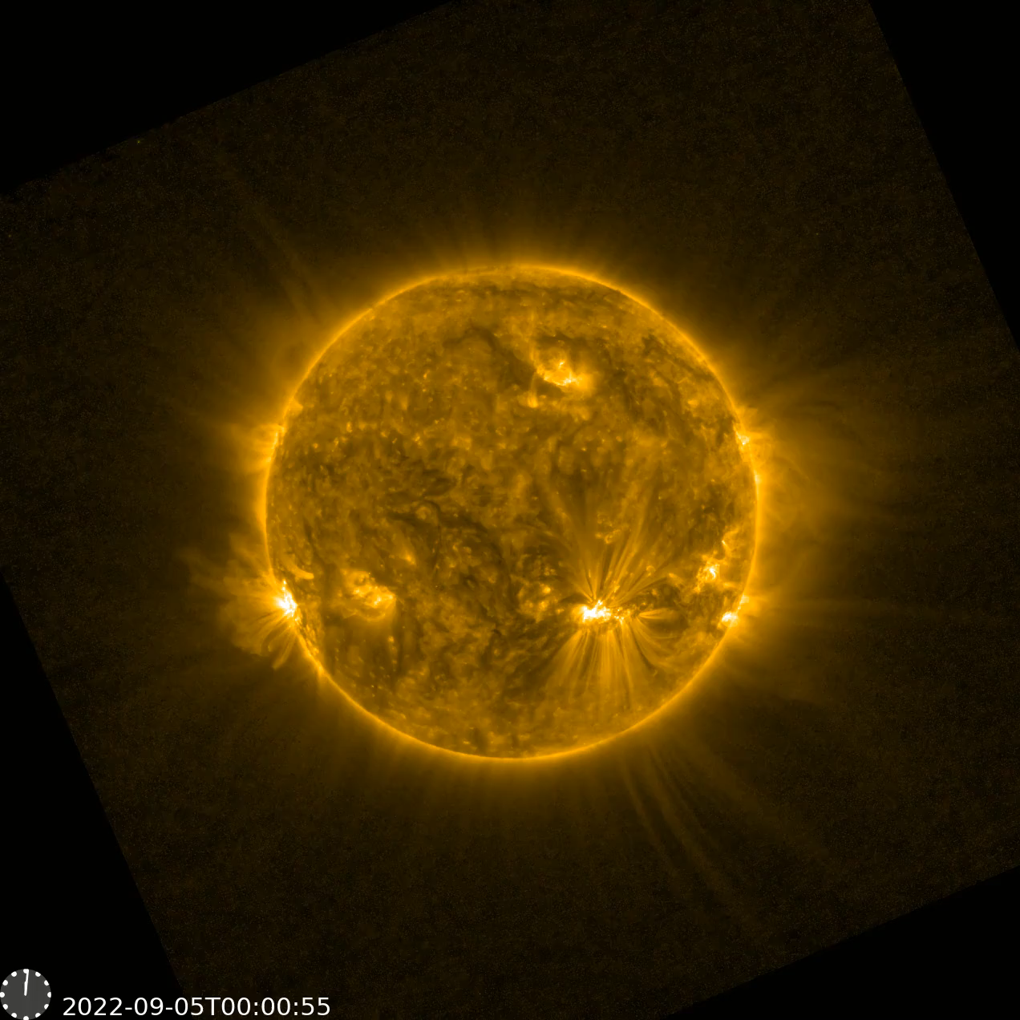
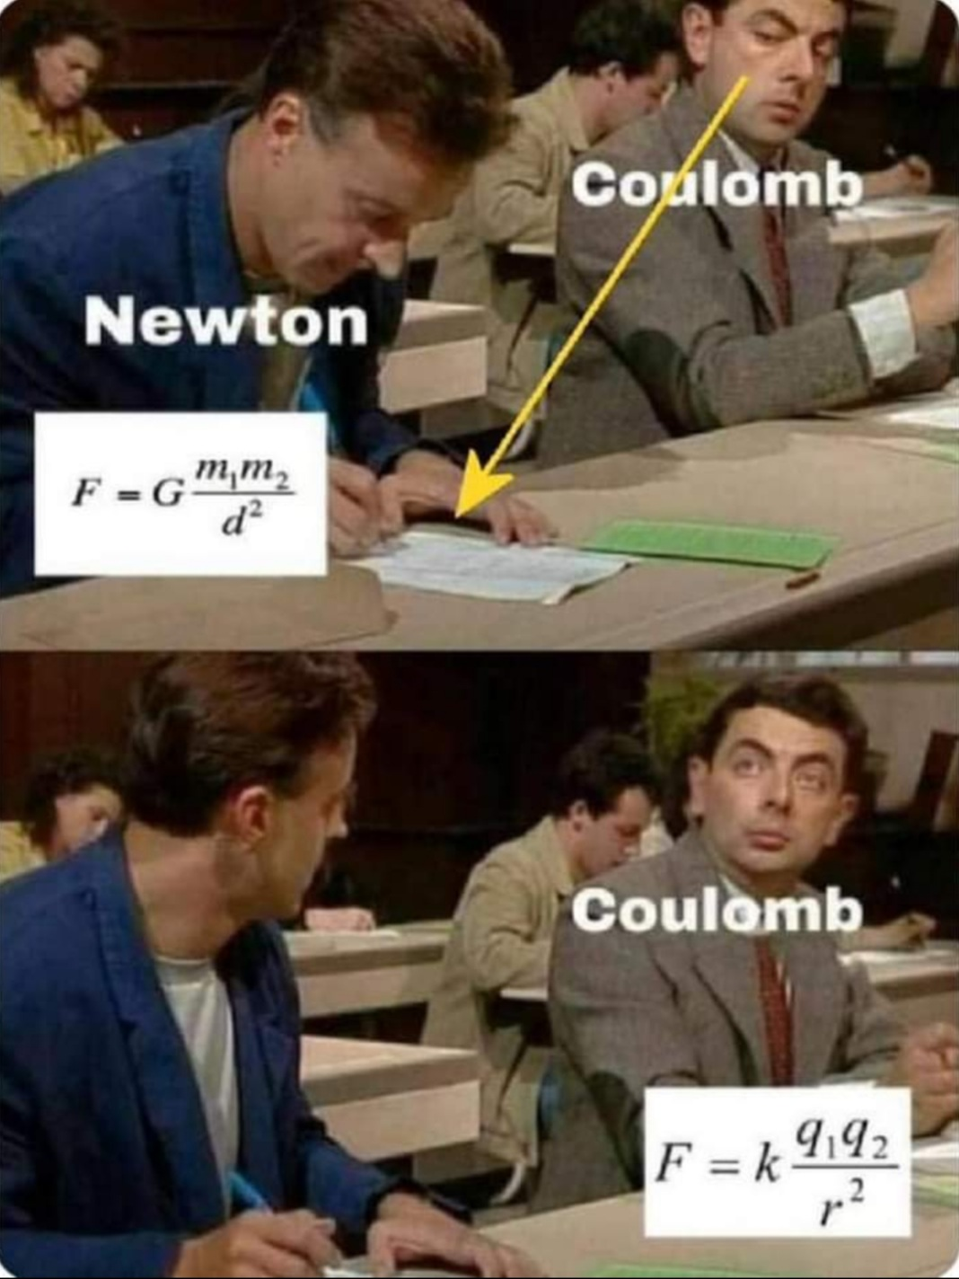
Thank you for
the attention
Lorenzo Neri

