Slide 1


Optimizing electrochemical conversion of CO₂ to C2 products via multi-physics simulations
Dr. Aviral Rajora, Dr. Simone Dussi, Endino Gieske

Slide 2
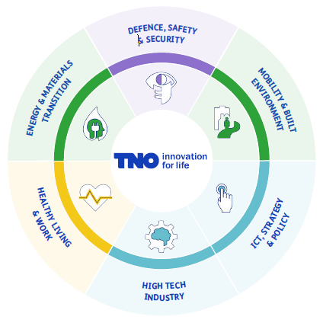
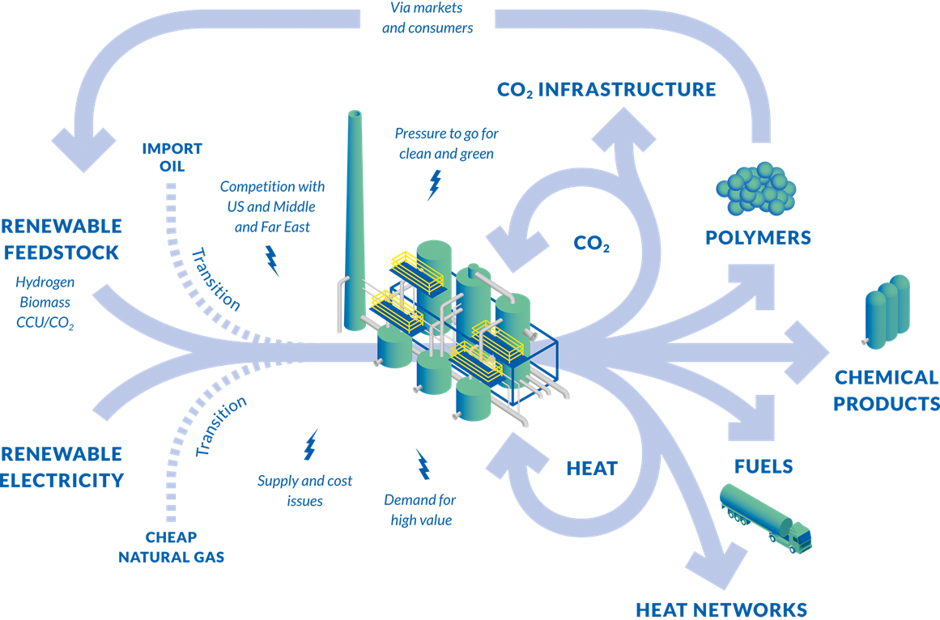

About TNO
Groningen
Petten
TNO: Netherlands Organization for Applied Scientific Research
  >4200 employees, several locations in the Netherlands
  Independent not-for-profit organization for research in between academia and industry
  From public-private collaborative projects (NL, EU) to contract research
  Six main research units
Energy & Materials Transition unit
  R&D division focusing on industrial processes
From 2015 VOLTACHEM Program for accelerating industrial electrification
Amsterdam
Leiden
Soesterberg
The Hague
Utrecht
Zeist
Rijswijk
Delft
Bergen op Zoom
Eindhoven
Helmond
Geleen
          Lab facilities
          Locations
https://www.voltachem.com/
TNO, 2024. All rights Reserved.

Slide 3

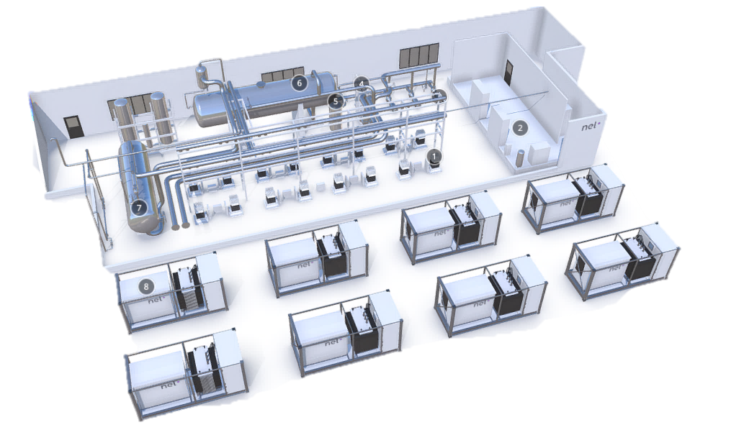
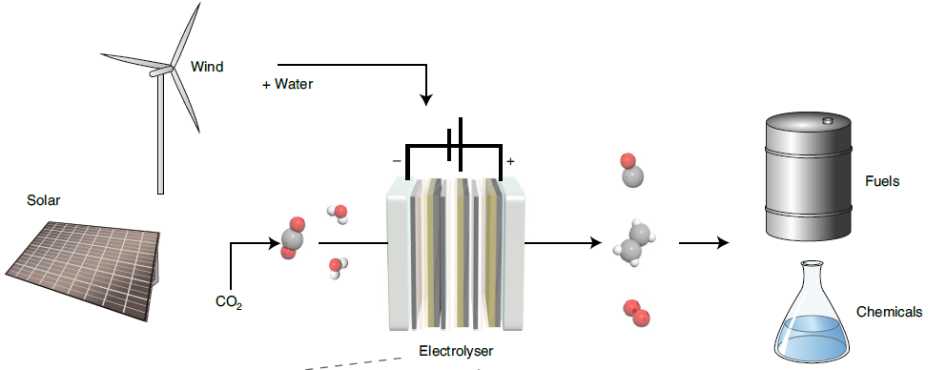

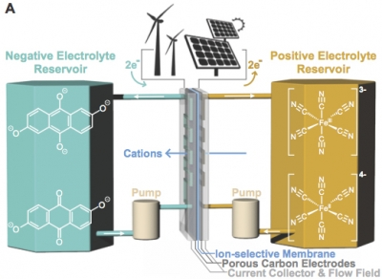
Multi-scale Electrochemical Flow Modelling
CO₂ electrolyser
Water electrolyser
Redox Flow Battery
Science 349, 1529 (2015)
TNO, 2024. All rights Reserved.

Slide 4
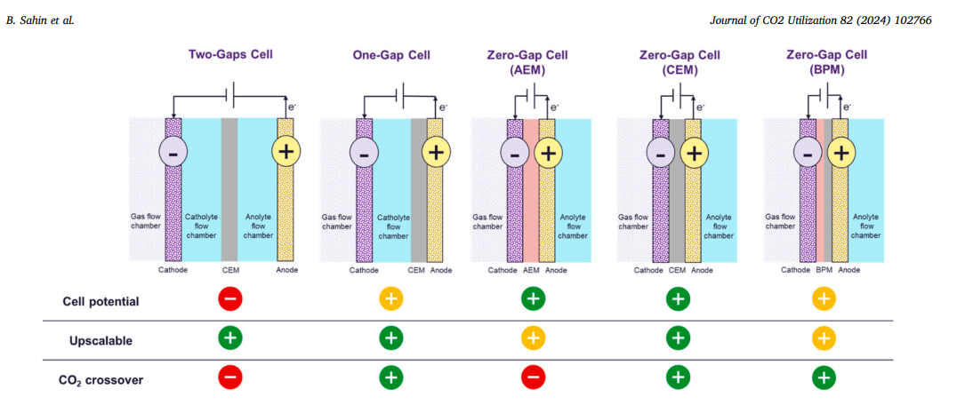
There are a lot of different configurations
Current TNO focus: one-gap flow cell or membrane-electrode-assembly (MEA) with zero-gap, using AEM
TNO, 2024. All rights Reserved.

Slide 5
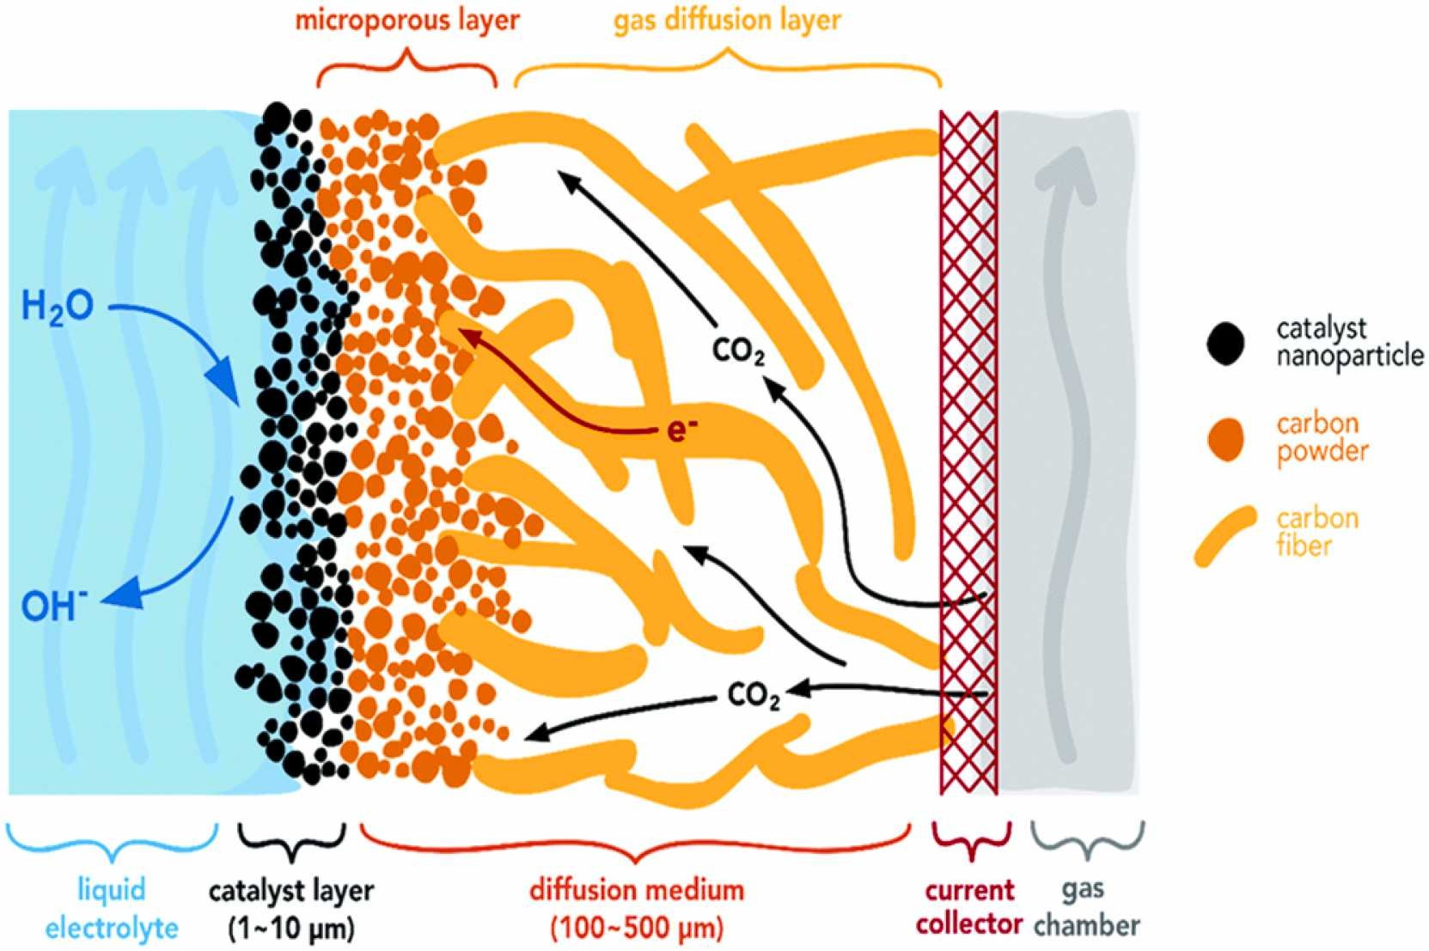
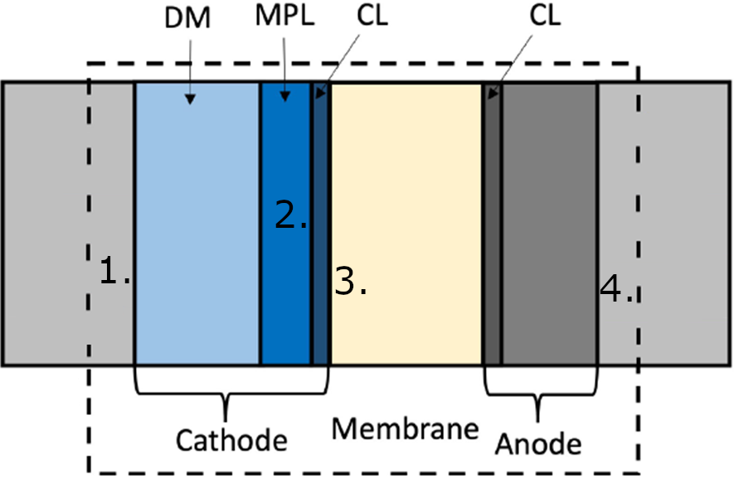
Multi-physics modelling to guide cell design
  Models needed to quickly screen different designs and operating conditions
  1D models developed based on pioneering works of Weng, Bell, Weber and recent study of Ehlinger et al.
  Steady-state and isothermal simulations of coupled phenomena at cell-level:
  Flow
    Darcy’s law, simplified 2-phase using saturation curves
  Species transport (12 species)
    Gaseous species transport using multicomponent diffusion
    Aqueous species using Nernst-Planck
    Donnan potential included in transport across AEM for MEA configuration
  Reactions (7+5 heterogeneous + homogeneous)
Outputs: I-V curve, Faraday efficiency, spatial distributions of key quantities
  Weng, Bell, Weber PCCP (2018),
  En. Env. Sci. (2019), En. Env. Sci. (2020)
Ehlinger et al., ChemElectroChem 11 (2024)
TNO, 2024. All rights Reserved.

Slide 6
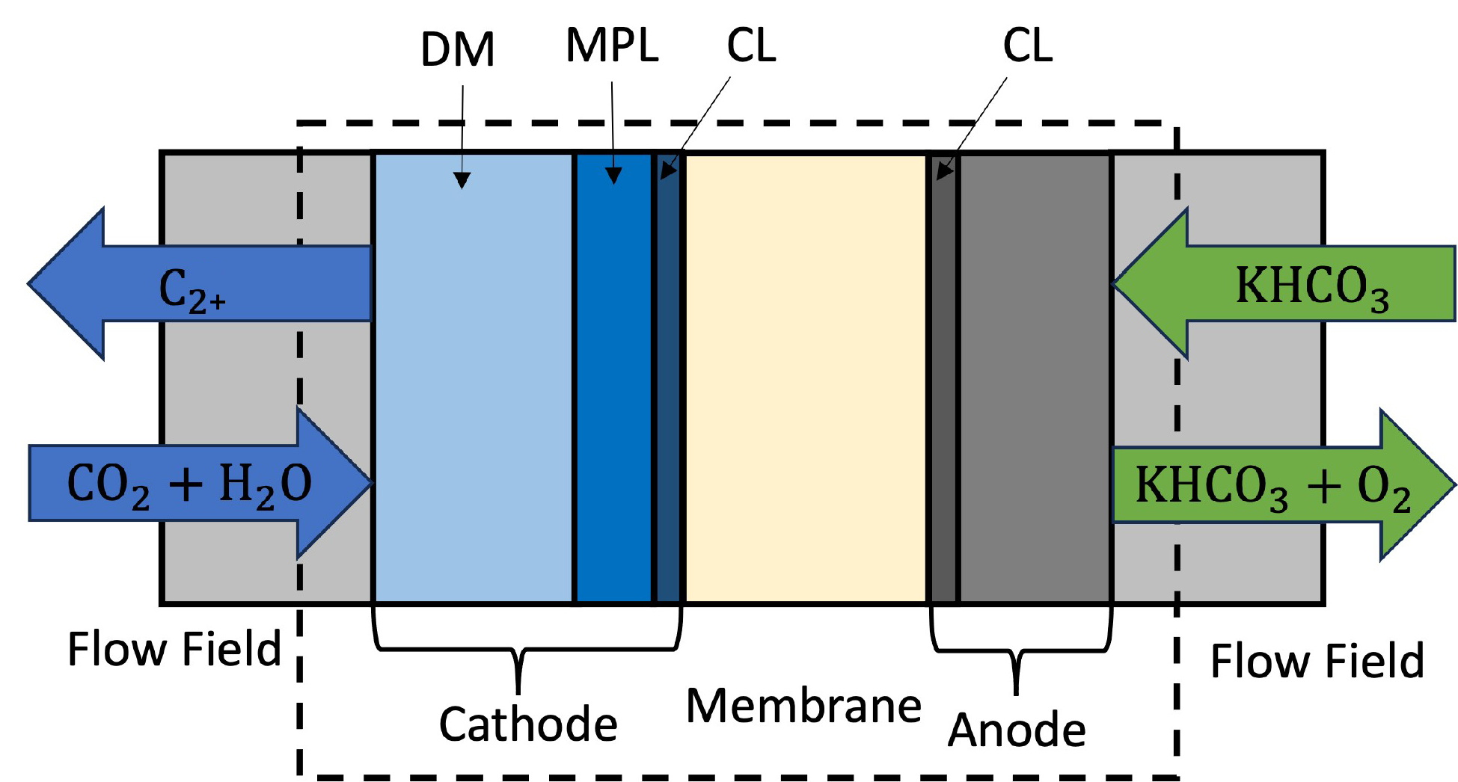
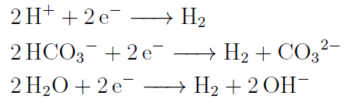
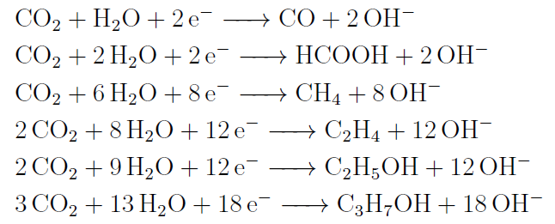
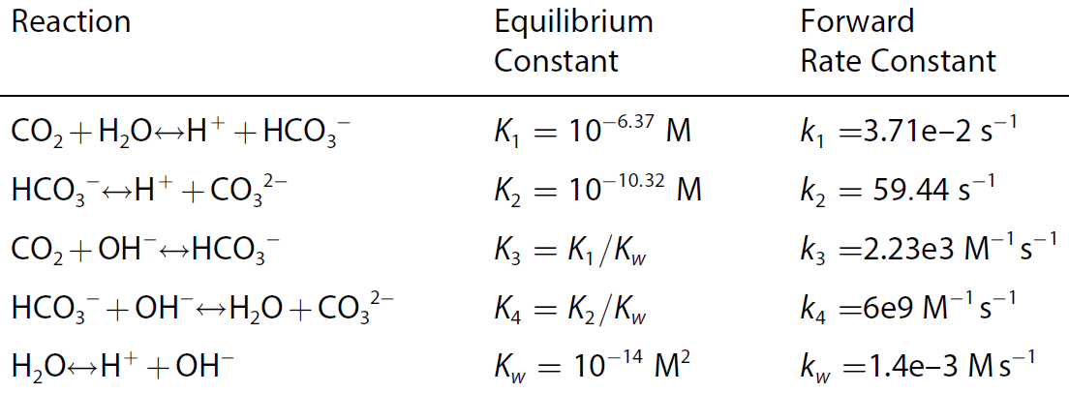

1D MEA model
Tertiary Current Distribution
  Porous Electrode: DM,MPL,CL
  Porous Electrode Reactions: CL
  Ion Exchange Membrane: Membrane
HER
CO₂R
Butler-Volmer or Tafel kinetics
Homogeneous reactions
Law of mass action
OER
TNO, 2024. All rights Reserved.

Slide 7
1D MEA model
Tertiary Current Distribution
  Porous Electrode: DM,MPL,CL
  Porous Electrode Reactions: CL
  Ion Exchange Membrane: Membrane
Transport of Concentrated Species in Porous Media
  Cathode DM, MPL, CL
Darcy’s law
  Cathode DM, MPL, CL
TNO, 2024. All rights Reserved.

Slide 8
Boundary conditions
Physics
Gas channel | Cathode Diffusion Medium:
  P = 1 atm
  ω_{CO2} = 0.94, ω_{H2O} = 0.04, ω_{H2} = 0.01, ω_{CO} = 0.01
  φ_{s} = 0 V
Microporous Layer | Cathode Catalyst Layer:
  J_{aq} = 0
Cathode Catalyst Layer | Membrane:
  J_{gas} = 0
Anode Diffusion Medium | Anolyte:
  c_{i} = c_{equi}
  φ_{s} = φ_{applied}

Slide 9
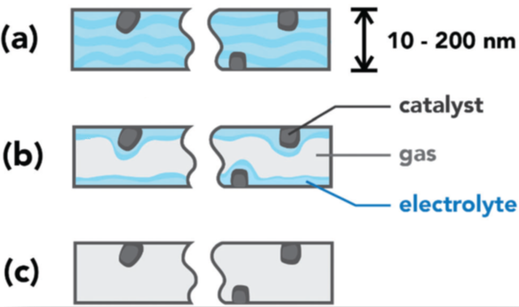
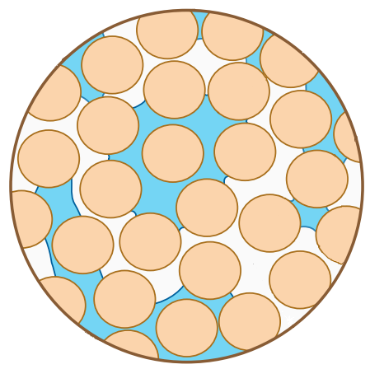
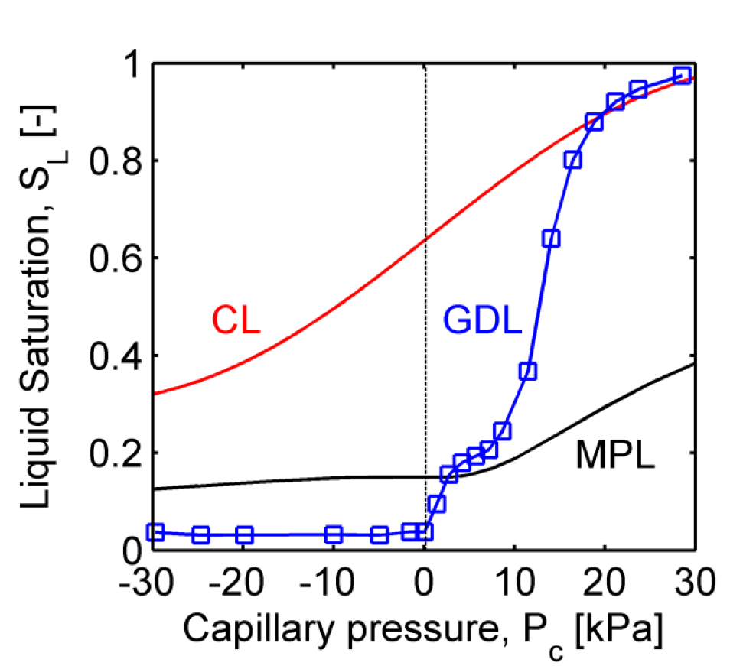
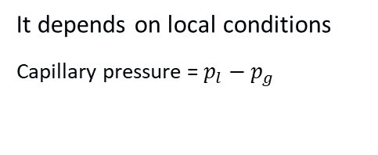
Modelling electrode flooding
S: pore saturation
S = 1, flooded case
0 < S < 1, wetted case
S = 0, dry case
Multiphase flow in porous media
Weng et al. (2018)
It depends on local conditions
Capillary pressure = $p_{l}−p_{g}$
Simplified to parameter S
Zenyuk et al. (2015)
TNO, 2024. All rights Reserved.

Slide 10
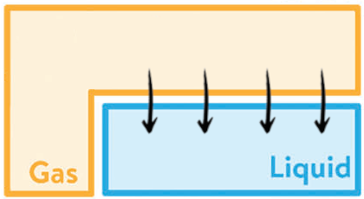
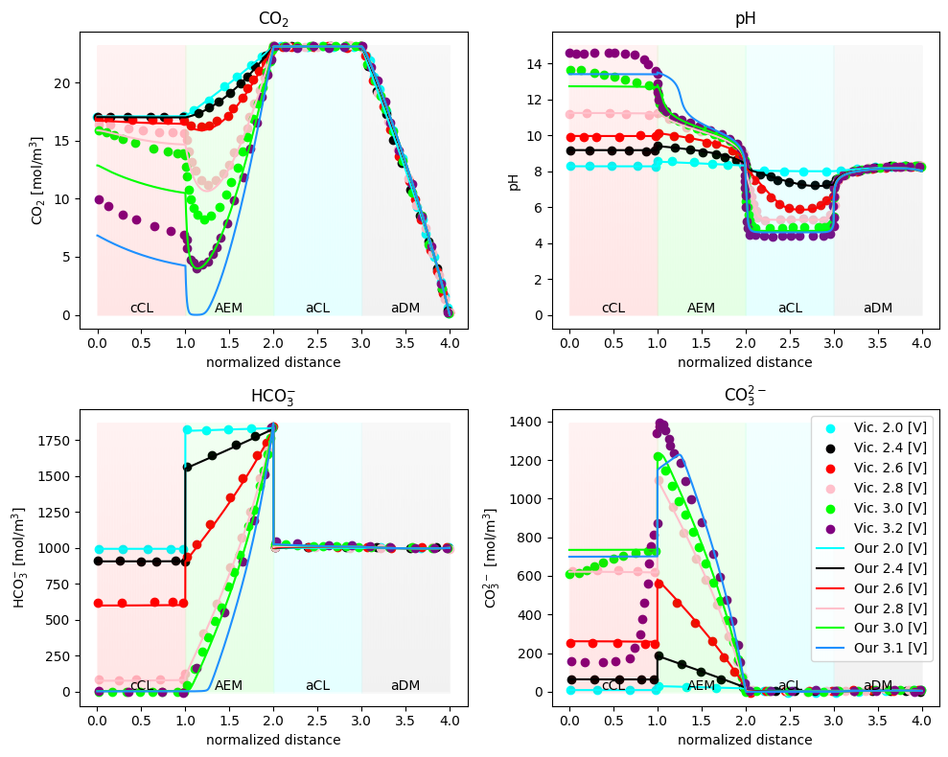
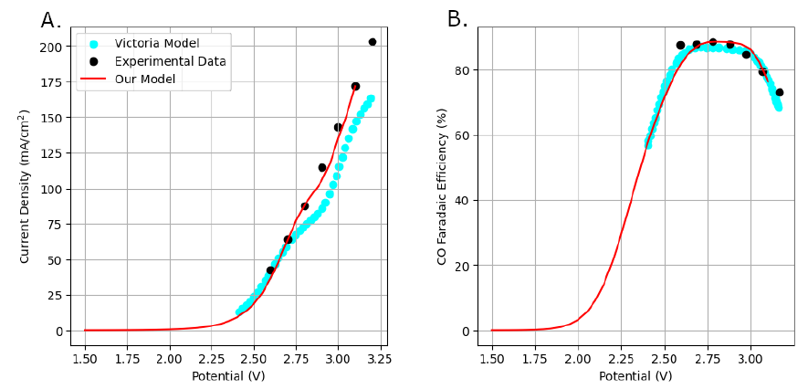

Model validation (for CO₂ to CO)
CO₂ (g)
Focus on gas-liquid behavior in cathode
Accurate saturation curves crucial to capture decrease in Faradaic efficiency
Several complex coupled phenomena: implementation details matter!
CO₂ (aq)
Porous layer
Catalyst layer
CO₂ dissolution in CL described as source term
    We thank Victoria Ehlinger for useful correspondence
TNO, 2024. All rights Reserved.

Slide 11
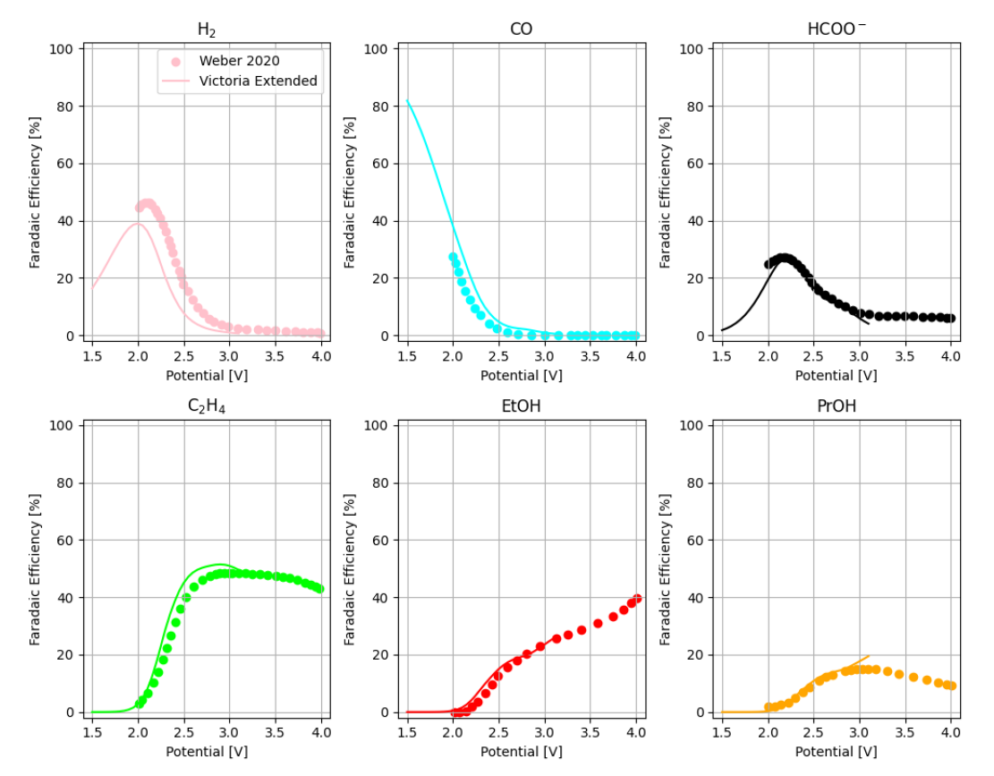

Extending the model to ethylene
Include additional reactions to C2+ products
Good agreement with previous literature (for “ideal” wetting of S=0.64)

Slide 12
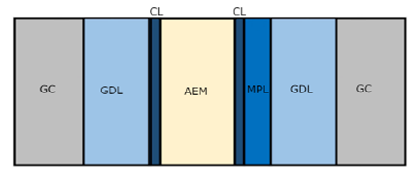
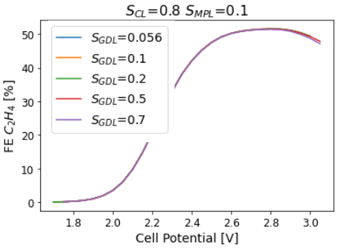
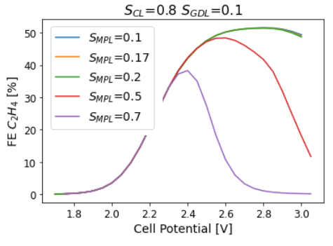
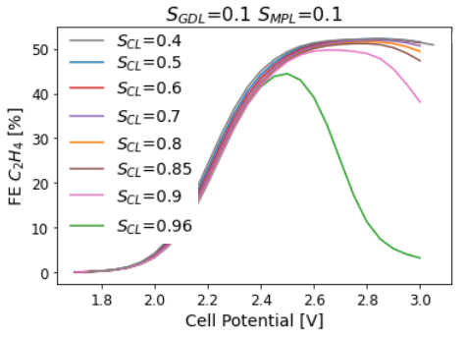
1D simulation results: gas-liquid management
Impact of (average) saturation level of the different cathode layers on Faradaic efficiency
  GDL has minor impact
  Flooding of MPL can also be detrimental
  Catalyst layer is the most important one
cathode
TNO, 2024. All rights Reserved.

Slide 13
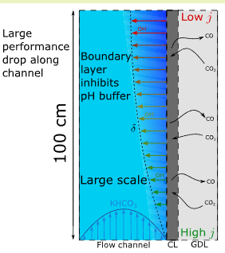
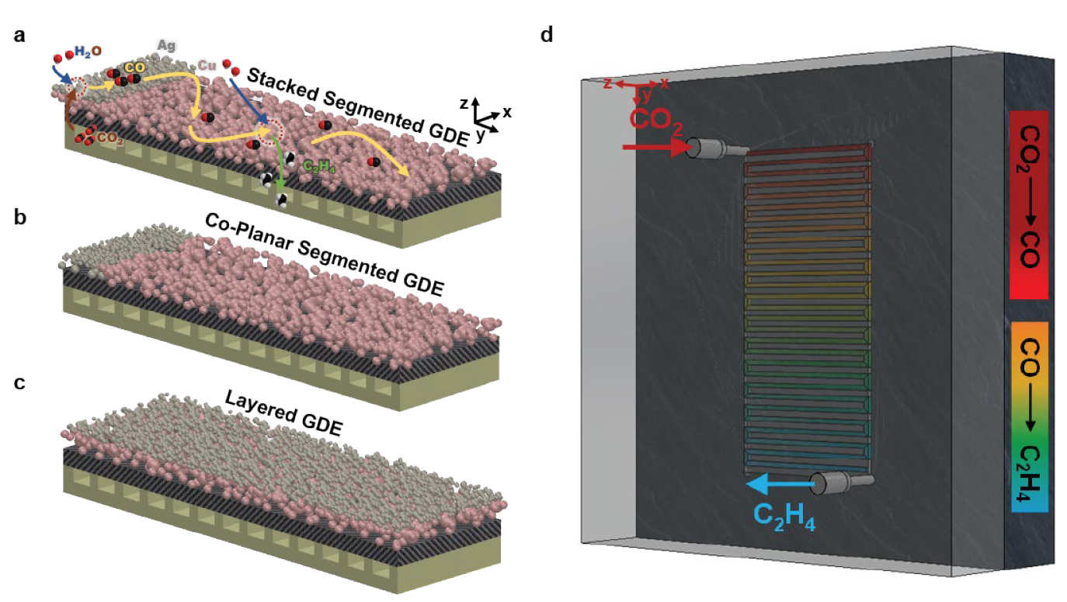
2D simulations to address upscaling challenges
Much less done in literature for 2D, especially for CO₂ to C₂H₄
  Few studies on planar electrodes, microfluidic and GDE flow cells
2D simulations to understand limitations to single-pass conversion
  Blake et al. shown limitations in 1m-long CO₂->CO GDE flow cell, related to inhomogeneities in catalyst local environment
2D simulations to optimize catalyst distribution
  Segmented GDE: two types of catalysts (silver + copper) to promote in-situ tandem reaction (CO₂->CO->C₂H₄)
  What about non-uniform catalyst distribution?
Qiu et al., Env. Chem. Lett. (2023), Yang et al. ACS Sus. Chem. Eng. (2020), Kas et al. ACS Sus. Chem. Eng. (2021)
Blake et al., ACS Sust. Chem. Eng., 11, 2840, (2023)
Zhang et al., Nat. Catal., 5, 201, (2022)
TNO, 2024. All rights Reserved.

Slide 14
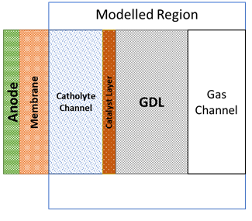
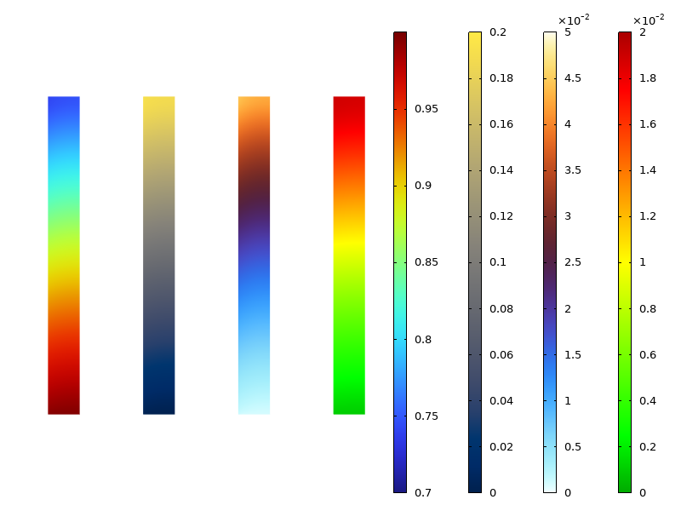
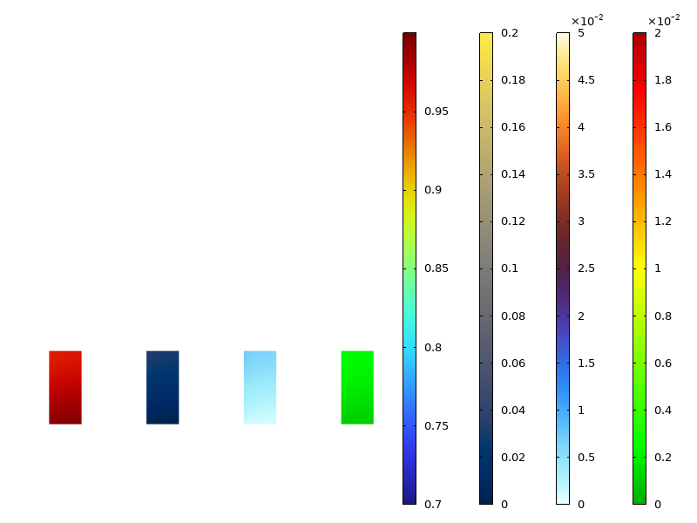
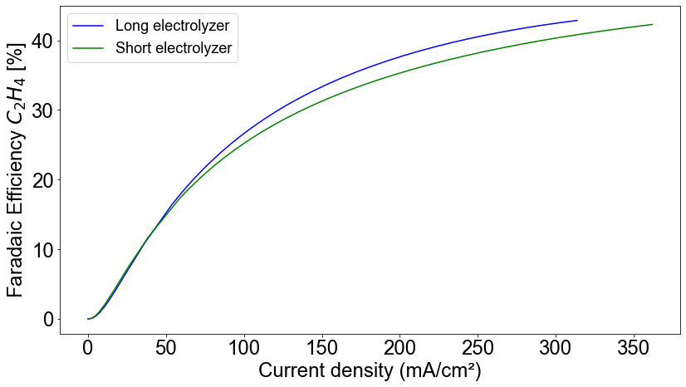
(ongoing) 2D simulations: counteracting inhomogeneities
  Upto 10 cm long channel simulated
  High current density (300 mA/cm²)
  For long channels, large mass fraction gradients seen in the simulation snapshot
  Performance is influenced due to inhomogeneity.
CO₂
CO
C₂H₄
H₂
CO₂
CO
C₂H₄
H₂
Shown mass fractions in gas channel (3mm wide)

Slide 15
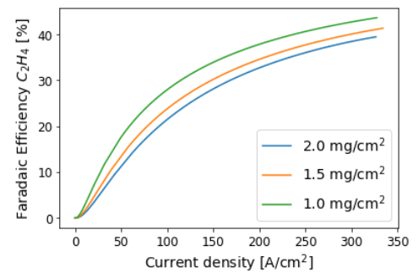
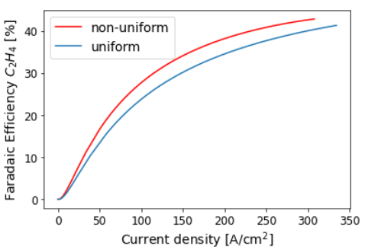
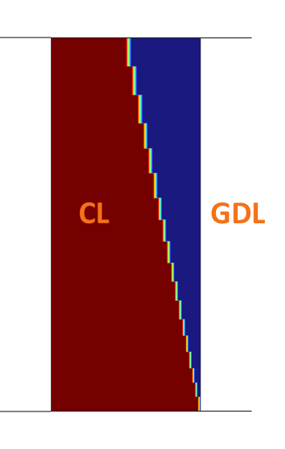
(ongoing) 2D simulations: tuning catalyst loading
Depending on manufacturing process, changes in catalyst loading can affect catalyst layer porosity, thickness, active surface area…
For a 10cm cell, decreasing (uniform) catalyst loading can improve performance
TNO, 2024. All rights Reserved.

Slide 16
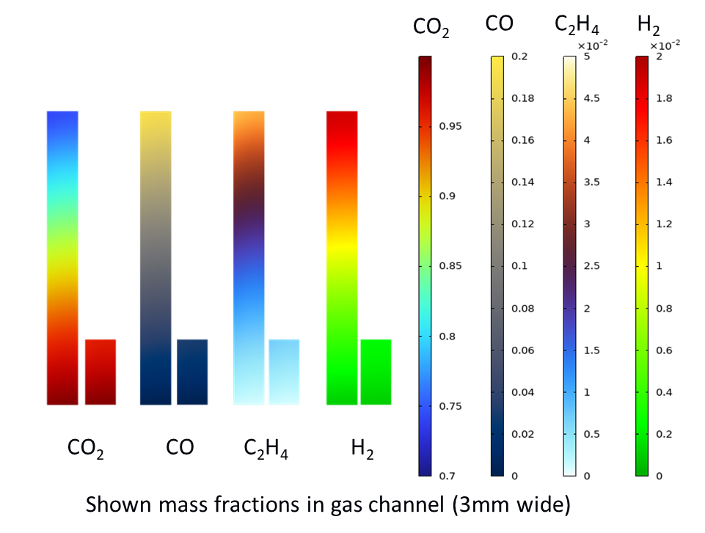
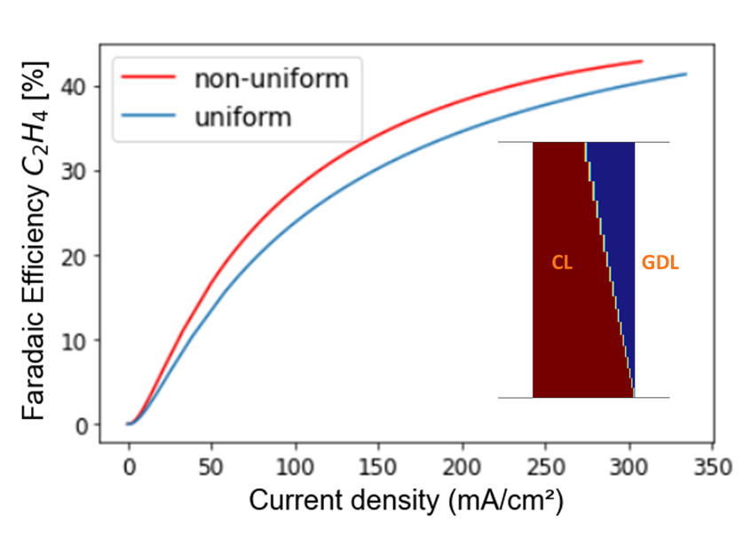
CONCLUSIONS
We model different electrolyzer configurations: MEA and one gap configuration
Catalyst layer design is crucial for performance of CO2 electrolyzer
MPL could also be detrimental
There are large inhomogeneties in long electrolyzers
Catalyst loading can be tuned to improve performance
Thank you for your attention!
For more info, collaborations, internships/vacancies:
aviral.rajora@tno.nl
TNO, 2024. All rights Reserved.

