Slide 1


Numerical prediction of the eigenfrequencies of an idealized bridge pier under local scour
Mauro Aimar and Sebastiano Foti
Department of Structural, Building and Geotechnical Engineering, Politecnico di Torino, Torino, Italy

Slide 2
LIST OF CONTENTS
Introduction and motivation
Case study
Numerical model
Parametric study
Final remarks

Slide 3
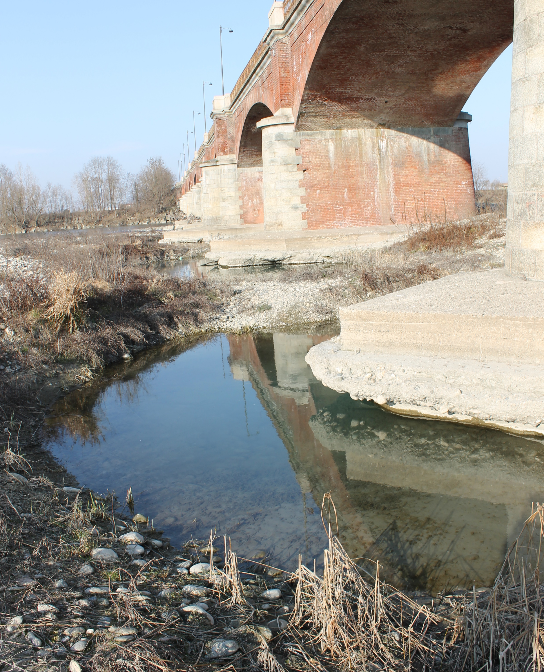
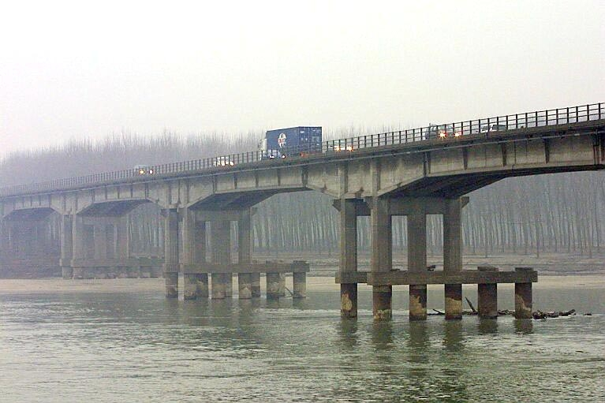
Introduction and motivation
Local scour
General scour
Bridge scour
Bridge scour is the result of the erosive action of flowing water, which excavates and carries away material from the riverbed
Scour can cause the subsidence and tilt of the piers, contributing to 60% of failures of road bridges (e.g., Imhof 2004)

Slide 4
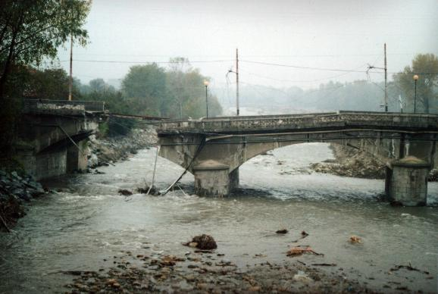
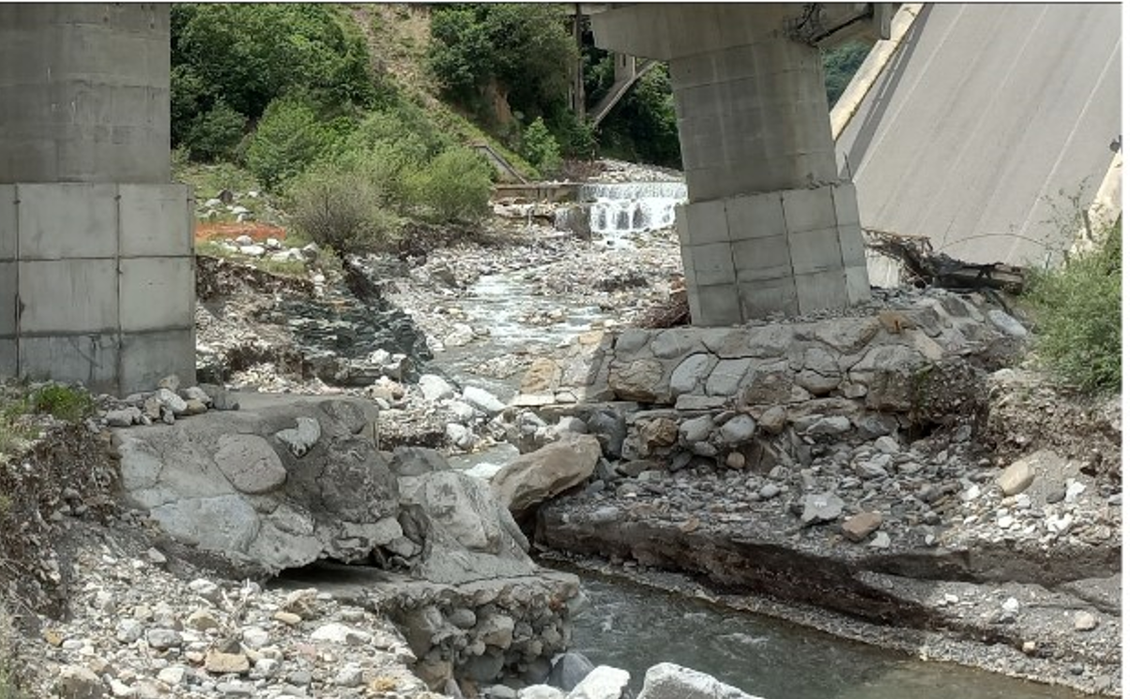
Introduction and motivation
Local scour
General scour
Bridge scour
Bridge scour is the result of the erosive action of flowing water, which excavates and carries away material from the riverbed
Scour can cause the subsidence and tilt of the piers, contributing to 60% of failures of road bridges (e.g., Imhof 2004)
Collapse of the Chisone bridge
(Torino, 2000)
Collapse of the Longobucco bridge, (Cosenza, 2023)

Slide 5
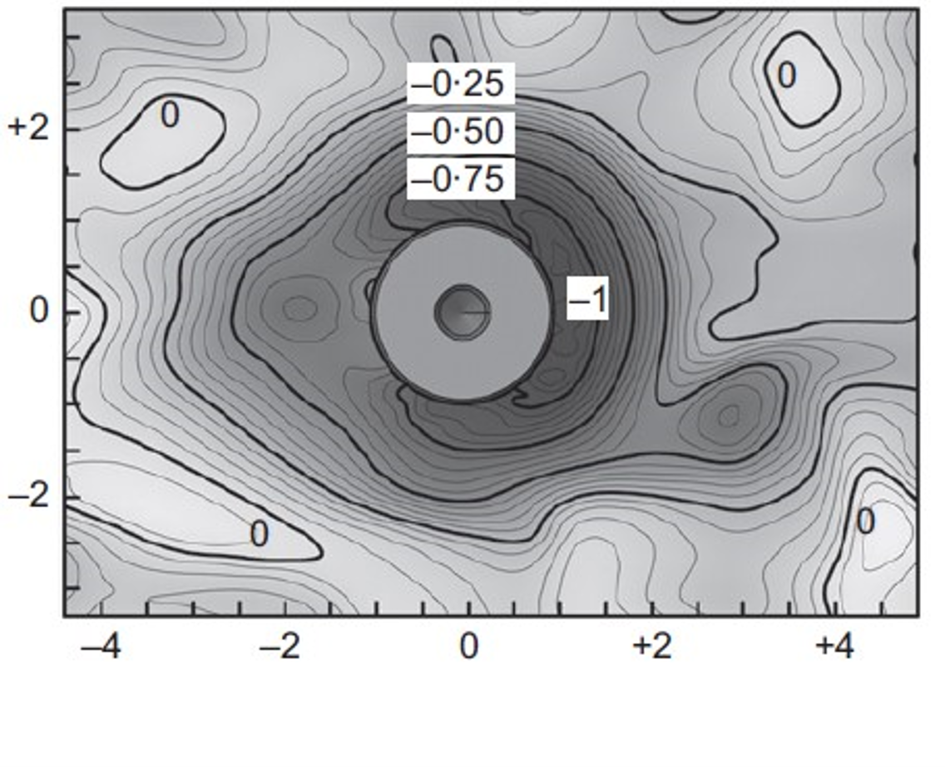
Introduction and motivation
Local scour
General scour
Bridge scour
Bridge scour is the result of the erosive action of flowing water, which excavates and carries away material from the riverbed
Scour can cause the subsidence and tilt of the piers, contributing to 60% of failures of road bridges (e.g., Imhof 2004)
Proper modeling requires rigorous representation of the problem geometry and adequate constitutive models to reproduce the soil response → Advanced numerical simulations
Ciancimino et al. (2022a)

Slide 6
Introduction and motivation
Local scour
General scour
Bridge scour
Bridge scour is the result of the erosive action of flowing water, which excavates and carries away material from the riverbed
Scour can cause the subsidence and tilt of the piers, contributing to 60% of failures of road bridges (e.g., Imhof 2004)
Proper modeling requires rigorous representation of the problem geometry and adequate constitutive models to reproduce the soil response → Advanced numerical simulations
This study presents a numerical model to reproduce the dynamic behavior of an R.C. bridge pier supported on a caisson foundation embedded in sand, and it estimates the modal parameters under various local scour scenarios.
Ciancimino et al. (2022a)

Slide 7
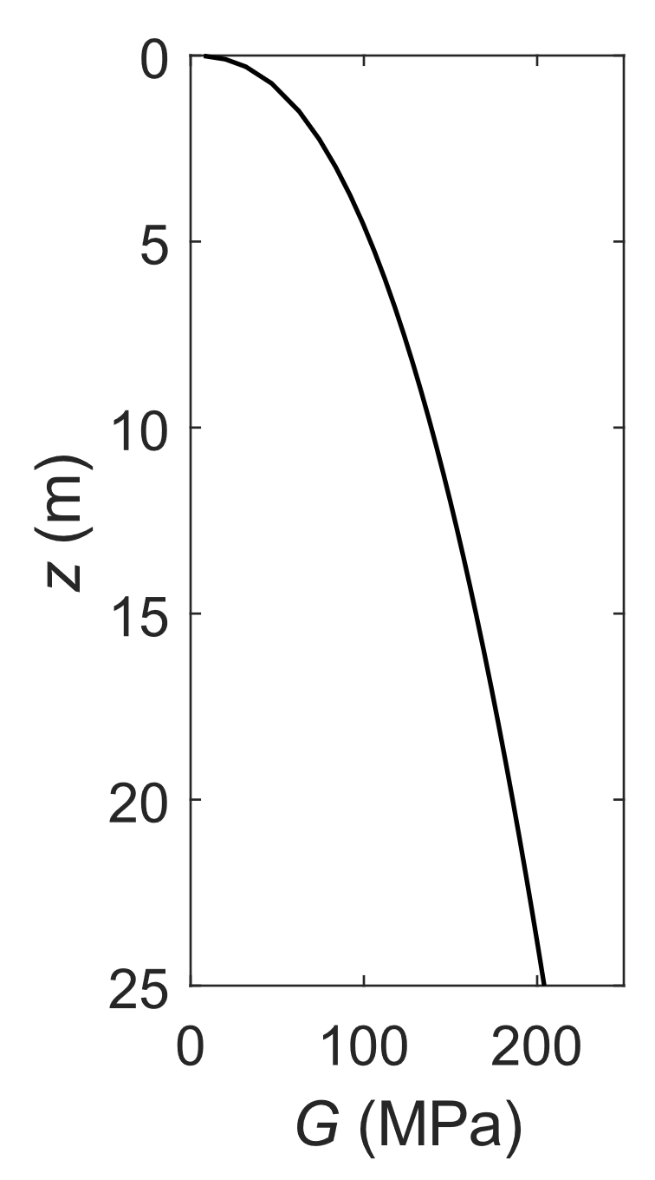
CasE STUDY
Target: circular, full RC pier founded on a cylindrical caisson
Superstructure: deck composed by simply supported, isostatic, RC beams
→ Pier modeled as a SDOF system
Soil: dense homogeneous sand, characterized in terms of G(z) profile (parabolic type)
Deck: m = 4,3×10⁵ kg
(Approx length 20-25 m)
6 m
z
6 m
25 m
6 m

Slide 8
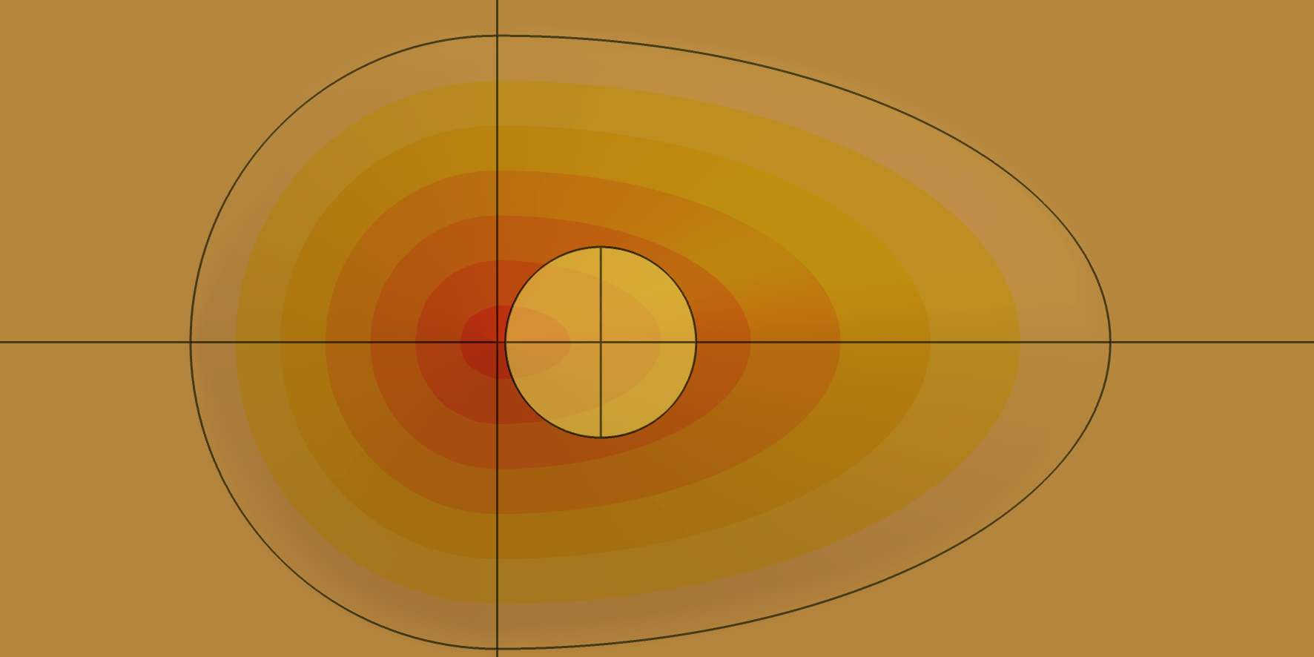
CasE STUDY
Full embedded “S00”
Local scour scenarios “Sxx”
“S38”; “S50”; “S63”; “S75”
Target: circular, full RC pier founded on a cylindrical caisson
Superstructure: deck composed by simply supported, isostatic, RC beams
→ Pier modeled as a SDOF system
Soil: dense homogeneous sand, characterized in terms of G(z) profile (parabolic type)
Scour: the dynamic response of the system is addressed considering the foundation fully embedded (“S00”) and four local scour scenarios (“S38” to “S75”), with a standard shape of the scour hole
(xx/100)H
H
0
max.
Water flow
Ciancimino et al. (2022a)
Top view
Depth

Slide 9
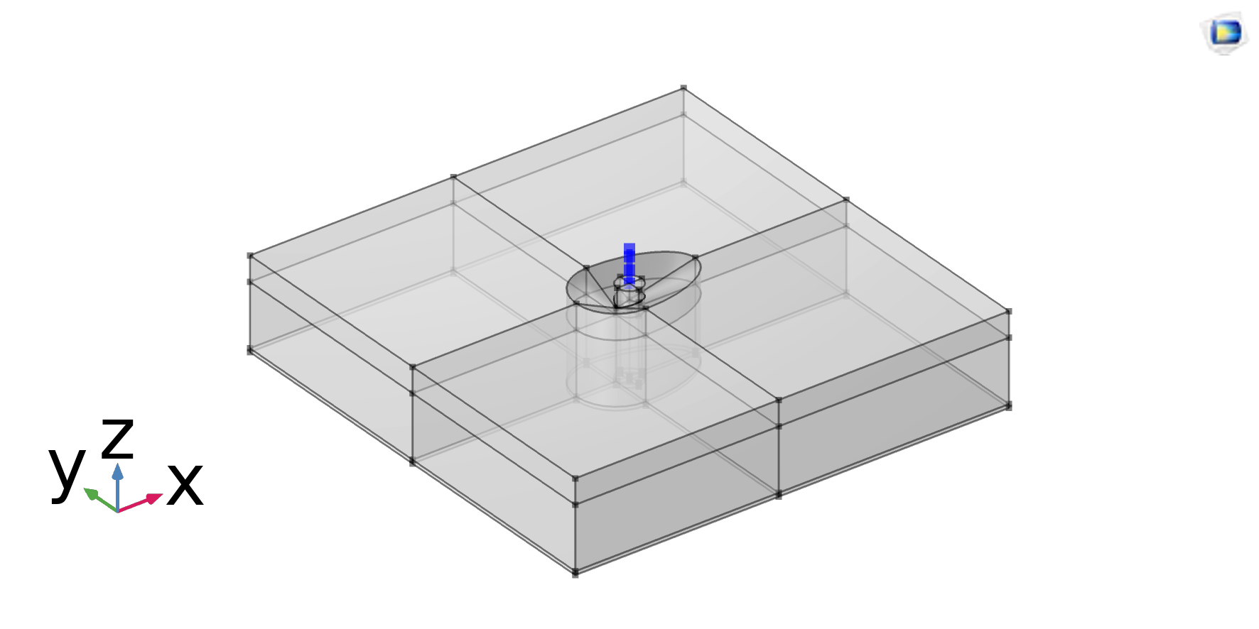
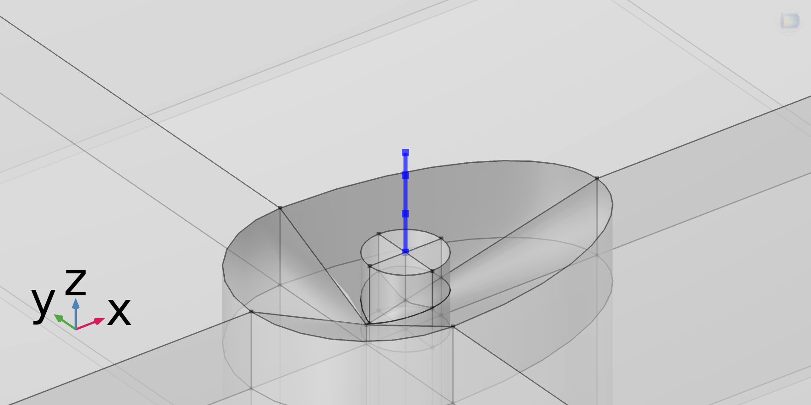
NUMERICAL MODEL – GEOMETRY AND MATERIALS
Structural Mechanics Module of the COMSOL Multiphysics® software.
Deck (mass) → Beam interface (Euler-Bernoulli beams), introduced as a Rigid Domain
Pier → Beam interface (Euler-Bernoulli beams)
Caisson foundation → Solid Mechanics interface, linked with the superstructure by a Solid-Beam Connection node.
Sand deposit → Solid Mechanics interface, as L×W×D = 75×75×25 m box. For simplicity, also the soil was modeled as isotropic linear elastic, with a Weak Contribution node to update stiffness as a function of the confining pressure.
Foundation scour is introduced by removing a portion of the soil from the sides of the caisson to create an excavation, using the available Boolean operations and solid primitives.

Slide 10
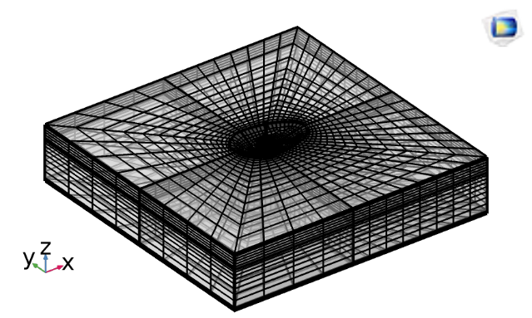
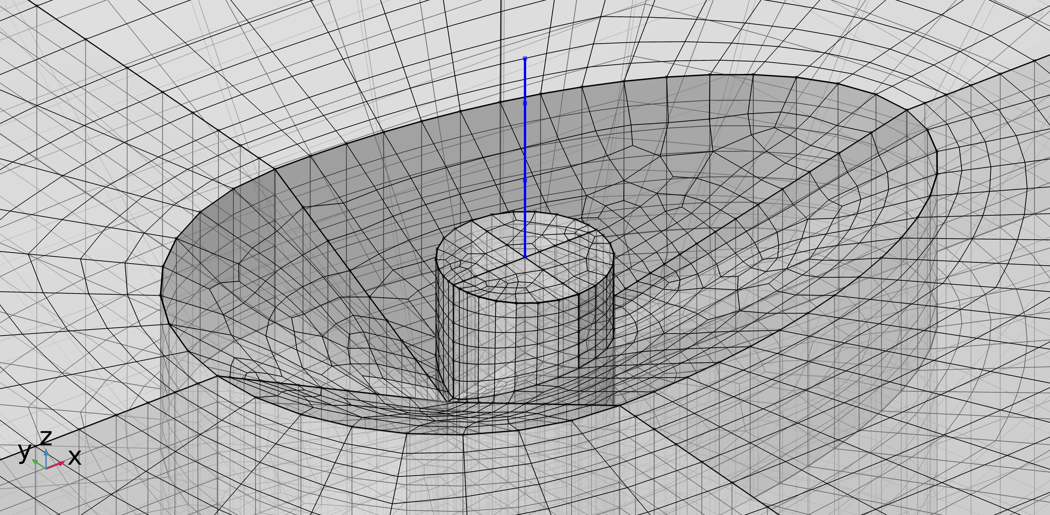
NUMERICAL MODEL – BOUNDARY CONDITIONS AND MESH
No normal displacement
Periodic B.C.
Boundary conditions
The boundary conditions force pure shear deformation in the soil deposit, which occurs when affected by the vertical propagation of horizontally polarized shear waves (common scenario in geotechnical earthquake engineering).
Mesh
Partially structured mesh with hexahedron elements
Scour hole footprint discretized through an unstructured quadrilateral mesh
Structured mesh on the external region, with exponential growth of the element size
→ 15,000 elements, with adequate element density close to the caisson
Analyses: Eigenfrequency study
Periodic B.C.
No normal displacement
Base: fully constrained

Slide 11
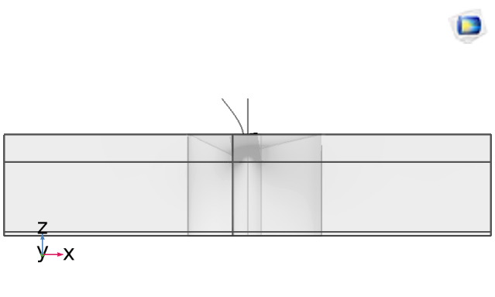

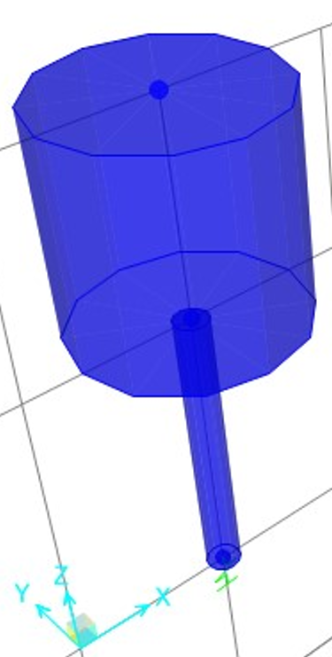




NUMERICAL MODEL – VALIDATION
Scenario: fully embedded (“S0”) configuration
First rocking mode of the caisson-pier system
Benchmark: soil-structure FE model on SAP2000, with SDOF supported by a set of springs and dashpots applied at the base of the caisson (Gazetas, 1991).
In both cases, the eigenfrequency equals 2.9 Hz →
$K_{H}$
$$K_{θ}$$
$$K_{v}$$

Slide 12

NUMERICAL MODEL – VALIDATION
Scenario: fully embedded (“S0”) configuration
First rocking mode of the caisson-pier system
Benchmark: soil-structure FE model on SAP2000, with SDOF supported by a set of springs and dashpots applied at the base of the caisson (Gazetas, 1991).
In both cases, the eigenfrequency equals 2.9 Hz →
First shear mode of the sand deposit
Benchmark: peak of the soil deposit shear-mode transfer function predicted by the Deepsoil software.
In both cases, the eigenfrequency equals 4.0 Hz →

Slide 13
PARAMETRIC STUDY
Local scour scenarios “Sxx”
“S38”; “S50”; “S63”; “S75”
Focus: first rocking mode
Eigenfrequency
Modal shape descriptors
  Foundation rotation θ
  Pier curvature ν
All these parameters were normalized with respect to the fully embedded (“S00”) configuration, to better appreciate scour-related variations in the modal response.
(xx/100)H
H
D
D
C
C
H_{p}
u
B
B
H
A
A

Slide 14
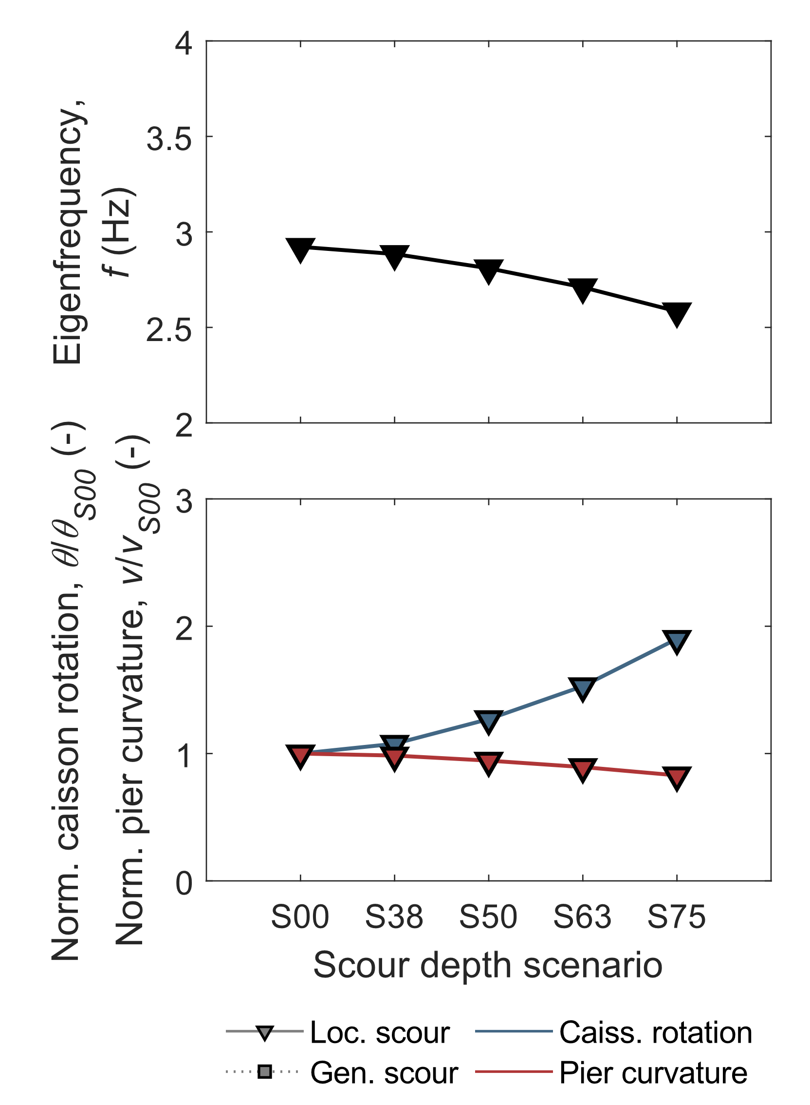
PARAMETRIC STUDY
Influence of local scour
The presence of a deeper scour hole results in a reduced eigenfrequency and a large increase in the caisson rotation, up to 50%. The concavity of the trend suggests stronger changes for deeper scour hole scenarios.
This is partially compensated by a smaller curvature in the pier.

Slide 15
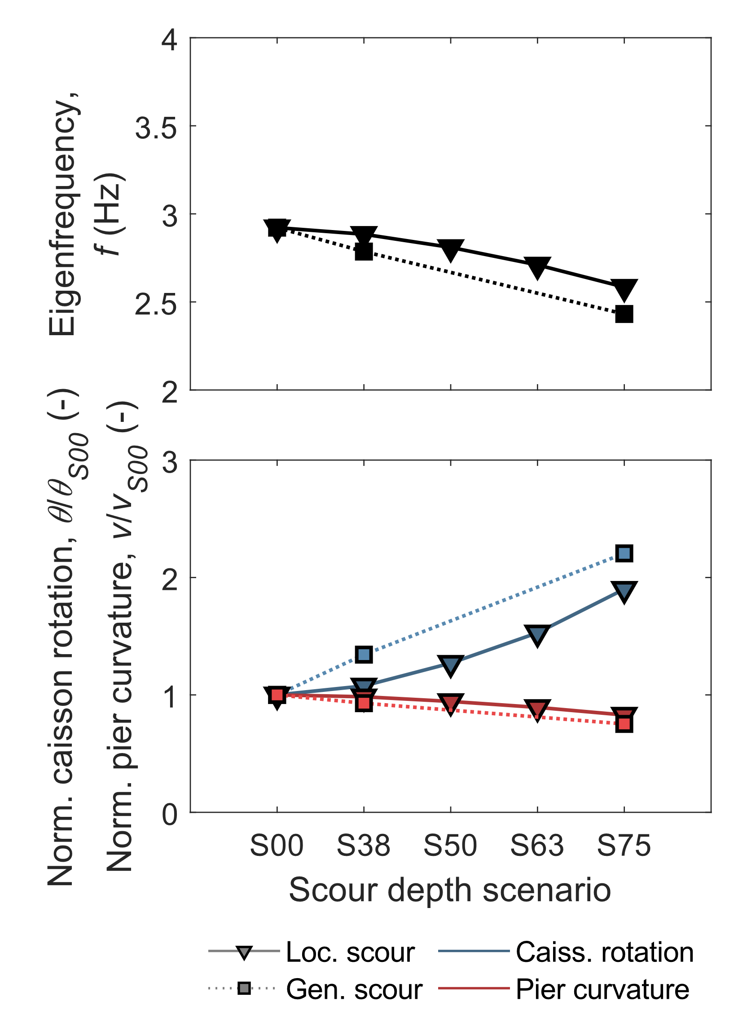
PARAMETRIC STUDY
Influence of local scour
The presence of a deeper scour hole results in a reduced eigenfrequency and a large increase in the caisson rotation, up to 50%. The concavity of the trend suggests stronger changes for deeper scour hole scenarios.
This is partially compensated by a smaller curvature in the pier.
Comparison with “general scour” scenarios = uniform lowering of the ground surface → larger variations in both eigenfrequencies and mode shape parameters.

Slide 16
FINAL REMARKS
This study has addressed the influence of local scour on the modal response of a bridge pier supported by a caisson foundation.
The numerical model was validated against alternative numerical schemes, with reference to the first rocking mode of the pier-caisson system and the first shear mode of the soil deposit.
Then, a parametric analysis highlighted a reduction of the system eigenfrequencies and an increase of base rotations, with a simultaneous slight decrease of pier curvature with increasing scour depth. Furthermore, using simpler representations of the geometry would result in misleading estimates in terms of the dynamic response.
The study highlights the importance of properly modeling the hydraulic scenario when dealing with the dynamic response of bridge piers under scour and the potentialities of the COMSOL software to deal with this kind of problems.

Slide 17
Thank you for your kind attention!
Mauro Aimar, Sebastiano Foti
email: mauro.aimar@polito.it
Web: http://www.soilmech.polito.it/people/aimar_mauro

