Slide 1
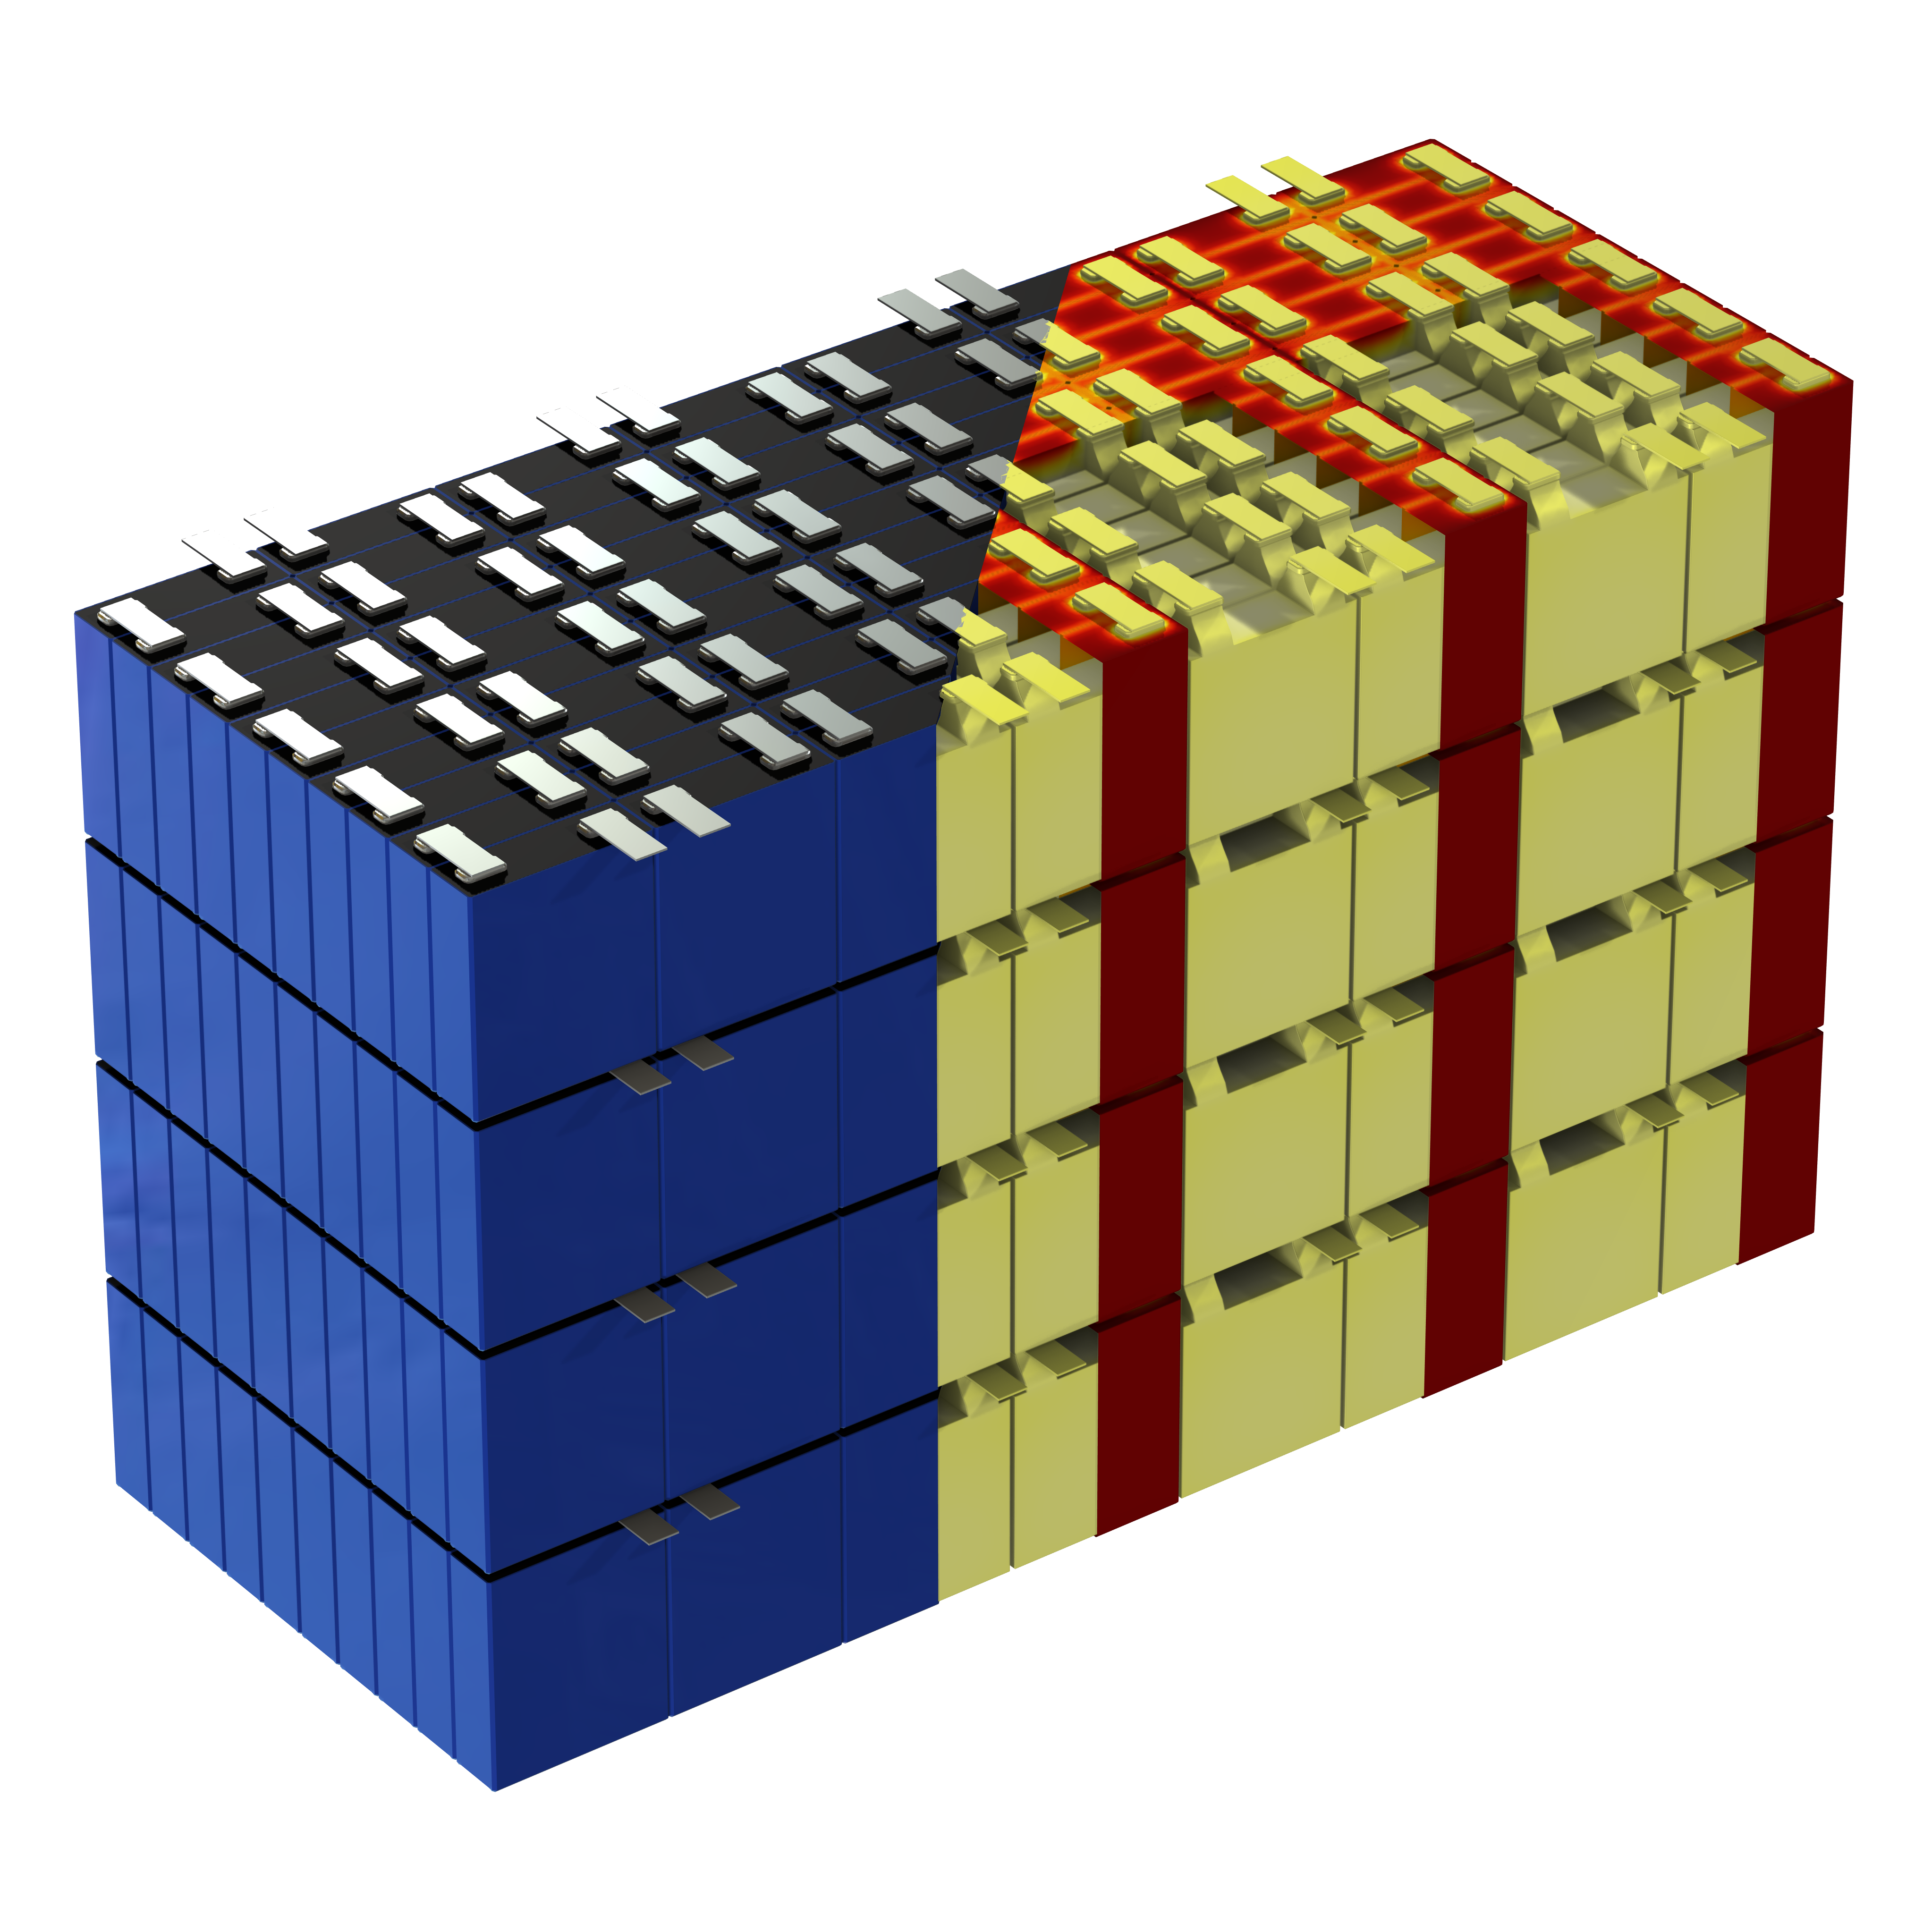

resolvent
Novel Method For Predicting Lifetime Degradation Of
Battery Packs Using COMSOL Surrogate Models
By André G. Steckel, Thomas Bisgaard, Martin Refslund Nielsen

Slide 2

Introduction
resolvent
Visit our website: https://resolvent.com/
Batteries
Modelling specialist
Fuel / electrolysis cells
Microfluidics
Acoustics
André G. Steckel
Acoustofluidics
Email: ags@resolvent.dk
COMSOL apps
Reduced order models
Magneto statics
Electromagnetic induction
Medical diagnostics equipment

Slide 3
Introduction
resolvent
Visit our website: https://resolvent.com/
Batteries
Modelling specialist
Fuel / electrolysis cells
Microfluidics
Acoustics
André G. Steckel
Acoustofluidics
Email: ags@resolvent.dk
COMSOL apps
Reduced order models
Magneto statics
Electromagnetic induction
Medical diagnostics equipment

Slide 4



Introduction
resolvent
Visit our website: https://resolvent.com/
Batteries
Modelling specialist
Fuel / electrolysis cells
Microfluidics
Acoustics
André G. Steckel
Acoustofluidics
Email: ags@resolvent.dk
COMSOL apps
Reduced order models
Magneto statics
Electromagnetic induction
Medical diagnostics equipment
Invited talk: Electrochemistry II
Impact of Battery Operation and Manufacturing Process on Battery Performance over Lifetime
Wednesday 3:30 p.m.
Keynote
Battery App Optimizing Lifetime and Robustness for Volvo
Thursday 10:30 a.m.
Thomas Bisgaard
Martin Refslund Nielsen
Email: tb@resolvent.dk
Email: mrn@resolvent.dk

Slide 5
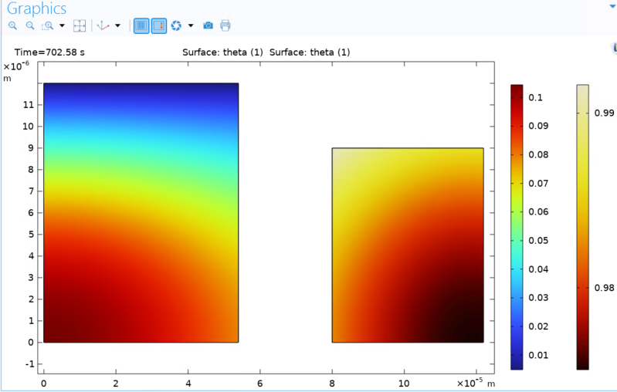
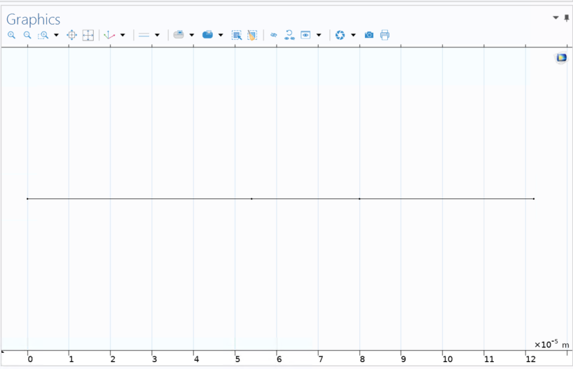
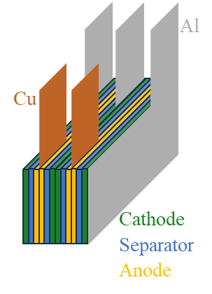
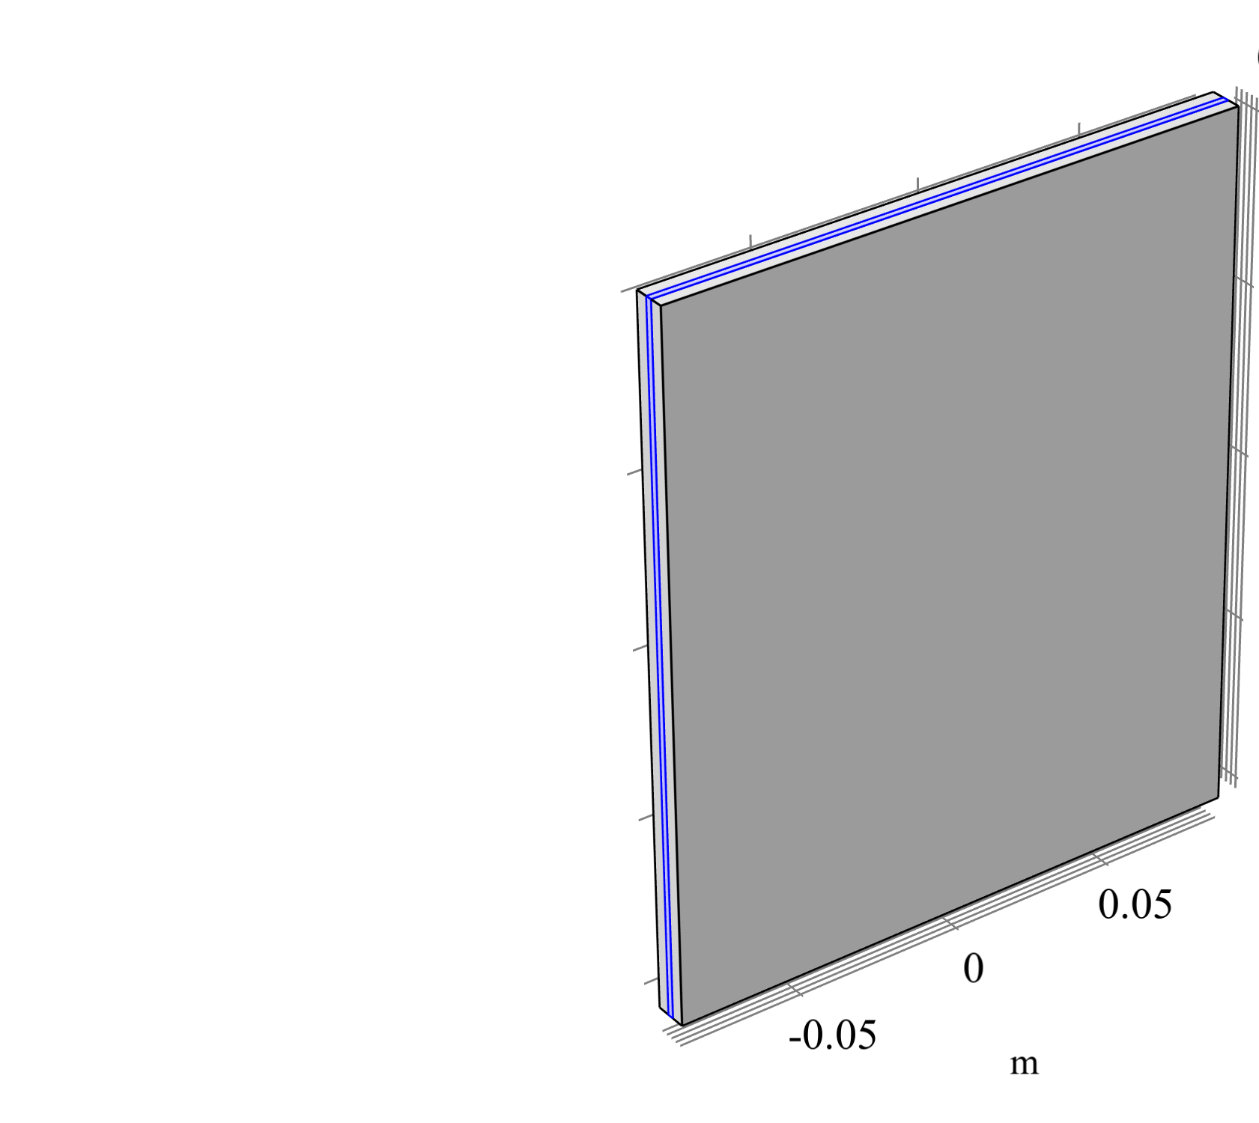
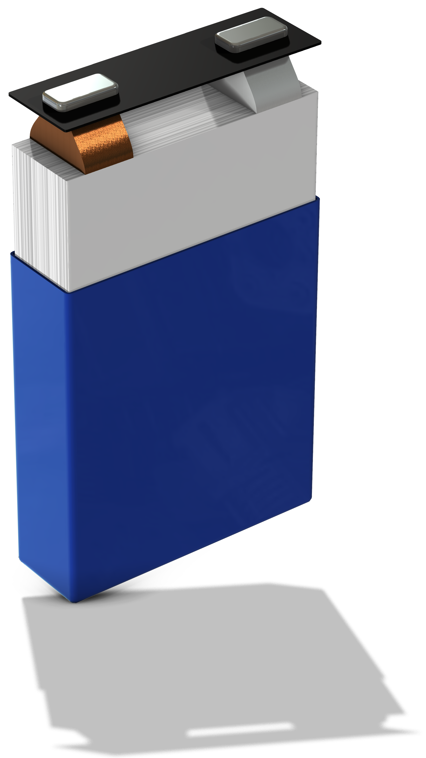


Battery chemistry
1D Cell chemistry
2D Radial chemistry
Particle surface
Particle surface
Anode
Cathode
Radial anode concentration
Anode
Separator
Cathode
Radial Cathode concentration
Particle center
Particle center
Spherical Electrode Particles
Degradation - Irreversible SEI growth
Single layer
Intercalation
“insertion between layers”
/lithiation
$$δ_{P}$$
$$δ_{SEI}$$
Graphite particle
r
~350 layers
Li⁺
Cathode
Anode
Separator

Slide 6
Battery chemistry
1D Cell chemistry
2D Radial chemistry
Invited talk: Electrochemistry II
Impact of Battery Operation and Manufacturing Process on Battery Performance over Lifetime
Wednesday 3:30 p.m.
Particle surface
Particle surface
Anode
Cathode
Thomas Bisgaard
Radial anode concentration
Anode
Separator
Cathode
Radial Cathode concentration
Particle center
Particle center
Spherical Electrode Particles
Degradation - Irreversible SEI growth
Single layer
Intercalation
“insertion between layers”
/lithiation
$$δ_{P}$$
$$δ_{SEI}$$
Graphite particle
r
~350 layers
Li⁺
Cathode
Anode
Separator

Slide 7
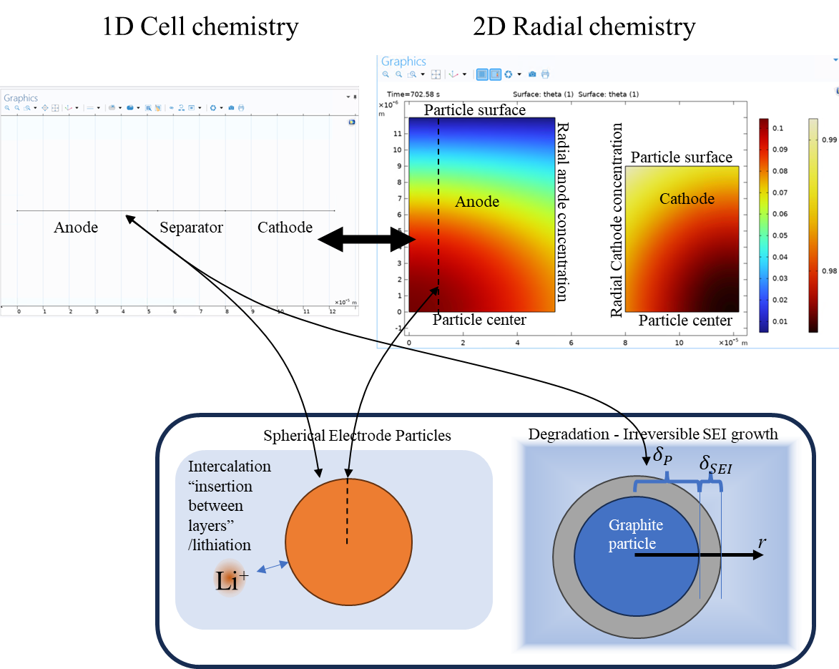
Battery chemistry to surrogate modelling
Surrogate modelling
Generate parameters
1D
?
2D
+
~350 layers
Latin Hypercube Sampling:
Temperature
Current (Record voltage)
SOC (Transient simulation)
SEI layer thickness

Slide 8
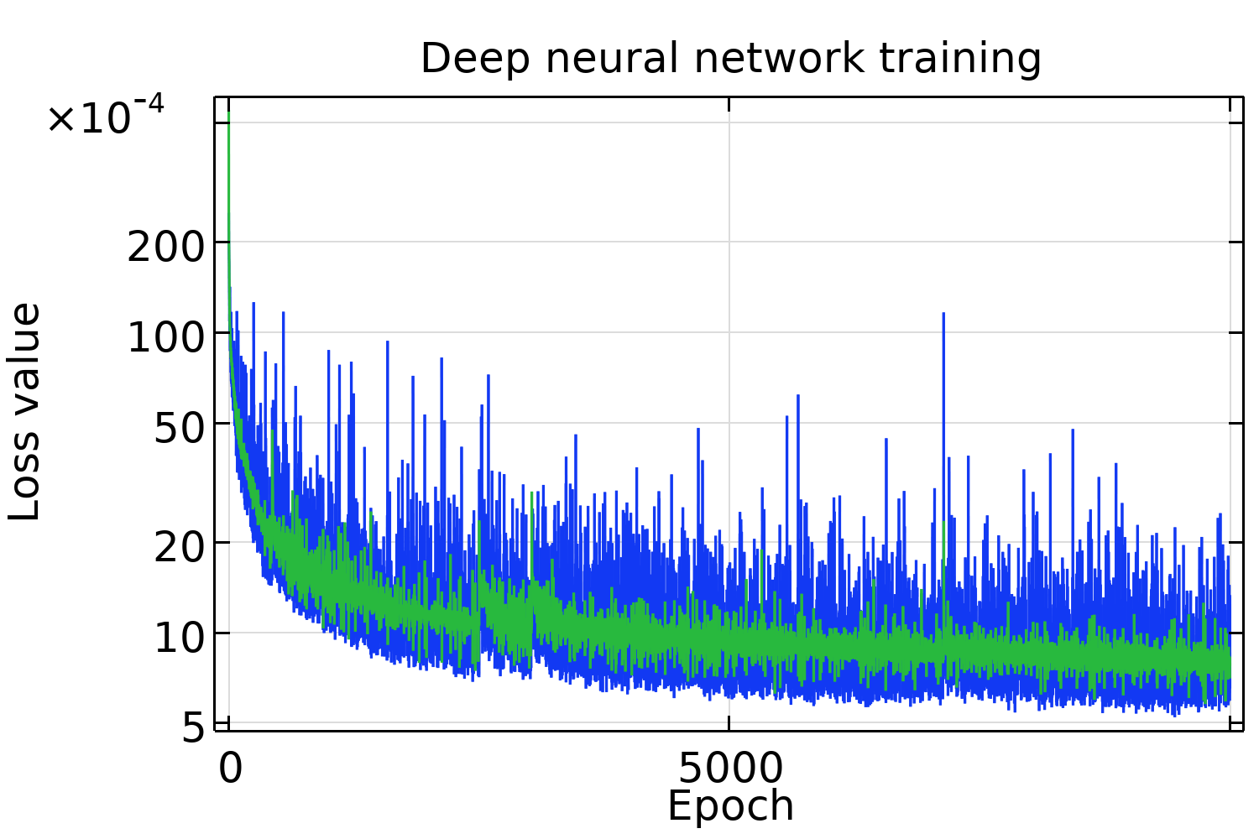
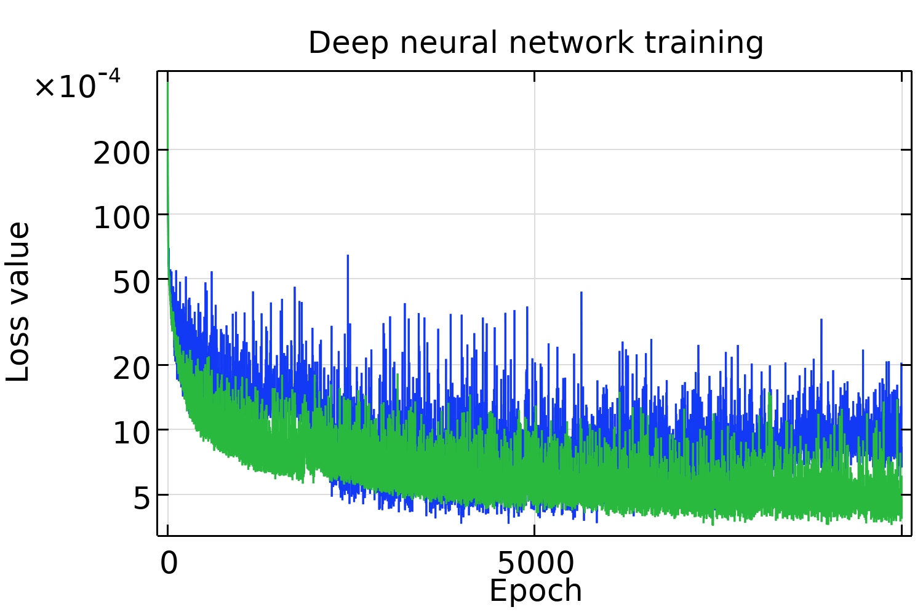



Train Deep Neural Networks for Predictions
Surrogate modelling
I
$$Ave\left(\left|\frac{I −DNN_{I}}{I}\right|\right)=\text{0.1}\text{8}\text{\%}$$
Generate parameters
1D
?
2D
LHS
+
Run
Train
Latin Hypercube Sampling:
Temperature
Current (Record voltage)
SOC (Transient simulation)
SEI layer thickness
V_{SEI}, dH
$$Ave\left(\left|\frac{V_{SEI} −DNN_{V_{SEI}}}{V_{SEI}}\right|\right)=\text{0.}\text{32}\text{\%}$$
$$Ave\left(\left|\frac{dH −DNN_{dH}}{dH}\right|\right)=\text{2}\text{.}\text{4}\text{\%}$$

Slide 9
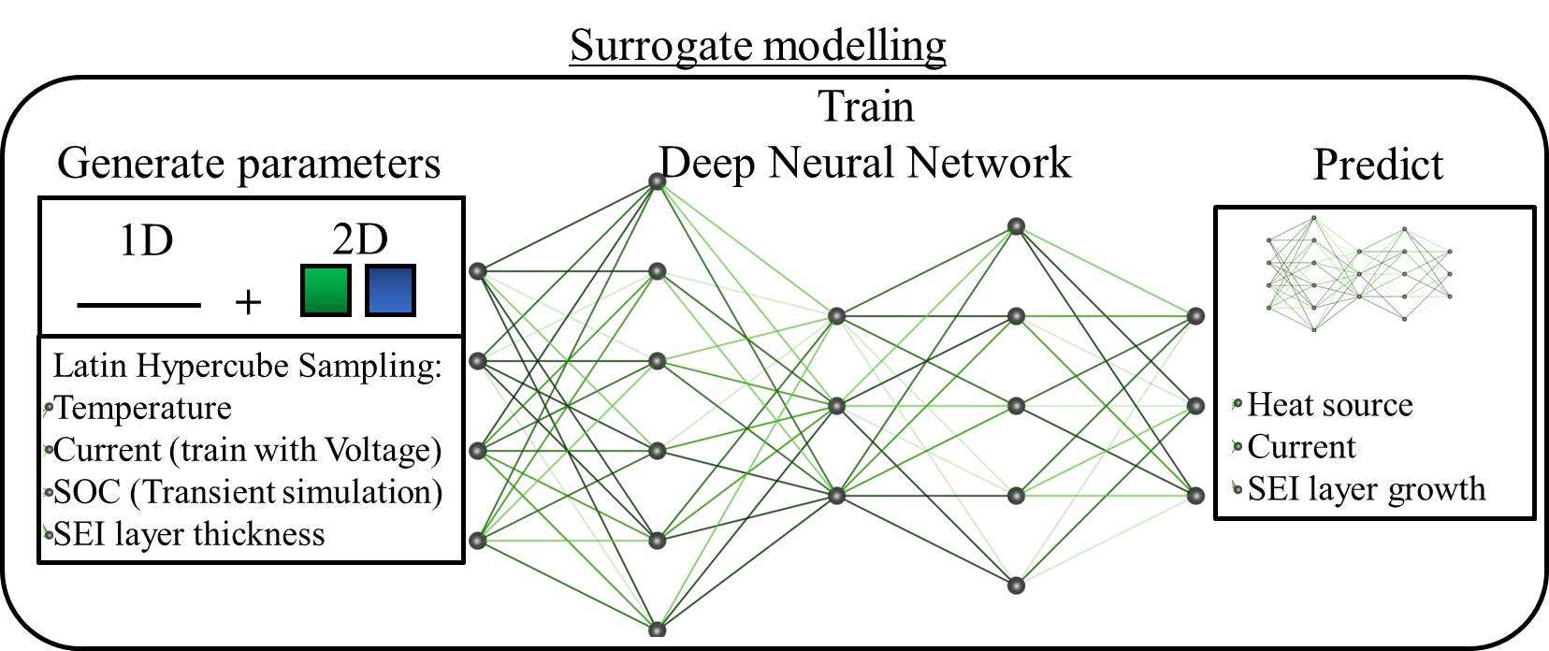
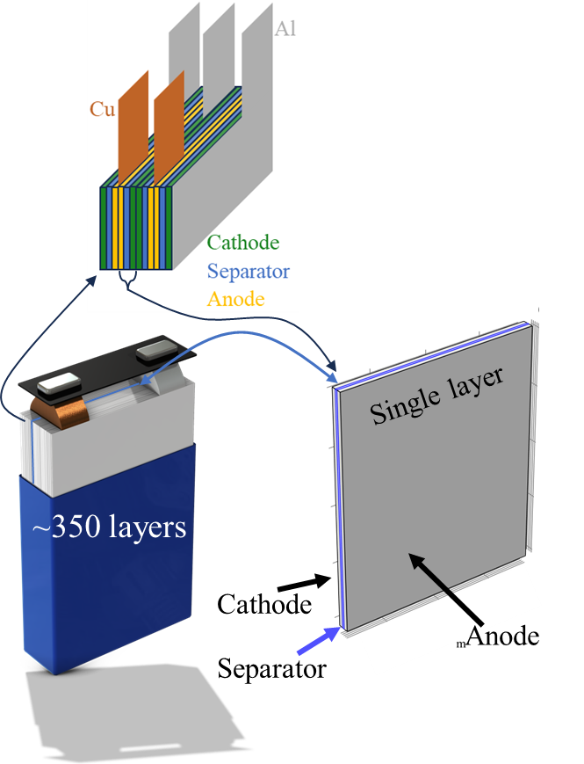





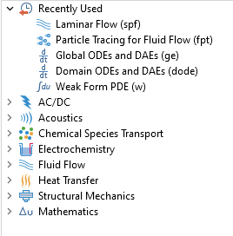
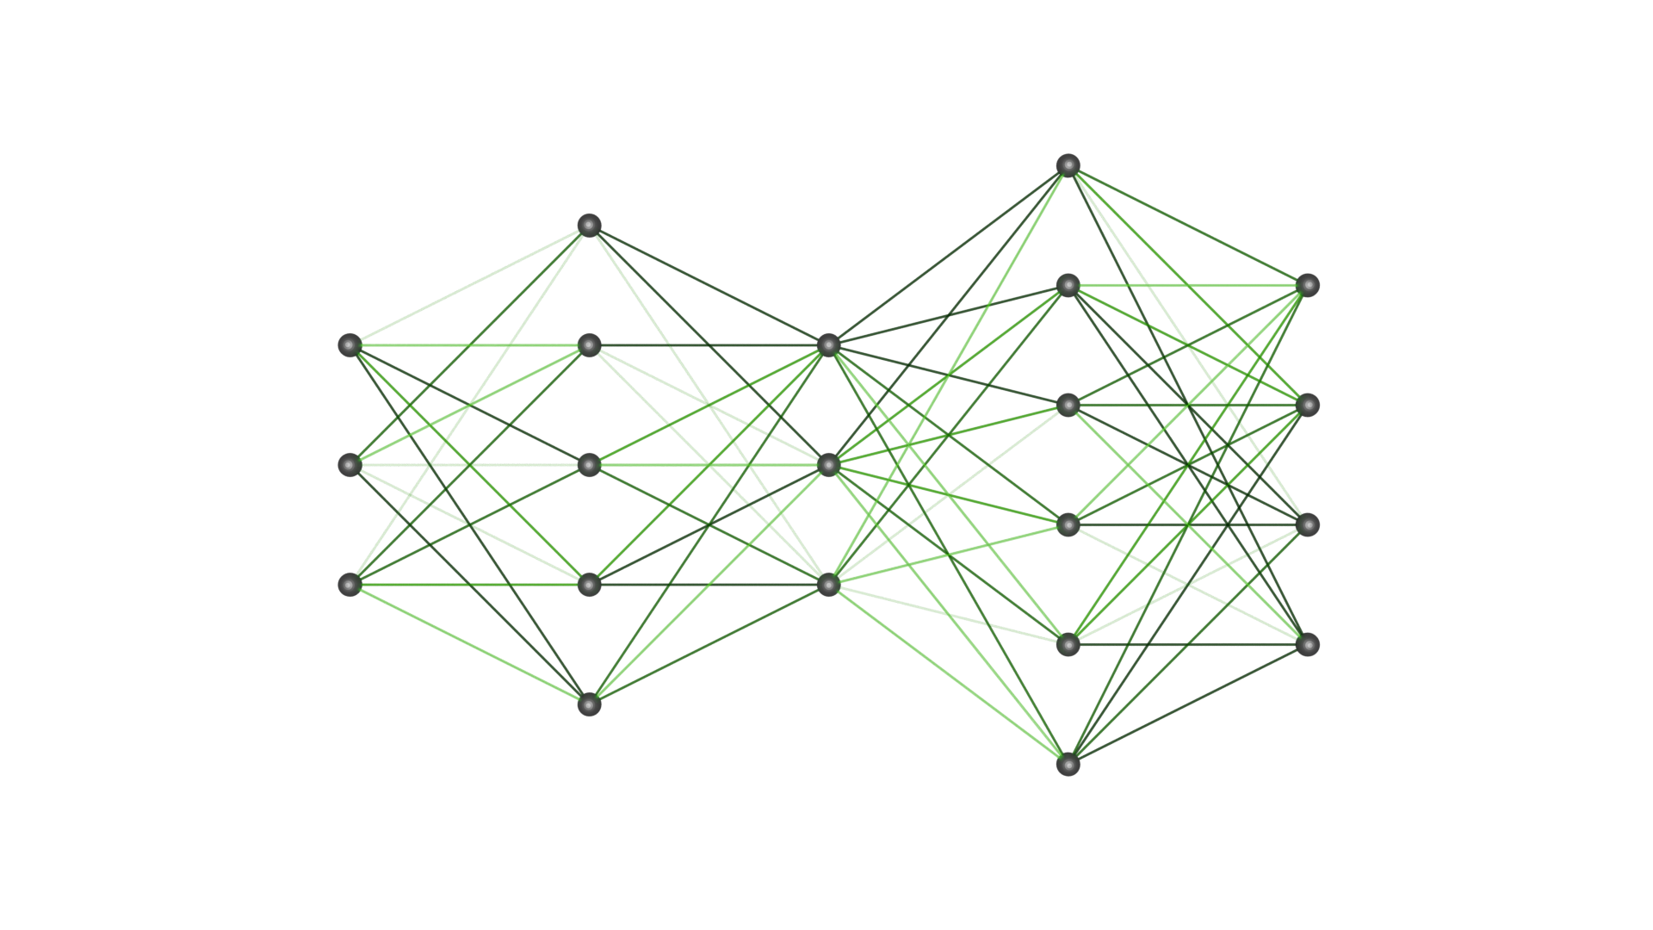
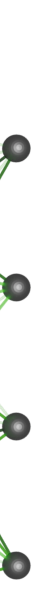
Deploying Deep Neural Networks in COMSOL Reduced Order Models
Conventional physics
Self-defined fields
AC/DC
Global ODE
Fluid Flow
Weak form
Heat Transfer
Surrogate modelling
Train
Deep Neural Network
Generate parameters
Predict
1D
?
2D
Heat source
Current
SEI layer growth
+
Latin Hypercube Sampling:
Temperature
Current (train with Voltage)
SOC (Transient simulation)
SEI layer thickness

Slide 10
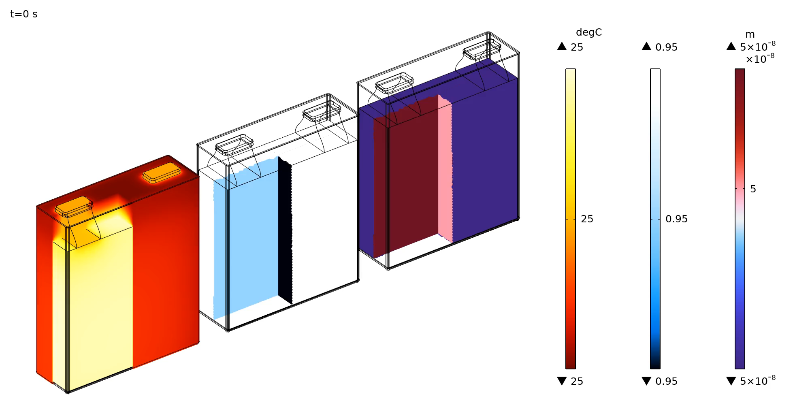
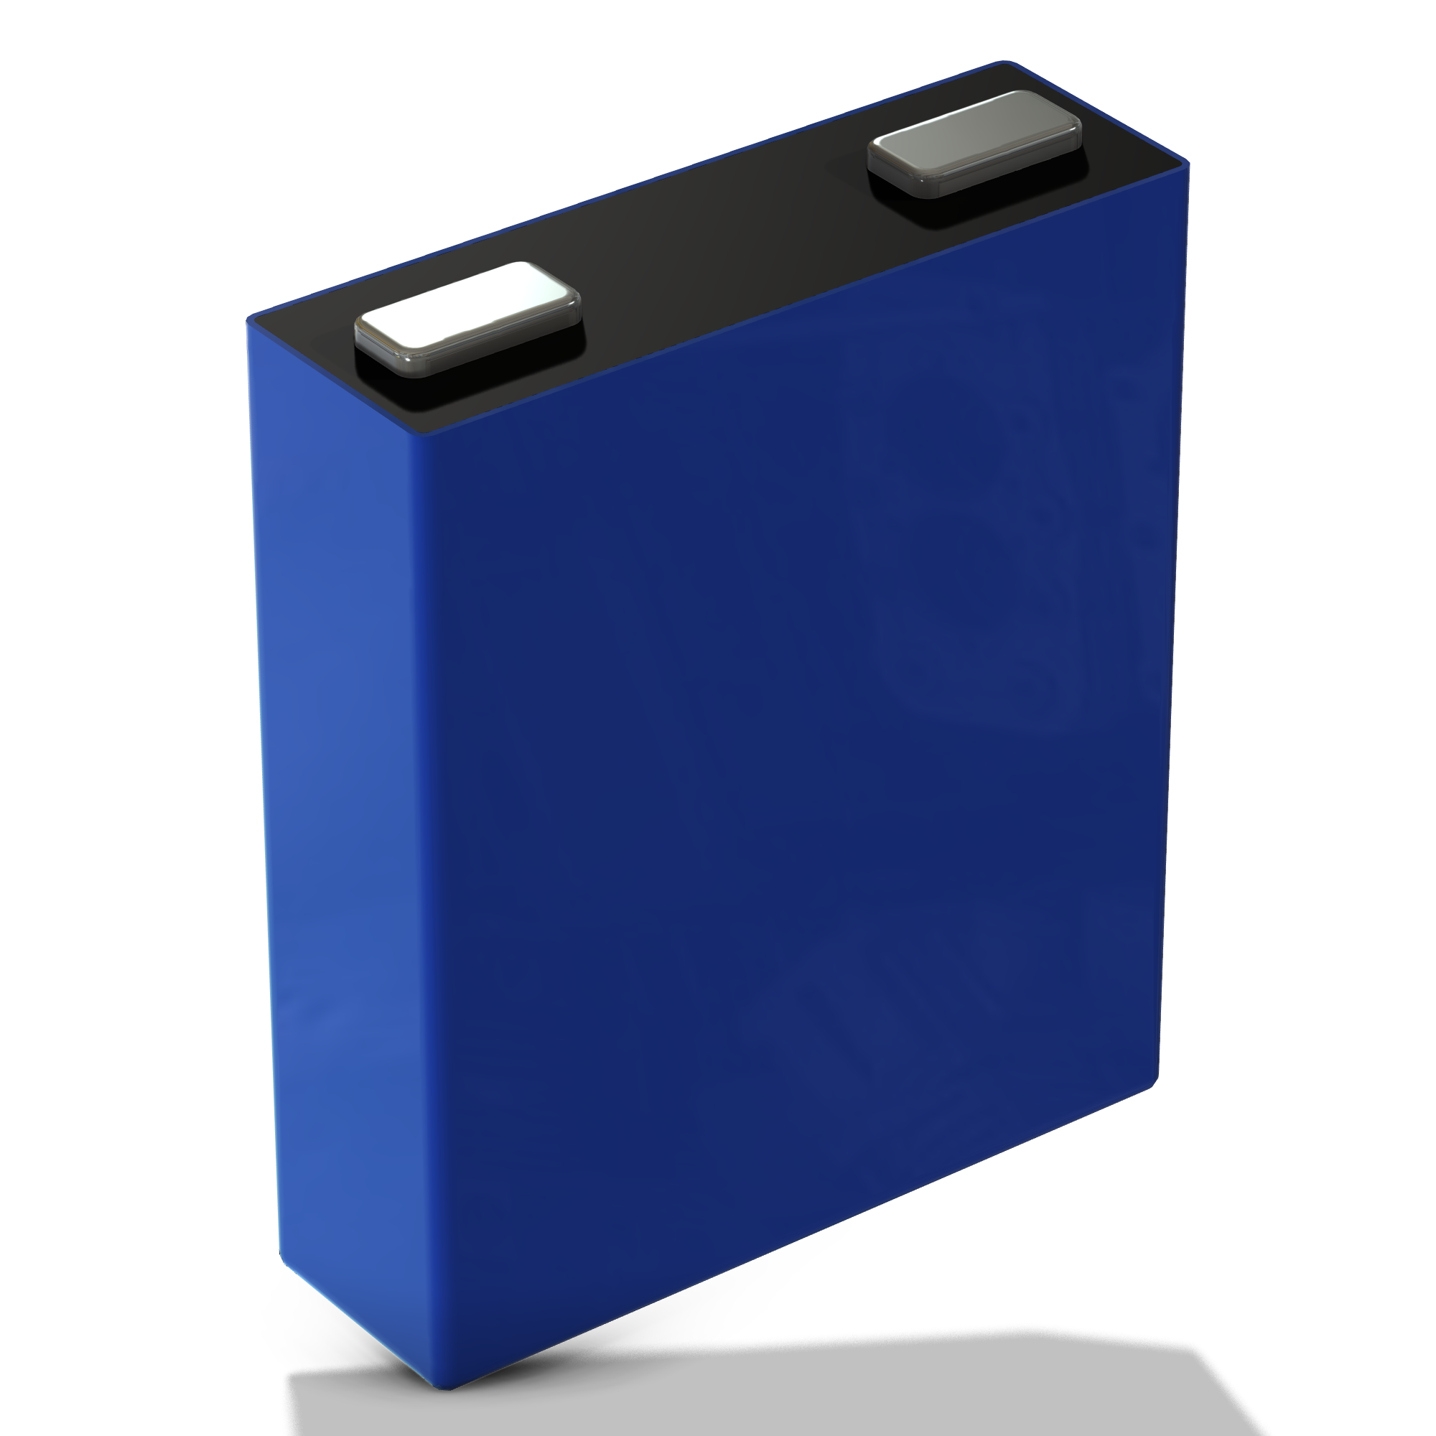
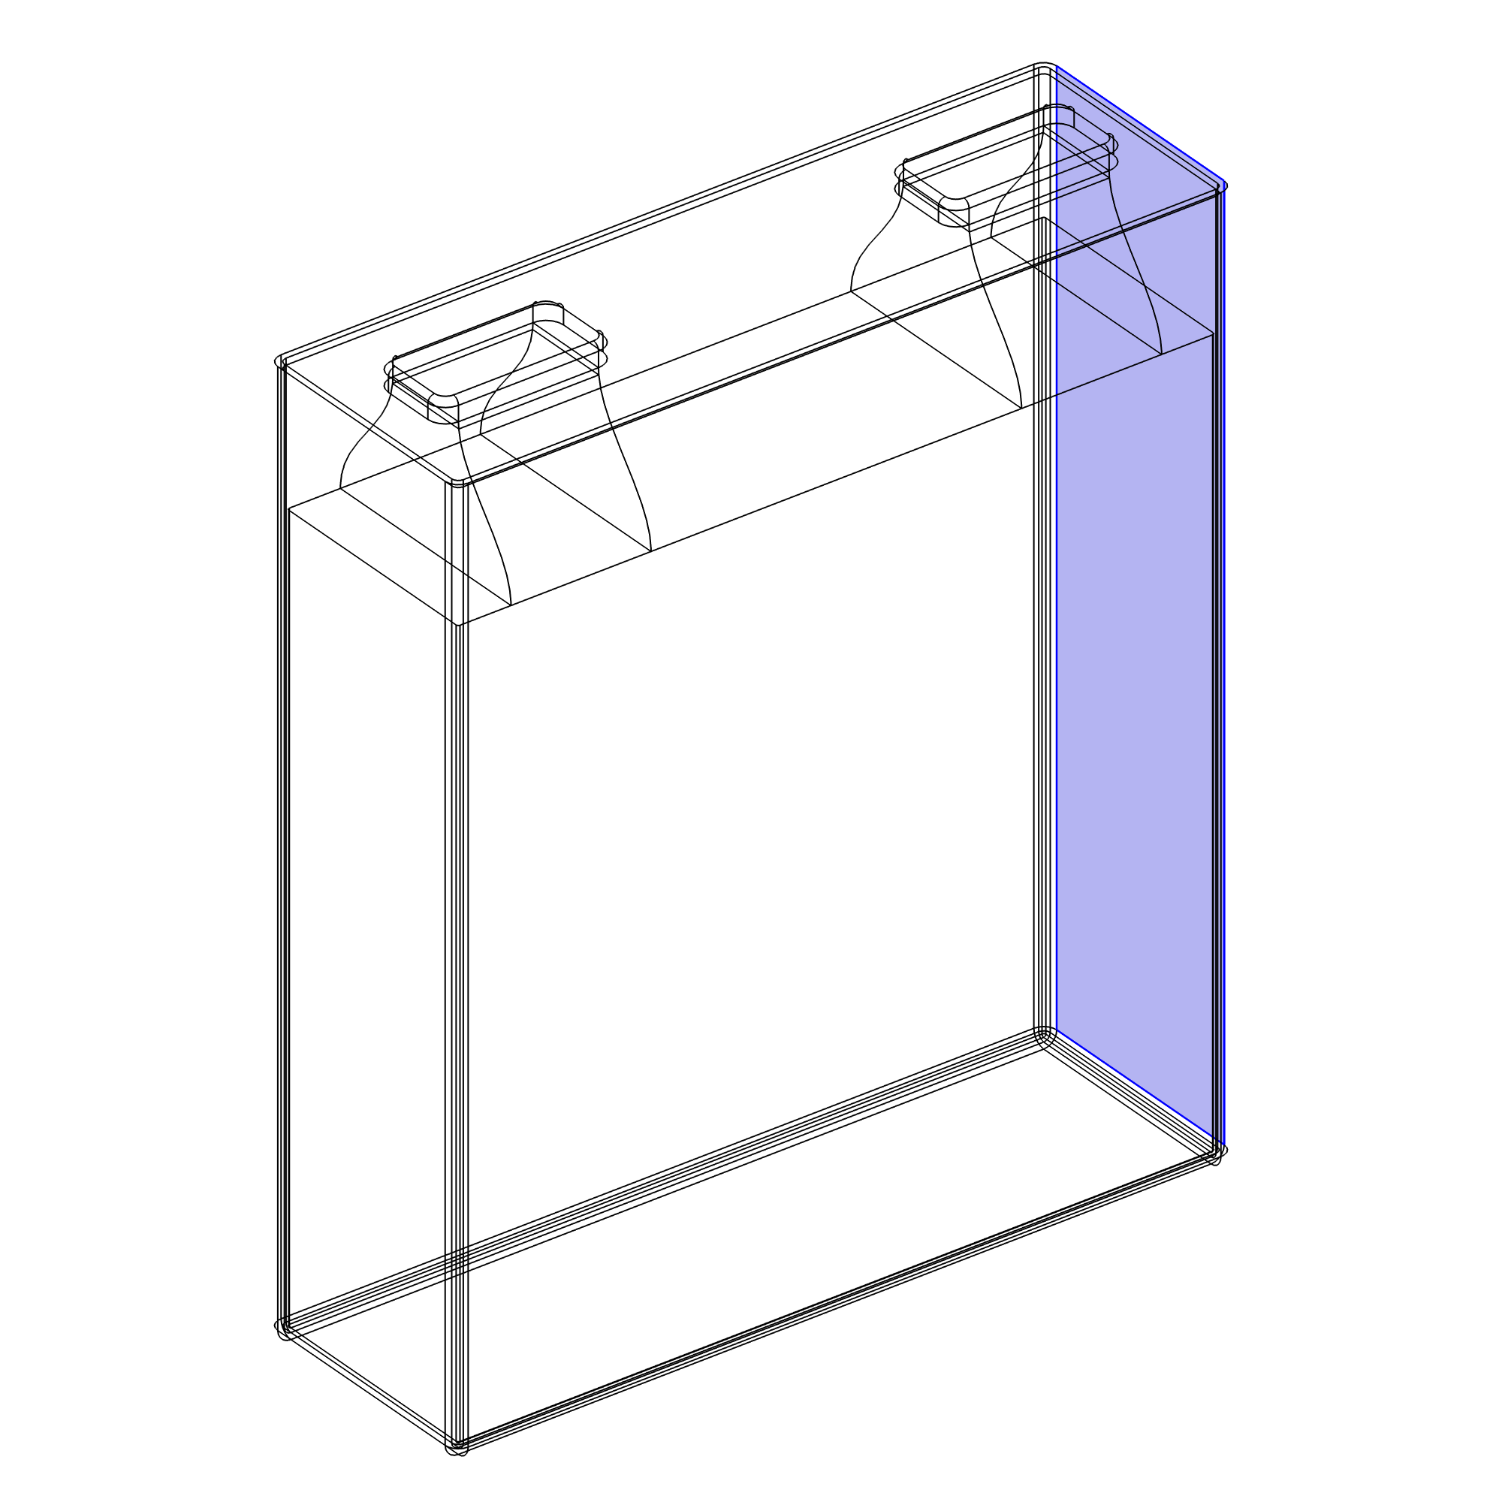
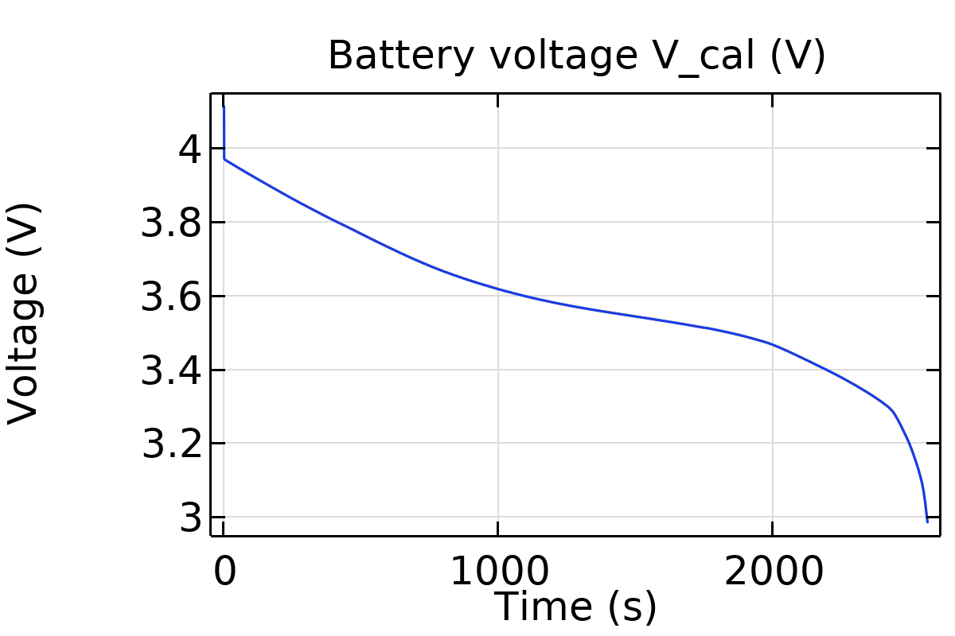
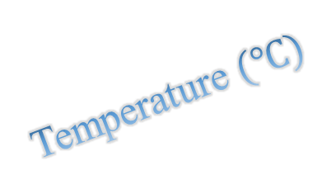
Degradation – Full Battery Cell 300A Discharge
SEI layer thickness
25 ºC
Temperature $(℃)$
State of Charge

Slide 11
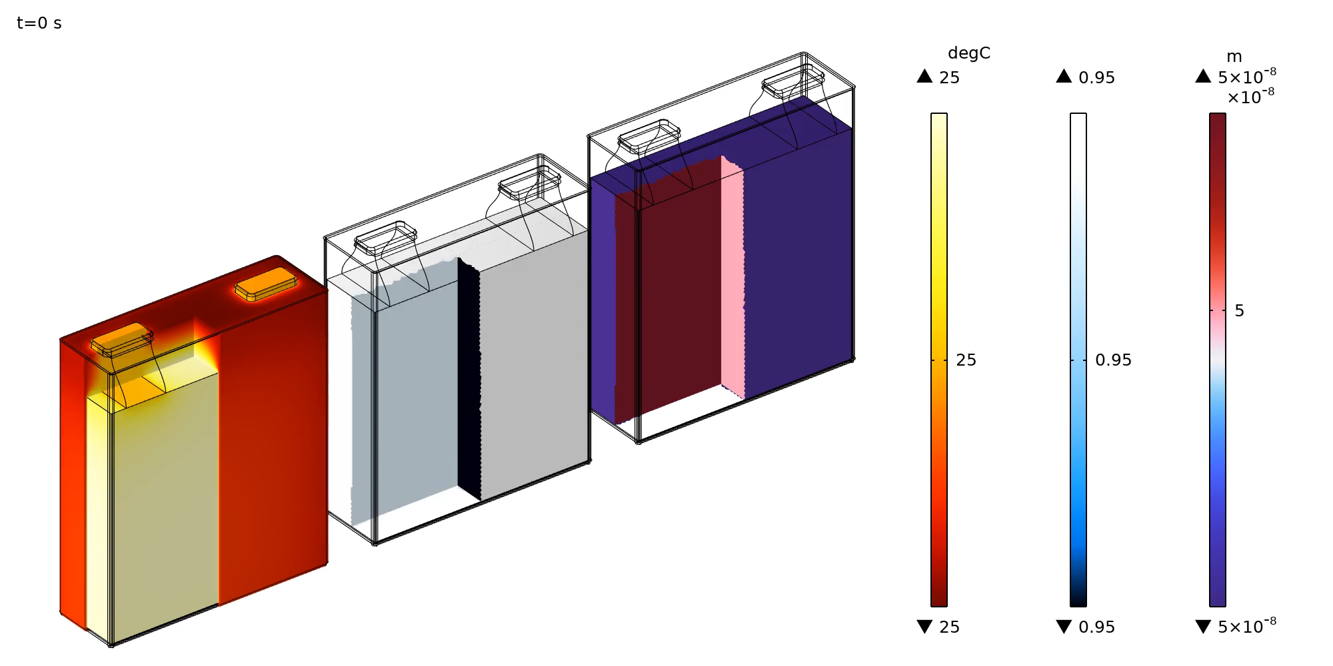
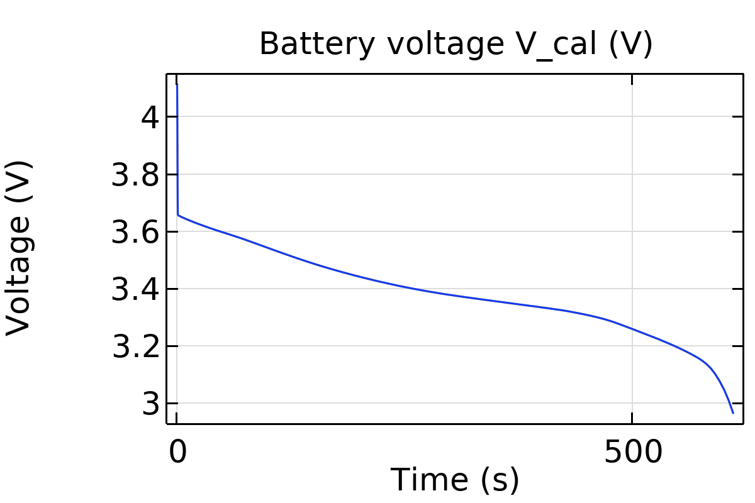
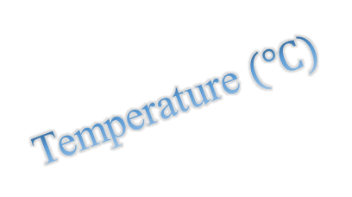
Degradation – Full Battery Cell 1200A Discharge
SEI layer thickness
25 ºC
Temperature $(℃)$
State of Charge

Slide 12
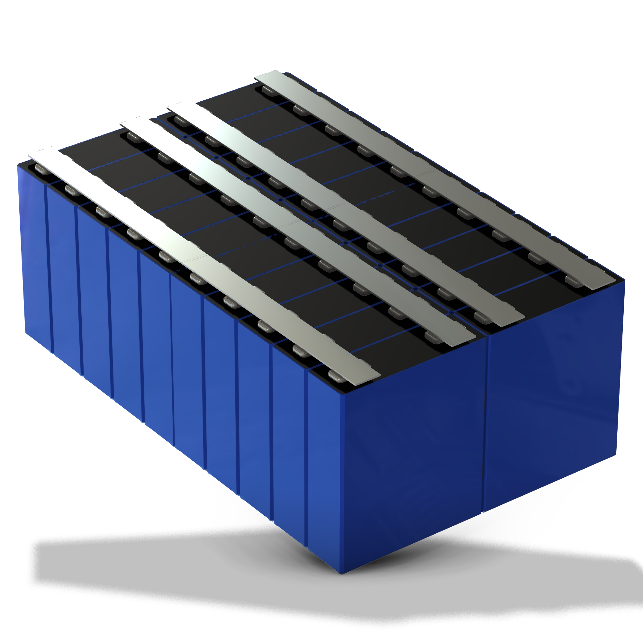
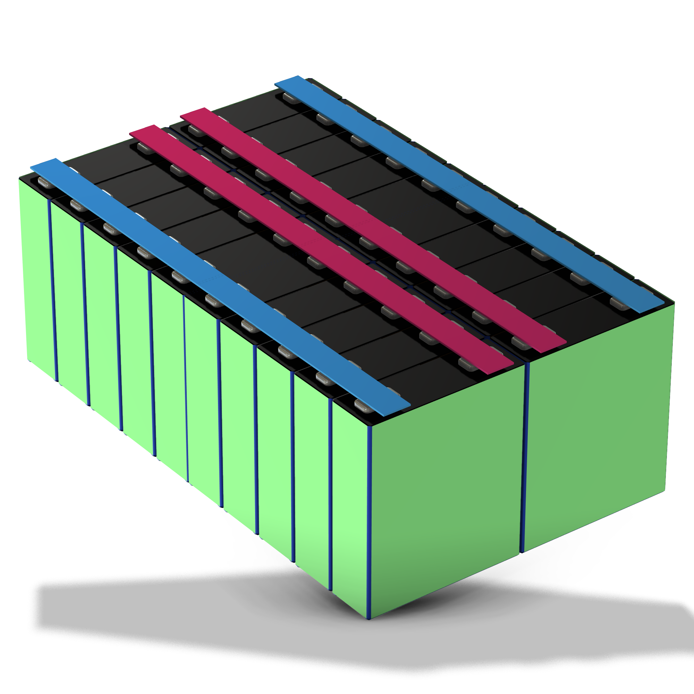
Going from Cell to Module degradation
Electrical Ground
Constant Current
Room Temperature

Slide 13
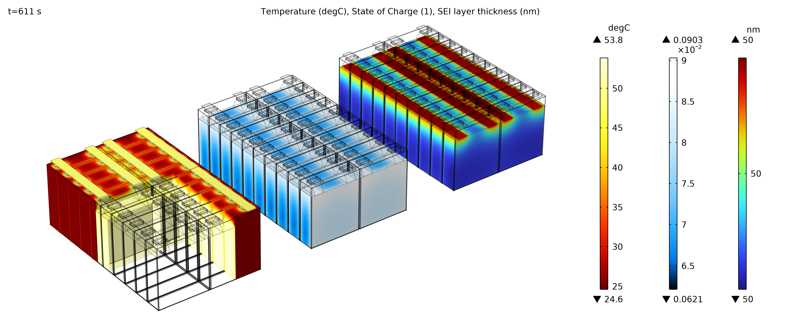
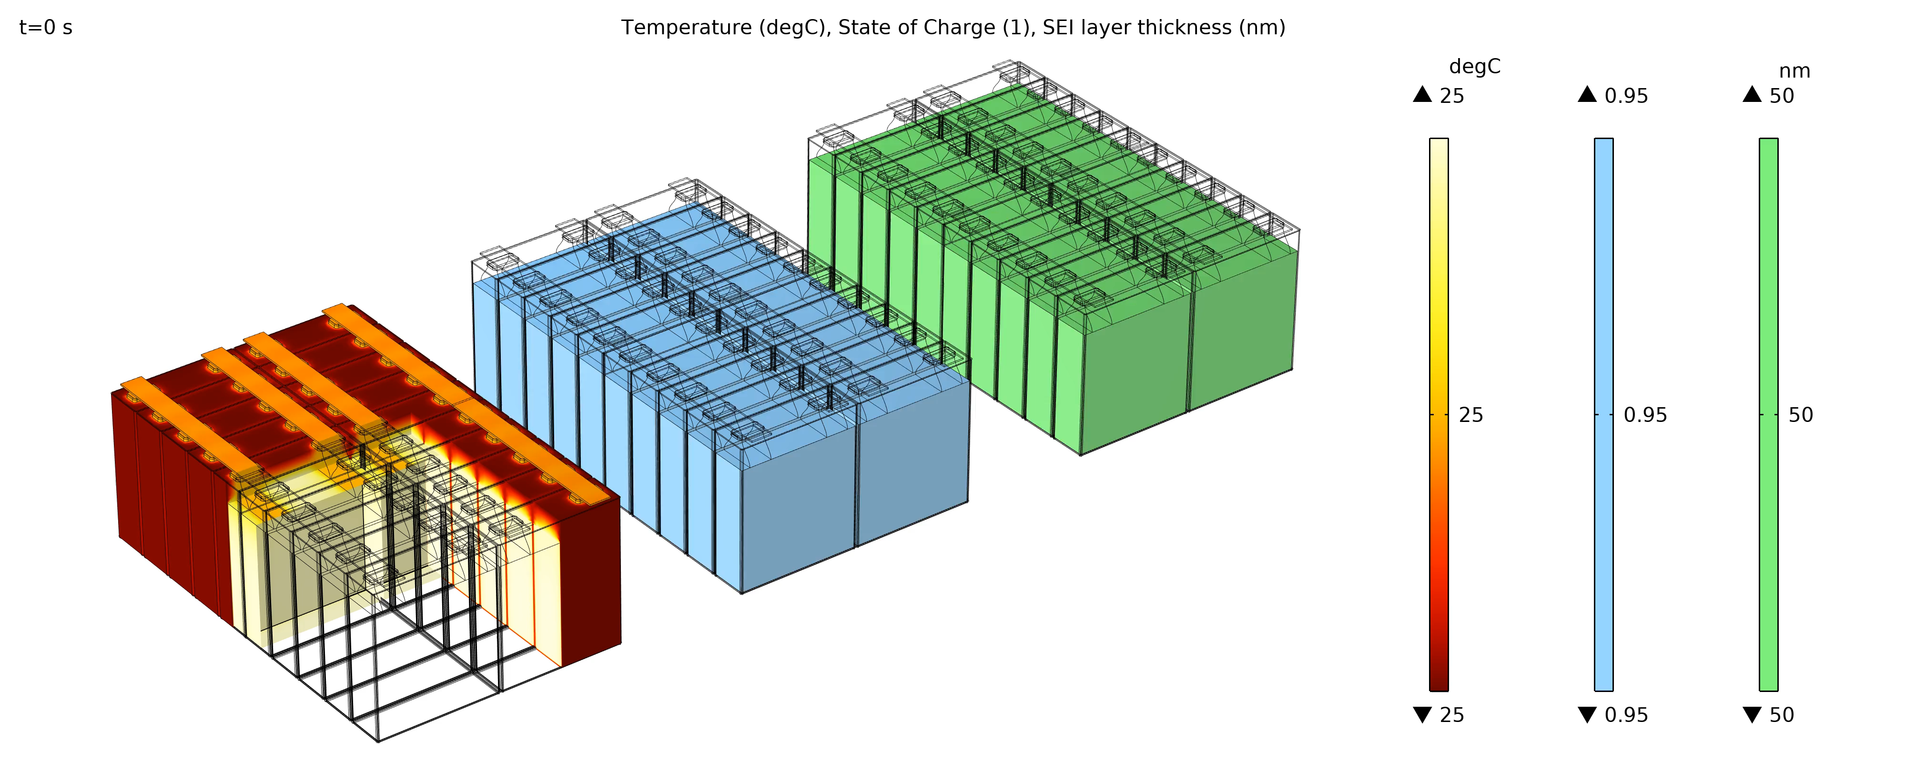
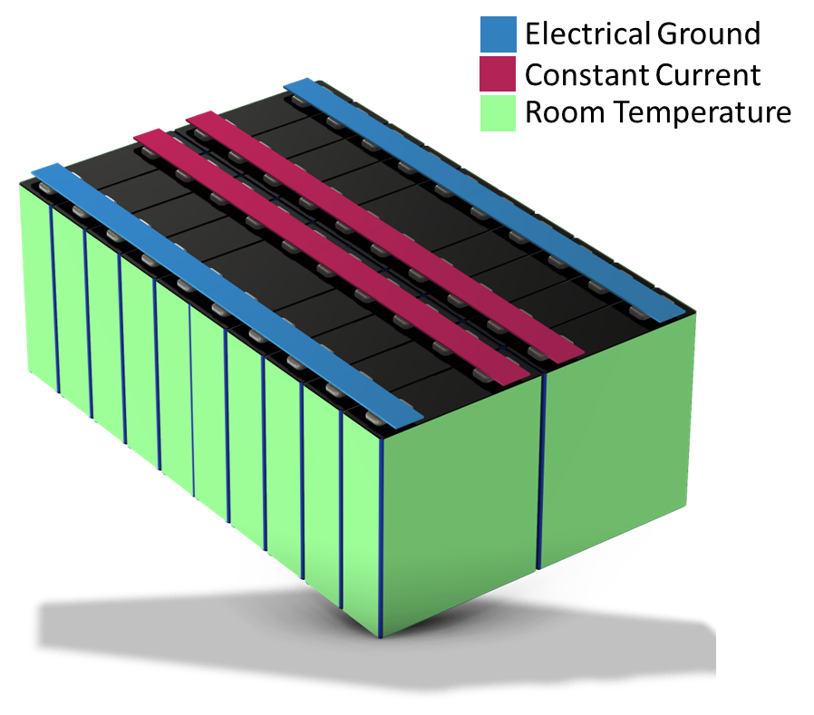
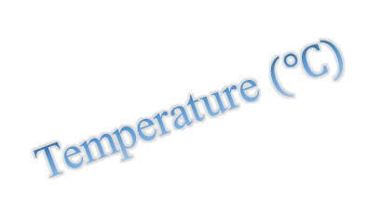
Going from Cell to Module degradation
State of Charge
Temperature $(℃)$
SEI layer thickness

Slide 14
Going from Cell to Module degradation
State of Charge
Temperature $(℃)$
SEI layer thickness

Slide 15
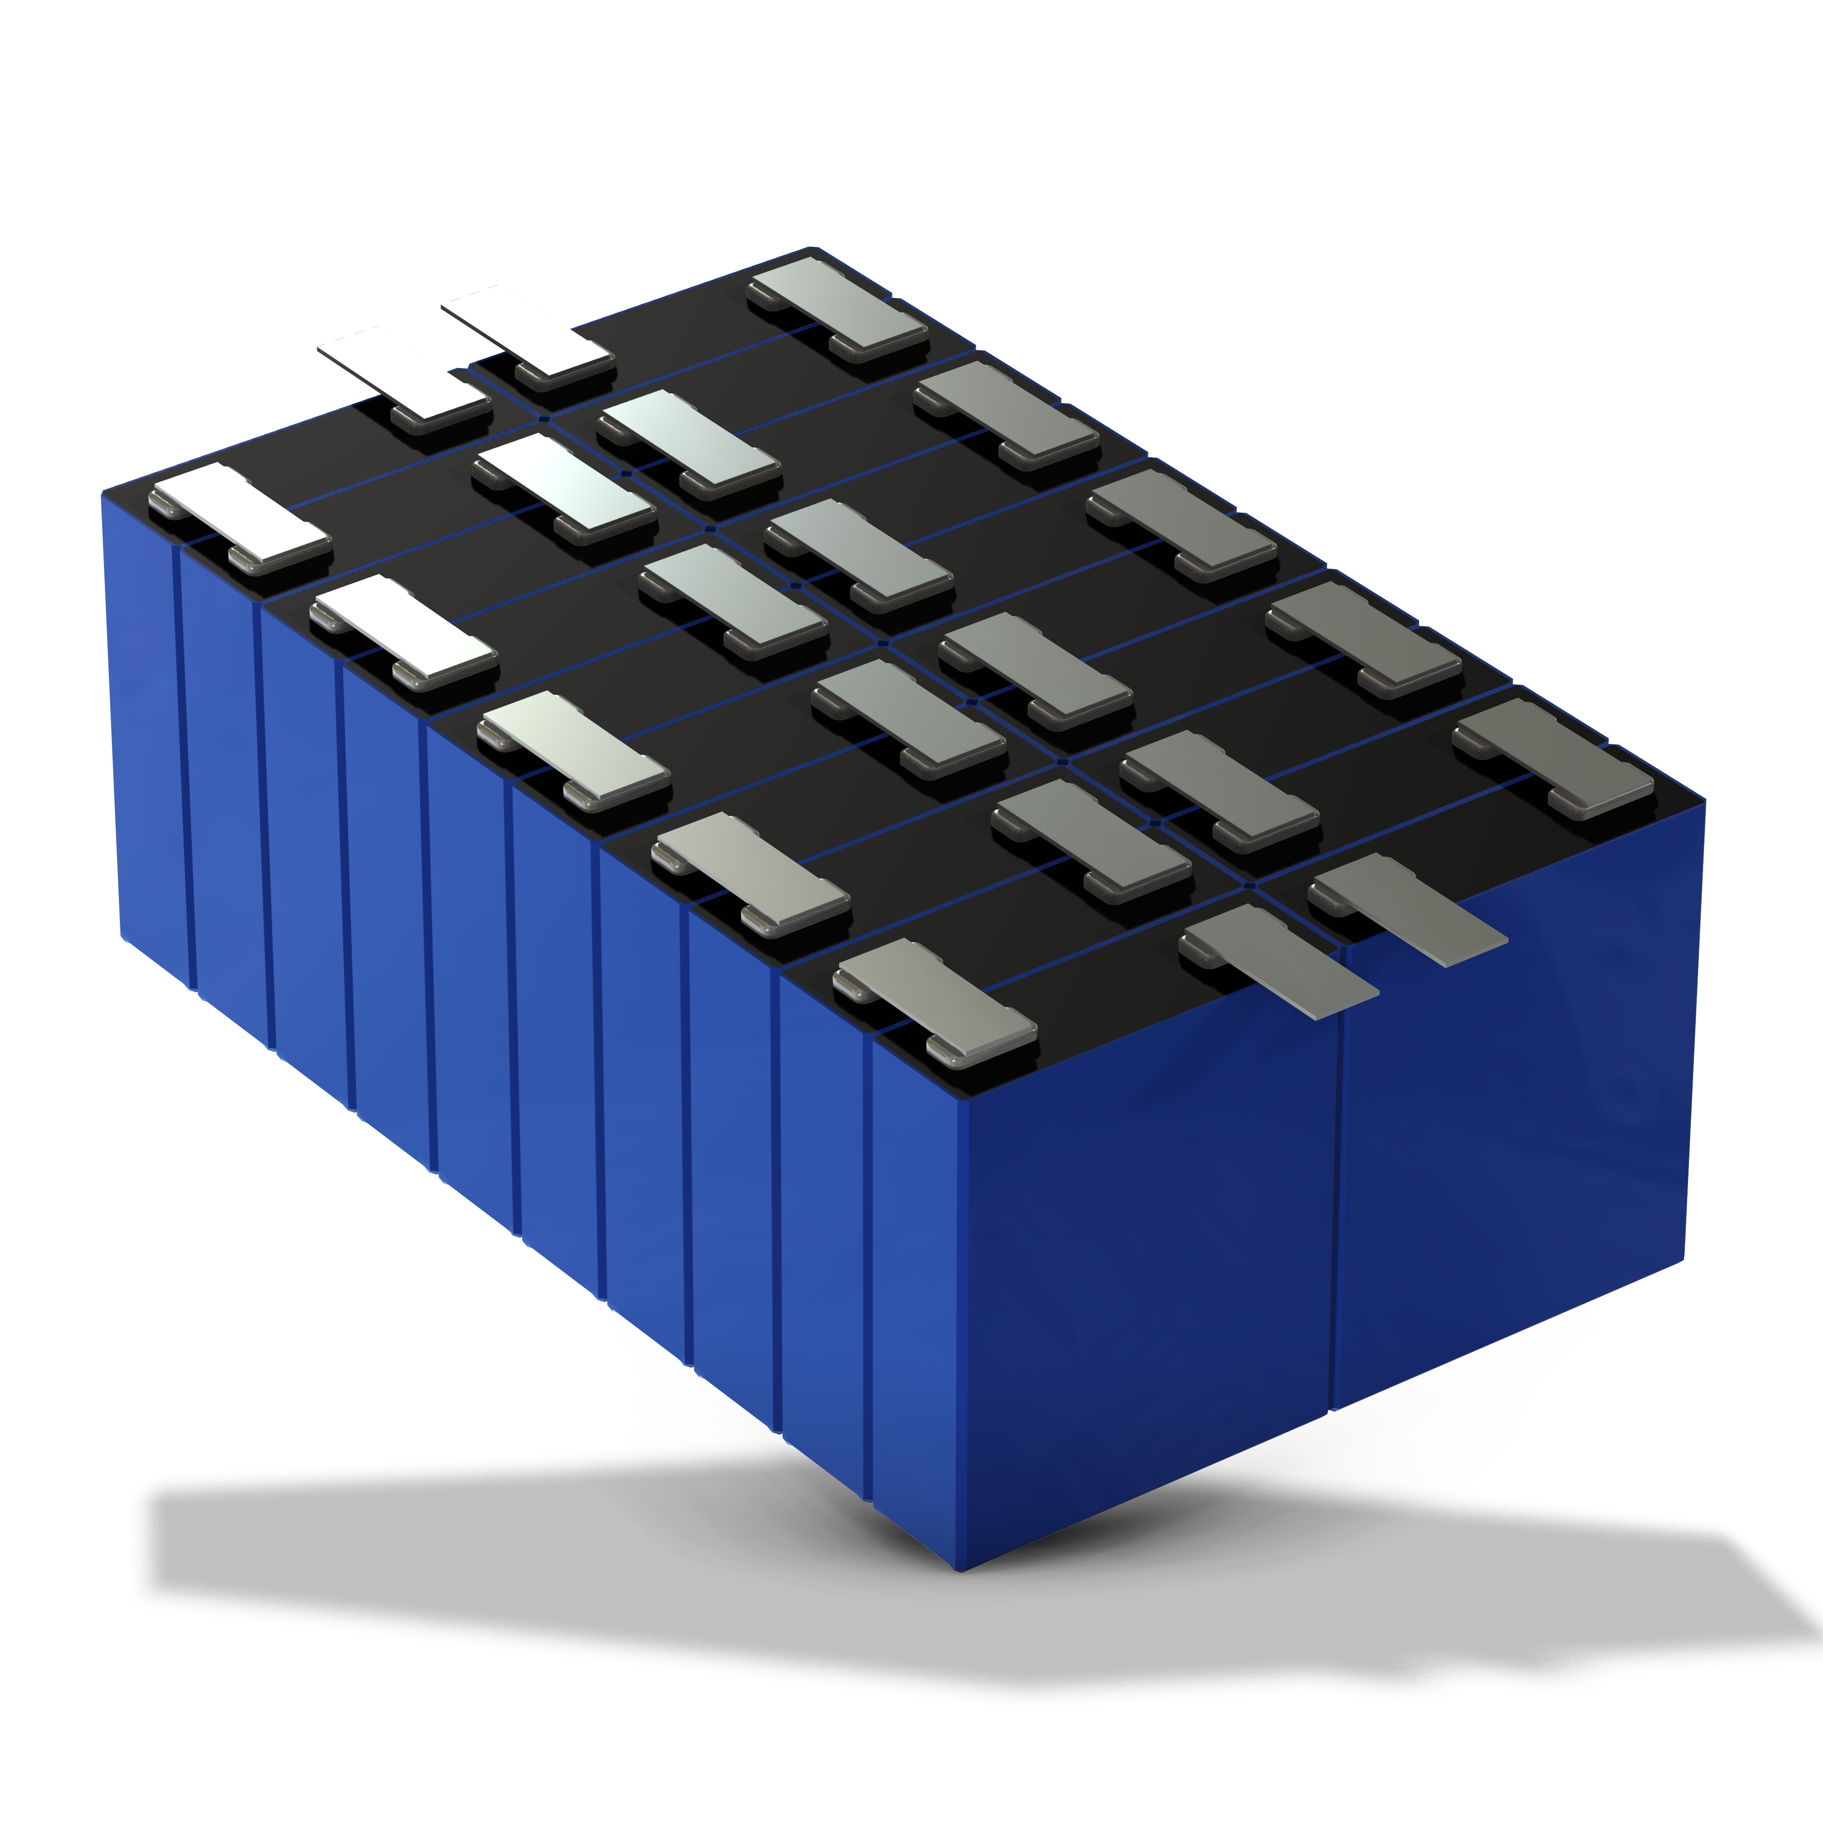
Module Serial Connection for High voltage
Current
controlled
(load)
Ground

Slide 16
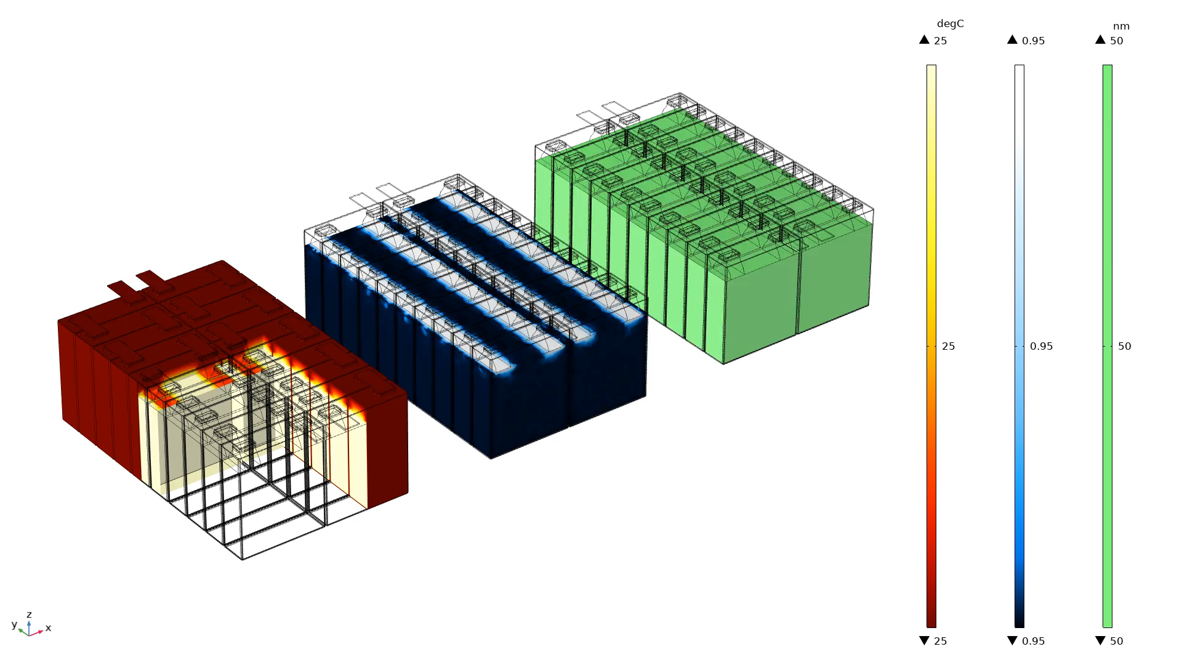

Module Serial Connection Degradation Pattern
SEI layer thickness
Temperature $(℃)$
State of Charge

Slide 17
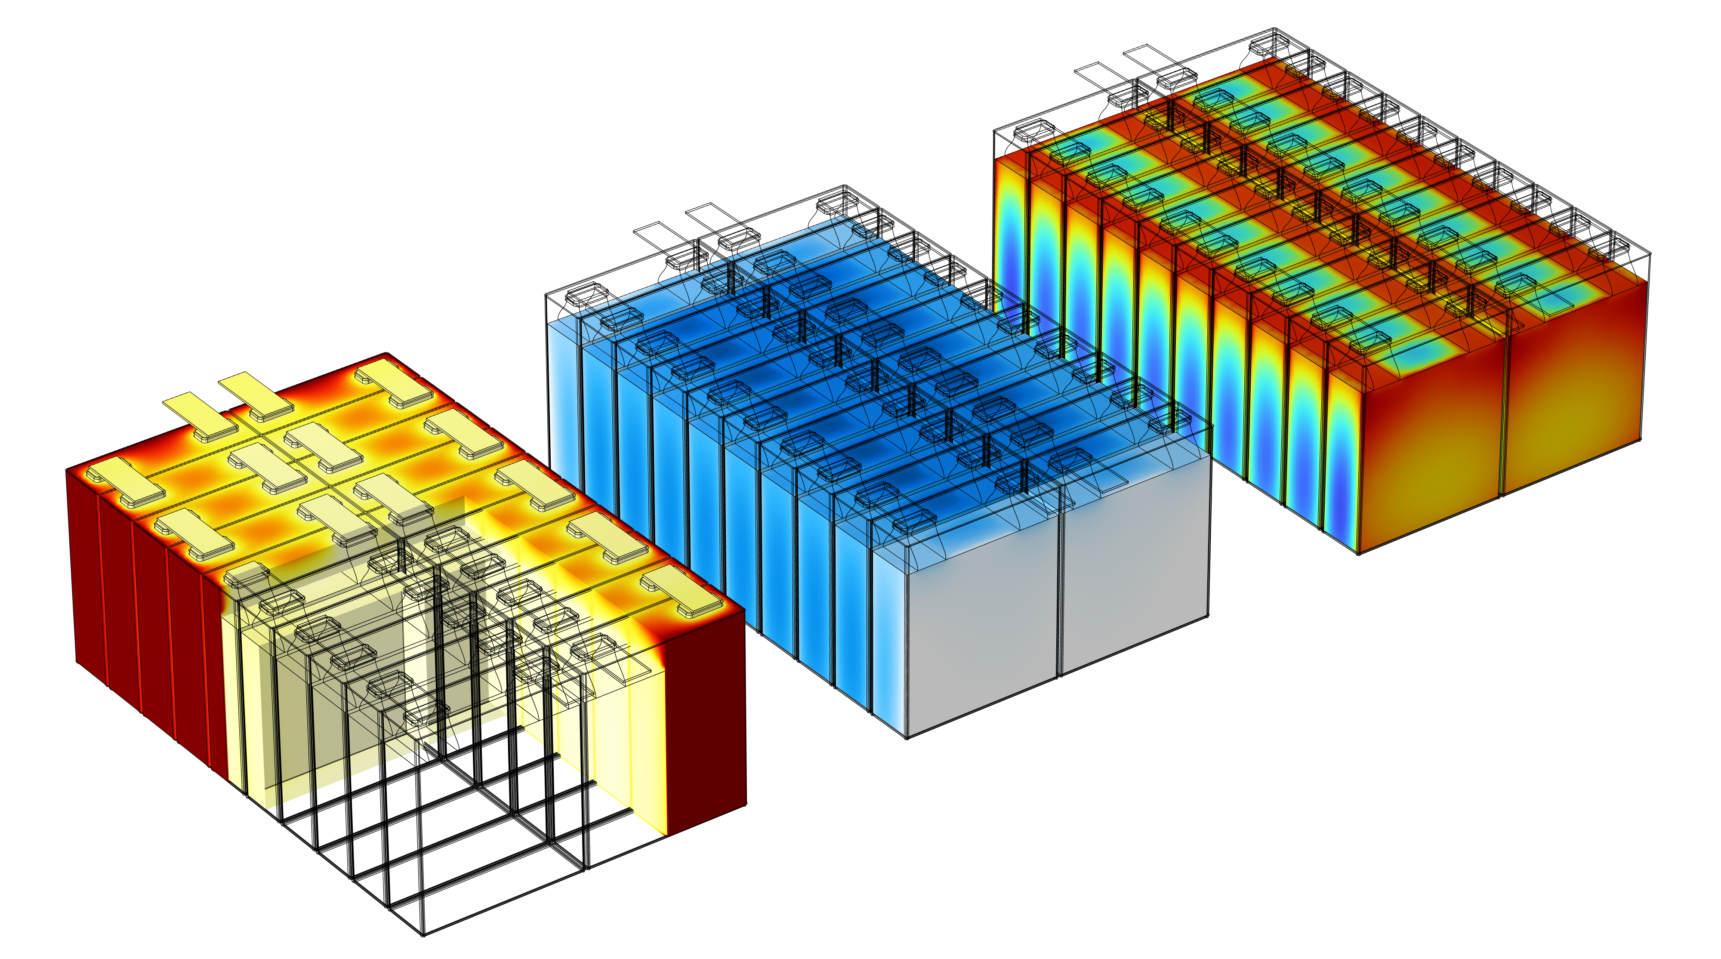

Module Serial Connection Degradation Pattern
Temperature $(℃)$
SEI layer thickness
State of Charge

Slide 18
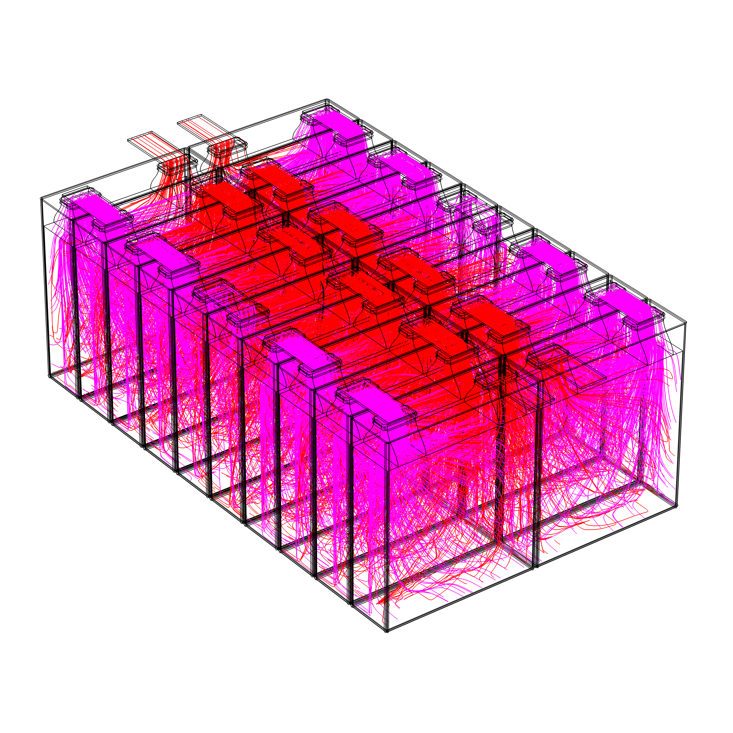
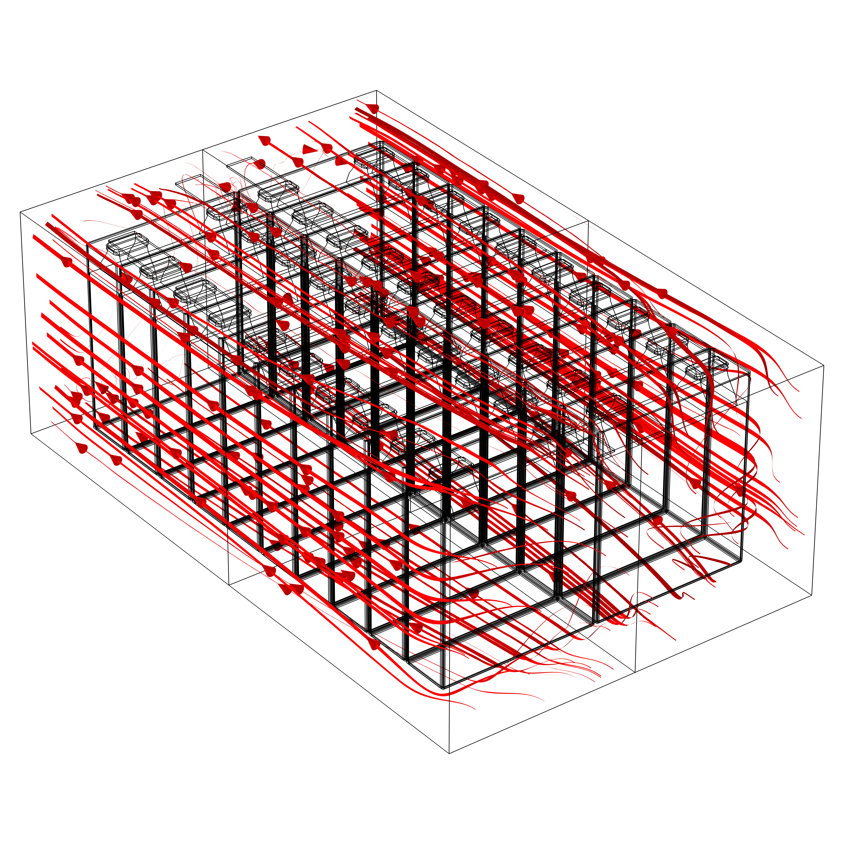
Module including physics important for temperature of module
Current distribution
Flow distribution for cooling

Slide 19
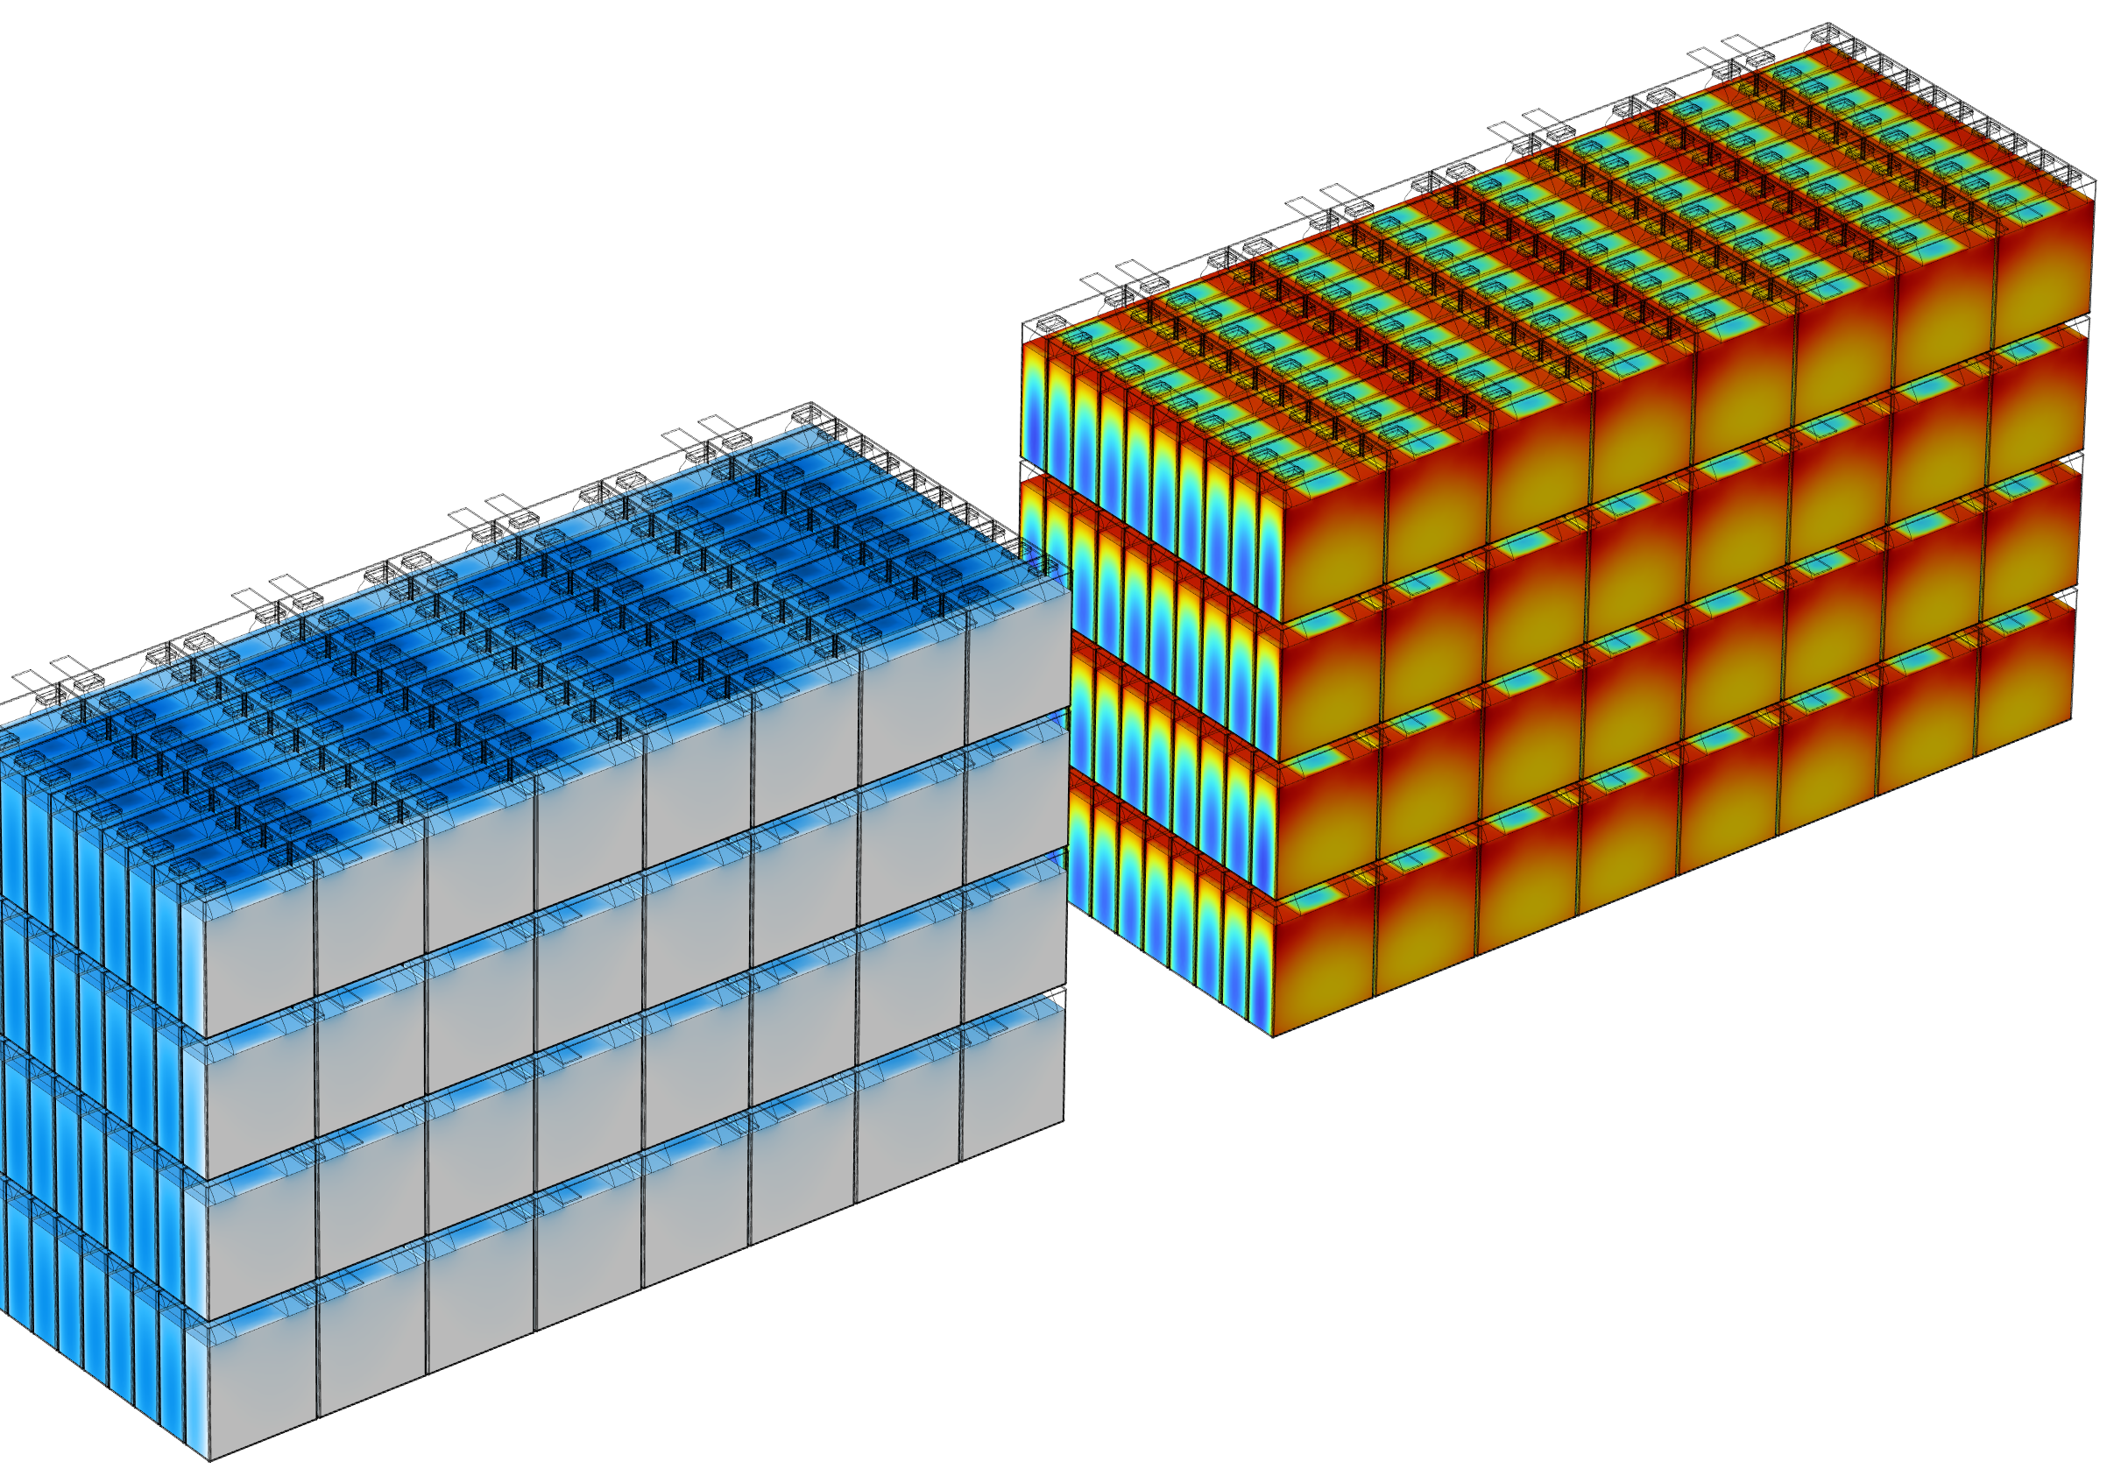
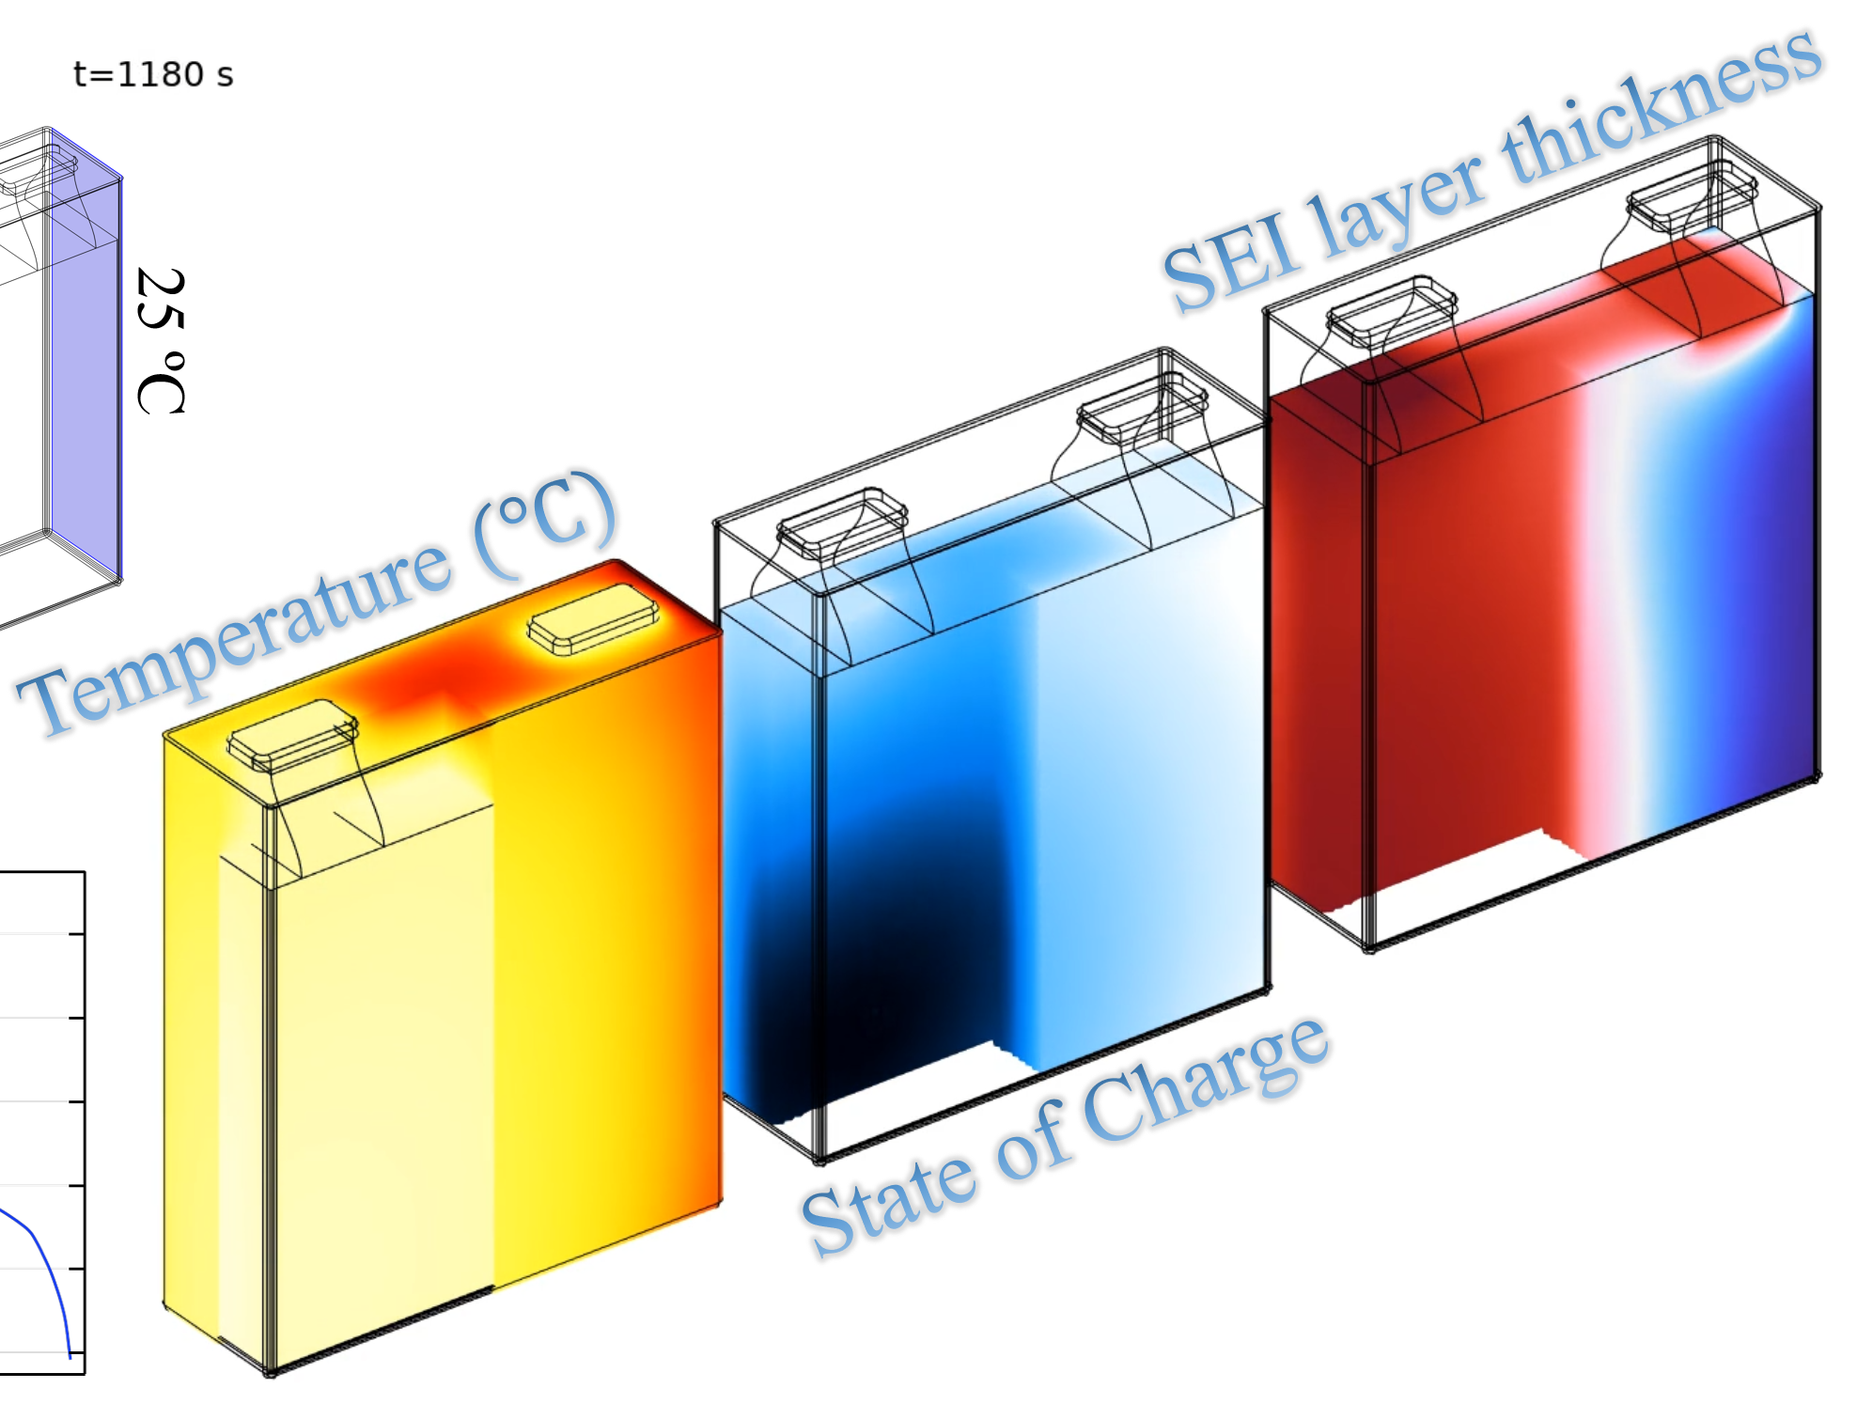
From Cell to Pack
Single Cell
Module
Pack

Slide 20
Thank you for listening
André G. Steckel
Email: ags@resolvent.dk
resolvent
Thomas Bisgaard
Email: tb@resolvent.dk
Visit our website: https://resolvent.com/
Contact us on
Tel: +45 61 66 99 03
Email: info@resolvent.dk
Follow us on: https://www.linkedin.com/company/resolvent-p-s/mycompany/
Martin Refslund Nielsen
Email: mrn@resolvent.dk
The authors would like to acknowledge the financial support by the European M-ERA.NET 3 call (project9468 LaserBATMAN), Innovation Fund Denmark (grant number 1139-00001), and the Swedish Governmental Agency for Innovation Systems (Vinnova grant number 2022-01257).

Slide 21
End of presentation

Slide 22
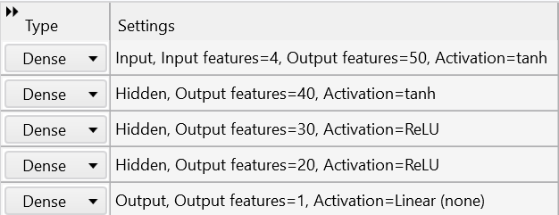
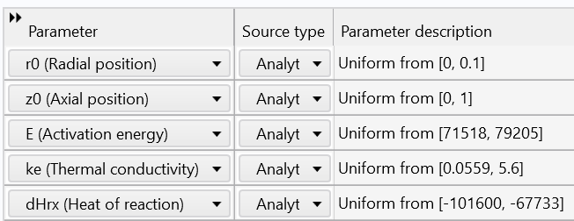






What is COMSOL surrogate modelling
Preprocessing in model builder
DOE sampling methods, like Latin hypercube sampling (LHS)
On some parameter space
$$σ$$
x
$$σ$$
Generate table of all the values
$$g(x)$$
$$u_{target}\left(x,y\right)−g(x,y)=Loss$$
y
……
Train Deep Neural Network (DNN) on the results table
Use DNN in results to plot intermediate solutions for some coordinates r, z and the parameter E, ke, dHrx
$$σ$$
Minimize NN $→σ$
Loss
$$ℝ^{3}→NN\left(x,y\right)→ℝ^{1}$$

Slide 23
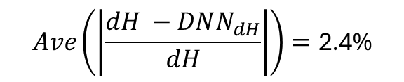
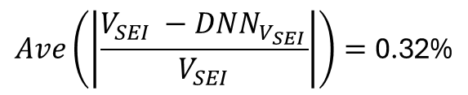
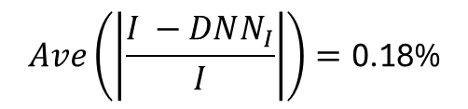
Learnings from surrogate modelling
I
V_{SEI}, dH
Example of DNN training
$$Ave\left(\left|\frac{V_{SEI} −DNN_{V_{SEI}}}{V_{SEI}}\right|\right)=\text{0.}\text{32}\text{\%}$$
$$Ave\left(\left|\frac{I −DNN_{I}}{I}\right|\right)=\text{0.1}\text{8}\text{\%}$$
$$Ave\left(\left|\frac{dH −DNN_{dH}}{dH}\right|\right)=\text{2}\text{.}\text{4}\text{\%}$$

