Slide 1


COMSOL Conference 2024 Florence
Monte-Carlo Model for Radiation
Transport in Solid X-Ray Targets
Dr. Christian Feist
Consulting engineer | Accredited and
certified expert | COMSOL certified consultant
CENUMERICS
6020 Innsbruck
Austria
Christian.Feist@cenumerics.com
Dr. Arno Plankensteiner
Director Corporate
Research & Development
PLANSEE SE
6600 Reutte
Austria
Arno.Plankensteiner@plansee.com

Slide 2
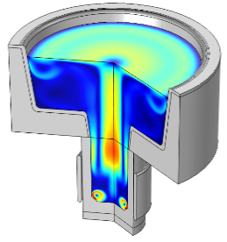
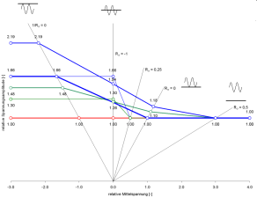
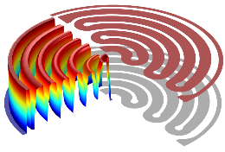
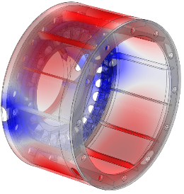
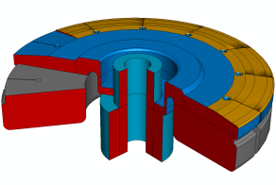
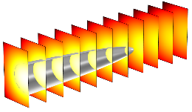
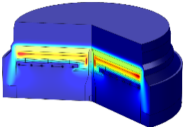
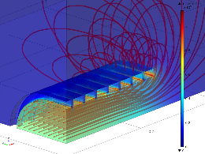
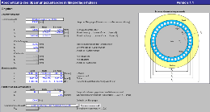



INTRODUCTION
CENUMERICS
  engineering consultancy founded in 2005
  in Innsbruck, Austria
  mathematical modeling and numerical simulation
    multiphysics modeling
    component and process simulation
    application and software development
      COMSOL Application Builder
      COMSOL Physics Builder
      C/C++, Java

Slide 3
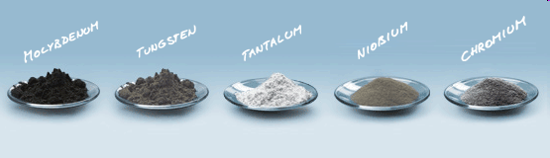
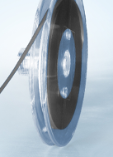
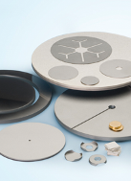
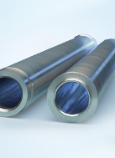
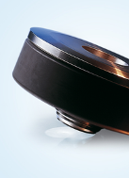
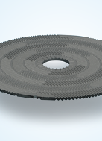
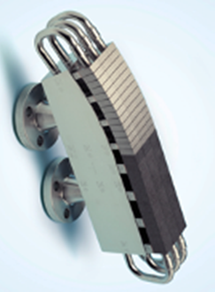
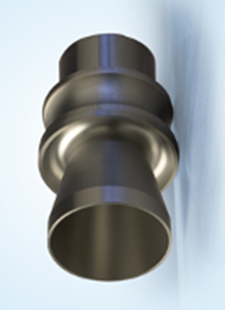
INTRODUCTION
PLANSEE
  founded in 1921 for production of molybdenum (Mo) and tungsten (W) wires
  1,000 MEUR turnover; 3,500+ employees worldwide (2023/24)
  world market leader in powder-metallurgical (P/M) production of refractory metals
    used in wide range of high-tech applications and industries
    unique combination of material properties
      high melting point
      excellent high temperature strength
Mo
W
Ta
Nb
Cr

Slide 4
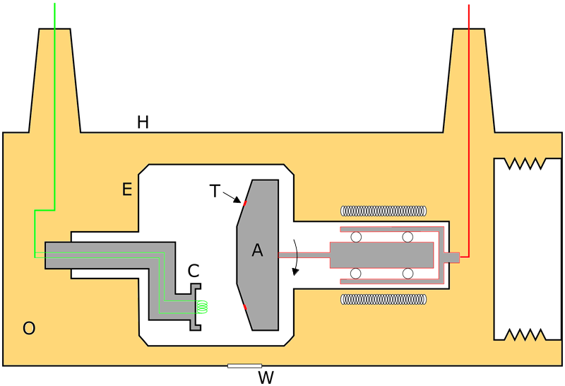
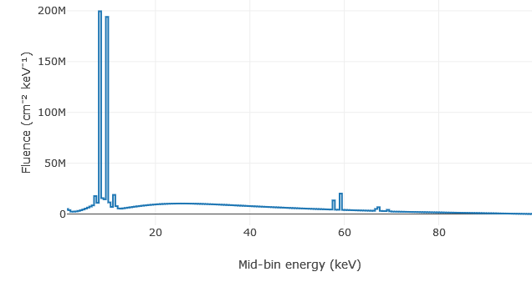
X-RAYS
High-energy electromagnetic radiation
  discovered 1895 by Conrad Röntgen
  energy range above UV light
  good penetration of solid matter (ρ ≈ 0)
  widely used in medical diagnostics and material testing
Production using high-vacuum X-ray tubes
  electrons e– thermionically emitted from cathode (C)
  accelerated to anode (A), voltage 10¹…10² kV, formation of e-beam
  impact on target or focal track (T)
  cascade of atomic interactions within target material
  emission of X-ray photons γ as:
    bremsstrahlung → continuous spectrum
    characteristic X-rays → discrete spectrum
  escaping by tube window (W) → utilizable radiation
Ref: wikipedia:User:ChumpusRex, X ray tube in housing, Accessed: 2024-08-28
spectrum computed using
SpekPy [Poludniowski et al., 2021]
for W 10° target @ 100 kV
fluorescent lines (characteristic X-ray)

Slide 5
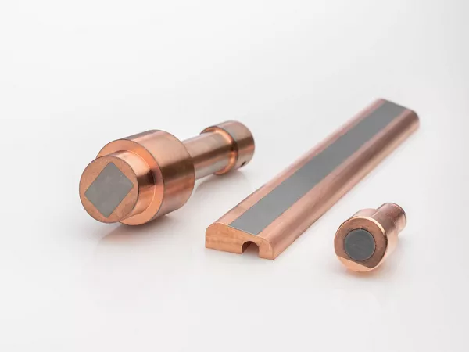
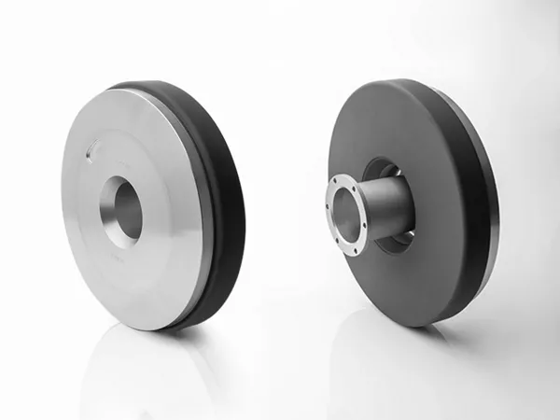
X-RAYS
Low efficiency, high heat dissipation
  only 0.1…1% as photon emission
  significant thermo-mechanical loads
Concepts for increased power
  active cooling of stationary anodes
  rotating anodes
  rotating envelope anode
  line-focus-principle (target inclination, stretched beam)
Motivation for study
  numerical model for radiation transport in X-ray target
  gain insight into performance of target, emitted spectrum,
  heat dissipation, influence of main design parameters
Ref (top, bottom): PLANSEE

Slide 6
MODELING
Modeling of radiation transport
  transport of high-energy electrons and photons (particles) through matter (medium)
  interaction with atoms and molecules
  energy transfer and secondary particle emission (cascade, particle shower)
  energy deposition within medium
Monte Carlo method
  particle-based approach
  history of particles discretized as random sequence of
    free „flights“ (sampled from mean free path length)
    subsequent particle-interactions (sampled from relative interaction probability)
      change of flight direction and energy
      possible emission of secondary particles
    tracked until energy absorption
φ
x_{n}
θ
t_{n}
x_{n+1}
t_{n-1}

Slide 7
INTERACTION MODEL
Relevant atomic interactions
  electrons
    elastic scattering inelastic scattering bremsstrahlung emission
  photons
    photoelectric absorption coherent (Rayleigh) scattering incoherent (Compton) scattering
  X-ray production from combined electron and photon interactions (“shower”):
    ① bremsstrahlung emission
    ② electron ionization characteristic X-ray emission
    ③ photon-atom interaction through radiative transitions
e– (E)
e– (E)
e– (E)
e– (E – W)
e– (E)
e– (E – W)
Z
Z
e– (W – U_{i})
Z
γ (W)
γ (E)
e– (E – U_{i})
γ (E)
γ (E)
γ (E)
e– (E – E‘– U_{i})
Z
Z
Z
fluorescence
γ (E‘)
e–
γ
γ
→
①
γ
②
target
③
Ref: reproduced from [Poludniowski et al., 2022]

Slide 8
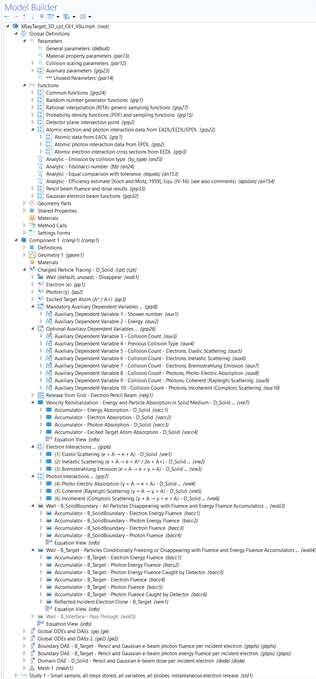
IMPLEMENTATION
Monte Carlo model implementation
  using COMSOL Multiphysics 6.1
    no ready-made interface for coupled electron-photon transport
    COMSOL “Particle Tracing Module” allowing custom implementation
  main features:
    particle types:
      electrons
      photons
      excited target atoms (energy transfer to medium)
    particle state variables:
      particle energy E (Note: “massless” formulation)
      quantities for sampling and statistics
    interaction model:
      using Velocity Reinitialization and Secondary Emission features
      interaction data (cross sections etc.) for Mo, W, Re from EPICS-database (IAEA)
      random sampling methods [Salvat, 2019] implemented in extensive function library
      (native/external C++)
    domain accumulators: energy deposition (absorbed dose)
    boundary accumulators: fluence and energy fluence

Slide 9
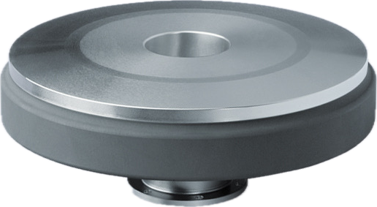
APPLICATION
Typical rotating X-ray anode with graphite body
anode body (Mo-alloy)
focal track (W-alloy)
graphite body (heat sink)
Ref: PLANSEE

Slide 10
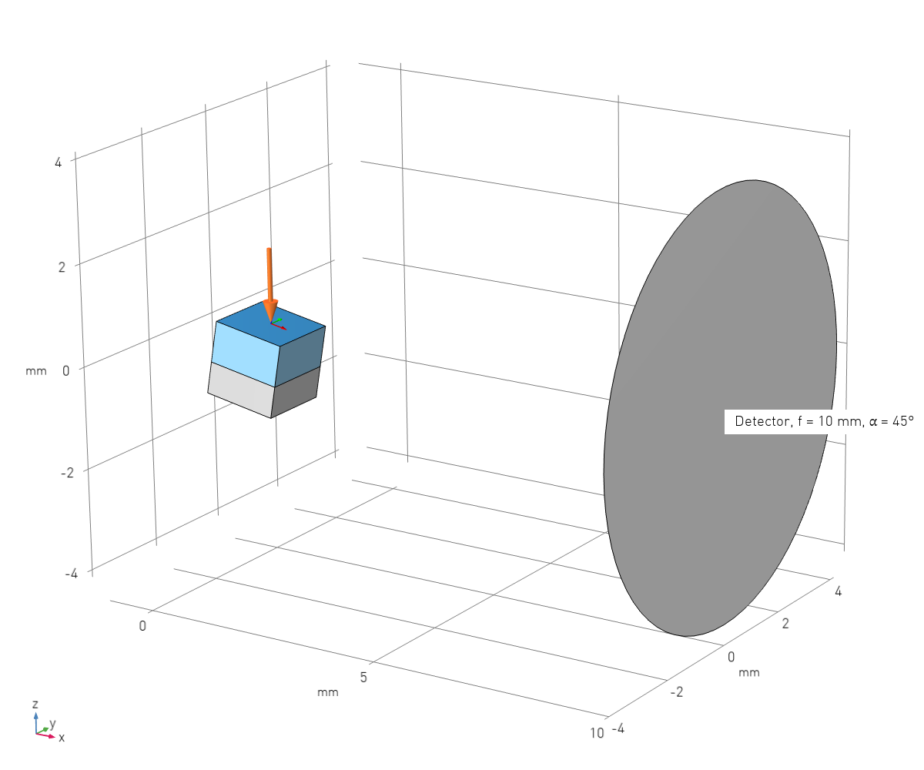
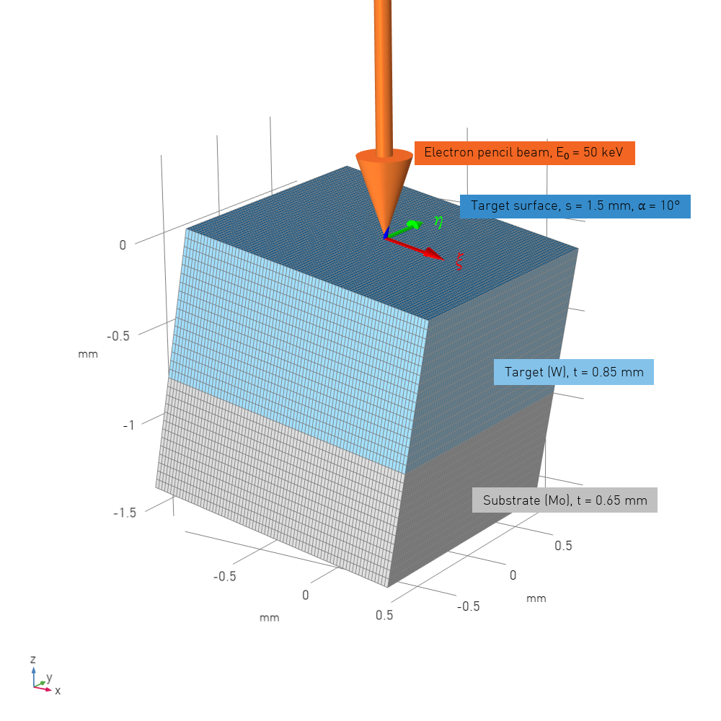
APPLICATION
System
  Geometry with target and detector
Computational domain with accumulator grid

Slide 11
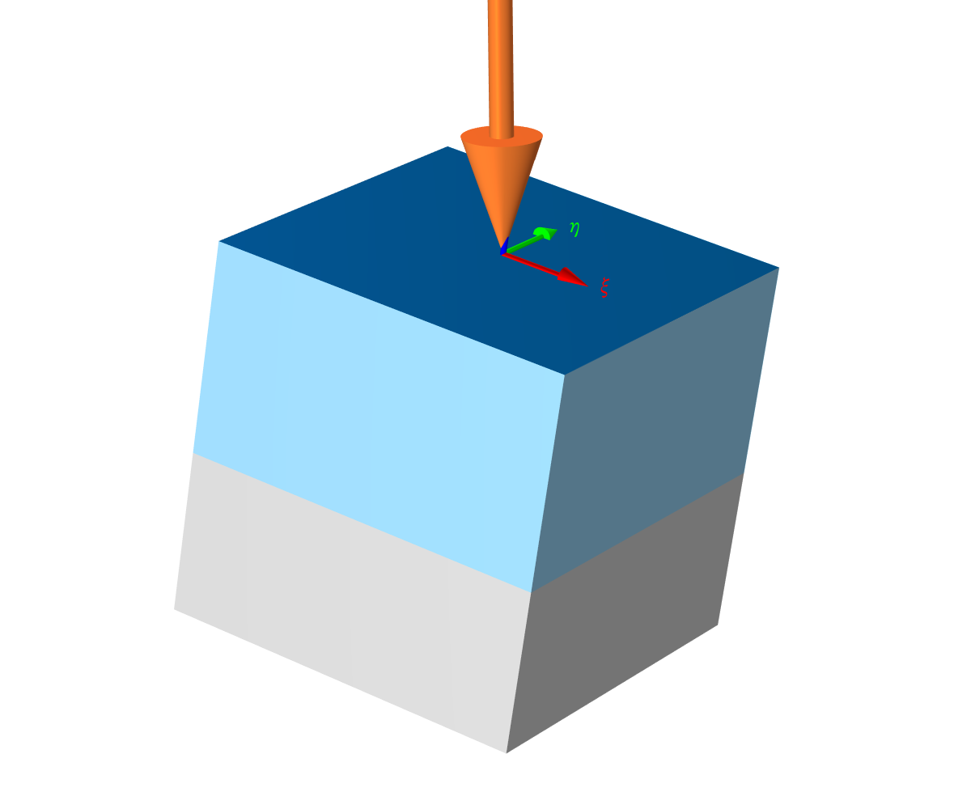
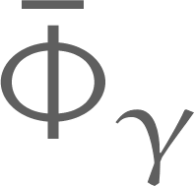

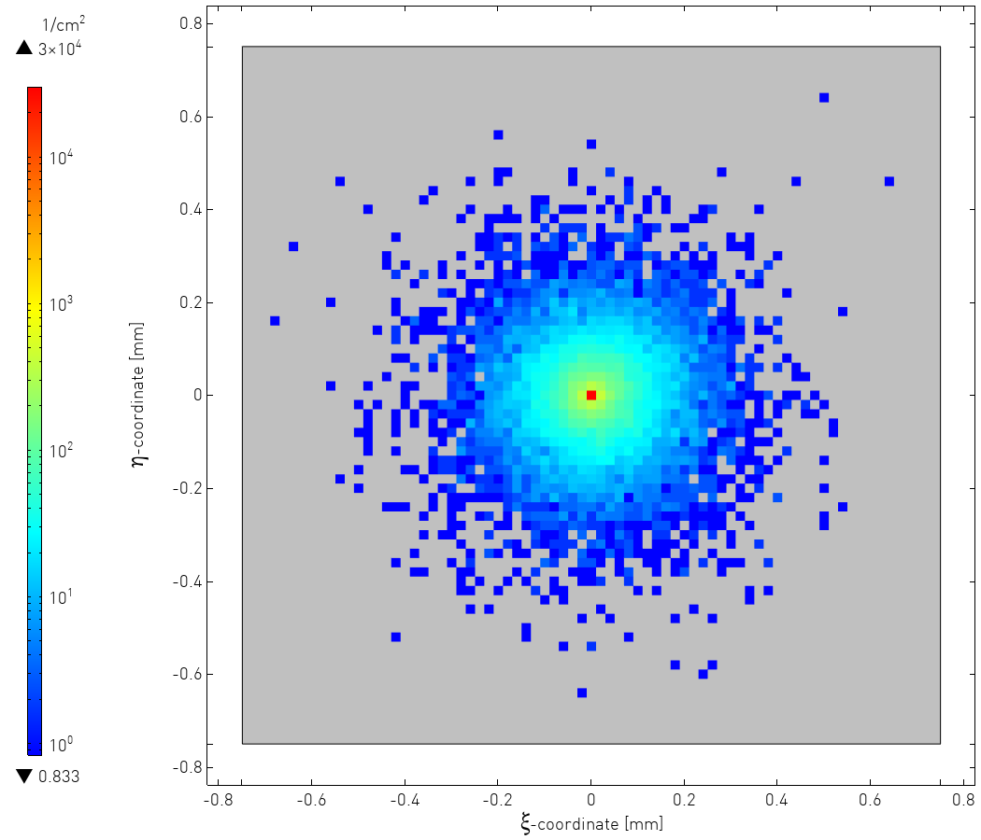
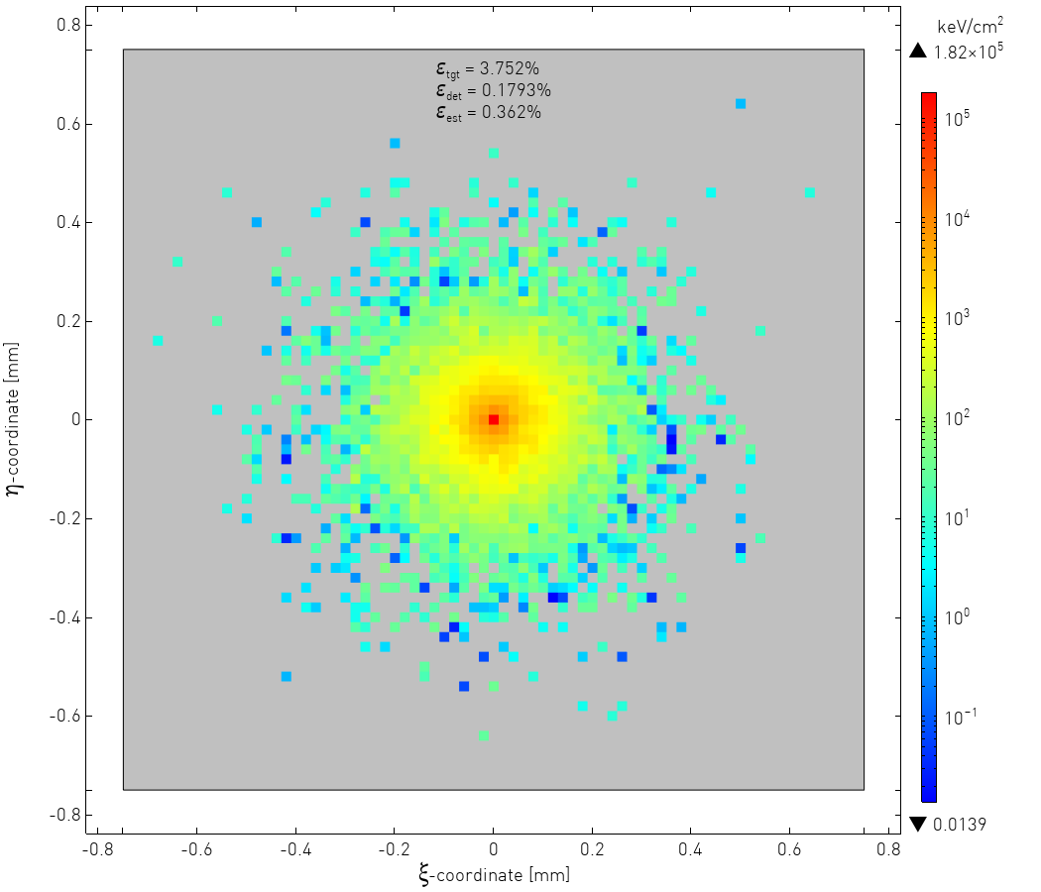
APPLICATION
Results for pencil electron beam
  Total target photon fluence and energy fluence per incident electron
    Fluence Energy fluence
      sample size: N_{e} = 3·10⁵
distributions app. symmetric wrt. η = 0
(slightly) biased
towards ξ > 0
(target inclination!)

Slide 12
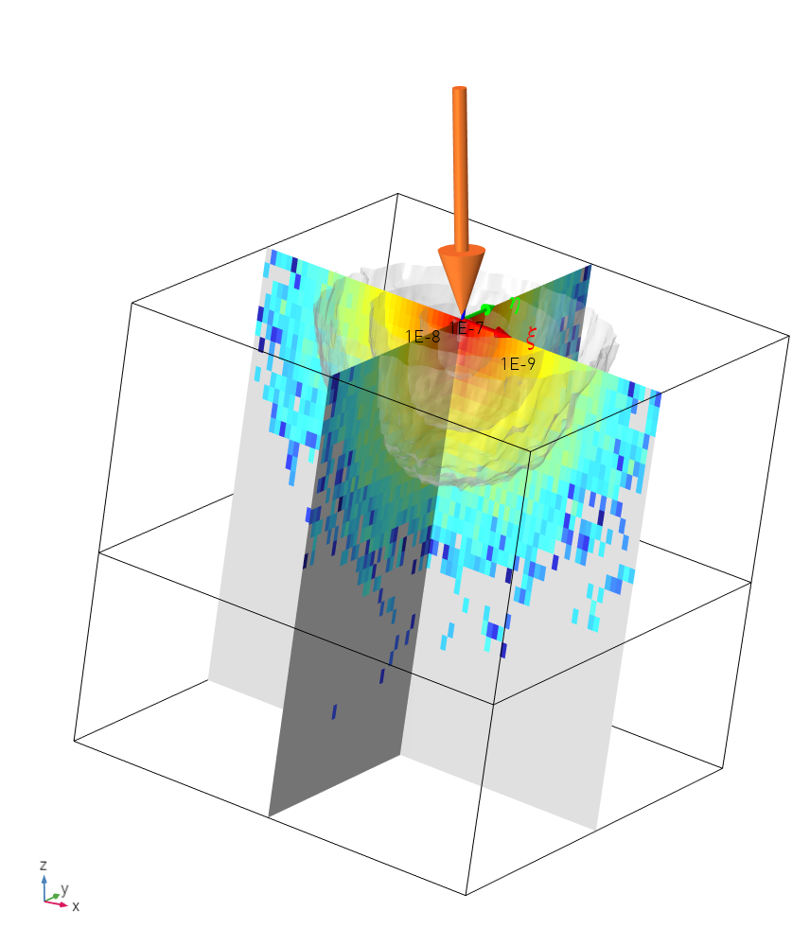

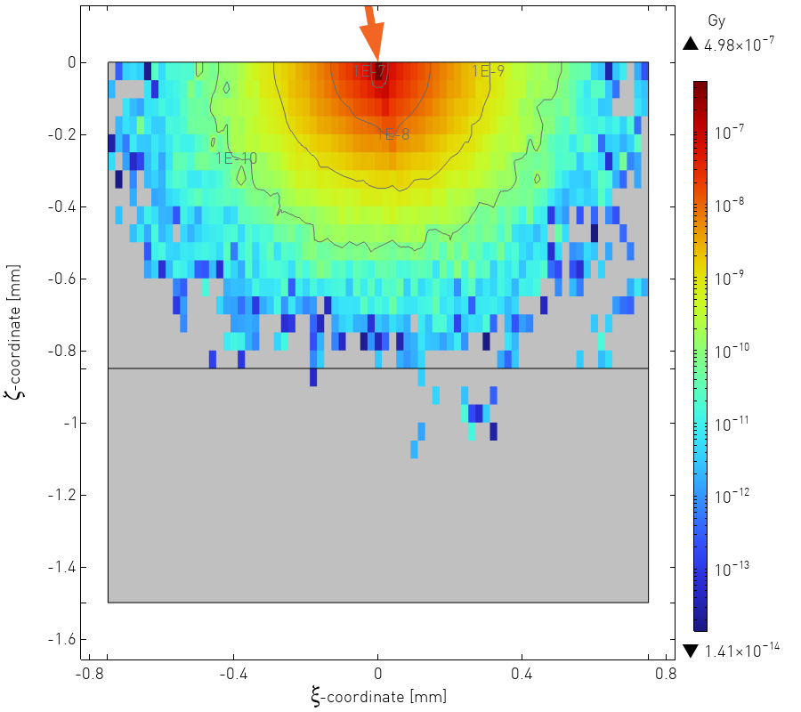
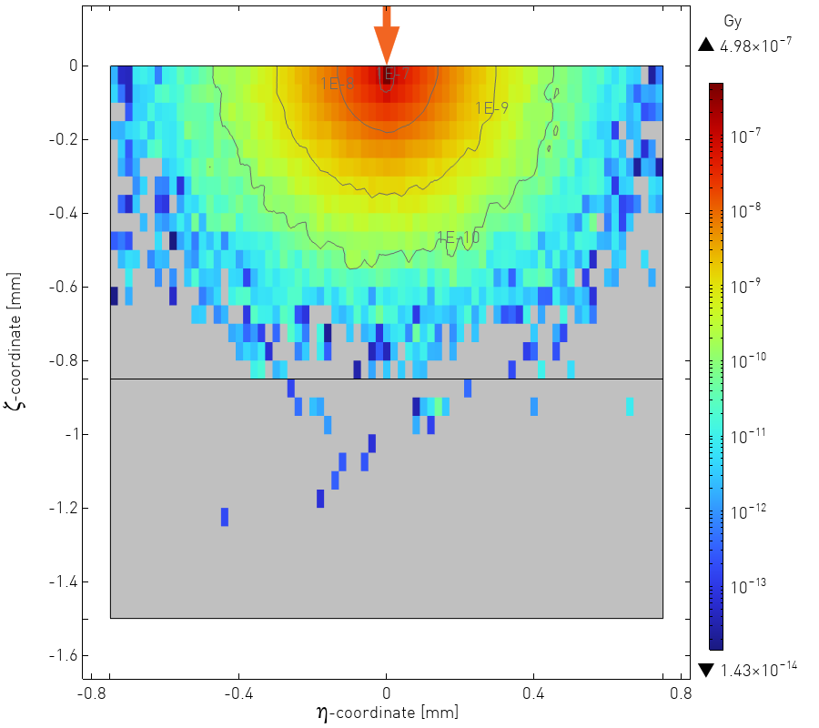
APPLICATION
Results for pencil electron beam
  Absorbed dose per incident electron
    Solid body Focal spot section η = 0 Focal spot section ξ = 0
      sample size: N_{e} = 3·10⁵

Slide 13
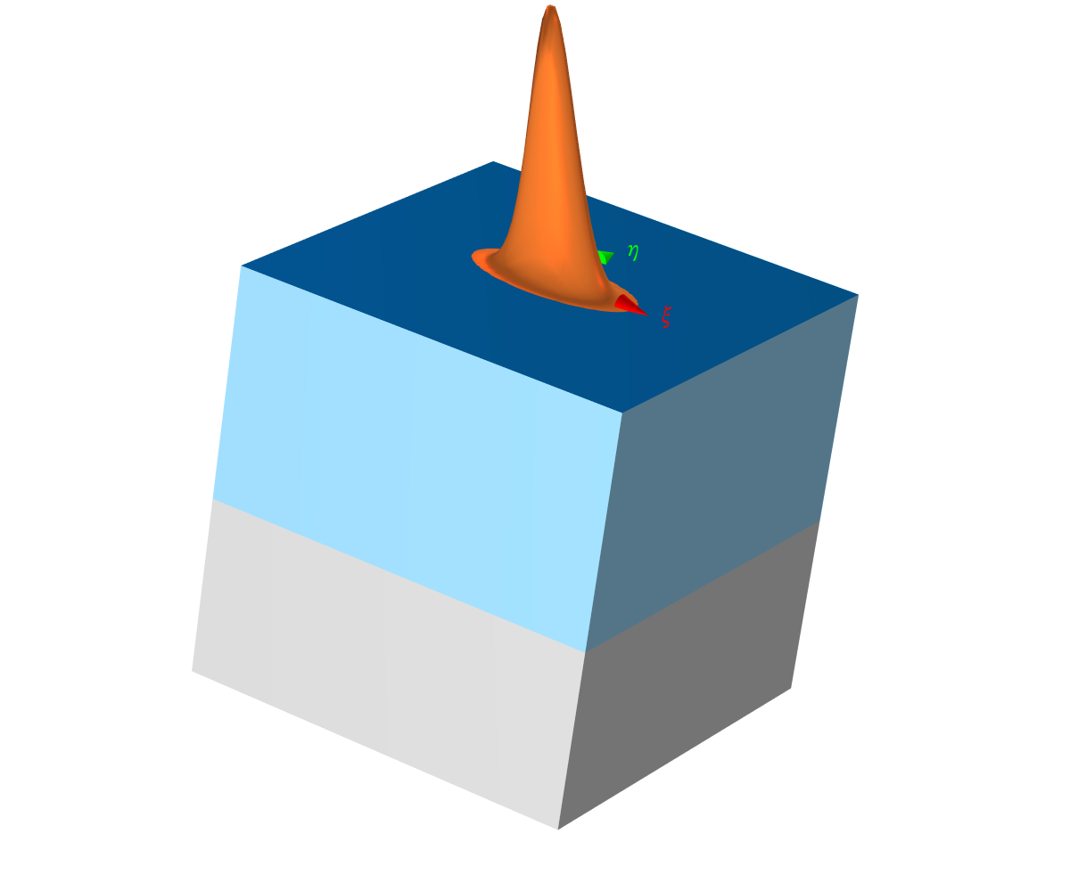
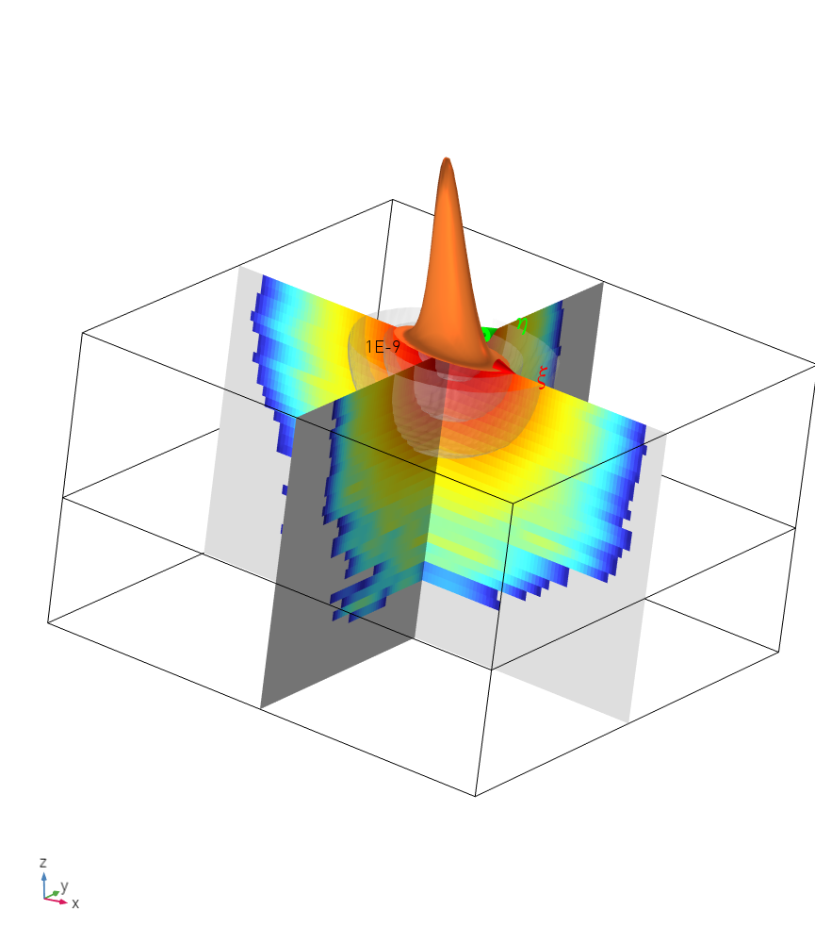
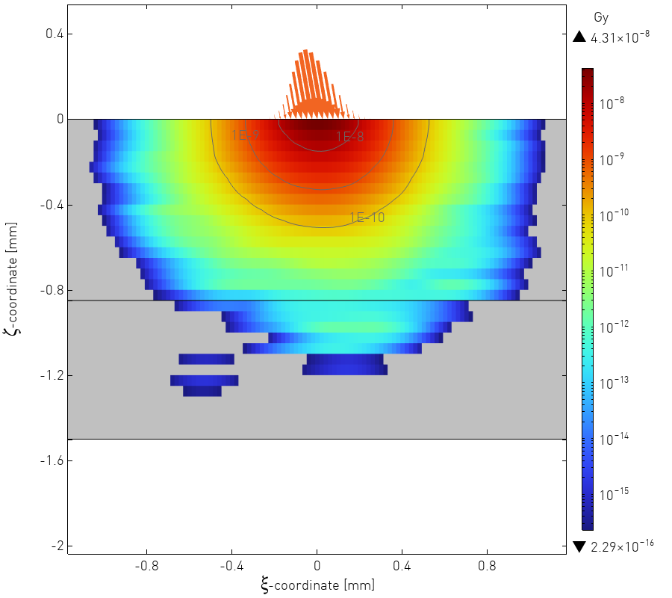
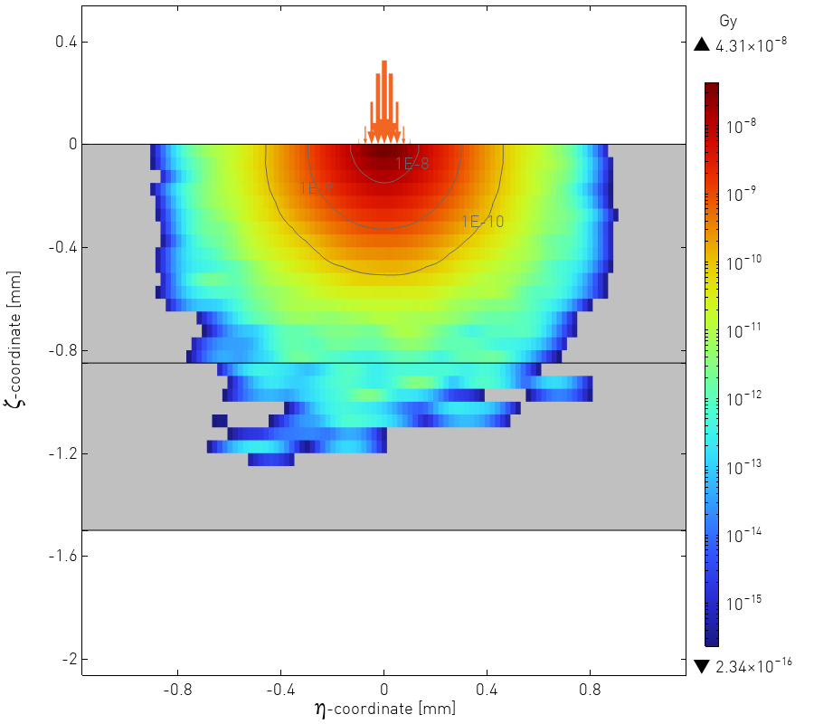
APPLICATION
Results for Gaussian electron beam
  Absorbed dose per incident electron
    Solid body Focal spot section η = 0 Focal spot section ξ = 0
    transformation from electron pencil beam to arbitrary finite beam using convolution theorem (beam shape as kernel)

Slide 14
SUMMARY AND OUTLOOK
Summary
  implementation of Monte Carlo model in COMSOL Multiphysics
  radiation transport in solid X-ray targets
  focus on bremsstrahlung emission (continuous spectrum)
  state-of-the art sampling methods
  convolution of pencil electron beam results to arbitrary finite e-beam
Outlook
  model enhancement
    performance improvements, increase sample size
    radiative transitions and characteristic X-ray production
  model application
    assessment of main parameters: tube voltage, target angle, thickness
    better understanding of heat source distribution for use in nonlinear cyclic thermo-mechanical FEA

Slide 15
COMSOL Conference 2024 Florence
Monte-Carlo Model for Radiation
Transport in Solid X-Ray Targets
Dr. Christian Feist
…thanking you for your attention and
looking forward to your questions

