Slide 1
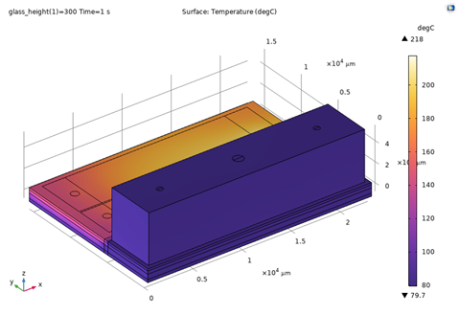
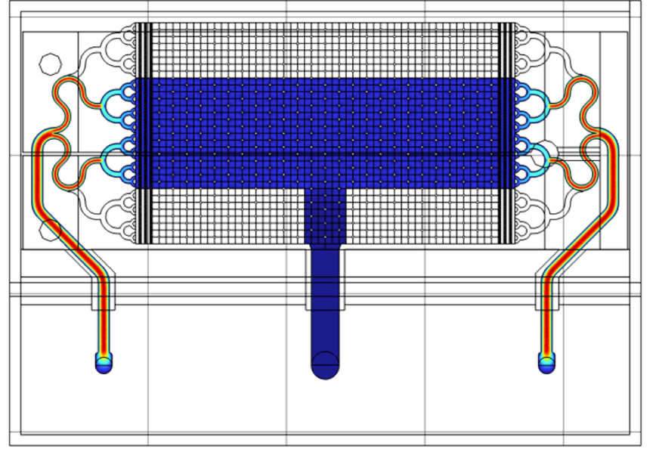

MEMS Gas-Chromatograph
Pre-concentrator Multi-physics
Simulation
G. Spinola Durante (Presenter),
A. Hoogerwerf, D. Z. Bayat

Slide 2
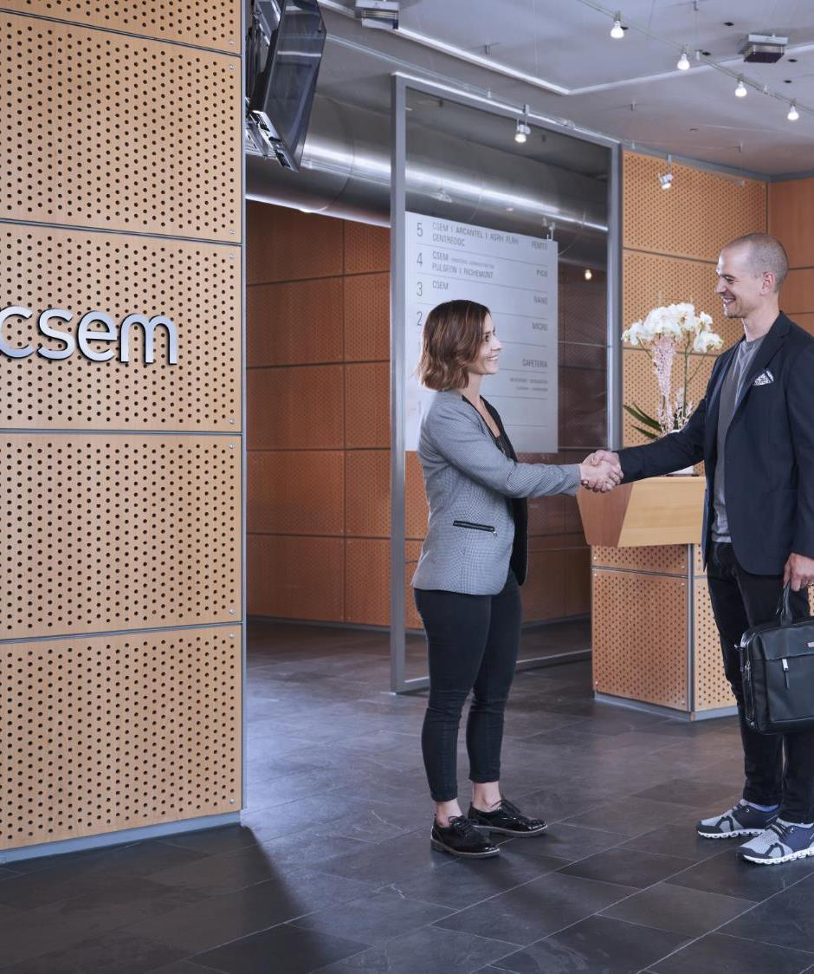
TABLE OF CONTENTS
What is CSEM?
Introduction on MEMS-GC
Pre-concentrator (PC) Design challenges
Goal of simulation tasks
Porous material – thermal/flow properties
Multi-physics coupled model description
Post-processing strategy
MEMS PC parametric optimization
Results summary
Benefits of simulations

Slide 3
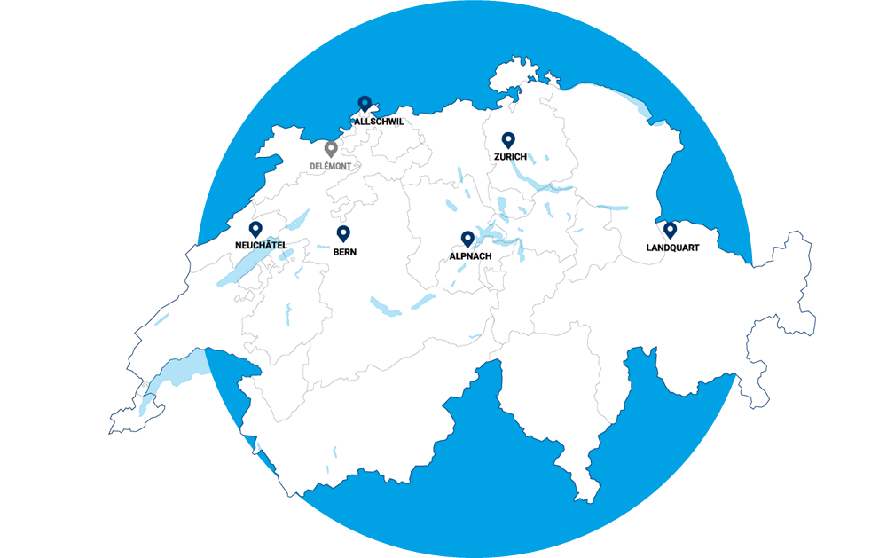


Csem at a glance
We are a public-private, non-profit Swiss technology innovation center
We enable competitiveness by developing and transferring world-class technologies to the industrial sector
600
SPECIALISTS
177
PATENT
FAMILIES
1984
FOUNDED
107.6
M TURNOVER
in 2023
> 50
VENTURES
since 1984

Slide 4
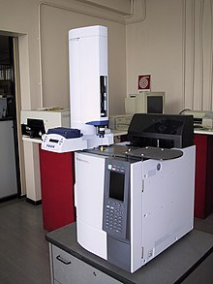
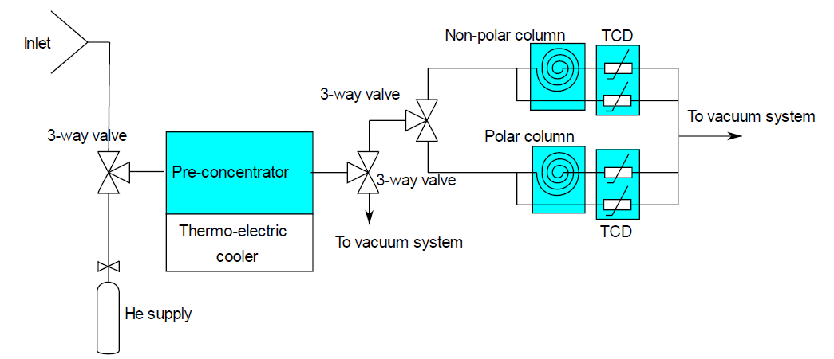
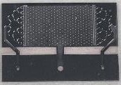
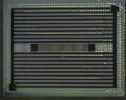
INTRODUCTION: what’s a MEMS
GAS-Chromatograph (MS-GC)?
Source: wikipedia
Gas-Chromatograph working principle
Pre-concentrator absorbs/fast-desorbs
Gas impurities (VOCs) in carrier gas (He)
to increase pulse VOCs concentration
Gas impurities pulse time delay is
generated in a long column μ-channel
Thermal conductivity variation detector measures VOCs type and amount
Mems Benefits (in blue)
System size reduction from 50cm to 5cm i.e. 10X
Large Volume/weight reduction i.e. ~1000x
Heater Power consumption reduction
Sensing Speed increased

Slide 5
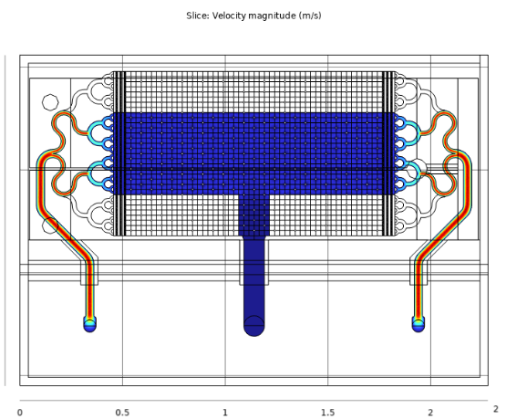
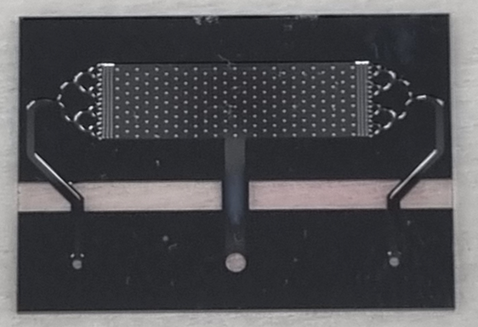
Pre-concentrator Design challenges
CHIP SIZE
  limited due to yield & costs issues
FLOW FIELD
  Uniform gas speed in porous material (Tenax®)
  to improve VOCs absorption uniformity and speed
THERMAL FIELD
  Peltier for controlling absorption in Tenax®
  Tenax® temperature uniformity during fast heating
    280-300°C in <5s in >70% volume: target specifications
  Thermal mass connected to the MEMS
HERMETICITY
  System interconnects carried out with invar block bonding.
HEATER DESIGN
  voltage is limited to 28V (space application)
  current lower than electro-migration limit <1E7A/cm²

Slide 6
GOAL OF SIMULATION TASKS
Simulation to extract material properties of Porous material (Tenax®)
Flow uniformity check with defined tree-geometry
Check thermal resistance to Peltier is acceptably slow during cooling to perform VOCs absorption in Tenax® porous material
Heater thermal design optimization to achieve fast heating
to perform fast VOCs desorption in Tenax® porous material (pre-concentrator)

Slide 7
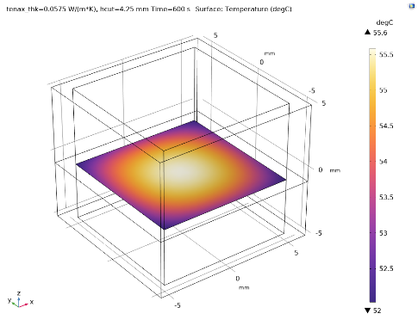
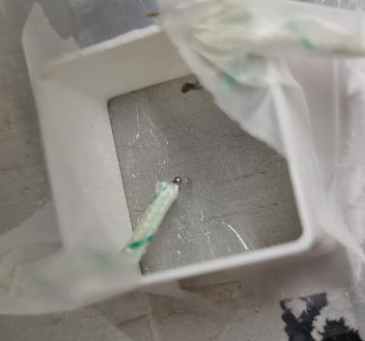
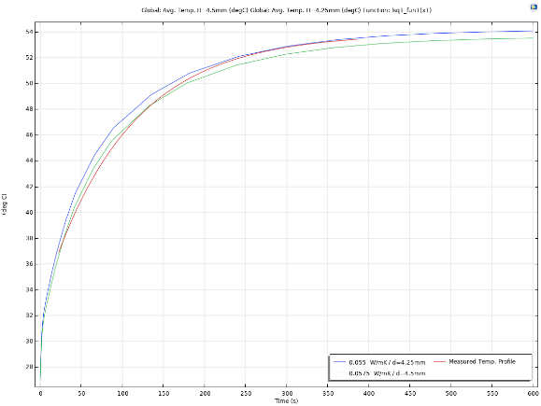
Porous material – thermal properties
Thermal conductivity estimated from heating of a 1cm³ cube filled with Tenax®. The assumptions are:
  Tenax® porosity of 60% and around
  30% of air around the Tenax® pellets (~packed spheres)
  Density estimated from datasheet
  Heat capacity estimated from literature and porosity assumption
Good fit of Tenax® polymer heating curve measured in the middle section of the reference cube with simulated curve.
  thermal conductivity estimated to be 0.0575 W/m*K
    Lower limit is bound by air 0.0257 W/m*K
    Error is most likely underestimated value. This leads to higher values, improving speed & uniformity of heating
Filled with Tenax® particles
Thermocouple

Slide 8
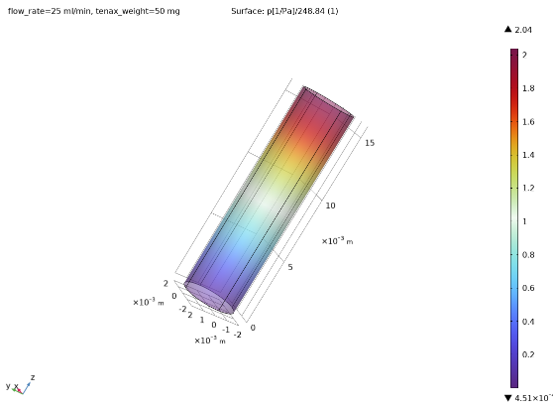
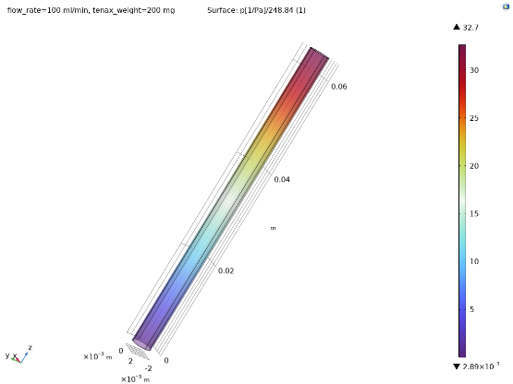
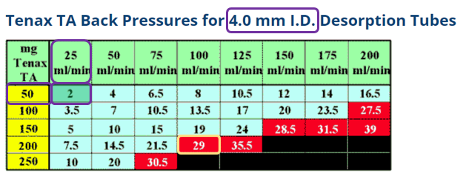
Porous material – flow properties
A parametric COMSOL model is set-up to simulate the porous flow with defined tube diameter & flow-rate
Permeability parameter of Tenax® is estimated to be:
k = 1.9e-11m²
  back-pressure is within 10% in accordance with the calibration data.
  The flow speed is also in accordance with flow ranges of selected Darcy porous flow model.

Slide 9
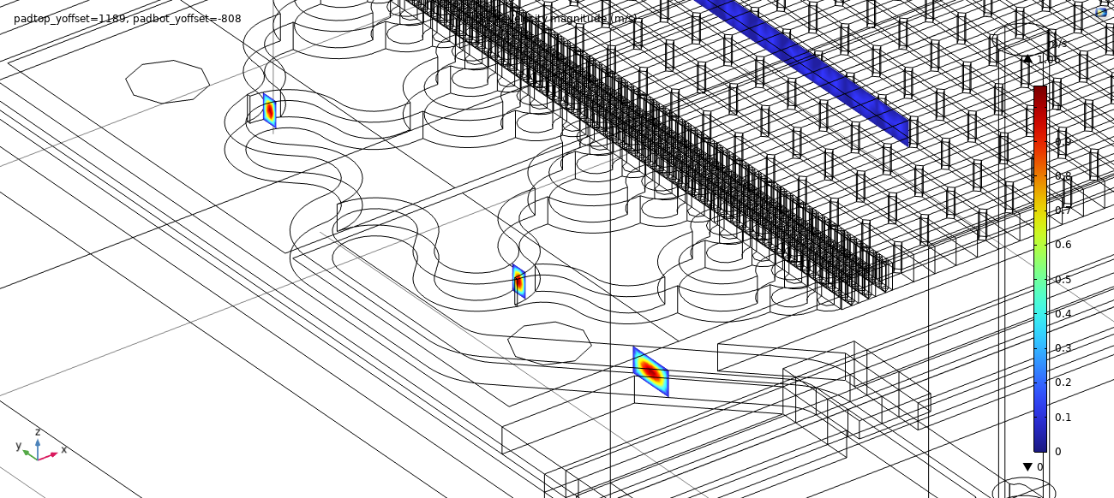
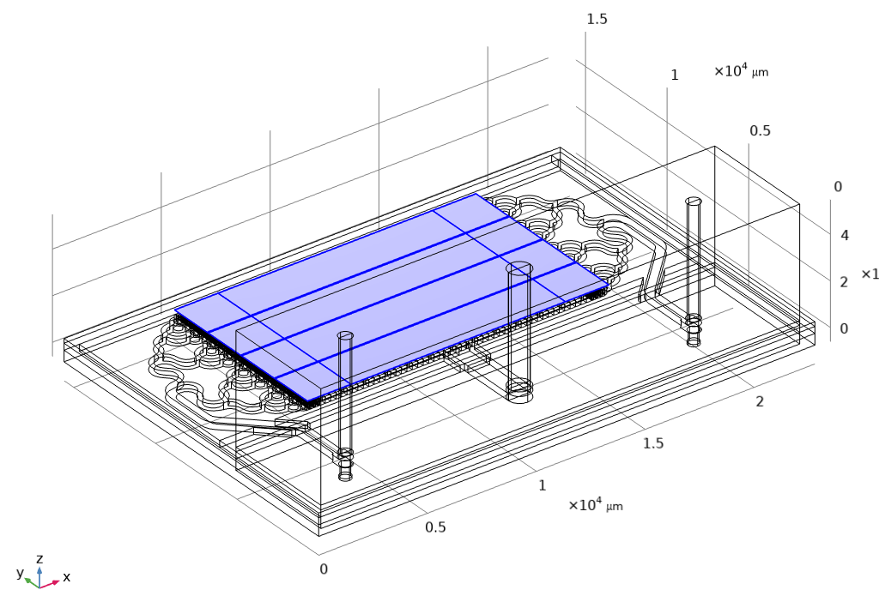
Multi-physics coupled model description
Selected Physics
heat transfer in solid and fluids
laminar flow, including porous flow (Tenax®)
electrical current in shells (2D-layer) to model the pre-concentrator heater.
Multi-physics coupling
Electrical – thermal
  Modeling of ohmic losses in the heater
Fluidic - thermal
  Modeling of non-isothermal flow

Slide 10
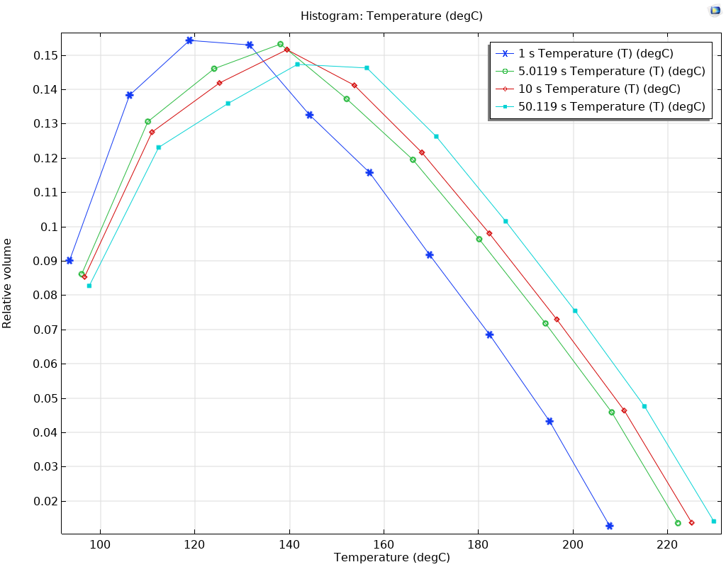
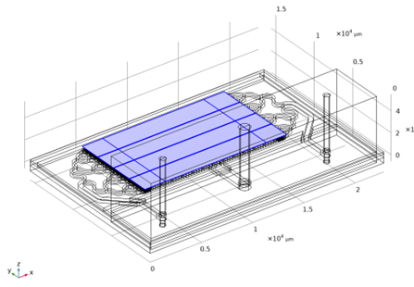
Post-processing strategy
Initial test with not optimized heater
  Heater geometry caused non-uniformity
  of temperature across Tenax® volume
  Heater reached high voltage limit
Post-processing based on histogram
  Temperature plot divided in bins of
  volume % to check for uniformity
150°C<T_{Tenax®}<165°C
11.5% volume

Slide 11
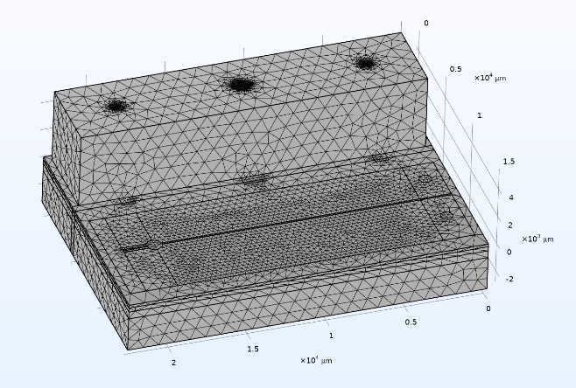
MEMS PRE-CONCENTRATOR parametric optimization
Flow speed impact analysis
Size of heater (length, width)
Folding and symmetry of heater analysis
Insulation thickness towards Peltier
Starting temperature of Tenax® before heat pulse
(VOCs de-sorption step)
900K elements

Slide 12
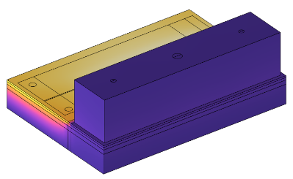
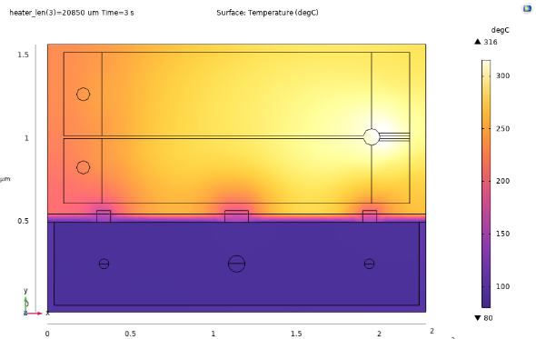
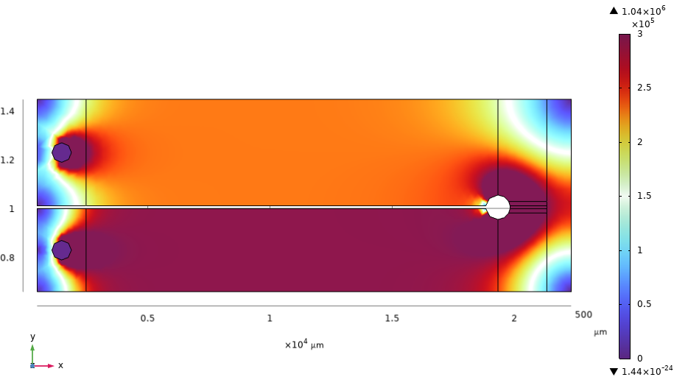
RESULTS SUMMARY – TEMPERATURE PLOTS
Large heater provides max temperature above 300°C while keeping below 300°C in Tenax® cavity
Strong gradient from Invar block can be partially requires asymmetric heater to compensate
Glass block below chip helps to insulate from Peltier. Cooling from +80°C to -10°C takes 100s
Heater voltage is ~13.5V
Heater current density peaks at ~3E5 A/cm²

Slide 13
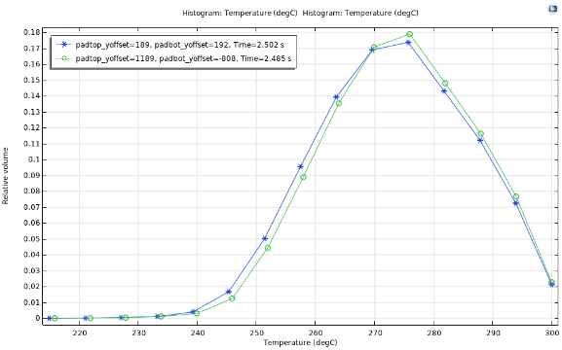
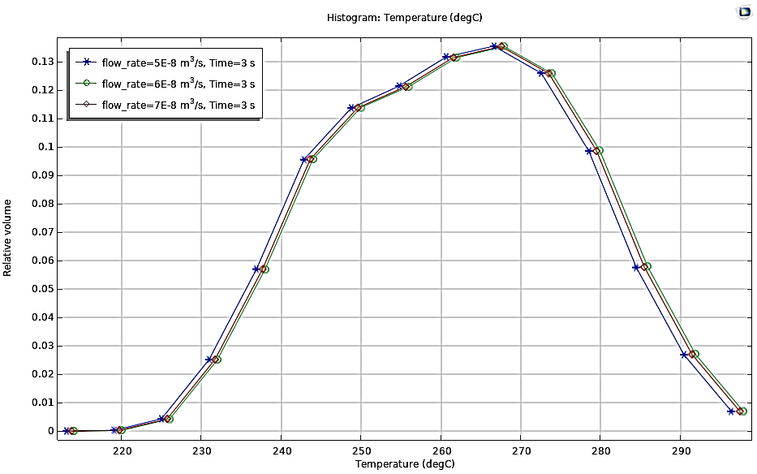
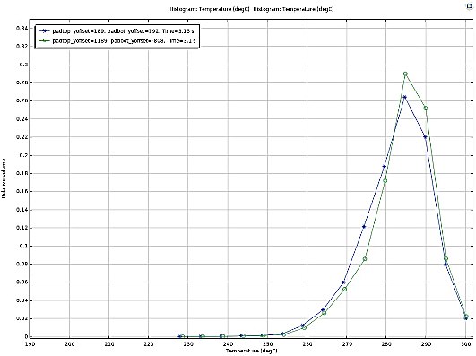
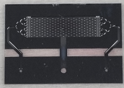
RESULTS SUMMARY – TEMPERATURE HISTOGRAMS
Flow speed impact is minimal on heating pulse
Optimized heater: Tenax® reaching 265-285°C in ~2.5s within >64% volume at ~23W (1)
Second configuration yields Tenax® reaching 275-295°C in ~3.1s within >84% volume (1-mask change) (2)
Vol. max
~18%
Vol. max
~13.5%
FWMH ~33°C
(1)
FWMH ~45°C
Vol. max
~29%
FWMH ~15°C
(2)

Slide 14
CONCLUSIONS & SIMULATION BENEFITS
CONCLUSION
Tenax® thermal/flow properties validated with
experimental values and literature data
A multi-physics model was implemented including flow, porous flow, heat transfer and electric current analysis
Parametric investigation was done and took for each simulation case 1h40m to solve
Optimized heating in Tenax®: reaches 265-285°C in ~2.5s within >64% volume at heating power of ~23W
Second configuration yields Tenax® reaching 275-295°C in ~3.1s within >84% vol. (1-mask) change
SIMULATION BENEFITS
Non-trivial design optimization of on-chip asymmetric heater design
Chip analysis of temperature rise time & volume % i.e. transient and spatially impacting factors
System estimate and optimization of time constant of cooling with the Peltier

Slide 15


