Slide 1
Improving The Design Process Of A MEMS-IR-Emitter
Toni Schildhauer, Andreas T. Winzer, Julia Baldauf

Slide 2

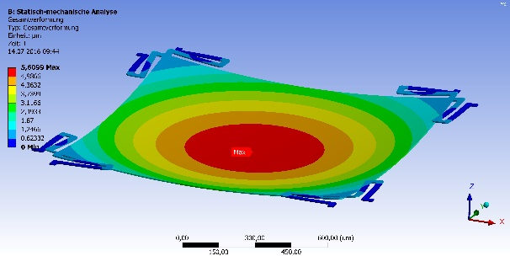
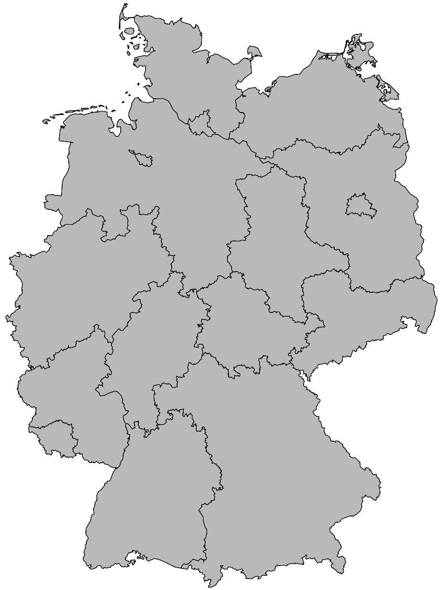
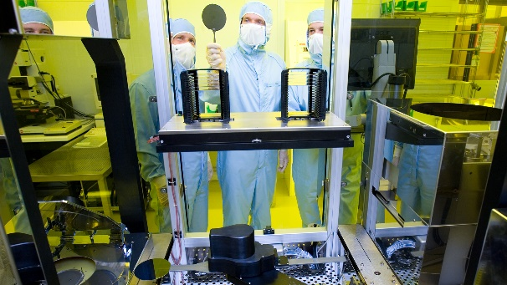
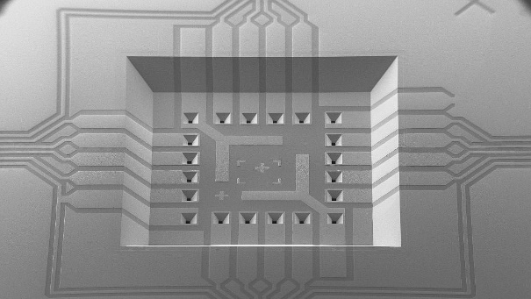
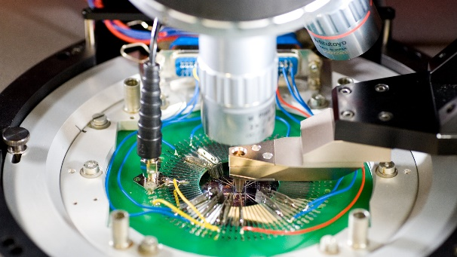
SHORT FACTS – „CiS Forschungsinstitut“
    Research institution in Erfurt, Thuringia, Germany
    Independent - non-profit - close to business
  16,5 MIO. € TOTAL OUTPUT IN 2022
    ~120 Employees
    52 % Public research projects
    48 % Industrial contract research
    and manufacturing
    No basic funding, only project funding
  TECHNOLOGICAL EXPERTISE
  In MEMS and MOEMS sensors
  Simulation
  & Design
  Wafer Technology
  & Manufacturing
  Packaging &
  Assembly
  Test &
  Analytics
→ MOEMS Development
and Prototyping
Notes:
Zum mal kurz drüber springen
service provider

Slide 3
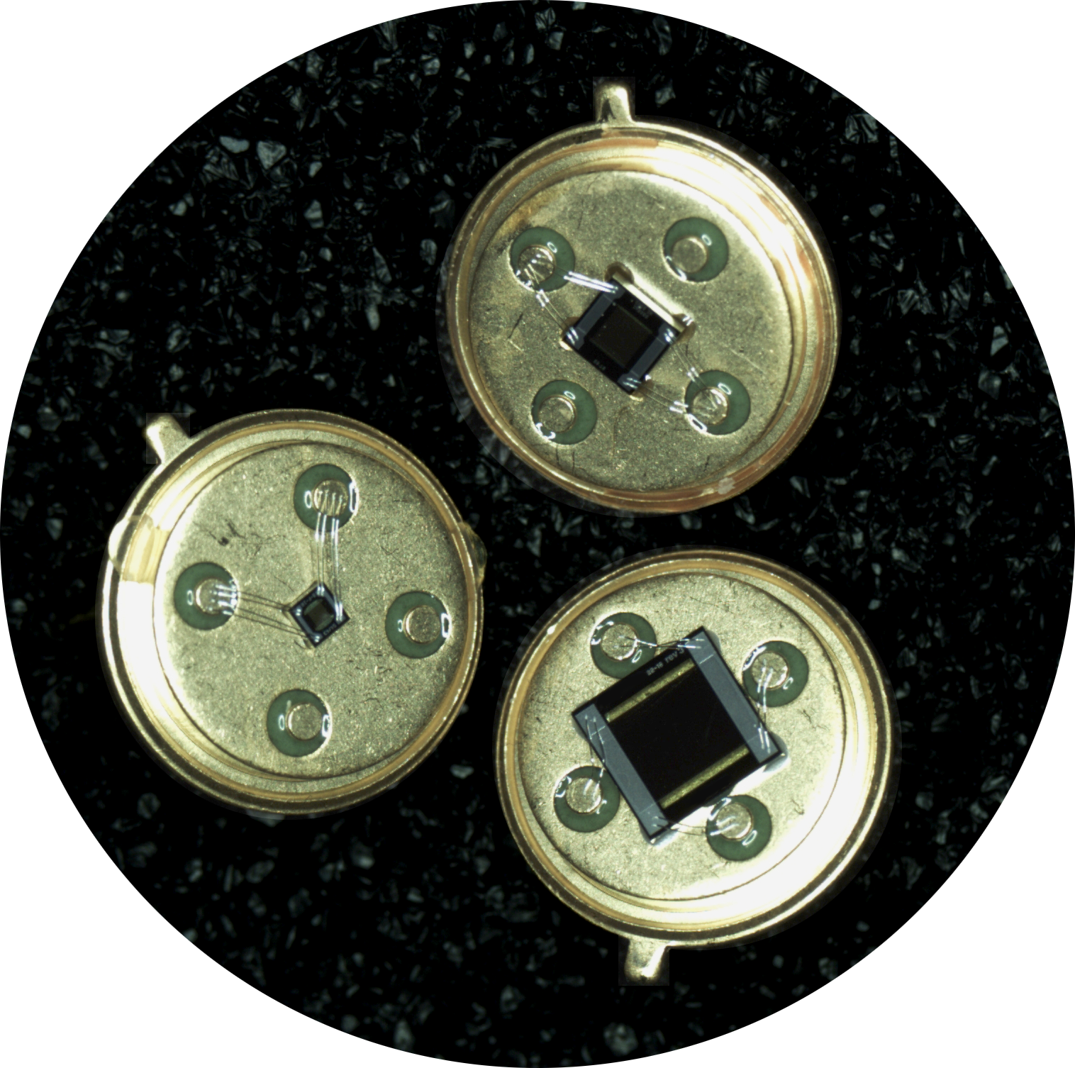
Background: IR-MEMS-Technology And Fabrication

Slide 4
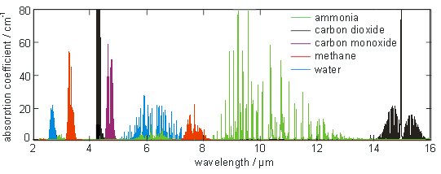
Background: IR-Emitter-Technology
Nondispersive Infrared Gassensor
Inlet
Outlet
(Pulsed)
IR-light source
Sample cell
Reference cell
Detector
with filter
Rogalski, Antoni & Chrzanowski, K. (2014). Infrared Devices And Techniques (Revision). Metrology and Measurement Systems. 21. 10.2478/mms-2014-0057
Notes:
Typical Life expectancy: 24h x 365 days x 5 years = 43‘800 h

Slide 5
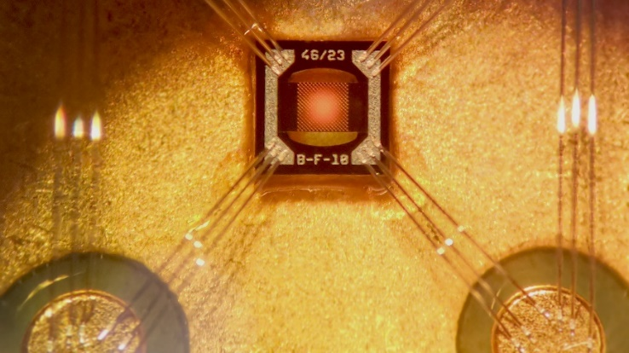
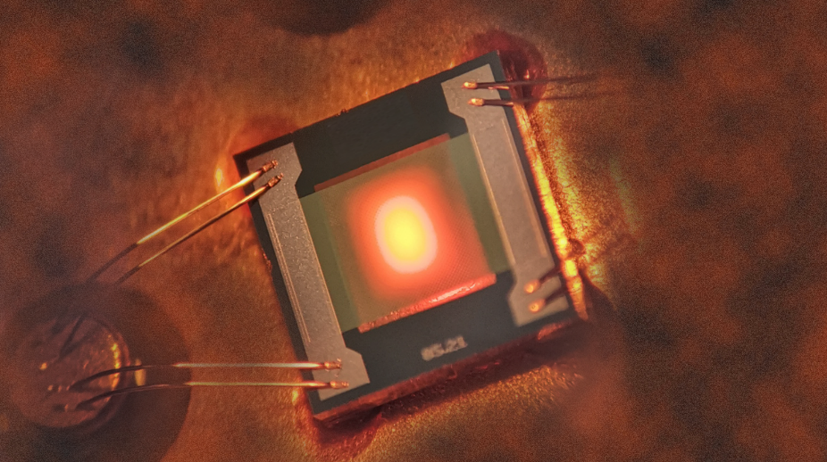
Background: IR-Emitter-Technology
800 °C
1 mm
+
-
< 150 °C
Ohmic Resistor
1 mm

Slide 6
M(O)EMS - Fabrication
Customer query
Design and technology flow
Clean room manufacturing
Wafer inspection and measurements
Assembling
Module testing (performance, life time, …)
1 month
3-6 month
1 week
2-4 weeks
3-6 month
Process development:
Try
Fail
Success = End
Approval, selling
Optimization potential

Slide 7
M(O)EMS - Fabrication
Customer query
Design and technology flow
Clean room manufacturing
Wafer inspection and measurements
Assembling
Module testing (performance, life time, …)
1 month
3-6 month
1 week
2-4 weeks
3-6 month
Process development:
Try
Fail
Success = End
Approval, selling
Optimization potential

Slide 8
M(O)EMS - Fabrication
SIMULATION
Customer query
Design and technology flow
Clean room manufacturing
Wafer inspection and measurements
Assembling
Module testing (performance, life time, …)
Analyze Current Product
1 month
3-6 month
1 week
2-4 weeks
3-6 month
Material Parameters?!
Process development:
Try
Fail
Success = End
SIMULATION
Approval, telling
Improve Design Process
Optimization potential

Slide 9
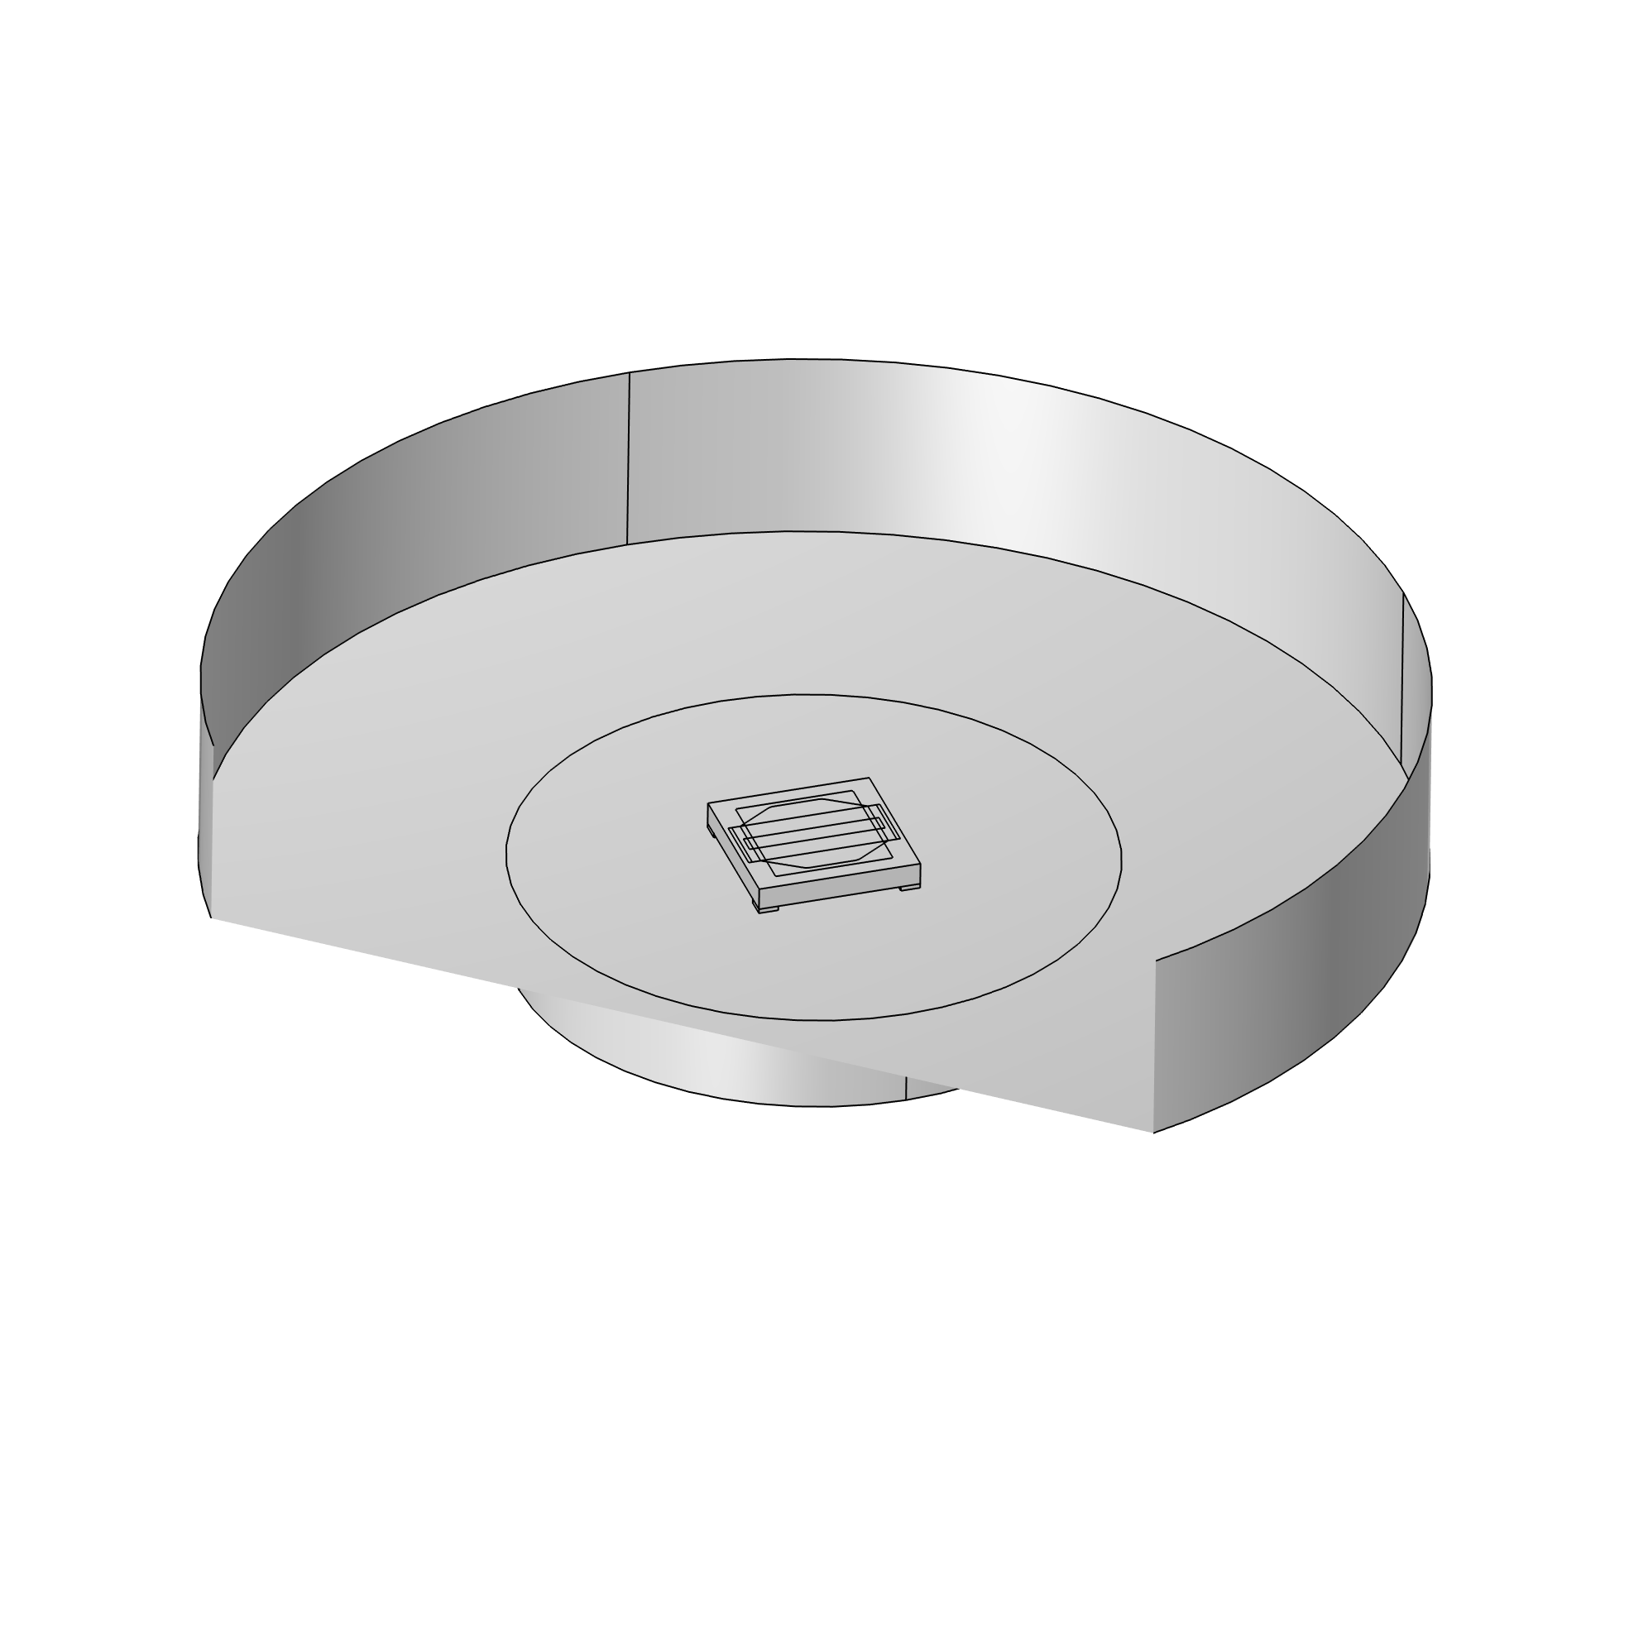
Building The Model
Challenge: Material Parameters Of Our Thin Layers

Slide 10


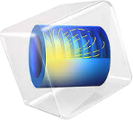

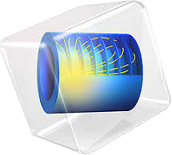

The Inverse Problem
forward calculation:
obtain the device characteristic
inverse calculation:
obtain the material parameters

Slide 11
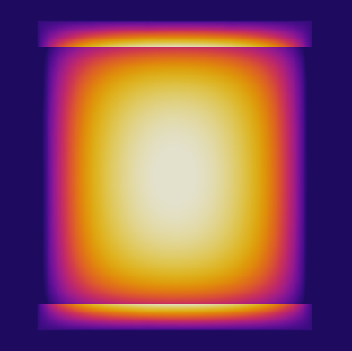
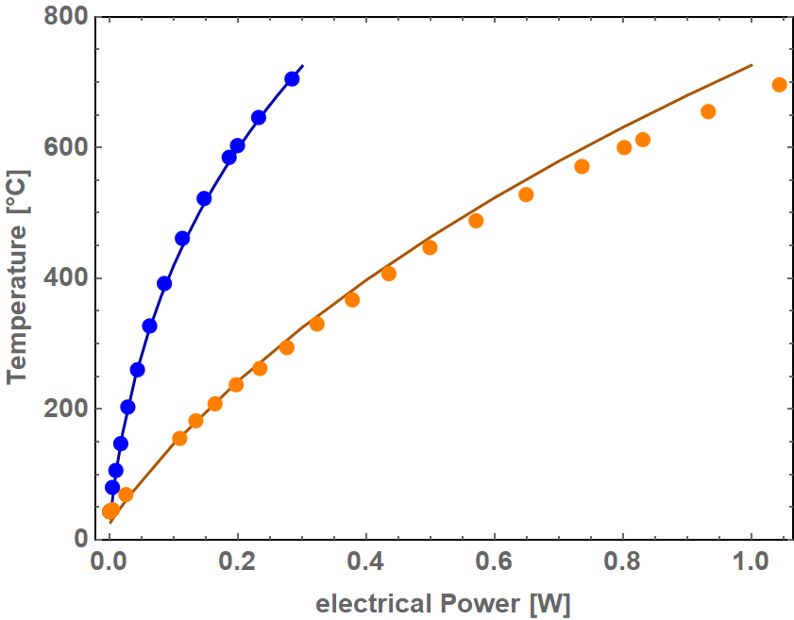
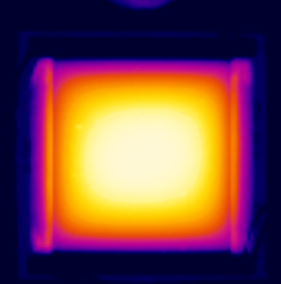
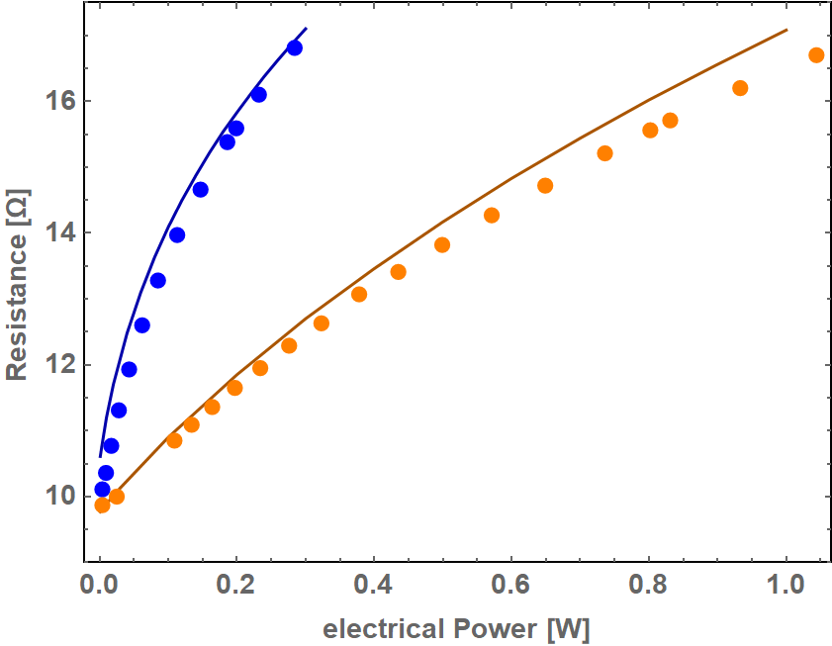
The Inverse Problem - Result
°C
630
150
Simulation
°C
630
150
Heat camera image

Slide 12
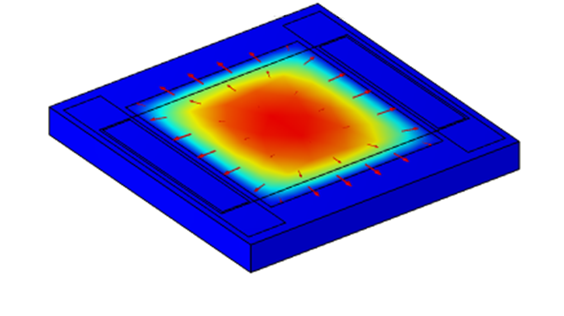
Using The Model In Design Processes

Slide 13
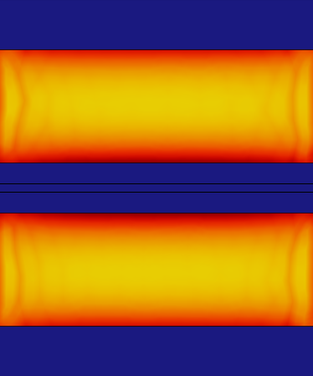
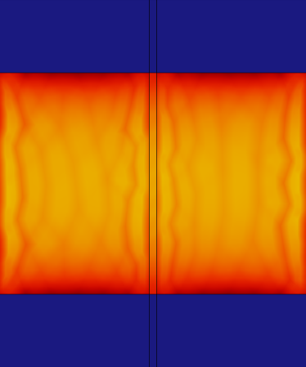
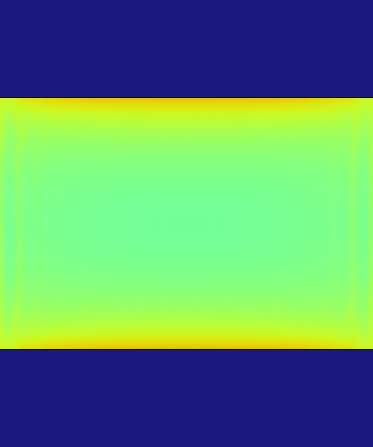
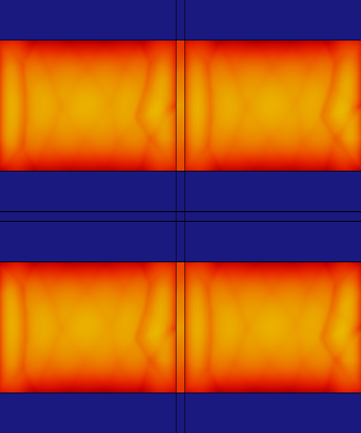






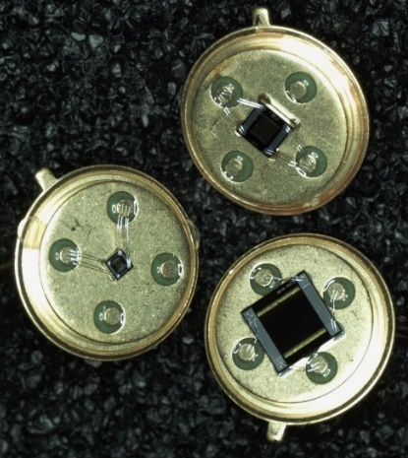
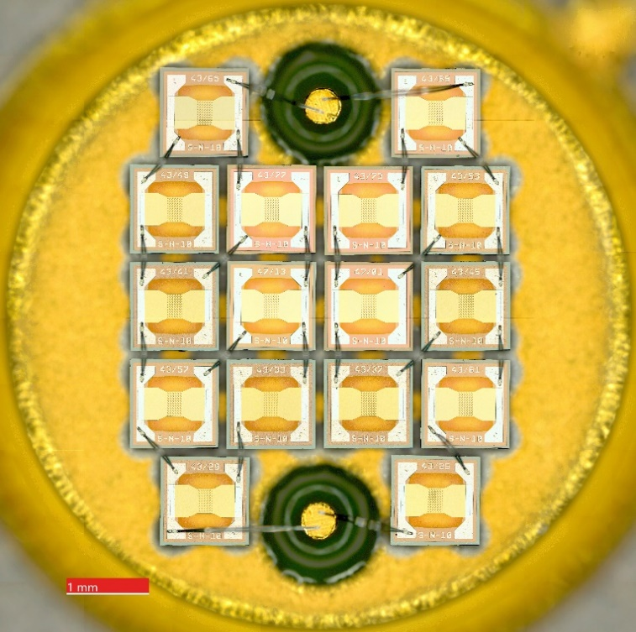
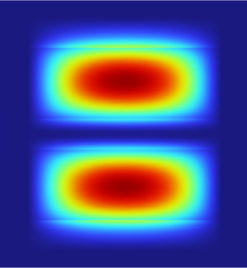


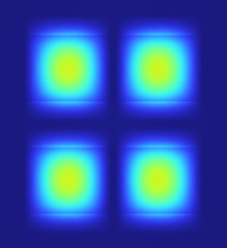

First Design Task
One lengthwise Beam
One crosswise Beam
Either bright or fast
  Fast
Big discrete parameter studies
  Good prediction, what is worth to manufacture
Smaller conductive Layer
Two crossed Beams
Current Design
A/m
140
130
Current Density
120
110
100
90
80
70
°C
700
Temperature
600
500
400
300
200
W/m²x10⁴
3
Radiosity
2
1
0

Slide 14
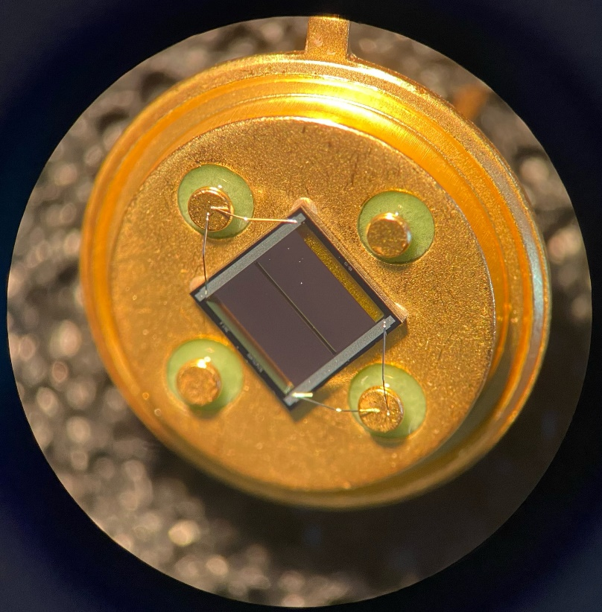
Helping In Design
Same life time in simulation
Simulation results
Notes:
I_{20Hz} 0.610 0.565 0.696 0.692
R_{650°C} 19.27 Ω 20.15 Ω 19.87 Ω 21.18 Ω

Slide 15
Helping In Design
Same life time in simulation
Simulation results
Better than expected
Notes:
I_{20Hz} 0.610 0.565 0.696 0.692
R_{650°C} 19.27 Ω 20.15 Ω 19.87 Ω 21.18 Ω

Slide 16
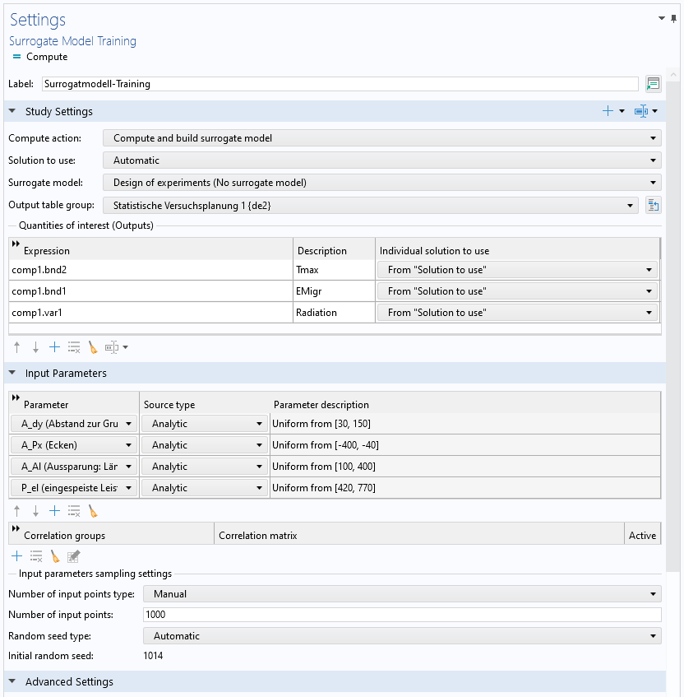
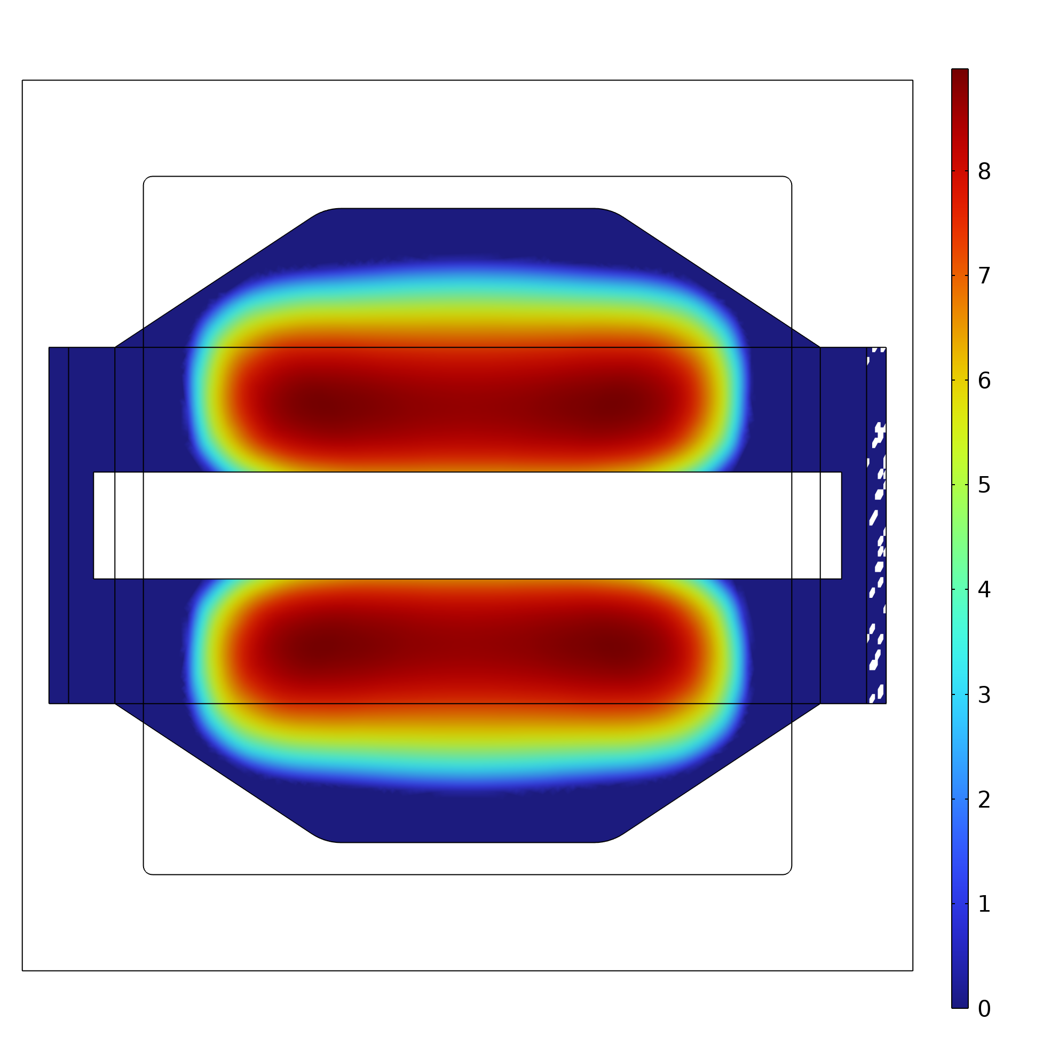
Improve Design Process With Surrogate Modelling
3 geometrical parameters + applied electrical power
In parameter study only discrete combinations
Surrogate Modelling
Log(Ionic Flow)

Slide 17
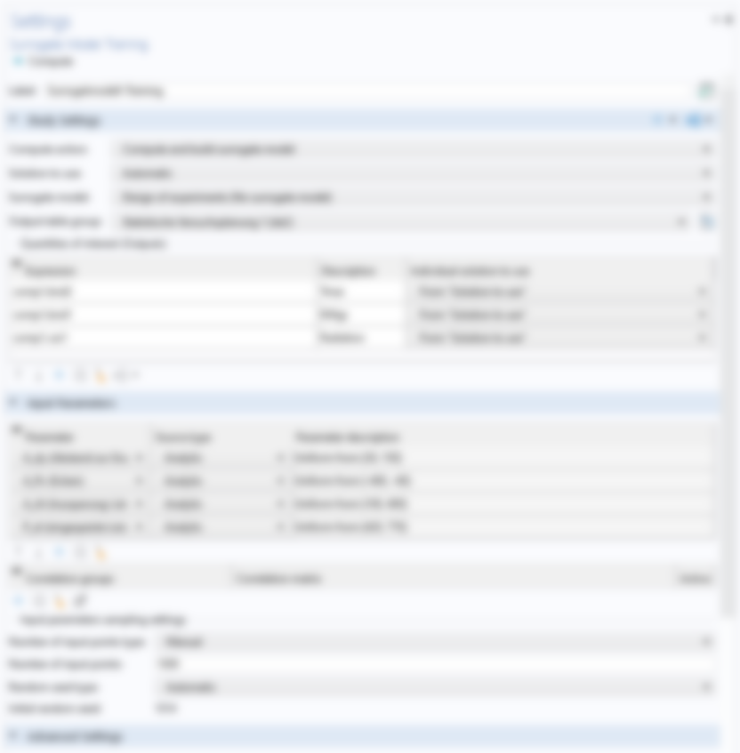
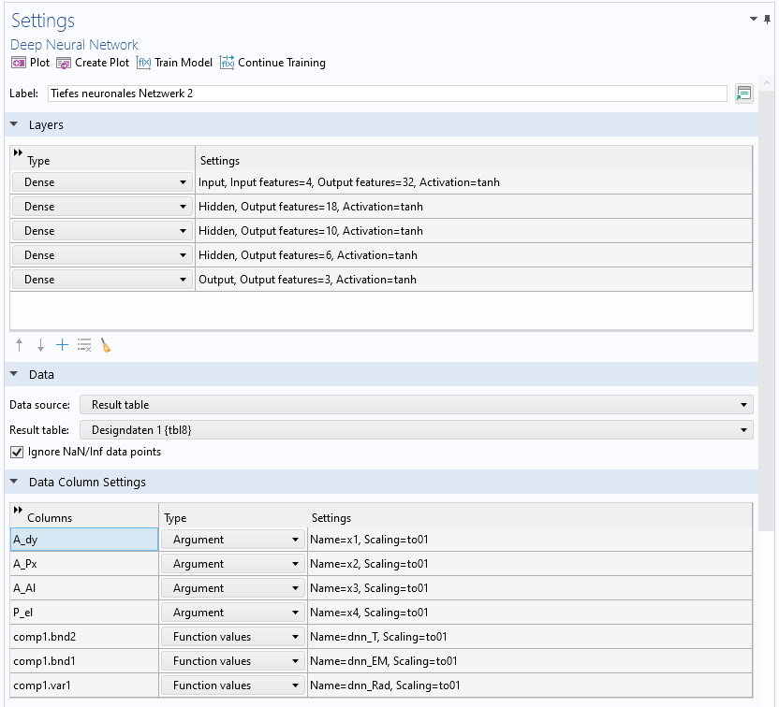
Improve Design Process With Surrogate Modelling
3 geometrical parameters + applied lectrical power
In parameter study only discrete combinations
Surrogate Modelling
Log(Ionic Flow)

Slide 18
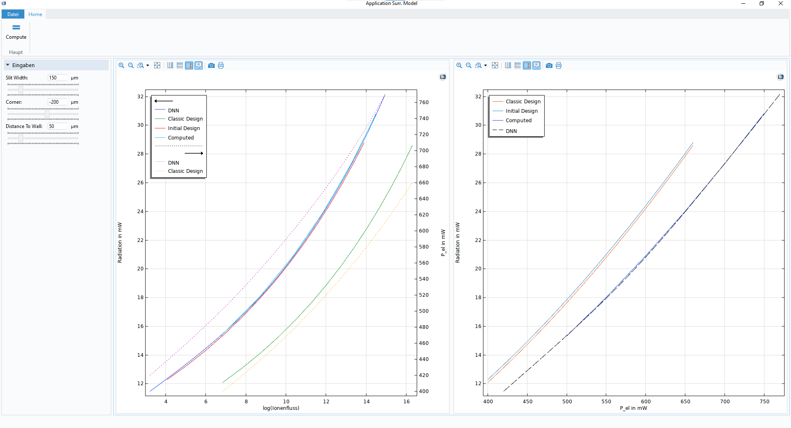

Application For Better Visualation
log(Ion Flux)

Slide 19
Conclusion
Model building of existing technology without knowing exact material parameters
New evaluation of current designs
  Life time prediction
Developing new designs
  Better preselection of design worth manufacturing
  Surrogate Modelling allows steplessly adjustable parameters

Slide 20

Thank you for your attention!
Toni Schildhauer tschildhauer@cismst.de
QSolid
Funding code: 13N16172

Slide 21
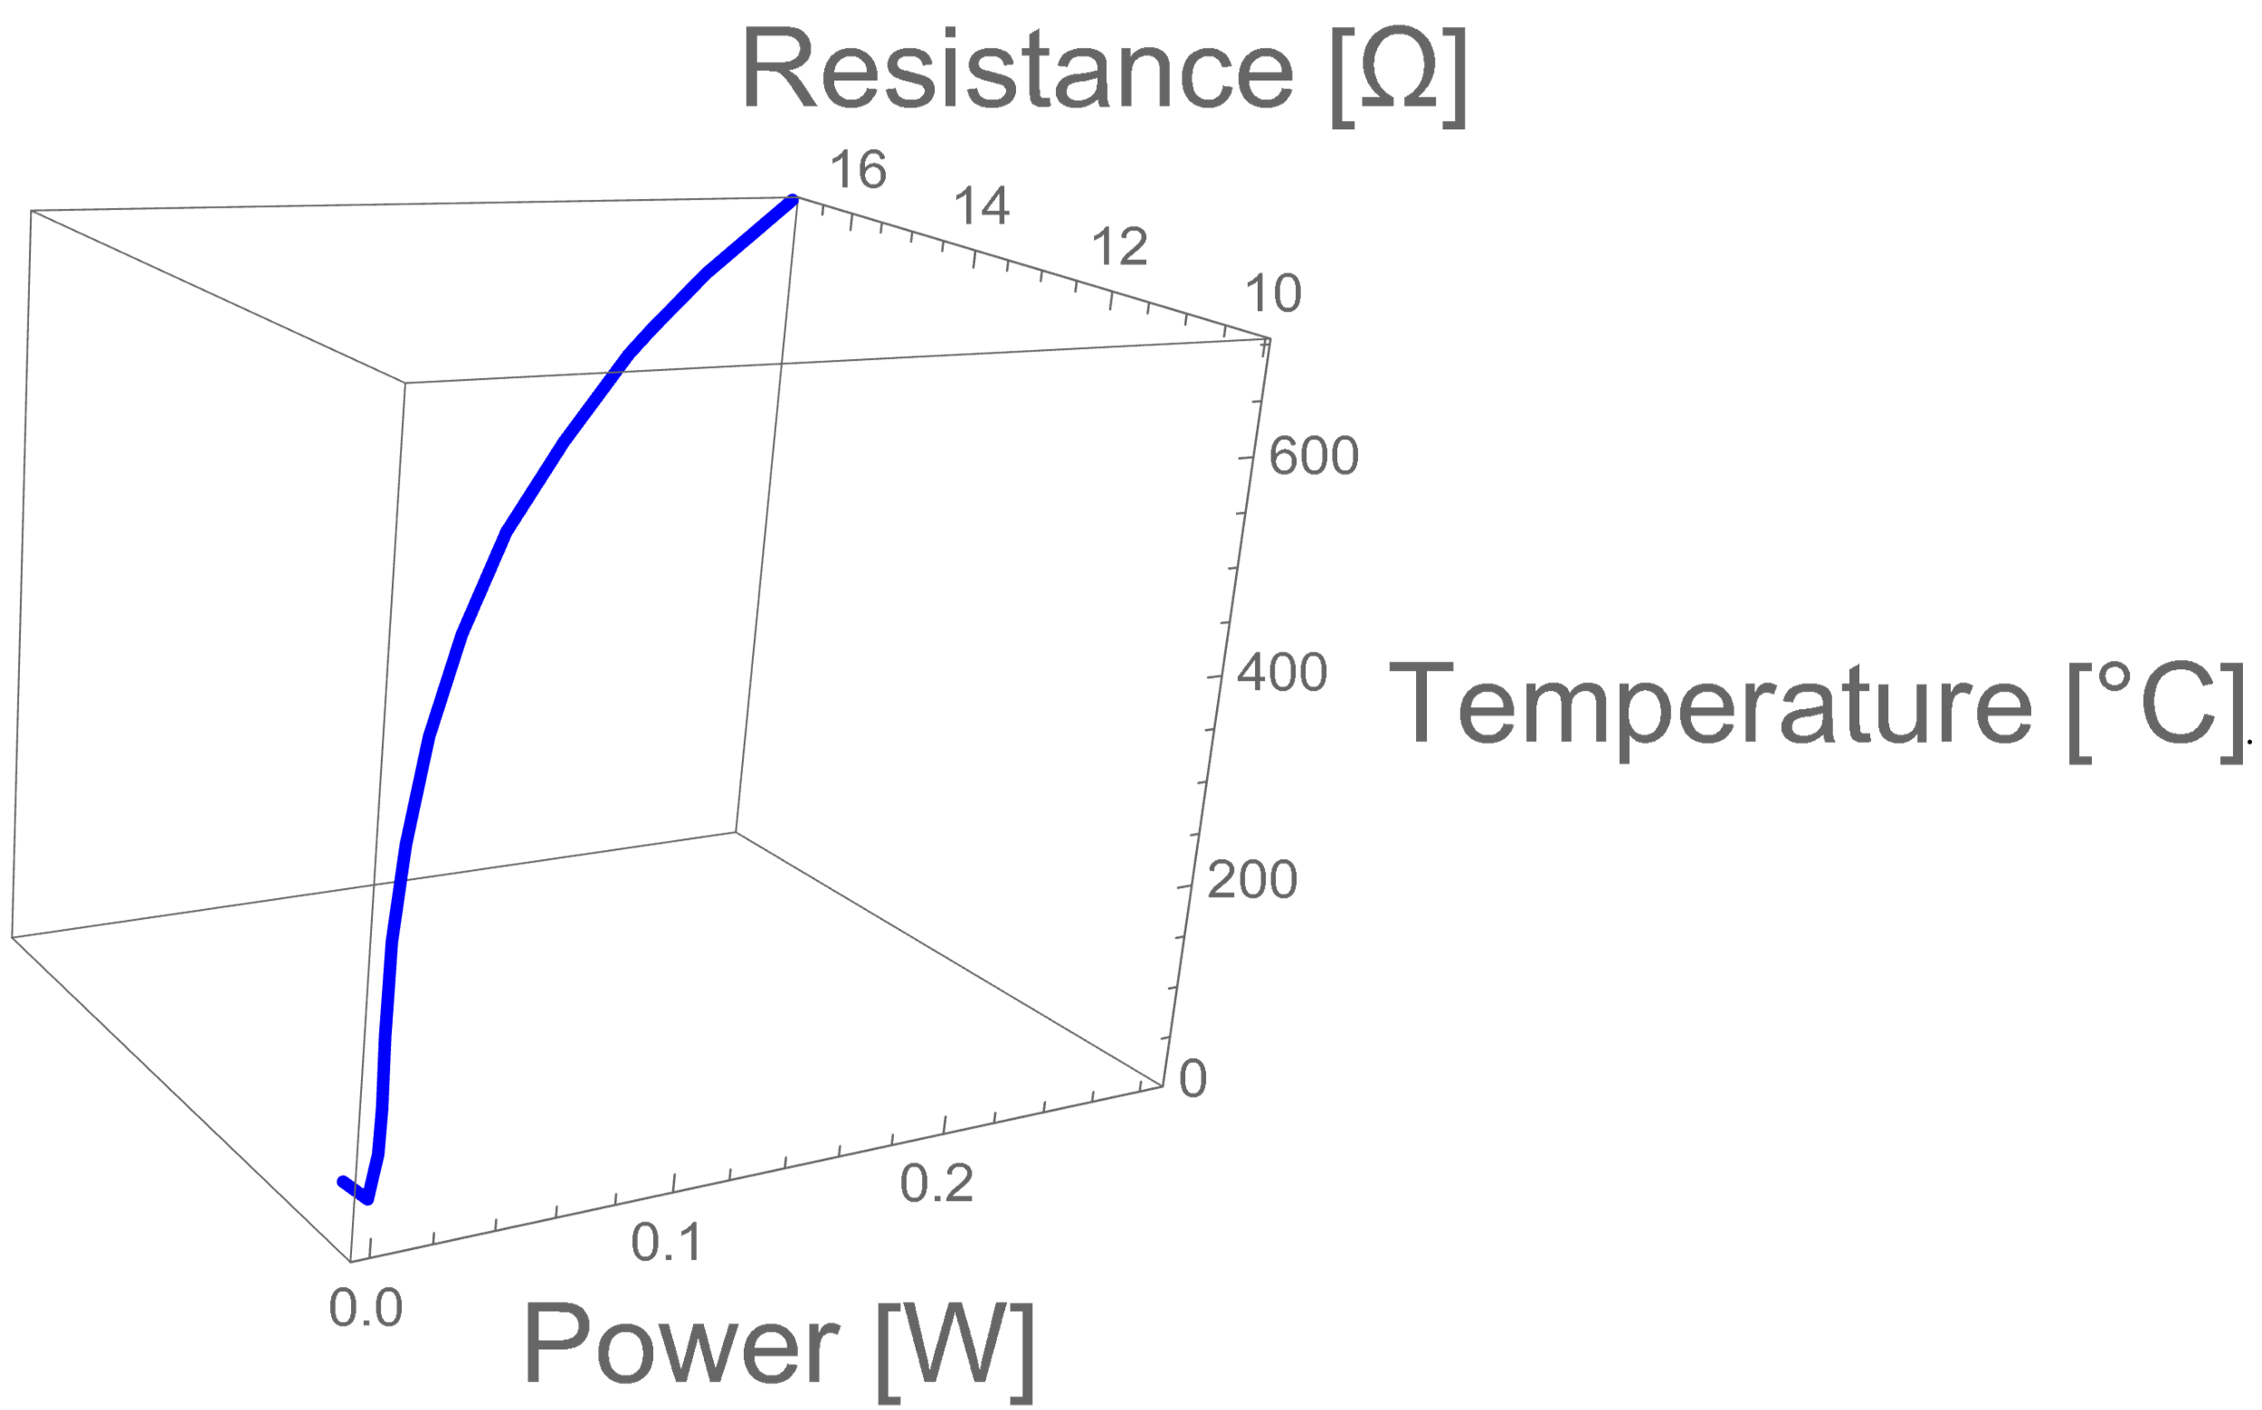
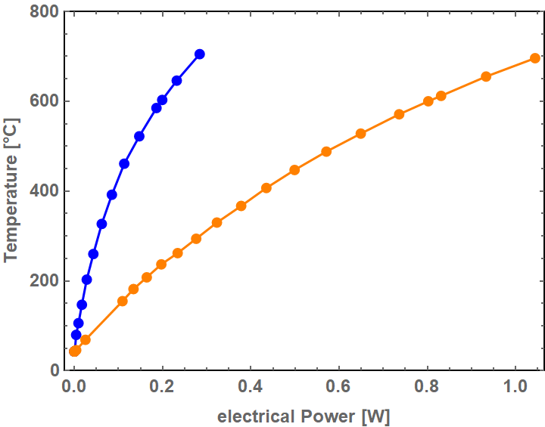

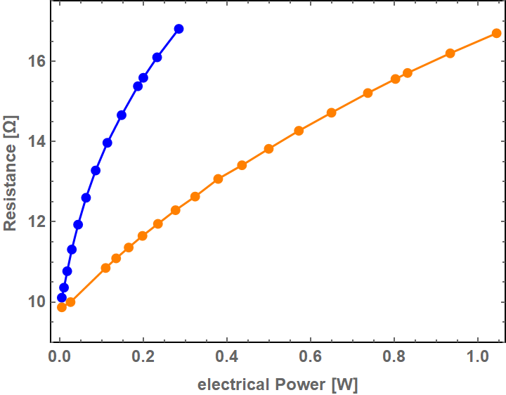

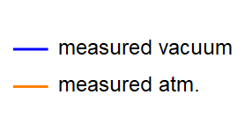
Verification experiment
Unknown parameters:
Temperature dependent resistance
Temperature dependenent thermal conductivity
Remove influence of thermal conduction and convection by air
Vacuum container
Source measure unit
Turbo pump
+
-
Notes:
Temperaturmessung?

Slide 22
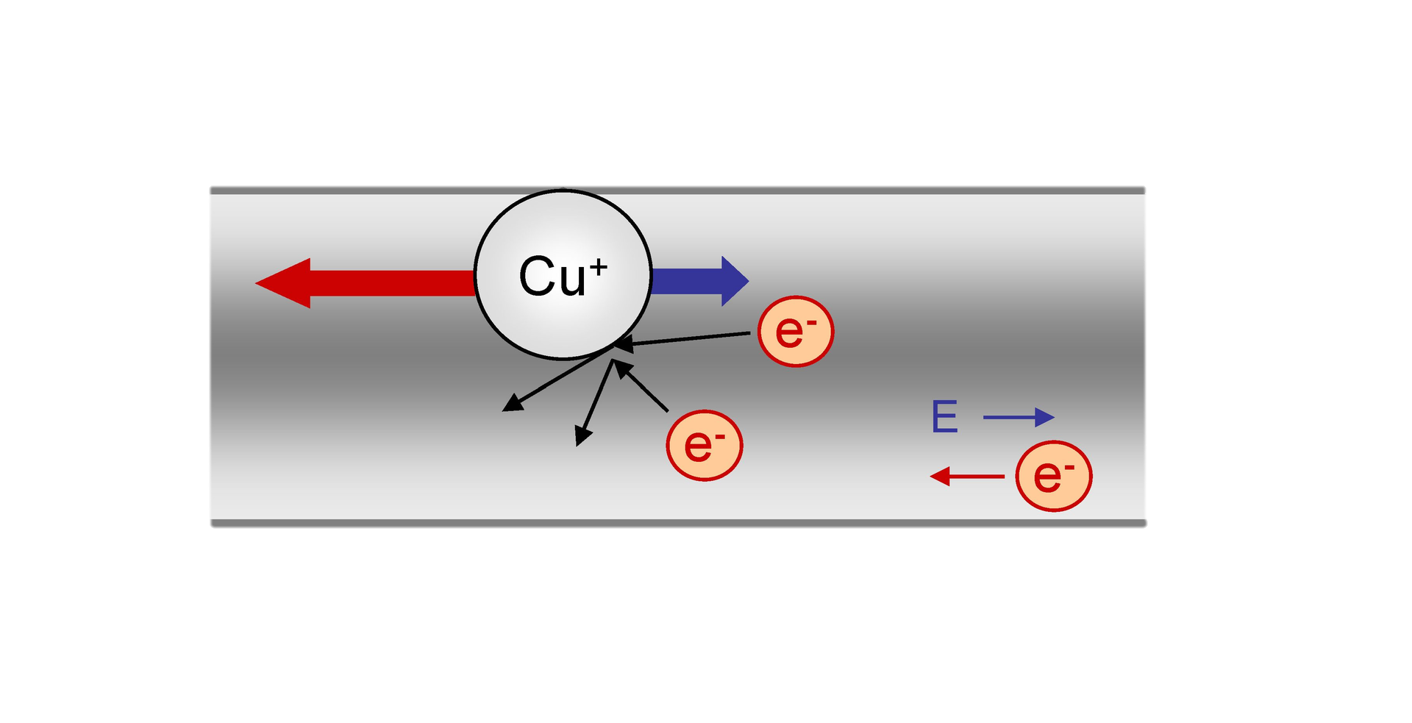
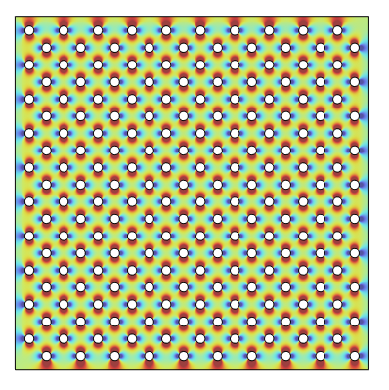
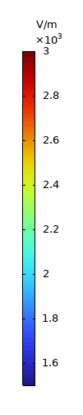
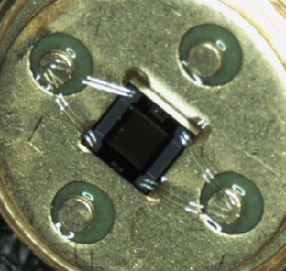
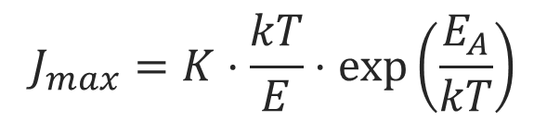
Life Time Modeling
+
-
Dominant failure mechanism is Electromigration
K - summarized material properties, k - Boltzmann constant,
T - Temperature, E_{A} - Activation energy, E - Electric Field
$$J_{max}=K⋅\frac{kT}{E}⋅\exp\left(\frac{E_{A}}{kT}\right)$$
https://commons.wikimedia.org/wiki/File:Electromigration.png
Authour: Linear 77, Source: Own work
Analyzing current design
with perforated conductive layer
E-Field of the IR-emitter

