Slide 1
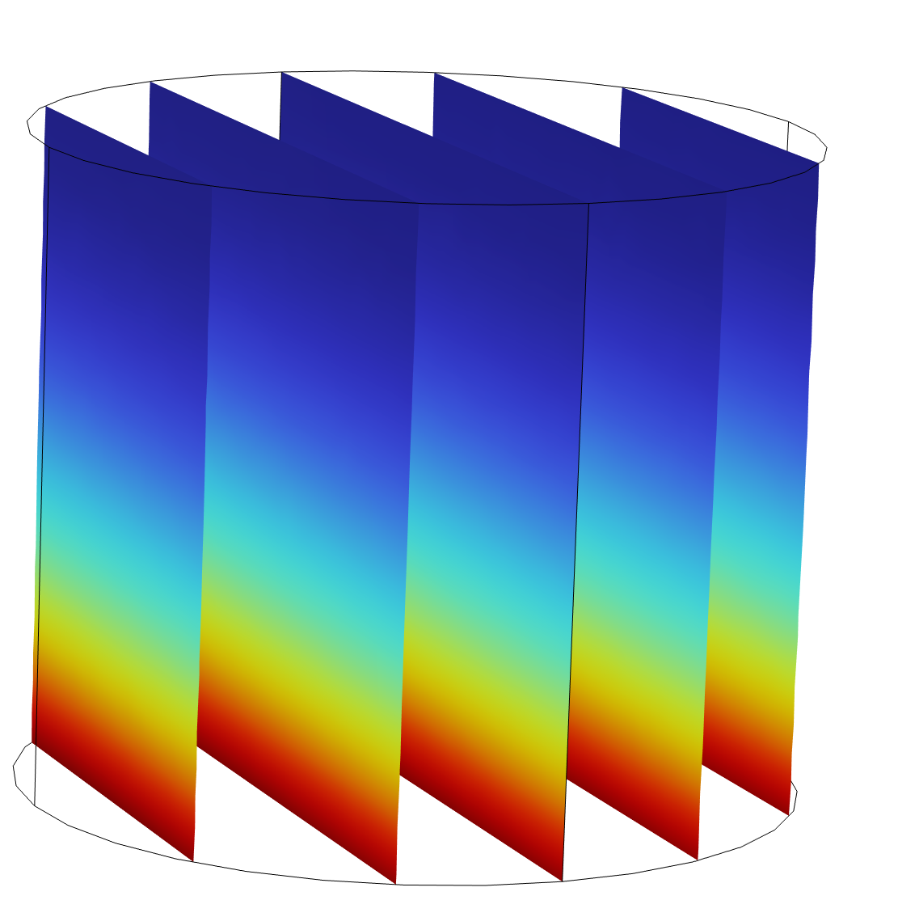

Implementing a new type of boundary condition using the COMSOL Physics Builder
Michael Kröhn, GRS
22nd October, 2024
COMSOL Conference, Florence

Slide 2
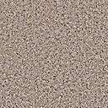
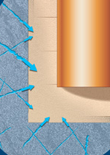
Introduction
Swedish deposition concept: KBS-3
  Excavation of the deposition tunnel
  Drilling of the deposition boreholes
  Installation of bentonite blocks and waste cannisters
  Filling of the deposition tunnel
Planned development:
  Waterflow through fractures towards the cannisters

Slide 3
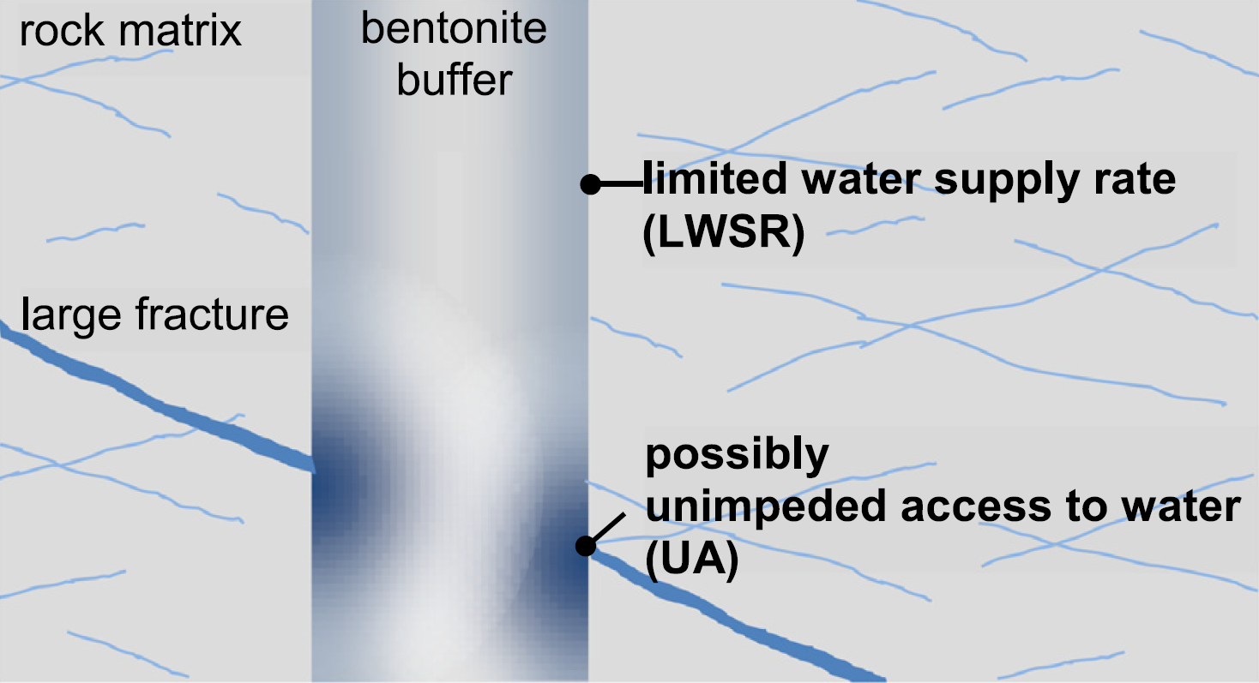
Introduction

Slide 4

Experimental set-up
Bentonite sample
Compacted from granular material
target density (air dry): 1450kg/m³
initial water content: ~12.74 %
Syringe pump
  pump rate: 0.01 – 99.99 ml/h
  accuracy: 2.5 % (for intervals > 1 h and pump rates > 2 ml)
  obstruction alarm at 0.3 bar
41.6 mm
⌀50mm
0,01 ml/h

Slide 5
Workflow for creating an own COMSOL Interface
Coupling with Heat Transfer in Porous Media Interface
Adding Neumann boundary condition
Theory
1
2
3
4
5
Implementation in COMSOL Physics Builder
Comparison with non-isothermal experiment data

Slide 6
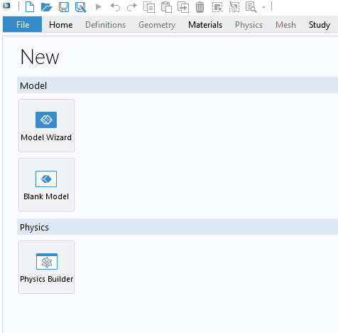
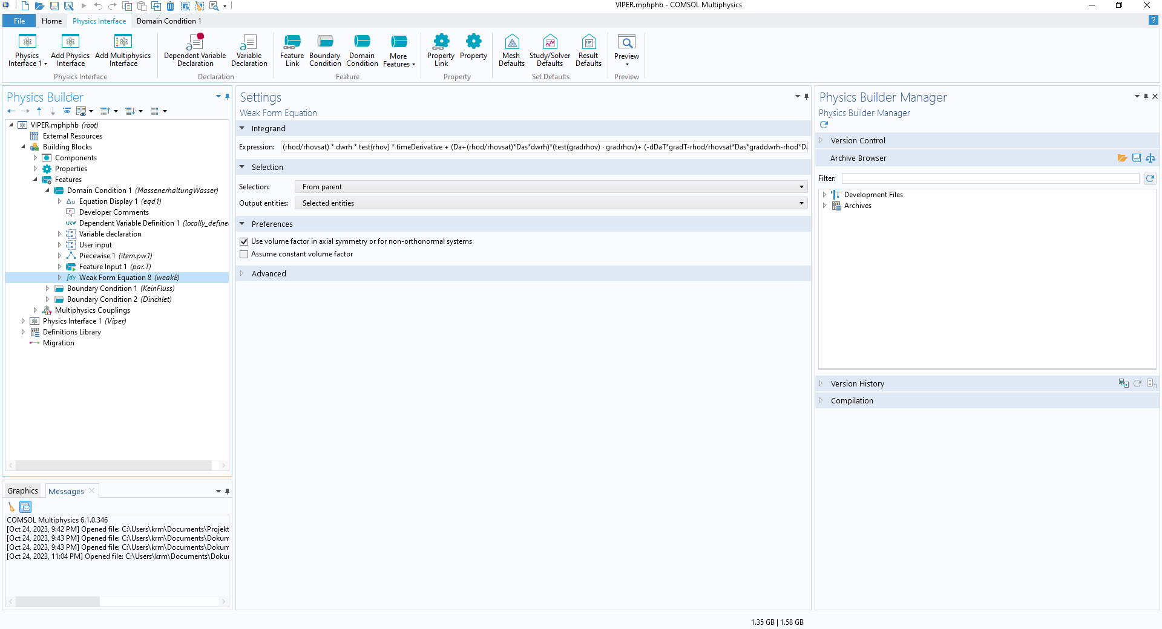
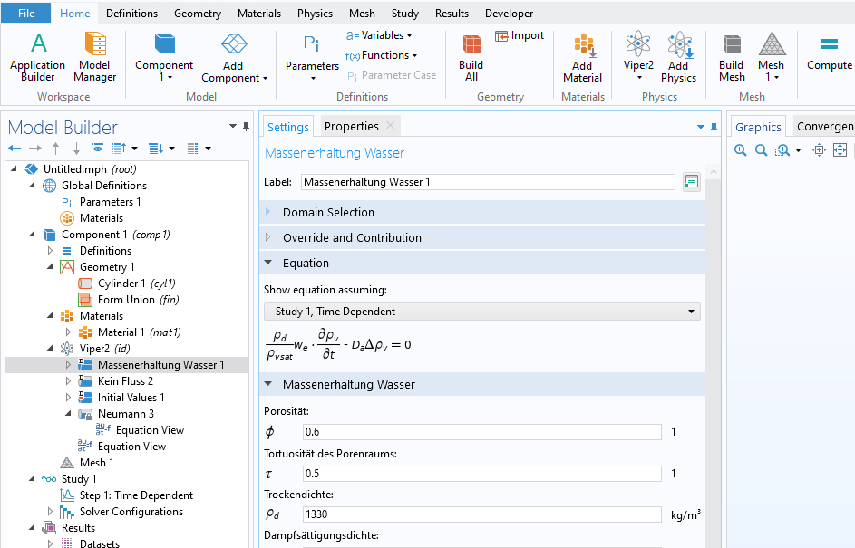
COMSOL Physics Builder

Slide 7
COMSOL model geometry
Boundary condition: Neumann condition
Boundary condition: no flow
Inflow between 1,41*10⁻⁶ and 7,07*10⁻⁶ kg/m²s

Slide 8
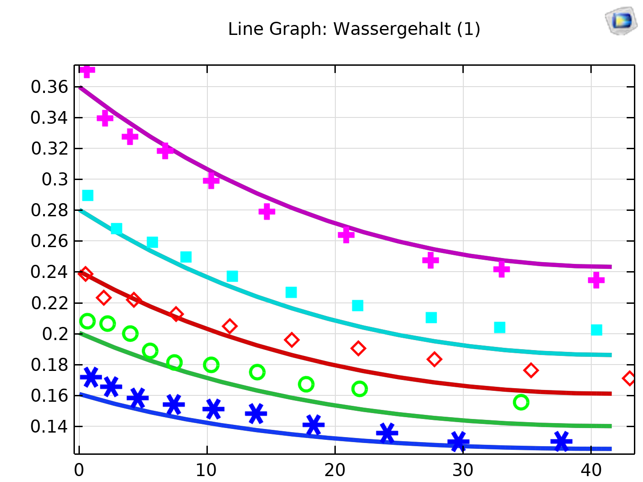
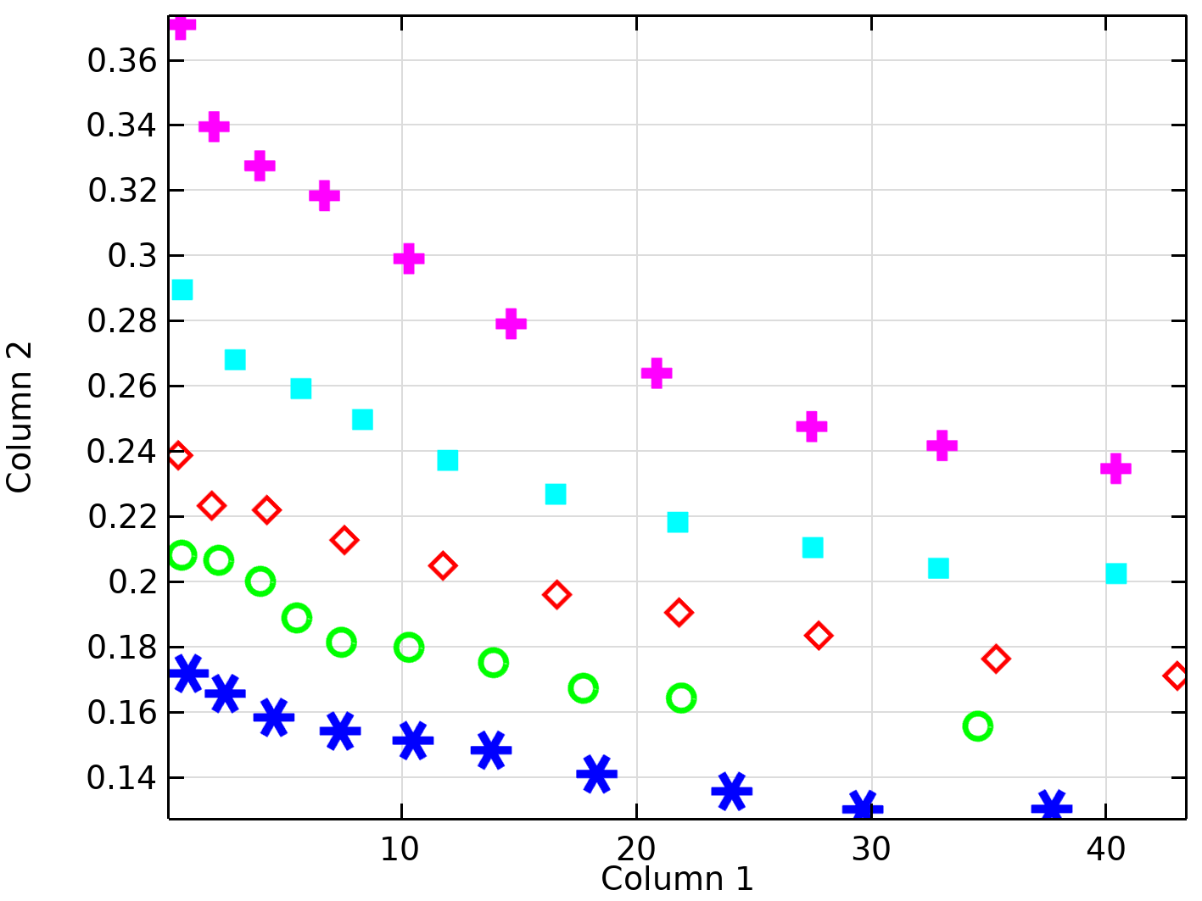
Comparison of measurement and simulation results
1 Week
2 Weeks
3 Weeks
4 Weeks
6 Weeks
watercontent
length [mm]

Slide 9
Conclusions
Results:
Successful implementation of Neumann boundary condition
Promising first simulations
Whats next:
Checking against other test scenarios
Advancing simulation capabilities
  Switching from Neumann to Dirichlet condition when full saturation is reached at the boundary
  Adapt the diffusion coefficient of the interlayer according to the water content

Slide 10
Thanks for your attention

