Slide 1

Impact of Battery Operation and Manufacturing Process on Battery Performance over Lifetime
Thomas Bisgaard, Senior Simulation Specialist
André Gugele Steckel, Modelling Specialist
Martin Refslund Nielsen, Chief Commercial Officer, Robust Design Expert, and Partner

Slide 2






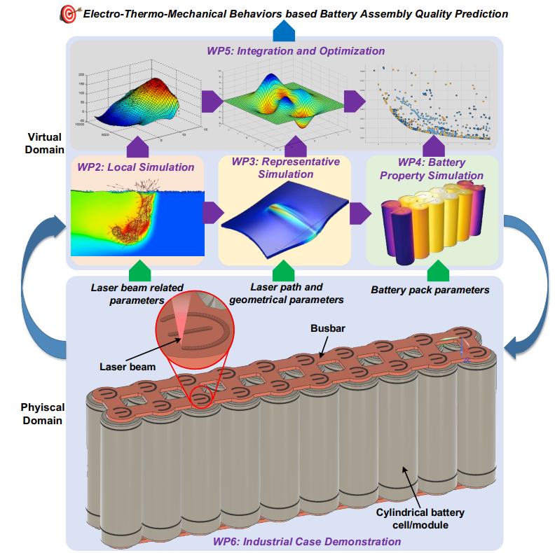

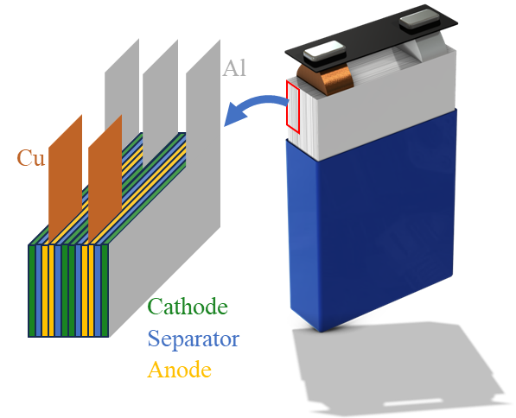

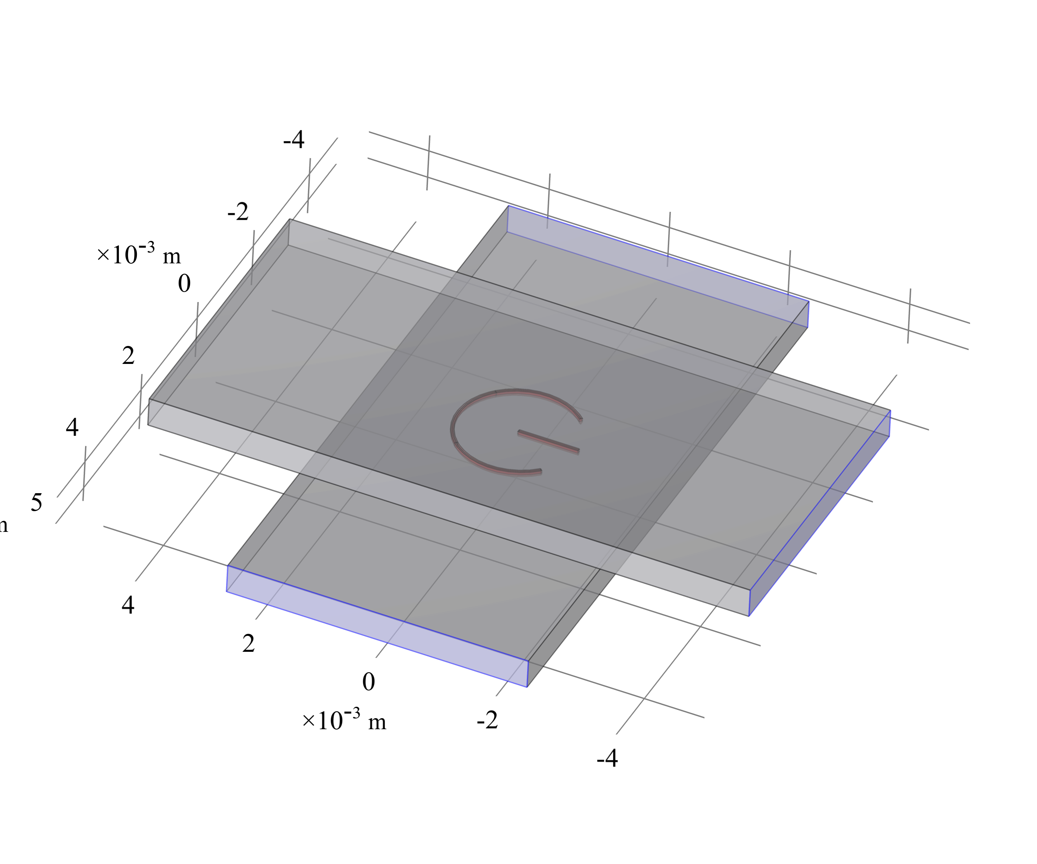
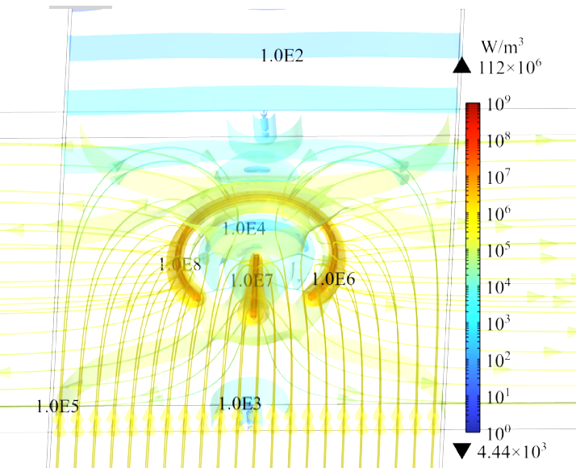




Project Goals
Battery cell performance
PRESENTATION
& POSTER
Busbar/tab joint performance
PRESENTATION
Andre G. Steckel
System performance
PRESENTATION
Design Tool
Martin R. Nielsen

Slide 3
Electrochemical Battery Model
Anode
Electrolyte (Li)/solvent
External circuit
External circuit
Cathode
e⁻
Graphite particle
e⁻
Li
Li⁺
PF₆⁻
Li⁺
Metal oxide particle
Li
Li
Li⁺
Li⁺
PF₆⁻
PF₆⁻
(Li)NiMnCoO₂
EC
Li⁺
“Degradation” layer
EC
Anode
Separator
Cathode
Li⁺
Lithium diffusion
Degradation
Intercalation
Electric current distribution
Ionic current distribution

Slide 4
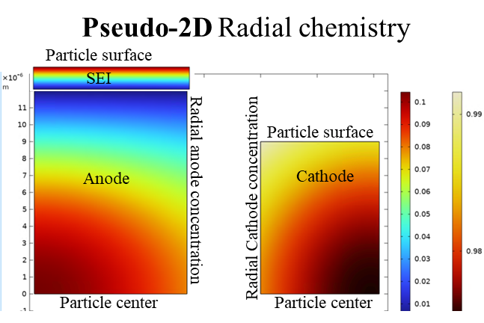
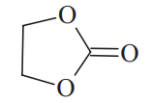



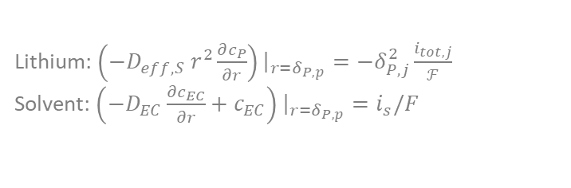


Electrochemical Battery Model
Solvent diffusion through SEI layer
EC concentration at particle surface
Solvent (EC)
$$\frac{∂c_{EC,P}}{∂t}=\frac{∂}{∂r}\left(D_{EC,P}\frac{∂c_{EC,P}}{∂r}\right)−\frac{dδ_{SEI}}{dt}\frac{∂c_{EC,P}}{∂r}$$
Anode particle
$$\frac{dδ_{SEI}}{dt}=−\frac{i_{s}}{2ℱ}\frac{M_{SEI}}{ρ_{SEI}}$$
Reaction on particle surface
SEI Layer formation$2EC+2e^{−}+2Li^{+}→SEI+C_{2}H_{4}\left(g\right)$
$$i_{s}=−Fk_{f,s}c_{EC}\exp\left[−\frac{βF}{RT}\left(φ_{S,n}−\frac{δ}{κ_{SEI}}i_{tot}\right)\right]$$
Spherical Electrode Particles
Degradation kinetics:
Intercalation $LiC_{6}\left(s\right)↔C_{6}\left(s\right)+Li^{+}\left(soln\right)+e^{−}$
$$i_{int}=i_{int,0}⋅2\sinh\left[\frac{0.5F}{RT}\left(φ_{S,n}−φ_{E,n}−U_{0,n}−\frac{δ}{κ_{SEI}}i_{tot}\right)\right]$$
√ Loss of lithium inventory
√ Temperature
√ Current density
√ State-of-charge
Li⁺
Total$i_{tot}=i_{s}+i_{int}$
Mass balance in particle surface:
Lithium: $\left(−D_{eff,S} r^{2}\frac{∂c_{P}}{∂r}\right){\left.​\right|}_{r=δ_{P,p}}=−δ_{P,j}^{2}\frac{i_{tot,j}}{ℱ}$
Solvent: $\left(−D_{EC}\frac{∂c_{EC}}{∂r}+c_{EC}\right){\left.​\right|}_{r=δ_{P,p}}=i_{s}/F$
Safari et al., Journal of The Electrochemical Society, 156 3 A145-A153 2009.

Slide 5
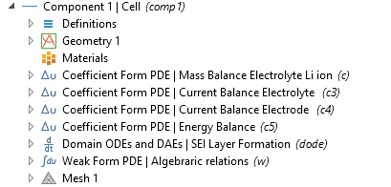
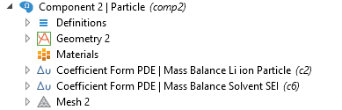
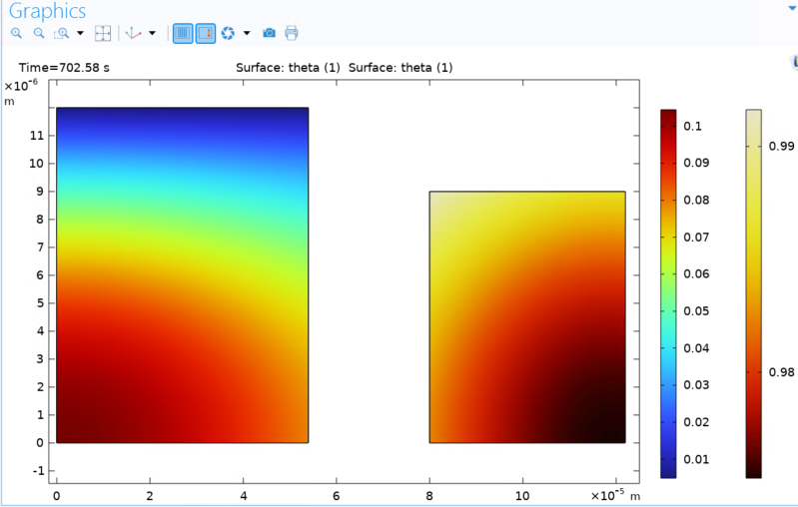
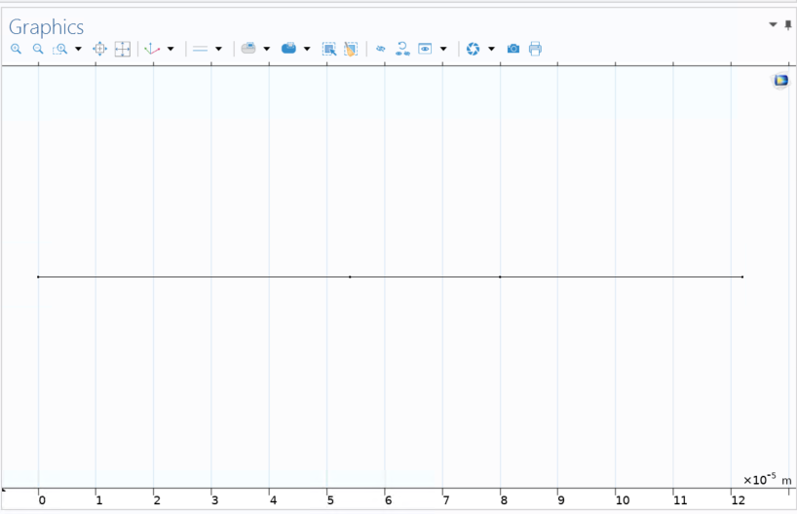
COMSOL Implementation
Electrochemistry & Degradation
Particle and SEI Layer Diffusion
Lithium mass balance
Lithium mass balance
Current balance
Degradation
Heat balance
Degradation
Particle surface
Particle surface
Anode
Cathode
Domain Mapping
2D
Radial anode concentration
1D
Radial Cathode concentration
Anode
Separator
Cathode
Particle centre
Particle centre

Slide 6
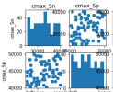

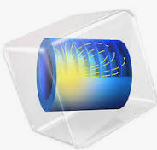
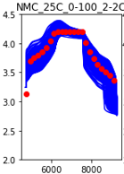



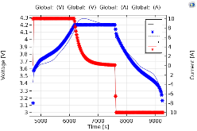
COMSOL Implementation
Parameter set Sample generation
LHS Samples
Simulation Timeseries data
COMSOL Multiphysics
Python
SALib [1]
csv file
csv file
Post processing
Experimental Timeseries data
Cost Functions
Python
SALib [1]
Experimental data
csv file
Battery Archive [2]
csv file
Stop Signal
Final simulation
Simulation instance manager
Analysis
csv file
COMSOL
Windows /COMSOL [3]
Model Builder
Application Builder
[1] https://salib.readthedocs.io/en/latest/ ; [2] www.batteryarchive.org; [3] COMSOL documentation

Slide 7
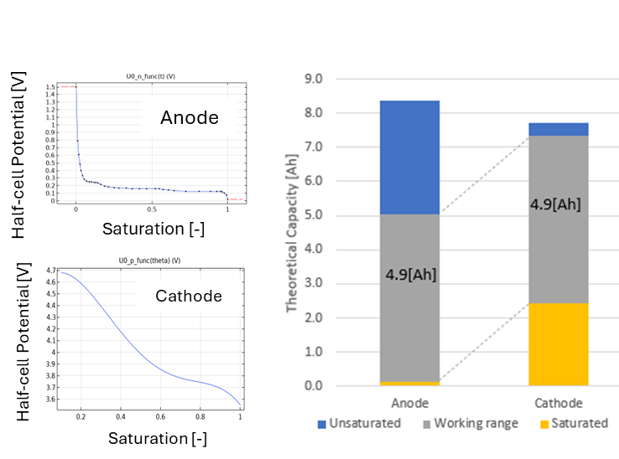
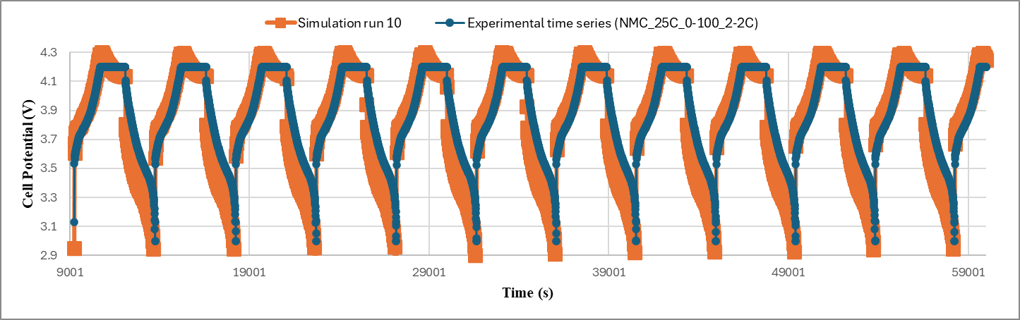
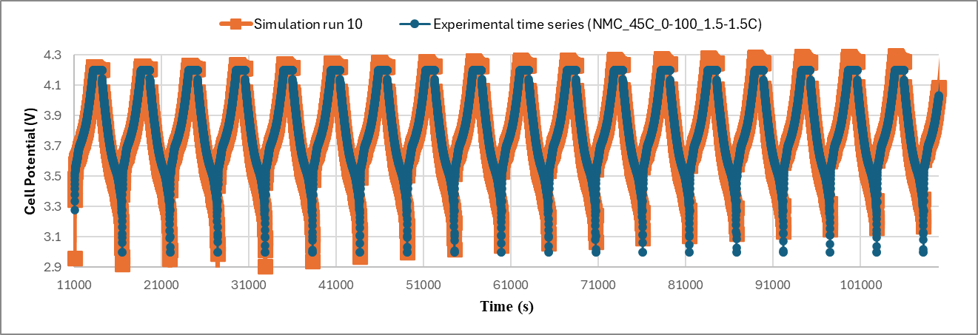




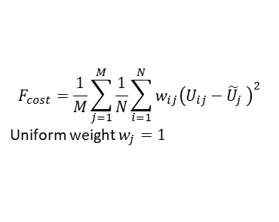

Parameter Fitting Method
Pre-Cycling
Open cell voltage
Half cell voltage
SEM micrographs
Design /Manufacturer data
First-principles parameters
1. Sample
$N$ samples
2. Simulate
$M$ datasets
Single Cycle (“Fresh”)
System parameters
Temperature dependent kinetics and diffusion
3. Evaluate
Fresh battery
Time-potential-current time series data
Charge /Discharge /Rest
Varying conditions (temperature, C-rates, SOC min /max)
$$F_{cost}=\frac{1}{M}\sum_{j=1}^{M}{\frac{1}{N}\sum_{i=1}^{N}{w_{ij}{\left(U_{ij}−{\tilde{U}}_{j} \right)}^{2}}}$$
Uniform weight $w_{j}=1$
$$\left(k_{n},E_{kn}\right),\left(k_{p},E_{kp}\right),$$
$$\left(D_{n},E_{Dn}\right),\left(D_{p},E_{Dp}\right),$$
$$R_{cell}$$
No
Acceptable $F_{cost}$?
Multiple Cycles
System Parameters
Degradation
Yes
Multiple cycling data
Time-potential-current time series data
Charge /Discharge /Rest
Varying conditions (temperature, C-rates, SOC min /max)
Finish
$$D_{EC,SEI}$$
$$k_{SEI}$$

Slide 8
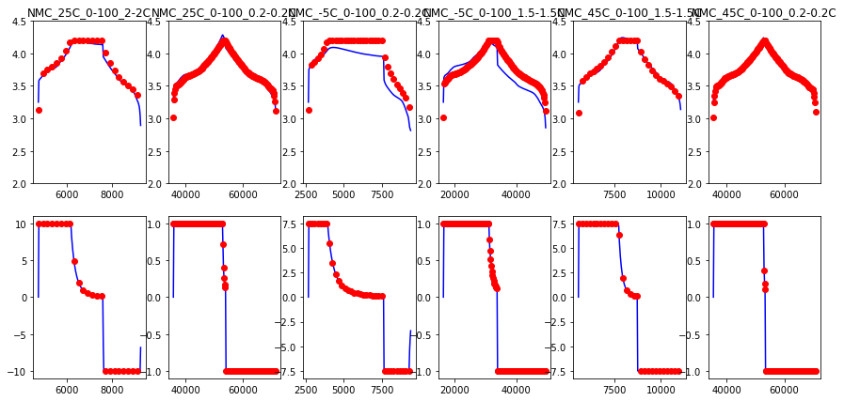
Expected vs Obtained Results
Medium temp. 25°C
Low temp. -5°C
High temp. 45°C
High current
2C/2C
Low current
0.2C/0.2C
High current
1.5C/0.2C
Low current
0.2C/0.2C
High current
1.5C/1.5C
Low current
0.2C/0.2C
Cell Potential
[V]
Current
[A]

Slide 9
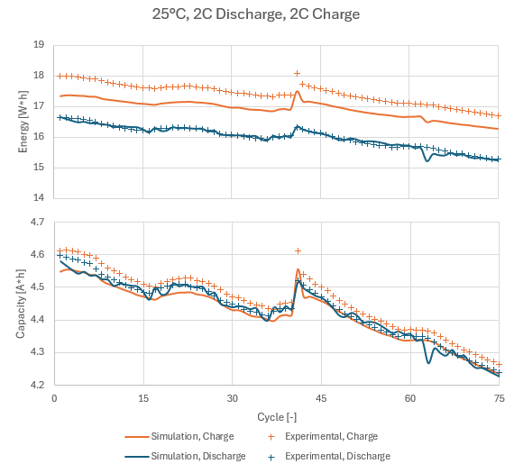
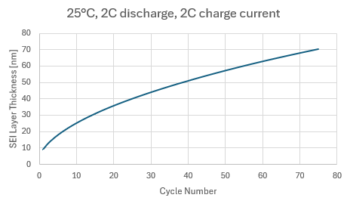
Expected vs Obtained Results

Slide 10
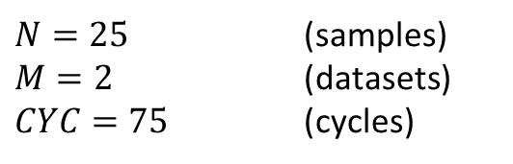
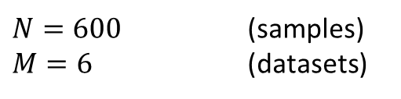


Quality of Fit
Fresh Battery
Degradation
$N=600$ (samples)
$M=6$ (datasets)
$N=25$ (samples)
$M=2$ (datasets)
$CYC=75$ (cycles)
$$\min{F_{cost}}=0.012\left[V^{2}\right]$$
$$\min{F_{cost}}=0.667[V^{2}]$$

Slide 11
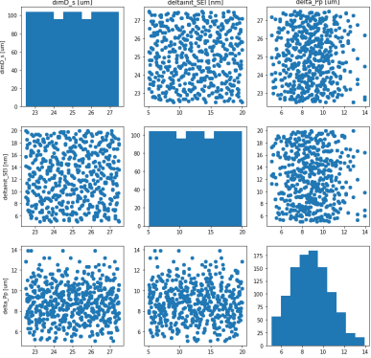
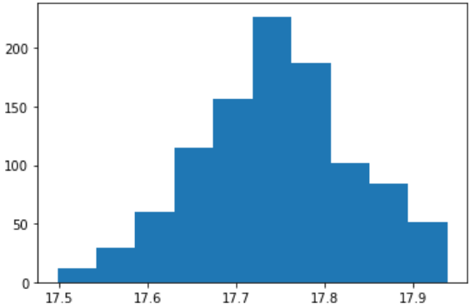
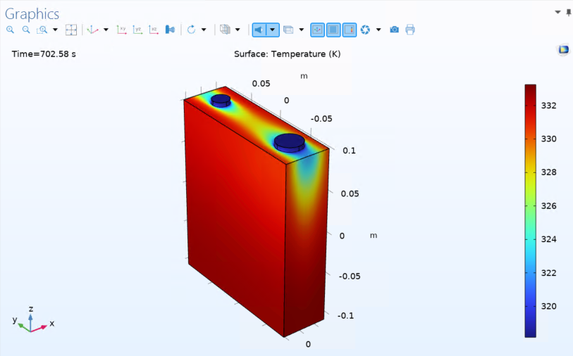
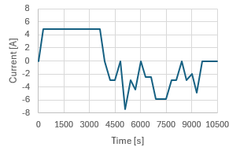
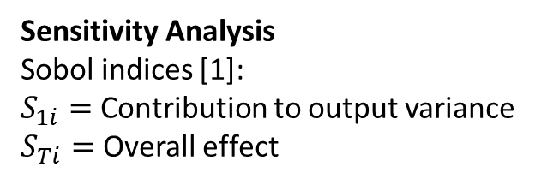
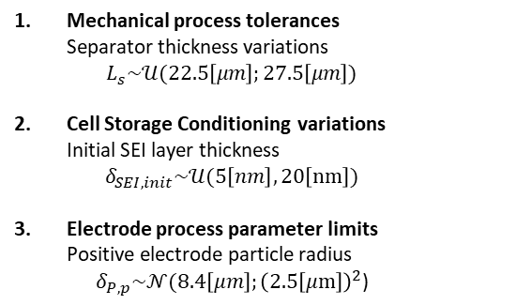
Uncertainty and Sensitivity Analysis
Inputs – Manufacturing Parameters
Uncertain Parameter Sampling
Outputs – Cell Quality Control
Mechanical process tolerances
Separator thickness variations
$L_{s}\sim 𝒰(22.5\left[μm\right];27.5\left[μm\right])$
Cell Storage Conditioning variations
Initial SEI layer thickness
$δ_{SEI,init}\sim 𝒰(5\left[nm\right],20\left[nm\right])$
Electrode process parameter limits
Positive electrode particle radius
$δ_{P,p}\sim 𝒩(8.4\left[μm\right];{\left(2.5\left[μm\right]\right)}^{2}\text{)}$
Uncertainty Analysis
Battery Cell Electrochemical Model
Sample size=1024
Inputs – Operating Parameters
Load curve
Sensitivity Analysis
Sobol indices [1]:
$S_{1i}=$ Contribution to output variance
$S_{Ti}=$ Overall effect
Charge: 1C
Discharge conditions: Varying
Temperature: 25°C
[1] Sobol’, I.M., 2001. “Global sensitivity indices for nonlinear mathematical models and their Monte Carlo estimates”

Slide 12
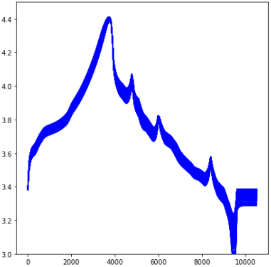
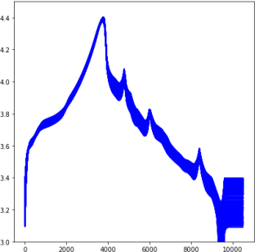
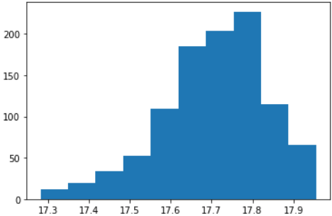
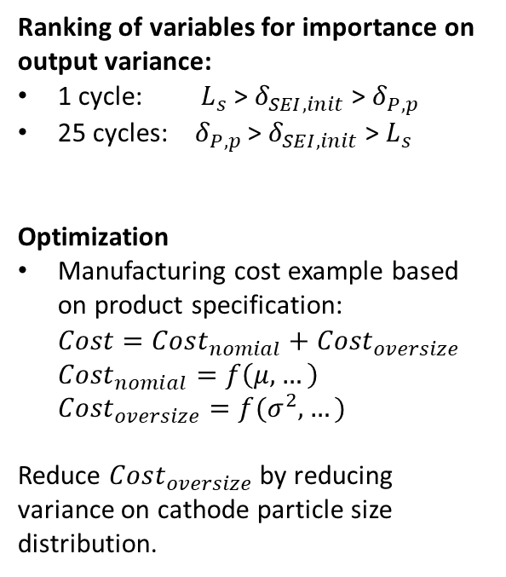
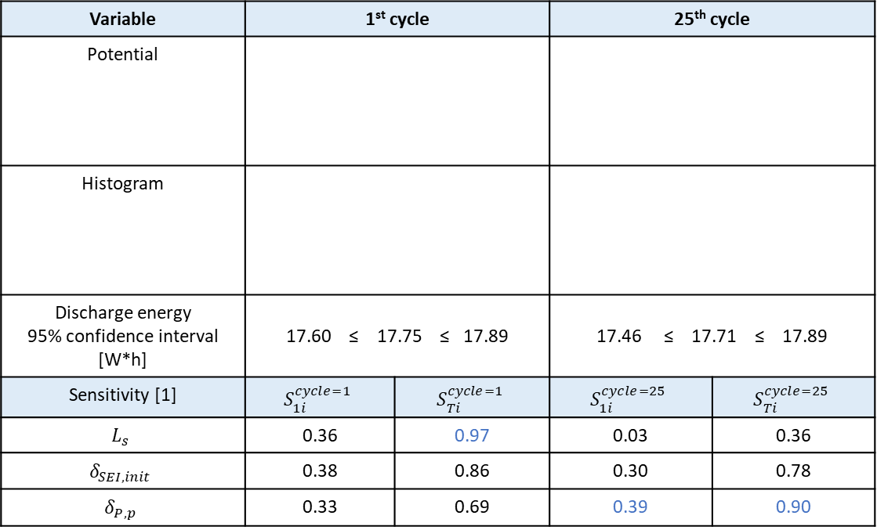
Uncertainty and Sensitivity Analysis
Ranking of variables for importance on output variance:
1 cycle: $L_{s}$ > $δ_{SEI,init}$ > $δ_{P,p}$
25 cycles: $δ_{P,p}$ > $δ_{SEI,init}$ > $L_{s}$
Optimization
Manufacturing cost example based on product specification:
$Cost=Cost_{nomial}+Cost_{oversize}$
$Cost_{nomial}=f\left(μ,…\right)$
$Cost_{oversize}=f(σ^{2},…)$
Reduce $Cost_{oversize}$ by reducing variance on cathode particle size distribution.
Variable | 1st cycle |  | 25th cycle
Potential
Histogram
Discharge energy 95% confidence interval [W*h] | 17.60 ≤ 17.75 ≤ 17.89 |  | 17.46 ≤ 17.71 ≤ 17.89
Sensitivity [1] | $$S_{1i}^{cycle=1}$$ | $$S_{Ti}^{cycle=1}$$ | $$S_{1i}^{cycle=25}$$ | $$S_{Ti}^{cycle=25}$$
$$L_{s}$$ | 0.36 | 0.97 | 0.03 | 0.36
$$δ_{SEI,init}$$ | 0.38 | 0.86 | 0.30 | 0.78
$$δ_{P,p}$$ | 0.33 | 0.69 | 0.39 | 0.90
[1] Sobol’, I.M., 2001. “Global sensitivity indices for nonlinear mathematical models and their Monte Carlo estimates”

Slide 13
Conclusions
Successful implementation of an electrochemical model of a battery including degradation
Robust framework for parameter fitting
Parameters successfully tuned for data set (incl. temperature dependency)
Uncertainty/Sensitivity Analysis to quantify performance parameter variance
Uncertainty/Sensitivity Analysis to prioritize optimization efforts on e.g., manufacturing process
COMSOL Application Builder offers excellent freedom and flexibility for handling large data sets and complex scenario simulations

Slide 14


Acknowledgement

Slide 15

End of Presentation
Martin Refslund Nielsen
Commercial Lead, Partner
Visit our website: https://resolvent.com/
Contact
Tel: +45 61 66 99 03
Email: info@resolvent.dk
Follow us on: https://www.linkedin.com/company/resolvent-p-s/
André Gugele Steckel
Modelling Specialist
Thomas Bisgaard
Simulation Specialist

