Slide 1


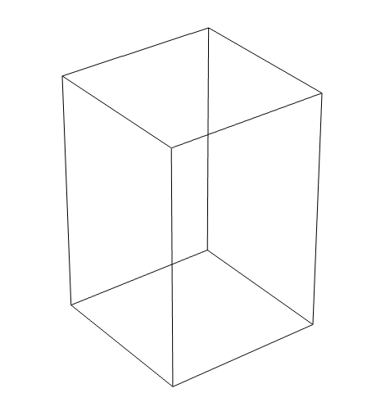
Investigation for thermal analysis in COMSOL for fused filament fabrication
Robrecht Abts¹, Jie Zhang¹, Ming Wu ^{1,2}, Mathias Verbeke^{2 ,} Eleonora Ferraris¹
1 Department of Mechanical Engineering, KU Leuven, 3000 Leuven, Belgium
2 Department of Computer Science, KU Leuven, 3000 Leuven, Belgium
robrecht.abts@kuleuven.be

Slide 2
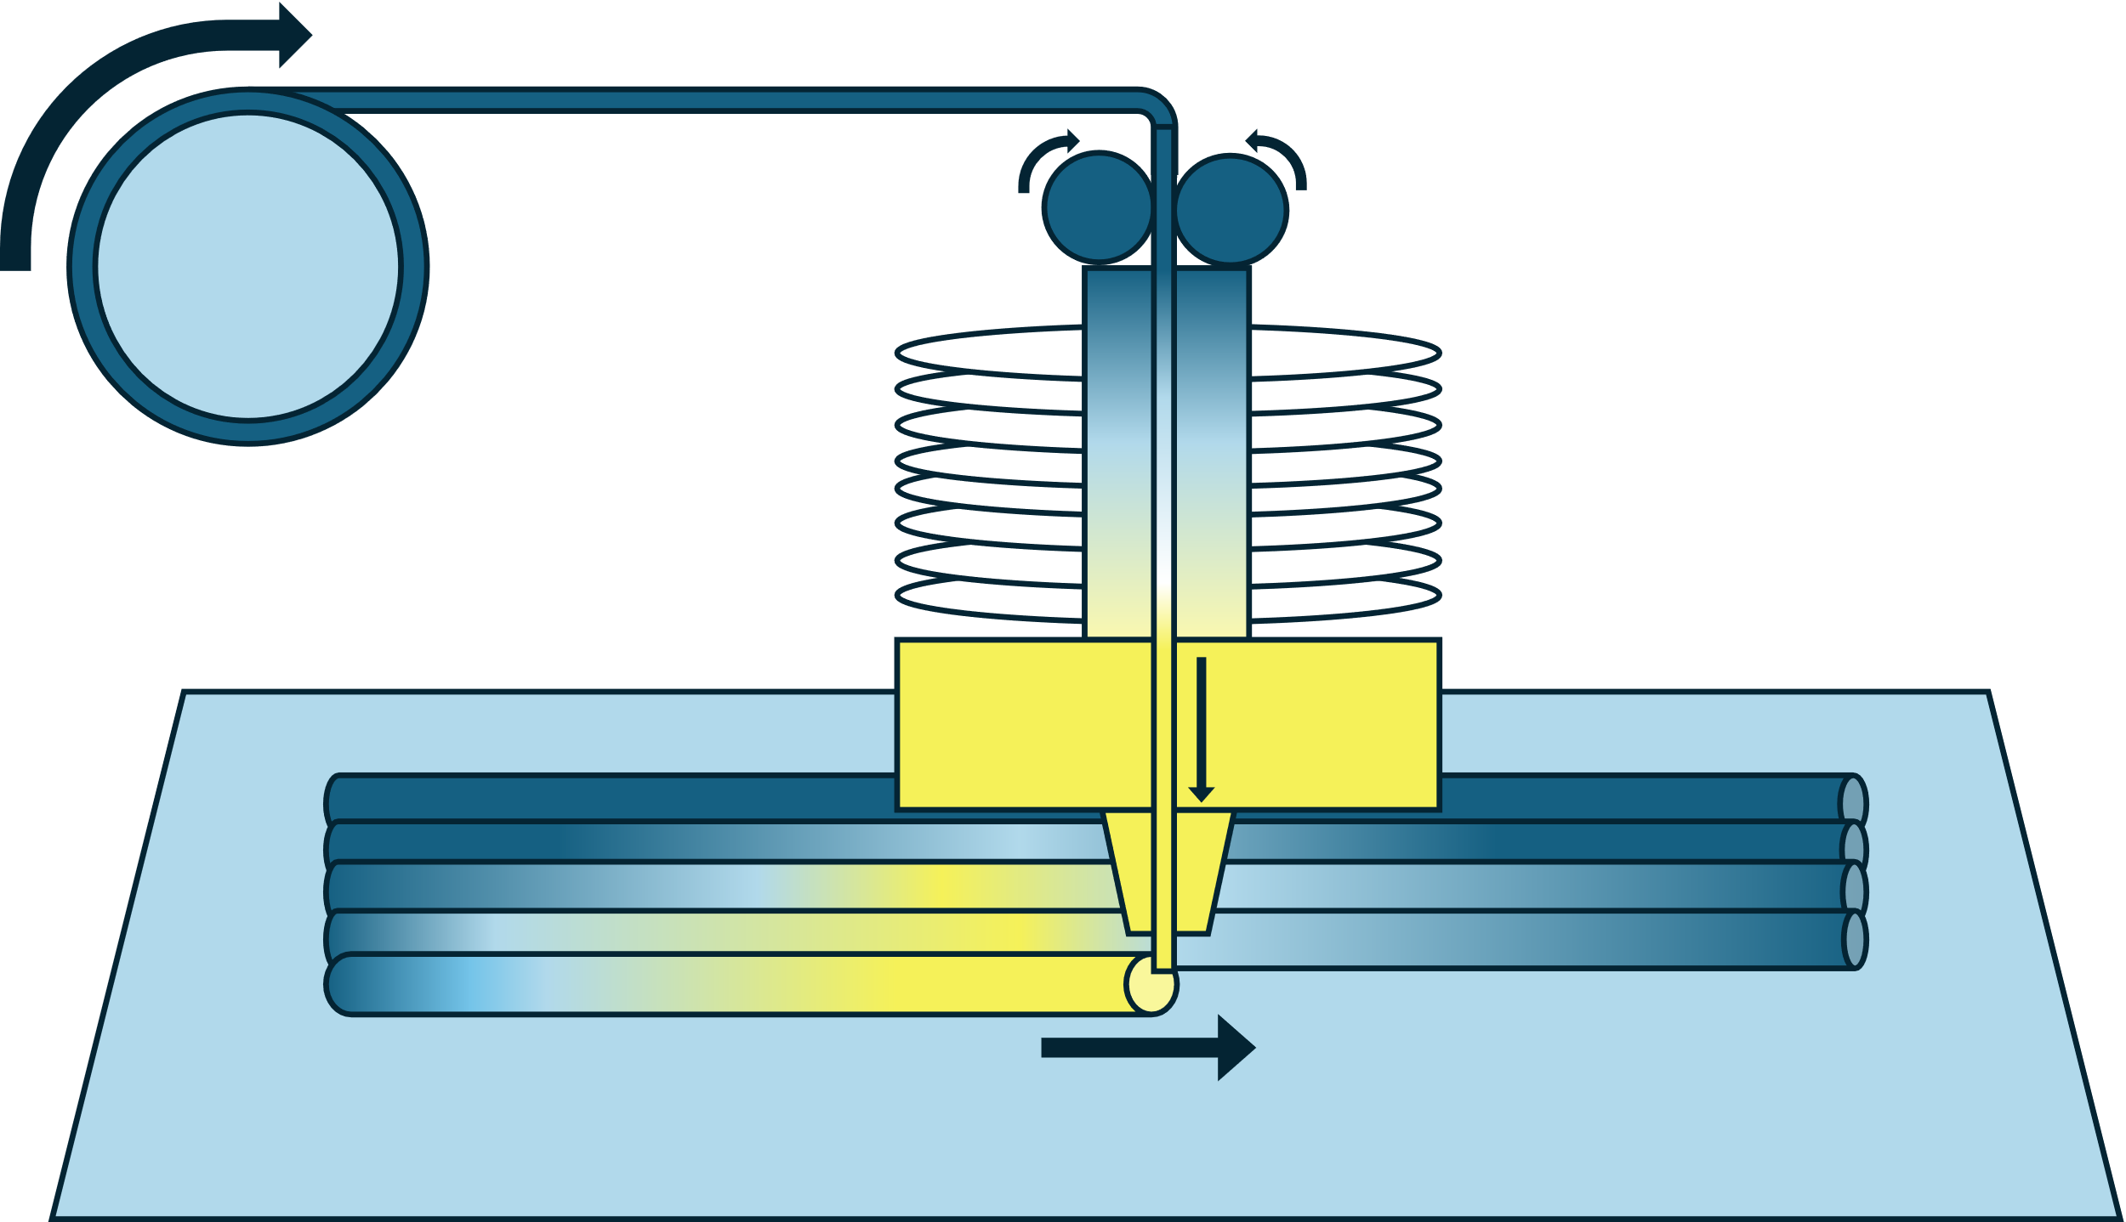


Fused Filament Fabrication (FFF)
Feedstock
Feed rollers
Cold end
Hot end
Nozzle
Build plate
Working principle of the Fused Filament Fabrication technology

Slide 3
Importance of build temperature in FFF
Diffusion at the interface
Temperature criterion for the (glass) phase transition ( T > T_{c})
Cooling pattern during printing is essential
Evolution of bond formation: (1) neck formation (2) neck growth (3) diffusion at interface

Slide 4
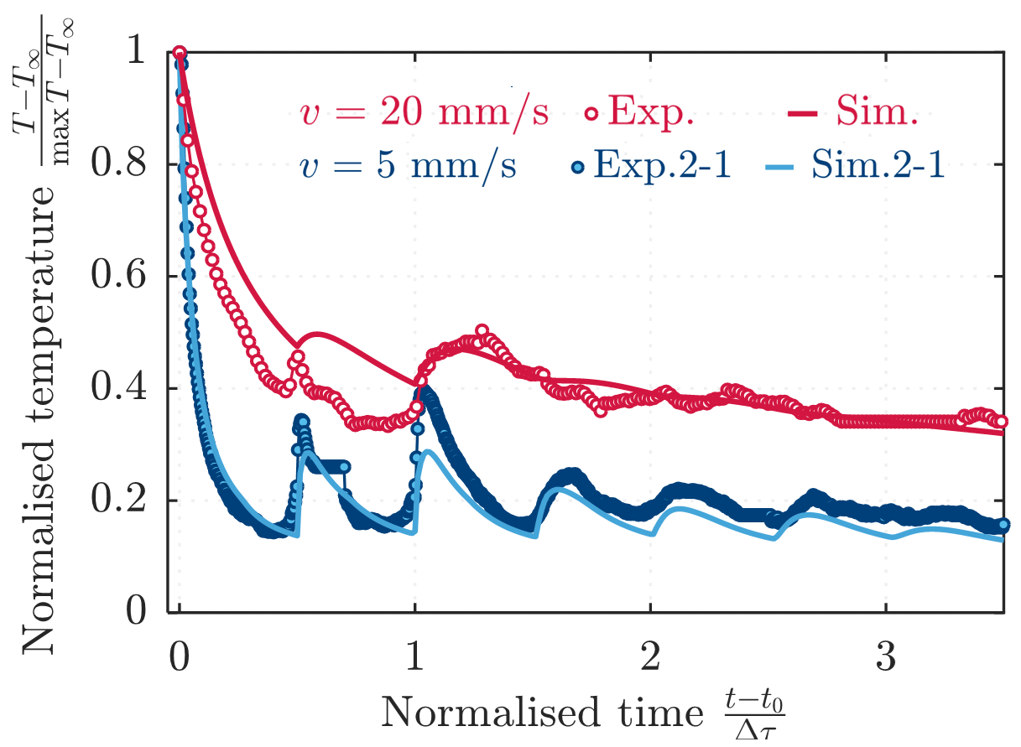
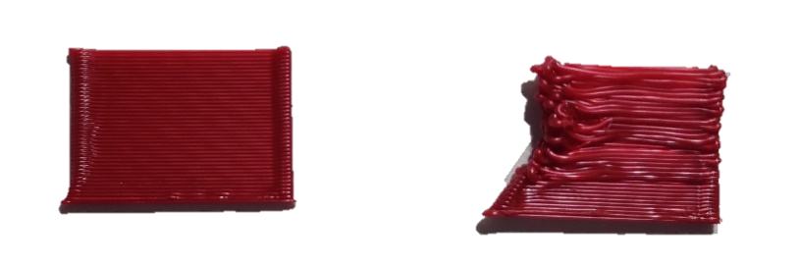

Importance of build temperature in FFF
Coupled-Multiphysics
polymer melt flow
heat transfer
phase change
10 times longer
Layer thickness $300→100μm$
Comparison of printing speed influence on temperature and print quality
Notes:
This slide can give you some inspiration to expalin the role of temp in FFF

Slide 5
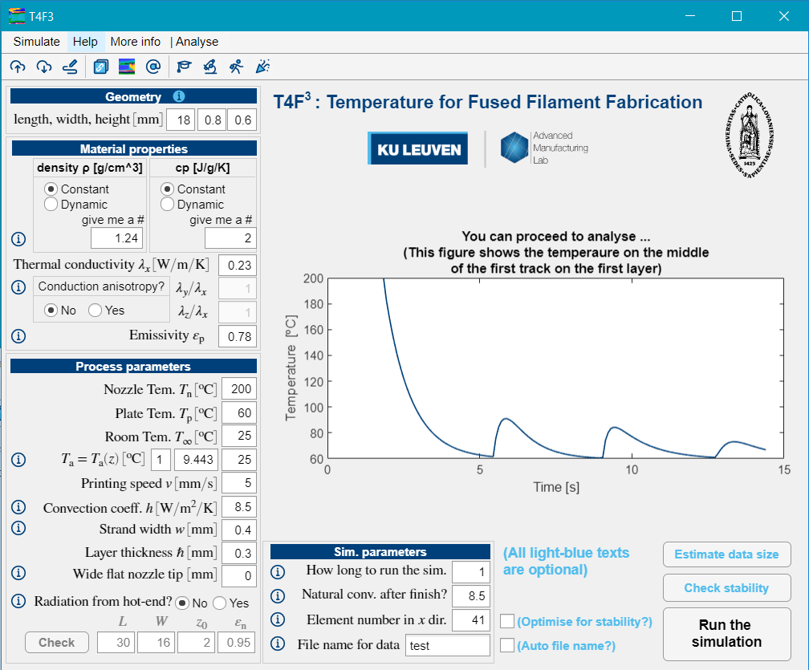
T4F3 simulation code
Types of energy transportation between elements
Interface T4F3-software to calculate temporal temperature

Slide 6
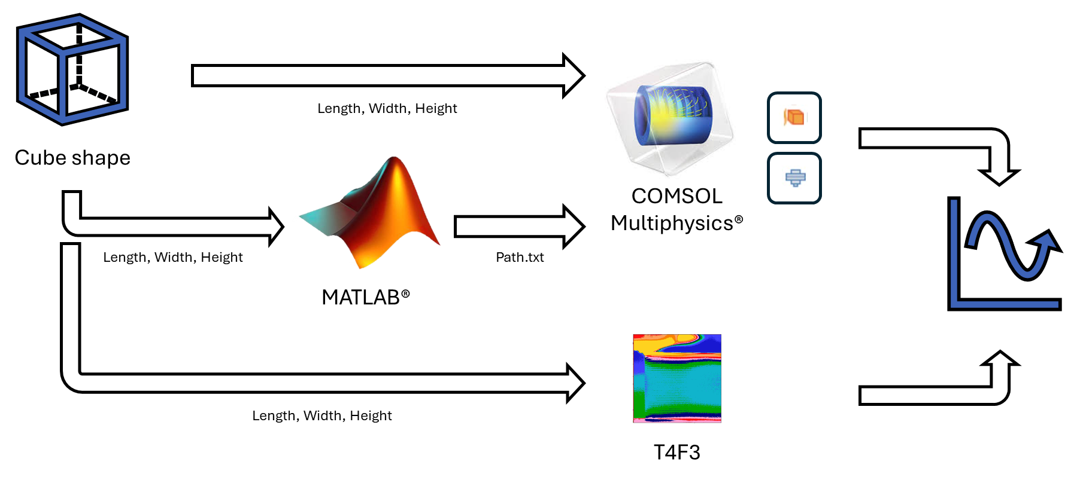
Validation methodology
Overview of working method used in this study to compare T4F3 with COMSOL

Slide 7
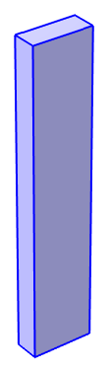

MATLAB implementation
Input
MATLAB-code
Output
for z = z_list
for y_index = 1:length(y_list)
for x = x_list
dist = sqrt((data.X(end)-x)^2+((data.Y(end)-y)^2));
time = time + dist / printingSpeed;
new_row = {time, x, y, z};
data(row_counter, :) = new_row;
row_counter = row_counter + 1;
end
end
end
t(s) x y x
0 0 0.2 0.25
1.4 18 0.2 0.25
1.5 18 0.6 0.25
2.9 0 0.6 0.25
3 0 0.2 0.75
4.4 18 0.2 0.75
4.5 18 0.6 0.75
5.9 0 0.6 0.75
6 0 0.2 1.25
7.4 18 0.2 1.25
7.5 18 0.6 1.25
8.9 0 0.6 1.25
0 0.2 1.75

Slide 8



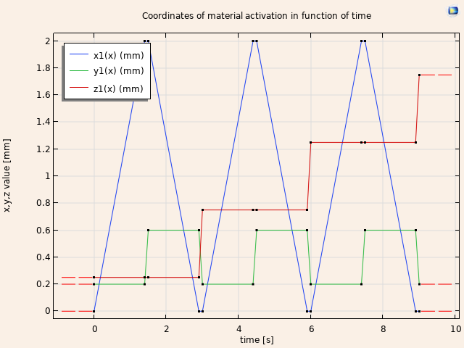
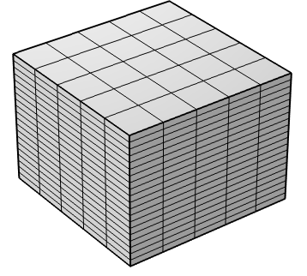
COMSOL implementation
Interpolation & Activation | Heat transfer module | Mesh
If (abs(x-x1(t))<= x_length/4 && abs(y-y1(t))<= Strand_width/2 && abs(z-z1(t))<= Layer_heigth/2 ,1,0) | Solid: Thermal cond., density, heat capacity ➔ user defined If(solid.isactive, PLA, Air) Temperature: Build plate temperature Heat source: Go to T_{nozzle} at activation function location Heat flux: Convection at boundary | Cubic mesh Mesh size: Y: Size of strand Z: Layer heigth/4

Slide 9
Preliminary results
Simulation settings
4x4x6 mm cube
Printing speed 5 mm/s
PLA print material
T_{nozzle} = 200°C
T_{build plate} = 60°C
T_{room} = 20°C

Slide 10
Preliminary results: Comparison to T4F3
A: Different temperature peaks
  Data collection method
  Source temperature difference
  Cooling rate difference
B: Time shifts
  Different path generation
C: Similar effect next layers
  More analysis of patterns is needed
A
C
B
B
B

Slide 11
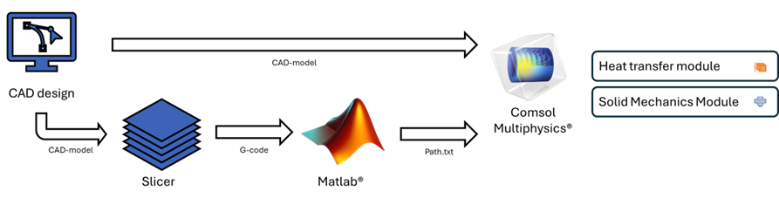
Conclusion
New insights
Future work
Workflow for use of COMSOL in FFF thermal simulation
Conversion from T4F3 results
Improve current model (accuracy and calculating efficiency)
Make step towards free-form simulations

Slide 12
Thank you! robrecht.abts@kuleuven.be

Slide 13
References
[1] Bellehumeur, C., Li, L., Sun, Q., & Gu, P. (2004). Modeling of Bond Formation Between Polymer Filaments in the Fused Deposition Modeling Process. Journal of Manufacturing Processes, 6(2), 170–178. https://doi.org/10.1016/S1526-6125(04)70071-7
[2] J. Zhang, B. Van Hooreweder, and E. Ferraris, “T4F3: temperature for fused filament fabrication,” Progress in Additive Manufacturing, vol. 7, no. 5, pp. 971–991, Oct. 2022, doi: 10.1007/S40964-022-00271-0/FIGURES/15.

