Slide 1
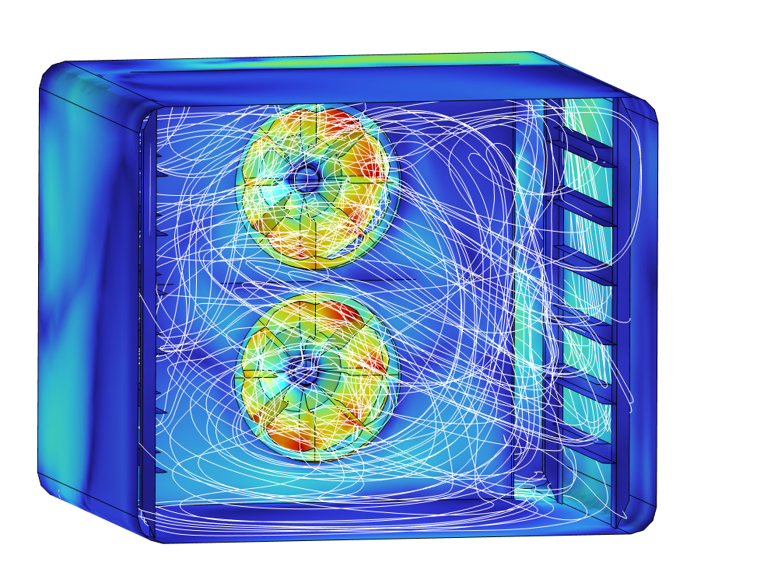
Fluid Dynamic Modeling in Oven Chambers: Balancing Accuracy and Computational Efficiency
Comsol Conference
Florence, October, 2024
Ph.D, Christian Bianchi

Slide 2
Main goal of the investigation
Reduction of computational complexity by choosing the best model strategy to simulate the fluid dynamics in a closed oven chamber
Optimization of the process workflow to maximize the efficiency of module usage

Slide 3
Basic Hypothesis
The classical way to investigate the forced ventilation and thermal distribution in a closed chamber is to simulate the coupled CFD and HT problem in the full domain
A simpler, but less accurate way to make the same investigation is to separate the study of the driving force (fan) from the effect in the remaining chamber.
How good this accuracy can be?

Slide 4
General concept
1
2
STEP 1
STEP 2
STEP 3
CFD + HT
Complex domain
CFD
Pipe & Distibutor domain
HT
Chamber domain
Complex fan
Cylindrical velocity profile and pressure
pipe
chamber
distributor
radial fan
chamber

Slide 5
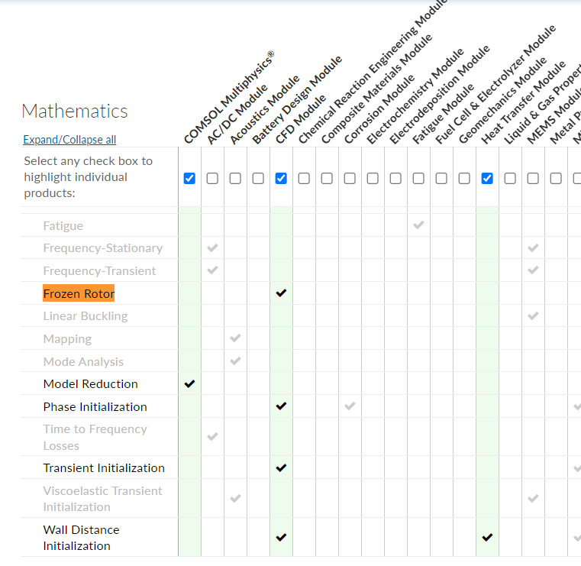
Steps
The analysis is characterized by three steps:
Step 1
Need of both CFD and HT modules for the entire simulation time over a complex domain
Step 2
Need of only the CFD module for a simplified domain
Step 3
Need of the only HT module for the chamber domain (complexity of the fan is excluded)

Slide 6
Module usage and timing
STEP 1
CFD
HT
It can take longer if multiple angular position
must be assessed for full rotation (the lower the number of blades, the higher the impact)
STEP 2
STEP 3
CFD
HT
Time

Slide 7
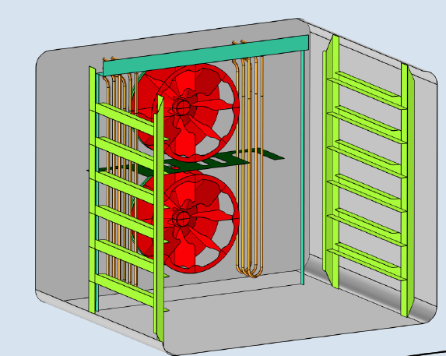
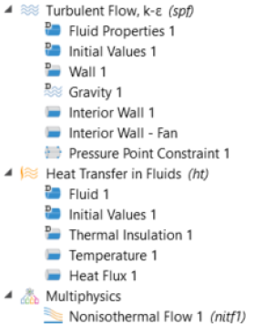
Step 1 – Model characteristics
Two frozen rotors are defined
Gravity is also included
Pressure reference is set at one corner
physics setting
Temperature is set at the resistors surface (500 degC), thermal dissipation can occur at the door

Slide 8
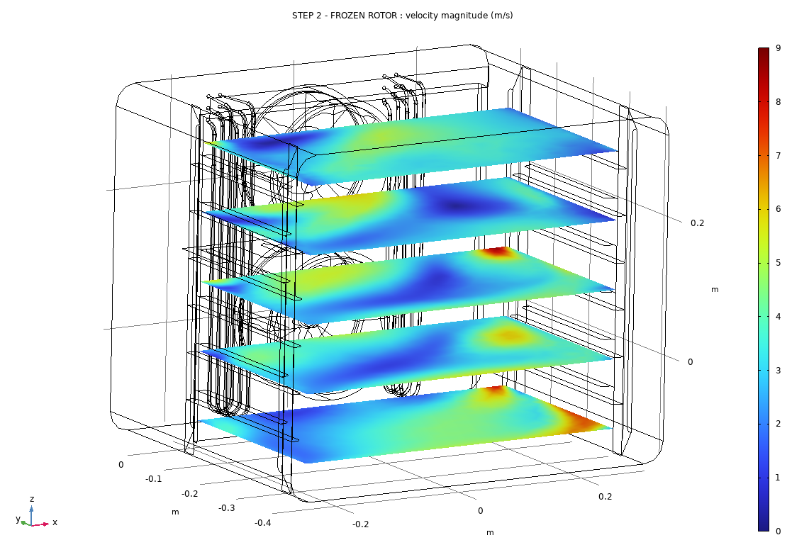
Results - Step 1 – Full oven simulation
Full domain with fan, carter, resistors and cavity
PRESSURE POINT CONSTRAIN: p_{stat} = 0 Pa
Fluido weakly compressible
Turbolence model: k-ε
ω = 2000 rpm
RESISTORS: wall + thermal source
FANS: wall
Mag(U) (m/s)
OVEN WALLS: wall + thermal insulator
OVEN DOOR: wall + thermal dissipation

Slide 9
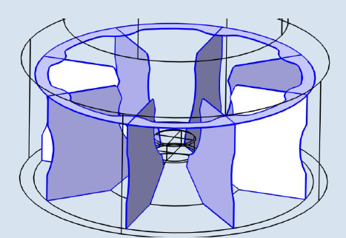
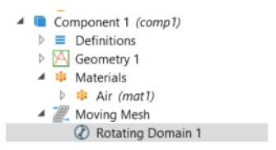
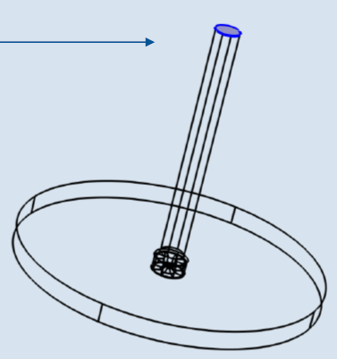
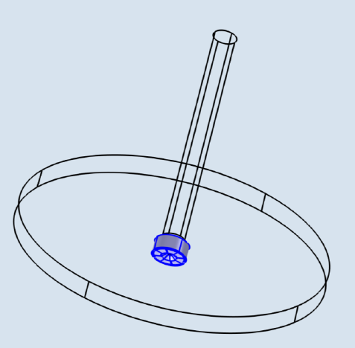
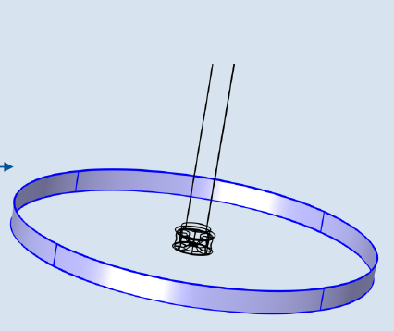
Step 2 – Model characteristics
Thin faces used to define the fan geometry
Domain setting
Inlet pressure
Frozen rotor
Outlet pressure

Slide 10
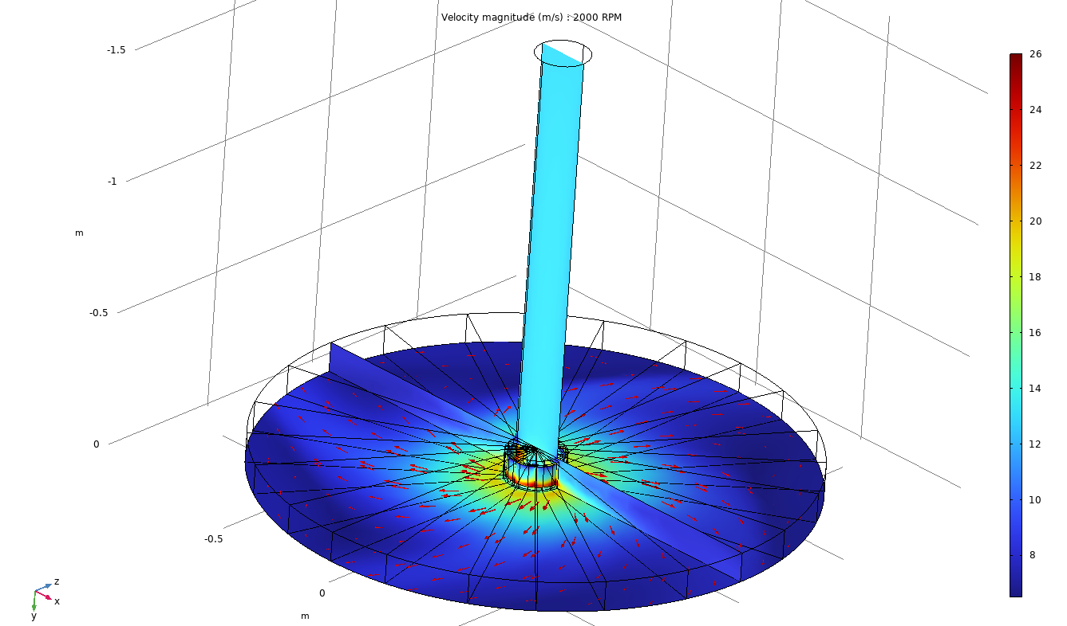
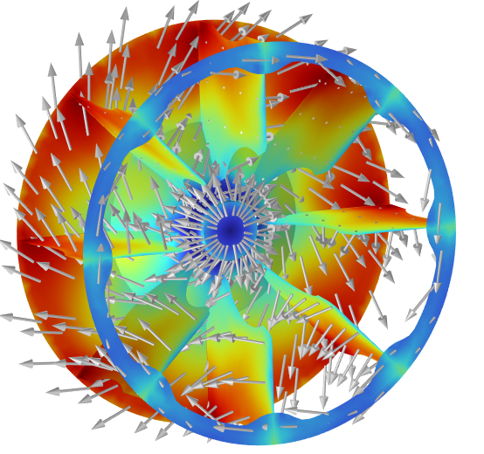
Step 2 – simplified domain
Condotto di aspirazione + outlet indefinito.
Incompressible fluid
Turbolence model: k-ε
ω = 1000 rpm;
1600 rpm;
2000 rpm (fig);
2600 rpm
INLET: p_{totale} = 0 Pa
Mag(U) (m/s)
Fan and walls: wall condition
OUTLET: p_{stat} = 0 Pa
OUTLET_WALL: wall
*OUTLET (free flow) and OUTLET_WALL (stopped flow) are considered in the same ratio as in the real oven, given to the following value A_{outlet} / A_{outlet_wall} = 0,6470

Slide 11
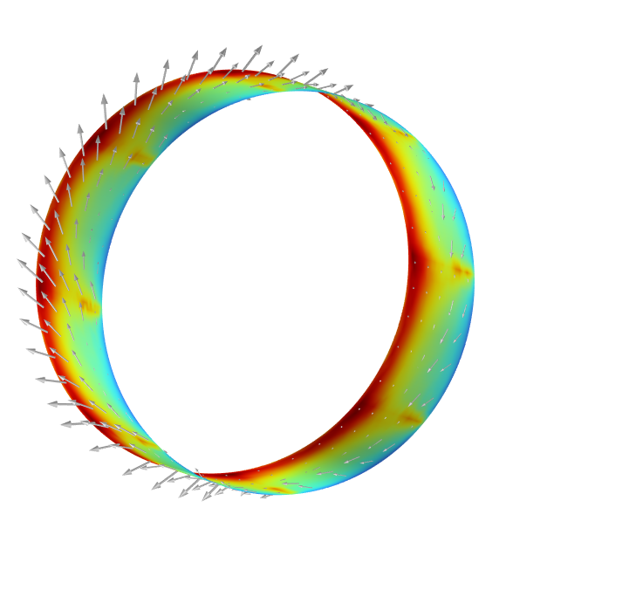
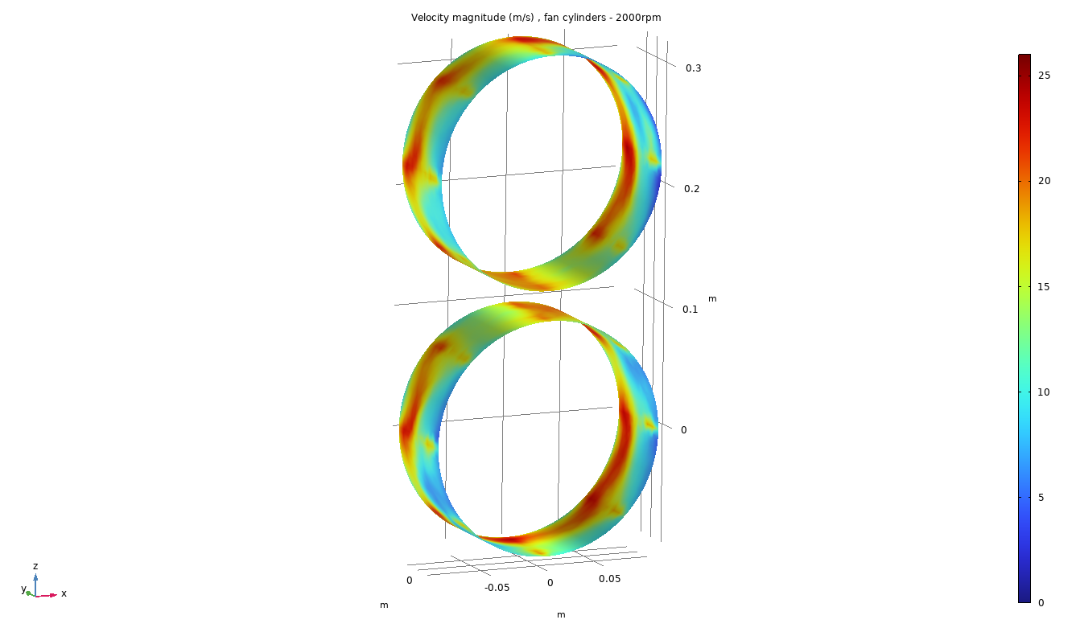
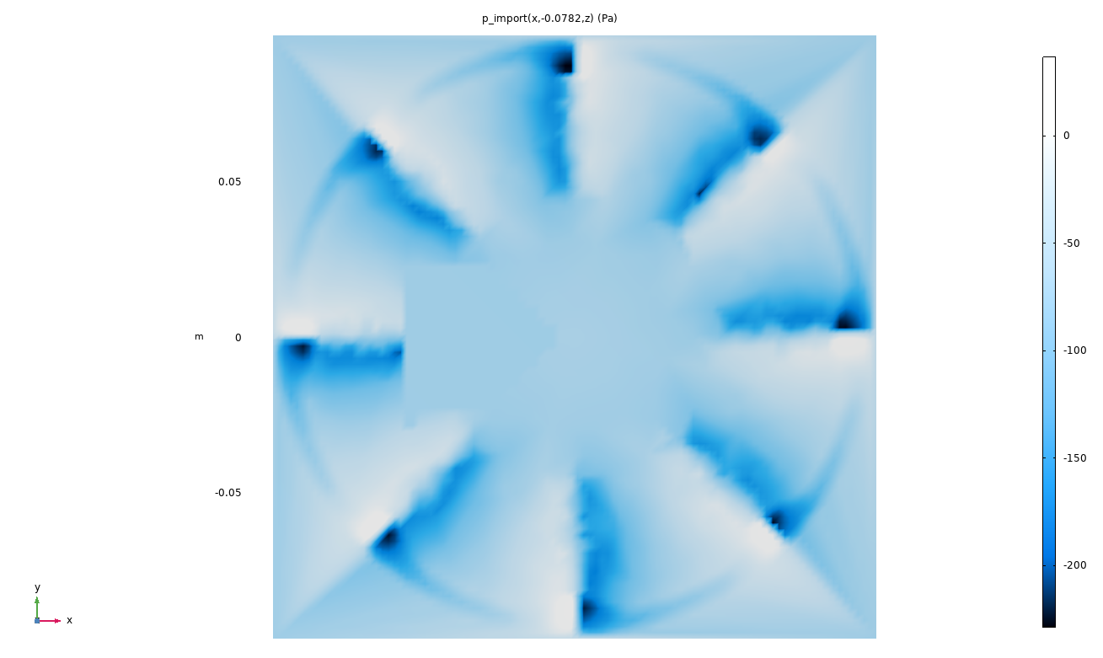
Step 2 – Output quantities
Vector velocity profile around external surface of the cylinder
Static pressure at the suction section of the fan
Mag(U) (m/s)
p (Pa)
These two output profiles of step 1 are the input for step 3

Slide 12
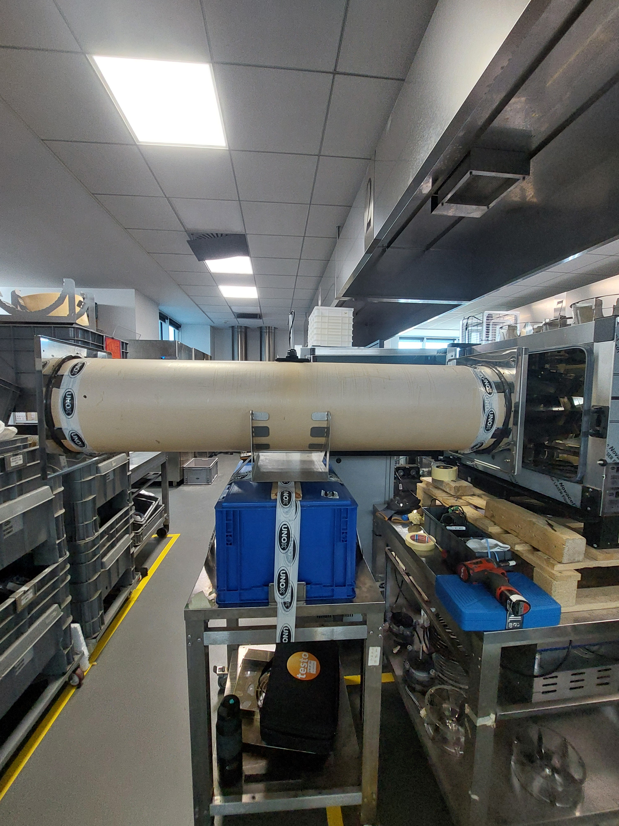
Step 2 – Experimental validation
The door of the oven was open to let the insertion of the pipe. The pipe was placed in front of the fan. A digital anemometer was used to measure the volumetric flow rate.
forno
anemometro digitale
v
Condotto aspirazione D=250mm , L=3m
ventola
Rpm | ṁ experimental (kg/s) | ṁ simulation (kg/s) | shift (%)
1000 | 0,163 | 0,153 | 6,22
1600 | 0,248 | 0,247 | 0,25
2000 | 0,302 | 0,311 | 2,65

Slide 13
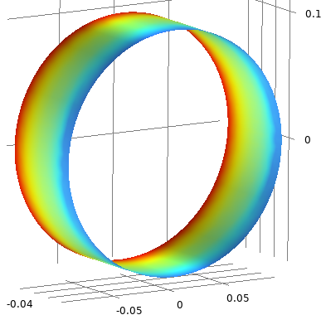
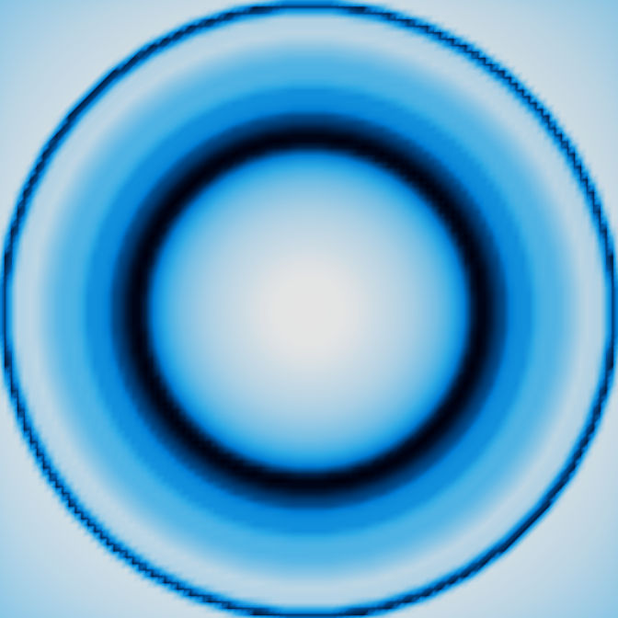
Velocity and pressure U e p – Average over a full rotation step 2 (output)/ step 3 (input)
Since the frozen rotor captures a snapshot of a specific angular position of the fan, another velocity and pressure profile has been considered by averaging all the quantities along the rotation axis
U Profile step3’’ + p profile step3’’
Mag(U) (m/s)
p (Pa)

Slide 14
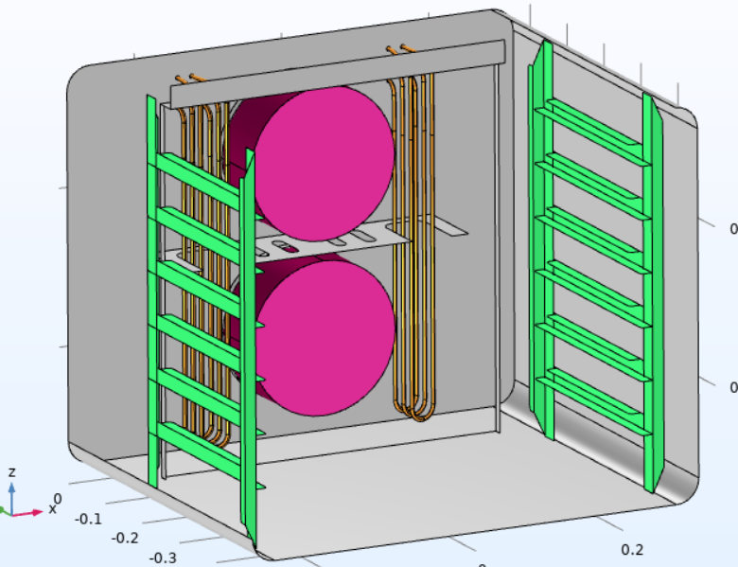
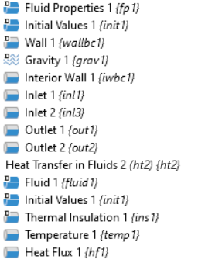
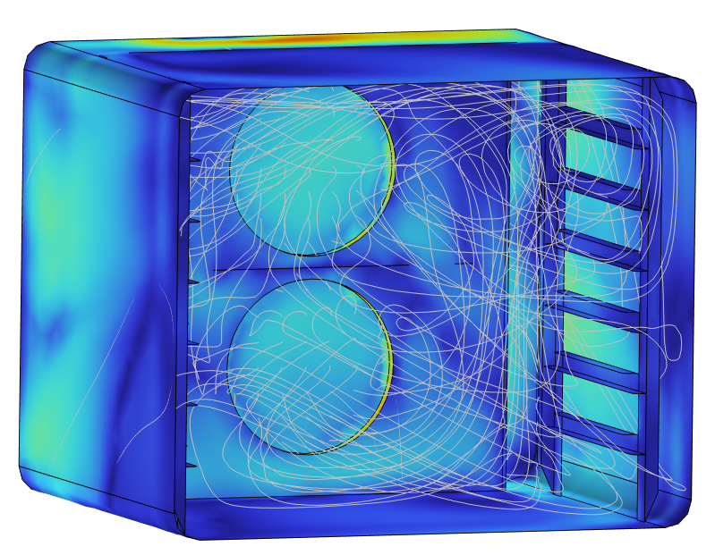
Step 3 – Model characteristics
Velocity profile and pressure at the suction are imported
Gravity is also included
Pressure reference is set at one corner
physics setting
Temperature is set at the resistors surface (500 degC), thermal dissipation can occur at the door

Slide 15
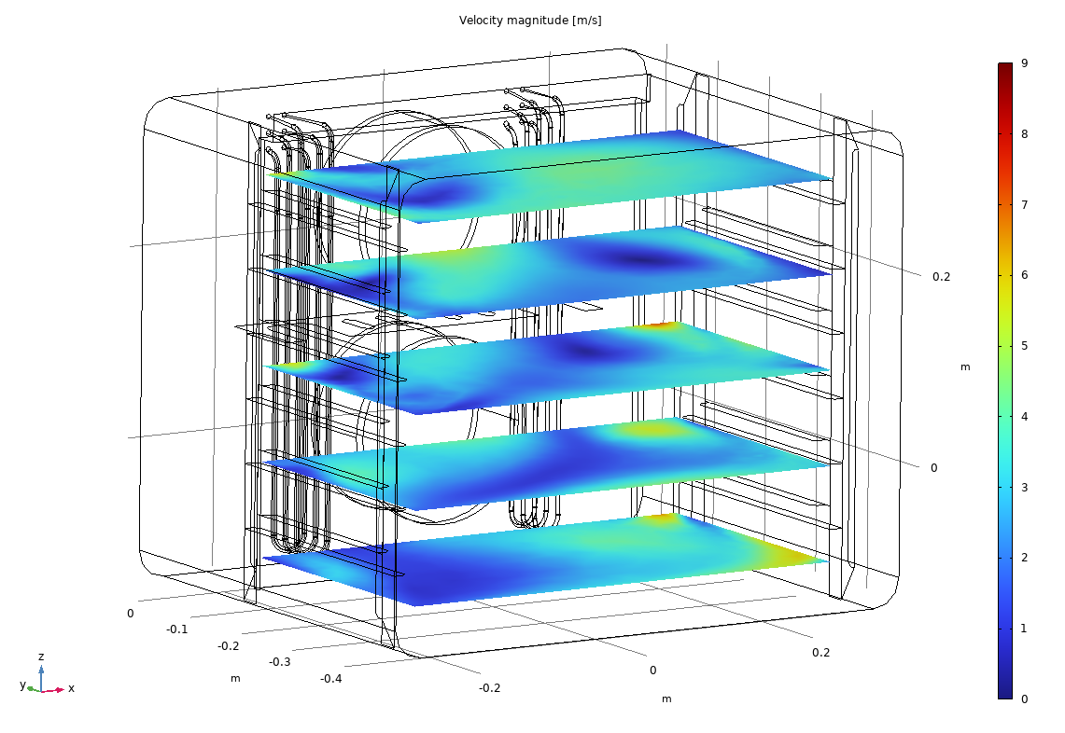
Results - Step 3 – Simplified simulation Averaged over full rotation
Forno 0611 privato degli elementi superflui e delle ventole, profili mediati.
weakly compressible fluid
Turbolence model: k-ε
ω = 2000 rpm
RESISTORS: wall + thermal source
PRESSURE POINT CONSTRAIN: p_{stat} = 0 Pa
CYLINDRICAL FAN: inlet (U profile from step 2 with average along the rotation axis)
FAN FACES:
outlet (profile p_{stat} from step 2 with average along the rotation axis)
Mag(U) (m/s)
OVEN WALLS: wall + thermal insulator
OVEN DOOR: wall + thermal dissipation

Slide 16
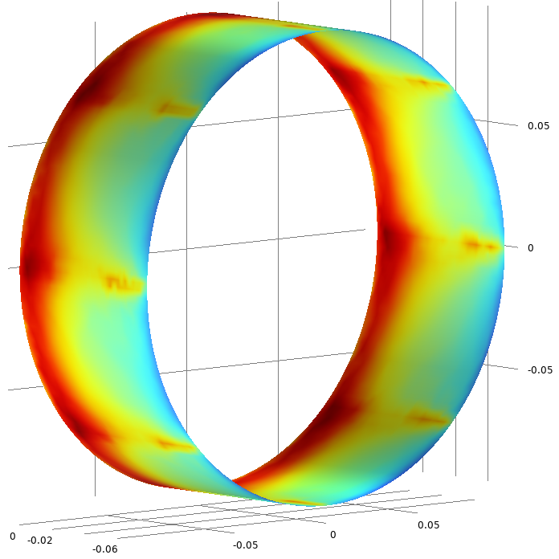
Results – Velocity profile – step1 vs step2
We can compare the results in terms of magnitude of field velocity along the lateral surface of the cylinder that defines the frozen rotor domain
Step 1
Step 2 (output) /Step 3 (input)
Mag(U) (m/s)
Velocity gradient toward the bottom of the fan is captured by both the models.

Slide 17
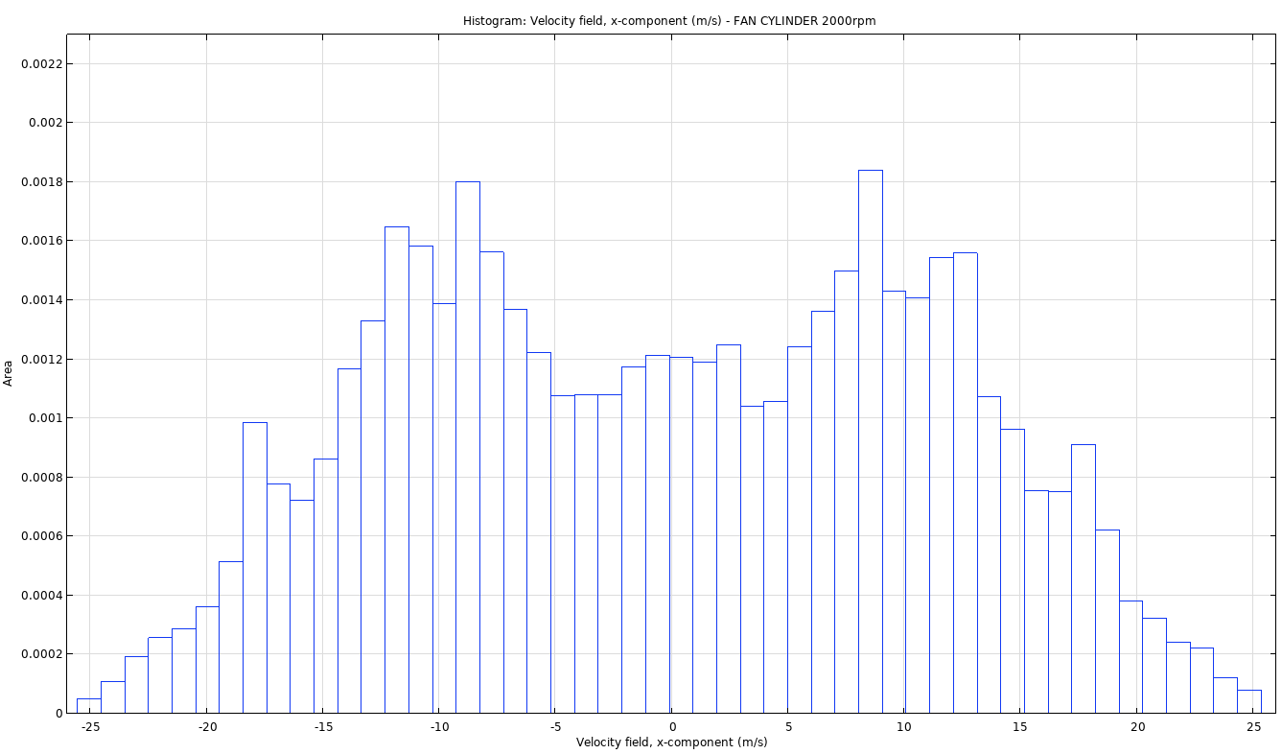
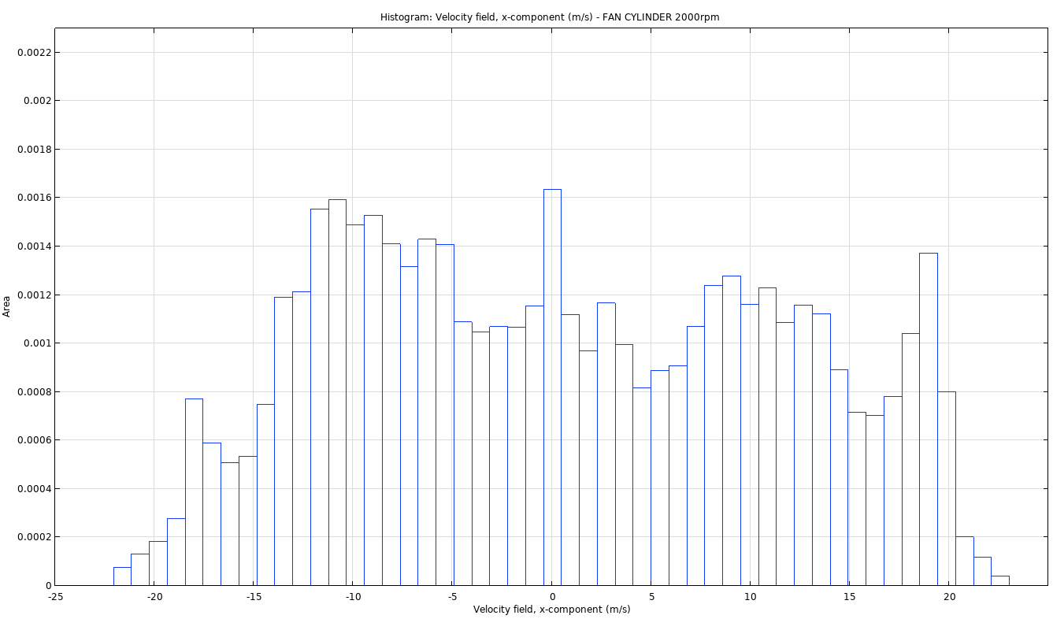
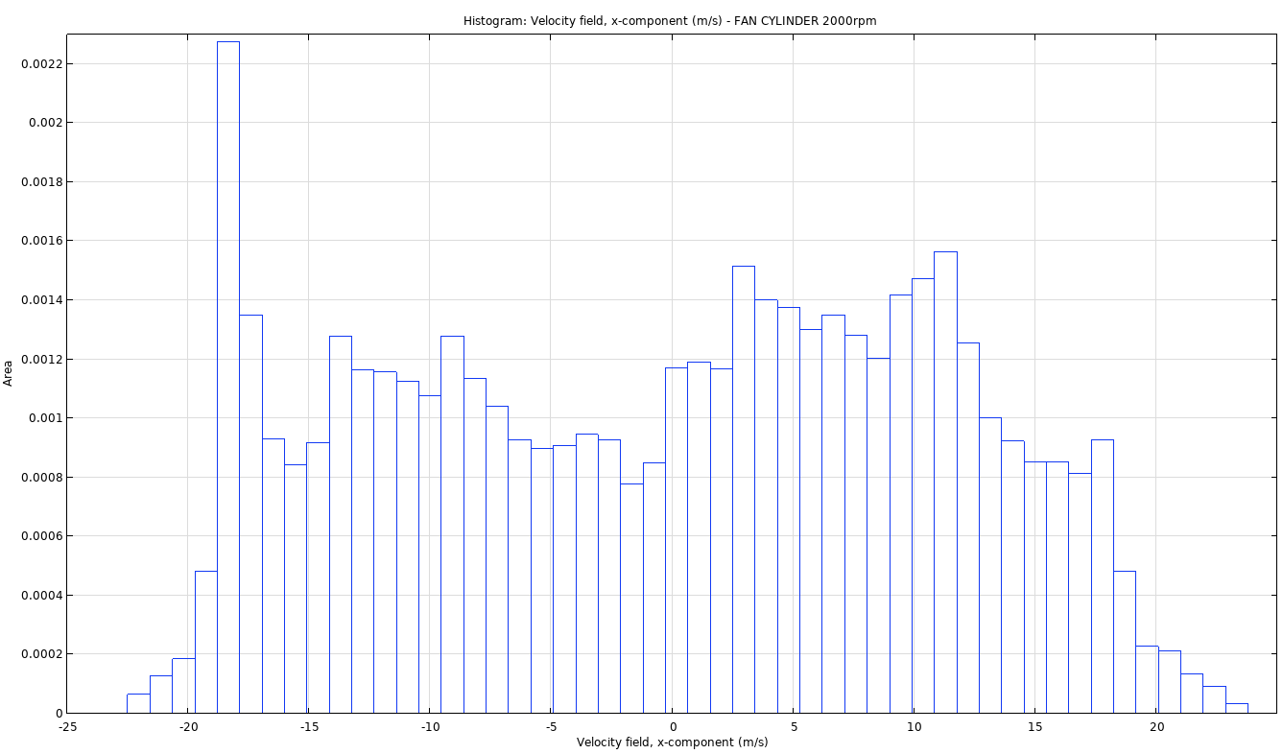
Profilo velocità – step1 vs step2
Component u (m/s) along the external cylinder of the fan
Area
Step2
Z (w)
- 25
-20
-15
-10
-5
0
5
10
15
20
25
Y (v)
X (u)
Area
Step1
bottom fan
- 25
-20
-15
-10
-5
0
5
10
15
20
25
Area
Step1
top fan
- 25
-20
-15
-10
-5
0
5
10
15
20
25
Velocity (m/s)

Slide 18
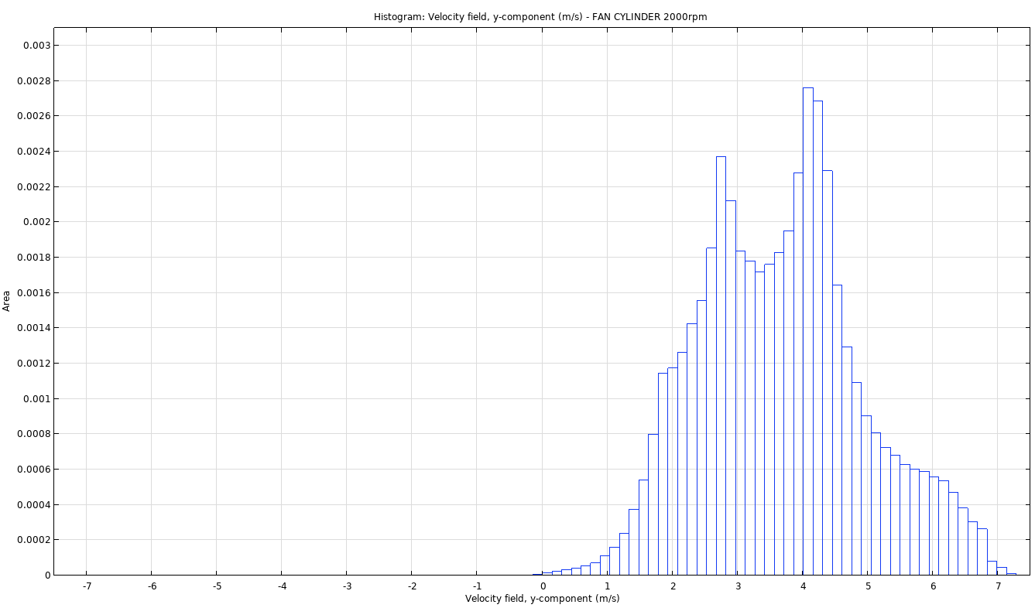
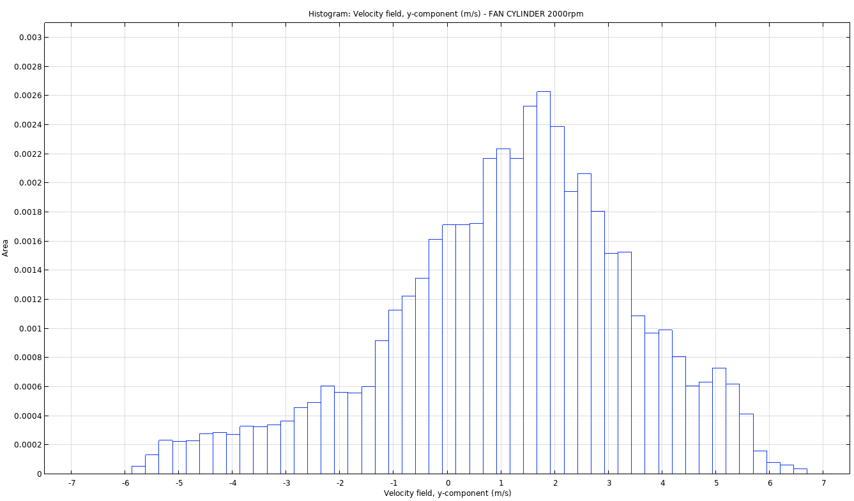
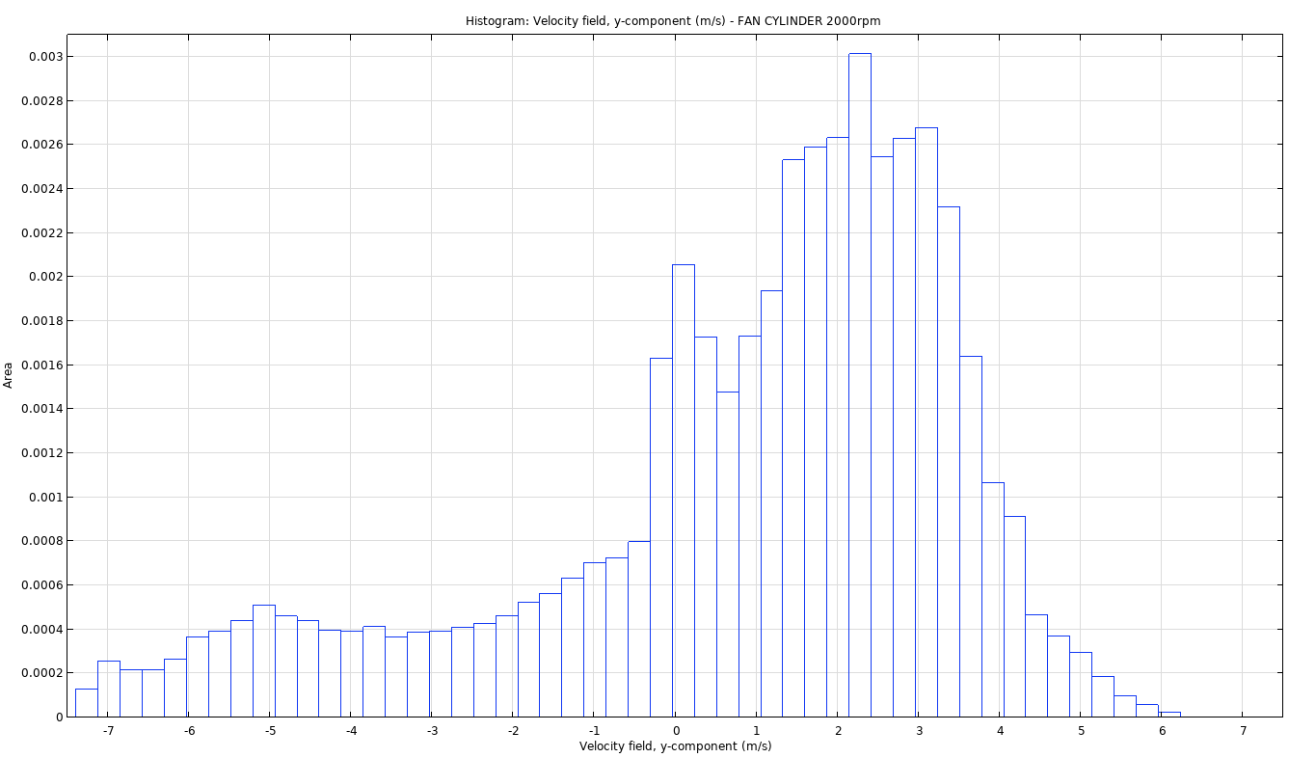
Profilo velocità – step1 vs step2
Component v (m/s) along the external cylinder of the fan
Slightly different results here
(Turbolent components along the suction axis)
Area
Step 2
Z (w)
-7
-5
-3
-1
1
3
5
7
Y (v)
X (u)
Area
Step 1
bottom fan
-7
-5
-3
-1
1
3
5
7
Area
Step 1
top fan
-7
-5
-3
-1
1
3
5
7
Velocity (m/s)

Slide 19
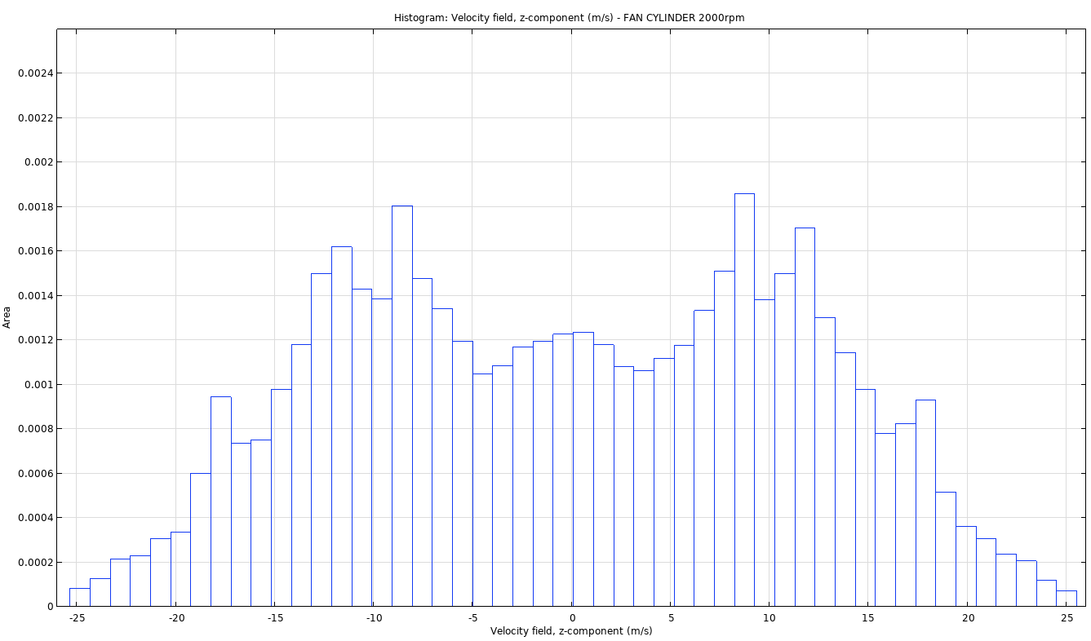
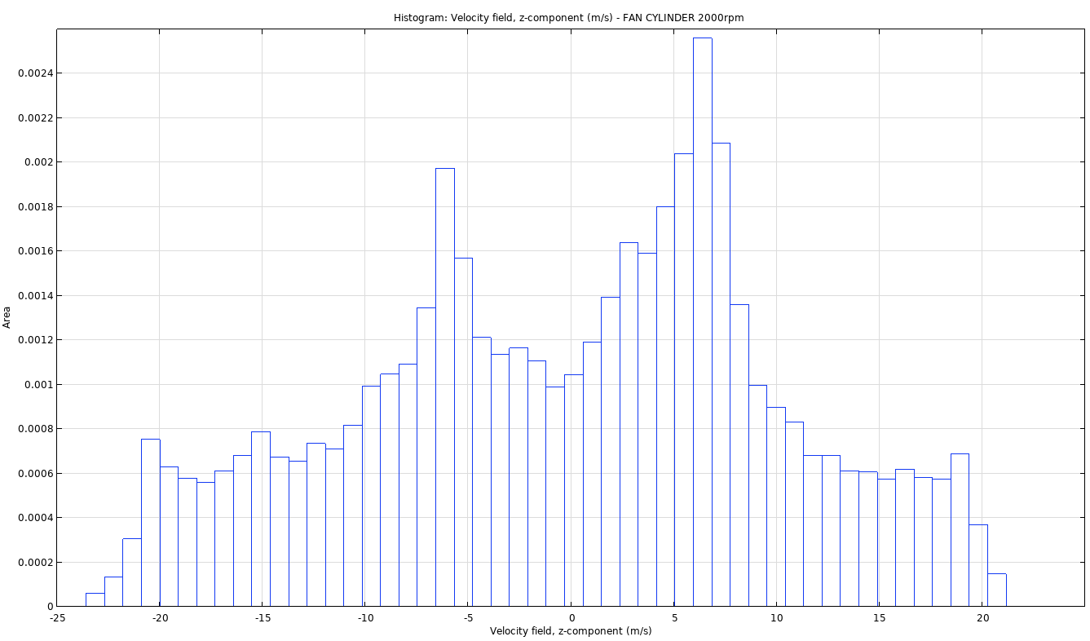
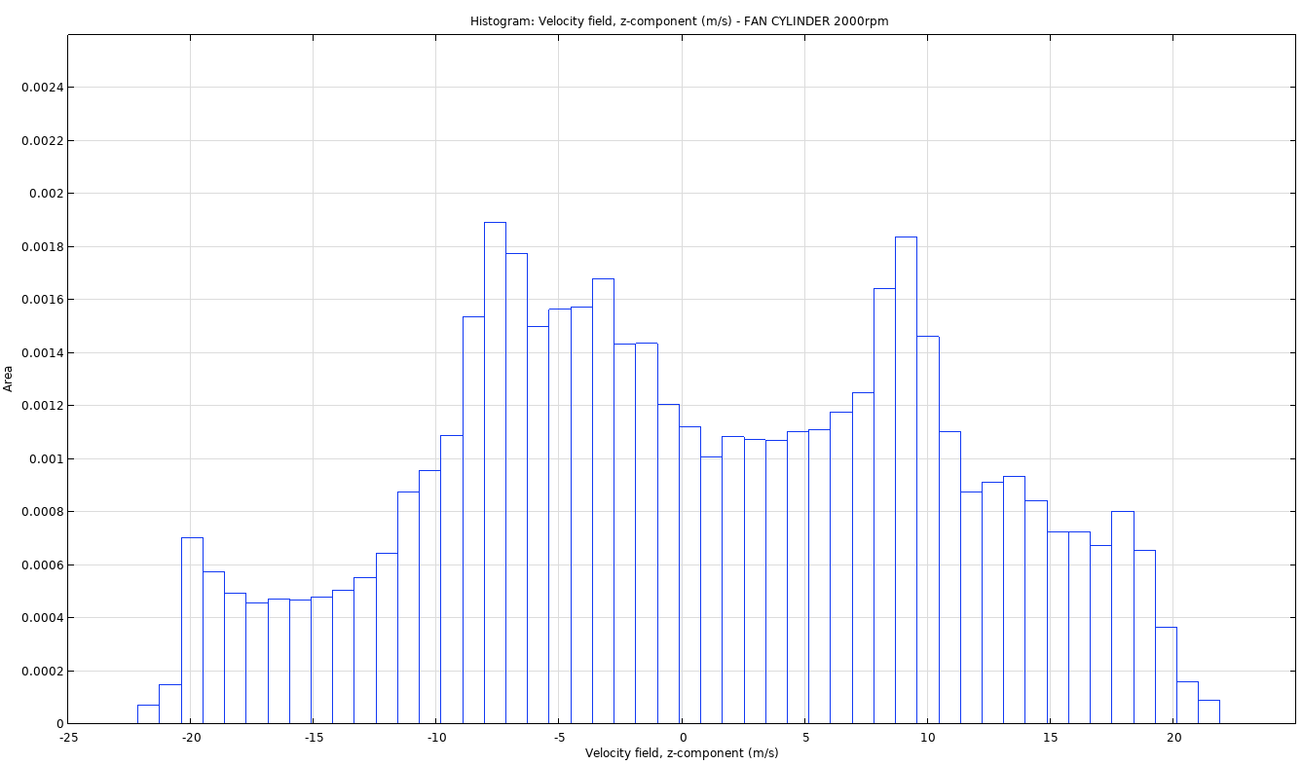
Profilo velocità – step1 vs step2
Componente w (m/s) lungo il cilindro circoscritto alla ventola.
Area
Step 2
Z (w)
- 25
-20
-15
-10
-5
0
5
10
15
20
25
Y (v)
X (u)
Area
Step 1
bottom fan
- 25
-20
-15
-10
-5
0
5
10
15
20
25
Area
Step 1
top fan
- 25
-20
-15
-10
-5
0
5
10
15
20
25
Velocity (m/s)

Slide 20
General overview – step1 vs step3
Velocity magnitude over different tray level positions
Step 1
Step 3
Mag(U) (m/s)

Slide 21
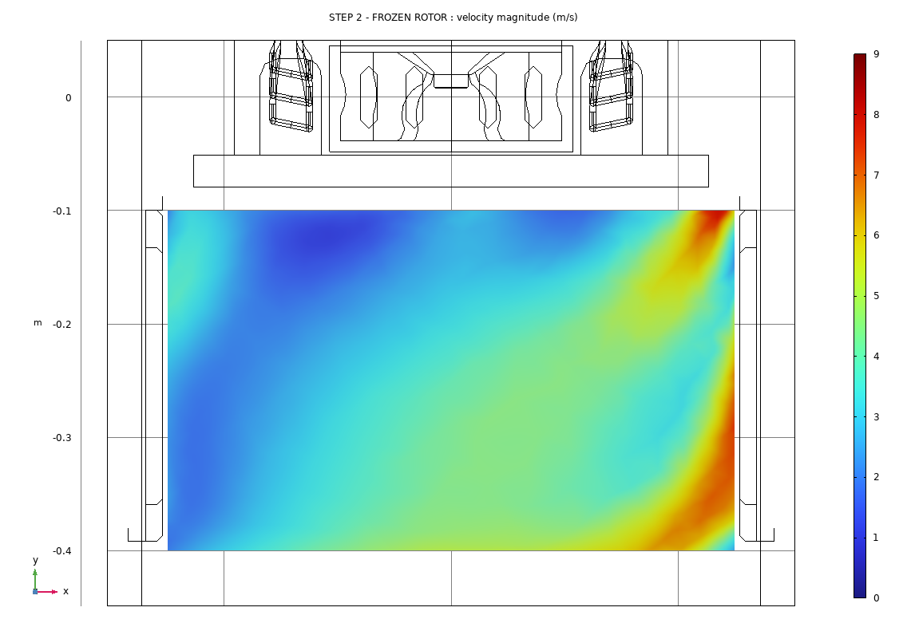
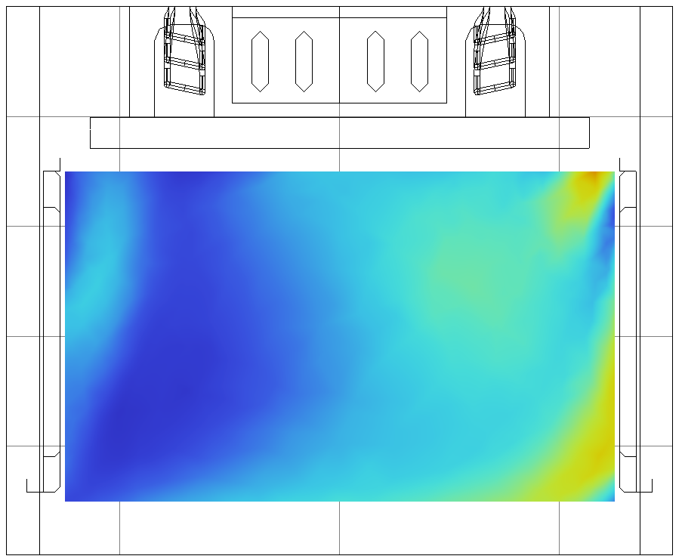
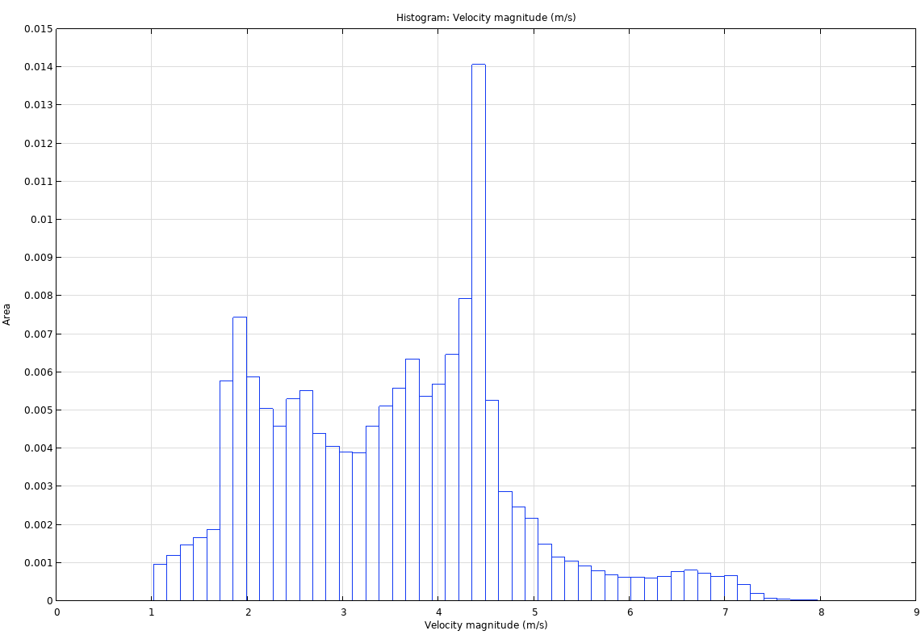
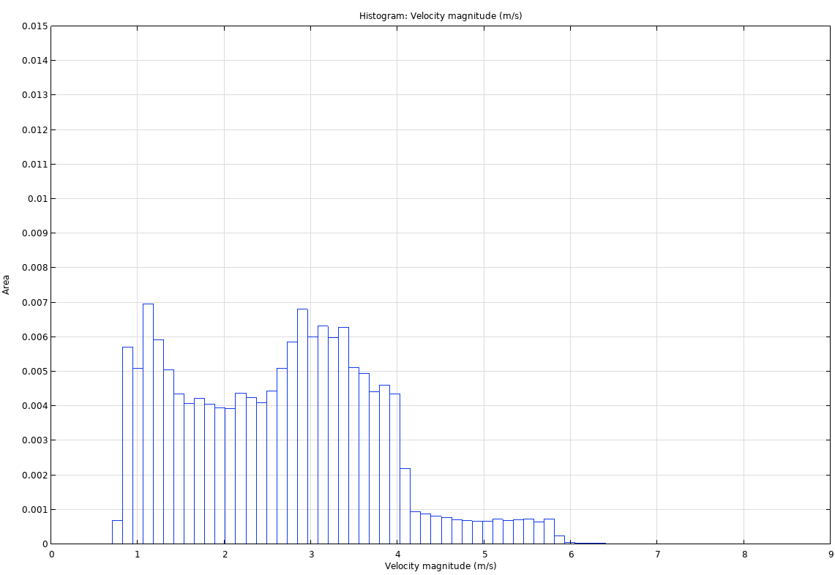
Results Tray 1 position – step 1 vs step 3
Step 1
Step 3
Mag(U) hystogram at h = 0,1 m from the bottom.
Mag(U) (m/s)
Velocity (m/s)
Area
0
-1
2
3
4
5
6
7
8
9
2
3
4
6
9
0
-1
5
7
8

Slide 22
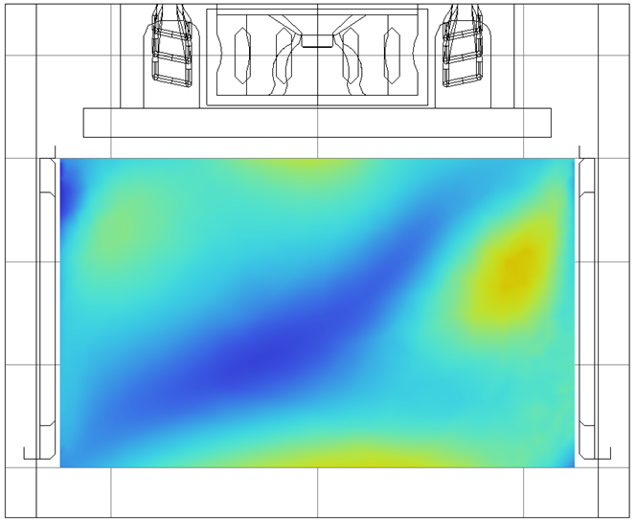
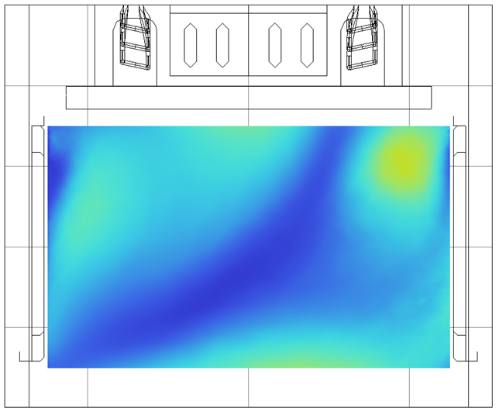
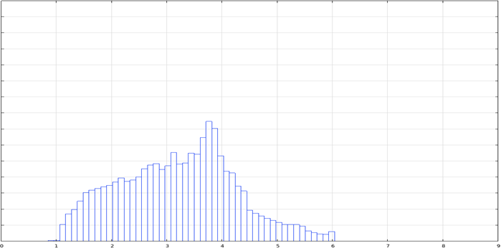
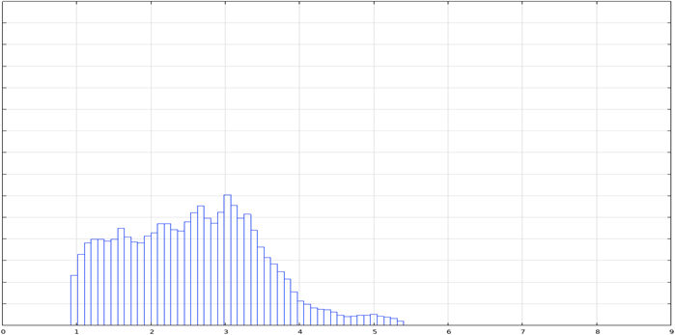
Results Tray 2 position – step 1 vs step 3
Step 1
Step 3
Mag(U) hystogram at h = 0,2 m from the bottom.
Mag(U) (m/s)
Velocity (m/s)
22
0
-1
2
3
4
5
6
7
8
9
2
3
4
6
9
0
-1
5
7
8

Slide 23
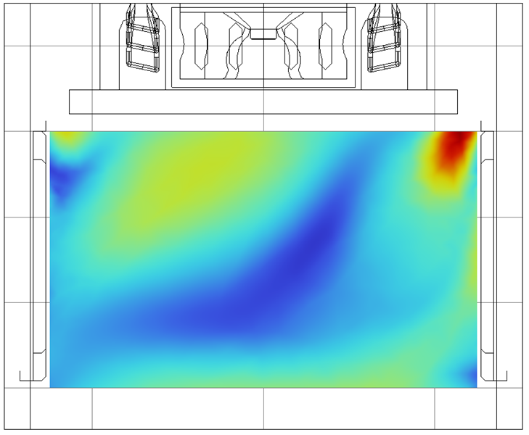
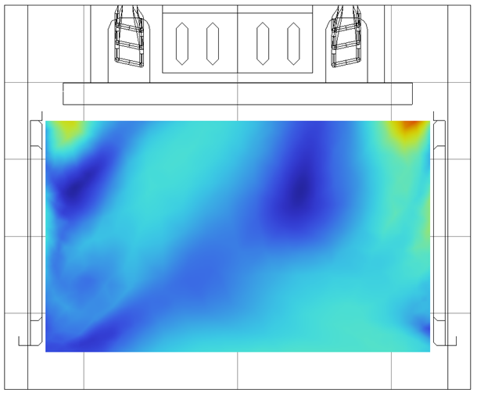
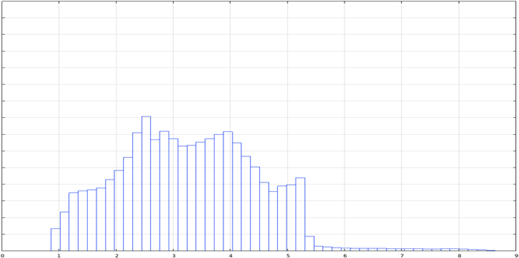
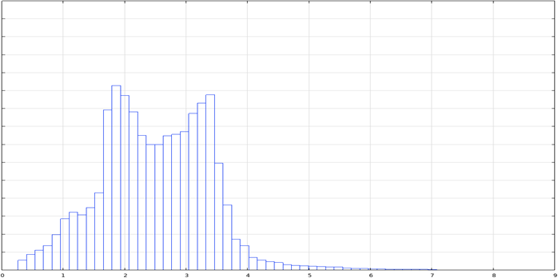
Results Tray 3 position – step 1 vs step 3
Step 1
Step 3
Mag(U) hystogram at h = 0,3 m from the bottom.
Mag(U) (m/s)
Velocity (m/s)
Area
23
0
-1
2
3
4
5
6
7
8
9
2
3
4
6
9
0
-1
5
7
8

Slide 24
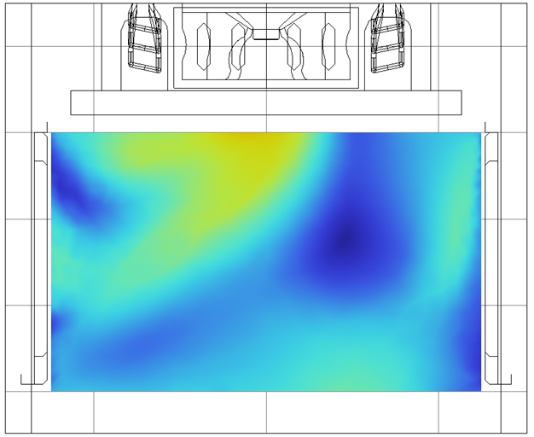
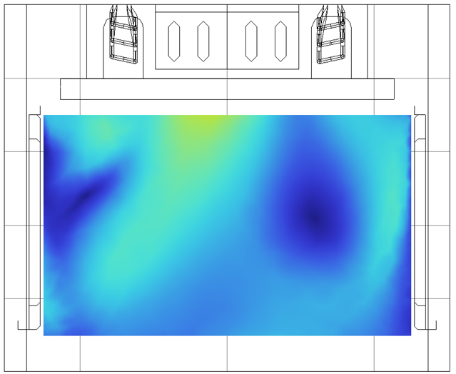
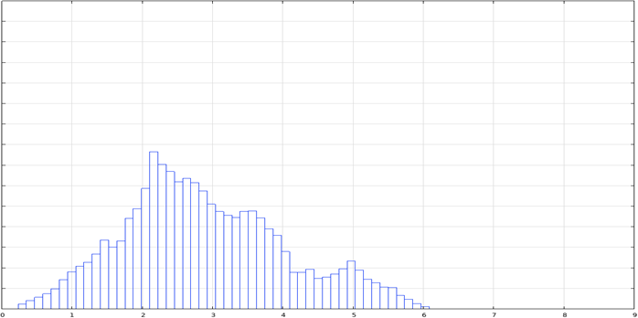
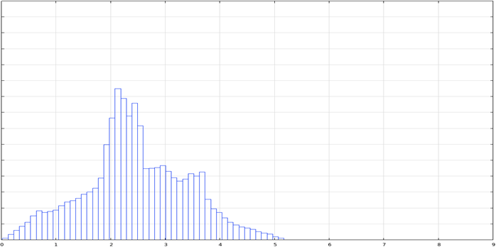
Results Tray 4 position – step 1 vs step 3
Step 1
Step 3
Mag(U) hystogram at h = 0,4 m from the bottom.
Mag(U) (m/s)
Velocity (m/s)
Area
Area
0
-1
2
3
4
5
6
7
8
9
2
3
4
6
9
0
-1
5
7
8

Slide 25
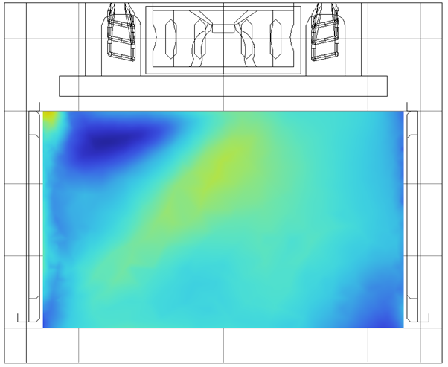
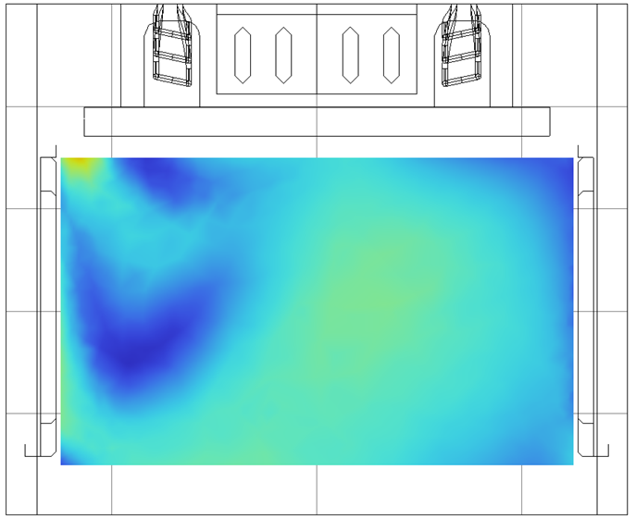


Results Tray 5 position – step 1 vs step 3
Step 1
Step 3
Mag(U) hystogram at h = 0,5 m from the bottom.
Mag(U) (m/s)
Velocity (m/s)
Area
0
-1
2
3
4
5
6
7
8
9
2
3
4
6
9
0
-1
5
7
8

Slide 26
Results Comparison step 1 vs step 3
Let’s consider how off are the mean values for each tray position between the two steps given the previous hystograms
Tray | shift 1-3 (%)
1 | 6,45
2 | 5,48
3 | 5,60
4 | 3,03
5 | 2,30
average | 4,57

Slide 27
Final considerations
The numerical model has been experimentally validated for step 2 and deviation from the experimental values ​​can be considered good.
The average deviation of the speed distribution in the trays between step 1 and step 3 is less than 5% at all the levels.
Qualitatively, the velocity profiles between step 1 and step 2 are very similar, and the main difference is due to loss of some turobent components at the outlet of the fan along the suction axis.

Slide 28

Conclusion
A good balance between accuracy and computational performances can be achieved by studing the fan alone and then imposing velocity profile and pressure
A better usage of the modules can be achieved differentiating the analysis in different steps as presented

