Slide 1
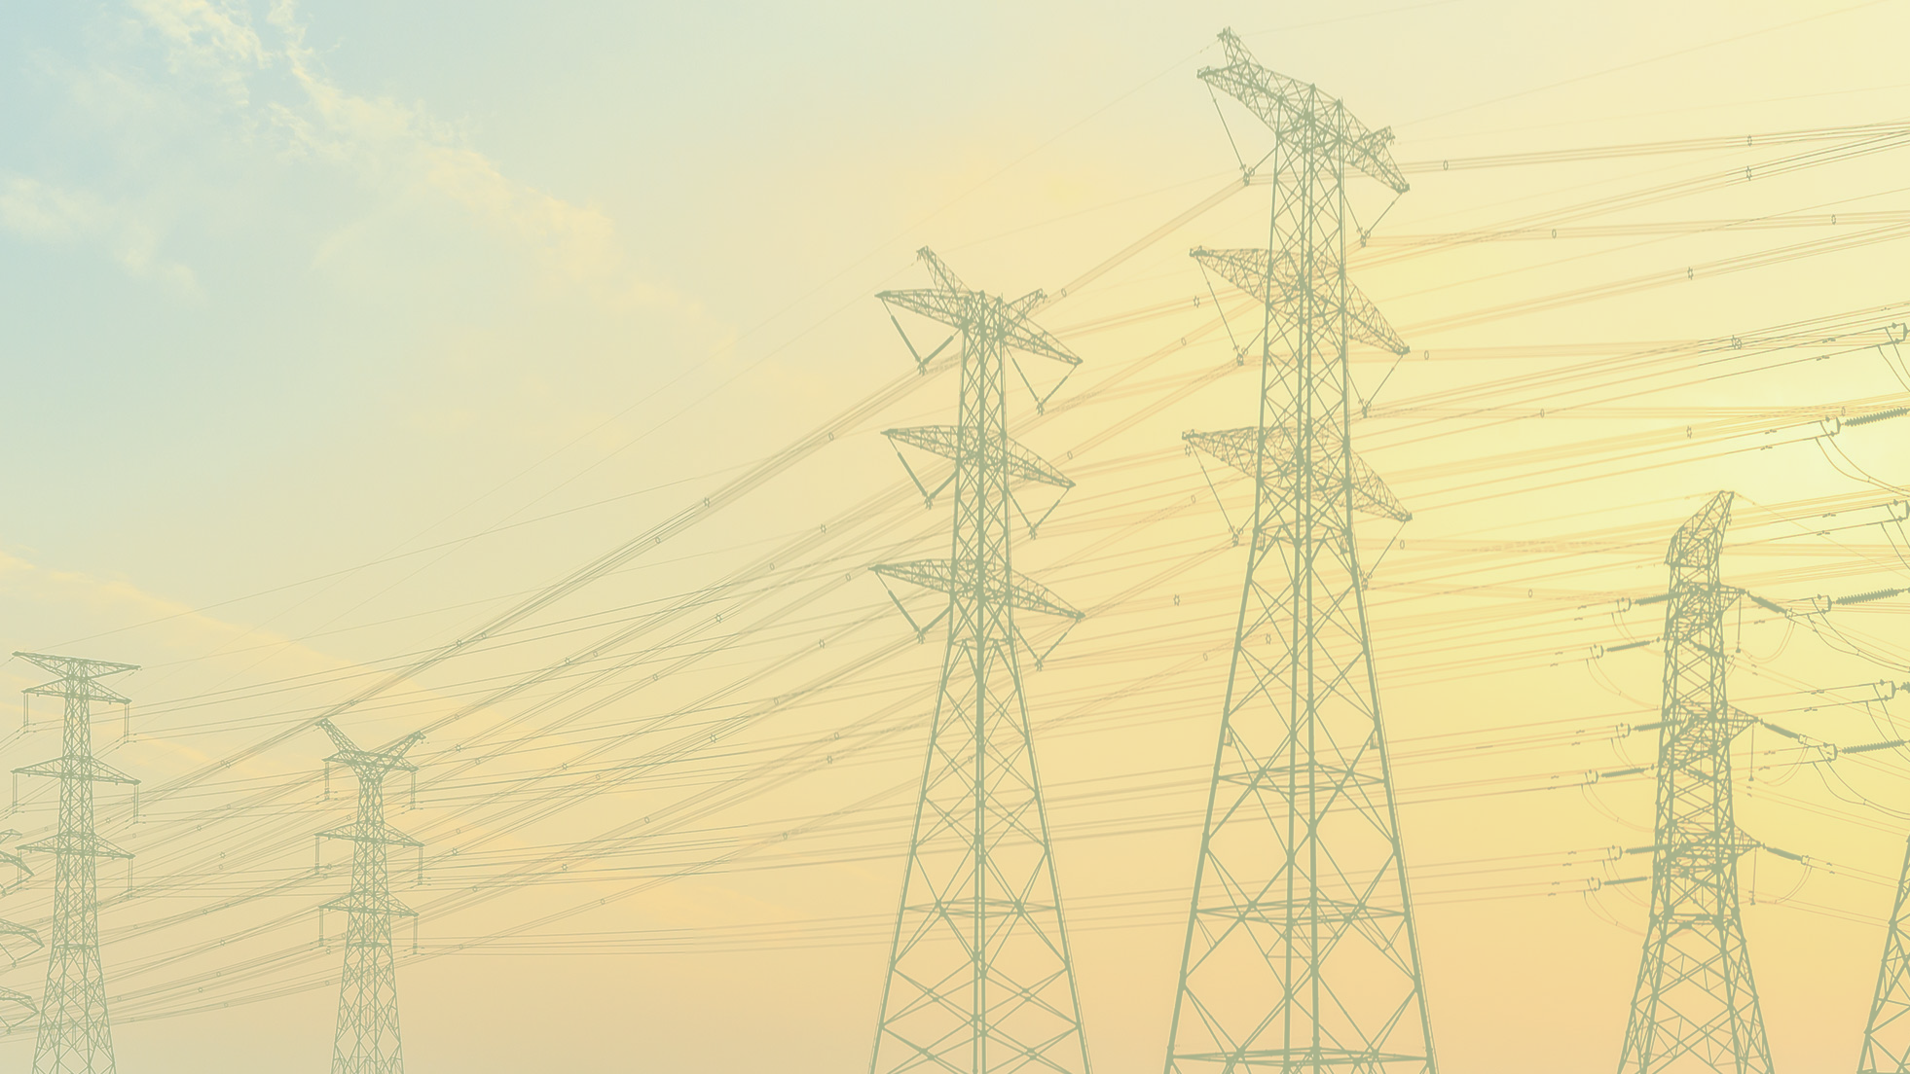

Electrodynamical analysis of a high voltage surge arrester extracted from
Electromechanical simulations of high voltage equipment
Dario Pellegrini, PhD
EB Rebosio – Gruppo Bonomi

Slide 2
Introduction

Slide 3
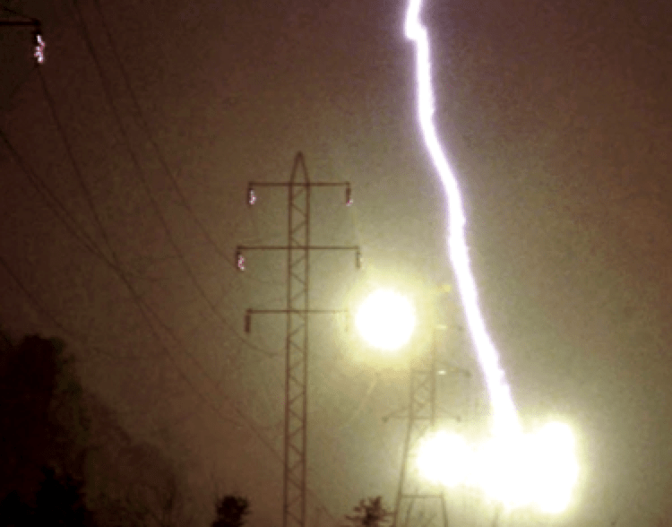

The Problem
The information contained in this presentation is confidential and may contain proprietary information owned by Gruppo Bonomi S.p.A that is protected by intellectual property laws. Any unauthorized use, disclosure, reproduction, or distribution of this information is strictly prohibited.

Slide 4
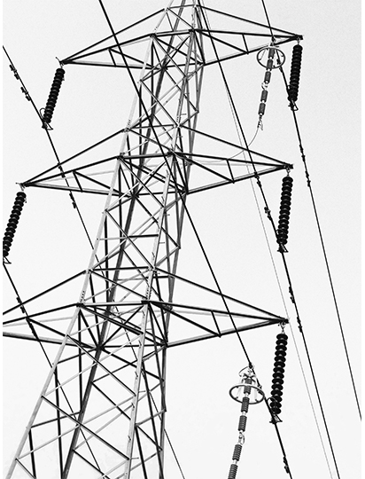
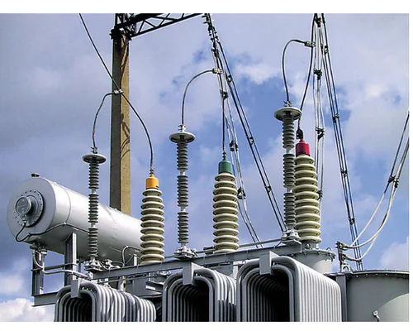
Surge Arresters
The information contained in this presentation is confidential and may contain proprietary information owned by Gruppo Bonomi S.p.A that is protected by intellectual property laws. Any unauthorized use, disclosure, reproduction, or distribution of this information is strictly prohibited.

Slide 5
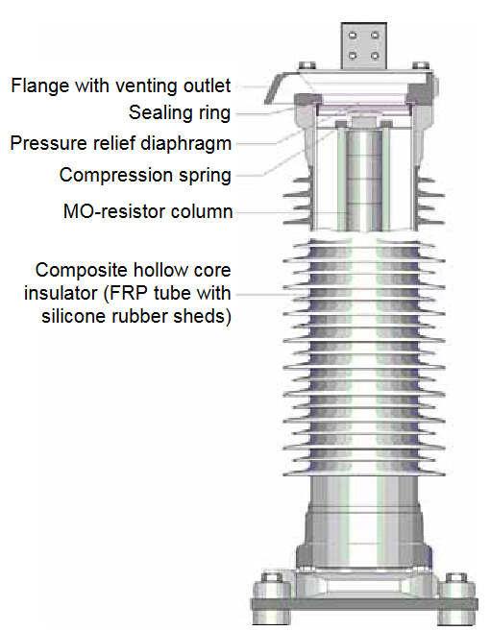
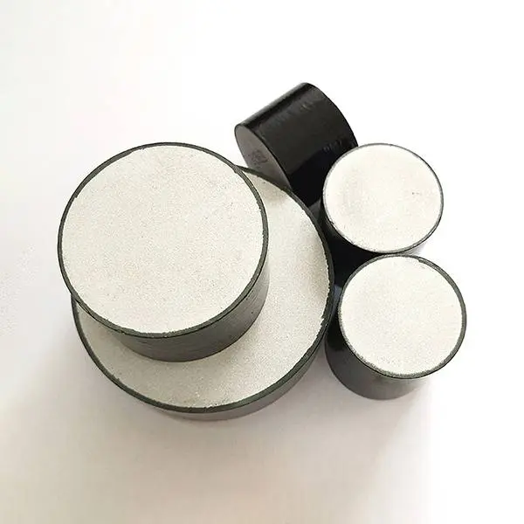
Structure
Doped Metal Oxide Tab Resistors
The information contained in this presentation is confidential and may contain proprietary information owned by Gruppo Bonomi S.p.A that is protected by intellectual property laws. Any unauthorized use, disclosure, reproduction, or distribution of this information is strictly prohibited.

Slide 6
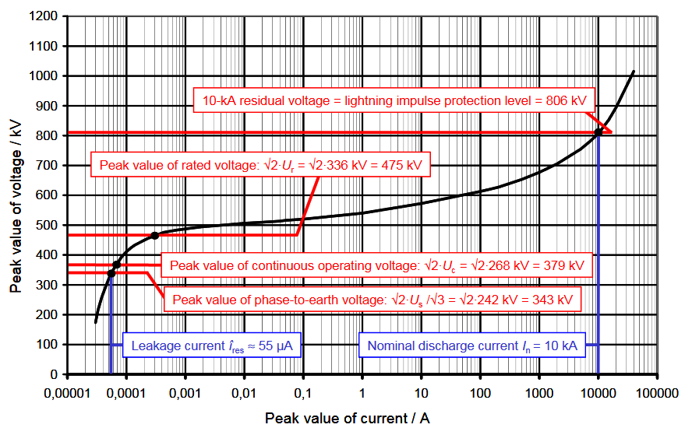
Zinc Oxide Properties
Highly non linear resistivity, acting almost as an open circuit for low voltages, switching to a high conductivity at higher voltages.
The information contained in this presentation is confidential and may contain proprietary information owned by Gruppo Bonomi S.p.A that is protected by intellectual property laws. Any unauthorized use, disclosure, reproduction, or distribution of this information is strictly prohibited.

Slide 7
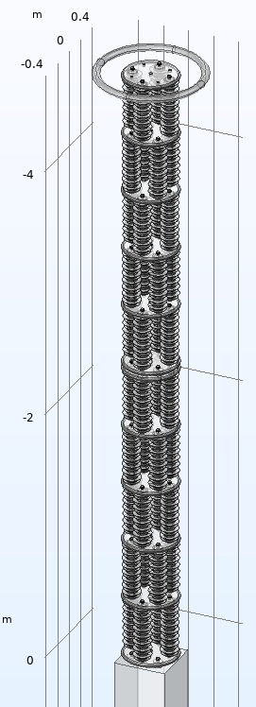
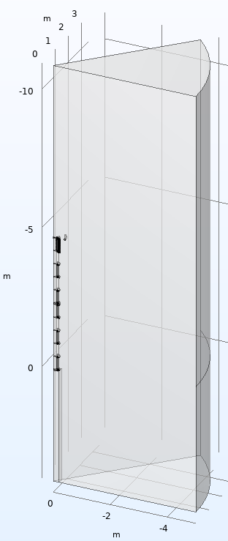
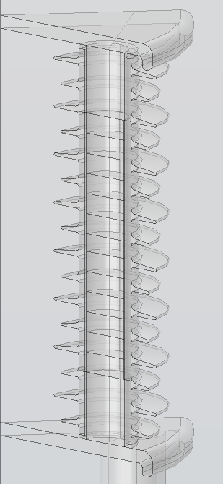
The Project
Multistage surge arrester tower for a nominal 420 kV line.
Composed by 40 modules (4 per floor, 10 floors)
Module geometry
Space modelled profiting from sector symmetry
The information contained in this presentation is confidential and may contain proprietary information owned by Gruppo Bonomi S.p.A that is protected by intellectual property laws. Any unauthorized use, disclosure, reproduction, or distribution of this information is strictly prohibited.

Slide 8
Methods and use of
COMSOL Multiphysics

Slide 9
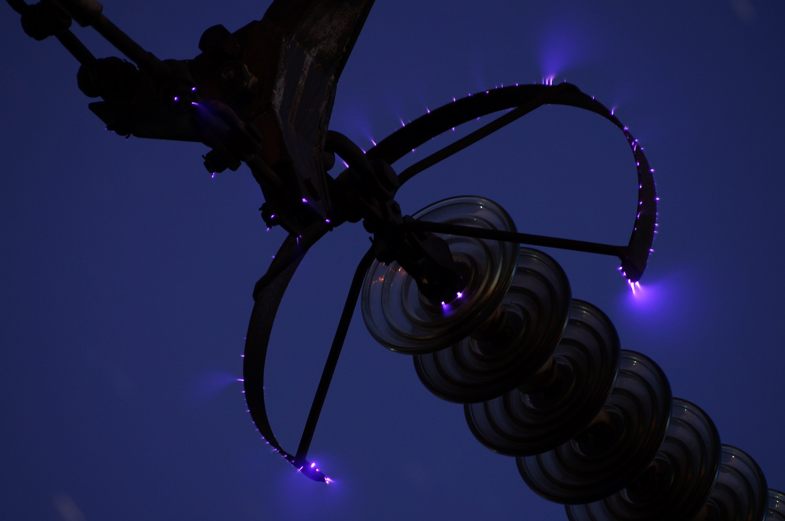
How COMSOL AC-DC Module can help
Evaluation of the electric field
1. Inside the Metal Oxide tabs:
  Prevent excessive stress and premature ageing
2. At the surface:
  Prevent corona activity, tracking, and erosion of the silicone housing
The information contained in this presentation is confidential and may contain proprietary information owned by Gruppo Bonomi S.p.A that is protected by intellectual property laws. Any unauthorized use, disclosure, reproduction, or distribution of this information is strictly prohibited.

Slide 10
Complication
Current distribution
Highly Coupled System
MO resistivity
Voltage profile
Electric field outside and inside the tower
The information contained in this presentation is confidential and may contain proprietary information owned by Gruppo Bonomi S.p.A that is protected by intellectual property laws. Any unauthorized use, disclosure, reproduction, or distribution of this information is strictly prohibited.

Slide 11
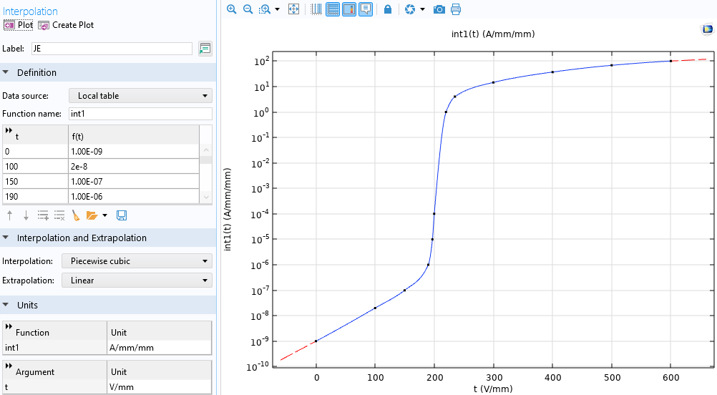
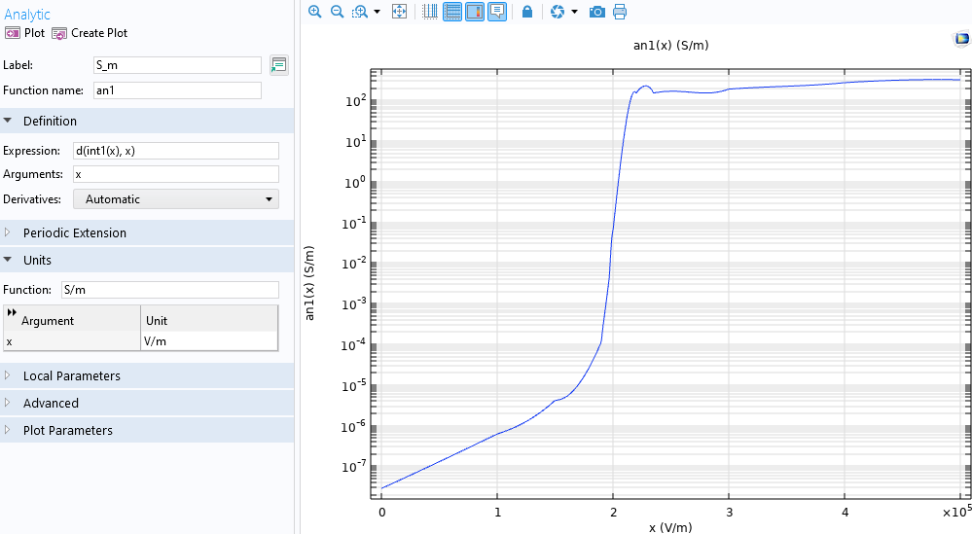
Setup
Voltage-current caracteristic of a tab with particular size from supplier.
Size independent electric field-current density input to COMSOL.
Electric field-Conductivity material property obtained taking a derivative.
The information contained in this presentation is confidential and may contain proprietary information owned by Gruppo Bonomi S.p.A that is protected by intellectual property laws. Any unauthorized use, disclosure, reproduction, or distribution of this information is strictly prohibited.

Slide 12
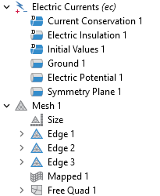
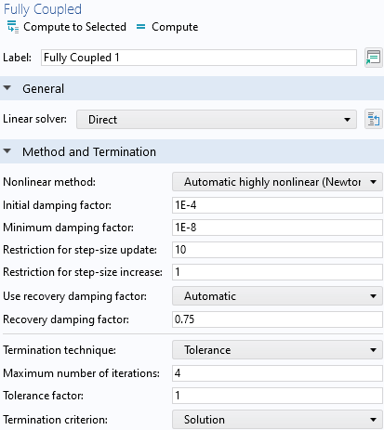
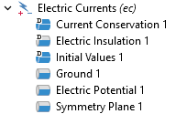
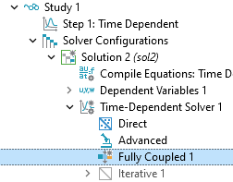
Other Settings
Material | Permittivity [#] | Conductivity [S/m]
Air | 1 | 10⁻¹⁸
Alluminium | 1 | 10^{6 *}
Silicone Gum | 3.5 | 10⁻¹²
Epoxy Fiber Glass | 4.5 | 10⁻¹⁵
ZnO | 830 | an1(root.comp1.ec.normE)
* Can be reduced by a couple of orders of magnitude to improve convergency without impacting on the result (unstable current loops are sometimes observed)
The information contained in this presentation is confidential and may contain proprietary information owned by Gruppo Bonomi S.p.A that is protected by intellectual property laws. Any unauthorized use, disclosure, reproduction, or distribution of this information is strictly prohibited.

Slide 13
Obtained Results

Slide 14
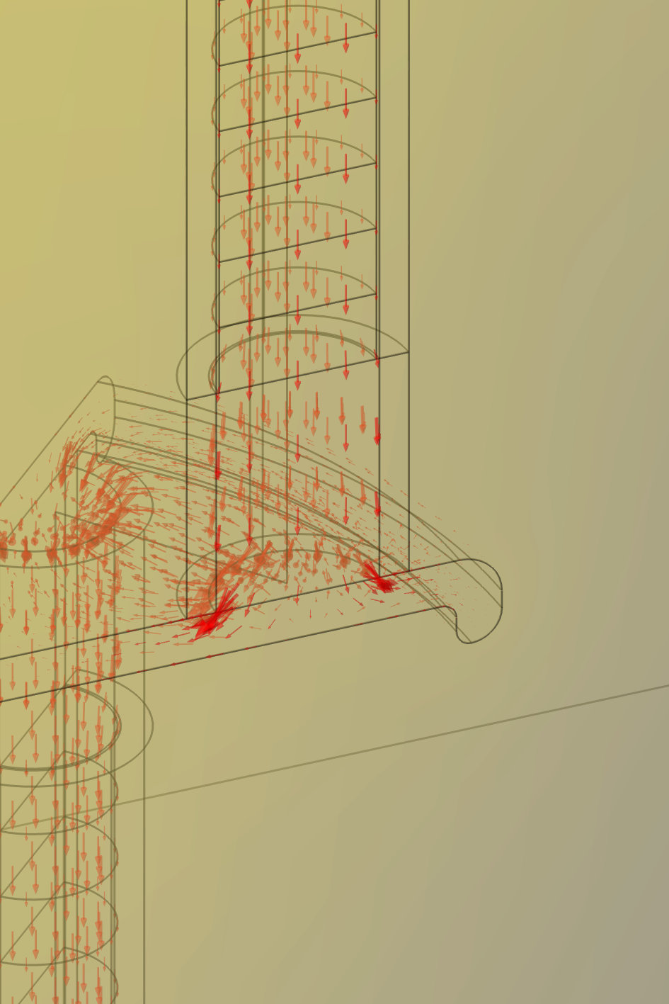
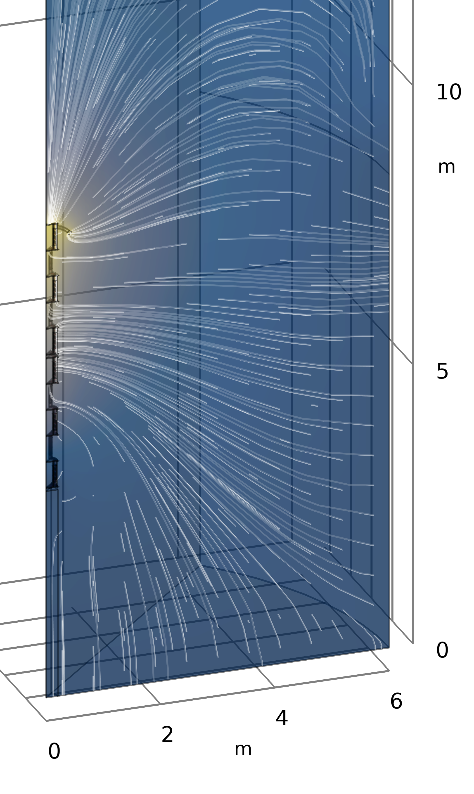
Overview
Check of:
Voltage distribution (blue to yellow)
Electric field lines (white lines)
Current density along the tower (red arrows)
The information contained in this presentation is confidential and may contain proprietary information owned by Gruppo Bonomi S.p.A that is protected by intellectual property laws. Any unauthorized use, disclosure, reproduction, or distribution of this information is strictly prohibited.

Slide 15
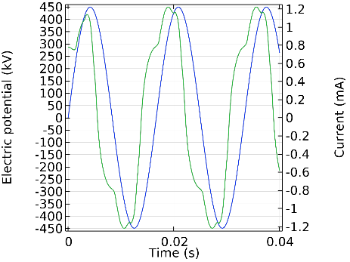
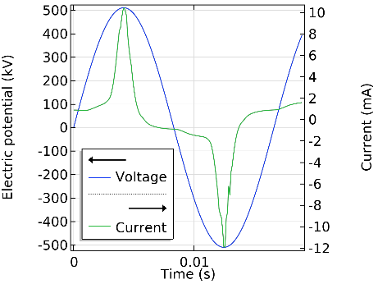
Time dependent current and voltage
Slightly below activation voltage:
strong capacitive component.
Slightly above activation voltage:
strong resistive component.
The information contained in this presentation is confidential and may contain proprietary information owned by Gruppo Bonomi S.p.A that is protected by intellectual property laws. Any unauthorized use, disclosure, reproduction, or distribution of this information is strictly prohibited.

Slide 16
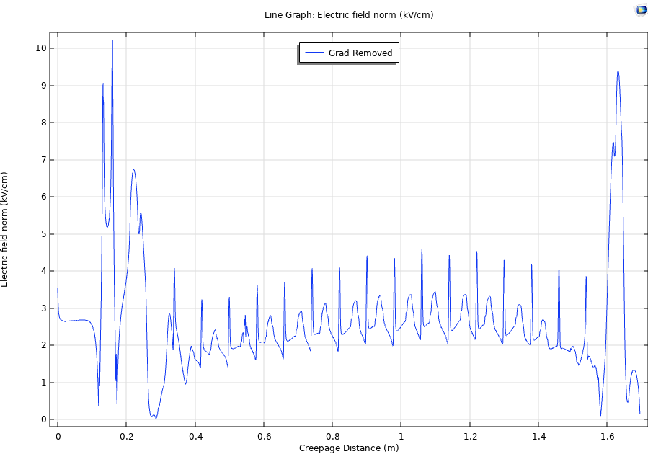
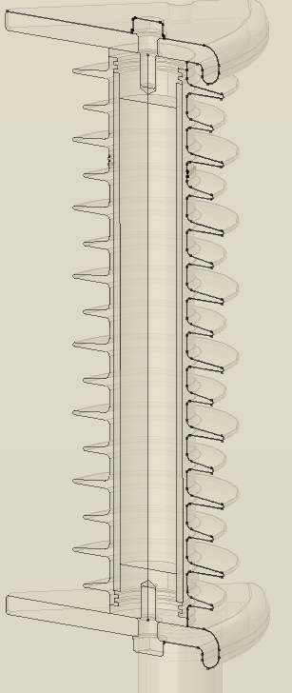
Field at the surface
Field magnitude plotted along a line running 0.5mm from the external surface
The information contained in this presentation is confidential and may contain proprietary information owned by Gruppo Bonomi S.p.A that is protected by intellectual property laws. Any unauthorized use, disclosure, reproduction, or distribution of this information is strictly prohibited.

Slide 17
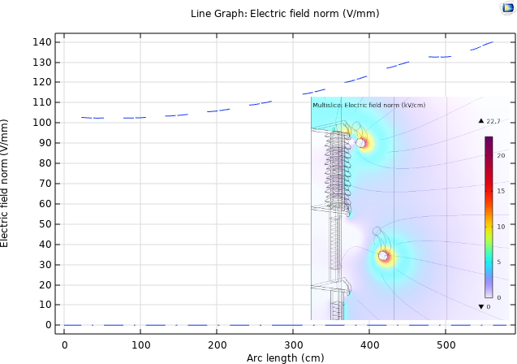
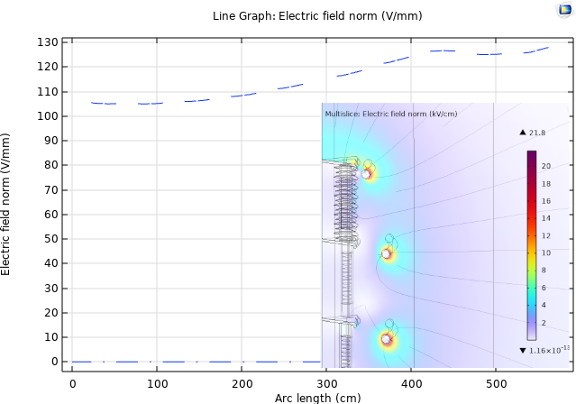
Electric field in the tabs along the tower
Tower base
Tower tip
Design of shielding devices (grading rings) to keep the field within 130 V/mm
The information contained in this presentation is confidential and may contain proprietary information owned by Gruppo Bonomi S.p.A that is protected by intellectual property laws. Any unauthorized use, disclosure, reproduction, or distribution of this information is strictly prohibited.

Slide 18
Conclusions
The study performed with COMSOL AC-DC Module allowed to characterize the electrical behavior of a surge arrester tower, establishing a design for protective devices (grading rings).
The completion of the study required a time transient analysis considering the field dependent conductivity of the metal oxide core.
In addition to the inspection of the field distribution, it was possible to investigate the current density distribution along the tower and to reproduce the transition from capacitive to resistive mode above the threshold voltage.
The information contained in this presentation is confidential and may contain proprietary information owned by Gruppo Bonomi S.p.A that is protected by intellectual property laws. Any unauthorized use, disclosure, reproduction, or distribution of this information is strictly prohibited.

Slide 19
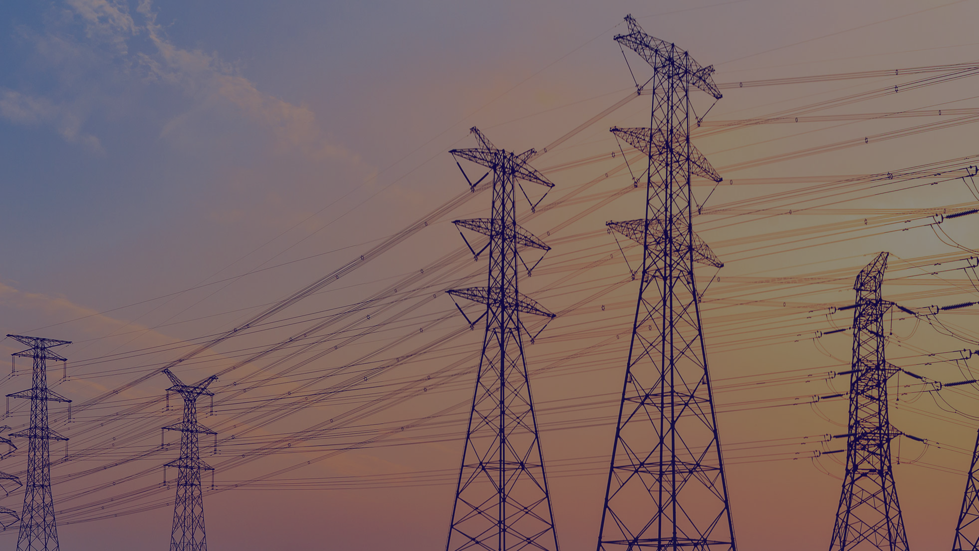
Thank you for your attention

