Slide 1
Development of Quenching Process Recipe Using Simulation
andritz group
J. KadkHodapour
Product Manager
October 2024

Slide 2
Insert chapter overview
01
Problem Statement
02
Data from Jmatpro
03
SimuLation by comsol
04
Result validation
05
Conclusion

Slide 3
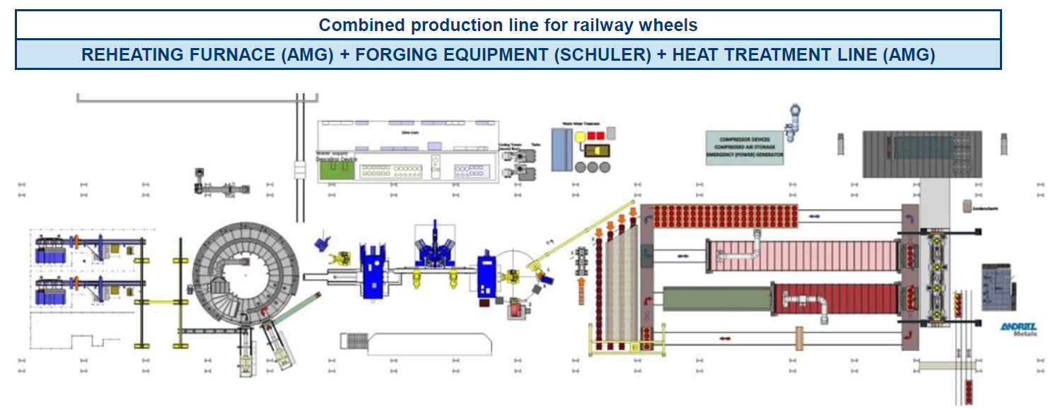






System Description
Simulation problem definition
200ºC
500ºC
1050ºC
780-250ºC
900ºC
450ºC

Slide 4
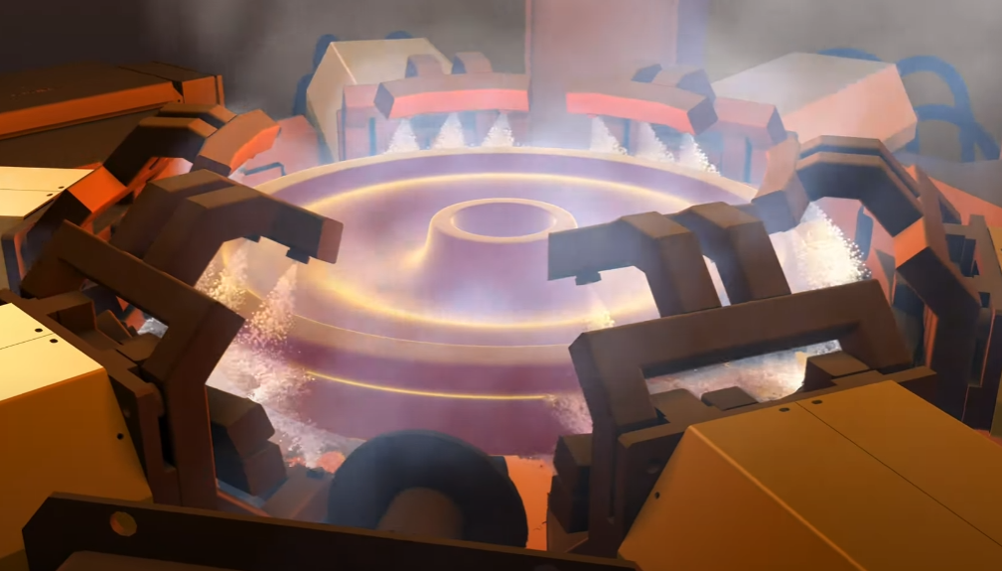
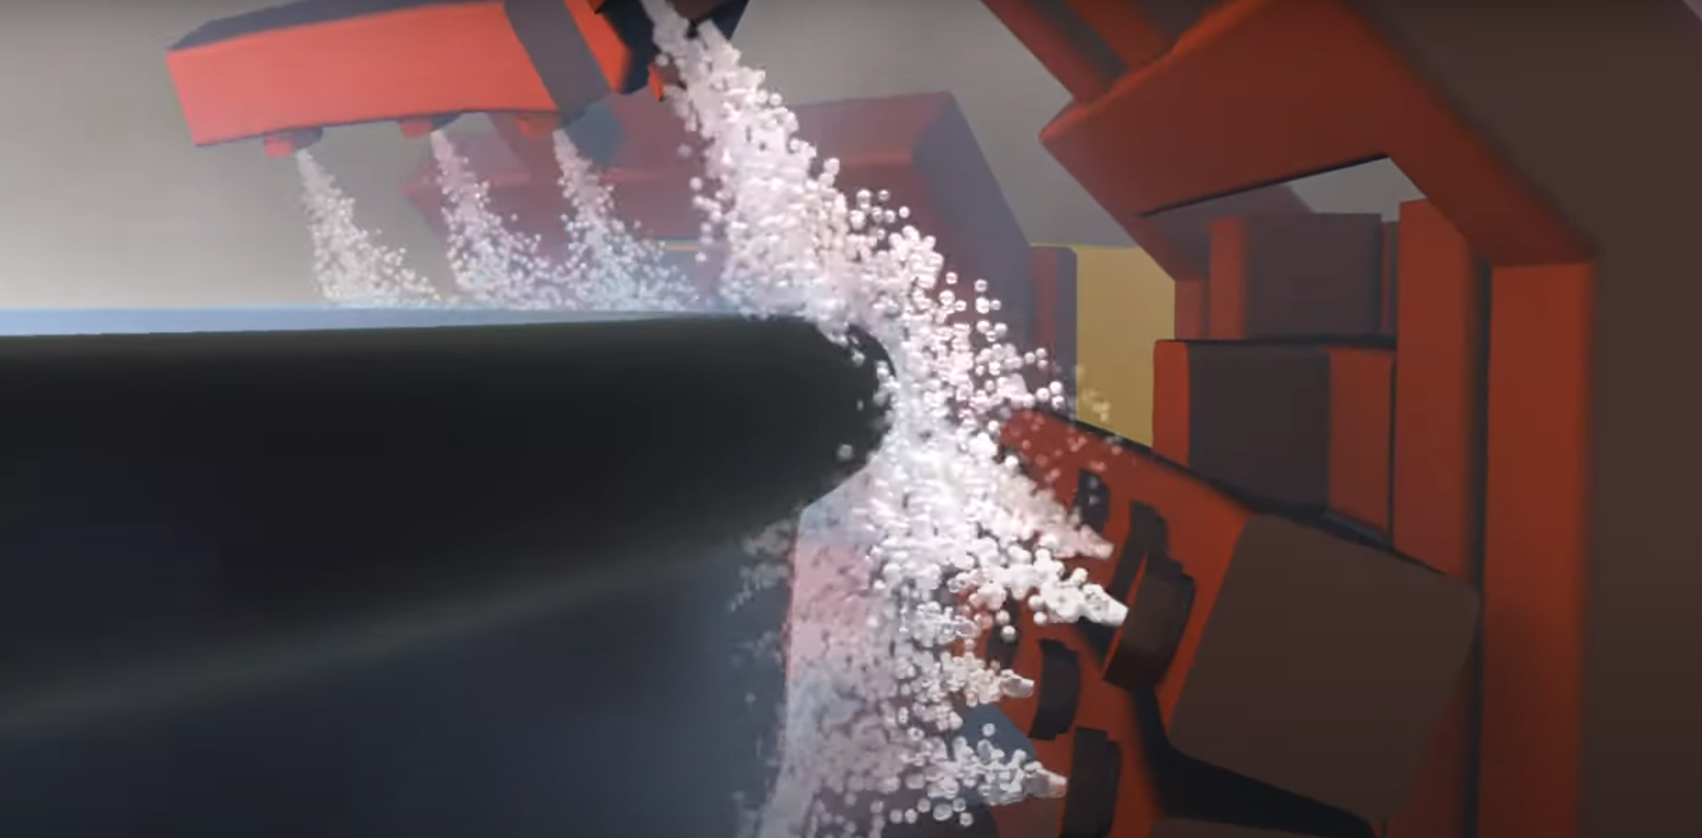
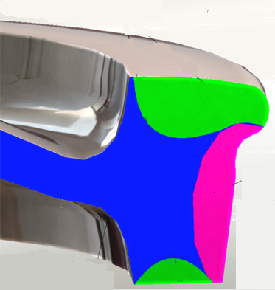
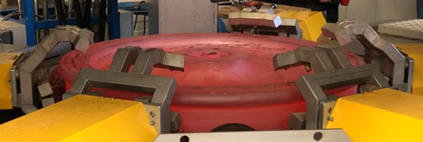
System Description
Simulation problem definition

Slide 5
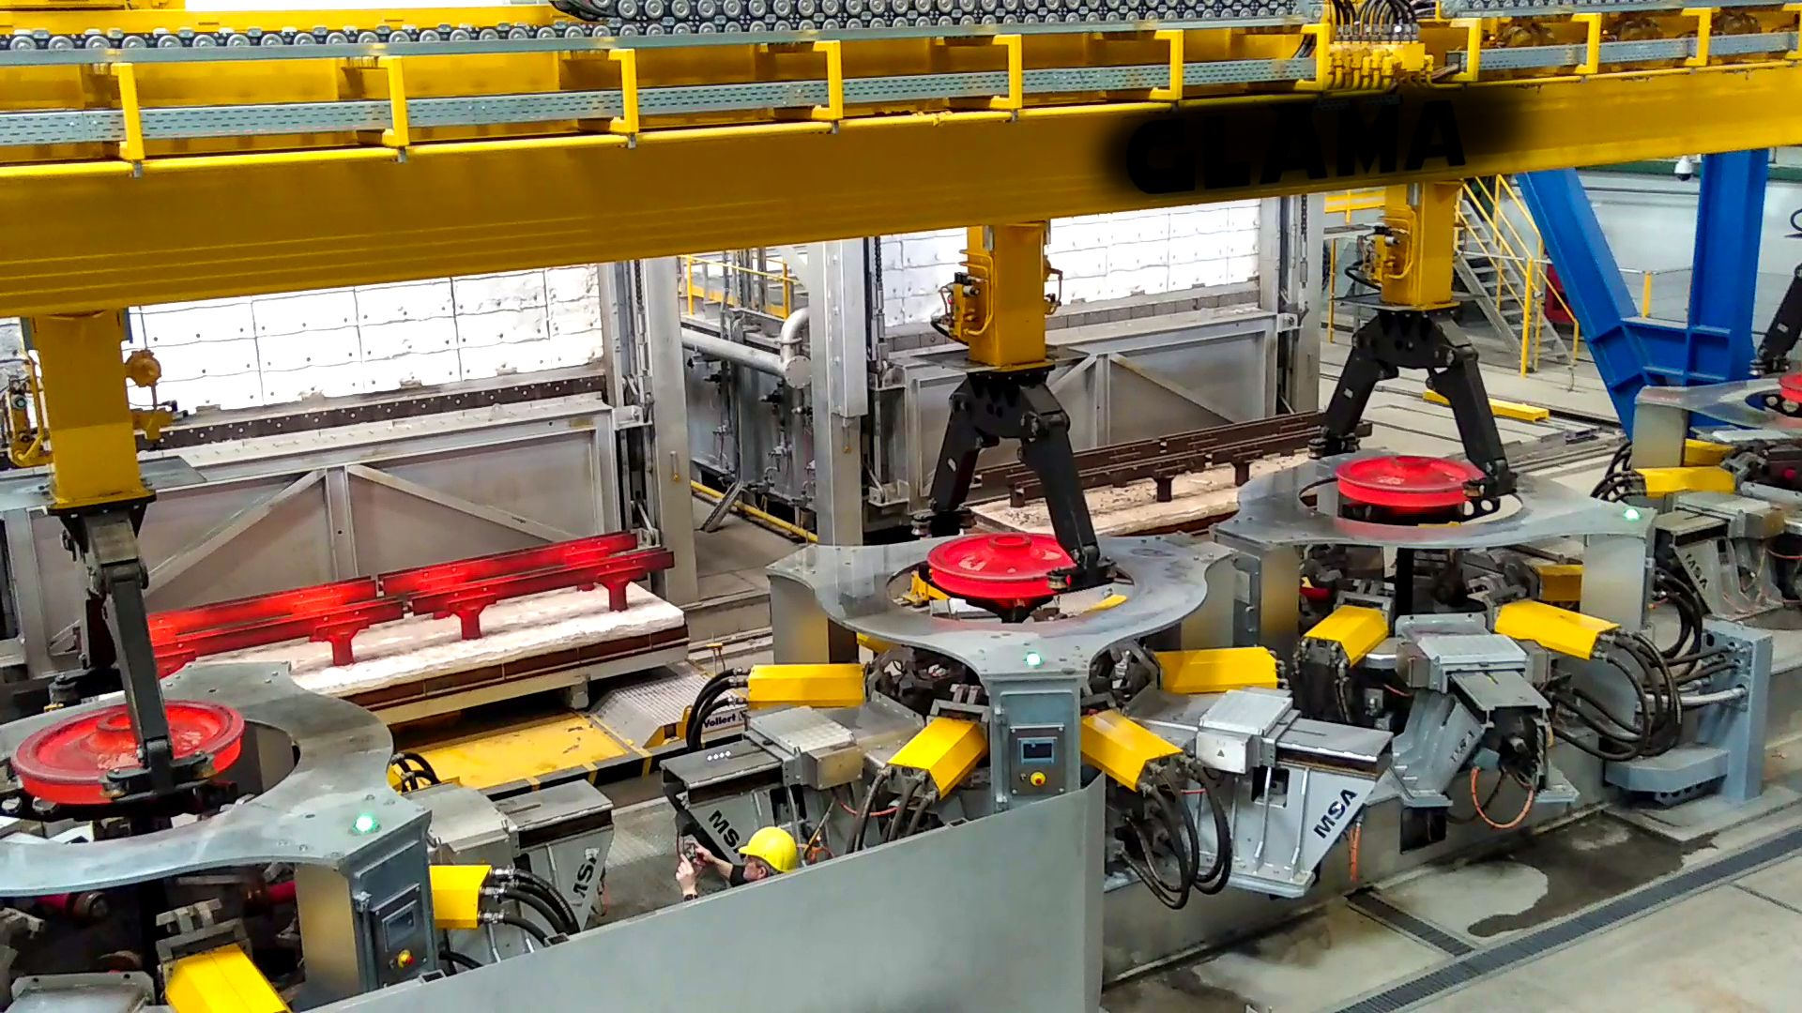

Slide 6
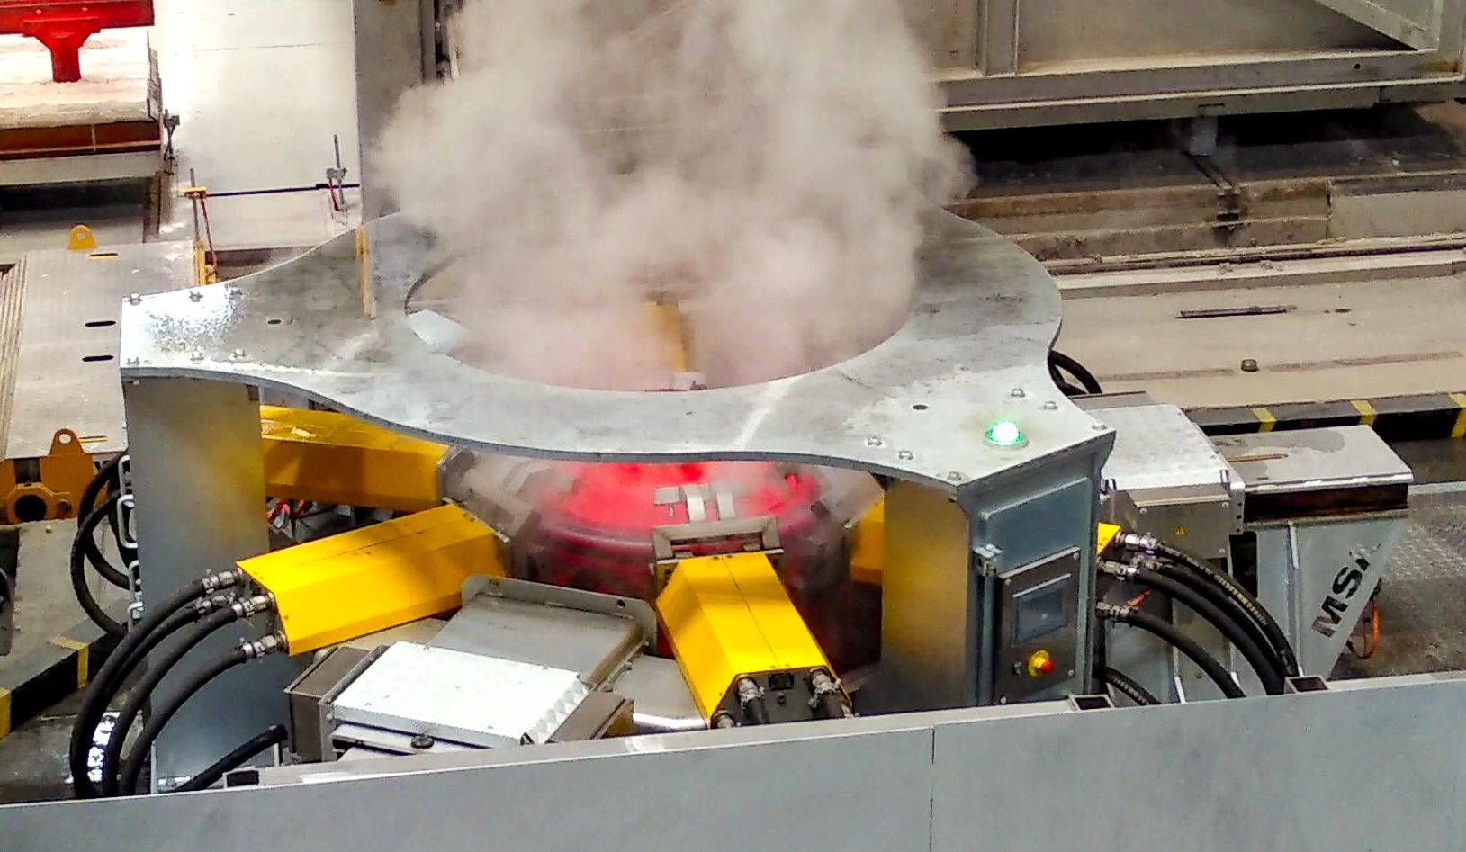

Slide 7
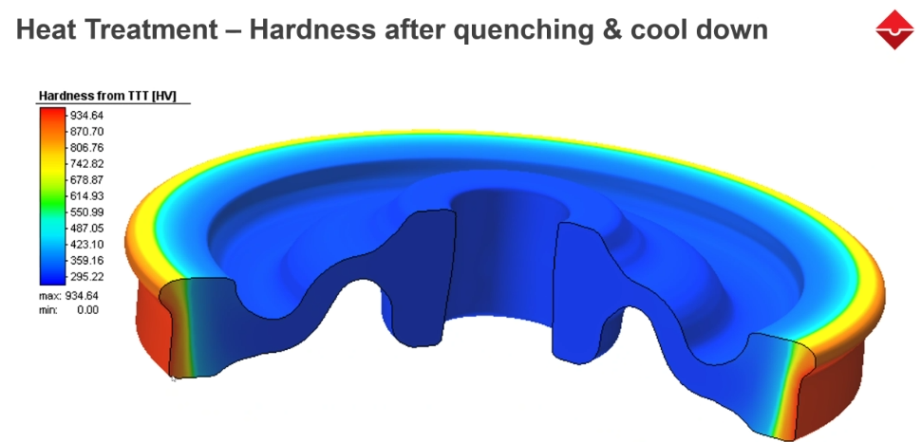
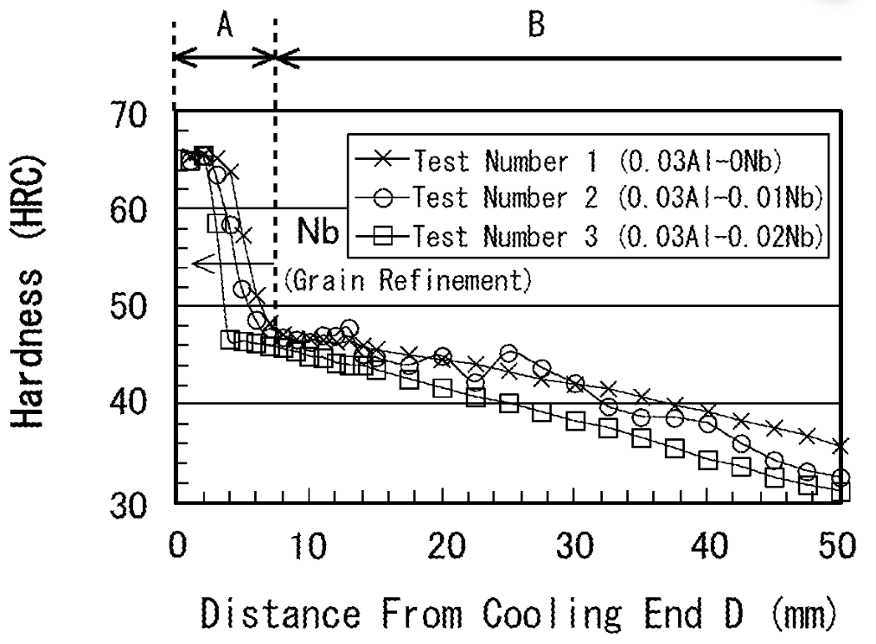
Problem statement
Simulation problem definition: Data
Ref: US11890894B2 patent, 2019, Nippon Steel Corp
Distance from surface

Slide 8
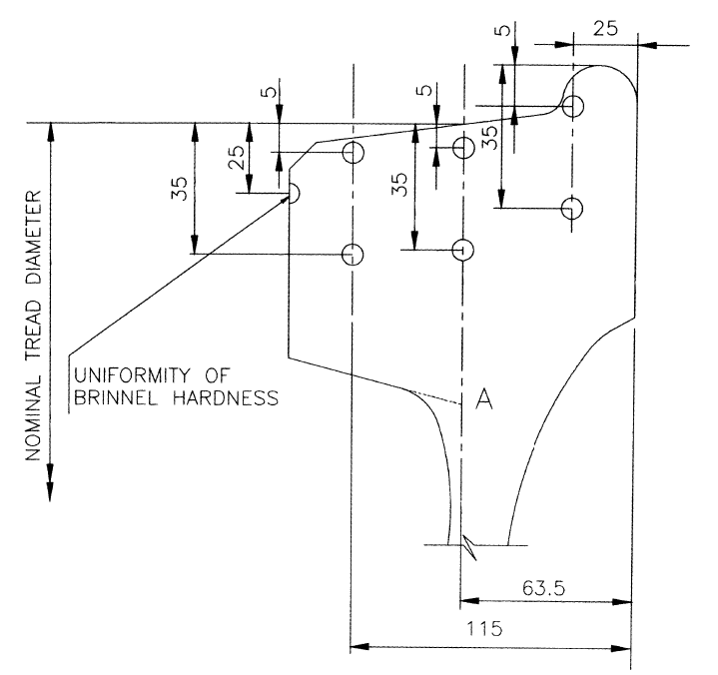
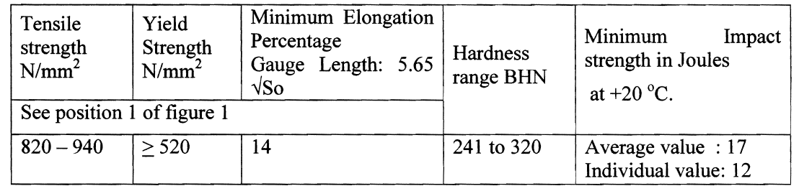
Hardness value in EN IRS-R-19/93 Standard
Test for measurement of hardness
The difference between extreme hardness values within a batch shall not exceed 30 BHN.
The microstructure of wheel shall be "Fine Pearlite structure with ASTM grain size 6 or finer."

Slide 9
Insert chapter overview
01
Problem Statement
02
Data from Jmatpro
03
SimuLation by comsol
04
Result validation
05
Conclusion

Slide 10
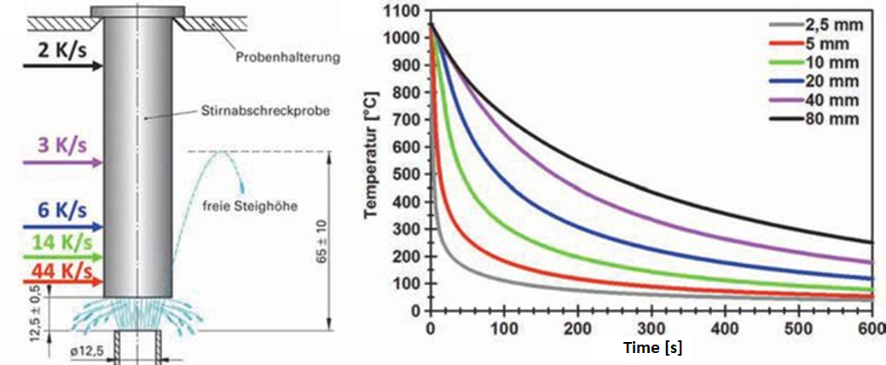
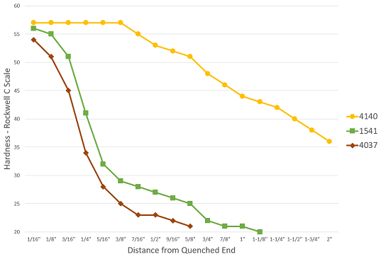
Simulation flow and required data
Standard Test for Hardenability
Jominy Test: based on ISO 642 is what we want to focus on and validate by simulations results

Slide 11
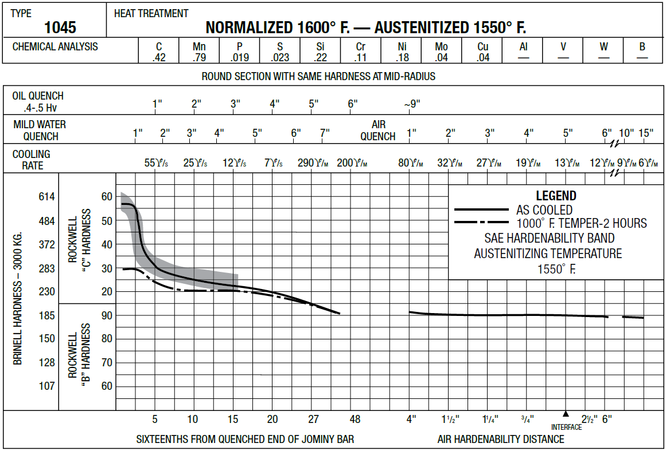

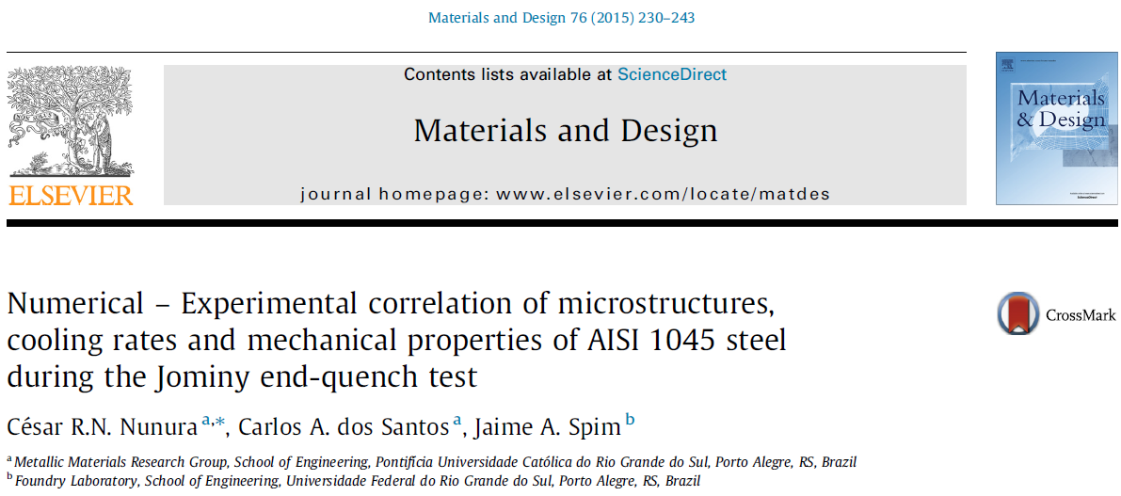
Chemical compositions and Hardenability
Experimental Data for the 1045 Steel

Slide 12
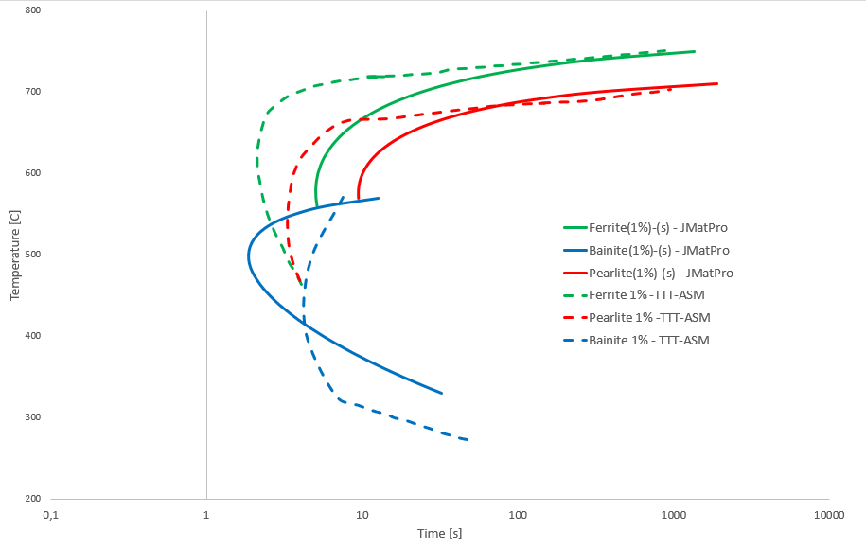
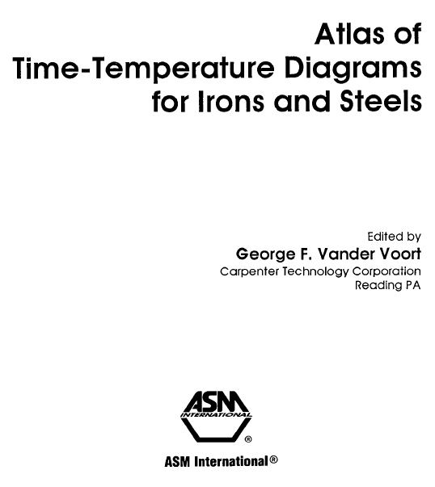
Chemical compositions and TTT Diagram
Experimental Data for the 1045 Steel and JMatPro output

Slide 13
Insert chapter overview
01
Problem Statement
02
Data from Jmatpro
03
SimuLation by comsol
04
Result validation
05
Conclusion

Slide 14
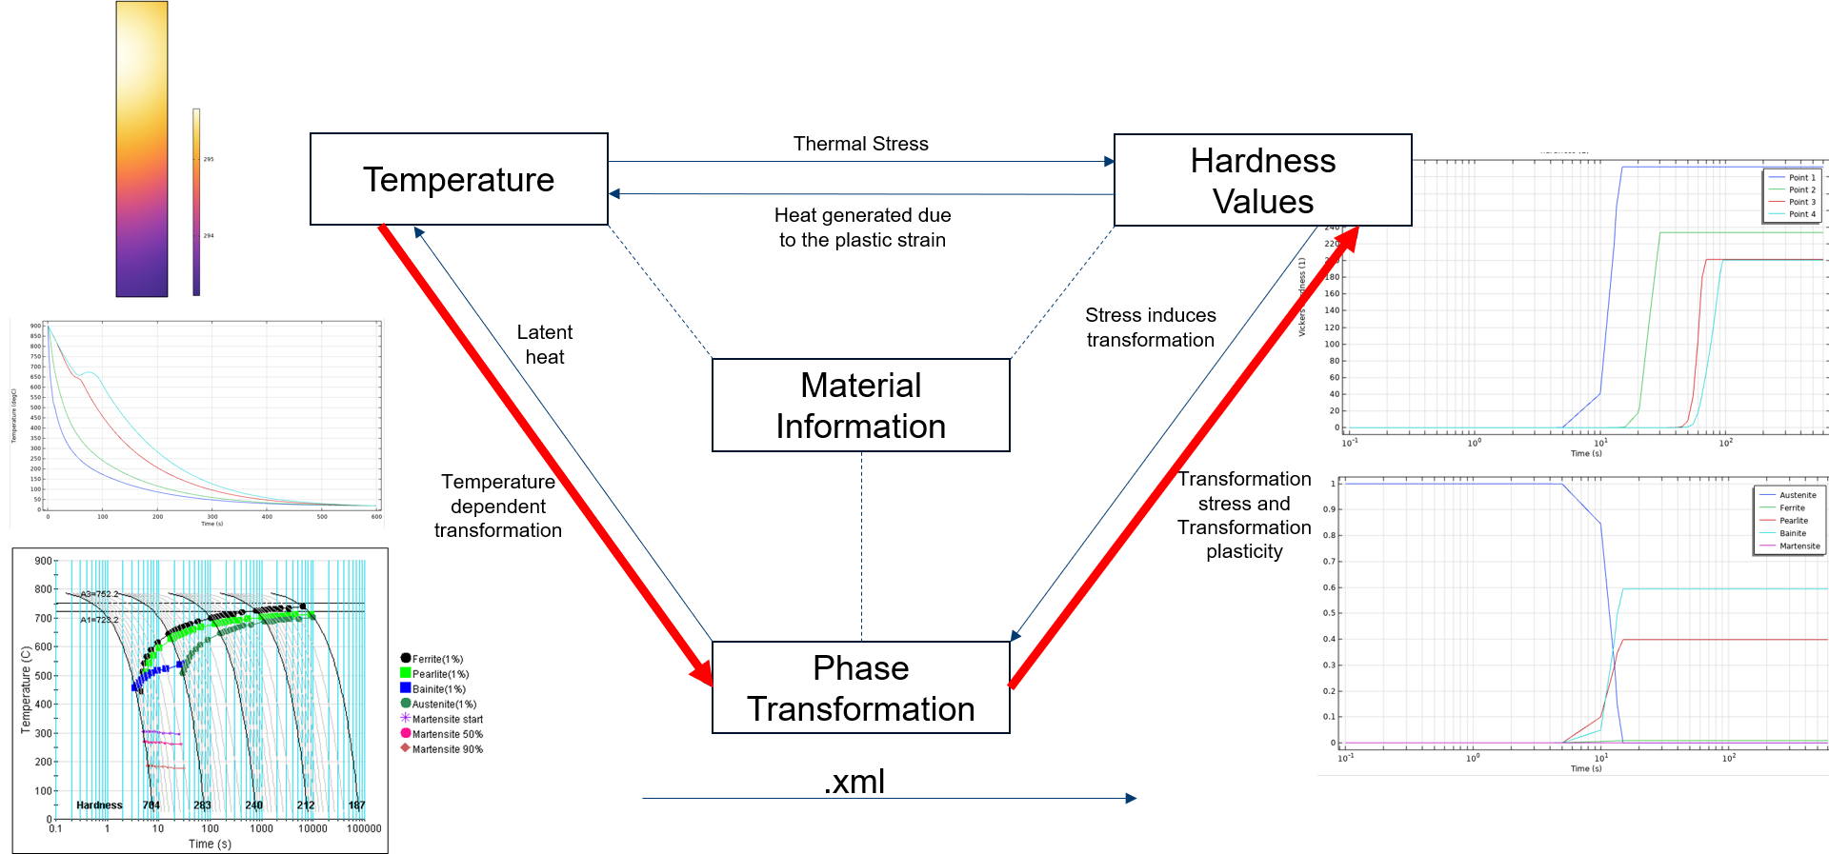
Comsol Simulation flow

Slide 15
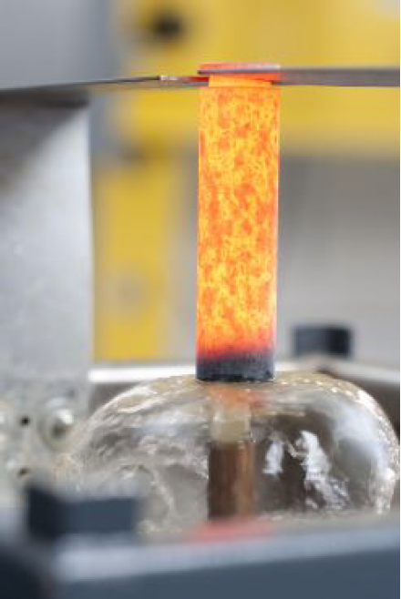
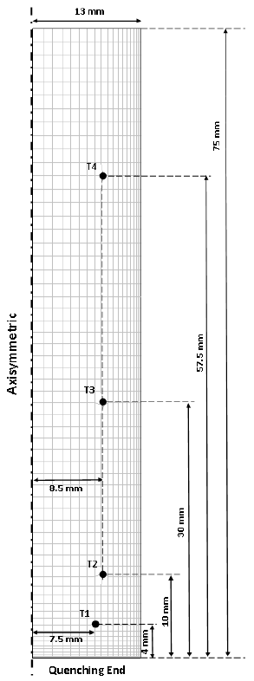
Model boundary conditions
Dataloger
Radiative Emisivity (ε) = 0.8
Heat Transfer Coefficient (hc) = *Next Slide

Slide 16
Insert chapter overview
01
Problem Statement
02
Data from Jmatpro
03
SimuLation by comsol
04
Result validation
05
Conclusion

Slide 17
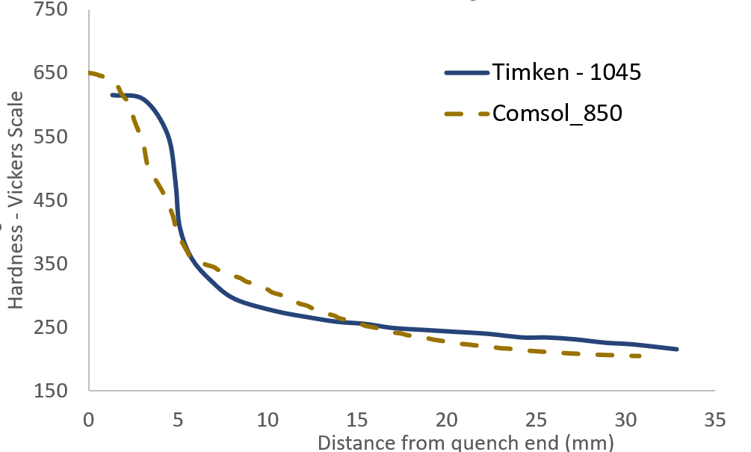
Comsol simulation results

Slide 18
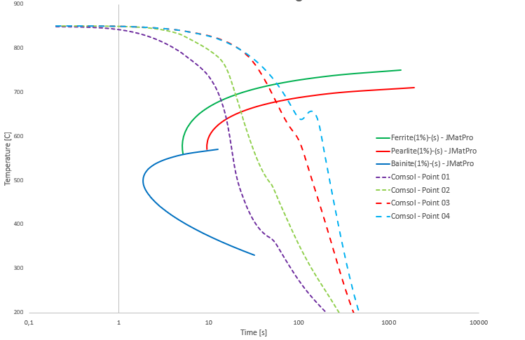
Austenatizing temperature effect

Slide 19
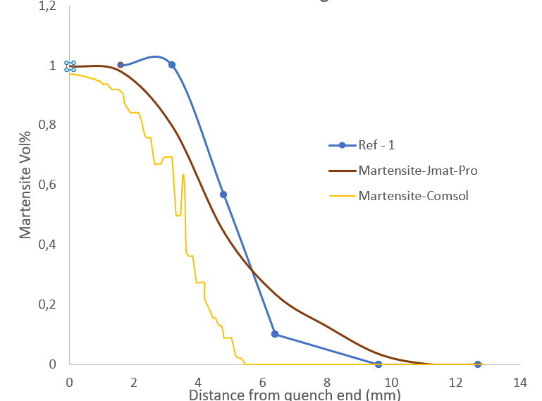
Martensite phase fraction
Martensitic microstructures for
Distance from quenched end: 1.6 mm.
Etching: Nital 3%.

Slide 20
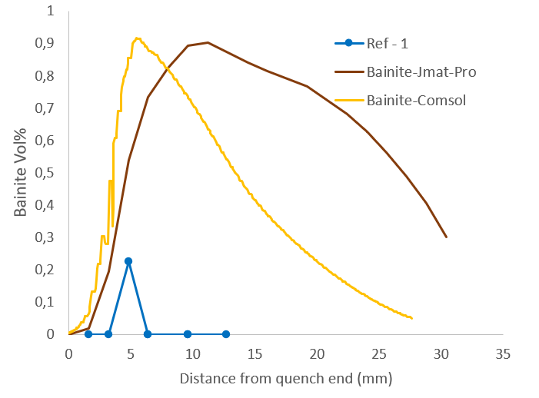
Bainite phase fraction
Microstructures for
Distance from quenched end: 4.8 mm.
Etching: Nital 3%.

Slide 21
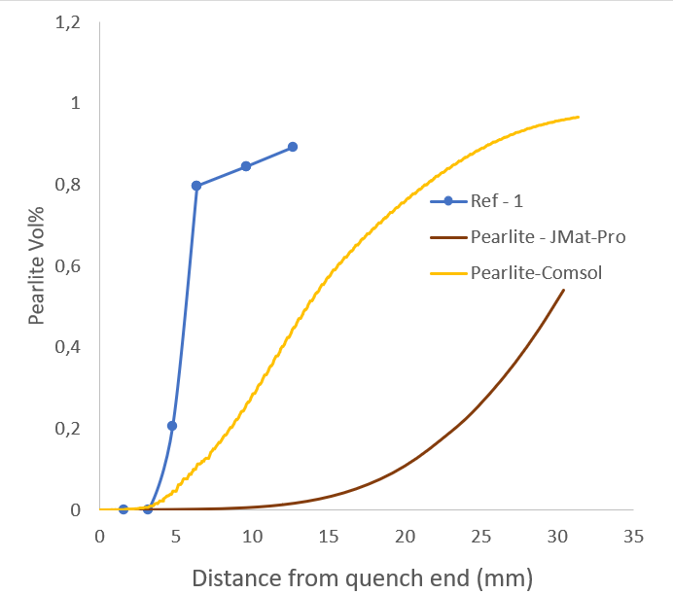
Pearlite phase fraction
Microstructures for
Distance from quenched end: 12.7 mm.
Etching: Nital 3%.

Slide 22
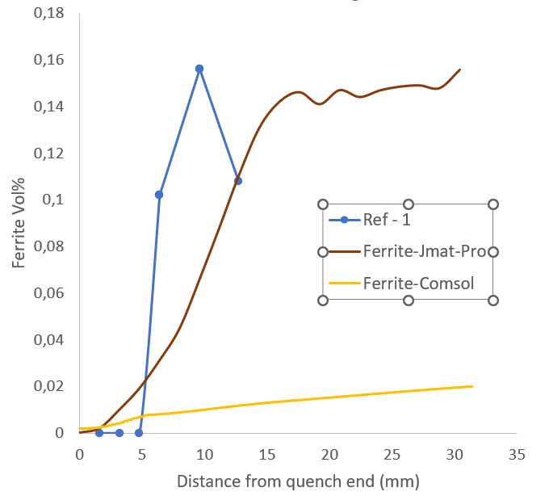
Ferrite phase fraction
Microstructures for
Distance from quenched end: 12.7 mm.
Etching: Nital 3%.

Slide 23
Insert chapter overview
01
Problem Statement
02
Data from Jmatpro
03
SimuLation by comsol
04
Result validation
05
Conclusion

Slide 24
Conclusion
The combination of JMatPro and COMSOL can well predict the hardness of material after quenching.
Some further parametric study is required to be sure about the values of different phases from simulation.
The validated results can be used to design process for railway quench.

Slide 25
Andritz
Stays Hot On Your Trail
To Uncover The Coolest Solutions!

