Slide 1
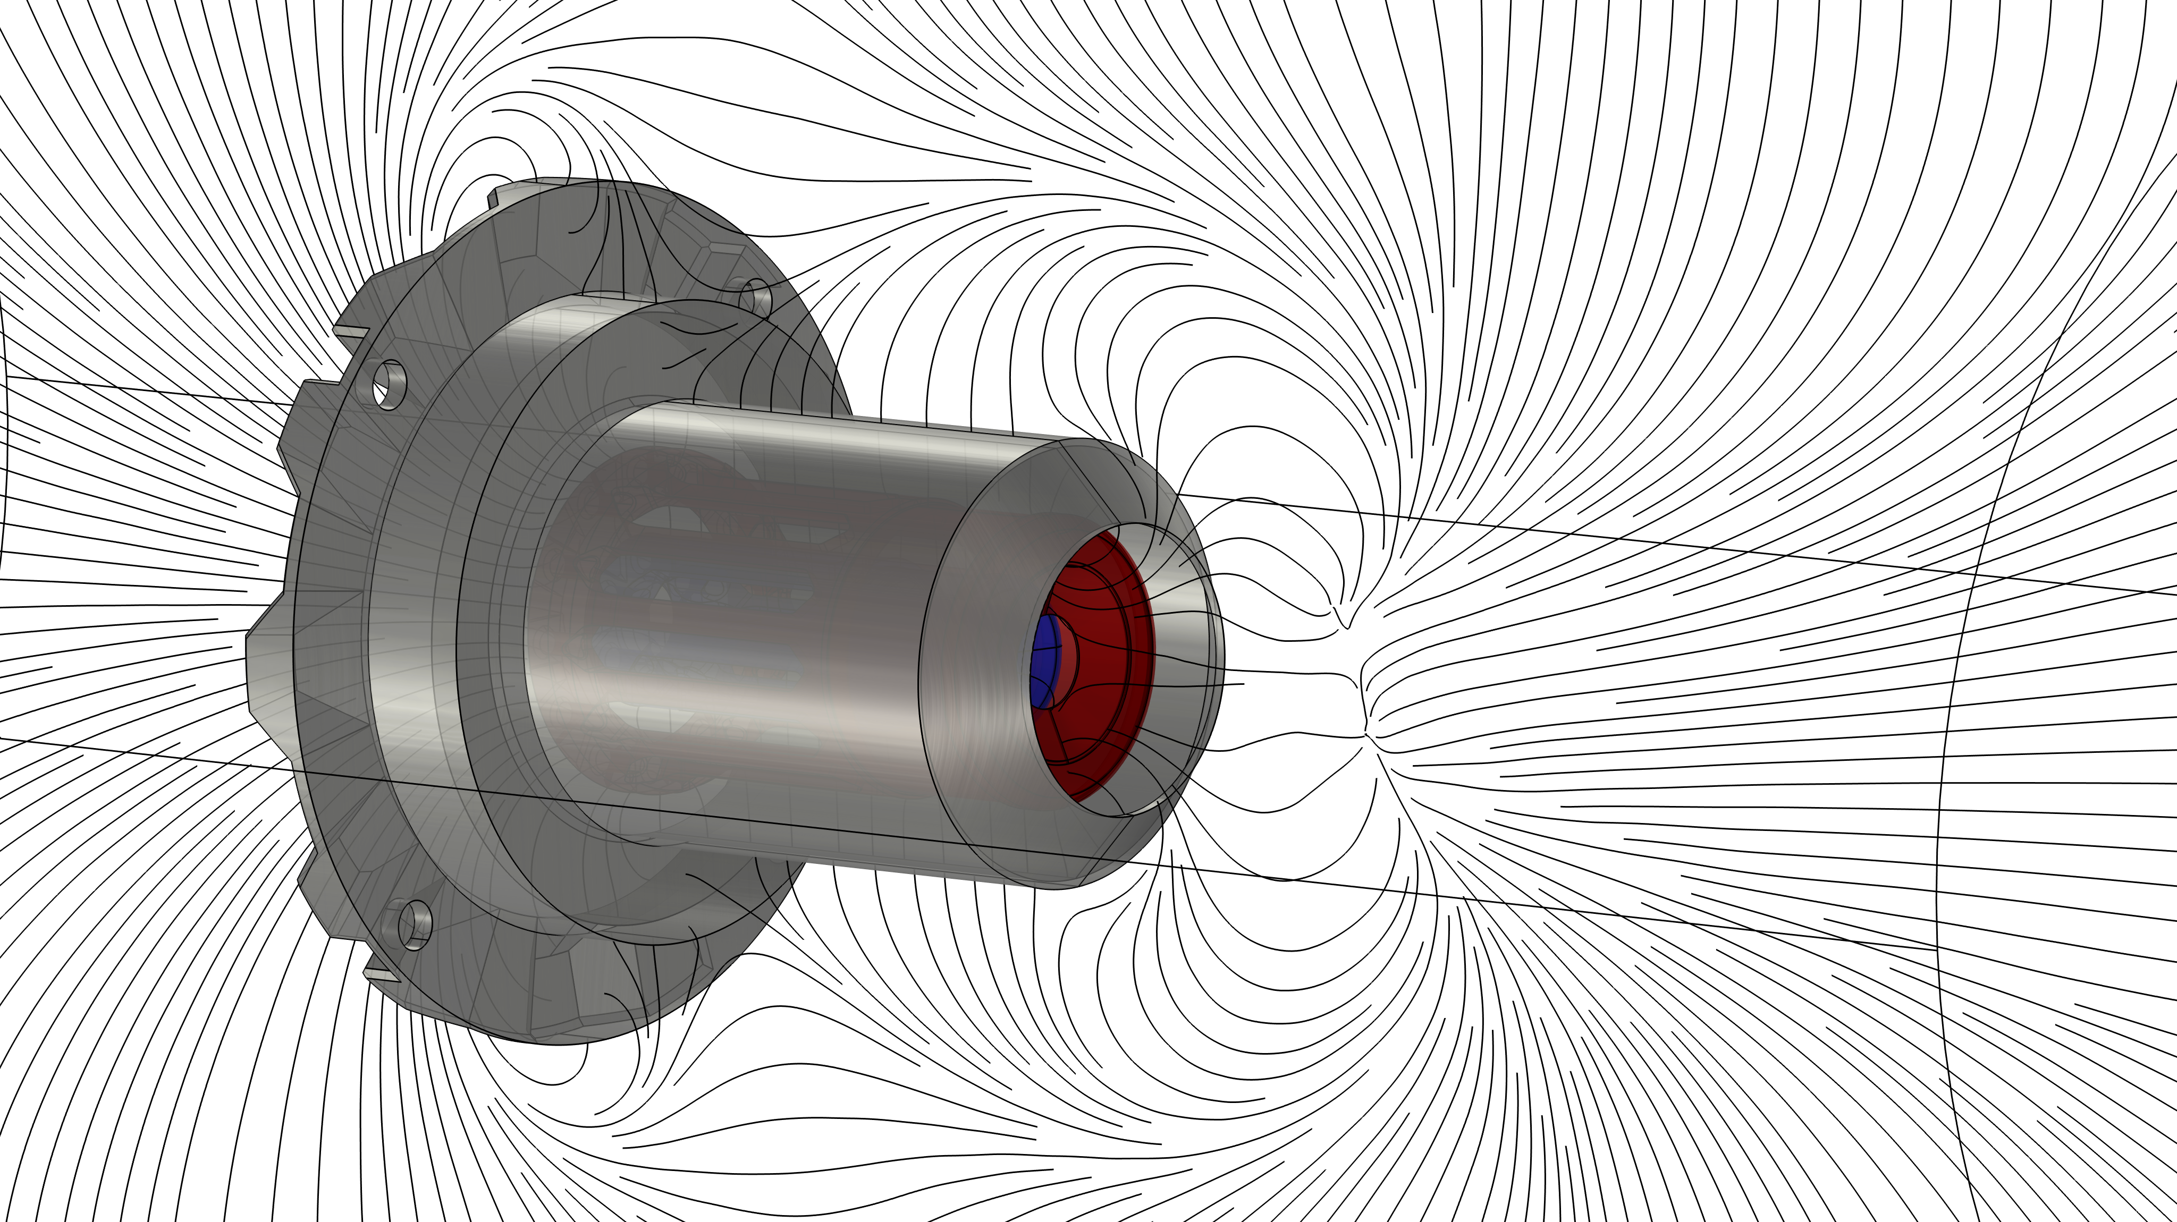

Development of a Spacecraft Neutralizer
COMSOL Conference 2024| October 22-24, 2024 | Florence, Italy
Linda Oster, Bernhard Seifert, Andreas Siegl
FOTEC Forschungs- und Technologietransfer GmbH, 2700 Wiener Neustadt, Austria
Notes:
Introduction:
Company
developing thruster for small satellites
topic

Slide 2
Overview
Contents
Introduction and Background
  Earth Observation Missions
  Neutralization
  Dry Neutralizer System
Simulations with COMSOL Multiphysics
Results
Conclusion and outlook

Slide 3
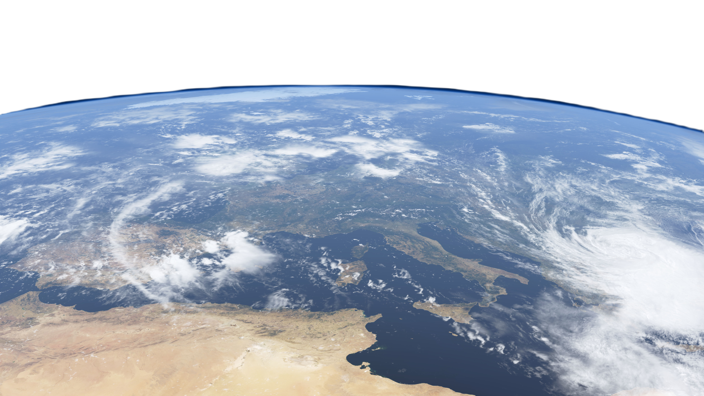

Introduction and Background
Earth Observation Missions
Sensitive measurement devices
Limited power budget
Mission requirements
Thruster
Glacier melting
Changes in sea level
Tectonic plate movement
Wind profiles
Soil moisture
Source: ESA - https://www.esa.int/Applications/Observing_the_Earth/ESA_for_Eartharth
Notes:
looking at our planet (show where we are with laserpointer) from space, there are many phenomena to be observed
examples...
to obtain data, satellites with sensitive measurement equipment are operating in space
often long duration missions for more than 5 years
power budget is limited
for drag compensation and station keeping the satellite needs a thruster
often ion thruster

Slide 4
Introduction and Background
Neutralization
Risk
Spacecraft charging effects due to plasma interaction, solar winds, photoelectric effect or ion thrusters
Compromise spacecraft measurement equipment or can lead to
sparkovers can damage components
+
+
+
+
+
+
+
+
-
-
-
-
-
-
-
-
Negatively charged space craft (left) and neutral space craft (right).
Notes:
Important because
UV photons from the sun release electrons from the spacecraft hull (outer photoelectric effect)
Ion thruster (often used for these missions)
imagine the spacecraft in orbit with ion thruster
electrons remain and cause a negative charge
Compromise measurement equipment
can lead to sparks or damages of the space craft equipment
Solution: remove the electrons

Slide 5
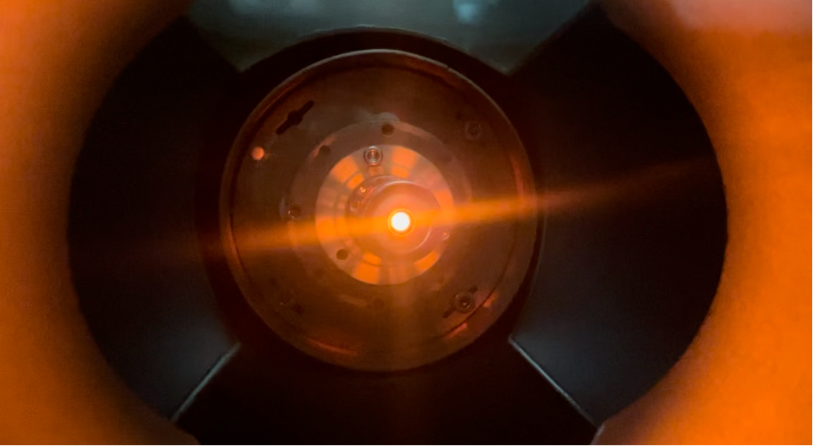
Introduction and Background
Dry Neutralizer System
Design Drivers and Features
Current up to 80 mA
Low power consumption
Propellant less
Thermionic electron source
Optics to form a laminar beam
Dry Neutralizer during operation at FOTEC’s test facilities
Notes:
to achieve this, the so-called dry neutralizer is being developed at fotec
dry neutralizer means, that in contrast to conventional neutralizers, no gas is needed as propellant for operation
only electric power is needed to supply the thermionic electron source
combination with optics is supposed to form a laminar electron beam with 80mA
image

Slide 6



Simulations with COMSOL Multiphysics
Challenges
Laminar electron beam with 80 mA
Geometry
Potentials of the electrodes
Influence of dimensions and potentials on the electron beam
Verification of the resulting mechanical design
-
-
-
-
Notes:
simulations with comsol were used in the beginning in order to find geometry and potentials to form the electron beam
further, the influence of dimensions and potentials on the beam were investigated
resulting mechanical design was verified with simulations

Slide 7
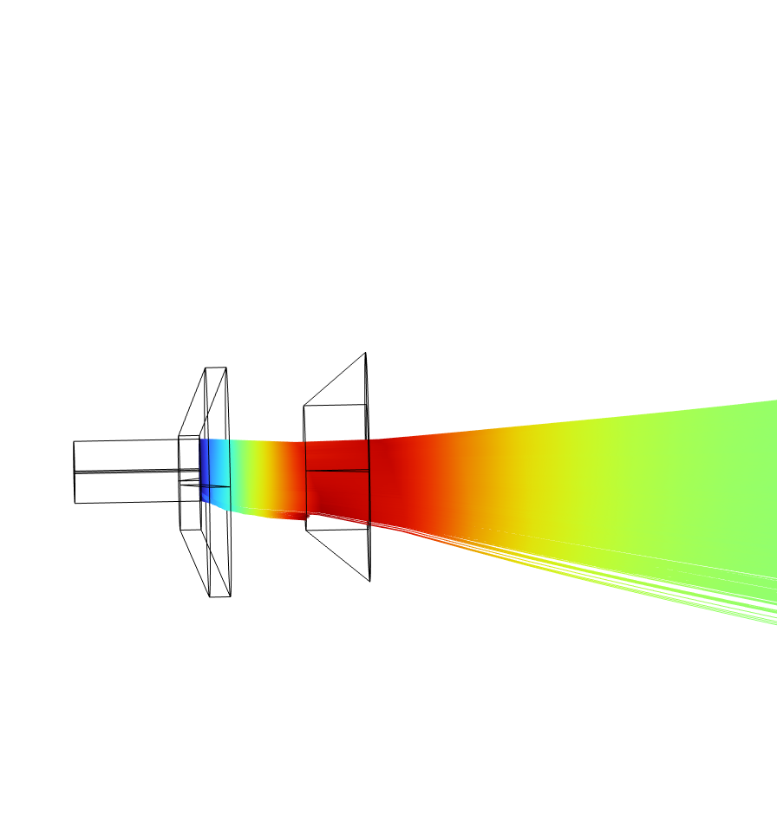
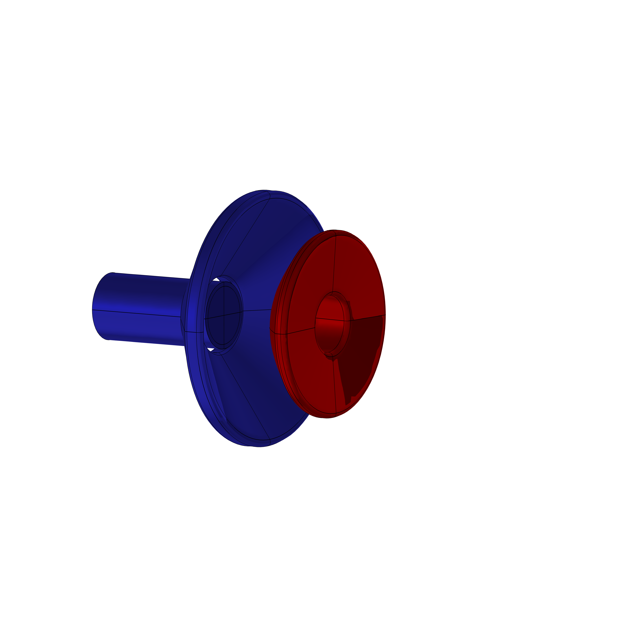
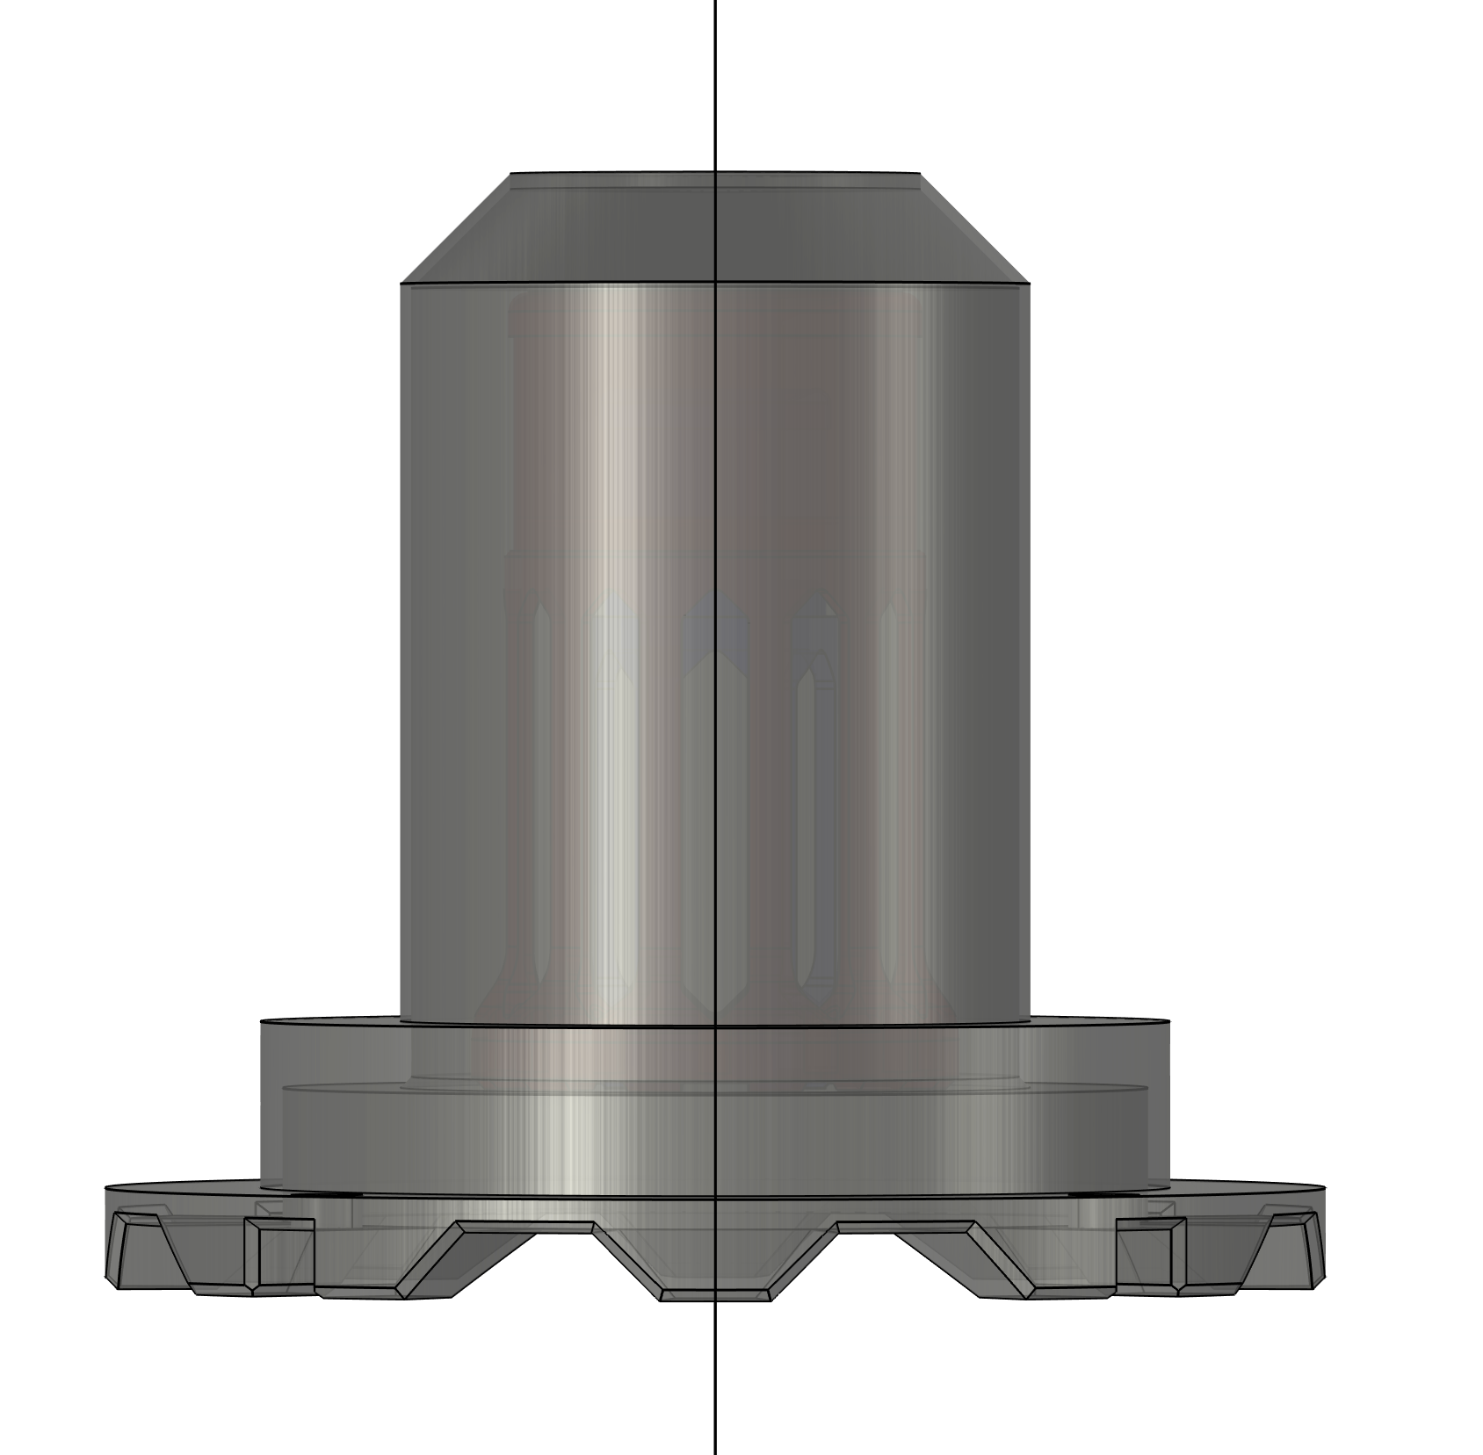
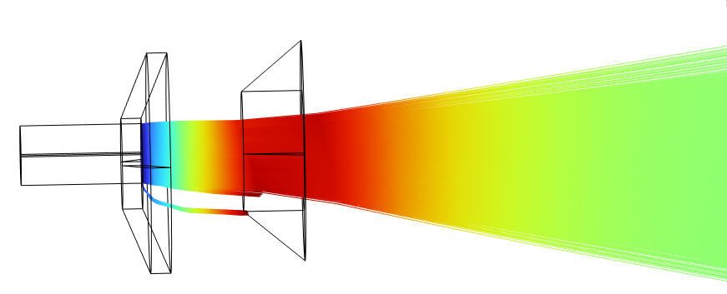
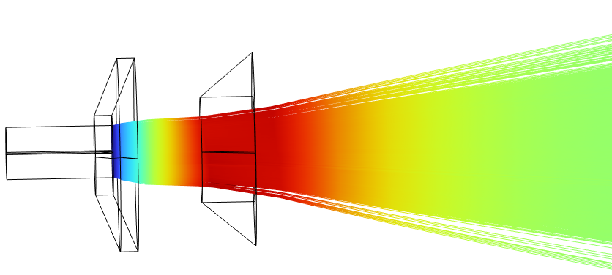
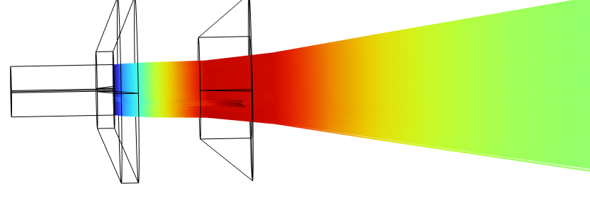
Simulations with COMSOL Multiphysics
Methodology
Basic Configuration
Optimization
Mechanical Design
Experimental Verification
Notes:
overview of the main steps in the development
setting up a simplified configuration, which was optimized
establishing the mechanical design
testing

Slide 8
Simulations with COMSOL Multiphysics
Methodology
Basic Configuration
Pierce design
COMSOL AC/DC module and charged particle tracing
Electric particle field interaction
Notes:
for the first step, a basic pierce gun configuration was modelled by using the ac/dc module and the cpt module
epfi was chosen to couple acdc and cpt

Slide 9
Simulations with COMSOL Multiphysics
Methodology
Optimization
Parametric sweeps
  Dimensions
  Electric Potentials
Notes:
- to find the best dimensions and potentials, parametric sweeps were performed

Slide 10
Simulations with COMSOL Multiphysics
Methodology
Mechanical Design
Derived from simulation results
Verification by computing electric fields and particle trajectories
Notes:
the results were used to establish the mechanical design
was verified with a simulation
computing the electric fields to investigate the risk of discharges
particle trajectory to verify, that the beam is leaving the aperture properly

Slide 11
Simulations with COMSOL Multiphysics
Methodology
Basic configuration
Optimization
Mechanical Design
Experimental Verification
Influence of misaligned electrodes
Different anode shapes
Chamber effects
Notes:
simulations were used to investigate different environmental effects
for example chamber effects, by modelling different boundary conditions
misalignment of electrodes was investigated
also different anode shapes were modeled

Slide 12
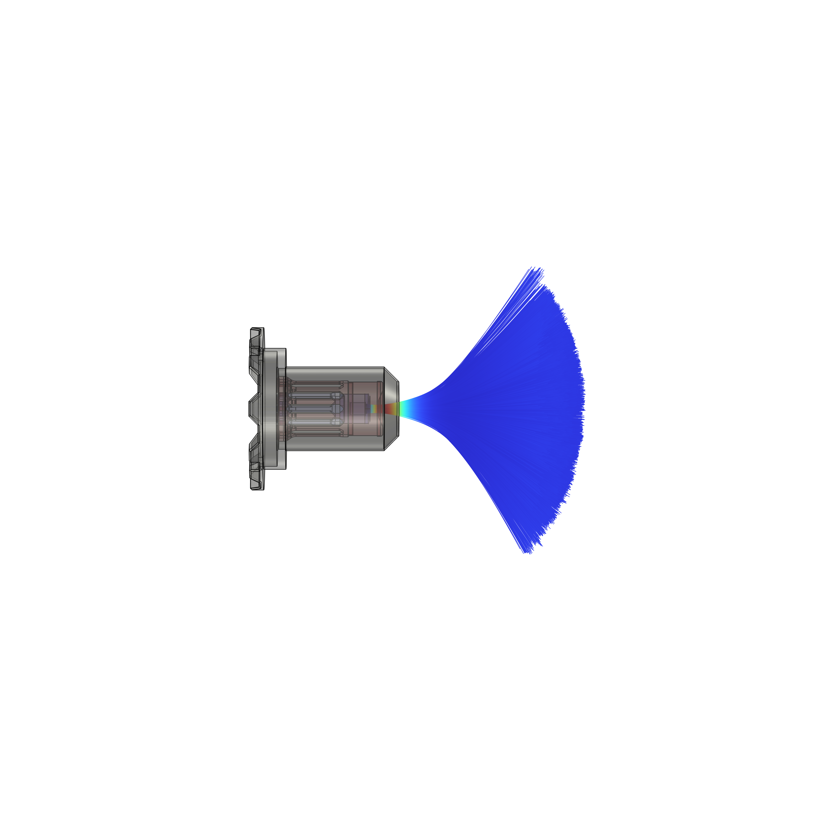
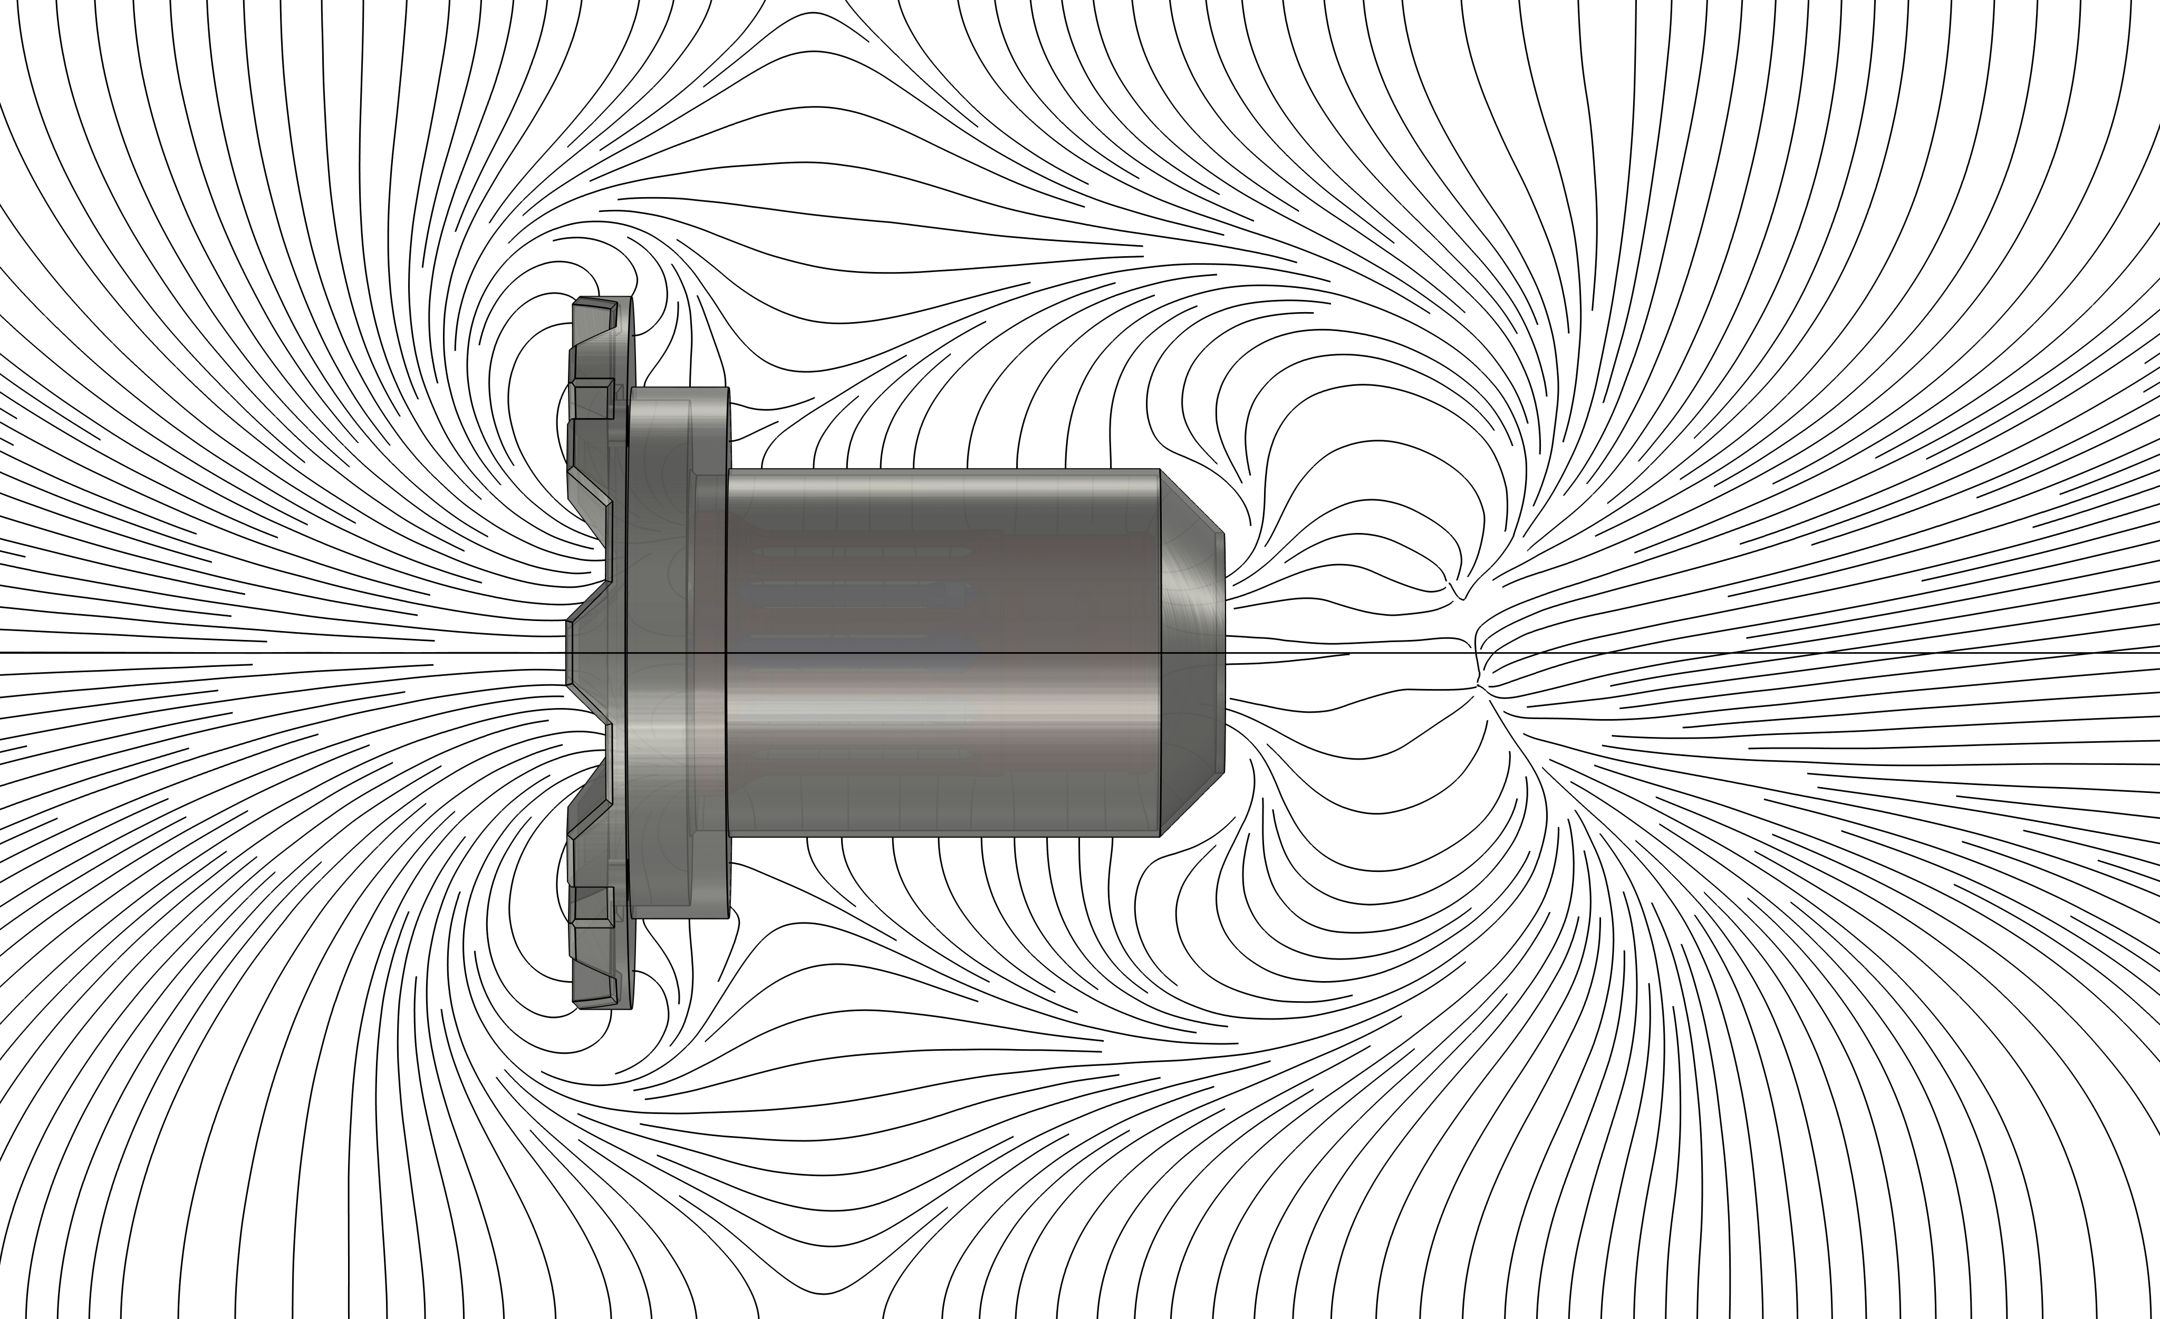
Results
Experimental results show that the electrons leave the aperture as expected
Mechanical design was derived from simulation results
Key challenge: bring together reality and simulation
  Simulations were used to explain effects observed while testing
  Results helped to improve the assembly
Notes:
this slide shows the results of the simulation of the mechanical design
This simulation was used to verify the design
left the particel trajectories
right electric fields
experimental results showed, that focussing and accelerating of the electrons works and the beam leaves the aperture as expected, just some small losses
Key challenge: sim and reality…

Slide 13
Results
Anode current
Inspection of the setup
Adaption of the simulations
Improvement of the assembly procedures
Misaligned electrodes
Notes:
…As an example the investigation of misaligned electrodes
Was done after finding a current at the anode
Inspection of the setup, remembering the assembly process -> electrodes are not perfectly aligned
Adapting simulation to reality
Improvement of assembly procedures

Slide 14
Conclusion and outlook
The use of COMSOL Multiphysics until now and in future
Idea
Simulations
Testing
COMSOL Multiphysics supported the complete design process from the idea to the first tests
First bradboard model manufactured and under test
Further use of COMSOL Multiphysics:
  In parallel with experimental efforts
  Further optimization

Slide 15






Thank you for your attention!
Feel free to ask your questions
Linda Oster
Aerospace Engineering Junior Researcher
Viktor Kaplan-Strasse 2
2700 Wiener Neustadt | Austria
+43 5 0421 8415
oster@fotec.at
www.fotec.at

Slide 16



Active Spacecraft Potential Control for CubeSats
Motivation
Spacecraft exposed to sun
Positive charging
Spacecraft in Earth’s shadow
Negative charging
–
+
+
–
–
+
+
–
suprathermal electrons
–
+
Earth‘s shadow
~
~
~
photons
~
~
~
~
~
–
~
~
~
~
~
Earth‘s magnetosphere
Photo-electrons
~

Slide 17
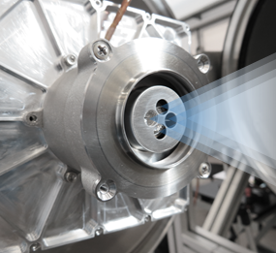


Active Spacecraft Potential Control for CubeSats
Key Features | ASPOC-NG
Successfully developed and tested ASPOC-NG instrument
  Based on electric propulsion technology
  Ion emission
  Solid electron emission without propellant
  High reliability
Current: ~100 µA
Accuracy: < 0.1 µA
Particle energy: < 6 keV
Mass: ~1.2 kg
Power: ~2.2 W

Slide 18
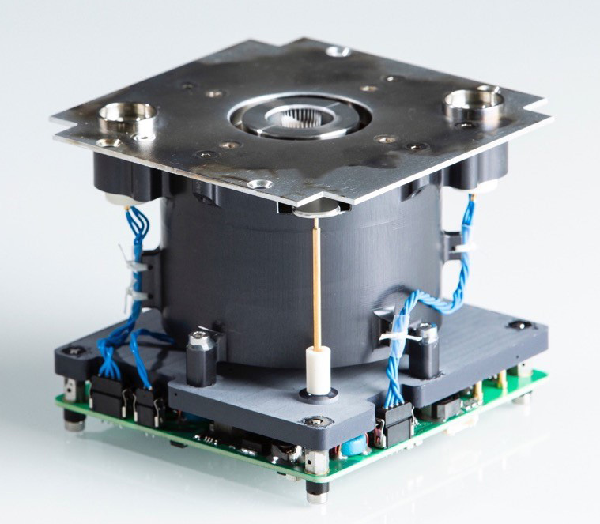
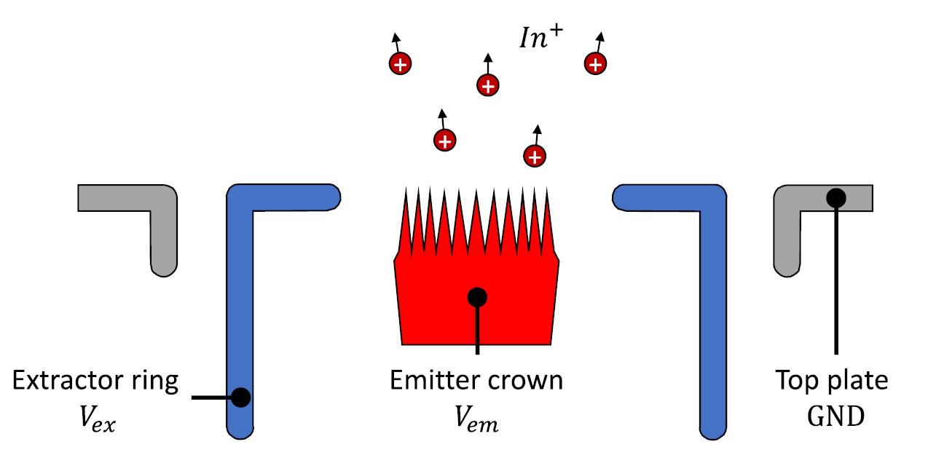
Introduction and Background
FEEP (Field Emission Electric Propulsion)-based electric propulsion system
IFM NANO Thruster
Developed by FOTEC and commercialized by spin-out ENPULSION
Successful in-orbit demonstration in 2018
> 200 systems already in space
Ionization directly from liquid metal
Thrust range: from µN up to mN
Propellant: Indium (non-toxic)
Notes:
an example for such a thruster is shown here
IFM NANO thruster, developed at fotec and commercialized by a spin off
based on the FEEP technology (Field Emission Electric Propulsion)
2018 succesfully tested in orbit and now there are more than 200 of them in space
uN to mN
Indium, a soft metal with a low melting point of 156°C
Working Principle
core element: porous tungsten multi emitter crown with 28 needles
wetted with indium
positive potential
In is heated up and forms a taylor cone in the liquid state
extractor ring at negative potential extracts and accelerates the In-ions
already an Idea why a neutralizer is needed

Slide 19
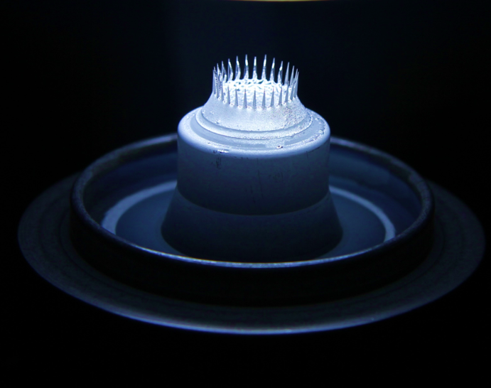
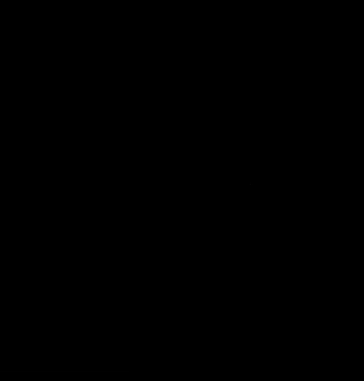
Introduction and Background
FEEP technology overview
Advantages
Designed for long-duration missions
Excellent stability and thrust control
No moving parts
Non-toxic propellant
Metallic propellant is solid during launch
Porous tungsten crown emitter (left) and during operation at FOTEC’s test facilities (right).
Notes:
- pictures
- main advantages...

