Slide 1

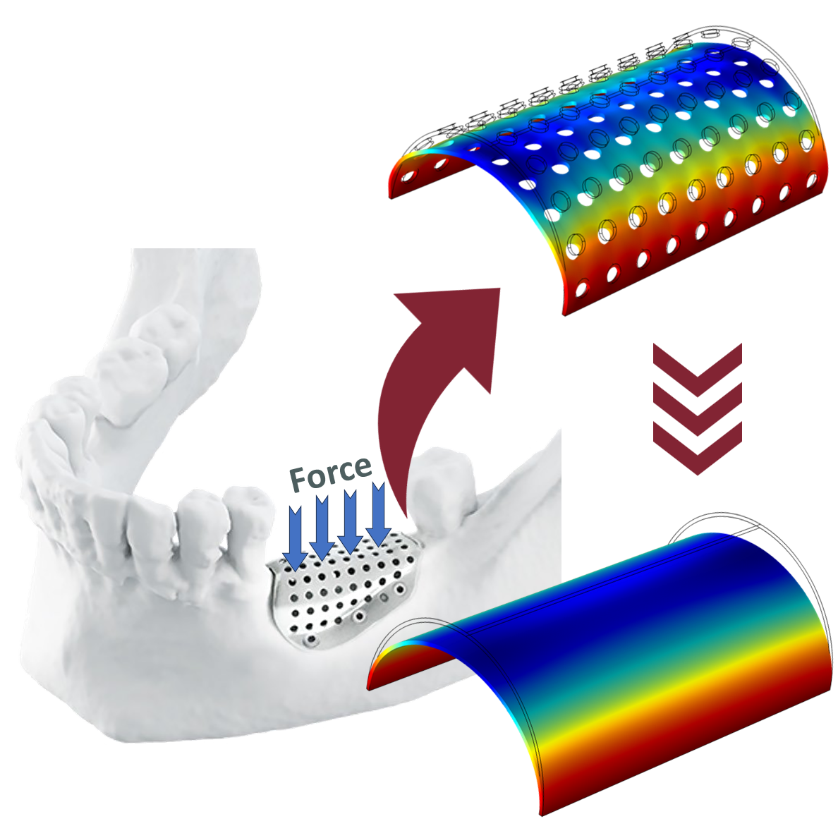


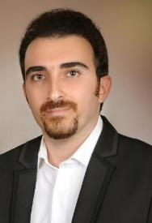


Developing 2D and 3D Micropolar FEM Models for Porous GBR Meshes in Dentistry Applications
22-24 October 2024, Florence, Italy
AbdolMajid Rezaei
Dr. Razie Izadi
Prof. N. Fantuzzi

Slide 2
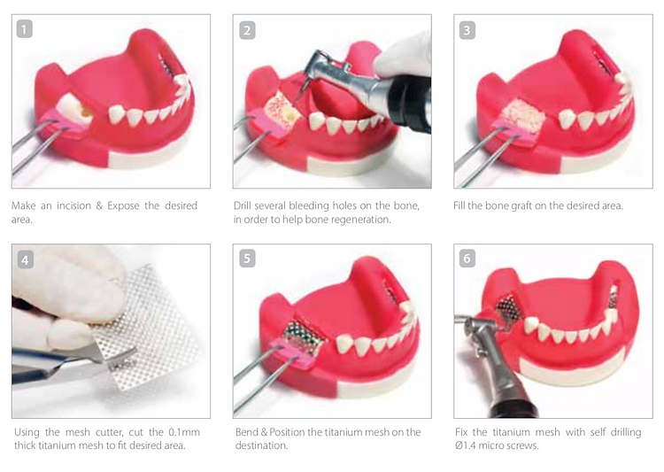


1
2
Introduction
Guided Bone Regeneration (GBR) Mesh
Bone Defect
Using a mechanical barrier, such as a membrane, to separate and protect the area of bone loss from the surrounding tissue.
1 Exposing the Bone Defect: A small incision to access the area of defect.
2 Bone Grafting: a cement that may contain bone, antimicrobial additives and stimulants that promotes new bone growth is placed under the membrane.
3 Preparing GBR Mesh: cut and formed by the surgeon
4 Placing and fixing the GBR Mesh
3
4
GBR Mesh
New bone can grow in the designated area.
Enough stiffness to create and maintain a suitable space for the intended bone regeneration.
Enough porosity to facilitate the diffusion of fluids, oxygen, nutrients, and bioactive substances for cell growth.
https://www.indigoortho.co.uk/gbr-systems
Stiffness
Porosity

Slide 3
Introduction
Equivalent Homogenised Models for Porous Structures
  Porous Geometry
When the geometry includes pores, there is an internal structure.
By using equivalent model and defining effective properties instead of the real microstructure, we can decrease computational expense of modelling and discretisation.
Non-classical continuum theories can consider the internal structure without direct modelling of details.
In the present work, non-classical micropolar theory as the homogenised equivalent model is implemented for the porous structures in 2D and 3D.
  Internal Structure
→
?
  Equivalent Continuum Model
→
Non-classical Theories
Micropolar Continua
Micromorphic Continua
Second-Gradient Continua
…

Slide 4
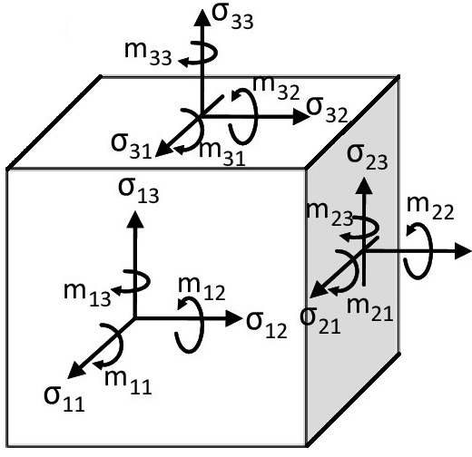
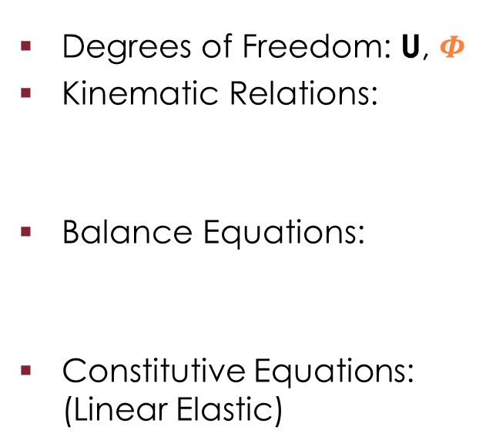
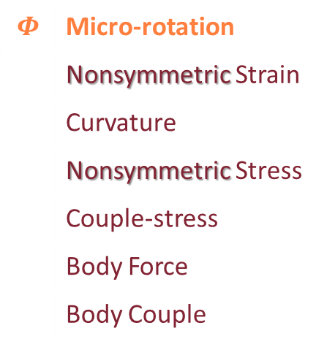
Introduction
Micropolar Theory
$$Φ$$ | Micro-rotation
 | Nonsymmetric Strain
 | Curvature
 | Nonsymmetric Stress
 | Couple-stress
 | Body Force
 | Body Couple
Degrees of Freedom: U, $Φ$
Kinematic Relations:
Balance Equations:
Constitutive Equations:
(Linear Elastic)
New strain measure as Curvature.
New stress measure as Couple-stress.

Slide 5
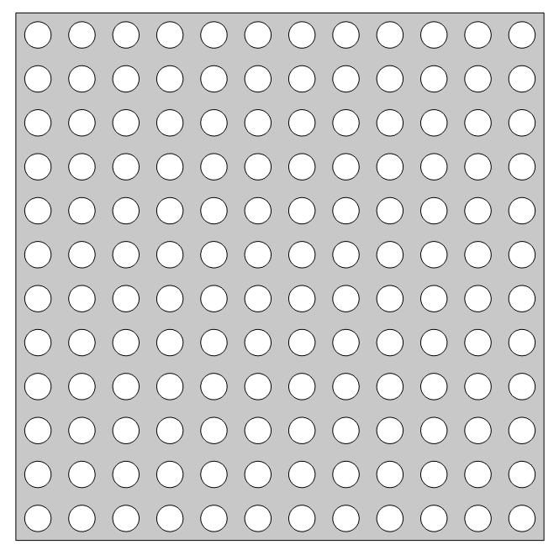
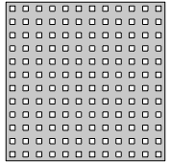
Methodology
2D Tetragonal Micropolar Model for Porous Plate
General linear elastic constitutive equations in plane
Ortho-tetragonal Material Symmetry
Considering the linear elastic micropolar in 2D, for the geometries we study here, 5 independent material parameters are required to define the equivalent model.
  5 Independent Material Parameters
A
A
D

Slide 6

Methodology
Homogenization of 2D Model
Cauchy
u,v
The heterogeneous structure, is called Micro Model and is described by Cauchy continuum.
Homogenised model is called Macro Model and is described by constitutive parameters of a micropolar continuum.
Kinematic Map: Links the two levels of description
Express the microscopic displacement field within the RVE as a function of the macroscopic strain measures at the material point on the macro-level.
Micro Model
Micropolar
Equivalent
Model
U,V,Φ
Macro Model

Slide 7
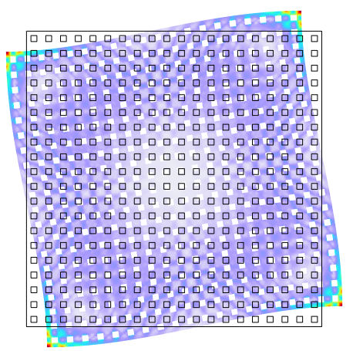




Methodology
Homogenization of 2D Model
Once the kinematic map is determined, we proceed to discover the micropolar material parameters.
We use the finite element method (FEM) to compute the response of the porous structure under different loadings.
  Extract the total elastic strain energy $W_{FEM}$ stored in the RVE from COMSOL.
  Equating to the energy of an equivalent micropolar continuum $W_{Micropolar}$ from analytical expression.
For each scenario, the micropolar material parameters are determined in such a way that the homogenized model retains the same amount of strain energy when exposed to the same loading conditions.
$W_{FEM}$
  $$W_{Micropolar}$$

Slide 8
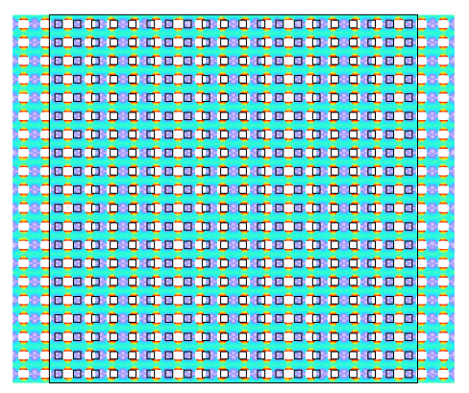
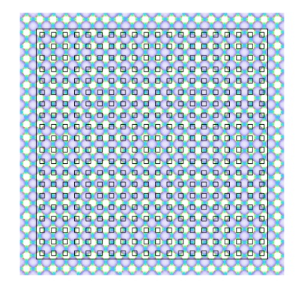
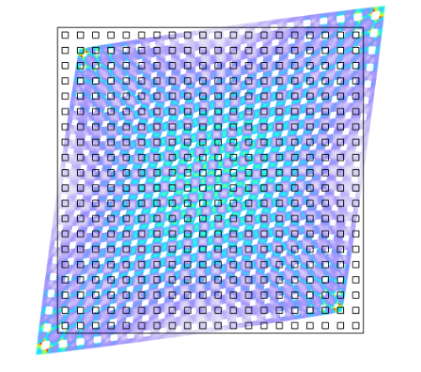
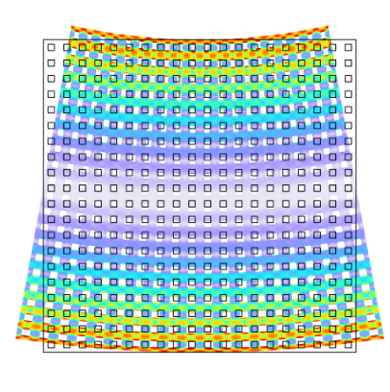

Methodology
Finding Effective Micropolar Material Parameters for 2D Model
Micropolar
Model
Cauchy Continua
Numerical FEM Simulation
Pore
Uniaxial Test
Biaxial Test
Shear (SYM) Test
Rotation Test
Bending Test

Slide 9
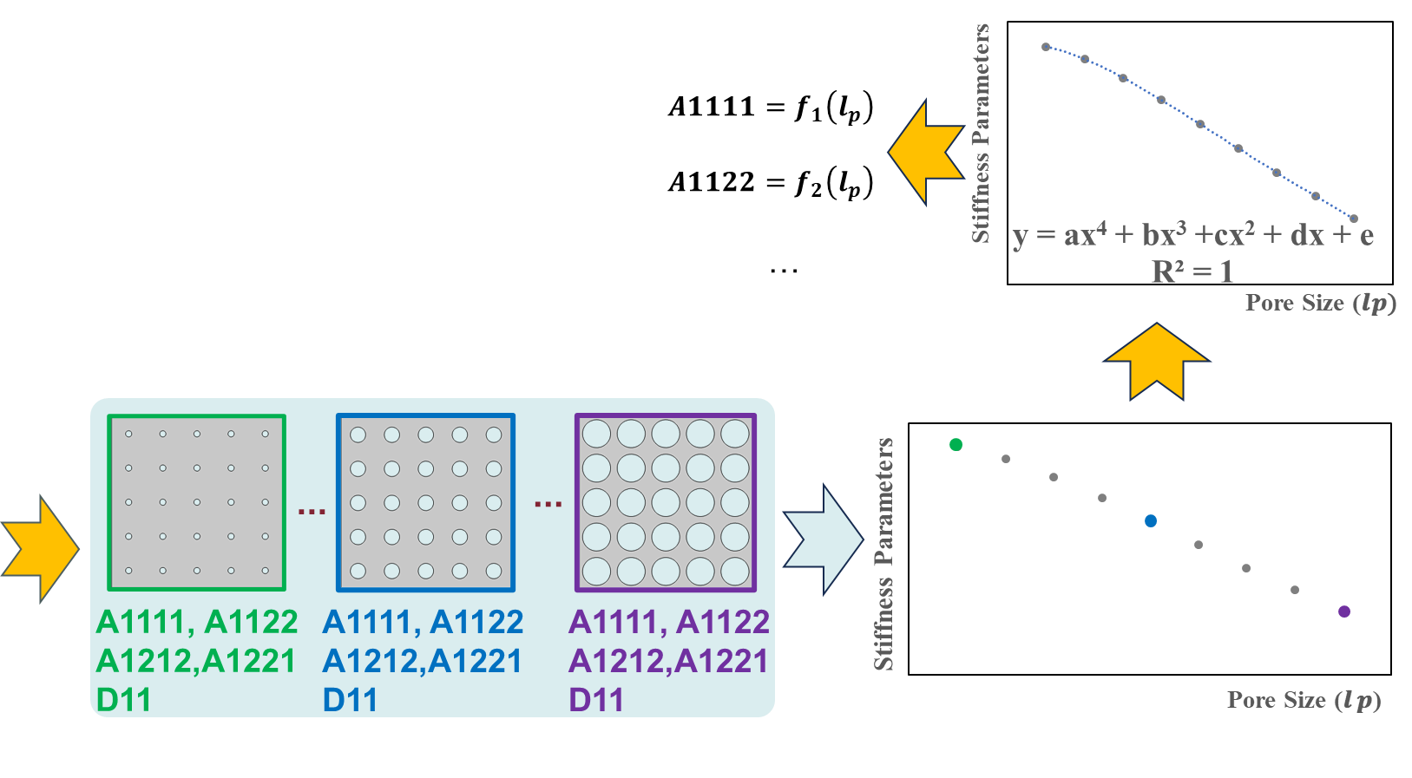
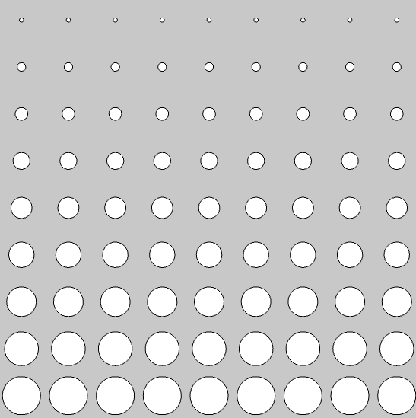
Methodology
Extending the Homogenization Procedure for FG Porous Structures
Equivalent homogenized model for Functionally Graded (FG) porous structure is derived by considering the homogenization procedure developed for homogenous porosities.

Slide 10
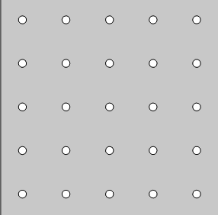
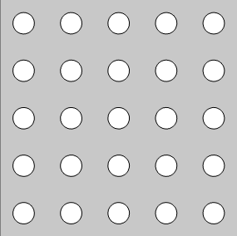
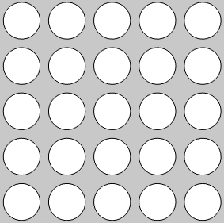
Methodology
Extending the Homogenization Procedure for FG Porous Structures
First, a parametric study is conducted to find the equivalent parameters of uniform porous plates with various pore sizes.
In this parametric study, the pore density (the number of pores per unit length) is kept constant.
...
...
A1111, A1122
A1212,A1221
D11
A1111, A1122
A1212,A1221
D11
A1111, A1122
A1212,A1221
D11

Slide 11
Methodology
Extending the Homogenization Procedure for FG Porous Structures
Pore sizes are changed to find the required equivalent parameters for each section of the FG porous structure.
...
...
A1111, A1122
A1212,A1221
D11
A1111, A1122
A1212,A1221
D11
A1111, A1122
A1212,A1221
D11

Slide 12
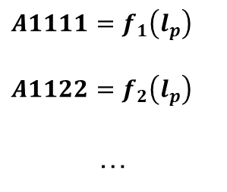
Methodology
Extending the Homogenization Procedure for FG Porous Structures
These data are then utilised to find curve-fitted functions for each material parameter with respect to the pore size.
$$A1111=f_{1}\left(l_{p}\right)$$
$$A1122=f_{2}\left(l_{p}\right)$$
…
...
...
A1111, A1122
A1212,A1221
D11
A1111, A1122
A1212,A1221
D11
A1111, A1122
A1212,A1221
D11

Slide 13
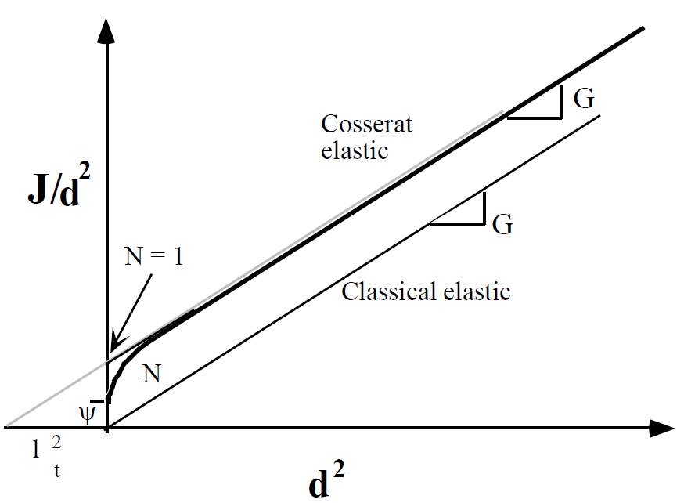

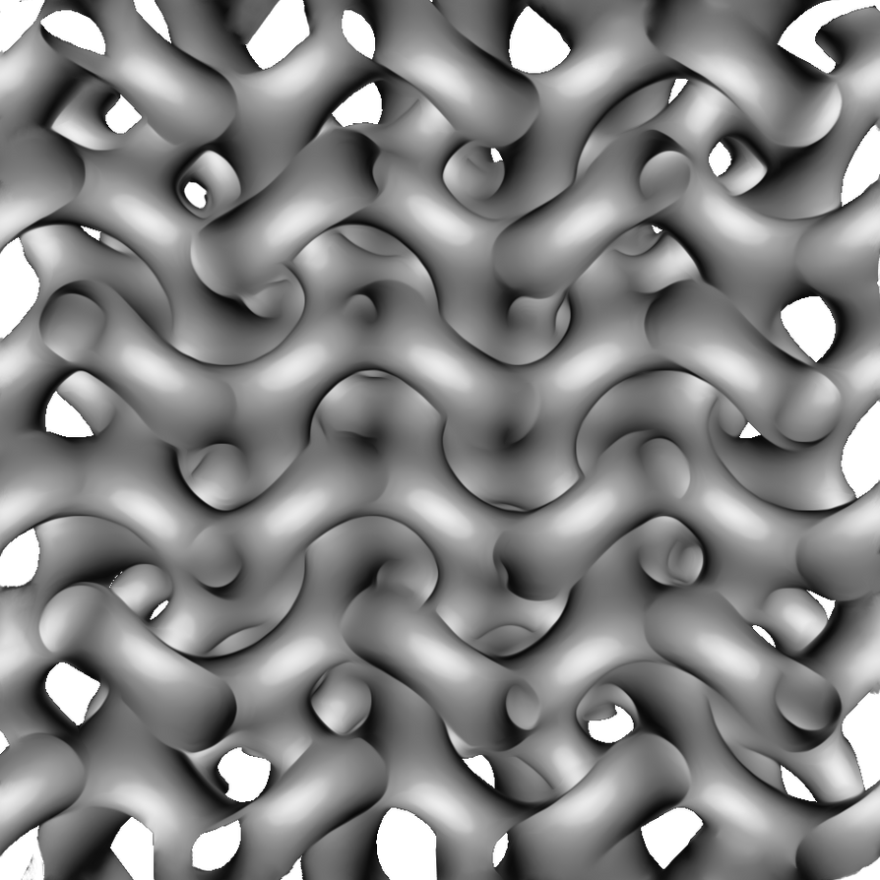



d: Diameter
J: Rigidity
Methodology
Homogenization of 3D Model
A size-effect is predicted by micropolar theory for the torsion of circular cylinders.
It is possible to determine the micropolar parameters by measuring the torsional rigidity vs size.
Specimens at different length scales, while keeping unit cell size constant.
$$T$$
$$T$$
$$T$$
Cauchy
Detailed Model
Micropolar
Equivalent Model

Slide 14


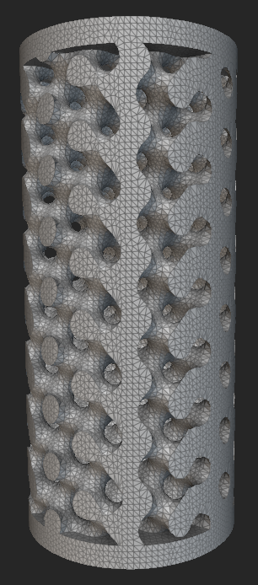
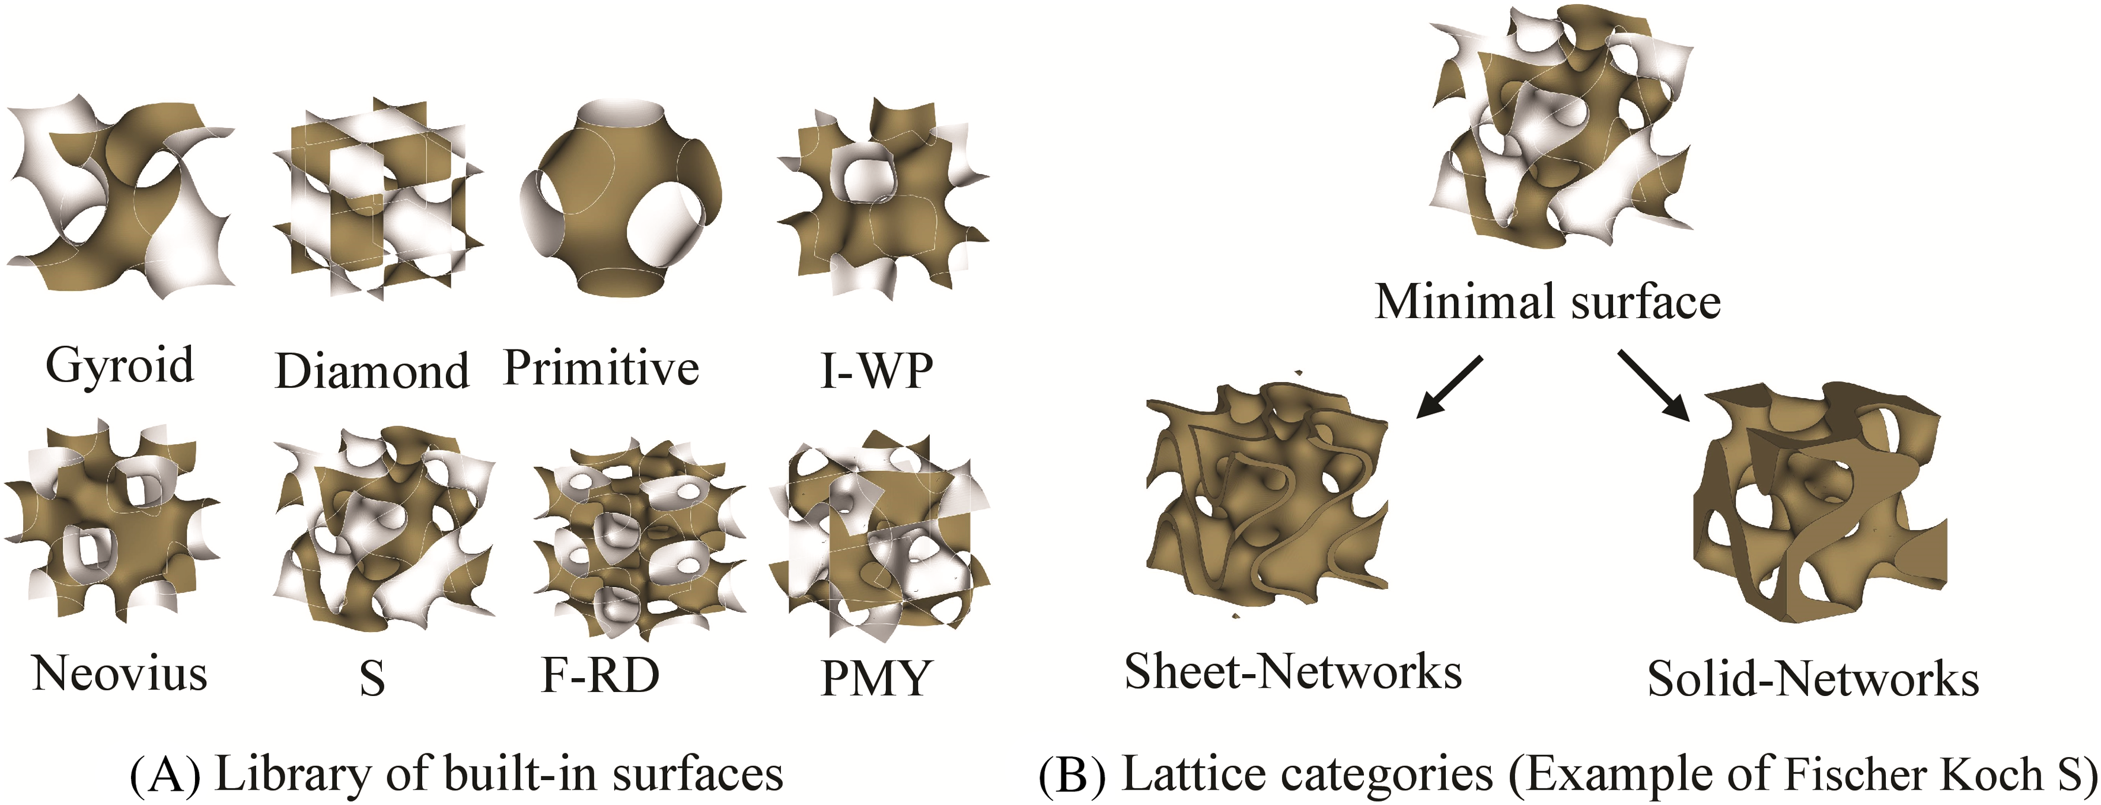
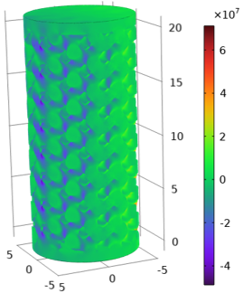
Methodology
Homogenization of 3D Model
Bio-inspired 3D microstructures such as gyroids and other Triply Periodic Minimal Surfaces (TPMS) can be employed for designing GBR bone scaffolds.
Studying the impact of changes in microstructural architecture which reflects in the equivalent micropolar parameters.
The unit cell design, porous structure and CAD model are developed using nTop software.
Final 3D meshed part is imported in COMSOL for further FEM analyses.
CAD Model
FEM Tests

Slide 15



Methodology
FEM Micropolar Model in COMSOL Using PDE Weak Form
Multiplying balance equations by the test functions, integrating over computational domain D
Based on the product rule of derivatives:
  Strong Form
  Test Function for U
  Weak Form
Balance Equations
  Test Function for $Φ$
And by using the divergence theorem:

Slide 16
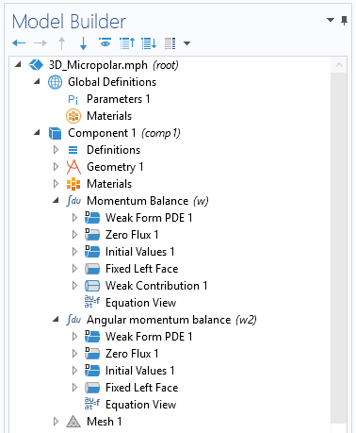


Methodology
FEM Micropolar Model in COMSOL Using PDE Weak Form
By using partial differential equation (PDE) modelling in COMSOL instead of traditional FE modelling, no user subroutine is required.
Various complex geometries, B.C., and loadings can be applied in a user-friendly graphical interface.
Visualisation of the results is convenient.
-(s11*test(ux)+s12*test(uy)+s21*test(vx)+s22*test(vy)
+s23*test(vz)+s31*test(wx)+s32*test(wy)+s33*test(wz))
+ p1*test(u)+p2*test(v)+p3*test(w)
-(mu11*test(phi1x)+mu12*test(phi1y)+mu13*test(phi1z)
+mu21*test(phi2x)+mu22*test(phi2y)+mu23*test(phi2z)
+mu31*test(phi3x)+mu32*test(phi3y) + mu33*test(phi3z))
-((s12-s21)*test(phi3)+(s31-s13)*test(phi2)
+(s23-s32)*test(phi1))+q1*test(phi1)+q2*test(phi2)
+q3*test(phi3)

Slide 17
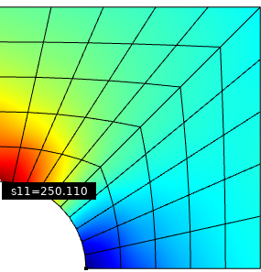


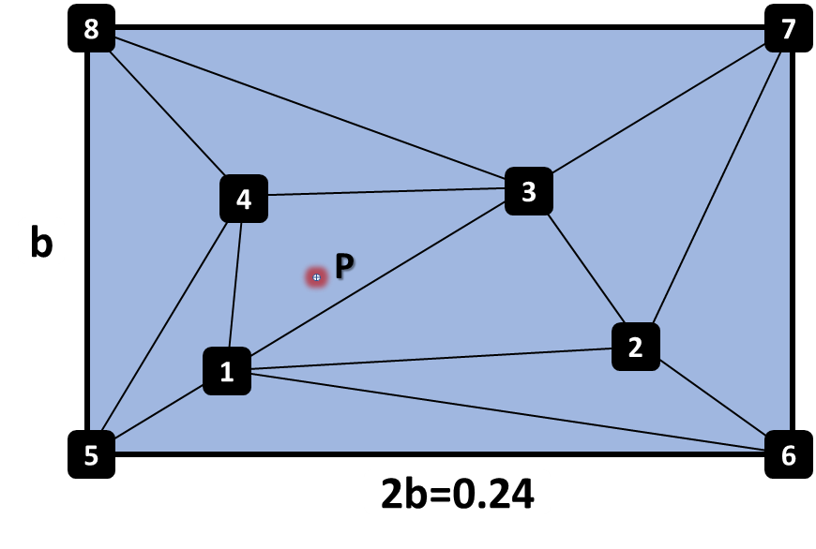

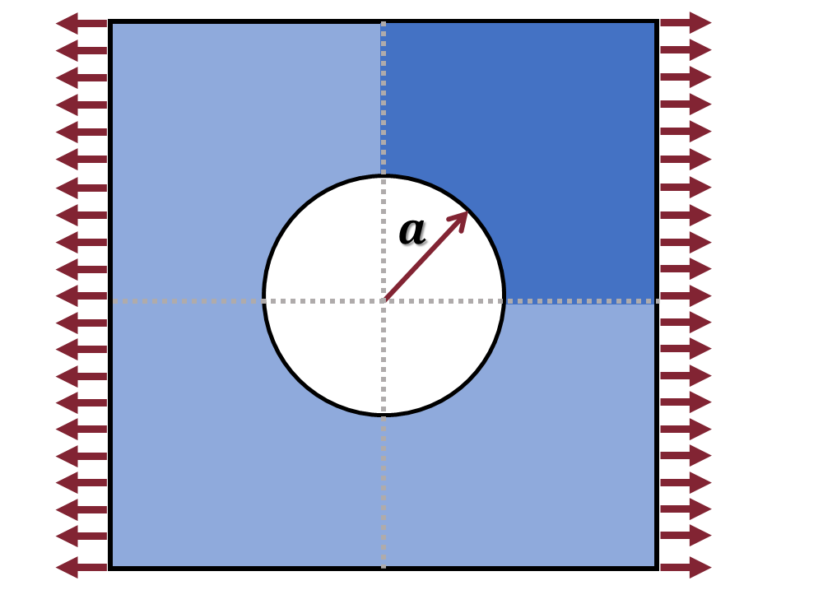
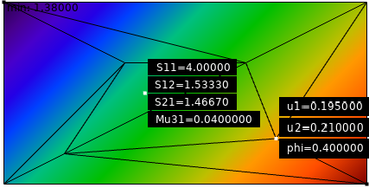




Methodology
FEM Micropolar Model in COMSOL / Benchmarks for 2D Model
$$σ_{0}$$
Patch Tests
Test 1 (Cauchy)
Test 2 (Micropolar, without Curvature)
Test 3 (Micropolar + Curvature)
Stress Concentration Factor
Micropolar plate with a circular hole under uniform tension.
Stress concentration factor (SCF) is compared with those of Reference.
M. Tuna et al., 2021
DOI:
10.1007/978-3-030-63050-8_11
E. Providas, M.A. Kattis, 2002
DOI:
10.1016/S0045-7949(02)00262-6
$$σ_{0}$$
$$A$$
 | @ | Benchmark | COMSOL
u1 | P | 0.1950 | 0.19500
u2 | P | 0.2100 | 0.21000
phi | P | 0.0004 | 0.00040
S11 | Node 2 | 4.0000 | 4.00000
S21 | Node 2 | 1.4667 | 1.46670
Mu31 | Node 2 | 0.0400 | 0.04000
 | L / a | Element | Benchmark | COMSOL
1 | 3.0 | 4Node | 2.49640 | 2.50110
2 | 3.0 | 9Node | 2.42046 | 2.42128
3 | 10.0 | 4Node | 2.28474 | 2.29980
4 | 10.0 | 9Node | 2.22525 | 2.26834
$$SCF=\frac{σ_{xx}@Point A}{σ_{0}}$$

Slide 18
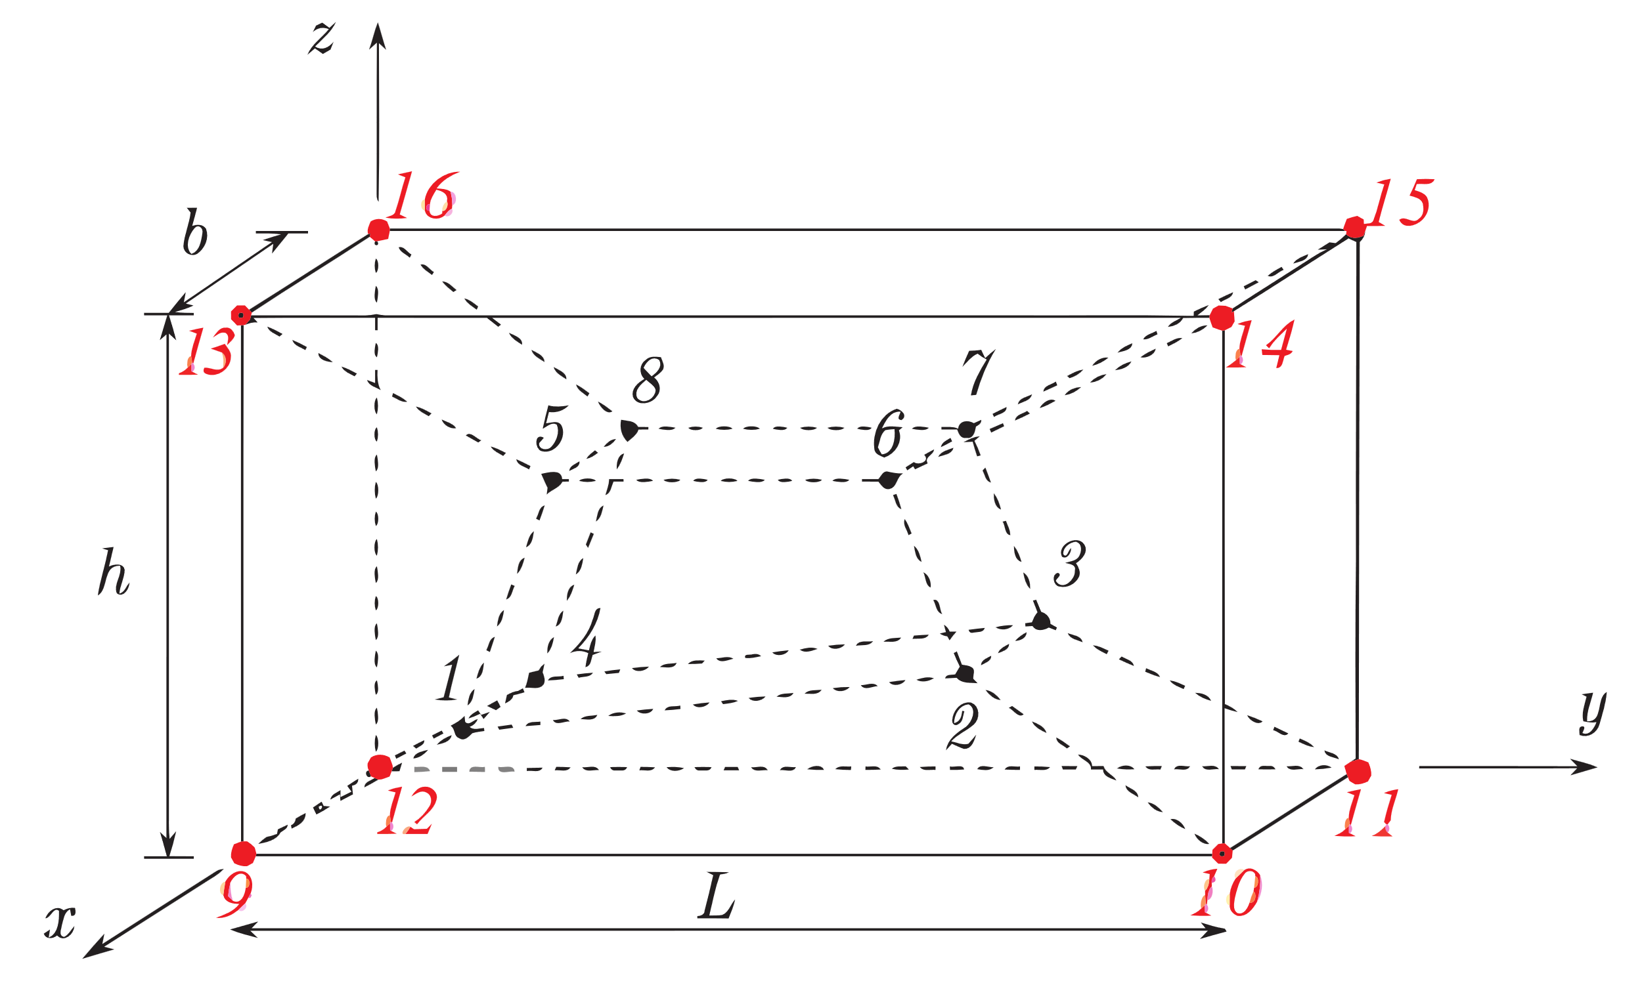
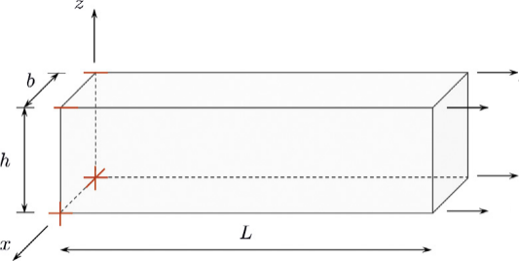

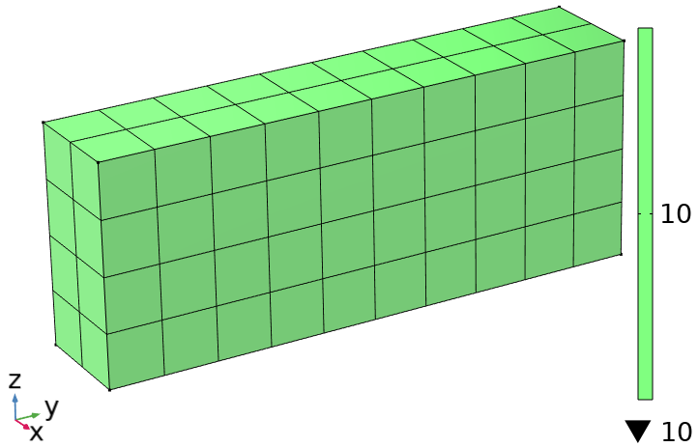
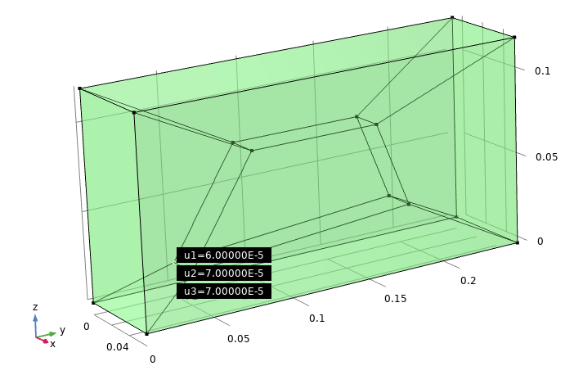
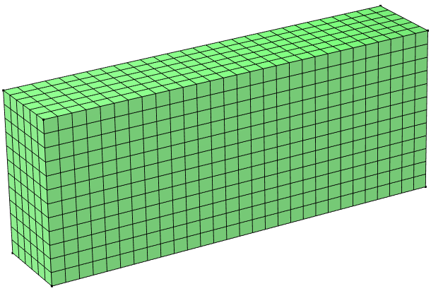



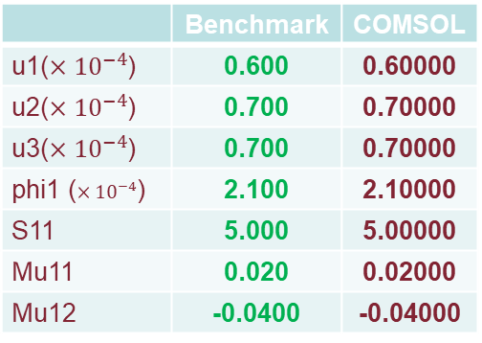
Methodology
FEM Micropolar Model in COMSOL / Benchmarks for 3D Model
Force Patch Test
Cantilever beam subject to pure tension
Seeking the state of constant stress.
For an arbitrary number of finite elements.
Displacement Patch Tests
A generalization of 2D patch tests.
Discretization with 7 arbitrarily distorted hexahedral finite elements.
$$p_{y}=10N/m^{2}$$
$$p_{y}$$
 | Benchmark | COMSOL
u1(${×10}^{−4}$) | 0.600 | 0.60000
u2(${×10}^{−4}$) | 0.700 | 0.70000
u3(${×10}^{−4}$) | 0.700 | 0.70000
phi1 (${×10}^{−4}$) | 2.100 | 2.10000
S11 | 5.000 | 5.00000
Mu11 | 0.020 | 0.02000
Mu12 | -0.0400 | -0.04000
S. Grbčić et al., 2018
DOI:10.1016/j.compstruc.2018.04.005
$$σ_{22}$$

Slide 19
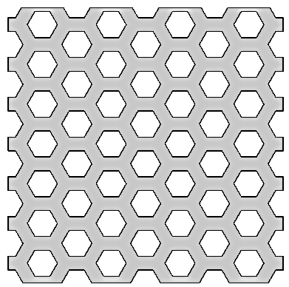
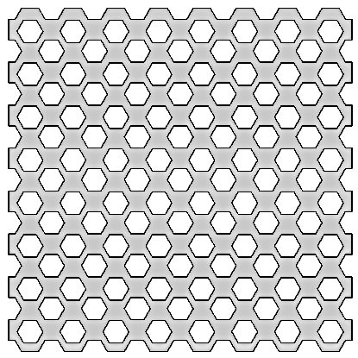
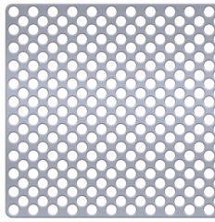
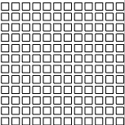
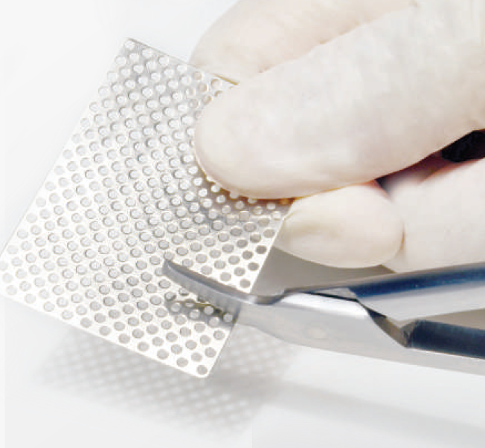
Results
Parametric Study for Various Pore Patterns Using COMSOL
  Pore Type & Pattern:
  Rectangular pores
  Honeycomb pattern
  Triangular pores, Honeycomb pattern
  ...
  Pore Size:
  Different length scale
  Pore Density:
  Different No. of pores per length

Slide 20
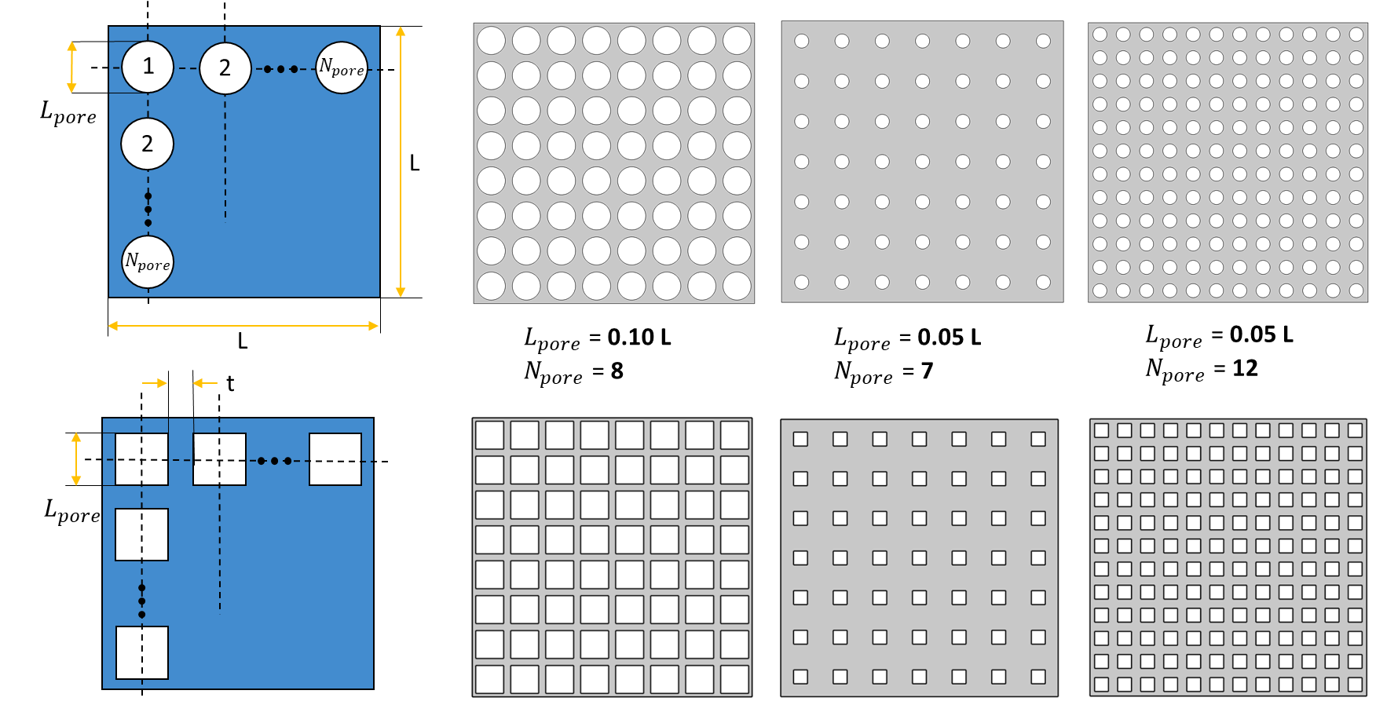
Results
Parametric Study for Various Pore Patterns Using COMSOL / Parametrisation
Titanium Alloy Ti6Al4V | Poly- Lactic Acid (PLA)
Young’s Modulus, GPa
114 | 1.03
Poisson Ratio
0.30 | 0.32
Density, kg/m³
4500 | 1250
    Mechanical Characterization of 3DPrinted Individualized Ti-Mesh for Alveolar Bone Defects L. Bai et al.
    Physical and mechanical properties of PLA S. Farah et al.

Slide 21
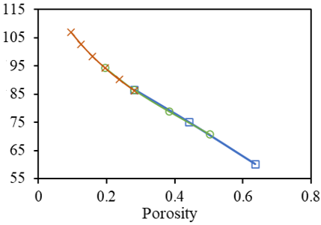
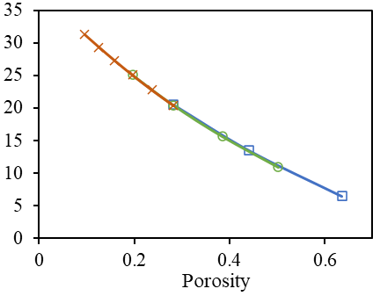
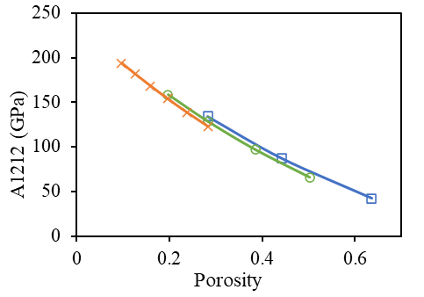
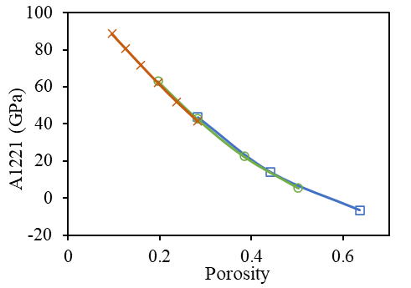
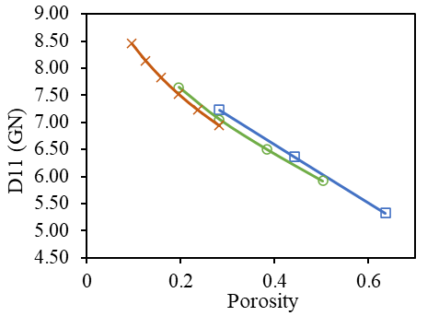
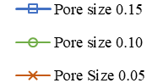
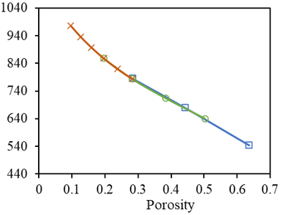
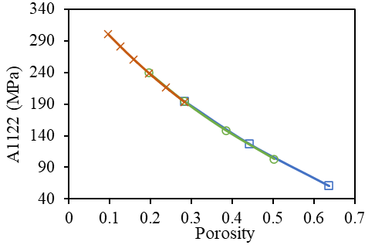













Results
Parametric Study for Various Pore Patterns/Materials Using COMSOL
$$A_{1111}(GPa)$$
$$A_{1122}(GPa)$$
$$A_{1212}(GPa)$$
$$A_{1221}(GPa)$$
$$D_{11}(GN)$$
Ti6Al4V
$$A_{1111}(MPa)$$
$$A_{1122}(MPa)$$
$$A_{1212}(MPa)$$
$$A_{1221}(MPa)$$
$$D_{11}(MN)$$
PLA

Slide 22

Discussion
Using the Equivalent Mechanical Parameters for Designing GBR Mesh
Optimum Design for Porous GBR Meshes:
Nearest mechanical properties to the bone.
GBR mesh is in contact with the cortical (compact) bone.
Try to make the material parameters of the GBR mesh consistent with its adjacent bone.
Experimental estimate of the micropolar parameters of compact bone.
Finding a configuration with the material parameters close to those reported for compact bone in the literature.
 | Value | Unit
A₁₁₁₁ | 12.00 ~ 43.43 | GPa
A₁₁₂₂ | 4.00 | GPa
A₁₂₁₂ | 21.10 ~ 36.77 | GPa
A₁₂₂₁ | -13.05 ~ 2.67 | GPa
D₁₁ | 3.24 | kN
    Experimental study of micropolar and couple stress elasticity in compact bone in bending J. Yang & R. Lakes

Slide 23










Discussion
Using the Equivalent Mechanical Parameters for Designing GBR Mesh
Circular pores, Titanium Alloy
→ Parameters are beyond the required values.
Rectangular pores, Titanium Alloy
→ Pore sizes of 0.13 L - 0.15 L and porosity about 0.7, a good agreement for A1122, A1212, A1221 can be achieved.
 | Value | Unit
A₁₁₁₁ | 12.00 ~ 43.43 | GPa
A₁₁₂₂ | 4.00 | GPa
A₁₂₁₂ | 21.10 ~ 36.77 | GPa
A₁₂₂₁ | -13.05 ~ 2.67 | GPa
D₁₁ | 3.24 | kN
$$A_{1111}(GPa)$$
$$A_{1122}(GPa)$$
$$A_{1212}(GPa)$$
$$A_{1221}(GPa)$$
$$D_{11}(GN)$$

Slide 24







Discussion
Functionally Graded (FG) Porous Design for GBR Mesh
GBR meshes are fixed to the mandible bone using biocompatible screws
At these fixing locations higher stiffness is required. Therefore, smaller pore sizes are more desirable there.
Mimicking natural FG structure of the bone
FG structure of type O is suggested
Central part → mechanical properties close to cancellous (trabecular) bone while providing a proper diffusion properties.
Part near fixing areas → as near as possible to cortical (compact) bone to provide required load-bearing capacities.
Conventional Design (uniform porosity)
$$l_{p}=0.01L$$
$$l_{p}=0.075L$$
$$l_{p}=0.01L$$
FG Porous Design

Slide 25




Discussion
3D FG Design for Porous GBR Dental Scaffold
Currently, metallic GBR sheets are used as a mechanical barrier and bone grafts are inserted into the space created by the barrier.
After the healing period, it is necessary another surgery for removing the GBR mesh.
To avoid a second surgery, a recent solution is to use biodegradable materials such as polylactic acid (PLA) instead of metallic meshes.
However, suboptimal mechanical properties of biodegradable materials such as low stiffness and strength have limited their application.
Bone Grafts
(Stimulating Bone Regeneration)
GBR Mesh
(Space Maintaining)
3D GBR Dental Scaffold

Slide 26

Discussion
3D FG Design for Porous GBR Dental Scaffold
Dense
Porous
With the developed framework, an innovative 3D design for GBR meshes is suggested.
The microstructure evolves from the porous structure at the lower level to the compact structure at the top surface.
The porous structure can host bio-active agents for stimulating bone regeneration
While the upper compact surface should provide the required stiffness.
By implementing our model, the distribution in both the internal structure and the material properties (for instance using bimodal material such as PLA+HA (Hydroxy appetite) or adding nano-reinforcements) can be customized.
3D Design
for
GBR Dental Scaffold

Slide 27


  For Your Attention and Time…

Slide 28

Questions

Slide 29


Results
Effectiveness of Homogenized Micropolar Model
Comparison of displacement magnitude contours for detailed and homogenized micropolar model.
Indentation Test.
Predicted values are close to those of the detailed model
Micro Model
Macro Model

