Slide 1
BI Dry 3.0 – A COMSOL® App for Simulating Concrete Drying
D. Ericsson¹, J. Carlswärd², M. Emborg², M. Westerholm³, M. Åhs⁴
¹ Deflexional, Täby, Sweden
² Heidelberg Materials Betong, Stockholm, Sweden
³ Heidelberg Materials Cement, Stockholm, Sweden
⁴ Lund University, Lund, Sweden

Slide 2
Contents
Introduction
Graphical User Interface
Setting Up a Model
Graphics
Results
Preferences
Underlying COMSOL Model
Access to Specific Functionality
Conclusions

Slide 3
Introduction
Background and benefits of the software

Slide 4
Concrete Drying
Moisture enhances concrete curing, but fast drying and low relative humidity (RH) are essential for flooring to prevent deterioration of flooring adhesive
Drying is slow and can delay construction, resulting in premature floor installation and costly testing, disputes, or repairs
Factors like temperature, wind, rain, construction type, and dimensions affect drying rates

Slide 5
Simulating Concrete Drying
An effective way to predict concrete drying is through finite element-based simulations
Setting up a finite element model requires expertise, but the process is simplified with a compiled COMSOL® app
  Any contractor can leverage the power of COMSOL Multiphysics®
By using simulations, contractors can choose the optimal concrete mix, minimizing environmental impact and reduce costs

Slide 6


Reductions & Savings
CO₂ Emission Reductions
  Decrease the amount of binder
  Use lower-grade concrete where applicable
  Incorporate binder combinations with slag, fly ash and other additions
  Select an optimal design
Cost Savings
  Accelerate construction timelines
  Prevent costly failures

Slide 7



Background
Longstanding Expertise
For decades, Heidelberg Materials has offered customers finite element-based software solutions
Launch of HETT²² in 2022 [1]
A COMSOL Multiphysics®-based tool, HETT²² was developed to simulate early-age temperature and strength development
Development of BI Dry 3.0
Following the success of HETT²², Heidelberg Materials chose the same platform to support BI Dry 3.0, a software focused on simulating concrete drying
1. D. Ericsson et al., COMSOL Conference 2023 Munich
www.comsol.com/paper/hett22-a-comsol-app-to-accurately-simulate-plan-and-monitor-concrete-castings-122611

Slide 8



Differences between HETT²² and BI Dry
Timescale
While HETT²² and BI Dry share similarities, concrete drying in BI Dry spans months or years, unlike the shorter timescale of hours or days required for early-age strength development in HETT²².
Modeling
Both HETT²² and BI Dry utilize the Maturity Method and the heat transfer equation. Additionally, BI Dry solves a convection-diffusion equation for moisture content, which is coupled with heat transfer.

Slide 9


Joint Efforts
Collaborative Development of HETT²²
Created through a partnership between Deflexional AB, a COMSOL Certified Consultant, and Heidelberg Materials
BI Dry 3.0 Development Team
Deflexional worked closely with concrete drying experts from Lund University and Heidelberg Materials
Project Success
The achievements of this project underscore the essential contributions and collaboration from all involved parties

Slide 10
Graphical User Interface
An intuitive interface enables contractors to perform advanced simulations with ease

Slide 11
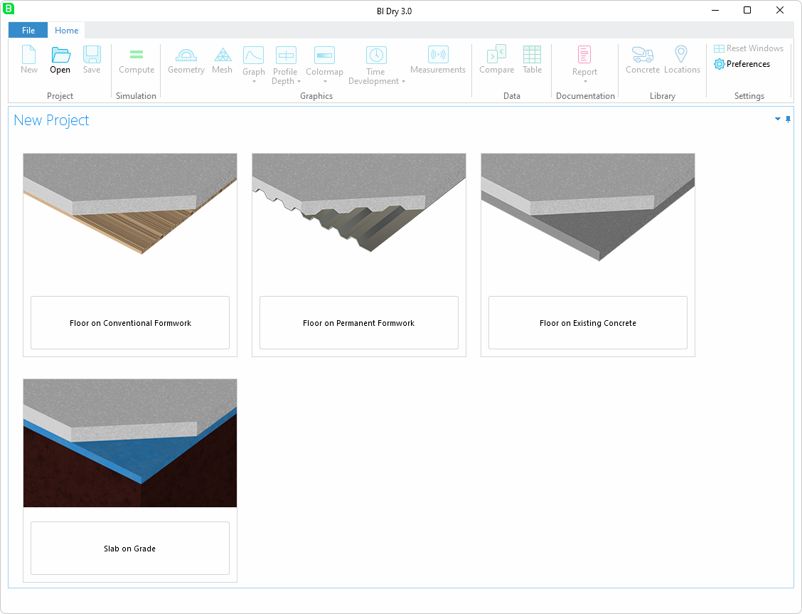
Select construction
scenario to start a
new project

Slide 12
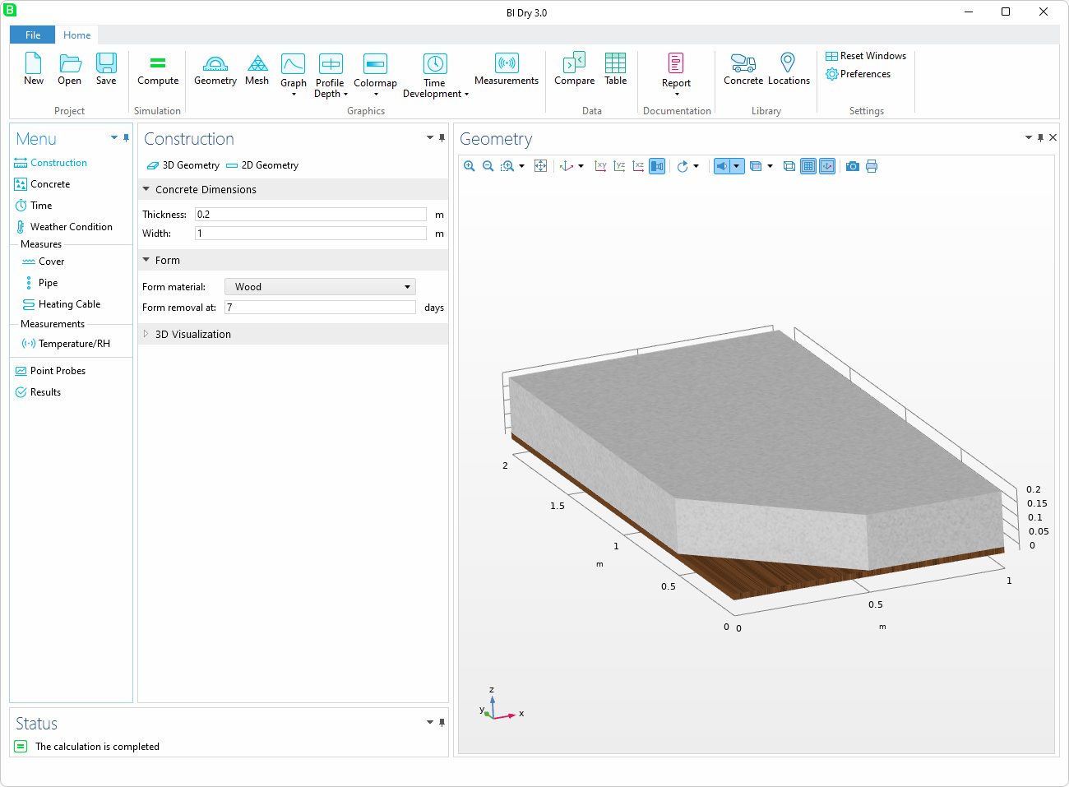
File Menu
Ribbon
Menu
Status
Settings
Graphics

Slide 13
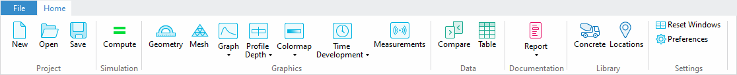
Ribbon
Results as
numerical data
Standard libraries
and user libraries
Compute
Settings
Create a new project,
open, and save
Visualize geometry, mesh,
graphs, 2D plots, and 3D plots
Microsoft® Word® and
Microsoft® PowerPoint® reports

Slide 14
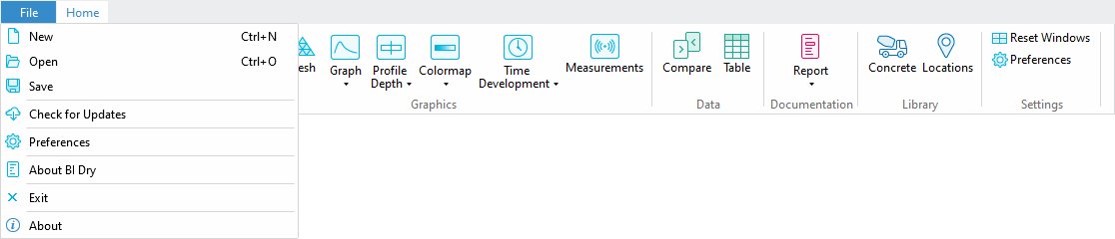
File Menu
Check for new versions
License information

Slide 15
Setting Up a Model
Follow the left menu step-by-step from start to finish

Slide 16
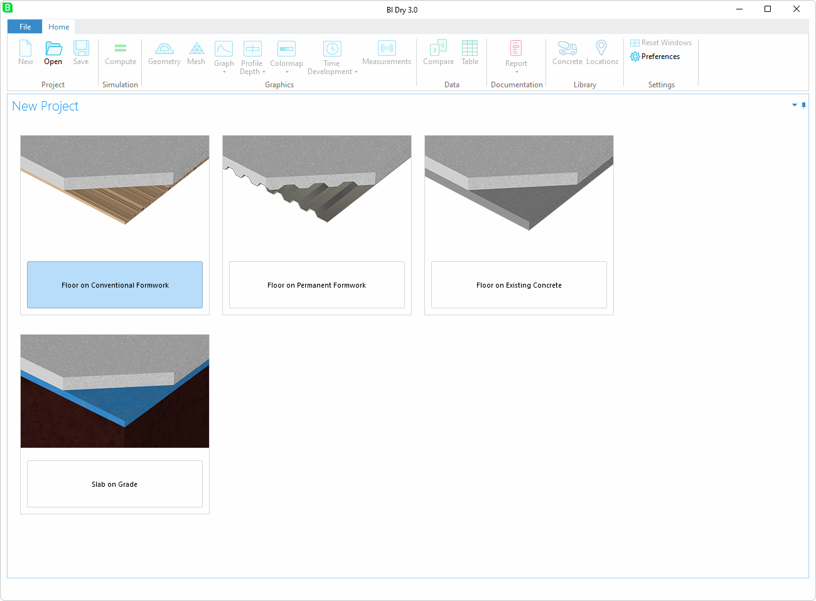
New Project
Select the construction
scenario

Slide 17
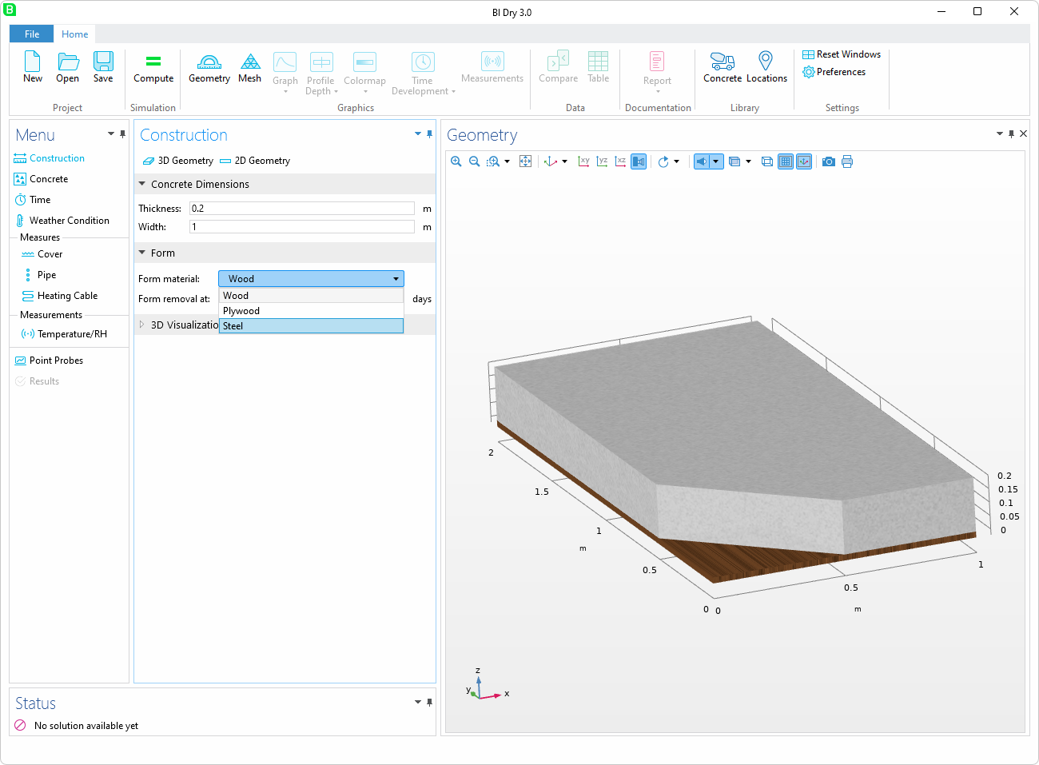
Menu
Construction
Change dimensions and
materials

Slide 18
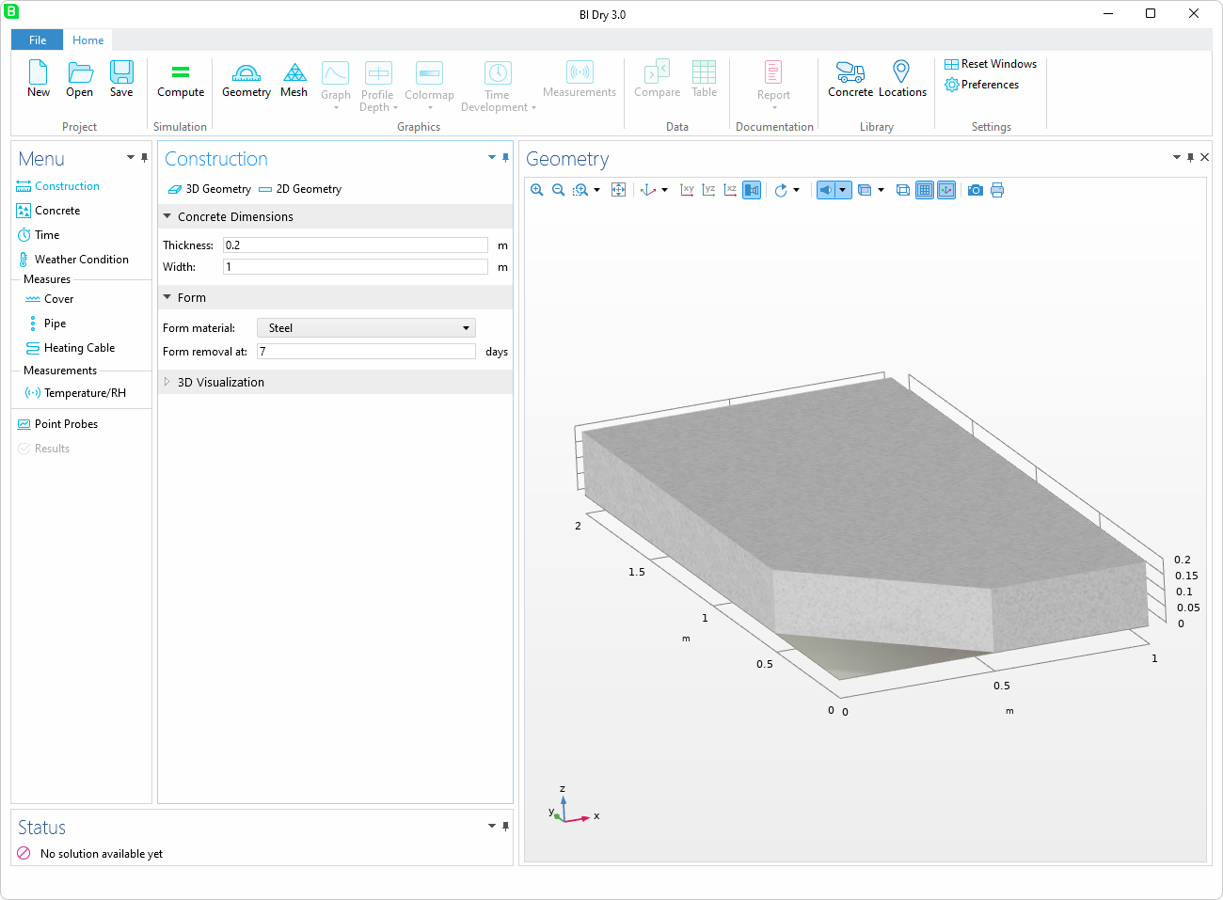
Menu
Construction
Visualization in 3D of the
construction and the
materials

Slide 19
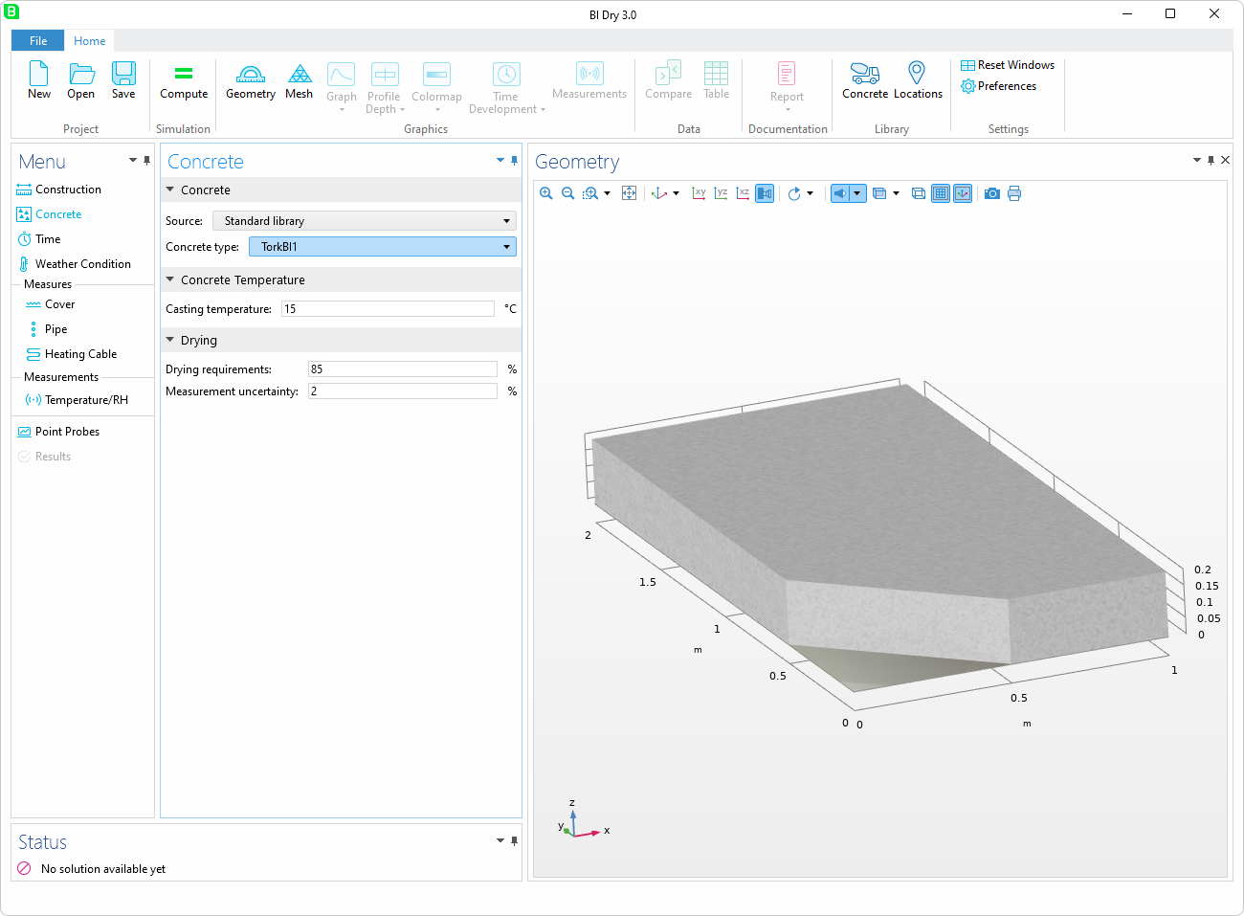
Menu
Concrete
Set the concrete type
and the casting
temperature
Define drying
requirements

Slide 20
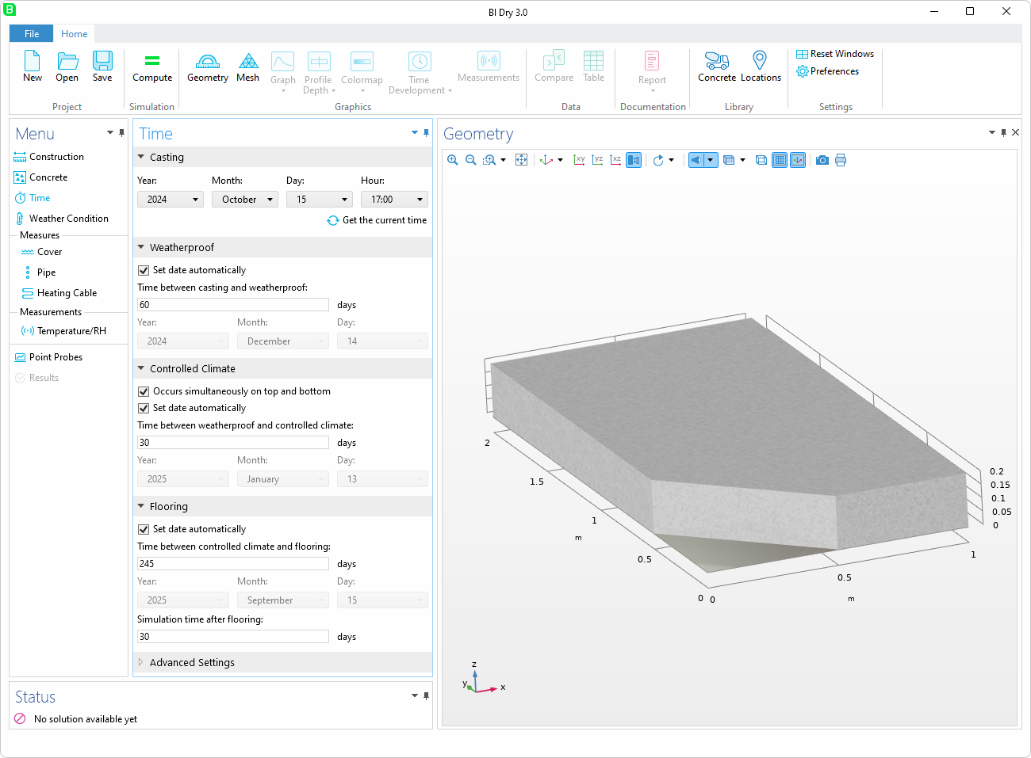
Menu
Time
Set dates for the
different events
The time between
the casting and the
simulation time after
flooring will be the
total simulation time

Slide 21
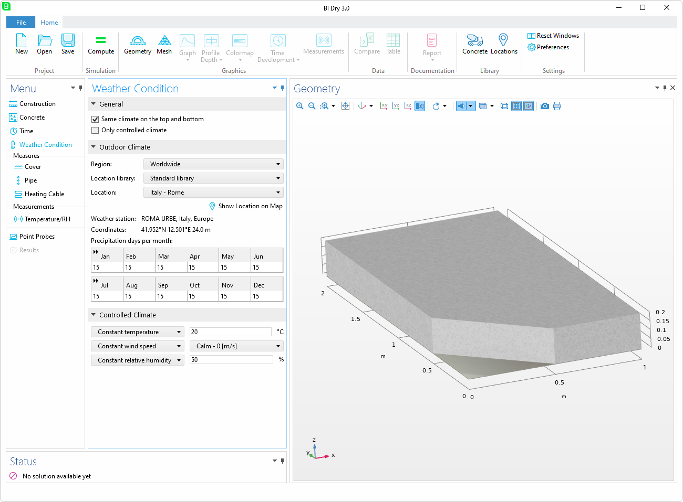
Menu
Weather Condition
Temperature, wind,
and RH comes from the
ASHRAE 2021 database
Precipitation days per
month must be set
manually for locations
outside of Sweden
For Sweden, precipitation
data is sourced from
SMHI

Slide 22
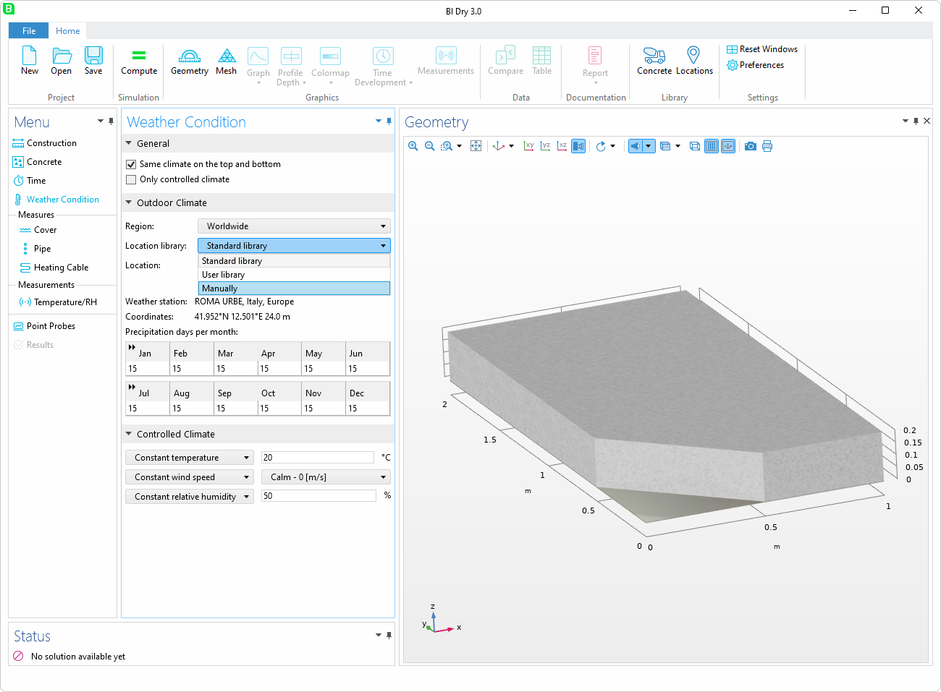
Menu
Weather Condition
The Location Library
makes it easy to re-use
data for construction
sites

Slide 23
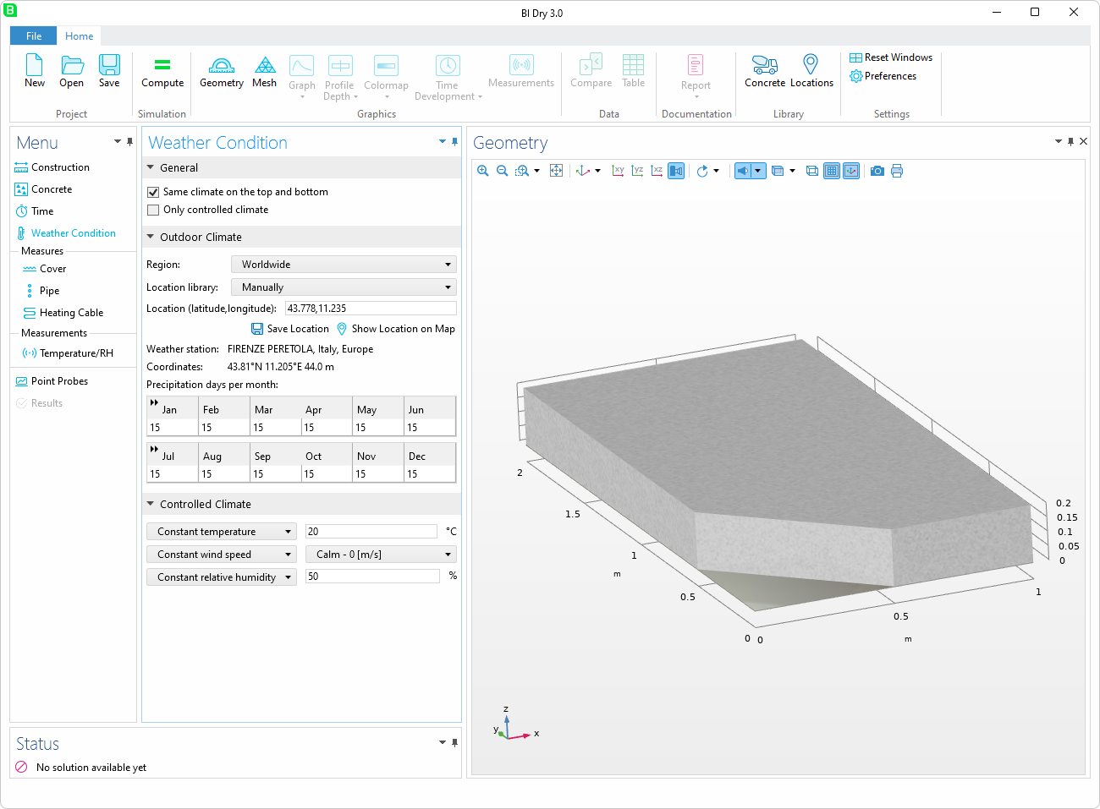

Menu
Weather Condition
Enter the coordinates
for Teatro del Maggio
Musicale Fiorentino
Show Location on Map
opens Google Maps
Save Location opens a
new dialog to save the
location:

Slide 24

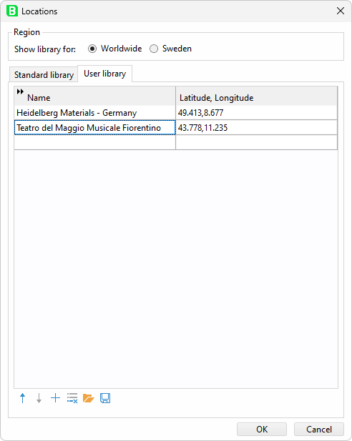
Menu
Weather Condition
Locations are saved
to the library

Slide 25
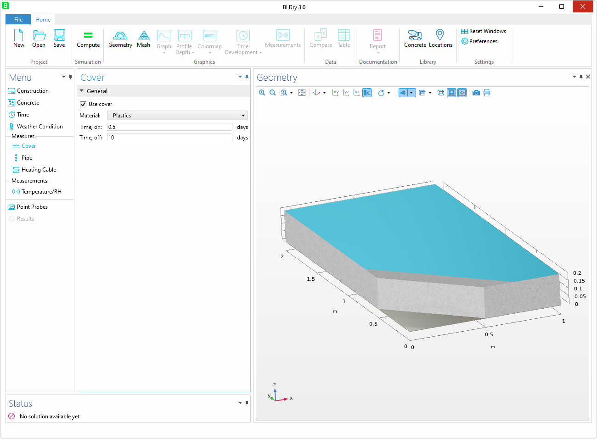
Menu
Cover
Cover of different
materials can be added
Time for on/off condition

Slide 26
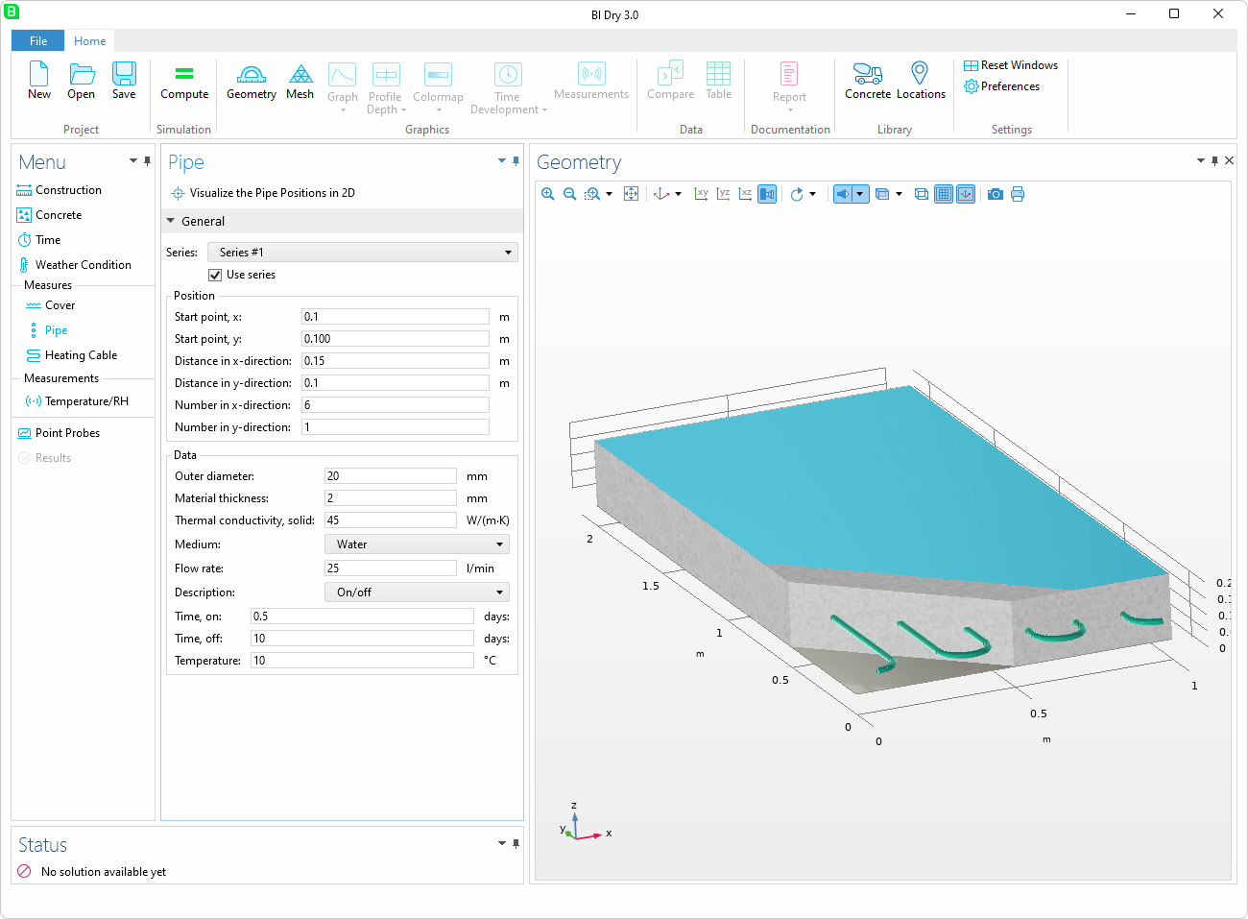
Menu
Pipe
Pipes with fluid can
cool or heat the
concrete

Slide 27

Menu
Pipe
Can include several
pipe series with
different properties
The pipe medium can
be altered

Slide 28
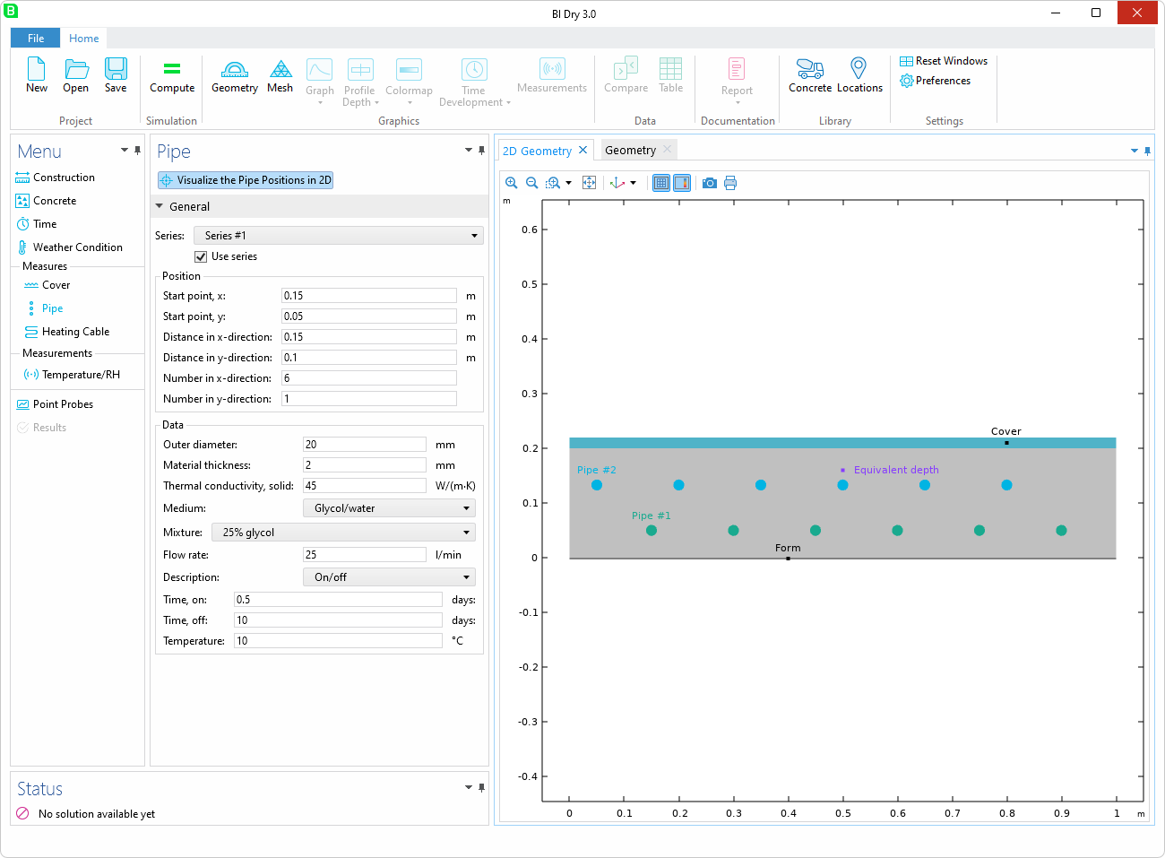
Menu
Pipe
2D visualization
provides an easy-to-use
interface for geometric
dimensioning

Slide 29
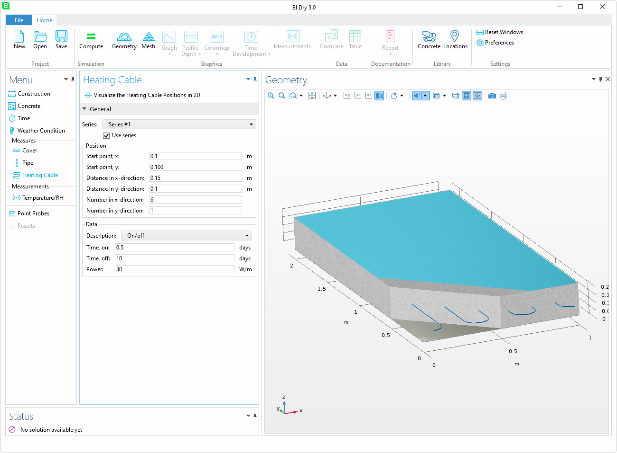
Menu
Heating Cable
Heating cables can be
arranged in a manner
similar to pipe
installation

Slide 30
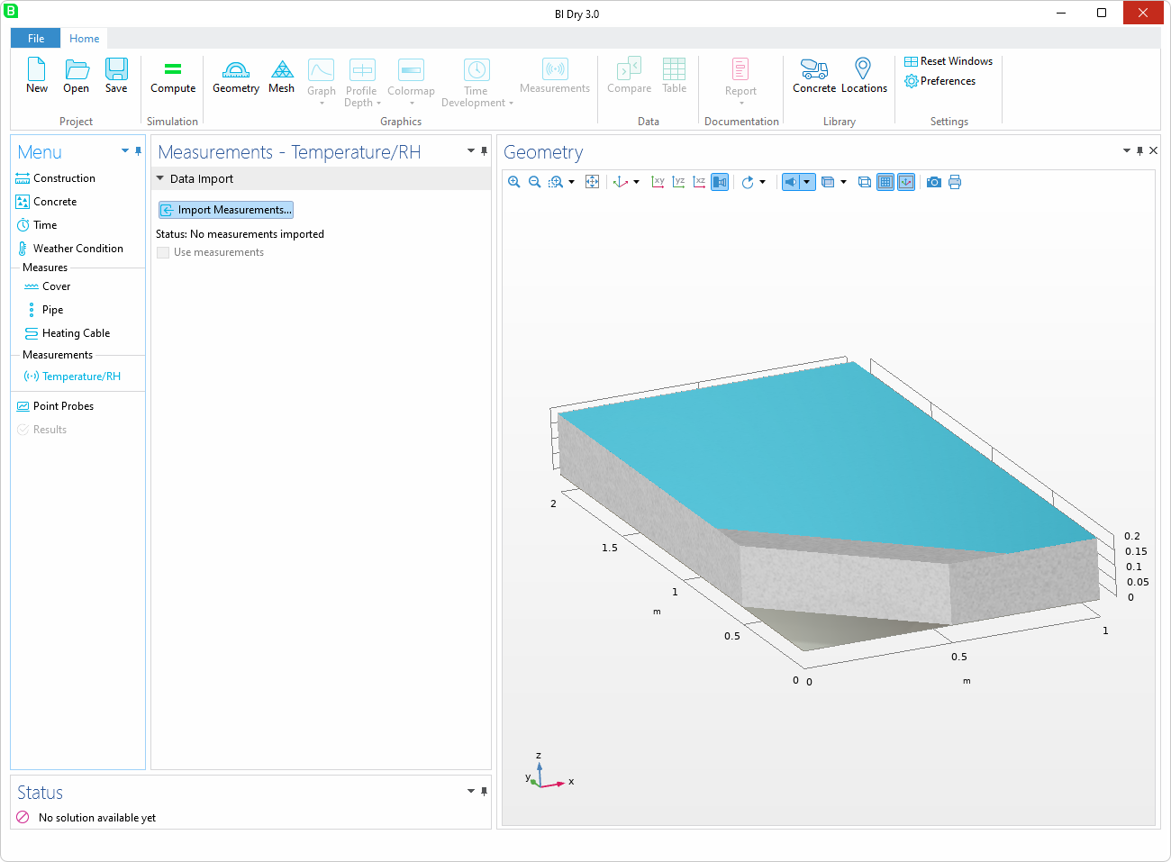
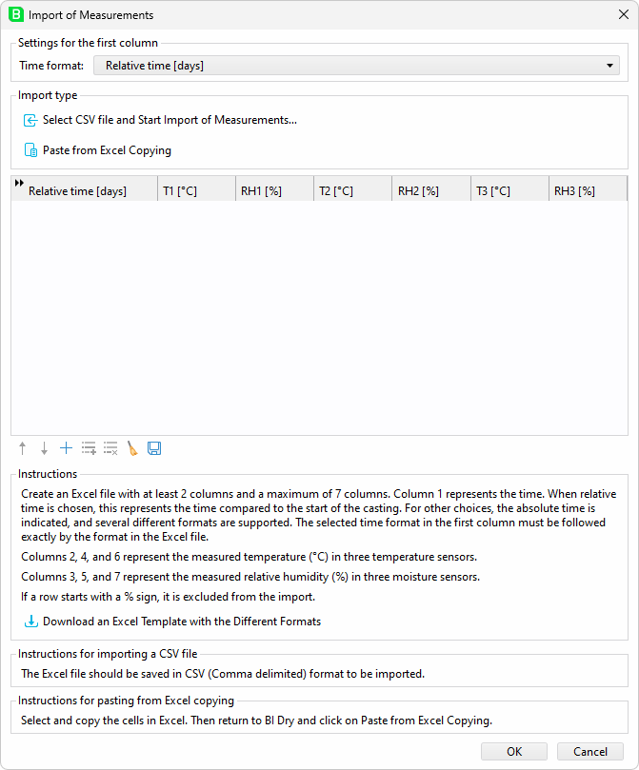
Menu
Measurements
Add measurements to
compare simulations
with on-site sensor data
Capable of handling
large datasets efficiently
Accepts local user
settings in a
comma-delimited format

Slide 31
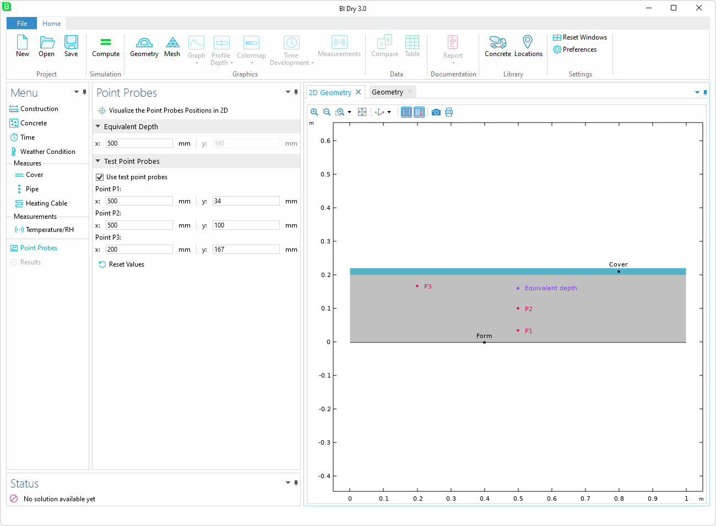
Menu
Point Probes
Enables the visualization
of output data at
selected points
The y-coordinate for
the equivalent depth is
fixed and cannot be
edited, as it depends
on the construction type
The x-coordinate is
crucial when using
pipes or heating cables

Slide 32
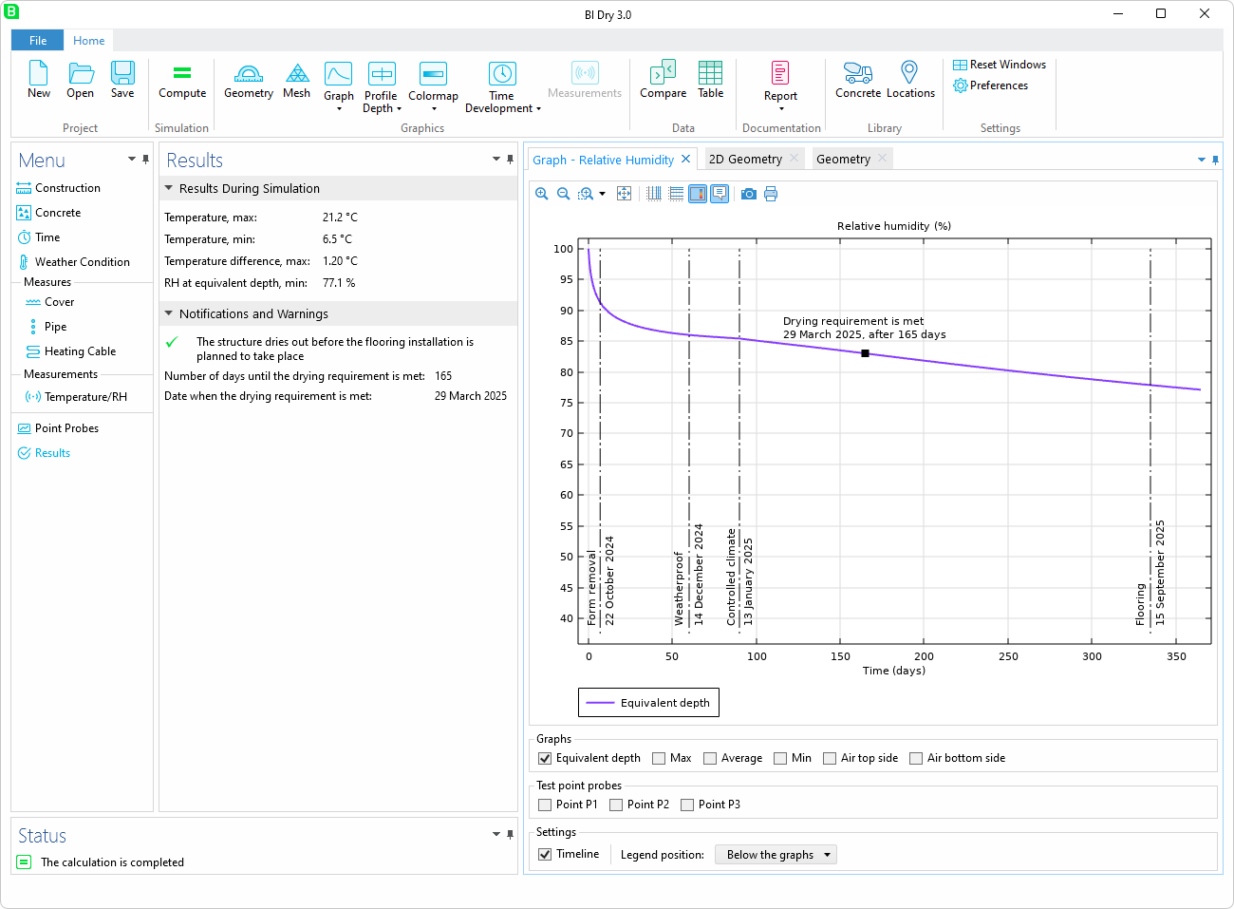
Menu
Results
Notifications and
warnings
Date when drying
requirement is met

Slide 33
Graphics
Results visualization

Slide 34
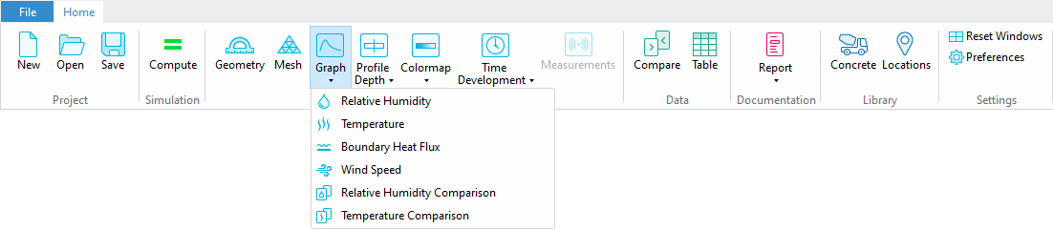
Graphics
Graph Menu

Slide 35
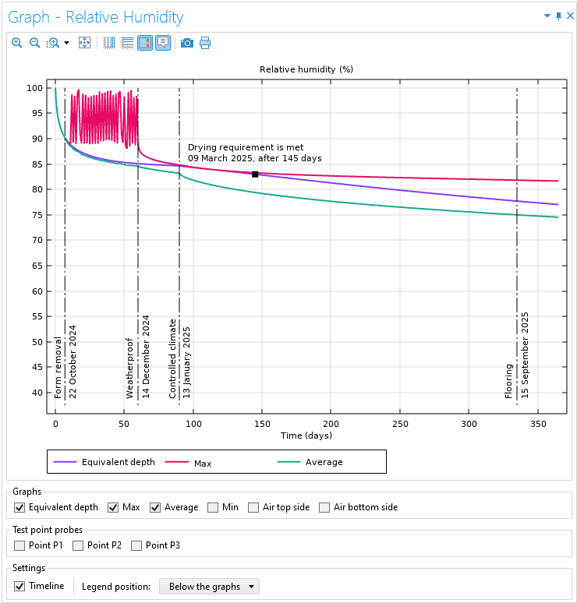
Graphics
Graph - Relative Humidity
Cover removed
Weatherproof

Slide 36
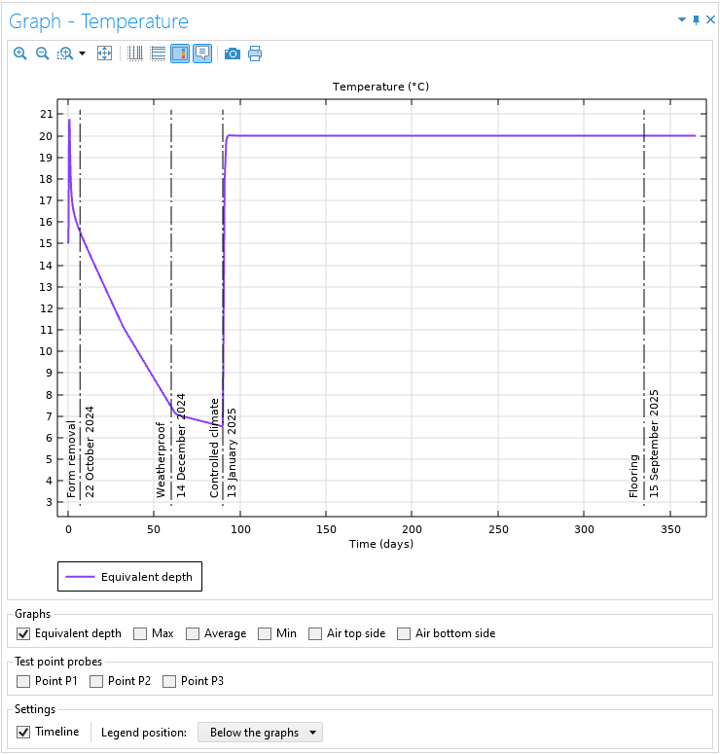
Graphics
Graph - Temperature
Controlled climate
Select graphs

Slide 37
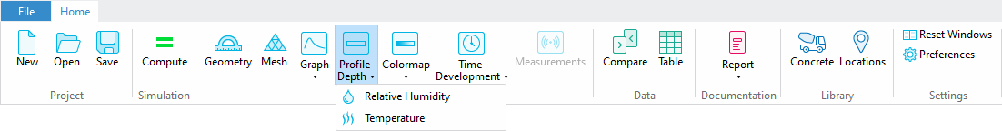
Graphics
Profile Depth Menu

Slide 38
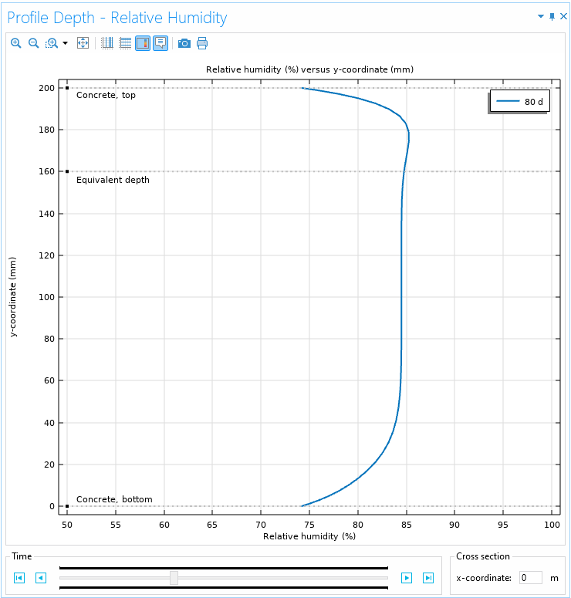
Graphics
Profile Depth – Relative Humidity
y
x
Drag slider to change time step

Slide 39
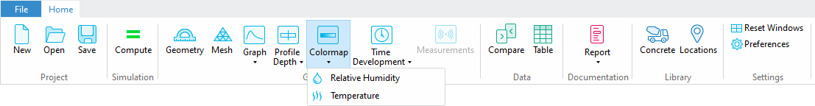
Graphics
Colormap Menu

Slide 40
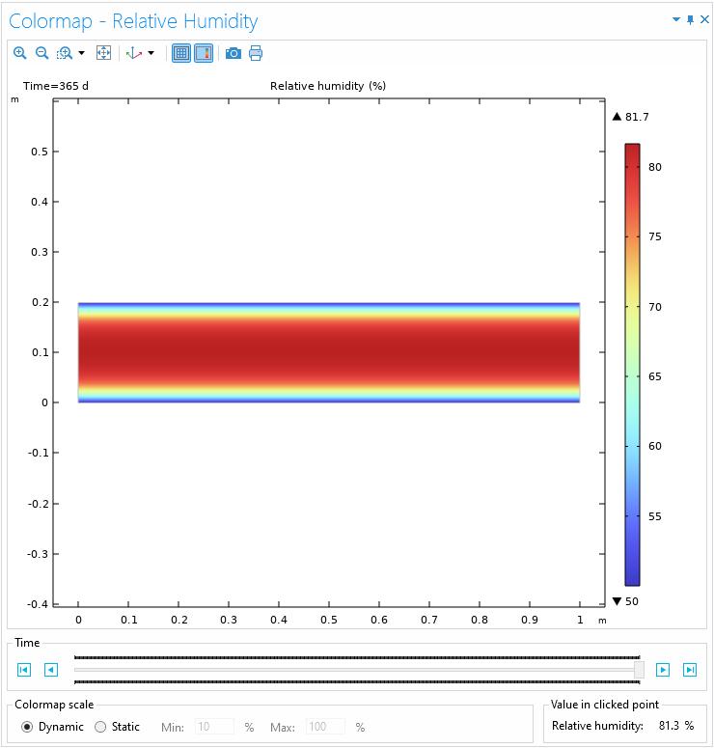
Graphics
Colormap – Relative Humidity
Drag slider to change time step
Set dynamic or static colormap scale

Slide 41
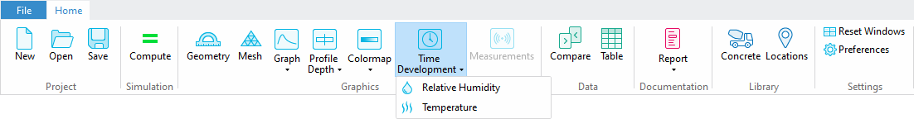
Graphics
Time Development Menu

Slide 42
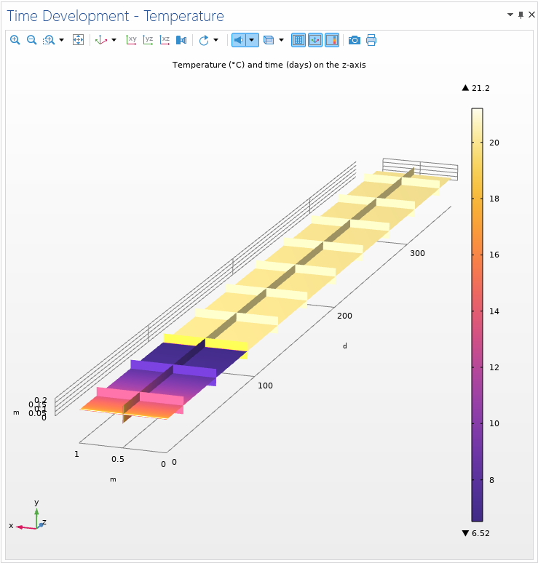
Graphics
Time Development - Temperature
The z-coordinate represent time (days)

Slide 43
Results
Compare data and create reports

Slide 44
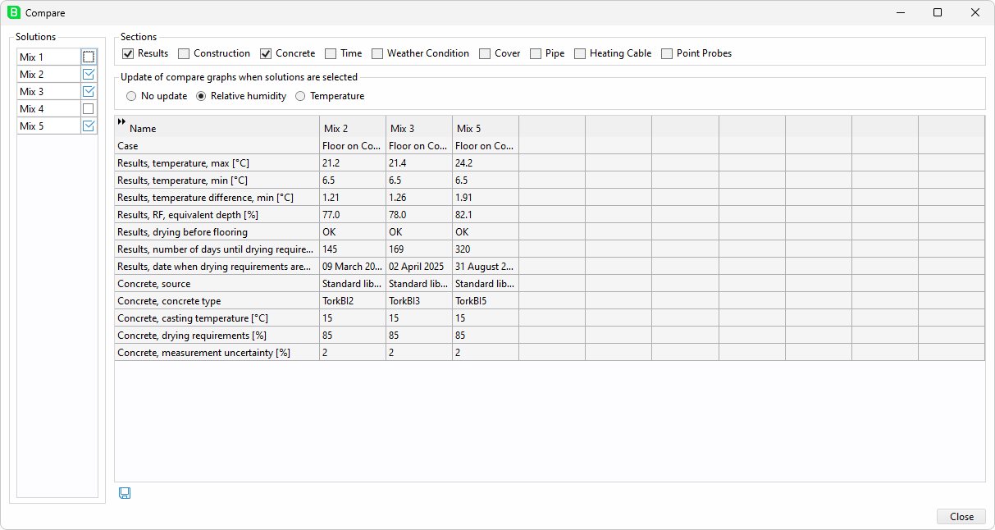
Compare
Compare and Visualize Different Solutions
Each time a solution is
computed, relevant data is
saved, allowing for easy
comparison of different
inputs and outputs
Solutions can be renamed
and sections can be filtered
Plots can be updated
automatically

Slide 45
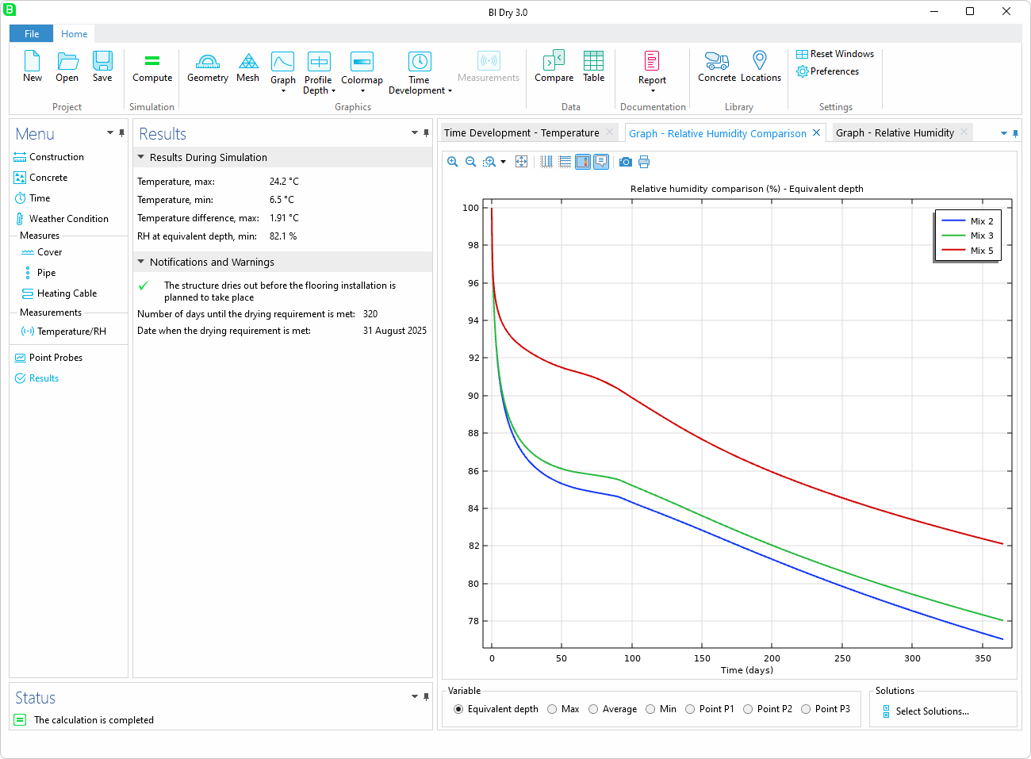
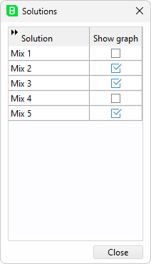
Compare
Visualize
Easy to rename and
enable/disable the
visualization of different
solutions

Slide 46
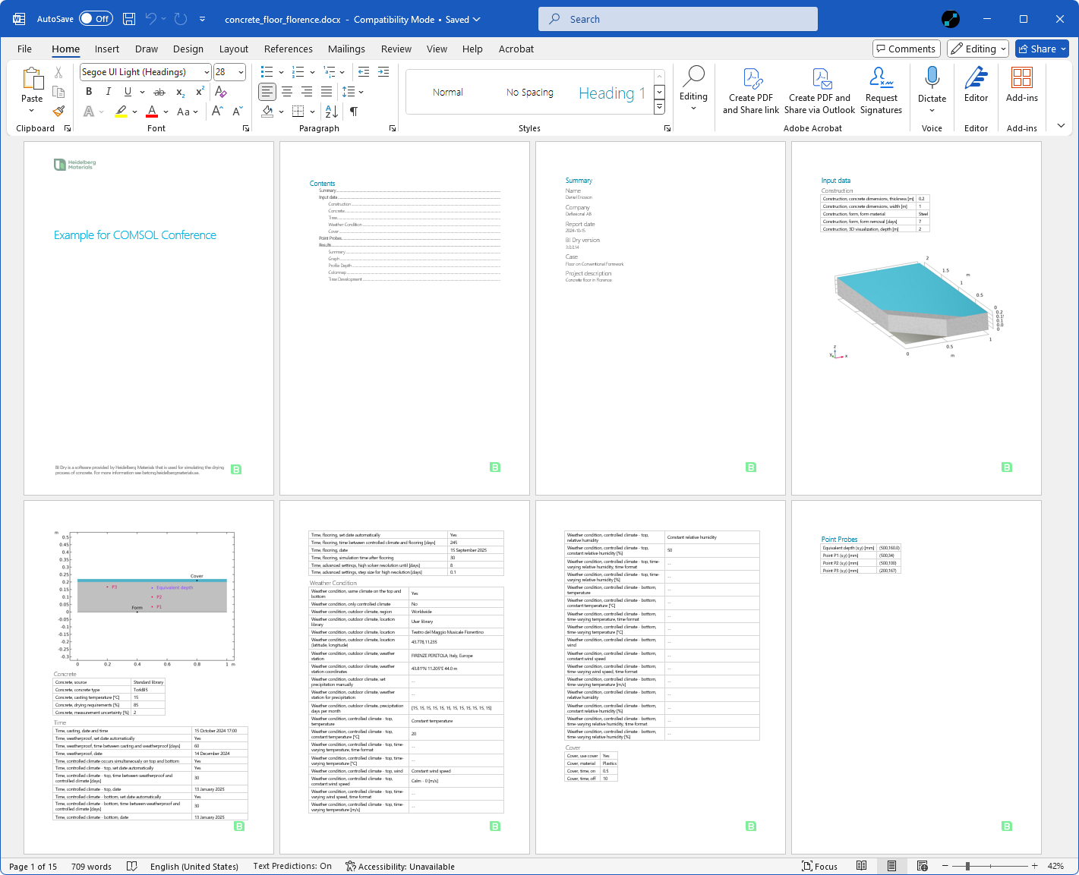
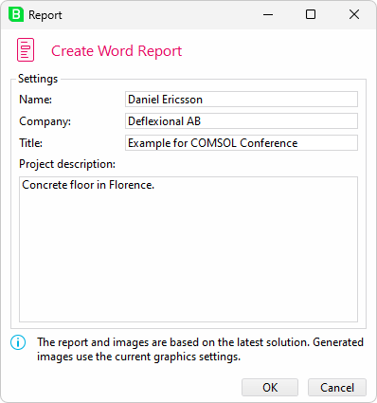
Report
Microsoft Word

Slide 47
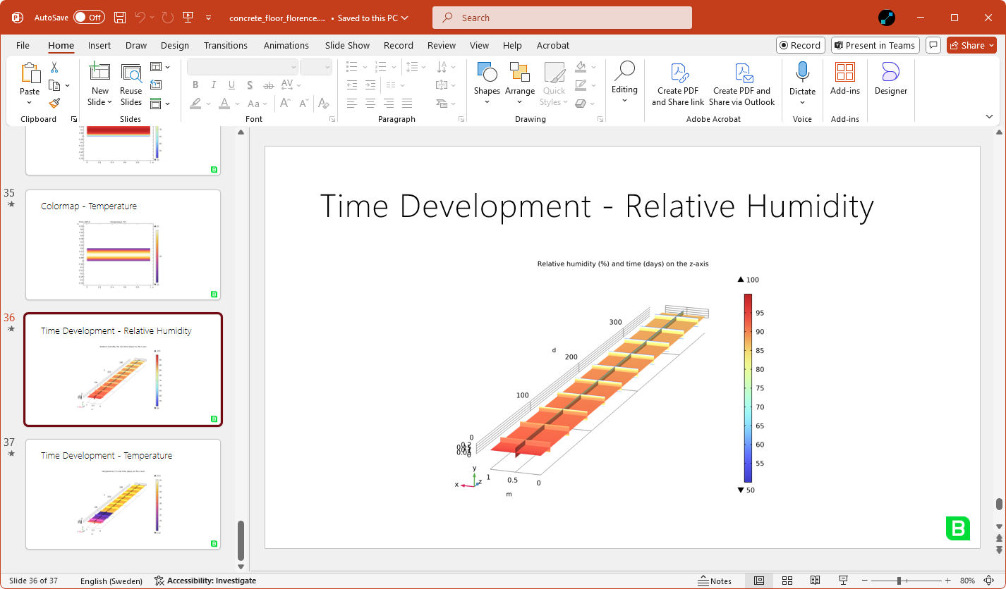
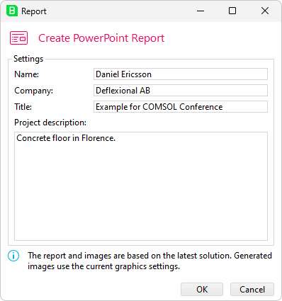
Report
Microsoft PowerPoint

Slide 48
Preferences
Set language, region, appearance, and more

Slide 49
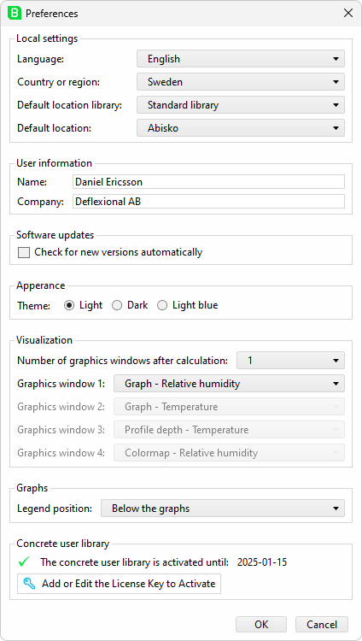
Preferences
Local Settings
Language can be set to English or Swedish
If the region is set to Sweden, precipitation
data averaged from 1991 to 2020 is provided
by the Swedish Meteorological and
Hydrological Institute (SMHI).

Slide 50
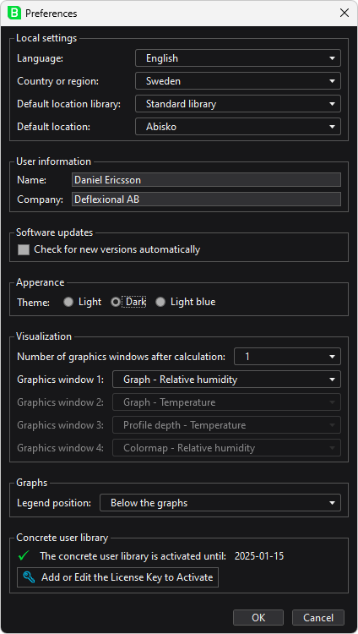
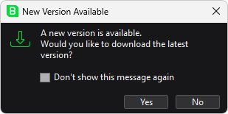
Preferences
Software Updates and Appearance
The user can choose between three
different themes
Every time BI Dry starts it can check for new
versions automatically

Slide 51
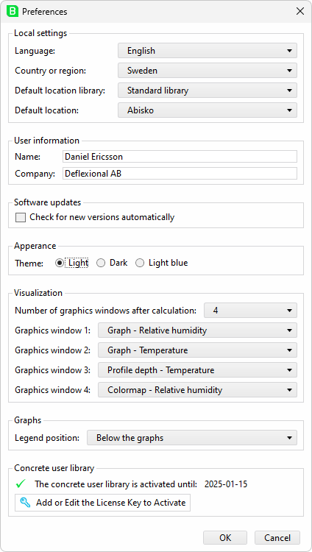
Preferences
Visualizations and Graphs
The number of graphics windows after a
calculation can be adjusted from 1 to 4
Each graphics window can have a default plot
For graphs, the default position for the legends
can be set

Slide 52
Underlying COMSOL Model
Combining the Model Builder with methods

Slide 53
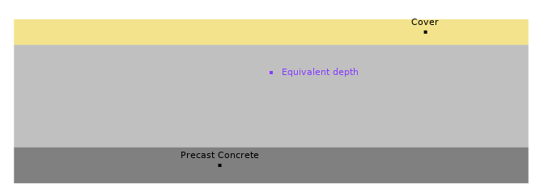
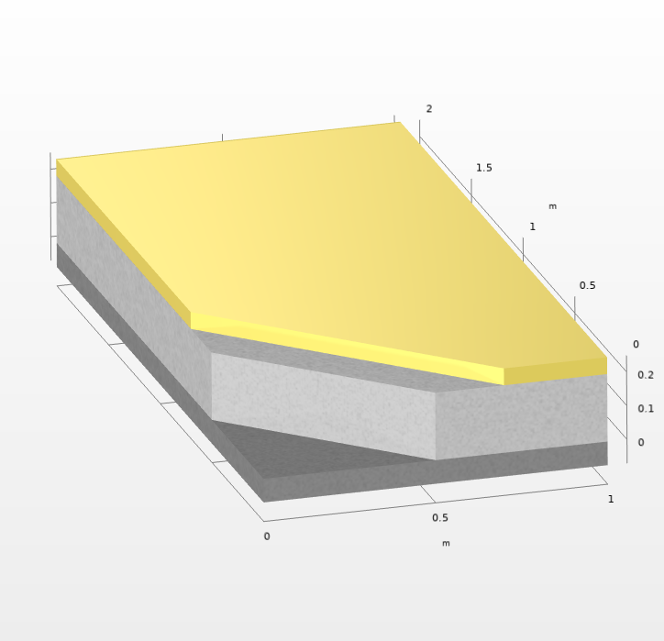
Geometry
The 2D geometry is dynamically generated in the Application Builder using methods tailored to the selected construction case
A secondary 3D component is used to visualize the construction with material colors

Slide 54
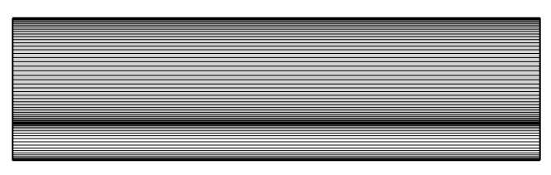
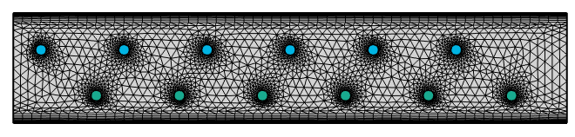
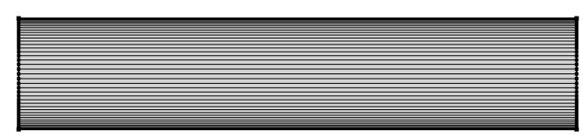
Mesh
The mesh automatically adjusts to the selected construction scenario.
If pipes or heating cables are included, boundary layer meshing is added automatically
The problem is always solved in 2D, but the mesh has only one element in the x-direction, effectively reducing it to 1D when possible

Slide 55
Physics Interfaces
Heat Transfer in Solids
  Heat Source
  Heat Flux
  Thin Layer
Stabilized Convection-Diffusion Equation
Domain ODEs and DAEs
  Calculate the equivalent time (maturity)
Events
  Efficiently manages dynamic changes in the model such as formwork removal, cover additions, or the activation/deactivation of heating cables or pipes

Slide 56
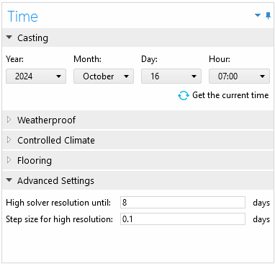
Solver Settings
The solver uses MUMPS
The time stepping method is set to BDF
The app users can control
  High solver resolution form the start until a certain amount of days
  The solver step size for the high resolution

Slide 57
Access to Specific Functionality
A portion allocated for advanced users and researchers

Slide 58
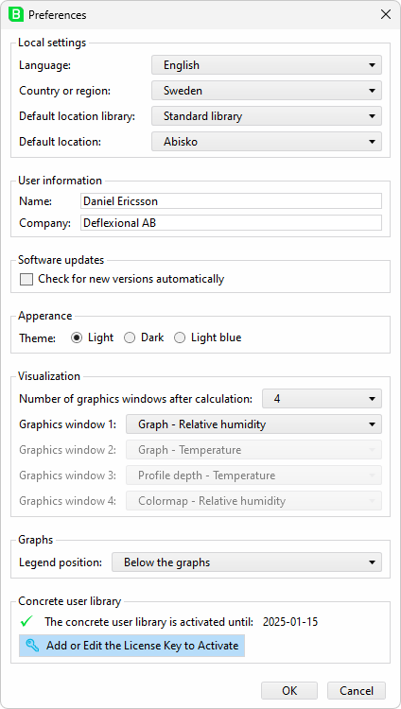
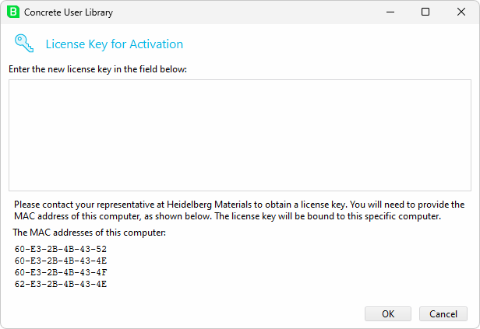
Preferences
Concrete User Library
The Concrete User Library
enables researchers to add
their own concrete mixes
Requires a license key
which is bound to the
MAC address

Slide 59

License Keys
The Deflexional License Manager manages license key generation and integration with the COMSOL App
Can be tested for free at:
deflexional.com/license-manager

Slide 60
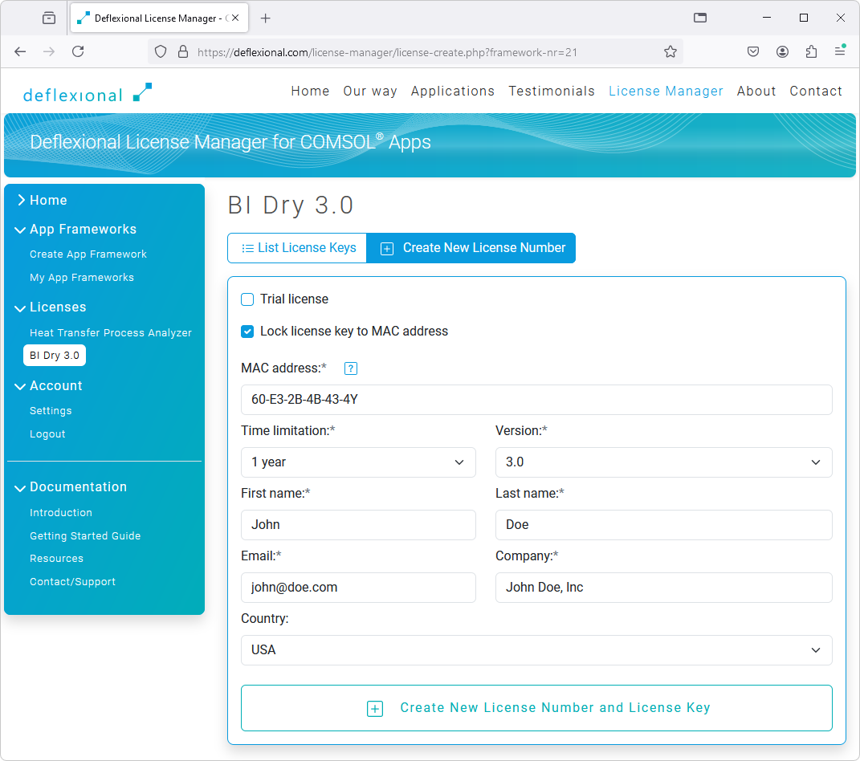

Slide 61


Slide 62
Conclusions
Contractors can now use the latest technology
to simulate drying of concrete

Slide 63
Conclusions
Given the success of HETT²², BI Dry 3.0 has been completely rebuilt on the same platform utilizing COMSOL Multiphysics® and COMSOL Compiler™.
BI Dry 3.0 uses the Maturity Method and the heat transfer equation plus a convection-diffusion equation for moisture content, coupled with heat transfer.
By using simulations, significant cost savings and environmental benefits can be realized by choosing the right concrete and construction under certain conditions.
BI Dry 3.0 is scheduled for release before the end of 2024.
Any contractor can now leverage the power of COMSOL Multiphysics® to simulate the drying of concrete.

Slide 64
We maximize the benefits of
engineering simulations
Daniel Ericsson
CEO & Founder
daniel.ericsson@deflexional.com
Phone: +46-70-586 00 98
www.deflexional.com

Slide 65


