Slide 1


Atmospheric Plasma Modelling Applied For Thermal Plasma Assisted Processes
Aurélien Lejeune (Ph.D., President)
+33 (0)7 86 53 03 85, aurelien.lejeune@protostep.fr
PROTOSTEP, Cergy-Pontoise, 95015, France

Slide 2
About PROTOSTEP
Simulation, Expertise, R&D solutions
Expertises:
Fundamental Physics
Plasma Physics
CFD, turbulence and shock wave
PROTOSTEP, SAS
32, Boulevard du Port, CS20001, 95015, Cergy-Pontoise
On-going developments:
Neural Networks based methods
French company founded in 2019
Fields of application:
DC/RF/microwave plasmas
Wind/water fluid-structure interactions
EM/High-voltage environnements
Structural mechanics and Fatigue
Heat transfers
Headquarters in La Turbine (95015, Cergy-Pontoise)
Main premisses in Paris-Saclay campus (91120, Palaiseau)
2 Doctors with Ph.D. in Physics
1 Engineer in Electrotechnics
Missions:
Expertise and Consultancy
Numerical modelling and Study
Standalone Application

Slide 3
Plasma, the fourth state of matter
  Rare on Earth at the natural state: aurora borealis, lightning, flame
  Most abundant form of ordinary matter in the Universe: stars, intracluster medium, intergalactic medium
  Plasma contains electrons, ions and neutrals (atoms and molecules)
  Plasma can be artificially generated over a wide range of operating conditions: Low-pressure plasma, Atmospheric-pressure plasma, DC discharge, Arc discharge, RF/microwave plasma, …
  3 categories of plasma:
    Cold plasmas (low pressure < 1 mbar, ambient temperature ~300 K)
    Thermal plasmas (atmospheric pressure, medium temperature ~10³⁻⁴ K)
    Fusion plasmas (high pressure ≥ 1 atm, high temperature ~10⁶ K)
The more the particle interactions increase, the more the challenges in simulation are met
Atmospheric Plasma Modelling Applied For Thermal Plasma Assisted Processes

Slide 4
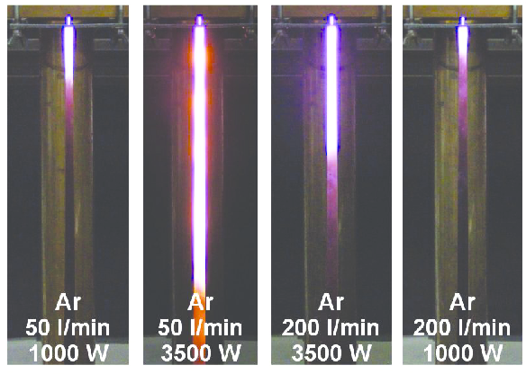
Problem statement
  Microwave plasmas (0.3-300GHz) are used in industry for various applications such as in microelectronics or decomposition of greenhouse gases
  High-pressure microwave plasmas are still studied in laboratories since they are experimentally characterized by specific phenomena of contraction or filamentation [1]
Ar
Energy source
+
Ar flow
Ar*
Ar⁺
e⁻
FIGURE 1. Cylindrical microwave plasma source operated with Argon at atmospheric pressure [2].
Ar plasma
Atmospheric Plasma Modelling Applied For Thermal Plasma Assisted Processes
[1] M. Moisan and J. Pelletier, Physique des Plasmas Collisionnels - Application aux décharges haute fréquence, EDP Sciences, 2006
[2] B. Hrycak, M. Jasinski and J. Mizeraczyk, Tuning characteristics of cylindrical microwave plasma source operated with argon, nitrogen and methane at atmospheric pressure, PRZEGLĄD ELEKTROTECHNICZNY (Electrical Review), ISSN 0033-2097, R. 88 NR 6/2012

Slide 5
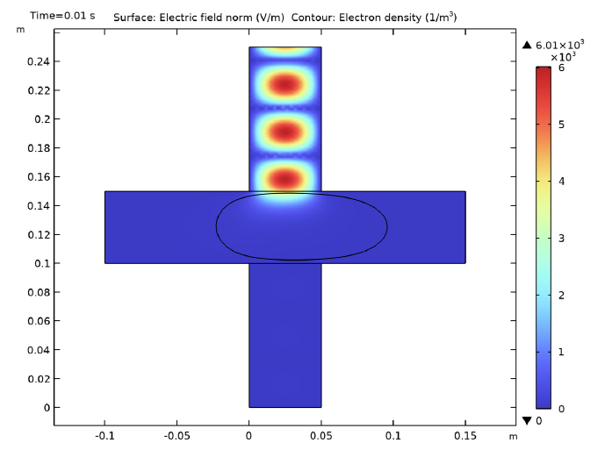
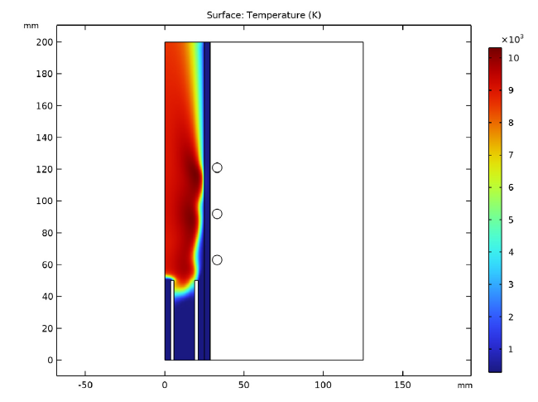
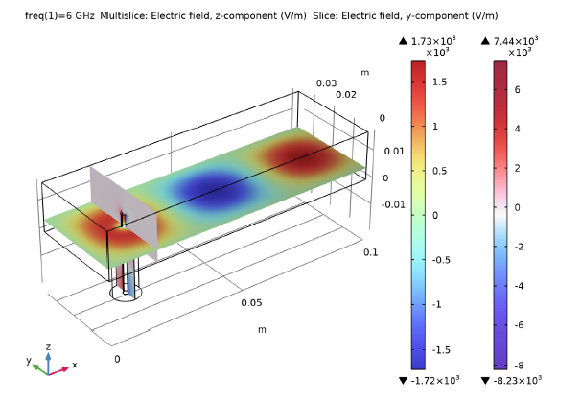
Overview of the existing models
  In-Plane Microwave Plasma - Application ID: 8664
  Inductively Coupled Plasma (ICP) Torch - Application ID: 18125
  Coaxial to Waveguide Coupling - Application ID: 1863
RF module + Plasma module
→ valid at low pressure, no increase in temperature
AC/DC module + Plasma module
→ valid at atmospheric pressure with an increase in temperature, no reaction set is considered, thermodynamic equilibrium vs T is assumed for the gas mixture properties
RF module
→ waveguide-to-coaxial coupling is observed, no plasma
Atmospheric Plasma Modelling Applied For Thermal Plasma Assisted Processes

Slide 6
Main goals and expected results
  In that context, a fully-coupled microwave plasma model at atmospheric pressure with COMSOL Multiphysics® is a necessary step to optimize the development of such a plasma reactor
  Four blocks of Physics must be considered to study this problem:
    Electromagnetics for the microwave propagation and plasma interaction – RF module
    Fluid dynamics for the gas mixture flow – CFD module
    Heat transfers for the thermodynamic equilibrium – Heat transfer module
    Plasma physics for the electron and heavy particule production – Plasma module
  The expected results are:
    Production of the plasma
    Absorption of the microwave (skin effect)
    Waveguide-to-coaxial coupling
    Increase in the gas temperature
Atmospheric Plasma Modelling Applied For Thermal Plasma Assisted Processes

Slide 7





Simulation of plasmas: Numerical assumptions [3]
  Fluid approach:
    Continuum
    Transport equations
    Assumed Maxwellian EEDF
  Limitations:
    Reduced electric field:
    Electron density:
    Debye length:
    Gas pressure:
$$\begin{matrix}1 atm@300K & ⇒ & N≈{10}^{25} m^{−3}\end{matrix}$$
$$\frac{\left|E\right|}{N}<500 Td$$
$$\begin{matrix}1 Td={10}^{−21} V.m² & ⇒ & {\left|E\right|}_{max}≈5 MV/m\end{matrix}$$
$$n_{e}≪N$$
(low degree of ionization)
$$λ_{D}≪L$$
(apparent charge neutrality)
$$p>{10}^{−3} mbar$$
These assumptions are satisfied in the present case study.
Atmospheric Plasma Modelling Applied For Thermal Plasma Assisted Processes
[3] J. Crompton and L. Gritter, Plasma modeling in COMSOL Multiphysics®, AltaSim Technologies - https://www.comsol.fr/video/modeling-plasmas-in-comsol-multiphysics

Slide 8
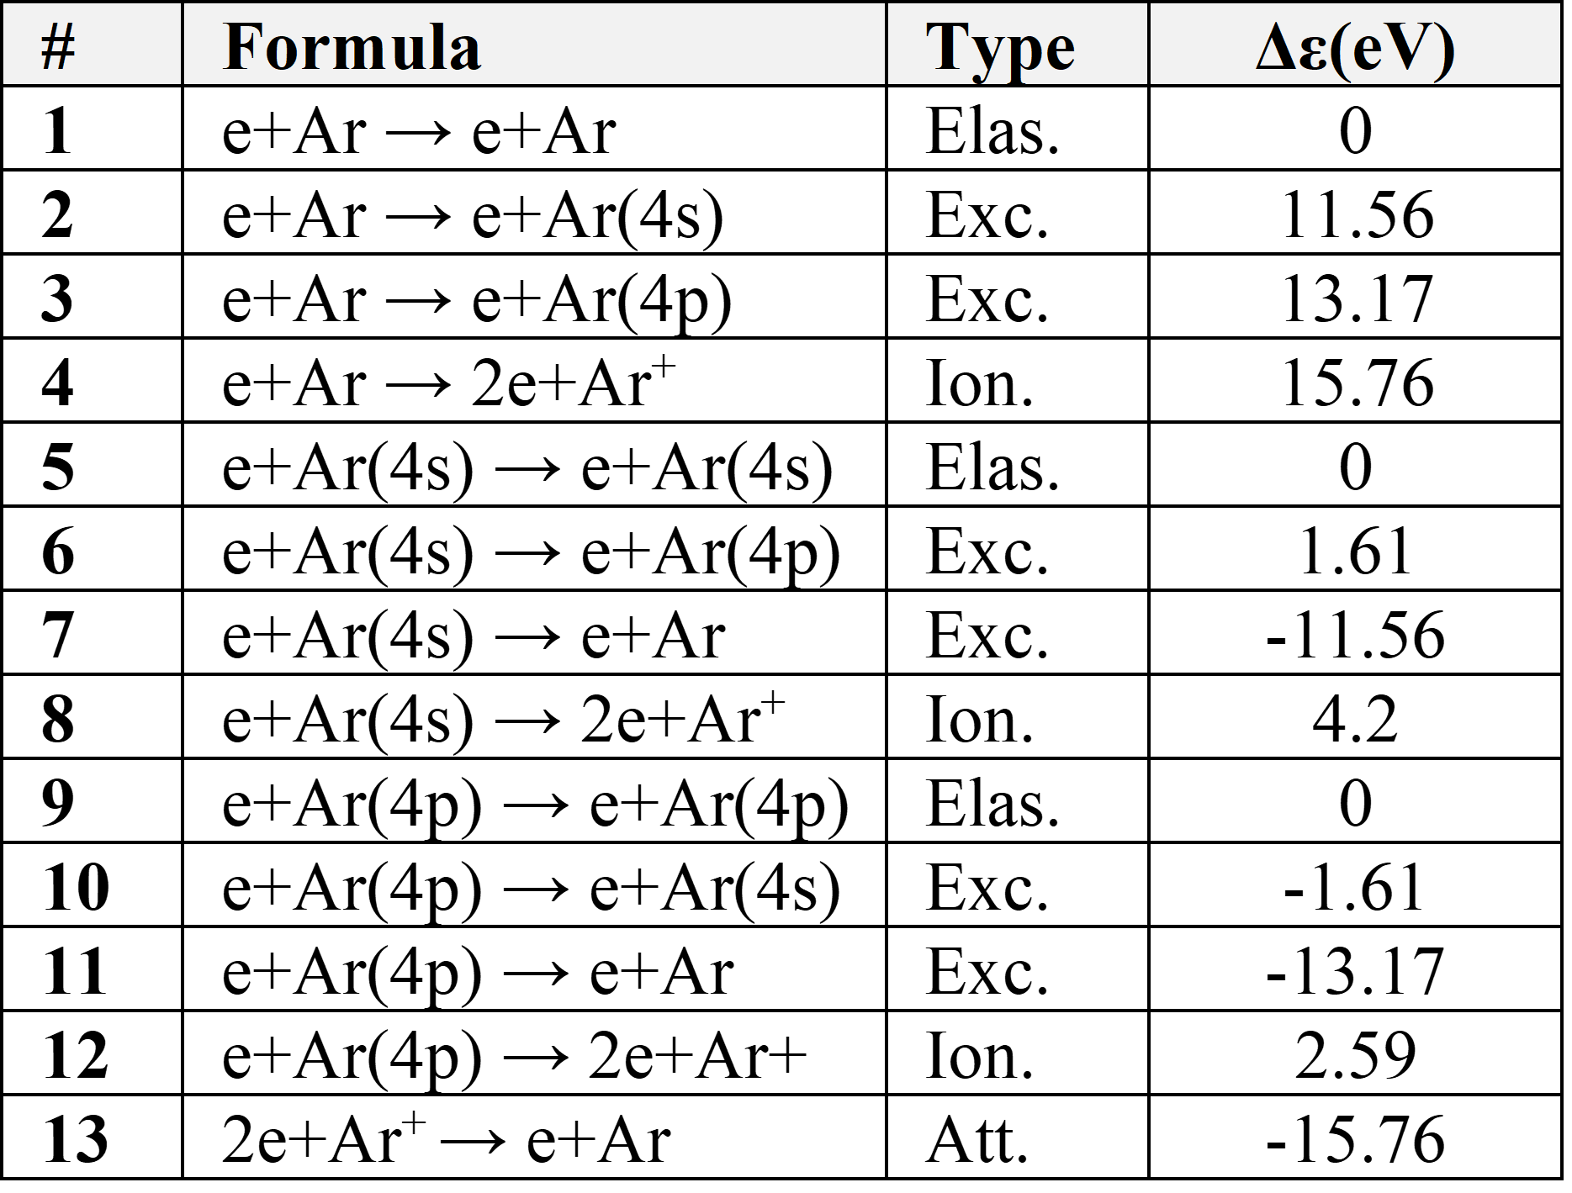
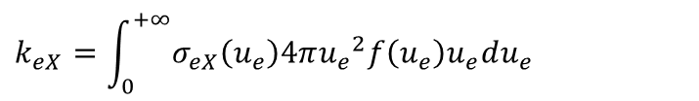

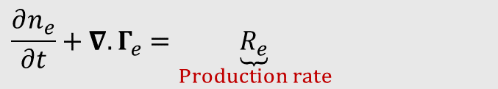

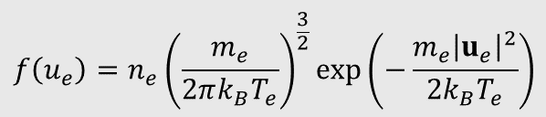
Simulation of plasmas
  Electron density transport [4]:
$$\frac{∂n_{e}}{∂t}+∇.Γ_{e}=\underset{Production rate}{\underbrace{R_{e}}}$$
[1/(m³.s)]
$$Γ_{e}=−\underset{Convective flux}{\underbrace{\left(μ_{e}E\right)n_{e}}}−\underset{Diffusive flux}{\underbrace{∇\left(D_{e}n_{e}\right)}}$$
[1/(m².s)]
Convection of electrons due to fluid motion (u) is neglected
E is the electric field driven by the Maxwell’s equations
$$\begin{aligned}&k_{eX}=\int_{0}^{+∞}{σ_{eX}\left(u_{e}\right)4π{u_{e}}^{2}f\left(u_{e}\right)u_{e}du_{e}}\#\end{aligned}$$
$$R_{eX}=±n_{e}n_{X}k_{eX}$$
$$\begin{aligned}&f\left(u_{e}\right)=n_{e}{\left(\frac{m_{e}}{2πk_{B}T_{e}}\right)}^{\frac{3}{2}}\exp\left(−\frac{m_{e}{\left|u_{e}\right|}^{2}}{2k_{B}T_{e}}\right)\#\end{aligned}$$
Maxwellian EEDF [1]
Net electron production [5]
This is how electron density balance is computed.
Atmospheric Plasma Modelling Applied For Thermal Plasma Assisted Processes
[4] COMSOL Help Resources: Plasma Module > User's Guide > Plasma Interfaces > Plasma Reactors Theory
[5] W. Zhang, Recherche numérique et expérimentale sur les propriétés de décharge et les caractéristiques de propagation électromagnétique dans les torches à plasma micro-ondes, Toulouse INP, 2019

Slide 9
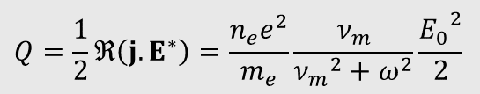
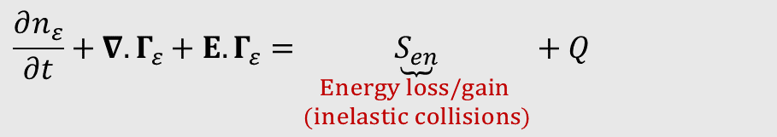
Simulation of plasmas
  Electron energy density transport [6]:
$$\frac{∂n_{ε}}{∂t}+∇.Γ_{ε}+E.Γ_{ε}=\underset{\begin{aligned}Energy loss/gain \\ (inelastic collisions)\end{aligned}}{\underbrace{S_{en}}}+Q$$
[W/m³]
$Γ_{ε}=−\left(μ_{ε}E\right)n_{ε}−$ $∇\left(D_{ε}n_{ε}\right)$
[W/m²]
Convection of electrons due to fluid motion (u) is neglected
E is the electric field driven by the Maxwell’s equations
Q is an external heat source driven by the Electron heat source
$$\begin{aligned}&Q=\frac{1}{2}ℜ\left(j.E^{∗}\right)\#=\frac{n_{e}e^{2}}{m_{e}}\frac{ν_{m}}{{ν_{m}}^{2}+ω^{2}}\frac{{E_{0}}^{2}}{2}\end{aligned}$$
Heat source for the electrons
(absorbed power density [1])
Electron energy transfers [5]
This is how microwave power is transferred to the electrons.
Atmospheric Plasma Modelling Applied For Thermal Plasma Assisted Processes
[6] COMSOL Help Resources: Plasma Module > User's Guide > The Drift Diffusion Interface > Theory for the Drift Diffusion Interface > Electron Transport Theory

Slide 10
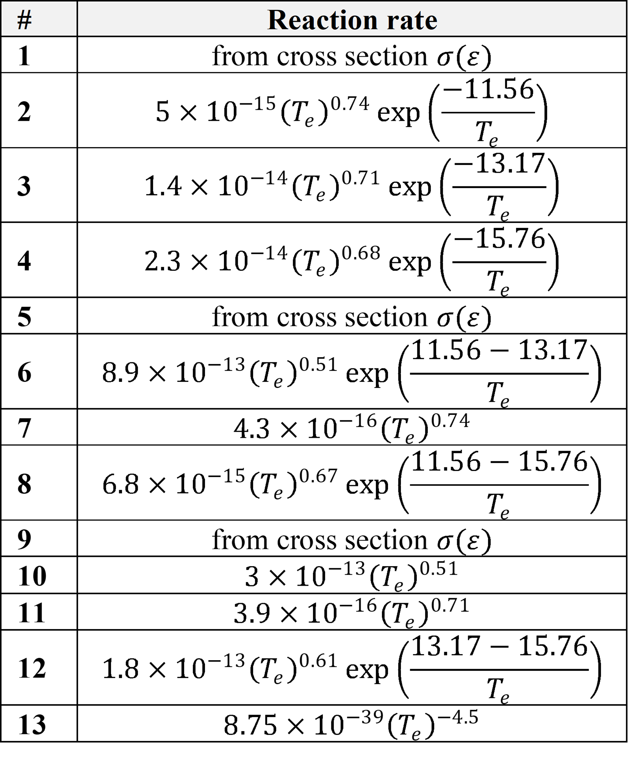
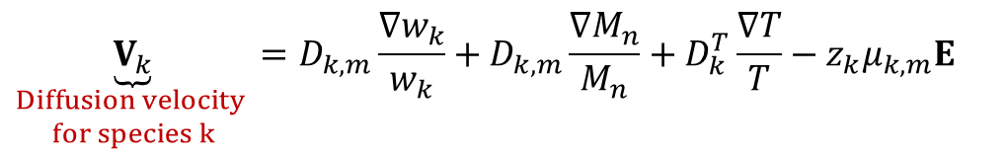

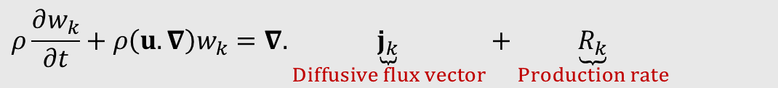
Simulation of plasmas
[5]
  Heavy species mass fraction transport [7]:
$$ρ\frac{∂w_{k}}{∂t}+ρ\left(u.∇\right)w_{k}=∇. \underset{Diffusive flux vector}{\underbrace{j_{k}}}+\underset{Production rate}{\underbrace{R_{k}}}$$
[kg/(m³.s)]
$j_{k}=ρ$ $w_{k}V_{k}$
[kg/(m².s)]
$$\underset{\begin{aligned}Diffusion velocity \\ for species k\end{aligned}}{\underbrace{V_{k}}}=D_{k,m}\frac{∇w_{k}}{w_{k}}+D_{k,m}\frac{∇M_{n}}{M_{n}}+D_{k}^{T}\frac{∇T}{T}−z_{k}μ_{k,m}E$$
This is how heavy species mass fraction balance is computed.
Atmospheric Plasma Modelling Applied For Thermal Plasma Assisted Processes
[7] COMSOL Help Resources: Plasma Module > User's Guide > The Heavy Species Transport Interface > Theory for the Heavy Species Transport Interface > Multicomponent Diffusion Equations

Slide 11
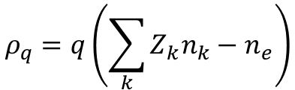

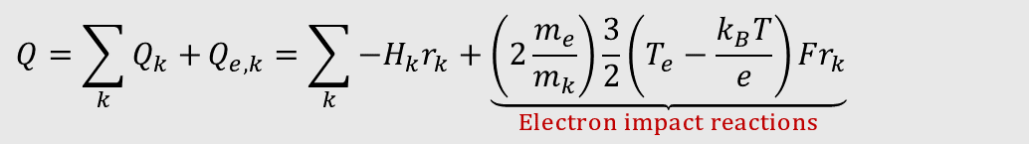
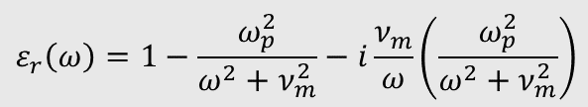
Simulation of plasmas
  Thermodynamic properties: Total heat source for heavy species [8]
$${Q=\sum_{k}{Q_{k}+}Q}_{e, k}=\sum_{k}{−H_{k}r_{k}+\underset{Electron impact reactions}{\underbrace{\left(2\frac{m_{e}}{m_{k}}\right)\frac{3}{2}\left(T_{e}−\frac{k_{B}T}{e}\right)Fr_{k}}}}$$
[W/m³]
$$h_{k}=R_{g}\left(a_{1}T+\frac{a_{2}}{2}T^{2}+\frac{a_{3}}{3}T^{3}+\frac{a_{4}}{4}T^{4}+\frac{a_{5}}{5}T^{5}+a_{6}\right)+F∆h$$
Enthalpy of reaction in J/mol from the NASA polynomials [9]
This is how reactions in a plasma heat the background gas.
  Poisson’s equation [4]
$$\begin{aligned}&ε_{r}\left(ω\right)=1−\frac{ω_{p}^{2}}{ω^{2}+ν_{m}^{2}}−i\frac{ν_{m}}{ω}\left(\frac{ω_{p}^{2}}{ω^{2}+ν_{m}^{2}}\right)\#\end{aligned}$$
$$ρ_{q}=q\left(\sum_{k}{Z_{k}n_{k}−n_{e}}\right)$$
$$∇.(ε_{0}ε_{r}E)=ρ_{q}$$
Im(ε_{r}) → Absorption is expected in the plasma
Space charge density
This is how plasmas react with an external electric field.
Atmospheric Plasma Modelling Applied For Thermal Plasma Assisted Processes
[8] Plasma Module > User's Guide > The Heavy Species Transport Interface > Theory for the Heavy Species Transport Interface > Thermodynamic Properties
[9] E. Goos, A. Burcat and B. Ruscic, “EXTENDED THIRD MILLENIUM IDEAL GAS AND CONDENSED PHASE THERMOCHEMICAL DATABASE,” [Online]. Available: http://garfield.chem.elte.hu/Burcat/THERM.DAT

Slide 12


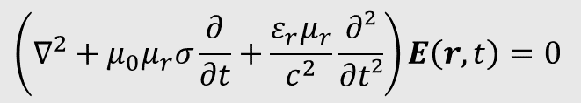
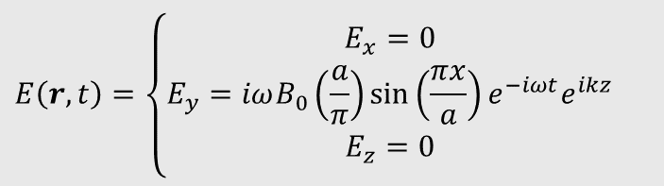
Simulation of electromagnetic wave propagation
  Wave equation:
    In a rectangular waveguide:
$$\left(∇^{2}+μ_{0}μ_{r}σ\frac{∂}{∂t}+\frac{ε_{r}μ_{r}}{c^{2}}\frac{∂²}{∂t²}\right)E\left(r,t\right)=0$$
$$E\left(r,t\right)=E\left(x,y\right)e^{−iωt}e^{ikz}$$
Magnetic field is not considered here since its interaction with the electrons can be neglected (non-magnetized plasma)
$$\begin{aligned}&E\left(r,t\right)=\left\{\begin{matrix}E_{x}=0 \\ E_{y}=iωB_{0}\left(\frac{a}{π}\right)\sin\left(\frac{πx}{a}\right)e^{−iωt}e^{ikz} \\ E_{z}=0\end{matrix}\right.\#\end{aligned}$$
$$k^{2}={k_{10}}^{2}=μεω^{2}−\frac{π^{2}}{a^{2}}$$
TE10 mode is expected in the rectangular waveguide
This is how EM field propagation is computed.
Atmospheric Plasma Modelling Applied For Thermal Plasma Assisted Processes

Slide 13

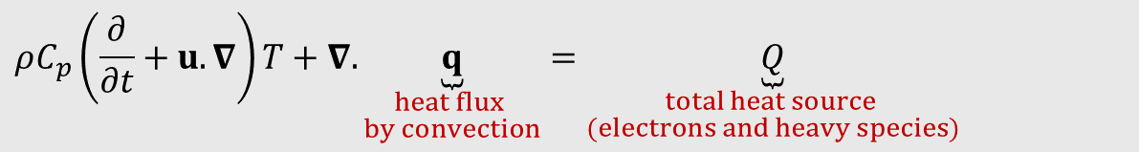
Simulation of heat transfers
  Heat equation:
$$ρC_{p}\left(\frac{∂}{∂t}+u.∇\right)T+∇.\underset{\begin{aligned}heat flux \\ by convection\end{aligned}}{\underbrace{q}}=\underset{\begin{aligned}total heat source \\ (electrons and heavy species)\end{aligned}}{\underbrace{Q}}$$
[W/m³]
$$q=−k∇T$$
k is the thermal conductivity in W/m/K
C_{p} is the heat capacity in J/K/kg
$$C_{p,k}=R_{g}\left(a_{1}+a_{2}T+a_{3}T^{2}+a_{4}T^{3}+a_{5}T^{4}\right)$$
Heat capacity in J/mol/K from the NASA polynomials [9]
This is how thermal equilibrium is computed.
Atmospheric Plasma Modelling Applied For Thermal Plasma Assisted Processes

Slide 14
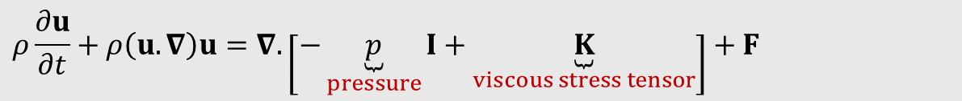
Simulation of fluid dynamics
  Navier-Stokes equation:
$$ρ\frac{∂u}{∂t}+ρ\left(u.∇\right)u=∇.\left[−\underset{pressure}{\underbrace{p}}I+\underset{viscous stress tensor}{\underbrace{K}}\right]+F$$
[N/m³]
$$\frac{∂ρ}{∂t}+∇.(ρu)=0$$
This is how fluid flow is computed.
Atmospheric Plasma Modelling Applied For Thermal Plasma Assisted Processes

Slide 15
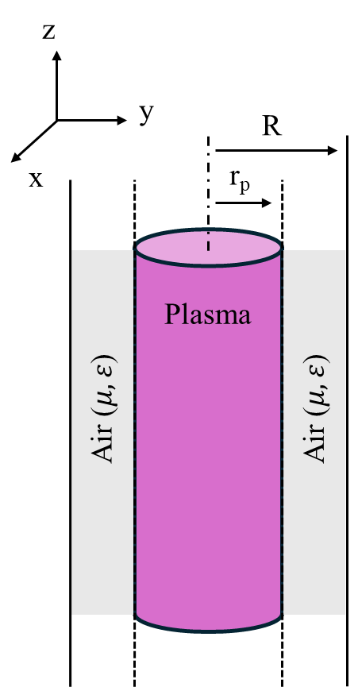
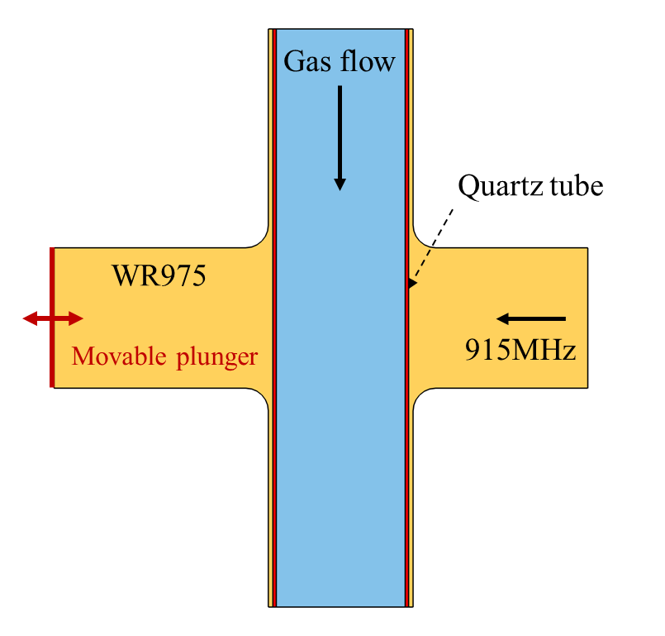
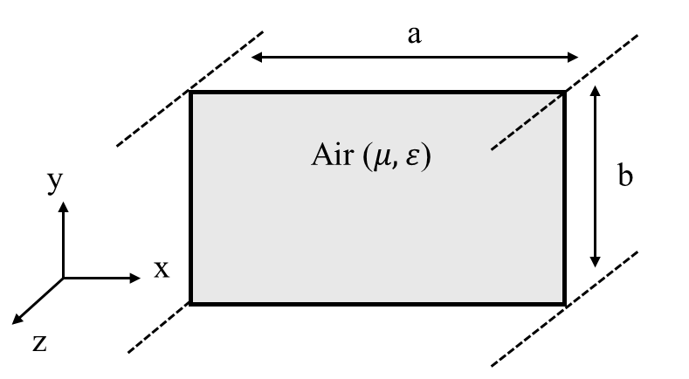
Experimental set-up (2D model)
WR975 rectangular waveguide
2D Model design
Cylindrical plasma
Atmospheric Plasma Modelling Applied For Thermal Plasma Assisted Processes

Slide 16
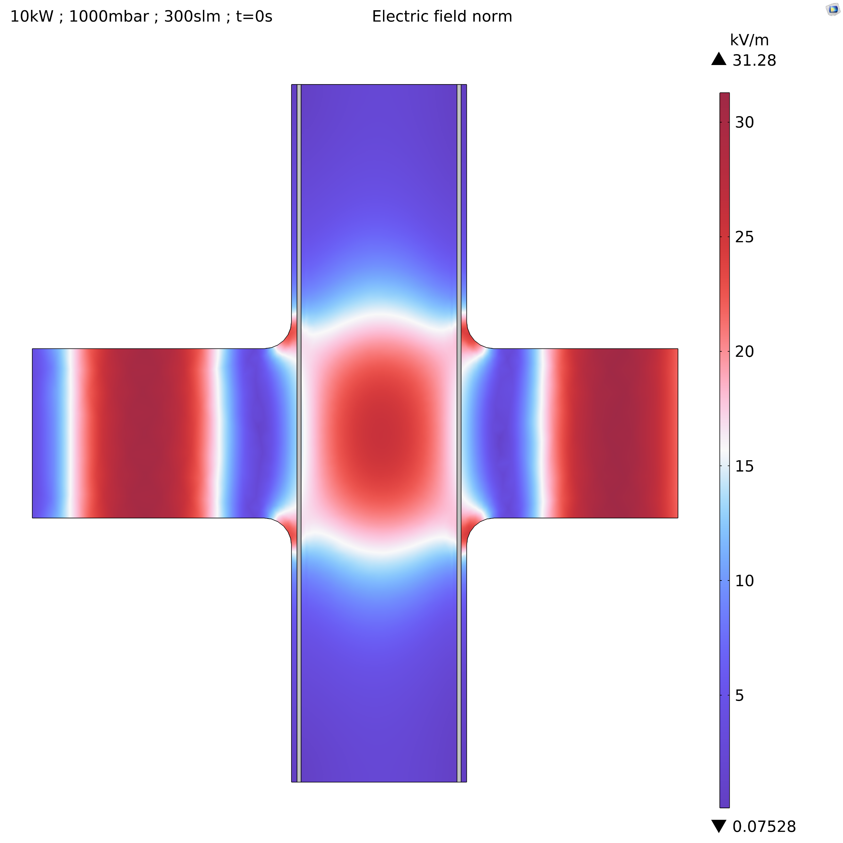
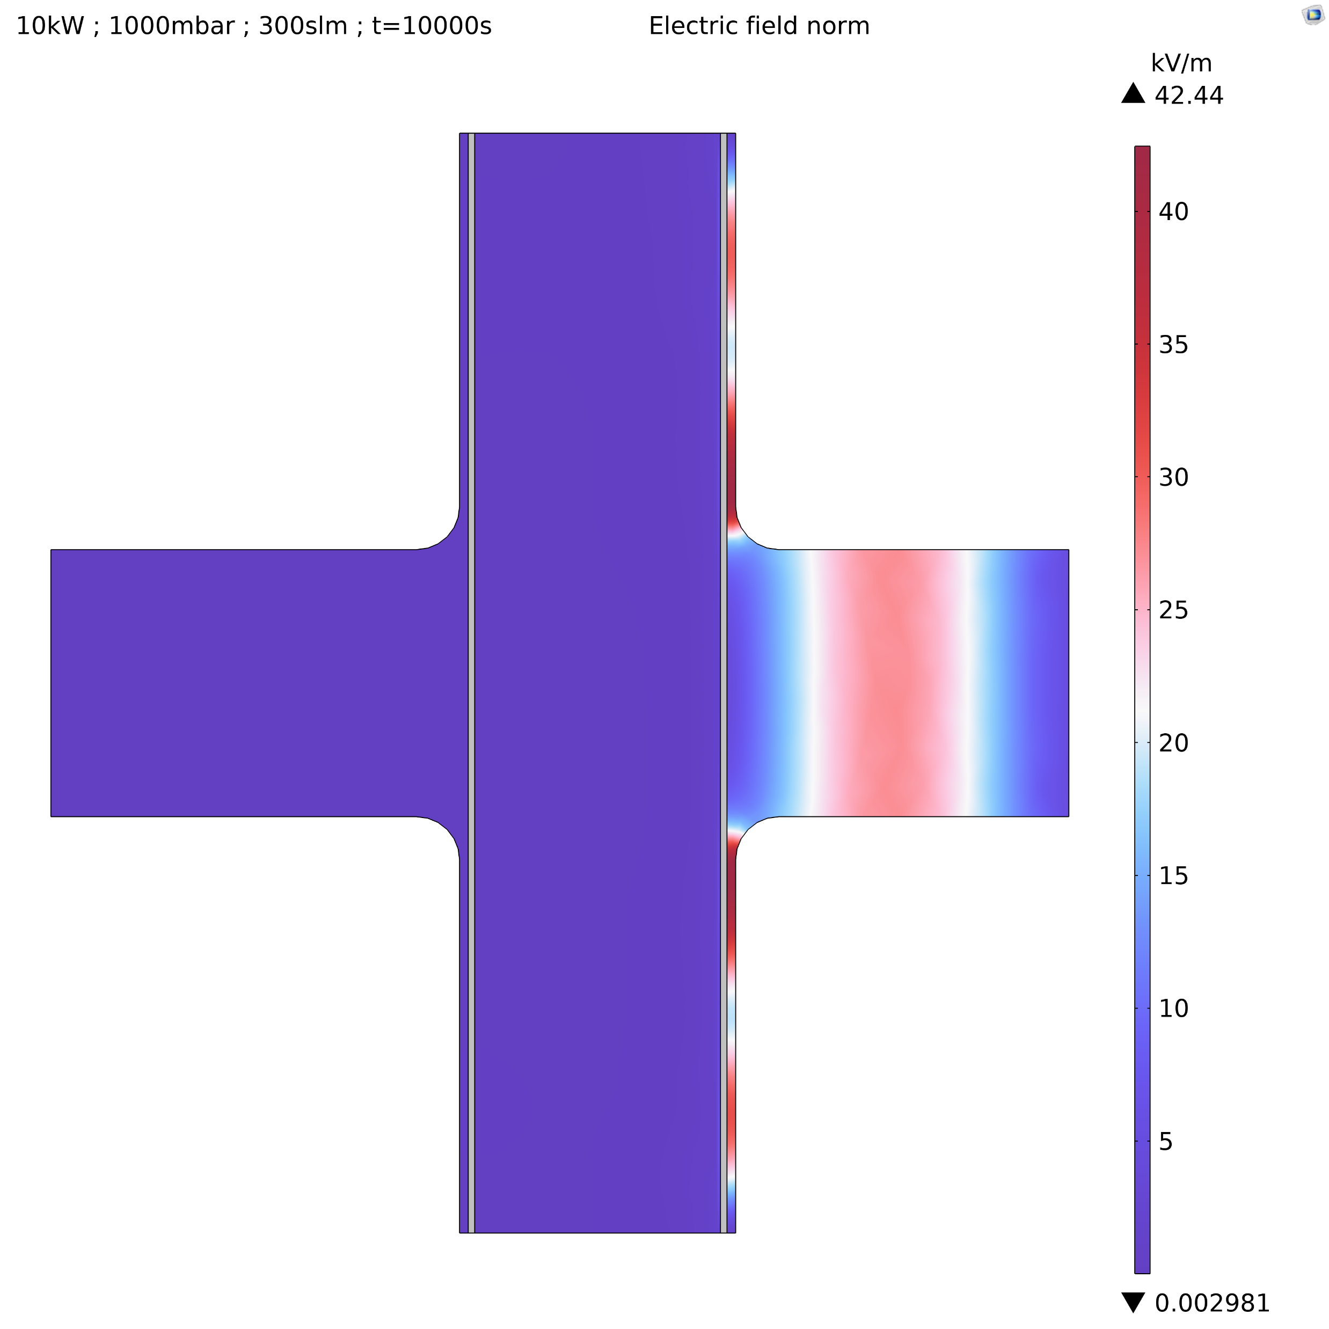
Results: Waveguide-to-coaxial coupling
w/o plasma
with plasma
TEM
TE10
TE10
TE10
TEM
Atmospheric Plasma Modelling Applied For Thermal Plasma Assisted Processes

Slide 17
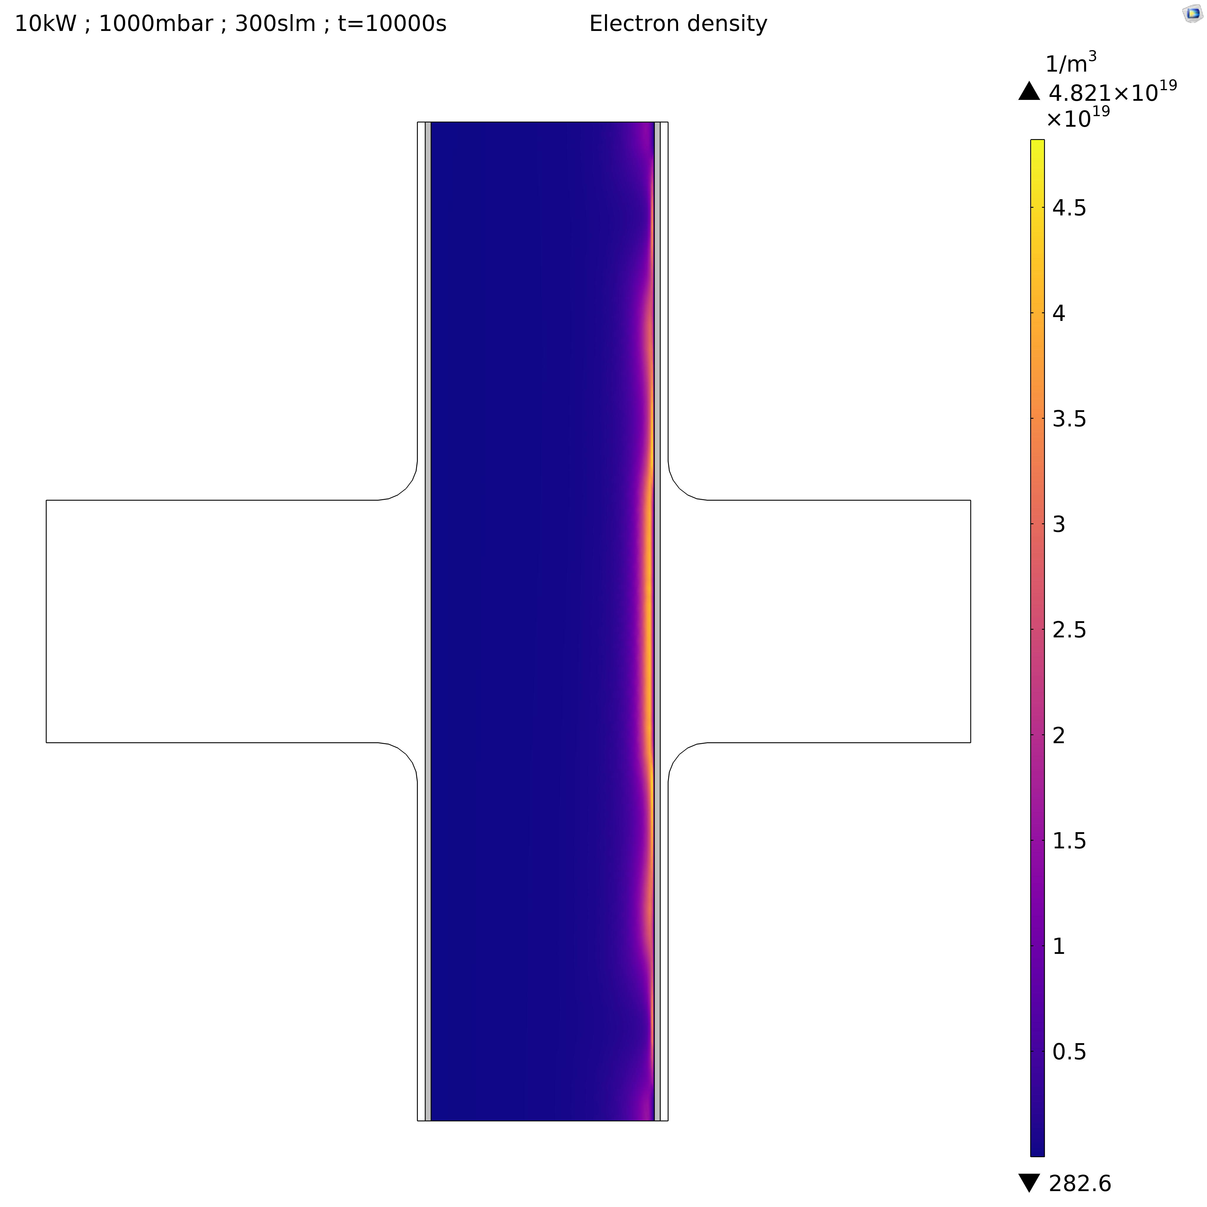
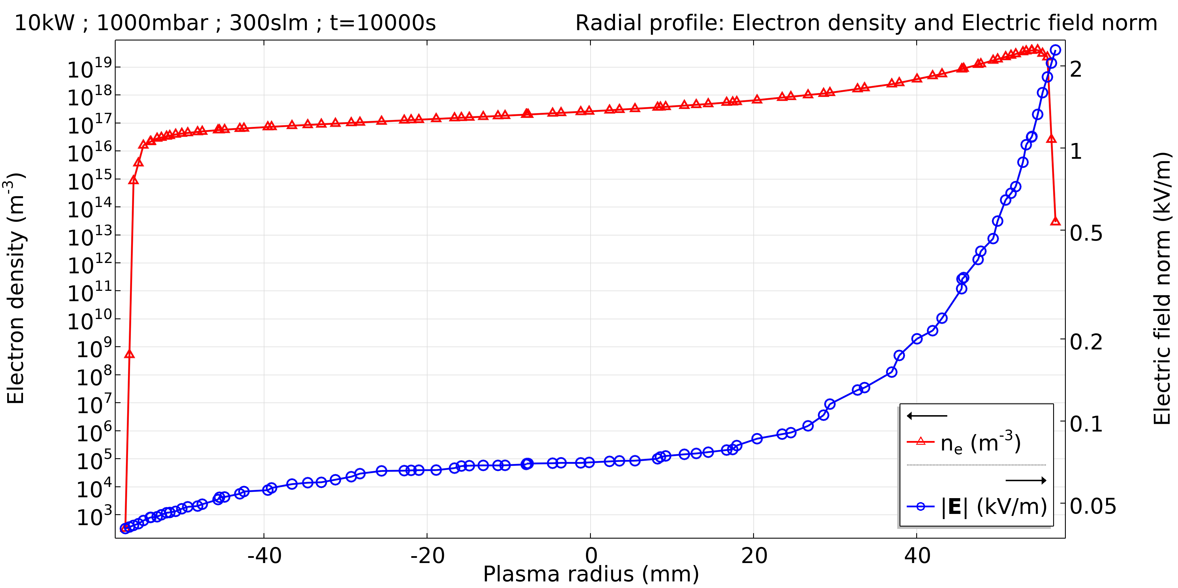


Results: Wave absorption and skin effect
with plasma
Skin effect
Wave absorption
$$δ$$
$$δ:skin depth$$
Atmospheric Plasma Modelling Applied For Thermal Plasma Assisted Processes

Slide 18
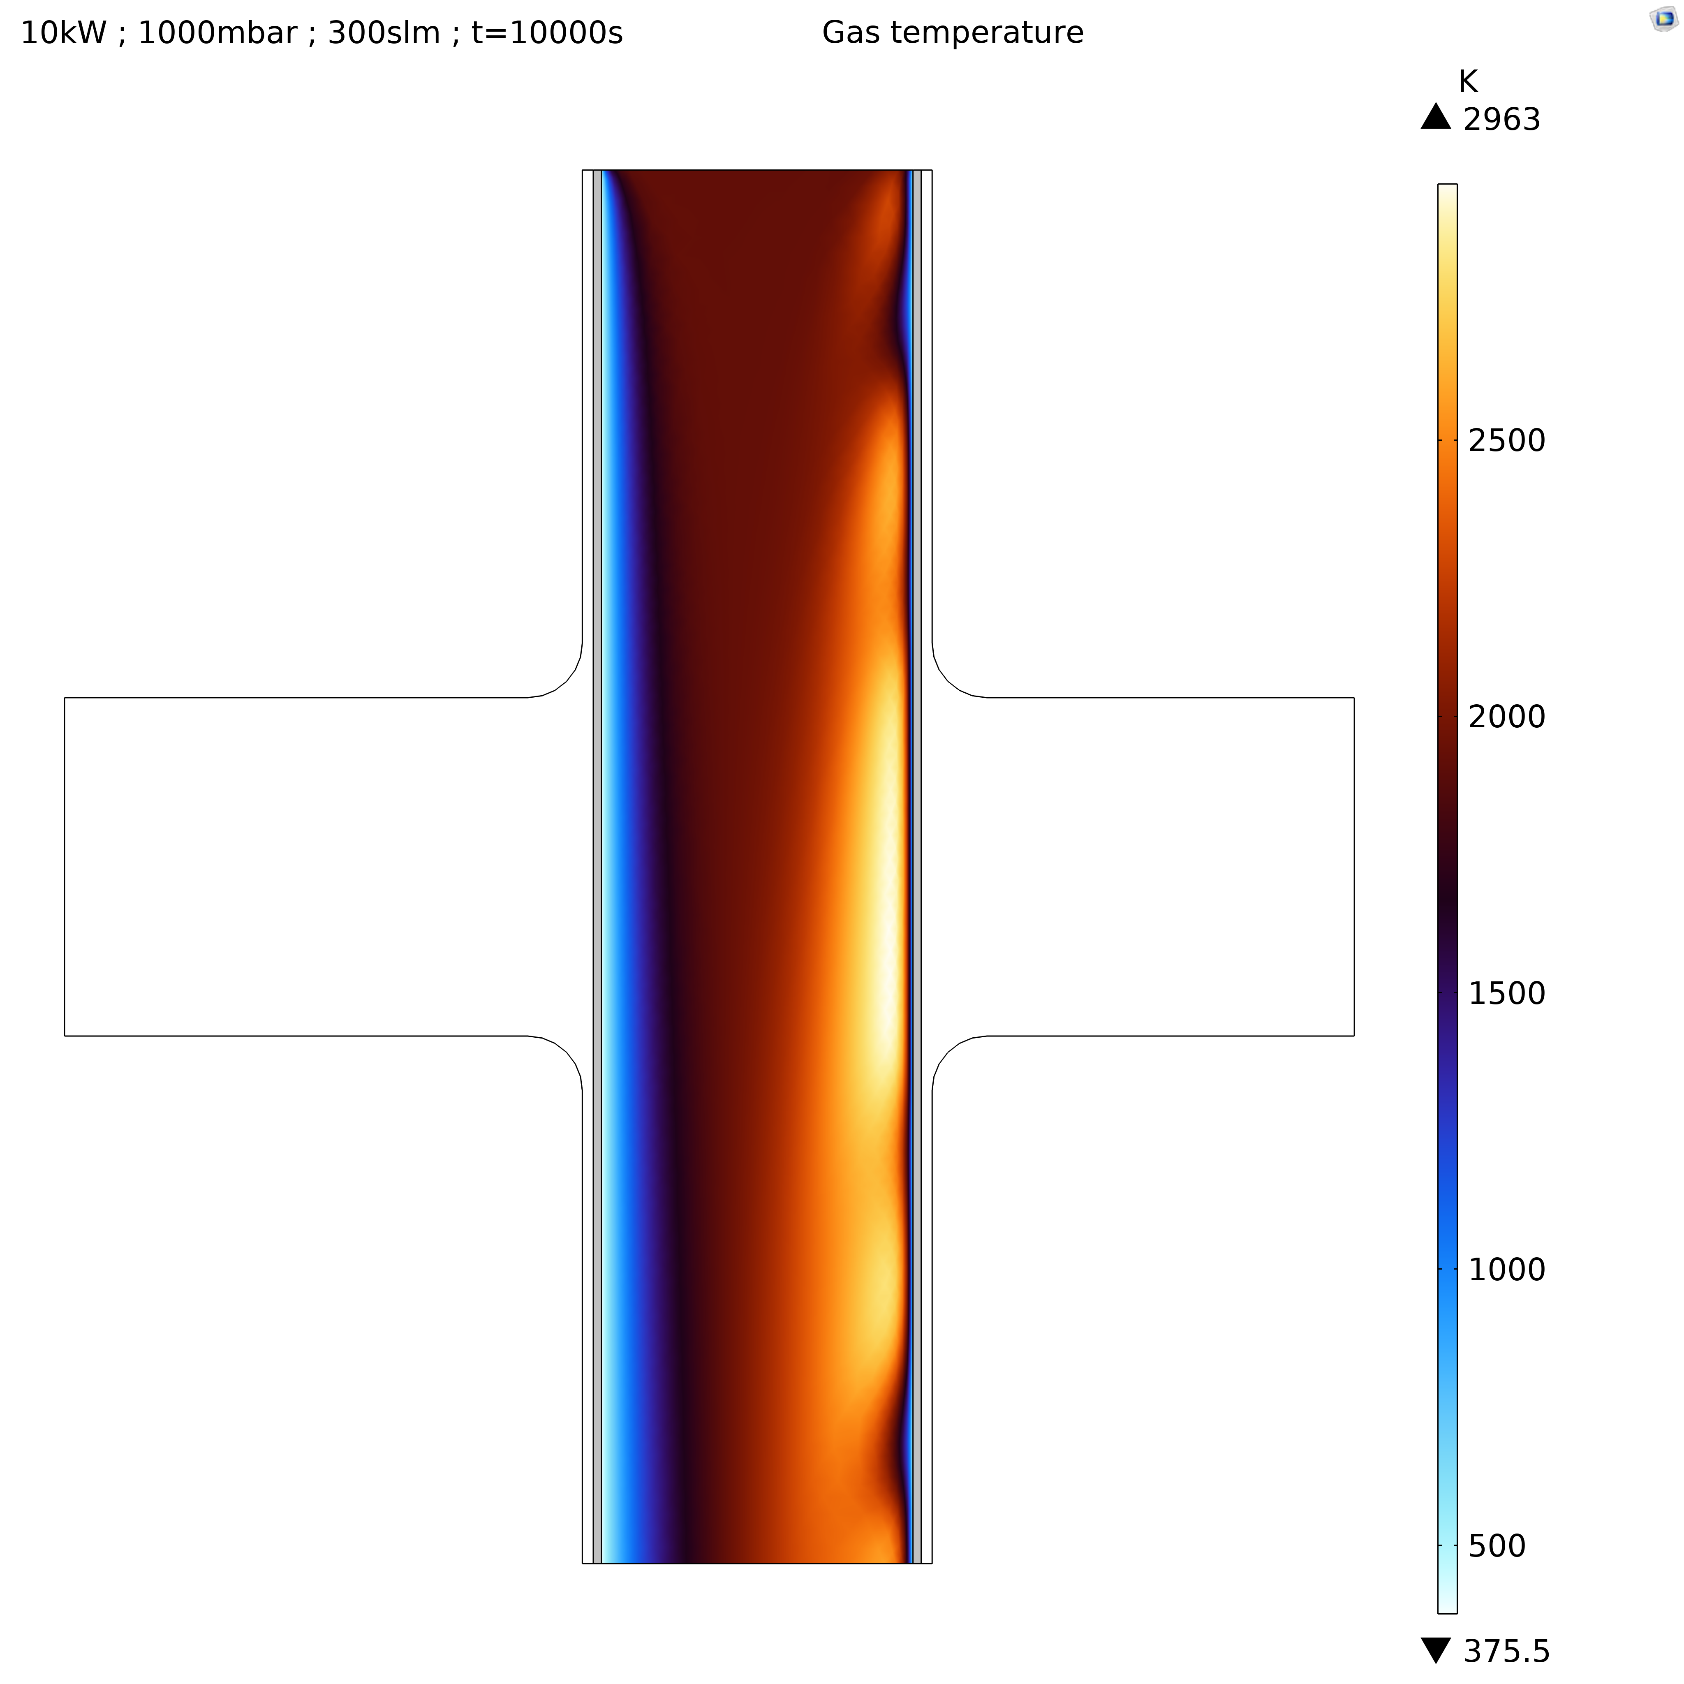
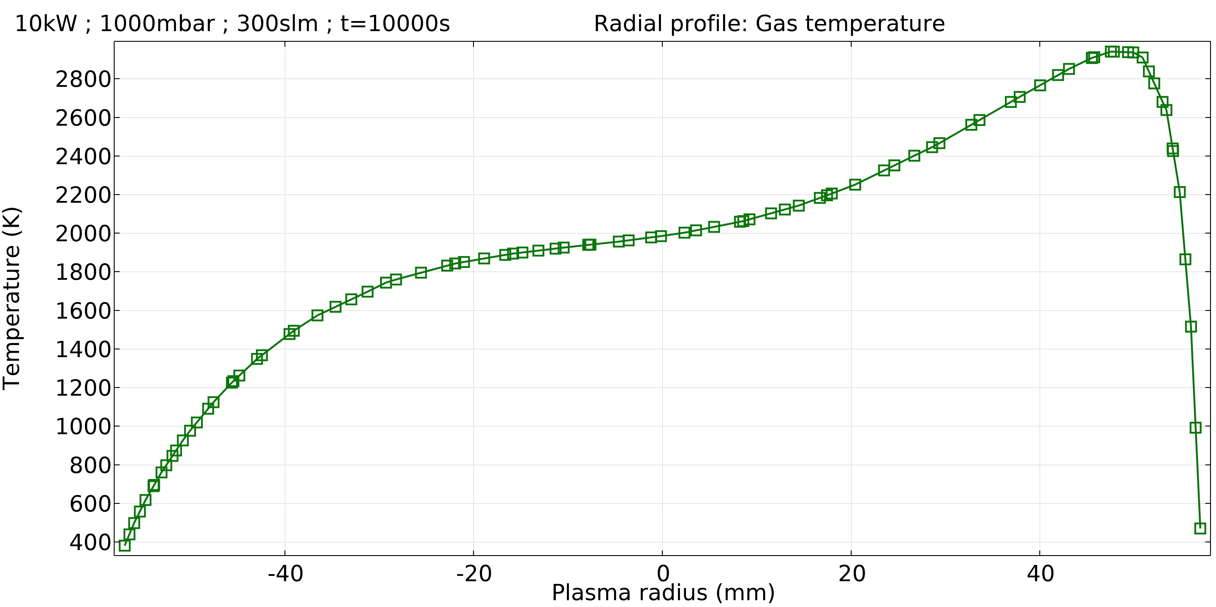
Results: Gas mixture temperature
with plasma
Wave heating
Atmospheric Plasma Modelling Applied For Thermal Plasma Assisted Processes

Slide 19
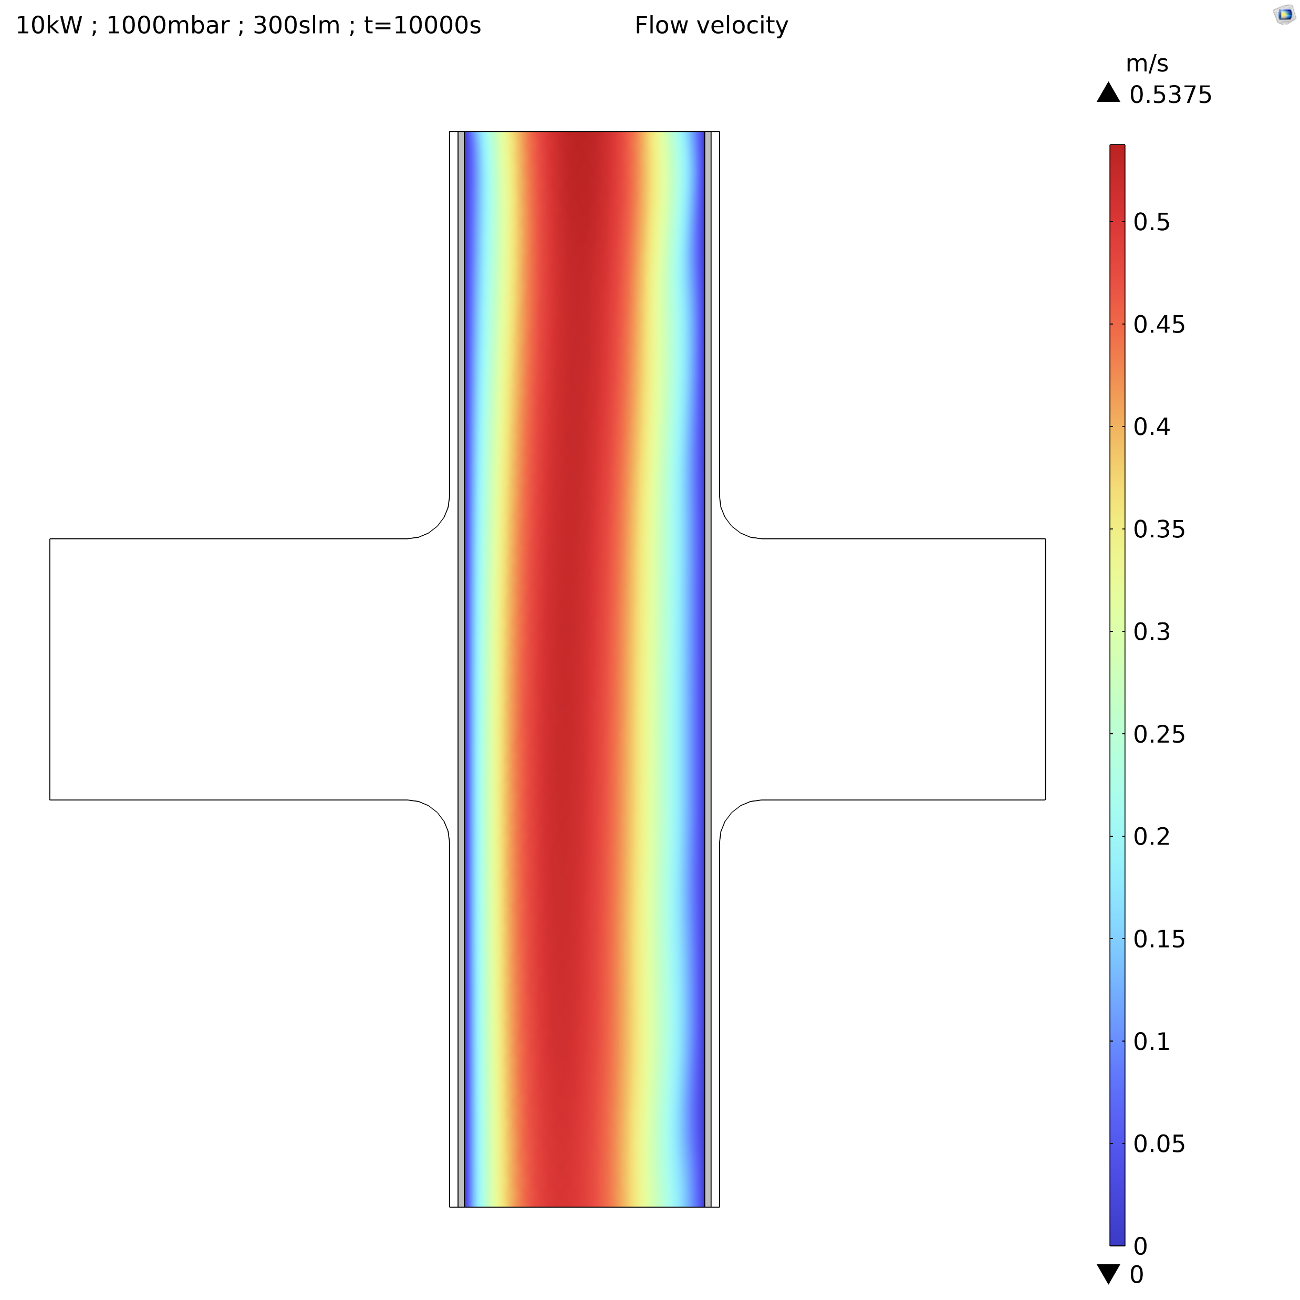
Results: Gas mixture flow velocity
with plasma
The change of the thermodynamic and fluid properties of the gas mixture with the gas temperature may affect the flow velocity.
Atmospheric Plasma Modelling Applied For Thermal Plasma Assisted Processes

Slide 20
Conclusions
  A fully-coupled microwave plasma model at atmospheric pressure has been successfully achieved in Ar with COMSOL Multiphysics®
  Waveguide-to-coaxial coupling has been recovered in the presence of a cylindrical plasma crossing a rectangular waveguide as expected from the theory of the transmission lines
  Skin effect has been observed as expected from the high-pressure plasma theory
  A rise of the gas mixture temperature has been observed according the thermodynamic properties and the wave-heating due to the electrons in a resistive plasma
Atmospheric Plasma Modelling Applied For Thermal Plasma Assisted Processes

Slide 21
Next steps
  Next works will focus on:
    The EEDF’s when they are computed from the Boltzmann equation
    The operating conditions and design
    The gas flow regime at higher mass flow rates
    Other feed gases with more by-products
    Heavy-heavy particle collisions
    Radiative heat transfers
Thank you for your attention
Atmospheric Plasma Modelling Applied For Thermal Plasma Assisted Processes

