Slide 1
App For The Thermal Simulation Of Power Electronics Test Devices
D. Tscharnuter (KAI MSS)
10.10.2024

Slide 2
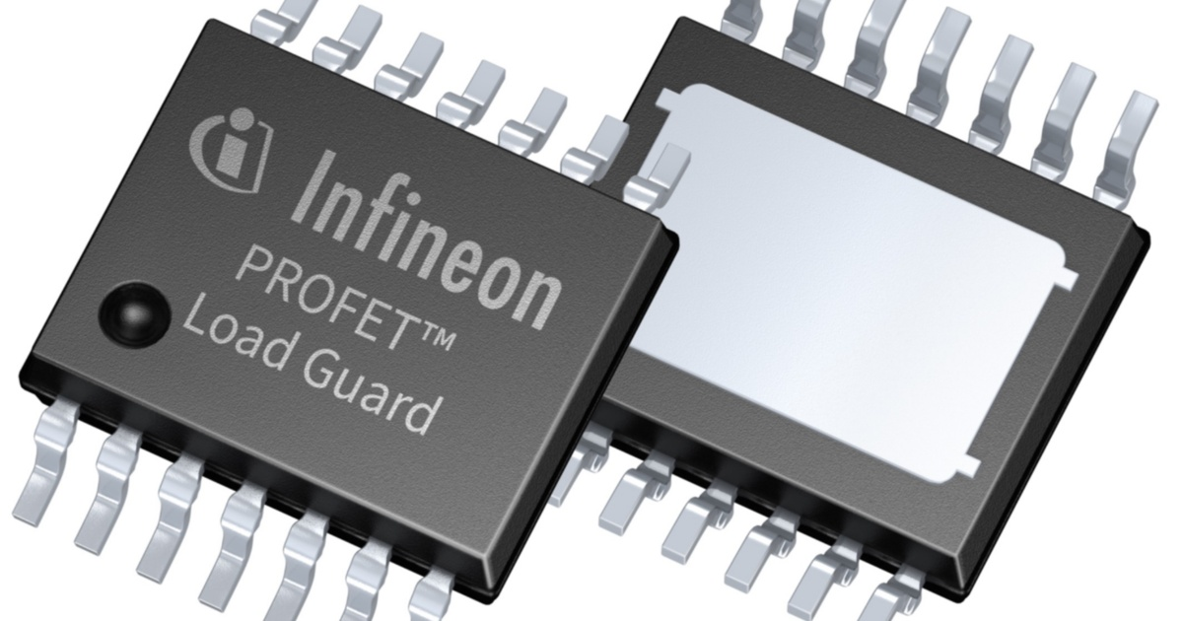
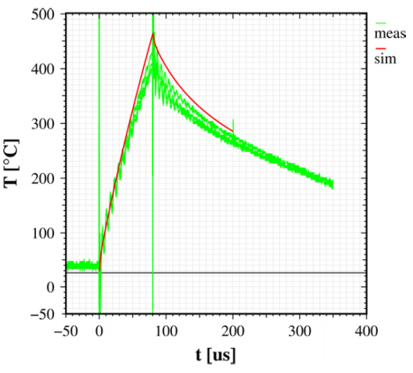
Introduction & Motivation
Power microelectronic devices
  Silicon substrate + active area + metallization
Automotive high-side switches are used to turn electrical loads ON and OFF by switching the positive side of the load supply. Additionally, smart high-side switches are designed with the ability to protect themselves and diagnose possible unintended system behavior.
Short circuit events, overload events, power cycling, ...
  Rapid changes in temperature
  ⇒ mechanical stress
    (CTE_{Cu} = 17 ppm/K, CTE_{Si} = 2.56 ppm/K)
  Thermo-mechanical fatigue
  Eventually, failure of the device
Temperature profile during a short circuit pulse in a trench power MOSFET.
[M. Nelhiebel et al., Microelectron. Reliab. (2011)]
Heating rate:
~10⁶ K/s

Slide 3
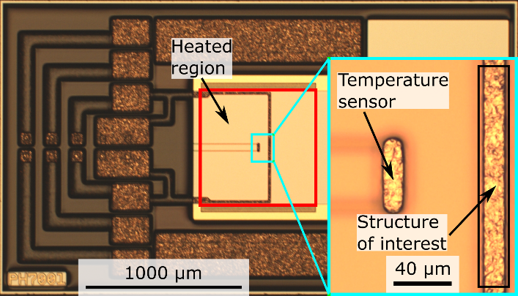
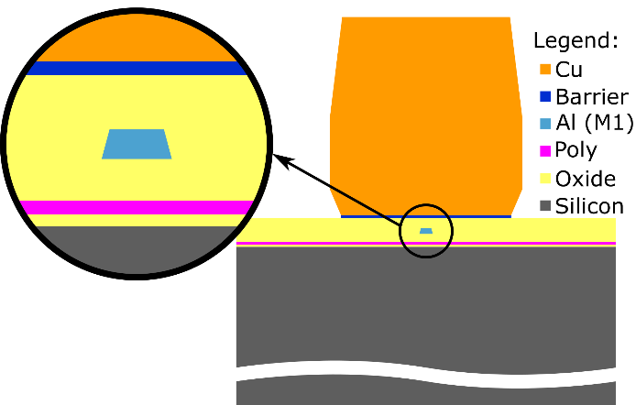
Polyheater test devices
Study thermo-mechanical fatigue of power metallizations
  at application-relevant heating rates
  under highly accelerated stress conditions
Polyheaters consist of:
  Structural layers:
    Si substrate (120 µm)
    Cu power metallization (20 µm)
  Functional layers:
    Polysilicon for Joule heating
    Aluminium (M1)
    Oxides/dielectrics
Fig. 3: Light microscope image of a polyheater device featuring a Cu line with width and thickness of 20 µm.
Fig. 4: Cross-sectional schematics of a polyheater.

Slide 4
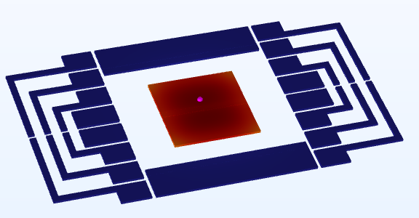
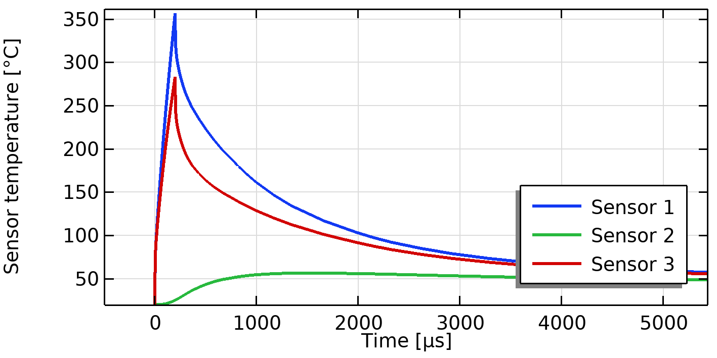
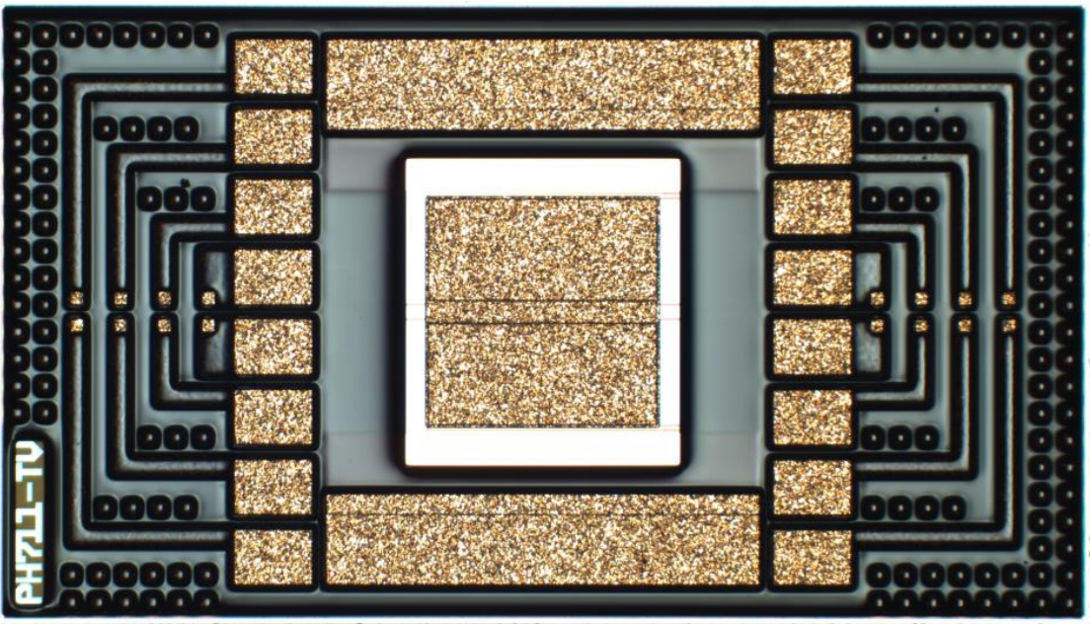
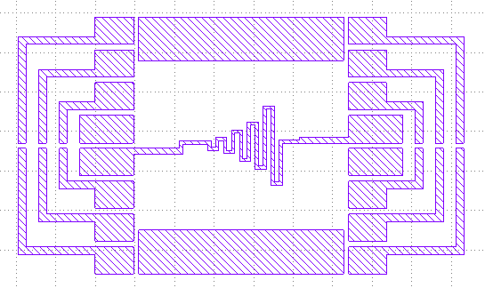
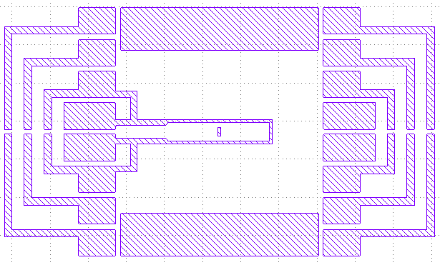
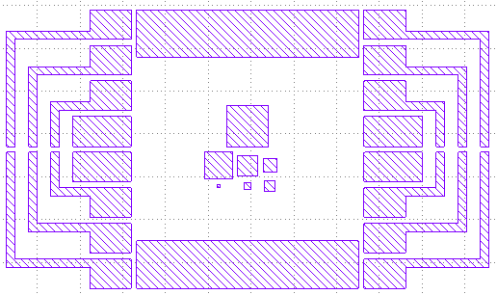
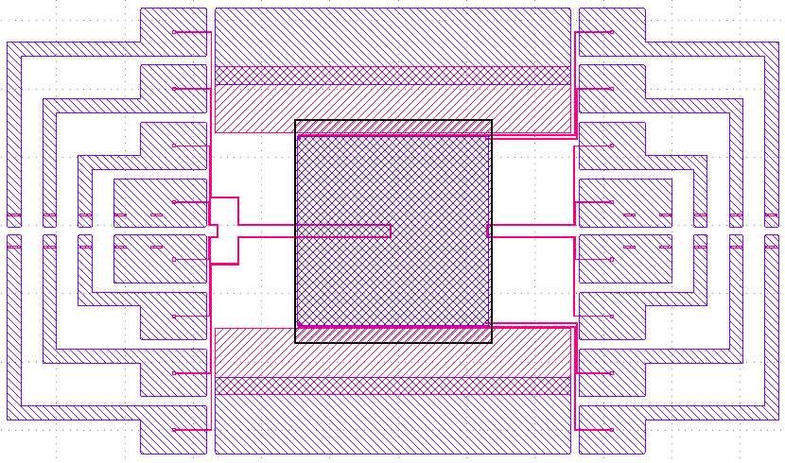
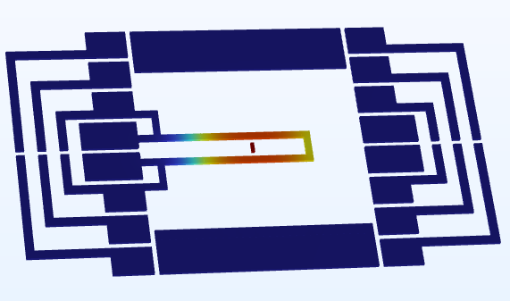
Why do we need thermal simulations?
The temperature field has to be known to calculate
thermal stresses
We can only measure locally by including temperature sensors
  Temperature sensors measure their own temperature
For the plate-type polyheaters, there is a relation between the sensor and copper temperature
330°C
There are polyheaters containing various other geometric patterns, where the relation between sensor and copper temperatur is very different from plate-type polyheaters
... and temperature is not always homogeneous

Slide 5
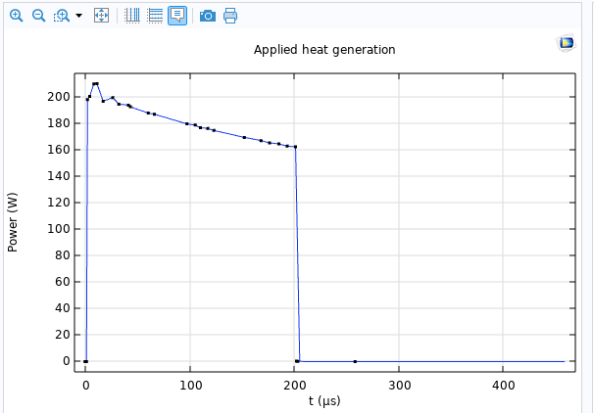
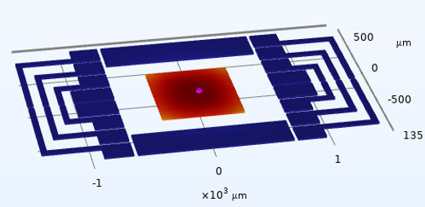
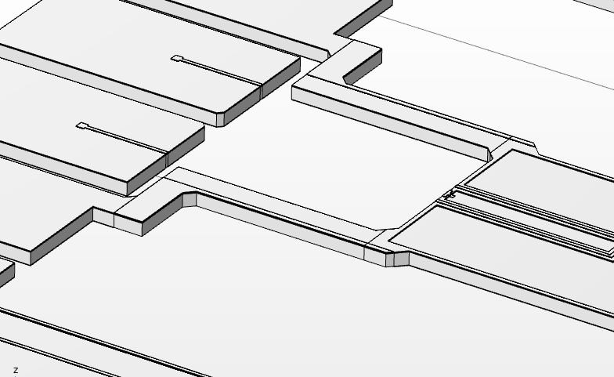
Objective and requirements for the simulation app
Build model from GDS layout file
  More than 50 different device types are available
Load and pre-process experimental data
  Smoothing and down-
  sampling of
  oscilloscope data
Provide predefined and user defined evaluations
  Min/max, statistics and local transients
Extruded geometry
  Millimeter scale devices with hundreds of nm thick layers need a swept mesh

Slide 6
Modules and modelling technique

Slide 7
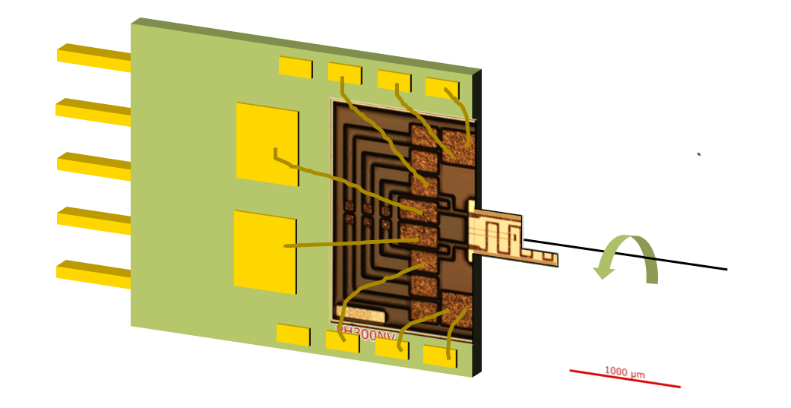
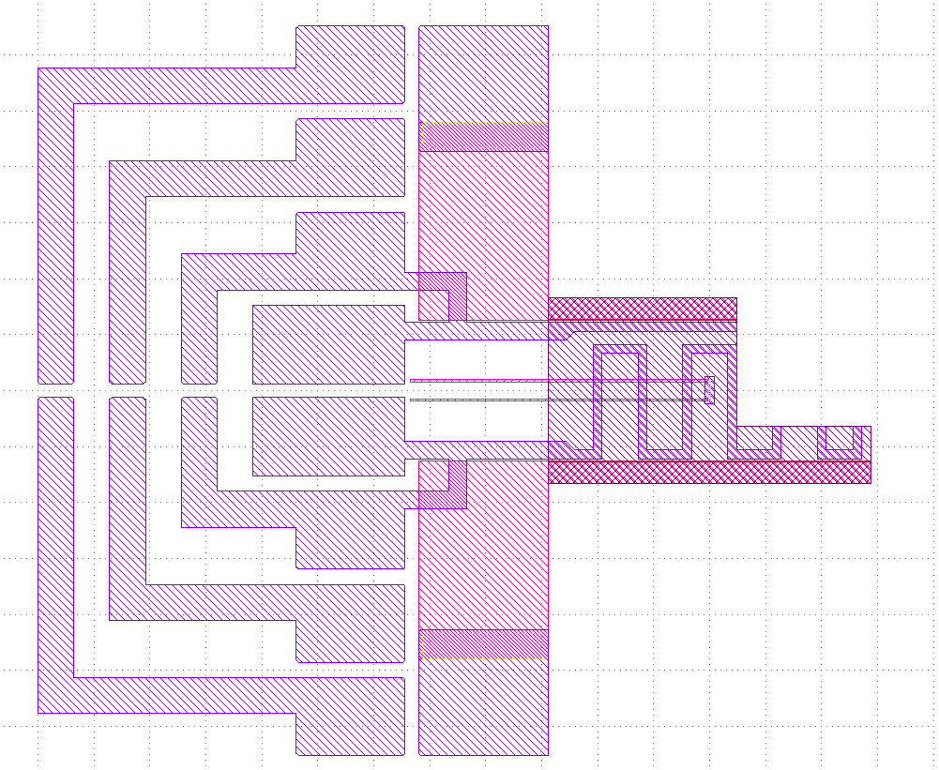
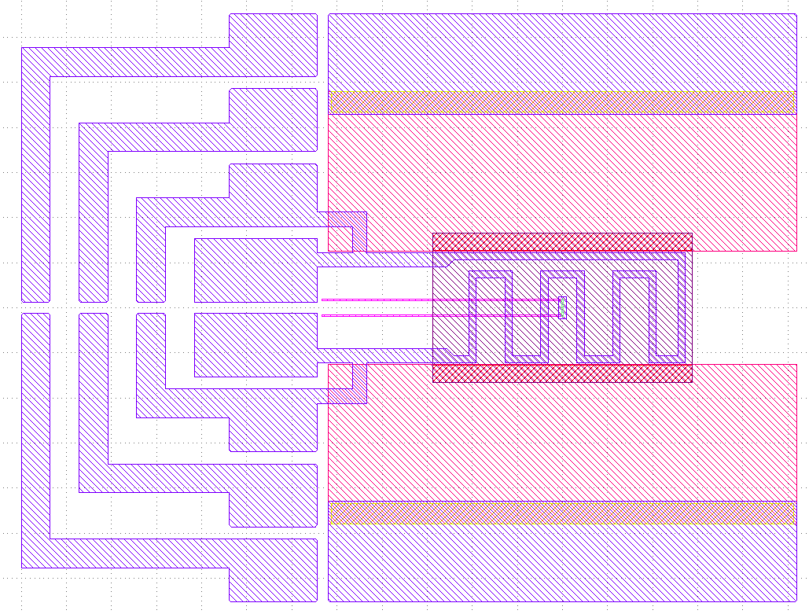
ECAD module
The ECAD module is used to load the device layout from a GDS file, which contains the 2D footprint of every layer
A layer represents either a deposition or removal of a material and extrusion and boolean operations are used to build a 3D geometry
This appears trivial, but it is a key feature!
  It not only enables the easy setup of models for a variety of devices, experimentalists can even draw and simulate their design ideas for new polyheater types without needing a simulation expert to build models
Example: Will it work to FIB cut a PH300NV polyheater to enable x-ray microscopy measurements?

Slide 8
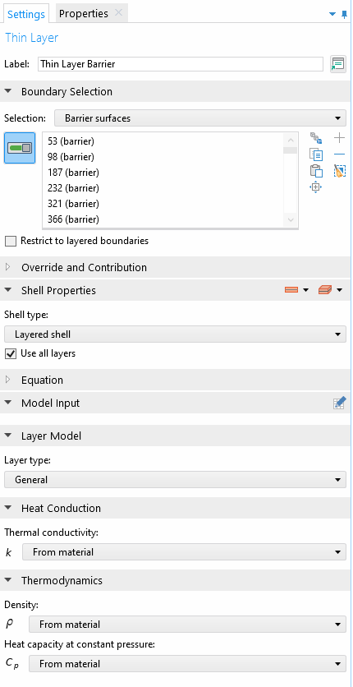
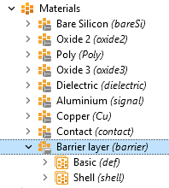
Heat transfer module
The Thin Layer node of the Heat Transfer module is used to avoid meshing functional
layers that do not require detailed resolution
Improved accuracy on edges without needing to explicitly model sidewall deposition
Conformal deposited thin layer
Modelling sidewall deposition:
Lateral mesh size = layer thickness!

Slide 9
App building and validation

Slide 10
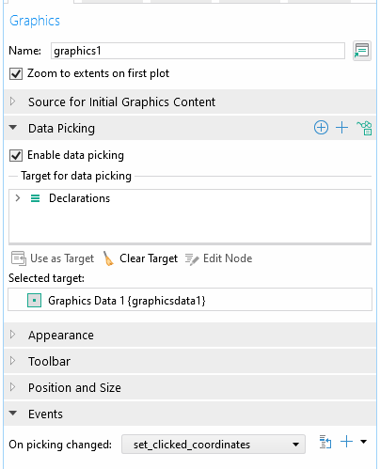
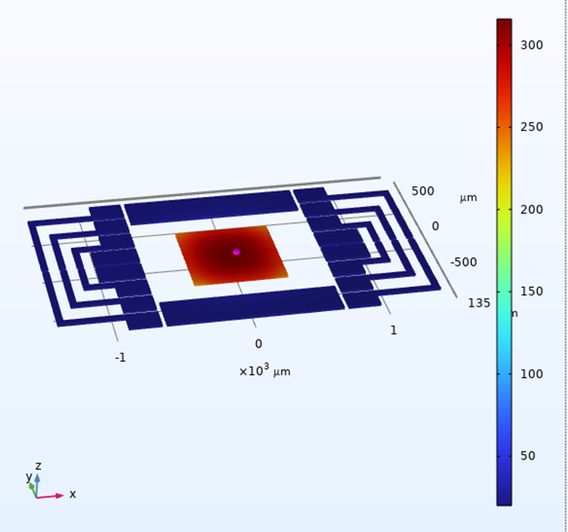
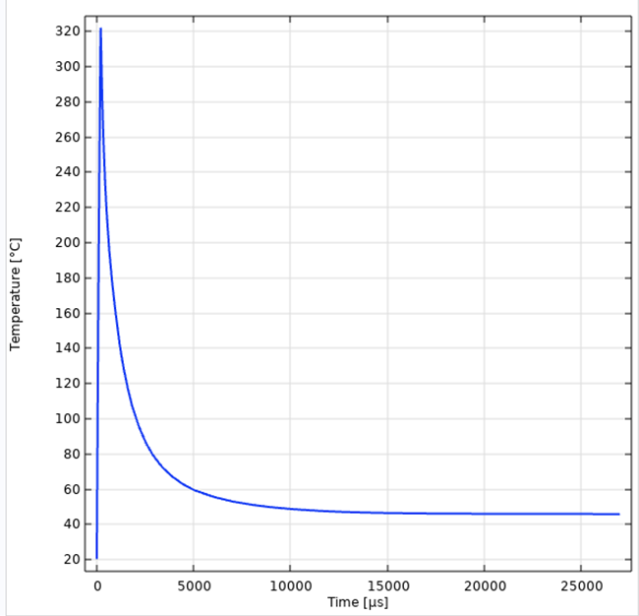
App builder
An app was built on the model using a template from the default library
  Inputs were created automatically from the model parameters
  Non-COMSOL functions like reading csv-data and downsampling of a signal were implemented as Java methods
The major advantage of an app over other solutions such as parameterized command line execution is in the visualization of results and interactive post-processing in addition to standardized outputs
Coordinates of clicked position with data picking
Global evaluation at clicked coordinates with at3() operator

Slide 11
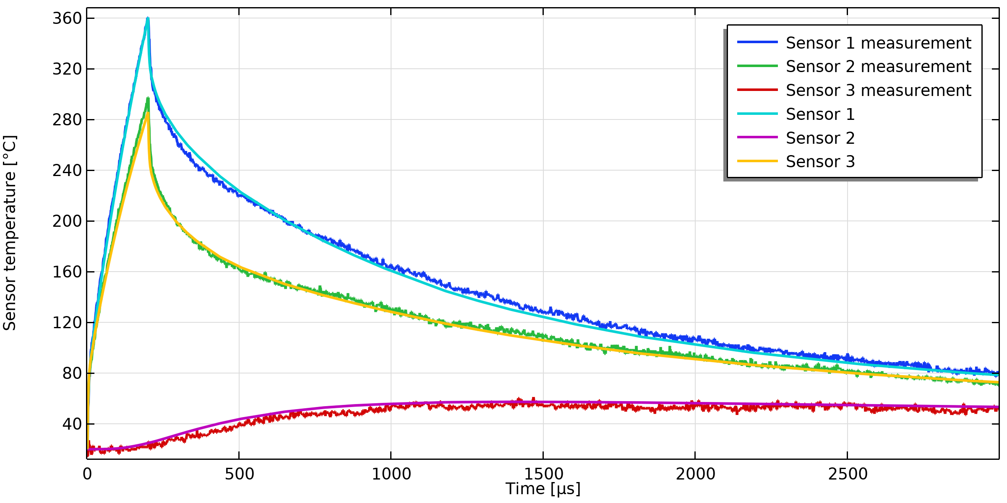
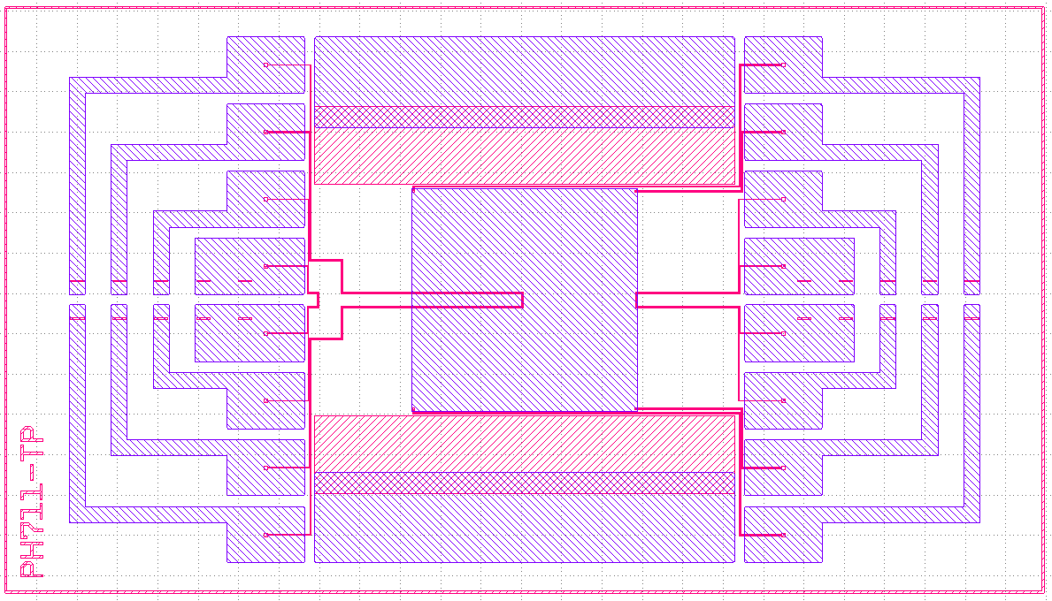
Validation
A polyheater type with three temperature sensors has been specifically designed for validating the thermal simulations
The sensors near the center and edge of the heated metallization and away from it enables us to verify that the heating and heat flow inside the device are predicted correctly
Sensor 1
Sensor 3
Sensor 2

Slide 12
