Slide 1
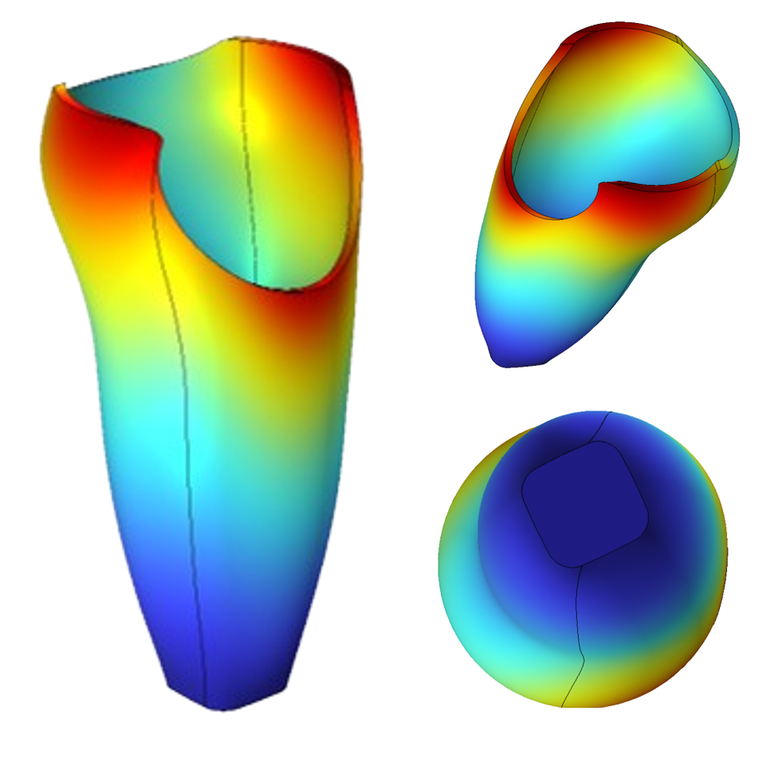

Analysis of Stress and Deformation in PALF-reinforced Prosthetic Composite
E.W Gaba¹, J.B Holman², B.O Asimeng³, E.E Kaufmann³, E.K Tiburu³, T. Verstraten¹
1. Department of Mechanical Engineering, Vrije Universiteit Brussel, Belgium.
2. Department of Electronic Engineering and Information Science, University of Science and Technology of China, Hefei, China.
3. Department of Biomedical Engineering, University of Ghana, Accra, Ghana.

Slide 2

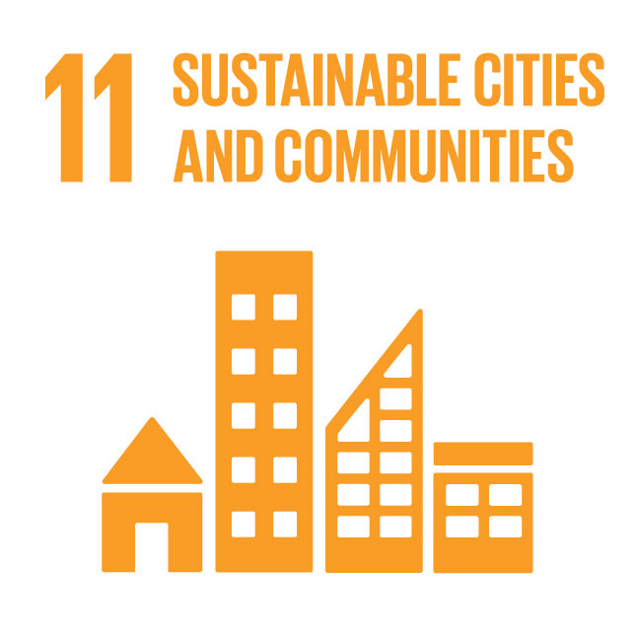
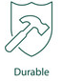
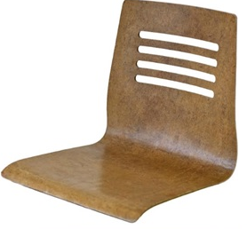
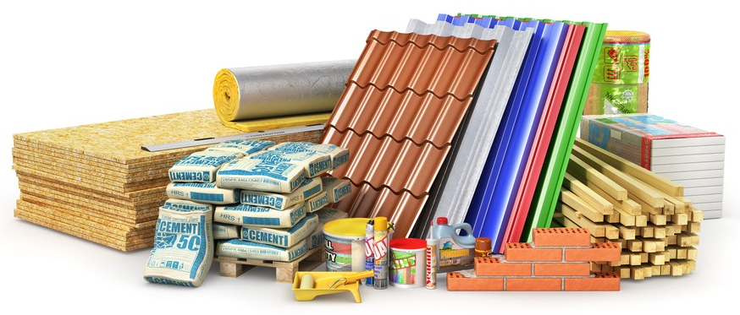
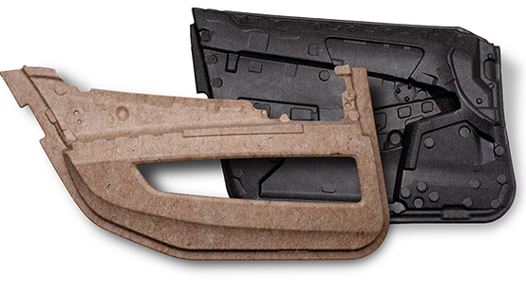
Introduction
Globally, there is a rising demand for sustainable materials and technologies that are:¹
Plant fibre polymer composites are attractive due to their appealing mechanical properties, the potential for biodegradability, affordability, low-energy demand for processing, and availability.

Slide 3
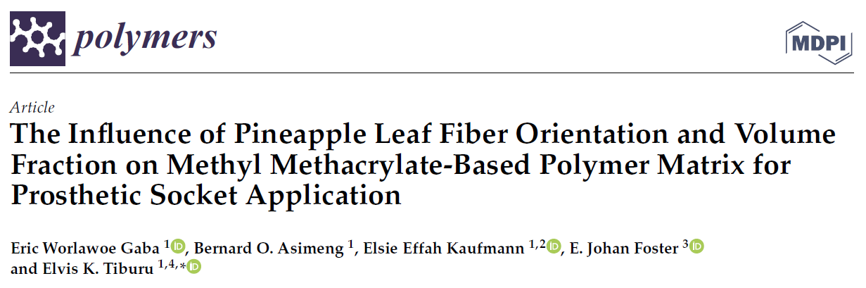
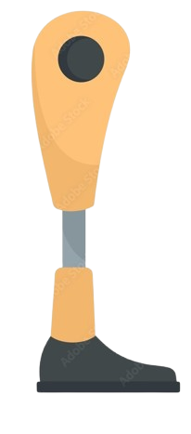
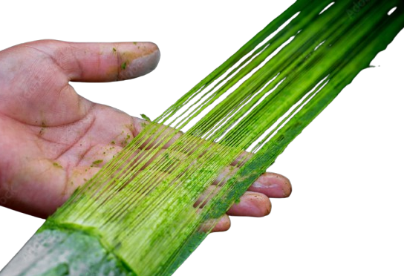
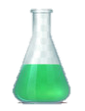

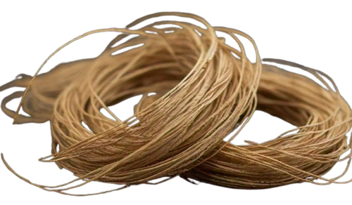
Introduction…cont’d
Pineapple leaf fibres (PALF), often considered agricultural waste, have shown promising properties for polymer reinforcement in previous research^{2,3}.
However, there has been little effort to investigate how PALF composite can be applied to prosthetic socket fabrication.

Slide 4
Introduction
Rationale: Understand how PALF can be a good material for developing sustainable prostheses.
Challenge: Limited experimental data on the performance behaviour of the PALF composite with a real pilot.
Goal: Determine the potential range of stresses and deformation behaviour of a modelled transtibial prosthetic socket (PS) using experimental data on PALF composite³.

Slide 5
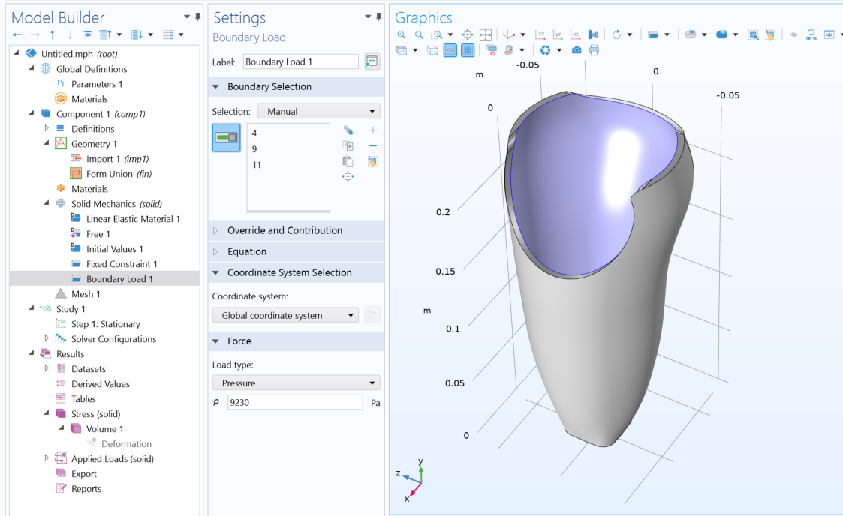
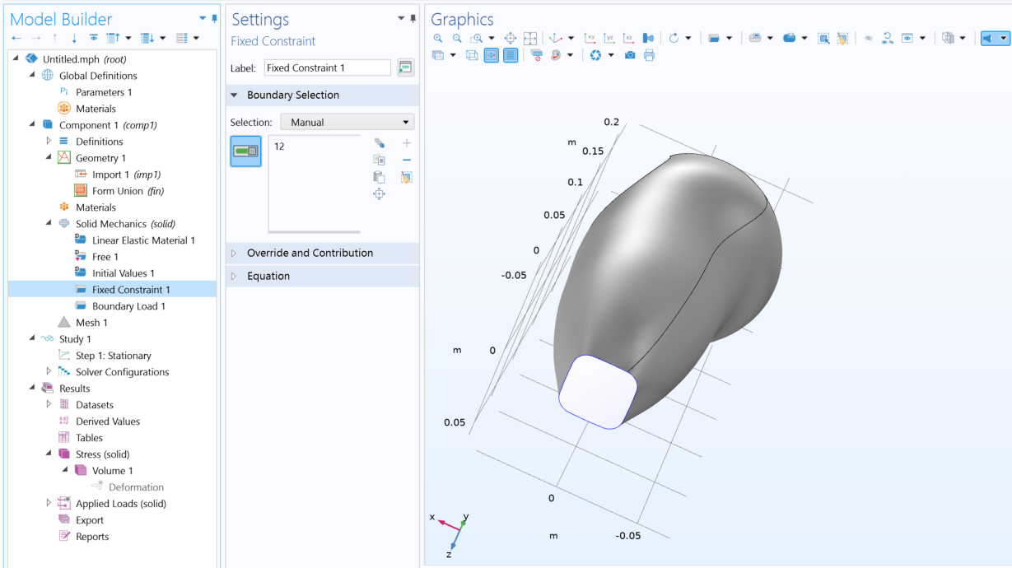
Methods
Experimental and Finite Element Analysis.
Why modelling?
  Very low-risk platform
  Time efficiency
  Allowed for multiple simulations on PS composites and iteration at low resource cost.
Static Structural analysis: mimic the midstance phase of gait.

Slide 6
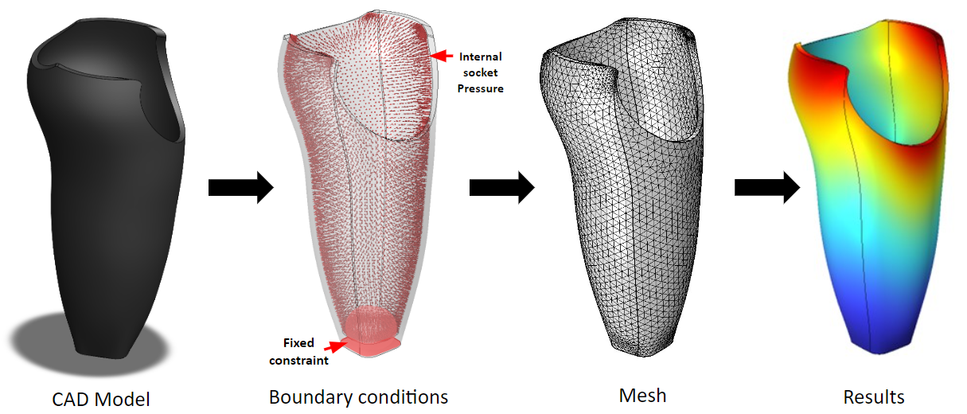
Methods
COMSOL Multiphysics?

Slide 7
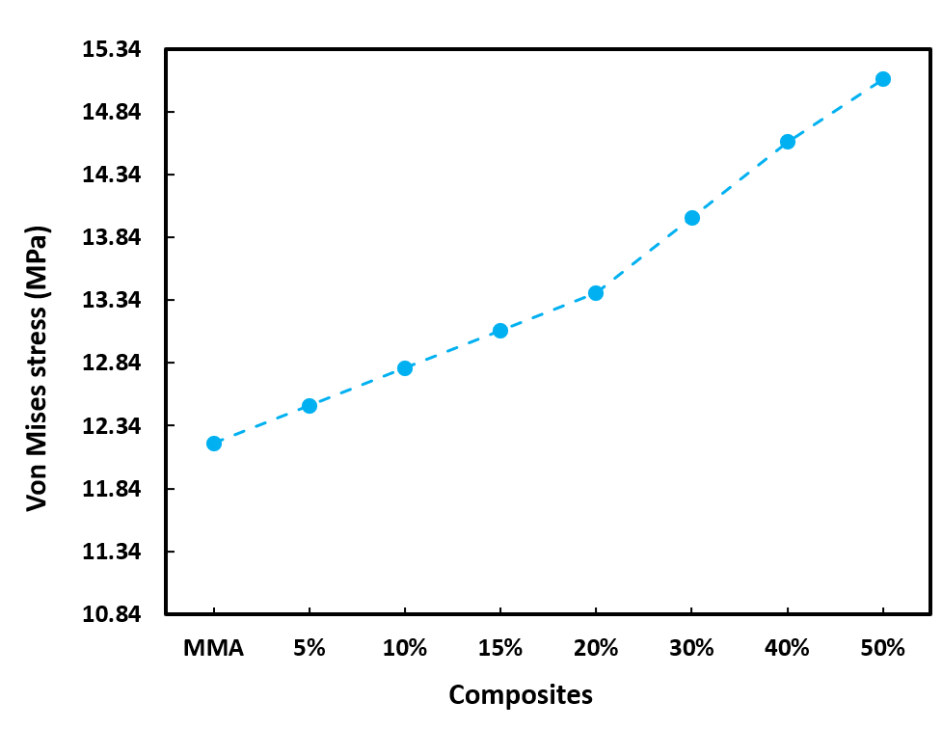
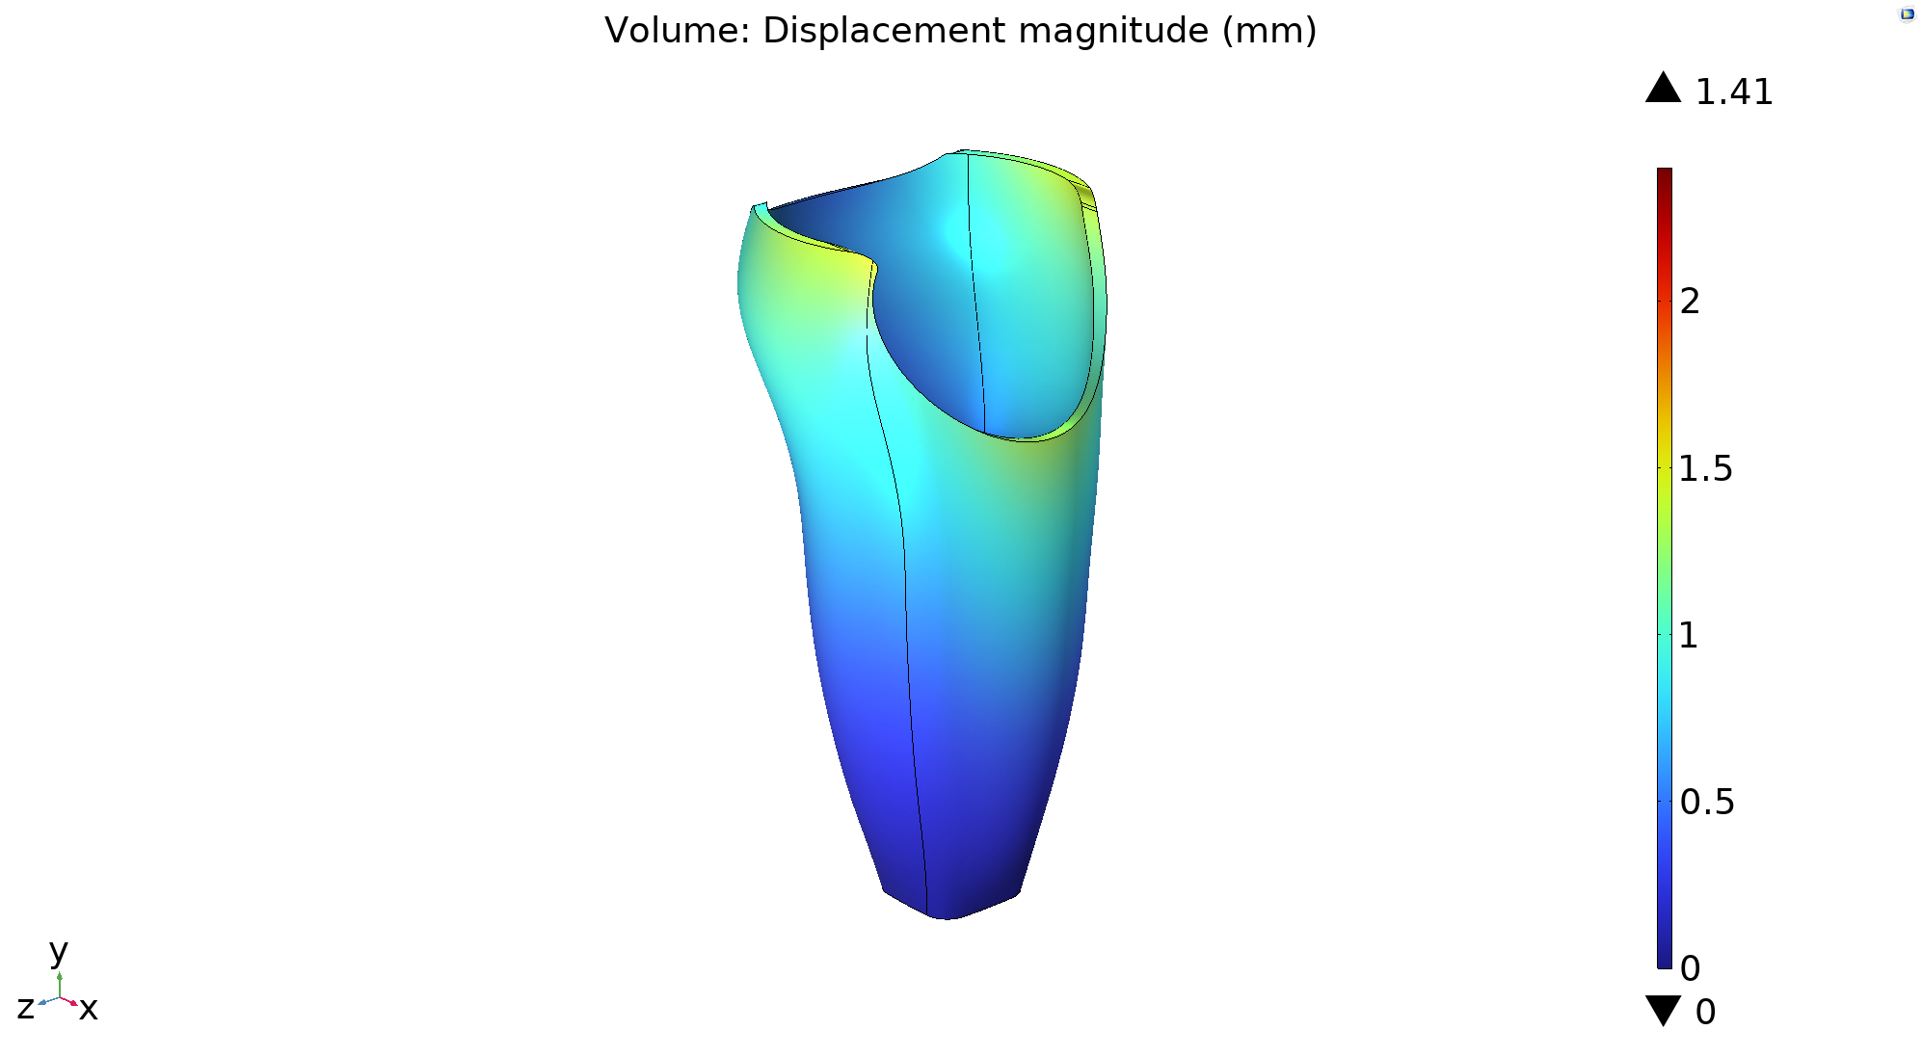
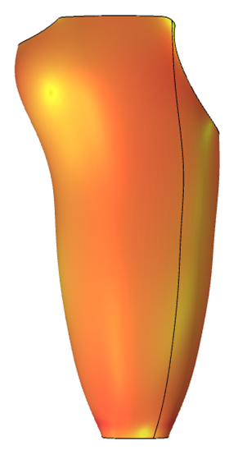
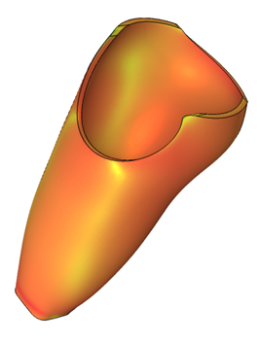

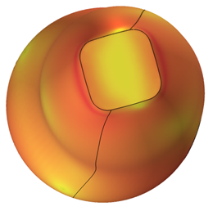
Results
Stress pattern
MPa

Slide 8
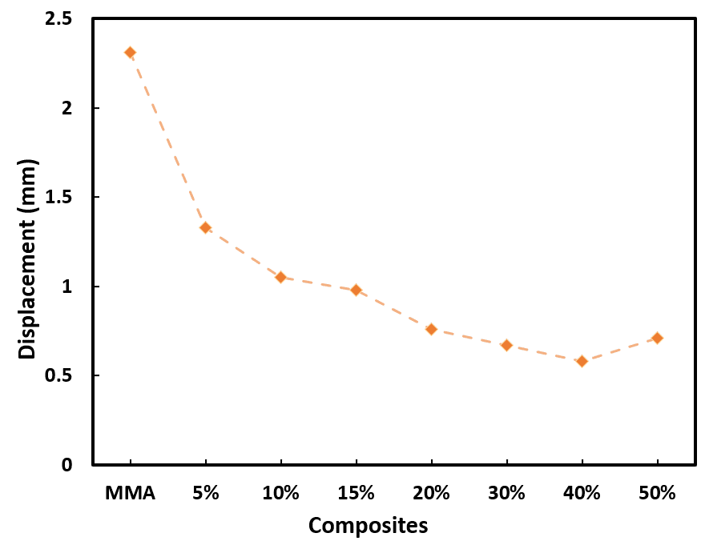
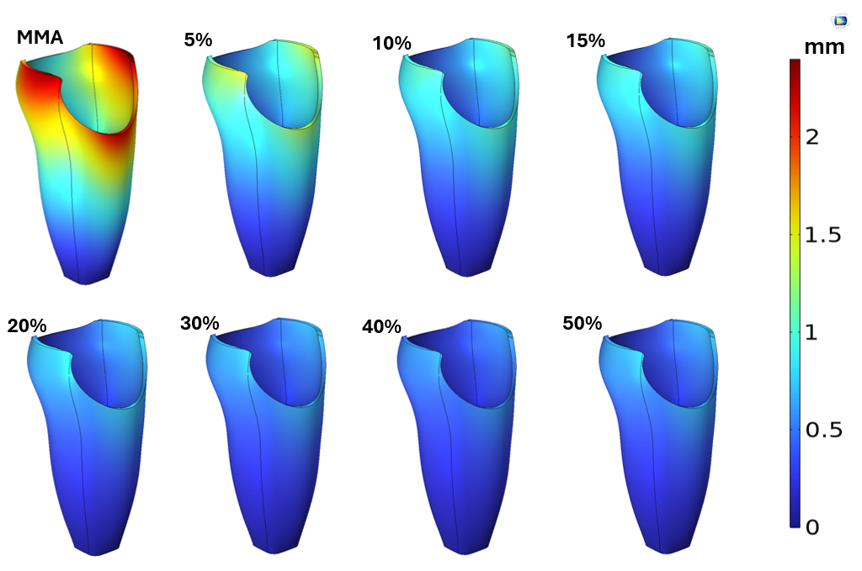
Results…cont’d
Deformation (Max)

Slide 9
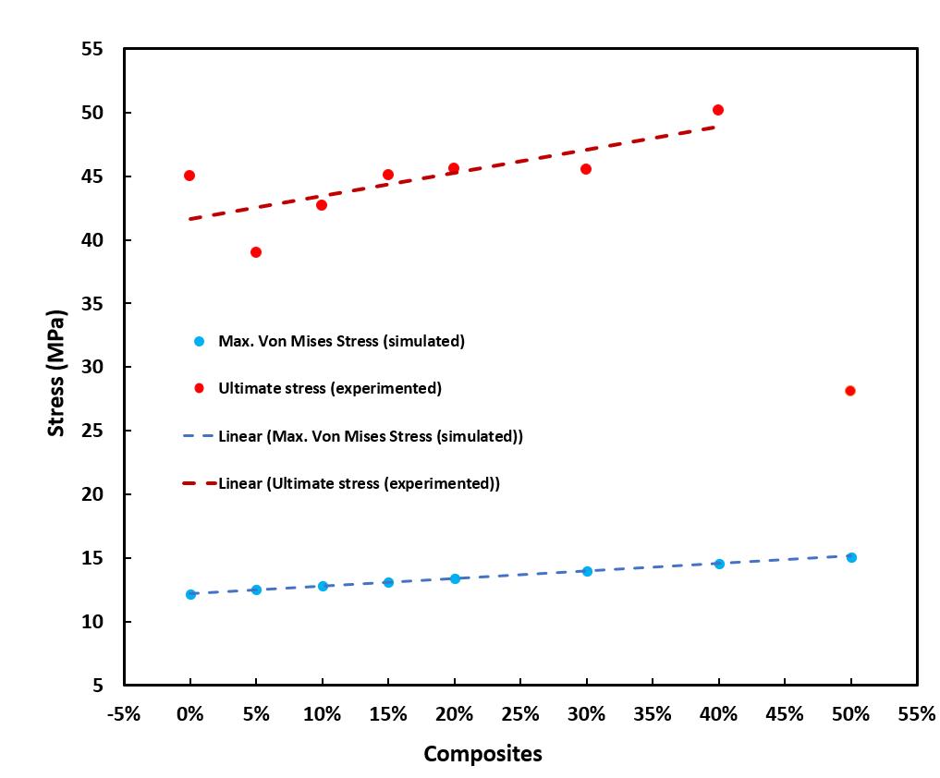
Conclusions
Impact of results on the project.
  Insight on the range of PS stresses (12 - 15 MPa) given the boundary conditions.
  Deformation patterns of the different PS composites.
  Experiment vs Simulation
  PALF composite material has the potential for prosthetic socket development depending on PALF volume fraction and type of resin.

Slide 10
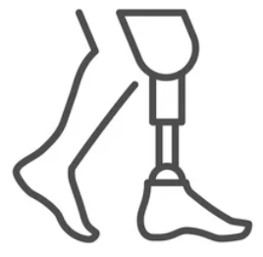
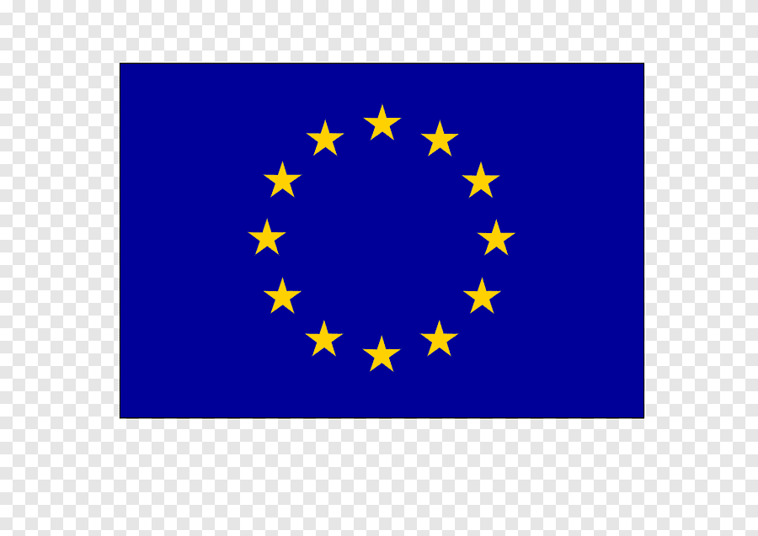
Thank you for listening!
πne-PROSTHETICS®
This project is co-funded by the European Union’s Horizon 2020 programme under the Marie Skłodowska-Curie Grant Agreement No. 101034352
TOGETHER WE CONNECT SCIENCE AND SOCIETY

Slide 11
References
A. Cislaghi, et al., Towards More Sustainable Materials for Geo-Environmental Engineering: The Case of Geogrids. Sustainability 13, 2585 (2021).
Djafari Petroudy, S. R. Physical and mechanical properties of natural fibres. in Advanced High Strength Natural Fibre Composites in Construction 59–83 (Elsevier, 2017).
E. W. Gaba, et al., The Influence of Pineapple Leaf Fiber Orientation and Volume Fraction on Methyl Methacrylate-Based Polymer Matrix for Prosthetic Socket Application. Polymers 13, 3381 (2021).

