Slide 1


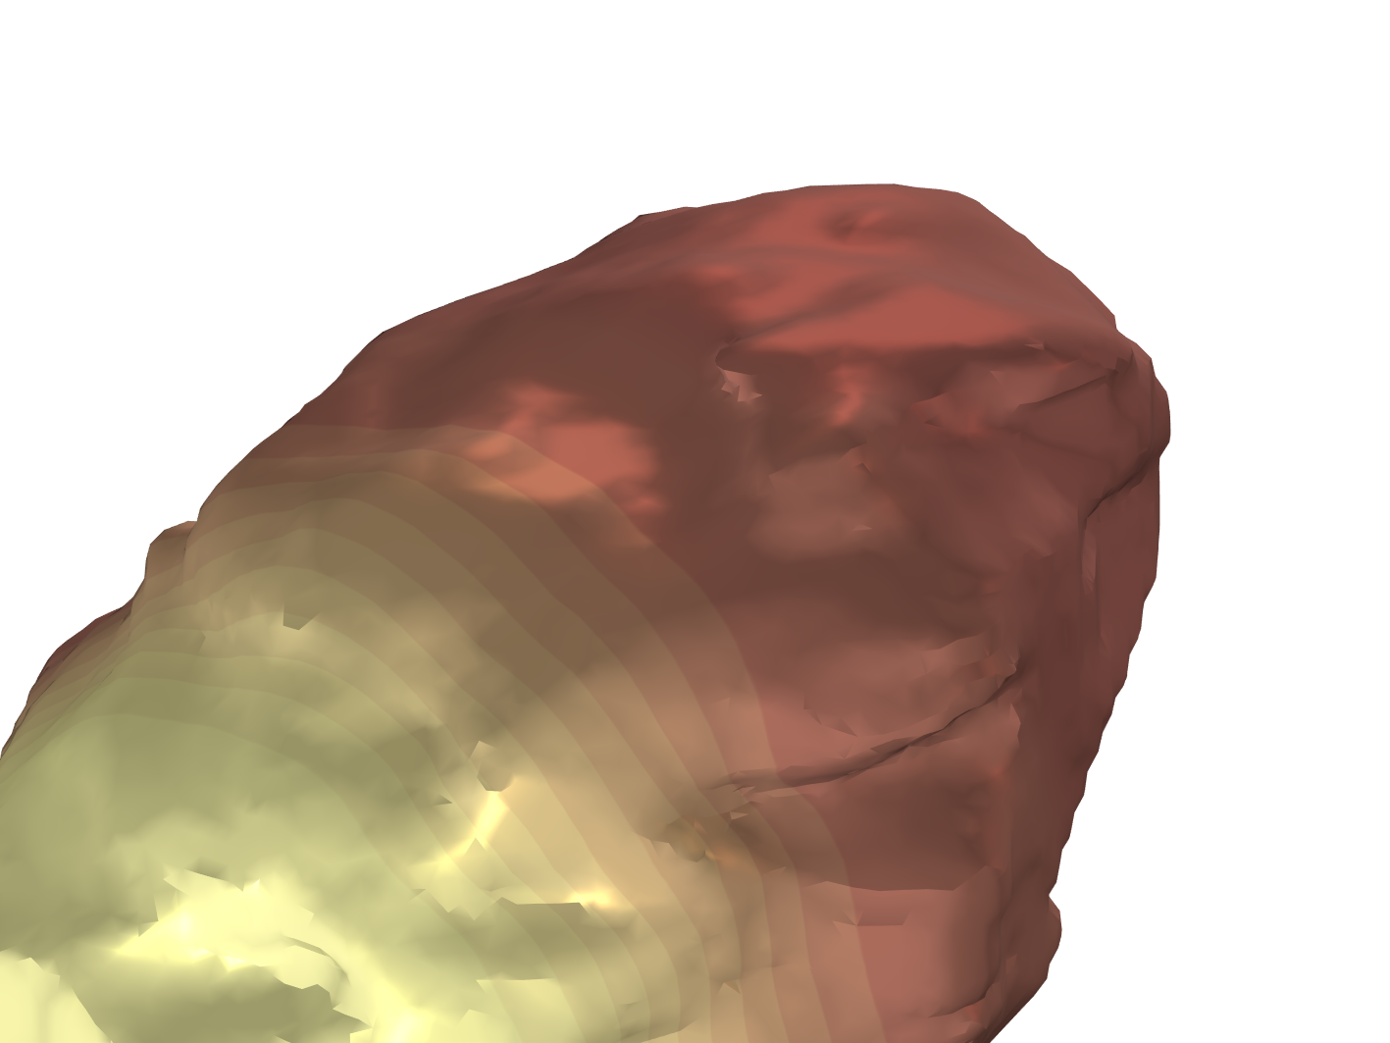
Advanced modelling for Li-ion battery design, diagnostics and R&D
Stefano Caverni, Marco Lagnoni, Antonio Bertei
Department of Civil and Industrial Engineering
University of Pisa - Italy

Slide 2
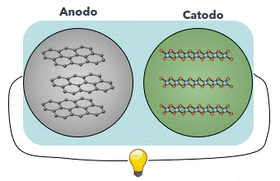
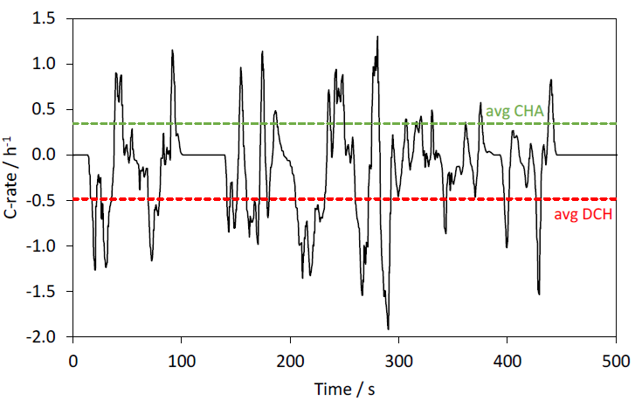
Li-ion batteries in dynamic operations
Li-ion batteries are energy storage devices → no steady-state operation
We need to characterise dynamic processes: reactions, charge transport, diffusion, degradations, etc.
Anode Cathode
WLTC
GITT

Slide 3
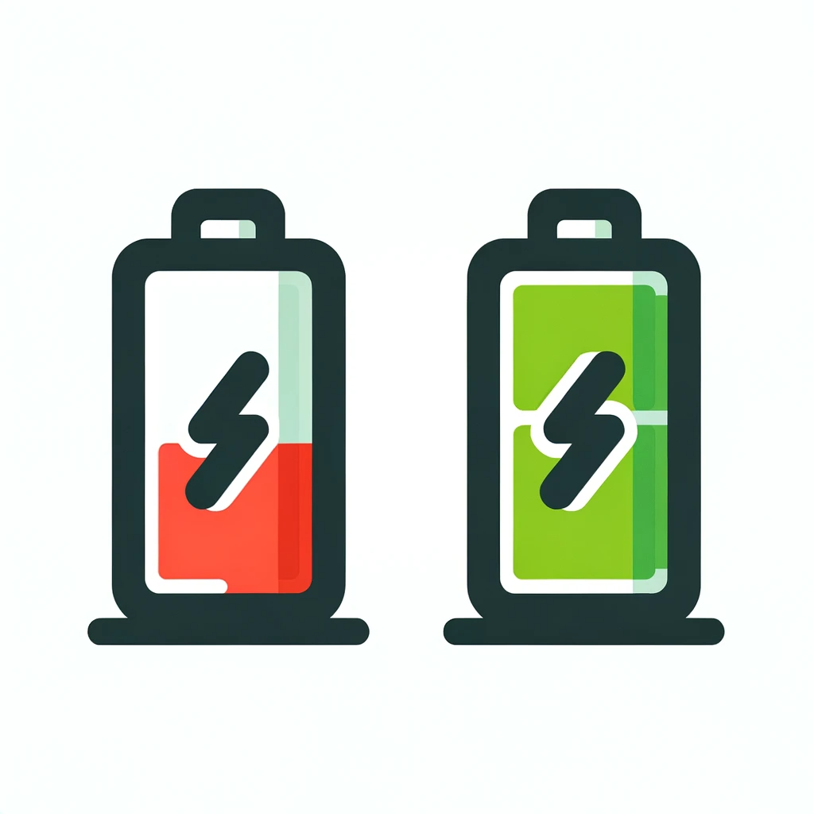
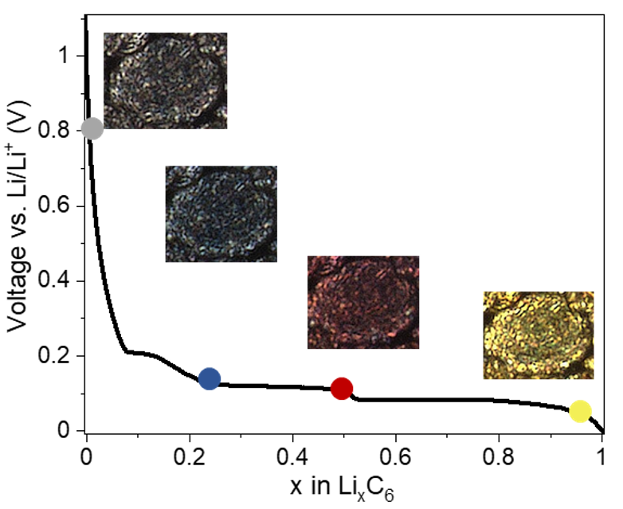



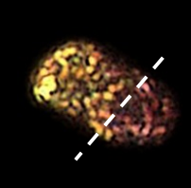
What hinders fast charging
Desired reaction: Li intercalation in graphite
Stage 1L
*
Gao et al., Joule 5, 393–414, 2022
Yang et al., Journal of Power Sources, 28-40,360, 2017
Electrolyte
*
Intercalation
Lithium plating
Li ions
SEI
Intercalated lithium
Plated lithium
Graphite
Electrons
Phase separation in Li-rich and Li-poor phases
Undesired reaction: Li plating
for E < 0 V vs Li

Slide 4
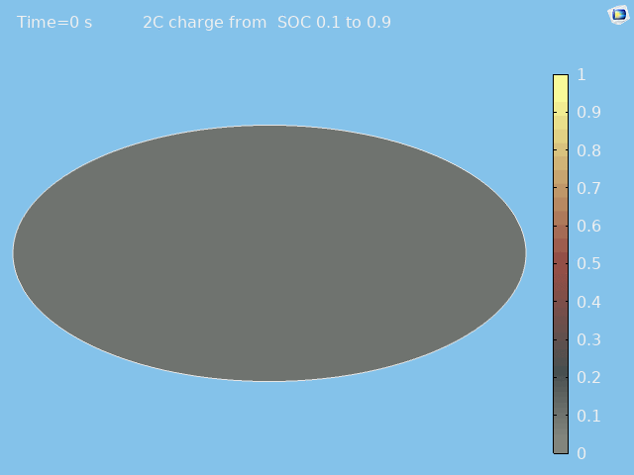
What hinders fast charging
Desired reaction: Li intercalation in graphite
electrolyte
1 μm
Yang et al., Journal of Power Sources, 28-40,360, 2017
Electrolyte
*
Intercalation
Lithium plating
Li ions
SEI
State of lithiation [-]
Intercalated lithium
graphite
Plated lithium
Graphite
Electrons
Undesired reaction: Li plating
for E < 0 V vs Li

Slide 5
Goals of the study
Model the interplay between graphite phase-separation and Li plating
Quantify kinetic and transport parameters
Develop model-guided fast-charging protocols

Slide 6
Electrochemical modelling: from 1D to 3D
electrolyte
1 μm
Electron and Li conservation
General Form PDE
+
Boundary ODEs
+
State of lithiation [-]
graphite
Phase-field approach
Ion conservation
Kinetics of intercalation and plating

Slide 7
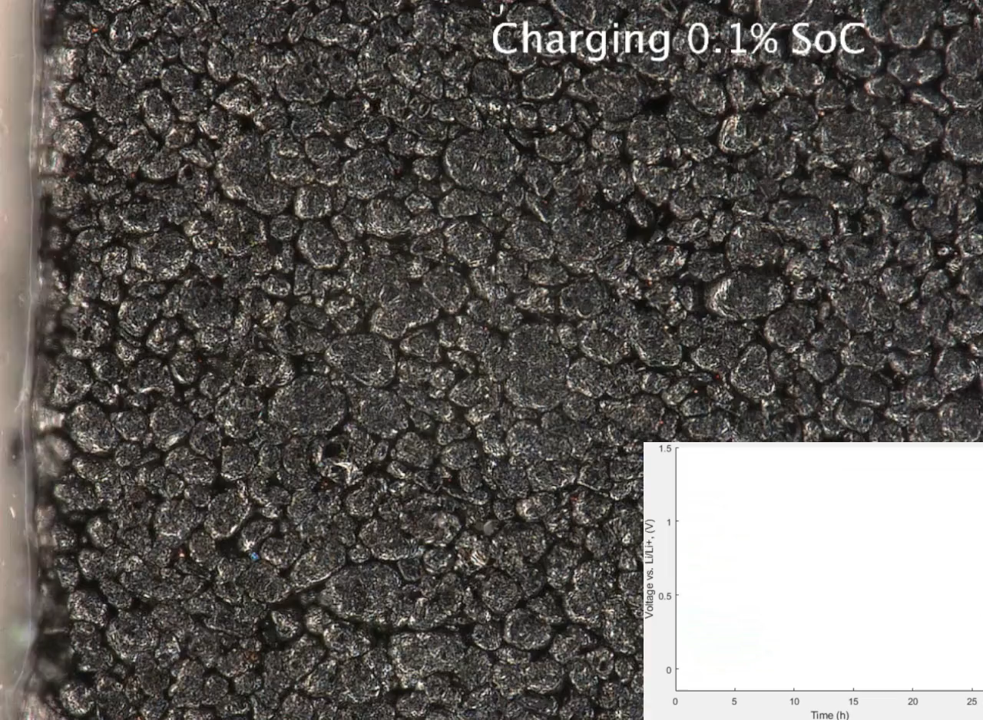
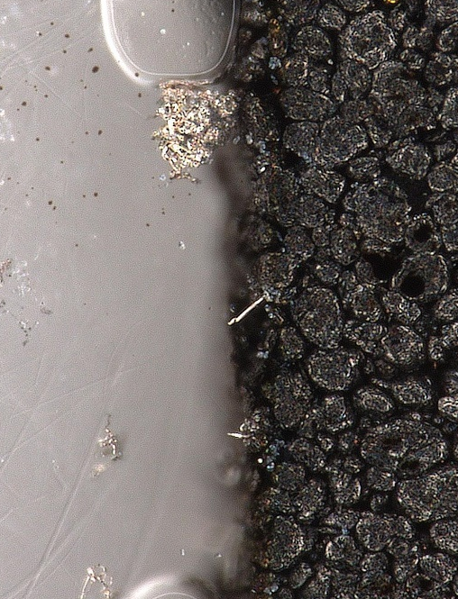
Optical visualisation of intercalation and plating*
100 μm
2 mA cm⁻²
Li plating
Li metal loss
*X. Lu et al., Nat. Comm. 14 (2023) 5127

Slide 8
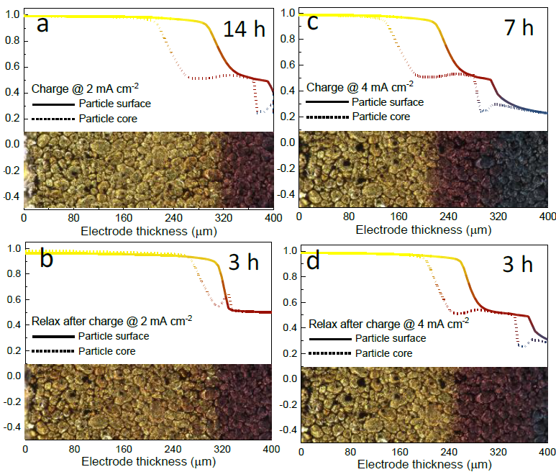
Revealing the internal Li distribution
Model allows us to “look inside the particles” (radial distribution & diffusion limitations)
Model captures full evolution at all times:
  electrolyte transport
  phase separation
  lithium intercalation
  reversible plating
Strong validation of model and parameters
State of lithiation [-]
State of lithiation [-]

Slide 9
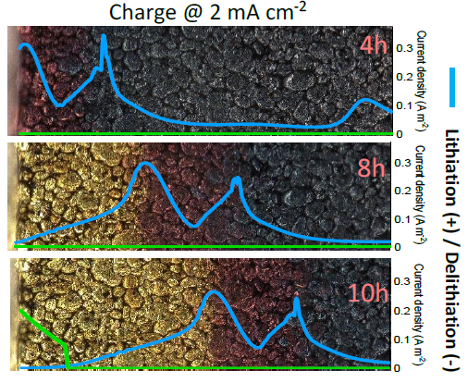
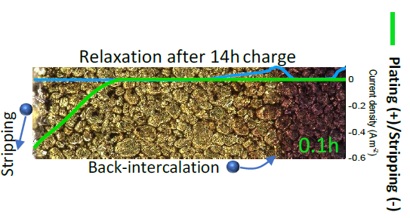

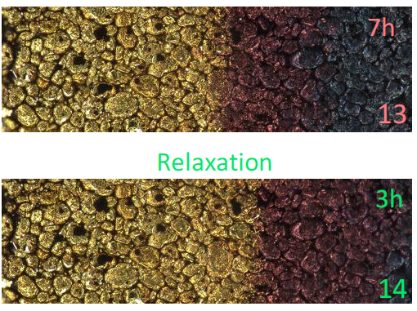
Kinetics of Li intercalation and Li plating/stripping
Li intercalation occurs at phase boundaries
Plating takes place only on saturated graphite
Li plating is (partly) reversible
Back-intercalation at the phase boundary

Slide 10
Lessons learned for model-guided charging protocols

Slide 11
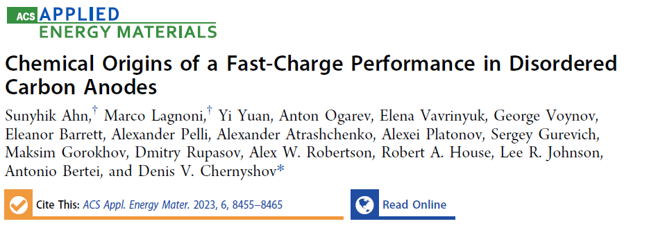

Take-home messages
Graphite phase separation and Li plating kinetics implemented in the model
Coupling with operando optical experiments for validation
Model-guided protocols enable fast-charging in 15 min
Non phase-separating anode materials (e.g., disordered carbon)

Slide 12







Acknowledgments
These projects have received funding from :
The University of Pisa through the funding program “Progetti di Ricerca di Ateneo PRA 2020–2021”, project no. PRA_2020_48
“Network 4 Energy Sustainable Transition – NEST”, project funded under the National Recovery and Resilience Plan (NRRP), Mission 4 Component 2 Investment 1.3 – NextGenerationEU, project code PE0000021, Concession Decree No. 1561 of 11.10.2022 adopted by Ministero dell’Università e della Ricerca (MUR), CUP I53C22001450006 according to attachment E of Decree No. 1561/2022
“Integrated procedures for FAST ChARging with online state-of-health evaluation of lithium-ion batteries - FASTCAR ”, PRIN 2022, project funded by the Ministry of University and Research (MUR) under the National Recovery and Resilience Plan (NRRP), Mission 4 Component 2 Investment 1.3 – NextGenerationEU, CUP I53D23001550006
Prof. Antonio Bertei
Un. of Pisa
Dr. Xuekun Lu
Queen Mary Un. London
Students:
Andrea Distefano
Stefano Caverni
Thank you!

