Slide 1


A Multifaceted Model Exploring the Role of Mucus and Shear Stress in Intestine
Ibrahim Erbay
Understanding Biology Through COMSOL
COMSOL Conference, Florence, 2024

Slide 2
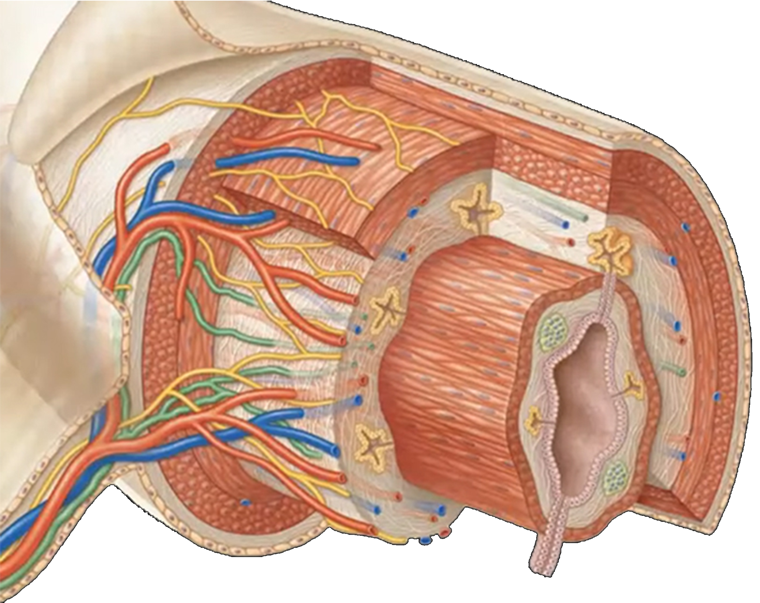
Introduction: Organization of the human intestine
Muscle
Epithelium
Lumen
Pearson, 2019
1/10

Slide 3
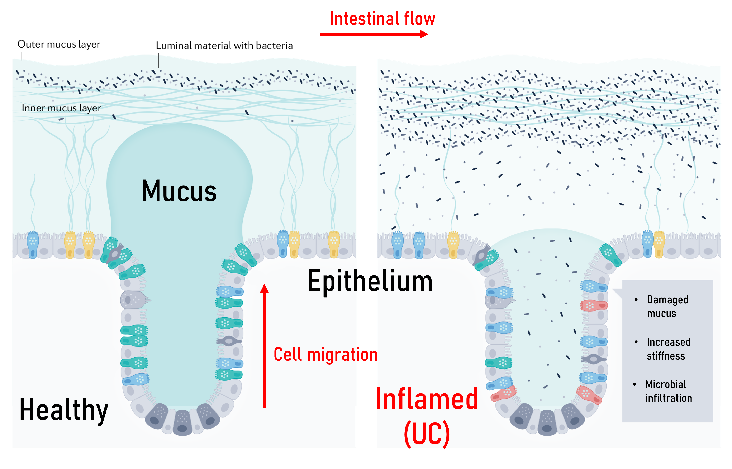
Introduction: Intestine in Health and Disease
~10¹¹ cells/day
Highly mechanical process
Deformed mucus leads to inflammation
Crypt
Stem cells
2/10

Slide 4
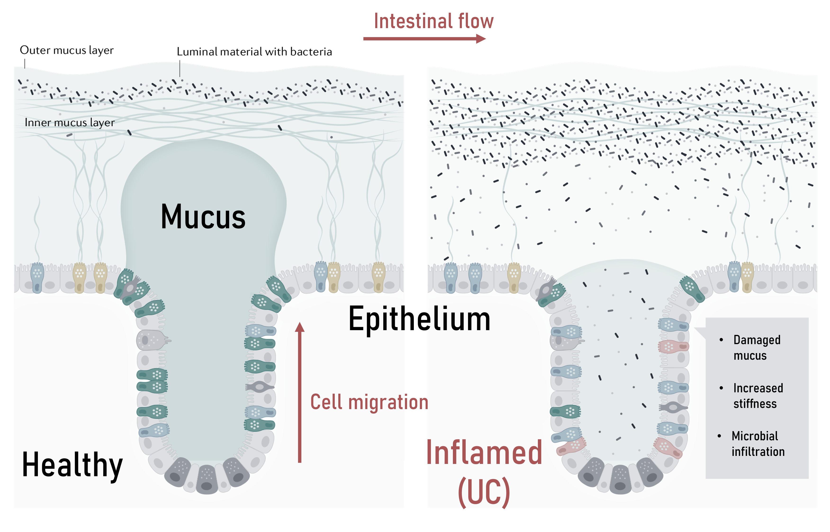
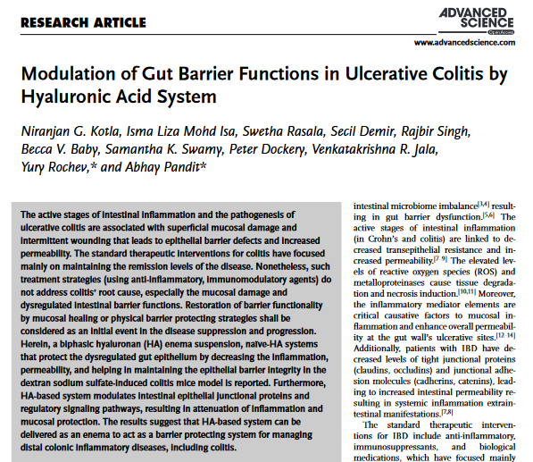
Introduction: Intestine in Health and Disease
What is the mechanical role of the mucus?
All cells respond to mechanical stimuli
2/10

Slide 5
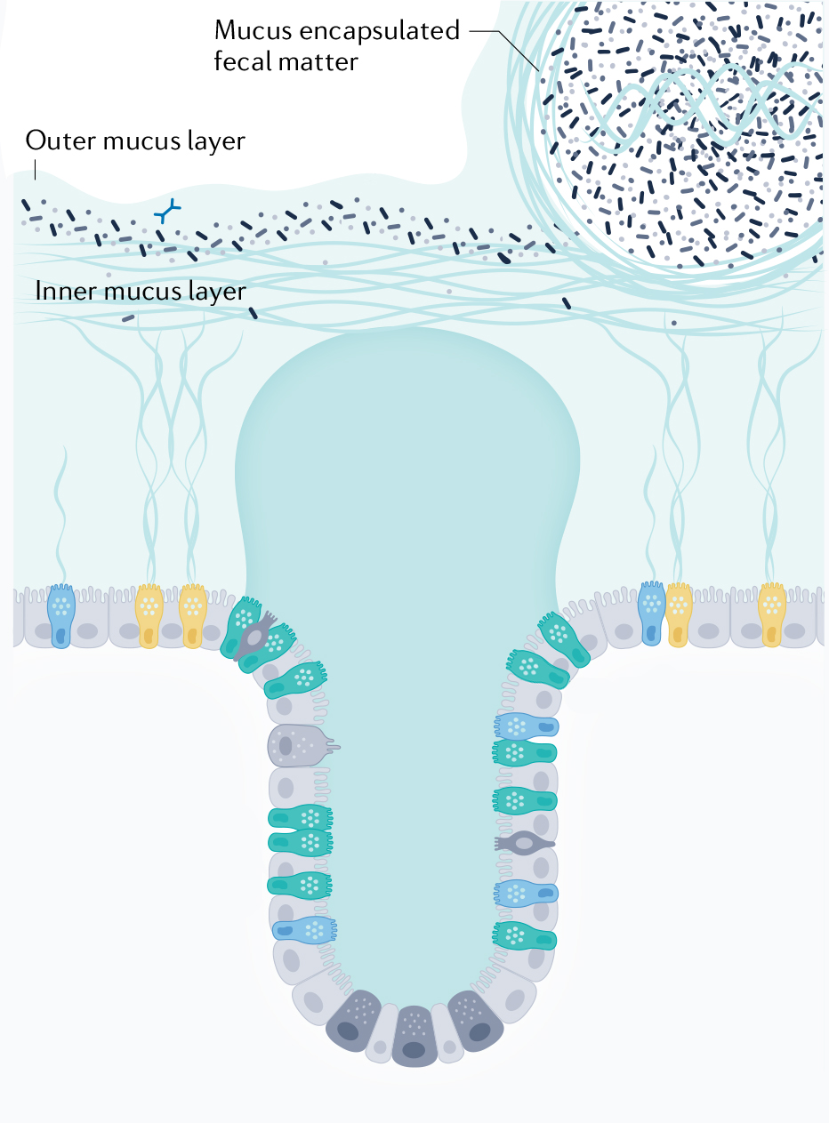
Modelling Epithelial Geometry and Intestinal Motility
Intestinal flow
Feces
Outer mucus
Inner mucus
Epithelium
Poster #09
3/10

Slide 6
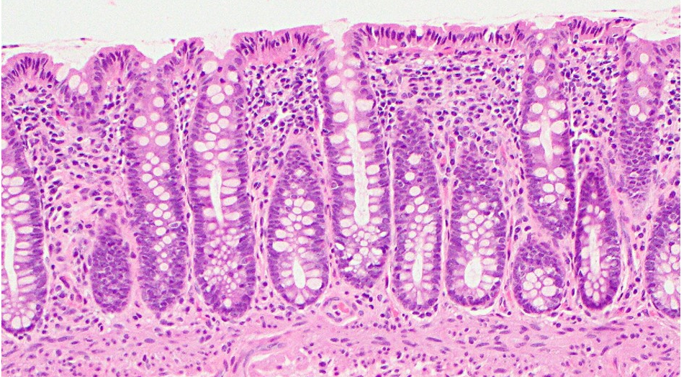
Modelling Epithelial Geometry and Intestinal Motility
Intestinal flow
Human Colon Histology
Feces
Outer mucus
Inner mucus
L
w
Webpath Utah
Crypt geometry
Epithelium
Poster #09
3/10

Slide 7
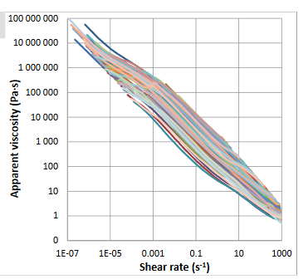
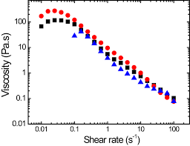
Modelling Epithelial Geometry and Intestinal Motility
Intestinal flow
Human fecal and mucosal rheology
Feces
Outer mucus
Inner mucus
Rheological properties
Woolley et al., 2013
Srinivasan et al., 2022
Epithelium
Poster #09
3/10

Slide 8
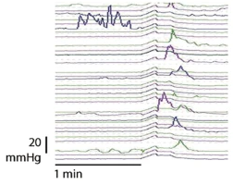
Modelling Epithelial Geometry and Intestinal Motility
Human intestinal pressure waves
Intestinal flow
Feces
Outer mucus
Inner mucus
Epithelium
Chen et al., 2017
Flow characteristics
Poster #09
$$P\left(t\right)=P_{max}e^{−\frac{{(t−t_{0})}^{2}}{{(2Dt)}^{2}}}$$
3/10

Slide 9

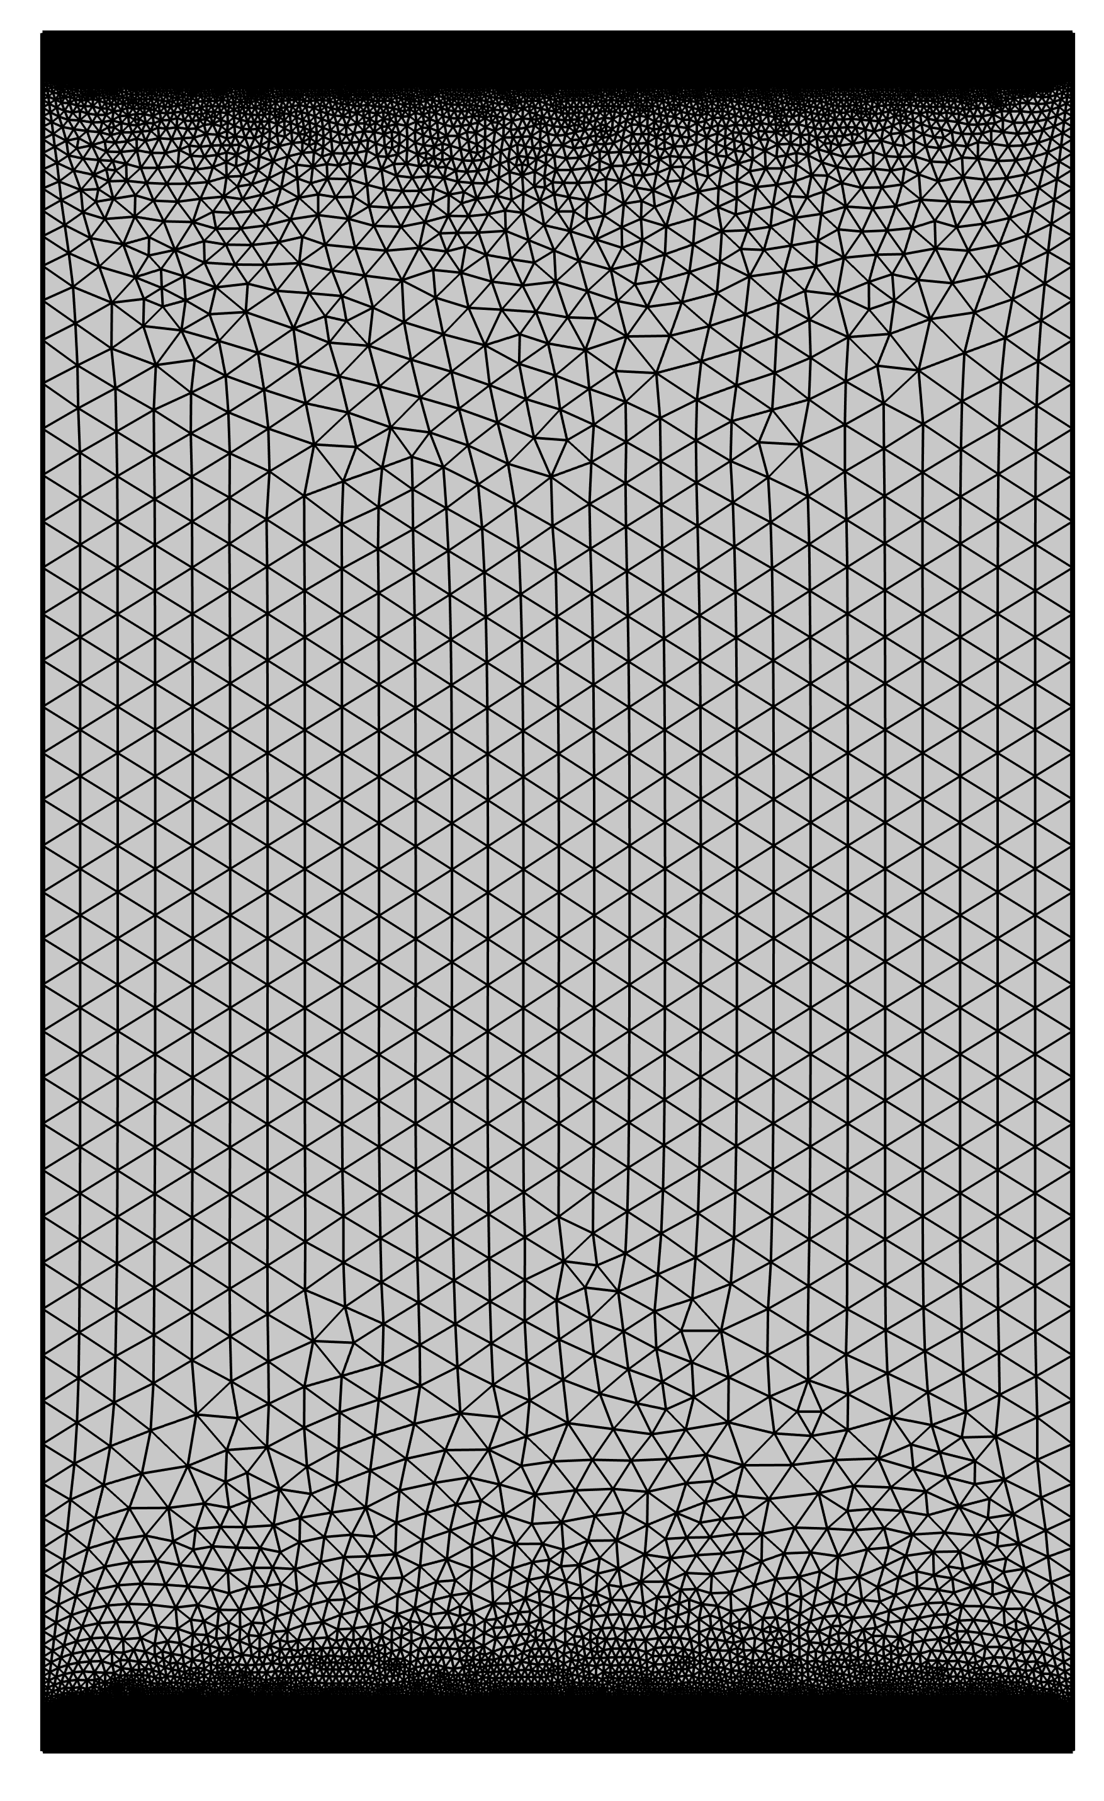
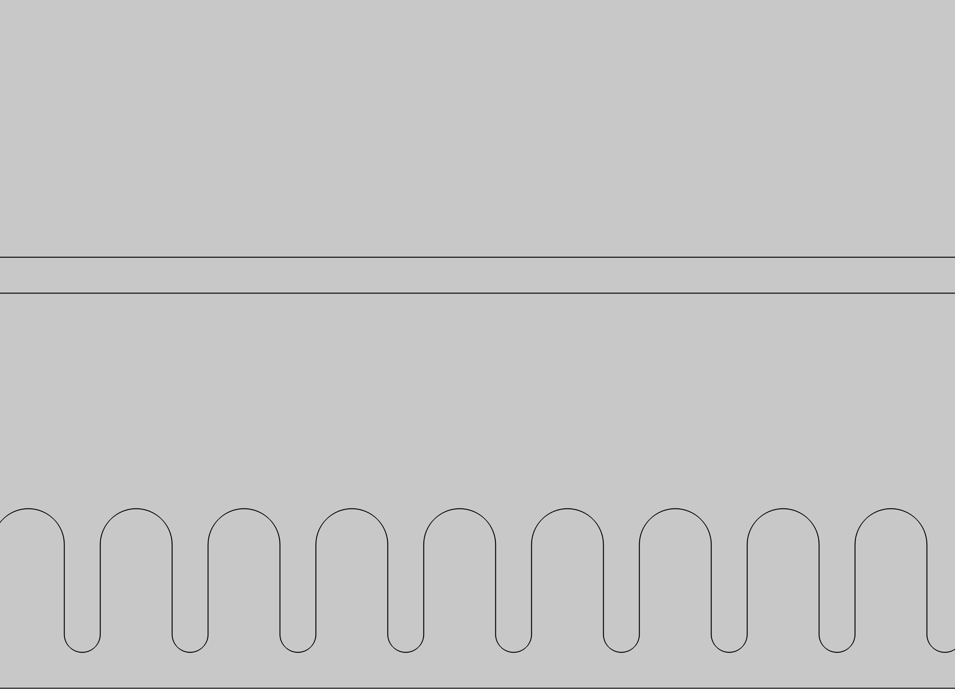
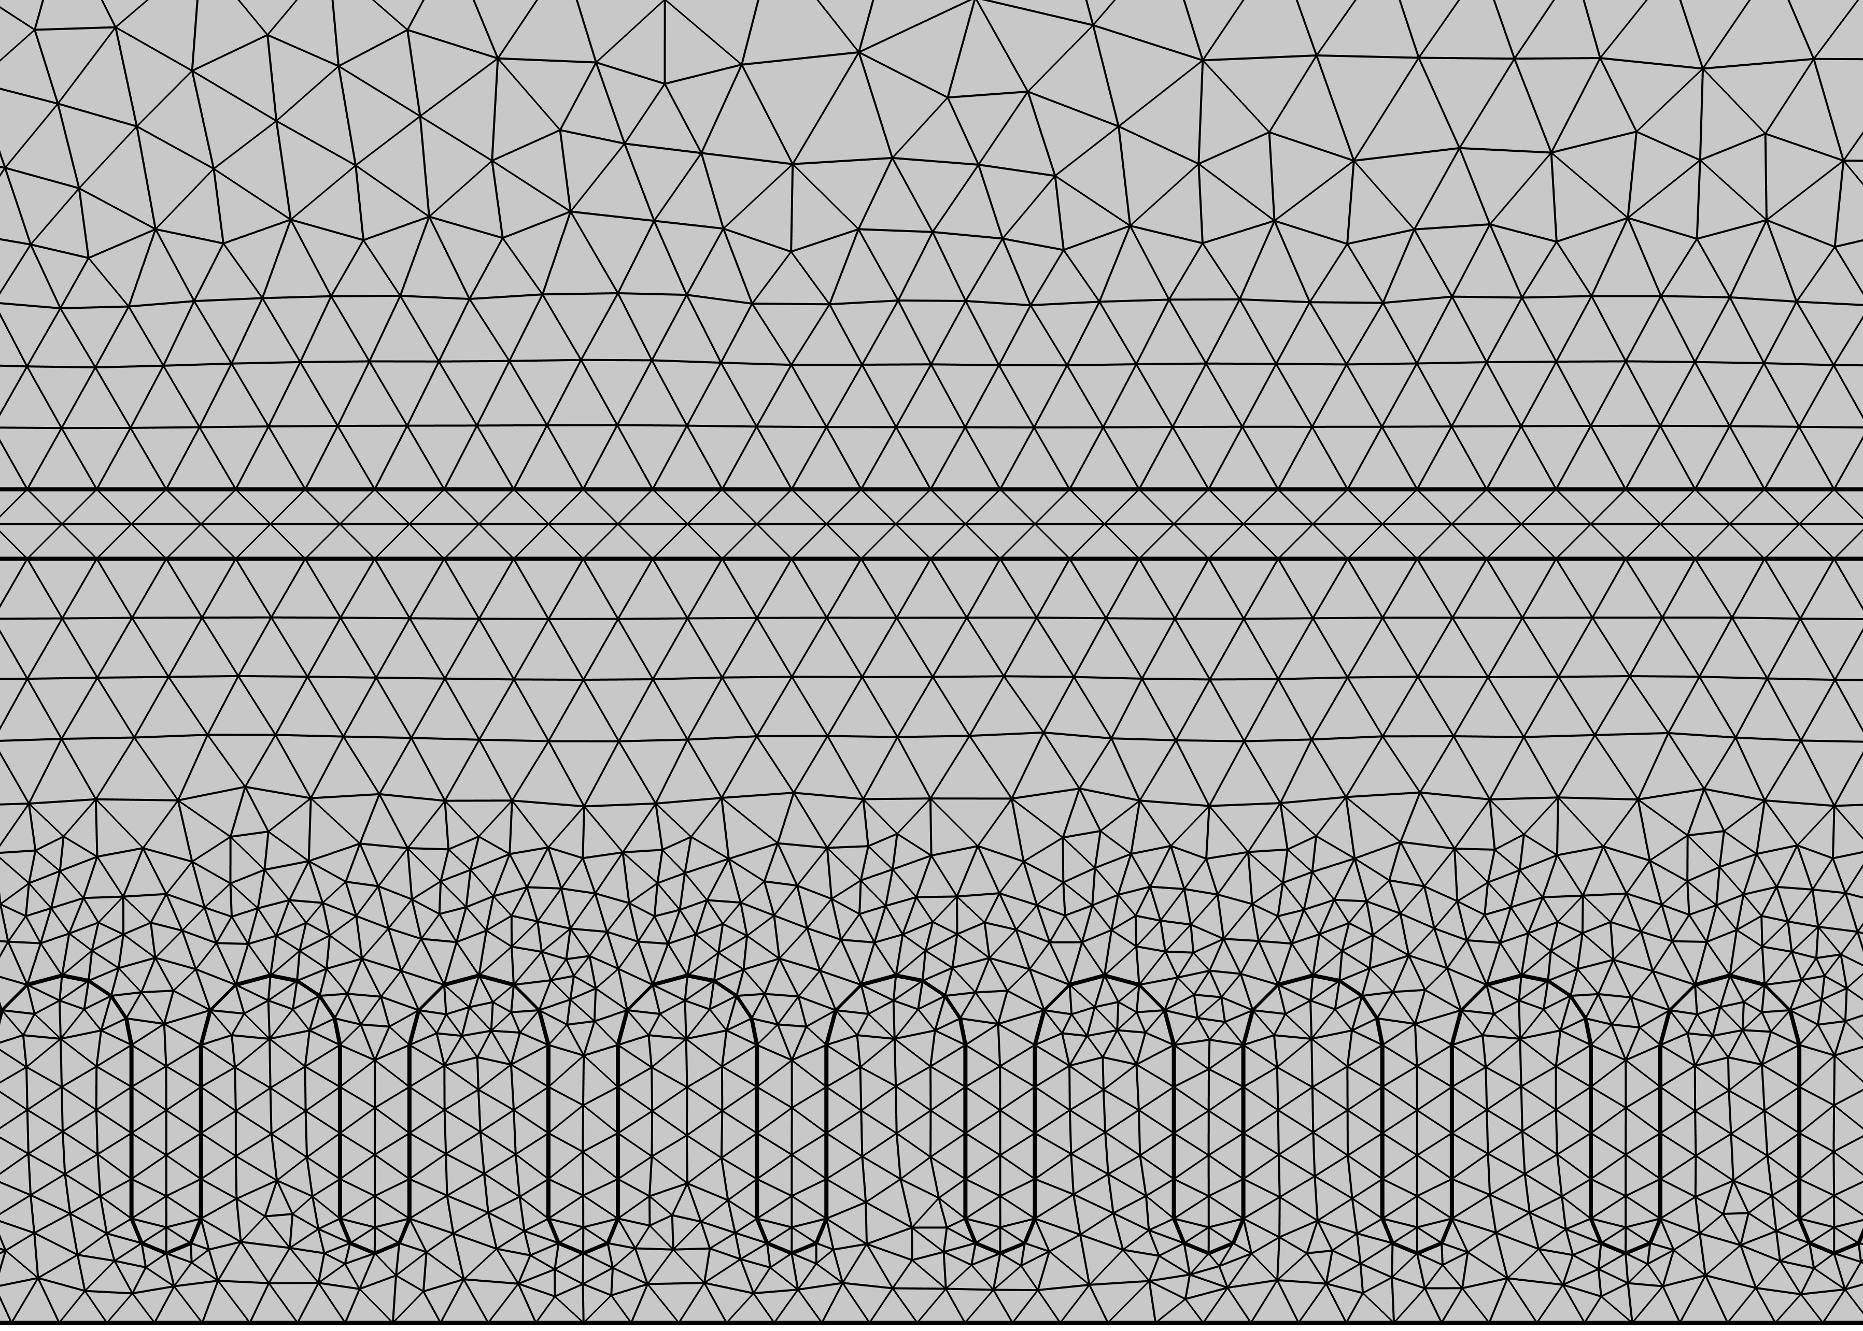
3 cm
Geometry and Mesh
Outer mucus
100 µm
Inner mucus
100–800 µm
Lumen
5 cm
Epithelium
500 µm
Poster #09
4/10

Slide 10


Boundary Conditions and Domains
Laminar flow
Structural mechanics
Ternary-phase field
Outlet
Inlet
Lumen
Moving mesh
$$P$$
$$P\left(t\right)$$
Solid Domain
Fluid domain
Feces (Power Law Fluid)
Outer mucus (Carreau Fluid)
Inner mucus (Carreau Fluid)
Epithelium
Poster #09
5/10

Slide 11
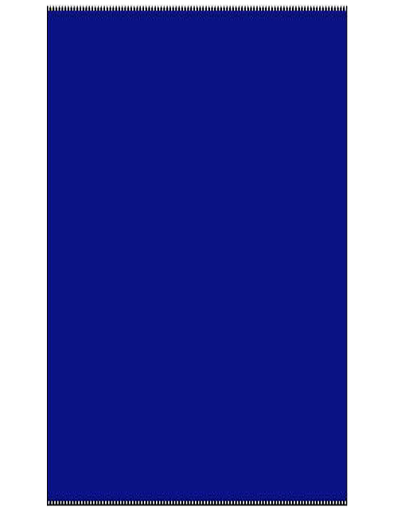
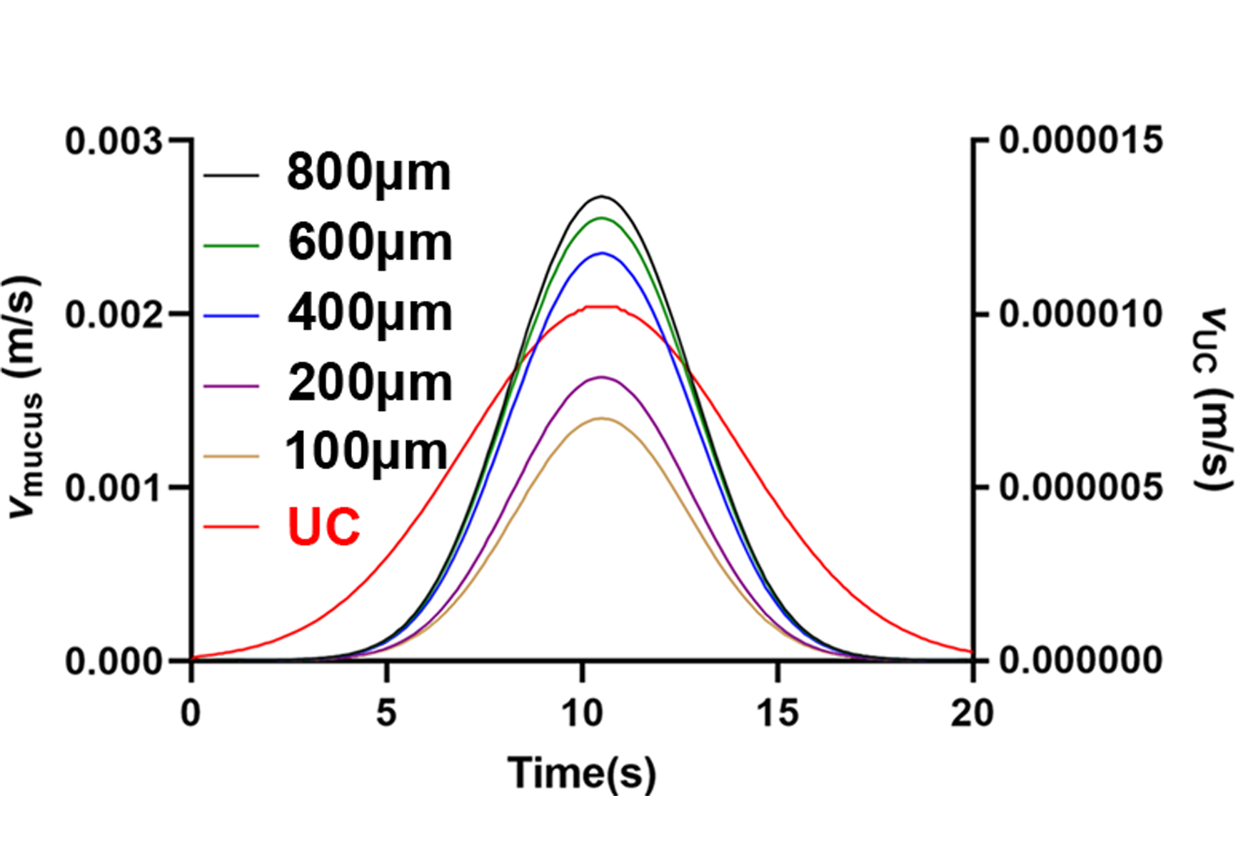
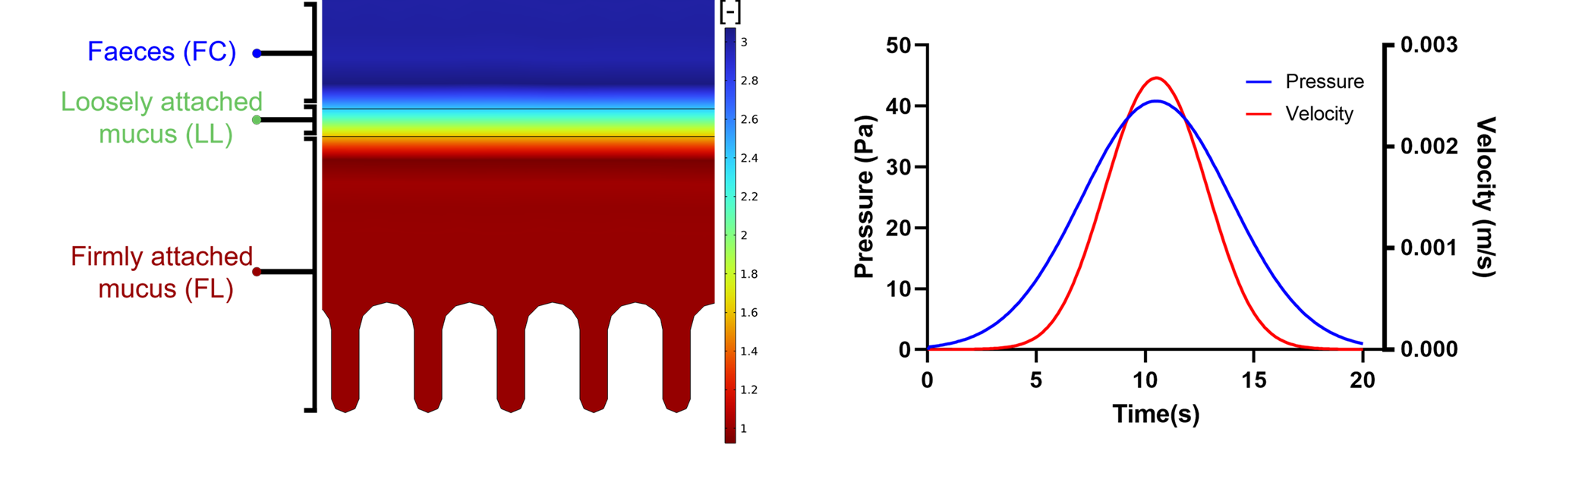
Mucus Increases Flow Velocity
Volume fractions of the ternary phase
Temporal Pressure-Velocity Profile
Two orders of magnitude lower velocity in the inflamed model
Increasing mucus thickness resulted in increased flow velocity
Poster #09
6/10

Slide 12
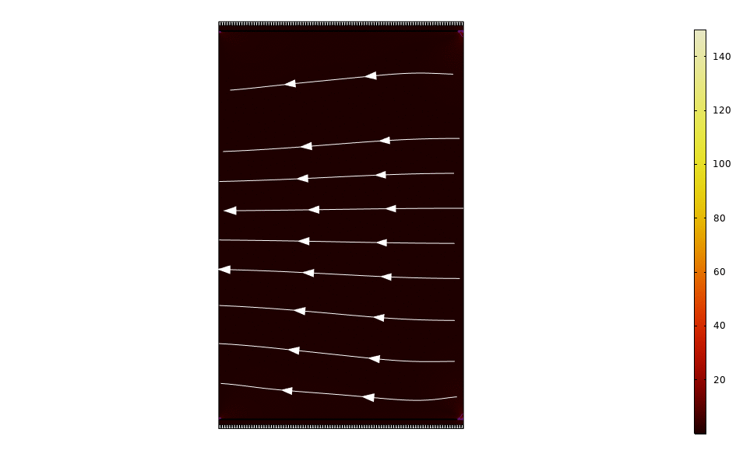
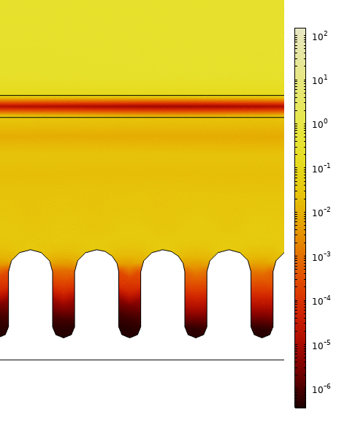
Mucus reduces shear stress applied on the epithelium
Pa
Pa
Poster #09
7/10

Slide 13
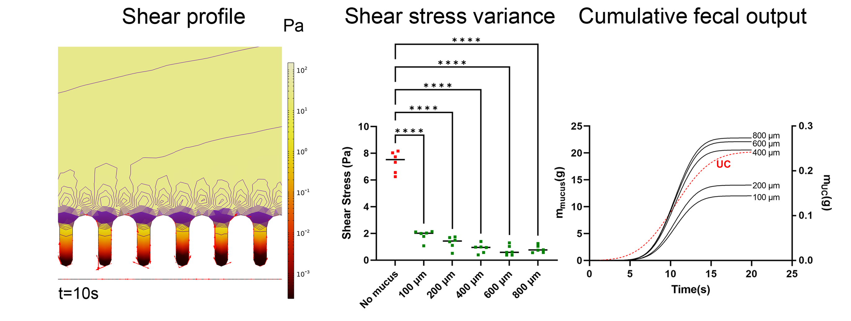
Mucus reduces shear stress applied on the epithelium
Lower shear magnitude on epithelium in mucus models
Increased fecal mass output in mucus models
Poster #09
8/10

Slide 14
Why does this matter?
Shear stress is known to change cell behaviour in intestine (e.g. division, differentiation, death, mucus secretion and migration)
We hypothesize that mucus modulates the shear stress transferred to the epithelium and its absence may cause crypt damage via increased mechanical input
This model could be used for optimizing understanding intestinal biology and drug delivery applications (e.g. nanoparticles)
9/10

Slide 15









Acknowledgements
Dr Yury Rochev
University of Birmingham
Dr Alessio Alexiadis
All CURAM and lifETIME CDT members
Thanks for the attention!
Any questions?
Poster #09
i.erbay1@universityofgalway.ie
iherbay
@iherbay
This work was supported by Science Foundation Ireland 18/EPSRC-CDT/3583 and the Engineering and Physical Sciences Research Council EP/S02347X/1.
This work has emanated from research supported in part by a grant from Science Foundation Ireland (SFI) and the European Regional Development Fund (ERDF)
under grant number 13/RC/2073_P2.

