Slide 1



“A 2D Computational Model of a ThermoMagnetic Device”
F. Rodríguez M.¹, Lorenzo Gallo^{2,3}, S. Fabbrici², F. Cugini³, B. Chinè¹
¹School of Materials Science and Engineering, Costa Rica Institute of Technology, Cartago, Costa Rica
²Institute of Materials for Electronics and Magnetism, National Research Council, Parma, Italy
³Department of Mathematical, Physical and Computer Sciences, University of Parma, Italy
2024 FLORENCE

Slide 2
Agenda
    Introduction
        Background and objective
    Solution with COMSOL Multiphysics®
        Governing Equations
        TMEC modeling
    Results and discusión
        TMEC magnetic and kinetic response
        MCM efficiency evaluation
    Conclusions

Slide 3


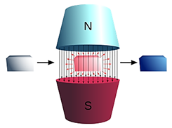
Introduction
Primary energy consumption is increasing constantly
Thermal losses up to 72% of energy produced [1],
45% are waste heat below 100ºC (low-grade heat) [2]
High global warming effect [3]
Environmental-friendly alternative
Thermo-Magnetic Generation (TMG) [4]
Converting low-grade waste heat into usable energy
High potential efficiency and cost-effective [5][6]
Based on functional materials with magnetocaloric properties (MCM) [7]

Slide 4
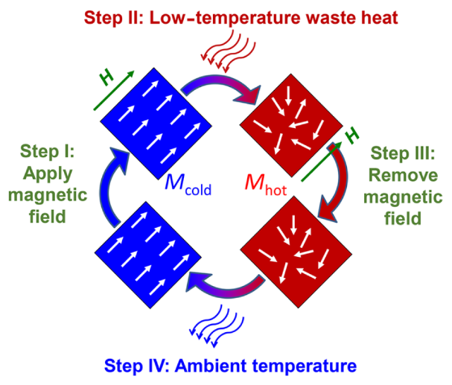
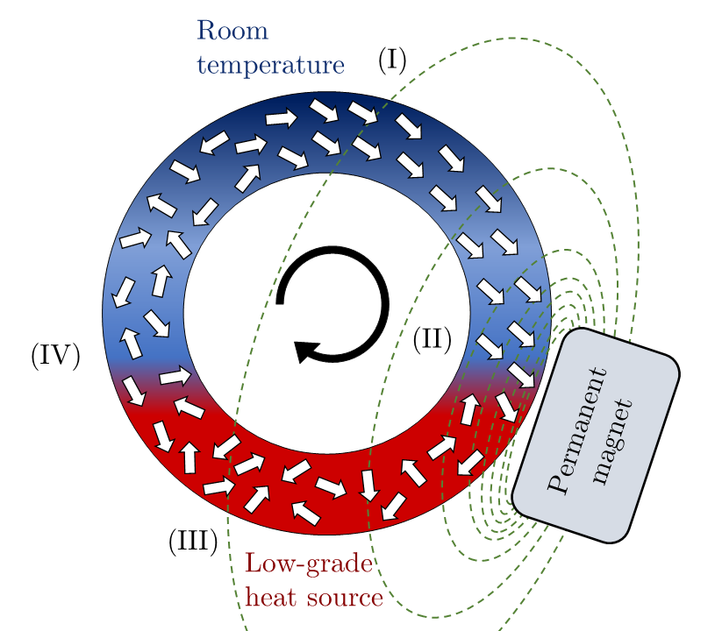
Introduction
This work aims to study the performance of a Thermo-Magnetic Energy Converter (TMEC) for harvesting low-grade heat waste, using a computational model developed in COMSOL Multiphysics®
Thermo-Magnetic Cycle [8]
Thermo-Magnetic Motor, with Ni₄₈Mn₃₆Sn₁₆ as MCM

Slide 5
Solution with COMSOL Multiphysics®. Governing Equations
Constitutive relations for the magnetic field generated by the magnets, using their magnetization
$$H=−∇V_{m}$$
$B=μ_{0}\left(H+M\right)$ ; $∇∙B=0$
$$−∇∙\left(μ_{0}∇V_{m}−μ_{0}M\right)=0$$
Energy-balance relation for heat transfer in solids and fluids
$$ρC_{p}u∙∇T+∇∙\left(−k∇T\right)=Q_{in}$$

Slide 6
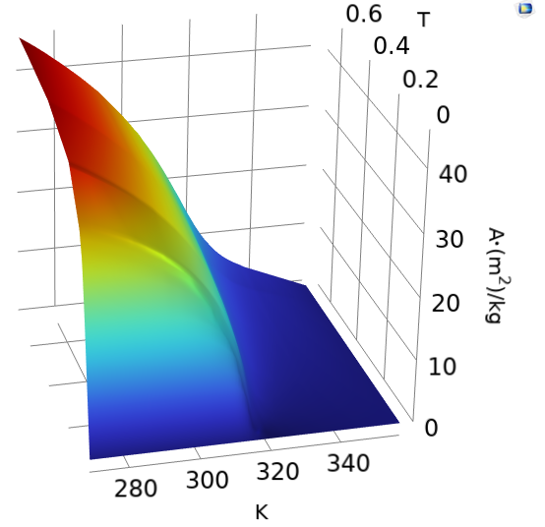

Solution with COMSOL Multiphysics®. Governing Equations
System angular acceleration based on Kelvin force and MCM mass magnetization [9]
$$F=μ\left(M∙∇\right)H$$
$$τ=r_{avg}F$$
Momentum
$$α=\frac{τ}{I}$$
Angular acceleration
$$I=\frac{1}{2}m\left(r_{ext}^{2}+r_{in}^{2}\right)$$
Moment of inertia
Angular velocity
$$w\left(t\right)=w\left(t−dt\right)+α\left(t\right)dt$$
Ni₄₈Mn₃₆Sn₁₆ magnetization per unit mass

Slide 7
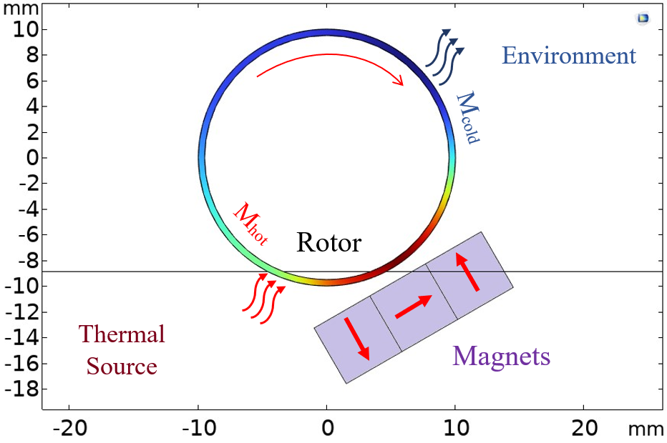
Solution with COMSOL Multiphysics®. TMEC modeling
5GHz
Initial Conditions and working parameters
10GHz
Parameter | Value
NdFeB magnets magnetization | 900 kA/m
Ni₄₈Mn₃₆Sn₁₆ permeability | 1.237e⁻⁶ N/A²
Ni₄₈Mn₃₆Sn₁₆ conductivity | 20 W/(m∙K)
Ni₄₈Mn₃₆Sn₁₆ heat capacity | 500 J/(kg∙K)
Ni₄₈Mn₃₆Sn₁₆ density | 7900 kg/m³
Rotor total mass | 3 g
Low-grade thermal source T_{hot} | 333,15 K
Environment T_{Cold} | 293,15 K
Rotor surface submerged | 10%
Thermo-Magnetic Device geometry and boundary conditions

Slide 8
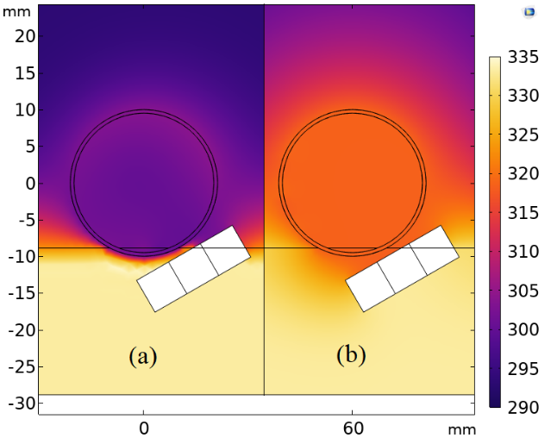
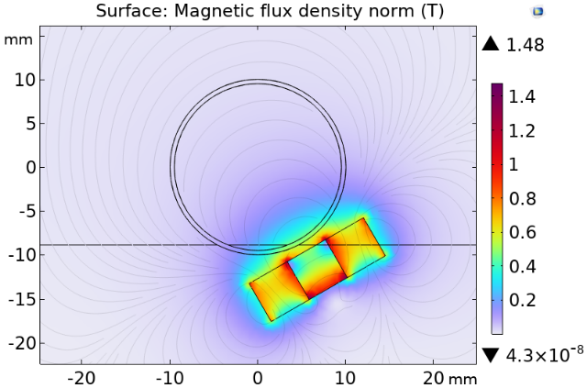
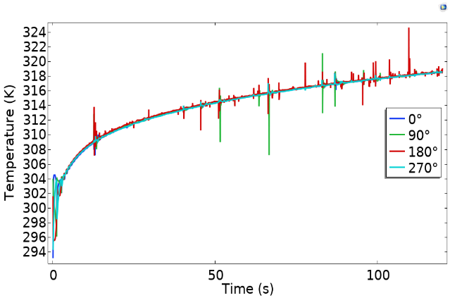
Results and discussion
5GHz
Temperature profile over the TMEC model at (a) 2.5s, and (b) 120s.
Magnetic Field generated by magnets array
Temperature gradient at different angles along the MCM rotor

Slide 9
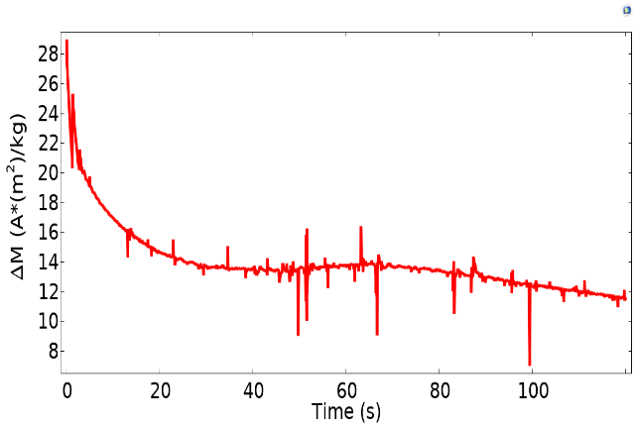
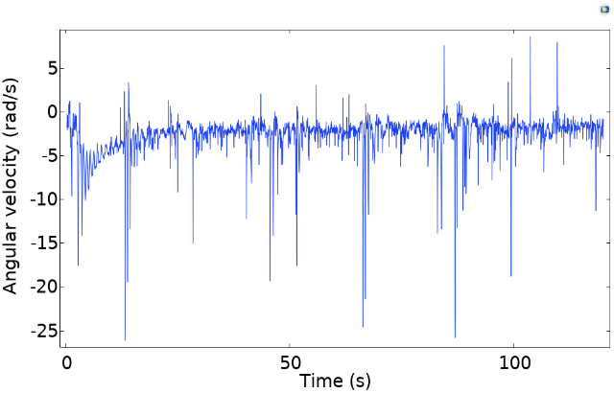
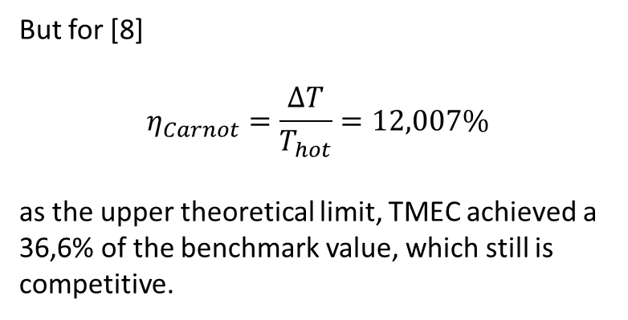


Results and discussion
5GHz
Material Efficiency
$$η=\frac{μ_{0}\left(M_{cold}−M_{hot}\right)H}{Q_{in}}$$
$$η=4,41\%$$
Change in the Ni₄₈Mn₃₆Sn₁₆ rotor magnetization per unit mass over time
But for [8]
$$η_{Carnot}=\frac{ΔT}{T_{hot}}=12,007\%$$
as the upper theoretical limit, TMEC achieved a 36,6% of the benchmark value, which still is competitive.
Rotor angular velocity over time

Slide 10
Conclusions
The performance of a Thermo-Magnetic Energy Converter (TMEC) has been evaluated in terms of angular velocity, material magnetization, and efficiency using a 2D-model of a thermomagnetic motor based on magnetocaloric materials.
The TMEC, with a Ni₄₈Mn₃₆Sn₁₆ Heusler compound rotor, exhibits a low efficiency performance due to the constant heating of the material, which halts the change in its magnetization, but if compared with the theoretical upper efficiency limit, still is a viable and competitive alternative for harvesting low-grade waste heat.
The computational results obtained with COMSOL Multiphysics® are encouraging for future studies where certain parameters of the model can be varied to optimize the response of different magnetocaloric materials or the overall performance of the TMEC.

Slide 11
Acknowledgments
The authors gratefully acknowledge:
  Vicerrectoría de Investigación y Extensión of the Instituto Tecnológico de Costa Rica, through the project 5402-1351-2301.

Slide 12
References
[1] M. Araiz, A. Martínez, D. Astrain and P. Aranguren, "Experimental and computational study on thermoelectric generators using thermosyphons with phase change as heat exchangers," Energy Conversion and Management, vol. 137, pp. 155-164, 2017.
[2] N. Jaziri, A. Boughamoura, J. Müller, B. Mezghani, F. Tounsi and M. Ismail, "A comprehensive review of Thermoelectric Generators: Technologies and common applications," Energy Reports, vol. 6, pp. 264-287, 2020.
[3] C. Formann, I. K. Muritala, R. Pardemann and B. Meyer, "Estimating the global waste heat potential," Renewable and Sustainable Energy Reviews, vol. 57, pp. 1598-1579, 2016.
[4] S. Hur, S. Kim, H.-S. Kim, A. Kumar, C. Kwon, J. Shin, H. Kang, T. H. Sung, J. Ryu, J. M. Baik and H.-C. Song, "Low-grade waste heat recovery scenarios: Pyroelectric, thermomagnetic, and thermogalvanic thermal energy harvesting," Nano Energy, vol. 114, p. 108596, 2023.
[5] V. Srivastava, Y. Song, K. Bhatti and R. D. James, "The Direct Conversion of Heat to Electricity Using Multiferroic Alloys," Advanced Energy Materials, vol. 1, no. 1, pp. 97-104, 2011.
[6] A. Kitanovski, M. Diebold, D. Vuarnoz, C. Gonin and P. W. Egolf, "Applications of Magnetic Power Production and Its Assessment–A Feasibility Study," Swiss Federal Office of Energy, Bern, Switzerland, 2008.
[7] A. Post, C. Knight and E. Kisi, "Thermomagnetic energy harvesting with first order phase change materials," Journal of Applied Physics, vol. 114, no. 3, p. 033915, 2013.
[8] D. Dzekan, A. Waske, K. Nielsch and S. Fähler, "Efficient and affordable thermomagnetic materials for harvesting low grade waste heat," APL Materials, vol. 9, p. 011105, 2021.
[9] L. Gallo, "Conversione termomagnetica di energia basata su materiali magnetici allo stato solido," Università degli Studi di Parma, Parma, Italia, 2020.

Slide 13
Q/A

