Slide 1
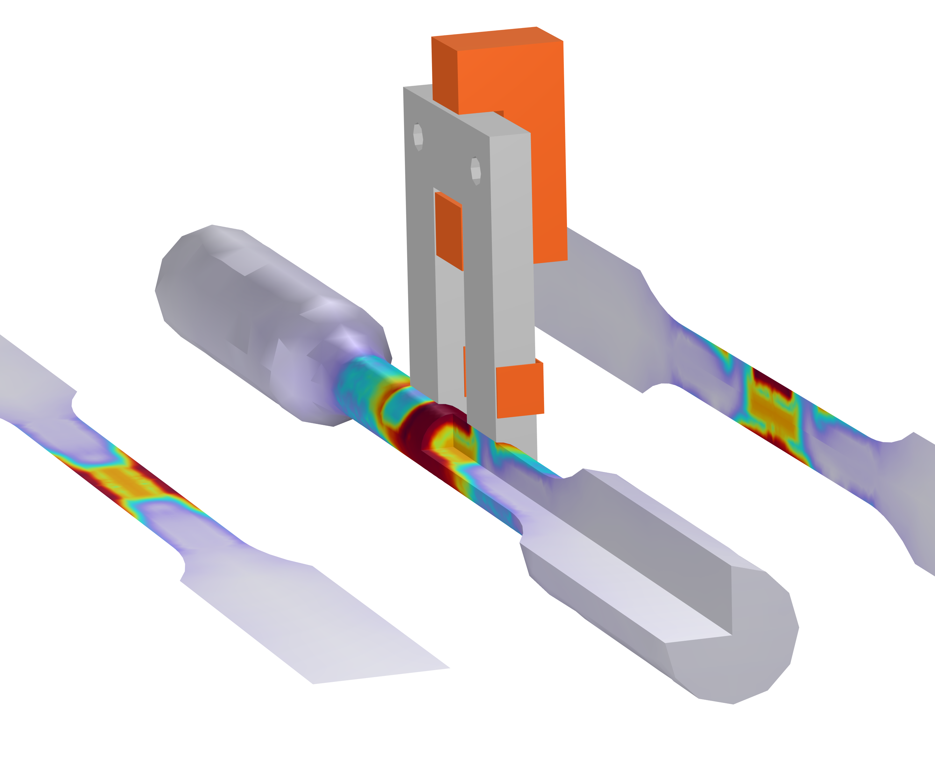
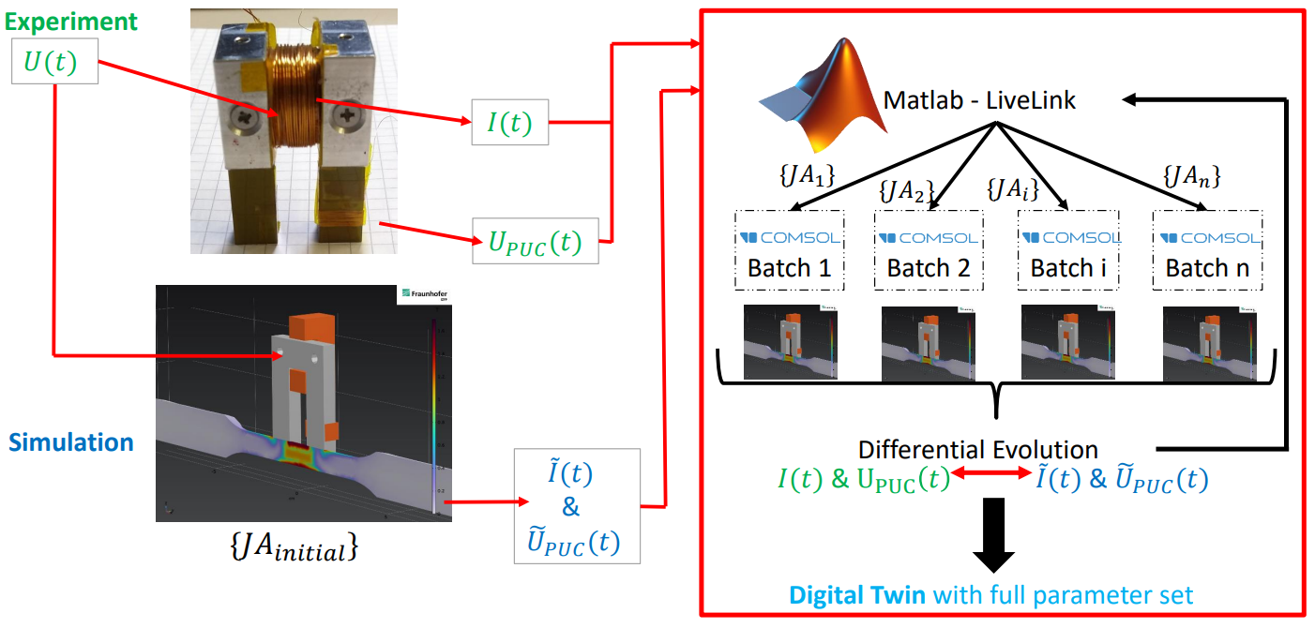
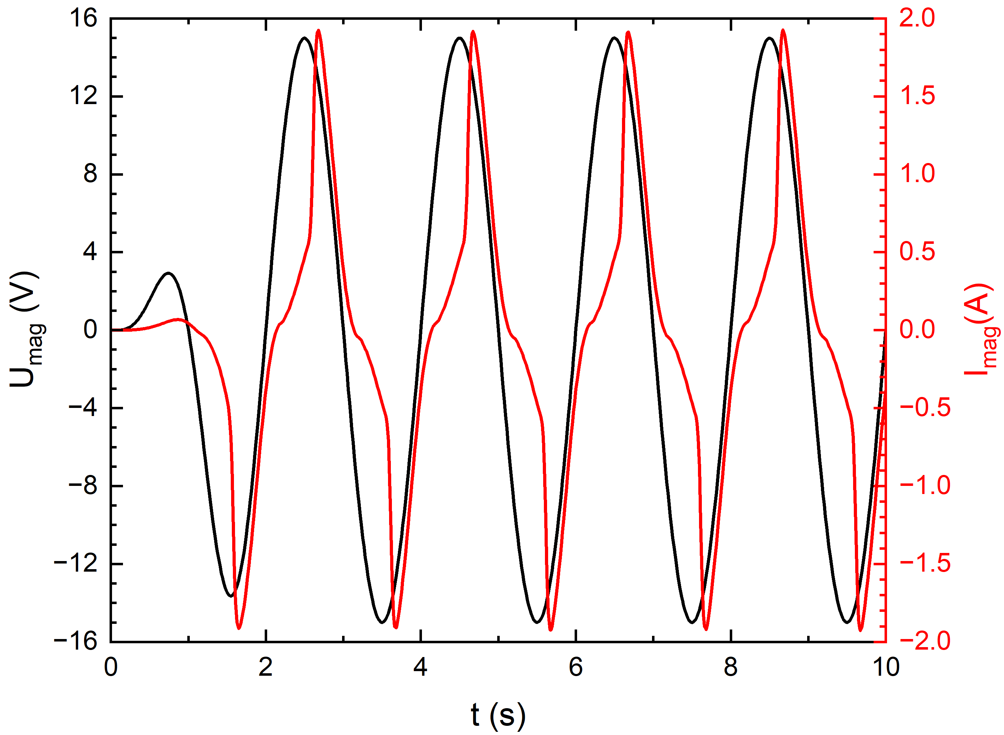
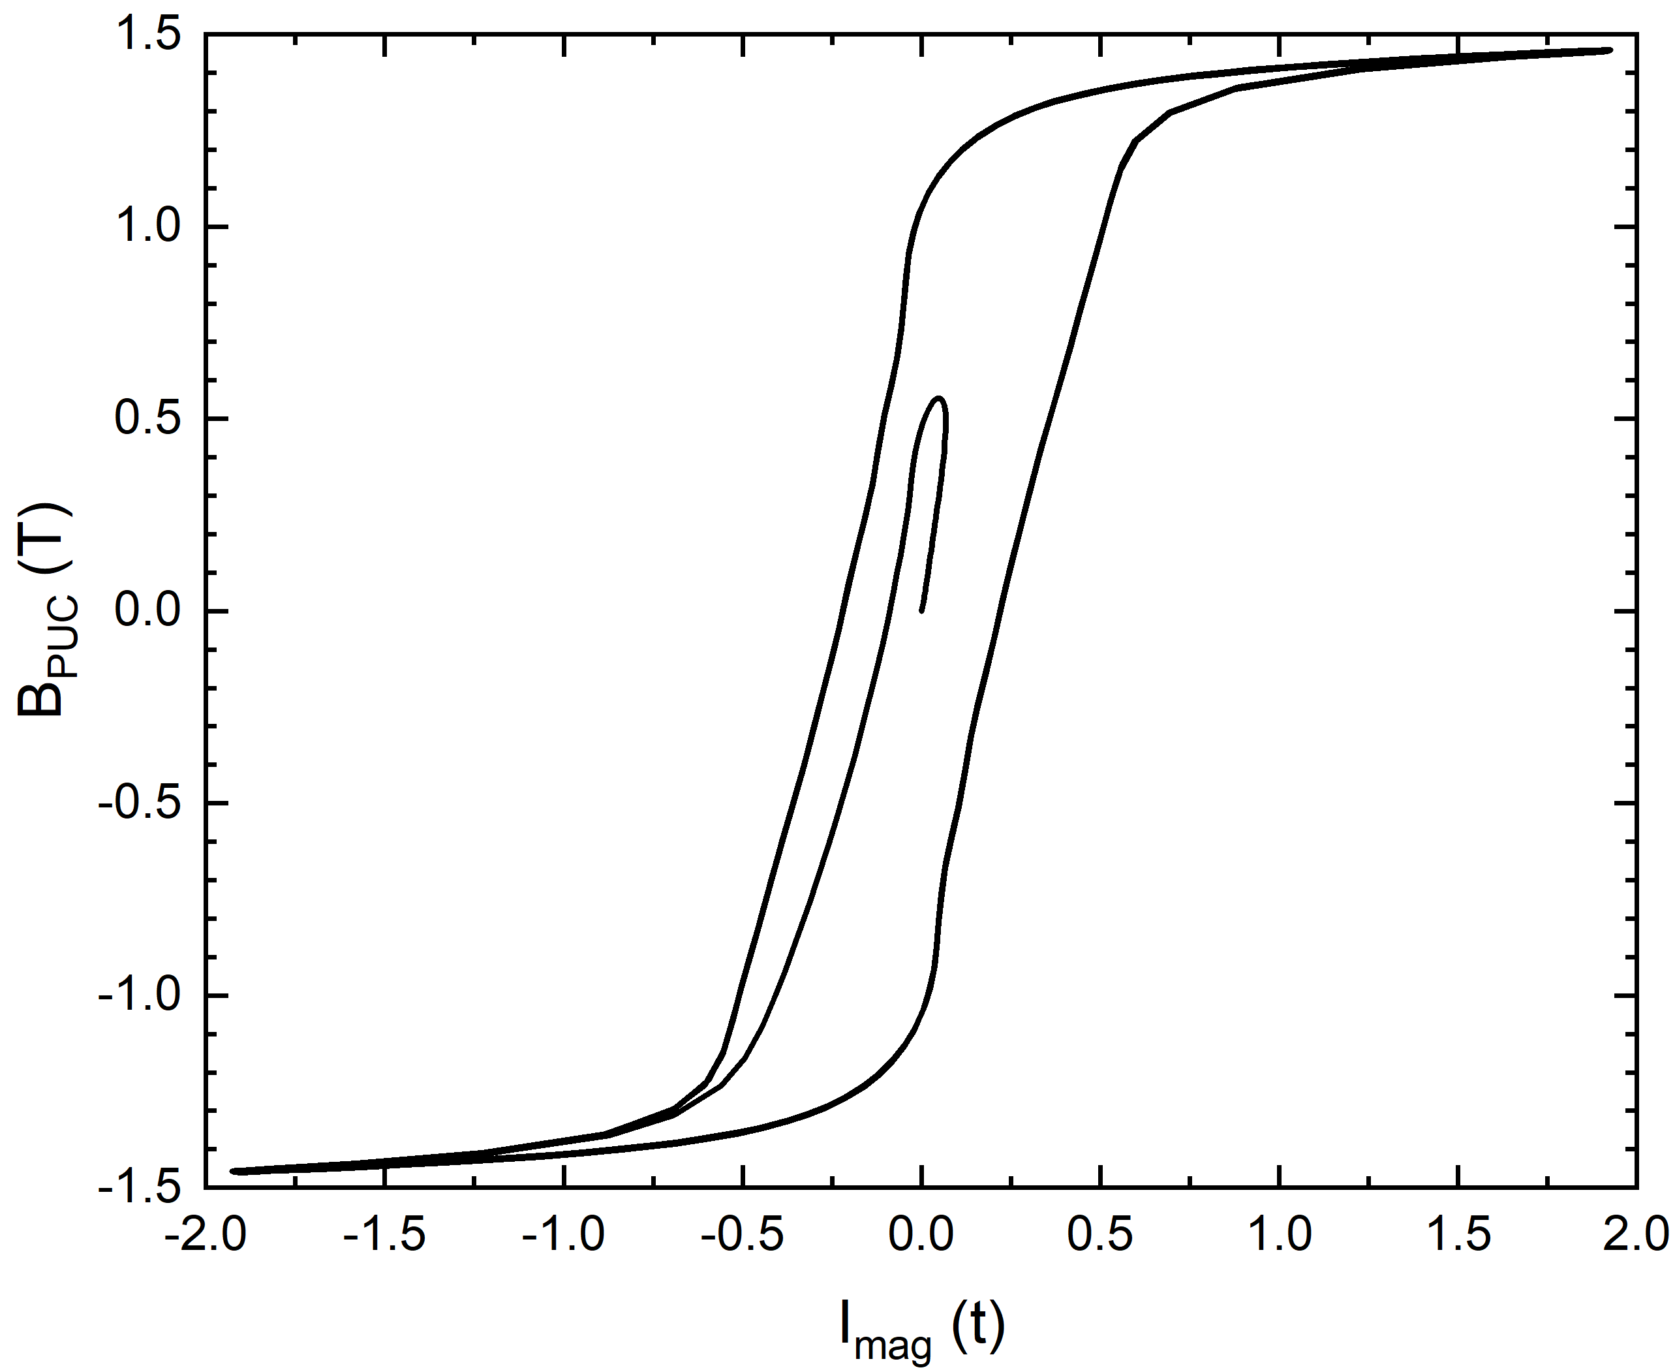


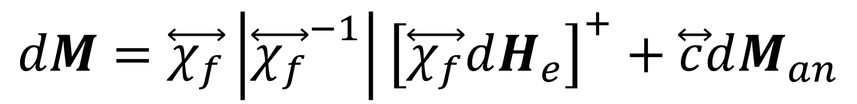
Experimental data + Evolutionary algorithms: Modeling and understanding the ferromagnetic hysteresis
The core objective is to bridge the gap between experimental measurements and computational simulations by incorporating measured data into the modeling process.
S. Thieltges¹, U. Hartmann²
1. Fraunhofer Institute for Nondestructive Testing, Saarbrücken, Germany
2. Institute of Experimental Physics, Saarland University, Saarbrücken, Germany
Introduction & Goals
Standard hysteresis measurement methods are challenging to implement in industrial environments due to their time-consuming and cost-intensive nature. By employing a U-shaped soft magnetic yoke in an attachment technique on ferromagnetic materials, the combined/ superimposed hysteresis of the yoke and the sample can be measured. The primary challenge lies in separating the superimposed hysteresis. By integrating experimental data with Matlab in COMSOL simulations, the superimposed hysteresis can be decoupled using an evolutionary algorithm, allowing for the precise determination of the sample material's hysteresis.
Methodology
Both the sample and the yoke are modeled in 3D with time-dependent simulations. The ferromagnetic hysteresis behavior of both components is described using the Jiles-Atherton (JA) model. During the simulations, the JA parameters of the sample are iteratively adjusted to ensure that the simulation results align with experimental data, as defined by the objective function. This parameter optimization is carried out in Matlab using a differential evolution algorithm (Fig. 1).
FIGURE 1. Schematic representation of the optimization process.
$$dM=\overset{⃡}{χ_{f}}\left|{\overset{⃡}{χ_{f}}}^{−1}\right|{\left[\overset{⃡}{χ_{f}}dH_{e}\right]}^{+}+\overset{⃡}{c}dM_{an}$$
Results
The present study highlights the potential of using advanced optimization techniques and integrated simulation environments to greatly improve the modeling of magnetic systems. By accurately simulating the magnetic behavior of hard magnetic samples magnetized with a one-sided access yoke, this approach provides a valuable tool for designing and analyzing magnetic devices. Future work will explore the extension of the methodology to other magnetic configurations and the inclusion of additional physical phenomena to further improve the model's predictive capabilities.
FIGURE 2. Left: Voltage excitation of magnetizing coil in simulations. Right: Measured superimposed hysteresis in simulations.
1. Bergqvist, A. J. (1996): A Simple Vector Generalization of the Jiles-Atherton Model of Hysteresis. In: IEEE Trans. Magn. 32 (5), S. 4213–4215. DOI: 10.1109/20.539337.
2. Kacprzyk, J.; Onwubolu, G. C..; Davendra, Donald (2009): Differential Evolution: A Handbook for Global Permutation-Based Combinatorial Optimization. Berlin, Heidelberg: Springer Berlin Heidelberg (175).

