Slide 1
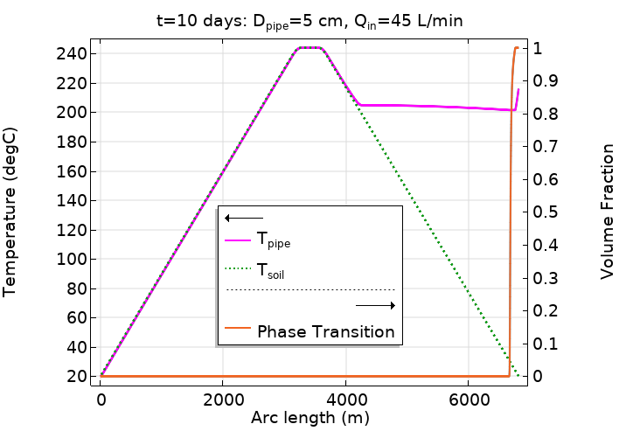
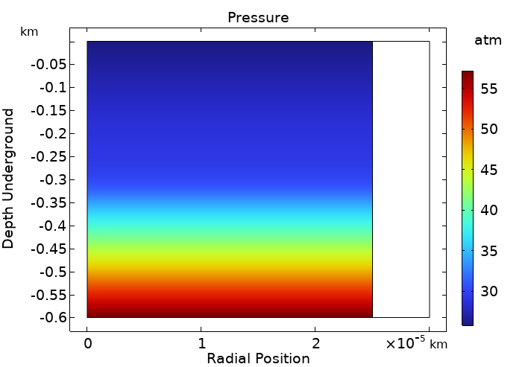
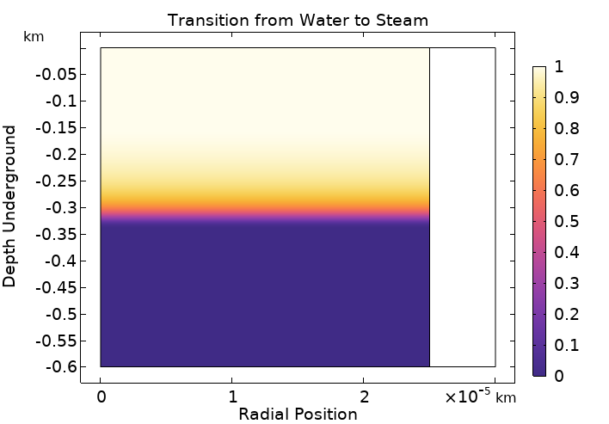

Modeling of Closed Geothermal Systems
This work shows how edges in 3D can be used to model pipe flows, specifically geothermally pipes that go kilometers underground, which can not be done in full 3D. It also takes a small insulated section of the end of the pipe and explores the water-steam transition more closely in 2D.
AltaSim Technologies, LLC
Jessica Rosenberg, Luke Gritter, Josh Thomas, and Kyle Koppenhoefer
Introduction & Goals
Closed loop geothermal systems (CLGS) consist of pipes that go kilometers underground filled with (in this case) cool water. The fluid in the pipe runs first vertically downward as a liquid, then as the pipe gets deeper it encounters hot rock which heats the pipe and water inside, and as the water comes back up the drop in pressure creates the steam. This hot steam can be used to generate electricity and afterward cools down, and the process begins again. Modeling kilometers of lengths of pipes, with diameters on the scale of centimeters, is impossible in 3D, so we simplify this by using 1D edges in 3D space. This doesn’t allow us to look as closely at the radial profiles, so to do this we take a very small section of the pipe and create a 2D axisymmetric model. This second model can represent a maximum pipe length of 0.6km. This approach enables the analyst to assess the phase change of water, to water-steam mixture, to steam.
Methodology
A 0.6km section of the 3.2km vertical upward part of a pipe with a diameter of 5cm is modeled explicitly to show the radial profiles. A stationary solution is used, and the pressure is ramped down, so that the system starts entirely filled with water, until it reaches the same pressures seen in the 1D system. The mesh has an aspect ratio of twenty to one to capture this transition (one of the difficulties that came with 2D modeling), making it impossible to run a large section of the pipe. In both versions the mass flow rate is 45L/min but represented in different ways; one as a mass flow and the other as a fully developed flow. The 2D model looks at an insulated part of the pipe, and so the heat transfer coefficient is taken from the results of the 1D model and used in the 2D model to create similar conditions. The water-steam mixture is modeled using material properties that transition from water to steam with a pressure-dependent boiling temperature.
Radial cross section showing the pipe (white) and the pressure inside of the pipe as represented in the 2D axisymmetric model
Results
The pipe needed to reach depths of kilometers to generate the desired heating. Increasing depths produced increased pressure in the pipe elevating the boiling temperature. Because of this higher boiling point, most of these systems only produce steam over a small region near the outlet. In our 2D system, we get a water-steam mixture only at the last 0.35km and finally steam for the last 300m, as can be seen in the Figure at the top of the page where the volume fraction only reaches 1 near the outlet due to the high pressures. Even though the temperature in the pipe reaches above 200°C in the pipe (as can be seen in the figure at the top) there is still no steam. A closer look at the end of the pipe in 2D is seen in the pressure figure above showing high pressures near the end of the pipe (lowering at the very end). We can correlate this well with the phase fraction shown in the figure on the right where the lower pressures correspond to the steam regions.
Radial cross section showing the pipe (white) and the phase fraction of water and steam, inside of the pipe where 0 represents no steam, and 1 represents all steam.
Alagoz, Ekrem, et al. "Overview of Closed–Loop Enhanced Geothermal Systems." International Journal of Earth Sciences Knowledge and Applications 5.1 (2023): 158-164.
Geothermal heat pumps. (n.d.). Energy.gov. https://www.energy.gov/energysaver/geothermal-heat-pumps
Schulz, Sven-Uwe. "Investigations on the improvement of the energy output of a Closed Loop Geothermal System (CLGS)." (2008).
Editor Engineeringtoolbox. (2024, June 28). Water - Heat of Vaporization vs. Temperature. https://www.engineeringtoolbox.com/water-properties-d_1573.html

