Slide 1
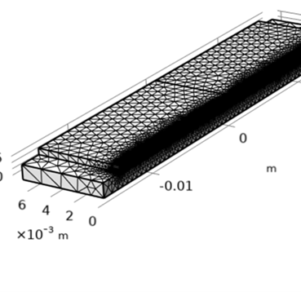
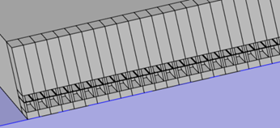
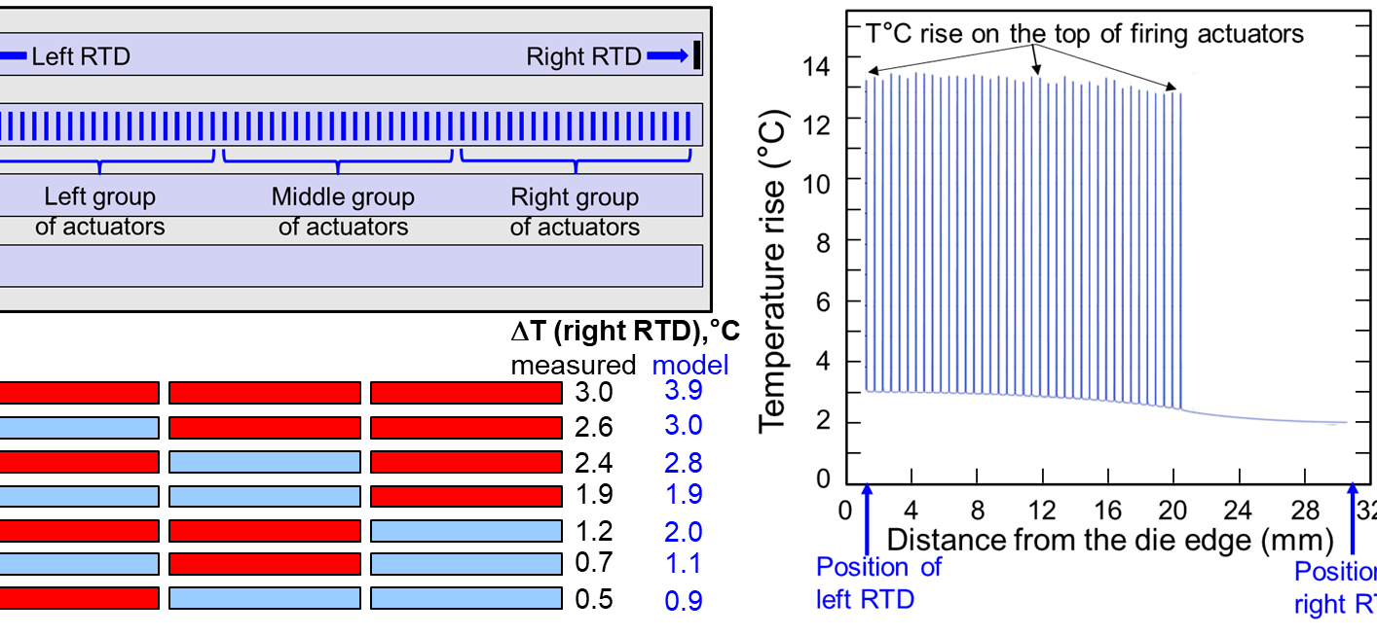

Thermal Modelling of Large Thin Film PZT MEMS Micro-actuator Arrays
Perform thermal modelling of an industrial thin film PZT inkjet MEMS die to predict the local temperature distribution in a large array of micro-actuators.
Mani Sivaramakrishnan
ARNDIT LLC, Portland, OR
Introduction
Thermal modelling of large micro-actuators is challenging due to conflicting requirements. The size of the die consisting of 1420 micro-actuators is large (32 mm x 13 mm x 0.5 mm). Individual actuator size is quite small (55 μm x1 mm x 5 μm). Heat generation takes place at the micro-actuator level. Heat dissipation takes place at the die level. Hence, the modelled geometry must have a good fidelity to both the overall size of the die and the details of the micro-actuators. The meshed geometry is shown at the top of this poster while a zoom-in view of a few actuators is shown in Fig. 1.
The die is made up of four rows of actuators. Only one row is used in the experiment. Each row is divided into three groups, each consisting of twenty actuators. Each group can be actuated alone or in combination with the other groups. The die has built-in temperature sensors at the ends of each row enabling a comparison between the measured and modelled temperatures. A schematic illustration of the different groups of actuators is shown in Fig. 2. The die was mounted on a polycarbonate substrate for well defined thermal boundary conditions.
Methodology
We start building the model with a single device with accurate dimensions and then use the array forming techniques in COMSOL geometry tools to build the entire row with a high fidelity. This not only simplifies the construction of the overall geometry with full details of the micro-actuators, but also makes the meshing easier. To keep the overall mesh size within manageable limits, only the actuated row is represented with full details of the individual actuators while treating the other rows simply as silicon. Heat generation rate was obtained from a measurement of P-E hysteresis loops. Heat conduction through the substrate and convection from the exposed die surfaces are included as heat dissipation mechanisms in the model. The predicted temperature rise from modelling is compared with the actual measurements.
Figure 1. Zoom-in view of a select number of micro-actuators
Results
Seven different firing schemes (‘a’ through ‘g’) involving different combinations of groups of actuators are utilized, as illustrated schematically in Fig. 2. The red bars represent the actuated groups while the unactuated groups are shown in blue. A comparison of the measured and the modeled temperature rise of the die for different schemes is also shown. The modeled temperature distribution at the micro-actuator level for one of the firing schemes is also shown in Fig. 2. It is seen that the individual actuators are about 10º C hotter than the average temperature of the die. The modeling also shows that the majority (about 85 percent) of the heat removal takes place by conduction through the substrate and the remaining (15 percent) by convection from the die surfaces exposed to the ambient.
Figure 2. Top left: Schematic diagram of the die illustrating different groups of actuators; Bottom left: Measured and modelled temperature rise for different actuation schemes; Right: Modelled temperature rise at the micro-actuator level for the 3rd firing scheme from the bottom.
1. C. Fragkiadakis et al., “Heat generation in PZT MEMS Actuator Arrays”, Appl. Phys. Lett., vol. 121, 162906 (2022).

