Slide 1
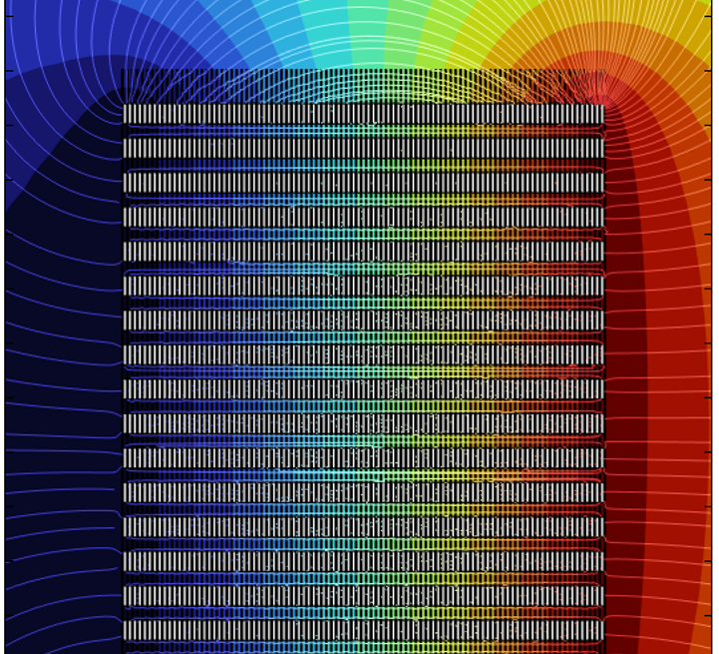
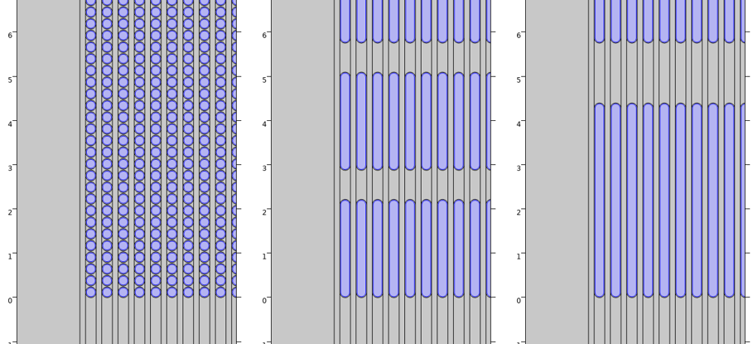
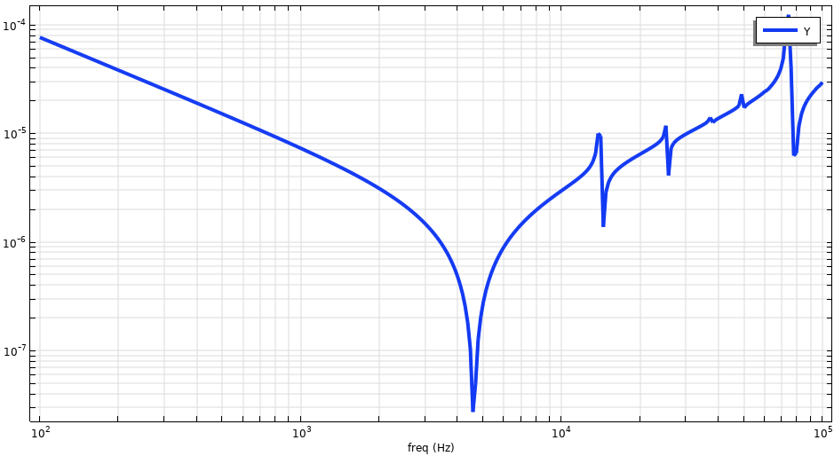
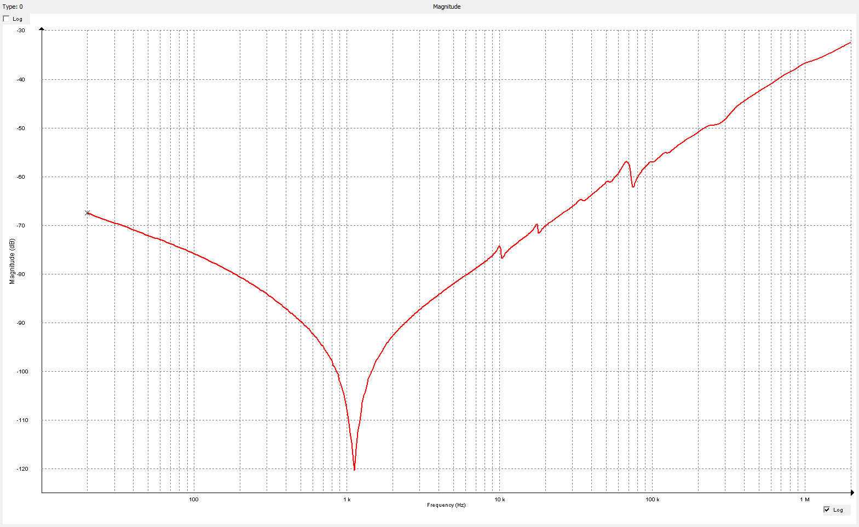
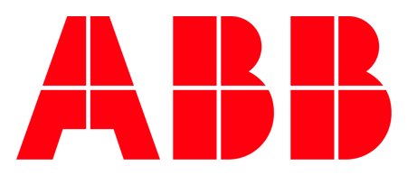
Sweep Frequency Response Analysis of VT for Medium Voltage Applications
A computational approach to characterize the impedance of VT as a function of frequency in the medium voltage distribution networks and evaluate a potential risk of higher harmonics.
V. Siddharth1, D. Raschka1, Wojciech Piasecki2, Maciej Kuniewski3, Paweł Mikrut3
1. ABB Inc. Instrument Transformers & Distribution Components, Pinetops, NC
2. ABB Corporate Technology Center, Krakow, Poland
3. AGH University of Krakow, Poland
Introduction & Goals
SFRA signatures are unique to VT and are used to identify problems that may occure during testing or operation. While SFRA has been primarily used to check the integrity of mechanical structures and electrical connections, it also provides valuable information about resonance frequencies of voltage transformer.
The goal is to evaluate the SFRA characteristics of voltage transformers during design stage and predict the risk of harmonic-induced failure. By comparing and fine tuning these simulations with real-world SFRA measurements, we can better understand the VT's behavior and identify potential weaknesses.
Methodology
A significant challenge in modeling of voltage transformer windings arises from the vast difference in scale between individual wires and the complete winding geometry. To reduce the model size while maintaining accuracy, the model utilizes the grouping of turns. This approach allows for efficient simulation of high-frequency behavior up to 100 kHz. The model automates the creation of simplified 2D models based on key design parameters. By specifying the number of turn groups per layer, we can balance model size and resonance prediction. For the analyzed winding, clustering of 10-20 turns per group was sufficient for frequency response and identifying the resonance frequencies within the desired frequency range.
Figure 1. Simulation models with different grouping: Left-full model; Center-20 groups per layer; Right- 10 groups per layer
Results
The winding admittance is estimated for the specified frequency range and plotted on a logarithmic scale in Figure 2, Left. As the frequency increases beyond the first resonance, the winding admittance rises due to its increasing capacitive character. Local resonances are observed at certain higher frequencies. The simulated SFRA plot was compared with measured responses (Figure 2, Right) and found to be similar. The second and subsequent resonant frequencies were less pronounced in measurements, likely due to simplified geometry, grouping of conductors, and neglecting the non-ohmic losses.
Identifying these internal resonances and their corresponding frequencies is crucial during the design phase of VTs.
Figure 2. Frequency response characteristic of winding admittance of voltage transformer: Left-Simulated, Right-Measurement
M. Popov, L. Van Der Sluis, G. Paap and H. De Herdt, "Computation of very fast transient overvoltages in transformer windings," IEEE Trans. Power Deliv., vol. 18, no. 4, p. 1268–1274, 2003
J. Smajic, T. Steinmetz, M. Rüegg, Z. Tanasic, R. Obrist, J. Tepper, B. Weber and Carlen, "Simulation and measurement of lightning-impulse voltage distributions over transformer windings," IEEE Trans. Magn., vol. 50, no. 2, 2014
M. Popov, L. van der Sluis, R. Smeets, J. Lopez-Roldan and V. Terzija, "Modelling, simulation and measurement of fast transients in transformer windings with consideration of frequency-dependent losses," IET Electr. Power Appl., vol. 1, p. 29–35, 2006
T. Župan, B. Trkulja, R. Obrist, T. Franz, B. Cranganu-Cretu and J. Smajic, "TransformerWindings’ RLC Parameters Calculation and Lightning Impulse Voltage Distribution Simulation," IEEE Trans. Magn., vol. 52, no. 2, 2016.
J. Furgał, M. Kuniewski and P. Pająk, "Analysis of Internal Overvoltages in TransformerWindings during Transients in Electrical Networks," Energies, vol. 13, no. 10, p. 2644, 2020.
B. Trkulja, A. Drandi´c and V. Ž. I. Milardi´c, "Evaluation of Methodology for Lightning Impulse Voltage Distribution over High-VoltageWindings of Inductive Voltage Transformers," Energies, vol. 14, no. 5144, 2021.

