Slide 1
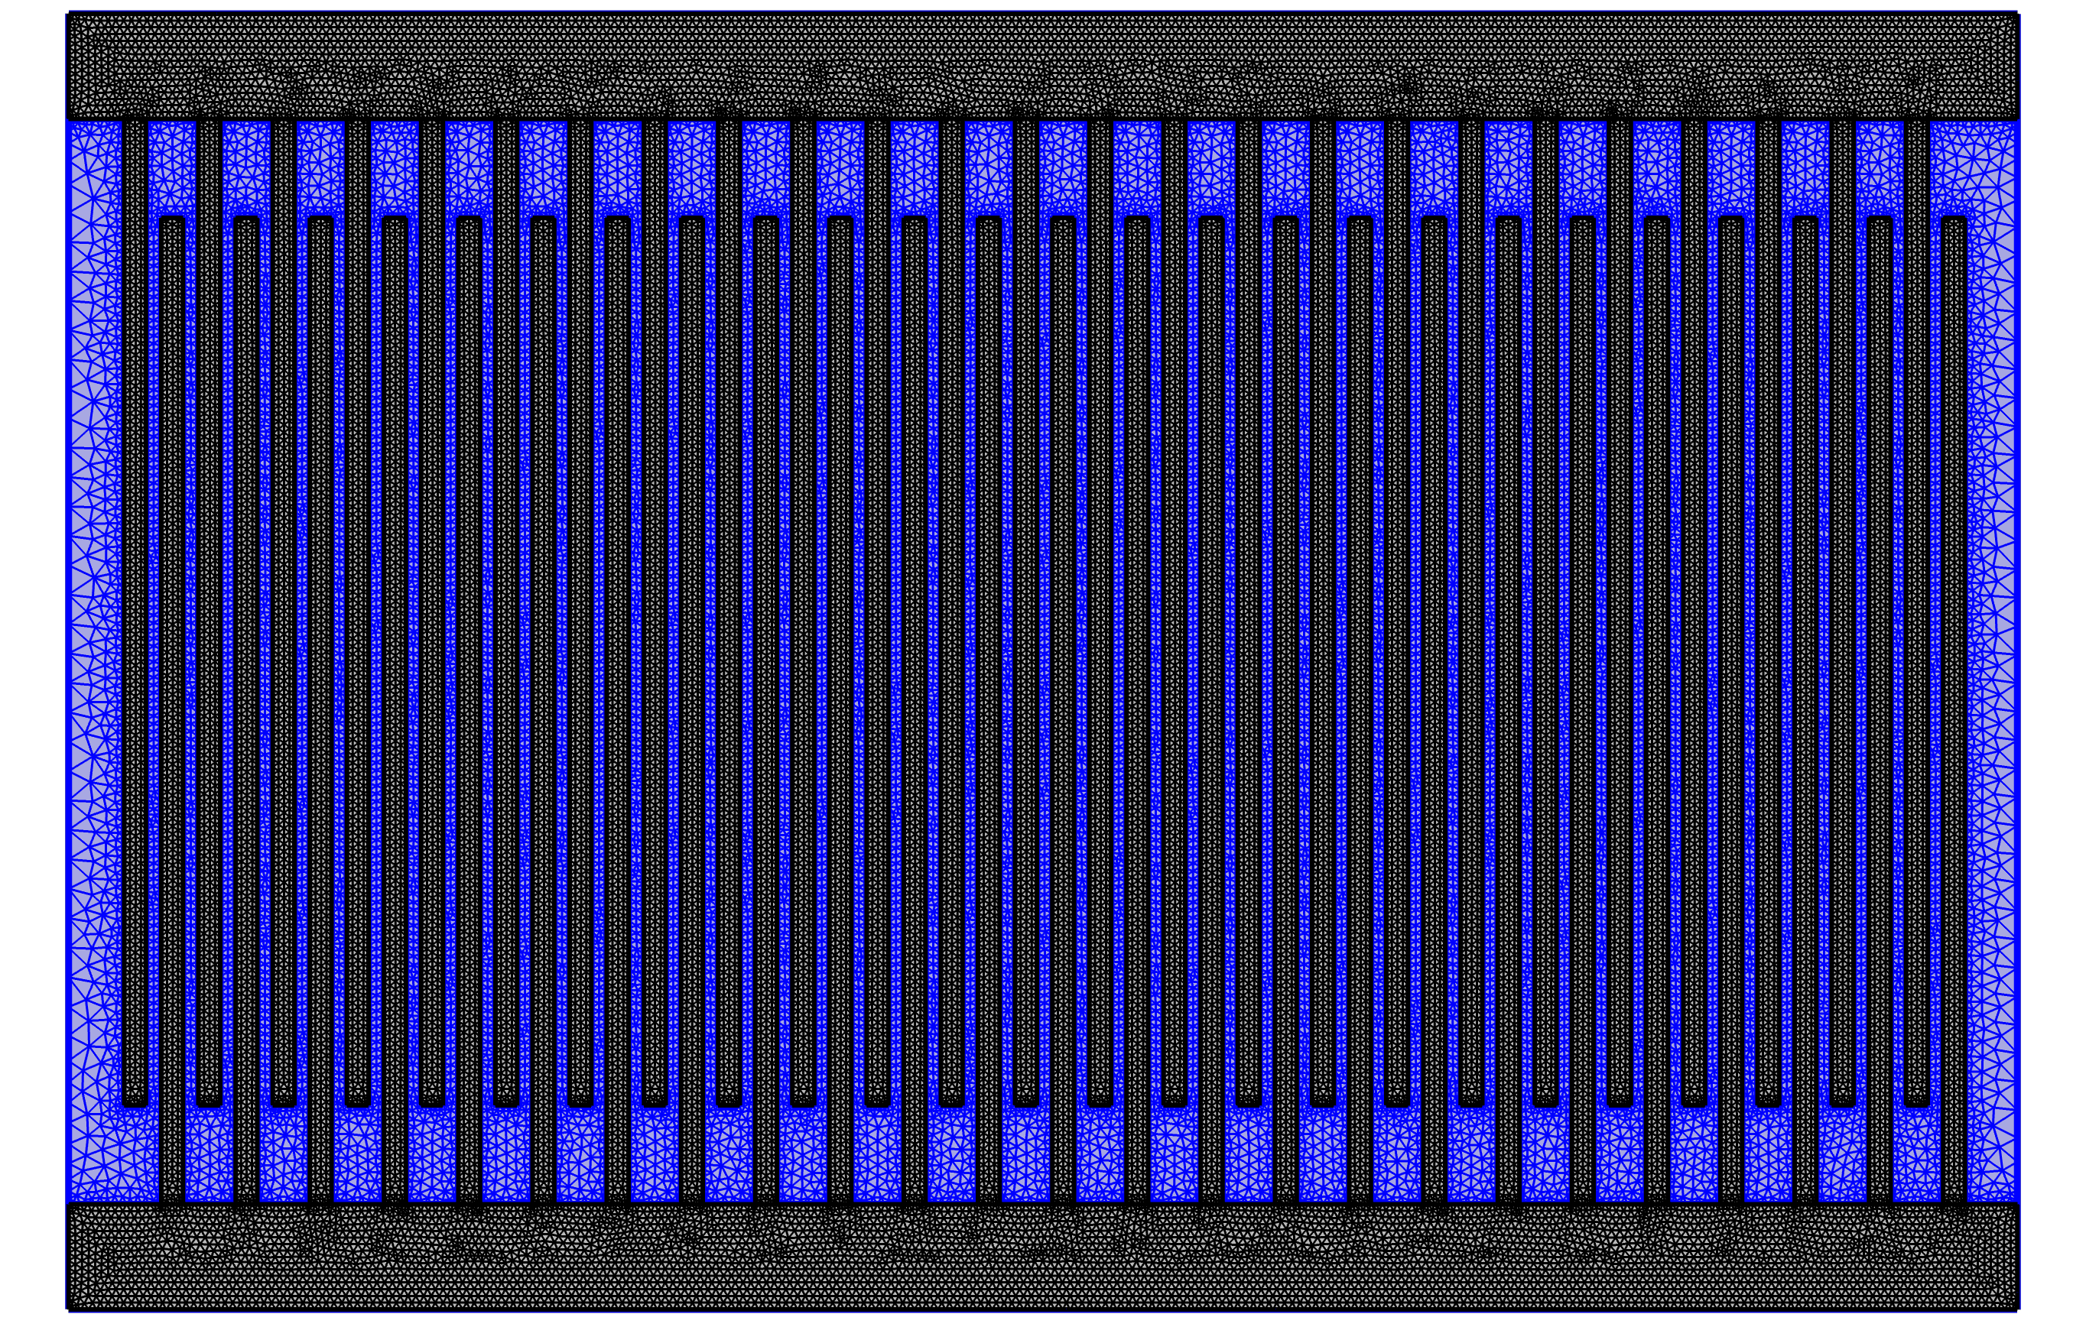

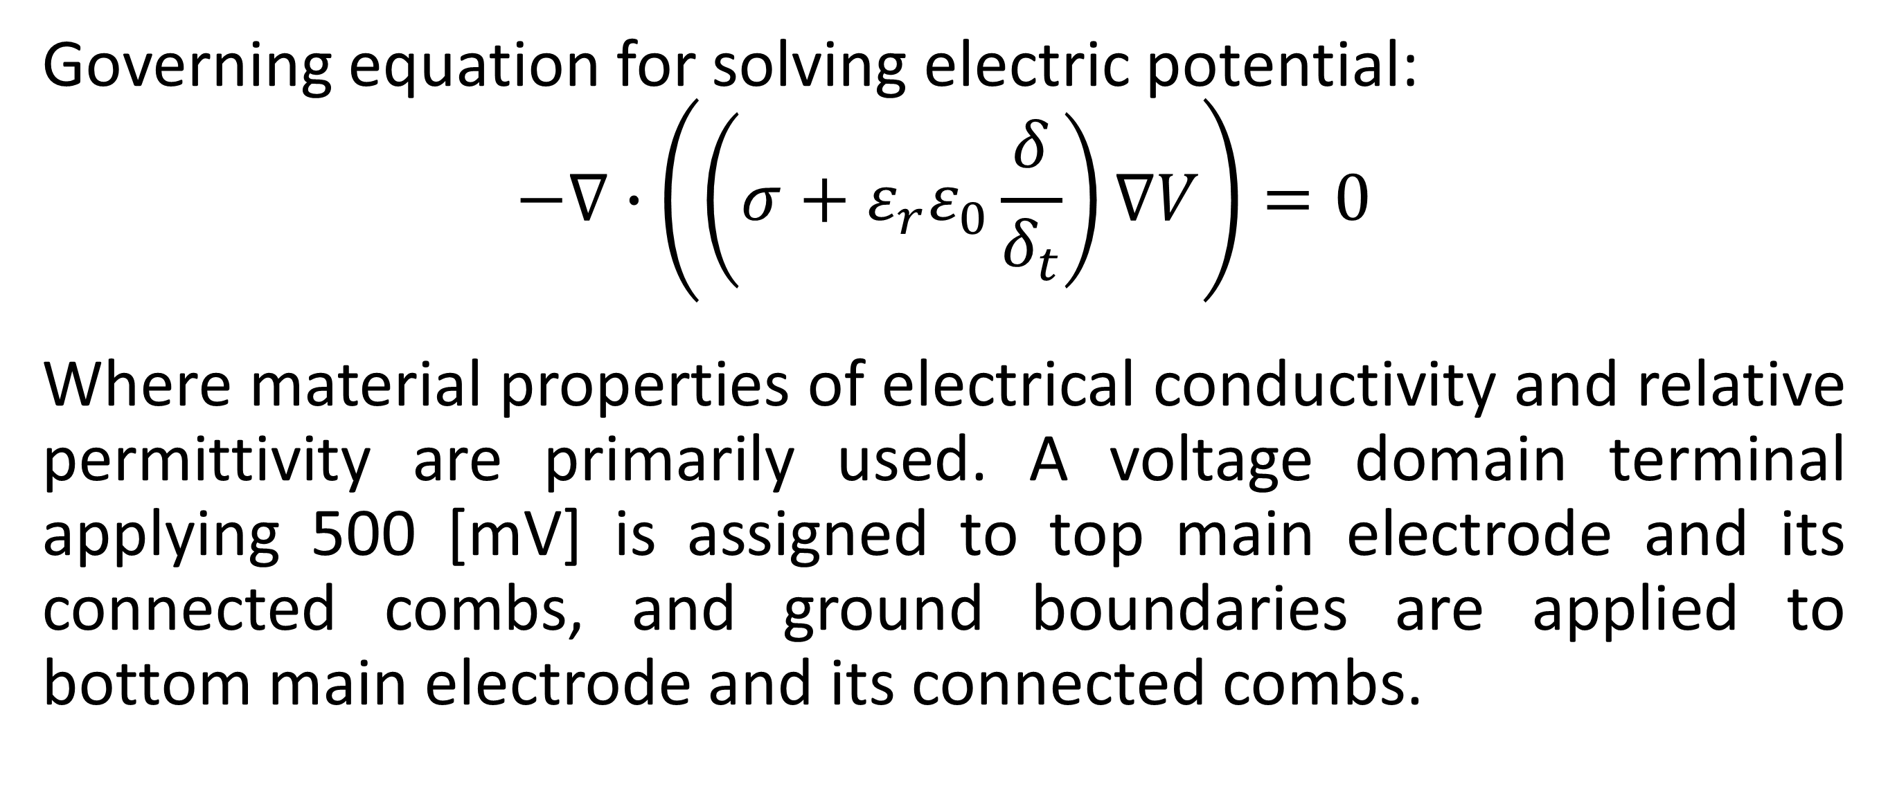
Simulating Ideal and Experimental Impedance Response of Interdigitated Printed Circuit Boards
Reverse solving for unknown material properties of experimental samples by use of simulations to better understand the trends in impedance response found under varying environmental conditions.
R. Titus¹, R. Gerhardt¹, J. Fowler²
1. School of Materials Science and Engineering, Georgia Institute of Technology, Atlanta, GA, USA.
2. Materials Characterization and Performance, Sandia National Laboratory, Albuquerque, NM, USA.
Introduction
The objective of this study is to create a model that matches experimental results of interdigitated circuit boards of unknown material composition. Inferences are made using the impedance responses measured in the lab to predict and adjust towards accurate model parameters. The experimental samples were fabricated using copper leads printed on FR4 boards then insulated over the entire circuit using solder mask. Modifications made to built-in material properties highlight differences between the material composition of experimental samples and ideal samples. Lack of incongruencies in ideal response within simulations highlight defects that may have formed during fabrication or processing of the experimental samples. By analyzing the theoretical and ideal samples predictions for future printed circuit board (PCBs) will rise in accuracy.
Methodology
Governing equation for solving electric potential:
$$−∇∙\left(\left(σ+ε_{r}ε_{0}\frac{δ}{δ_{t}}\right)∇V\right)=0$$
Where material properties of electrical conductivity and relative permittivity are primarily used. A voltage domain terminal applying 500 [mV] is assigned to top main electrode and its connected combs, and ground boundaries are applied to bottom main electrode and its connected combs.
FIGURE 1. Fine mesh created for interdigitated combs, where FR4 material is highlighted in blue.
Results
Frequency response broken down to low-, mid-, and high-frequency regions indicate variations in which experimental data matches more with the unmodified ideal response versus the modified ideal response.
FIGURE 2. Comparison between experimental impedance response, unmodified ideal material response, and modified ideal material response. The top image is real impedance, middle is imaginary impedance, bottom is phase angle (degrees).
1. R. C. Titus, M. R. Rath, R. A. Gerhardt and J. E. Fowler, "Effects of Solder Mask Variability on the Electrical Response of Commercially Manufactured Interdigitated Circuits," IEEE Transactions on Device and Materials Reliability, vol. 24, no. 2, 2024.
2. R. A. Gerhardt, "Impedance Spectroscopy and Mobility Spectra," in Encyclopedia of Condensed Matter Physics, Elsevier Press, 2023.
3. N. Xia, Y. Jin and R. A. Gerhardt, "Simulation of the Electrical Properties of Conductive ITO Thin Films by Finite Element Analysis," in 2018 COMSOL Conference, Boston, 2018.
4. S. Kumar and R. A. Gerhardt, "Numerical Study of the Electrical Properties of Insulating Thin Films Deposited on a Conductive Substrate," in 2009 COMSOL Conference, Boston, 2009.
5. M.-C. Tsai and D.-W. Gu, Robust and Optimal Control: A Two-port Framework Approach, London: Springer, 2014.

