Slide 1
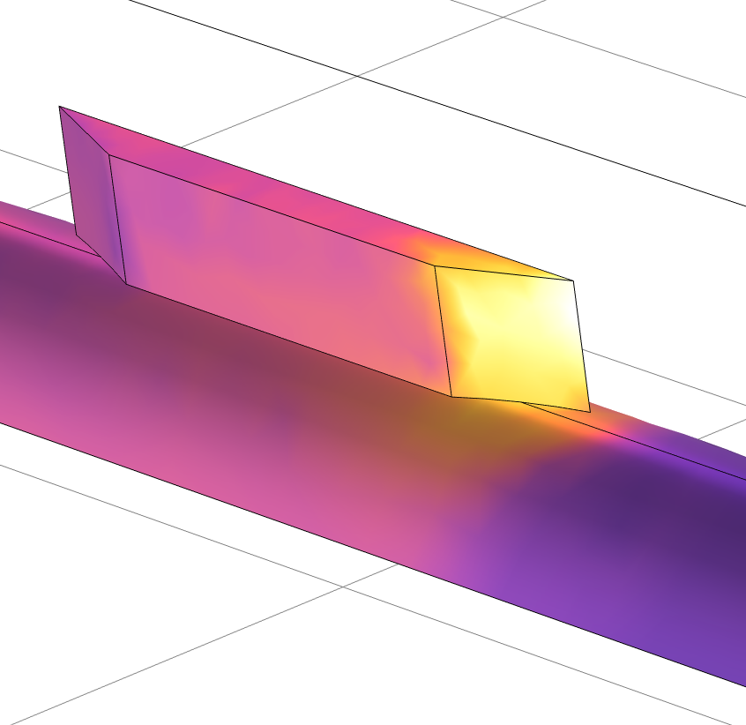
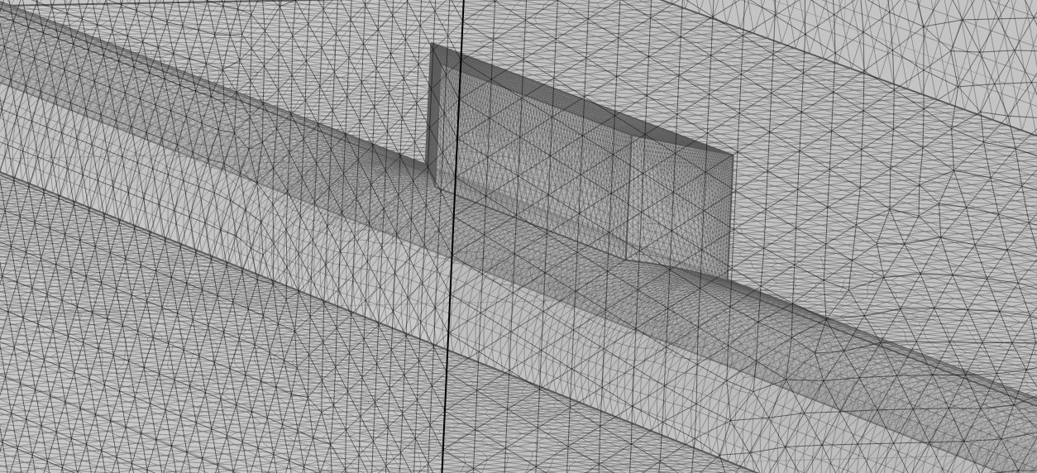
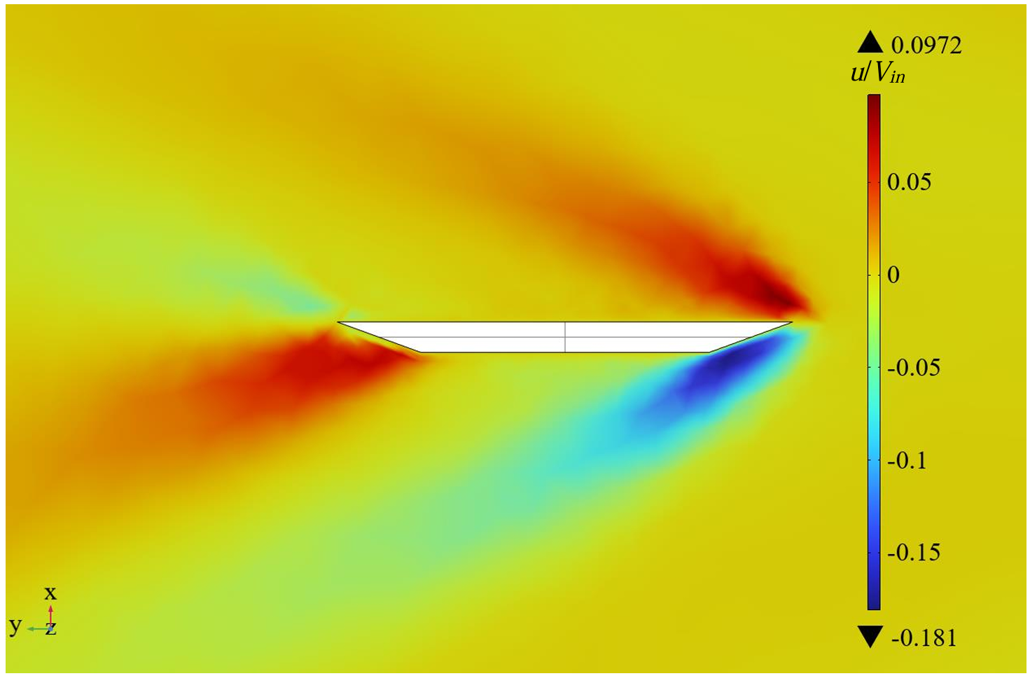

Shock Boundary Interactions Generated by the Fin on a Semi-cylindrical Body
This study investigates the shock boundary layer interaction occurring at the base of a double sharp fin. The flow field is characterized via numerical simulations and identifications of vortices in the flow field are made.
Jiawei Sun¹
1. Department of Mechanical and Aerospace Engineering, Tandon School of Engineering, New York University, Brooklyn, NY, USA.
Abstract
The base geometry is of particular interest, with comparisons made between flat and semi-cylindrical bases. There have been many studies on the shock boundary layer interaction generated by fins located on flat surfaces, but relatively few on fins located on semi-cylindrical surfaces.
When supersonic flow past a fin, the fluid in the contact region between the fin’s root and the semi-cylinder exhibits turbulent phenomena, and the angle between the shock wave and the fin will decrease continuously as the Mach number increases. The separation shock will continuously move towards the fin root, and the vortex generated by the fin will reduce the speed of the fluid passing over the surface of the fin. After comparing separation vortices generated by plate-based fins and semi-cylinder fins, vortices generated by both the downwind fin and upwind fin rotate in the same direction in the semi-cylinder fin model, but separation vortices will change direction in downwind plate-based fin model.
Methodology
This research built two 3D models of fin on the flat plate and fin on the semi cylinder, and then changed the air flow velocity at the inlet from 0.5 Mach to 3 Mach. Finally, conclusions are drawn through analysis of fluid flow velocity and pressure.
Governor equations includes Navier–Stokes equations:
Continuity equation: ∂ρ/∂t+∇∙(ρV)=0
Momentum equation: ∂/∂t (ρV)+∇∙(ρV⊗V)=-∇p+∇τ
Energy equation: ρ[∂y/∂x+∇∙(hV)]=-Dp/Dt+∇∙(k∇T)+Φ
General transport equations:
where V is the fluid velocity vector. τ is the viscous stress. h is the enthalpy. k is the thermal conductivity of the fluid. Φ is the viscous dissipation.
Figure 1: Mesh of the fin and semi-cylinder base. Orientation from the upwind to downwind.
Conclusions
1, When the supersonic fluid passes over the fin on semi-cylinder, it will inevitably generate a vortex between the root of the fin and its base, and this vortex can reduce the speed of the surface fluid passing over the fin in a certain area.
2, Whether it is a downwind or an upwind fin on semi-cylinder, the direction of vortex rotation generated by it is consistent: falling near the fin and rising far away the fin. When the fin is located on a plate, the rotation direction of separation vortices near the downwind fin reverses.
3, The shock wave generated by the fin shock boundary interaction will be changed in accordance with the change of the fin’s base.
4, The Strouhal number and Reynolds number of the vortex generated by the supersonic fluid passing over the fin are not a simple linear relationship.
Figure 2: Transverse velocity contour surface on the horizontal slice at the root of the fin (fin on cylinder) (M_{in} = 2.7).
[1] Pickles, J. D., & Narayanaswamy, V. (2020). Control of Fin Shock Induced Flow Separation Using Vortex Generators. AIAA Journal, 58(11), 4794–4806. https://doi.org/10.2514/1.J059624.
[2] McCormick, D. C. (1993). Shock/boundary-layer interaction control with vortex generators and passive cavity. AIAA Journal, 31(1), 91–96. https://doi.org/10.2514/3.11323.
[3] Gaitonde, D. V., & Adler, M. C. (2023). Dynamics of Three-Dimensional Shock-Wave/Boundary-Layer Interactions. Annual Review of Fluid Mechanics, 55(1), 291–321. https://doi.org/10.1146/annurev-fluid-120720-022542.
…

