Slide 1
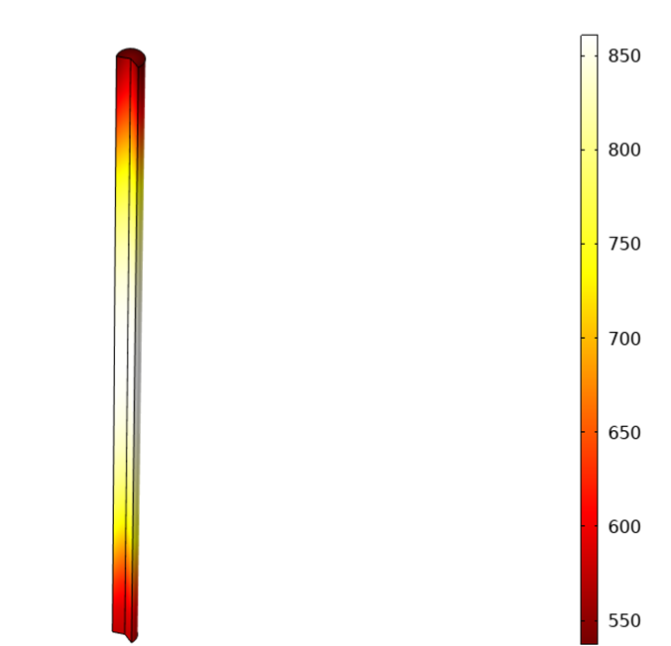
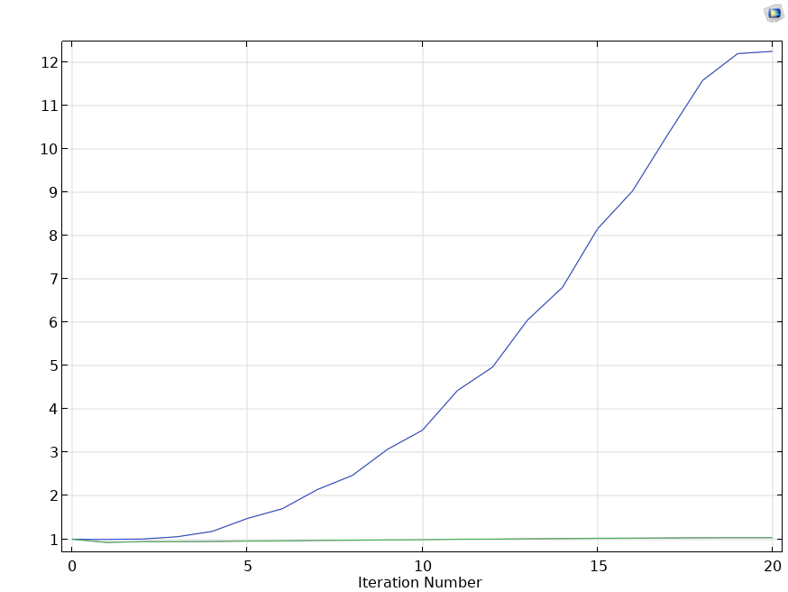
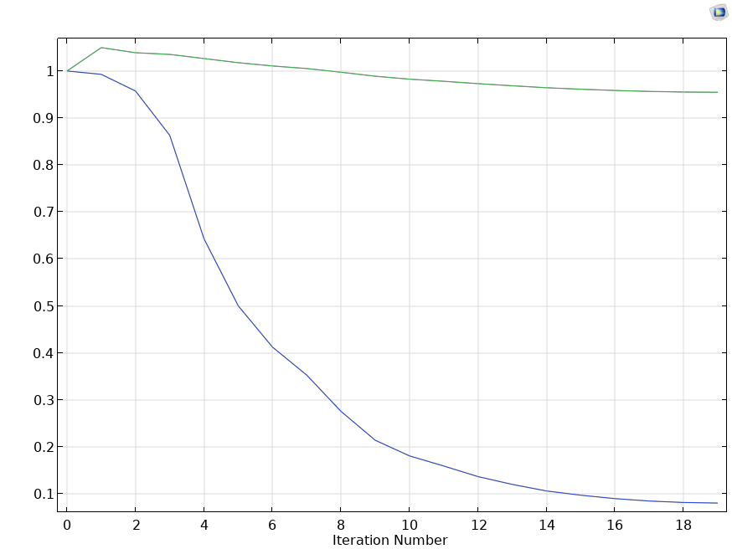

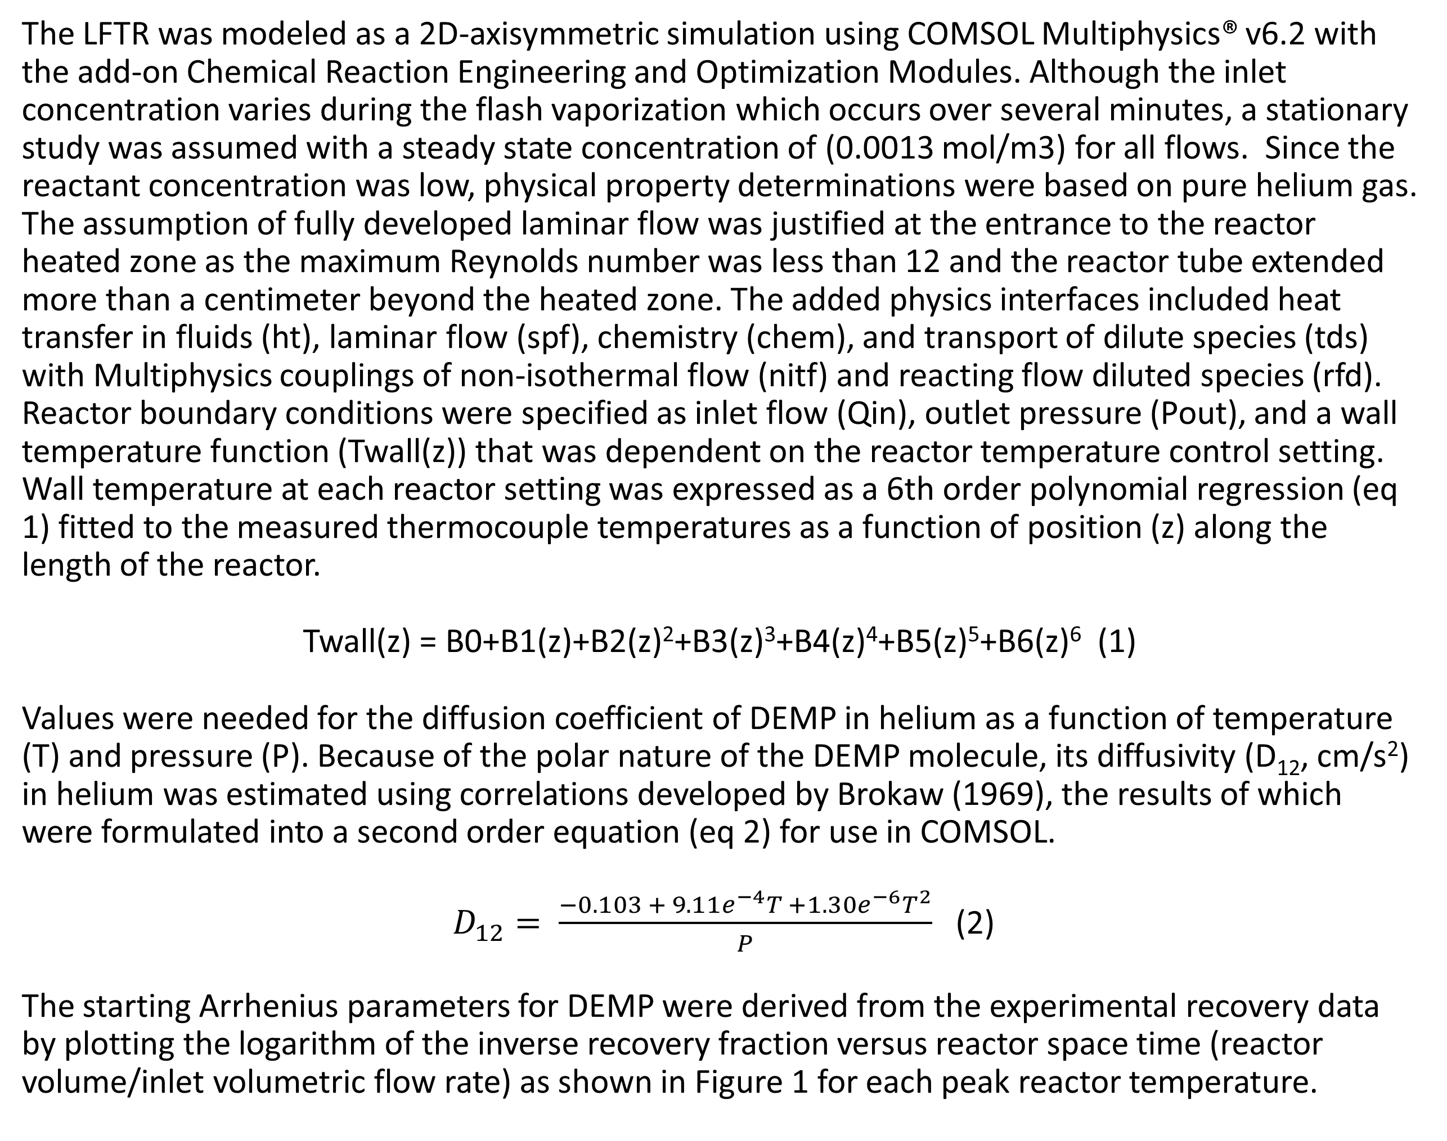
Predicting Arrhenius Parameters for Gas-Phase Decomposition Using a Non-Isothermal Reactor
In this work, a non-isothermal laminar flow tubular reactor is modeled to study decomposition kinetics and determination of Arrhenius parameters for the unimolecular decomposition of the chemical warfare nerve agent simulant diethyl methylphosphonate.
John C. Carpin¹ and Jeffrey M. McGuire²
¹EXCET, Inc., A Precise Systems Company, Edgewood, MD, USA
²U.S. Army DEVCOM Chemical Biological Center, APG, MD, USA
Introduction
A series of decomposition tests were conducted on the chemical warfare agent simulant diethyl methylphosphonate (DEMP) using a commercially available pyrolyzer (CDS Pyroprobe® 5200) with an optional reactor accessory. Ten micrograms of DEMP were flash vaporized from an electric coil into a helium stream at 300℃ and subsequently passed through a small quartz reactor tube (3.5 mm I.D.) with an effective heated length of 12 cm. The reactor exhibited a roughly parabolic temperature profile with peak temperatures controllable from 300 to 800℃ as determined by detailed thermocouple measurements at 2-cm intervals along the length of the reactor. Reactor residence time was adjusted varying the helium flow rate (50 to 400 mL/min nominal). The gaseous effluent from the reactor was collected on a solid sorbent and the recovery fraction (M/M₀) of the starting material (M₀) was quantified by GC-MS. The goal of this effort was to extract the activation energy (E_{a}, kcal/mol) and pre-exponential factor (A,s⁻¹) for the thermal decomposition of DEMP from the experimental recovery data obtained from this non-isothermal reactor with the aid of a reactor simulation developed using COMSOL Multiphysics®.
Methodology
589ºC
k = 12.62 s⁻¹
566ºC
k = 5.92 s⁻¹
E_{a} = 42 kcal/mol
A = 5.1e¹¹ s⁻¹
The LFTR was modeled as a 2D-axisymmetric simulation using COMSOL Multiphysics® v6.2 with the add-on Chemical Reaction Engineering and Optimization Modules. Although the inlet concentration varies during the flash vaporization which occurs over several minutes, a stationary study was assumed with a steady state concentration of (0.0013 mol/m3) for all flows. Since the reactant concentration was low, physical property determinations were based on pure helium gas. The assumption of fully developed laminar flow was justified at the entrance to the reactor heated zone as the maximum Reynolds number was less than 12 and the reactor tube extended more than a centimeter beyond the heated zone. The added physics interfaces included heat transfer in fluids (ht), laminar flow (spf), chemistry (chem), and transport of dilute species (tds) with Multiphysics couplings of non-isothermal flow (nitf) and reacting flow diluted species (rfd). Reactor boundary conditions were specified as inlet flow (Qin), outlet pressure (Pout), and a wall temperature function (Twall(z)) that was dependent on the reactor temperature control setting. Wall temperature at each reactor setting was expressed as a 6th order polynomial regression (eq 1) fitted to the measured thermocouple temperatures as a function of position (z) along the length of the reactor.
Twall(z) = B0+B1(z)+B2(z)²+B3(z)³+B4(z)⁴+B5(z)⁵+B6(z)⁶ (1)
Values were needed for the diffusion coefficient of DEMP in helium as a function of temperature (T) and pressure (P). Because of the polar nature of the DEMP molecule, its diffusivity (D₁₂, cm/s²) in helium was estimated using correlations developed by Brokaw (1969), the results of which were formulated into a second order equation (eq 2) for use in COMSOL.
$D_{12}= \frac{−0.103 + 9.11e^{−4}T +1.30e^{−6}T^{2}}{P}$ (2)
The starting Arrhenius parameters for DEMP were derived from the experimental recovery data by plotting the logarithm of the inverse recovery fraction versus reactor space time (reactor volume/inlet volumetric flow rate) as shown in Figure 1 for each peak reactor temperature.
541ºC
k = 2.33 s⁻¹
515ºC
k = 1.23 s⁻¹
492ºC
k = 0.56 s⁻¹
Figure 1. Initial kinetic (left) and Arrhenius (right) plots of DEMP experimental data.
Results
The general optimization interface was used to find the Arrhenius parameters that minimize the difference between the experimental recovery fractions and those produced by the simulation model using the Levenburg-Marquart least squares algorithm. Experimental input to the optimization solver included a separate line of data for each of 19 test runs containing Qin, Pout, the specified Twall(z) function together with the associated recovery fraction value. The initial Arrhenius parameters derived from Figure 1 were used as scaling factors to normalize both optimization control variables A_factor and Ea_factor to a starting value of 1.0. Figure 2 shows the results from the optimization solver using the starting Arrhenius parameter values derived from the experimental data on the lefthand plot. After 20 iterations, the final scale factors were 12.3 and 1.04 for A_factor and Ea_factor, respectively. To assess the possibility that the resulting factors could represent a local minimum, the optimization process was repeated using arbitrary starting parameters (E_{a} = 46 kcal/mol; A = 1e14 s⁻¹) which were well above the previous starting values. These results are shown in the righthand graph of Figure 2. In this case, the solver delivered the final scale factors of 0.081 and 0.95 for the A_factor and Ea_factor, respectively. The resulting optimized Arrhenius parameters for the decomposition of DEMP are shown in the table below. The numbers shown span the range of both optimization results indicating a high likelihood that the global minimum was achieved.
As a final note, it is encouraging to see that our results are close to published literature values (Glaude, 2000). Even so, our predicted rates constants are a factor or two higher than Glaude’s theoretical values within the range of reactor temperatures tested. While these results are quite good there is much room for improving the current simulation.
A_factor
E_{a}_factor
Source | Arrhenius Parameters |  | Reactor Temperature (°C)
 | E_{a} (kcal/mol) | A (x10¹³ sec⁻¹) | 500 | 550 | 575 | 600
 |  |  | Rate Constant (s⁻¹)
COMSOL | 43.5 - 43.9 | 0.63 - 0.81 | 3.1 | 17.5 - 17.7 | 38.2 - 39.0 | 80.1 - 82.2
Glaude | 45.3 | 1.0 | 1.6 | 9.4 | 21.3 | 45.9
E_{a}_factor
A_factor
Figure 2. Performance of the LM optimization solver (top) with starting Arrhenius parameter values below (left) and above (right) the optimum values.
R.S. Brokaw, “Predicting Transport Properties of Dilute Gases”, Ind. Eng. Chem. Process Des, Dev, 8, 240, 1969.
P.A. Glaude, et.al., “Kinetic Study of the Combustion of Organophosphorus Compounds”, Proceedings of the Combustion Institute, 28, 1749-1756, 2000.

