Slide 1
Potential Fields Modeling to Support Machine Learning Applications in Maritime Environments
J. McKenna¹, J. Karst², J. Luttrell IV¹, R. Riedel¹, S. Kar³, and P. Duff⁴
1. Roger F. Wicker Center for Ocean Enterprise, The University of Southern Mississippi Gulfport, MS, USA
2. CTI, Columbus, OH, USA
3. RENCI, Chapel Hill, NC, USA
4. Naval Research Laboratory, Bay St. Louis, MS, USA
4 October 2024

Slide 2
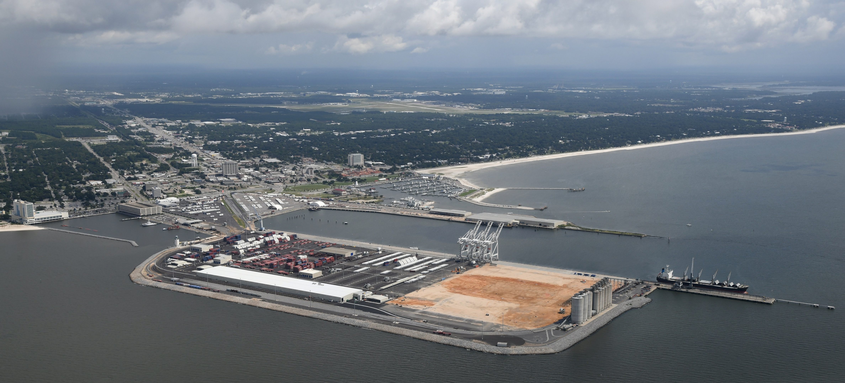
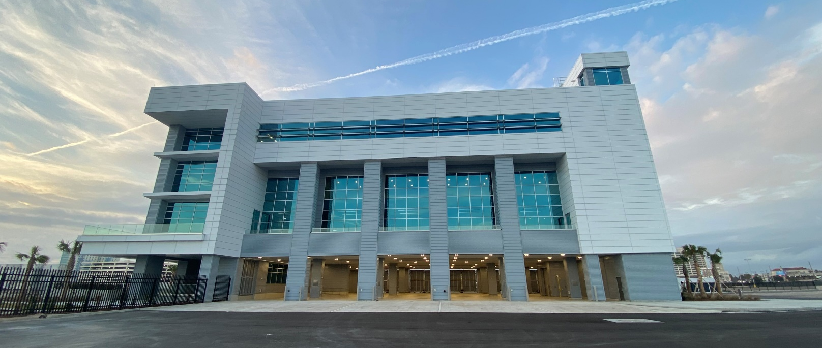
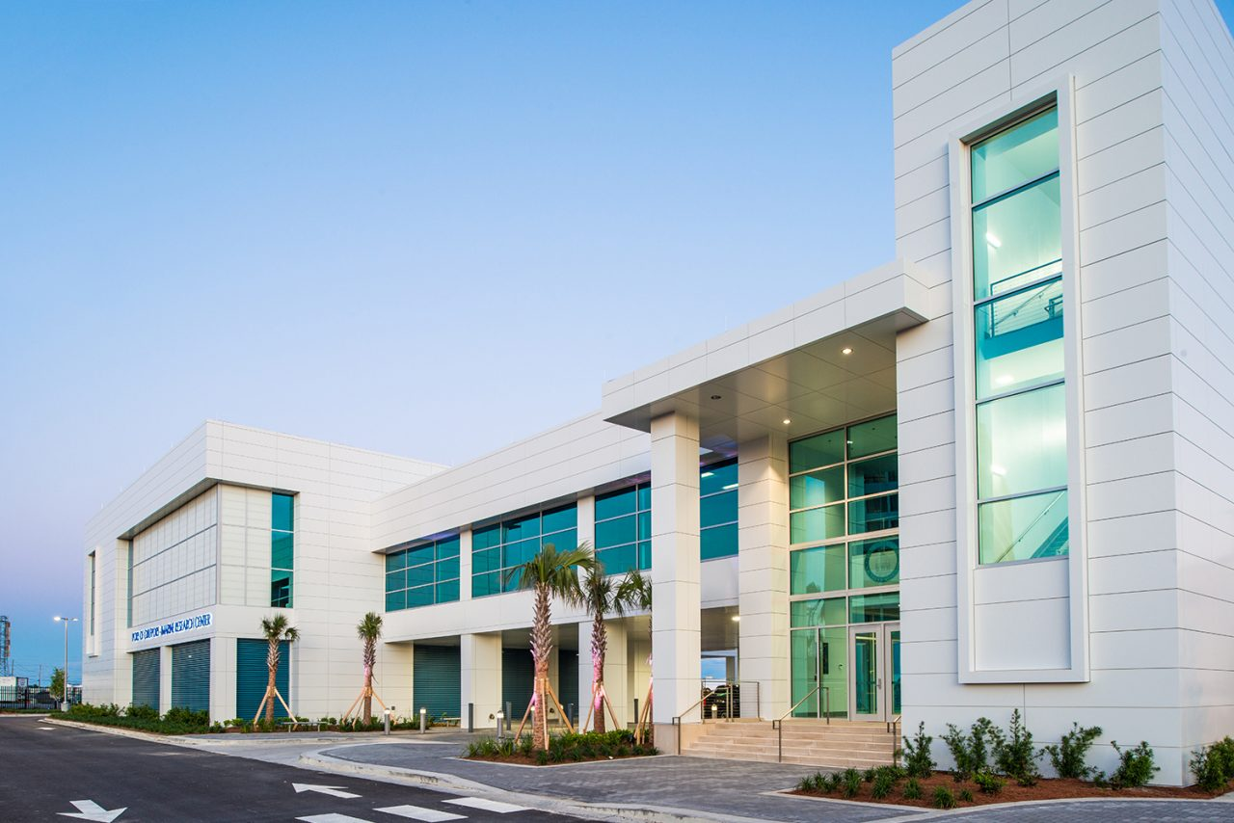
Port of Gulfport, Gulfport MS
The Roger F. Wicker Center for Ocean Enterprise is Located at the Port and is comprised of two buildings on Port property: The Marine Research Center (MRC), and the Roger F. Wicker Ocean Enterprise Facility (Wicker Building or OEF)

Slide 3
Motivation
Unmanned Underwater Vehicles (UUVs) equipped with magnetic sensors are crucial for detecting ferromagnetic objects underwater. Accurate modeling of the magnetic and gravitational field interactions in these environments ensures the effectiveness of detection operations.
Numerical modeling potential fields in maritime settings is important
  UXO
  Archeological Items (e.g. shipwrecks)
  Geological features
Field experiments are complex
Data collection areas are cluttered
Calibrated simulations are ideal to generate quality training data to develop ATRs using AI/ML techniques
Multiphysics modeling can be important (magnetic/gravity/acoustics)

Slide 4
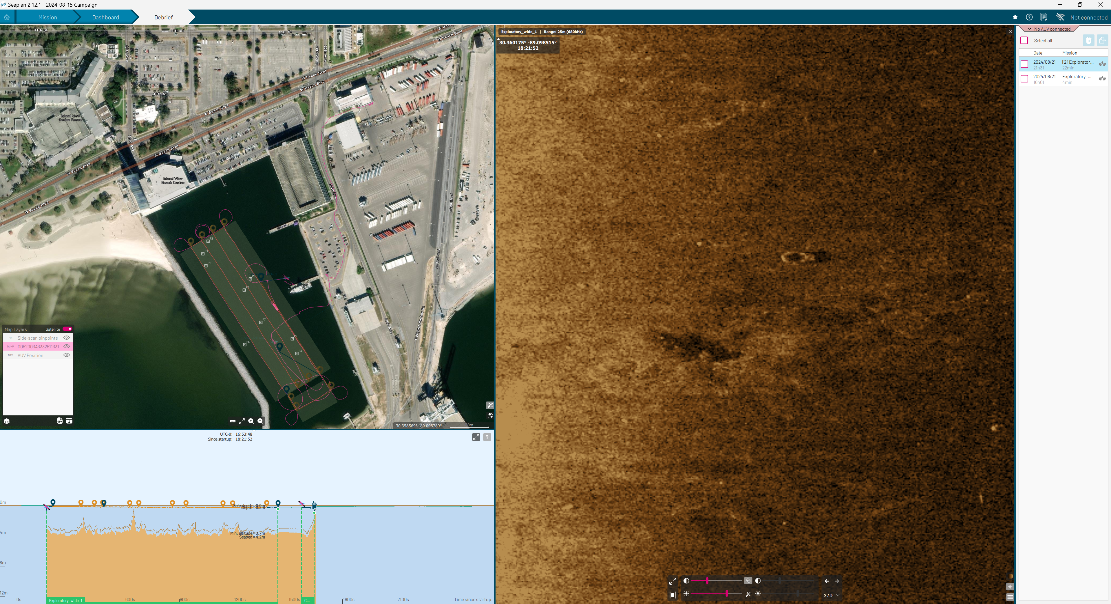
UUV SideScan Testing in Shallow Harbor

Slide 5
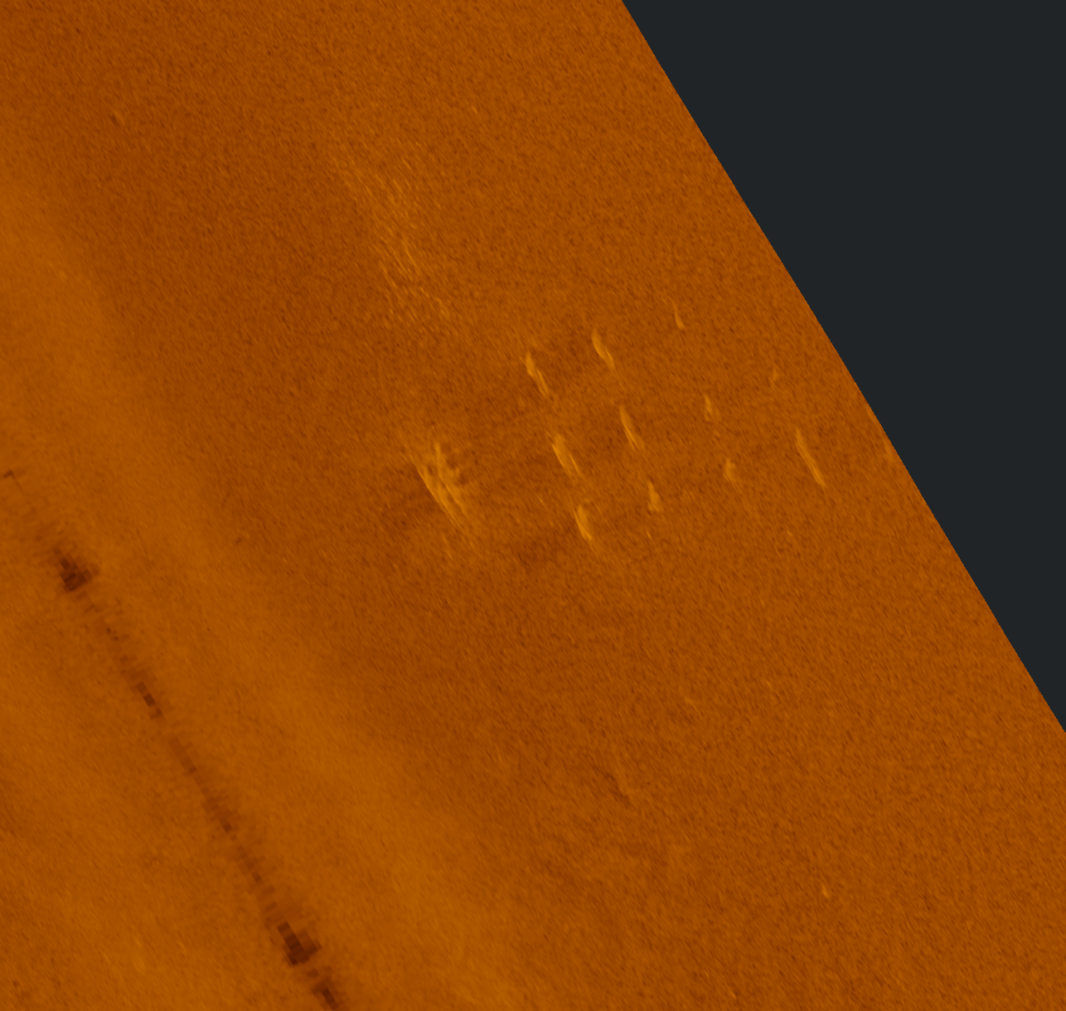
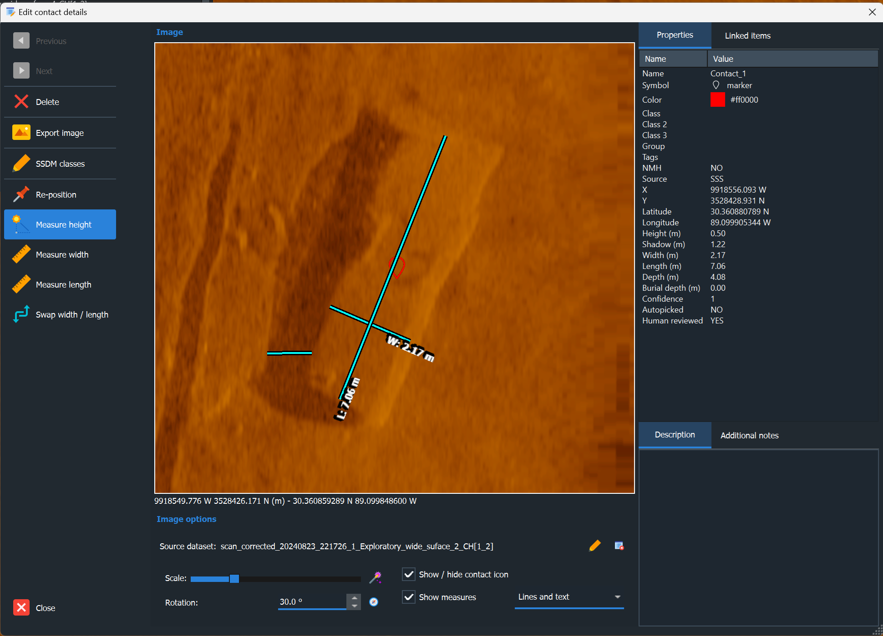
UUV SideScan Testing in Shallow Harbor

Slide 6
Background Theory

Slide 7
First Order Modeling: Earth’s Magnetic Field
Induces the Observed Anomaly
Angles needed to calculate the perpendicular and parallel components of B₀
N
N
Magnetic declination
Pipe azimuth
E
E
Pipe dip
Magnetic inclination
Z
Z

Slide 8
First Order Modeling: Earth’s Magnetic Field
Induces the Observed Anomaly
For assumed relative permeability 2, 5, 50, 100, 200, 500, corresponding susceptibility k would be 1, 4, 99, 199, and 499
For the direction perpendicular to the pipe, the effective susceptibility is given below with N being the self-demag factor (N=1)
Along the pipe length, the self-demag factor is approximately 0
For the first order modeling, we do the following:
  Calculate the pipe volume, and equivalent spherical radius
  Project the inducing field to two components: (1) perpendicular to the pipe and parallel to the pipe
  Obtain the magnetization for both directions:
  Calculate the responses by using a sphere with the above magnetization and equivalent volume of the pipe

Slide 9
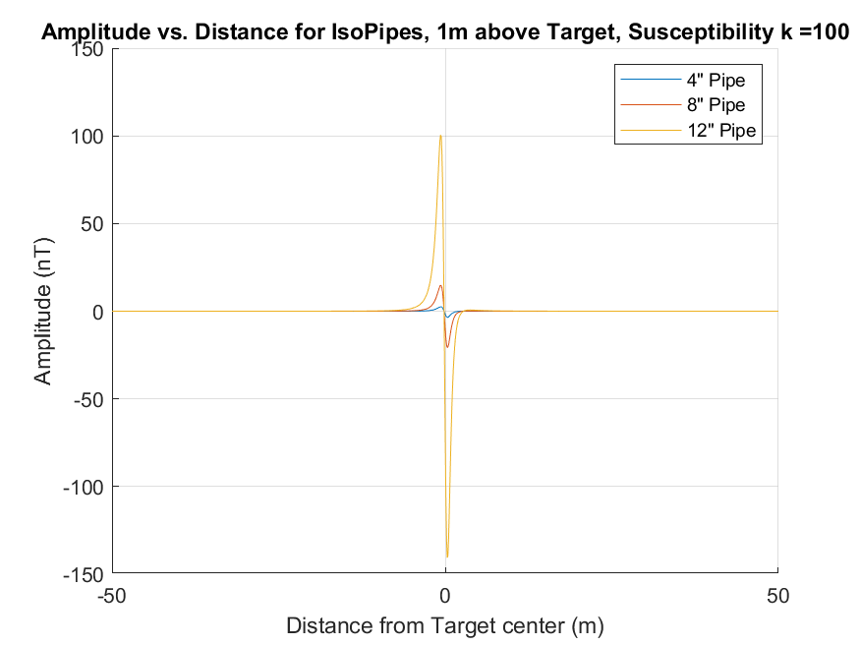
Frist Order Modeling: Earth’s Magnetic Field
Induces the Observed Anomaly
Assumptions: large stand-off distance (~5x target size)
Approximations: dipole representation
Inputs: calculated dipole moment
Outputs: magnetic anomaly

Slide 10
Field Data

Slide 11
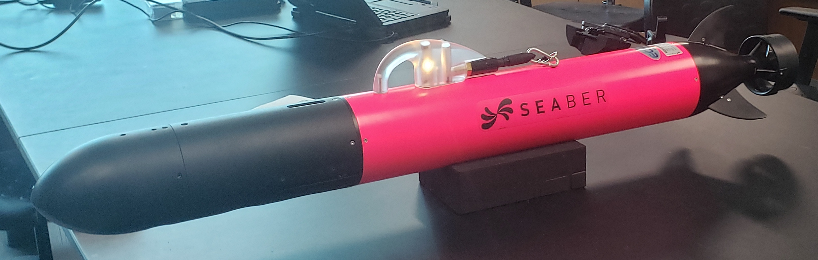
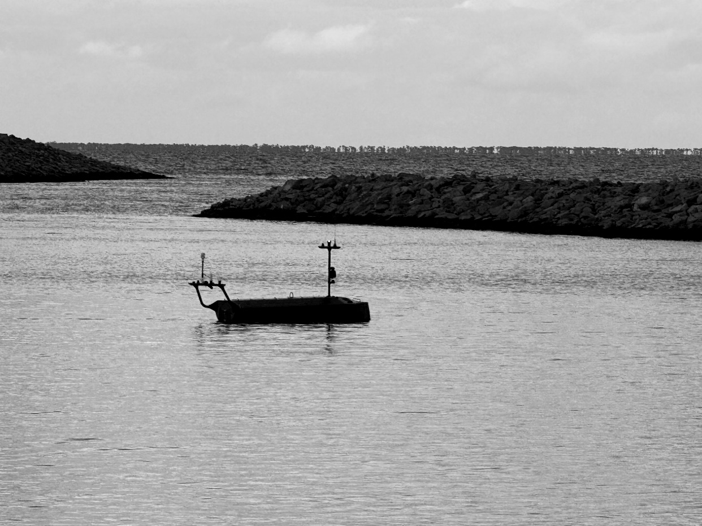
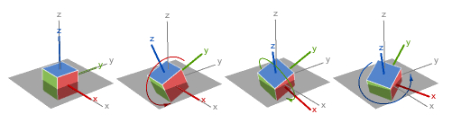
USV/UUV Platforms
Fused Sensor Data
Magnetics
IMU Gyro
(roll, pitch, yaw)
IMU Accel
(x, y, z)
GPS + RTK
IMU Mag
(x, y, z)
IMU

Slide 12
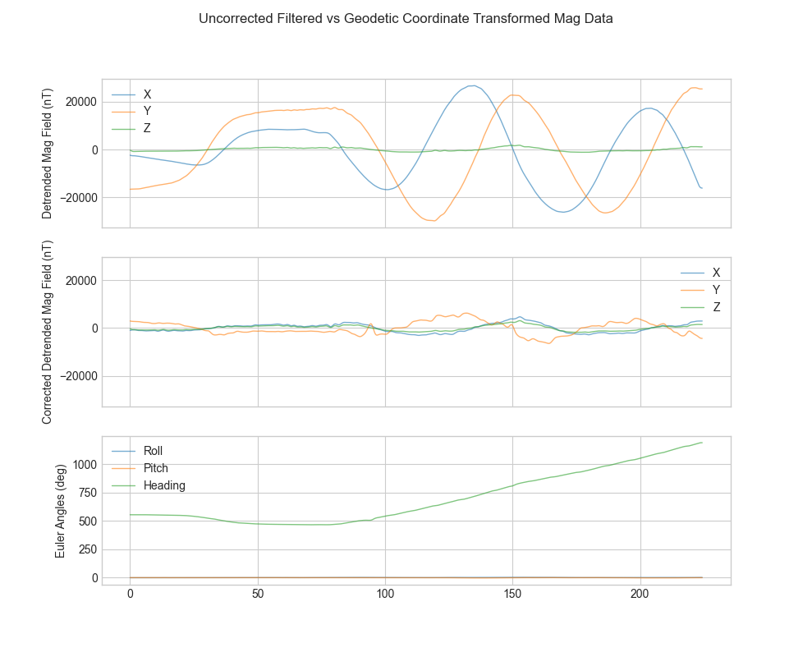
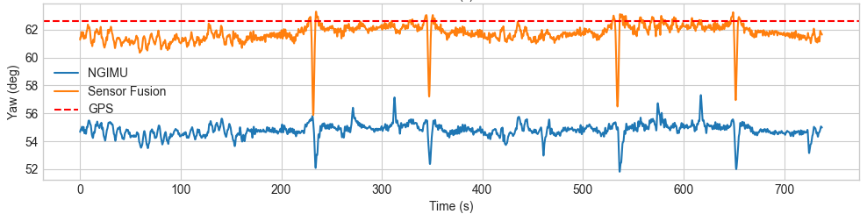
USV Orientation Correction
The uncorrected data in the top subplot has dramatic changes due to the circular course of the vehicle in this test.
After orientation correction, the second subplot shows a dramatically reduced variation in magnetic field due to the background environment. Note that onboard IMU data at a low sample rate was used for these corrections, and a higher quality source of orientation data would reduce these effects even further.
This orientation corrected data is more suitable for analysis to detect small magnetic changes indicative of a target of interest.

Slide 13
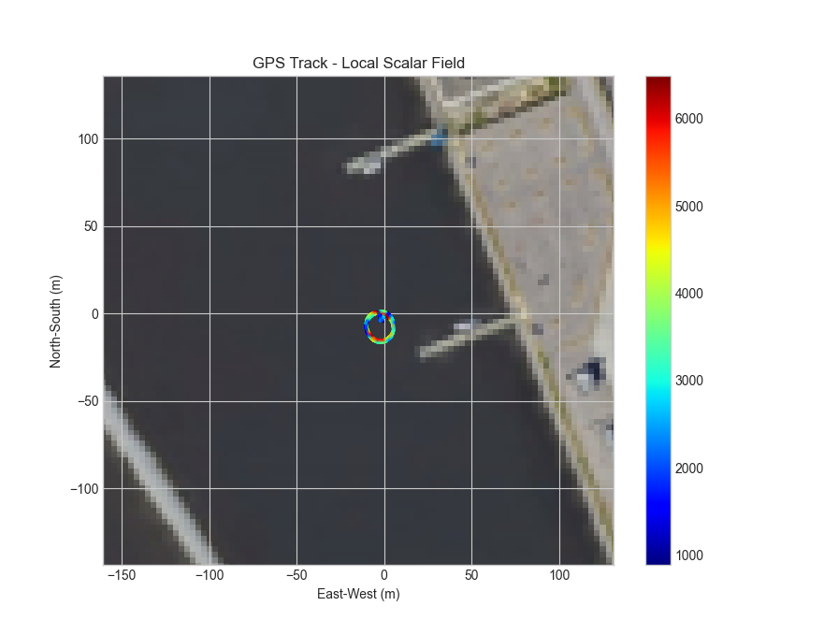
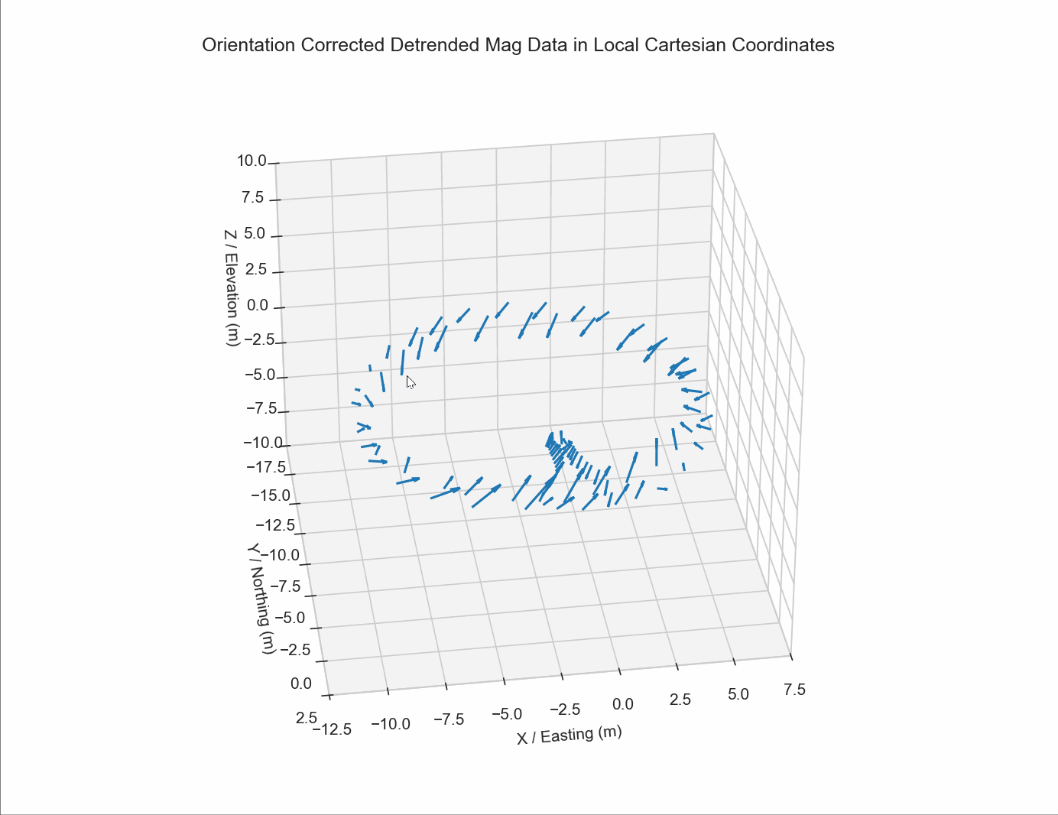
USV Shallow Harbor Data

Slide 14
Magnetic Testing
Pipe Parallel / Orthogonal
Pipe Vertical

Slide 15
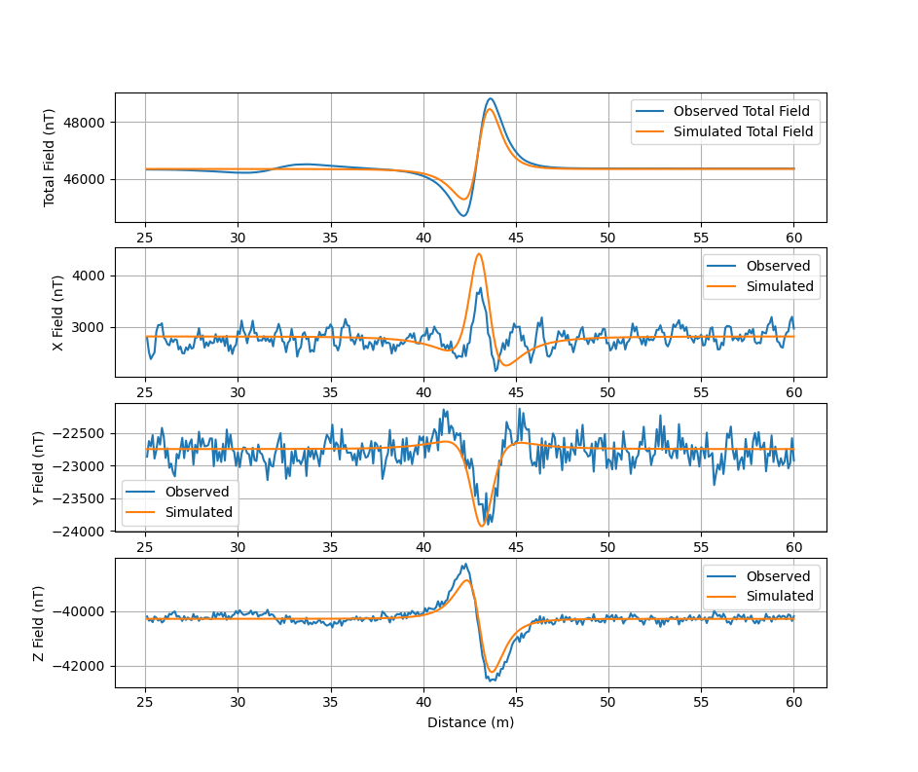
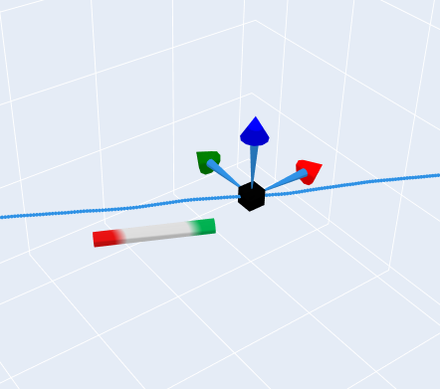
USV: Cylindrical Magnet
The plots at right show the observed vs simulation model results for an 8" long 1" diameter cylindrical magnet.The model uses the GPS path of the test platform, and target properties as input
The sensor array travels along a West-Northwest direction (X is Easting, Y is Northing, Z is Vertical)
The simulation matches the observed data within measurement accuracy for all four test passes for both the total field and vector components.
Z
Y
X

Slide 16
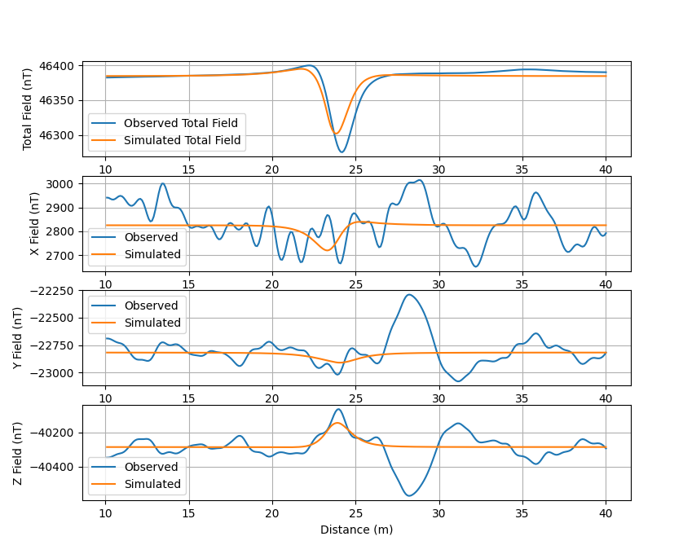
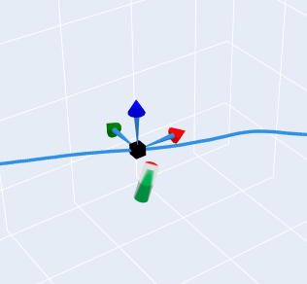
USV: 12" Vertical Pipe
The plots at right show the observed vs simulation model results for a 12" long ~4.5" diameter steel pipe. The model uses the GPS path of the test platform, and target properties as input
The simulation matches the observed data within measurement accuracy for all four test passes for both the total field and vector components. The background noise in this dataset is comparatively higher due to the lower amplitude of the pipe signature vs the magnet.
Z
Y
X

Slide 17
COMSOL Simulations

Slide 18
Parameters
Name | Expression | Value | Description
mur_pipe | 100 | 100 | Relative permeability
H0 | 46353.6[nT] | 4.6354E−5 T | Geomagnetic field
Incl | 58.77291[deg] | 1.0258 rad | Local inclination
Decl | -4.28[deg] | −0.0747 rad | Local declination
xx0 | 12[in] | 0.3048 m | Length of pipe
xx | 24[in] | 0.6096 m | Length of pipe
xxx | 36[in] | 0.9144 m | Length of pipe
pir | 4.026 [in] | 0.10226 m | Inner radius of pipe
por | 4.5[in] | 0.1143 m | Outer radius of pipe

Slide 19
Variables

Slide 20
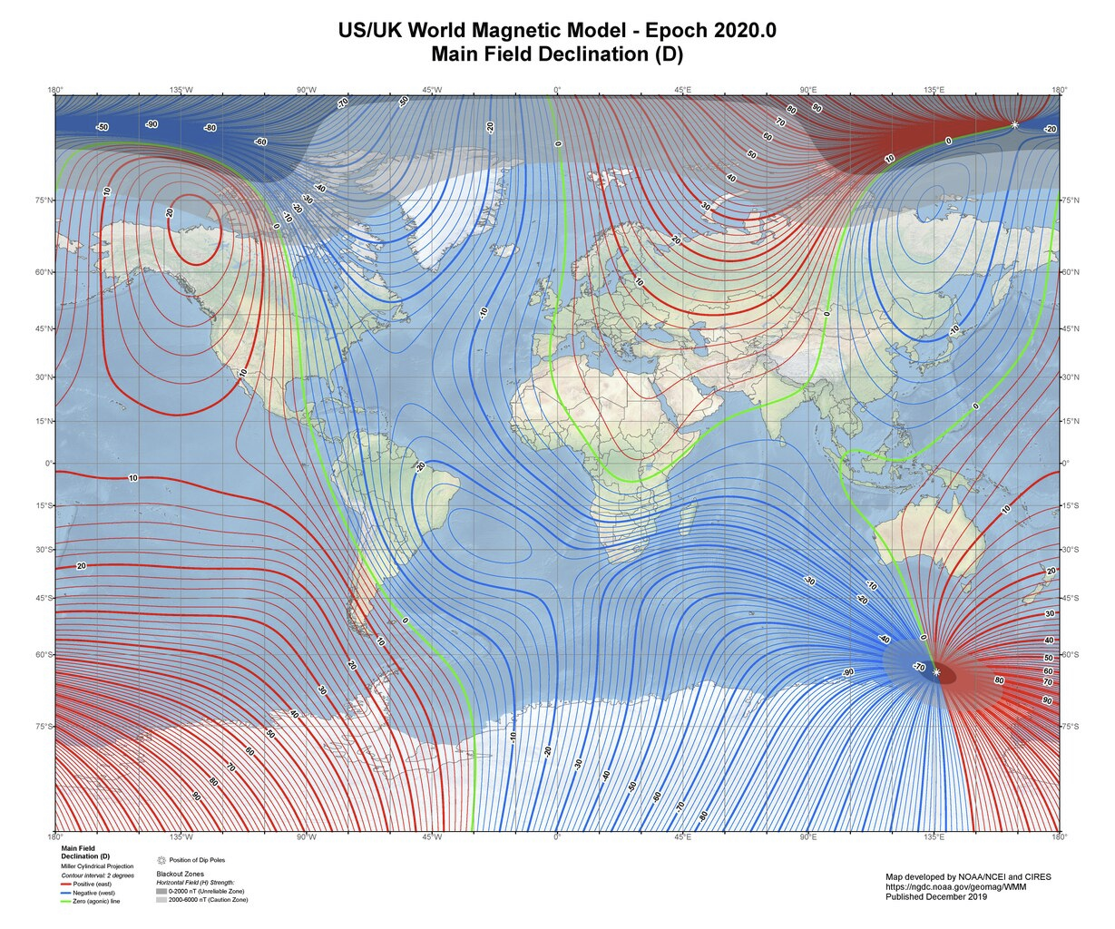
Variables
Name | Expression | Description
Gx | cos(Incl)*sin(Decl) | Geomagnetic field direction, x-component
Gy | cos(Incl)*cos(Decl) | Geomagnetic field direction, y-component
Gz | -sin(Incl) | Geomagnetic field direction, z-component

Slide 21
Component

Slide 22
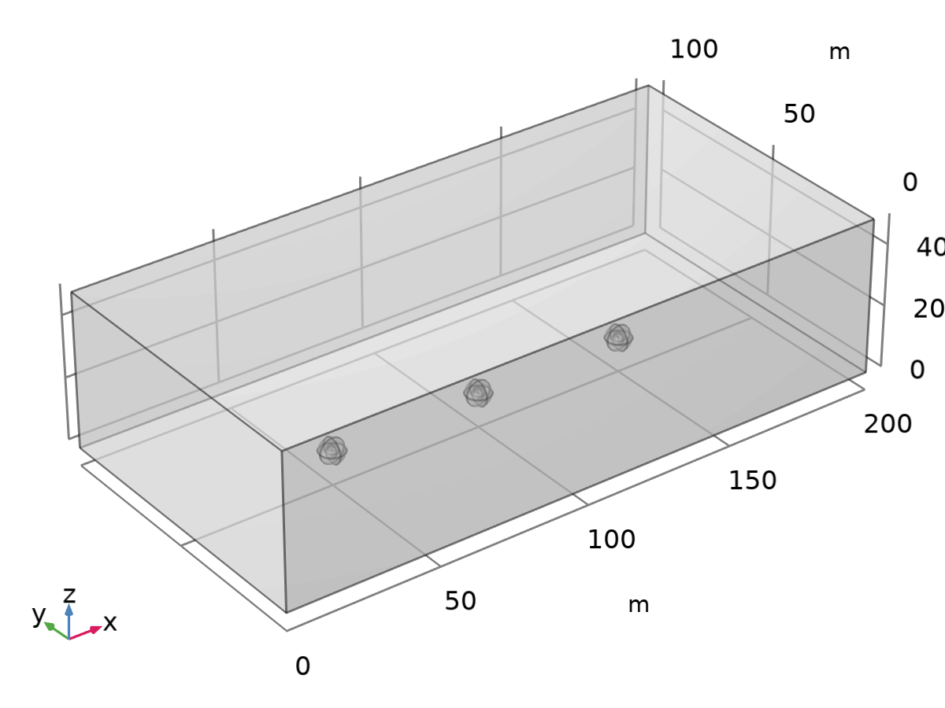
Geometry
Geometry statistics
Description | Value
Space dimension | 3
Number of domains | 10
Number of boundaries | 84
Number of edges | 156
Number of vertices | 92
Geometry 1

Slide 23
Materials

Slide 24
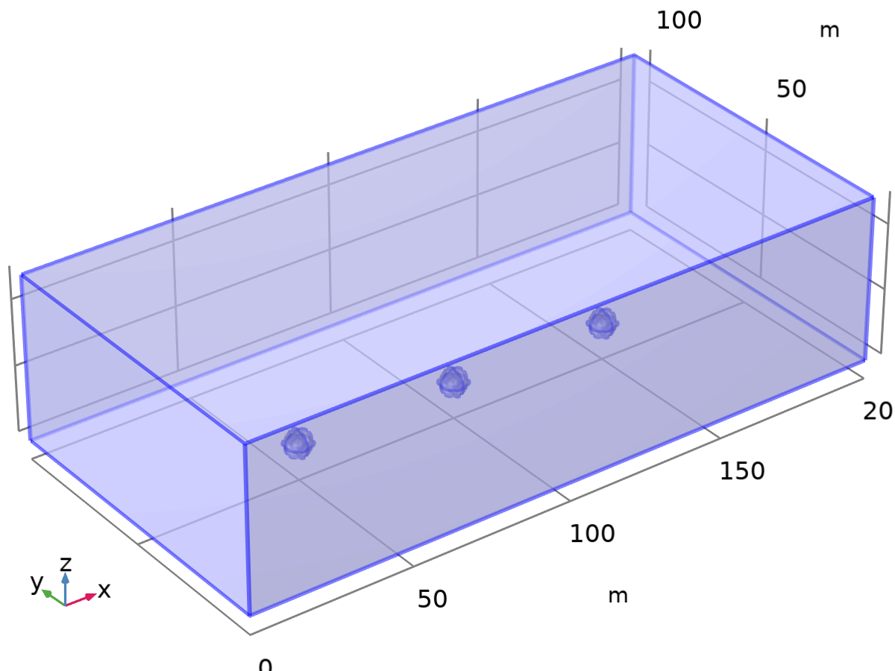
Background Material
Material parameters
Name | Value | Unit | Property group
Relative permeability | 1 | 1 | Basic
Basic
Description | Value
Relative permeability | 1
Background Material

Slide 25
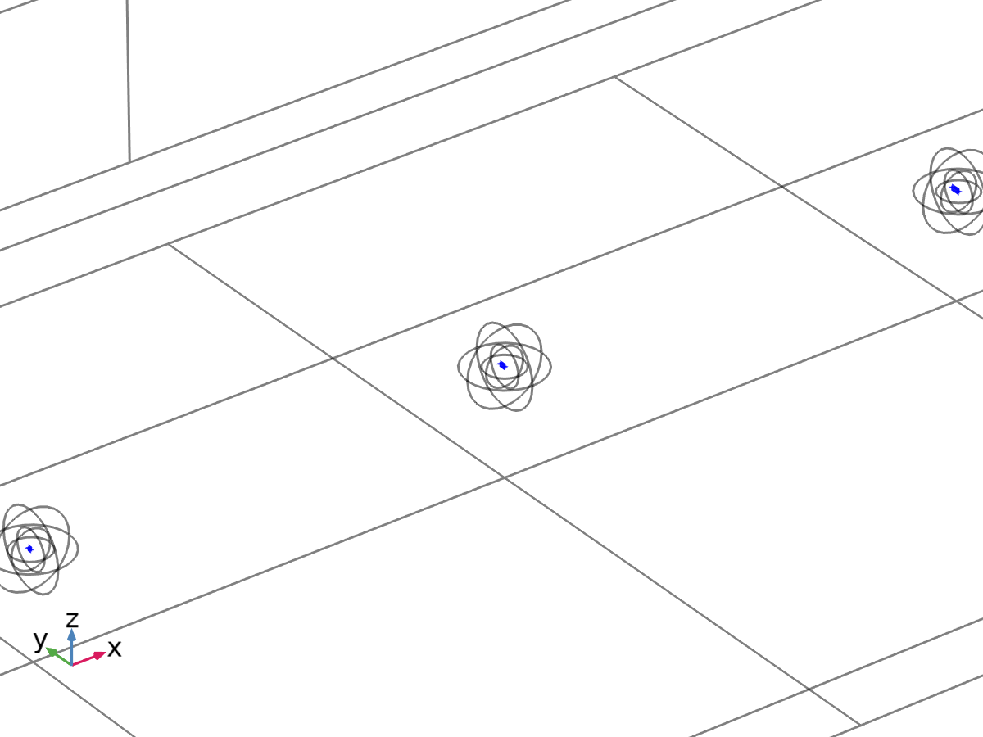
Pipe
Material parameters
Name | Value | Unit | Property group
Relative permeability | mur_pipe | 1 | Basic
36” Pipe
24” Pipe
Basic
Description | Value
Relative permeability | mur_pipe
12” Pipe

Slide 26
Magnetic Fields, No Currents
Settings
Description | Value | Unit
Solve for | Reduced field
Background magnetic field, x-component | H0*Gx/mu0_const | A/m
Background magnetic field, y-component | H0*Gy/mu0_const | A/m
Background magnetic field, z-component | H0*Gz/mu0_const | A/m
Magnetic Fields, No Currents

Slide 27
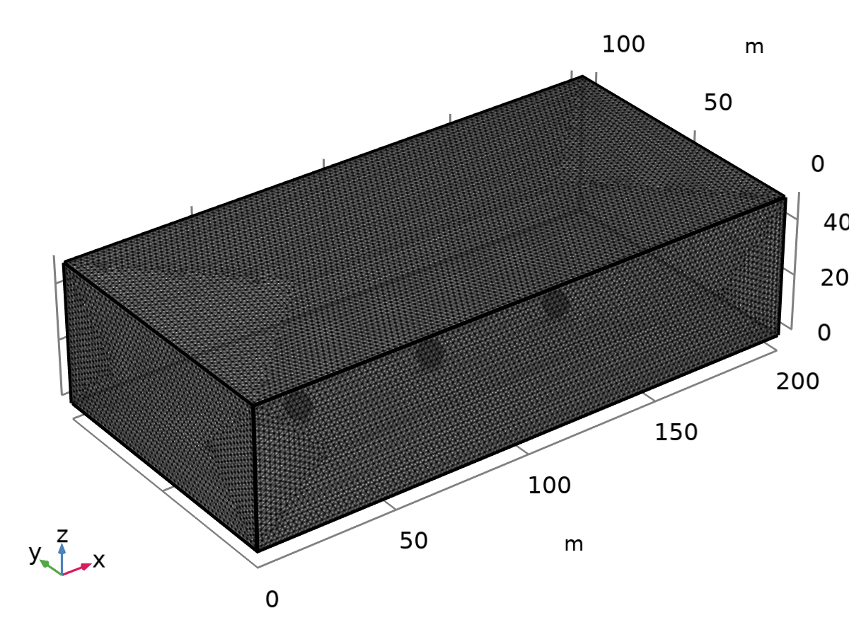
Mesh 1
Mesh statistics
Description | Value
Status | Complete mesh
Mesh vertices | 396865
Tetrahedra | 2328593
Triangles | 50614
Edge elements | 1868
Vertex elements | 92
Number of elements | 2328593
Mesh

Slide 28
Study
Computation information
Computation time | 2 min 37 s

Slide 29
Model Simulations

Slide 30
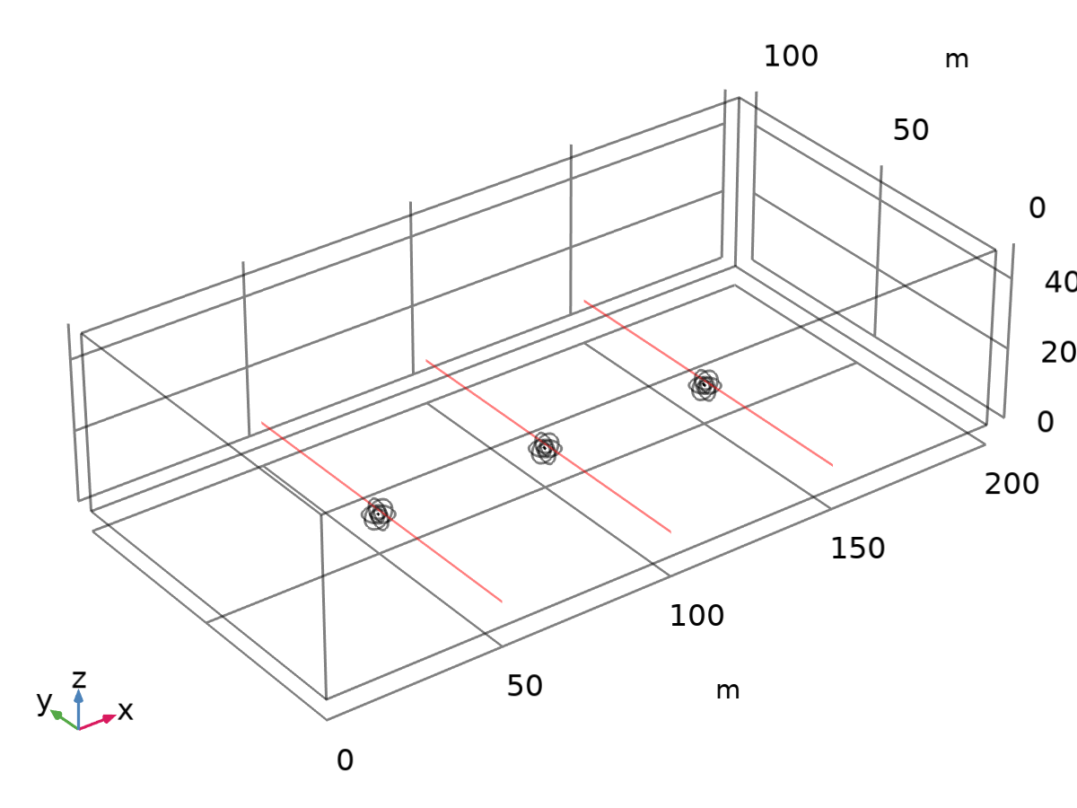
Cut Line Parallel to UUV: 1m Above
Line data
Description | Value
Line entry method | Two points
Points | {{50, 0, 6.8}, {50, 100, 6.8}}
Bounded by points | Off
Additional parallel lines | On
Distances | {50, 100}
Orthogonal vector | {1, 0, 0}
Dataset: Cut Line Parallel to UUV: 1m Above

Slide 31
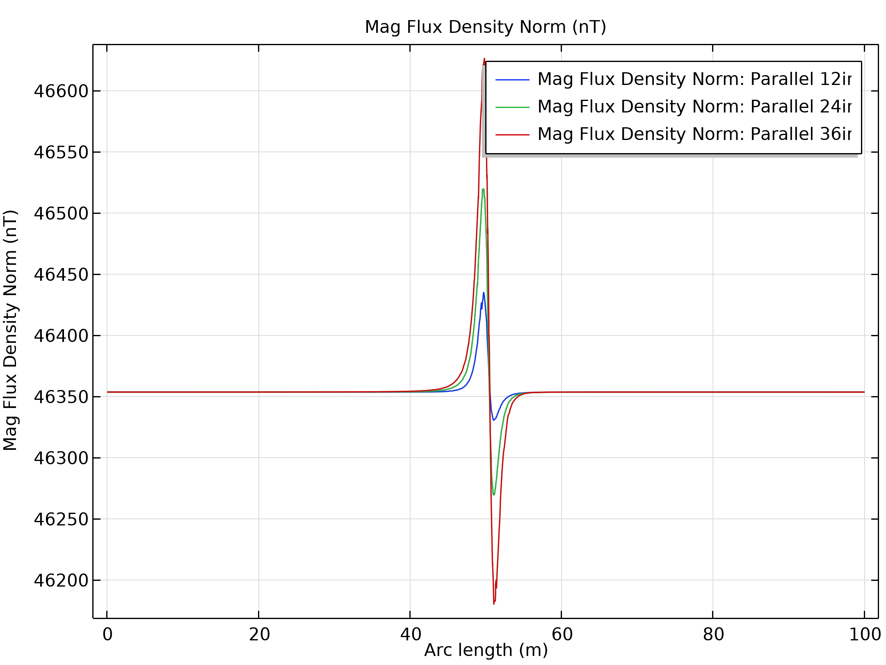
1m Above UUV Parallel to Path: B
Mag Flux Density Norm (nT)

Slide 32
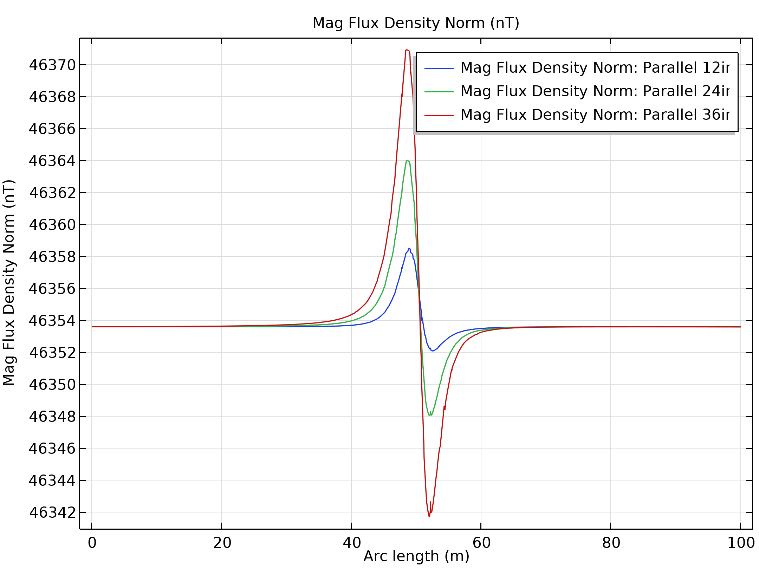
3m Above UUV Parallel to Path: B
Mag Flux Density Norm (nT)

Slide 33
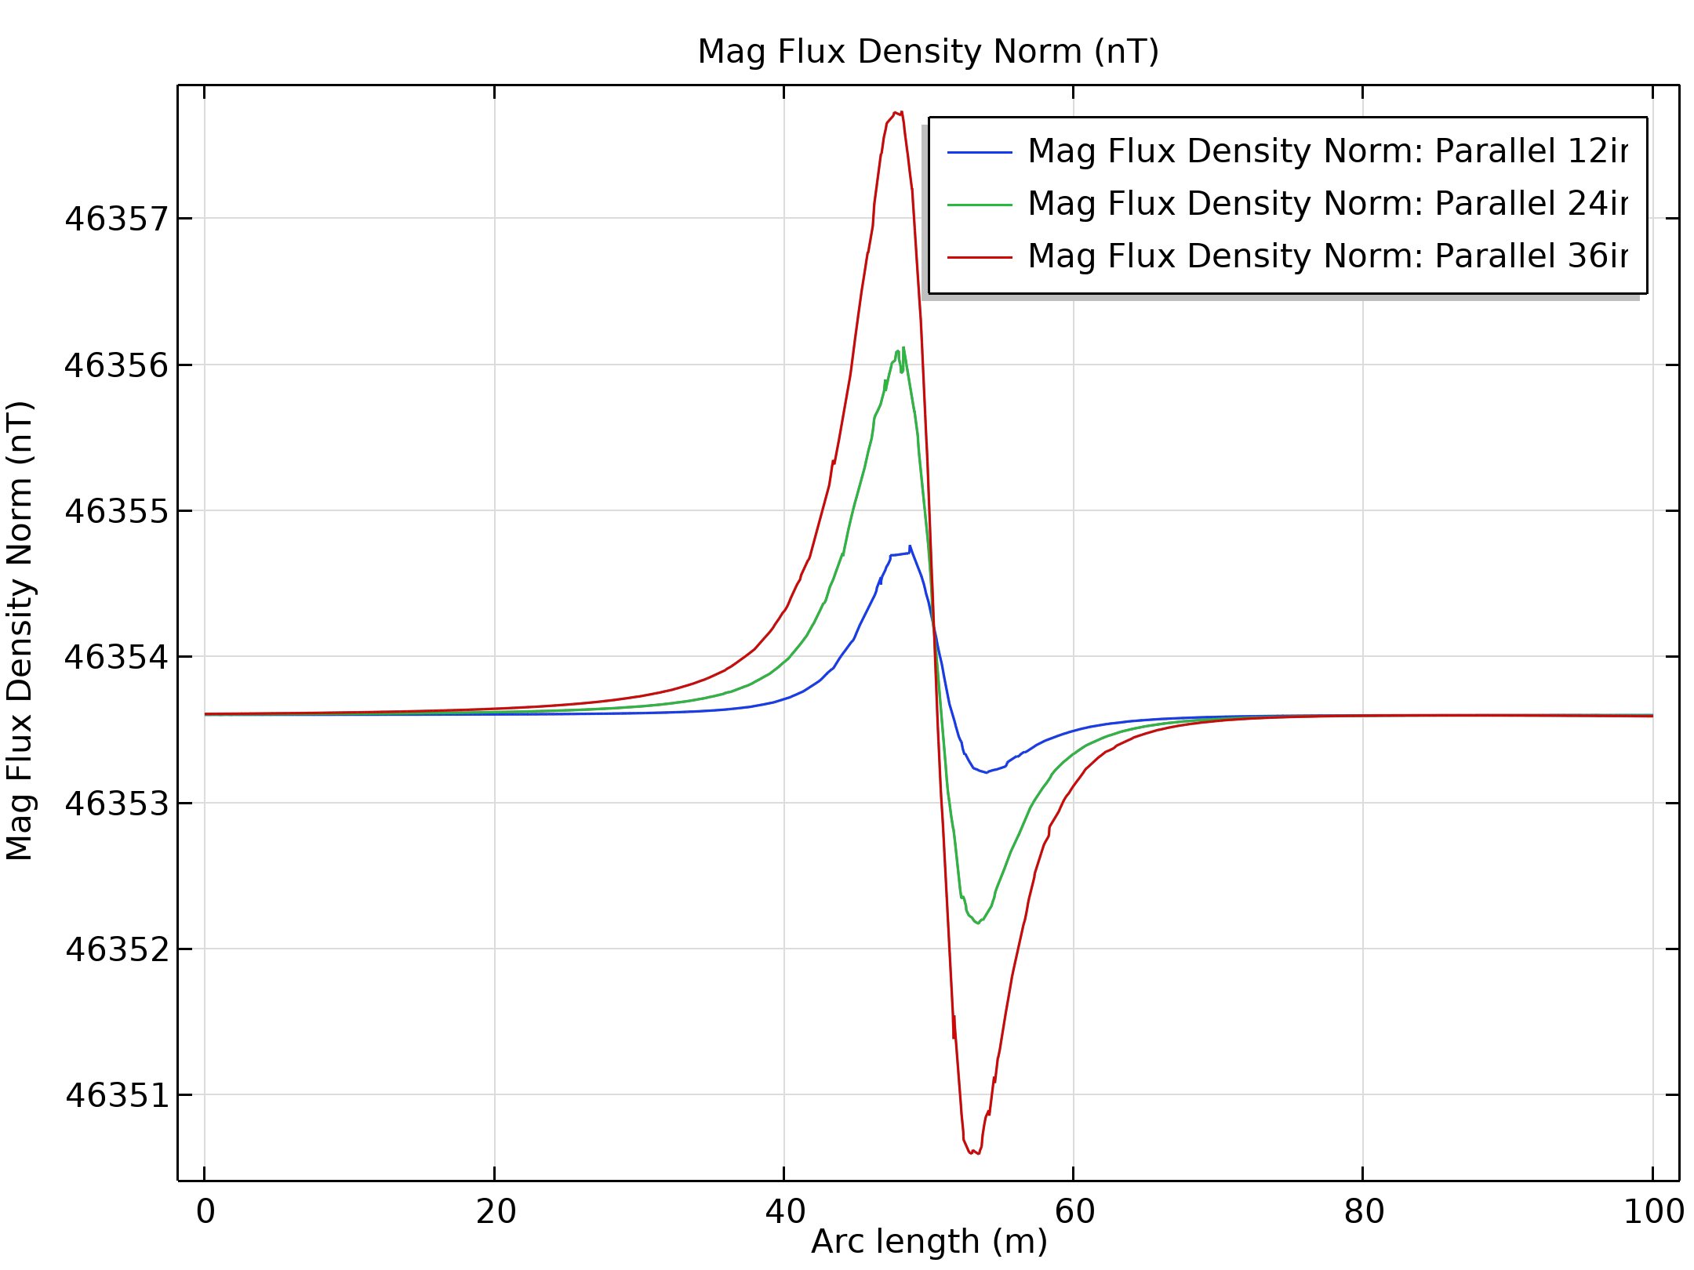
5m Above UUV Parallel to Path: B
Mag Flux Density Norm (nT)

Slide 34
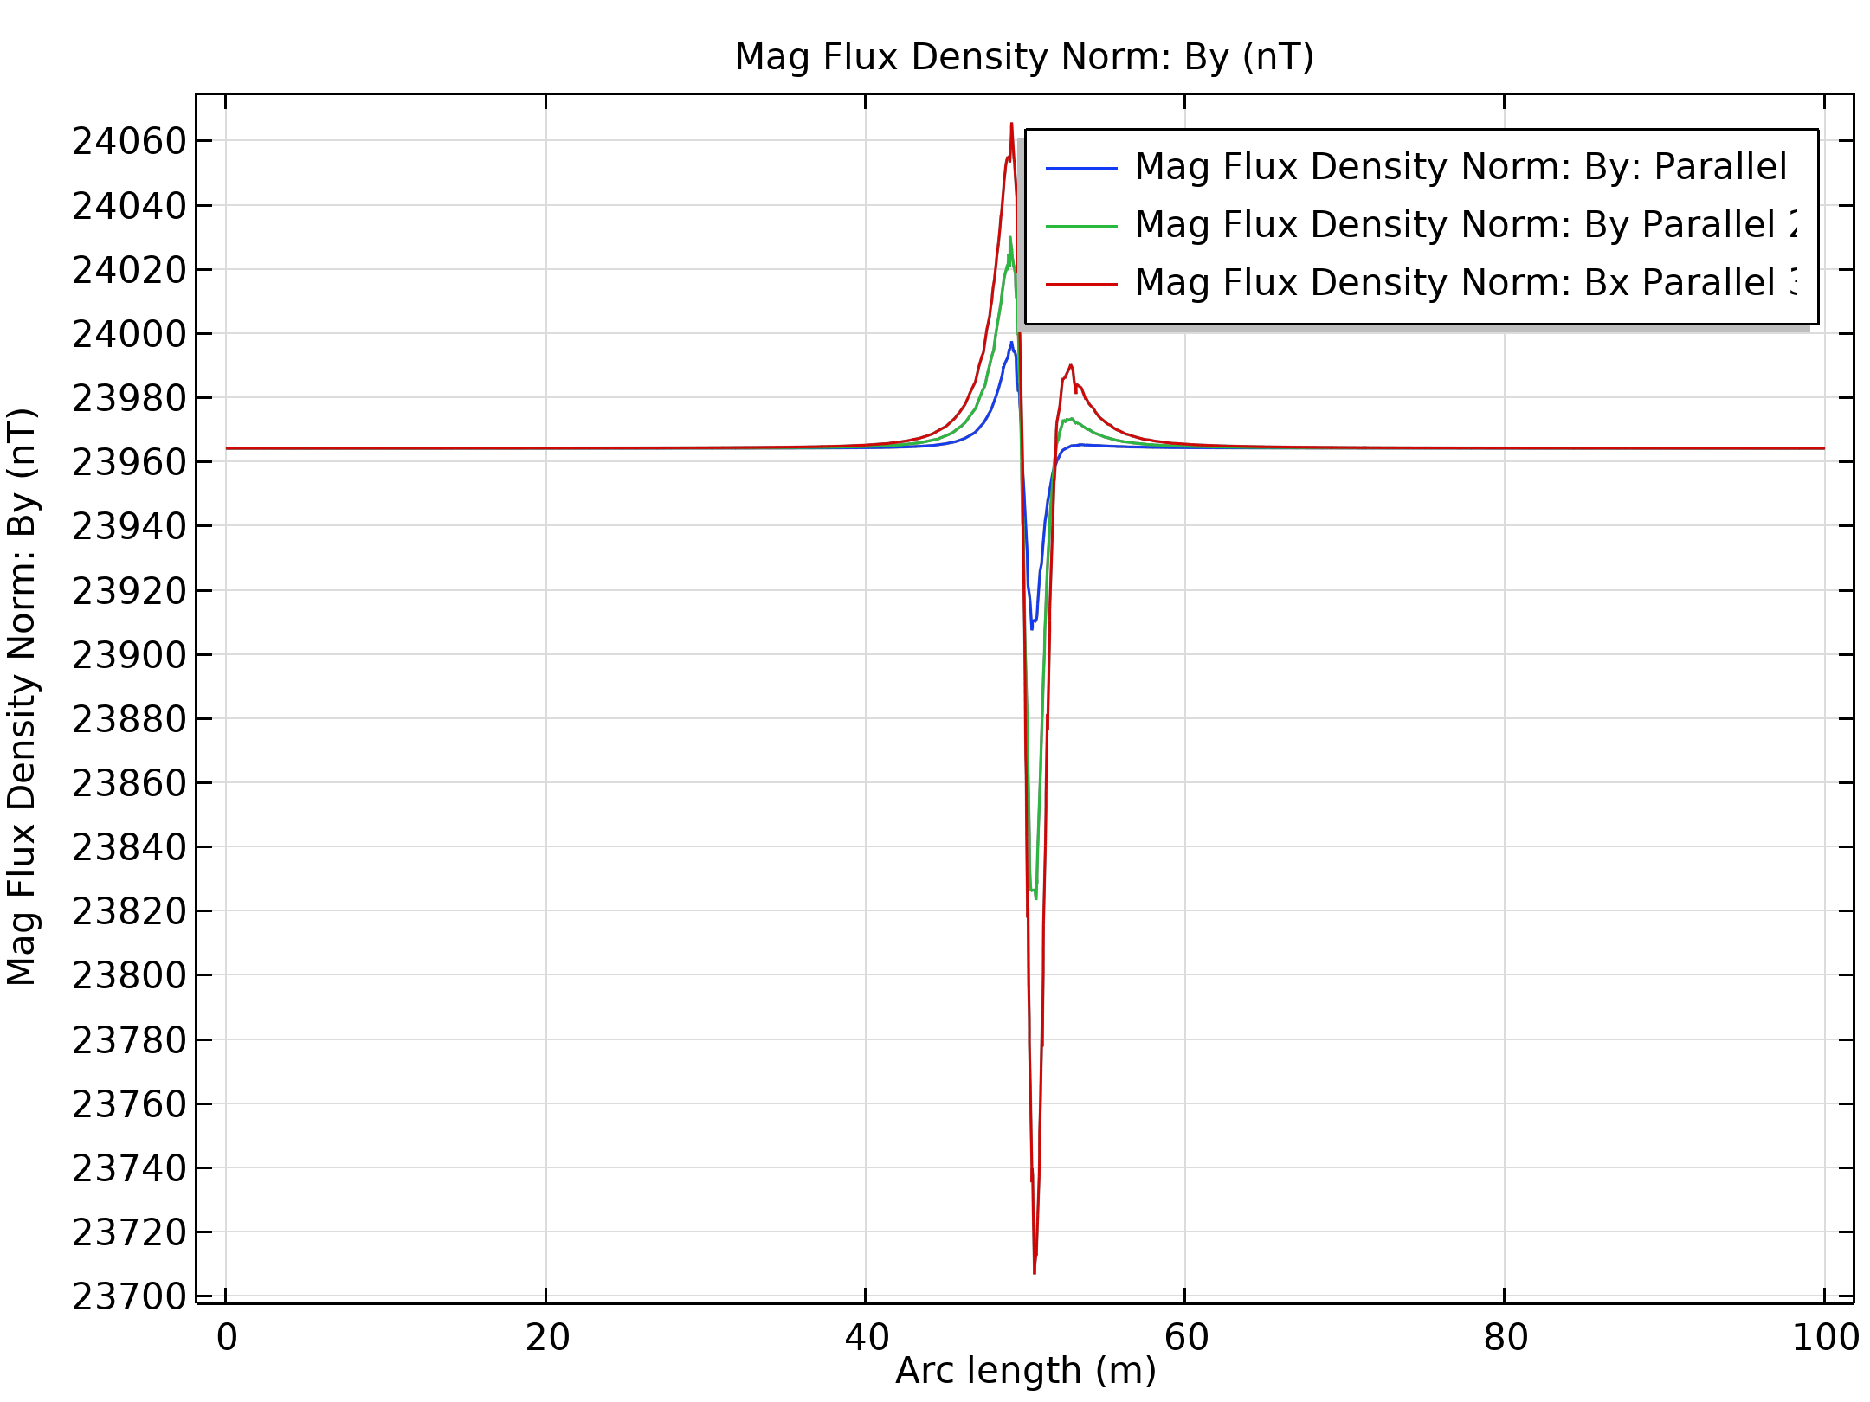
1m Above UUV Parallel to Path: By
Mag Flux Density Norm: By (nT)

Slide 35
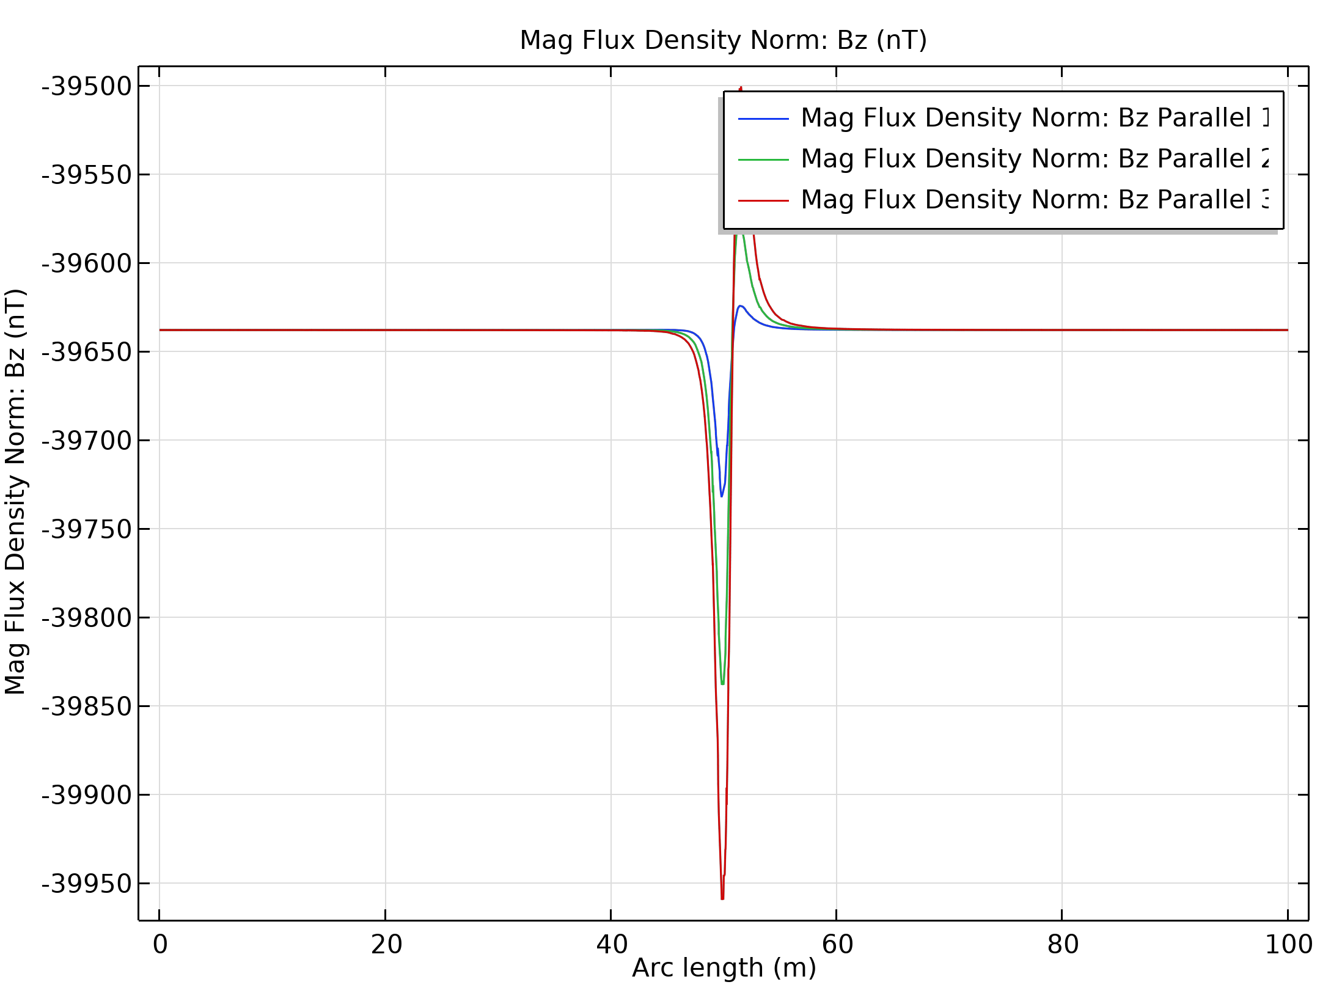
1m Above UUV Parallel to Path: Bz
Mag Flux Density Norm: Bz (nT)

Slide 36
ML Overview
Purpose: Use simulated magnetic sensor data to predict anomaly signatures
Approach: Four machine learning models for confirming findings
Results: Labeled simulated vs predicted sensor measurements

Slide 37
Machine Learning (ML) Background
An algorithm that "learns" from repetitive tasks
Based on models with several thousand parameters
Parameters are estimated using optimization
Models need large amounts of data to converge
Many models tend to be "black-box", not explainable inner-workings

Slide 38
ML Modeling
Regression: ML model based on multiple regression
Boosting: ML model based on tree ensembles
DNN (Deep Neural Network): ML model based on neuron layers (relies on present state only)
LSTM (Long Short-Term Memory): ML model based on present and past (remembered) states

Slide 39
ML Approach
General regression model:
y = β₀+β₁X₁+β₂X₂+…+β_{n}X_{n}+e, where
y is the dependent variable, β₀ is the intercept, β are coefficients, X are the predictors, and e is the independent and identically distributed error term.
Regression
  Trained as above for DNN:
    Training data was simulated from a modeled 12-inch isopipe (100 permeability)
    Testing data was simulated from a modeled 24-inch isopipe (100 permeability)
    Used to predict the total field (magnetic flux density norm) measurements that a sensor would see in the field

Slide 40
ML Approach
Boosting
  Dichotomized sensor readings to above and below mean absolute value
  Used target permeability, aspect ratio, and UUV speed as predictors
  Used grid-search to find best values for tree number and maximum depth

Slide 41
ML Approach
DNN
  Trained on the simulated vector components of the B field.
    Training data was simulated from a modeled 12-inch isopipe (100 permeability)
    Testing data was simulated from a modeled 24-inch isopipe (100 permeability)
    Used to predict the total field (magnetic flux density norm) measurements that a sensor would see in the field

Slide 42
ML Approach
Long Short-Term Memory (LSTM)
  Trained on the simulated vector components of the B field.
  Ran model for total-, x-, y-, and z-fields
  Used a sequence of 10 past data points to predict current point
  Iterated over entire data set

Slide 43
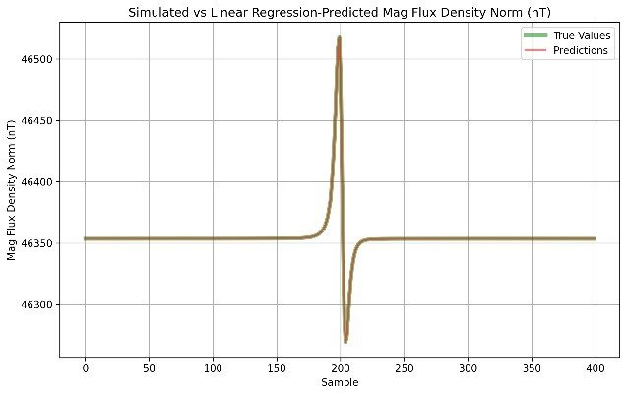
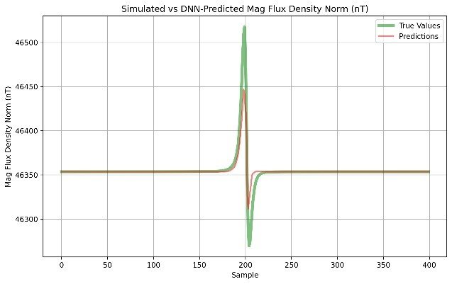
ML Results
Regression
  Best fit (top figure)
  R-squared 0.98
DNN
  Good fit, may need to increase data size (bottom figure)

Slide 44
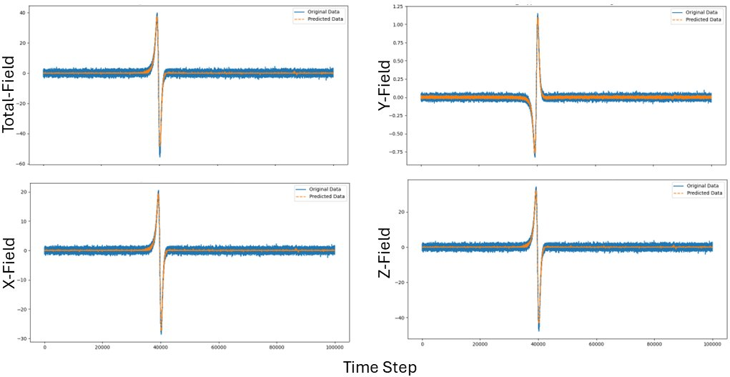
ML Results
LSTM
  Good fit (figure to the right)
Boosting feature importance (%)
  Target permeability (0.44)
  Target aspect ratio (0.30)
  UUV speed (0.26)

Slide 45
Conclusions & Way Ahead
Simulations in data-scarce situations are essential
Relatively simple ML models are able to reproduce simple target signatures for a variety of magnetic properties and geometries
Once a base model is validated is straightforward to generate more data for certain ML approaches
Next steps:
    Add Acoustics/Gravity Physics
    Deploy Apps internally for ML training using COMSOL Server
    Perform Uncertainty Quantification/Optimization

Slide 46
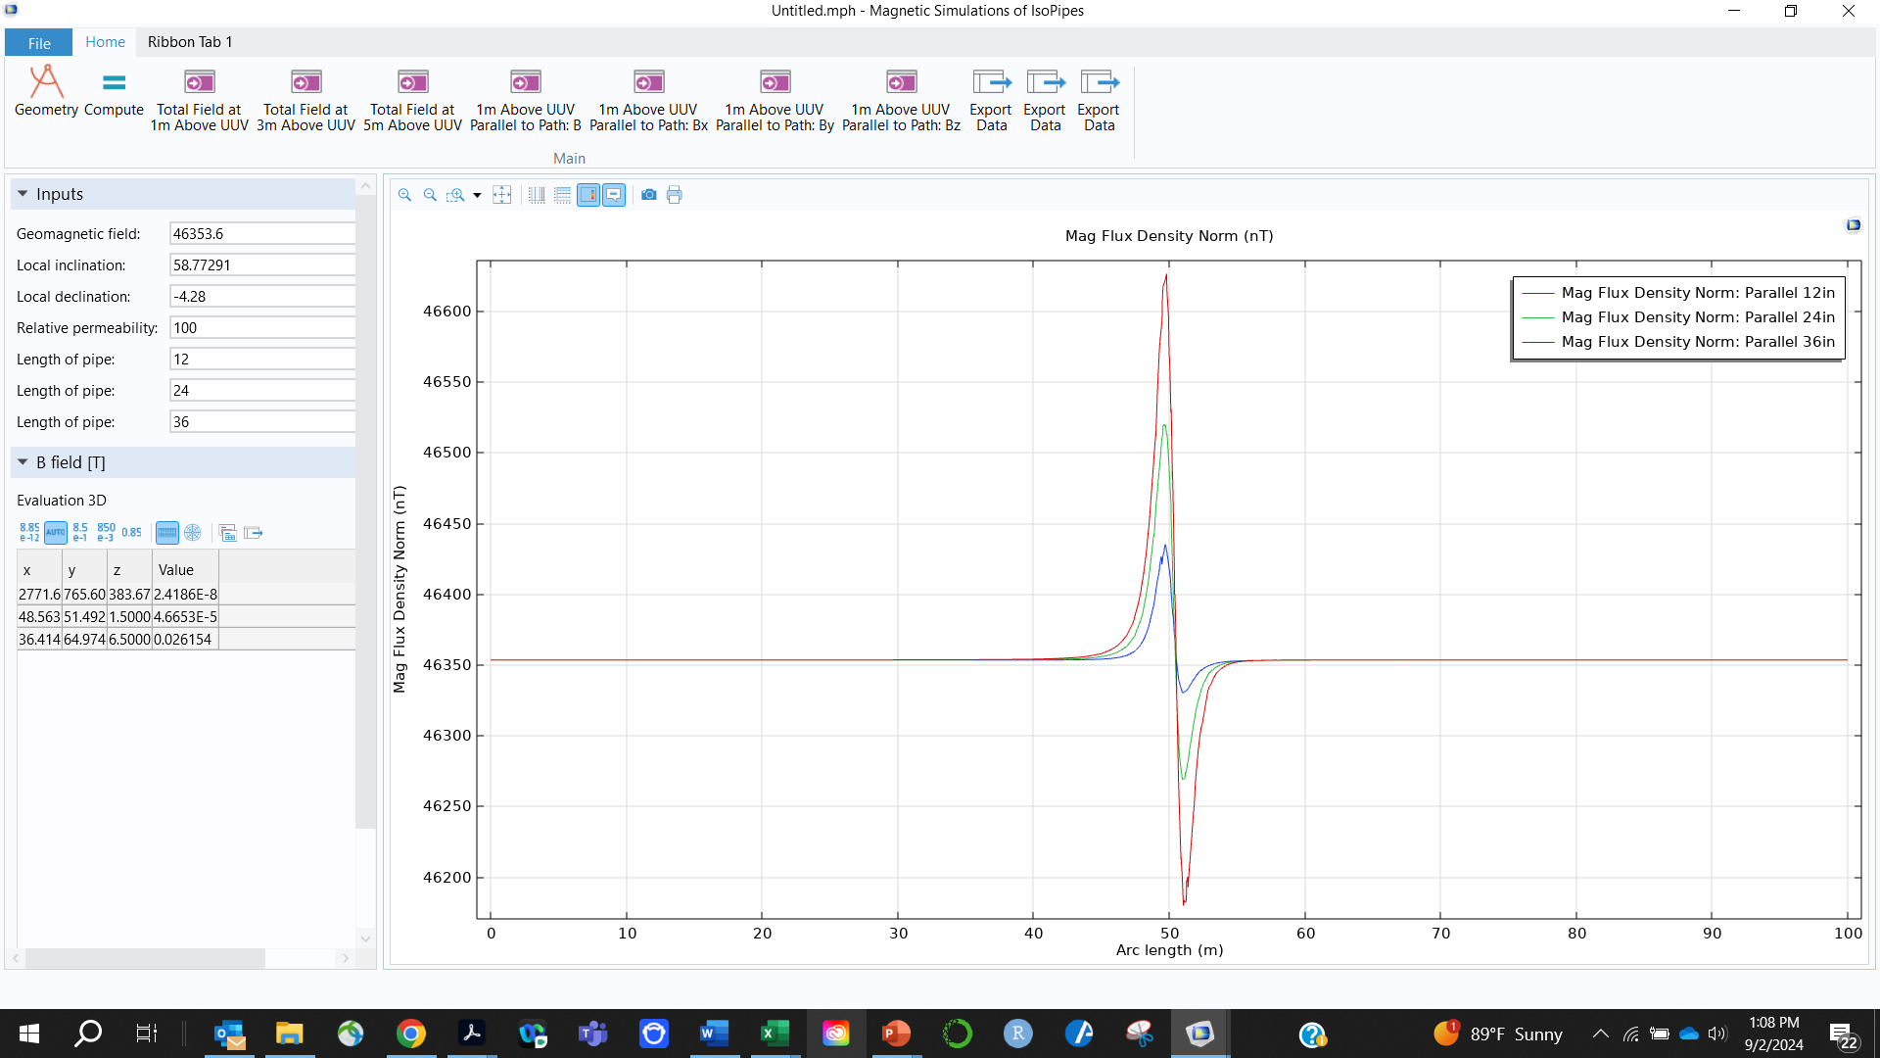
Simple COMSOL APP

Slide 47
Questions?
jason.mckenna@usm.edu

