Slide 1
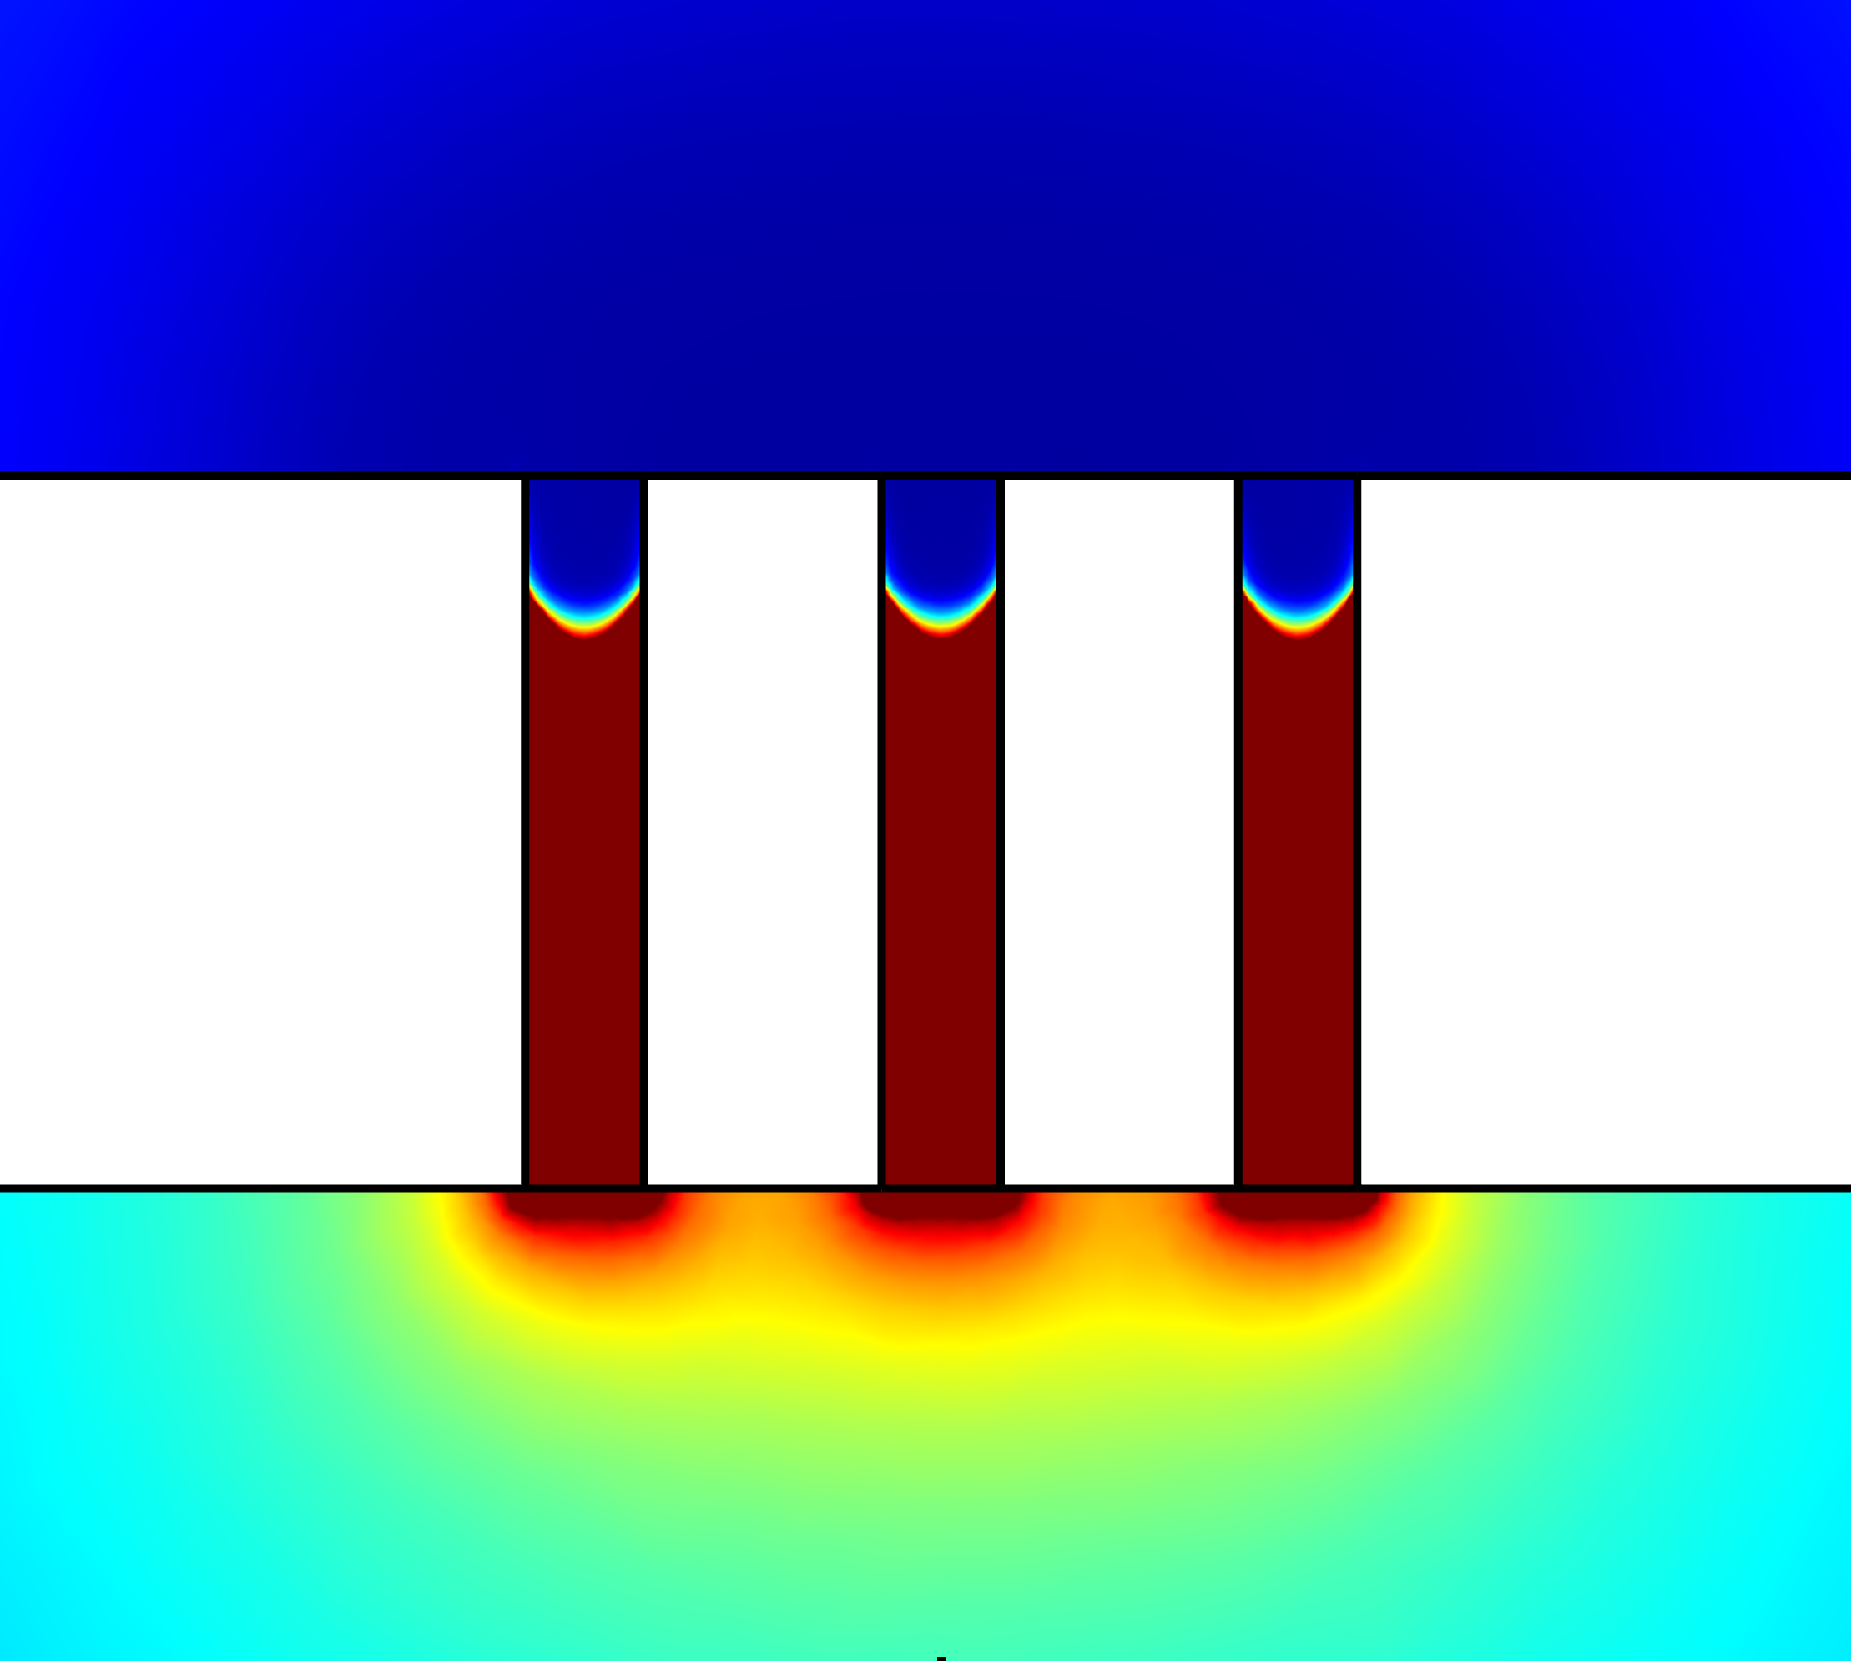
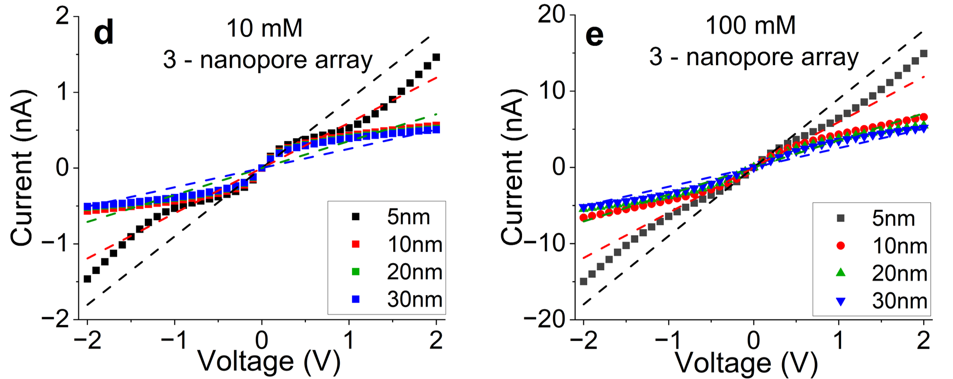
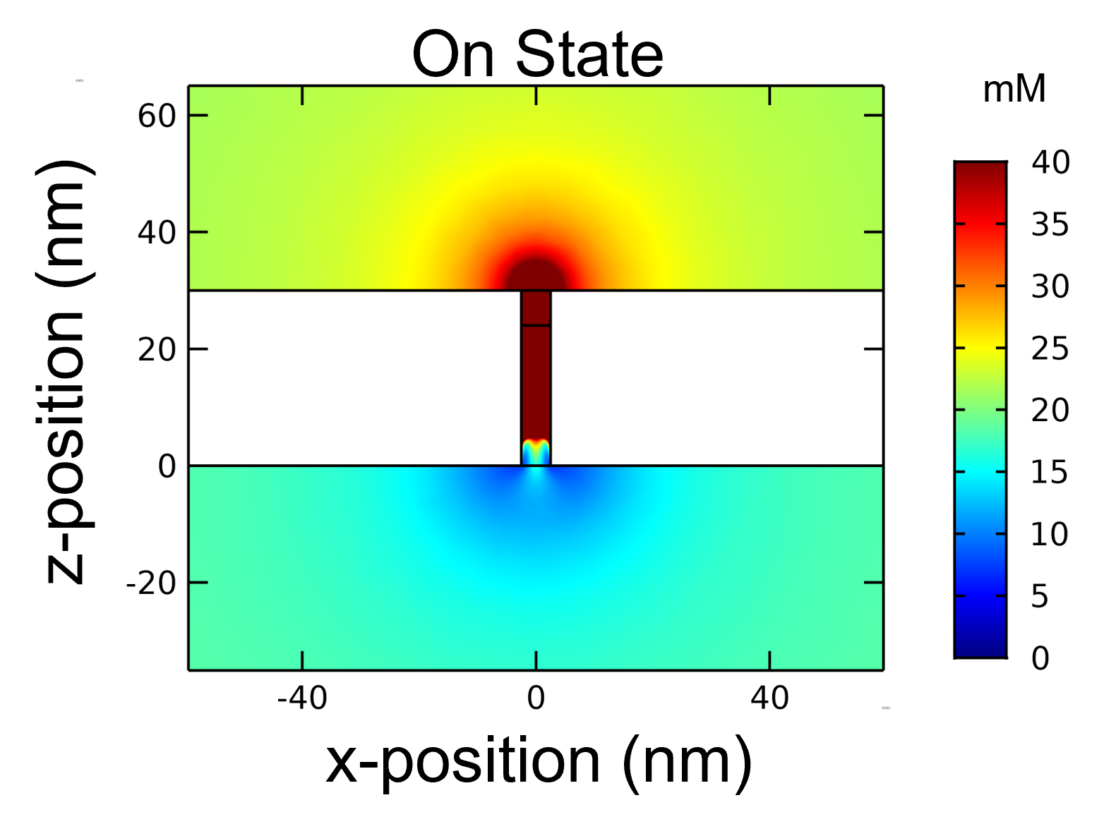
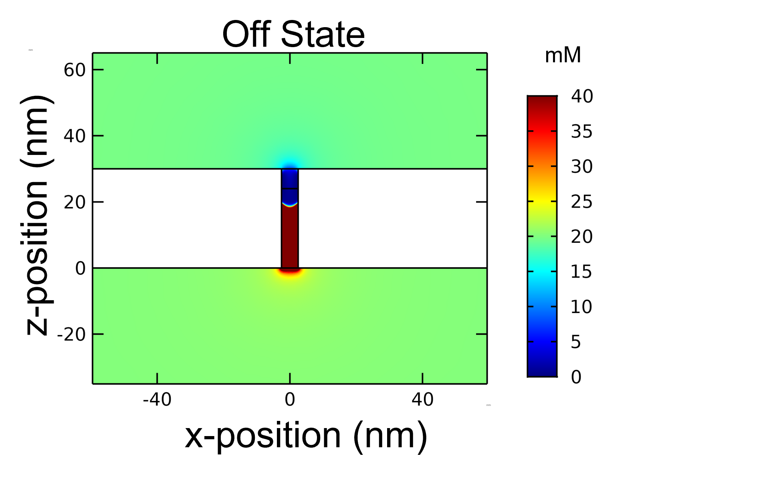


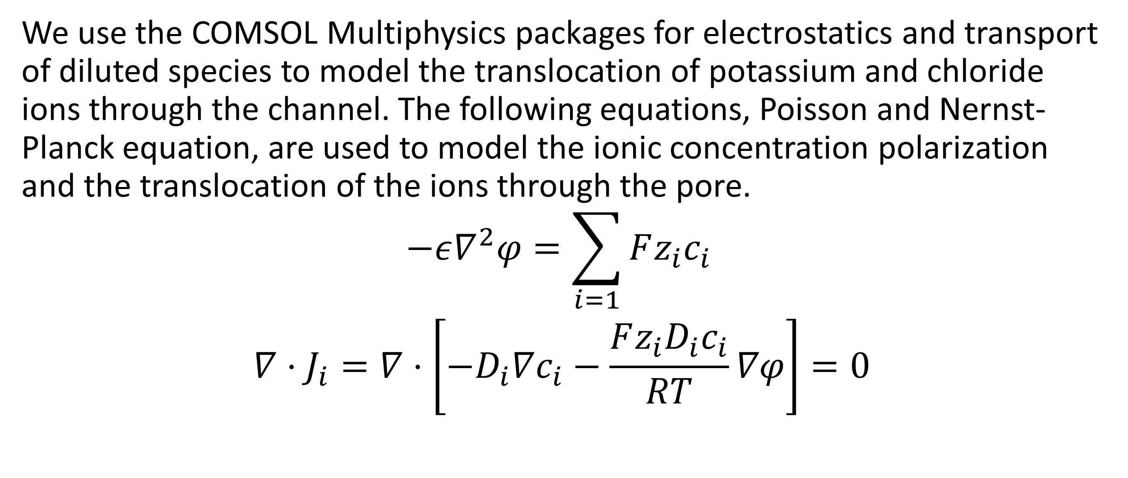
Nanopore Arrays: Selectivity, Conductance, and Interpore Interactions
Individual nanopores in a small nanopore array interact with one another via overlapping depletion zones where they compete for ion translocation. Conductance on the array is dependent on interpore distance and dependent on pore length.
DaVante Cain
Department of Physics and Astronomy University of California Irvine
Abstract
Biomimetic ion channels have applications in energy conversion, desalination, DNA and Protein sequencing, and biomimetic ionic circuits. Fundamentally single nanochannels act as an ideal system to study the transport of ions and molecules under nanoconfinement. In biology, voltage gated ion channels of unique selectivity function coherently to transduce signals in time and space. Biomimetic ionic circuits have been developed from nanopore arrays, but ionic circuits with multiple functioning pores working together coherently have yet to be produced. The models presented in this work hope to act as a steppingstone for fabricating and understanding how biomimetic nanopores interact with each other within a membrane. We show that individual nanopores in nanopore arrays with high aspect ratios interact with one another via overlapping depletion zones, and that the conduction and selectivity of small nanopore arrays are nearly independent on pore length.
a
b
Methods
We use the COMSOL Multiphysics packages for electrostatics and transport of diluted species to model the translocation of potassium and chloride ions through the channel. The following equations, Poisson and Nernst-Planck equation, are used to model the ionic concentration polarization and the translocation of the ions through the pore.
$$−ε∇^{2}φ=\sum_{i=1}{Fz_{i}c_{i}}$$
$$∇⋅J_{i}=∇⋅\left[−D_{i}∇c_{i}−\frac{{Fz_{i}D}_{i}c_{i}}{RT}∇φ\right]=0$$
I-V curves for 5, 10, 20, and 30 nm long arrays modeled with bulk concentration of 10mM and 100 mM
Results
a
b
We found that nanopore arrays interact via overlapping depletion zones where they compete for ion translocation. This competition between pores lowers the overall conduction of the array. Modification of the pore wall led to less interaction between the nanopores and ionic current rectification that was independent on pore distance. Conductance and selectivity were both nearly independent on pore length. We modeled nanopore arrays with three pores in the array with pore lengths of 5, 10, 20, and 30 nm. I-V curves were nearly identical for 10, 20, and 30 nm length arrays showing that their depletion and enhancement regions inside the pore were nearly identical, leading to selectivity and conduction that is independent of pore length.
Ionic Diodes modeled using a heterogenous surface charge distribution. Symmetric and Nonsymmetric modifications were considered.
Cao, E, et al., Adv. Funct. Mater. 2024, 34, 2312646
Cain, D, et al., Farraday Discussions. 2024, (Accepted)

