Slide 1
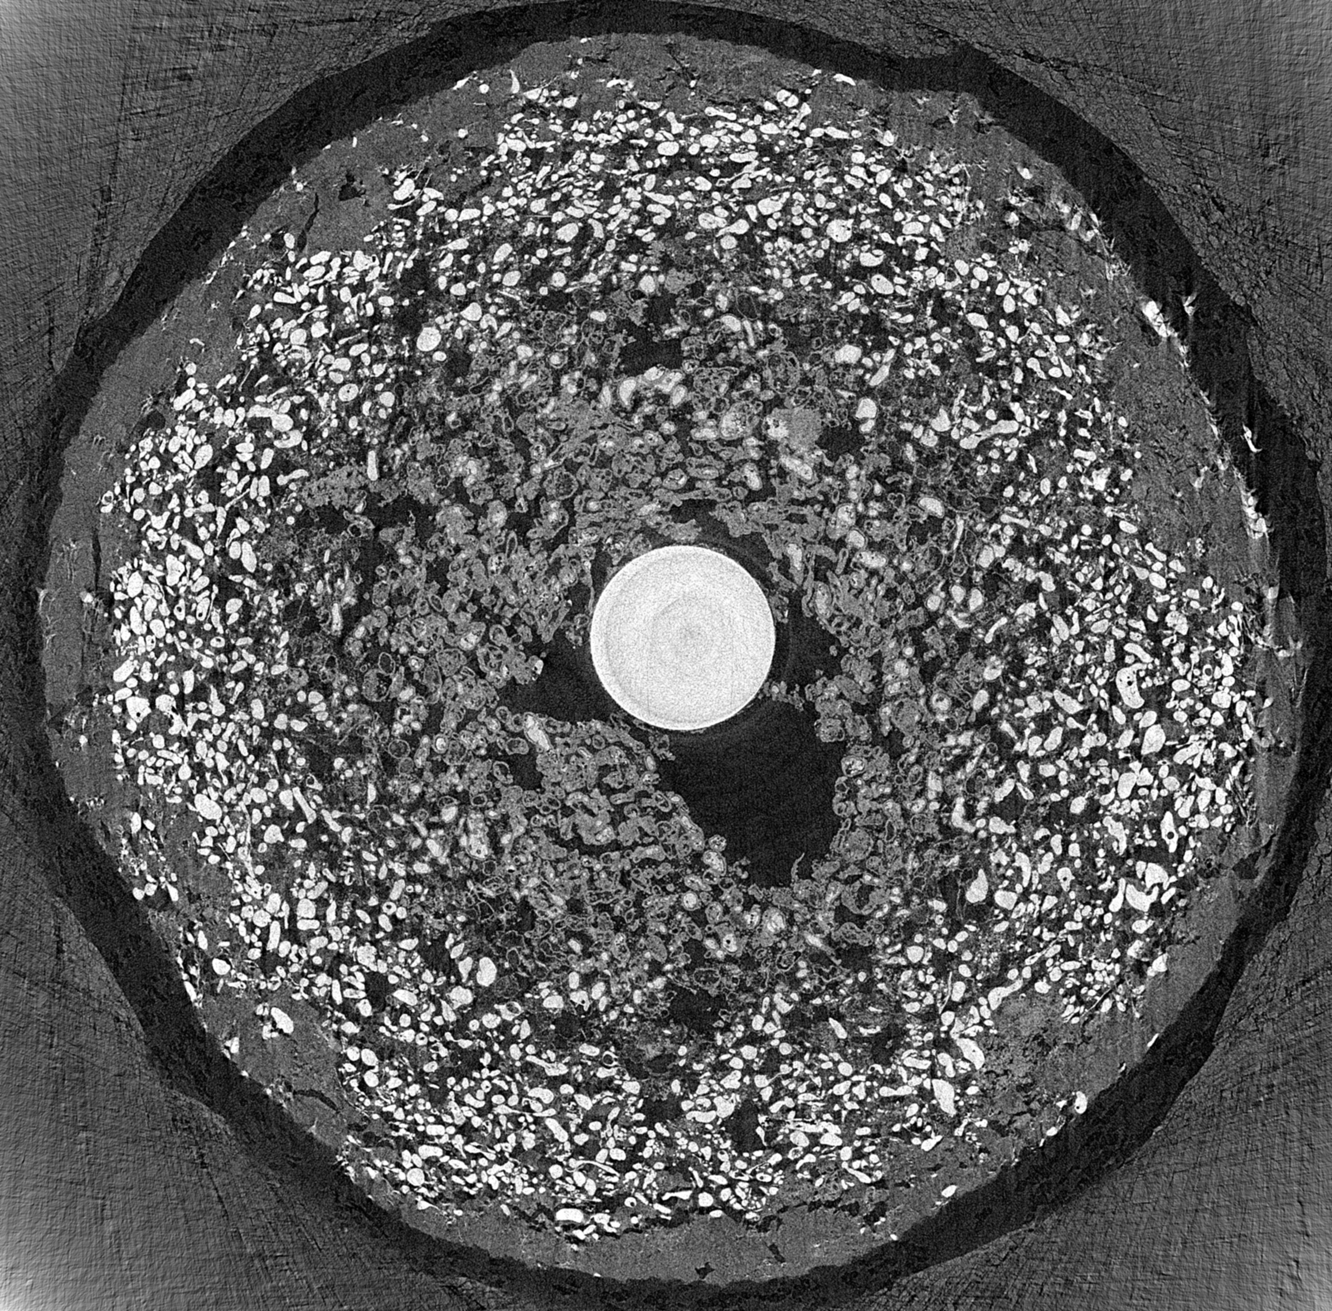
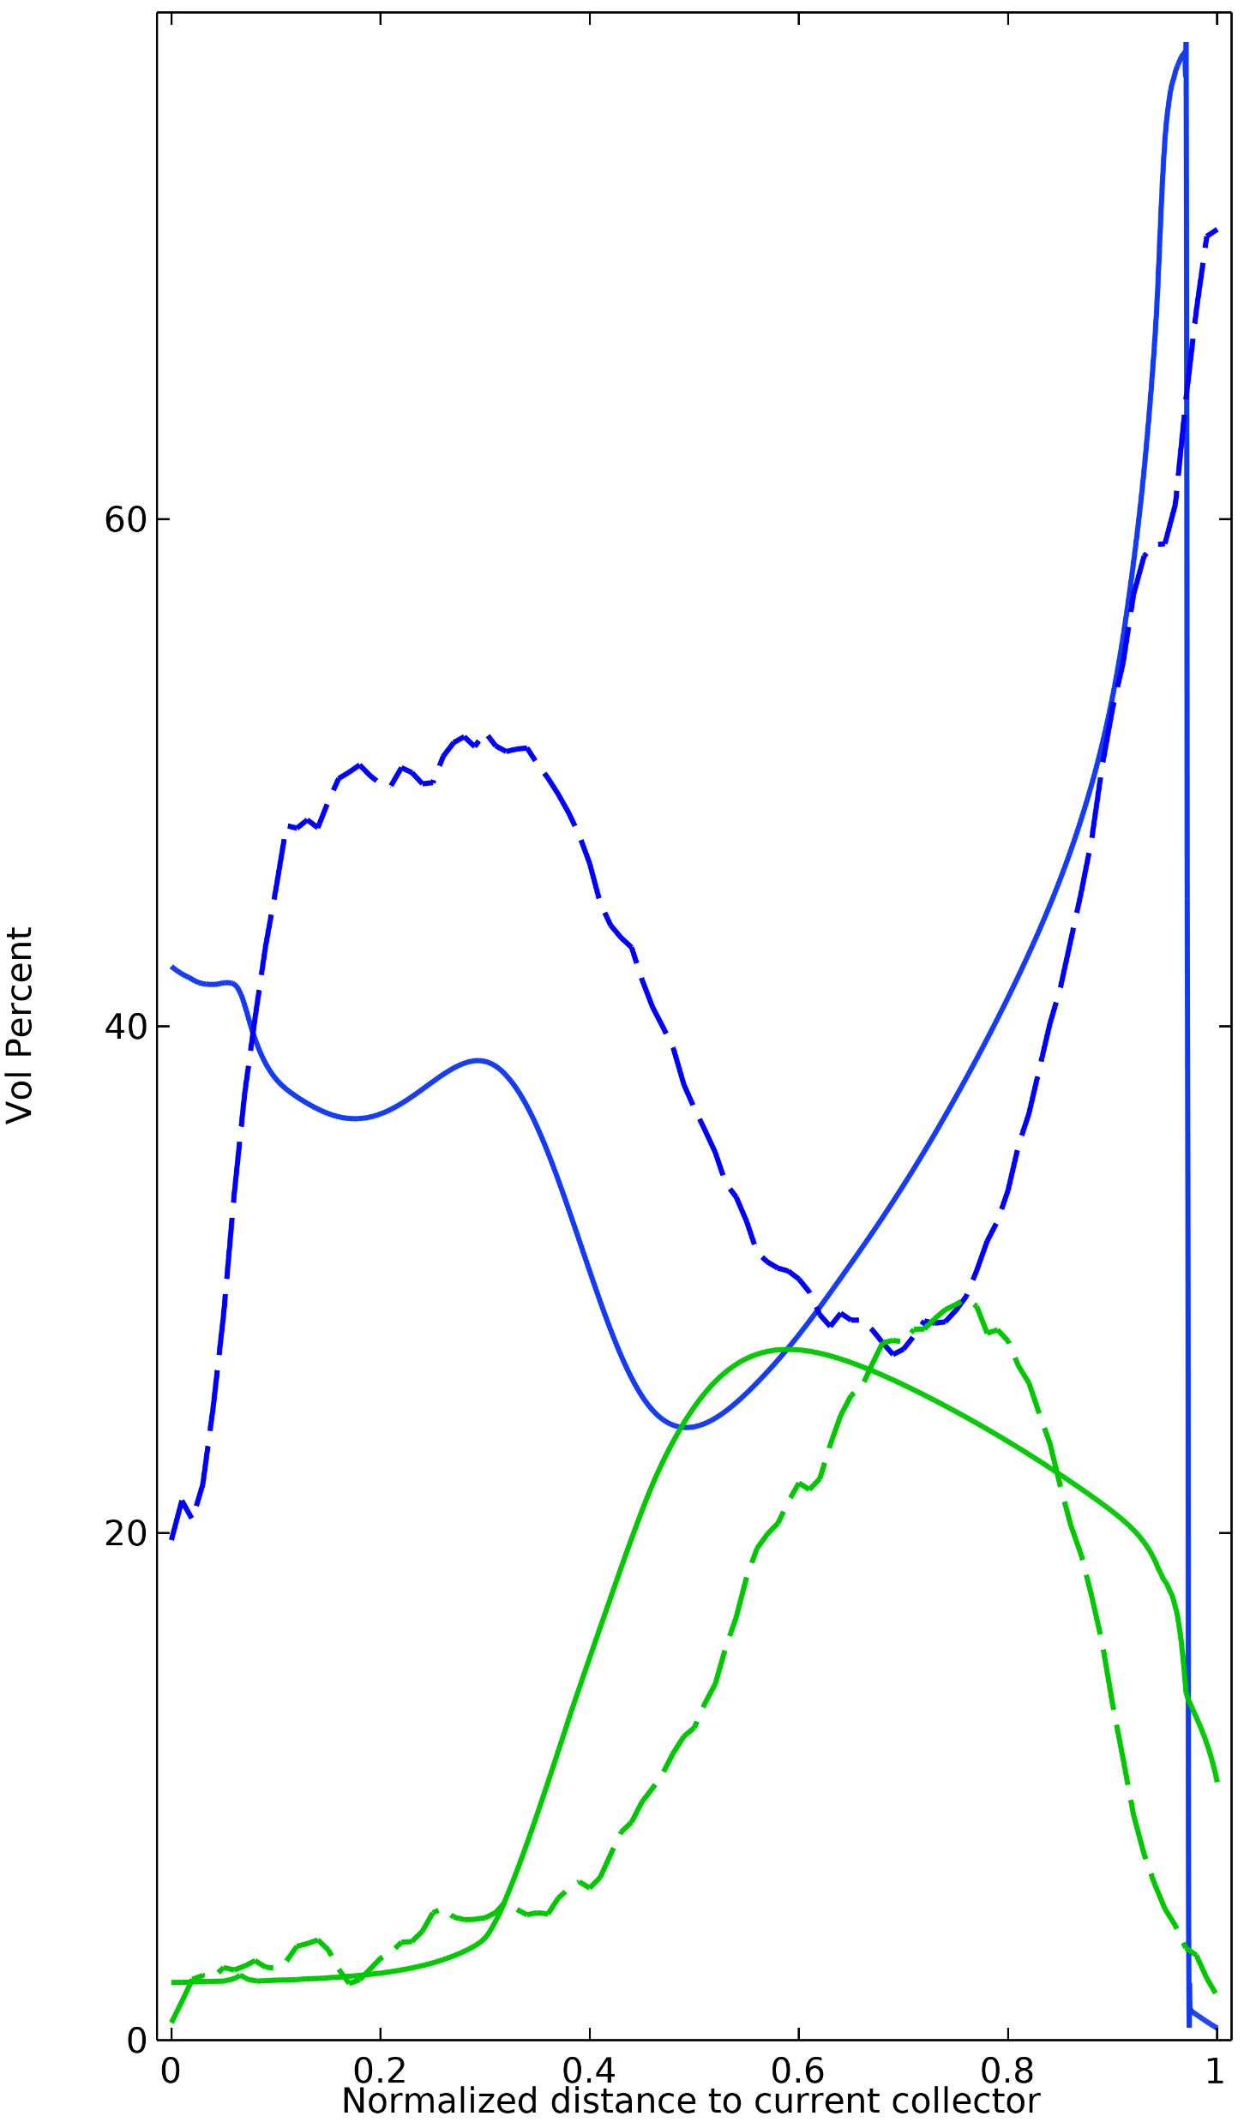
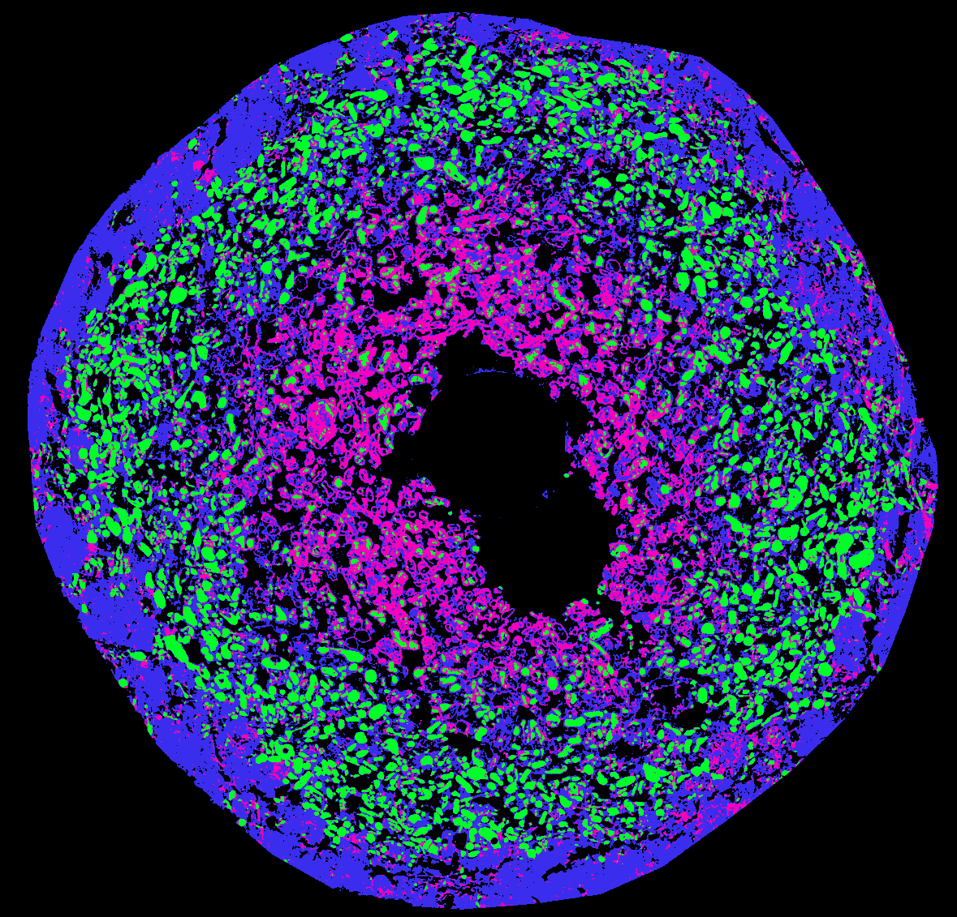
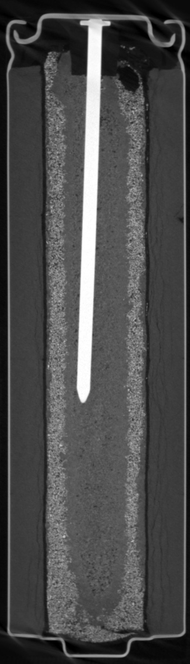
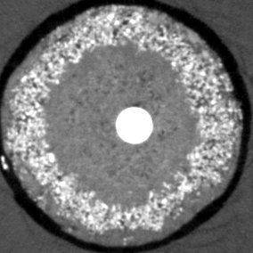
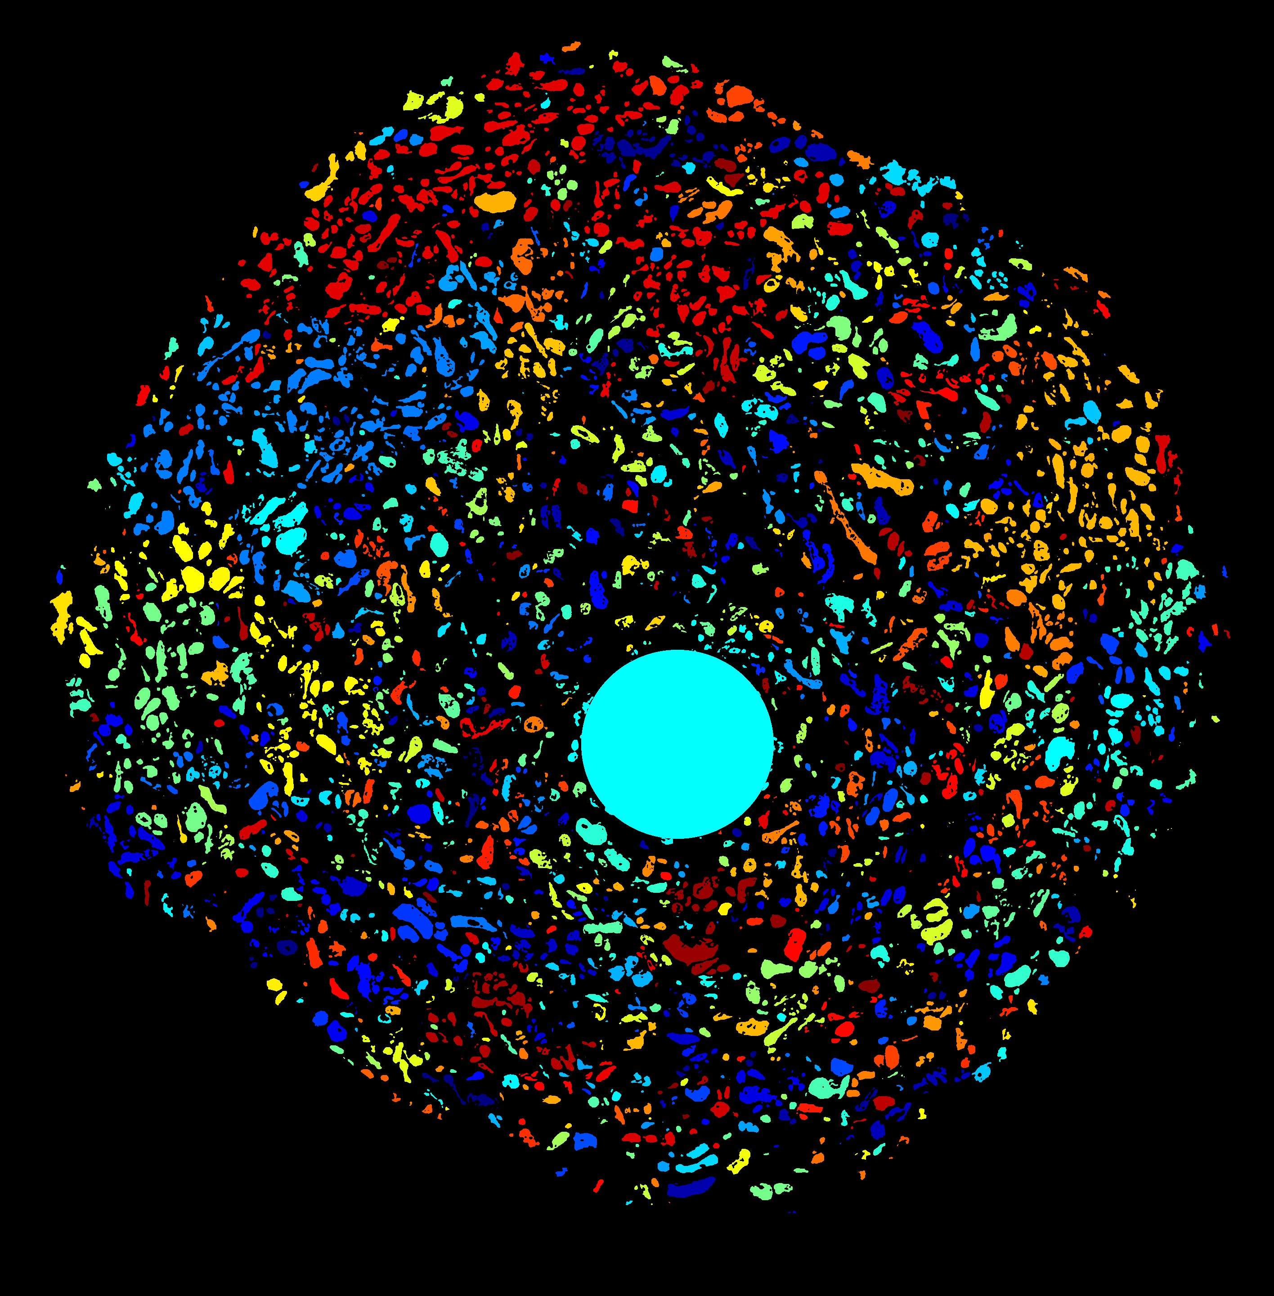
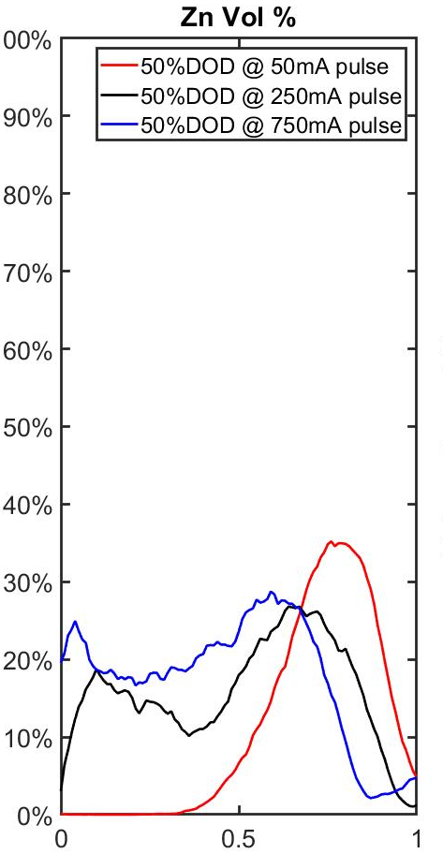
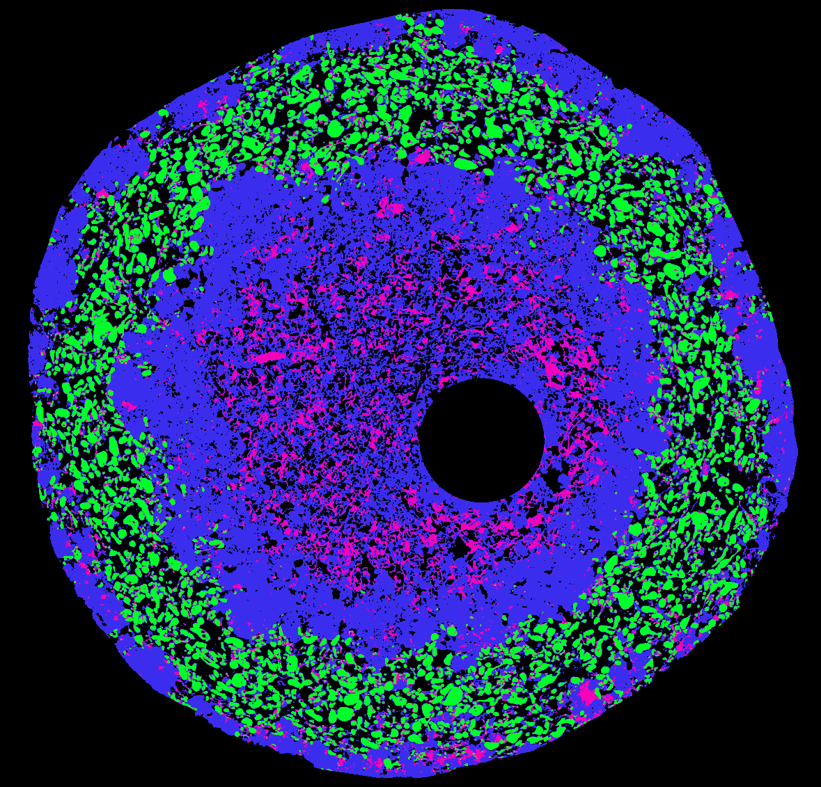
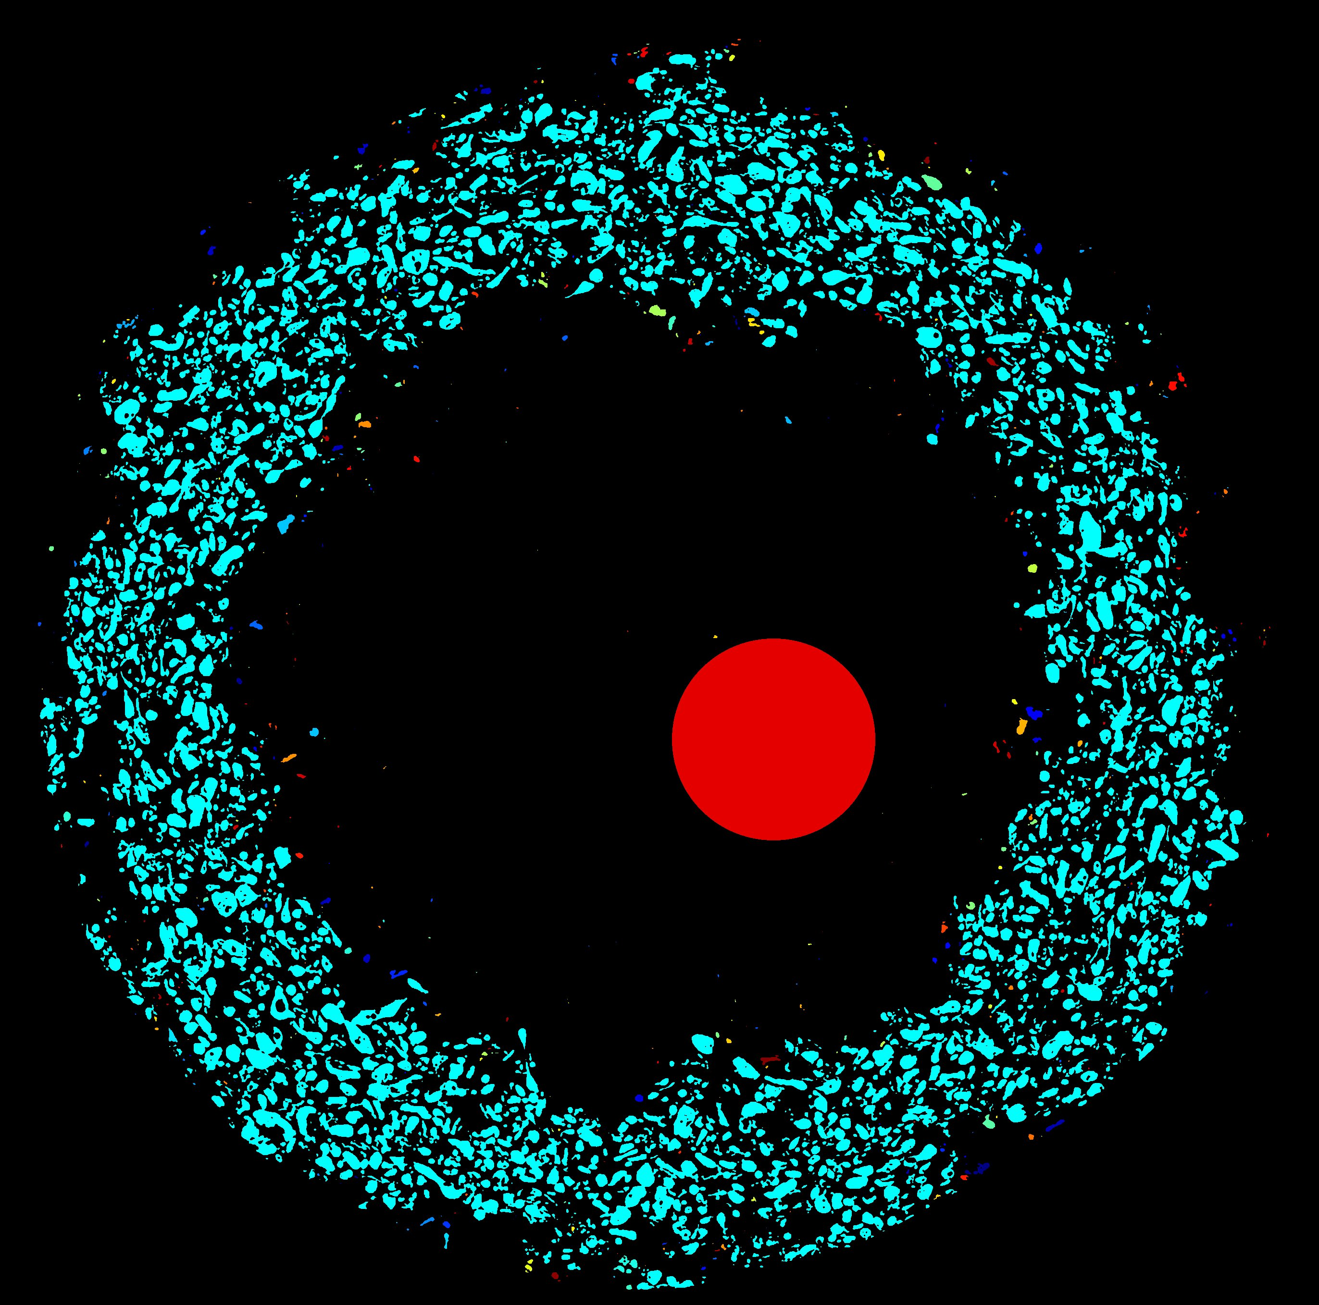
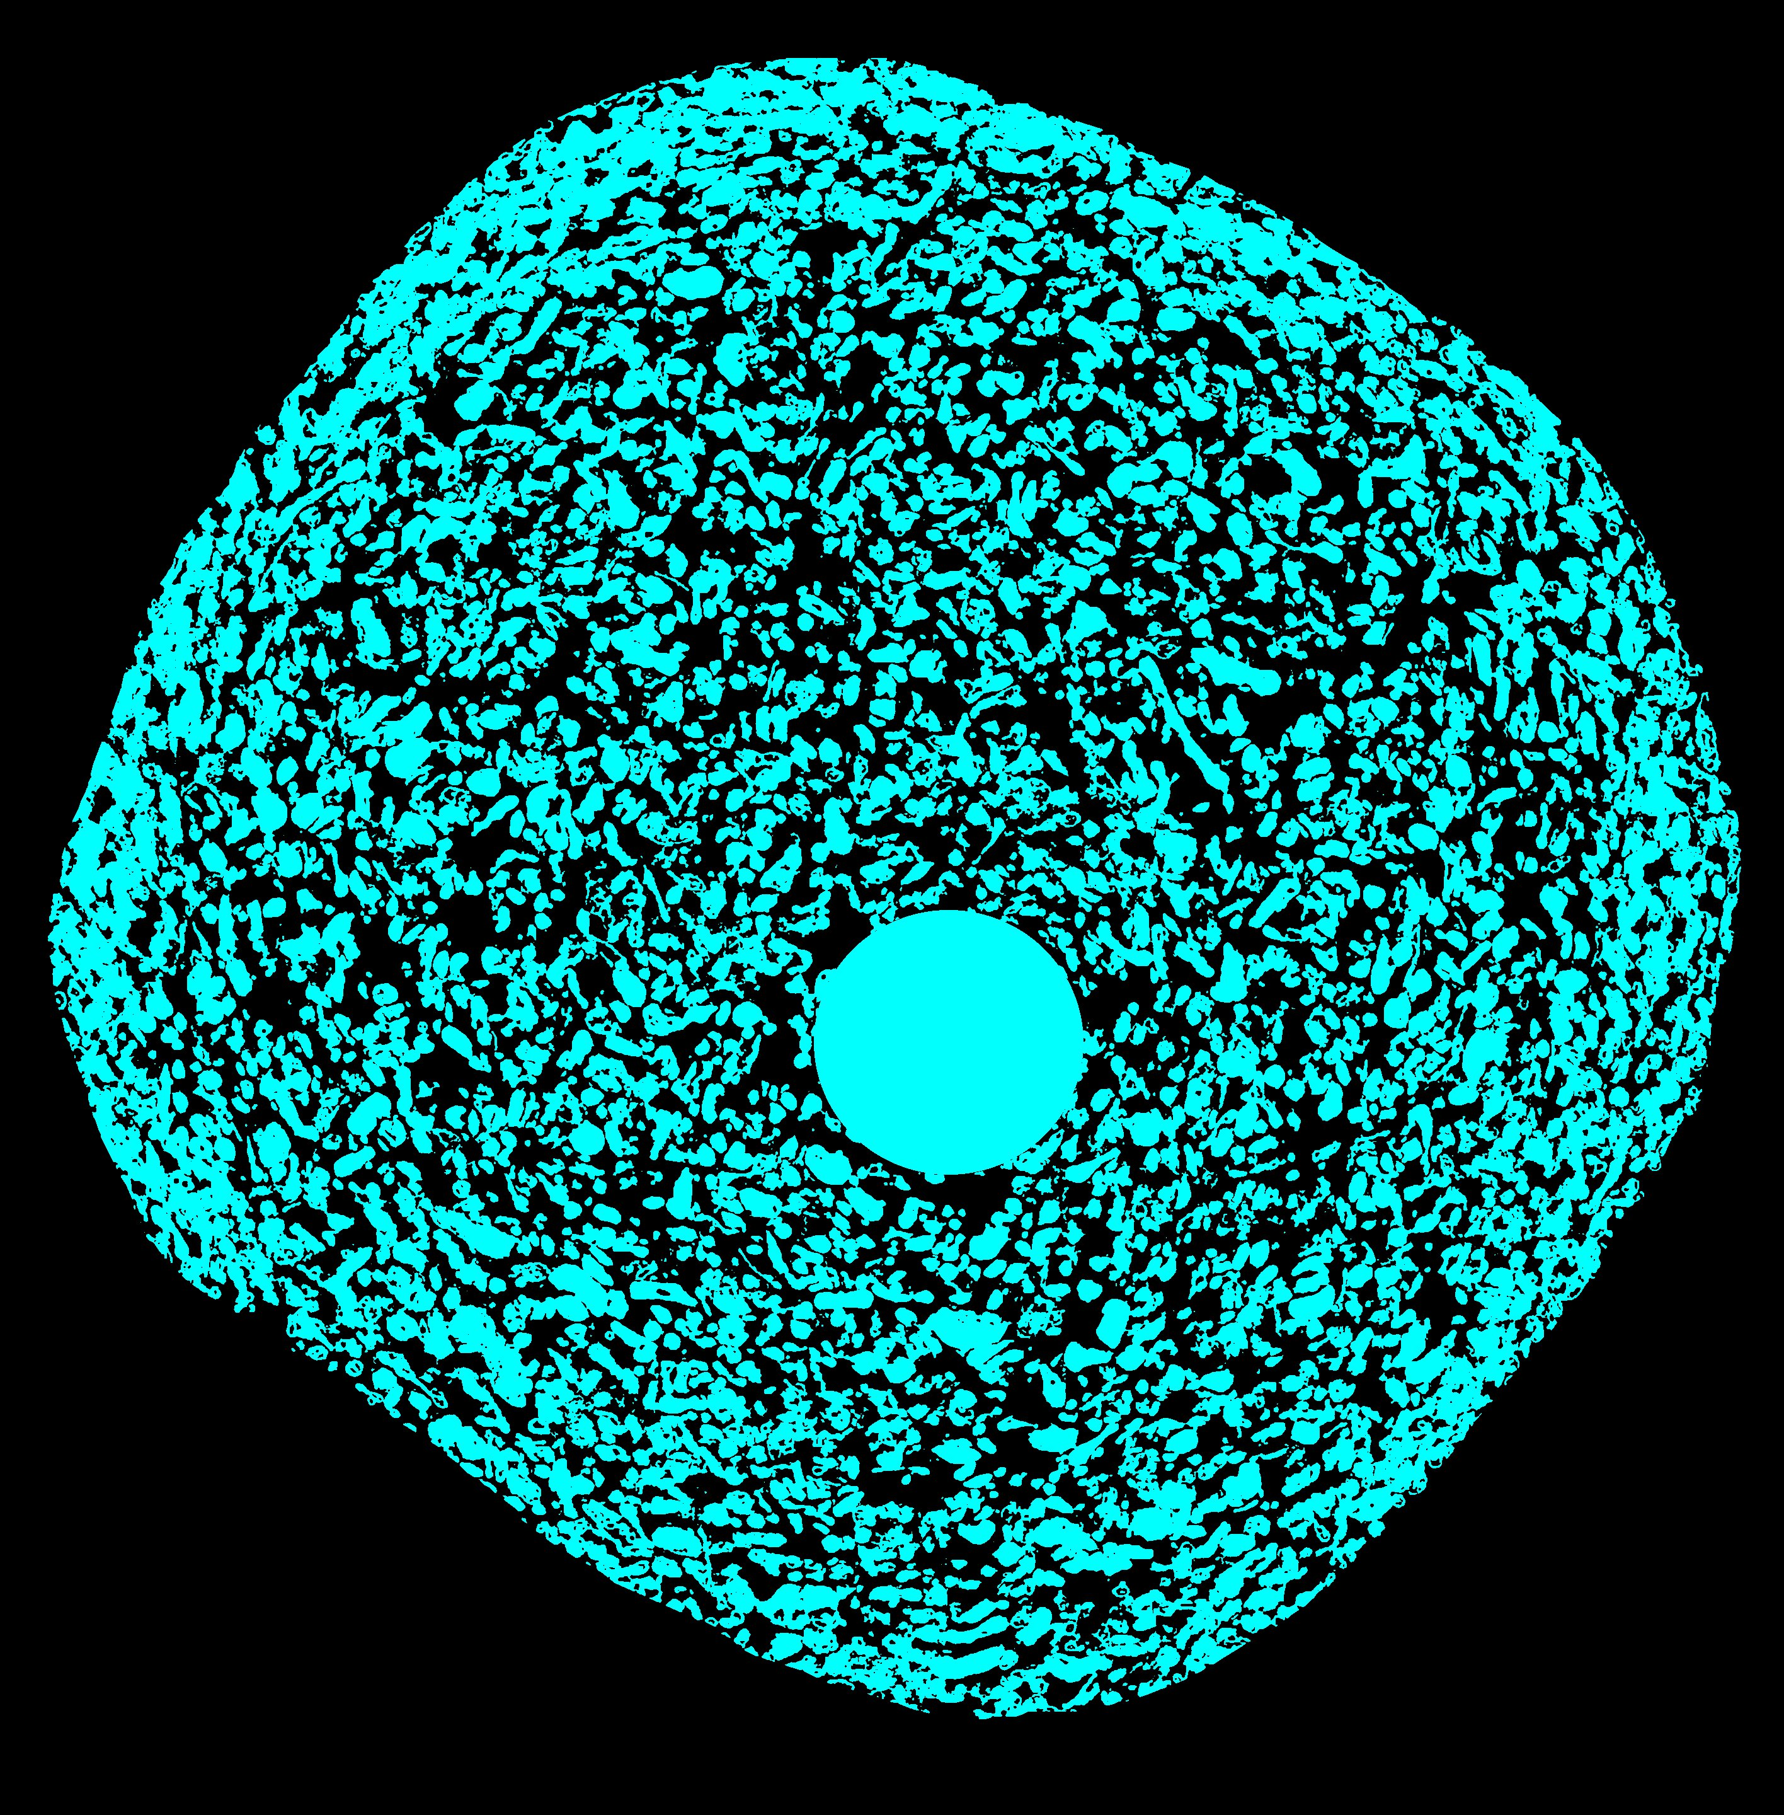
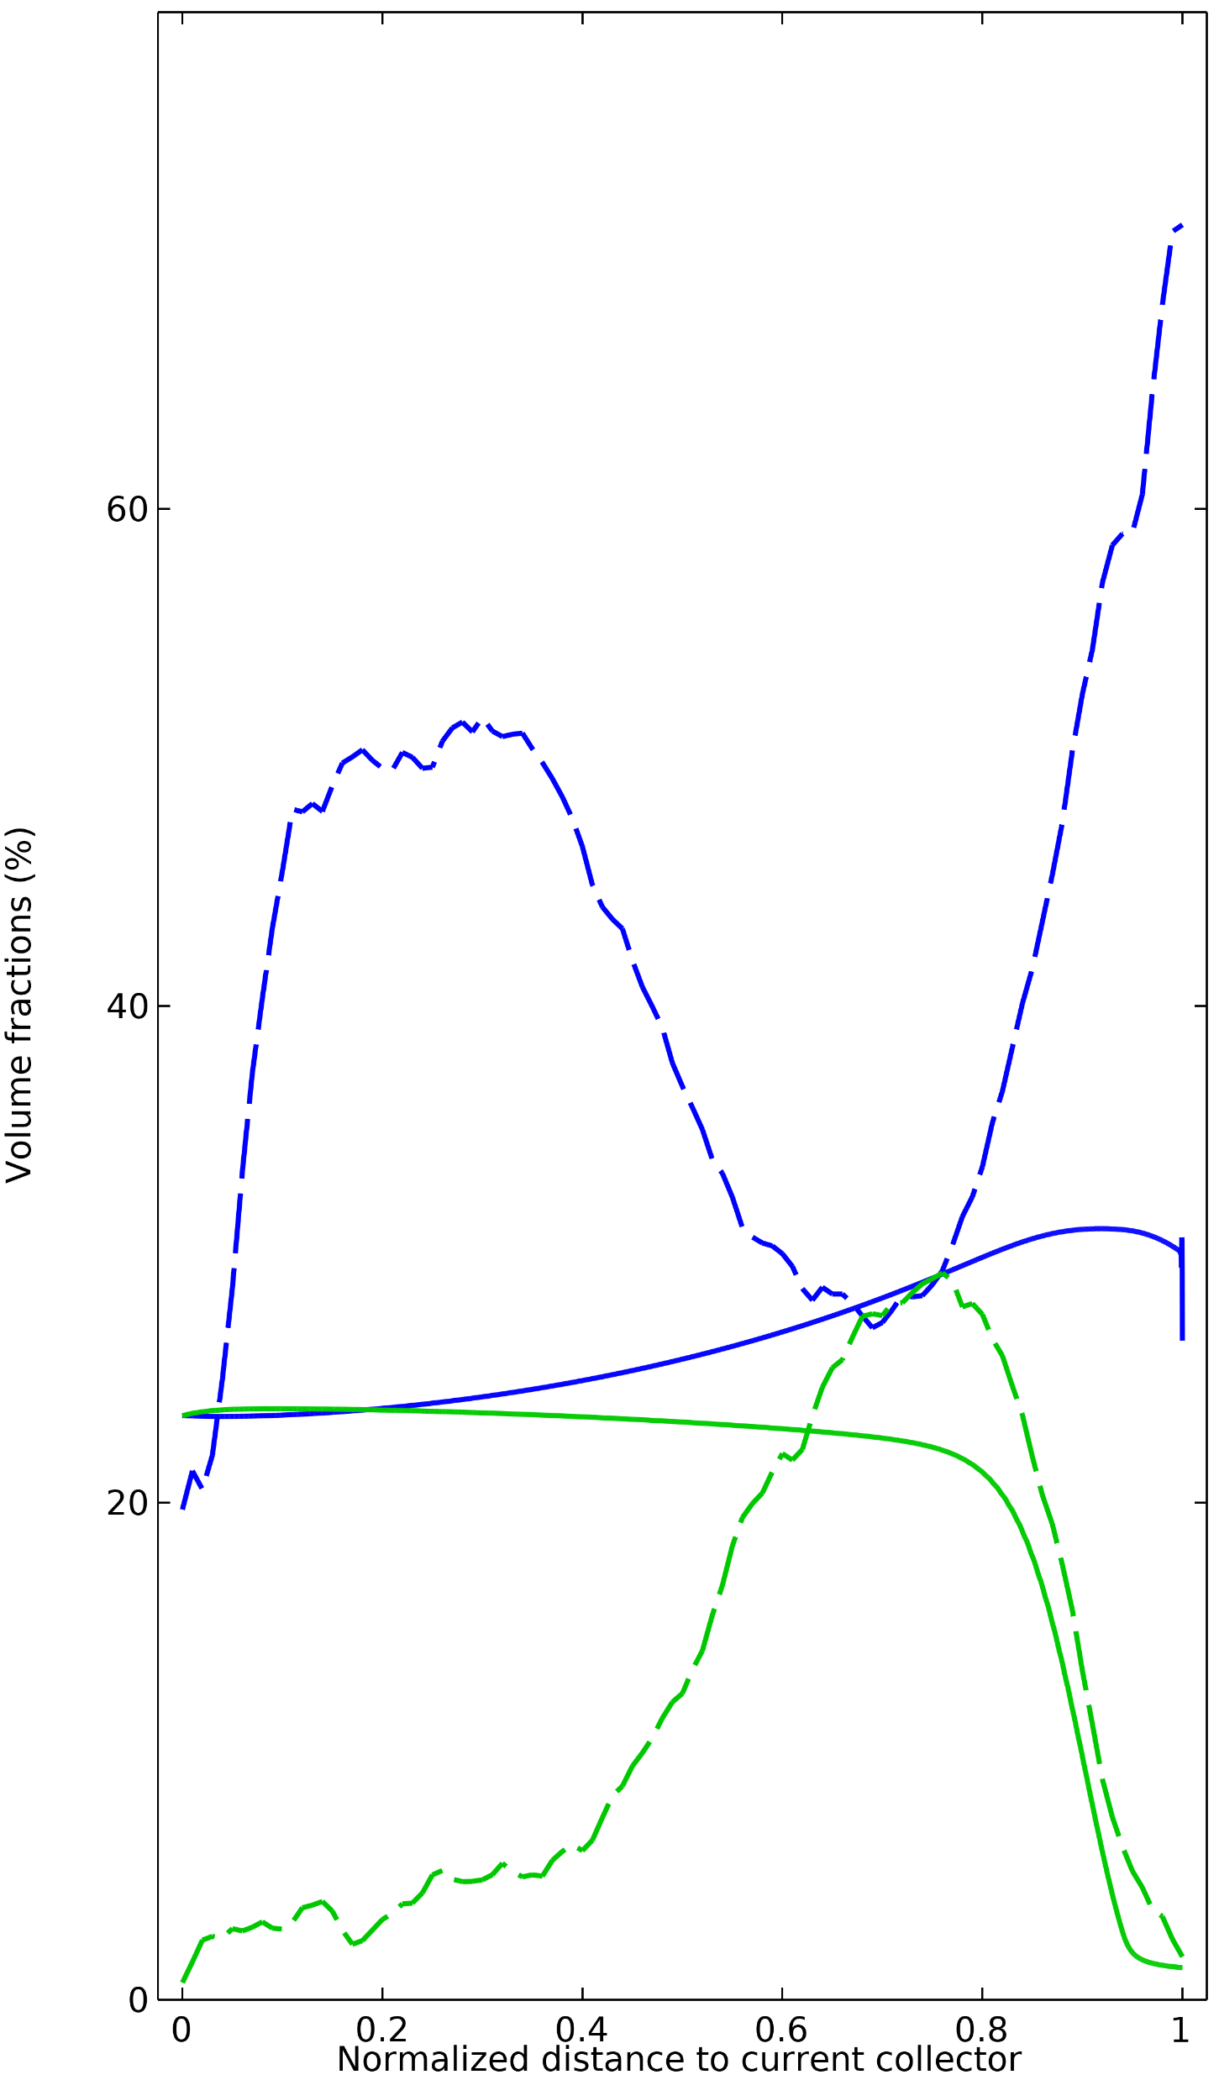


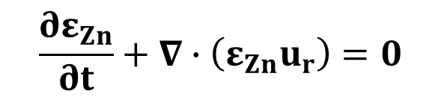
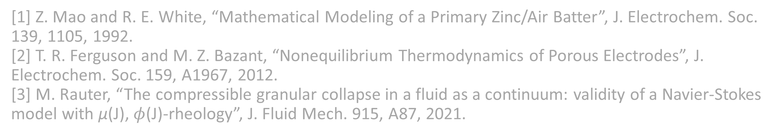

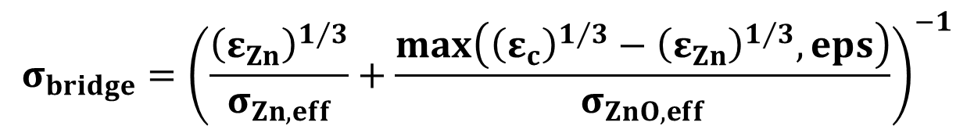
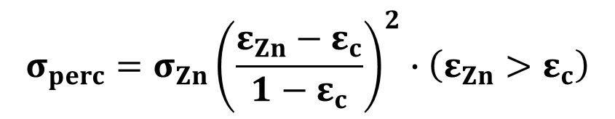
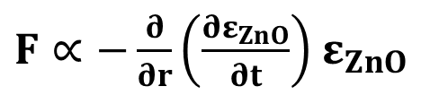
Modeling the Distribution of Active Phases in Alkaline Zn Anodes
ZnO – Model
ZnO – Experimental
Zn – Model
Zn – Experimental
Volume Fraction (%)
Computational modeling can be used to simulate the discharge of alkaline Zn-MnO₂ batteries, predicting performance. The Zn anode contains many complex phenomena that have been captured in this model.
Zn
Dimensionless Radial Position
D. P. Guida¹, X. H. Chadderdon², J. W. Gallaway¹
1. Dept. of Chemical Engineering, Northeastern University, Boston, MA.
2. Energizer Holdings, Inc., Westlake, OH.
Dense ZnO
Sparse ZnO
Pore
Introduction
The discharge of an alkaline Zn anode involves the conversion of Zn metal to solid ZnO through the zincate ion. With the heterogeneous dissolution of Zn and mobility of zincate in the electrolyte, complex radial distributions of Zn and ZnO have been observed to occur in the anodes of commercial bobbin-type alkaline batteries. These distributions are highly dependent on the discharge rate and lead to phase distributions that are difficult to predict. The distribution of Zn and ZnO within these electrodes is relevant to battery performance, as localized pore closure and breakdown of the electronically conductive network can lead to premature cell failure. As a result, the ability to accurately model material distribution in Zn anodes is imperative in predicting battery performance. Early work from Mao and White sought to model the material distribution in Zn anodes, but only agrees with experimental observation under high-rate continuous discharge.¹
(a)
Current Collecting
Center Pin
(b)
(c)
Methodology
Remaining
Undischarged Zn
50 mA Pulse Discharge
CT results show: 1. Zn particle-to-particle connections are lost under many discharge conditions and may rely on ZnO bridges to maintain electronic connectivity; 2. Substantial movement of the Zn particles during discharge.
Redefine anode electronic conductivity using percolation theory and resistors-in-series.²
Incorporate granular flow of Zn and ZnO phases to more accurately match the phase distributions observed by CT experiments during low-rate discharge.³
Interior ZnO Core
Radial View of Low-rate Pulsed Discharge
Zn Connectivity of Moderate-rate Cont. Discharge
Volume Fraction (%)
0% DOD
Zn Vol. Frac.
$$σ_{anode}=σ_{perc}+σ_{bridge}$$
$$σ_{perc}=σ_{Zn}{\left(\frac{ε_{Zn}−ε_{c}}{1−ε_{c}}\right)}^{2}∙\left(ε_{Zn}>ε_{c}\right)$$
$$σ_{bridge}={\left(\frac{{\left(ε_{Zn}\right)}^{1/3}}{σ_{Zn,eff}}+\frac{max\left({{\left(ε_{c}\right)}^{1/3}−\left(ε_{Zn}\right)}^{1/3},eps\right)}{σ_{ZnO,eff}}\right)}^{−1}$$
Axial View of Low-rate Pulsed Discharge
Connectivity of Low-rate Pulsed Discharge
Zn and ZnO Connectivity of Moderate-rate Cont. Discharge
Dimensionless Radius
Figure 1: (a) Loss of Zn connection to current collector under low-rate pulsed conditions. (b) Maintenance of connectivity through ZnO bridging. (c) Concentrated region of Zn is evidence of granular flow.
$\frac{∂}{∂r}\left(\frac{∂u_{r}}{∂r}\right)=\frac{1}{ν_{Zn}}\left(u_{r}−\frac{ν_{Zn}}{ε_{Zn}}\frac{∂ε_{Zn}}{∂r}−\frac{ν_{Zn}}{r}\right)\frac{∂u_{r}}{∂r}+\frac{1}{ν_{Zn}}\left(\frac{1}{2ε_{Zn}}\frac{∂ε_{Zn}}{∂r}+\frac{1}{2r}\right){u_{r}}^{2}+\frac{u_{r}}{r^{2}}−\frac{F}{2ν_{Zn}}$ (Navier-Stokes eqn.)
$F∝−\frac{∂}{∂r}\left(\frac{∂ε_{ZnO}}{∂t}\right)$ $ε_{ZnO}$
$$\frac{∂ε_{Zn}}{∂t}+∇∙\left(ε_{Zn}u_{r}\right)=0$$
Results
Basic Model
Model With New Mechanisms Added
ZnO – Model
ZnO – Experimental
Zn – Model
Zn – Experimental
ZnO – Model
ZnO – Experimental
Zn – Model
Zn – Experimental
By redefining the anode’s electronic conductivity and adding granular flow of the solid Zn and ZnO phases, the model was able to accurately predict the phase distributions of the anode under a range of discharge conditions. Figure 2 shows a substantial improvement in the model’s ability to predict an inverted reaction zone under low-rate conditions, which was observed experimentally using in situ CT.
Model Underestimates
Exterior ZnO
Volume Fraction (%)
Redefined Anode Electronic Conductivity
Volume Fraction (%)
Model Predicts Bimodal ZnO
Model Underestimates
Interior ZnO
Zn/ZnO Granular Flow
Model Overestimates
Interior Zn
Model Predicts Inverted Rxn. Zone
Dimensionless Radial Position
Dimensionless Radial Position
Figure 2: Model predictions without (left) and with (right) the new anode electronic conductivity and granular flow compared against quantitative CT results for low-rate continuous discharge.
[1] Z. Mao and R. E. White, “Mathematical Modeling of a Primary Zinc/Air Batter”, J. Electrochem. Soc. 139, 1105, 1992.
[2] T. R. Ferguson and M. Z. Bazant, “Nonequilibrium Thermodynamics of Porous Electrodes”, J. Electrochem. Soc. 159, A1967, 2012.
[3] M. Rauter, “The compressible granular collapse in a fluid as a continuum: validity of a Navier-Stokes model with μ(J), $φ$(J)-rheology”, J. Fluid Mech. 915, A87, 2021.

