Slide 1
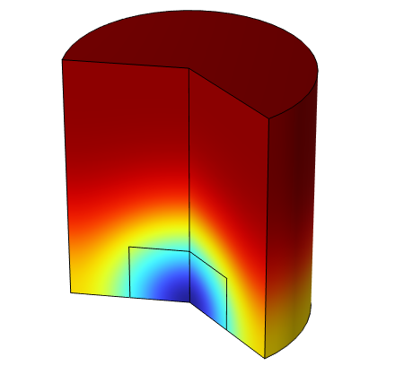
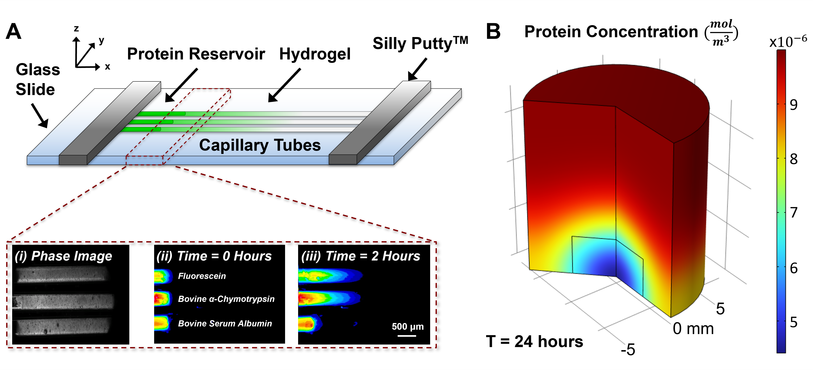
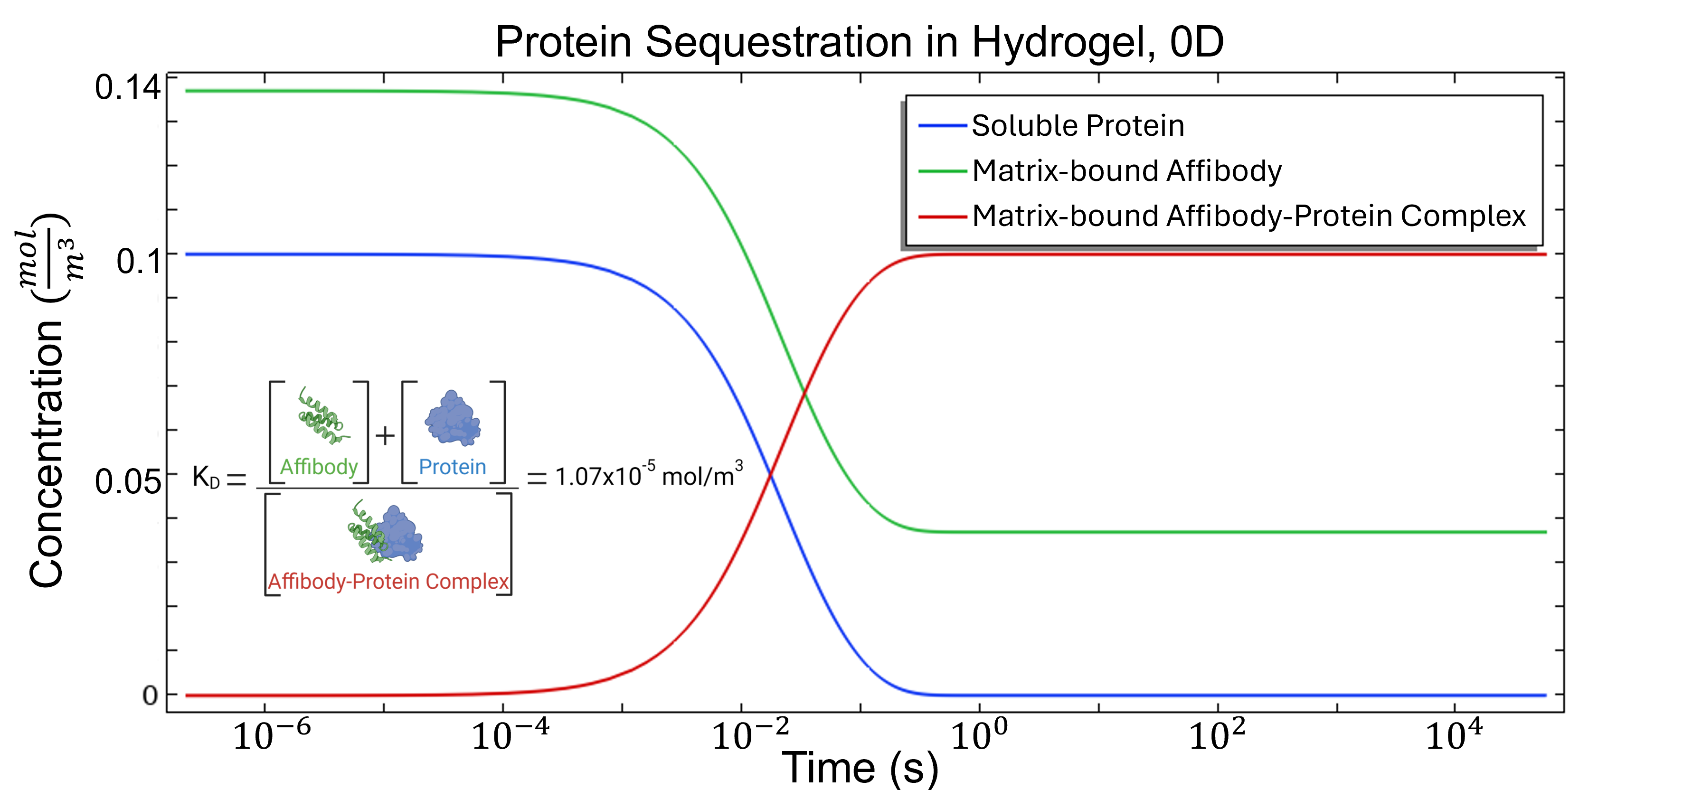
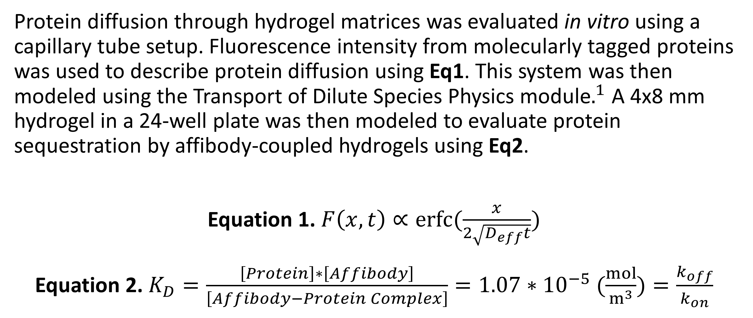
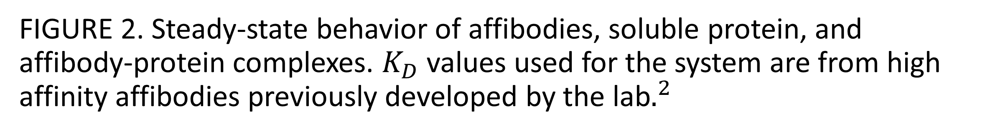
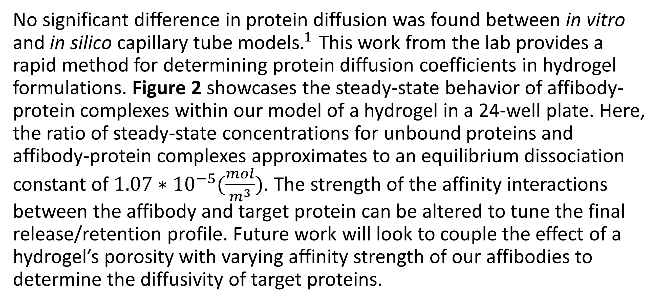
Modeling Reaction-Diffusion Systems in Affinity-based Biomaterials for Tissue Engineering
Hydrogels are widely used as protein delivery vehicles. Modeling protein release and retention profiles may help bioengineers optimize their drug delivery strategies for regenerative medicine applications.
D. A. Frey Rubio¹, M. H. Hettiaratchi^{1,2}
1. Phil & Penny Knight Campus for Accelerating Scientific Impact, University of Oregon, Eugene, OR, USA.
2. Department of Chemistry & Biochemistry, University of Oregon, Eugene, OR, USA.
Introduction
Hydrogels are water-swollen polymer matrices with mechanical properties similar to soft tissues. As such, bioengineers have leveraged these constructs to expedite tissue repair, often loading them with cells, small molecule drugs, and proteins. Proteins are of particular interest as their presentation can enhance cell recruitment and proliferation, guide specialized differentiation, and modulate overall tissue behavior. However, proteins freely loaded into hydrogels may suffer from rapid burst release upon implantation. Controlled release of protein drugs is necessary to prolong protein bioactivity and reduce off-target side effects. The Hettiaratchi lab specializes in the design of affibodies, small protein scaffolds that selectively and reversibly bind to a given protein. The bioconjugation of affibodies to hydrogel matrices allows for tunable control over the spatiotemporal presentation of proteins. Our model seeks to elucidate the effect of these affinity interactions on the release and retention of a variety of proteins.
Methodology
Protein diffusion through hydrogel matrices was evaluated in vitro using a capillary tube setup. Fluorescence intensity from molecularly tagged proteins was used to describe protein diffusion using Eq1. This system was then modeled using the Transport of Dilute Species Physics module$.^{1}$ A 4x8 mm hydrogel in a 24-well plate was then modeled to evaluate protein sequestration by affibody-coupled hydrogels using Eq2.
Equation 1. $F\left(x,t\right)∝erfc⁡(\frac{x}{2\sqrt{D_{eff}t}})$
Equation 2. $K_{D}=\frac{\left[Protein\right]∗\left[Affibody\right]}{\left[Affibody−Protein Complex\right]}=1.07∗{10}^{−5} (\frac{mol}{m^{3}})=\frac{k_{off}}{k_{on}}$
FIGURE 1. A: In vitro capillary system used to validate model of protein diffusion in hydrogels. B: Affibody-coupled hydrogels sequestering protein from a concentrated solution.
Results
No significant difference in protein diffusion was found between in vitro and in silico capillary tube models$.^{1}$ This work from the lab provides a rapid method for determining protein diffusion coefficients in hydrogel formulations. Figure 2 showcases the steady-state behavior of affibody-protein complexes within our model of a hydrogel in a 24-well plate. Here, the ratio of steady-state concentrations for unbound proteins and affibody-protein complexes approximates to an equilibrium dissociation constant of ${1.07∗10}^{−5}(\frac{mol}{m^{3}})$. The strength of the affinity interactions between the affibody and target protein can be altered to tune the final release/retention profile. Future work will look to couple the effect of a hydrogel’s porosity with varying affinity strength of our affibodies to determine the diffusivity of target proteins.
FIGURE 2. Steady-state behavior of affibodies, soluble protein, and affibody-protein complexes. $K_{D}$ values used for the system are from high affinity affibodies previously developed by the lab$.^{2}$
1. M. Hettiaratchi, “A rapid method for determining protein diffusion through hydrogels for regenerative medicine applications”, APL Bioeng., vol. 2, pp. 026110, 2018.
2. J. Dorogin, “Moderate-Affinity Affibodies Modulate the Delivery and Bioactivity of Bone Morphogenetic Protein-2”, Adv. Healthc. Mater., vol. 12, pp. 2300793, 2023.

Slide 2
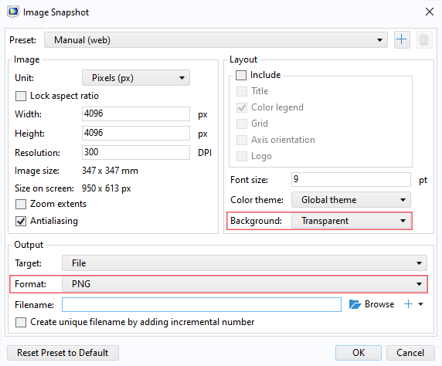
Guidelines
General Notes for Using the Template
Do not adjust the template; work within it. See the examples provided.
Left align text within textboxes, and do not justify your text.
Titles are the largest font on the slide (90–120 pt.), then subtitles (70–80 pt.). Captions, references, and affiliation are the smallest text (18–40 pt.).
Titles and subtitles are bold; any other use of bold should be for emphasis.
Text is either black or grey and should only be adjusted for diagrams.
Images can be adjusted and fitted into the boxes using the Crop feature. (In PowerPoint: Format tab → Size section on the right → Crop.)
Please keep in mind:
The solid red lines are the 3 mm that will be cut off during printing.
The dotted lines represent a small margin that may or may not be cut off during printing.
Exporting an Image for the Header
The settings shown on the right export the highest quality image with a transparent background.
The most important settings to use are the two outlined in pink. This will export an image that can be placed in the blue space of the header.

Slide 3
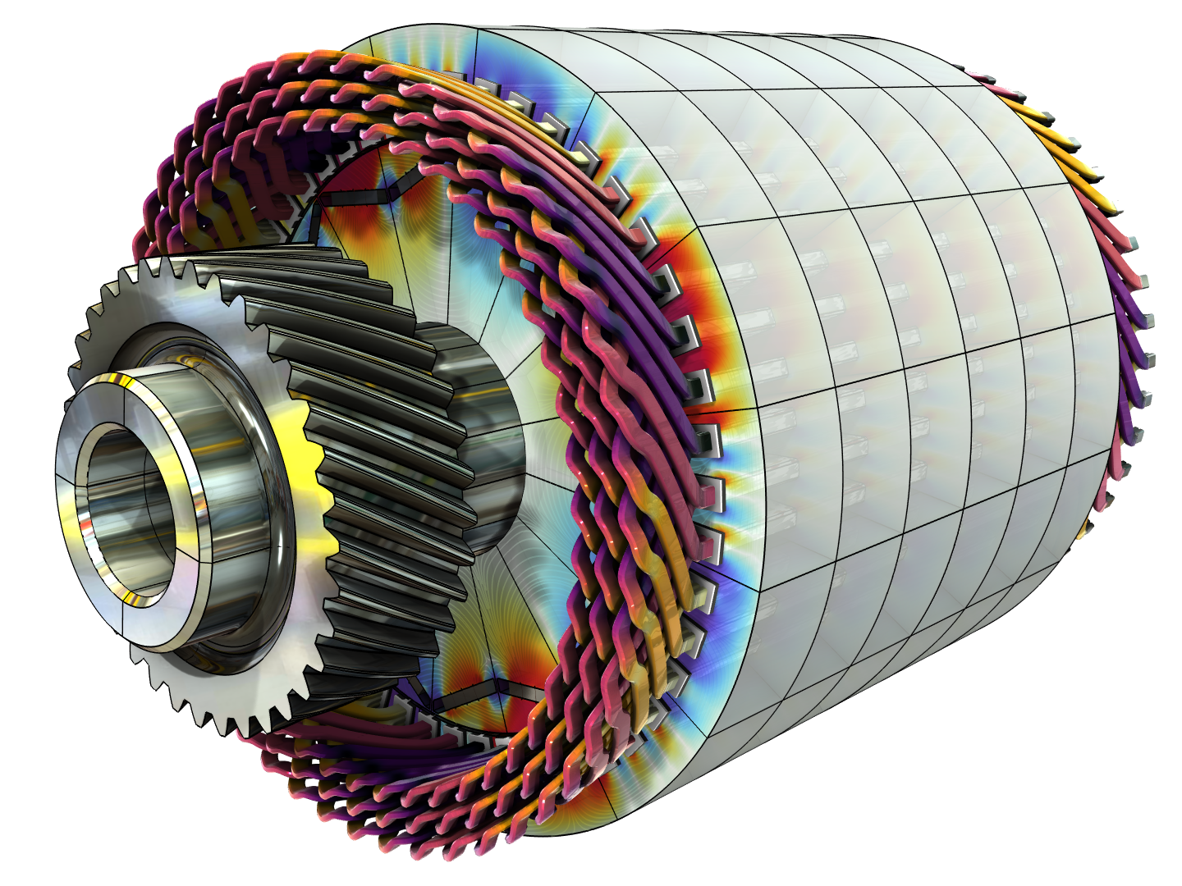
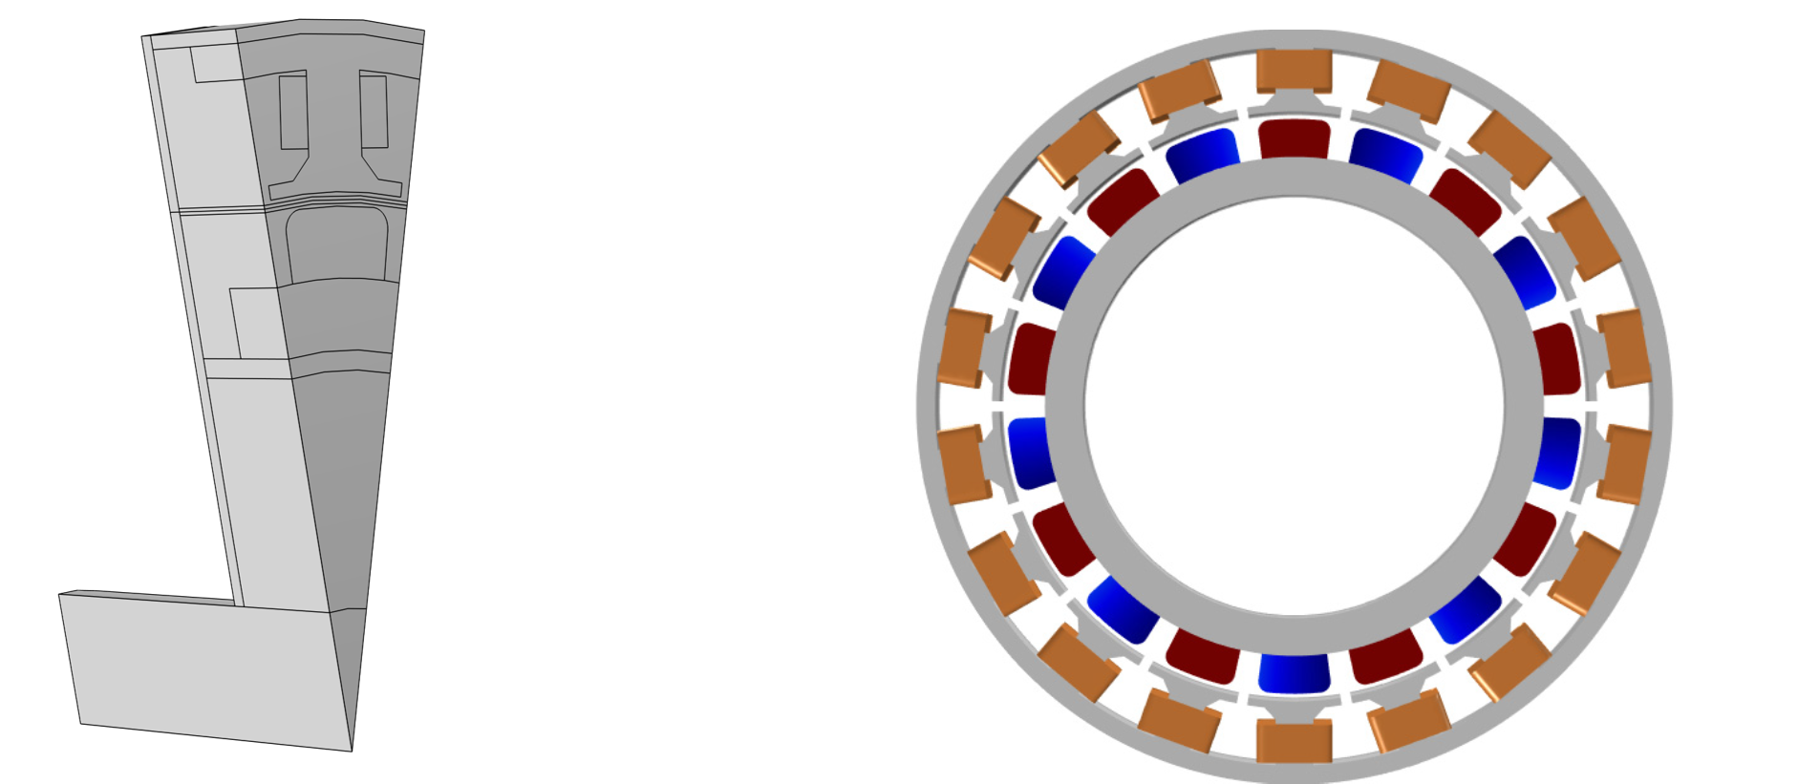
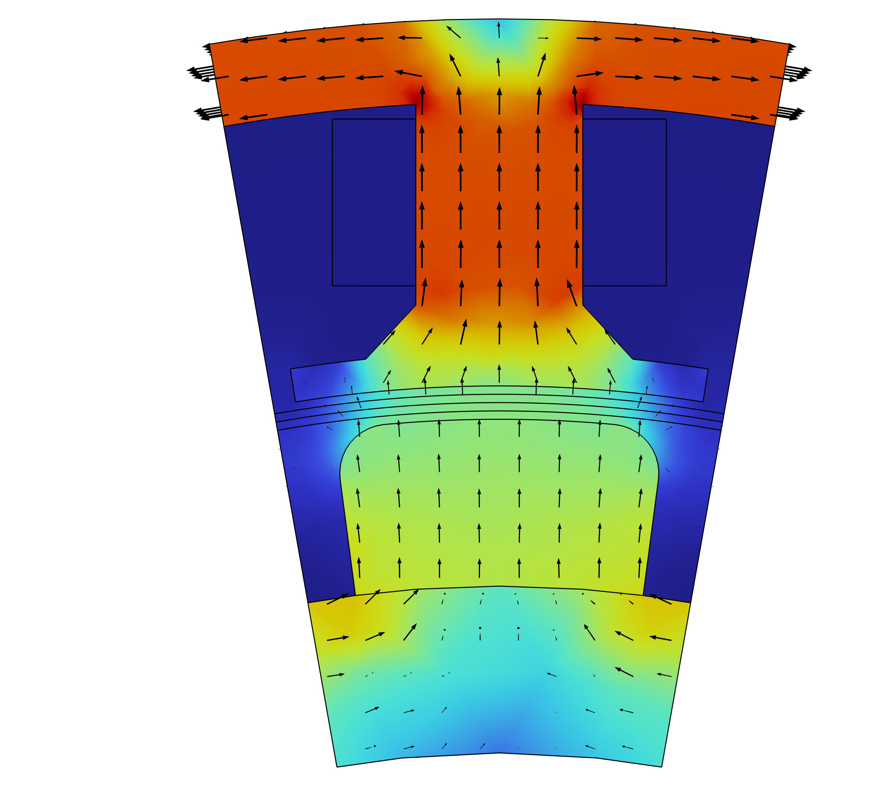
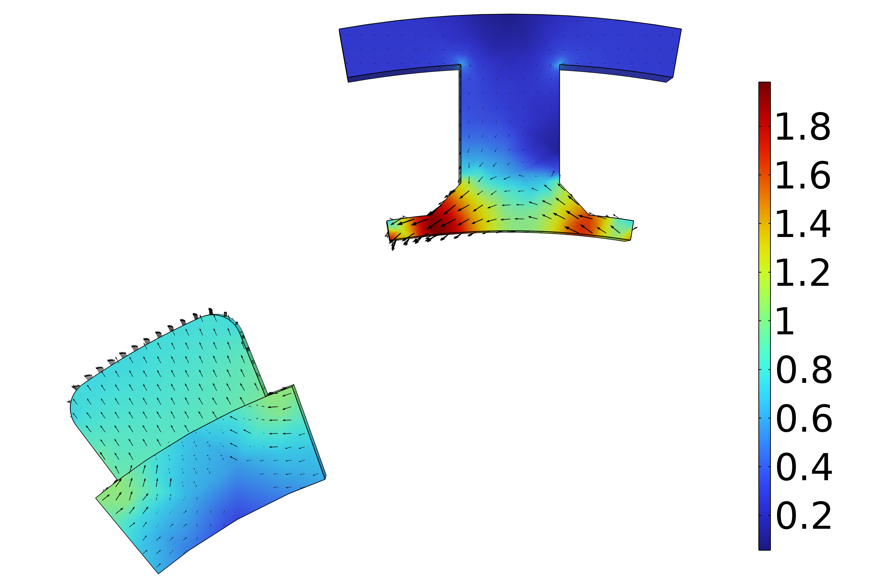
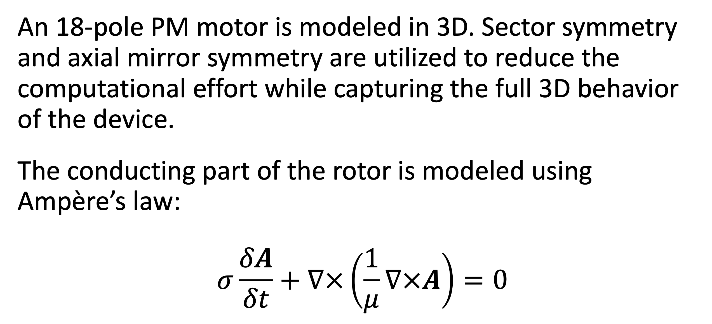
Analysis of a Permanent Magnet Motor in 3D
Optimize permanent magnet (PM) motor performance by understanding their full behavior, including sensitivity to high temperatures.
J. A. Smith¹, M. B. Smith²
1. Department (if applicable), Organization, City, Country.
2. Department (if applicable), Organization, City, Country.
Abstract
While PM motors are valued for the energy savings that they provide, there are some design limitations to address. For example, permanent magnets are sensitive to high temperatures. Such temperatures can occur when currents, particularly eddy currents, generate heat losses.
The findings offer greater insight into the behavior of PM motors, particularly by capturing the eddy current losses that occur within the magnets. This information serves as a useful resource for improving the design of PM motors, and therefore the technology they help power.
Methodology
An 18-pole PM motor is modeled in 3D. Sector symmetry and axial mirror symmetry are utilized to reduce the computational effort while capturing the full 3D behavior of the device.
The conducting part of the rotor is modeled using Ampère’s law:
$$σ\frac{δA}{δt}+∇×\left(\frac{1}{μ}∇×A\right)=0$$
FIGURE 1. Left: Permanent motor sector. Right: Drawing of the PM motor.
Results
The results can be seen in Figure 2, which shows the magnetic flux density for the motor in it’s stationary state, that is, the initial conditions for the time-dependent simulation. In this state, the coil current is zero. It also shows the magnetic flux density for the motor after revolving one sector angle. In this plot, the air and coil domains are excluded in order to get a better view.
FIGURE 2. Left: Magnetic flux density from the permanent magnets with only the rotor at rest. Right: Magnetic flux density after revolving one sector angle.
1. Author first initial and last name, “Article Title”, Journal, Volume (vol.), Page numbers (pp.), Year.
2. Author first initial and last name, “Article Title”, Journal, Volume (vol.), Page numbers (pp.), Year.
3. Author first initial and last name, “Article Title”, Journal, Volume (vol.), Page numbers (pp.), Year.

Slide 4
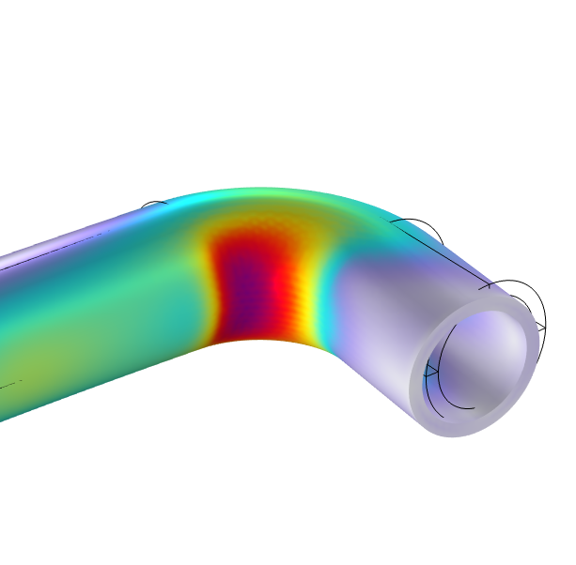
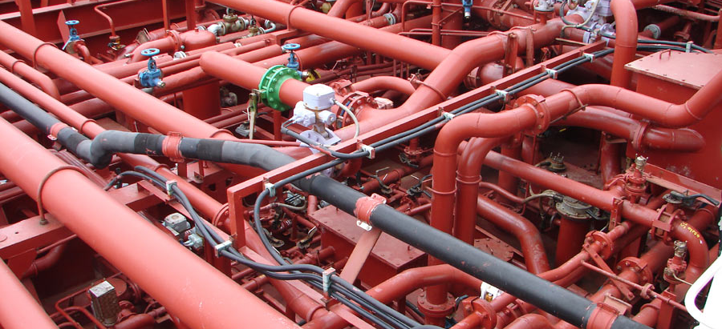
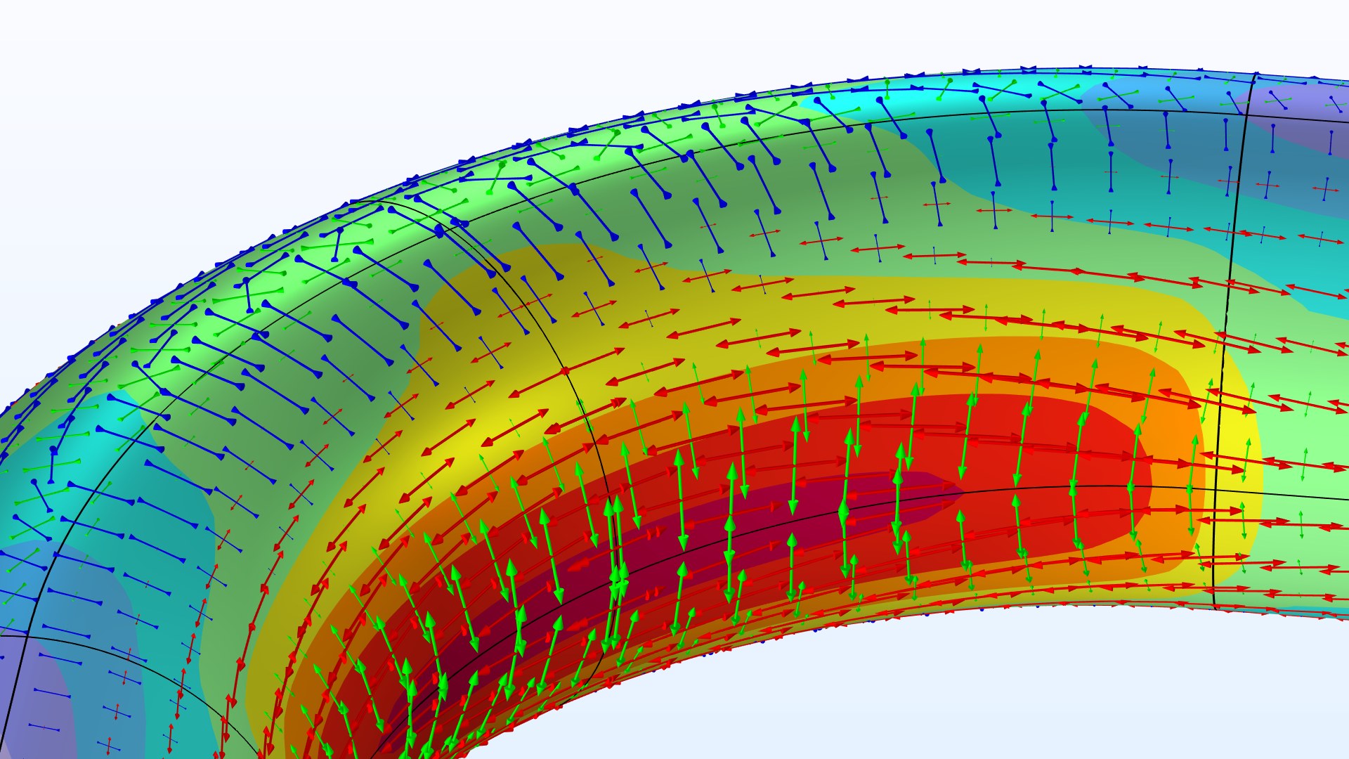
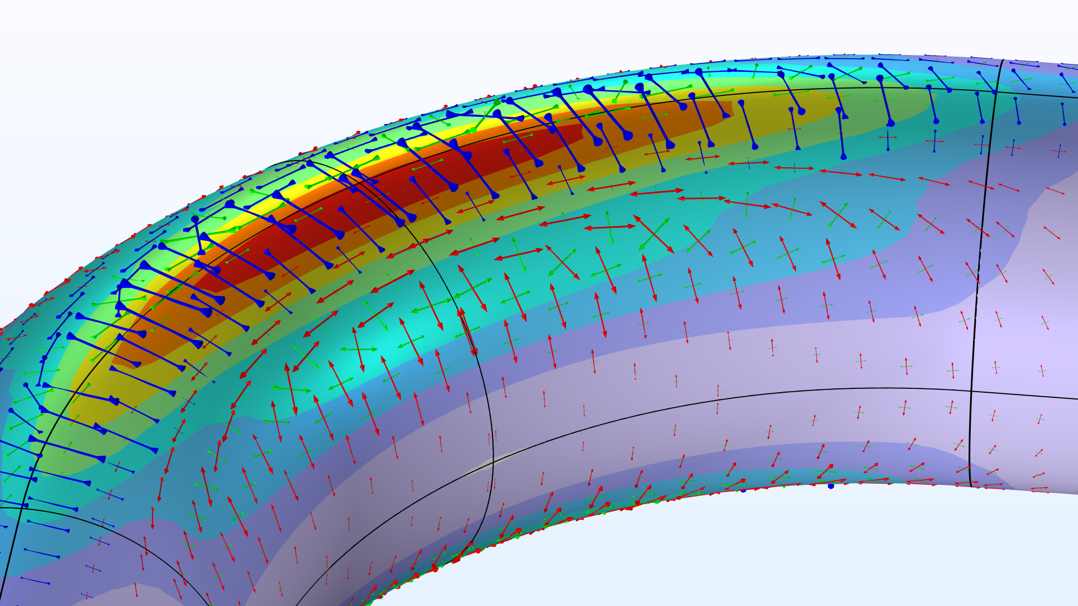
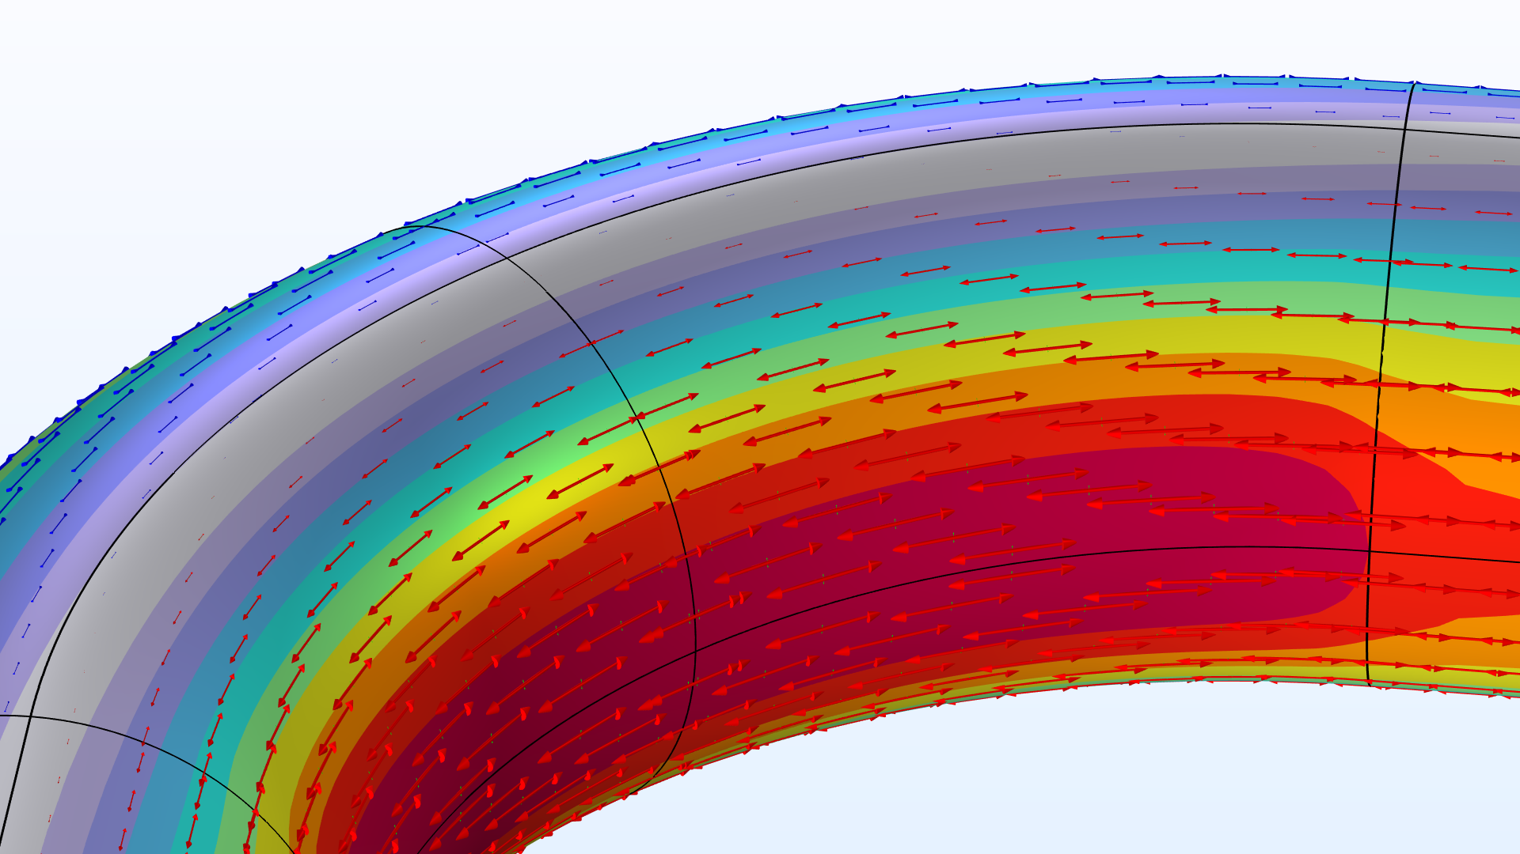
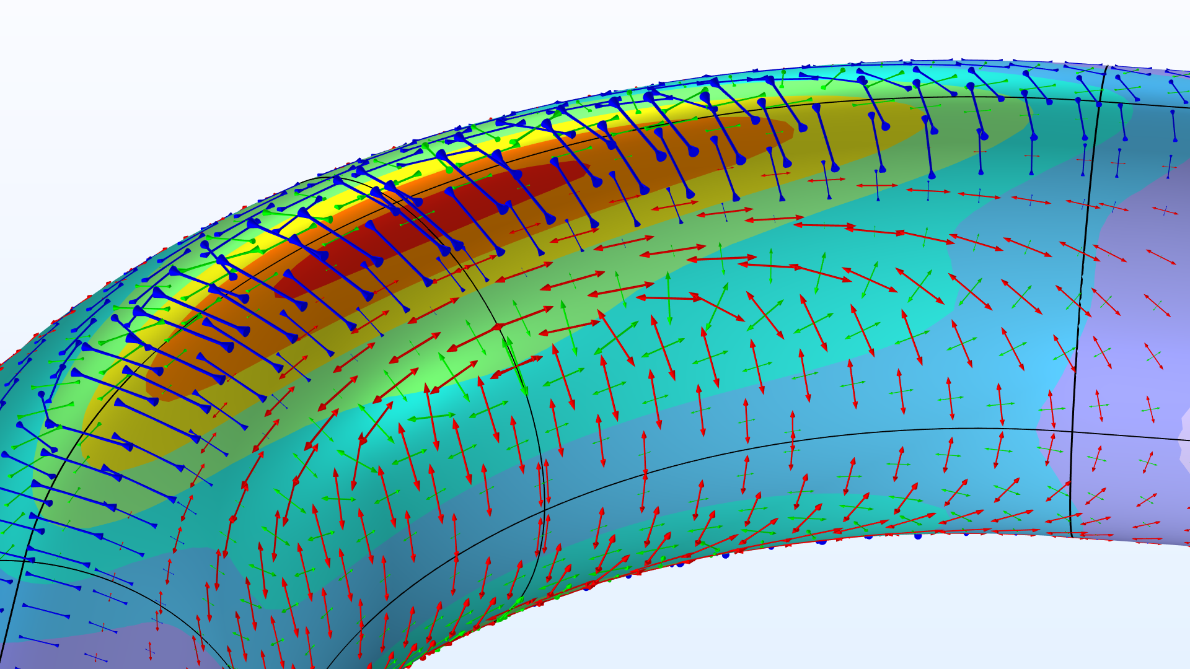
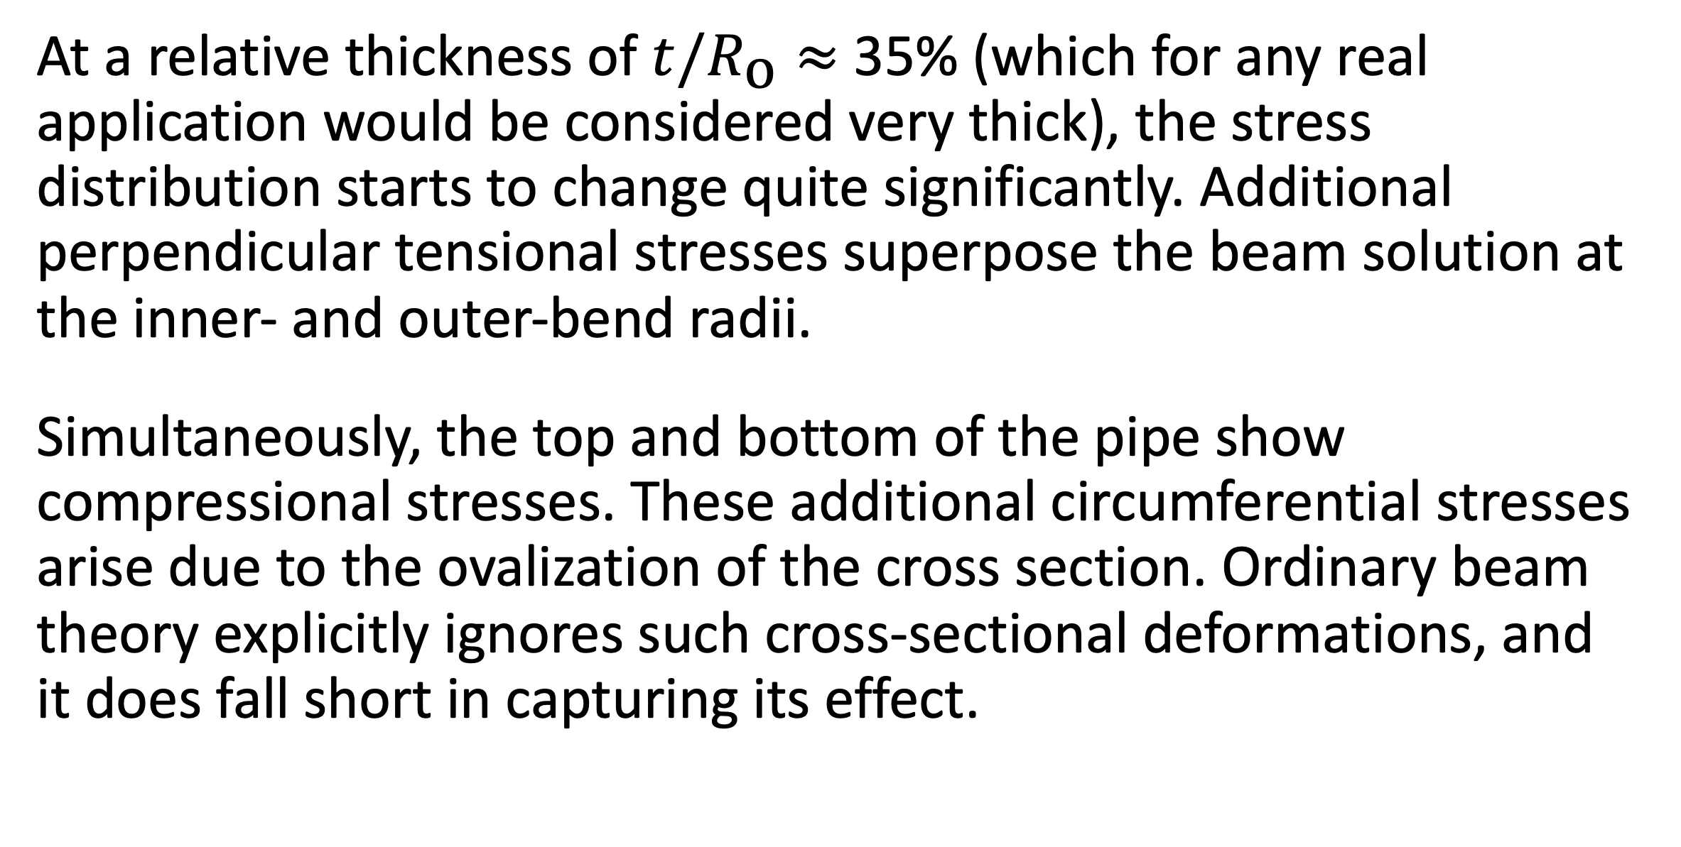
The Intriguing Stresses in Pipe Bends
For many structural engineers, beam theory is a popular analysis tool. Using the equations can be beneficial when considering structural behavior, as they are easy to apply and provide useful results. This work investigates one such case.
J. A. Smith¹, M. B. Smith²
1. Department (if applicable), Organization, City, Country.
2. Department (if applicable), Organization, City, Country.
Introduction & Goals
Pipe bends are common in piping systems, which typically transport liquids or gas, often under high pressure. One place where you may find a lot of pipes are oil tankers. The labyrinthine piping systems can look pretty fascinating.
Many piping standards (or codes) used for industrial applications are based on beam theory when it comes to the structural analysis. But, as we have already discovered, pipe bends generally do not behave like beams. When digging into piping standards, you will find a lot of information dedicated to pipe bends. In particular, piping standards recommend to apply correction factors to the stiffness and stresses for curved pipe sections. (Ref. 1)
Methodology
The pipe is slender with a constant cross section, so it would seem like a natural choice to treat such a structure as a beam in a simplified analysis. The bending moment is the only load acting on the structure, and it’s thus constant for any given section along the entire beam axis.
The maximum stress even occurs on the inside of the pipe. The cross section of the bend also deforms significantly, and, more specifically, it ovalizes with the major axis either being oriented in the bend plane or perpendicular to it depending on the direction of the bending moment.
FIGURE 1. Piping systems on an oil/chemical tanker. Image licensed under CC BY-SA 3.0 via Wikimedia Commons.
Results
At a relative thickness of $t/R_{\text{o}}≈$ 35% (which for any real application would be considered very thick), the stress distribution starts to change quite significantly. Additional perpendicular tensional stresses superpose the beam solution at the inner- and outer-bend radii.
Simultaneously, the top and bottom of the pipe show compressional stresses. These additional circumferential stresses arise due to the ovalization of the cross section. Ordinary beam theory explicitly ignores such cross-sectional deformations, and it does fall short in capturing its effect.
FIGURE 2. View of the pipe bend showing the von Mises stress (normalized) and principal stresses for different wall thicknesses.
E.A. Wais and E.C. Rodabaugh, “Background of SIFs and Stress Indices for Moment Loadings of Piping Components”, United States, 2005; https://www.osti.gov/biblio/841246
“Stress Intensification Factors (i-Factors), Flexibility Factors (k-Factors), and Their Determination for Metallic Piping Components”, ASME, 2017; https://www.asme.org/codes-standards/find-codes-standards/b31j-stress-intensification-factors-flexibility-factors-determination-metallic-piping-components/2017/drm-enabled-pdf

