Slide 1
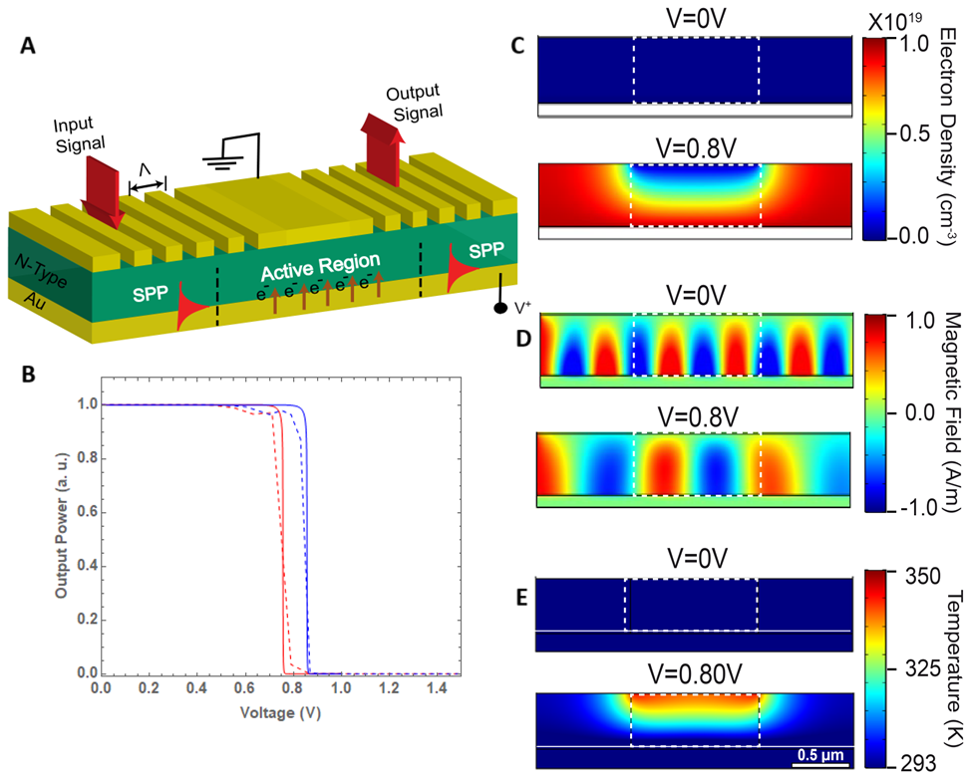
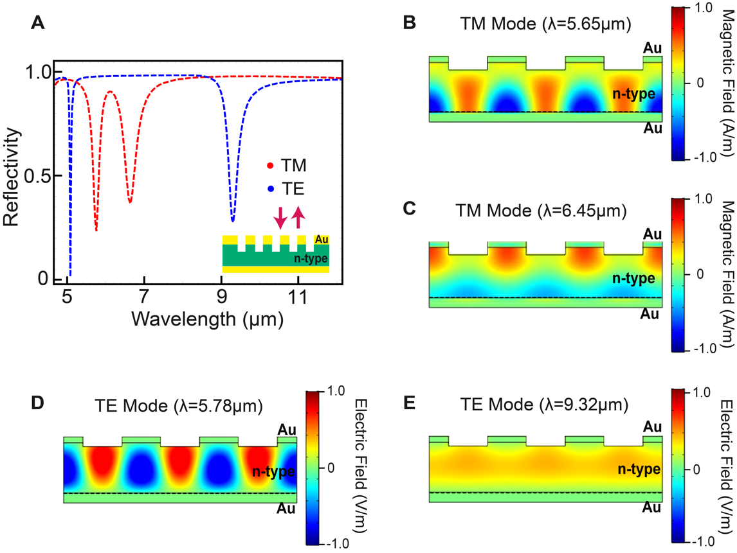
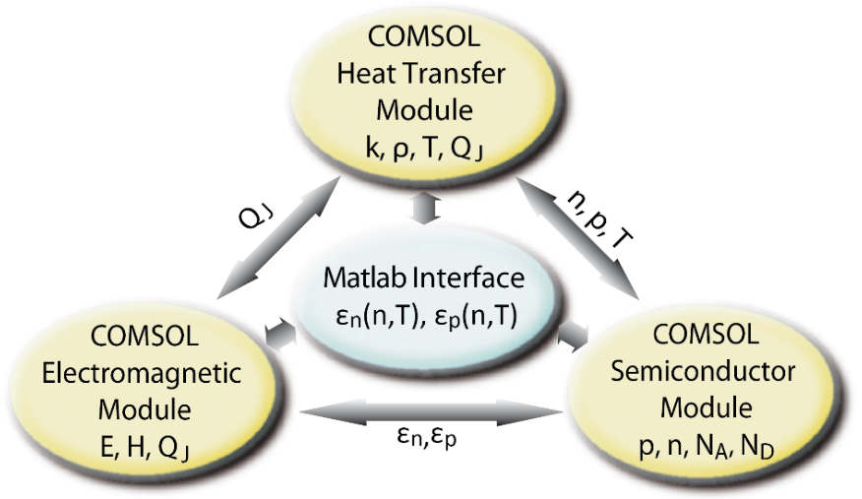
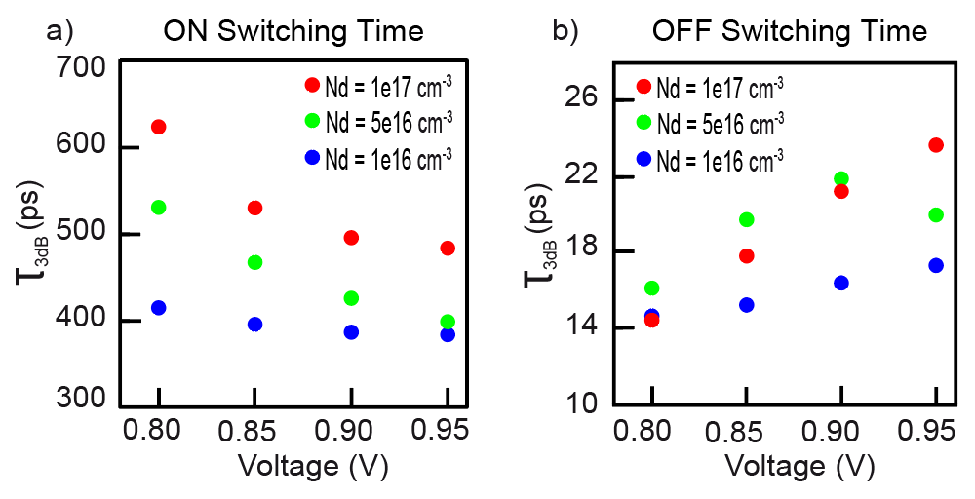

Metal-Doped Semiconductor Plasmonic Optoelectronic Switch
We present an electro-optic modulator based on a Metal-Semiconductor junction, engineered to enable functional plasmonic circuits through active control of surface plasmon polaritons (SPPs) at the junction interfaces.
FIGURE 1. (A) Basic schematic of the device, (B) The device’s transmittance for different doping concentrations, (C) Steady-state charge carrier concentration profiles, (D) SPP propagation along the length of the device, and (E) Local temperature profile at two different applied voltages.
Mayra M. Schliemann¹, Raj K. Vinnakota¹
1. Computational Optoelectronics Laboratory, Troy University, Troy, AL, USA.
Abstract
This research introduces an electro-optic modulator based on a Metal-Semiconductor (M-S) junction, aimed at advancing functional plasmonic circuits through active control of surface plasmon polaritons (SPPs) at the interfaces of M-S devices. To evaluate the device’s performance, we performed extensive self-consistent multi-physics simulations on COMSOL Software, including electromagnetic, thermal, and current-voltage (IV) characteristics, focusing on Germanium (Ge) based Schottky contacts.
These simulations were crucial for estimating the modulation of SPPs under different bias conditions and determining the switching times. Our goal was to improve both optical confinement and operational speed. The studied device exhibits signal modulation exceeding -25 dB, responsivity greater than -1500 dB/V, and switching rates of 25 GHz, suggesting potential data rates above 50 Gbit/s. These findings highlight the potential of Schottky junctions as active components in developing plasmonic-based integrated circuits.
Methodology
In order to study the complex phenomena behind this device's operation, we have developed a multi-physics model based on the COMSOL software. The model self-consistently couples the electromagnetic, semiconductor and heat transfer modules (Fig. 2). A common Matlab based control code (facilitator) is developed for seamless integration and to self-consistently solve the Maxwell’s equations, the Semiconductor Poisson equations and the Heat transfer equation in the steady state and temporal domain.
FIGURE 2. Self-consistent Thermo-Electro-Optic model.
FIGURE 3. (A) Reflectivity spectra of the device coupling structure under zero bias, showing Transverse Magnetic (TM) and Transverse Electric (TE) polarization in blue and (B-E) Magnetic field profiles across the device calculated at the wavelengths corresponding to the reflectivity dips.
Results
At a fixed operational frequency of 53.1THz, corresponding to a wavelength of 5.65μm, in the TM reflectivity spectra, and with zero applied bias, SPPs can effectively propagate along the M-S interface (Fig. 3b).
An applied voltage that surpasses the critical threshold establishes the OFF state of the device.
There is a notable difference in the rise times of local electron concentrations between the OFF and ON states (Fig. 4). The OFF times remain fairly independent on the applied external bias, while the ON times show an exponential relation on the external bias. Higher doping concentrations lead to accelerated switching or signal modulation rates.
SPP modulation capabilities of the device are significantly influenced by the applied DC bias, with higher voltages enabling broader bandwidths.
The device demonstrates responsivities of more than -1500 dB∙V^(-1), where an increase in doping concentration leads to a larger responsivity.
FIGURE 4. Extracted response times as a function of the peak applied bias and varying n-doping concentration.
-Dong Z, Vinnakota RK, Briggs AF, Nordin L, Bank SR, Genov DA, Wasserman D (2019) Electrical modulation of degenerate semiconductor plasmonic interfaces. Journal of Applied Physics 126:043101.
-Vinnakota RK, Dong Z, Briggs AF, Bank SR, Wasserman D, Genov DA (2020) Plasmonic electro-optic modulator based on degenerate semiconductor interfaces. Nanophotonics 9:1105-1113.
-R. K. Vinnakota, Z. Dong, A. F. Briggs, S. R. Bank, D. Wasserman, and D. A. Genov, “Response times of a degenerately doped semiconductor based plasmonic modulator,” J. Opt. Soc. Am. B 40, 978-985 (2023)

